Slide 1
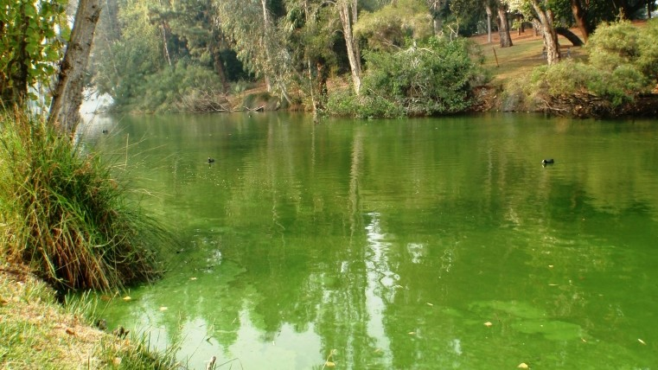
Learning Intention:
Explain the process of eutrophication
Success Criteria:
Complete Marine Education worksheet
’19. Nutrient overload’
Notes:
Image:

Slide 2
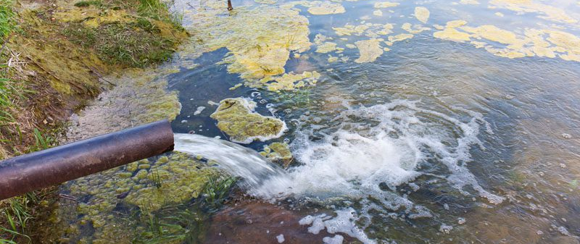
Eutrophication means nutrient enrichment
(the addition of nutrients to a body of water, making it ‘nutrient rich’)
Notes:
Image: https://www.wa.gov.au/service/natural-resources/water-resources/eutrophication-nutrient-enrichment

Slide 3
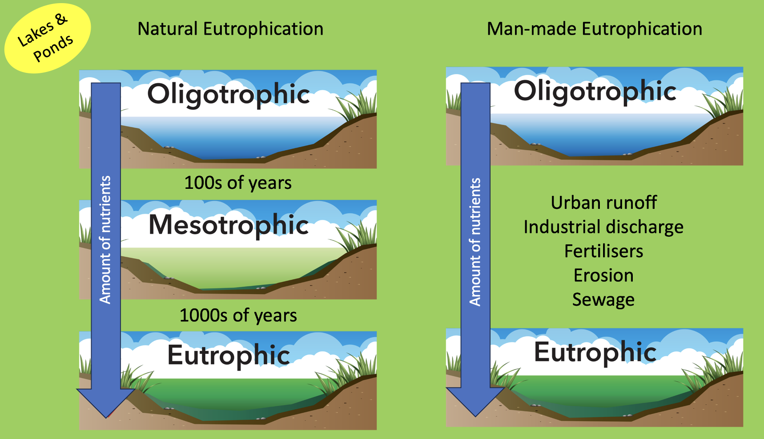
Eutrophication can be natural or man-made
Notes:
Image (adapted): https://www.laketech.com/lake-management

Slide 4
The process of eutrophication explained

Slide 5
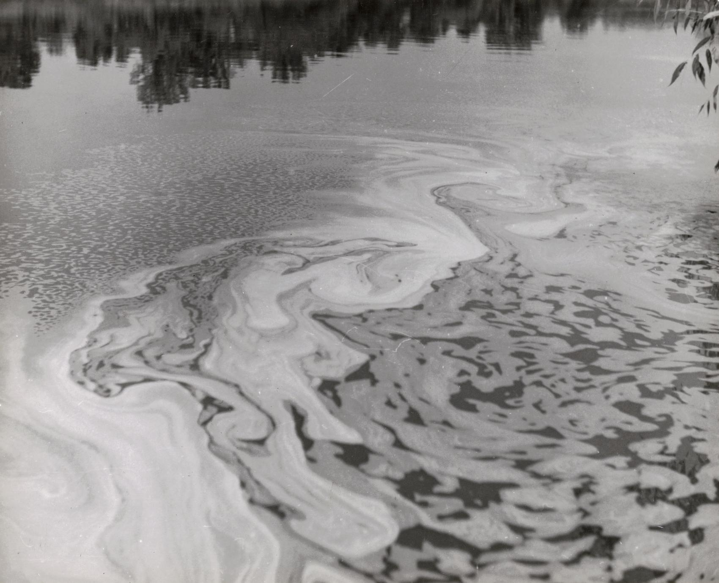
Nutrients are added to a body of water
Either naturally over hundreds and thousands of years, or as a pollutant by human activity
Notes:
Image: https://search.library.wisc.edu/digital/A6SGWOOMO7ZKI79A

Slide 6
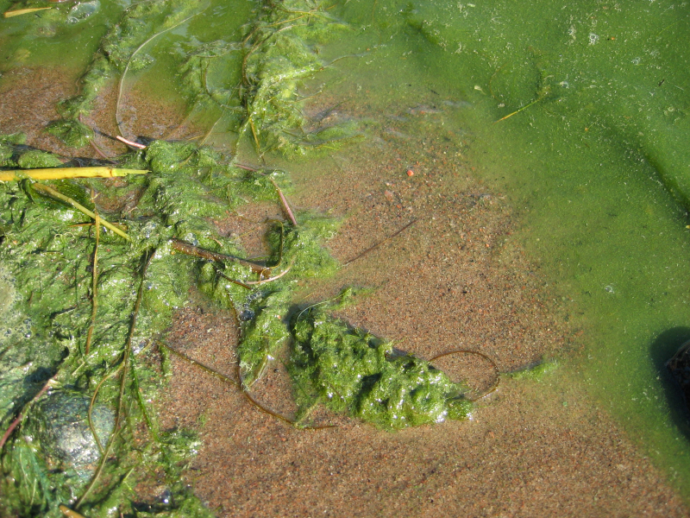
Algae blooms
in nutrient-rich water
(algae LOVE nutrients)

Slide 7
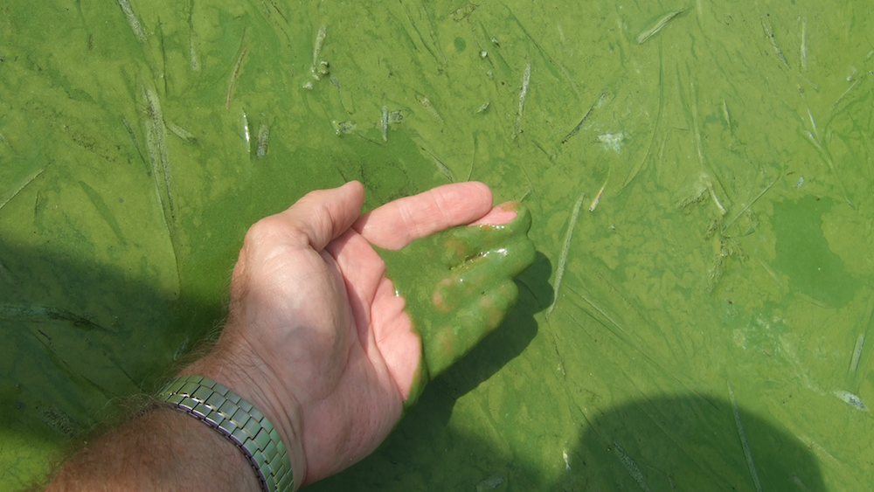
Algae bloom blocks sunlight and the algae dies

Slide 8
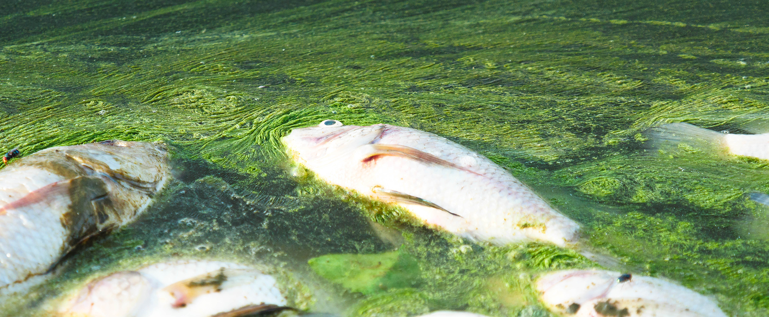
Decomposition depletes oxygen supplies and can lead to mass fish kills.
Notes:
Image: https://chelsea.co.uk/monitoring-algal-blooms-maintaining-water-quality-and-chelsea-technologies-solutions-for-commercial-aquaculture/

Slide 9
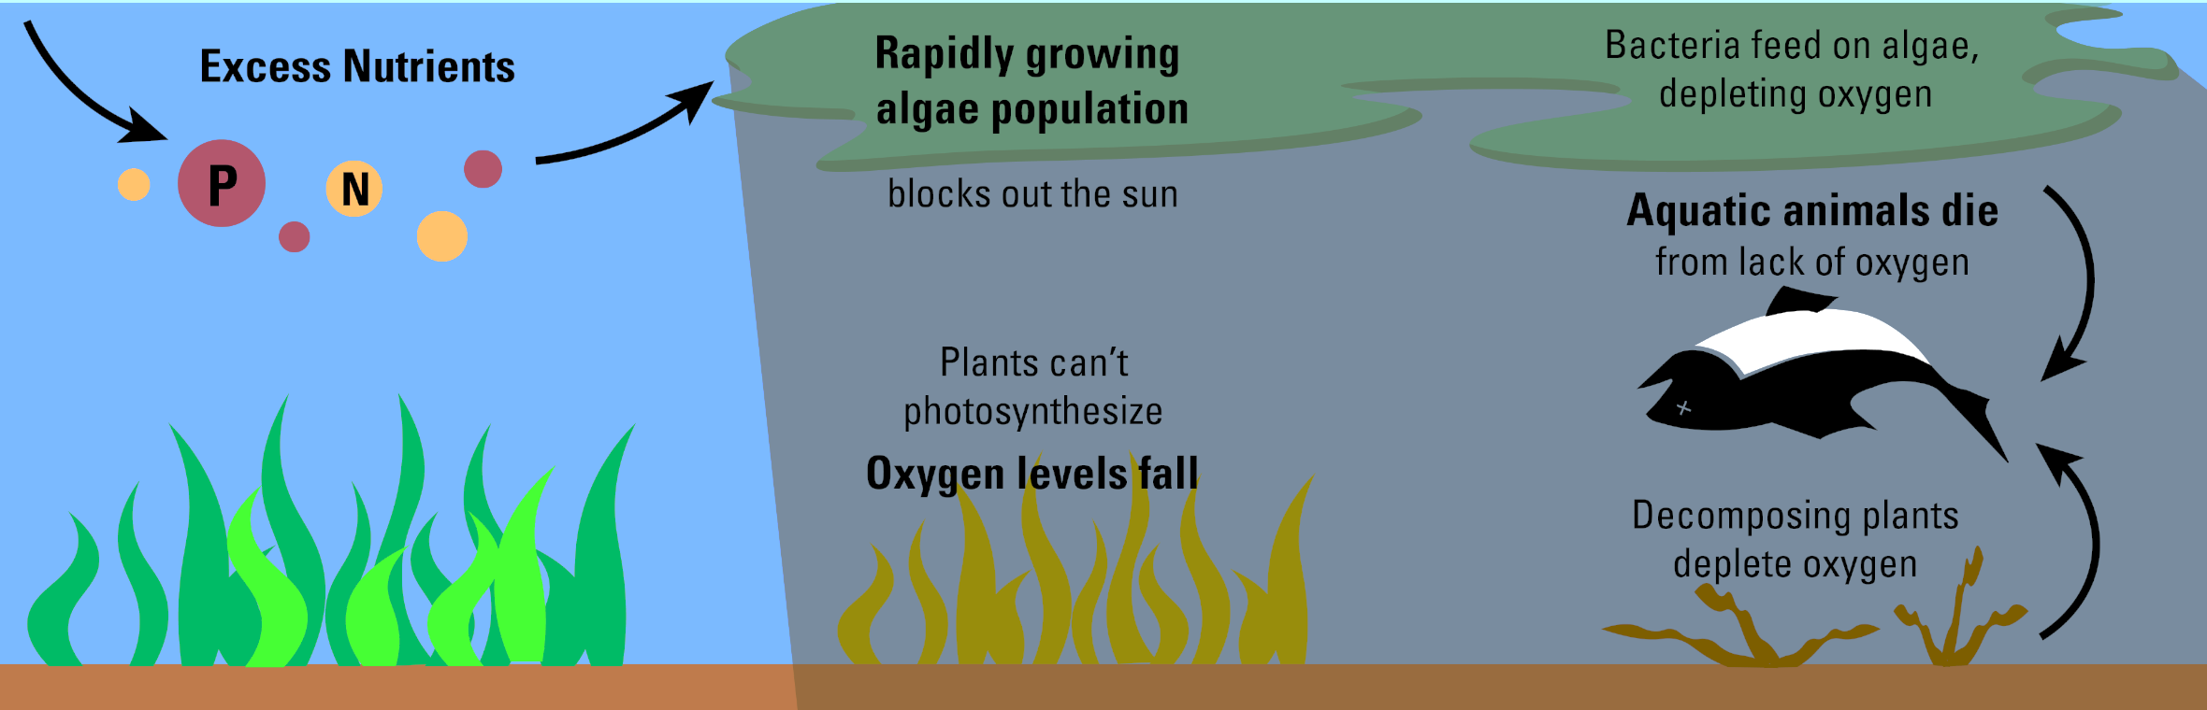
Eutrophication
Notes:
Image: https://www.usgs.gov/media/images/nutrient-pollution

Slide 10
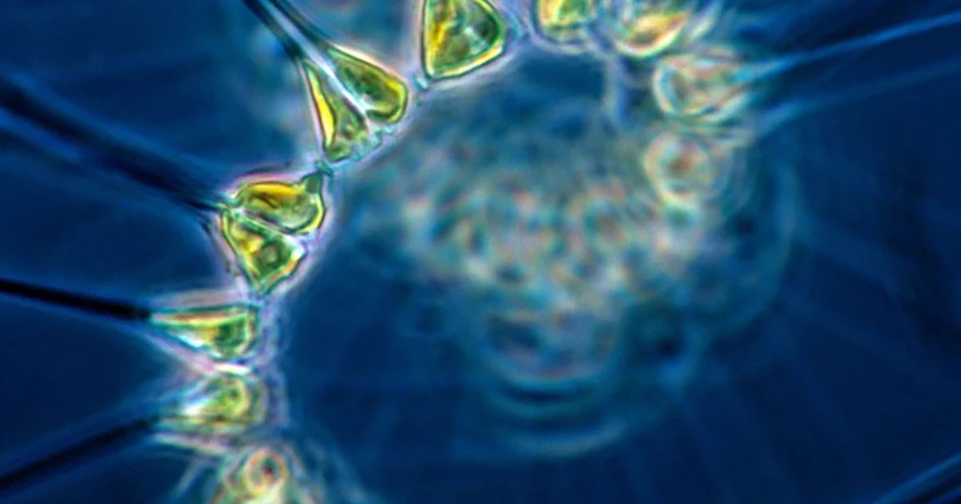
Algae

Slide 11
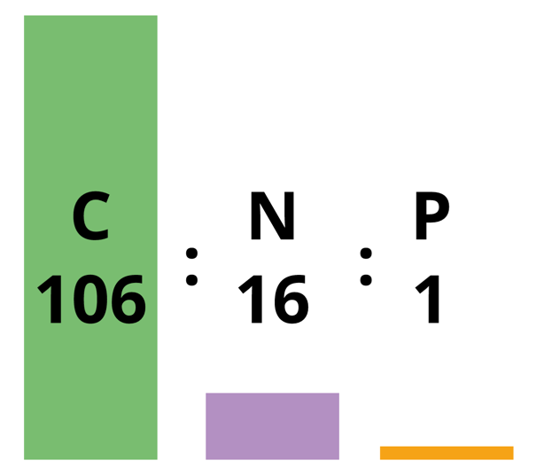
To grow (and bloom), algae need nutrients.
Specifically, 106 parts carbon, 16 parts nitrogen and 1 part phosphorus.
This is known as the Redfield Ratio.

Slide 12
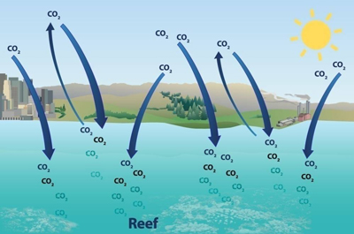
Even though carbon is needed most (106), carbon is plentiful in water
Notes:
Image: https://cfpub.epa.gov/watertrain/moduleFrame.cfm?parent_object_id=2499

Slide 13
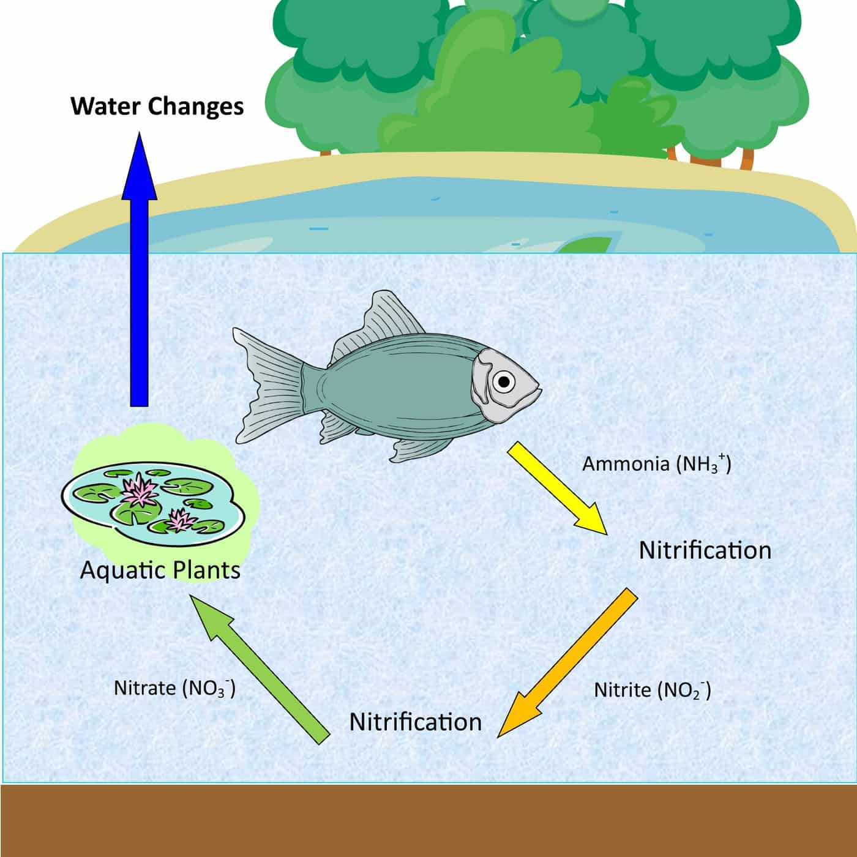
Nitrogen and phosphorus,
on the other hand, are not plentiful in clean water.
Their bioavailability limits the amount of photosynthesis that can occur.
Add a little nitrogen or phosphorus to the water and (with the help of some clever bacteria) BOOM the algae have what they need and BLOOM!
(by bacteria)
(by bacteria)
Notes:
Image: https://cafishvet.com/water-quality/the-nitrogen-cycle/

Slide 14
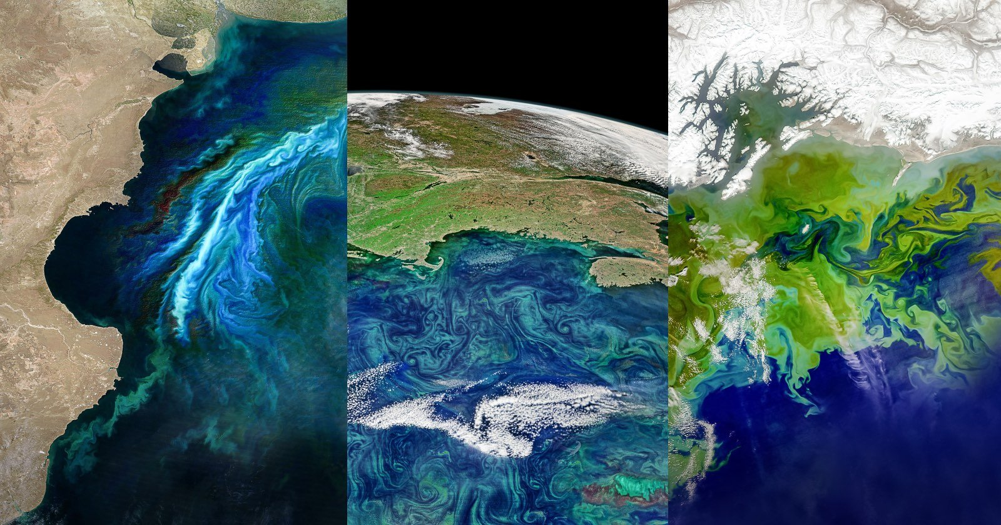
When water contains excess nitrogen and phosphorus, with enough sunlight, plants and algae grow like crazy!
Notes:
Image: https://petapixel.com/2023/03/07/satellite-images-reveal-danger-of-earths-toxic-algae-blooms/

Slide 15
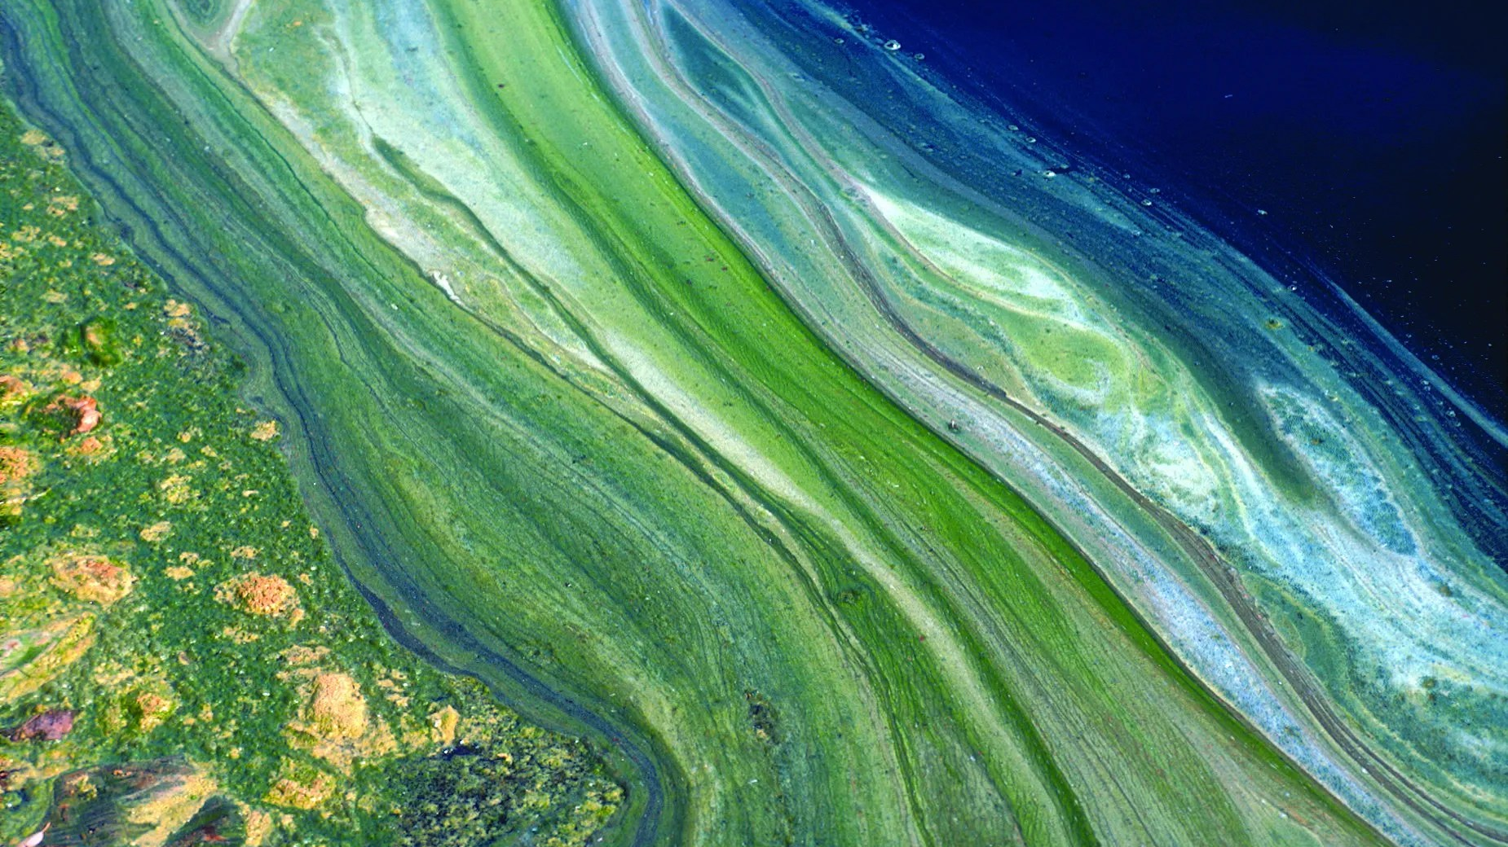
Notes:
Image: https://ecos.csiro.au/tag/water/page/5/

Slide 16
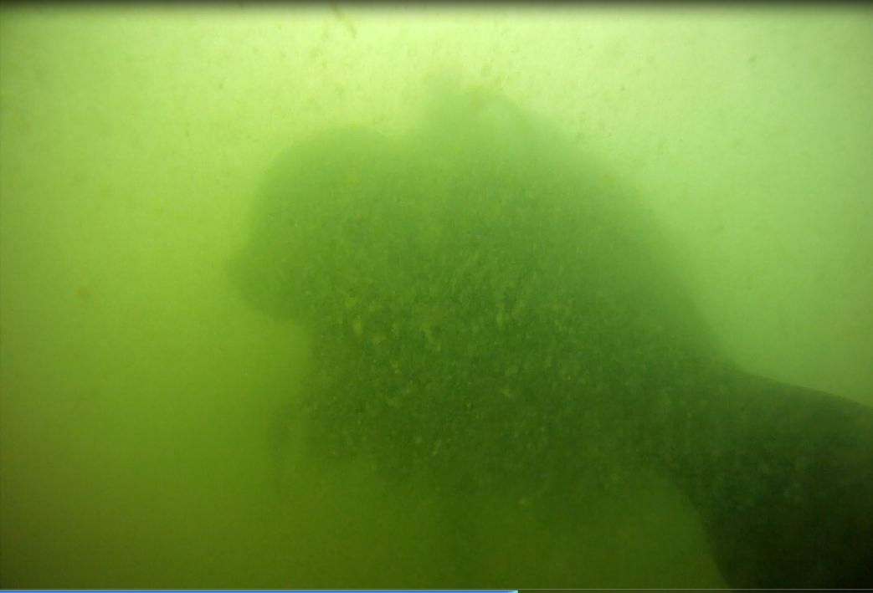
After the algae blooms, there is so much algae biomass, it blocks out the sun.
Algae need sunlight to survive.
So, the algae dies.

Slide 17
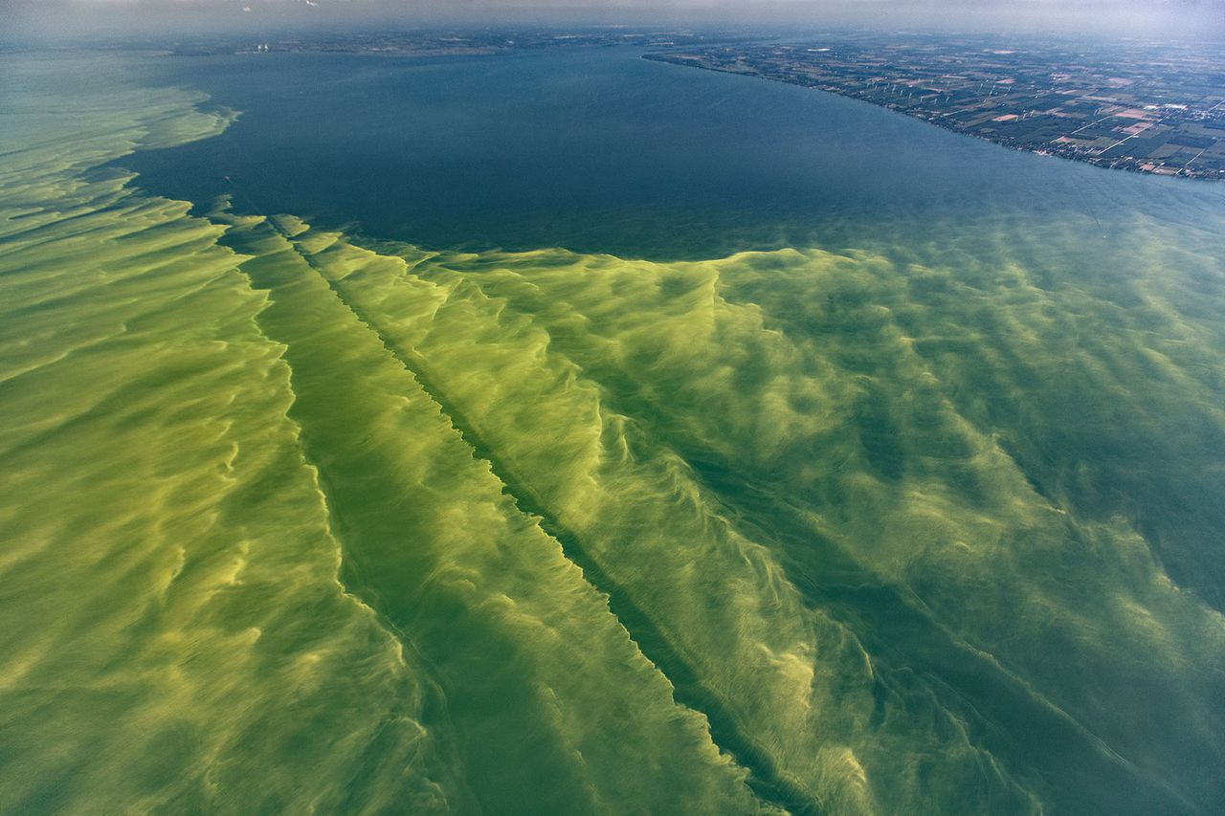
…and sinks
Notes:
Image: https://www.cleveland.com/opinion/2023/06/this-under-the-radar-climate-solution-would-also-address-toxic-algal-blooms-eyal-harel.html

Slide 18
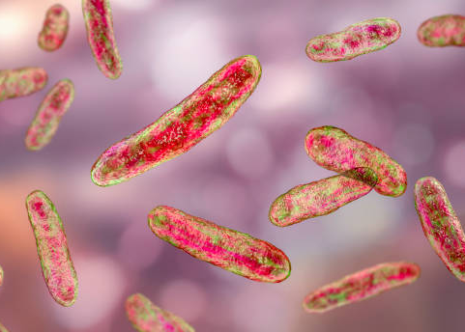
….and decomposes

Slide 19
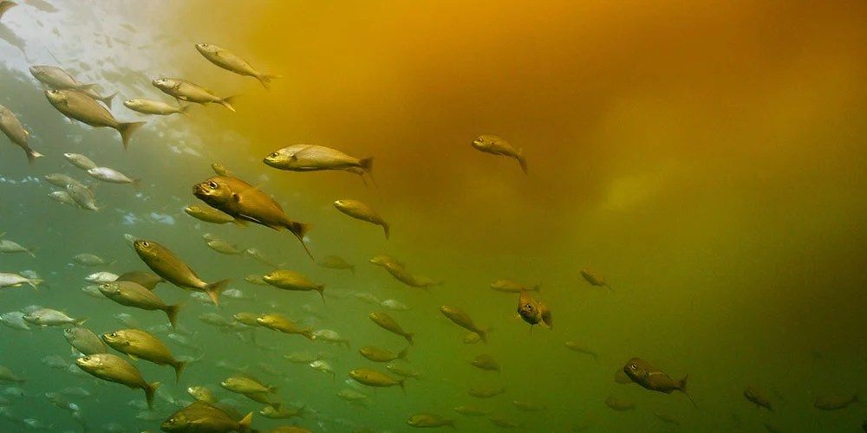
…deleting dissolved oxygen (DO) concentrations
Notes:
Image: https://atlas-scientific.com/blog/causes-of-low-dissolved-oxygen-in-water/

Slide 20
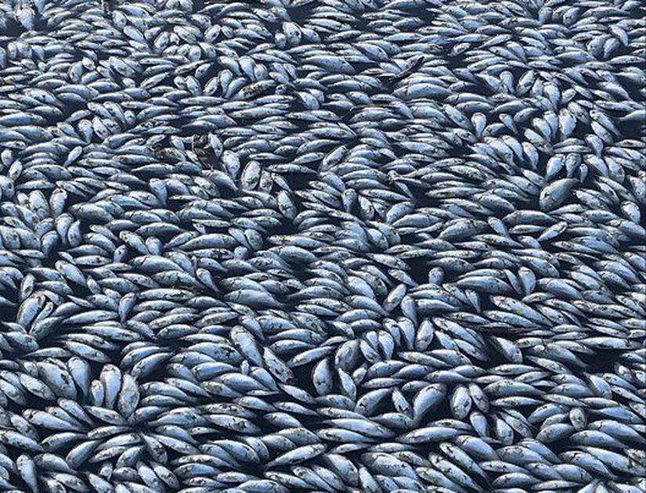
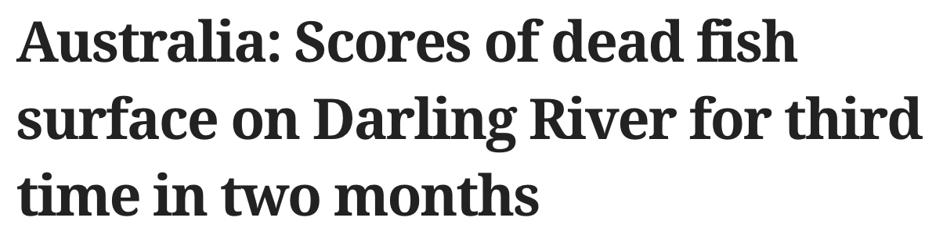

Animals
(such as fish) need oxygen to breathe.
No oxygen = mass fish kills
(& more decomposition)
Notes:
Image: https://scroll.in/latest/911271/australia-scores-of-dead-fish-surface-on-darling-river-for-third-time-in-two-months

Slide 21
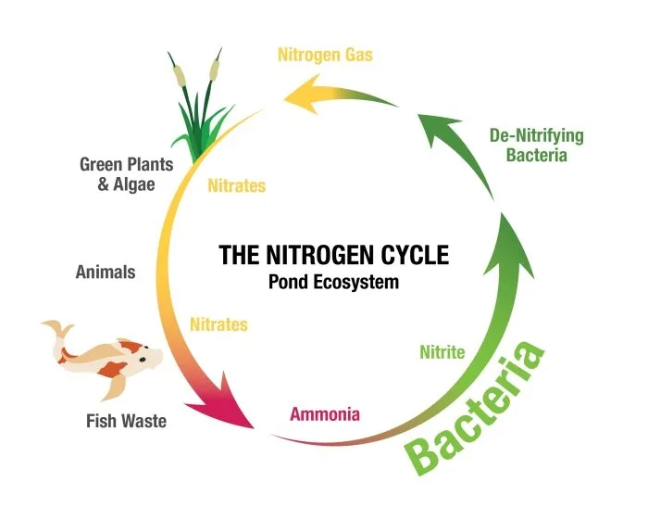
The Nitrogen (N) cycle
(A)
Growers add chemicals containing nitrogen to crops to help them grow
Nitrogen is found in our urine and faeces
Bacteria denitrify nitrogen compounds which makes them bioavailable (accessible) again for plants and algae to use for photosynthesis
(C)
(B)

Slide 22
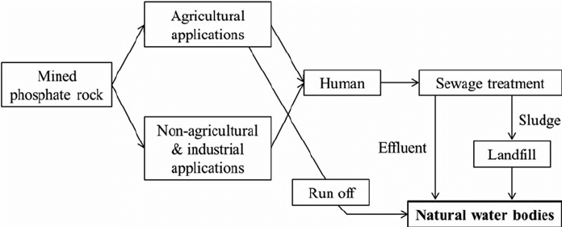


Phosphate in rocks
The Phosphorus (P) cycle
Weathering and Erosion
Predation
Grazing
Death
Excretion
Death
Excretion
Death
Excretion
Decomposition
Notes:
Image (adapted by Marine Education): https://www.researchgate.net/figure/Open-phosphorus-cycle-in-modern-society-modified-from-Centre-European-dEtudes-des_fig2_267875820

Slide 23
How to avoid man-made eutrophication?

Slide 24
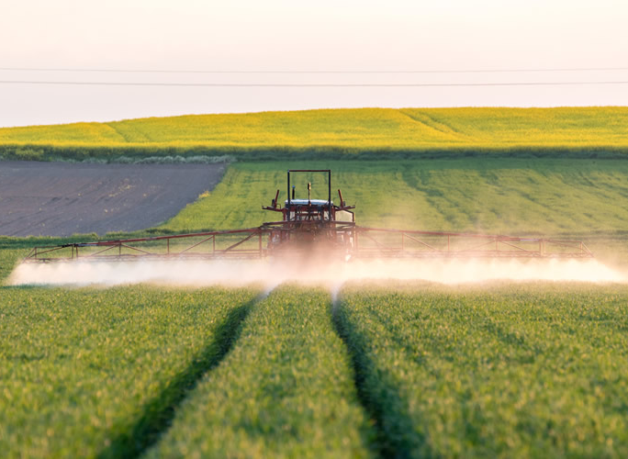
Farmers –
Use fewer fertilizers and adjust the timing of fertilizer applications to limit rainfall runoff of excess nutrients from farmland

Slide 25
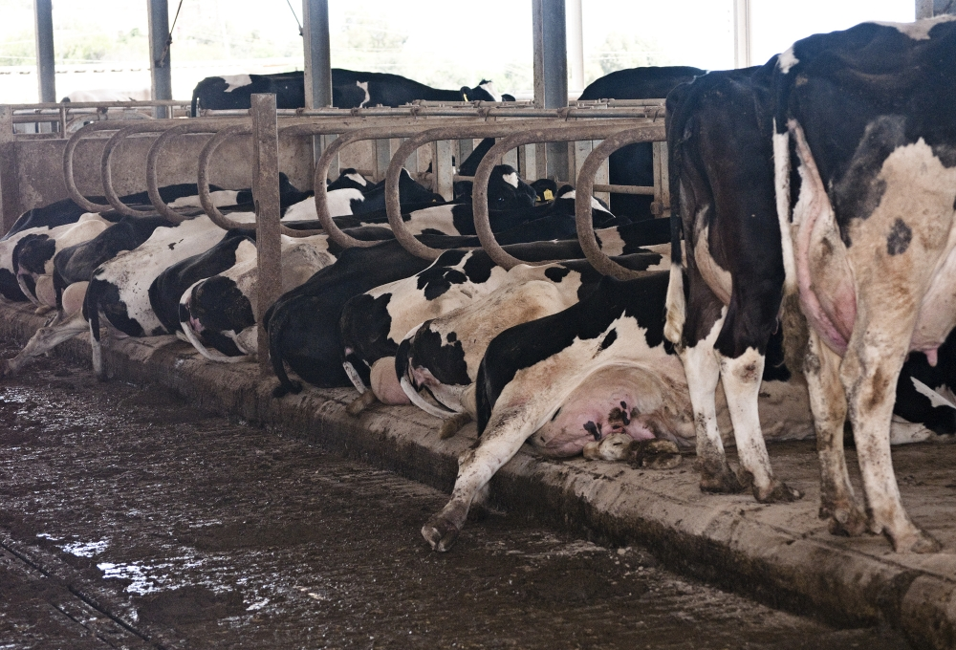
Farmers –
Control of animal wastes to prevent entry into waterways

Slide 26
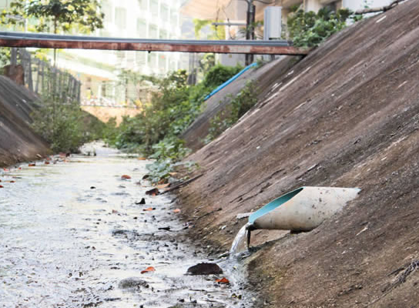
Industry –
Limit the discharge of nutrients, organic matter, and chemicals from industrial facilities

Slide 27
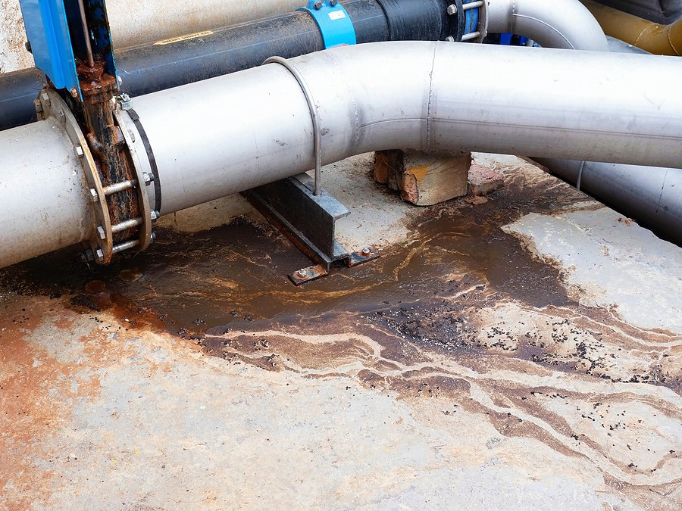
Industry & home owners -
Monitor sewage treatment and septic systems to reduce discharge of nutrients to surface water and groundwater

Slide 28
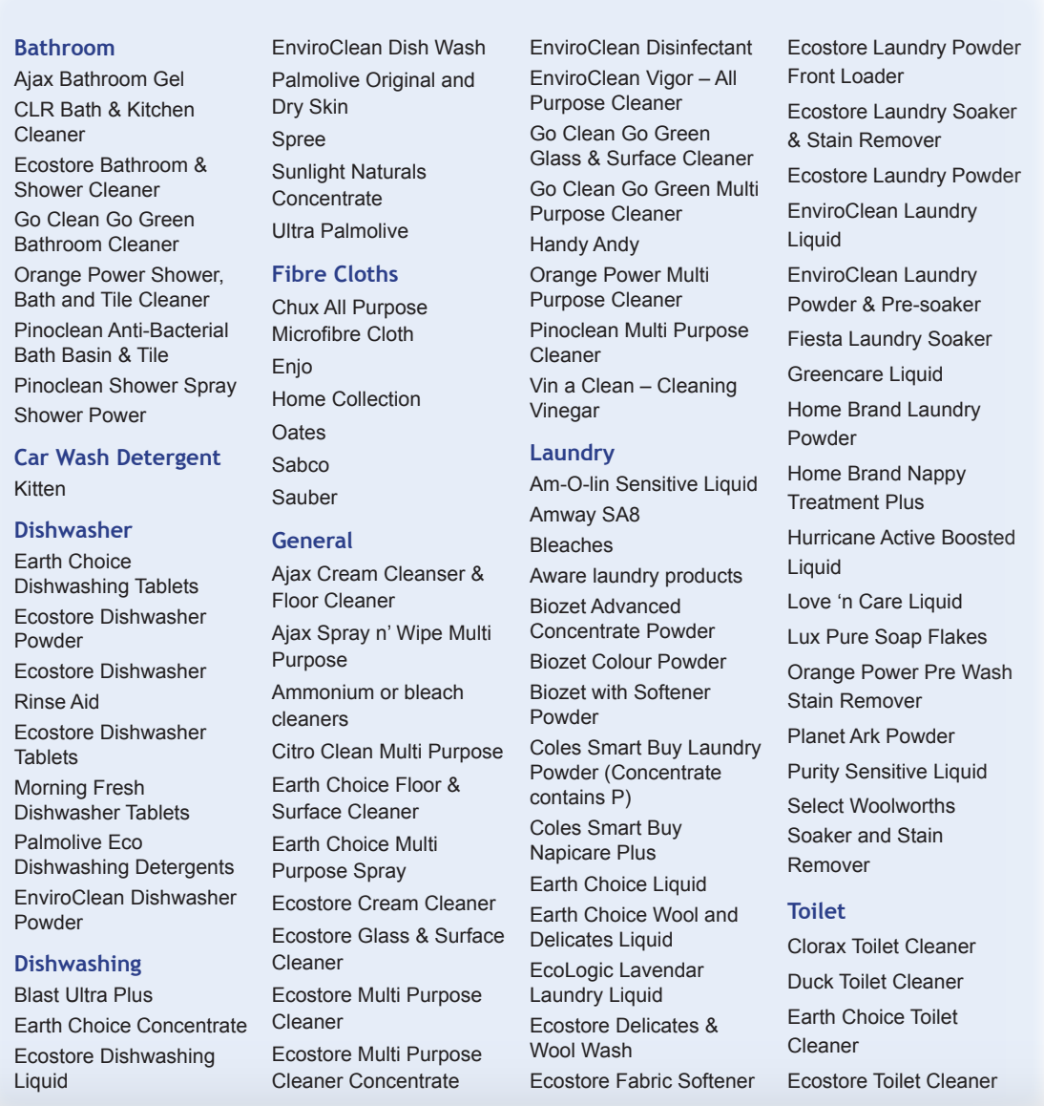

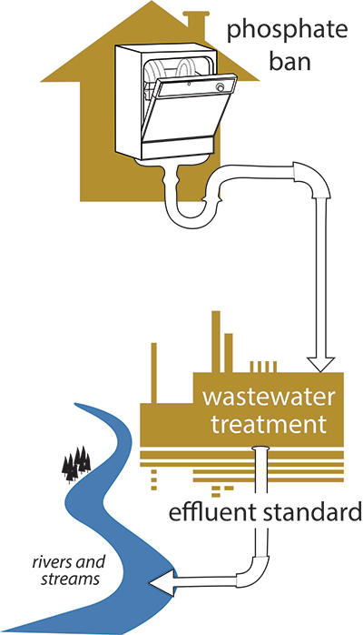
Consumers –
Only use cleaning products labelled NP
Governments –
Legislate and enforce phosphate bans and effluent industry standards

Slide 29
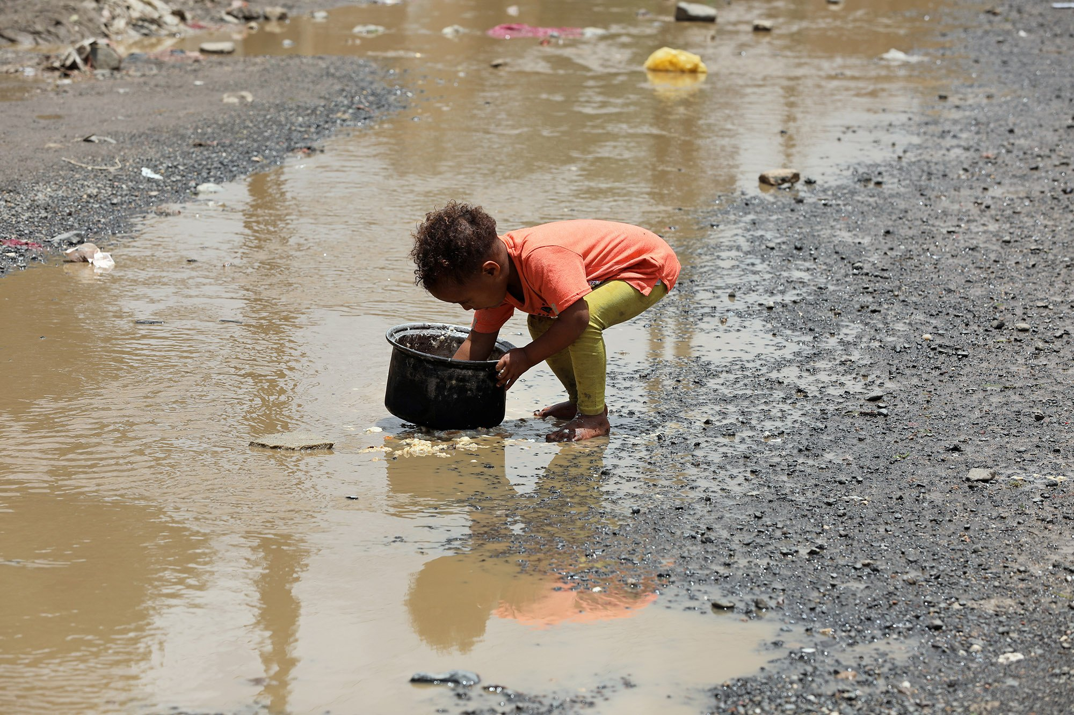
In developing countries, 90% of sewage is discharged into the water untreated.
Notes:
Quote: https://www.nature.com/articles/s41599-022-01140-5
Image: https://www.cfr.org/backgrounder/water-stress-global-problem-thats-getting-worse
A young boy washes a cooking pot in a pool of rainwater outside a slum where members of the Muhamasheen minority group live in Sanaa, Yemen, July 2020.

Slide 30
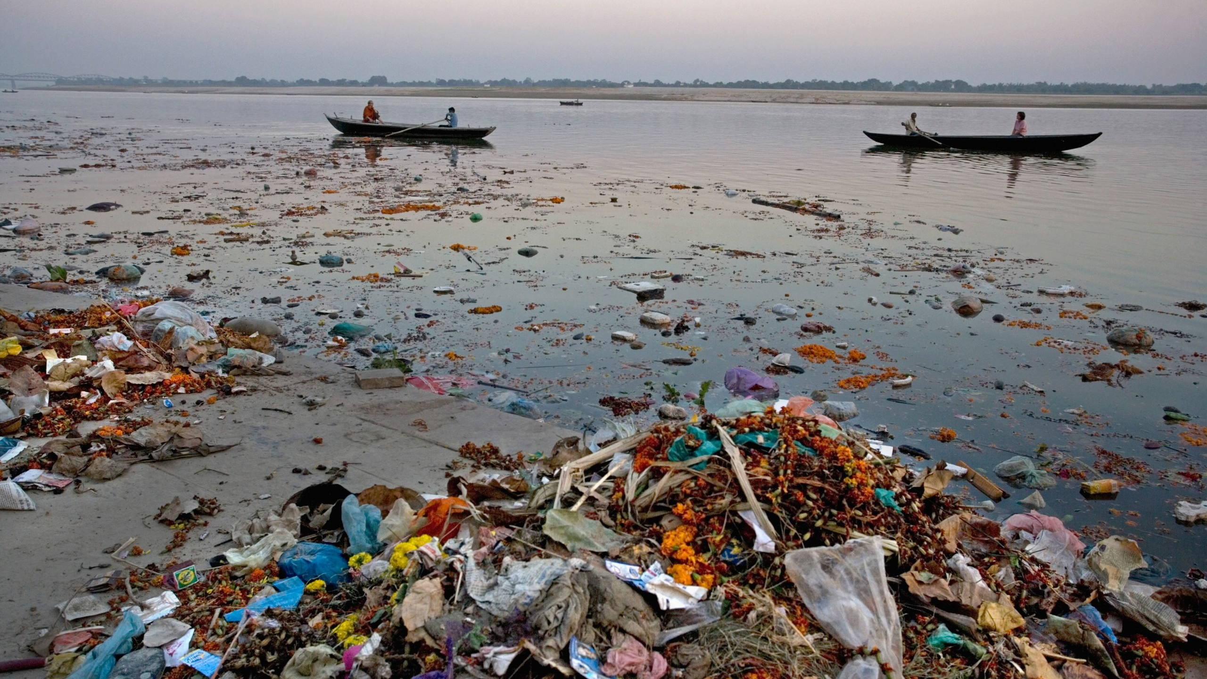
Litter in the Ganga River, India, Uttar Pradesh, Varanasi.
Notes:
Image: https://www.thethirdpole.net/en/pollution/drinking-sewage-in-varanasi/

Slide 31
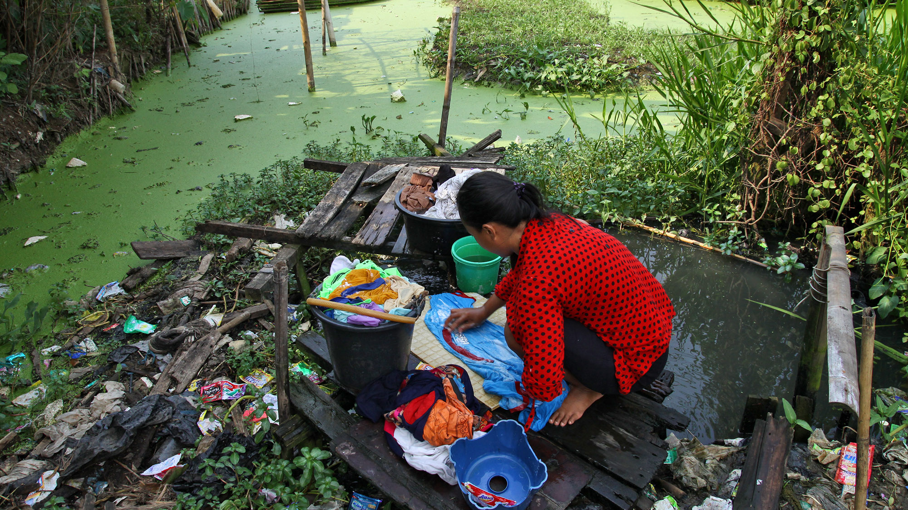
Notes:
Image: https://www.cfr.org/backgrounder/water-stress-global-problem-thats-getting-worse

Slide 32
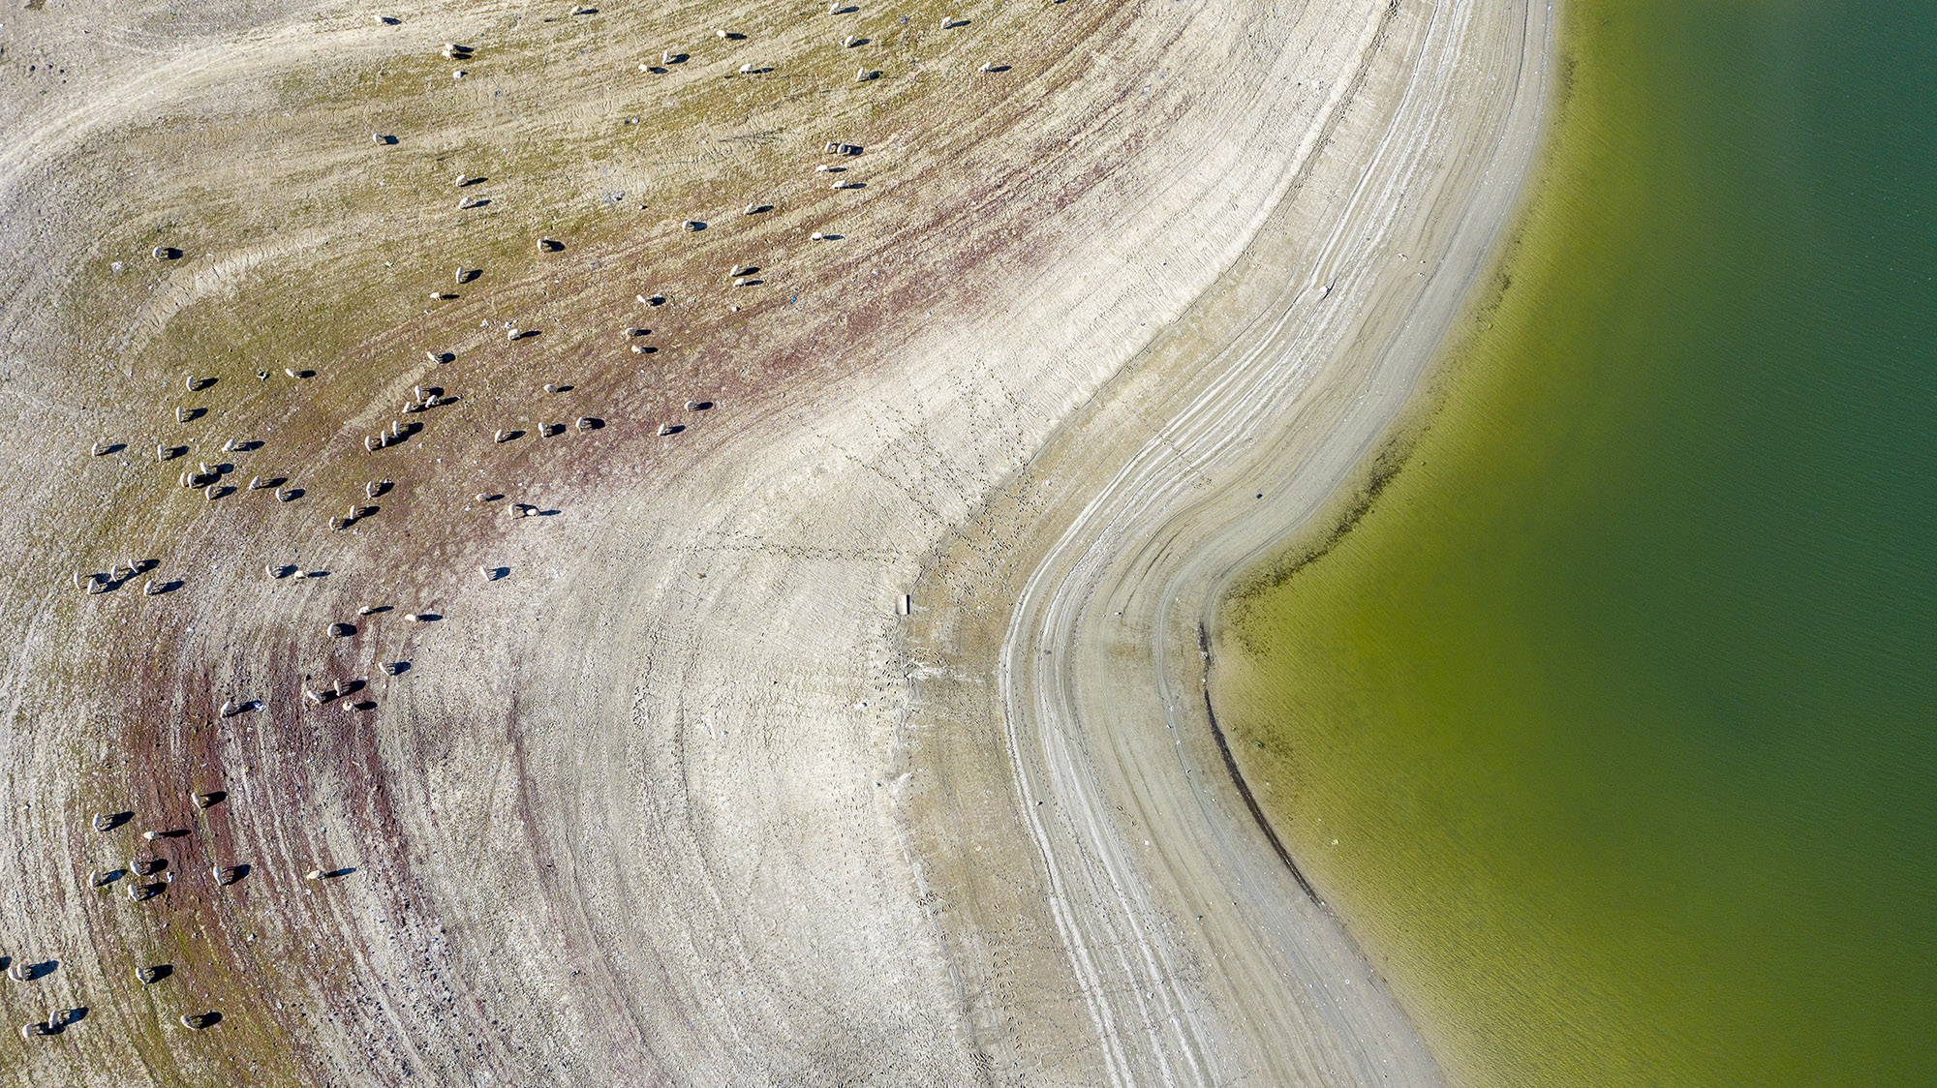
Notes:
Image: https://www.cfr.org/backgrounder/water-stress-global-problem-thats-getting-worse
The water level at Camlidere Dam in the Turkish capital of Ankara is low due to seasonal drought and high water consumption amid the COVID-19 pandemic, November 2020.

Slide 33
Eutrophication sequence of events
Excess nutrients (N & P) added to water
Algae blooms
Lots of algae biomass blocks out sunlight
No more photosynthesis
Biomass dies and sinks
Biomass decomposes
Oxygen is depleted
Animals (fish) die

Slide 34
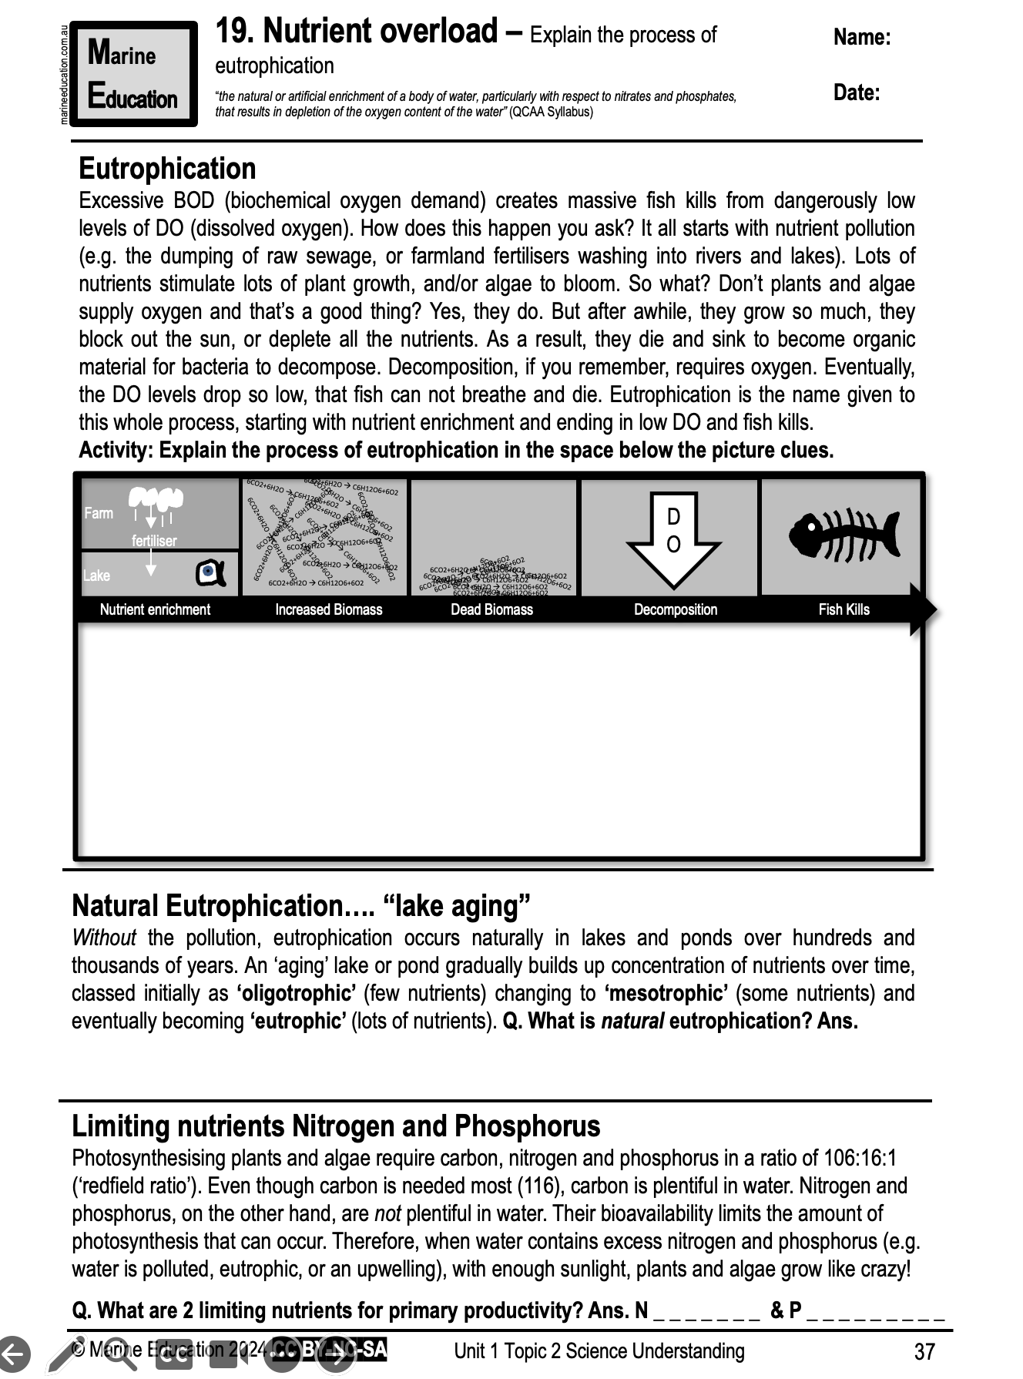
Learning Intention:
Explain the process of eutrophication
Success Criteria:
Complete Marine Education worksheet
’19. Nutrient overload’
Notes:
Image:

