Slide 1
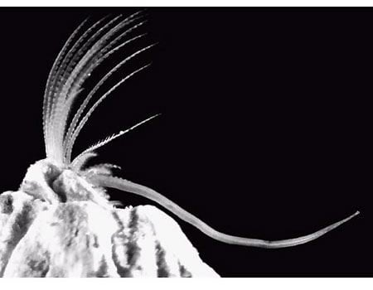
Learning Intention:
Explain the concept of zonation using the following terms: intertidal, pelagic (neritic, oceanic), benthic and abyss.
Success Criteria:
Complete Marine Education worksheet
‘21. Living in the Zone’
barnacle
Notes:
Image: https://www.reddit.com/r/pics/comments/c2rzd/a_male_barnacles_penis_can_grow_to_20_times_the/

Slide 2
Intertidal zone

Slide 3
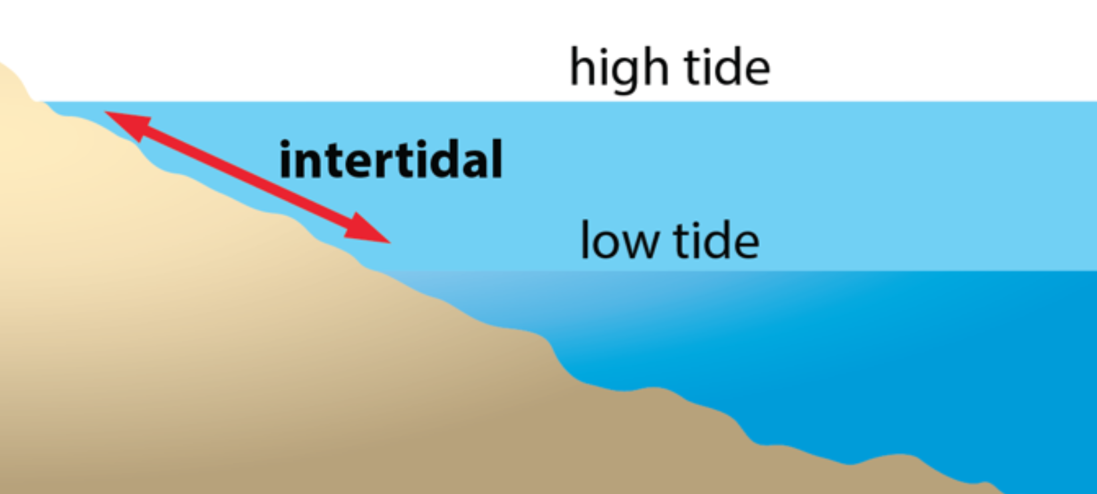
Intertidal zone: area between high tide and low tide
Notes:
Image: https://coe.hawaii.edu/opihi/about-opihi/

Slide 4
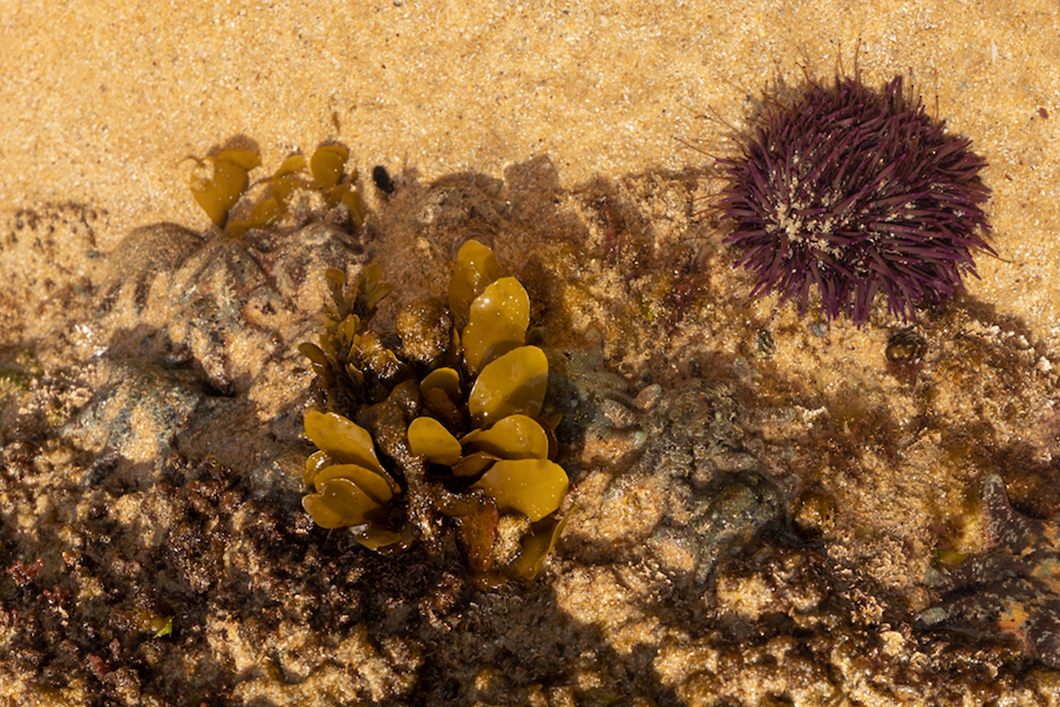
The intertidal zone: where a multitude of organisms living on the shore survive changes between high and low tides
Notes:
Image: https://www.peekdesigns.com.au/intertidal-zone-photos/

Slide 5
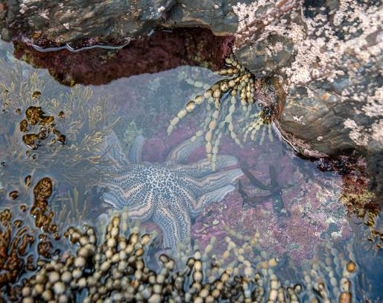
On the
low tide zone
of a rocky shore, the competition for space is fierce
Notes:
Image: https://www.istockphoto.com/search/2/image-film?phrase=rock+pools

Slide 6
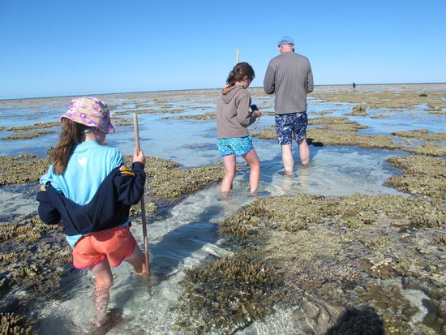
Lady Elliot Island
It’s covered in water for most of the day
Notes:
Image: https://www.tripadvisor.in/LocationPhotoDirectLink-g664432-d309999-i104578658-Lady_Elliot_Island_Eco_Resort-Lady_Elliot_Island_Queensland.html

Slide 7
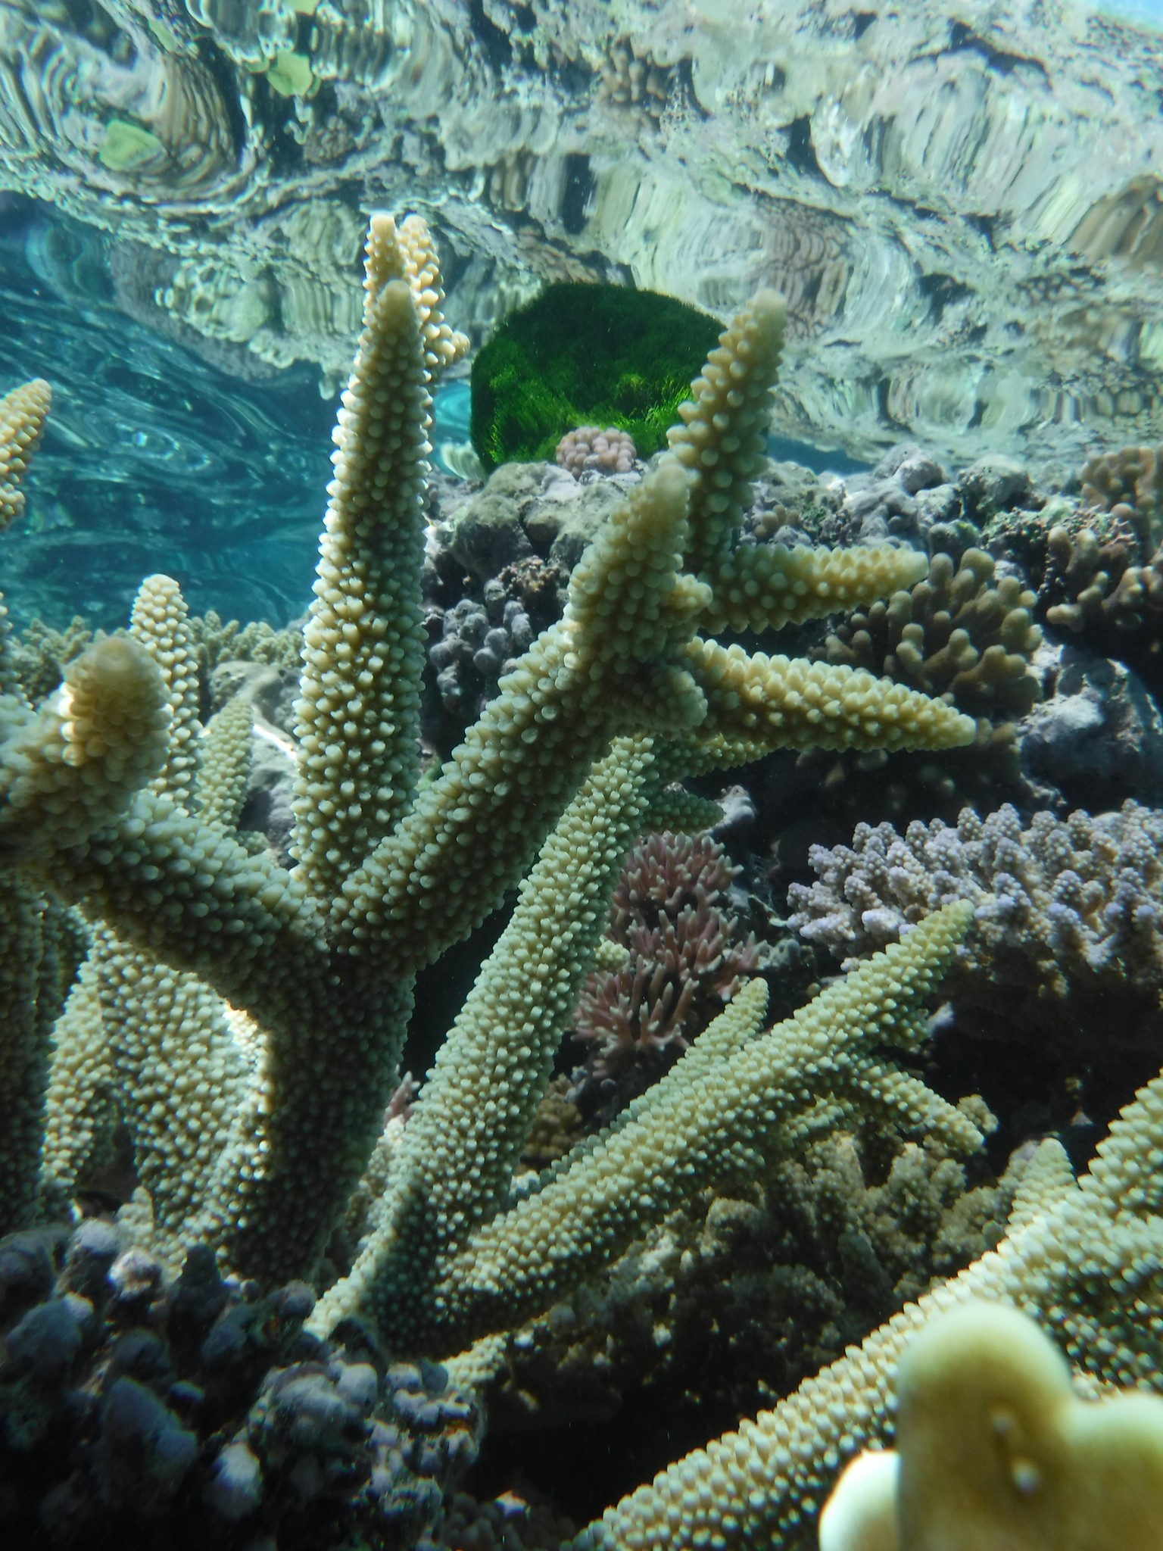
Not surprisingly, marine animals need to be in water.
Thus, competition for space is fierce.
Real estate in the low tide zone is highly sought after.
Notes:
Image: Gail Riches.

Slide 8
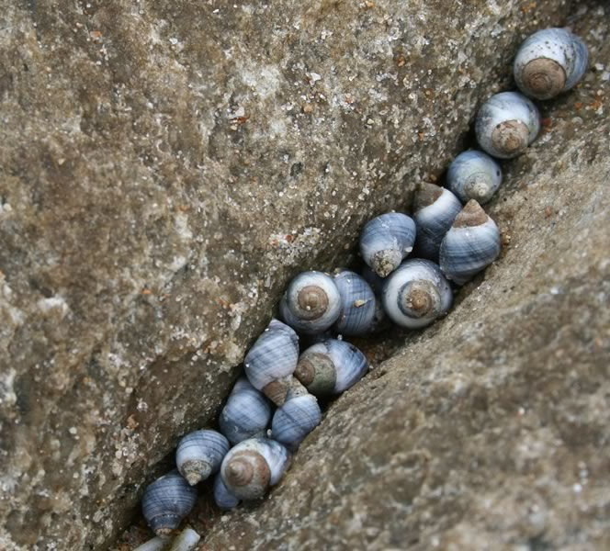
Some couldn’t be bothered competing, and so adapted to live in the high tide zone instead.
In the high tide zone, real estate is cheap and easy to find.
Only the toughest adapted to survive there.
Periwinkles
Notes:
Image: https://www.pinterest.com.au/pin/studio-marcy-marcy-lamberson-all-things-periwinkle-a-true-periwinkle-blue--172051648236173839/

Slide 9
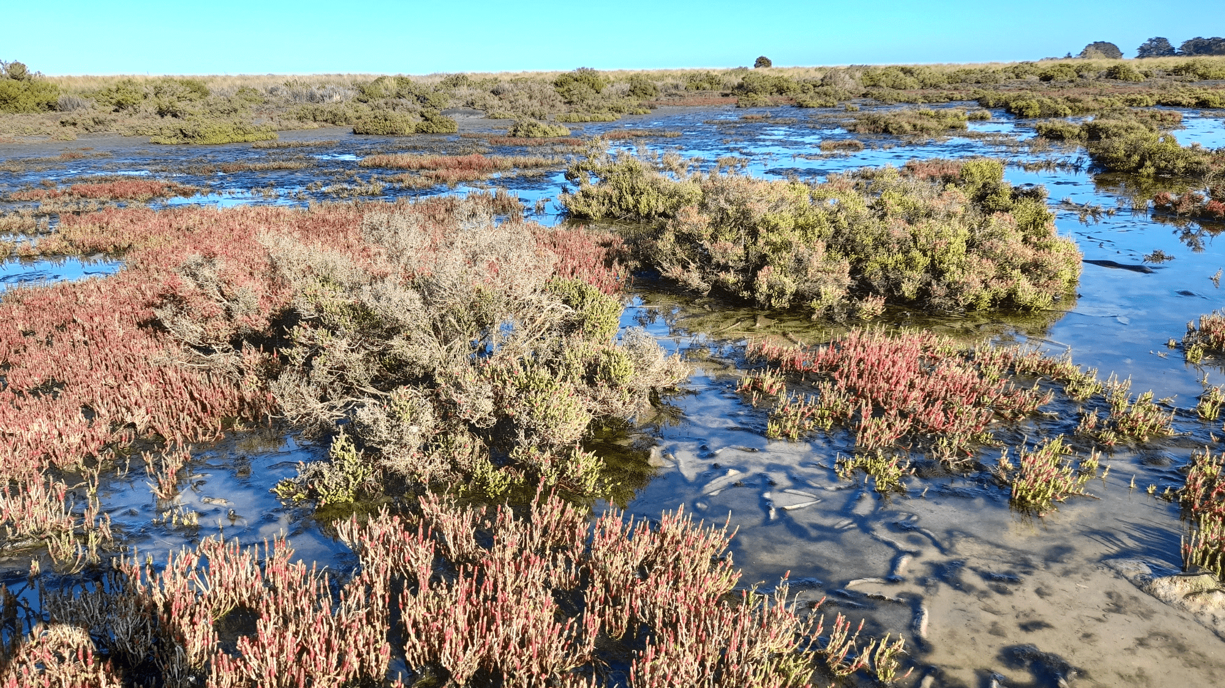
Including the salt marsh trees
Notes:
Image; https://www.ces.vic.gov.au/state-of-reports/state-marine-and-coastal-environment-2021-report/stories/collaborating-protect

Slide 10
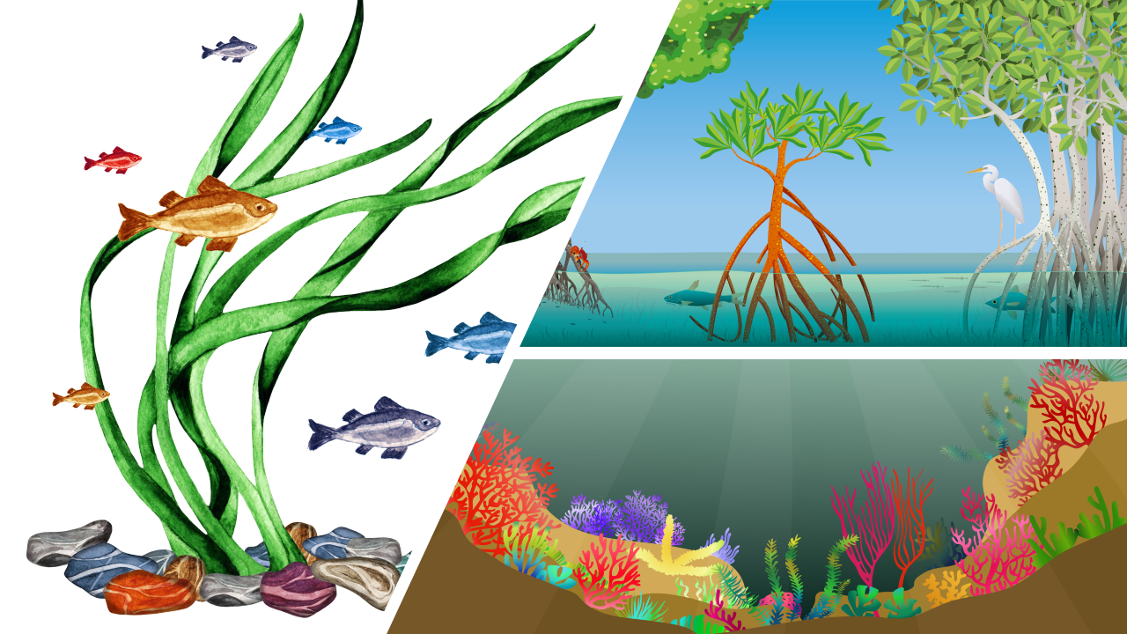
Zonation: “patterns of species abundance and distribution”
Notes:
Image: https://communities.adaptationportal.gca.org/knowledge-base/adaptation-of-coastal-areas/the-power-of-three-mangroves-seagrass-and-corals

Slide 11
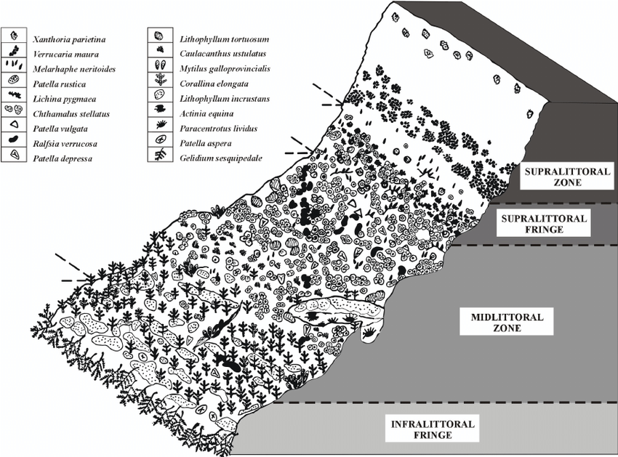
Zonation characterizes where certain species are found
(based on the conditions)
Notes:
Image; https://www.ces.vic.gov.au/state-of-reports/state-marine-and-coastal-environment-2021-report/stories/collaborating-protect

Slide 12
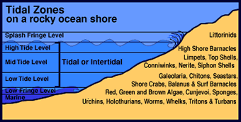
Likewise, each species has a zone where it prefers to live.
Source: mesa.edu.au/
Notes:
Image: http://www.mesa.edu.au/friends/seashores/high_tide_level_ewtz.html

Slide 13
Pelagic zone

Slide 14
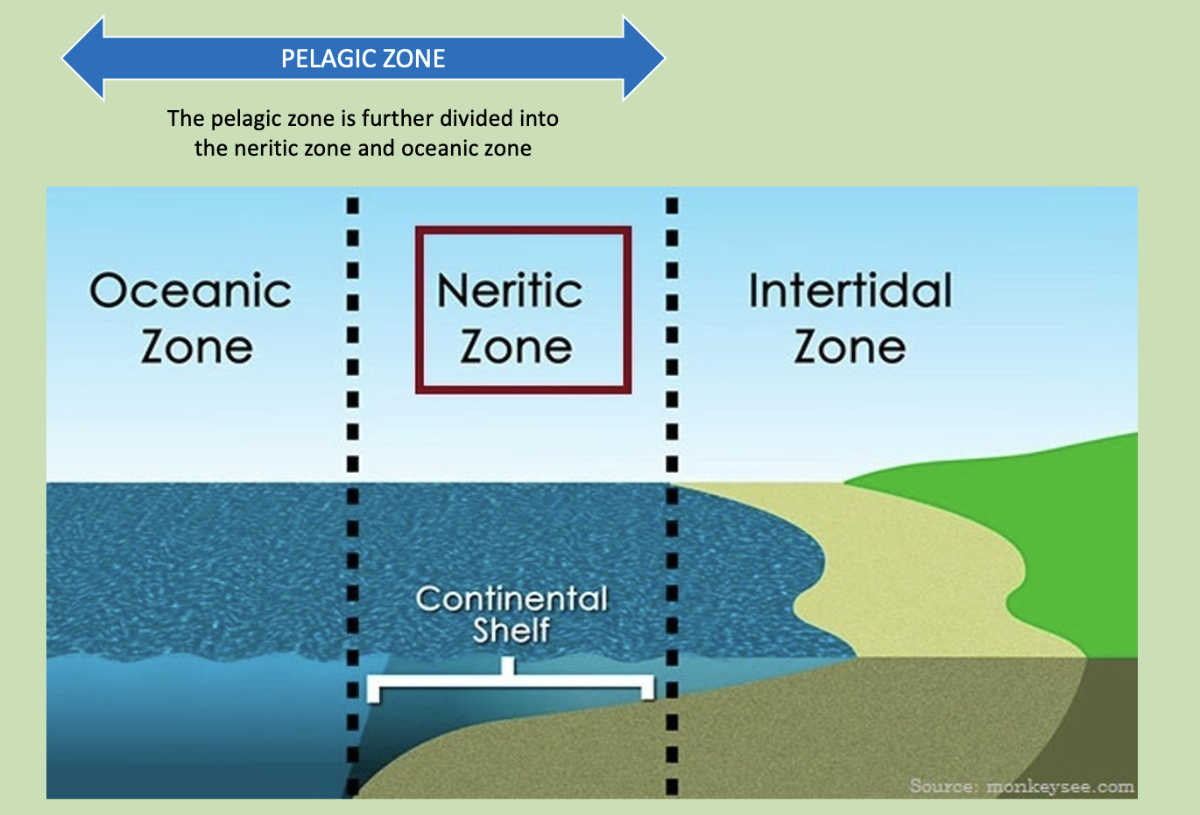
Anything BEYOND the intertidal zone is called the pelagic zone
Notes:
Image: https://www.jagranjosh.com/general-knowledge/what-is-the-neritic-zone-of-the-ocean-1555655177-1

Slide 15
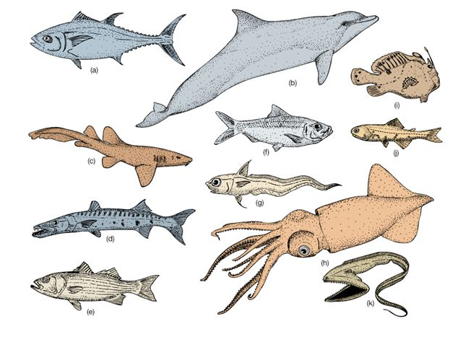
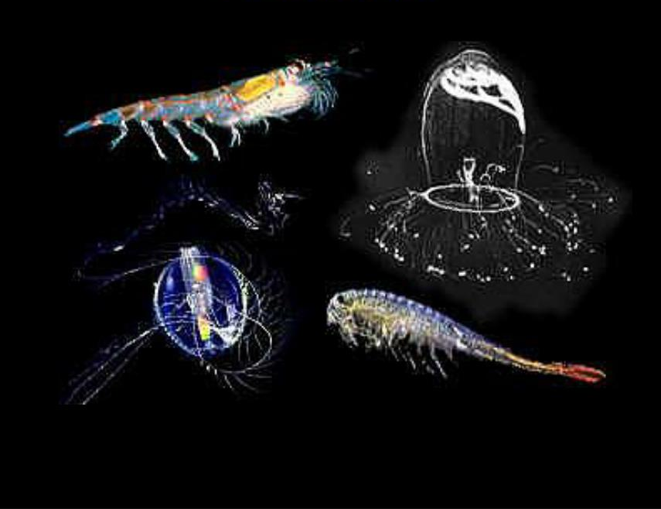
The pelagic zone supports 2 types of marine life: nekton & plankton
Nekton CAN swim against currents
Plankton can NOT
Notes:
Image (left): https://slideplayer.com/slide/5083788/
Image (right): https://www.slideserve.com/ady/plankton

Slide 16
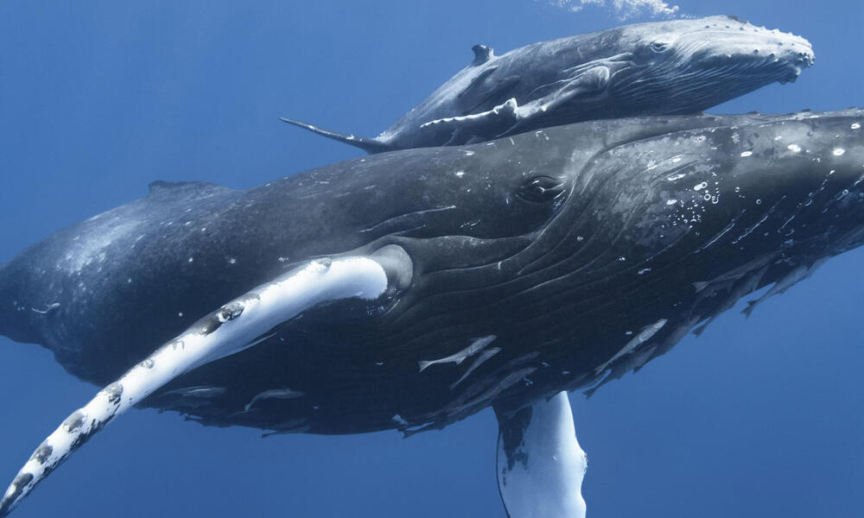
Nekton: can swim against currents
Humpback whale and calf
Notes:
Image: https://www.worldwildlife.org/species/whale

Slide 17
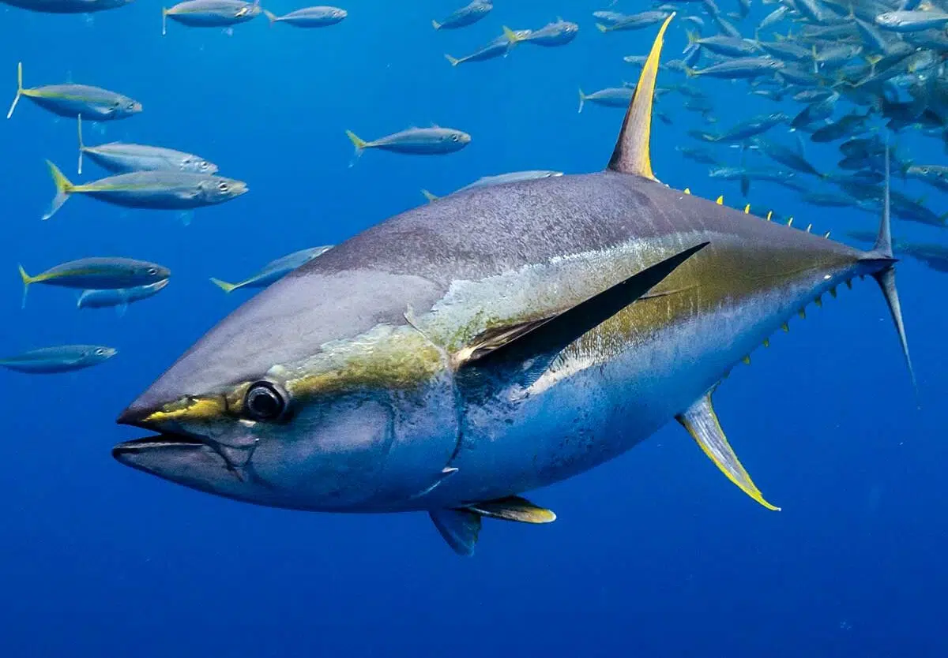
Nekton: can swim against currents
Tuna
Notes:
Image: https://nationaltoday.com/tuna-rights-day/

Slide 18
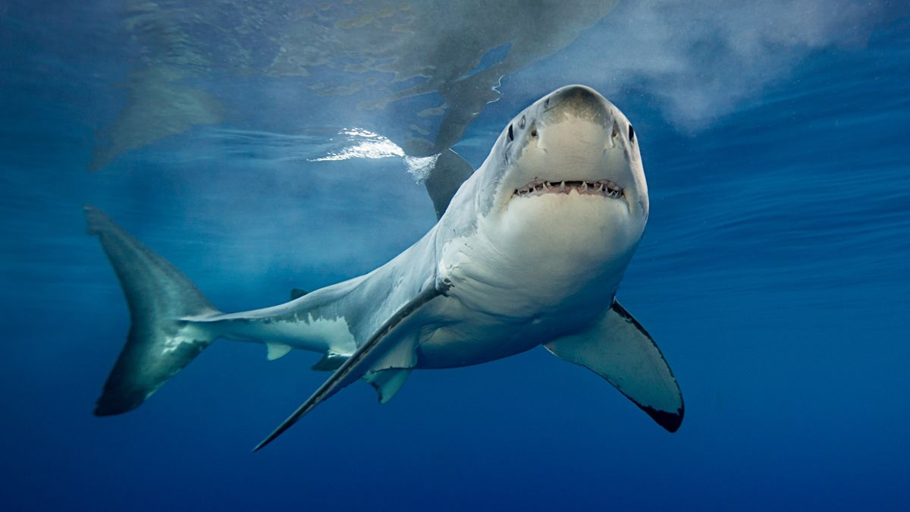
Nekton: can swim against currents
Great White Shark
Notes:
Image: https://www.livescience.com/shark-facts

Slide 19
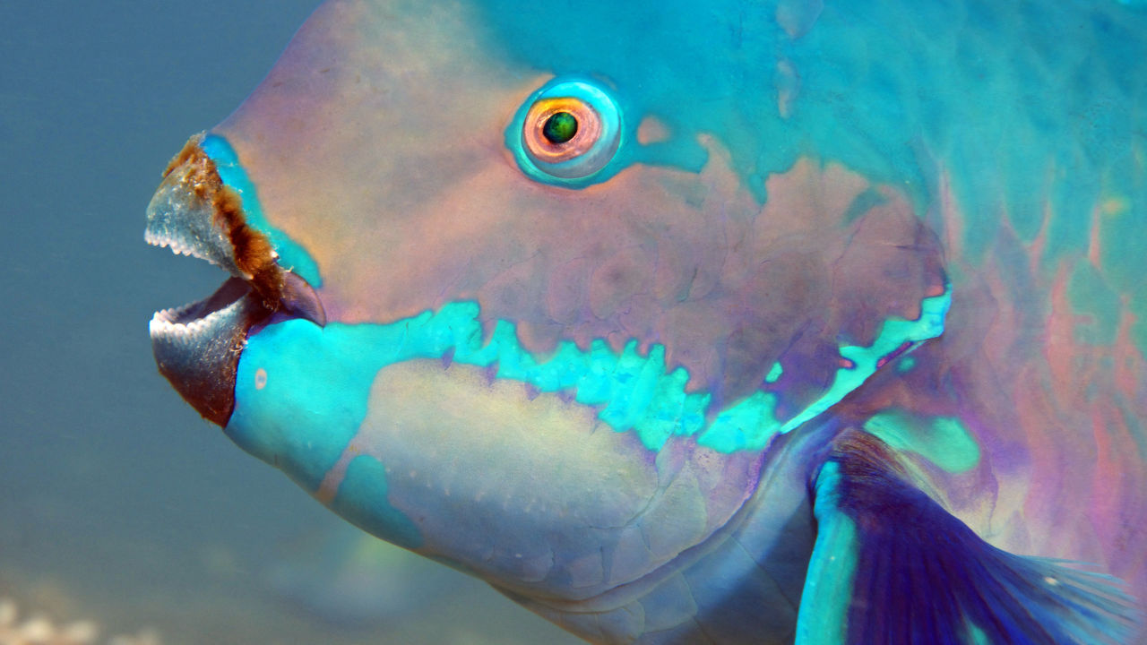
Nekton: can swim against currents
Parrotfish
Notes:
Image: https://www.barrierreef.org/news/blog/five-fascinating-facts-about-parrotfish

Slide 20
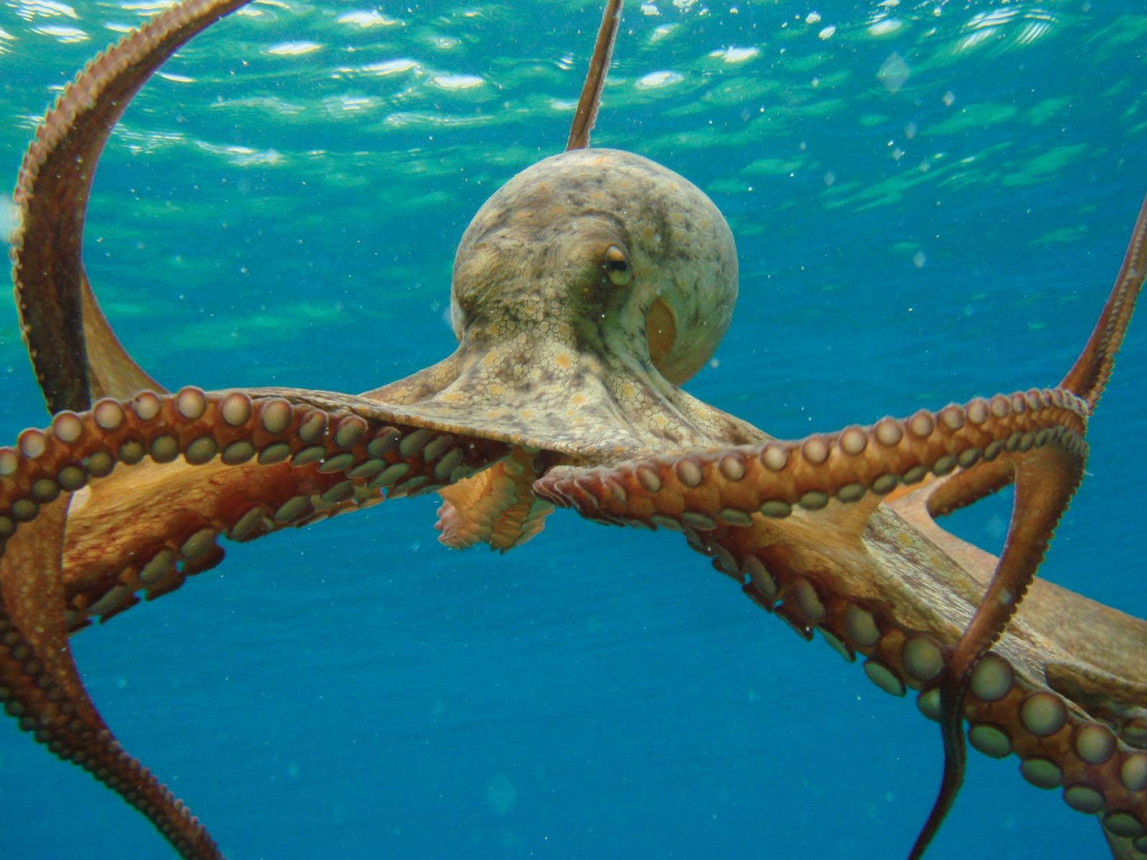
Nekton: can swim against currents
Octopus
Notes:
Image: https://www.britannica.com/animal/octopus-mollusk

Slide 21
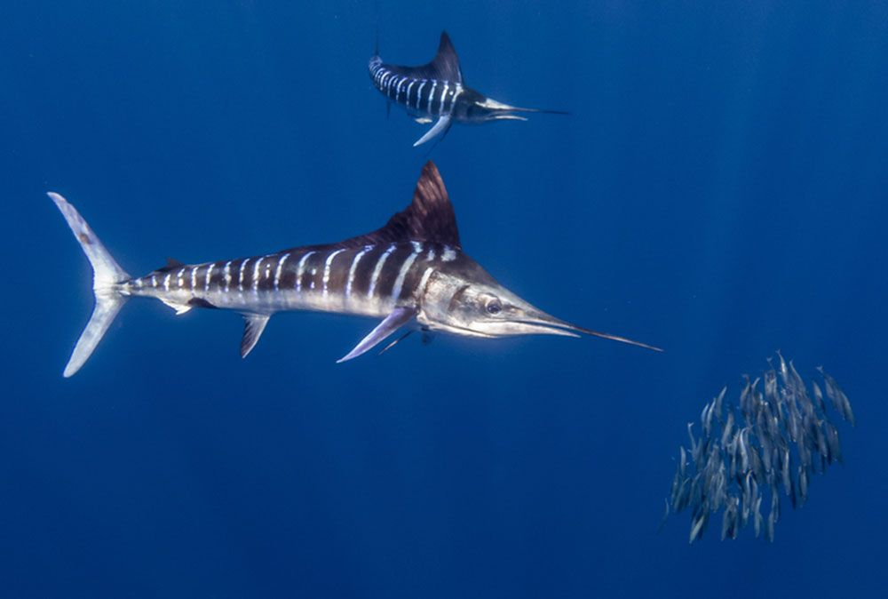
Nekton: can swim against currents
Billfish
Notes:
Image: https://www.britannica.com/animal/billfish

Slide 22
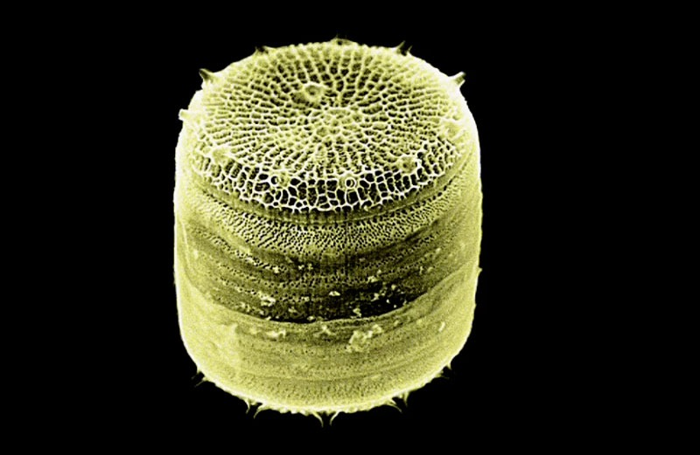
Plankton: can NOT swim against currents
Diatom
Notes:
Image: https://planktonchronicles.org/en/portfolio/diatoms-life-in-glass-houses/

Slide 23
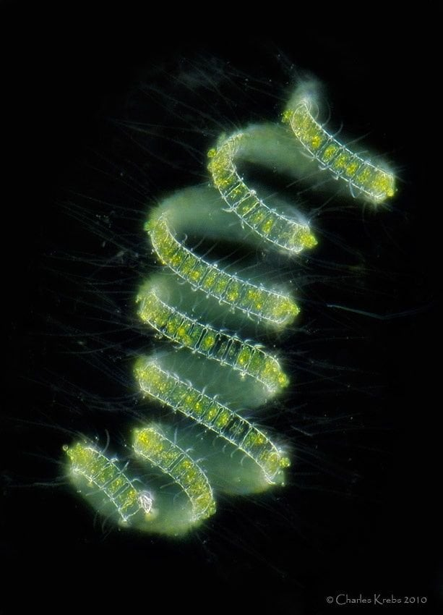
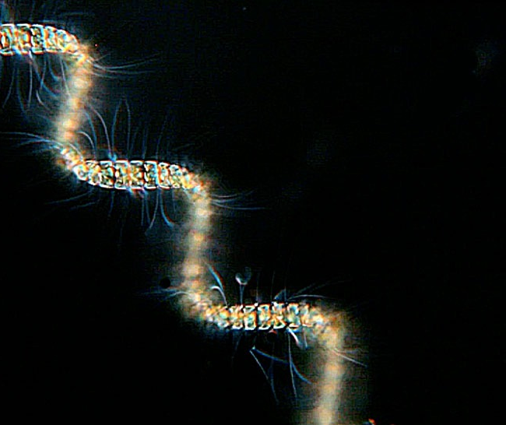
Plankton: can NOT swim against currents
Diatoms
Notes:
Image (left): https://planktonchronicles.org/en/portfolio/diatoms-life-in-glass-houses/
Image (right): https://www.reddit.com/r/biology/comments/1pj8pj/a_diatom_a_type_of_common_phytoplankton/

Slide 24
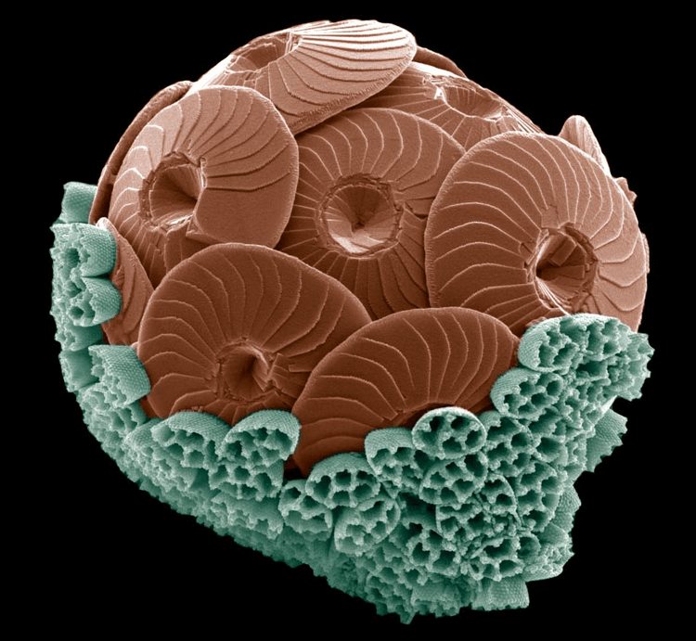
Plankton: can NOT swim against currents
Coccolithophore
Notes:
Image: https://knowablemagazine.org/content/article/living-world/2019/tiny-living-stones-sea
During coccolithophore blooms, the algae can become so prevalent that a single milliliter of water can contain as many as 100,000 individual limestone plates (or coccoliths). Some coccolithophore species produce two different types of plates, as shown in the false-colored image of the species Calcidiscus leptoporus, above. Balch says it’s rare to capture a cell in this transition from one set of plates to the other. “It’s truly amazing,” he says of the image, which a colleague made using a scanning electron microscope.
CREDIT: M. GEISEN ET AL / EUROPEAN JOURNAL OF PHYCOLOGY 2002

Slide 25
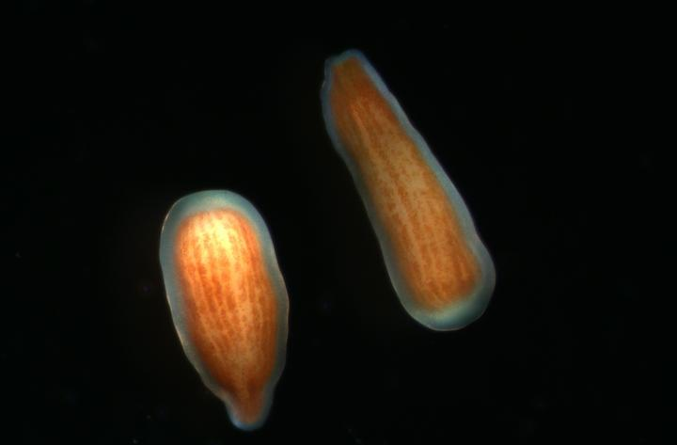
Plankton: can NOT swim against currents
Coral larvae
Notes:
Image: https://www.eurekalert.org/multimedia/904528

Slide 26
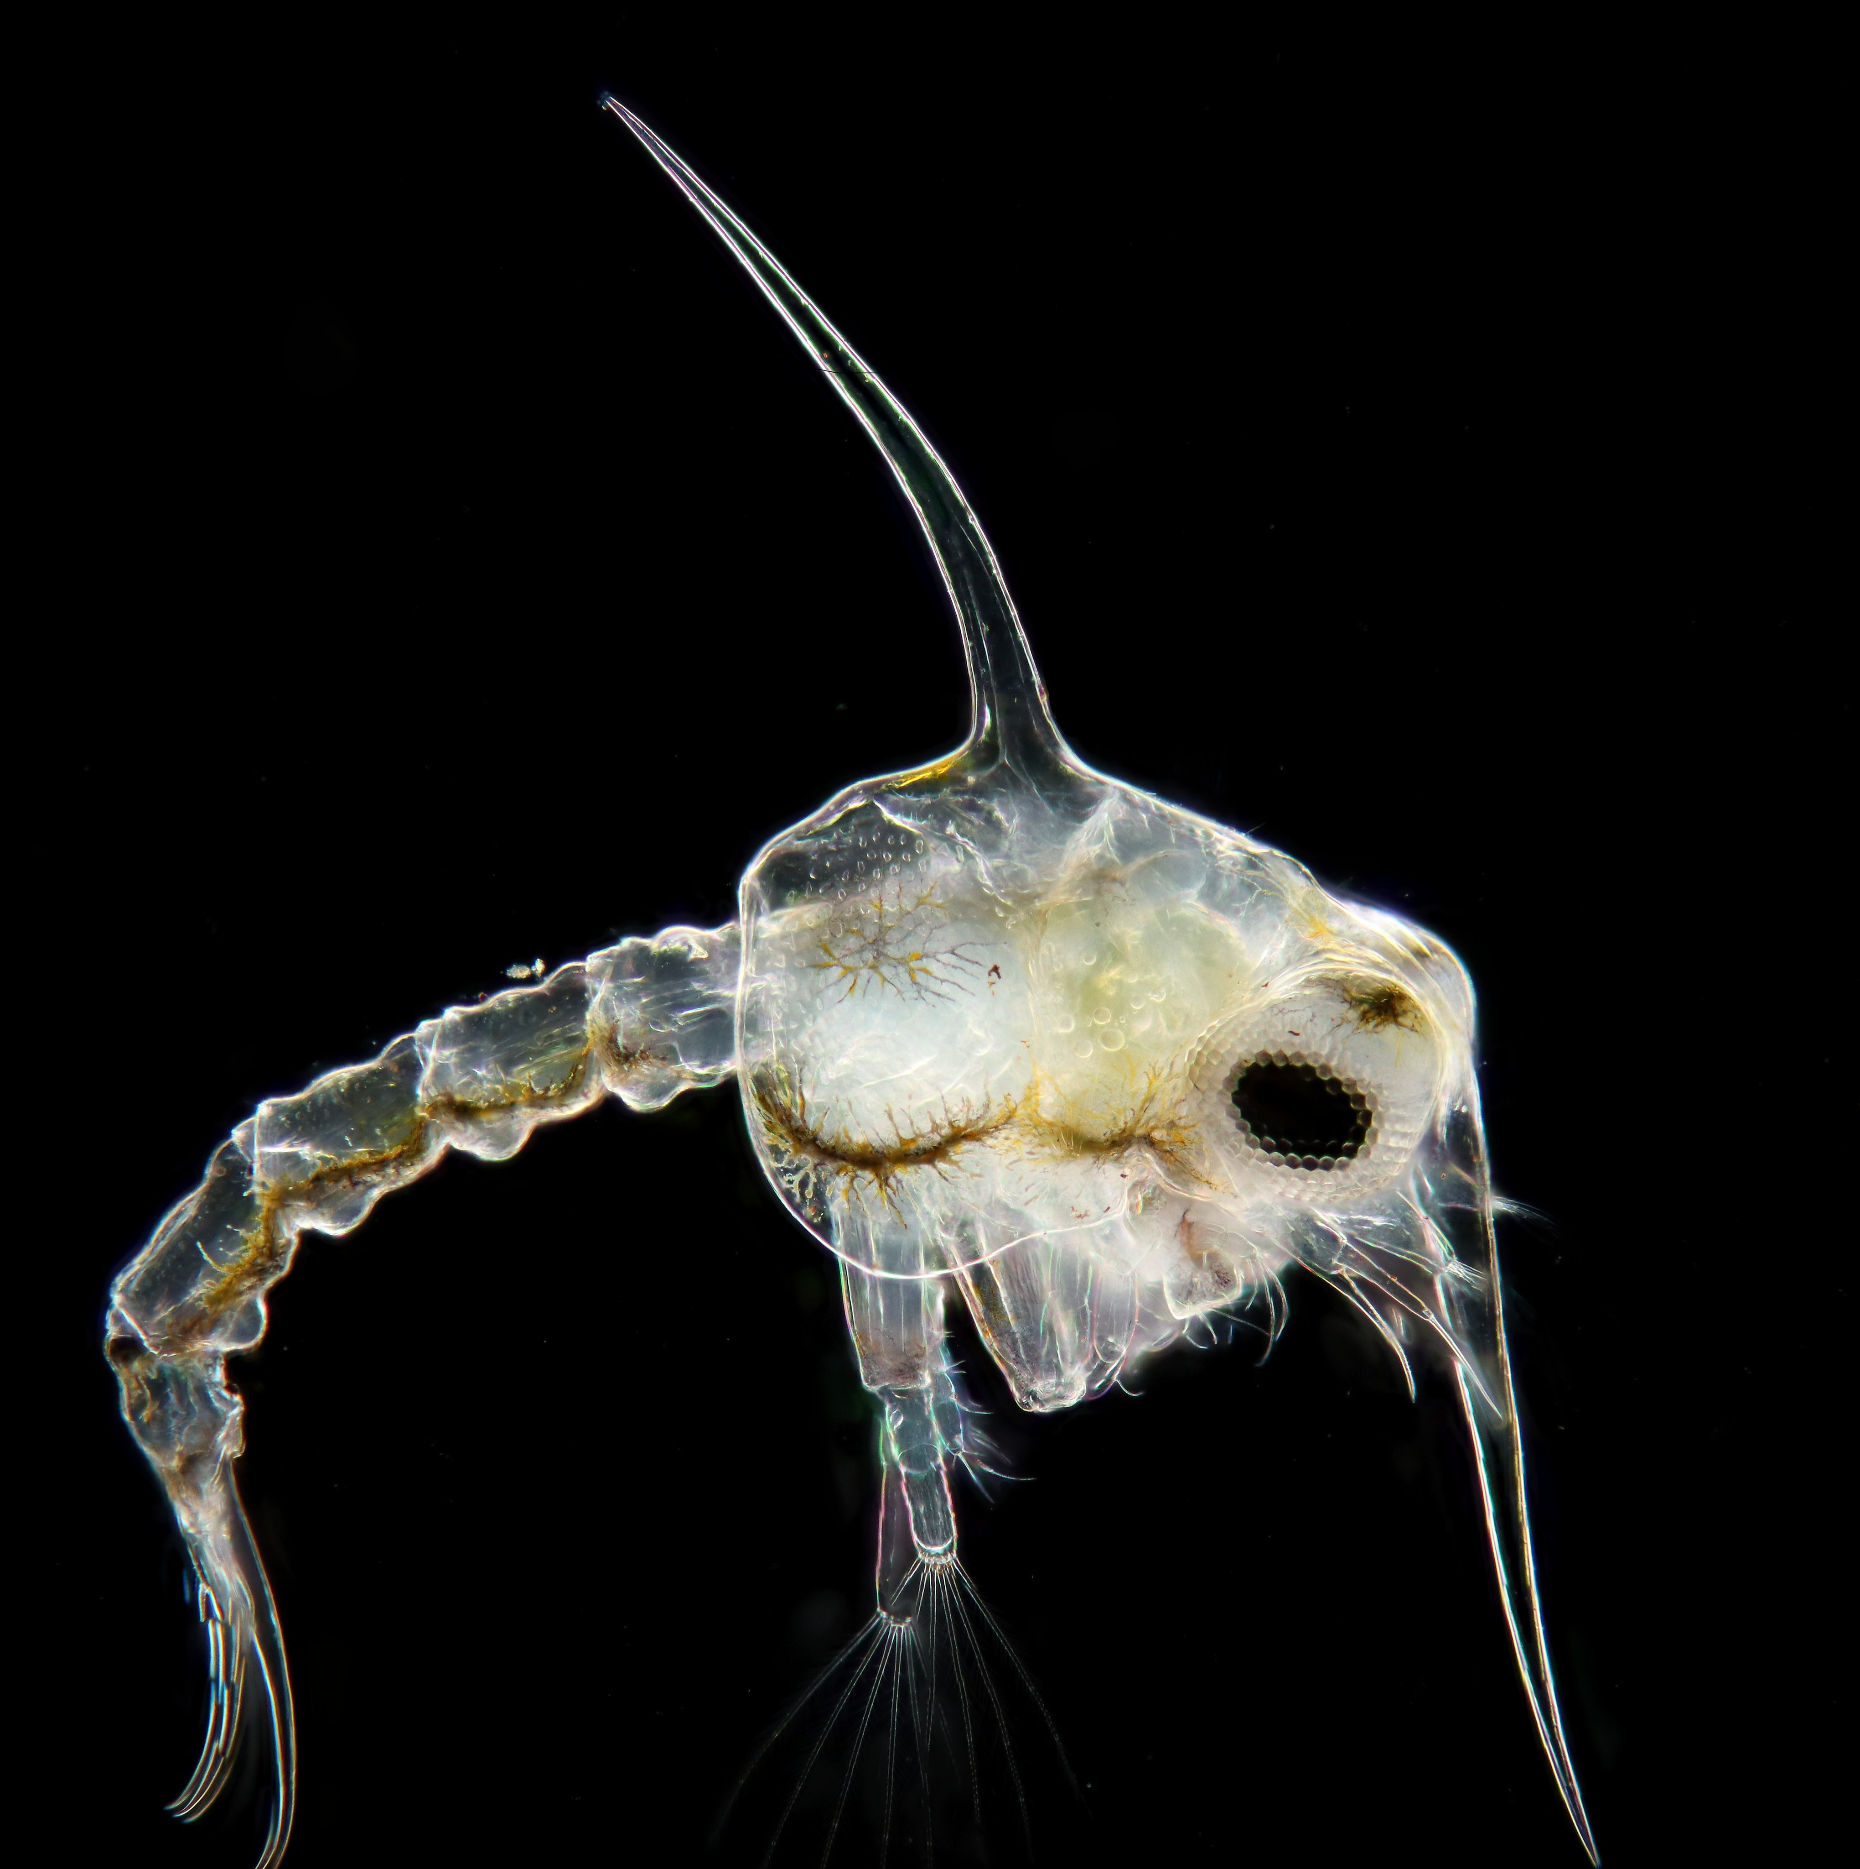
Plankton: can NOT swim against currents
Crab zoea
Notes:
Image: https://twitter.com/LodewijkW/status/1726873085658157192

Slide 27
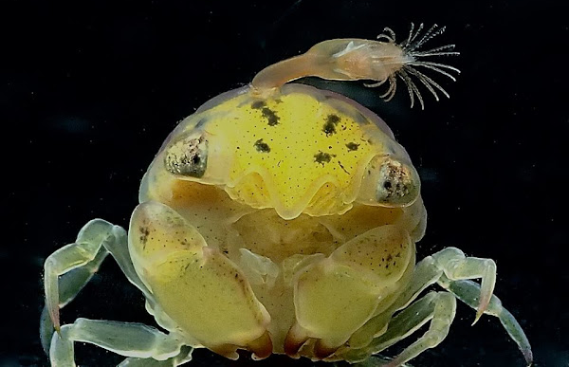
Plankton: can NOT swim against currents
Crab larvae
(with barnacle on top)
Notes:
Image: https://www.projectnoah.org/spottings/2014438221
Description:
Megalopa Crab are the final stage larvae of Crabs. During the larvae stages of their life cycle, this Crustaceans are found in the water column and usually active at night when they feeds, among tiny planktons. This particular Crab is less than 1 cm in size and I was surprised to noticed something on top of its shell, which turned out to be a Barnacle. The Barnacle was extending its feather-like feeding appendages, called cirri brushing through the water collecting planktons. Had to take many shots to capture the sequence when the cirri were fully extended as shown in both pics.
Notes:
Picture was taken during Black Water dive at night, meaning in water column over areas with depths of 100 meters or deeper.

Slide 28
Benthic zone

Slide 29
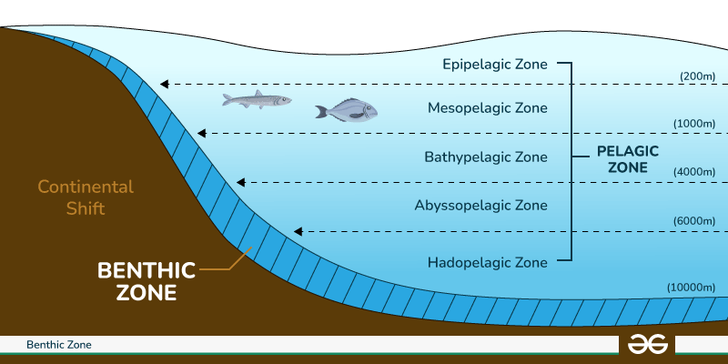
Benthic zone: ON the bottom of ANY body of water

Slide 30
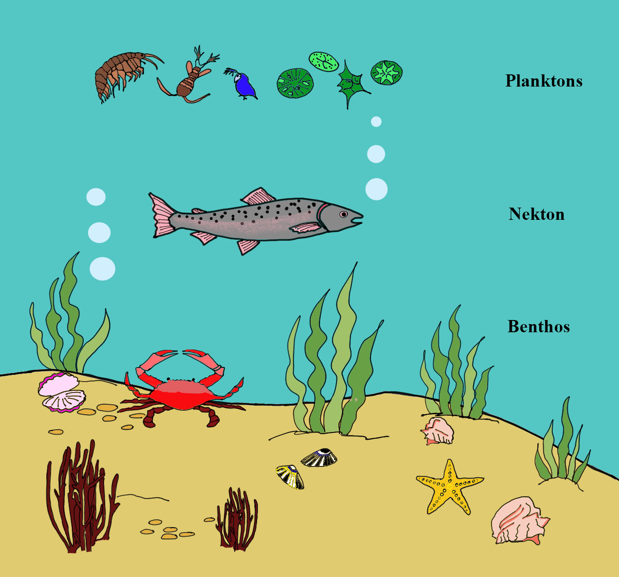
The benthic zone is where organisms live on, in, or near the bottom.
Notes:
Image: https://www.vedantu.com/question-answer/plankton-nekton-and-benthos-are-not-the-class-11-biology-cbse-5f9711732f43140eb8b81afa

Slide 31
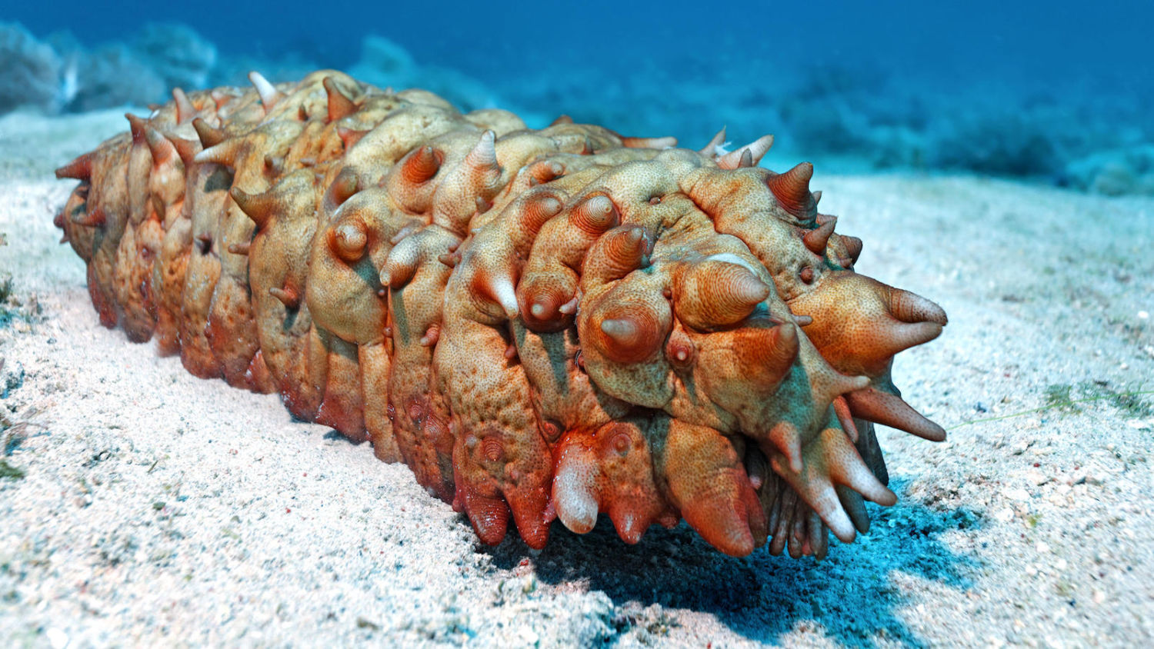
Benthos: organisms that live on, in, or near the bottom
Sea cucumber
Notes:
Image: https://e360.yale.edu/features/sea-cucumbers-fish-farms-excrement

Slide 32
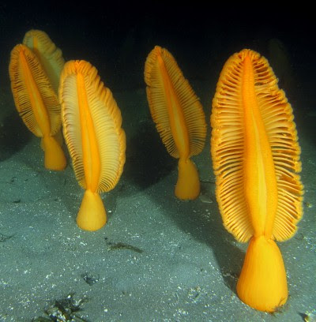
Benthos: organisms that live on, in, or near the bottom
Sea pens
Notes:
Image: http://www.seaslugforum.net/find/seapens

Slide 33
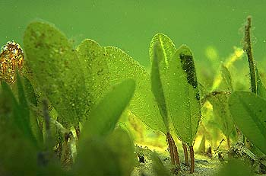
Benthos: organisms that live on, in, or near the bottom
Seagrass
Notes:
Image: https://www.qld.gov.au/environment/coasts-waterways/marine-habitats/seagrass

Slide 34
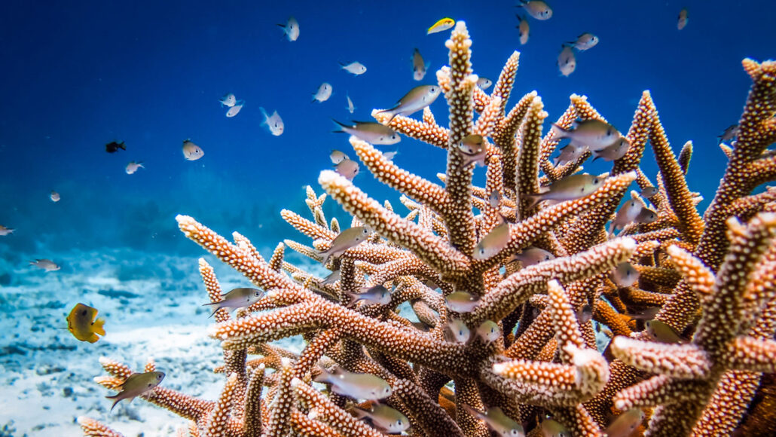
Benthos: organisms that live on, in, or near the bottom
coral
Notes:
Image: https://www.snexplores.org/article/scientists-say-coral-definition-pronunciation

Slide 35
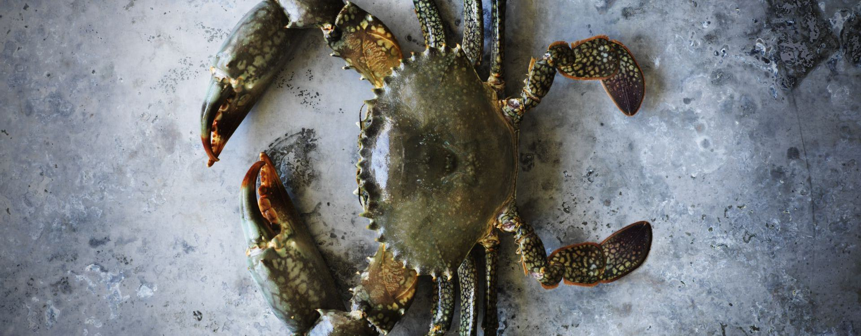
Benthos: organisms that live on, in, or near the bottom
Mud crab
Notes:
Image:

Slide 36
Abyssal zone

Slide 37
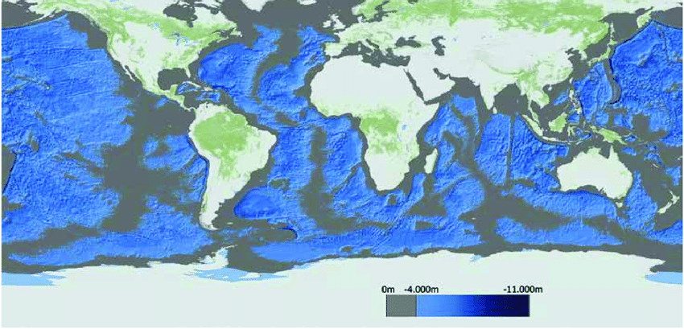
Abyssal zone: 4000-6000m
ALL blue areas are >40000m
Notes:
Image: https://www.researchgate.net/figure/Global-map-showing-global-deep-sea-areas-Areas-with-water-depths-up-to-4000m-are_fig10_337076609
From: Next Generation European Research Vessels: Current Status and Foreseeable Evolution

Slide 38
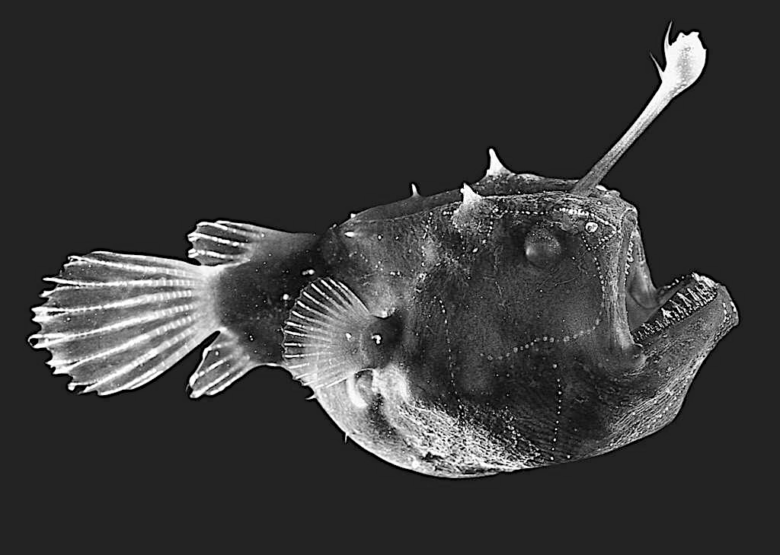
The abyss - reserved only for those adapted to living in complete darkness and under tremendously high amounts of pressure
Angler fish
Notes:
Image: https://aminoapps.com/c/wildanimals/page/blog/monsters-of-the-abyssal-zone-part-2/j0al_YzaHKugpaGaezlnmENmqzll3JPzLB3

Slide 39
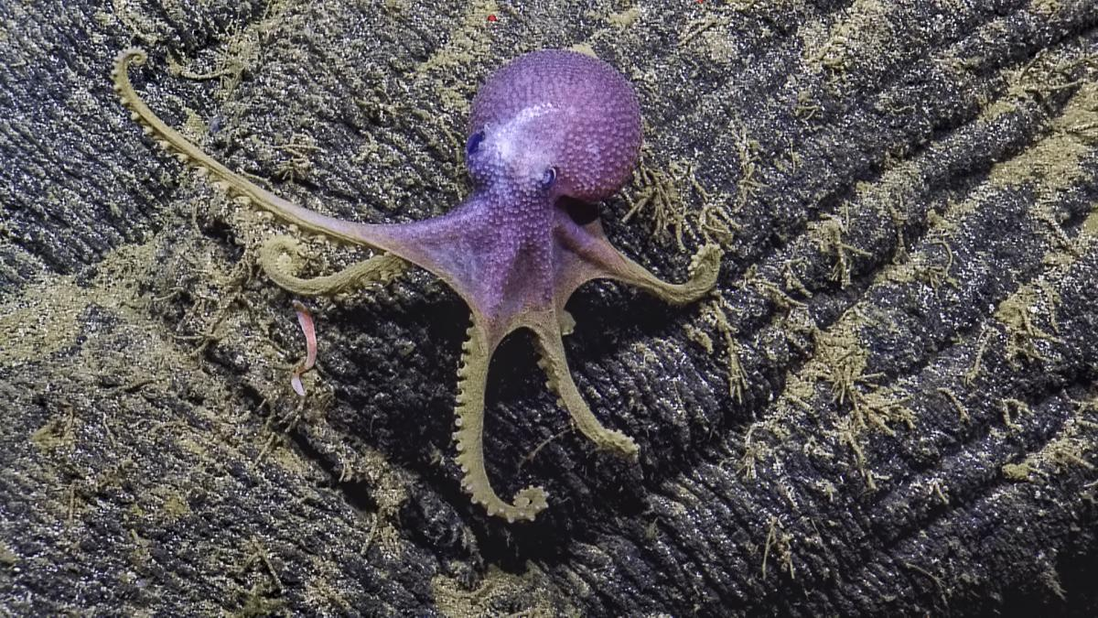
Abyssal creatures: >4000m
Deep sea octopus Grenaeledone boreopacifica
Hydrothermal vent site, Galapogos Rift
Notes:
Image: https://nautiluslive.org/album/2015/06/20/beautiful-creatures-deep-sea-hydrothermal-vents

Slide 40
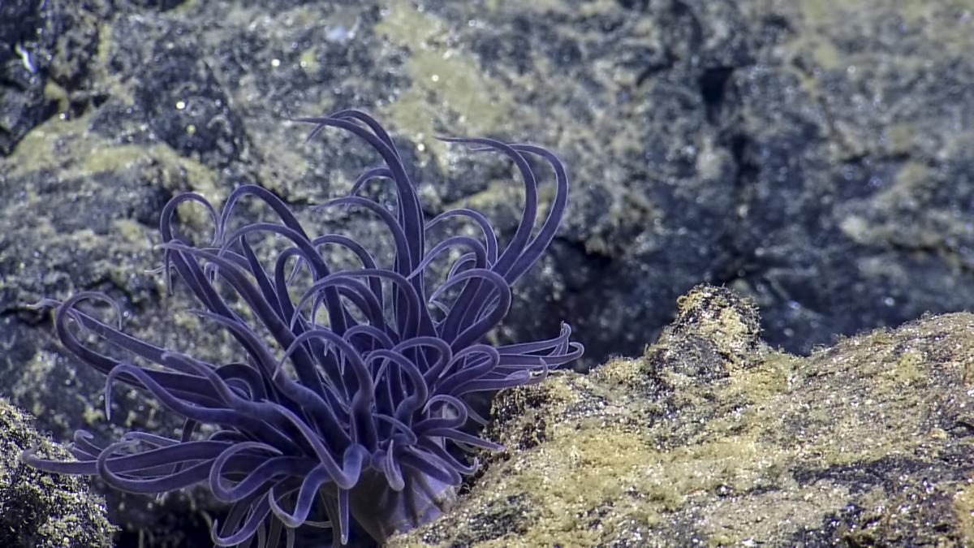
Abyssal creatures: >4000m
Deep sea anemone
Hydrothermal vent site, Galapogos Rift
Notes:
Image: https://nautiluslive.org/album/2015/06/20/beautiful-creatures-deep-sea-hydrothermal-vents

Slide 41
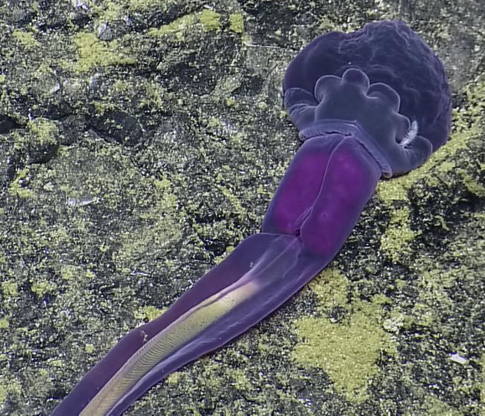
Abyssal creatures: >4000m
Enteropneusta worm
Hydrothermal vent site, Galapogos Rift
Notes:
Image: https://nautiluslive.org/album/2015/06/20/beautiful-creatures-deep-sea-hydrothermal-vents

Slide 42
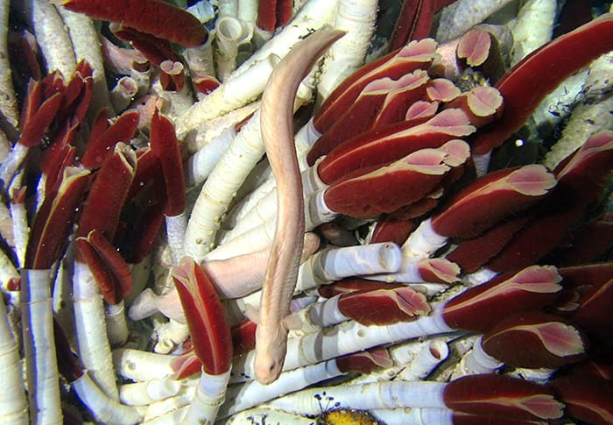
Abyssal creatures: >4000m
Tube worms
Hydrothermal vent site, Galapogos Rift
Notes:
Image: https://nautiluslive.org/album/2015/06/20/beautiful-creatures-deep-sea-hydrothermal-vents

Slide 43
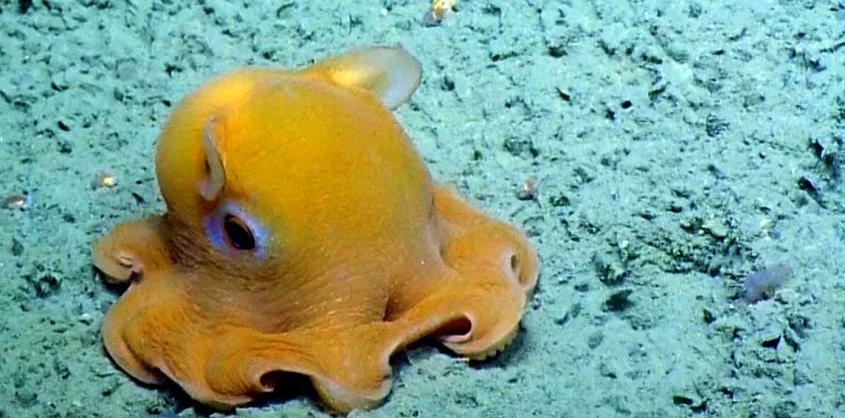
Abyssal creatures: >4000m
Dumbo octopus
Notes:
Image: https://medium.com/@critterscience/the-fascinating-and-adorable-dumbo-octopus-4b8603511030

Slide 44
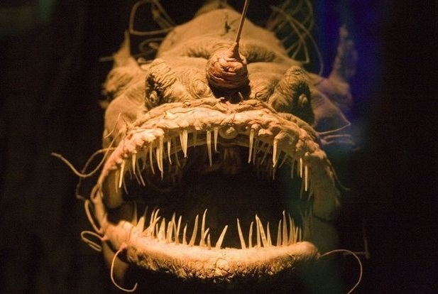
Abyssal creatures: >4000m
Angler fish
Notes:
Image: https://www.animalspot.net/humpback-anglerfish.html

Slide 45
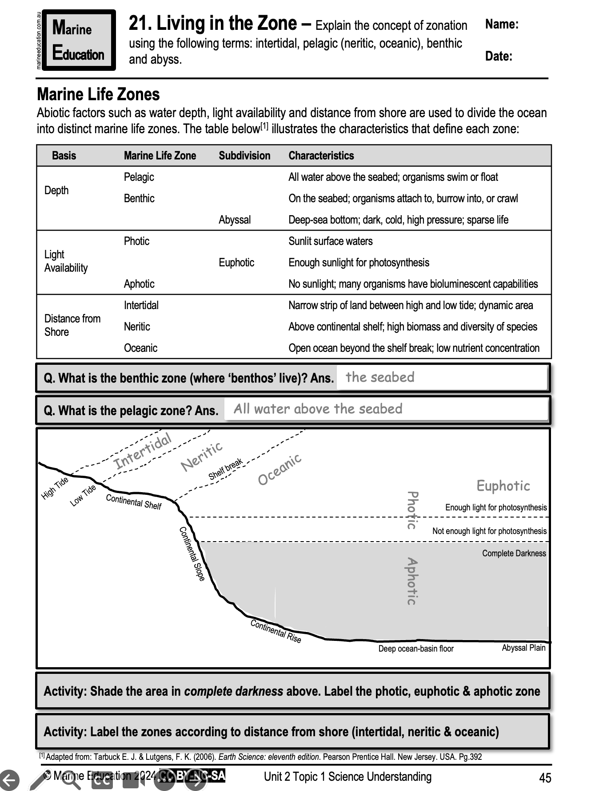
Learning Intention:
Explain the concept of zonation using the following terms: intertidal, pelagic (neritic, oceanic), benthic and abyss.
Success Criteria:
Complete Marine Education worksheet
‘21. Living in the Zone’
Notes:
Image: https://www.reddit.com/r/pics/comments/c2rzd/a_male_barnacles_penis_can_grow_to_20_times_the/

