Slide 1

Learning Intention:
Discuss the specific value systems that identified stakeholders use, i.e. anthropogenic, ecocentric and technocentric.
Success Criteria:
Complete Marine Education worksheet ‘4. Psychology Insights’
Notes:
Image: https://www.artshub.com.au/news/sponsored-content/can-studying-psychology-help-your-creative-career-254592-2357592/

Slide 2
Survey time!
You’re about to read 15 statements about the relationship between humans and the environment.
For each one, please indicate whether you:
Strongly agree = 5
Mildly agree = 4
Unsure = 3
Mildly disagree = 2
Strongly disagree = 1

Slide 3
STATEMENT | SCORE
1
2
3
4
5
6
7
8
9
10
11
12
13
14
15
Your results table should look like this →
SCORE
Strongly agree = 5
Mildly agree = 4
Unsure = 3
Mildly disagree = 2
Strongly disagree = 1

Slide 4
1. We are approaching the limit of the number of people the Earth can support.
Strongly agree = 5
Mildly agree = 4
Unsure = 3
Mildly disagree = 2
Strongly disagree = 1
Notes:
Questions: https://umaine.edu/soe/wp-content/uploads/sites/199/2013/01/NewEcologicalParadigmNEPScale1.pdf

Slide 5
2. Humans have the right to modify the natural environment to suit their needs.
Strongly agree = 5
Mildly agree = 4
Unsure = 3
Mildly disagree = 2
Strongly disagree = 1
Notes:
Questions: https://umaine.edu/soe/wp-content/uploads/sites/199/2013/01/NewEcologicalParadigmNEPScale1.pdf

Slide 6
3. When humans interfere with nature it often produces disastrous consequences.
Strongly agree = 5
Mildly agree = 4
Unsure = 3
Mildly disagree = 2
Strongly disagree = 1
Notes:
Questions: https://umaine.edu/soe/wp-content/uploads/sites/199/2013/01/NewEcologicalParadigmNEPScale1.pdf

Slide 7
4. Human ingenuity will ensure that we do not make the Earth unliveable.
Strongly agree = 5
Mildly agree = 4
Unsure = 3
Mildly disagree = 2
Strongly disagree = 1
Notes:
Questions: https://umaine.edu/soe/wp-content/uploads/sites/199/2013/01/NewEcologicalParadigmNEPScale1.pdf

Slide 8
5. Humans are seriously abusing the environment.
Strongly agree = 5
Mildly agree = 4
Unsure = 3
Mildly disagree = 2
Strongly disagree = 1
Notes:
Questions: https://umaine.edu/soe/wp-content/uploads/sites/199/2013/01/NewEcologicalParadigmNEPScale1.pdf

Slide 9
6. The Earth has plenty of natural resources if we just learn how to develop them.
Strongly agree = 5
Mildly agree = 4
Unsure = 3
Mildly disagree = 2
Strongly disagree = 1
Notes:
Questions: https://umaine.edu/soe/wp-content/uploads/sites/199/2013/01/NewEcologicalParadigmNEPScale1.pdf

Slide 10
7. Plants and animals have as much right as humans to exist.
Strongly agree = 5
Mildly agree = 4
Unsure = 3
Mildly disagree = 2
Strongly disagree = 1
Notes:
Questions: https://umaine.edu/soe/wp-content/uploads/sites/199/2013/01/NewEcologicalParadigmNEPScale1.pdf

Slide 11
8. The balance of nature is strong enough to cope with the impacts of modern industrial nations.
Strongly agree = 5
Mildly agree = 4
Unsure = 3
Mildly disagree = 2
Strongly disagree = 1
Notes:
Questions: https://umaine.edu/soe/wp-content/uploads/sites/199/2013/01/NewEcologicalParadigmNEPScale1.pdf

Slide 12
9. Despite our special abilities, humans are still subject to the laws of nature.
Strongly agree = 5
Mildly agree = 4
Unsure = 3
Mildly disagree = 2
Strongly disagree = 1
Notes:
Questions: https://umaine.edu/soe/wp-content/uploads/sites/199/2013/01/NewEcologicalParadigmNEPScale1.pdf

Slide 13
10. The so-called “ecological crisis” facing humankind has been greatly exaggerated.
Strongly agree = 5
Mildly agree = 4
Unsure = 3
Mildly disagree = 2
Strongly disagree = 1
Notes:
Questions: https://umaine.edu/soe/wp-content/uploads/sites/199/2013/01/NewEcologicalParadigmNEPScale1.pdf

Slide 14
11. The Earth is like a spaceship with very limited room and resources.
Strongly agree = 5
Mildly agree = 4
Unsure = 3
Mildly disagree = 2
Strongly disagree = 1
Notes:
Questions: https://umaine.edu/soe/wp-content/uploads/sites/199/2013/01/NewEcologicalParadigmNEPScale1.pdf

Slide 15
12. Humans were meant to rule over the rest of nature.
Strongly agree = 5
Mildly agree = 4
Unsure = 3
Mildly disagree = 2
Strongly disagree = 1
Notes:
Questions: https://umaine.edu/soe/wp-content/uploads/sites/199/2013/01/NewEcologicalParadigmNEPScale1.pdf

Slide 16
13. The balance of nature is very delicate and easily upset.
Strongly agree = 5
Mildly agree = 4
Unsure = 3
Mildly disagree = 2
Strongly disagree = 1
Notes:
Questions: https://umaine.edu/soe/wp-content/uploads/sites/199/2013/01/NewEcologicalParadigmNEPScale1.pdf

Slide 17
14. Humans will eventually learn enough about how nature works to be able to control it.
Strongly agree = 5
Mildly agree = 4
Unsure = 3
Mildly disagree = 2
Strongly disagree = 1
Notes:
Questions: https://umaine.edu/soe/wp-content/uploads/sites/199/2013/01/NewEcologicalParadigmNEPScale1.pdf

Slide 18
15. If things continue on their present course, we will soon experience a major ecological catastrophe.
Strongly agree = 5
Mildly agree = 4
Unsure = 3
Mildly disagree = 2
Strongly disagree = 1
Notes:
Questions: https://umaine.edu/soe/wp-content/uploads/sites/199/2013/01/NewEcologicalParadigmNEPScale1.pdf

Slide 19
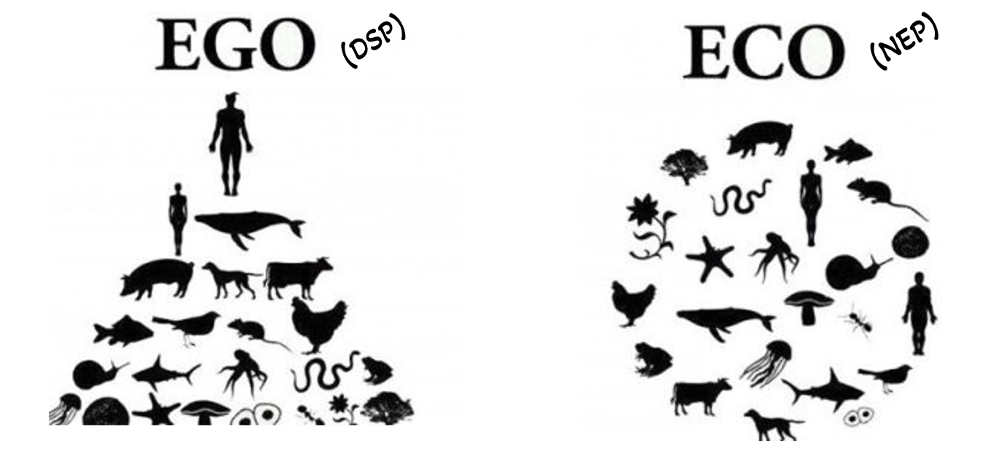
These are 15 statements from the
New Ecological Paradigm (NEP) scale – a widely used tool to measure the environmental concern of groups of people (e.g. stakeholders)
E.g. are you egocentric or ecocentric?
Notes:
Info: https://umaine.edu/soe/wp-content/uploads/sites/199/2013/01/NewEcologicalParadigmNEPScale1.pdf

Slide 20

These questions were originally designed to measure a population’s transition from the Dominant Social Paradigm (DSP) – dominant just before Silent Spring was published in the 1960s - to a more environmentally conscious,
New Environmental Paradigm (NEP).

Slide 21
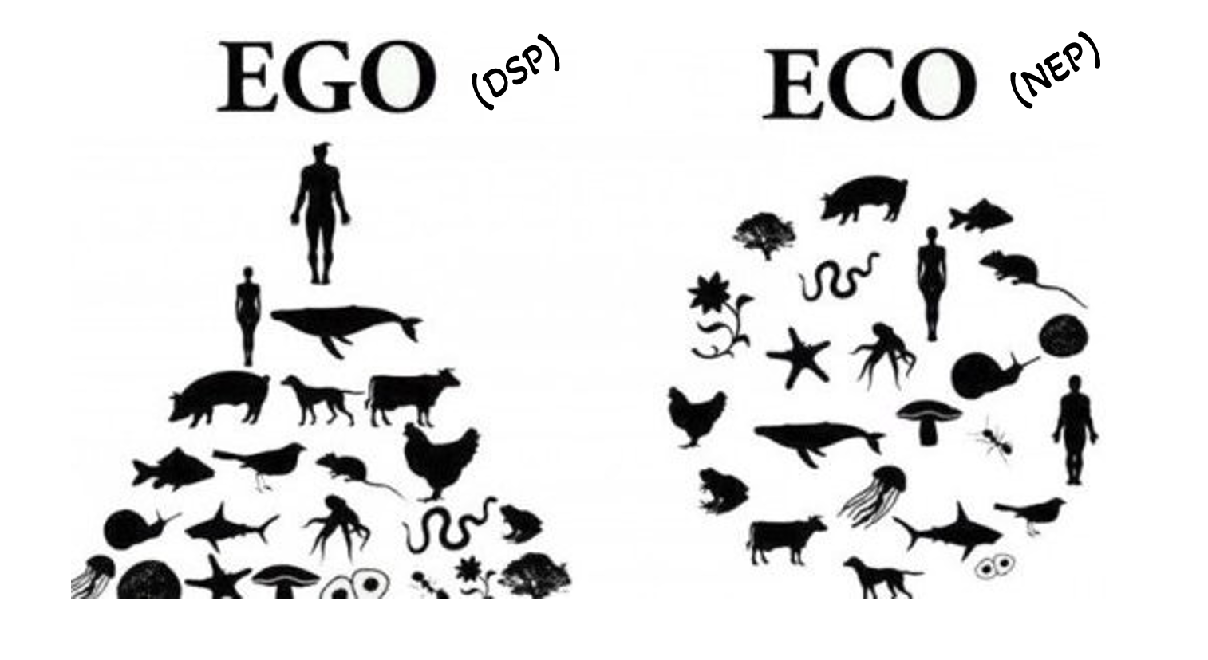
Notes:
Image: https://www.weforum.org/agenda/2020/01/egocentric-to-ecocentric-leadership/

Slide 22
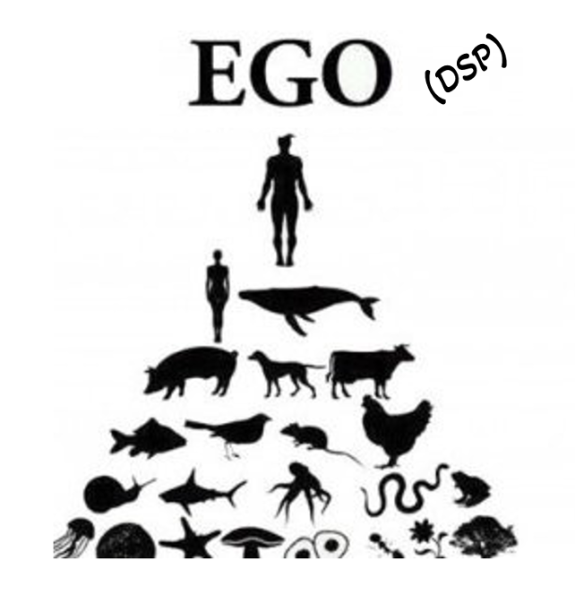
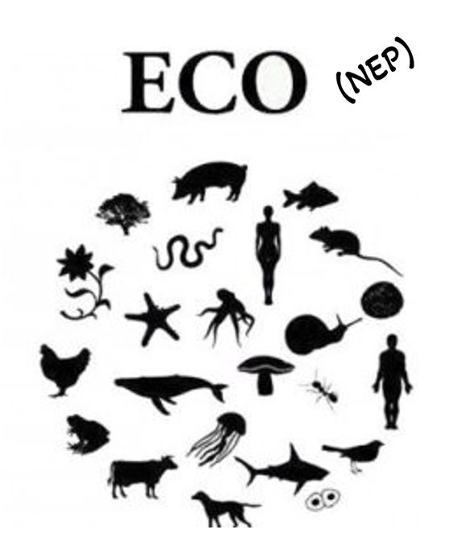
How did you score?
STATEMENT | SCORE
1
2
3
4
5
6
7
8
9
10
11
12
13
14
15
(DSP)
…score high (strongly agree) for EVEN numbered items.
(NEP)
…score high (strongly agree) for ODD numbered items.
Notes:
The seven even numbered items, if agreed to by a respondent, are meant to represent statements endorsed by the dominant social paradigm (DSP). Th e eight odd items, if agreed to by a respondent, are meant to refl ect endorsement of the new environmental paradigm (NEP).

Slide 23

For example…
2. “Humans have the right to modify the natural environment to suit their needs”.
Strongly agree=5
“We are approaching the limit of the number of people the Earth can support”
Strongly agree=5
Anthropogenic (ego-centric)
Eco-centric

Slide 24

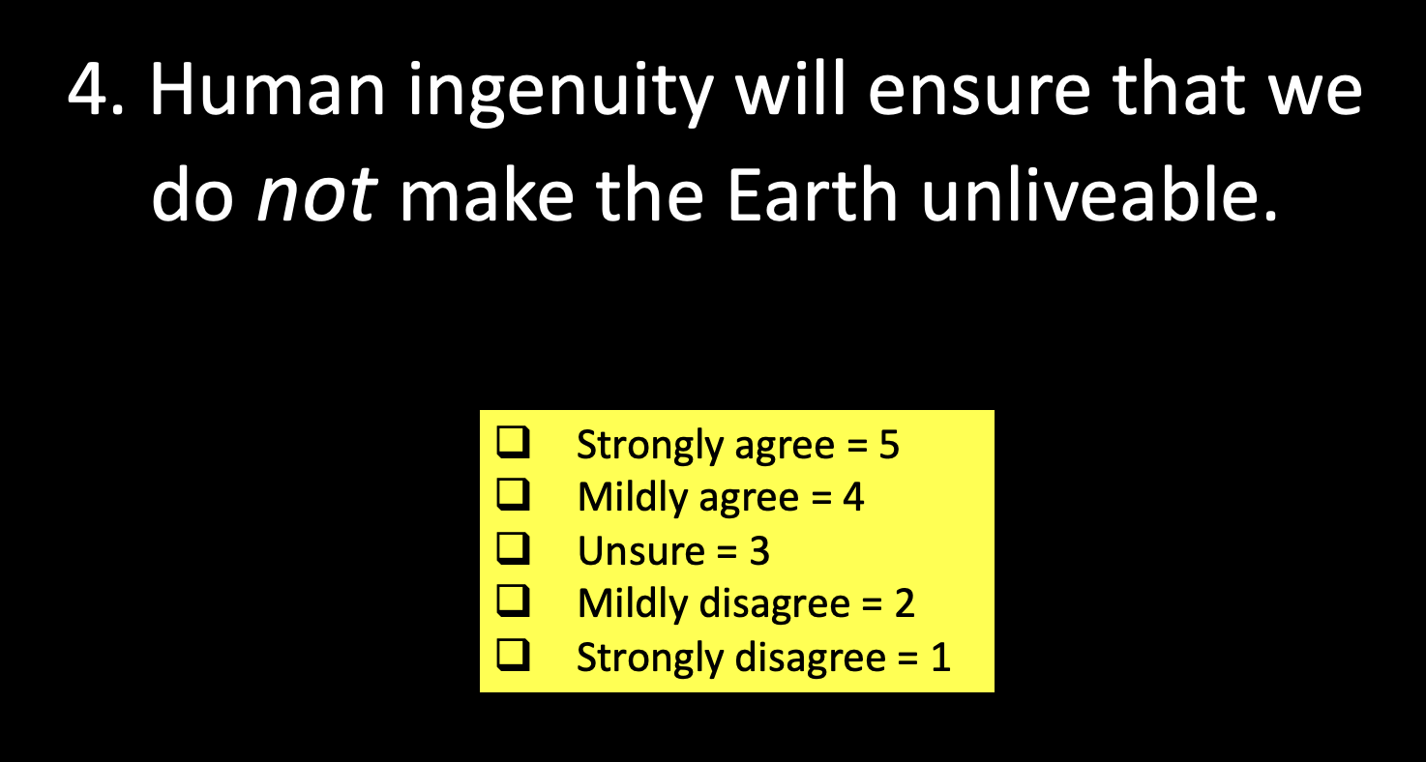

Technocentric
Do you share the view that shortages in natural resources will always be overcome by advances in technology?
If Yes, you are also ‘technocentric’

Slide 25
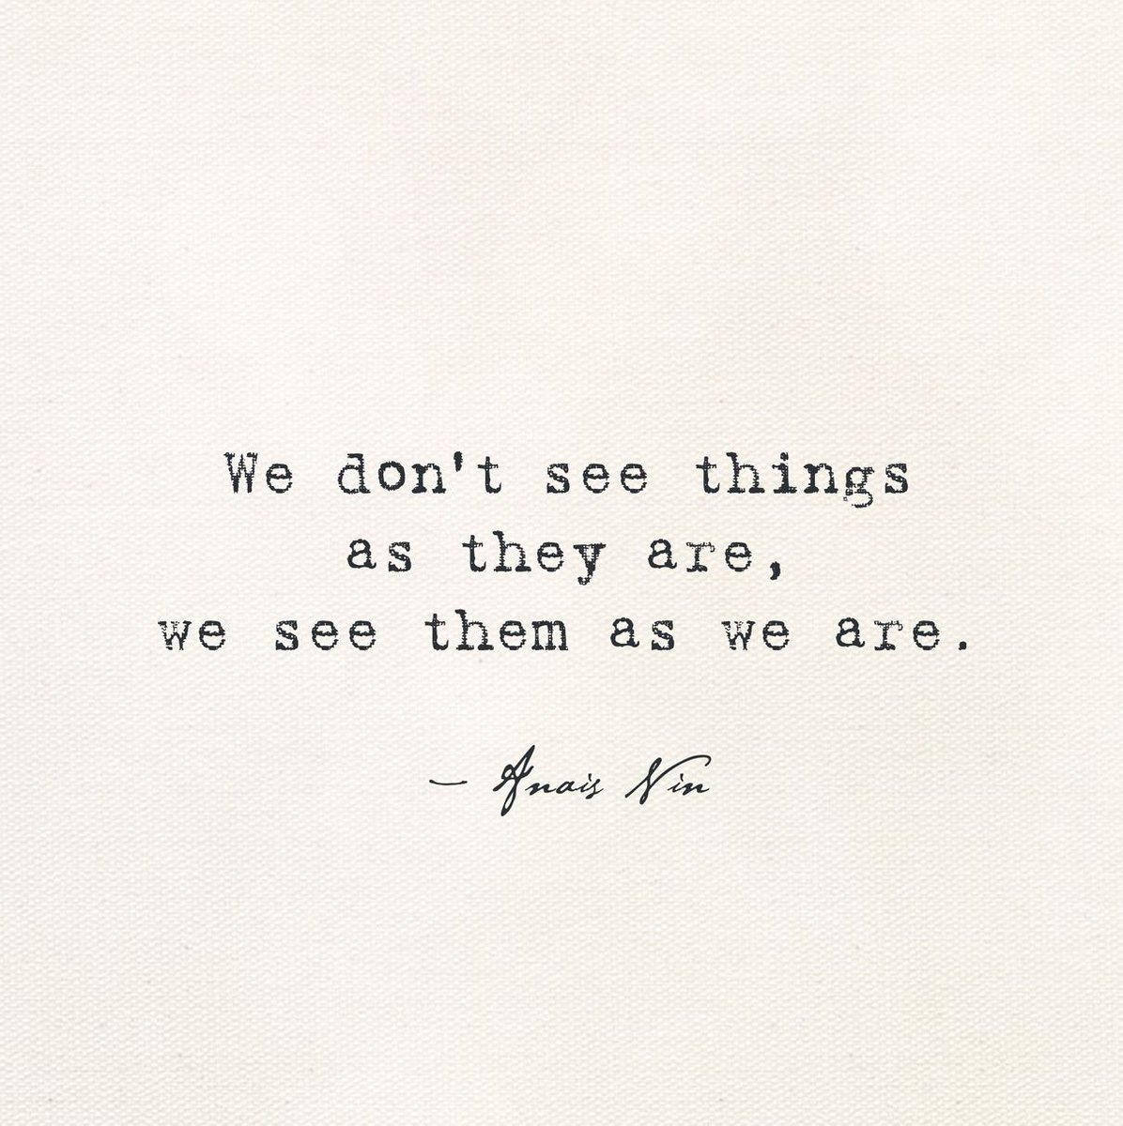
Notes:
Image: https://x.com/WeAreLAC/status/957881507451953153

Slide 26
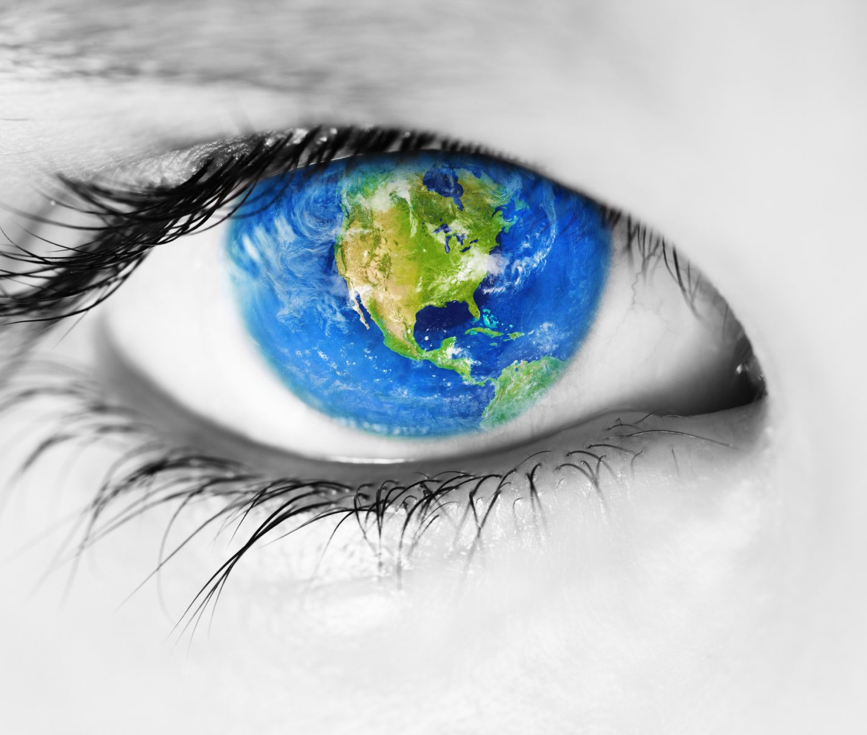
True or False?
Everyone has the same worldviews, beliefs and cultural theories
Notes:
Stakeholder participation! Invite stakeholders to meetings before decisions are made. As per previous syllabus elaboration.

Slide 27
Survey time!
Stand up. You are about to vote with your feet…
We are going to map the worldviews of your class
(which is collectively the culture of your class, as per the cultural theory).
This time, the worldviews are:
fatalism, hierarchism, individualism and egalitarianism.

Slide 28
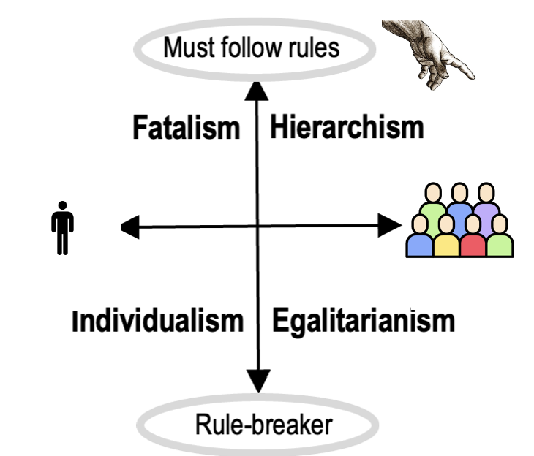
Position yourself where you belong.
If you feel obligated to follow rules, stand at the front of the class.
If not, stand at the back of the class.
If you feel compelled to act in accordance with the collective interests of the group, stand to the right of the class.
If you do your own thing, regardless of what others think or how it affects them, stand to the left of the class.
FRONT OF CLASSROOM
BACK OF CLASSROOM

Slide 29
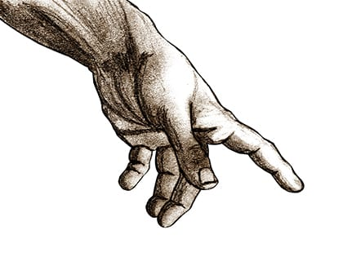

Fatalism
Weak group loyalty. But, thought (by the group) as powerless to matter and easily replaced. Passively obeys the rules.
Hierarchism
Strong preference for rules, power and customs. Empowered by the group.
Likely to accept the rules.
Responds to ‘sticks’
Social regulation
Social integration
Individualism
Only acts in self interest and only becomes concerned when problems impinge on their own personal freedoms and autonomy.
Can see risk as opportunities to develop
profitable technology (not considering what affect this will have on others).
Respond to ‘carrots’
Egalitarianism
Suspicious of anyone in authority who makes the rules. Prefer democratic, consensus-based decision-making. Expects everyone to ’pitch in’ for the common good. Responds to the fear of ‘naming’ and shaming’

Slide 30
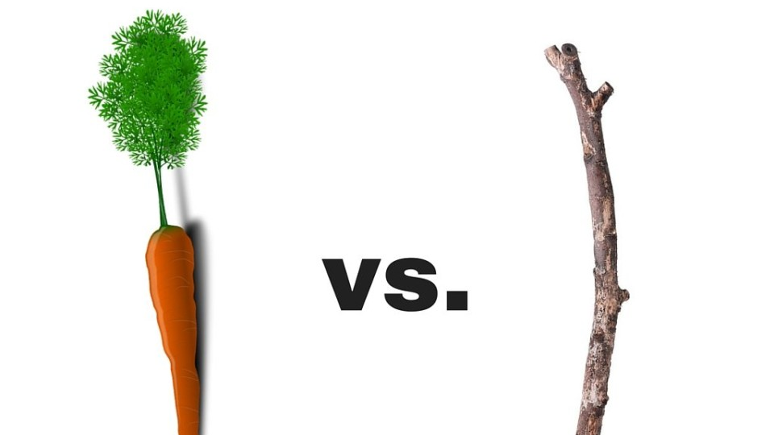
A "carrot" approach incentivizes good work with rewards.
A "stick" approach uses punishment to push people towards a particular behaviour.
Notes:
Stakeholder participation! Invite stakeholders to meetings before decisions are made. As per previous syllabus elaboration.

Slide 31
Stakeholder Values?
As you can see, there are many flavours of society and many different viewpoints.
Q. What might the following stakeholders say about what we should do about climate change?
Anthropogenic (ego-centric)
Eco-centric
Techno-centric

Slide 32
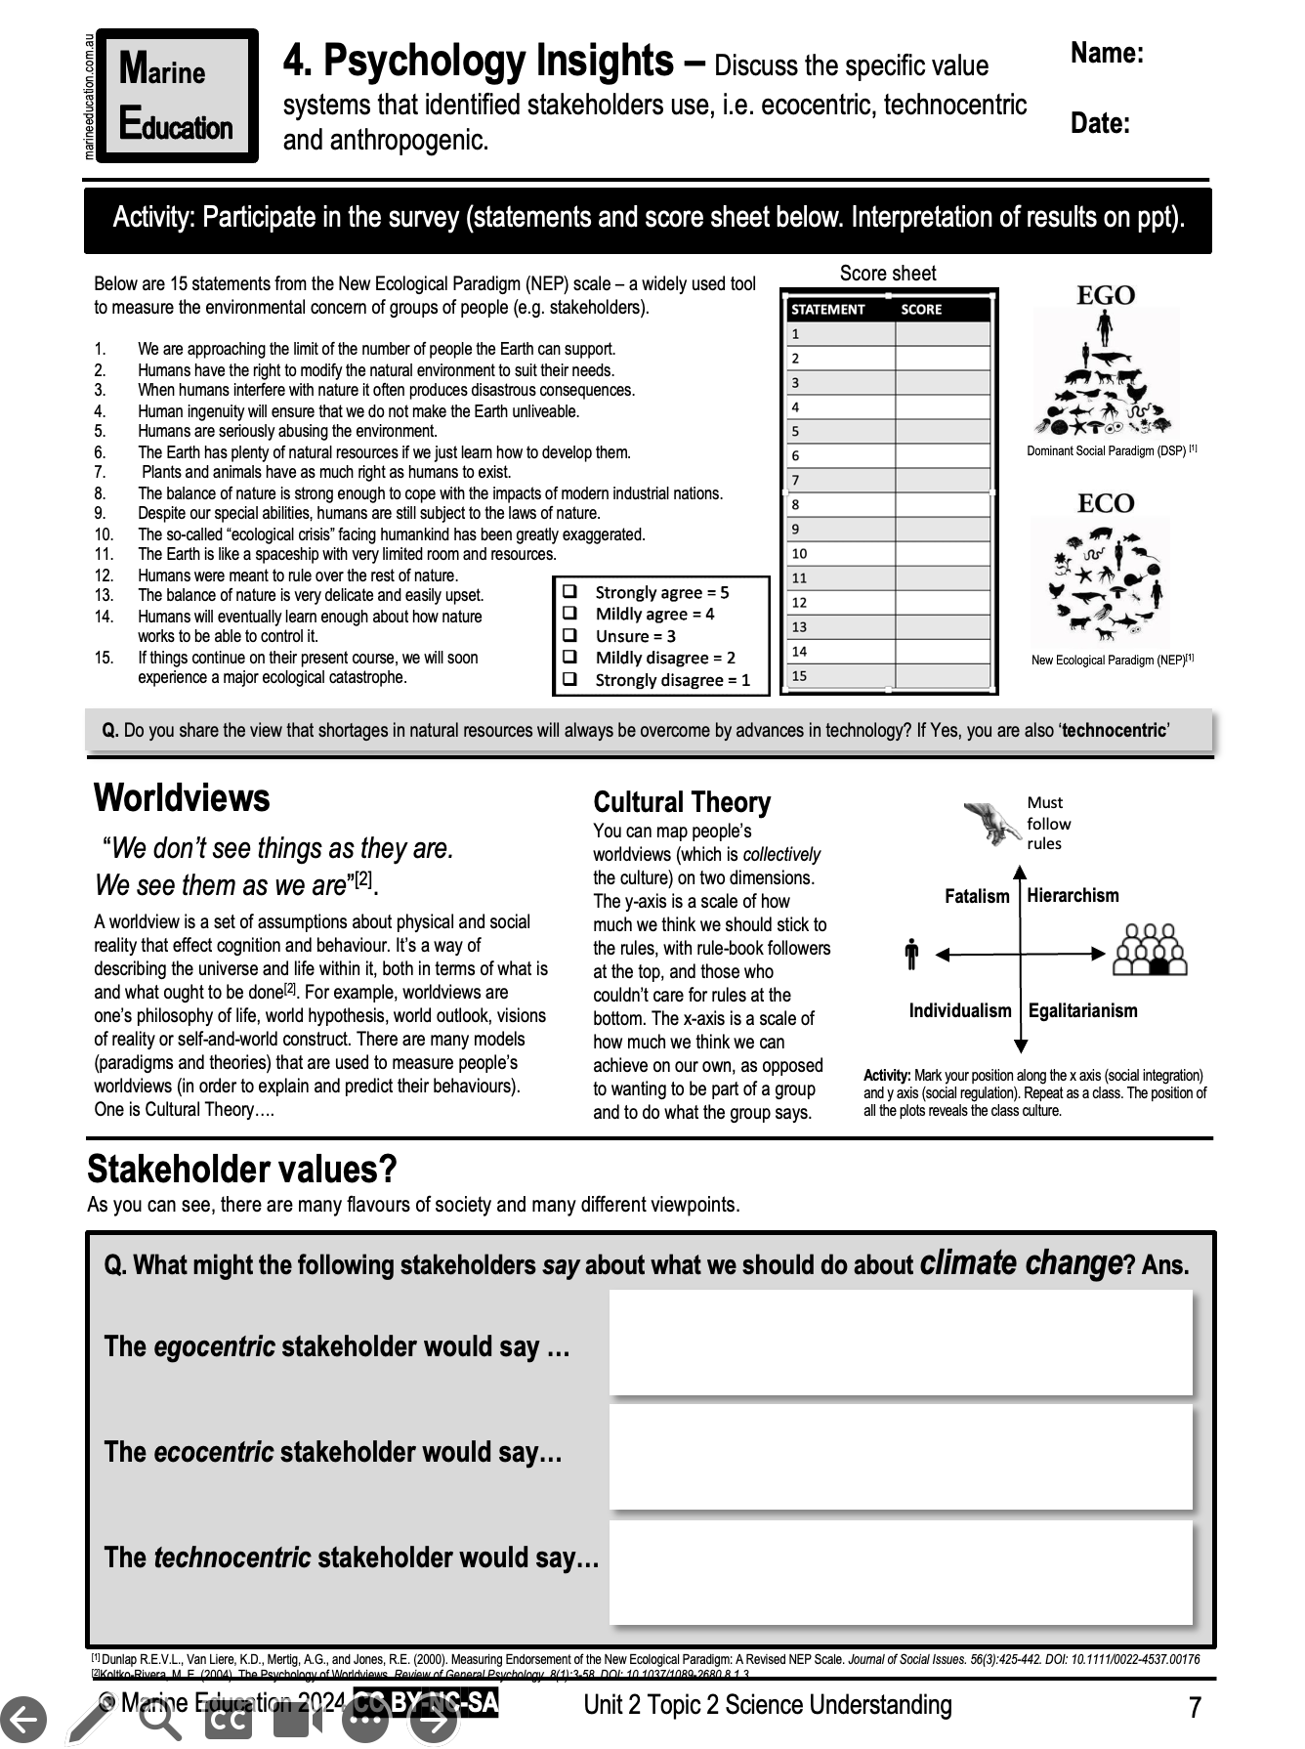
Learning Intention:
Discuss the specific value systems that identified stakeholders use, i.e. anthropogenic, ecocentric and technocentric.
Success Criteria:
Complete Marine Education worksheet ‘4. Psychology Insights’
Notes:
Image: https://www.artshub.com.au/news/sponsored-content/can-studying-psychology-help-your-creative-career-254592-2357592/

