Slide 1
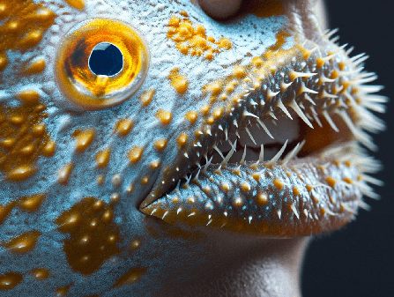
Learning Intention:
Classify adaptations as anatomical (structural), physiological (functional) or behavioural.
Success Criteria:
Complete Marine Education worksheet ‘24. Life Hacks’
Triggerfish
Notes:
Image: https://www.quora.com/How-can-the-lips-of-a-human-look-like-the-mouth-of-a-trigger-fish

Slide 2
Life is a game of survival

Slide 3
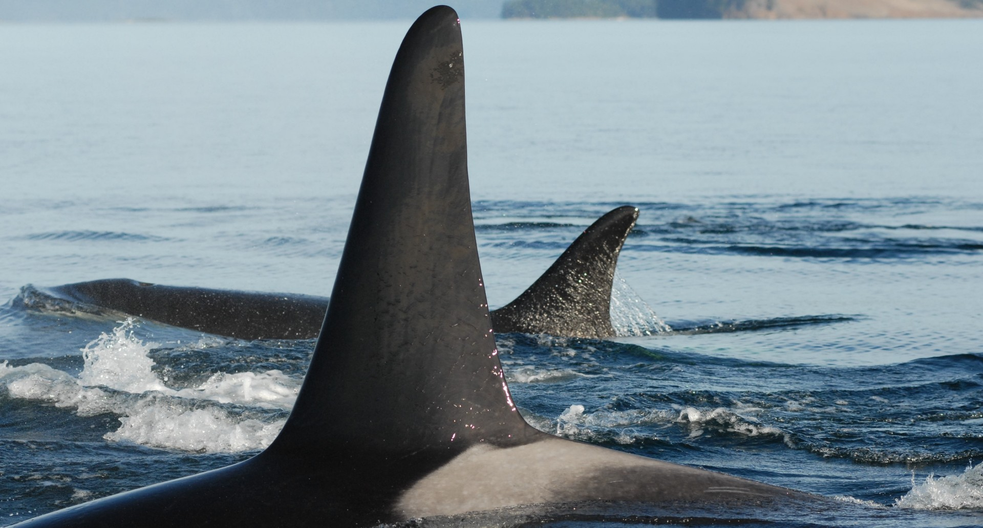
Killer whale (orca): top of the food chain
Notes:
Image: https://news.exeter.ac.uk/research/male-killer-whales-protected-by-post-menopause-mothers/
An adult male with travelling with its post-reproductive mother. Credit David Ellifrit / Center for Whale Research

Slide 4
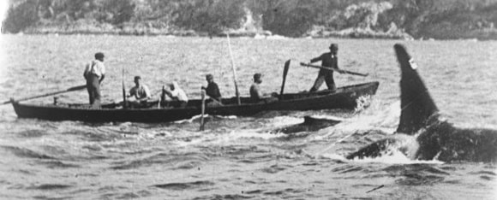
‘Killers in Eden’
Notes:
Image: https://www.hrmm.org/history-blog/media-monday-killers-in-eden
Detail of still from early documentary film, first shown publicly in 1912. In the foreground is a killer whale (Orcinus orca) named Old Tom, swimming alongside a whaling boat that is being towed by a harpooned whale (out of frame to the right). A whale calf can be seen between Old Tom and the boat. The whalers were based in Eden, New South Wales, Australia. Wikimedia Commons.

Slide 5
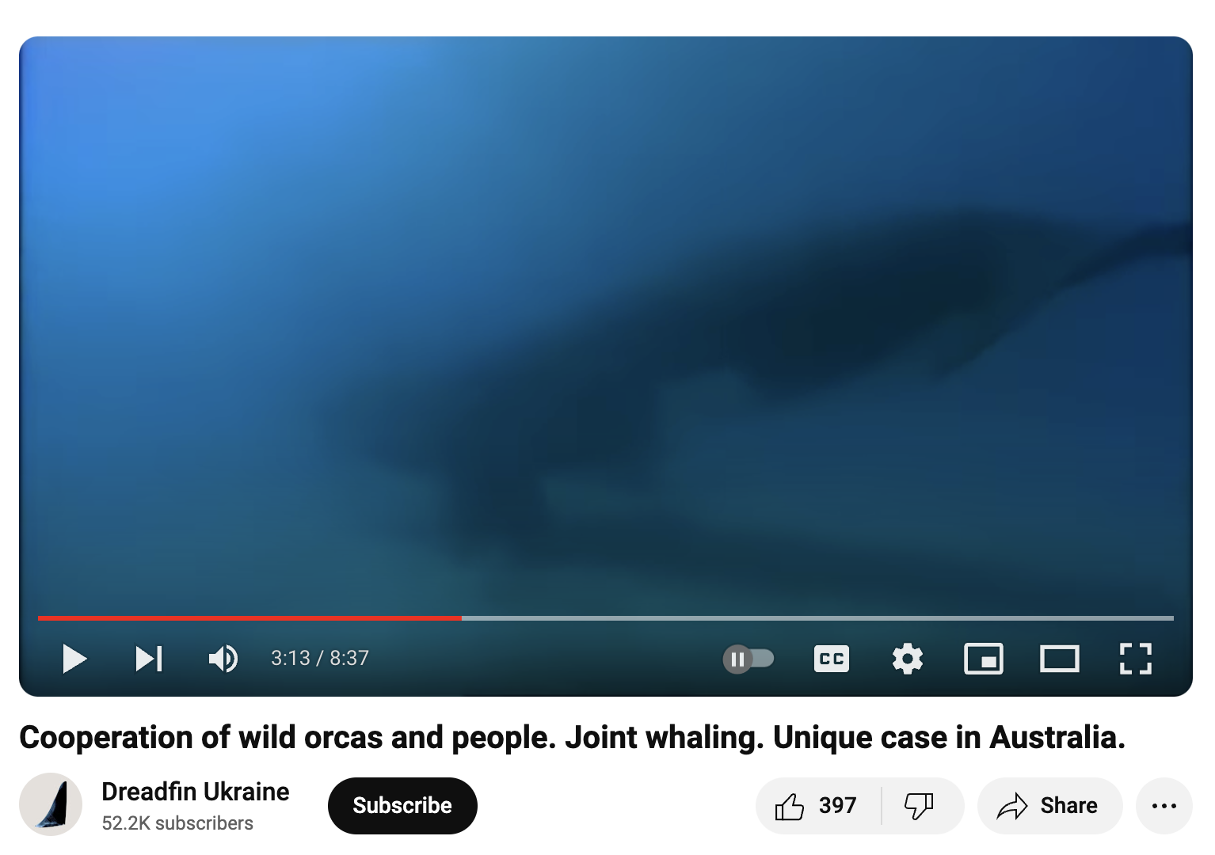
https://www.youtube.com/watch?v=YA39ZnV-mpA

Slide 6
Stopping at nothing to ensure there is a next generation

Slide 7
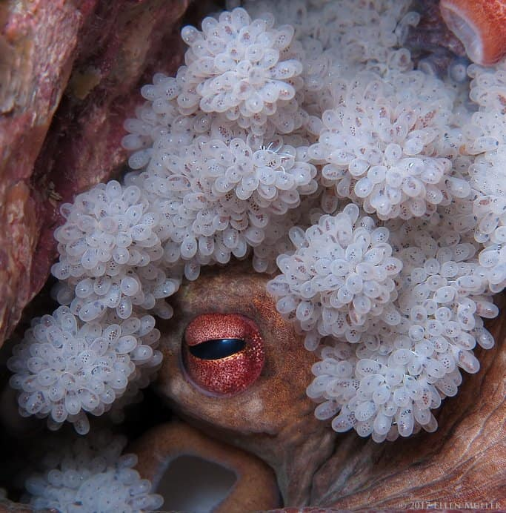
The octopus watches over her eggs until they hatch.
She then succumbs to starvation and death.
Notes:
Image: https://octonation.com/how-do-octopus-give-birth/

Slide 8
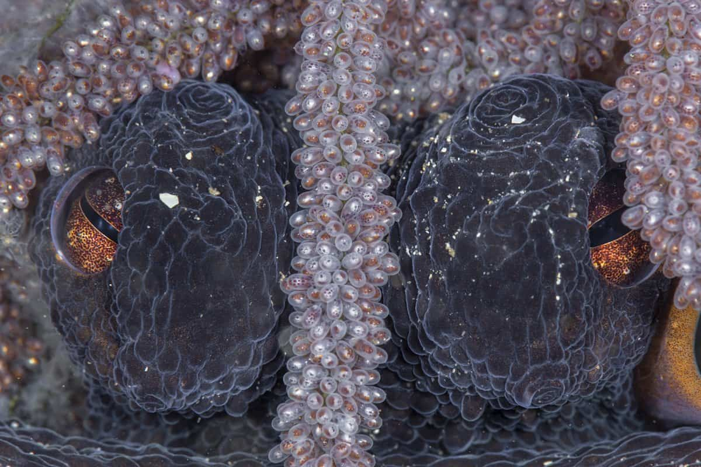
This usually occurs when octo mum is around 2 years of age
Notes:
Image: https://octonation.com/how-do-octopus-give-birth/

Slide 9
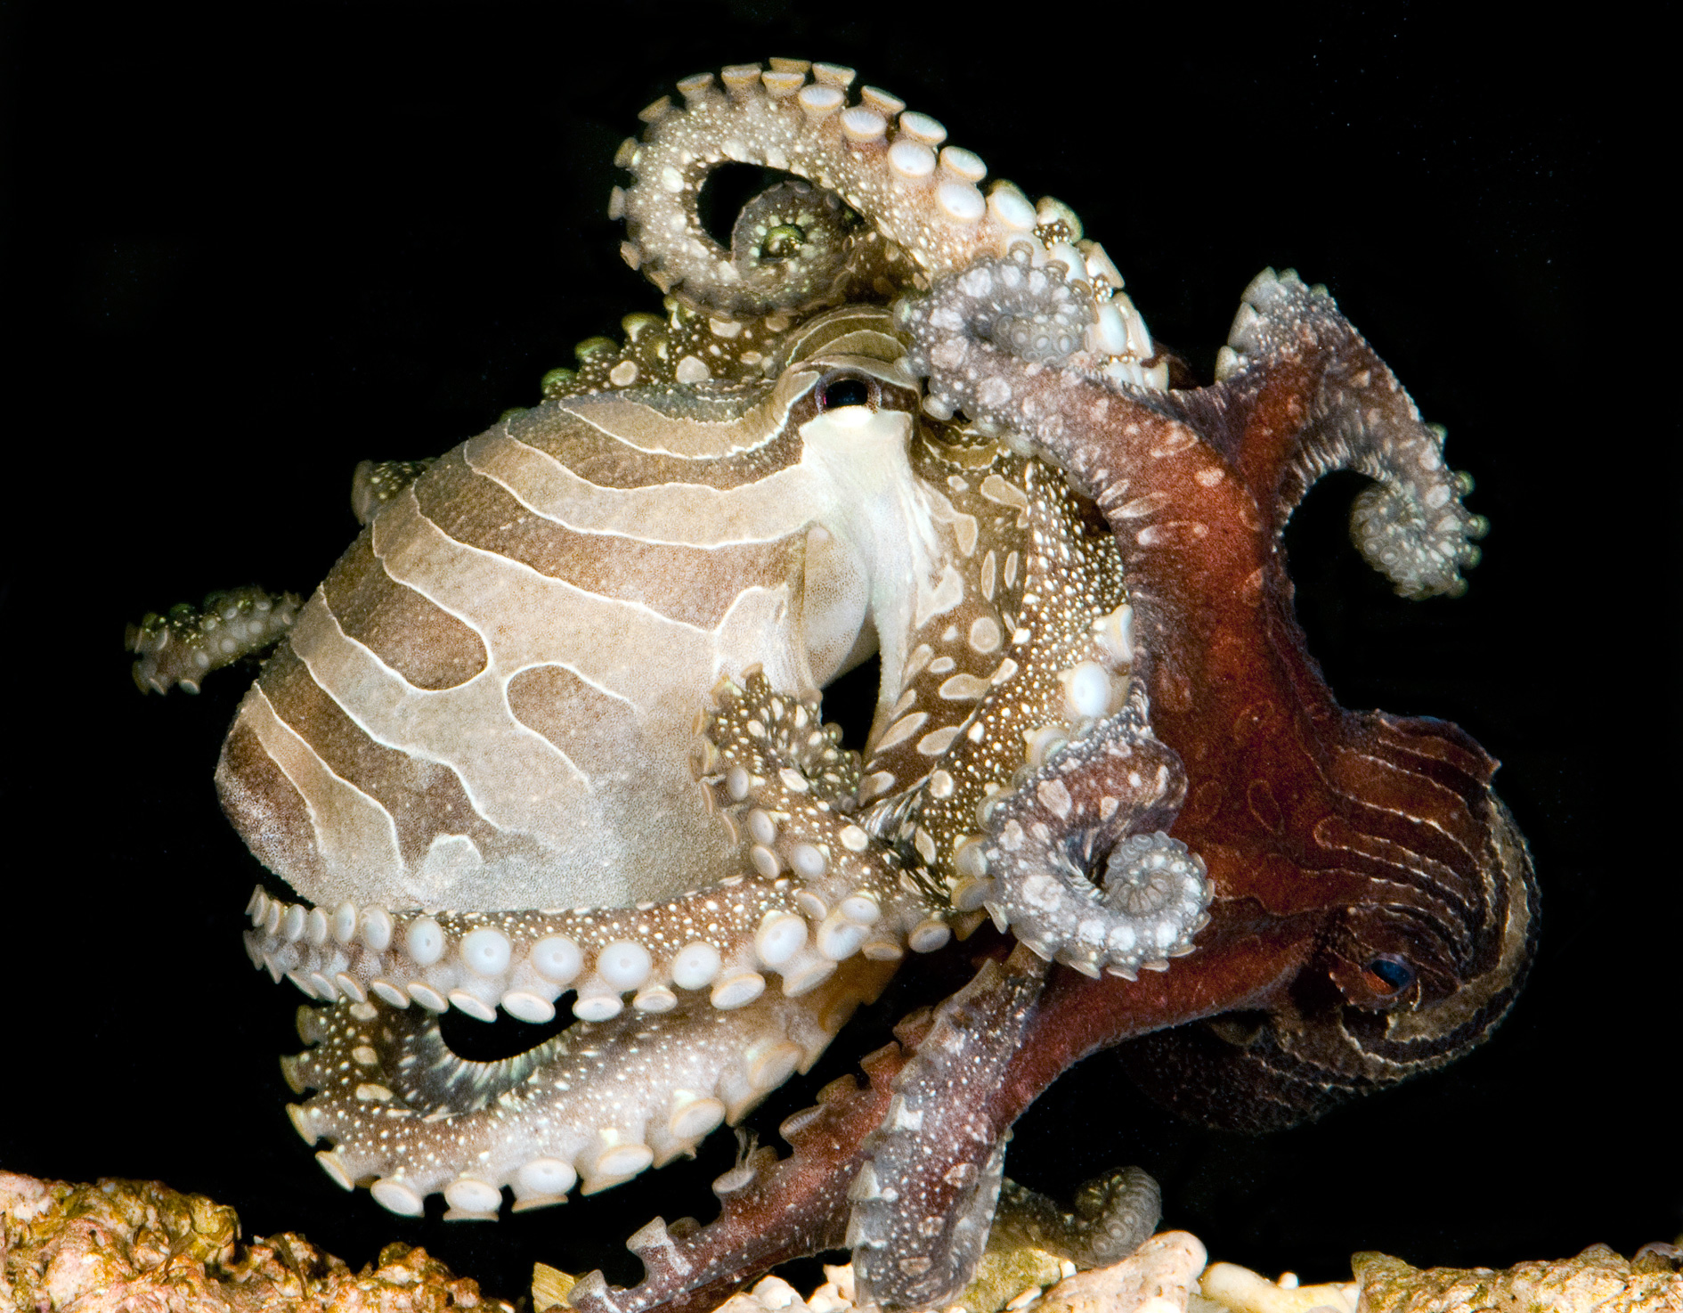
So, Where’s octo dad?
If you’re thinking octopus dads fare any better, they don’t.
After mating, he looks like a big juicy steak.
And so, she eats him, to fuel her egg-laying future.
Notes:
Image: https://www.calacademy.org/press/releases/rare-octopus-shocks-scientists-with-unusual-mating-and-reproductive-strategies
A male and female larger Pacific striped octopus align suckers during mating. Photo © Roy Caldwell

Slide 10
Adaptations that aid our chance of survival and reproduction can be classified into 3 general categories:
anatomical (structural)
physiological (functional)
behavioural

Slide 11
Anatomical (structural)
adaptations
are structural features that you can see and therefore draw and label with pen and paper.

Slide 12
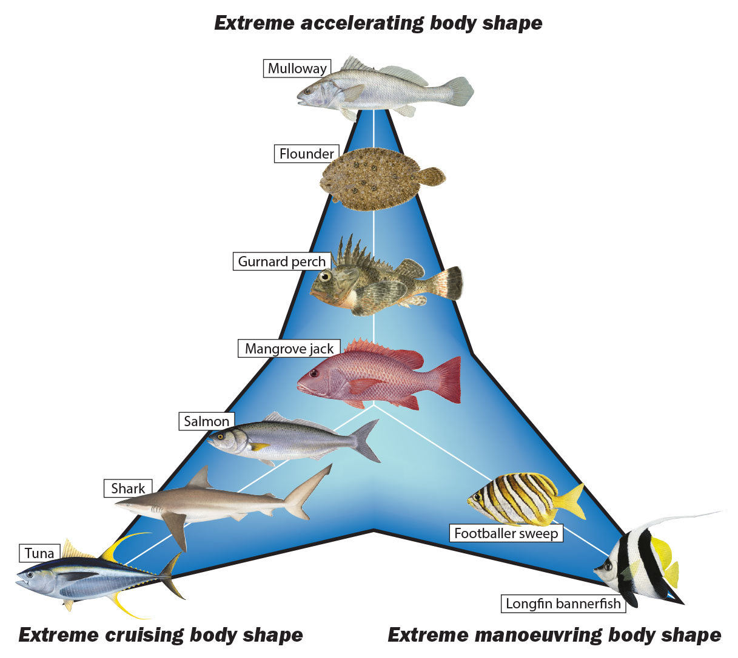
Structural
For example, Body Shapes
Notes:
Image: https://marinewaters.fish.wa.gov.au/resource/fact-sheet-fish-adaptations/

Slide 13
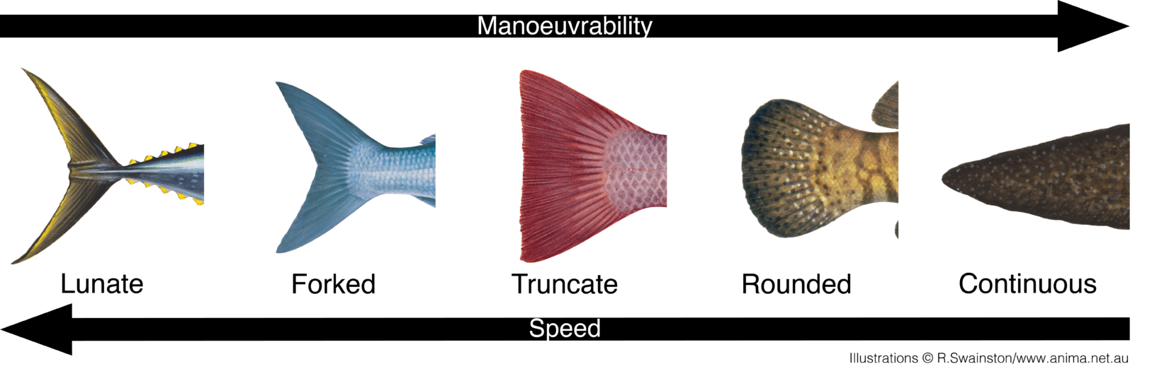
Structural
Fin shapes
Notes:
Image: https://marinewaters.fish.wa.gov.au/resource/fact-sheet-fish-adaptations/

Slide 14
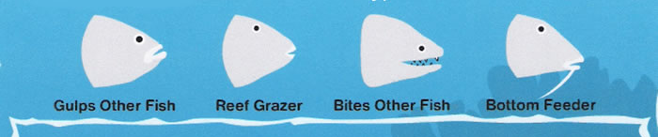
Structural
Mouth shapes
Notes:
Image: https://www.geocities.ws/jtnolde/Activity_4th.21.htm

Slide 15
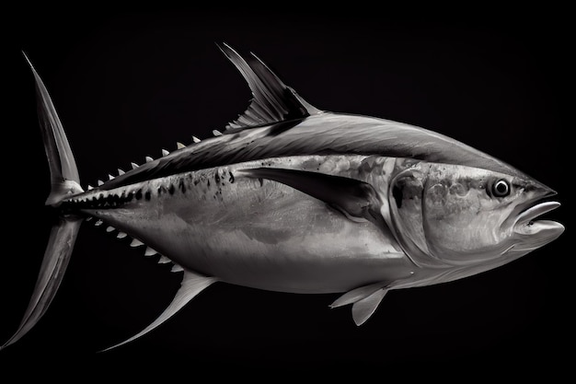
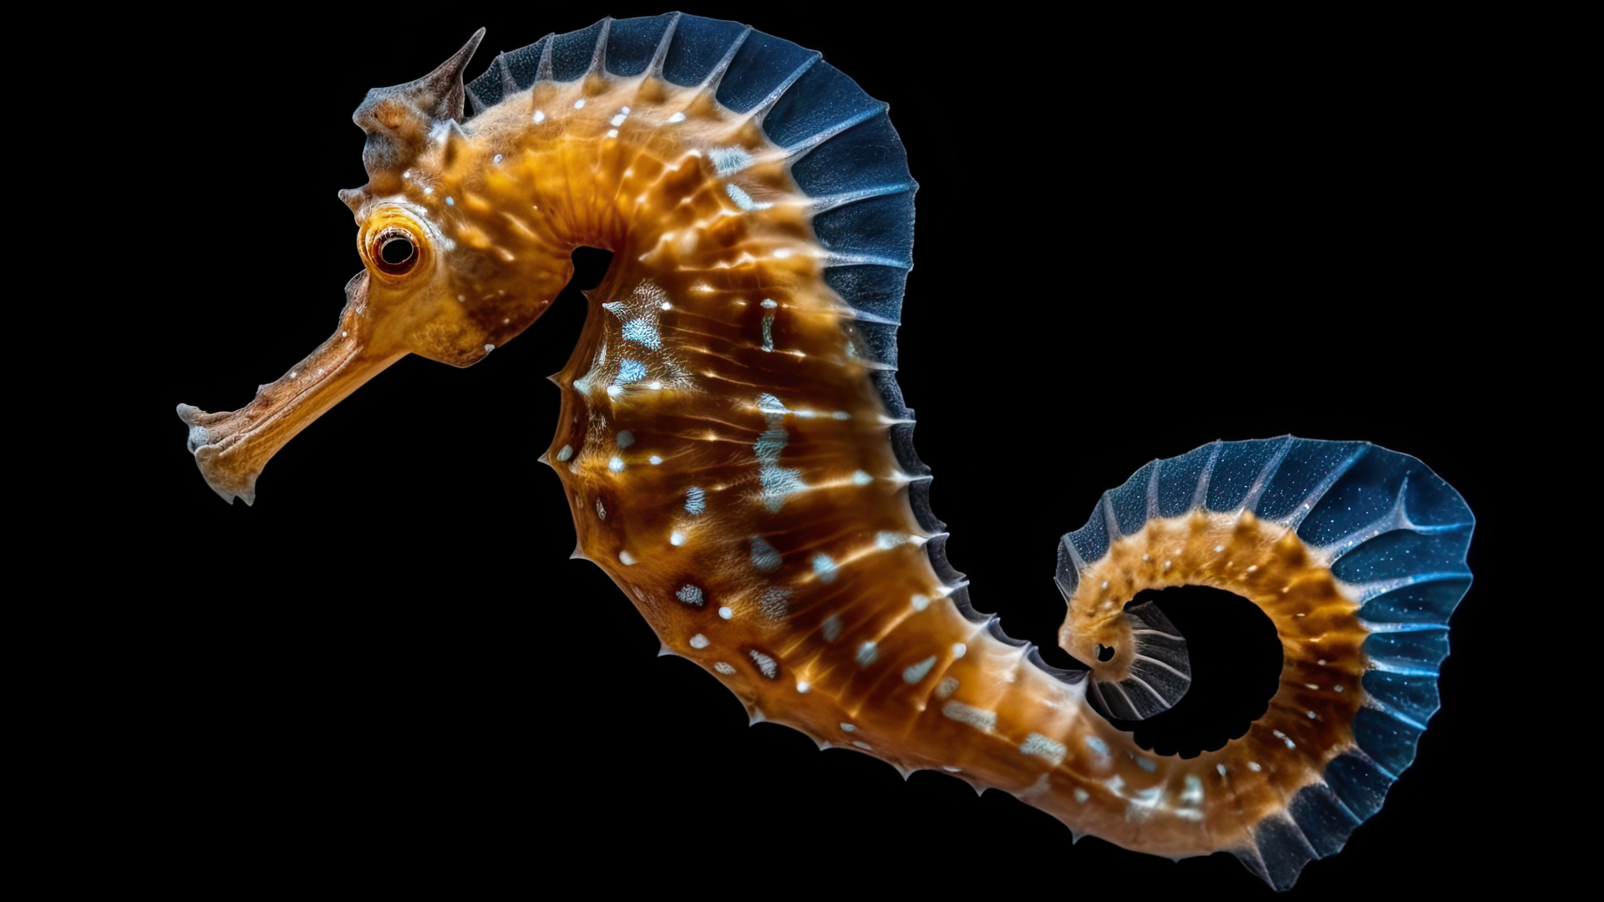
Structural
Scale size
(small scales = fast and streamlined)
Seahorse: Large scales for body armour
Tuna: Small scales for streamline
Notes:
Info: https://marinewaters.fish.wa.gov.au/resource/fact-sheet-fish-adaptations/
Image (left): https://www.nathab.com/blog/secret-life-seahorse/
Image (right): https://www.freepik.com/premium-photo/huge-tuna-with-skin-black-white-tones-isolated-dark-background_41666768.htm

Slide 16
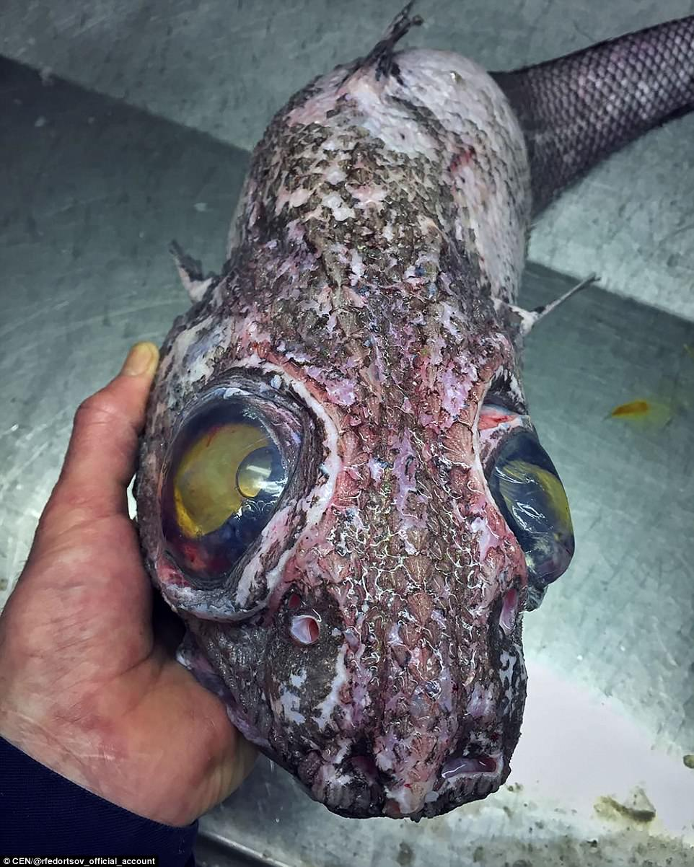
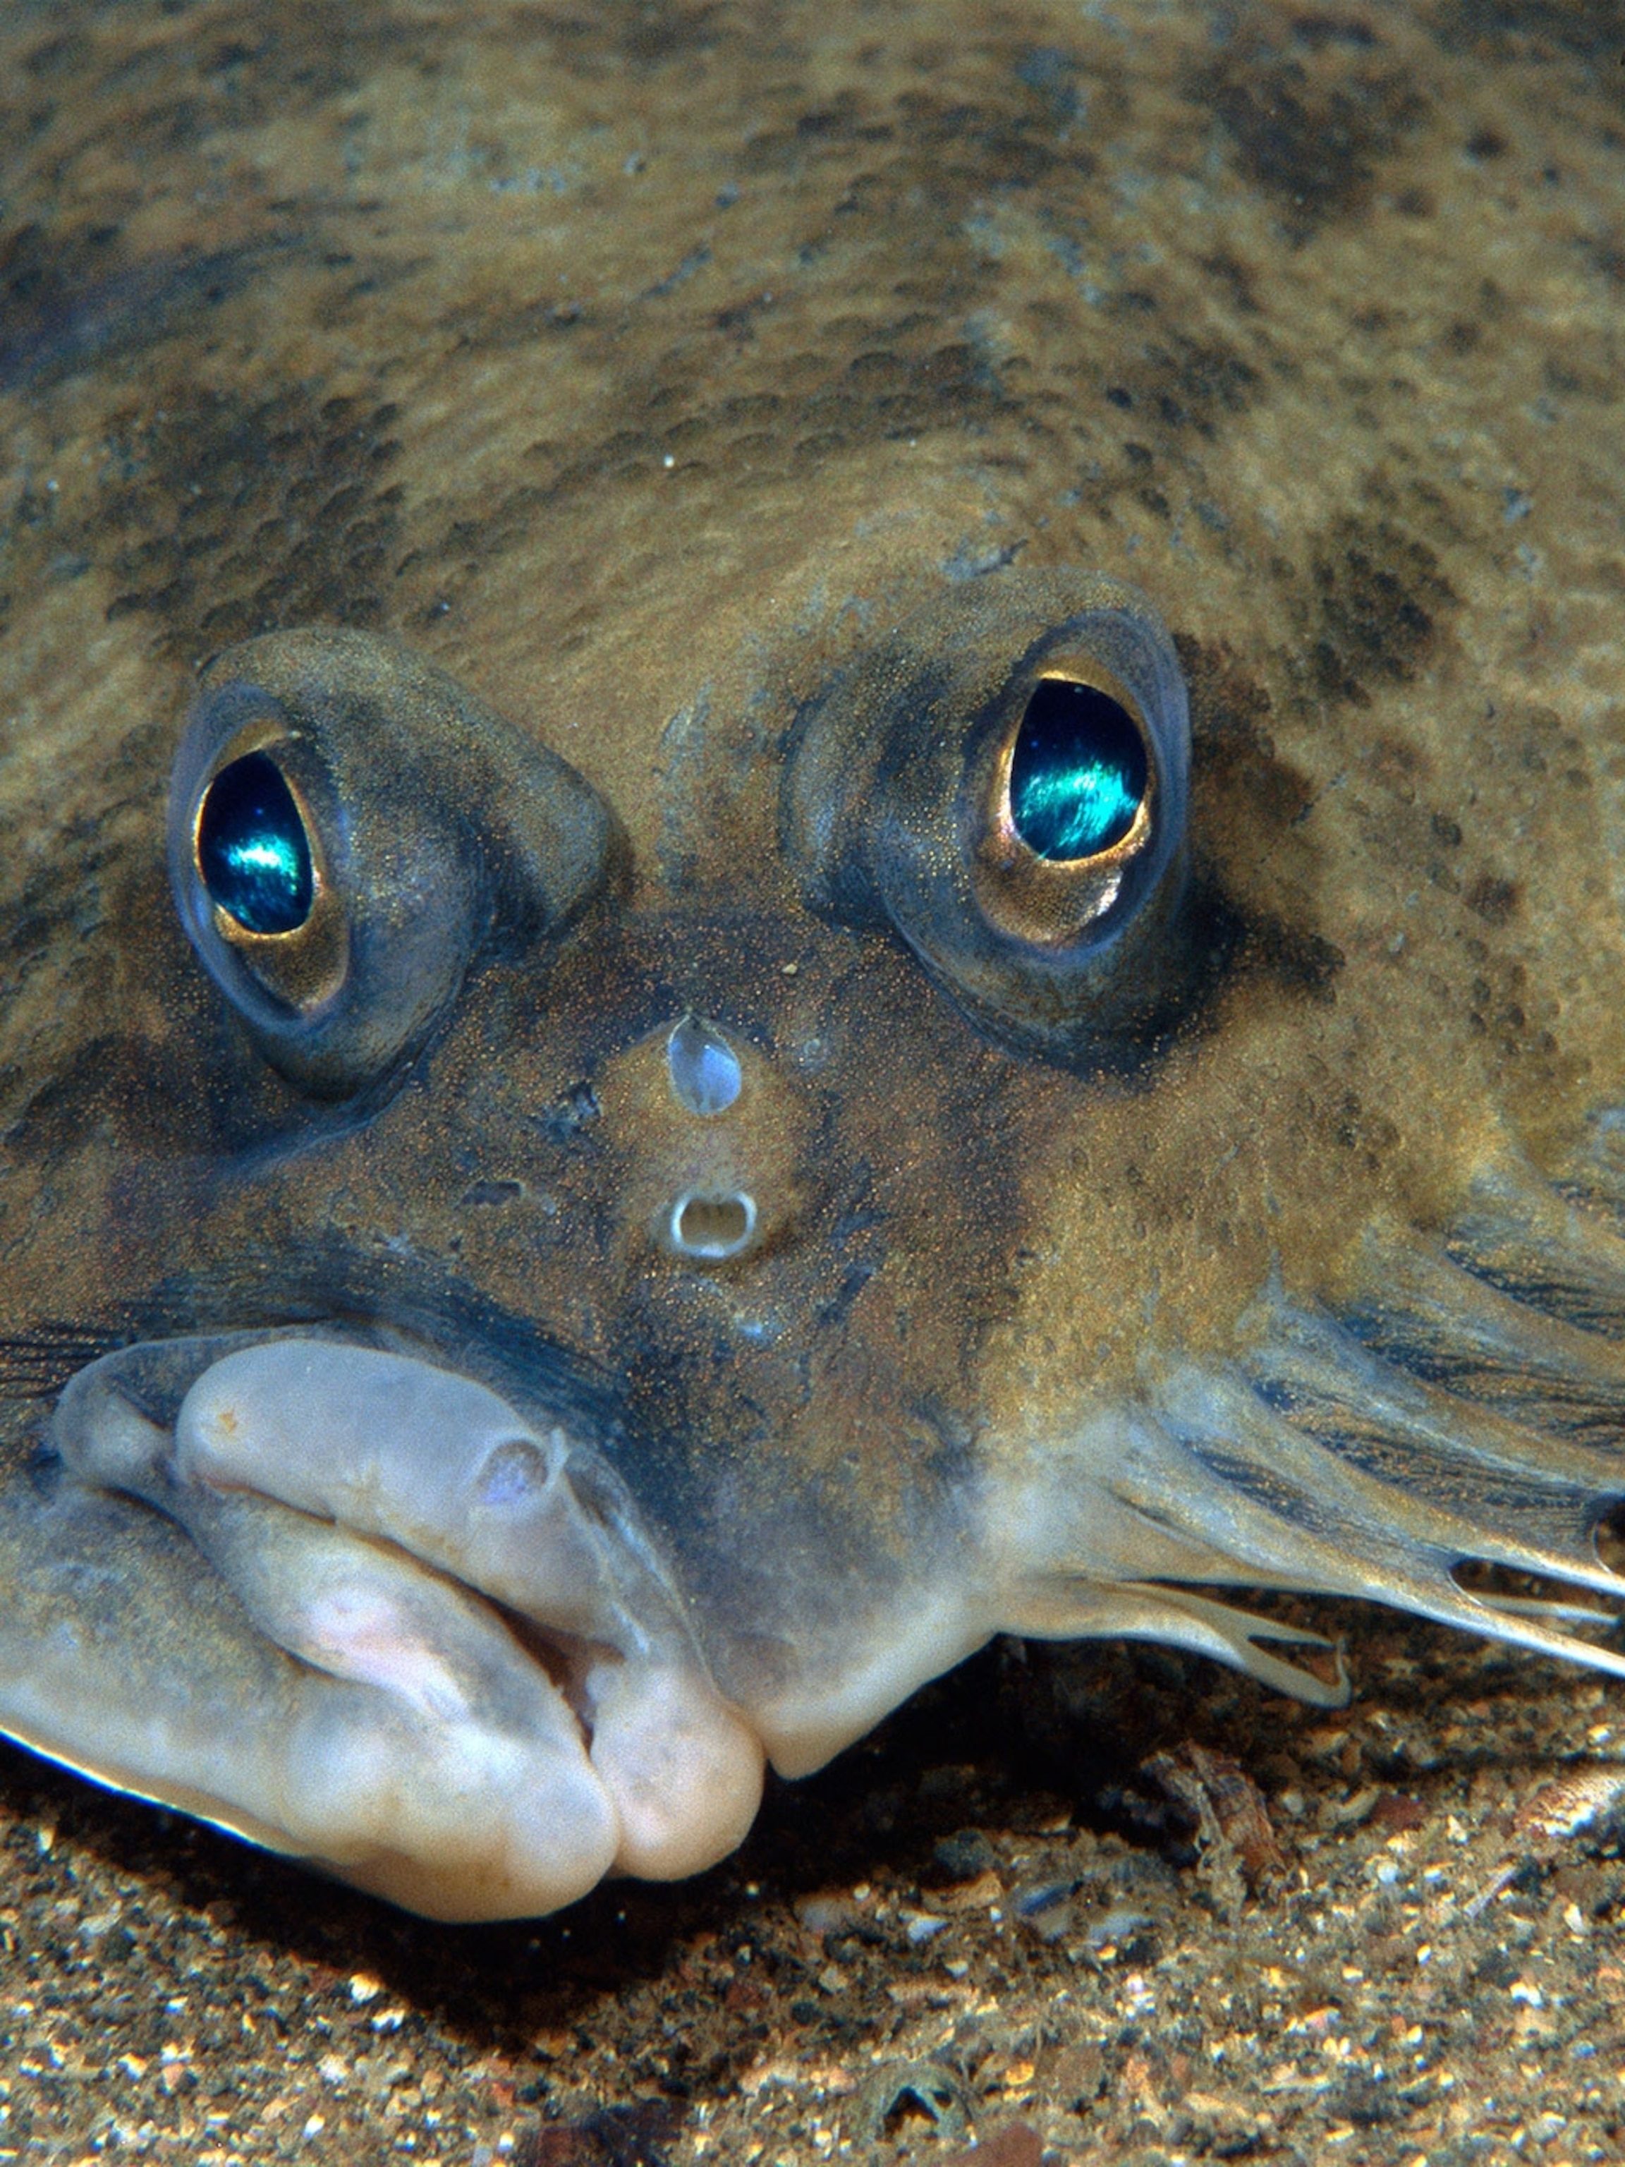
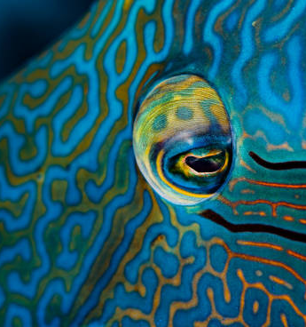
Structural
Eye position and size
Large eyes pointing upwards to absorb as much light as possible in the dark
A few days after hatching, one eye on a flounder migrates to the other side.
The eye of a maori wrasse can rotate almost 180 degrees giving it excellent range of view
Notes:
Image (left): https://www.mirror.co.uk/news/world-news/man-reels-mystery-nightmare-fish-27291415
Image (middle): https://www.nationalgeographic.com/animals/article/flatfish-animals-science-colors-flounders
Image (right):

Slide 17
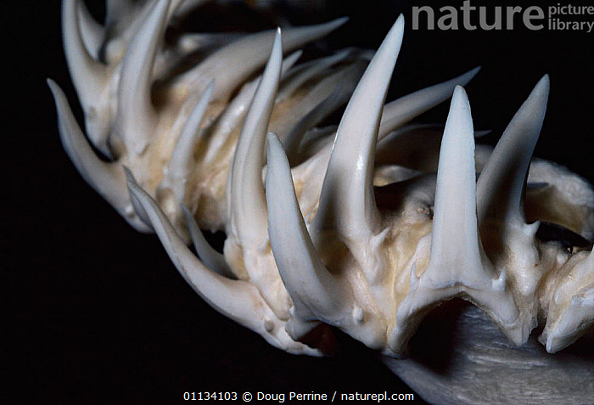
Structural
Teeth
Notes:
Image: https://www.naturepl.com/stock-photo-teeth-of-sand-tiger-shark-carcharias-taurus-or-grey-nurse-shark-image01134103.html

Slide 18
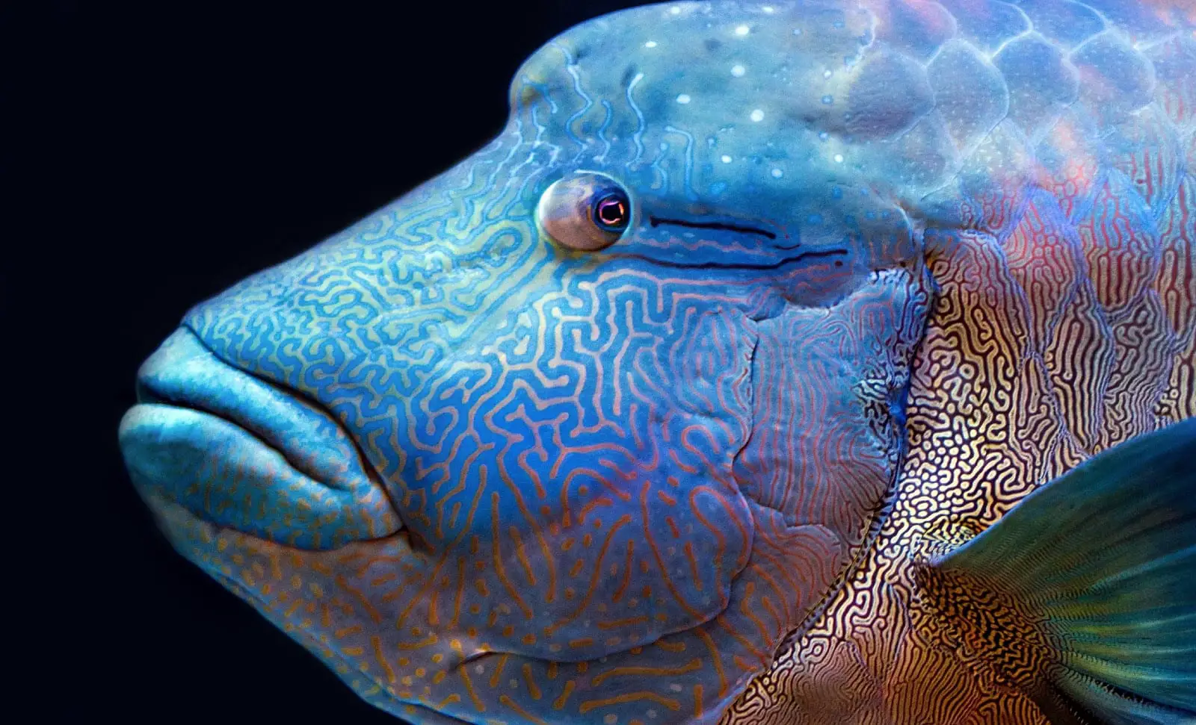
Structural
Colour
Notes:
Info: Image: https://www.geocities.ws/jtnolde/Activity_4th.21.htm

Slide 19
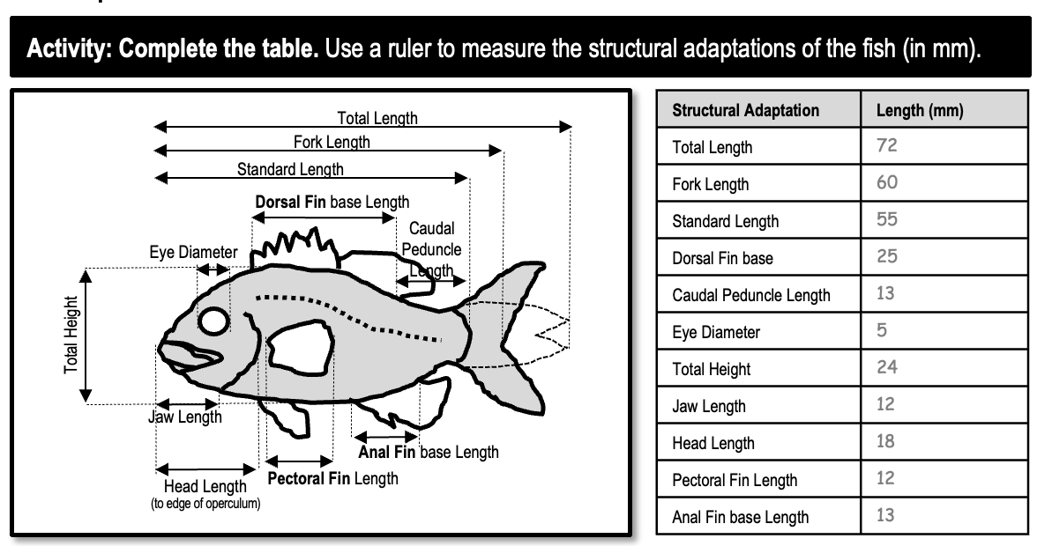

Slide 20
physiological (functional)
adaptations
are functional features that you usually can’t see.

Slide 21
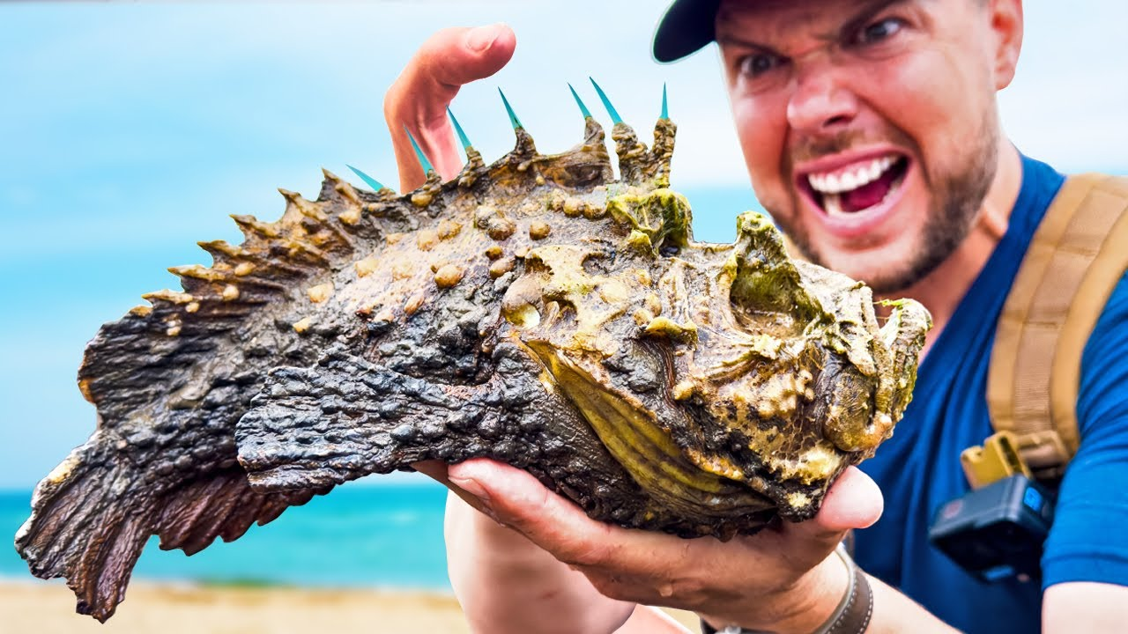
Functional
Venom
Notes:
Image: https://www.youtube.com/watch?v=52AuNyBbedE

Slide 22
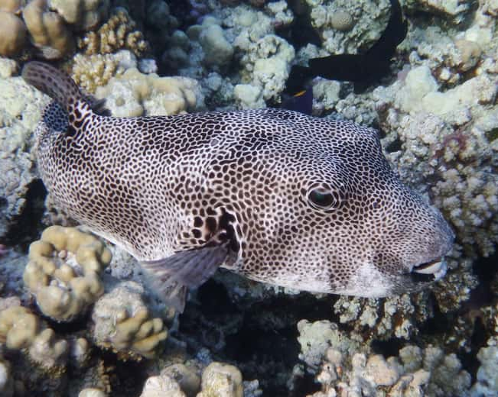
Functional
Poison
(toxic to eat)
Puffer Fish
Notes:
Image: https://www.ranker.com/list/most-poisonous-sea-creatures/eric-vega

Slide 23
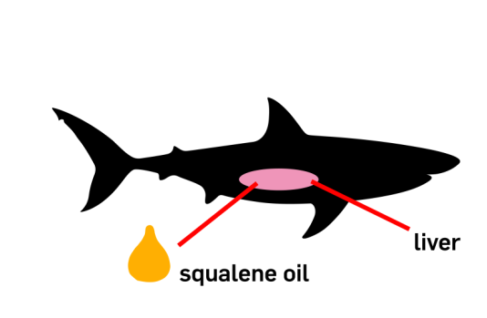
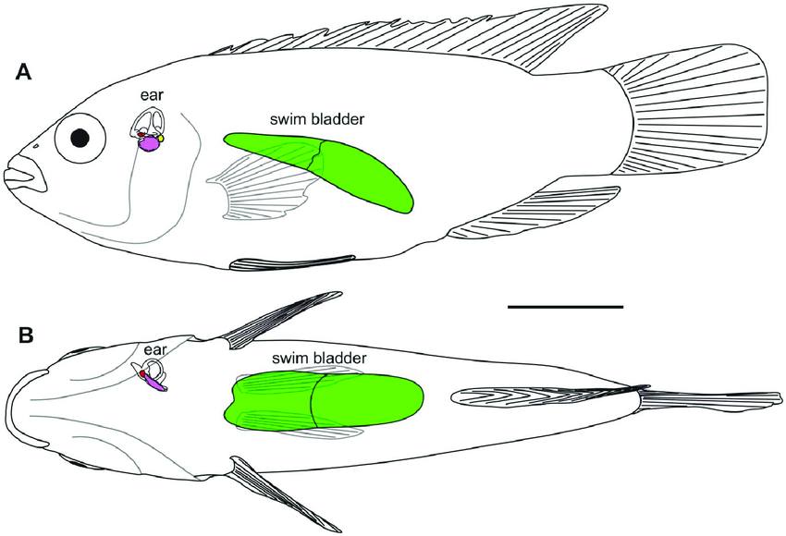
Functional
Buoyancy
Fish have a swim bladder they can inflate/deflate
Sharks do not have a swim bladder. They sink if they stop swimming. To compensate for their tendency to sink, sharks have large livers that are filled with oil that help them float.
Notes:
Image (left): https://www.researchgate.net/figure/Swim-bladder-and-inner-ear-of-H-guttatus-in-A-lateral-and-B-ventral-views-The-swim_fig12_230645973
Image (right): https://www.ctvnews.ca/health/coronavirus/advocacy-group-warns-that-500-000-sharks-may-need-to-die-for-a-covid-19-vaccine-1.5122624

Slide 24
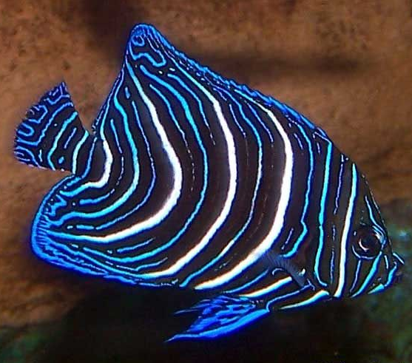
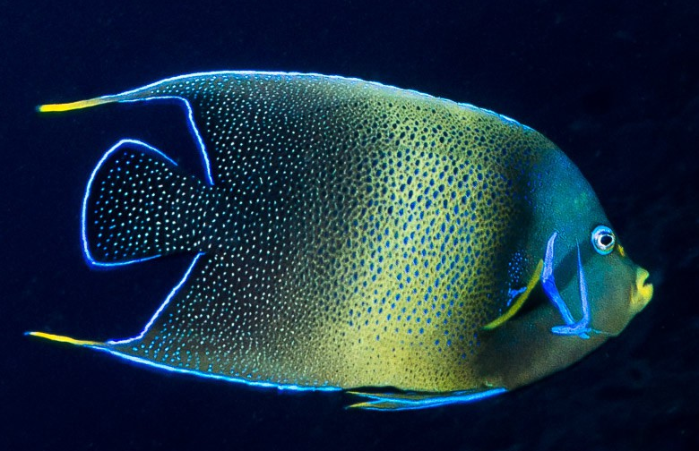
Functional
Colour change
Juvenile
Semicircle angelfish (Pomacanthus semicirculatus)
Adult

Slide 25
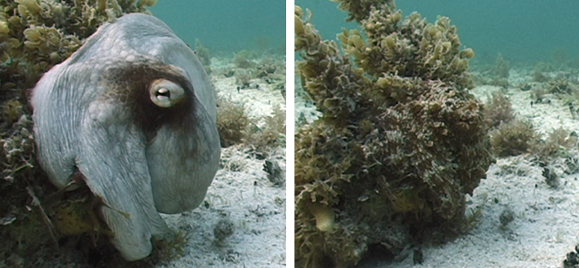
Functional
Colour change
Notes:
Image: https://mag.uchicago.edu/science-medicine/brain-waves

Slide 26
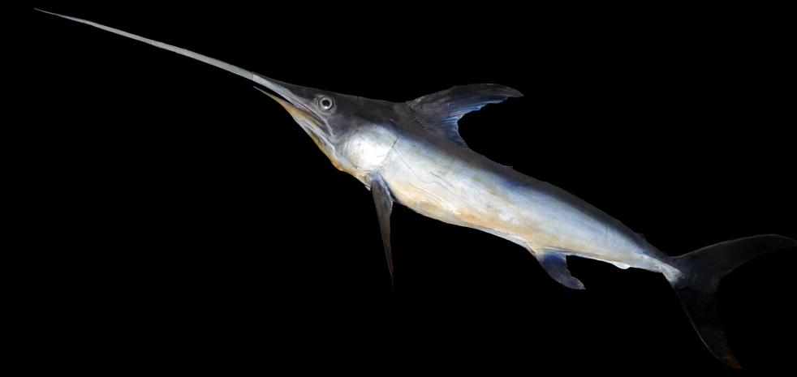
Functional
Thermoregulation
(temperature control)
Swordfish generate heat around the eyes.
Warm eyes enable it to see (and thus hunt) better in cold environments.
Notes:
Image: https://www.42evolution.org/heated-eyes-give-swordfish-deep-sea-night-vision/
More info: https://www.cell.com/current-biology/pdf/S0960-9822(04)00996-0.pdf

Slide 27
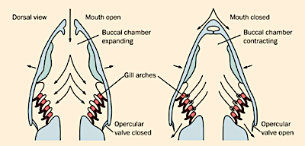
Functional
Gas exchange
(breathing)
Notes:
Image: https://www.pathwayz.org/Tree/Plain/FISH+-GAS+EXCHANGE

Slide 28
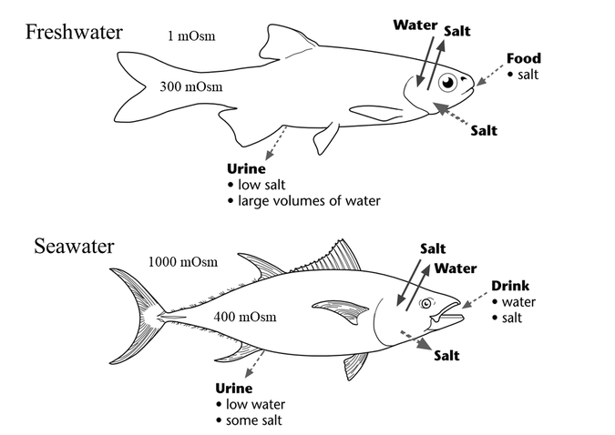
Functional
Osmoregulation
(salinity control)
Gills not only enable a fish to breathe but they also play the very important function of osmoregulation – the process of maintaining an internal balance of salt and water in a fish’s body.
Notes:
Image: https://www.researchgate.net/figure/Mechanisms-of-osmoregulation-by-teleost-fishes-Solid-arrows-represent-passive-movements_fig4_327531685
Mechanisms of osmoregulation by teleost fishes. Solid arrows represent passive movements of salt and water, and dashed arrows represent active pathways of osmoregulation. Adapted from Evans (2008); Evans (20

Slide 29
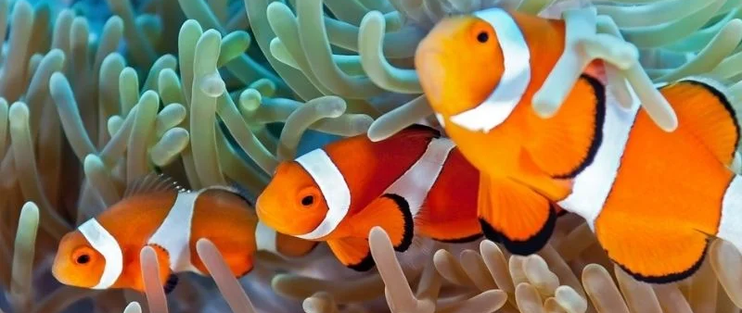
Functional
Change in sex
Male
Female
Male
Notes:
Image: https://www.aquariumcircle.com/do-clownfish-need-anemones/

Slide 30
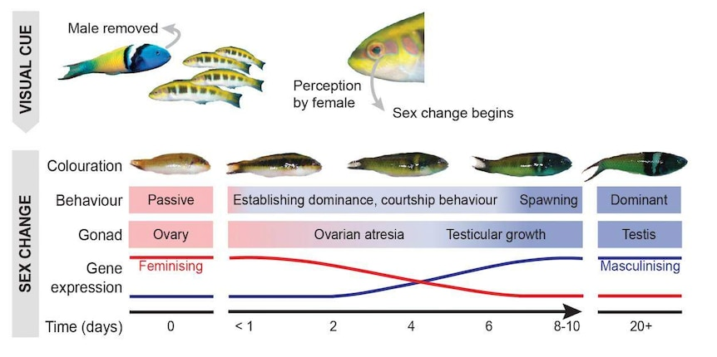
Functional
Change in sex
Bluehead wrasse
Notes:
Image: https://www.abc.net.au/news/science/2019-07-11/bluehead-wrasse-change-sex-epigenetic-stress/11291332
Paper: https://www.science.org/doi/10.1126/sciadv.aaw7006

Slide 31
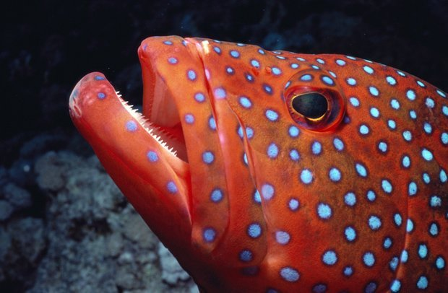
Functional
Change in sex
Coral trout are protogynous hermaphrodites.
They’re born as female and change into males (after breeding as females at least once)

Slide 32
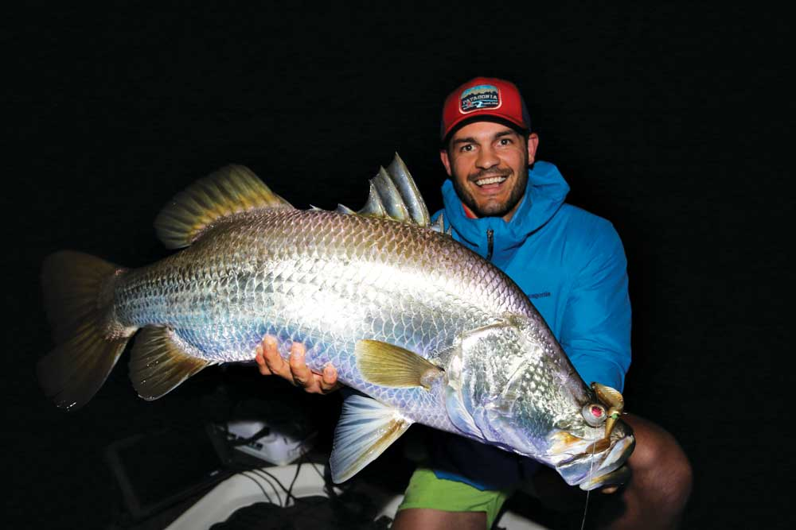
Functional
Change in sex
Whereas,
Baramundi are protandrous hermaphrodites.
They’re born as male and change into females.
Notes:
Image: https://afn.com.au/chasing-chrome/

Slide 33
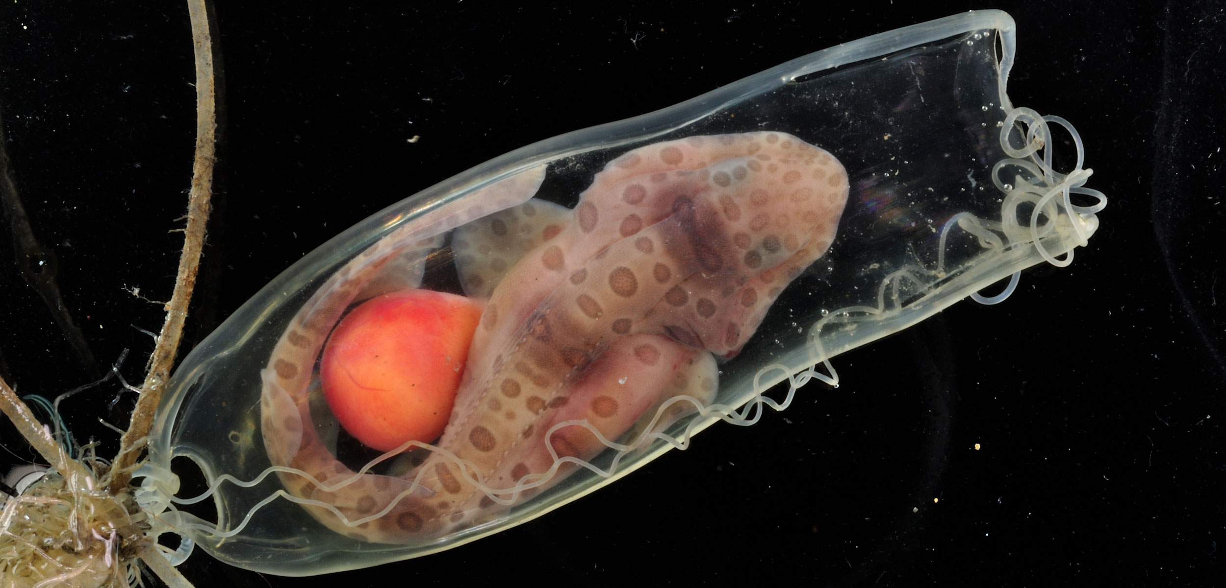
Functional
Reproductive system
Sarawak swellshark
Notes:
Image: https://hakaimagazine.com/news/this-mommy-shark-has-a-unique-way-of-making-babies/
While most shark egg cases are opaque, those belonging to Sarawak swellsharks are transparent—allowing the baby inside to be seen. Photo by Cheng-Chang Lee

Slide 34
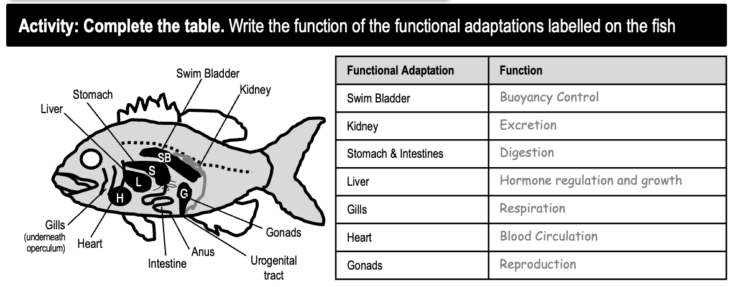
Functional

Slide 35
Behavioural adaptations
are behaviours
instinctual or learned
that you can observe.

Slide 36
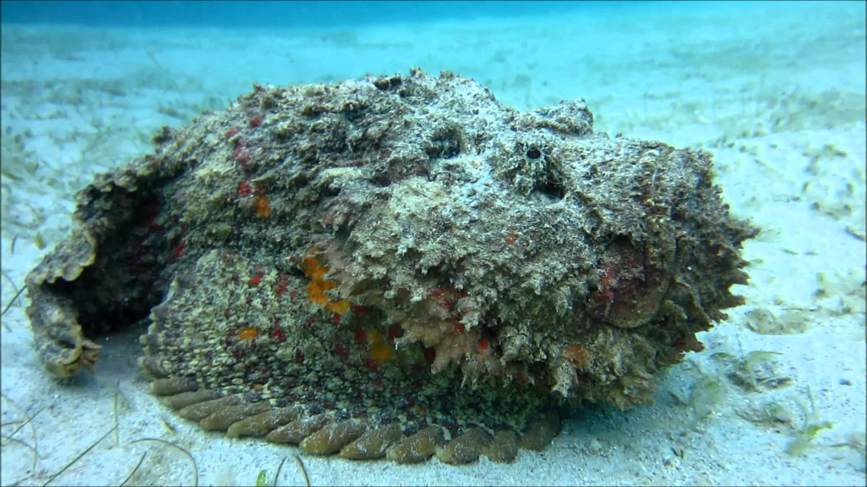
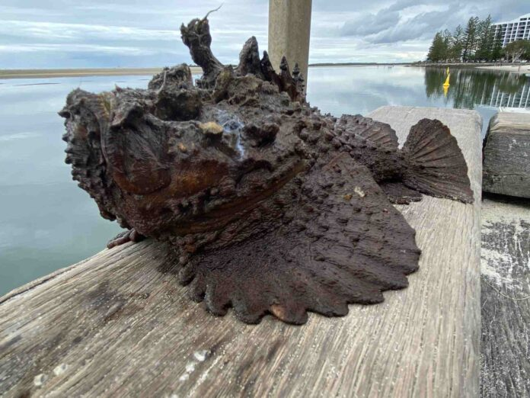
Behavioural
Warning signals
Spines down – fish is just chilln’
Spines up – fish is in ‘damage mode’
Notes:
Image (left): https://sanookscuba.com/stonefish/
Image (right): https://www.sunshinecoastnews.com.au/2023/02/13/sharp-advice-after-dozens-stung-by-stonefish/

Slide 37
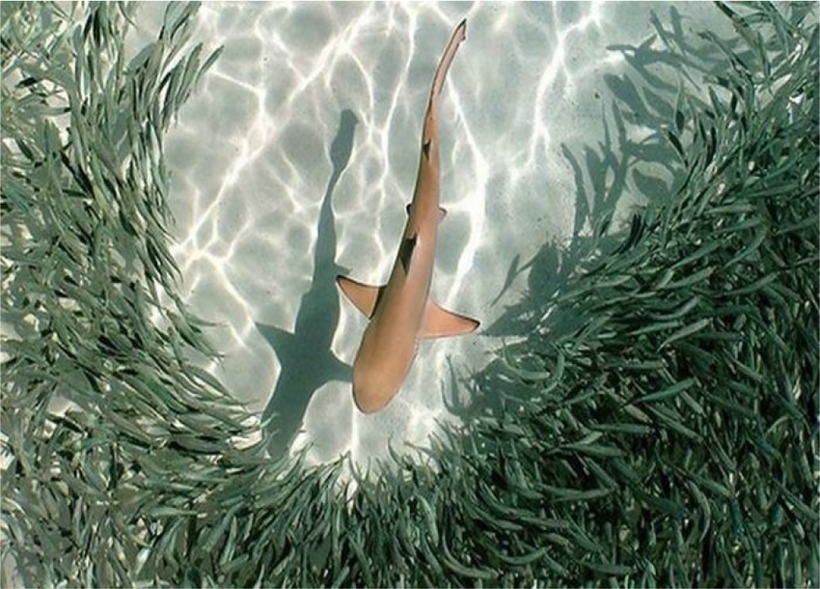
Behavioural
Schooling
Notes:
Image: https://www.researchgate.net/figure/Behaviour-of-a-school-of-fish-during-a-shark-attack_fig1_289896756
Paper: Congestion Avoidance for Multiple Micro-Robots Using the Behaviour of Fish Schools

Slide 38
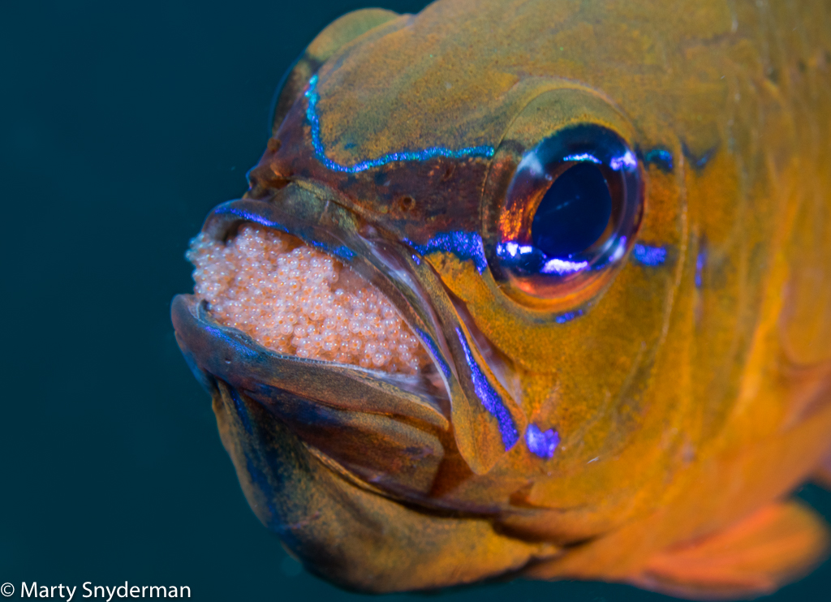
Behavioural
Parental care
This male Yellowhead jawfish is a mouth brooder. Photo: Marty Snyderman
Notes:
Image: https://ultimatedivetravel.com/mouthbrooder/

Slide 39
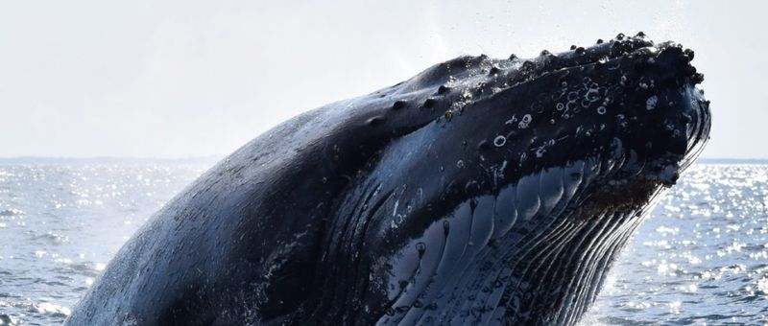
Behavioural
Migration

Slide 40
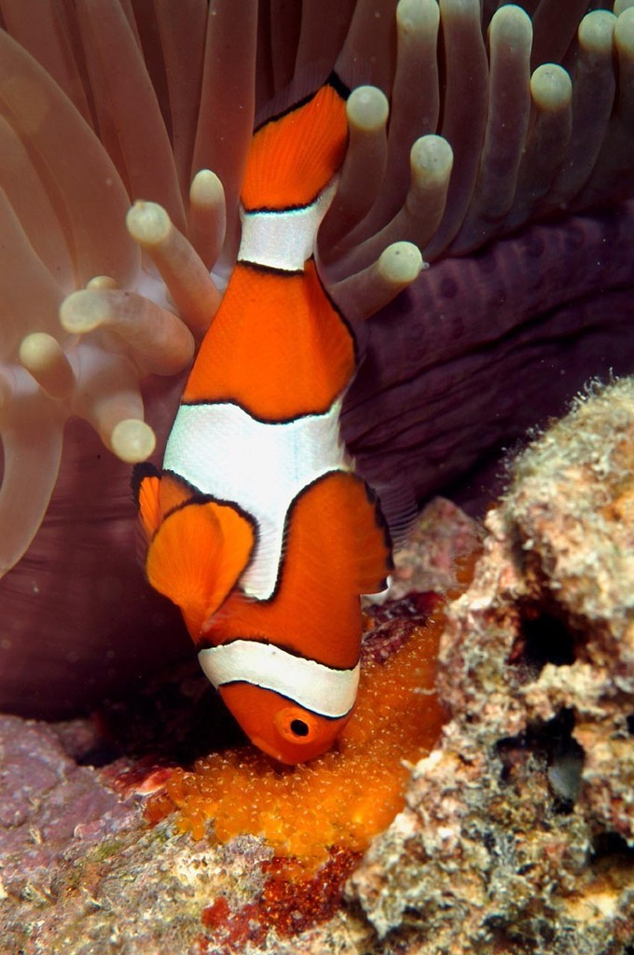
Behavioural
Territorial
Notes:
Image: https://www.sail-world.com/USA/photo/64924

Slide 41
Classify the following adaptations as either anatomical (structural), physiological (functional) or behavioural.
Are you ready?

Slide 42
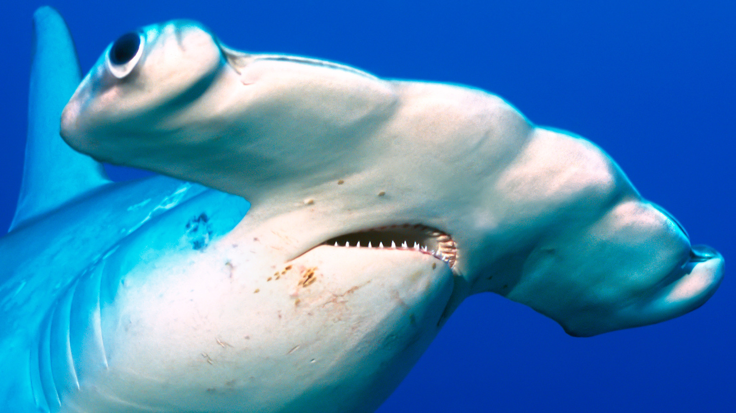
Eyes and teeth
Notes:
Image: https://www.jdohdds.com/?y=the-size-of-these-hammerhead-sharks-will-keep-you-ww-QPBj5nIG
Ans: structural

Slide 43
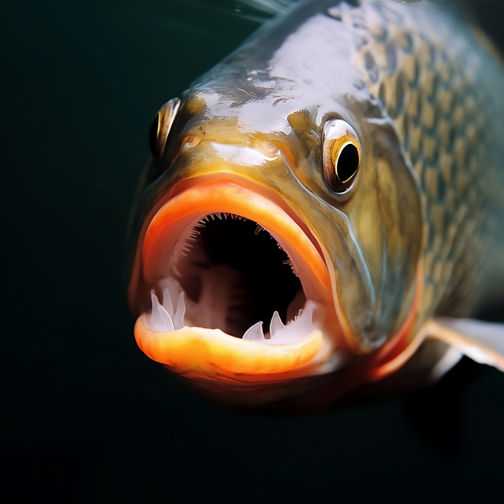
Respiration and osmoregulation
Notes:
Ans: functional

Slide 44
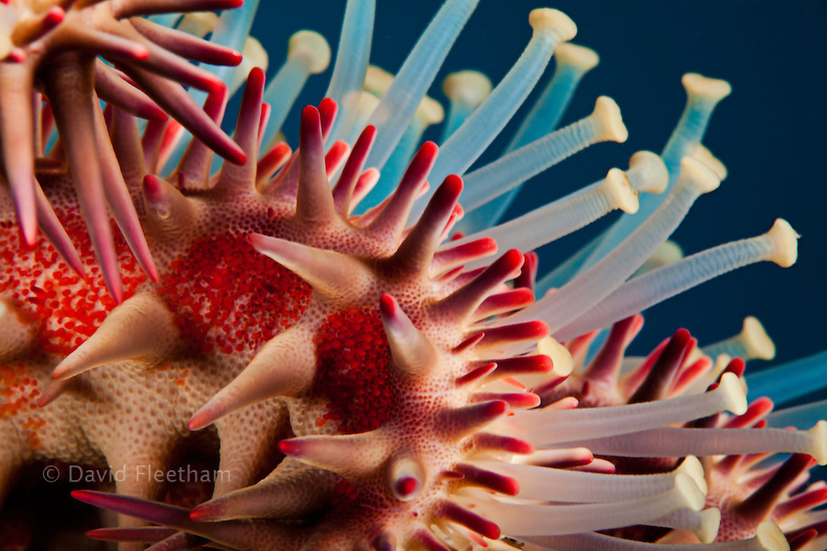
Tube feet
Hint: could be more than one type of adaptation
Notes:
Image: https://fleetham.photoshelter.com/image/I0000BmF9sWbu14g
Ans. structural (tube feet) and functional (breathing, locomotion)

Slide 45
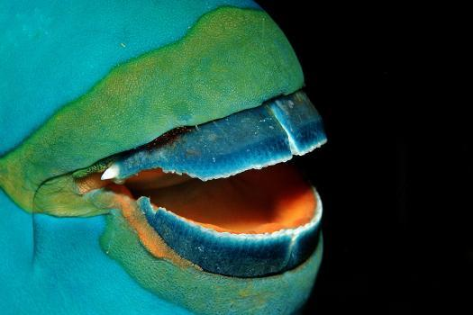
Parrotfish
Mouth shape
Notes:
Ans: structural

Slide 46
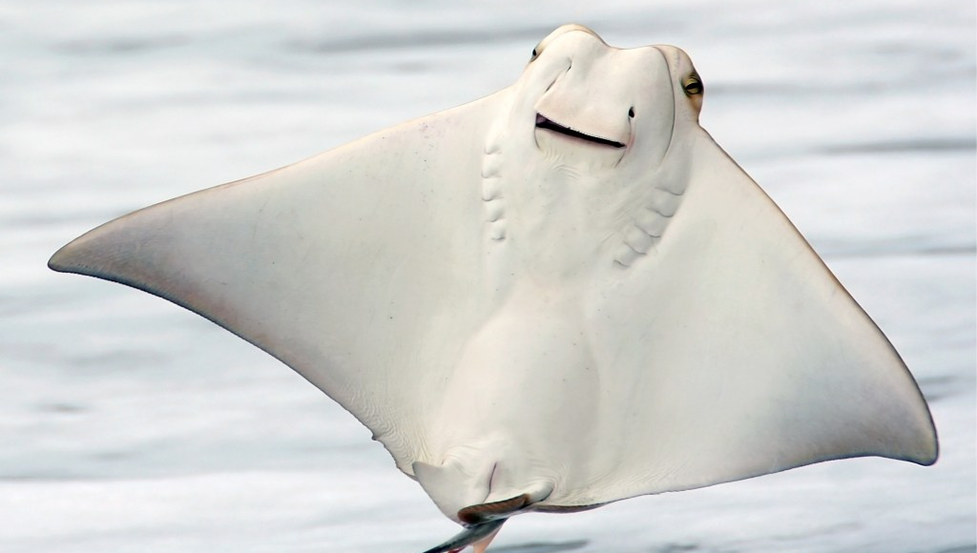
Leaping
Notes:
Ans: behavioural

Slide 47
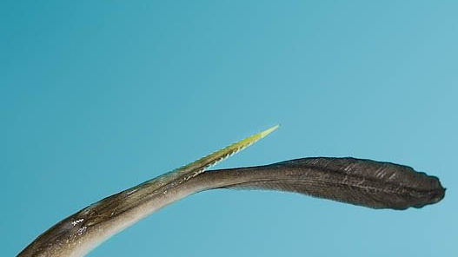
Barb
Notes:
Image: https://www.quora.com/How-does-a-stingrays-barb-work-and-why-is-it-so-dangerous
Ans. structural (the barb), functional (poison) and behavioural (use)

Slide 48
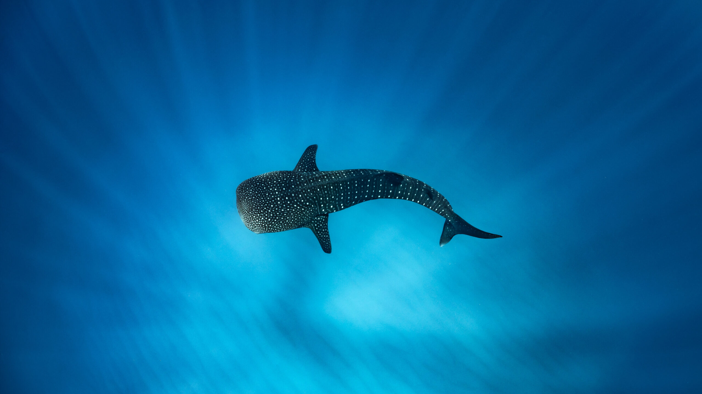
Whale shark
Migrating
Notes:
Ans. behavioural

Slide 49
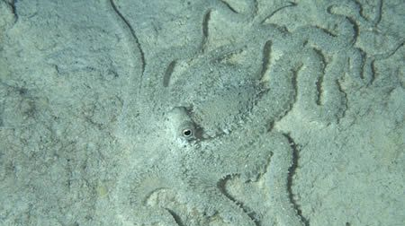
Camouflage
Notes:
Ans: functional

Slide 50
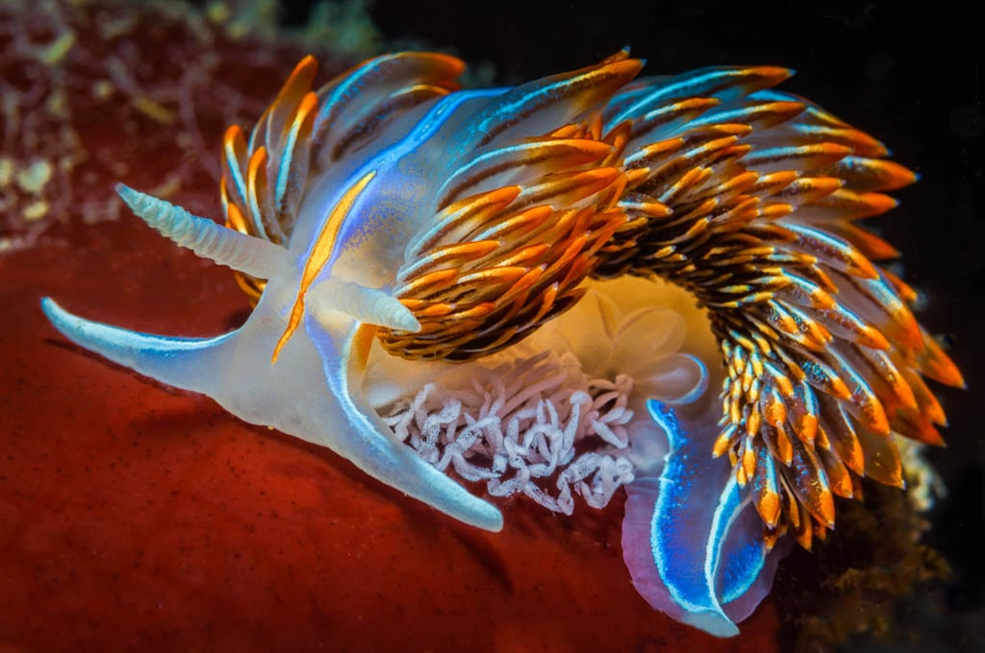
Colour
Nudibrach
Notes:
Ans. Structural

Slide 51
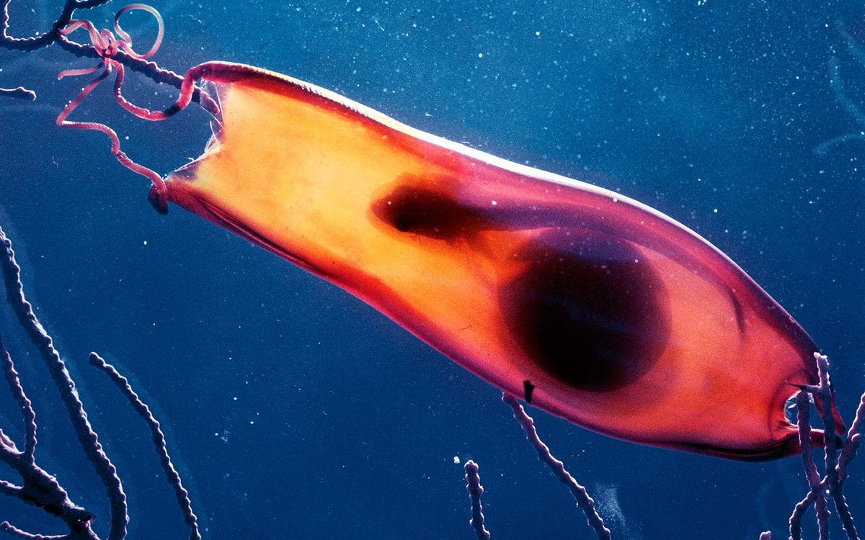
Reproductive system
Notes:
Ans: functional
Image: https://www.livescience.com/62325-shark-egg-embryo-gif.html
About 30 percent of sharks lay eggs like these. Can you see the baby squirming inside? (Image credit: DeAgostini/Getty)

Slide 52

Thresher shark
Tail shape
Notes:
Ans: structural

Slide 53

Fake eye
Notes:
Ans. Structural (can draw/label it)

Slide 54

Learning Intention:
Classify adaptations as anatomical (structural), physiological (functional) or behavioural.
Success Criteria:
Complete Marine Education worksheet ‘24. Life Hacks’
Notes:
Image: https://www.quora.com/How-can-the-lips-of-a-human-look-like-the-mouth-of-a-trigger-fish

