Slide 1
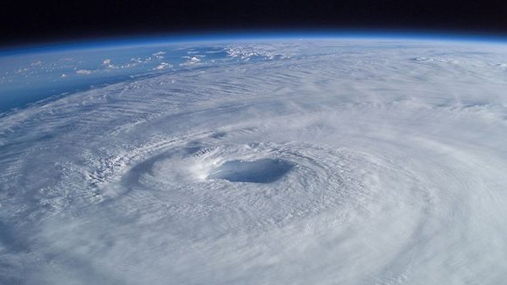
Learning Intention:
Discuss how scientific evidence from the impact of cyclones and/or floods, allows scientists to offer reliable predictions about the loss of biodiversity of a chosen marine ecosystem.
Success Criteria:
Complete Marine Education worksheet
’26. Cyclone warning’
Notes:
Image: https://www.australiangeographic.com.au/topics/science-environment/2011/02/the-biggest-cyclones-in-recorded-history/

Slide 2
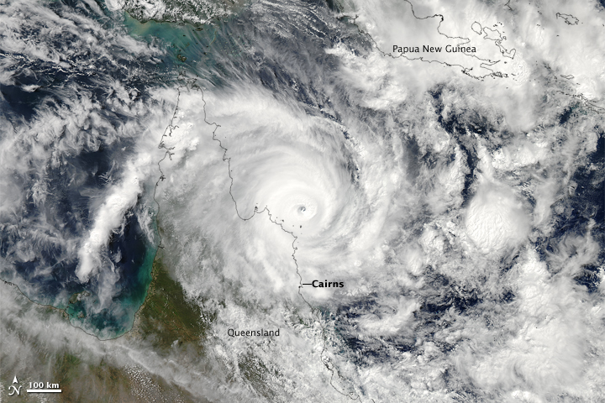
Category 4 cyclone Ita approaching Lizard Island in 2014,
7 hours before landfall.
Notes:
Image: https://earthobservatory.nasa.gov/images/83486/cyclone-ita-approaching-australia

Slide 3
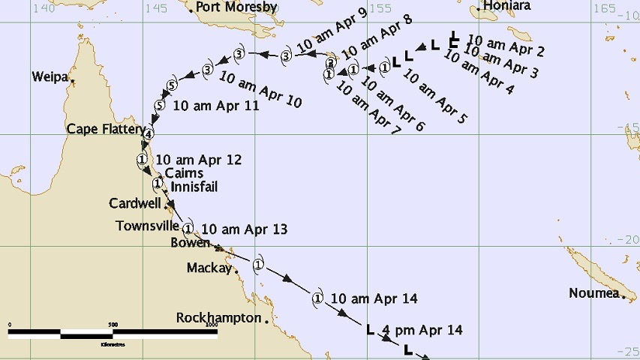
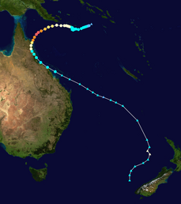
Cyclone Ita
Lizard Island
Notes:
Image (large): http://www.bom.gov.au/cyclone/history/Ita.shtml
Image (small): https://en.wikipedia.org/wiki/Cyclone_Ita

Slide 4
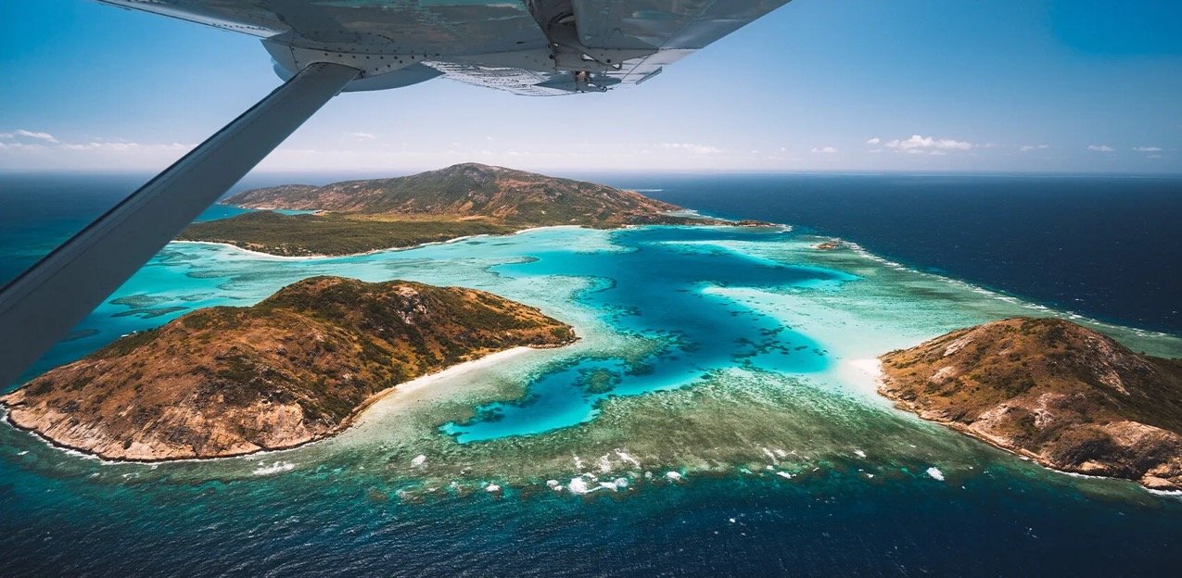
Lizard Island came within 5km from the eye of the cyclone
Notes:
Info: http://www.bom.gov.au/cyclone/history/Ita.shtml

Slide 5
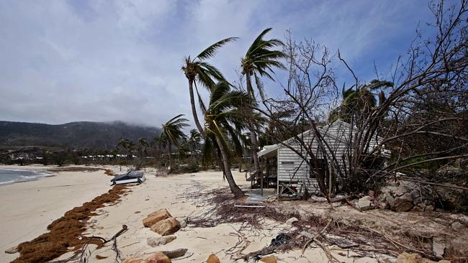
Image: Cairns Post
Considerable vegetation damage but only minor structural damage to buildings was recorded at Lizard Island (bom.gov.au).
Notes:
Image: https://www.cairnspost.com.au/news/special-features/iconic-lizard-island-resort-smashed-by-cyclone-ita/news-story/409a00bdfe23f5b9dcb7aeaad77d4c42

Slide 6
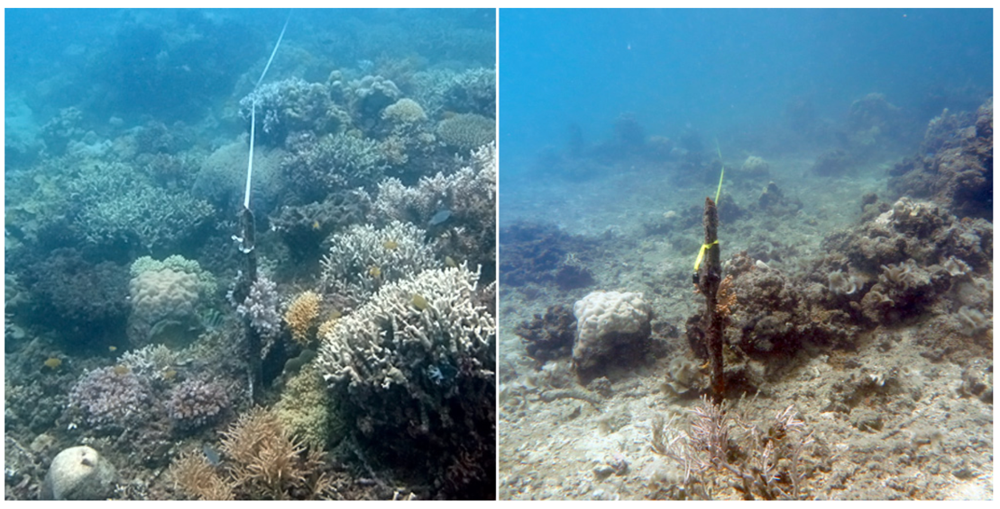
Before and After cyclone Ita hit Lizard Island
Notes:
Image: https://www.aims.gov.au/information-centre/news-and-stories/more-intense-cyclones-pose-threat-worlds-coral-reefs#:~:text=In%20the%20wake%20of%20the,it%20far%20more%20difficult%20for

Slide 7
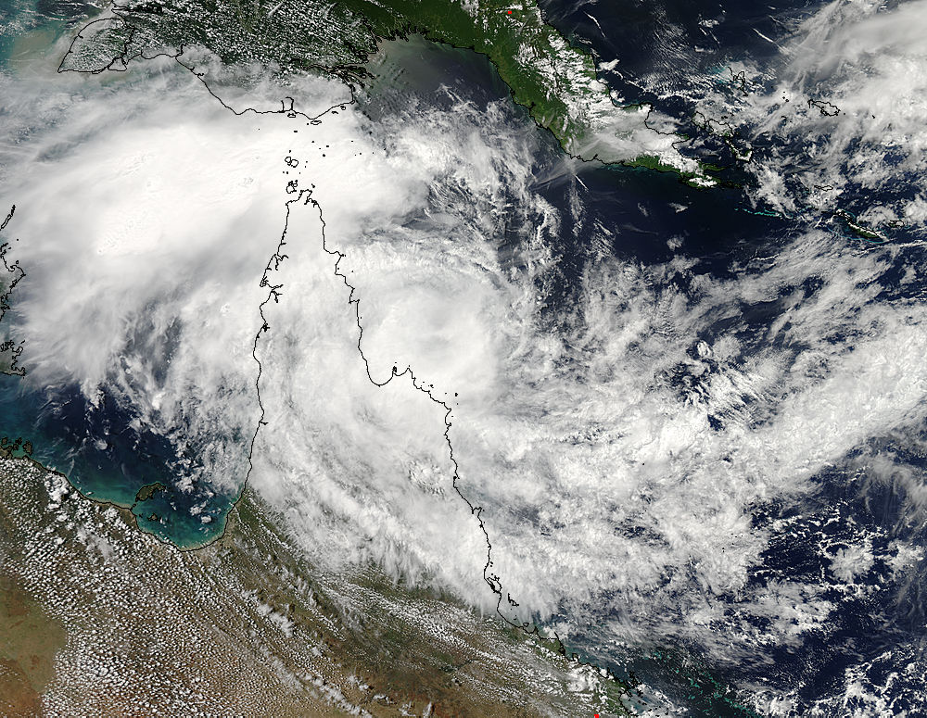
March 13, 2015 (cat 2)
One year later, cyclone Nathan hit Lizard Island.
It made landfall as a category 3.
Notes:
Image: https://phys.org/news/2015-03-tropical-cyclone-nathan-nasa-satellite.html

Slide 8
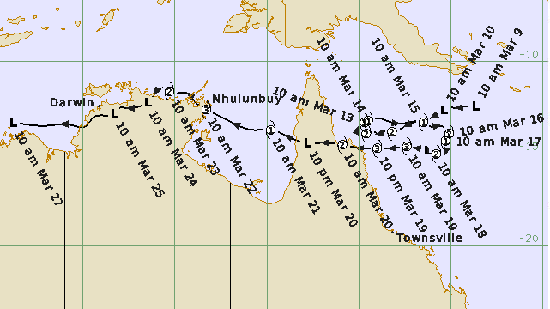
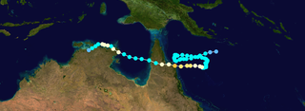
Notes:
Image (large): http://www.bom.gov.au/cyclone/history/Nathan-2015.shtml
Image (small): https://en.m.wikipedia.org/wiki/File:Nathan_2015_track.png

Slide 9
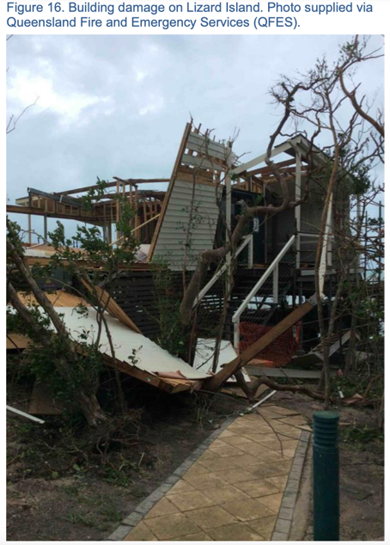
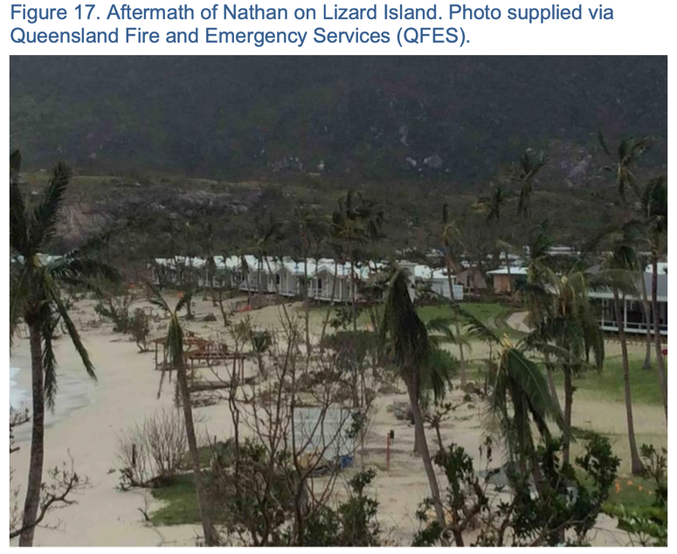
Notes:
Image: http://www.bom.gov.au/cyclone/history/pdf/Nathan2015_report.pdf

Slide 10
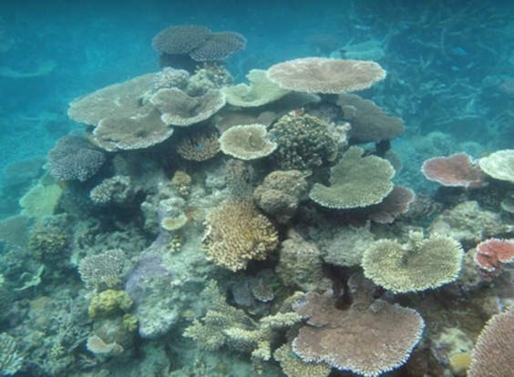
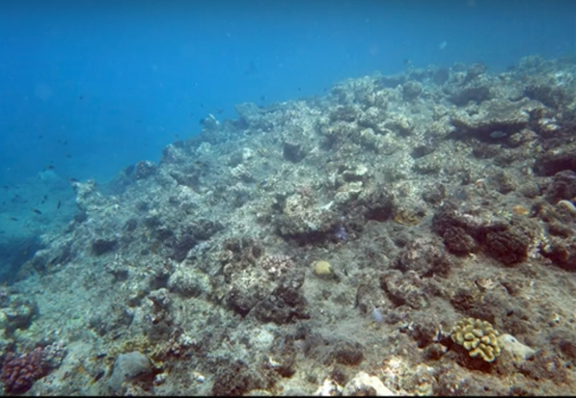
Coral loss was patchy and dependent on the direction of the waves.
2009
2016
North Reef, Lizard Island, before and after cyclones
Notes:
Image: https://www.youtube.com/watch?v=XXIGHpJ4Mho

Slide 11
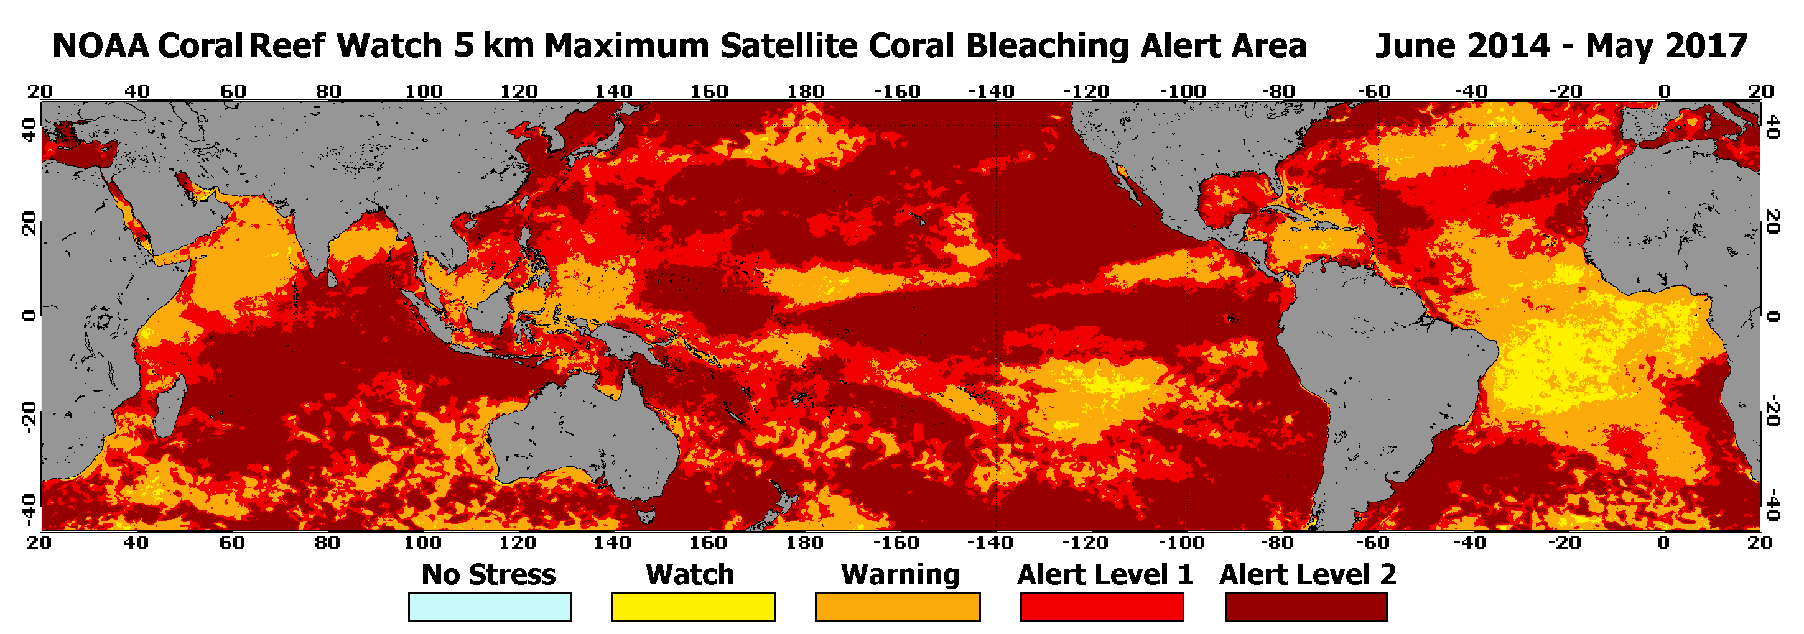
One year after cyclone Nathan, Lizard Island was left badly damaged from the mass coral bleaching event of 2015-16.
Notes:
Image: https://coralreefwatch.noaa.gov/satellite/analyses_guidance/global_coral_bleaching_2014-17_status.php

Slide 12
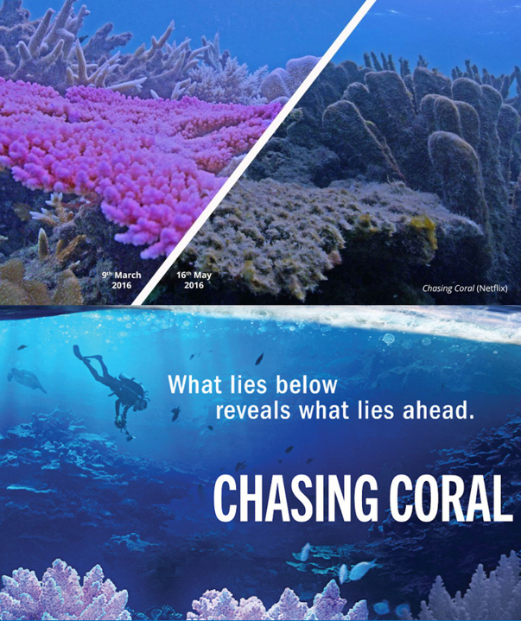
That hurt.
(watch Chasing Coral)
https://www.youtube.com/watch?v=aGGBGcjdjXA
Notes:
Chasing Coral: https://www.youtube.com/watch?v=aGGBGcjdjXA

Slide 13
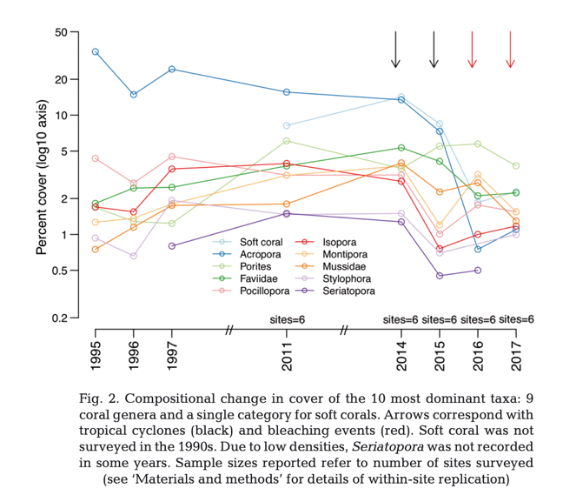
cyclones
bleaching
Percentage hard coral cover on Lizard Island dropped to below 4%
Notes:
Info/paper: Madin JS, Baird AH, Bridge TCL, Connolly SR, Zawada KJA, Dornelas M (2018) Cumulative effects of cyclones and bleaching on coral cover and species richness at Lizard Island. Mar Ecol Prog Ser 604:263-268. https://doi.org/10.3354/meps12735

Slide 14
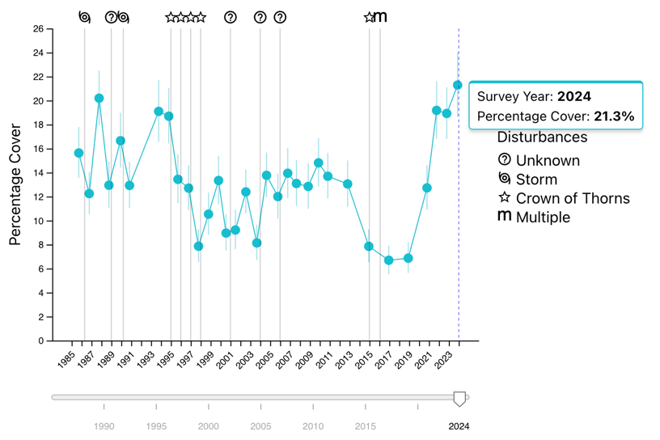
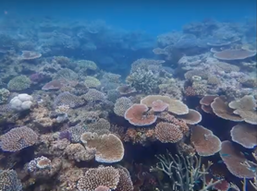
But it recovered fast.
% hard coral cover increased to 21.3%
in 2024
North Reef, Lizard Island 2021
Notes:
Info/Image: https://apps.aims.gov.au/reef-monitoring/reef/14116S/manta

Slide 15
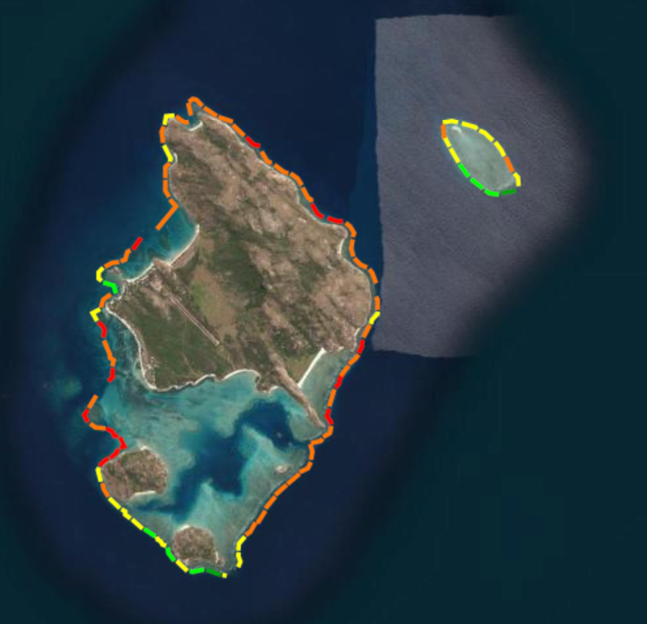
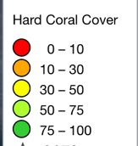
2023
Recovery was, however, patchy.
Notes:
Side note: And, although some of the reefs are presenting high percentages of hard coral cover, the species that are there, such as Pocillopora, are species that usually show up in the early stages of succession, plus they’re smaller
(but lots of them). Which brings to question, is %HC cover the best way to measure the health (recovery) of a reef?
Info/Image: https://apps.aims.gov.au/reef-monitoring/reef/14116S/manta

Slide 16
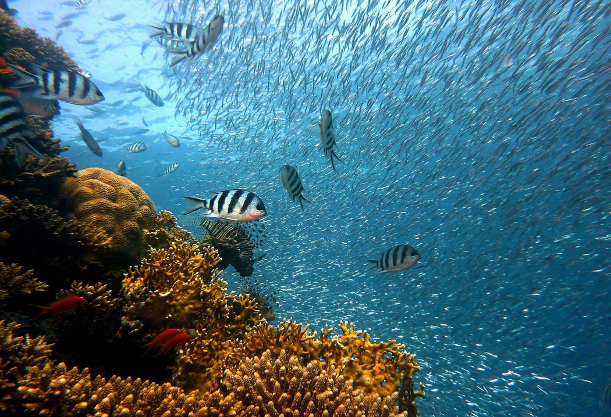
Hard corals provide habitat for many species.
Notes:
Image: https://www.twinkl.com.au/teaching-wiki/coral-reef

Slide 17
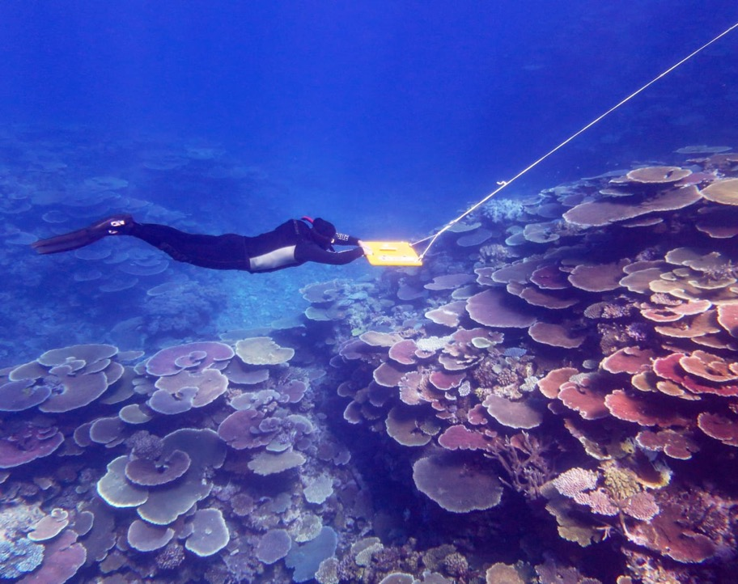
AIMS long term monitoring program
hard corals
habitat
biodiversity
Notes:
Image: https://www.nbcnews.com/news/world/great-barrier-reef-highest-coral-cover-36-years-australia-rcna41464
A diver is towed as part of the Great Barrier Reef monitoring program.Australian Institute of Marine Science

Slide 18
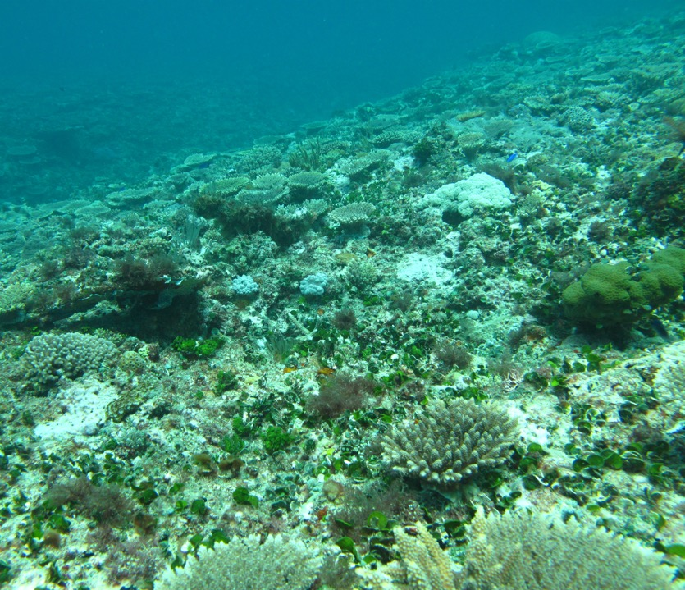
Wreck Island Reef recovering after Cyclone Hamish in 2009. Photo: Kate Osborne (AIMS)
hard corals
habitat
biodiversity
Notes:
Image: https://eatlas.org.au/media/572

Slide 19
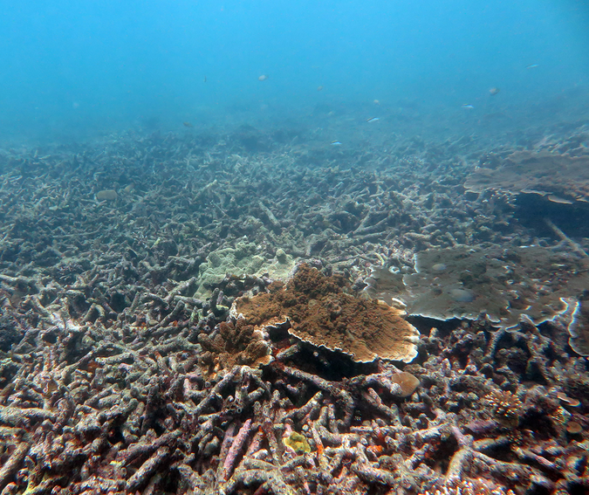
Whitsundays after category 4 cyclone Debbie
Big Cyclones ….
hard corals
habitat
biodiversity
Notes:
Image: https://www.researchgate.net/figure/Cyclones-can-turn-coral-gardens-into-rubble-fields-This-site-in-the-Whitsunday-Islands_fig2_338346913

Slide 20
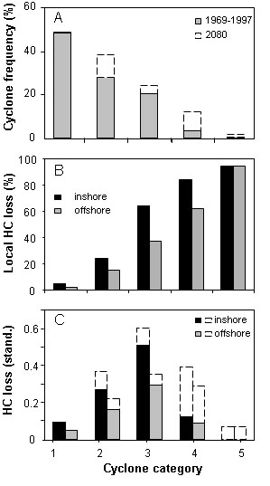
Big Cyclones ….
hard corals
habitat
biodiversity
Notes:
Image: Fabricius KE, De’ath G, Poutinen ML, Done T, Cooper TF, Burgess SC (2008) Disturbance gradients on inshore and offshore coral reefs caused by a severe tropical cyclone. Limnology and Oceanography 53: 690–704. Accessed from: https://eatlas.org.au/content/impacts-severe-tropical-cyclone-inshore-and-offshore-coral-reefs

Slide 21
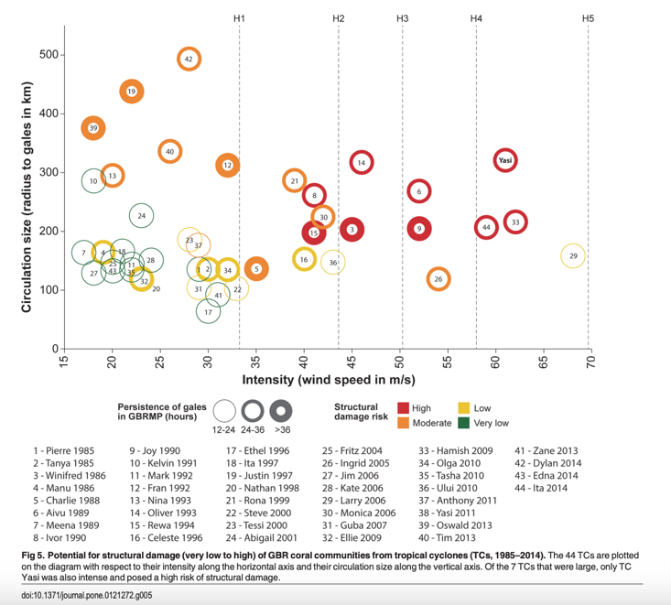
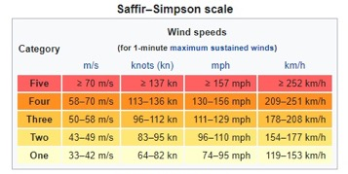
Cat 1
Cat 2
Cat 3
Cat 4
Cat 5
Intensity and size of cyclone?
to corals
Notes:
Info/paper: https://journals.plos.org/plosone/article?id=10.1371/journal.pone.0121272
Beeden R, Maynard J, Puotinen M, Marshall P, Dryden J, Goldberg J, et al. (2015) Impacts and Recovery from Severe Tropical Cyclone Yasi on the Great Barrier Reef. PLoS ONE 10(4): e0121272. https://doi.org/10.1371/journal.pone.0121272

Slide 22
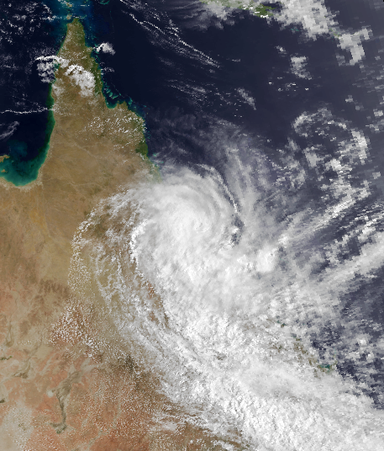
Category 1
Notes:
Image: https://en.wikipedia.org/wiki/1987%E2%80%9388_Australian_region_cyclone_season#/media/File:Charlie_Feb_29_1988_0621Z.png

Slide 23
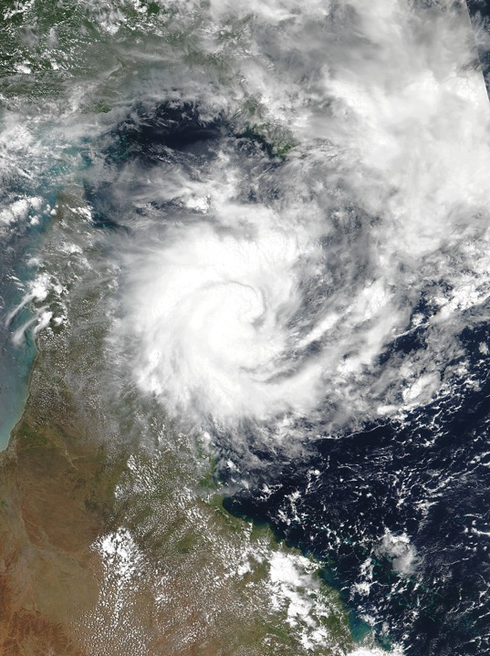
Category 2
Notes:
Image: https://en.wikipedia.org/wiki/List_of_Category_2_Australian_region_tropical_cyclones#/media/File:Tiffany_2022-01-09_0408Z.jpg

Slide 24
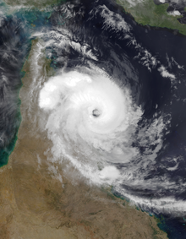
Category 3
Notes:
Image: https://en.wikipedia.org/wiki/Cyclone_Nathan_%282015%29

Slide 25
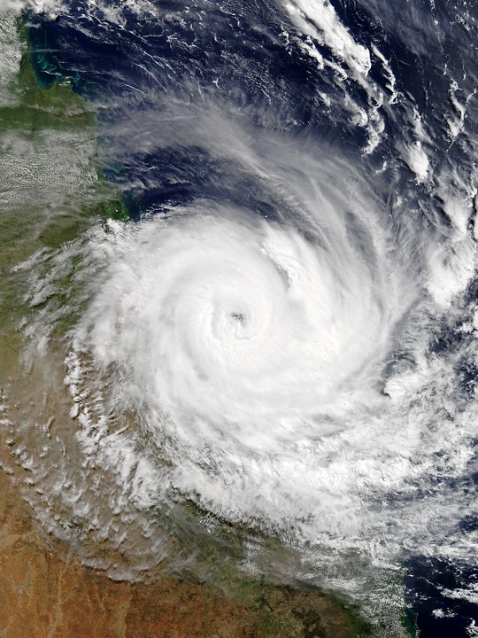
Category 4
Notes:
Image: https://en.wikipedia.org/wiki/Cyclone_Debbie#/media/File:Debbie_2017-03-28_0010Z.jpg

Slide 26
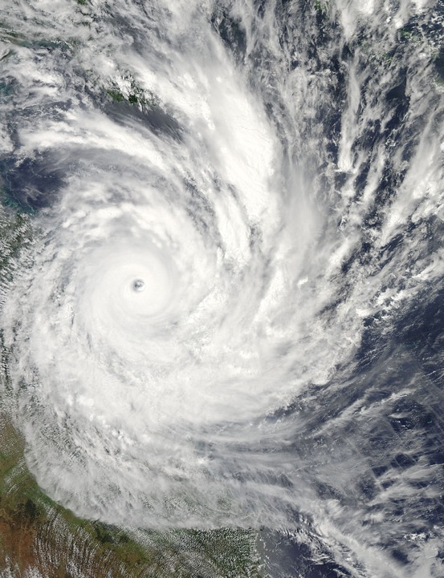
Category 5
Notes:
Image; https://en.wikipedia.org/wiki/Cyclone_Yasi

Slide 27
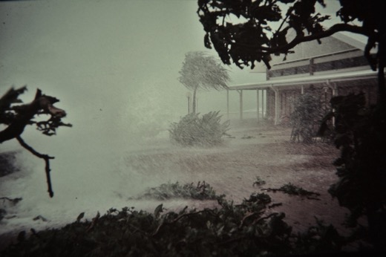
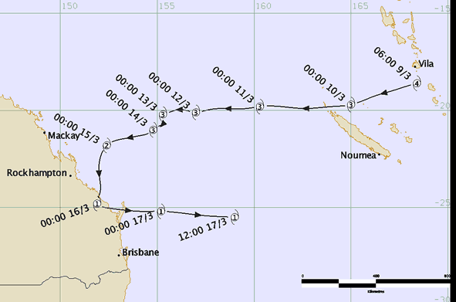
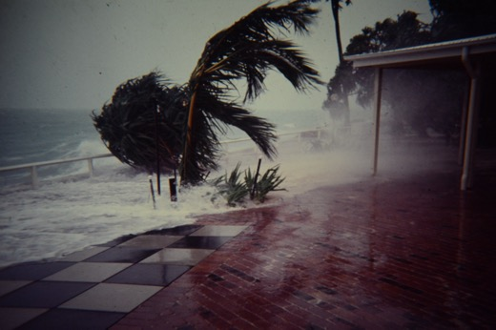
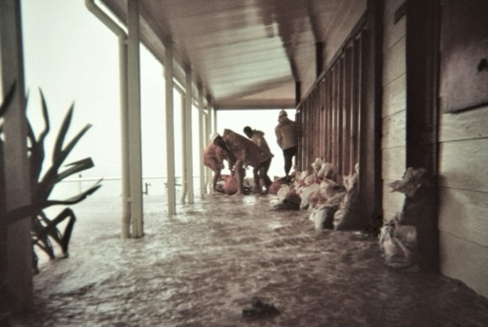
Category 2 cyclone Fran crossing Heron Island in 1992
Photos: Mark McCarthy ‘Heron island Survivors’ facebook page
Notes:
Images Heron Is: Mark McCarthy ‘Heron island Survivors’ facebook page
Image (map): http://www.bom.gov.au/cyclone/history/fran.shtml

Slide 28
Cyclone Fran 1992
Notes:
Image: http://www.bom.gov.au/cyclone/history/fran.shtml

Slide 29
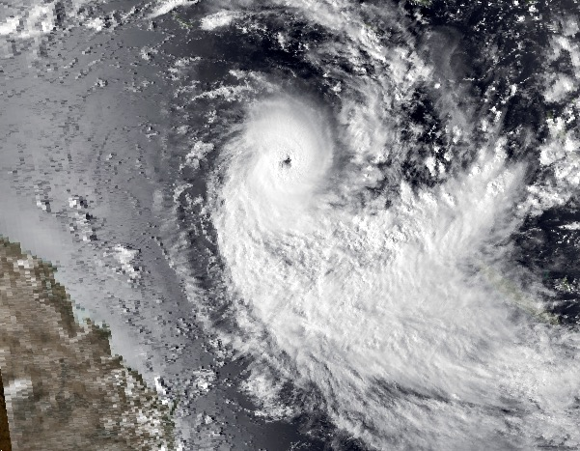
Category 2 cyclone Rewa crossed over Heron Island in 1994
Notes:
Image: https://en.wikipedia.org/wiki/Cyclone_Rewa

Slide 30
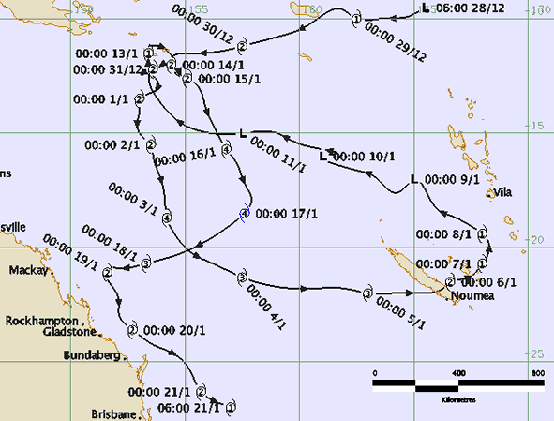
Cyclone Rewa 1994

Slide 31
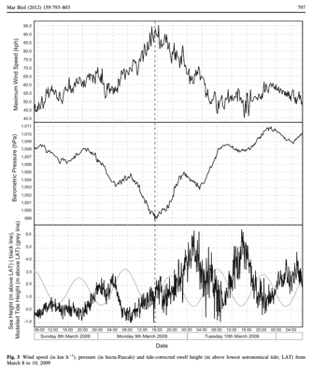
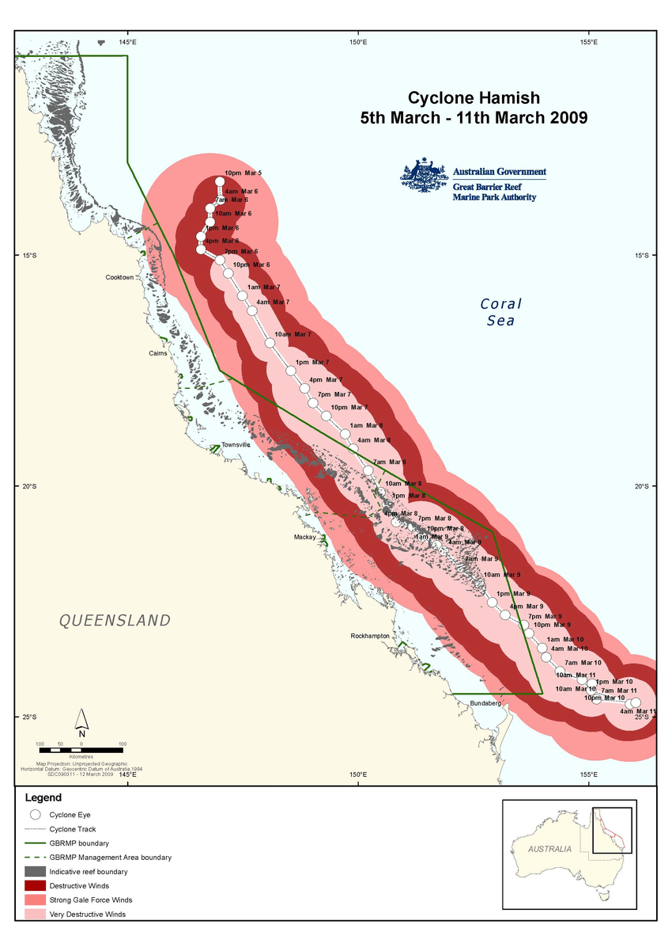
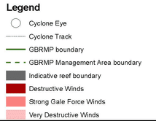
Wind speed
pressure
Category 4 cyclone Hamish passed Heron Island in 2009
Sea height
Notes:
Image (top left): Woolsey, E., Bainbridge, S.J., Kingsford, M.J. et al. Impacts of cyclone Hamish at One Tree Reef: integrating environmental and benthic habitat data. Mar Biol 159, 793–803 (2012). https://doi.org/10.1007/s00227-011-1855-8
Image (right): Tobin, A., Schlaff, A., Tobin, R., Penny, A., Ayling, Anthony, Krause, B., Welch, D., Sutton, S., Sawynok, B., Marshall, N., Marshall, P., and Maynard, J. (2010) Adapting to Change: Minimising Uncertainty about the Effects of Rapidly-Changing Environmental Conditions on the Queensland Coral Reef Fin Fish Fishery. Report. Fishing and Fisheries Research Centre, James Cook University, Townsville, Qld, Australia.

Slide 32
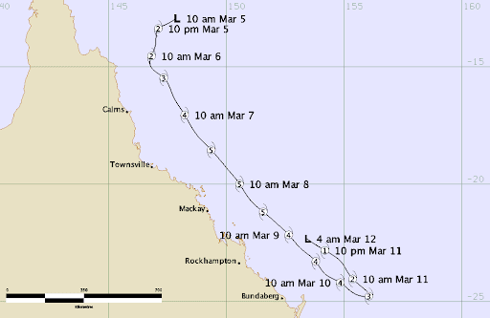
Cyclone Hamish 2009

Slide 33
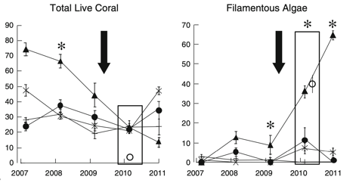
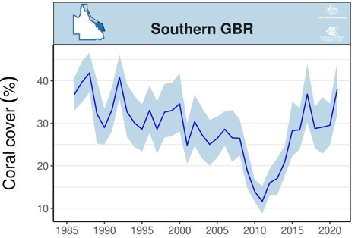
One Tree Island (next to Heron Island)
after cyclone Hamish….
Impacts felt on the windward side of island
Table and branching coral cover reduced.
More rubble and algae-dominated habitat.
Source: Woolsey et al., (2011).
AIMS long term monitoring data
Notes:
Paper: Woolsey, Erika & Bainbridge, Scott & Kingsford, Michael & Byrne, Maria. (2011). Impacts of cyclone Hamish at One Tree Reef: Integrating environmental and benthic habitat data. Marine Biology. 159. 10.1007/s00227-011-1855-8.
Image (below): https://www.aims.gov.au/reef-monitoring/gbr-condition-summary-2020-2021

Slide 34
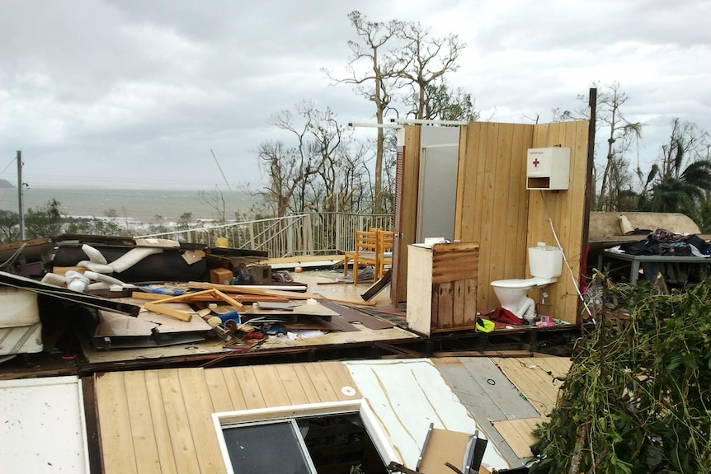
Mission Beach
Category 5 cyclone Yasi was the biggest storm in Queensland history making landfall near Mission Beach and Dunk Island in 2011.
Notes:
Image: https://www.abc.net.au/news/2021-02-02/cyclone-yasi-10-year-anniversary-biggest-storm-queensland/13088796

Slide 35
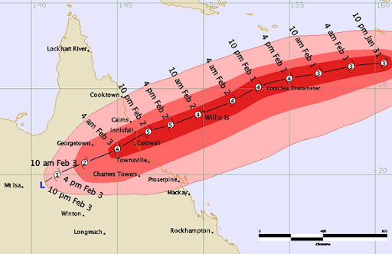
Category 5 cyclone Yasi
Notes:
Image: http://www.bom.gov.au/cyclone/history/yasi.shtml

Slide 36
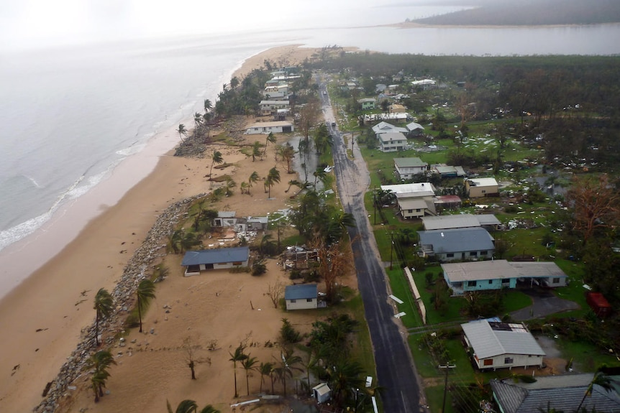
Tully River, Tully Heads, storm surge
Cyclone Yasi
(cat 5)
Notes:
The street along the foreshore of Tully Heads at the mouth of the Tully River was devastated by the storm surge whipped up by Cyclone Yasi.(ABC News: Kerrin Binnie)
Source: https://www.abc.net.au/news/2021-02-02/cyclone-yasi-10-year-anniversary-biggest-storm-queensland/13088796

Slide 37
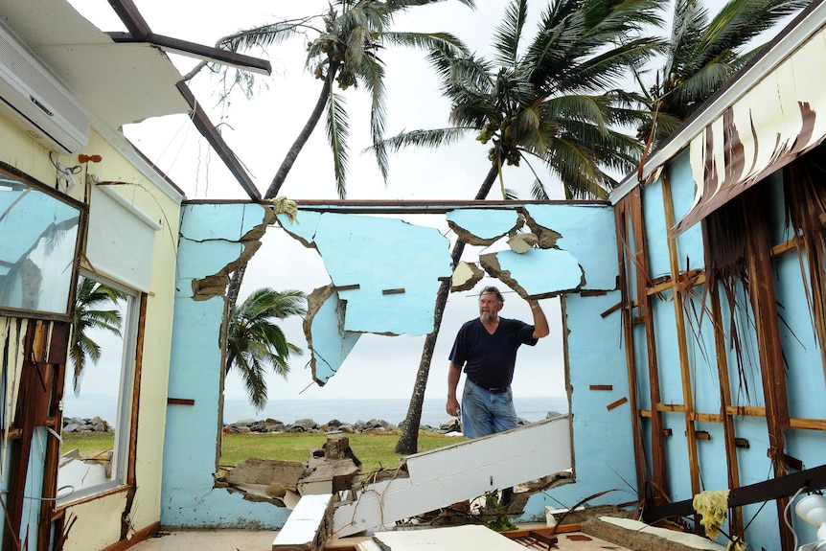
Resident, Tully Heads
Cyclone Yasi
(cat 5)
Notes:
Greville Blank surveys his destroyed home in the devastated town of Tully Heads after category five Cyclone Yasi tore through the region.(AAP: Dave Hunt)
Source: https://www.abc.net.au/news/2021-02-02/cyclone-yasi-10-year-anniversary-biggest-storm-queensland/13088796

Slide 38
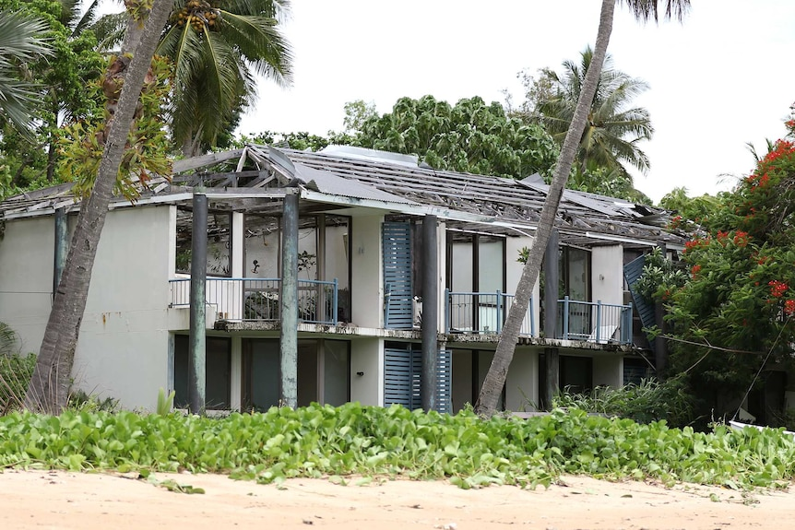
Dunk Island Resort
Cyclone Yasi
(cat 5)
Notes:
Image: https://www.abc.net.au/news/2021-02-02/cyclone-yasi-10-year-anniversary-biggest-storm-queensland/13088796

Slide 39

Port Hinchinbrook Boat Harbour, Cardwell
Cyclone Yasi
(cat 5)
Notes:
Greville Blank surveys his destroyed home in the devastated town of Tully Heads after category five Cyclone Yasi tore through the region.(AAP: Dave Hunt)
Source: https://www.abc.net.au/news/2021-02-02/cyclone-yasi-10-year-anniversary-biggest-storm-queensland/13088796

Slide 40

After making landfall, they’re not finished yet! Flood events follow.
Four days after Tropical Cyclone Kirrily made landfall in Townsville the weather system is causing havoc almost 1,500km away in Lismore, New South Wales
Notes:
Image: https://www.abc.net.au/news/2024-01-30/ex-tropical-cyclone-kirrily-flash-flooding-in-lightning-ridge/103401110

Slide 41

Notes:
Image: https://www.thenewdaily.com.au/news/weather/2024/02/03/kirilly-drenches-queensland-again

Slide 42

“Coastal and marine ecosystems do not like freshwater,
let alone the sediments, nutrients and pesticides that are carried along with it,”
TropWATER water quality scientist Jane Waterhouse
Notes:
Image: https://www.tropwater.com/author/tropwmanager_molly/

Slide 43


T.C. Larry
T.C. YASI
Dunk Island’s recovery
Notes:
Image: https://apps.aims.gov.au/reef-monitoring/reef/Dunk%20Island/benthic

Slide 44

Exam Revision Question part a [2 marks]
Q4a) Describe the family most affected by the cyclone.
Explain your reasoning.
2021 paper 2

Slide 45



Q4a) Describe the family most affected by the cyclone.
Explain your reasoning.
How did you go?

Slide 46


Exam Revision Question part b [6 marks]
Q4b) Draw conclusions about how changes in habitat complexity influenced the diversity of fish species found at the reef.

Slide 47


Q4b) Draw conclusions about how changes in habitat complexity influenced the diversity of fish species found at the reef.
How did you go?

Slide 48

Learning Intention:
Discuss how scientific evidence from the impact of cyclones and/or floods, allows scientists to offer reliable predictions about the loss of biodiversity of a chosen marine ecosystem.
Success Criteria:
Complete Marine Education worksheet
’26. Cyclone warning’
Notes:
Image: https://www.australiangeographic.com.au/topics/science-environment/2011/02/the-biggest-cyclones-in-recorded-history/

