Slide 1
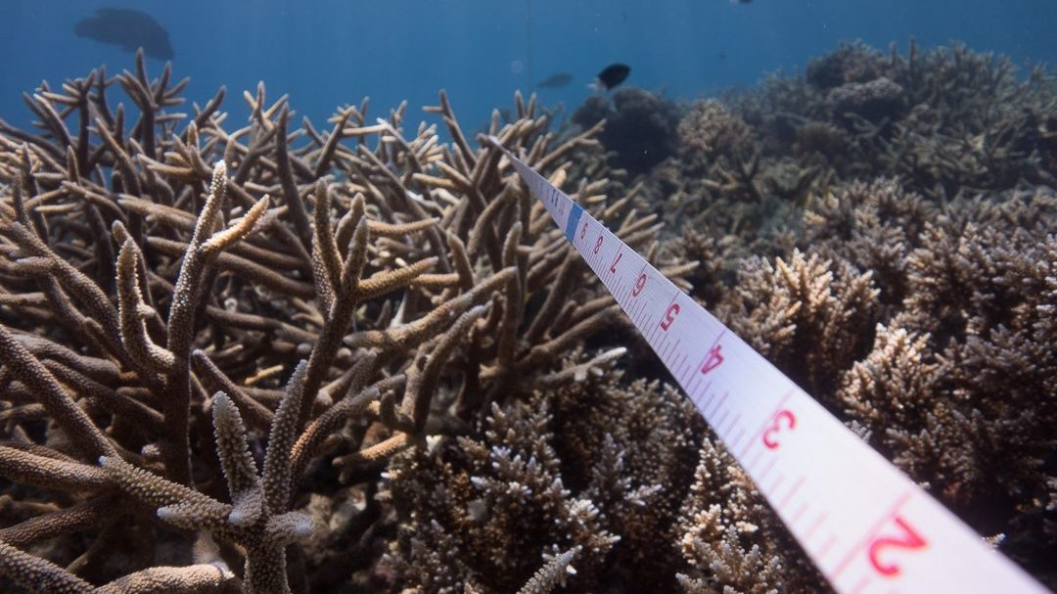
Learning Intention:
Discuss how scientists use the evidence from the monitoring and assessment of an ecosystem to inform scientific knowledge about ecosystem resilience and population recovery.
Success Criteria:
Complete Marine Education worksheet
’27. Reef rescue’
Notes:
Image: https://reefecologic.org/coral-shows-strong-recovery-across-the-great-barrier-reef/

Slide 2
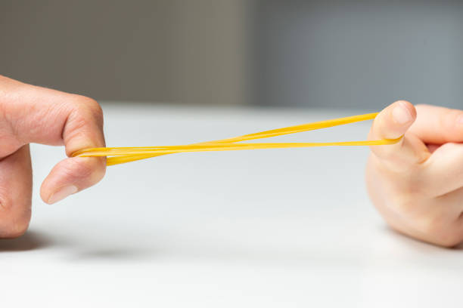
Resilience
“the capacity of a reef to recover in the future given its probable exposure regime”

Slide 3

Resilience = resistance + recovery
E.g. resistance is how far it falls after a disturbance (bomb) event, and recovery is how high it climbs back up to.
Community state of health
Resilience threshold (phase shift)
Notes:
Adapted from: GBRMPAs Chief Officer, Roger Beeden’s ppt slide, at the Reef Resilience Symposium 2024 in Cairns.

Slide 4
We need reefs to stay above the resilience threshold to avoid a phase shift
Community state of health
Resilience threshold (phase shift)
Phase Shift to an algae-dominated reef
Notes:
Adapted from: GBRMPAs Chief Officer, Roger Beeden’s ppt slide, at the Reef Resilience Symposium 2024 in Cairns.

Slide 5
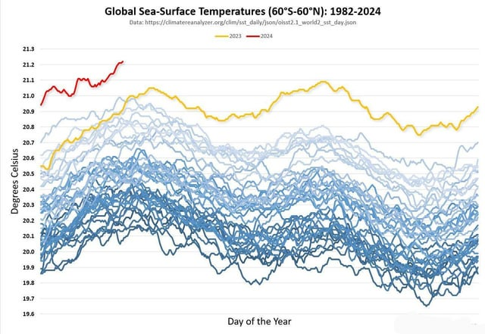
Marine heat waves are more frequent and severe now.
Will corals
resist?
Notes:
Image; https://www.reddit.com/r/dataisbeautiful/comments/1bddj0o/oc_global_sea_surface_temperatures_19842024/

Slide 6
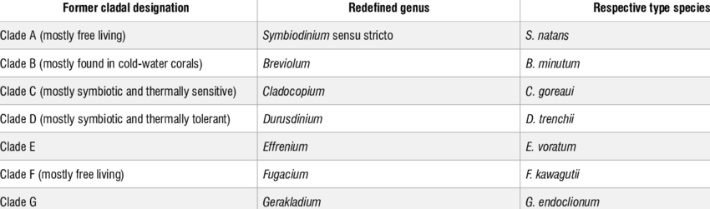
Corals with Clade D zooxanthellae are more thermal tolerant
Source: Curran, Anuschka & Bernard (2021).
Notes:
Image: Curran, Anuschka & Barnard, Sandra. (2021). What is the role of zooxanthellae during coral bleaching? Review of zooxanthellae and their response to environmental stress. South African Journal of Science. 117. 10.17159/sajs.2021/8369.

Slide 7
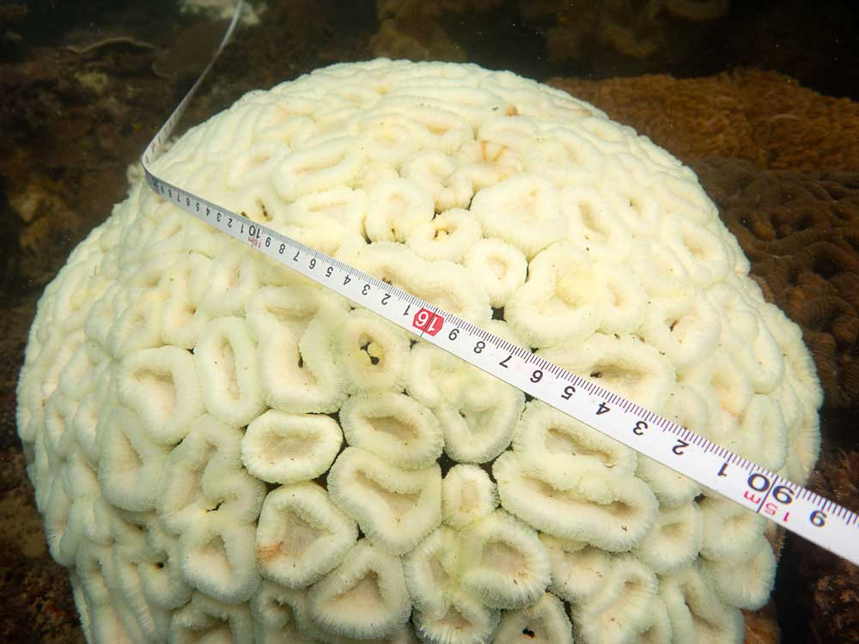
But,
conditions are becoming even too hot for them, and so,
corals are still bleaching.
Magnetic Island, 2020
Notes:
Image: https://reefecologic.org/coral-shows-strong-recovery-across-the-great-barrier-reef/
Figure 1: Bleached Lobophyllia sp coral demonstrating very little retention of symbiotic algae. Image taken Florence Bay. Magnetic Island 1st May 2020

Slide 8
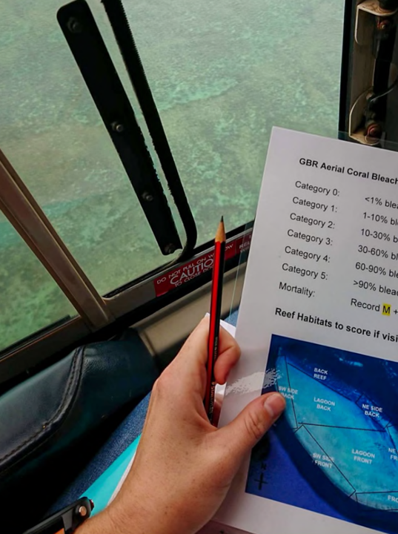
Aerial surveys are conducted by AIMS when a bleaching event occurs
(to assess the damage)
Notes:
Image: https://www.aims.gov.au/sites/default/files/2022-06/AIMS_SOP11v3_Aerial-Surveys-Coral-Bleaching_202206.pdf
Caption: Figure 12. A laminated copy of the bleaching categories and a diagram of reef zones is kept in the seat pocket in front of the observer.

Slide 9
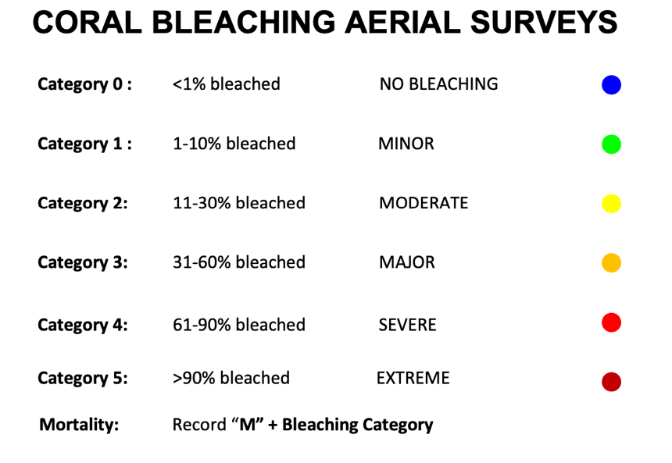
Coral bleaching categories
Notes:
Image: https://www.aims.gov.au/sites/default/files/2022-06/AIMS_SOP11v3_Aerial-Surveys-Coral-Bleaching_202206.pdf

Slide 10
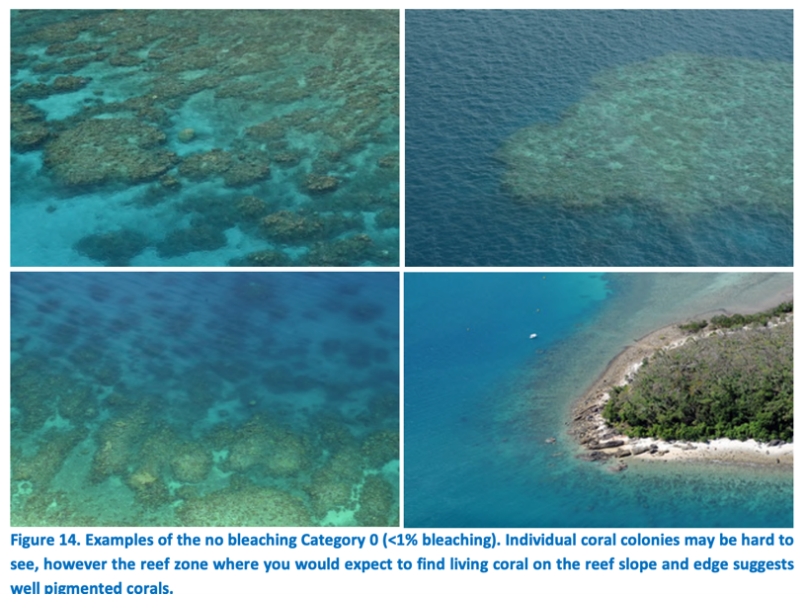
Category 0
<1% bleaching
Notes:
Image: https://www.aims.gov.au/sites/default/files/2022-06/AIMS_SOP11v3_Aerial-Surveys-Coral-Bleaching_202206.pdf

Slide 11
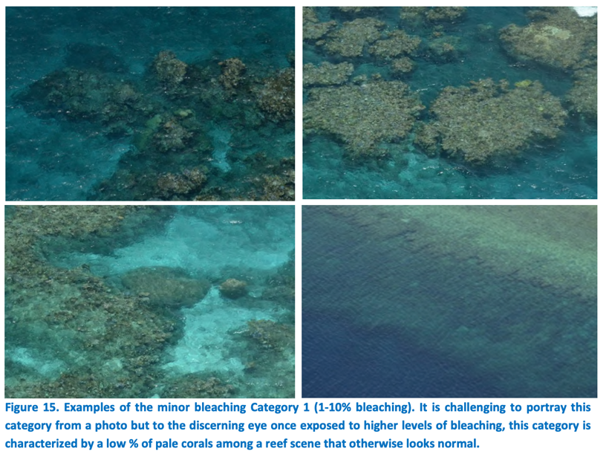
Category 1
1-10% bleaching
Notes:
Image: https://www.aims.gov.au/sites/default/files/2022-06/AIMS_SOP11v3_Aerial-Surveys-Coral-Bleaching_202206.pdf

Slide 12
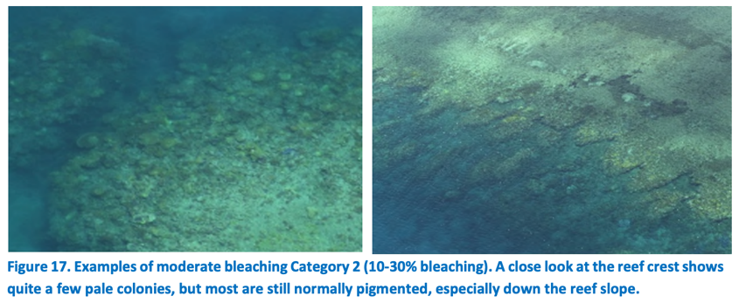
Category 2
10-30% bleaching
Notes:
Image: https://www.aims.gov.au/sites/default/files/2022-06/AIMS_SOP11v3_Aerial-Surveys-Coral-Bleaching_202206.pdf

Slide 13
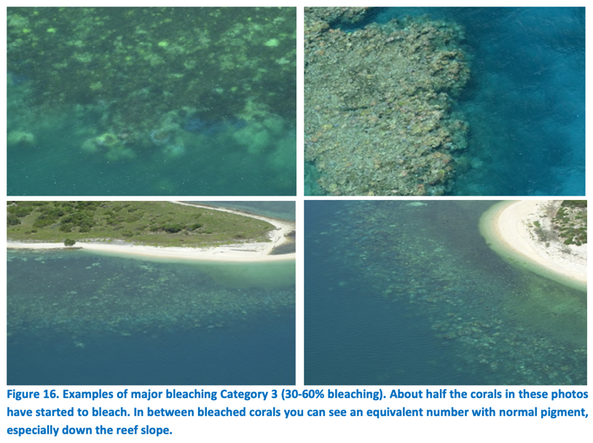
Category 3
30-60% bleaching
Notes:
Image: https://www.aims.gov.au/sites/default/files/2022-06/AIMS_SOP11v3_Aerial-Surveys-Coral-Bleaching_202206.pdf

Slide 14
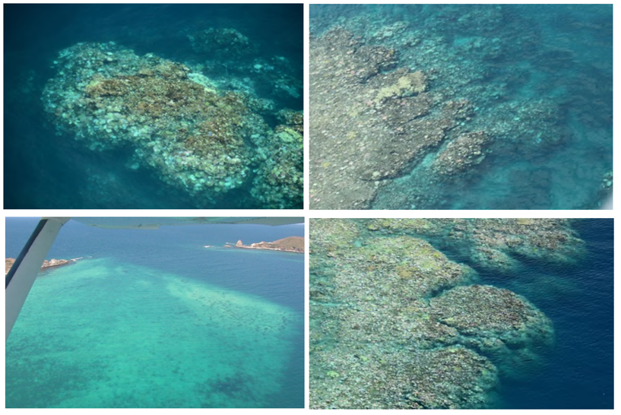

Category 4
60-90% bleaching
Notes:
Image: https://www.aims.gov.au/sites/default/files/2022-06/AIMS_SOP11v3_Aerial-Surveys-Coral-Bleaching_202206.pdf

Slide 15
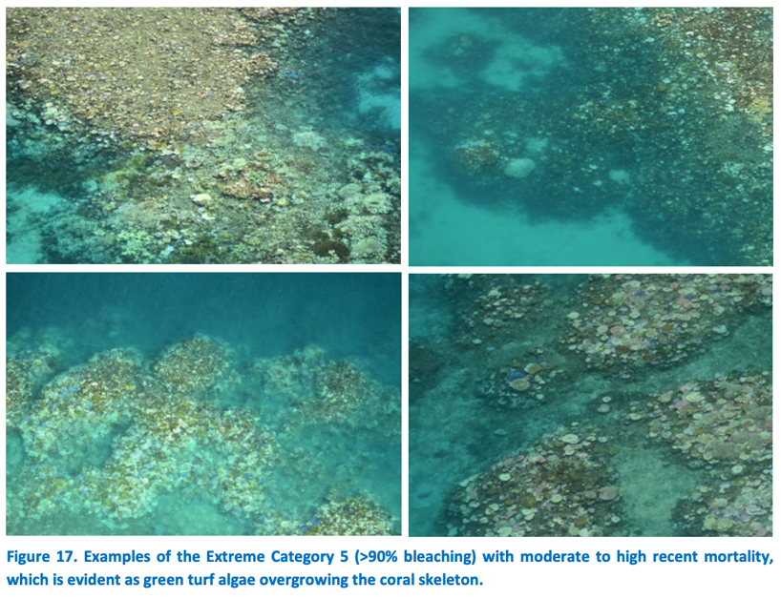
Category 5
>90% bleaching
Notes:
Image: https://www.aims.gov.au/sites/default/files/2022-06/AIMS_SOP11v3_Aerial-Surveys-Coral-Bleaching_202206.pdf

Slide 16
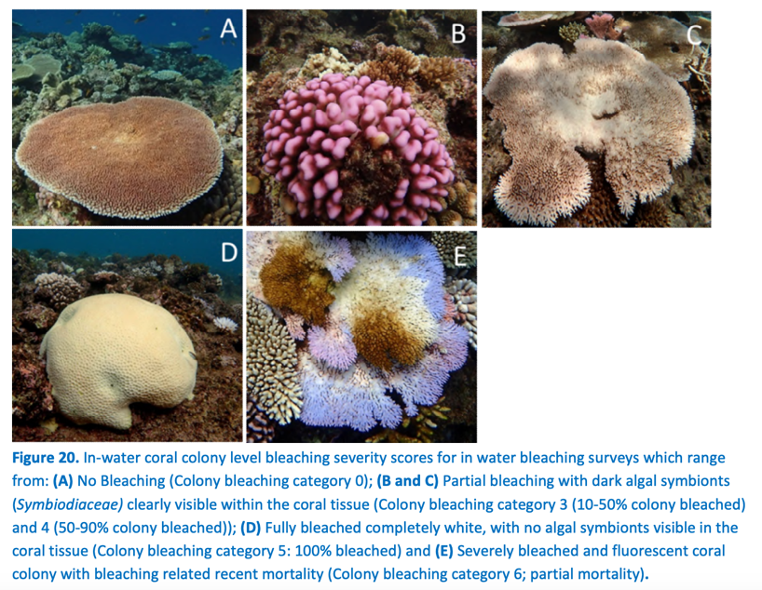
AIMS in-water surveys confirm aerial survey data
Notes:
Image: https://www.aims.gov.au/sites/default/files/2022-06/AIMS_SOP11v3_Aerial-Surveys-Coral-Bleaching_202206.pdf

Slide 17
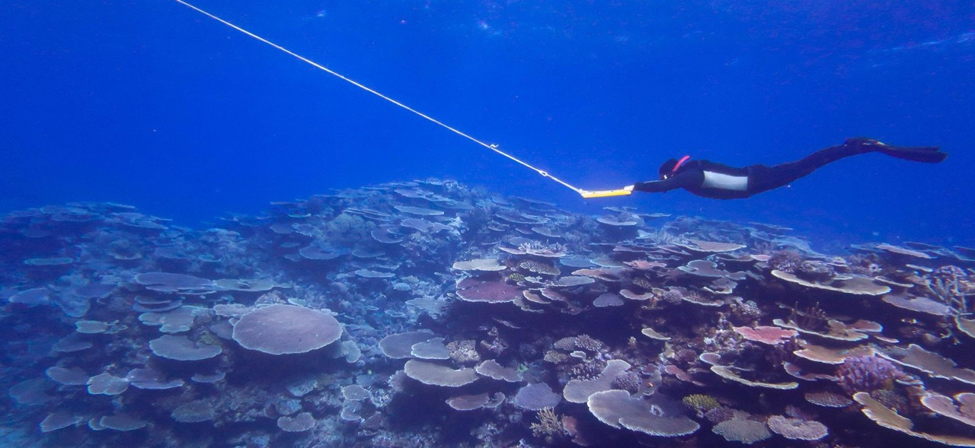
Rapid in-water surveys
AIMS Long Term Monitoring Program
Notes:
Image: https://www.aims.gov.au/research-topics/monitoring-and-discovery/monitoring-great-barrier-reef/long-term-monitoring-program

Slide 18
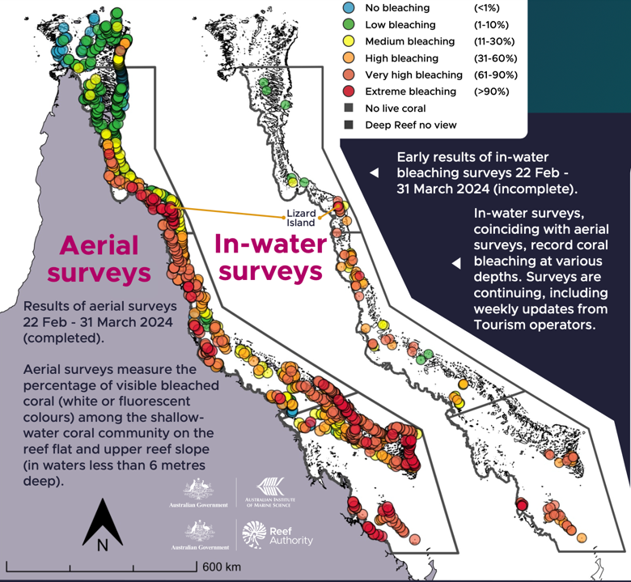

Aerial and in water surveys
of summer of 2023-24
show extensive bleaching
Source: GBMPAs Reef Snapshot Summer 2023-24
Notes:
Image: https://www2.gbrmpa.gov.au/our-work/reef-snapshot

Slide 19
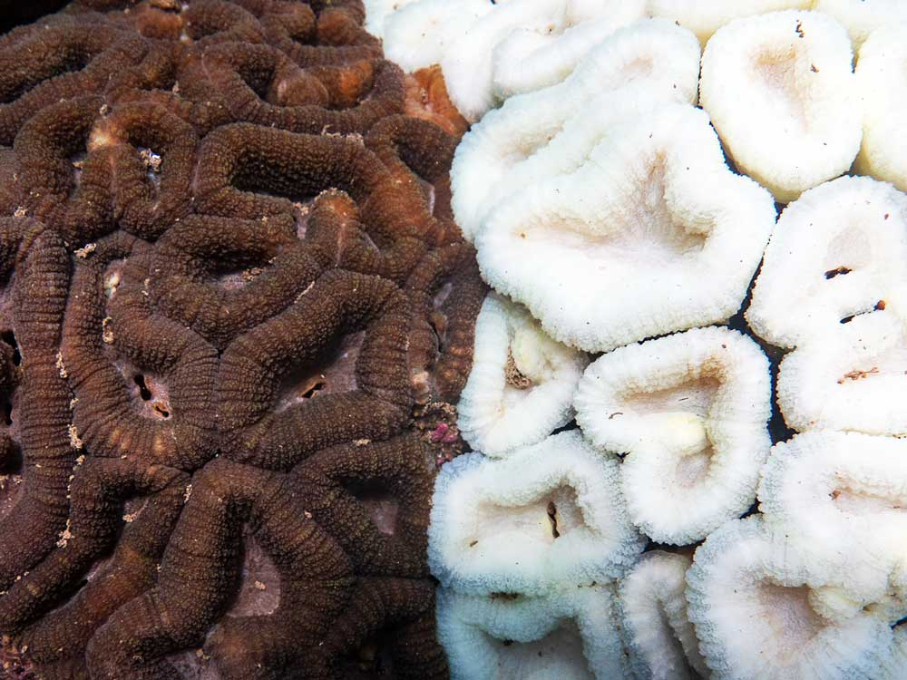
Two Lobophyllia sp with different bleaching response. Magnetic Island, 2020
Will they recover?
Notes:
Image: Two Lobophyllia sp corals demonstrating different bleaching responses. Image taken Florence Bay. Magnetic Island 1st May 2020
https://reefecologic.org/coral-shows-strong-recovery-across-the-great-barrier-reef/

Slide 20
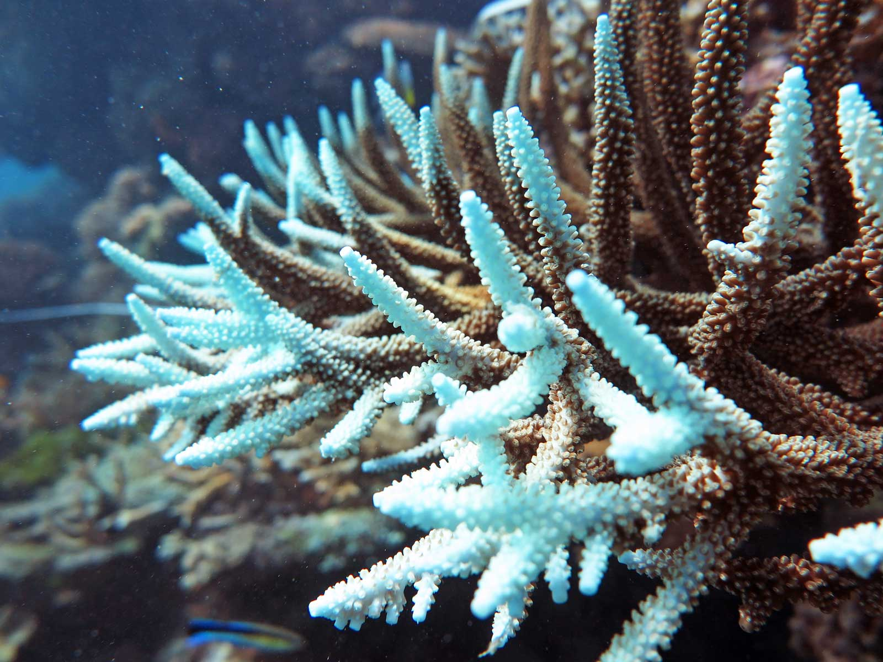
John Brewer Reef, offshore Townsville, 2020
Here you can see the return of zooxanthellae
(and it’s brown colour)
Notes:
Image: Acropora sp coral showing bleached branch tips but a healthy population of algae (as evident by the brown colour in the rest of the colony) indicates this coral should make a full recovery. Image taken at John Brewer Reef, offshore Townsville, 5 April 2020
Accessed: https://reefecologic.org/coral-shows-strong-recovery-across-the-great-barrier-reef/

Slide 21
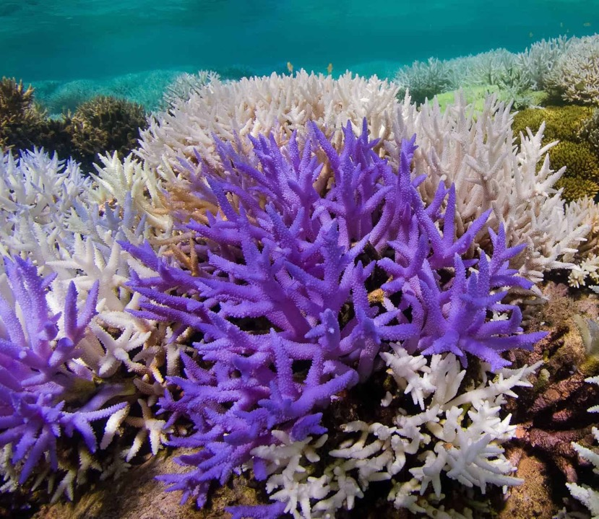
Corals that glow is a colourful last stand to encourage zooxanthellae to return
When bleached, corals are literally starving.
If temperatures drop before they starve to death, they can make a recovery.
Notes:
Image: https://www.zmescience.com/science/coral-reef-glowing-05235/

Slide 22
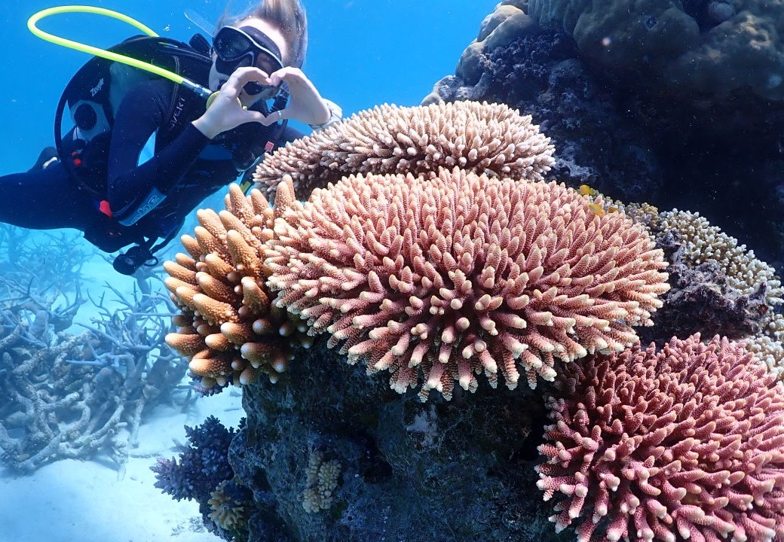
As the corals recover,
so does the reef
as a whole.
Notes:
Image: https://www.barrierreef.org/news/blog/world-first-tourism-and-research-partnership-fast-tracking-reef-recovery

Slide 23
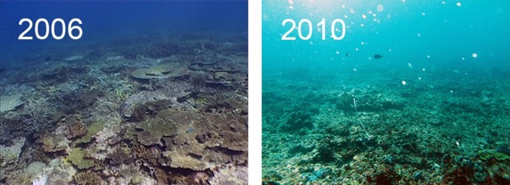
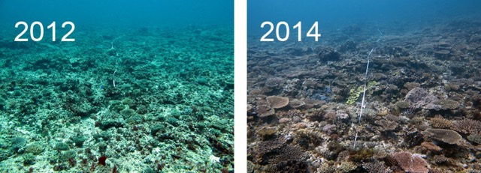
As a general rule,
reefs need at least 9-12 years without a disturbance to make a full recovery
Storms 2008 & 2009
North Reef, Capricorn Bunker Group
Notes:
Image: Time series of coral reef disturbance and recovery at North Reef in Capricorn-Bunkers on the Great Barrier Reef. The first survey on North Reef was in 2006. In 2008 and 2009 storms caused coral cover to decline to very low levels. Coral recovery was rapid. These photos show the start of a single 50 meter transect on the reef where coral cover had exceeded predisturbance levels in 2014. Source: https://eatlas.org.au/media/1046

Slide 24
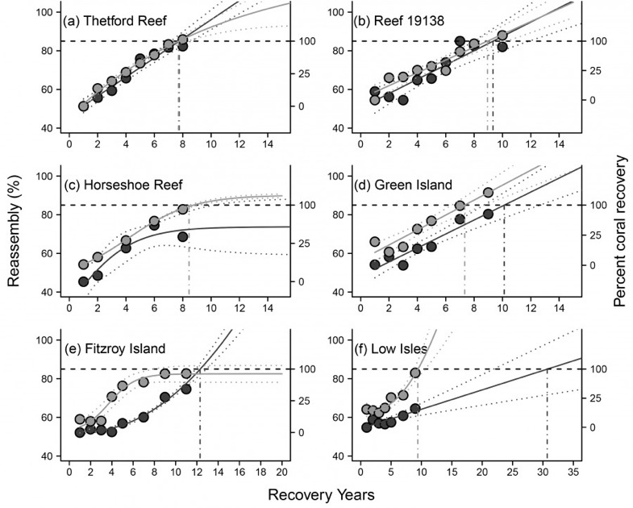
Quite often, reefs don’t have 9-12 years between disturbances.
So, different reefs are at different stages of recovery.
Notes:
Image: Time frames for reassembly (left y-axis; black points), and coral recovery (right y-axis; grey points) for six reefs on the Great Barrier Reef that suffered massive coral loss following disturbance. Time frames were estimated using models fitted to data collected as part of the AIMS Long-term Monitoring Program (LTMP). http://link.springer.com/article/10.1007/s00338-014-1148-z

Slide 25

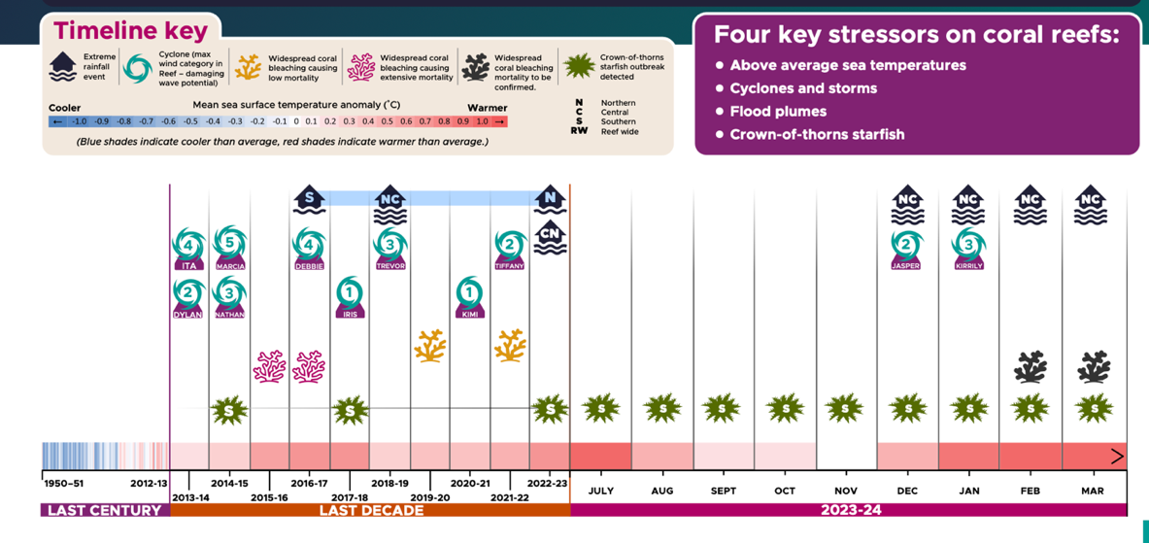
Since 2010, disturbances have been more frequent
Source: GBMPAs Reef Snapshot Summer 2023-24
Notes:
Image: https://www2.gbrmpa.gov.au/our-work/reef-snapshot

Slide 26
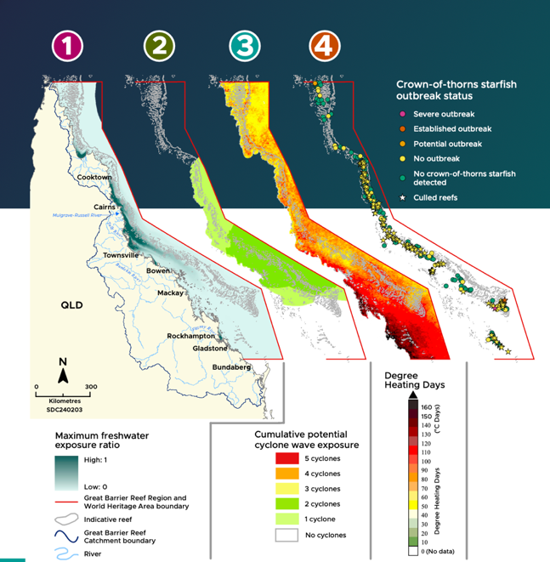
floods
cyclones
Heat waves COTs
Floods, cyclones, heat waves and COTs have impacted the entire Great Barrier Reef.
Distribution and severity of threats
Notes:
Image: https://www2.gbrmpa.gov.au/our-work/reef-snapshot

Slide 27
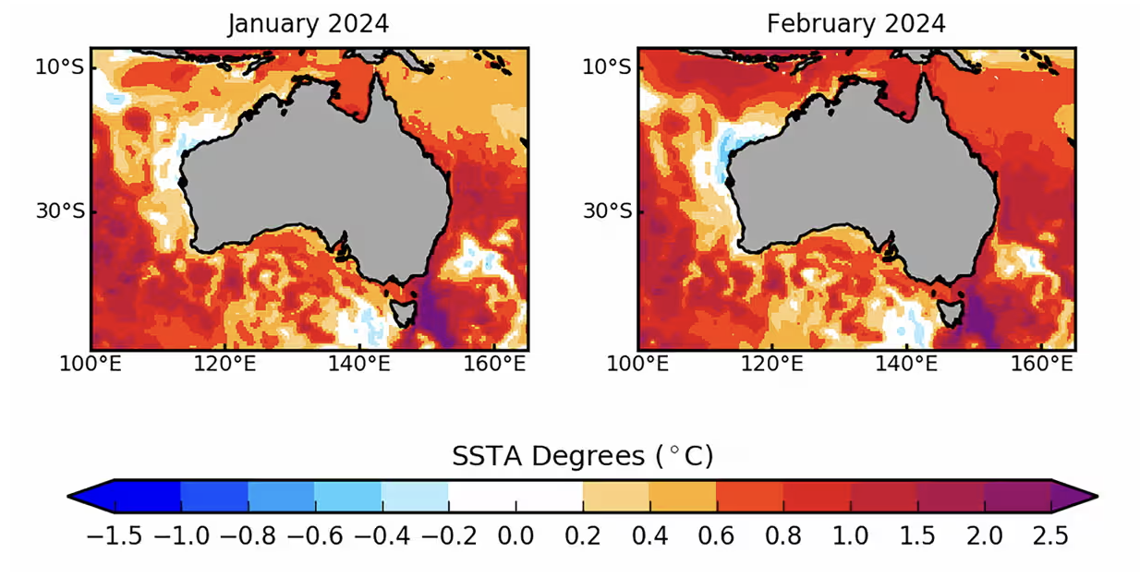
As well as the entire country
Notes:
Image: https://www.theguardian.com/australia-news/2023/aug/27/south-east-australia-marine-heatwave-forecast-to-be-literally-off-the-scale

Slide 28
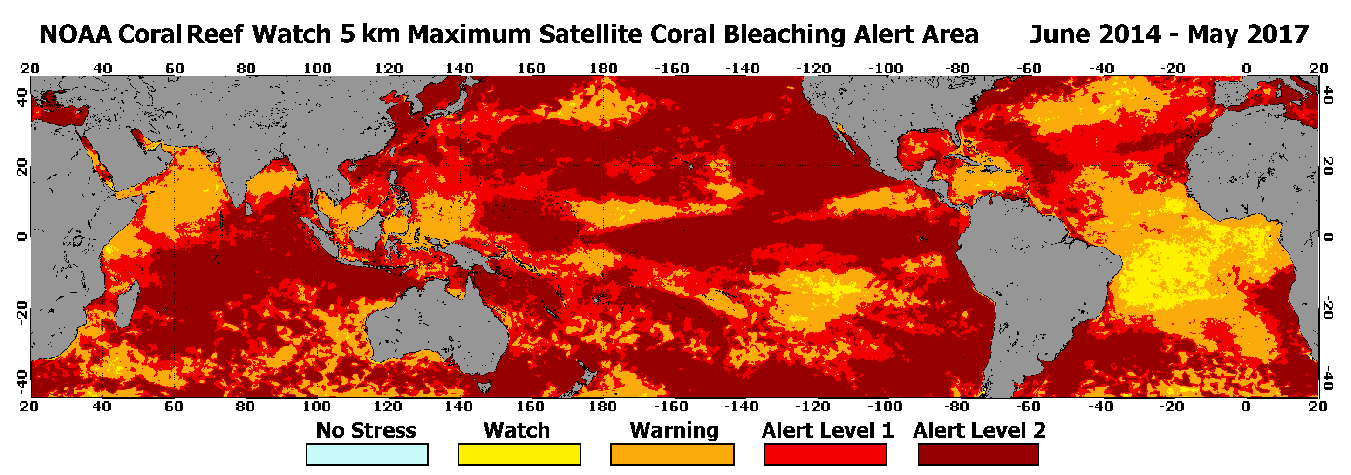
As well as the entire world.

Slide 29
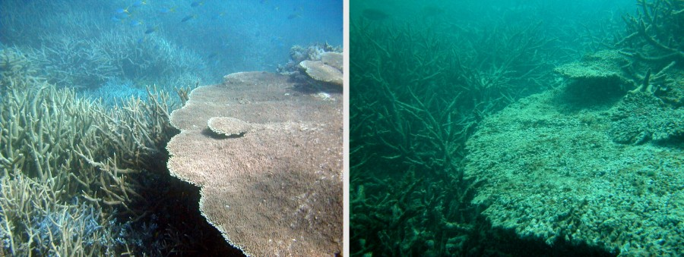
After a disturbance event, turf algae and macroalgae are quick to grow.
Notes:
Image: Crown-of-thorns outbreaks have a devastating effect on coral cover. Here is a picture of a reef before a COTS outbreak (left) and after (right). Once the coral has been eaten it rapidly becomes covered in algae and starts to break down.
Source: https://eatlas.org.au/media/1004

Slide 30
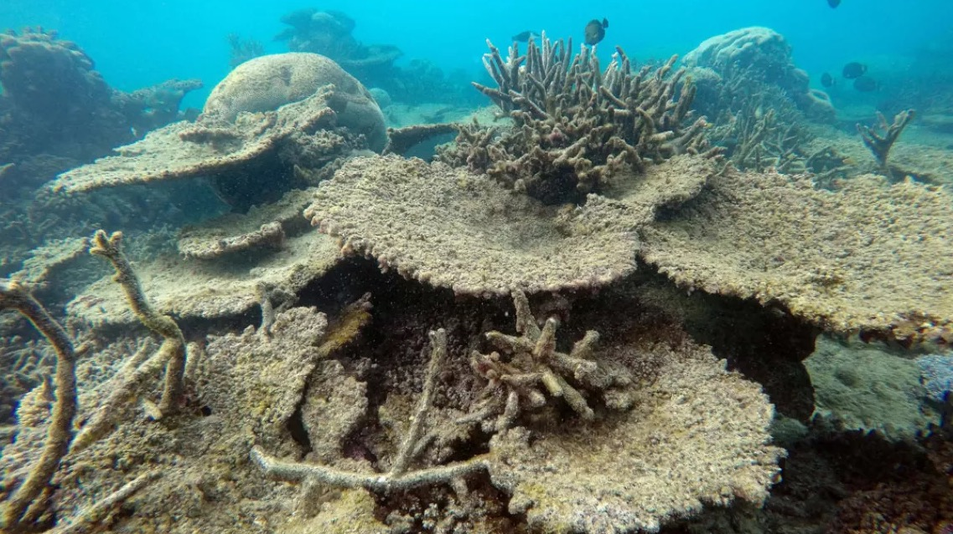
Dead coral covered in algae
Notes:
Image: https://www.sierraclub.org/sierra/2016-6-november-december/green-life/largest-die-corals-ever-just-happened-great-barrier-reef
Dead table corals killed by bleaching | Photo by Greg Torda, ARC Centre of Excellence for Coral Reef Studies

Slide 31
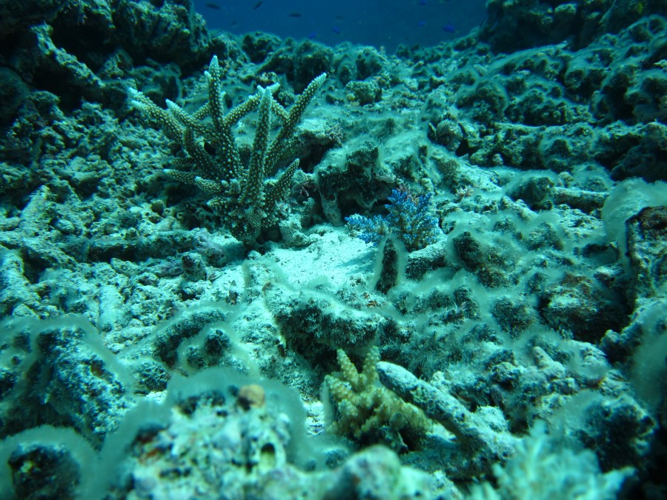
Macroalgae and turf algae compete with corals for space.
Notes:
Image: This image shows recovery of reef building corals is occurring, after Tropical Cyclone Hamish removed most of the live coral in this area of Reef 21-529. The Long-term Monitoring Program is able to track coral recovery through juvenile coral surveys and through fixed transects that allow the team to track changes in coral cover.
Source: https://eatlas.org.au/media/563

Slide 32
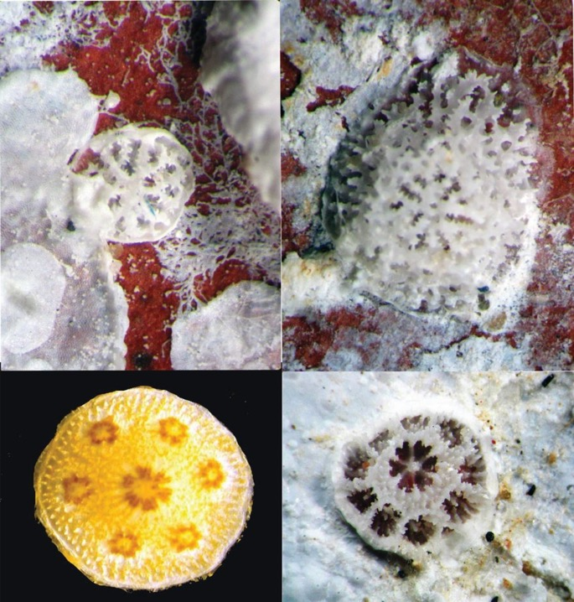
Macroalgae and turf algae stop baby corals from settling
Notes:
Image: https://reefbuilders.com/2019/04/08/gbr-coral-larval-decline/

Slide 33
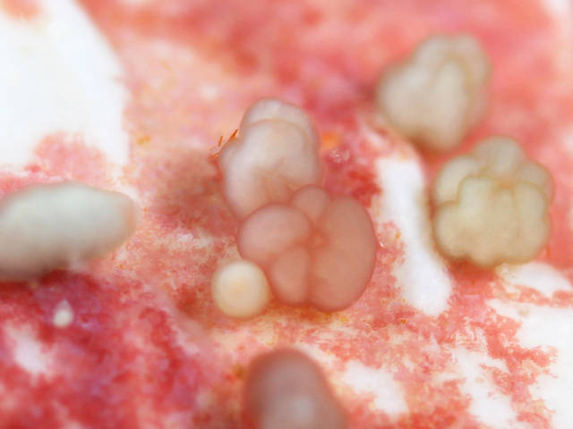
Baby corals need to settle, for the reef to recover
Notes:
Image: https://www.secore.org/site/corals/detail/larval-settlement.18.html
Jamie Craggs. SECORE.

Slide 34
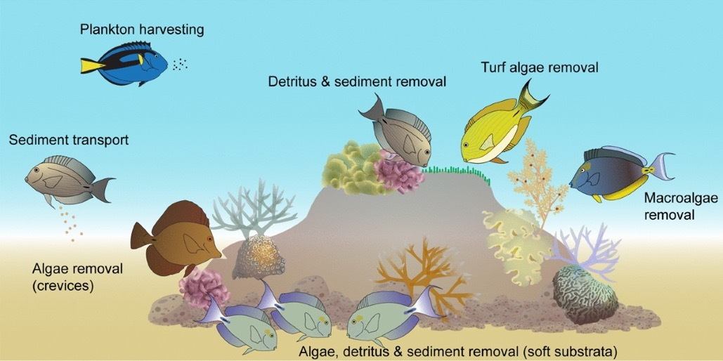
Herbivores such as surgeonfish eat macroalgae and turf algae.
S. B. Tebbett (&) A. C. Siqueira D. R. Bellwood (2022). Research Hub for Coral Reef Ecosystem Functions, College of Science and Engineering and ARC Centre of Excellence for Coral Reef Studies, James Cook University, Townsville, Australia.
Notes:
Image: https://link.springer.com/article/10.1007/s11160-021-09692-6

Slide 35
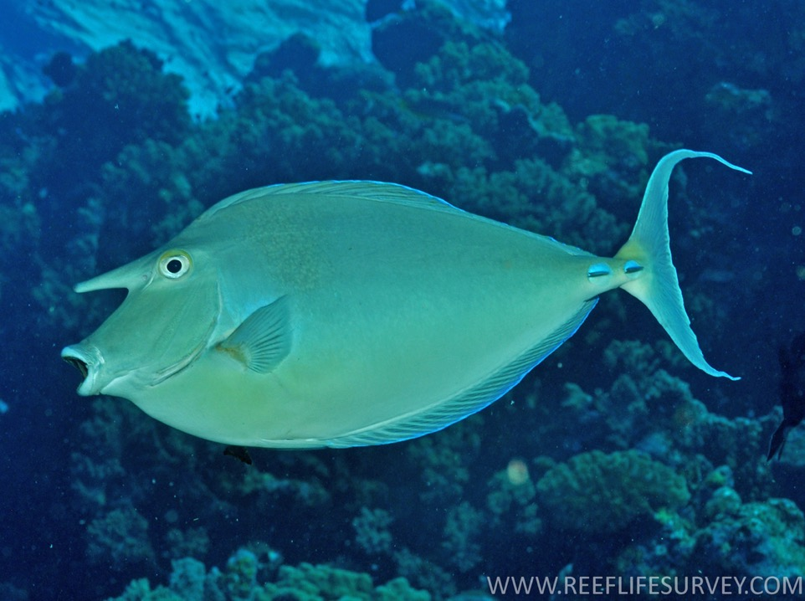
The bluespine unicornfish (Naso unicornis) also loves to eat macroalgae
Notes:
Info: S. B. Tebbett (&) A. C. Siqueira D. R. Bellwood (2022). Research Hub for Coral Reef Ecosystem Functions, College of Science and Engineering and ARC Centre of Excellence for Coral Reef Studies, James Cook University, Townsville, Australia
Image: https://fishesofaustralia.net.au/home/species/2201

Slide 36
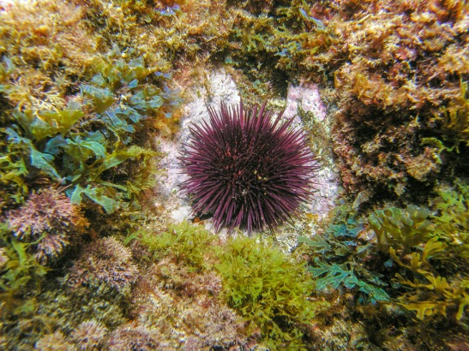
Sea urchins remove lots of macroalgae too
Notes:
Info: Mumby, P., Hastings, A. & Edwards, H. Thresholds and the resilience of Caribbean coral reefs. Nature 450, 98–101 (2007). https://doi.org/10.1038/nature06252
Image: https://fredsingerecology.com/tag/grazing/

Slide 37
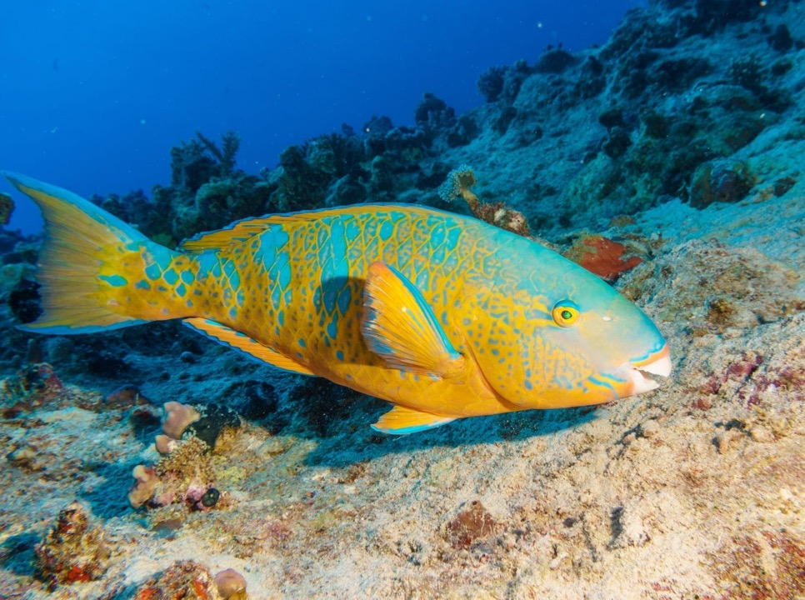
As well as parrotfish
An unexploited community of parrotfishes can maintain approximately 40% of the reef in a permanently grazed state but overfishing reduces this capacity to about 5%
(Mumby et al., 2007)
Notes:
Info: Mumby, P., Hastings, A. & Edwards, H. Thresholds and the resilience of Caribbean coral reefs. Nature 450, 98–101 (2007). https://doi.org/10.1038/nature06252
Image: https://ladymusgraveexperience.com.au/a-colorful-parrot-fish-feeds-on-a-tropical-coral-reef-indian-ocean/

Slide 38
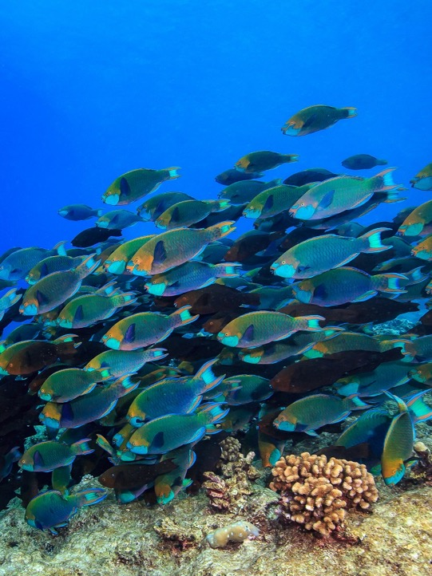
More grazing means faster recovery, freeing up space for baby corals to settle.
Notes:
Image: https://fesummaries.wordpress.com/2019/09/26/fishing-and-habitat-quality-control-grazing-functions-across-72-coral-reefs/
School of Singapore parrotfish (Scarus prasiognathos) grazing.

Slide 39

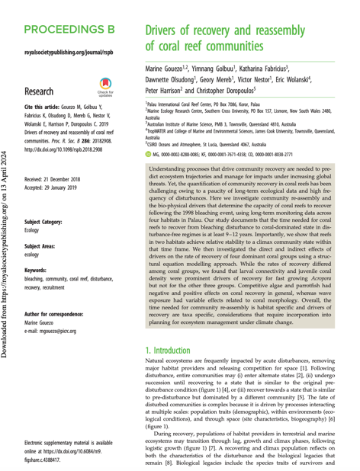
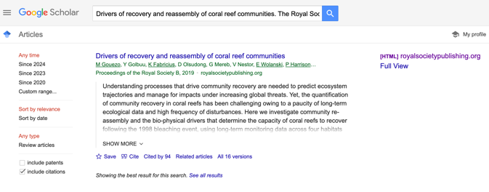
Notes:
Paper: Marine Gouezo et al., (2019). Drivers of recovery and reassembly of coral reef communities. The Royal Society. https://royalsocietypublishing.org/doi/full/10.1098/rspb.2018.2908

Slide 40
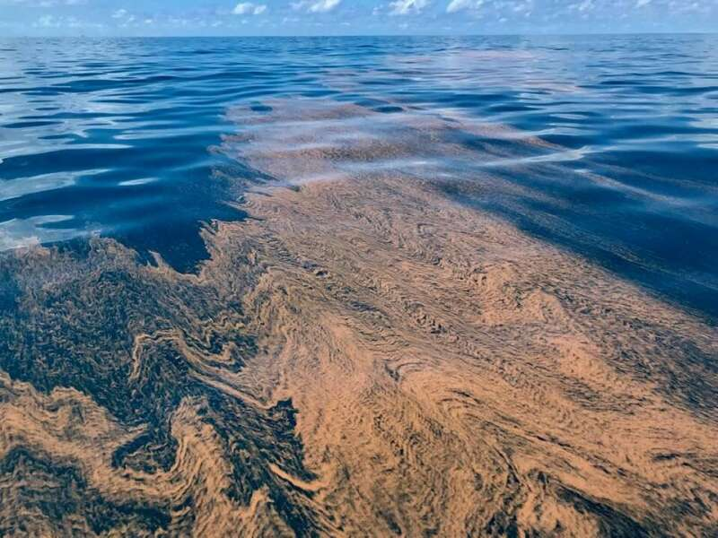
For reefs to recover, they also need the coral babies to arrive in the first place!
Notes:
Image: https://www.royalgazette.com/environment/news/article/20190829/acres-of-coral-spawn-shocks-veteran-conservationist/

Slide 41
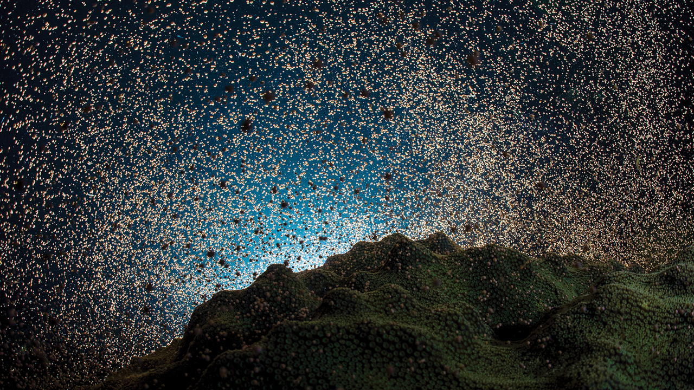
Mass spawning event
Notes:
Image: https://www.the-scientist.com/restored-corals-spawn-hope-for-reefs-worldwide-68368

Slide 42
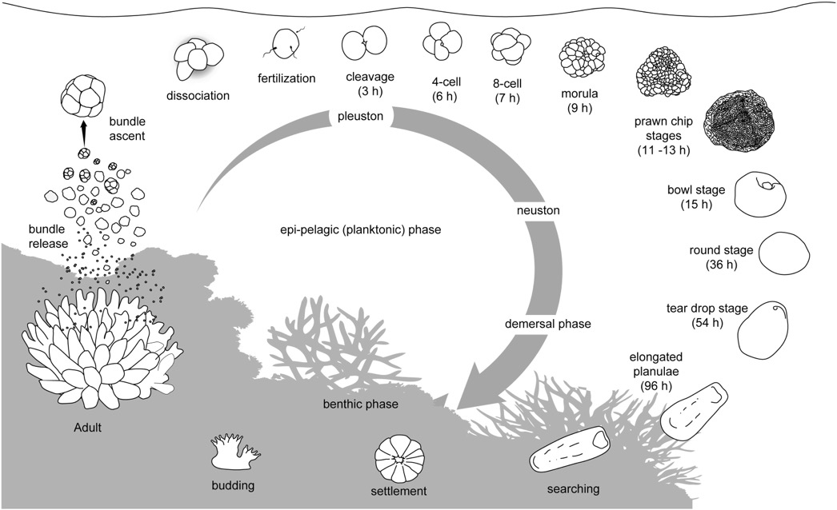
Source: Jones et al., 2015
Life cycle of a (broadcasting) coral
Notes:
Image: R. Jones, G.F. Ricardo, A.P. Negri (2015). Effects of sediments on the reproductive cycle of corals. Marine Pollution Bulletin, Volume 100, Issue 1,
Pages 13-33, ISSN 0025-326X, from: https://www.sciencedirect.com/science/article/pii/S0025326X15005251

Slide 43
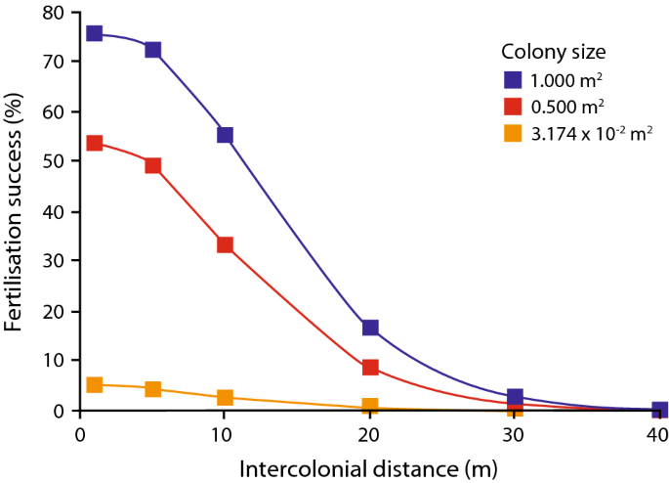
When a reef is badly damaged,
coral colonies may be spaced too far apart for fertilization to be successful
Fertilisation rarely occurred between coral colonies more than 30–40 m apart.
Even small coral colonies >8m apart had low fertilisation success rates.
Notes:
Info: https://www.abc.net.au/news/2017-11-26/scientists-discover-game-changer-for-great-barrier-reef/9190200
Image and quote: Teo, A., Todd, P.A. Simulating the effects of colony density and intercolonial distance on fertilisation success in broadcast spawning scleractinian corals. Coral Reefs 37, 891–900 (2018). https://doi.org/10.1007/s00338-018-1715-9

Slide 44
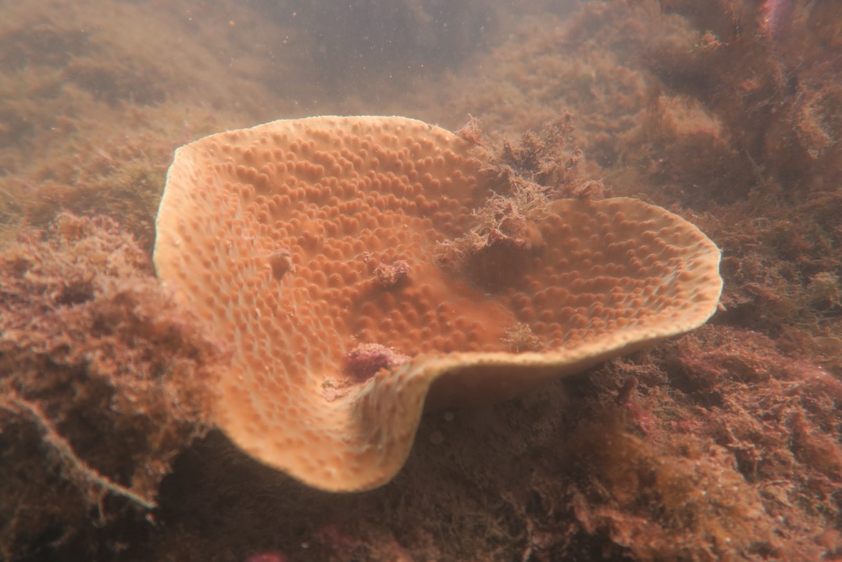
Cooo-eee?!
Notes:
Image: https://one15marina.com/news-post/eco-updates/coral-garden-updates/

Slide 45
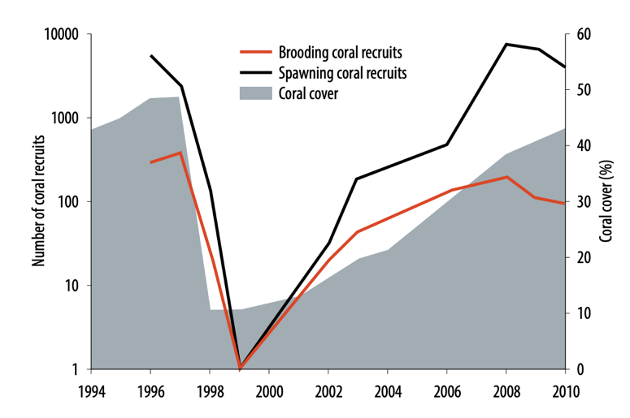
When a reef is badly damaged,
its production of coral babies declines
Mass bleaching event
Dead (or near-dead) corals don’t make babies!
Notes:
Image; https://www.aims.gov.au/sites/default/files/Discovering%20Scott%20Reef%20-%20Coral%20Ecology.pdf

Slide 46
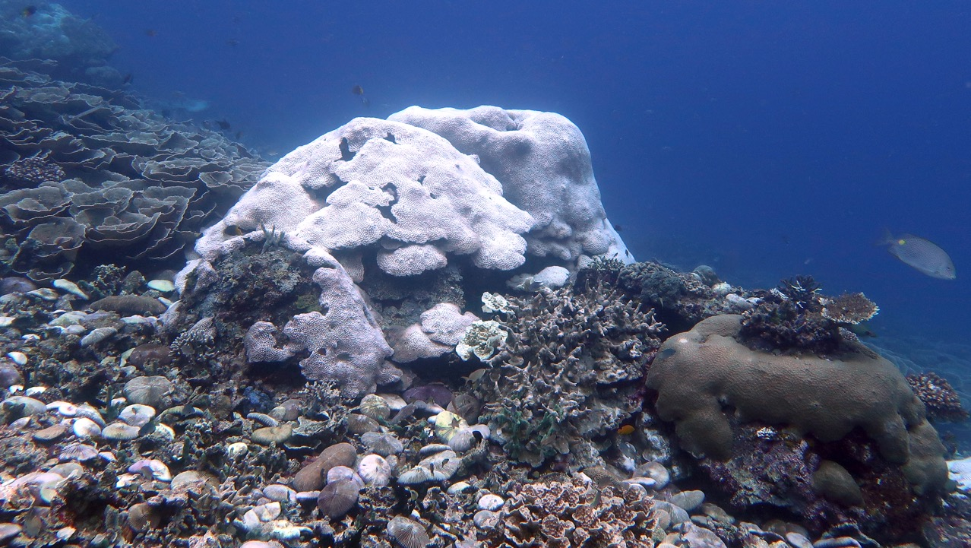
I just don’t have the energy ☹
Notes:
Image:

Slide 47
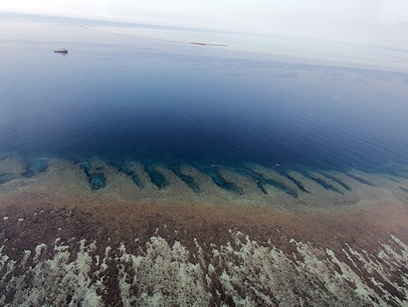
When a reef is badly damaged,
it needs larvae to arrive from elsewhere
???
Notes:
Image; https://www.csiro.au/en/research/natural-environment/oceans/Coral-spawn-harvesting

Slide 48
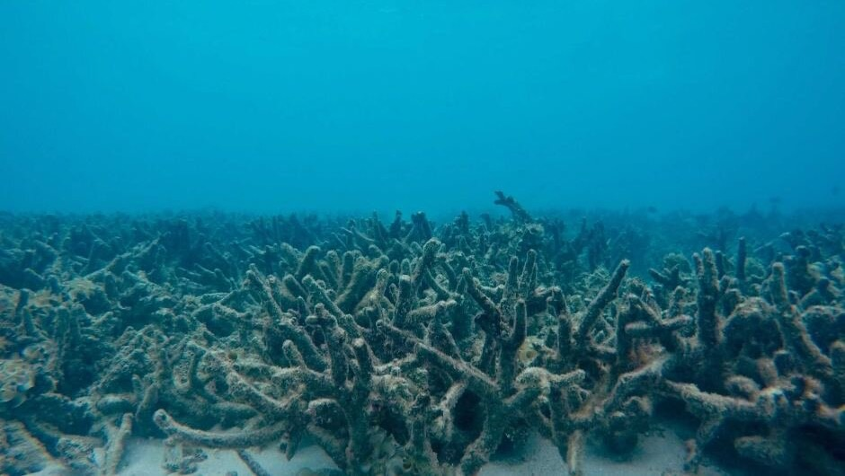
Somebody help!
Notes:
Image: https://www.themarinediaries.com/tmd-blog/be-part-of-the-solution-wfcrc-and-its-action-plan-for-the-ocean

Slide 49
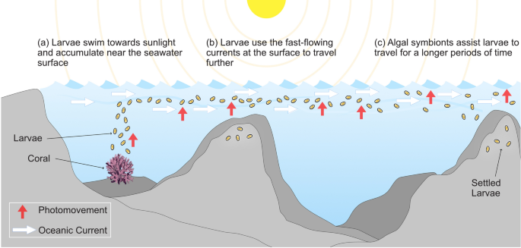
The source of larvae may come from a nearby reef
Source: Mulla et al., 2021
Notes:
Image: Mulla, A.J., Lin, CH., Takahashi, S. et al. Photo-movement of coral larvae influences vertical positioning in the ocean. Coral Reefs 40, 1297–1306 (2021). https://doi.org/10.1007/s00338-021-02141-7

Slide 50
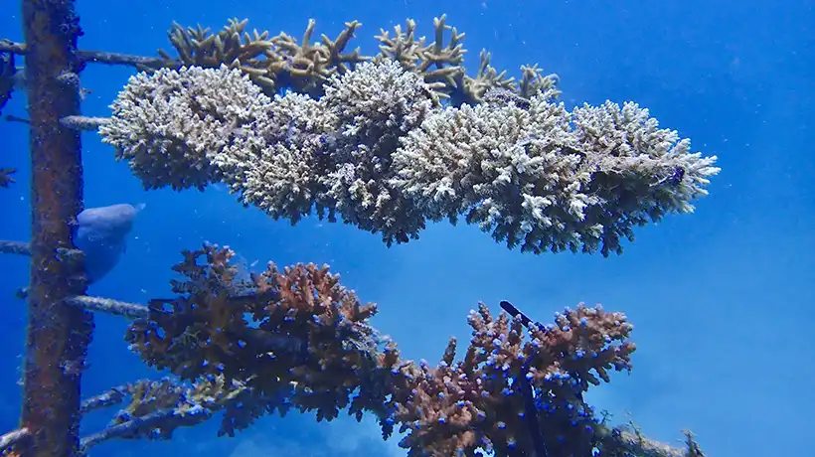
The source of larvae may come from a nearby nursery
The reef restoration foundation has coral trees in 3 Qld reef locations. Importantly, the trees can be moved to deeper cooler water during heat waves.
Notes:
Image: https://rrf.org.au/programs/

Slide 51

The source of larvae may come from a nearby nursery
POCILLOPORA FRAGMENTS HANGING IN A ROPE NURSERY in the Maldives WITH RESIDENT BATFISH (PLATAX TEIRA). IMAGE CREDIT: MAREN TOOR
Notes:
Image: https://earthzine.org/successes-and-setbacks-of-the-first-large-scale-coral-nurseries-in-the-maldives/

Slide 52

Corals for Conservation (based in Fiji) create reef nurseries that contain thermal tolerant corals that seed the recovery of adjacent reefs down-current.
The source of larvae may come from a nearby nursery
Notes:
Image: corals4conservation.org

Slide 53

Concentrating coral larvae in a culture net for release onto sections of damaged reef. Photo: SCU
OR
the source of larvae may come from a boat!
Notes:
Image: https://rrf.org.au/programs/
Concentrating coral larvae in a culture net for release onto sections of damaged reef. Photo: SCU

Slide 54



1.
Collect from the ocean
2.
Grow for 5 days (& drive to desired location)
3.
Deploy onto damaged reef to aid its recovery
Notes:
Images (left and top right): https://blog.csiro.au/coral-harvesting-helps-restore-great-barrier-reef/
Image (bottom right): https://www.abc.net.au/news/2021-12-03/coral-babies-deployed-onto-the-great-barrier-reef/100667280

Slide 55

6 week old coral juvenile after larval seeding onto the reef. Photo: Peter Harrison.
Notes:
Image: Six-week old coral juvenile after larval seeding onto reef Photo: Peter Harrison from: https://gbrrestoration.org/program/moving-corals/

Slide 56

AI-ENABLED ROBOTS, DUBBED LARVALBOTS AND FLOATYBOATS WERE USED TO COLLECT CORAL SPAWN AND DEPLOY LARVAE. CREDIT: SCU
Coral IVF?

Slide 57



Peter Harrison
Christopher Doropoulos
Notes:
Image: https://www.newscientist.com/article/mg24933160-700-inside-the-fight-to-save-the-great-barrier-reef-from-climate-change/

Slide 58

OR
the source of larvae may come from an aquarium
SCIENTISTS COLLECT EGG BUNDLES DURING THE ANNUAL CORAL SPAWNING EVENT. IMAGE: CHRIS BRUNNER
Notes:
Image: https://www.aims.gov.au/research-topics/featured-projects/reef-spawning-research-aims

Slide 59





1.
Collect in aquaria (e.g. AIMS Seasim)
3.
Grow in aquaria (e.g. in ’the auto-spawner’)
2.
Encourage settlement onto ceramic tiles (Acropora prefer to settle on pink concrete)
4.
Plant on the reef
Notes:
Image (bottom left): https://www.aims.gov.au/information-centre/news-and-stories/scientists-delivering-100k-baby-corals-major-step-towards-helping-reef
Image (top left, top right and bottom right): https://www.aims.gov.au/information-centre/news-and-stories/scientists-delivering-100k-baby-corals-major-step-towards-helping-reef

Slide 60

Survival rates are often density dependent.
Many deployed larvae usually die due to competition (and predation).
Notes:
Image: https://www.secore.org/site/corals/detail/coral-reproduction.15.html

Slide 61

Some
‘brother and sister corals’ fuse with their neighbour to make one big colony
called chimerism - the fusion of genetically different individuals of the same species.
Photo of two coral recruits fusing into one chimera
Notes:
Image:https://www.secore.org/site/newsroom/article/234.html

Slide 62


The reef restoration foundation exploits this adaptation to make its coral tree nurseries
https://www.youtube.com/watch?v=LL5jBIsvZIQ

Slide 63


AIMS Long-term monitoring program monitors the reefs
(which gives us a map of how all reefs are going, including sites close to nurseries)
Aerial surveys are used to assess bleaching events

Slide 64

Corals are slow growing.
Thus, communities in recovery are dominated by lots of small colonies.
They haven’t had time to grow big yet.
The more time they have, the more structurally complex the reef becomes (making more habitat).

Slide 65
How do we do avoid a phase shift?
Community state of health
Resilience threshold (phase shift)
Smaller and fewer disturbances!
Notes:
Adapted from: GBRMPAs Chief Officer, Roger Beeden’s ppt slide, at the Reef Resilience Symposium 2024 in Cairns.

Slide 66

Reduce Carbon Emissions!!

Slide 67



GBRMPAs plan
Protect the reef’s resilience
Enhance the reef authority’s capability
Co-manage sea country with traditional owners
Empower others to protect and manage
Do our (the Reef Authority’s) part to reduce emissions
Notes:
Images: https://www2.gbrmpa.gov.au/our-work/reef-management-strategies/reef-blueprint

Slide 68

The Australian Government’s plan to reduce emissions
(as of 2024)
Department of Climate Change, Energy the Environment and Water, 2024
Notes:
Images: https://www.dcceew.gov.au/climate-change/strategies#annual-climate-change-statement

Slide 69

Australia is the 3rd largest exporter of fossil fuels in the world
Notes:
Info: https://australiainstitute.org.au/initiative/coal-mine-tracker/
Image: Image (coal truck): https://michaelwest.com.au/all-fossils-go-tanya-plibersek-new-coal-mine-approval-due-friday/

Slide 70

Instead of closing coal mines, Australia is opening more.
Notes:
Info: https://australiainstitute.org.au/initiative/coal-mine-tracker/
Image (paper): https://www.nature.com/articles/s41893-020-0527-4

Slide 71

Notes:
Image: https://transparency.org.au/wp-content/uploads/2021/03/Australia_QLD_Feb-2021.pdf

Slide 72

Notes:
Image; https://theconversation.com/whats-the-economic-value-of-the-great-barrier-reef-its-priceless-80061

Slide 73

We will soon experience what Florida experienced
(an unprecedented heat wave).
What can we learn from them?
Notes:
Image; https://www.nytimes.com/2023/07/31/climate/coral-reefs-heat-florida-ocean-temperatures.html
Info: Andrew Baker, University of Miami. Pers. Comm. At Reef Resilience Symposium Cairns, April 2024. Andrew’s Abstract: Changing paradigms in the restoration of Florida’s reefs: novel interventions, transnational obstacles, and the urgent need to share genetic resources to maximize coral survival.

Slide 74

Evacuating a tree nursery in Florida
Plan for evacuations
Notes:
Image:

Slide 75

They rescued the coral genotypes by moving them to aquaria.
Now 75% of all Florida coral genotypes exist only in tanks
(the rest died in the wild).
Most not of reproductive size.
Notes:
Image; https://www.pinterest.com.au/pin/a-massive-florida-coral-reef-rescue-project-is-underway--116319602866394308/
Info: Andrew Baker, University of Miami. Pers. Comm. At Reef Resilience Symposium Cairns, April 2024. Andrew’s Abstract: Changing paradigms in the restoration of Florida’s reefs: novel interventions, transnational obstacles, and the urgent need to share genetic resources to maximize coral survival.

Slide 76

So, it’s not just about recovery anymore. Now it’s a rescue mission.
Hervey Bay bleaching
Image: Hervey Bay Coral Watch
Notes:
Image: https://www.echo.net.au/2024/03/climate-pollution-cooking-the-reef/
Hervey Bay area bleaching. Screenshot from video by Hervey Bay Coral Watch.

Slide 77

Australia’s coral biobank
(a growing bank of coral genotypes stored at Cairns Aquarium)
Notes:
Image: https://www.ecovoice.com.au/worlds-first-living-coral-biobank-opens-in-cairns/

Slide 78

Plan for relocations
(moving corals to cooler waters, sourced locally or from far away)
https://www.youtube.com/watch?v=KuOWxwnFZnk
Notes:
Image:

Slide 79

Conservation aquaculture
(now only gardening heat tolerant corals found not to bleach during mild bleaching events, and positioning them in ‘cooler’ spots on the reef)
Notes:
Image: https://www.globalseafood.org/advocate/a-wider-view-conservation-aquaculture-anchors-coral-reef-restoration/

Slide 80

Assisted adaptation (designing ’super corals’ with high thermal tolerance)
Notes:
Image: https://www.aims.gov.au/research-topics/environmental-issues/climate-change/assisted-evolution

Slide 81

Inducing out-of-season spawning in tanks
Notes:
Image: https://www.abc.net.au/news/2022-08-24/out-of-season-coral-spawning-hope-great-barrier-reef/101362444
Coral have reproduced in the middle of winter in a Townsville lab.(Supplied: Australian Institute of Marine Science)

Slide 82

Cryopreservation
(freezing them for later)
Notes:
Image: https://gbrrestoration.org/program/cryopreservation/

Slide 83

Using sound to attract fish to new patch
https://www.youtube.com/watch?v=RvYxEXLqAlE&t=46s

Slide 84

cloud seeding
https://www.youtube.com/watch?v=_LmV94WSkmc&t=86s

Slide 85

Mixing
Low cost pumps and tubes suck cool water up from 20m to reduce the temperature of surface waters during bleaching events, particularly on
no-wind days.
https://www.youtube.com/watch?v=0ldIzZzipBY
Notes:
Presentation at Reef Resilience Symposium, Cairns, April 2024.
Abstract: Could an inexpensive, low-tech, low-energy, small-scale intervention that reintroduces “normal” mixing of the water column improve outcomes for corals during acute mass bleaching events? Stanley D, Long S, Fisher E, Morris S, Pattiaratchi C.
Acute periods of low upper ocean turbulence create stressful conditions for corals by concentrating heat in the upper
water column, reducing the aggregate water flow available to corals, and increasing the transparency of the water
column due to reduced sediment resuspension. Temperature, irradiance and flow can thus be seen to be tied to a single
parameter: upper ocean turbulence. Analyses of millions of IMOS ocean glider temperature data points collected through
the water column of the Great Barrier Reef in bleaching and non-bleaching summers show that mass coral bleaching
events are coincident with acute oceanographic conditions characterised by periods of low winds, leading to the formation
of a stratified, low-turbulence upper ocean layer. These data are supported by models such as eReefs. Mass bleaching does
not occur unless these acute oceanographic conditions are in place. This increased mechanistic understanding leads to
the question of whether reintroduction of turbulence and resultant mixing of the water column adjacent to small valuable
reef sites could reduce coral stress and improve outcomes during these forecastable acute stratification events. This
potential intervention is an attractive option from an engineering perspective because the energy required to reintroduce
turbulence is very low, and the infrastructure required to accomplish mixing need not be high-tech or expensive, and could
be temporarily deployed (hours/days) during normal reef tourism activities. This presentation will use publicly-available
ocean glider data to demonstrate features of the water column on the Great Barrier Reef during “normal” conditions and
leading up to and during mass coral bleaching events. We will also demonstrate a prototype low-power mixer in operation
at Moore Reef that successfully moved cool water to the surface from a depth of 20 m during the 2020 bleaching event.
Dennis Stanley
University of Western Australia
dennis.stanley@uwa.edu.au

Slide 86

Bioadhesives (glue)
for sticking coral rubble pieces together
https://www.youtube.com/watch?v=aeBhBYj5GfU
Notes:
More info: https://www.shapingaustraliaawards.com.au/finalists/qut-future-adhesion-sticking-to-reef-restoration

Slide 87

Reef Stars
(MARS coral restoration)
https://www.youtube.com/watch?v=MKPA3R5izT4
Notes:
Image: https://www.buildingcoral.com/

Slide 88


ATSIMS
The Aboriginal and Torres Strait Islander in Marine Science (ATSIMS) Program is an outreach initiative by JCU providing
First Nations Year 10 students in North Queensland with opportunities to engage in marine science and marine management, citizen science, and the stewardship of Sea Country.
Notes:
Image: https://www.facebook.com/ATSIMSter/
More info: https://www.jcu.edu.au/__data/assets/pdf_file/0007/2092129/ATSIMS-Newsletter-Issue-4-September-2023.pdf

Slide 89

Citizen Science
E.g. Eye on the Reef & CoralWatch
Notes:
Image: https://www2.gbrmpa.gov.au/help/eye-on-the-reef

Slide 90

Information Collaboration
E.g. Reef Cloud
https://www.youtube.com/watch?v=LhGzoPzk8qs
Notes:
Image: https://www.youtube.com/watch?v=LhGzoPzk8qs
Website: https://reefcloud.ai/

Slide 91

Wetland restoration
Left: Salt pond shortly after reintroduction of tidal flow. Right: Nearly two years later. Photo: Sabine Dittmann
Notes:
Image: https://www.dcceew.gov.au/water/wetlands/publications/wetlands-australia/national-wetlands-update-february-2020/tidal-reconnection

Slide 92

modelling
E.g. C-scape
Notes:
Image: https://www.researchgate.net/publication/377684777_Reproducing_within-reef_variability_in_coral_dynamics_with_a_metacommunity_modelling_framework

Slide 93

A must watch!
EcoRRAP
Ecological Intelligence for Reef Restoration
including 3D Photogrammetry
https://www.youtube.com/watch?v=bGLS8H9BNf0
Notes:
Image: https://sketchfab.com/AIMSEcoRRAP

Slide 94
Learning Intention:
Discuss how scientists use the evidence from the monitoring and assessment of an ecosystem to inform scientific knowledge about ecosystem resilience and population recovery.
Success Criteria:
Complete Marine Education worksheet
’27. Rescue and Recovery’
Notes:
Image: https://reefecologic.org/coral-shows-strong-recovery-across-the-great-barrier-reef/

