Slide 1
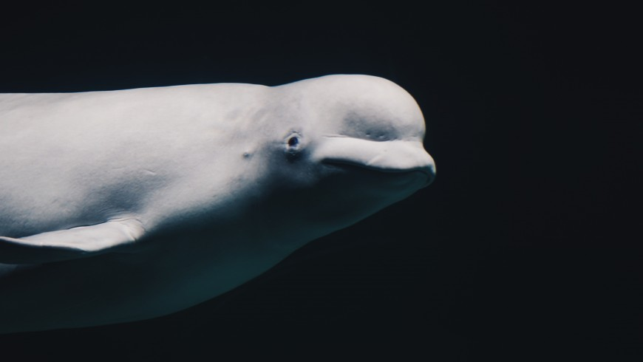
Learning Intention:
Discuss that the education of stakeholders is essential to encouraging sustainable management practices
Success Criteria:
Complete Marine Education worksheet
’28. High stakes’
Notes:
Image: https://roundglasssustain.com/species/mudskipper

Slide 2
What is a stake holder?

Slide 3


A stakeholder is a person or group of people who have an interest in
(and will be affected by) the outcome of an environmental management decision.

Slide 4
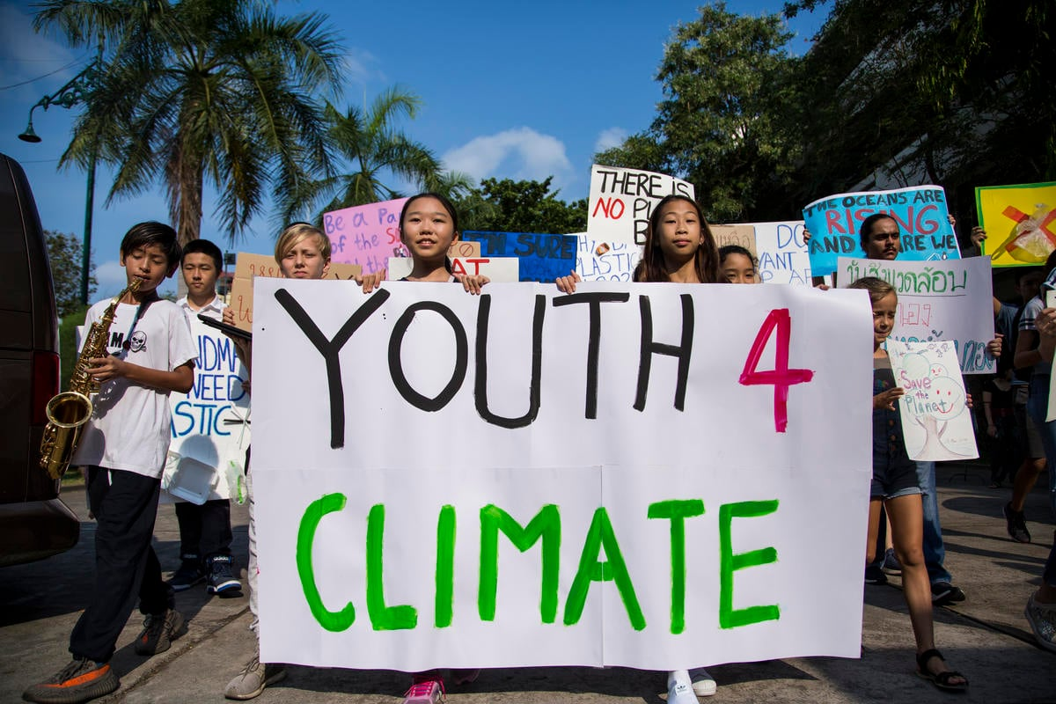
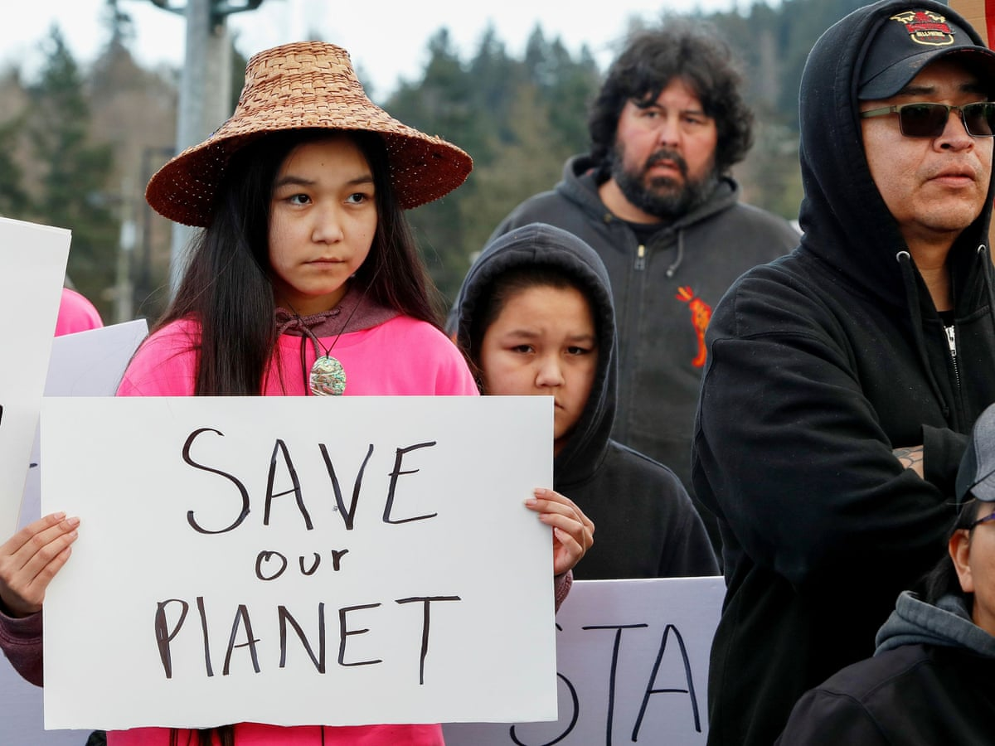
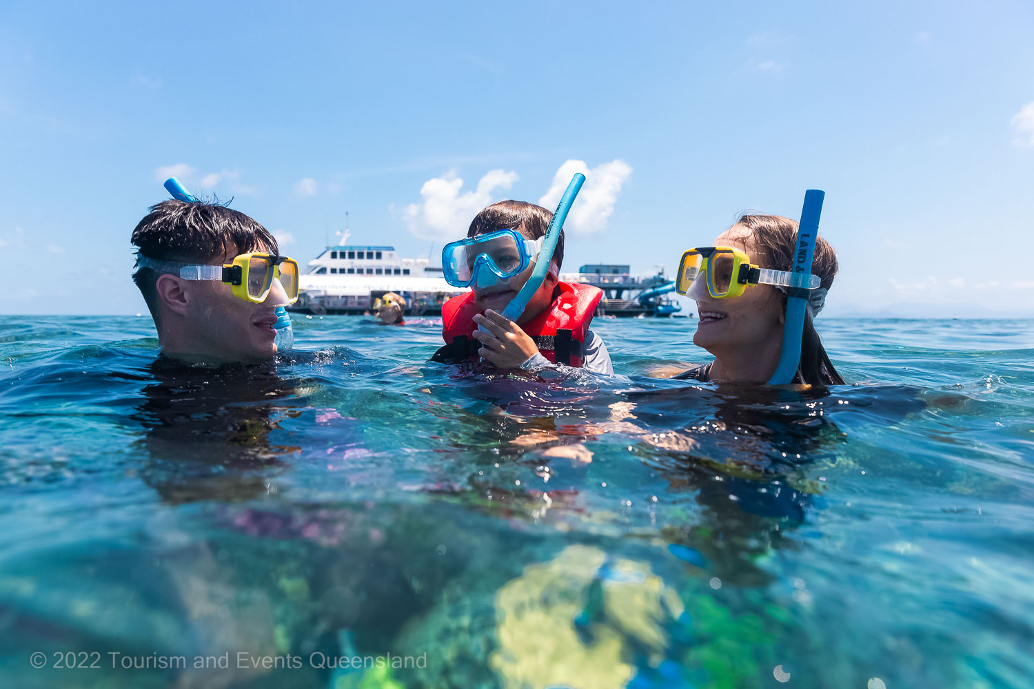
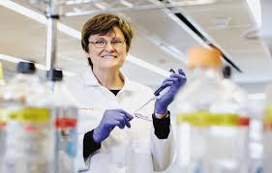
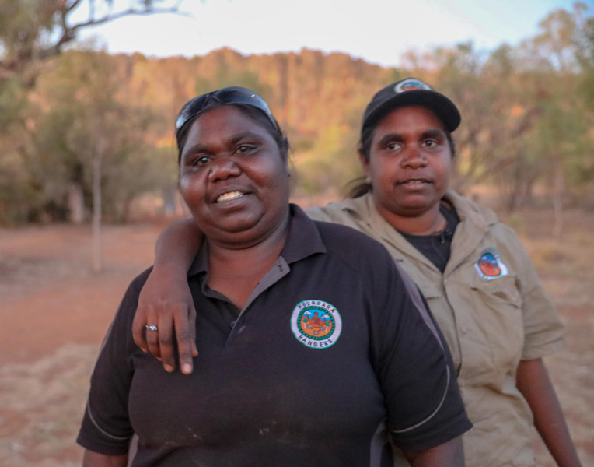
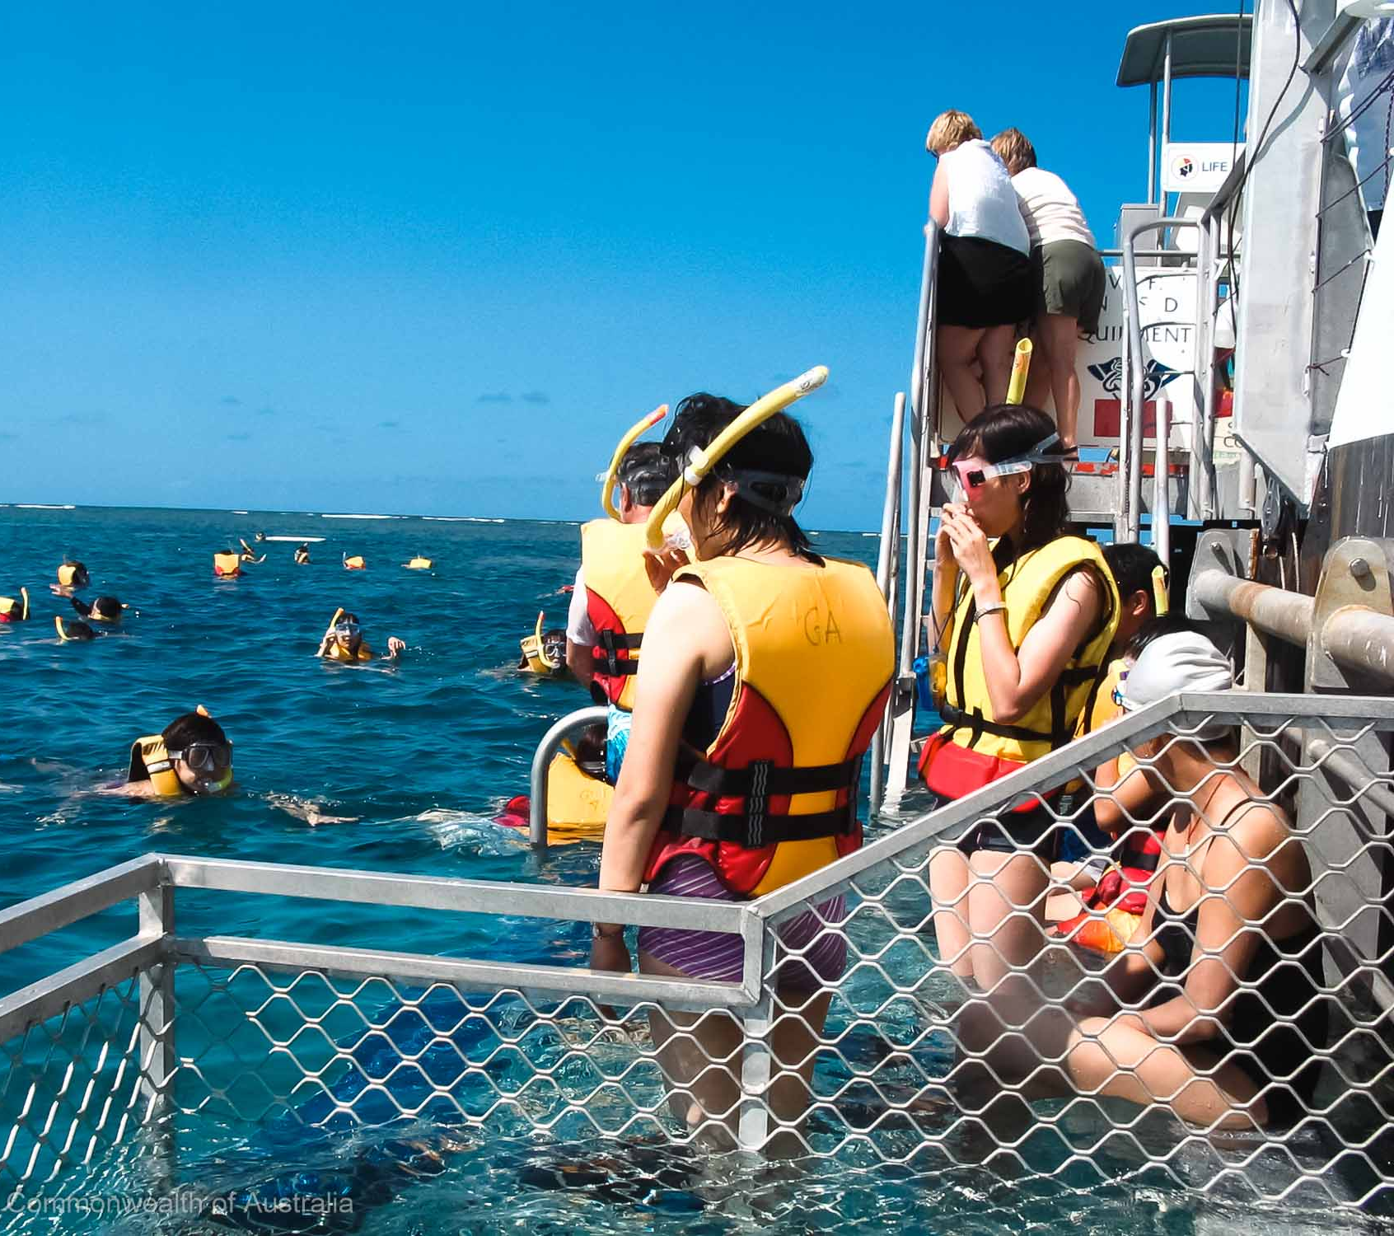
Examples of stakeholders include:
Locals
Students
Scientists
Agencies
business owners and
indigenous peoples

Slide 5


Stakeholder consultation and participation involves processes whereby all those with a stake in the outcome of a plan or project can actively contribute to decisions on planning and management.
A
Do we have a say too?

Slide 6
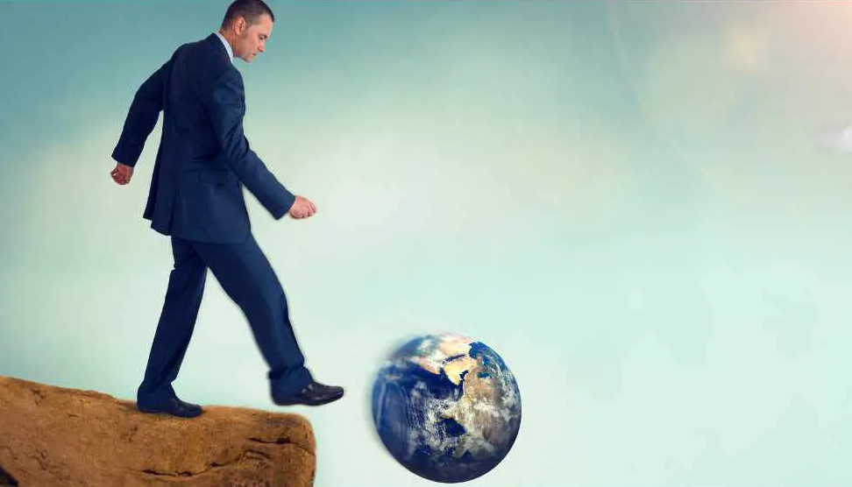
If no stakeholders speak up,
there’s a real risk that decisions made may not be sustainable

Slide 7
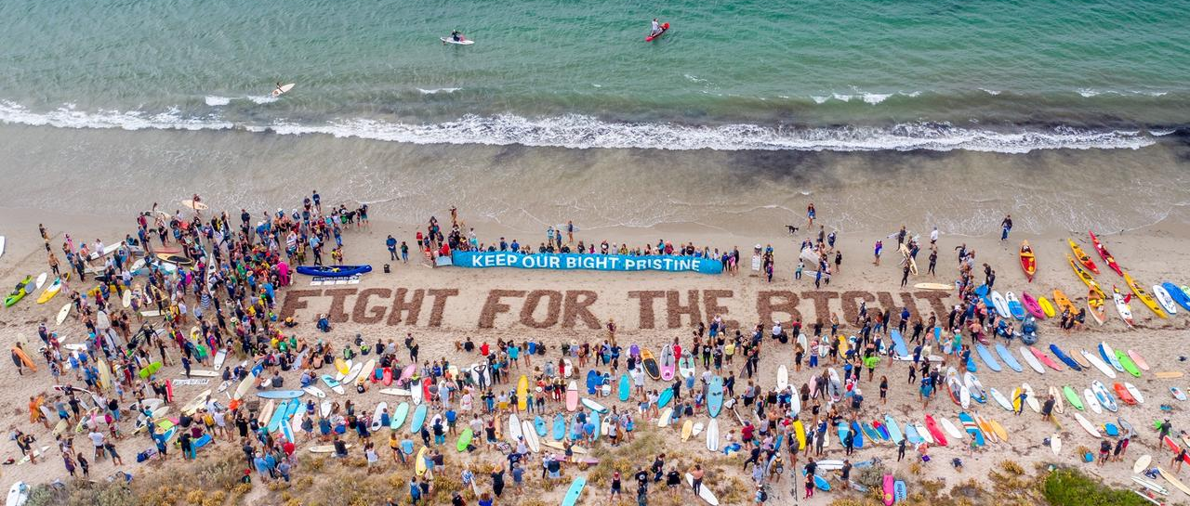
When stakeholders are willing to speak up,
they’re able to influence what decisions are made
Notes:
Image:

Slide 8
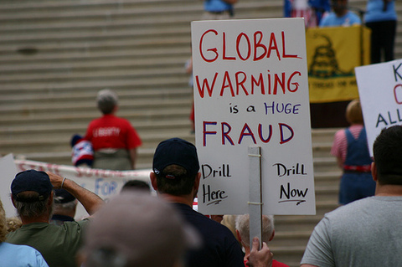
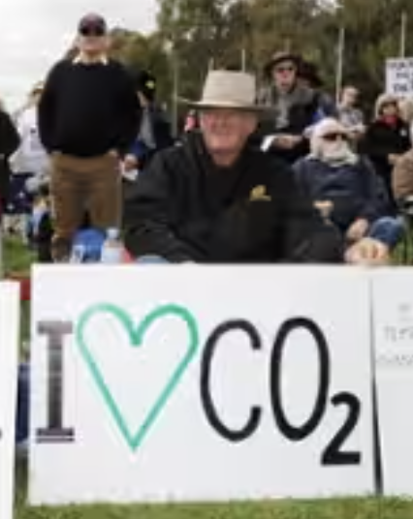
With so much influence, it’s important they’re well educated

Slide 9
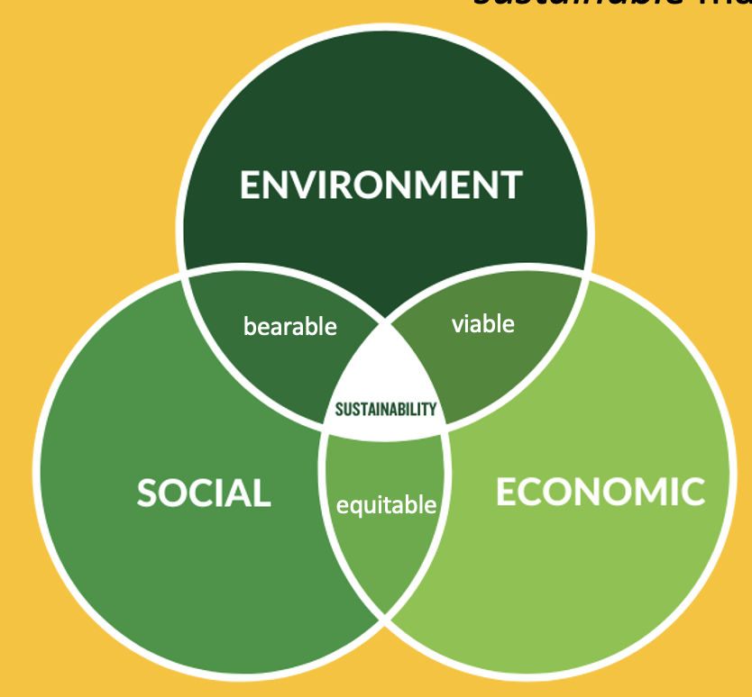
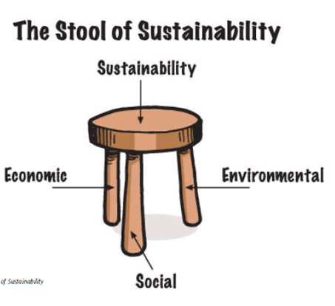
When educated, stakeholders can make informed decisions and contributions to the decision-making process that encourage sustainable management practices

Slide 10
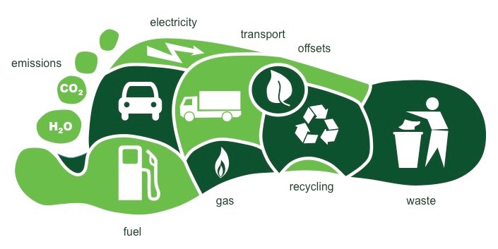
Notes:
Imaage: https://wp.wwu.edu/marketing474gill/2018/04/10/ecological-footprint/comment-page-1/

Slide 11
How do stakeholders become informed?
Where do stakeholders obtain their information from?
What and who influences opinions and behaviours?

Slide 12


Slide 13

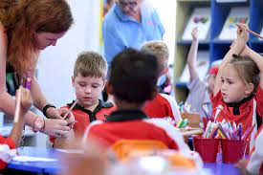

School community
Notes:
Images: Trinity College Gladstone

Slide 14

Religious figures
Religious symbols clockwise –
Judaisn
Christianity
Islam
Baháʼí Faith
Hinduism
Taosim
Buddhism
Sikhism
Slavic neopaganism
Celtic polytheism
Heathenism (German paganism)
Semitic neopaganism
Wicca
Kemetism (Egyption paganism)
Hellenism
Italo-Roman neopaganism

Slide 15

Family and friends
Notes:
Image: https://www.express.co.uk/life-style/health/1833327/loneliness-family-and-friends-visiting

Slide 16

Media
Notes:
Image: https://www.weforum.org/projects/value-in-media/

Slide 17
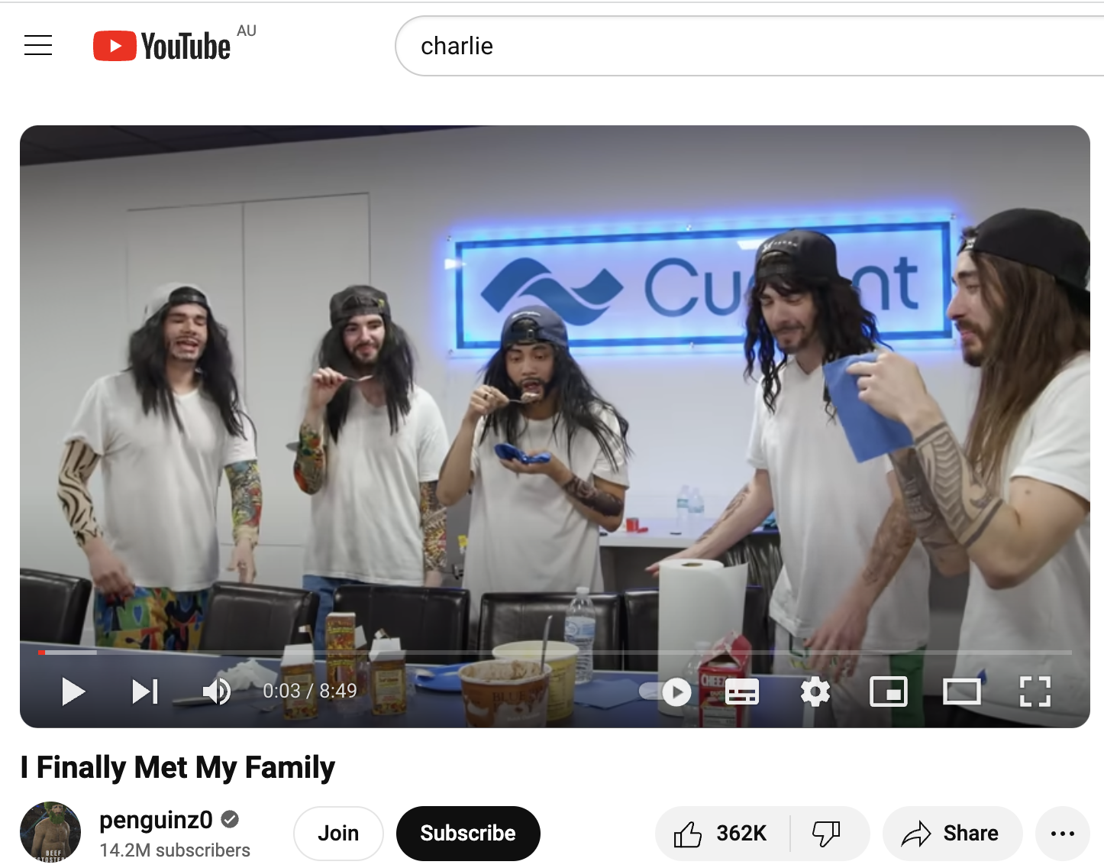
YouTube

Slide 18

Books

Slide 19


Slide 20

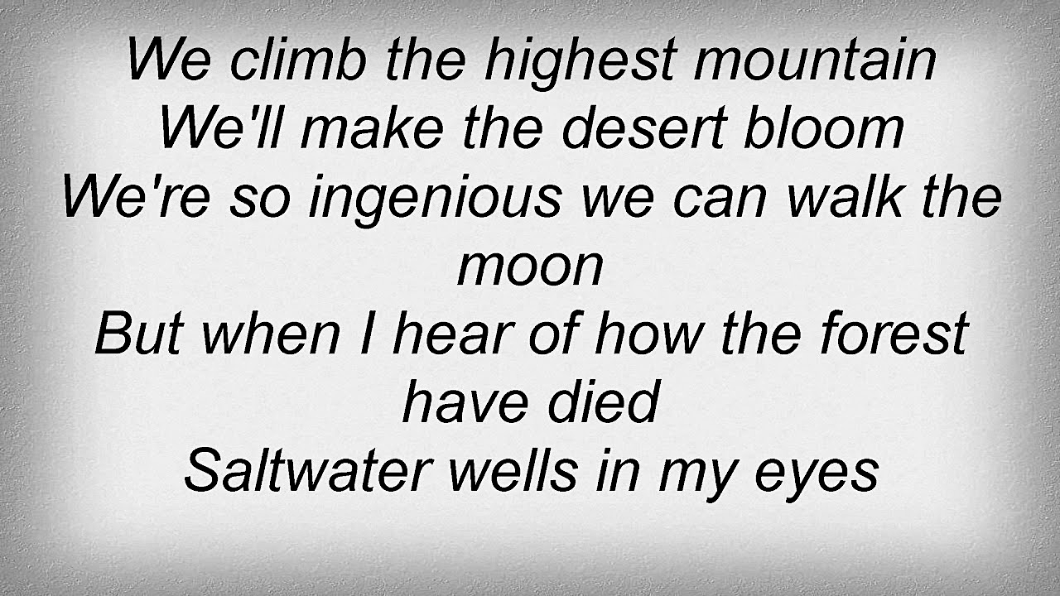
Music

Slide 21
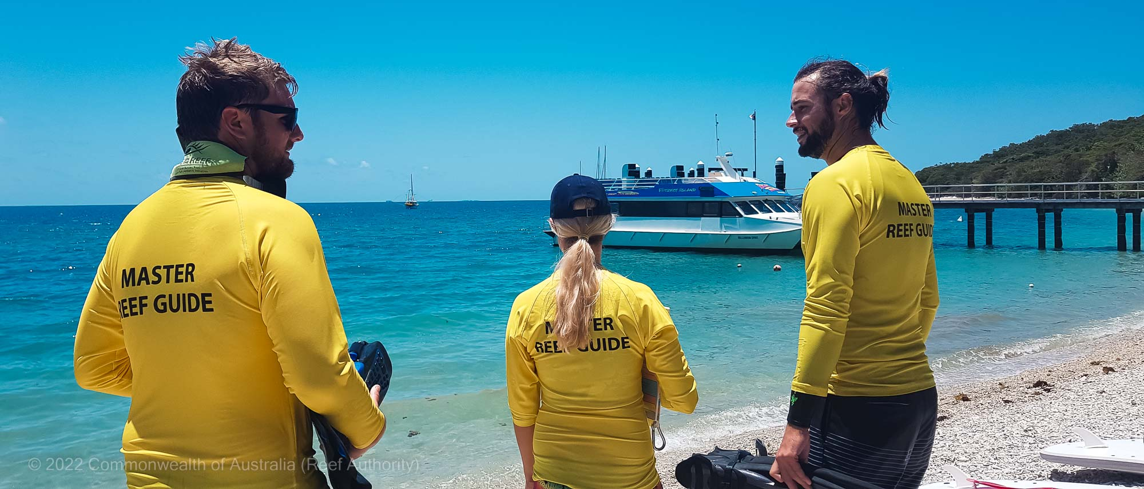
Experiences (e.g. Master Reef Guides are trained to deliver accurate information to those visiting the reef)

Slide 22

Life Experience

Slide 23

Nature

Slide 24
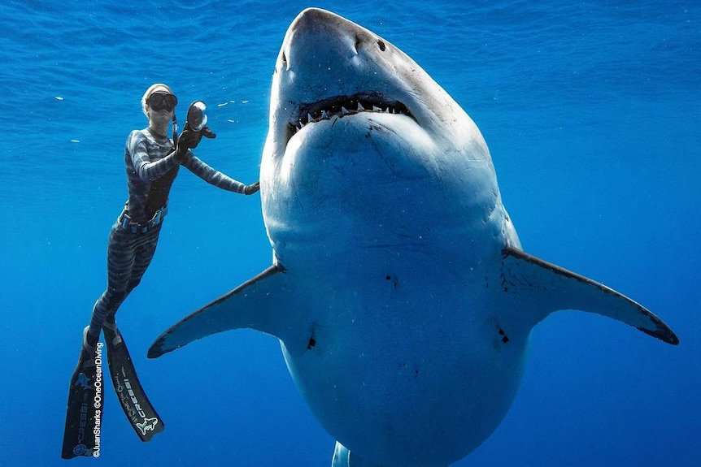
Notes:
Image: https://www.abc.net.au/news/2019-01-18/conservationist-slammed-for-touching-huge-shark-off-hawaii/10725478

Slide 25
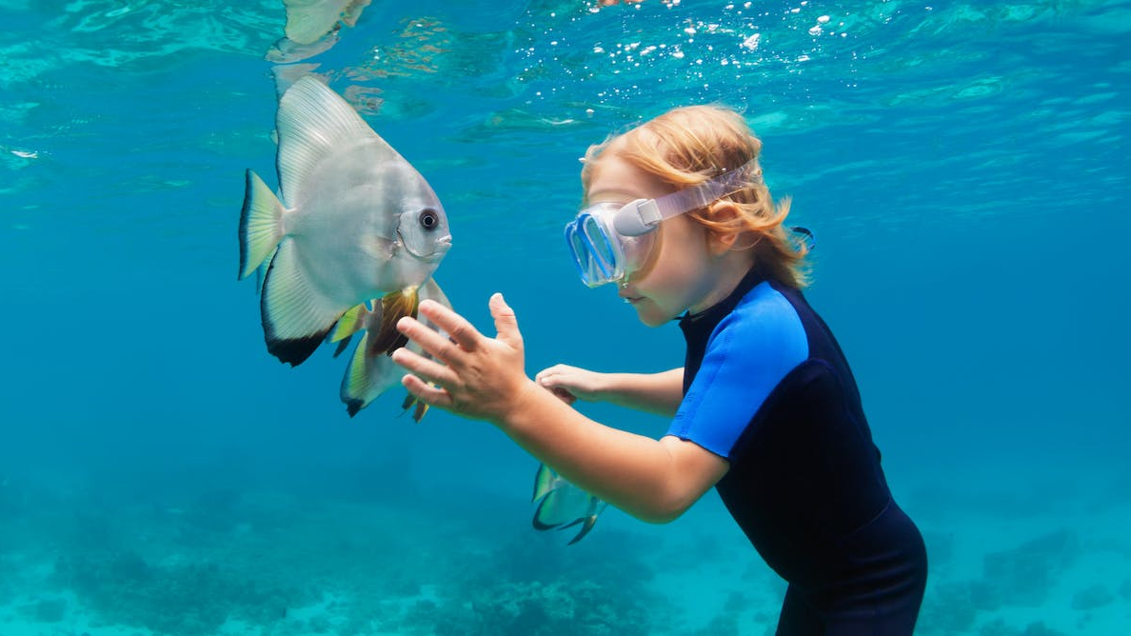
Notes:
Image: https://theconversation.com/when-we-swim-in-the-ocean-we-enter-another-animals-home-heres-how-to-keep-us-all-safe-193457

Slide 26
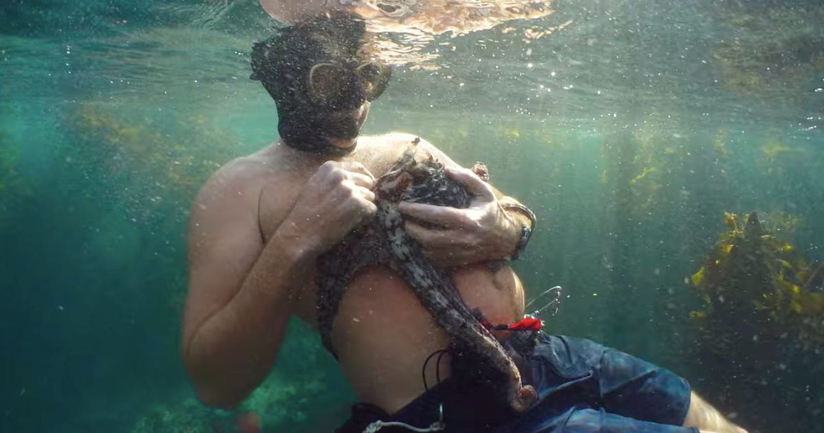
Notes:
Image: https://www.thecut.com/2020/09/my-octopus-teacher-on-netflix-is-the-love-story-we-need.html

Slide 27
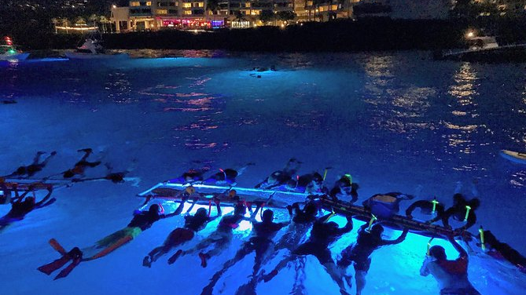
Kona, Hawaii
Notes:
Image: https://www.viator.com/en-AU/tours/Big-Island-of-Hawaii/Manta-Ray-Night-Snorkel/d669-30433P10

Slide 28
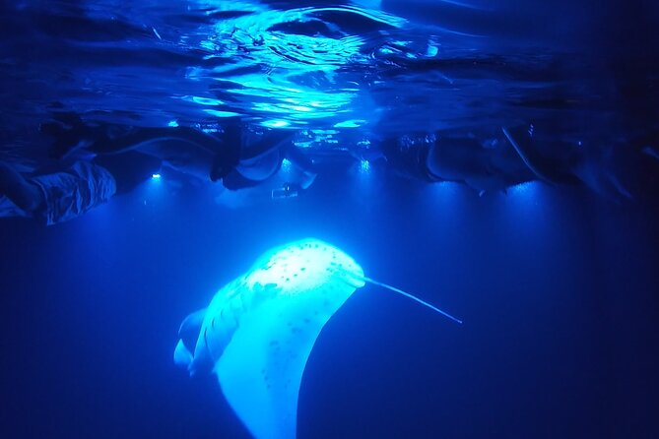
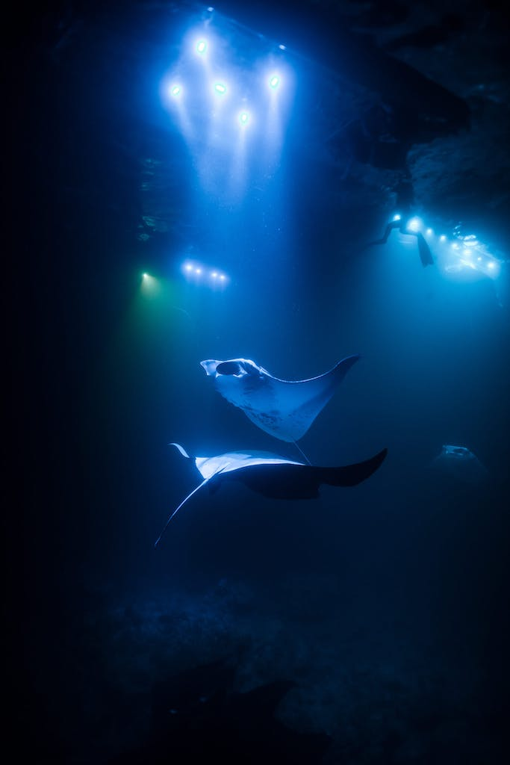

Slide 29
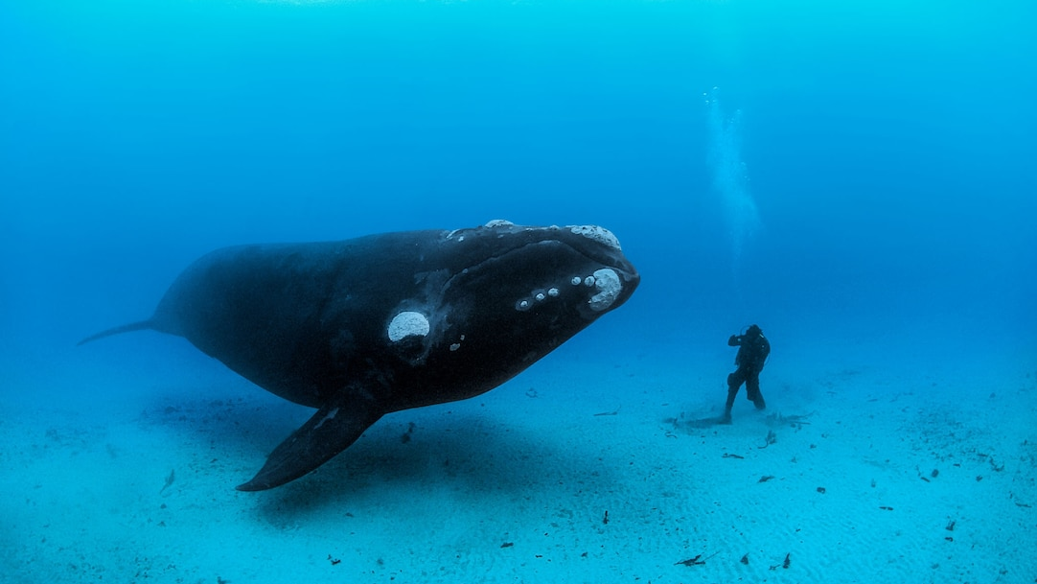
Notes:
Image: https://www.nationalgeographic.com/animals/article/whale-protects-diver-from-shark-video-spd

Slide 30
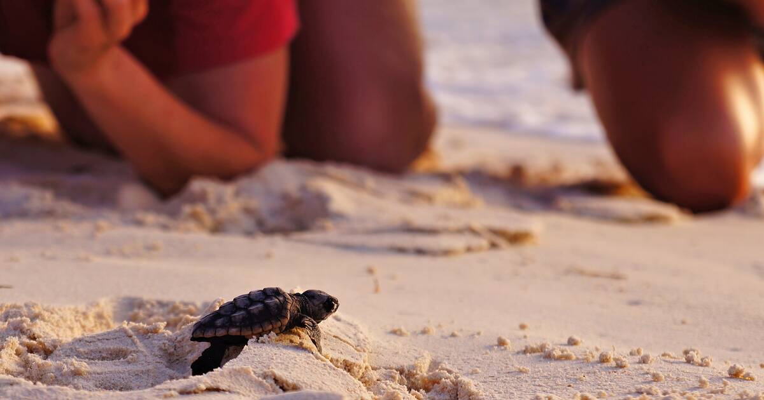

Slide 31
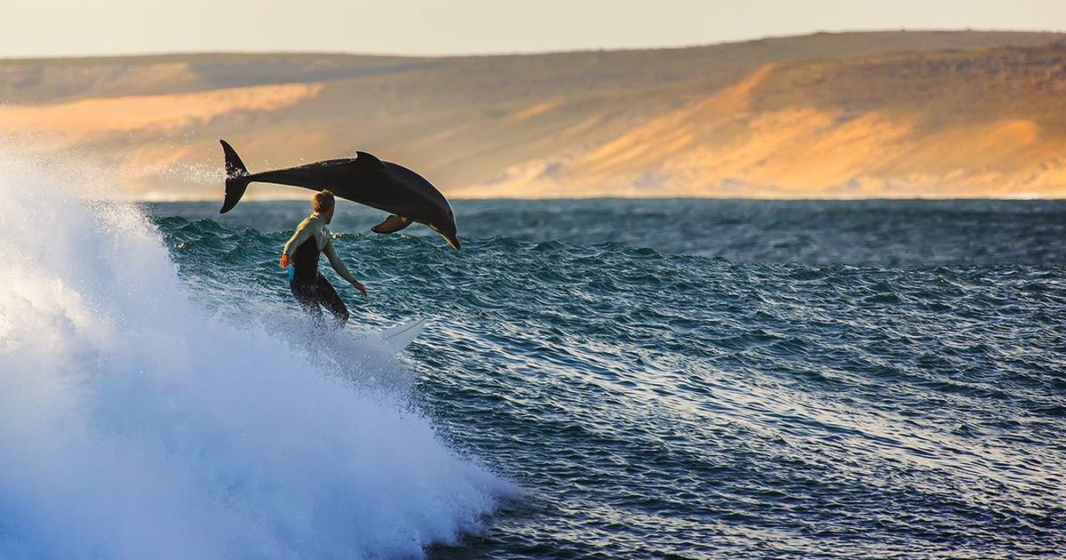

Slide 32
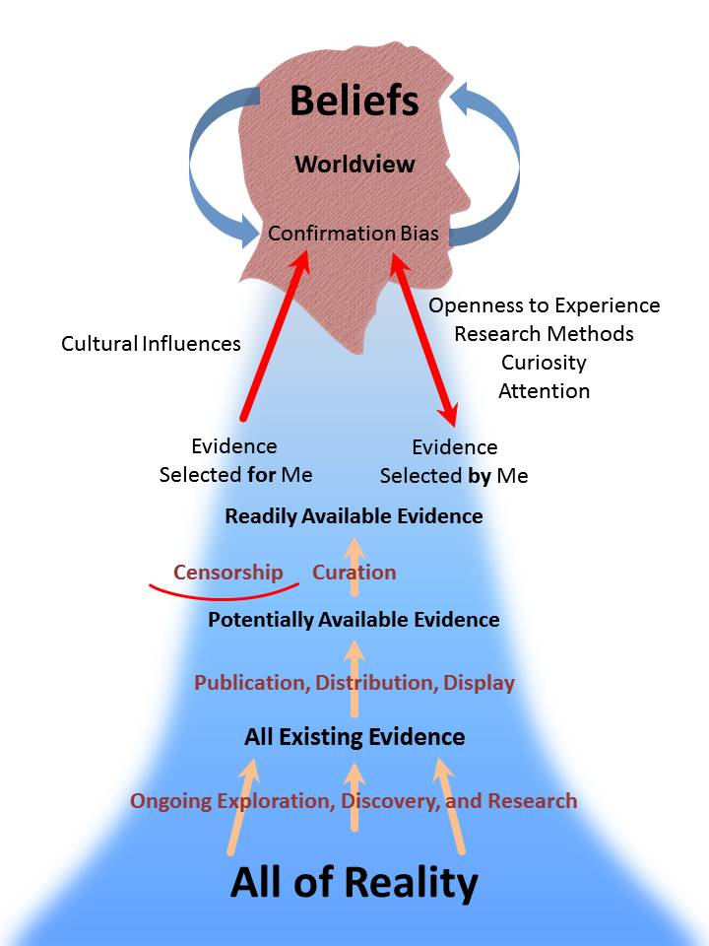
Available evidence is then filtered through our confirmation biases and interpreted through our worldview.
Notes:
Image: https://en.wikiversity.org/wiki/Exploring_Worldviews#/media/File:Spheres_of_Evidence.jpg

Slide 33
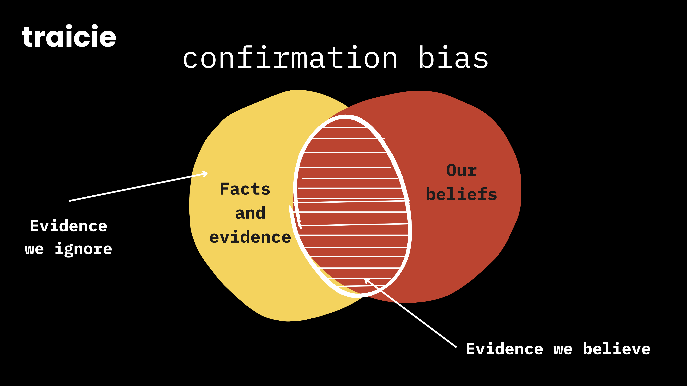
Notes:
Image: https://traicie.com/2022/11/07/confirmation-bias-in-hiring/

Slide 34

Worldview:
your view of the world
Notes:
Image; https://brocku.ca/unesco-chair/2021/09/09/we-cant-protect-our-planet-without-radically-transforming-our-worldview-is-it-possible/

Slide 35

View this ppt
(by Wet Paper)

Slide 36
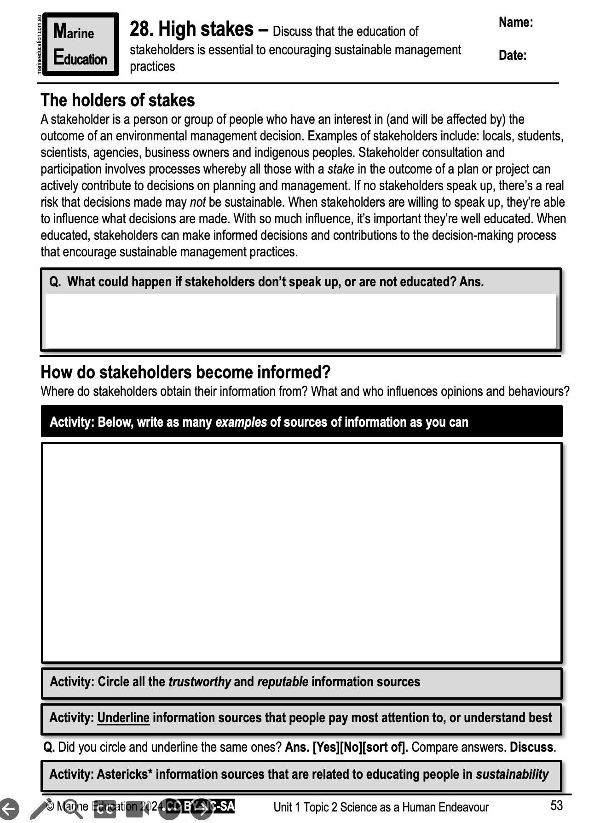
Learning Intention:
Discuss that the education of stakeholders is essential to encouraging sustainable management practices
Success Criteria:
Complete Marine Education worksheet
’28. High stakes’
Notes:
Image: https://roundglasssustain.com/species/mudskipper

