Slide 1
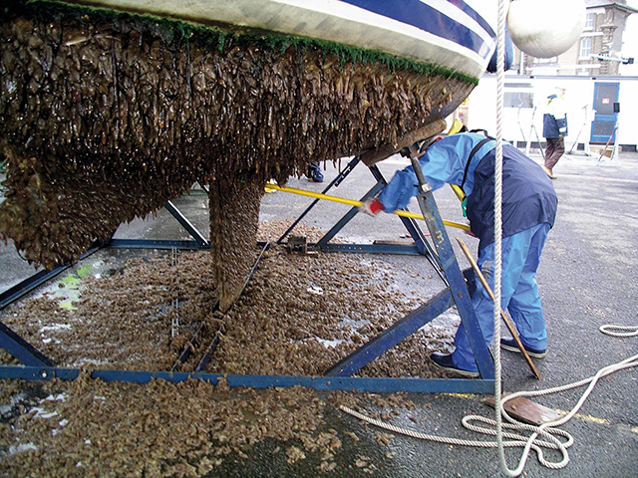
Learning Intention:
Evaluate the role of biosecurity measures in preventing or responding to incursions of invasive marine species in Australian ports.
Success Criteria:
Complete Marine Education worksheet ‘hitching a ride’
Notes:
Image: https://www.pbo.co.uk/news/the-future-of-diy-antifouling-its-apparently-in-your-gloves-24077

Slide 2
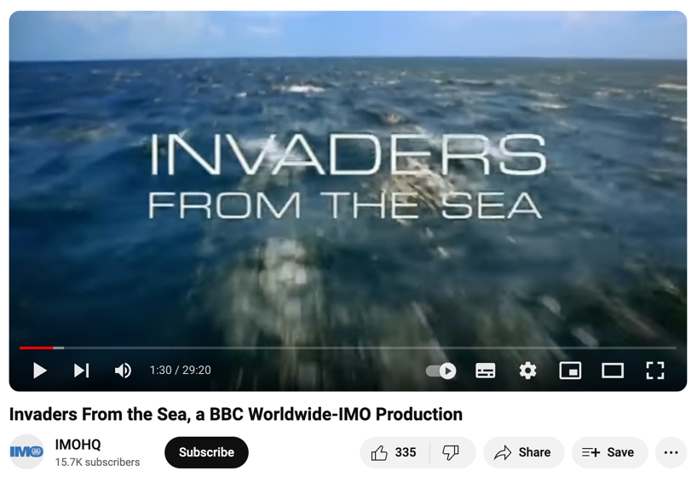
https://www.youtube.com/watch?v=u5JkRtMTEdI
Note: 30min long
Notes:
Video: https://www.youtube.com/watch?v=u5JkRtMTEdI

Slide 3
Prevention

Slide 4

Biosecurity Officer
Notes:
Image: https://www.agriculture.gov.au/about/jobs/apply/become-a-biosecurity-officer

Slide 5
Ballast water

Slide 6
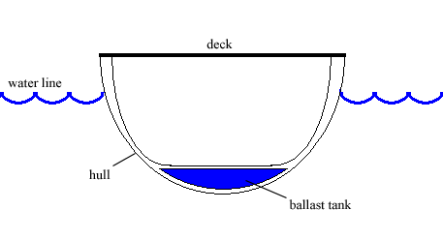
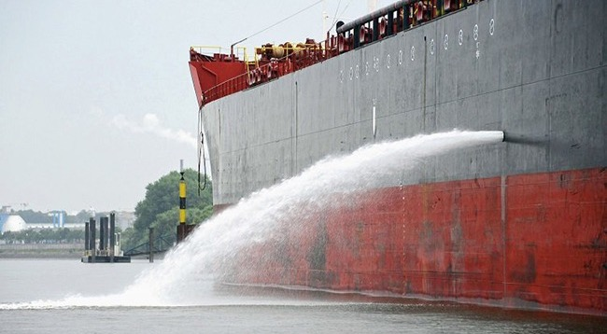
Seawater is pumped in and out of a ship to provide ballast (stability).
E.g. when a ship is full of cargo, ballast water is removed.
When a ship is empty of cargo, ballast water is added.
Notes:
Image (top): https://en.wikipedia.org/wiki/Ballast
Image (bottom): https://asiansealand.com/history-of-water-ballast-tank-and-why-is-ballast-water-treatment-important/

Slide 7
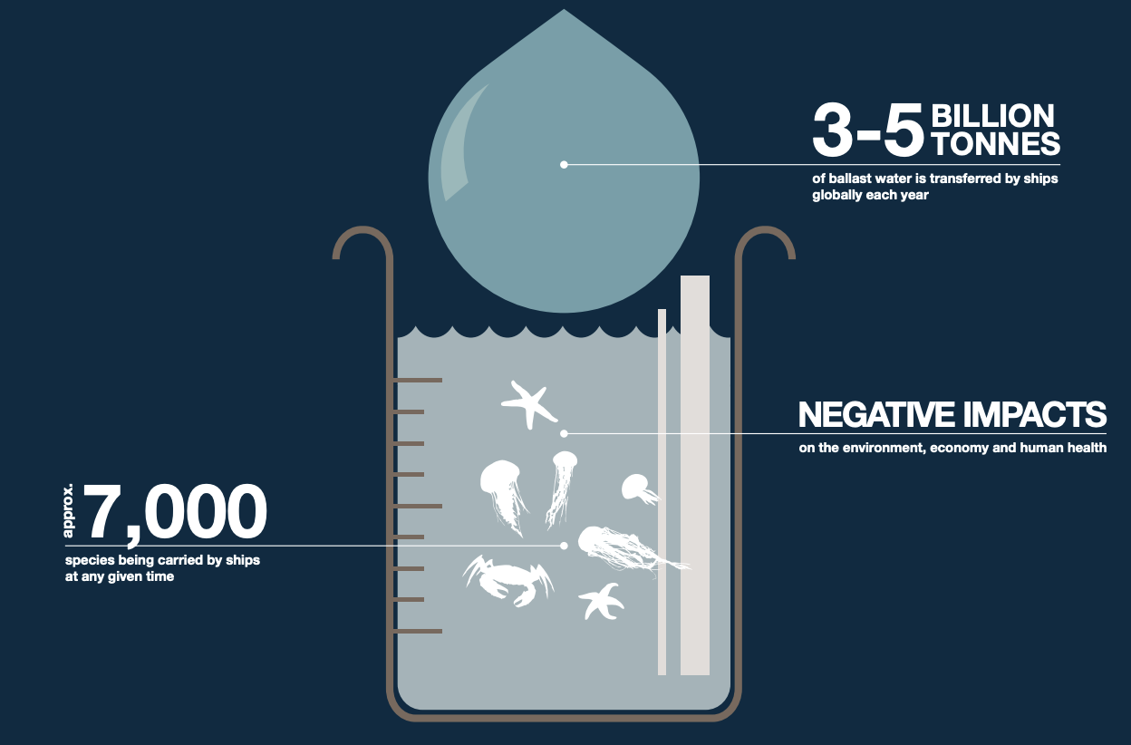
Ballast water contains whatever was in the water at the time of pumping.
Including tiny organisms.
Notes:
Image: https://archive.iwlearn.net/globallast.imo.org/resources/awareness-materials/index.html

Slide 8
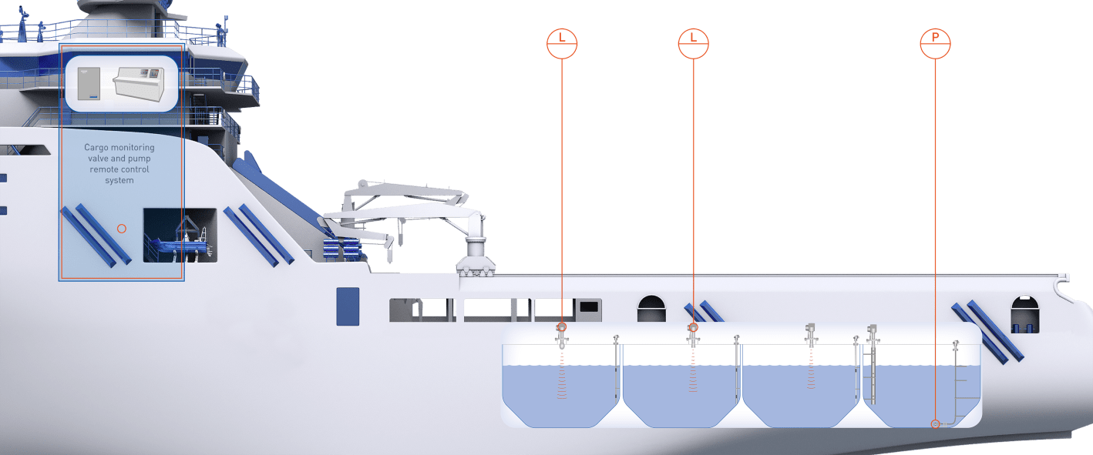
Once on board, the hitch-hikers get a free ride to wherever the ship goes to empty its ballast water.
Notes:
Image: https://bo.krohne.com/en/industries/marine-industry/supply-ships/cargo-monitoring-system-supply-ship

Slide 9
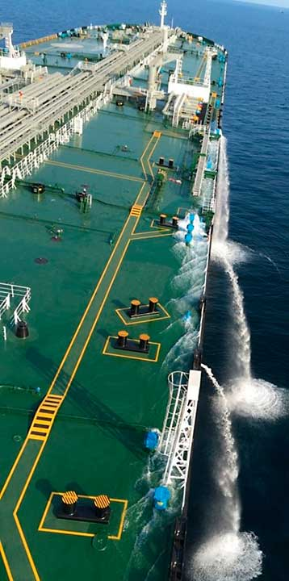
The D-1 standard requires ships to exchange their ballast water in open seas, away from coastal areas.
Ideally, this means at least 200 nautical miles from land and in water at least 200 metres deep.
Notes:
Info: https://www.imo.org/en/MediaCentre/HotTopics/Pages/Implementing-the-BWM-Convention.aspx
Image: https://www.dnv.com/news/ballast-water-management-new-requirements-and-operational-challenges-163770/

Slide 10
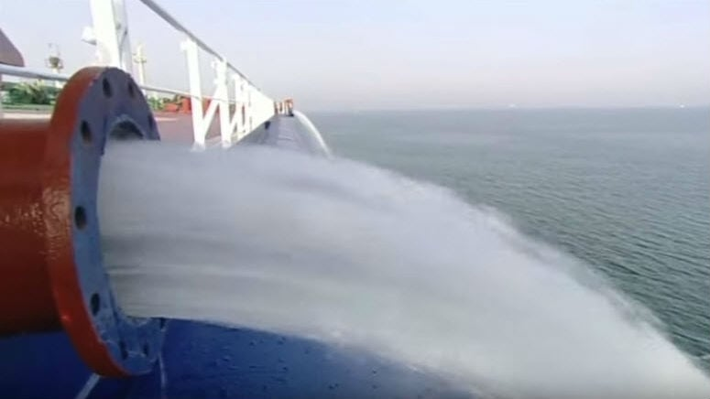
Ballast water exchange

Slide 11
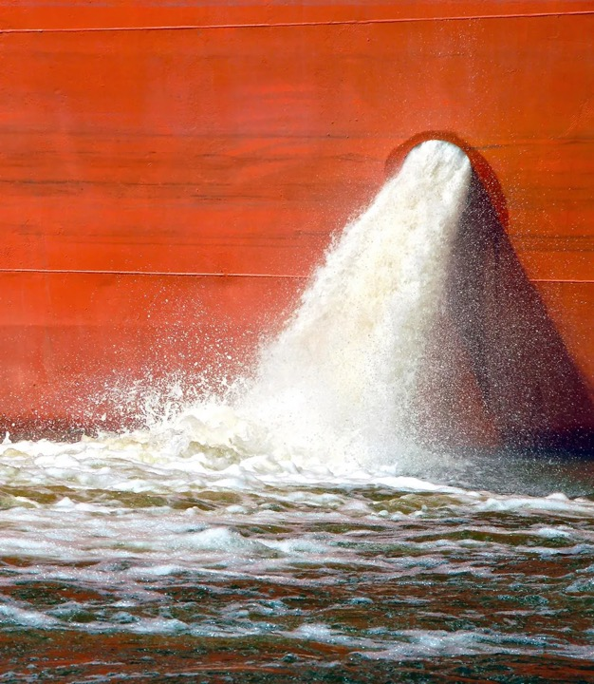
For some ships, it is easier to clean the ballast water instead.
Then it can be released in port (which saves time and money).
Notes:
Image: https://www.dnv.com/expert-story/maritime-impact/Ballast-Water-Treatment-Systems-at-a-glance/

Slide 12
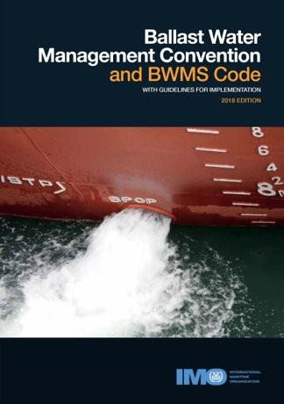
Under the BWM: International Convention for the Control and Management of Ships' Ballast Water
and Sediments (2017),
all ships in international traffic are required to manage their ballast water and sediments to a certain standard, according to a ship-specific ballast
water management plan.
Notes:
Image: https://www.imo.org/en/MediaCentre/HotTopics/Pages/BWM-default.aspx
Info: https://www.imo.org/en/MediaCentre/HotTopics/Pages/Implementing-the-BWM-Convention.aspx

Slide 13
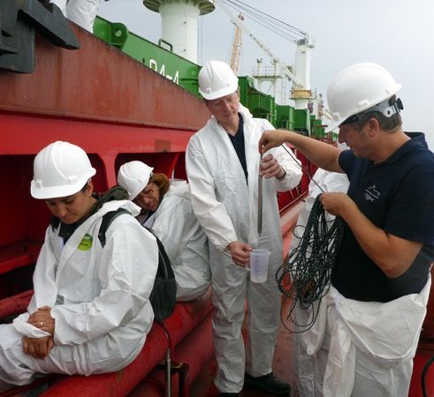
Aquatic organisms and pathogens must be removed or rendered harmless before any ballast water is released into a new location.
Notes:
Info: https://www.imo.org/en/MediaCentre/HotTopics/Pages/Implementing-the-BWM-Convention.aspx
Image: https://safety4sea.com/psc-inspection-under-imo-bwmc-requirements/
Image Credit: IMO/ Image hereabove is being used for illustration purposes only

Slide 14
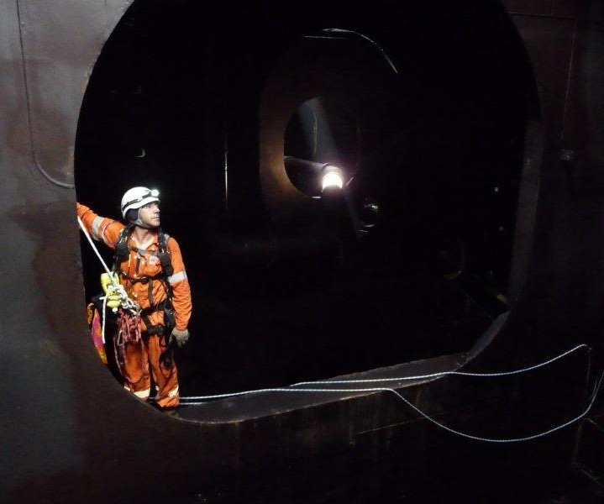
Ships may be inspected by port State control officers (Article 9 Inspection of Ships) who can check the ship’s ballast water management plan, ballast water record book, ballast water management certificate, and/or sample the ballast water.
Notes:
Info: https://www.imo.org/en/MediaCentre/HotTopics/Pages/Implementing-the-BWM-Convention.aspx
Image: https://www.flickr.com/photos/vertech/4384378120

Slide 15
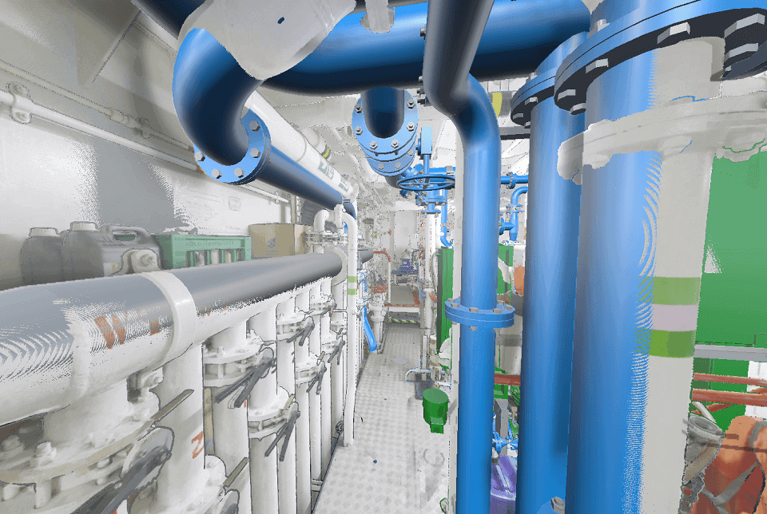
Ship’s Ballast water treatment plant
Notes:
Image: https://www.saifilter.com/everything-you-should-know-about-ballast-water-treatment-filter/

Slide 16
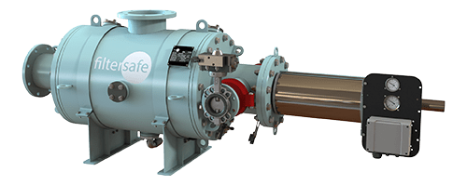
Physical filtration
e.g. ballast water filter
Notes:
Image: https://filtersafe.net/industries/ballast-water/

Slide 17
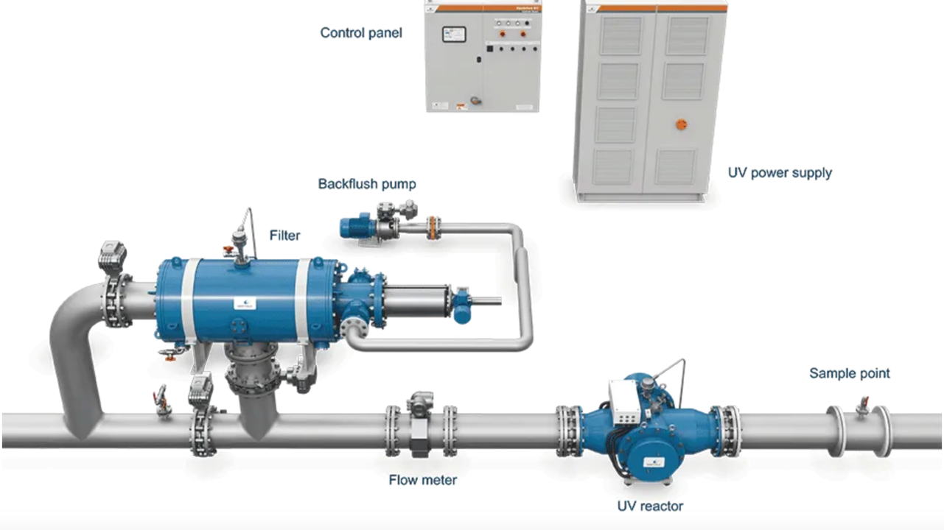
Mechanical filtration
e.g. UV treatment
Notes:
Image: https://www.wartsila.com/encyclopedia/term/ballast-water-treatment-systems-%28bwts%29

Slide 18
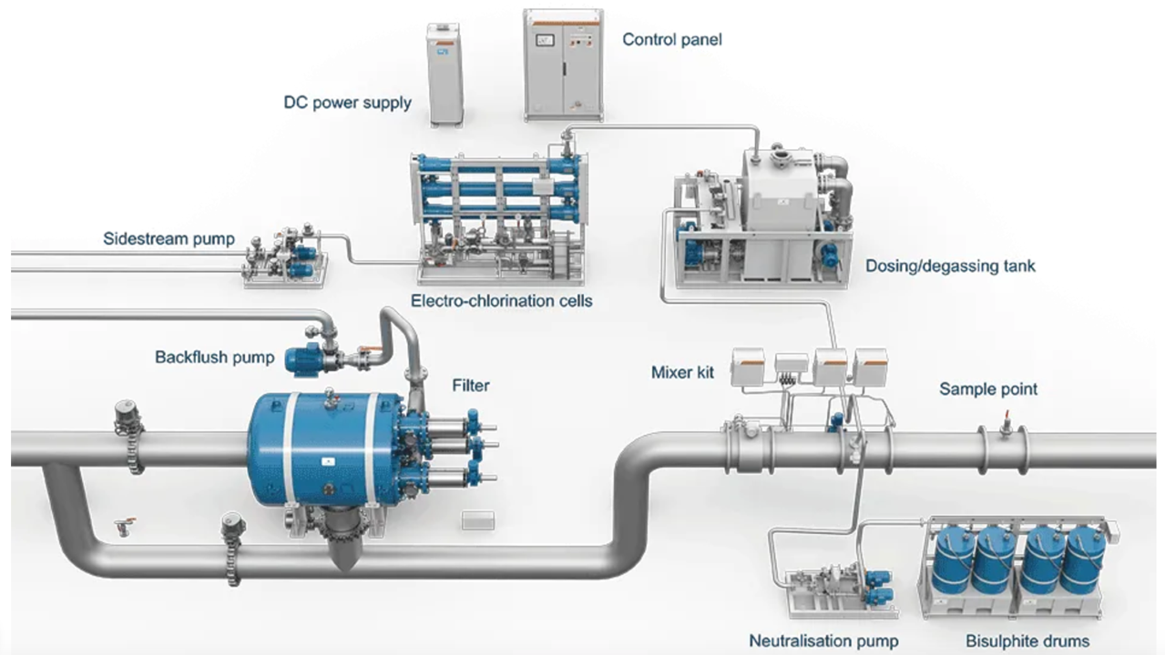
Chemical filtration
E.g. Chlorination treatment
Notes:
Image: https://www.wartsila.com/encyclopedia/term/ballast-water-treatment-systems-%28bwts%29

Slide 19
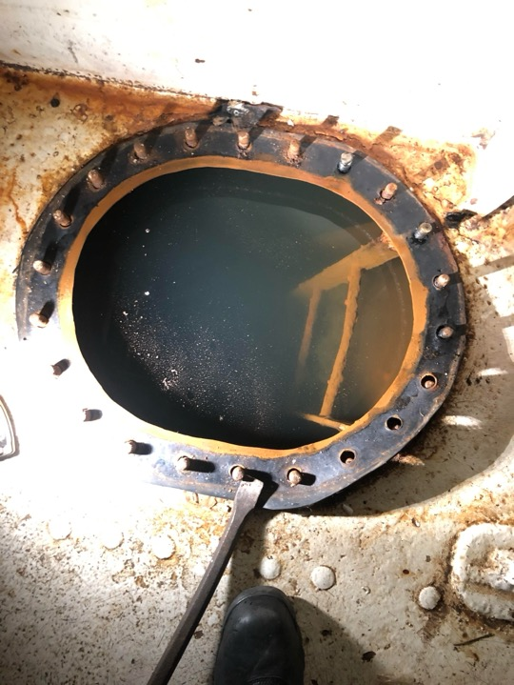
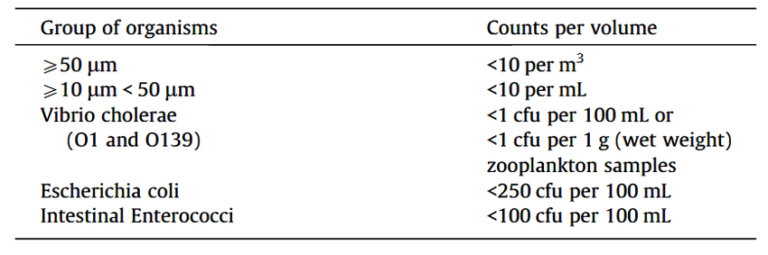
The D-2 standard specifies the maximum amount of viable organisms allowed to be discharged, including specified indicator microbes harmful to human health.
Notes:
Info: https://www.imo.org/en/MediaCentre/HotTopics/Pages/Implementing-the-BWM-Convention.aspx
Image: https://www.reddit.com/r/submechanophobia/comments/lq1jd8/aft_ballast_tank_on_my_ship_had_to_dewater_and/

Slide 20
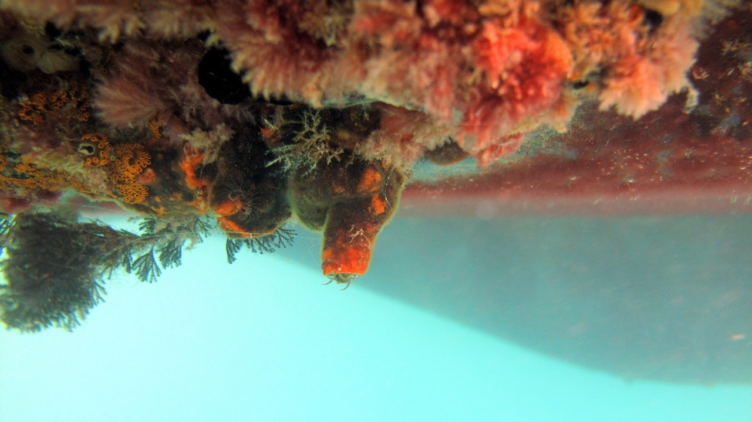
Hitch-hikers
can also stick to the hull.
Notes:
Image: https://sercblog.si.edu/california-and-new-zealand-crack-down-on-biofoul-play/

Slide 21
Antifoul paints

Slide 22
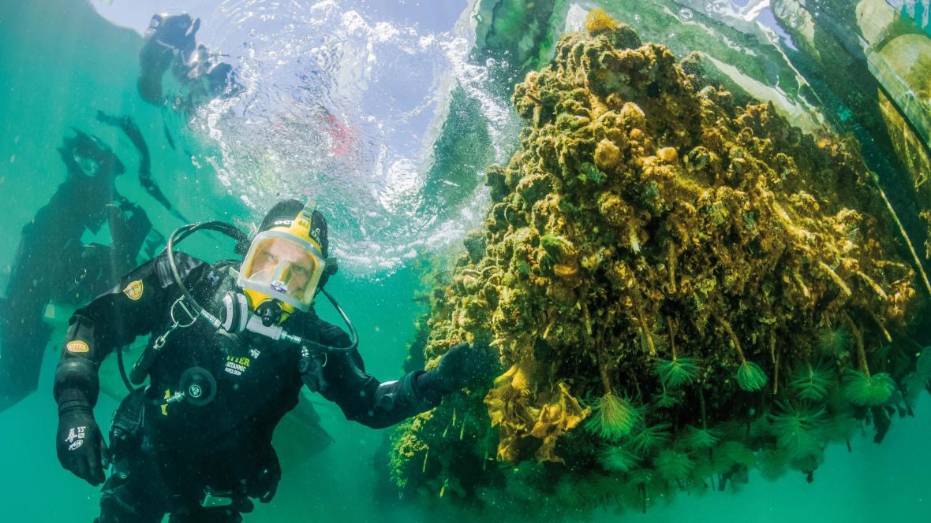
Time for a clean?
Notes:
Image: https://www.marinebiosecurity.org.nz/new-brains-sought-to-get-rid-of-marine-pests/
New Zealand is facing increasing biosecurity threats from marine pests. [Photo: Crispin Middleton, NIWA]

Slide 23
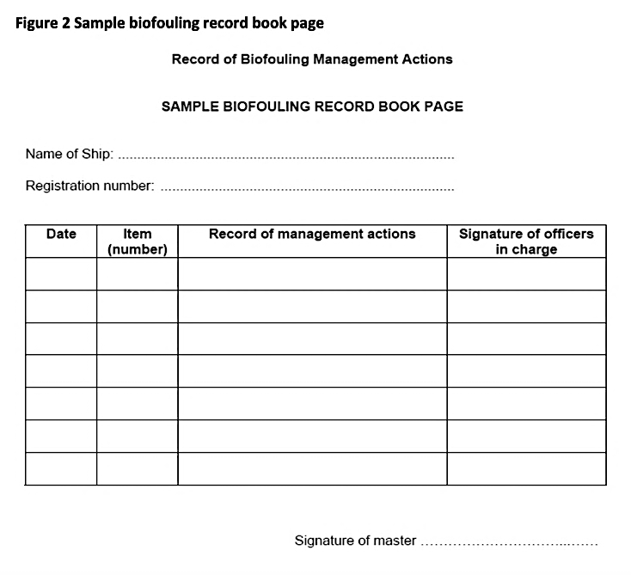
Keep a record book

Slide 24
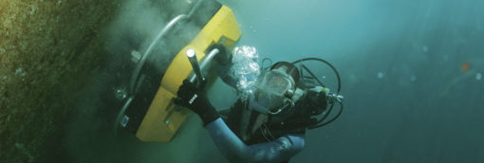
Hull cleaning
Notes:
Image; https://glomeep.imo.org/technology/hull-cleaning/
Diver performing underwater hull cleaning, Source: Hydrex

Slide 25
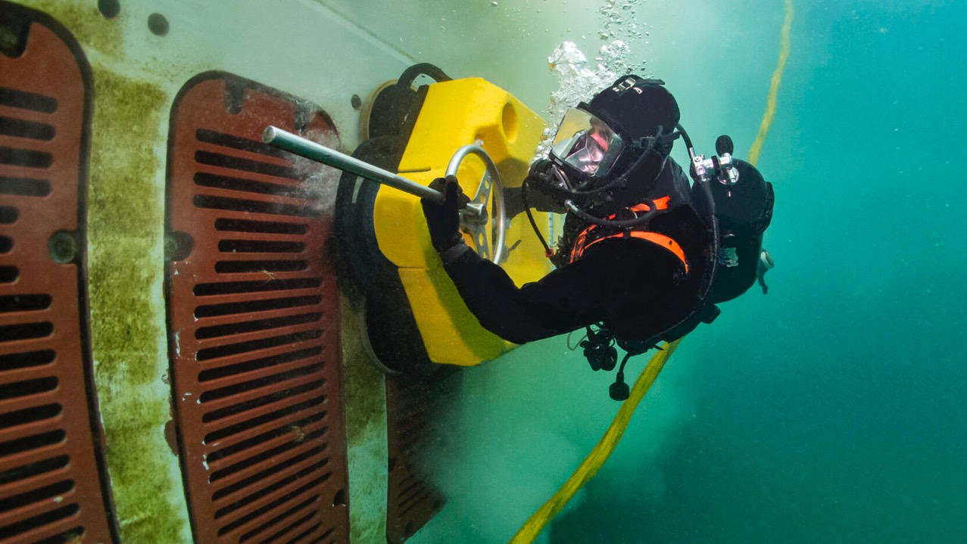
Notes:
Image: https://subind.net/equipment/mc313/

Slide 26
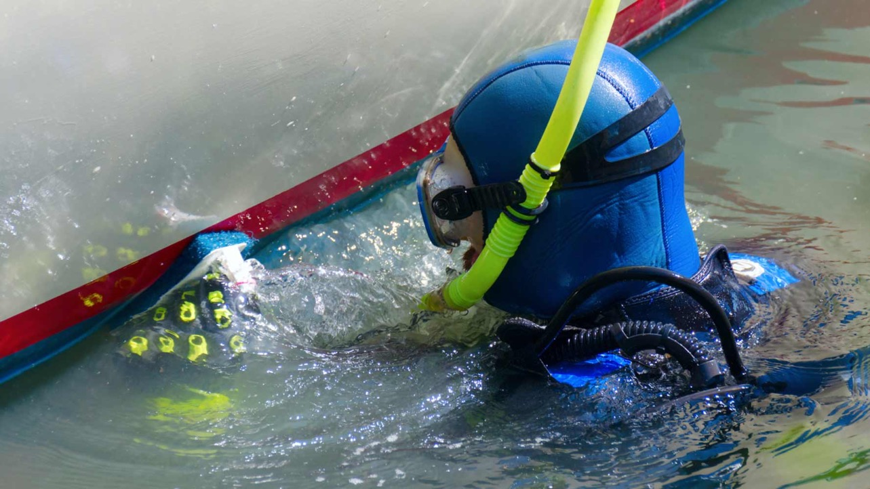

Slide 27
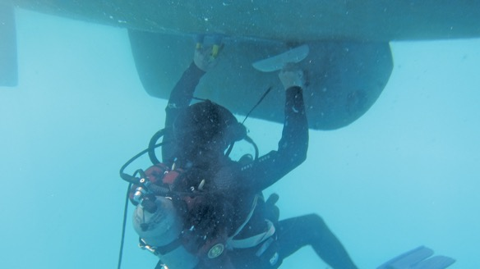
Notes:
Image: https://dolphindiveservices.com.au/

Slide 28
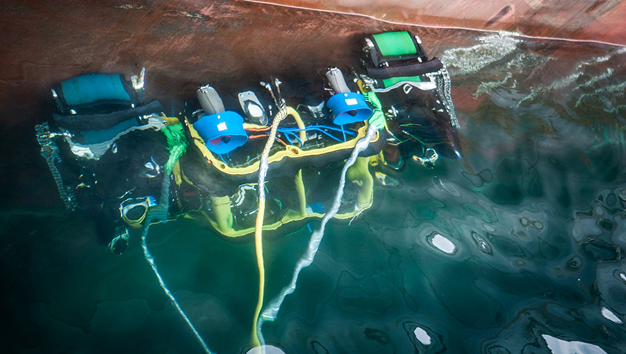
Notes:
Image: https://remotion.no/applications/hull-cleaning/

Slide 29
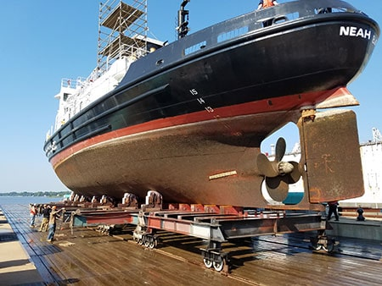
Slip yard

Slide 30
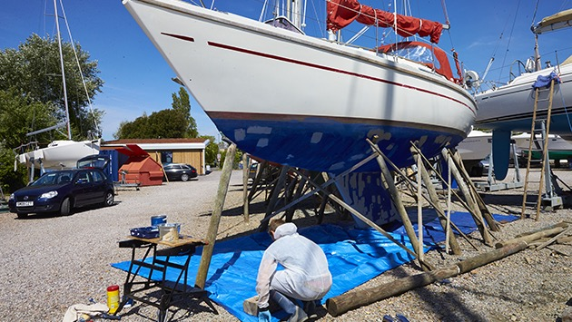
Notes:
Image; https://www.yachtingmonthly.com/gear/how-to-antifoul-your-boat-a-step-by-step-guide-77791

Slide 31
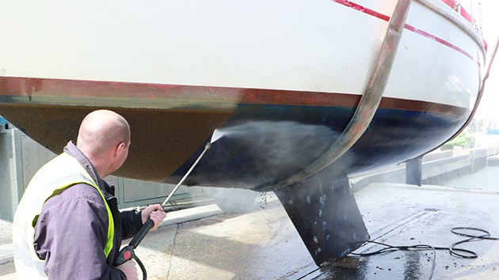
Notes:
Image: https://www.yachtingmonthly.com/gear/how-to-antifoul-your-boat-a-step-by-step-guide-77791

Slide 32

Notes:
Image: https://www.yachtingmonthly.com/gear/how-to-antifoul-your-boat-a-step-by-step-guide-77791

Slide 33
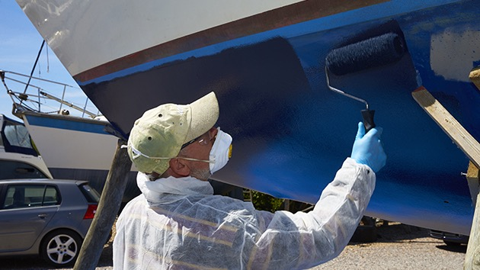
Notes:
Image: https://www.yachtingmonthly.com/gear/how-to-antifoul-your-boat-a-step-by-step-guide-77791

Slide 34
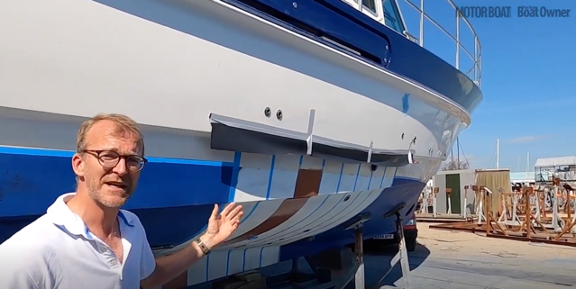
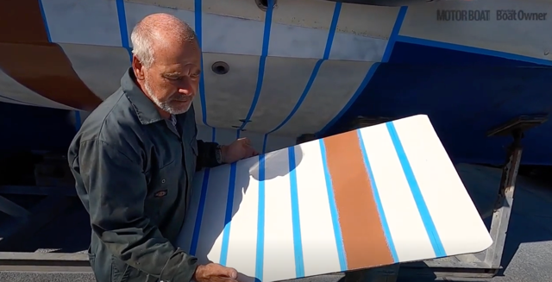
Testing antifoul paints
Screenshots from video:
https://www.pbo.co.uk/gear/best-antifouling-paint-head-to-head-test-71025
Notes:
Video: https://www.pbo.co.uk/gear/best-antifouling-paint-head-to-head-test-71025

Slide 35
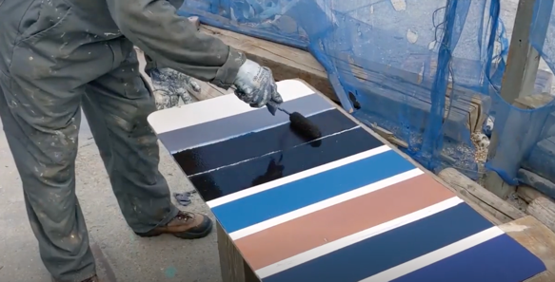
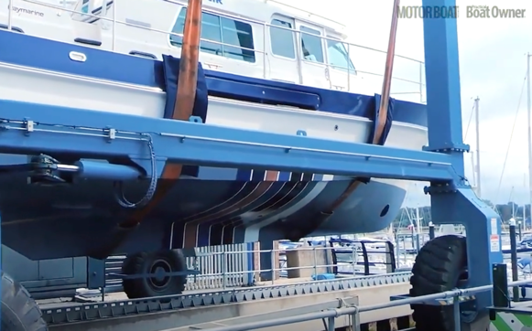
Applying the paint and putting the boat
(and test panel)
into the water
Notes:
Video: https://www.pbo.co.uk/gear/best-antifouling-paint-head-to-head-test-71025

Slide 36
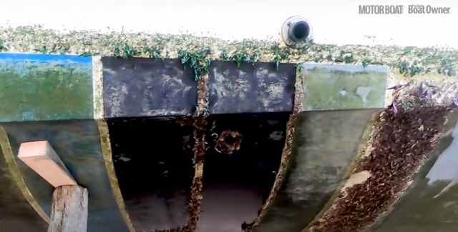
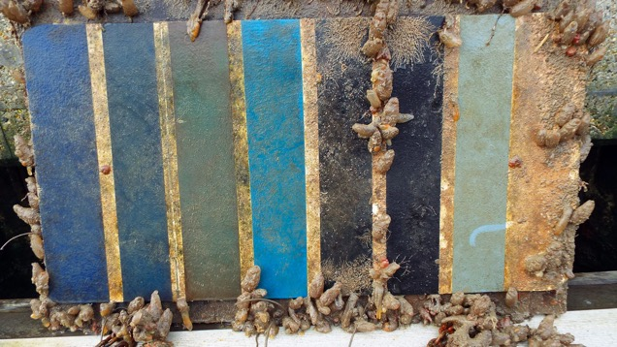
The boat 7 months later…
The test panel 18 months later…
Notes:
Video: https://www.pbo.co.uk/gear/best-antifouling-paint-head-to-head-test-71025

Slide 37
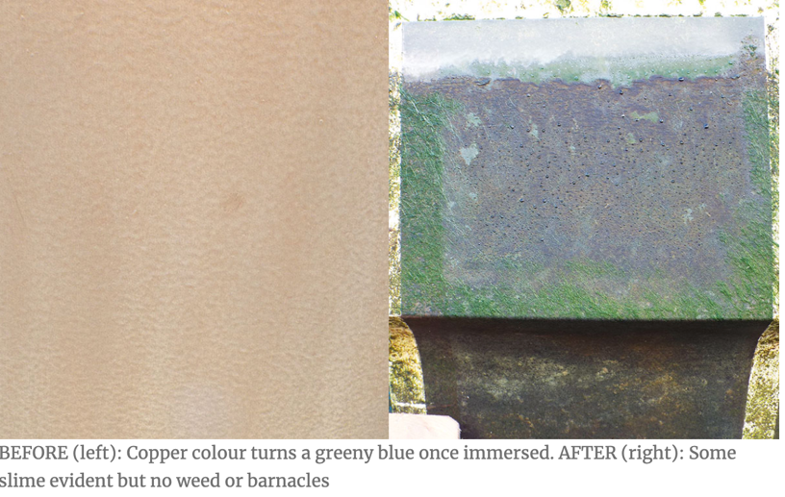
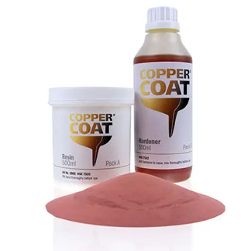
Ranked number 1: Coppercoat
$4000
Cost to paint 36ft boat
Lasts for 10 years, but has a high initial cost
Notes:
Image: https://www.pbo.co.uk/gear/best-antifouling-paint-head-to-head-test-71025

Slide 38
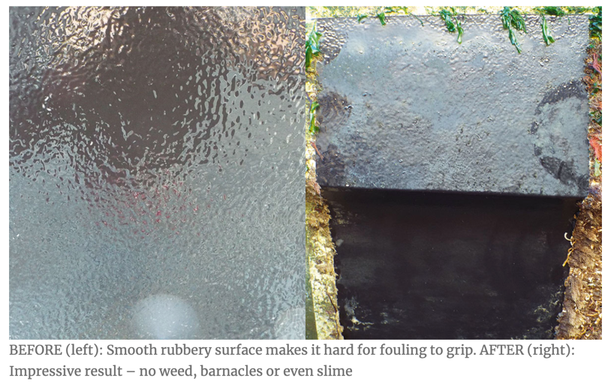
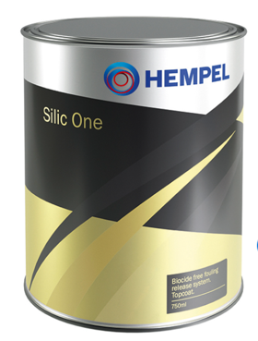
Ranked number 2: Hempel Silic One
$2000
Cost to paint 36ft boat
Best in performance but fiddly to apply
Notes:
Image: https://www.pbo.co.uk/gear/best-antifouling-paint-head-to-head-test-71025

Slide 39
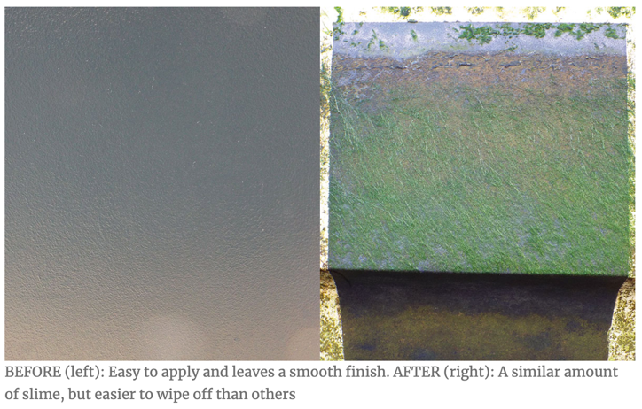
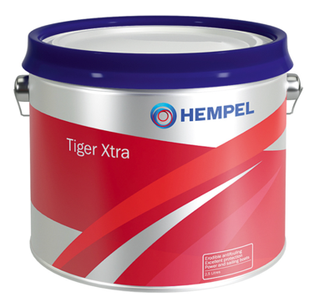
Ranked number 3: Hempel Tiger Xtra 7100
$500
Cost to paint 36ft boat
Impressive value, but needs applying every year
Notes:
Image: https://www.pbo.co.uk/gear/best-antifouling-paint-head-to-head-test-71025

Slide 40
Responding
to incursions of invasive marine species in Australian ports

Slide 41
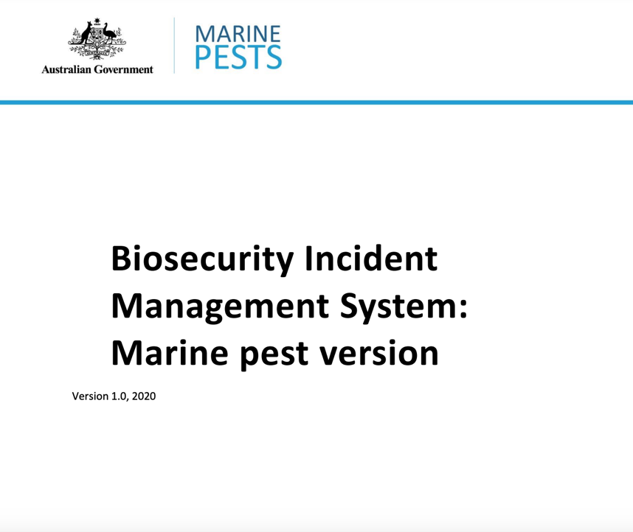
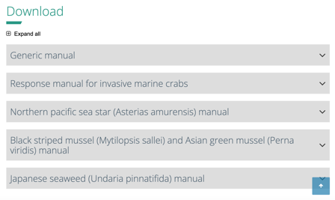
Government documents provide explicit instructions on how to respond.
Response Manuals
Notes:
Image: https://www.marinepests.gov.au/what-we-do/emergency/biosecurity-incident-management-system
Response Manuals: https://www.marinepests.gov.au/what-we-do/emergency/response-manuals#northern-pacific-sea-star--asterias-amurensis--manual

Slide 42
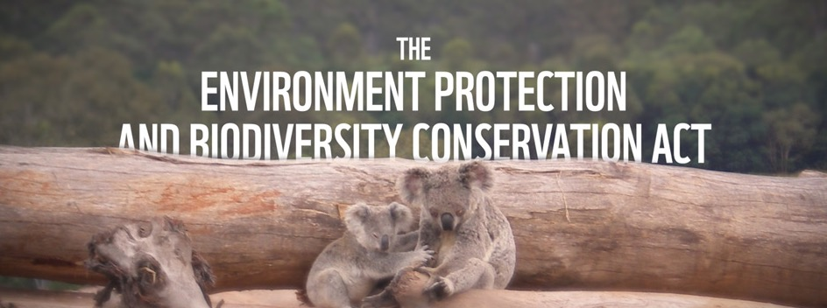
List it
Notes:
Image:

Slide 43
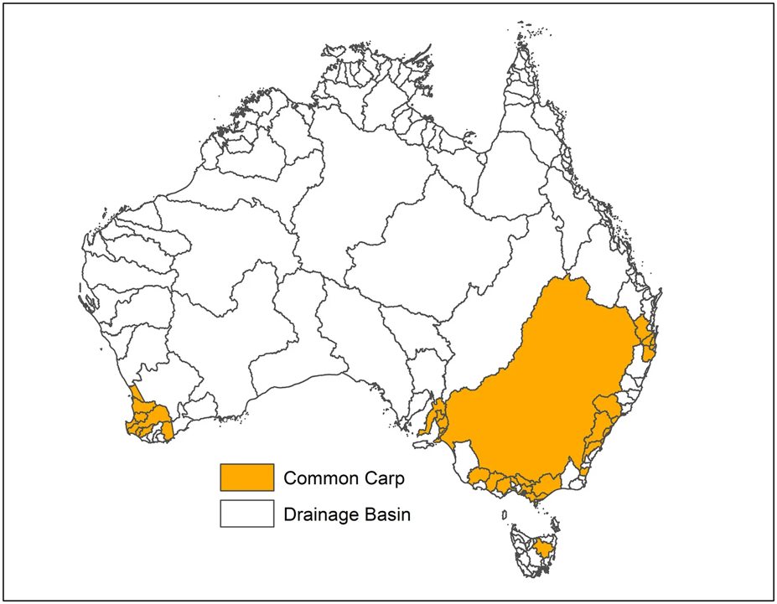
Model it
to identify emerging or future threats.
Notes:
Image; https://finterest.au/controlling-carp-numbers-biomass-modelling-to-support-native-fish-recovery/

Slide 44
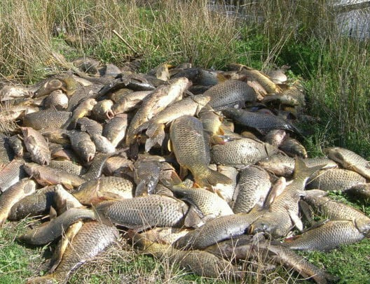
Pile of carp from cage trap. Photo credit: Invasive Animals CRC.
Remove it
Notes:
Image; https://finterest.au/controlling-carp-numbers-biomass-modelling-to-support-native-fish-recovery/
Pile of carp from cage trap. Photo credit: Invasive Animals CRC.

Slide 45
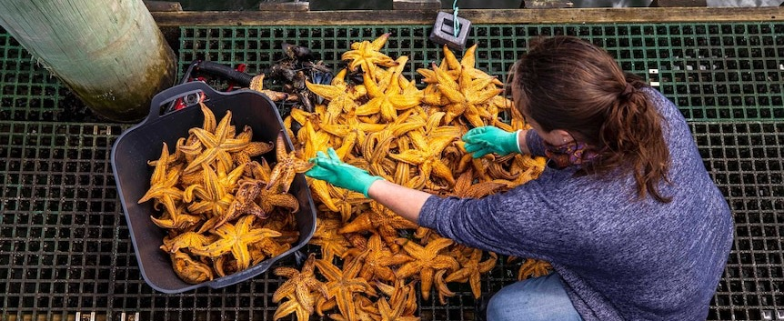
Contain it
Notes:
Image; https://www.abc.net.au/news/2021-02-20/tas-invasive-northern-pacific-seastar-removal-efforts/13164004
A pile of northern Pacific seastars collected in just minutes of diving on Hobart's waterfront.(ABC News: Luke Bowden)

Slide 46
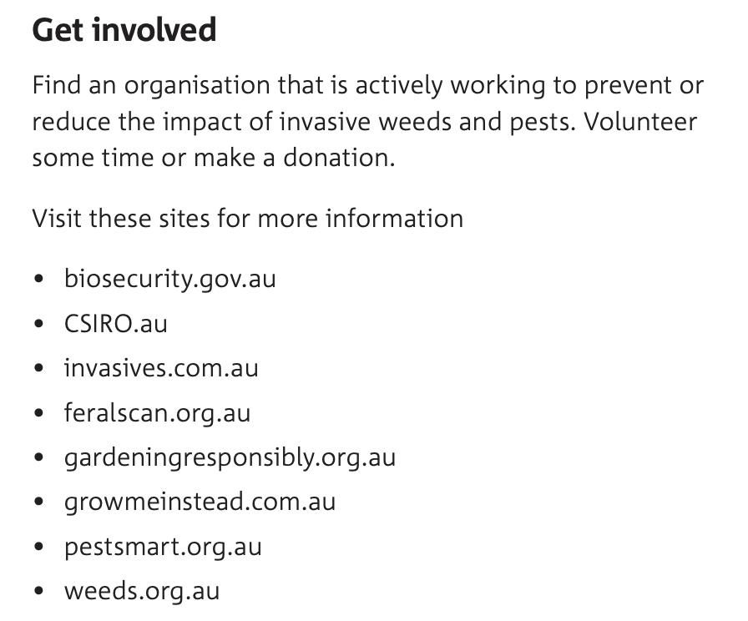
Educate
Notes:
Image Get involved: https://invasives.com.au/wp-content/uploads/2021/11/Fighting-Plagues-and-Predators-Report.pdf

Slide 47
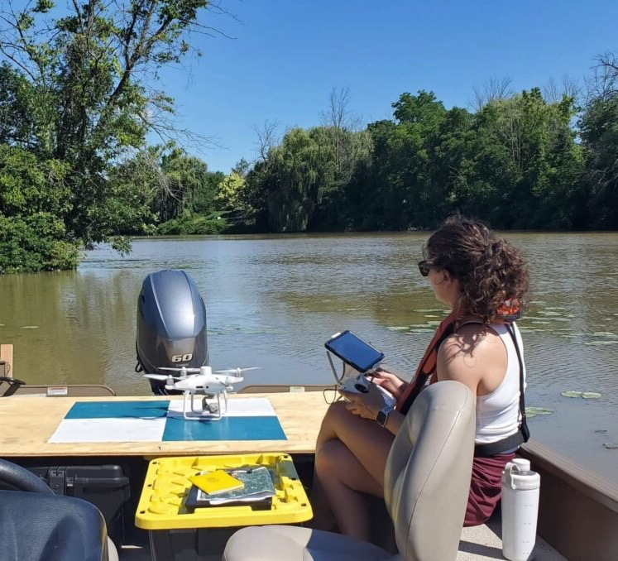
Strong surveillance
with rapid response and monitoring
AI?
Notes:
Image: https://www.ducks.ca/stories/biodiversity/putting-artificial-intelligence-to-work-identifying-invasive-species/

Slide 48

Prevention is cheaper!
Notes:
Image: https://invasives.com.au/wp-content/uploads/2021/11/Fighting-Plagues-and-Predators-Report.pdf

Slide 49

Learning Intention:
Evaluate the role of biosecurity measures in preventing or responding to incursions of invasive marine species in Australian ports.
Success Criteria:
Complete Marine Education worksheet ‘hitching a ride’
Notes:
Image: https://www.pbo.co.uk/news/the-future-of-diy-antifouling-its-apparently-in-your-gloves-24077

