Slide 1
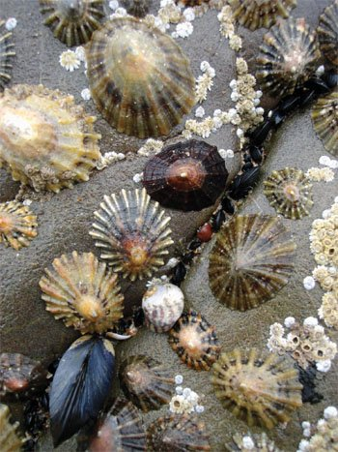
Learning Intention:
Investigate a local ecosystem to determine factors of population dynamics (e.g. density or distribution) and assess abiotic components, including:
estimating populations, e.g. survey count, quadrats, species density, percentage coverage, indirect or direct observation, catch and release
using field guides to identify to a genus level
using a range of field equipment to measure biotic factors related to marine environments
conducting in-field mapping of food webs via gut analysis to determine food sources
identifying physical structures of a specific marine organism (this could be virtual, practical or as a demonstration).
Success Criteria:
Complete Marine Education worksheet ‘rocky shore rambler’
Notes:
Image: https://answersingenesis.org/kids/sea-animals/common-limpet/

Slide 2
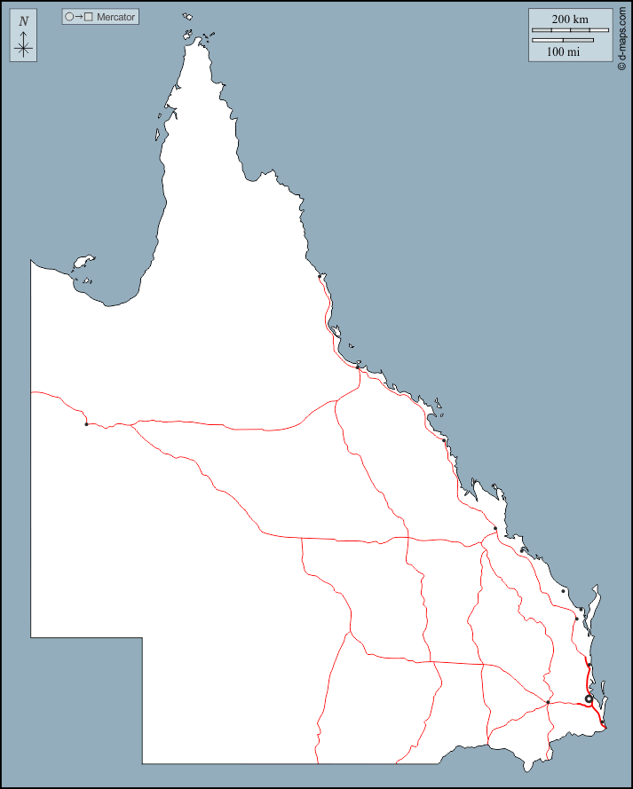
Populations can exist across large spatial scales (long distances)

Slide 3
When we can’t count them all at once,
we instead count a sample of the population to estimate total population size.
And with further calculations, estimate population density as well.

Slide 4
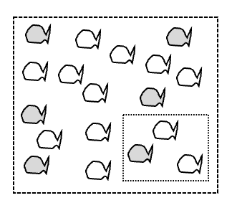
Total population (what you can’t see)
Estimating total population size:
Count within a smaller sample area and then do math to estimate (multiply to)
total population size.
Sample area

Slide 5
Why estimate population size?
To calculate how many we can sustainably harvest or need to protect!

Slide 6
Direct vs Indirect Observation
(within the sample)

Slide 7
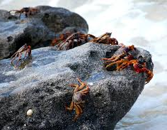
E.g. how many crabs?
Sometimes you can see
(and therefore count) them directly.
This is called
direct observation.
Notes:
Image: https://www.reefconservation.mu/gallery/discover-the-marine-environment/rocky-shores/

Slide 8
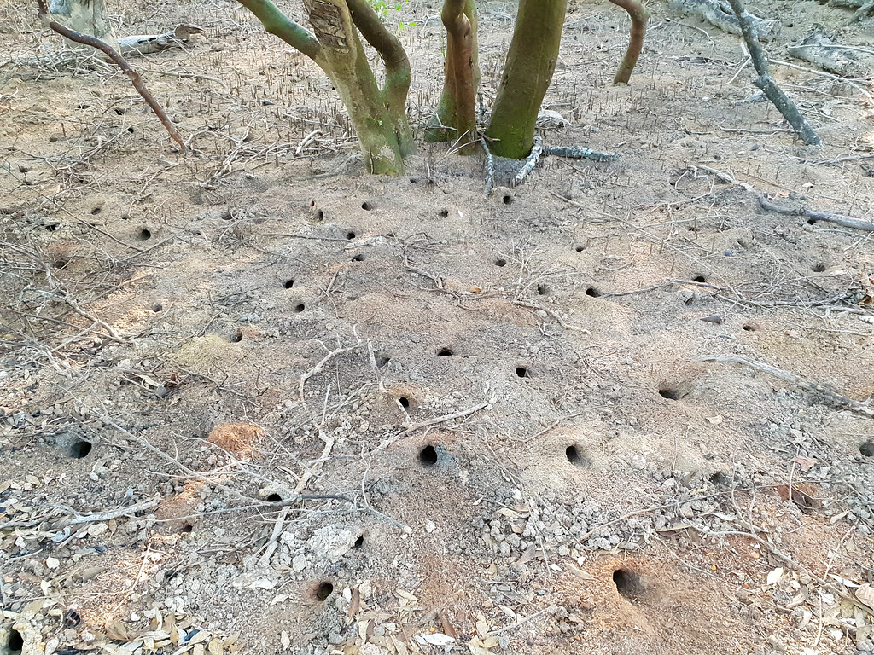
E.g. how many crabs?
Sometimes you can only observe ‘signs’ they leave behind.
This is called
indirect observation.
Notes:
Image; https://www.flickr.com/photos/centralaustralia/43124074311

Slide 9
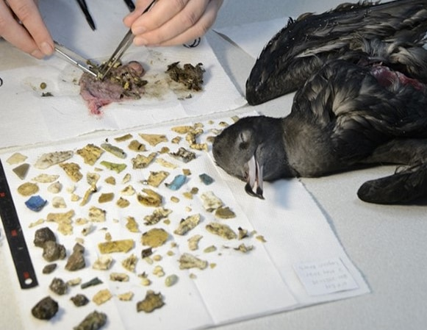
E.g. how much microplastic?
MUST OBTAIN ETHICS APPROVAL FIRST!!!
Ingested plastic from the stomach of a flesh-footed shearwater (mutten) bird.(Supplied: Silke Stuckenbrock)
Notes:
Image: https://www.abc.net.au/news/2023-03-06/plasticosis-disease-lorde-howe-island-seabirds-researchers/102058266

Slide 10
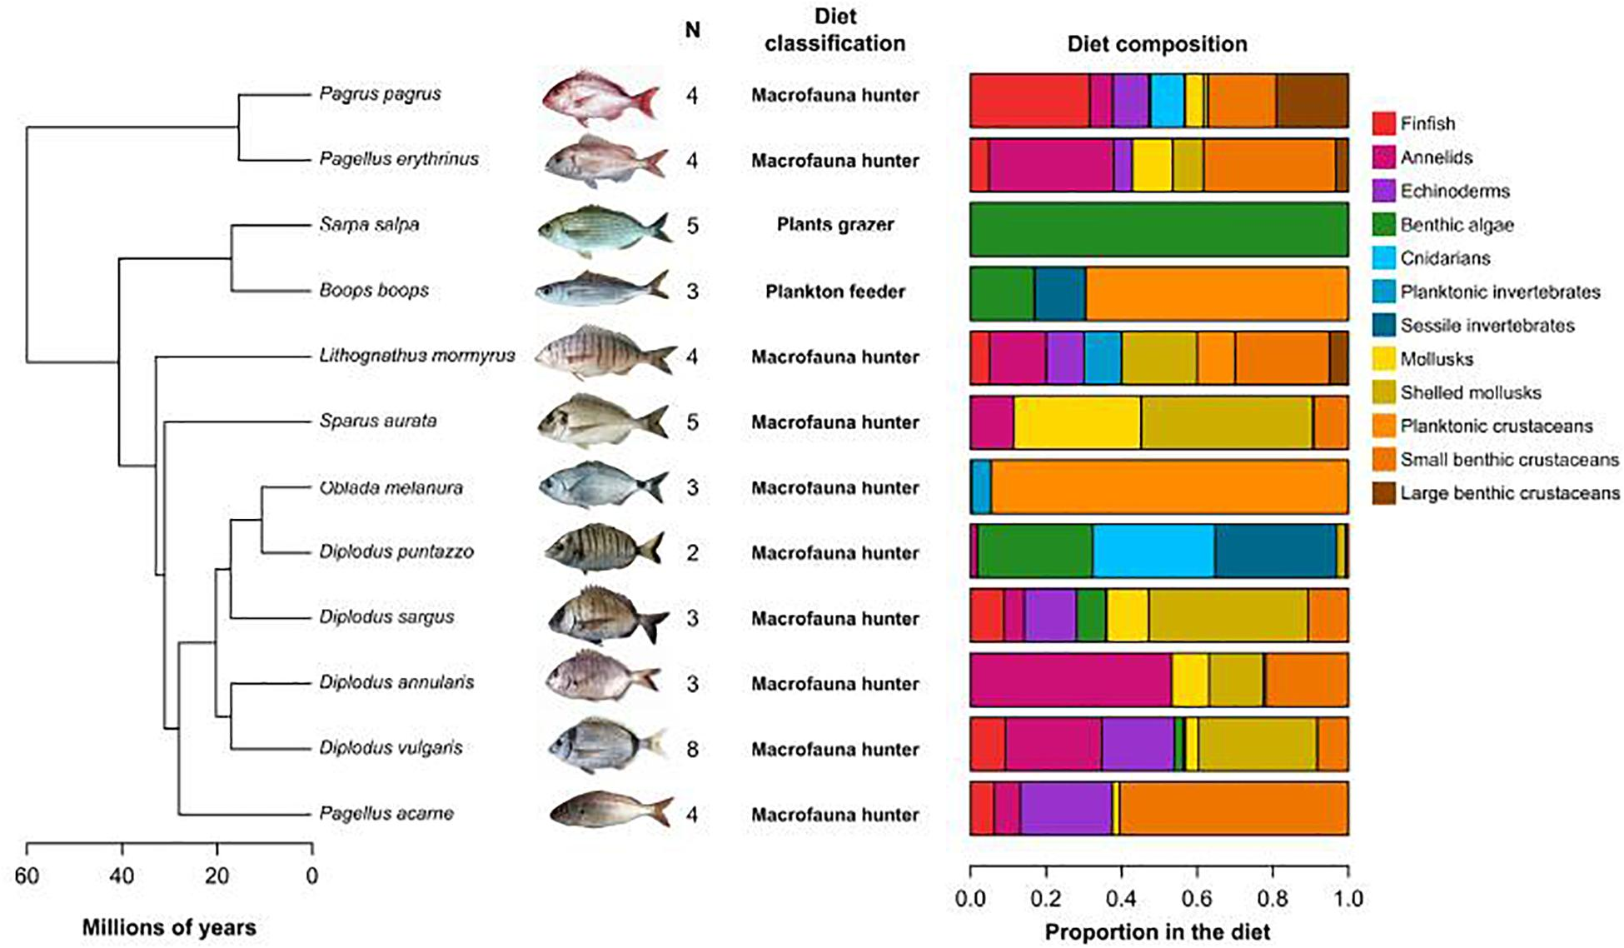
E.g. what did it eat?
FIGURE 1. Phylogenetic relatedness and diet of the 12 studied species. Phylogeny of the Sparidae used in this study (from Santini et al., 2014). N is the number of individuals analyzed per species. Diet classification and proportions of food items in the diet were collected in FishBase.. Source: Escalas Arthur, Auguet Jean-Christophe, Avouac Amandine, Seguin Raphaël, Gradel Antoine, Borrossi Lucie, Villéger Sébastien (2021). Ecological Specialization Within a Carnivorous Fish Family Is Supported by a Herbivorous Microbiome Shaped by a Combination of Gut Traits and Specific Diet. Frontiers in Marine Science. Vol.8. DOI=10.3389/fmars.2021.622883
Notes:
Image: https://www.frontiersin.org/articles/10.3389/fmars.2021.622883/full
Escalas Arthur, Auguet Jean-Christophe, Avouac Amandine, Seguin Raphaël, Gradel Antoine, Borrossi Lucie, Villéger Sébastien (2021).
Ecological Specialization Within a Carnivorous Fish Family Is Supported by a Herbivorous Microbiome Shaped by a Combination of Gut Traits and Specific Diet. Frontiers in Marine Science. Vol.8. DOI=10.3389/fmars.2021.622883

Slide 11
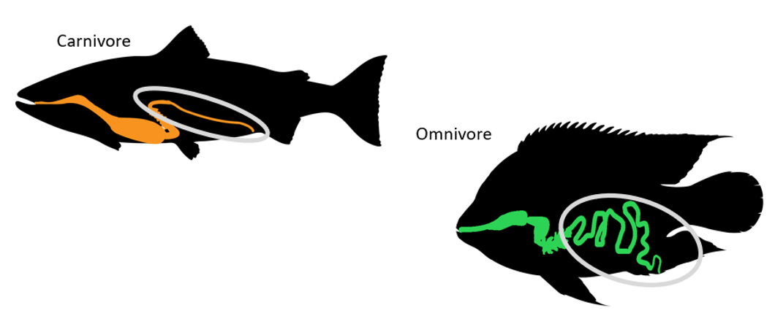
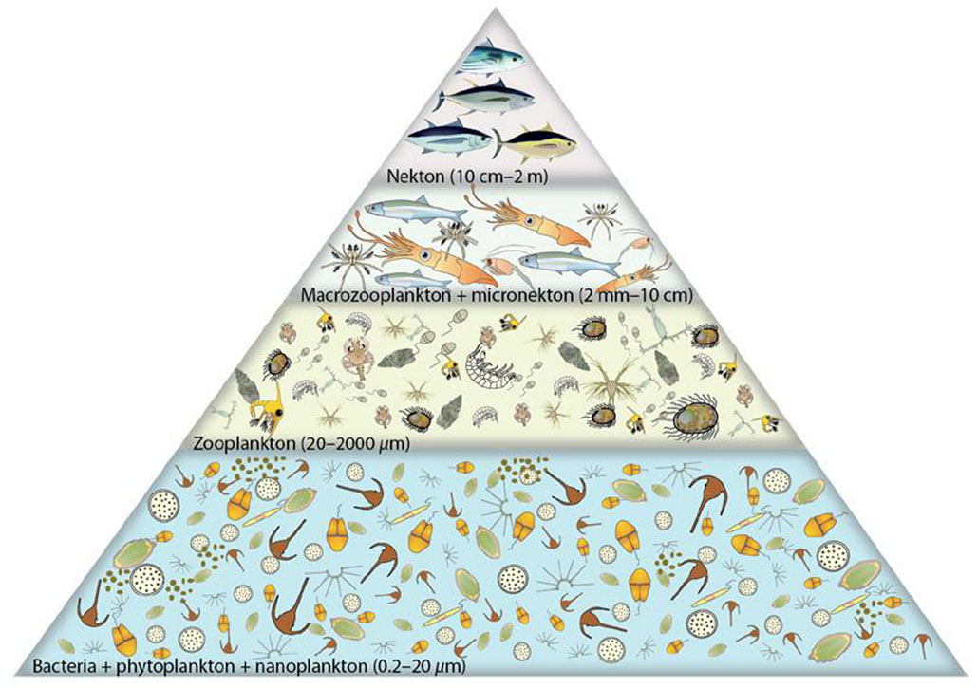
Notes:
Image (fish): https://www.open.edu/openlearncreate/mod/page/view.php?id=180457
Image (Food pyramid): https://pirca.org/2016/04/22/generalized-trophic-pyramid-for-the-tropical-pacific-ocean/

Slide 12
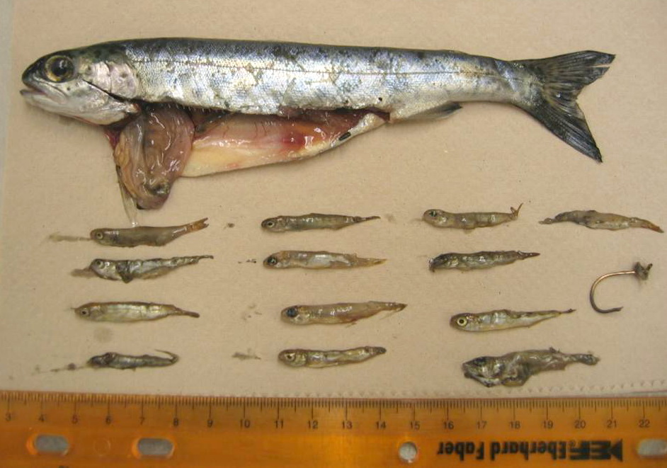
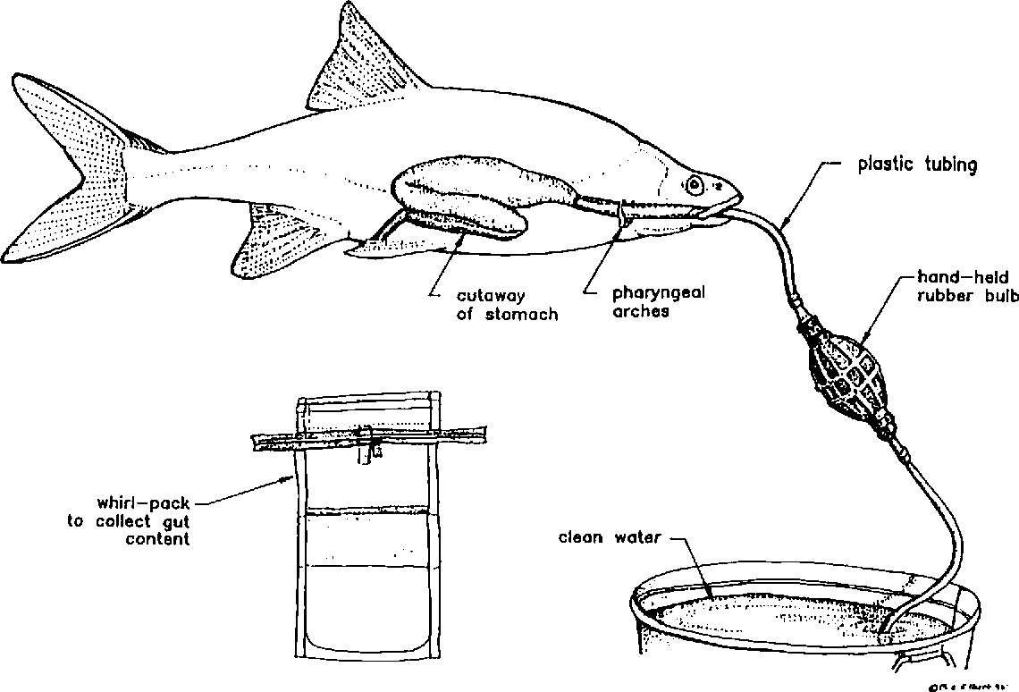
conducting in-field mapping of food webs via gut analysis to determine food sources
MUST OBTAIN ETHICS APPROVAL FIRST!!!
Notes:
Image (left): https://fishpathogens.net/image/stomachcontentcb01jpg
Image (Right): https://www.semanticscholar.org/paper/A-Nonlethal-Technique-to-Recover-Gut-Contents-of-Wasowicz-Valdez/7044faf9e20be42cce9a59584cd32cf06db54e6a/figure/0

Slide 13
Sampling equipment
(examples)

Slide 14
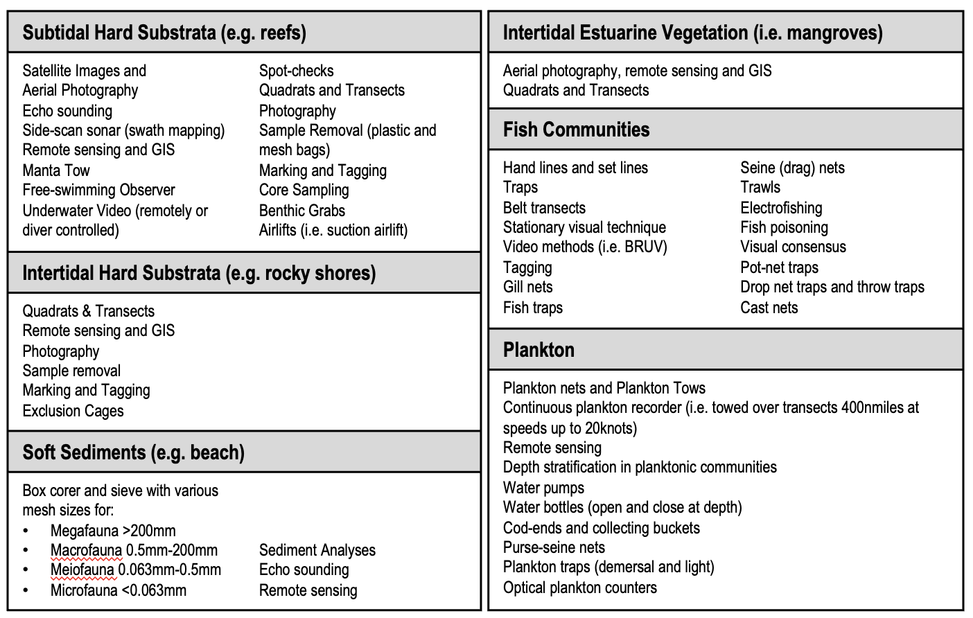
What to use?
Your choice of sampling technique and equipment depends on:
the environment that you are sampling,
the scale of the sample question,
the size and mobility of the organisms, and
time and budget constraints.
Notes:
Image:

Slide 15
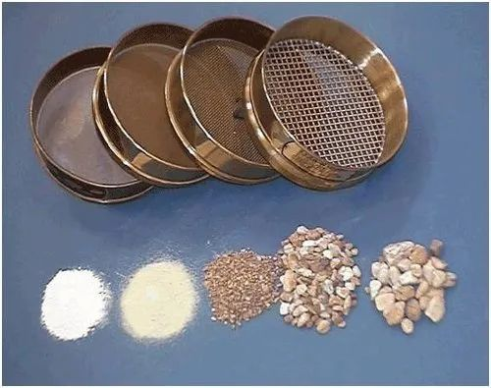
SEIVES
Notes:
Image: https://www.indiamart.com/proddetail/sieve-set-22032718930.html

Slide 16
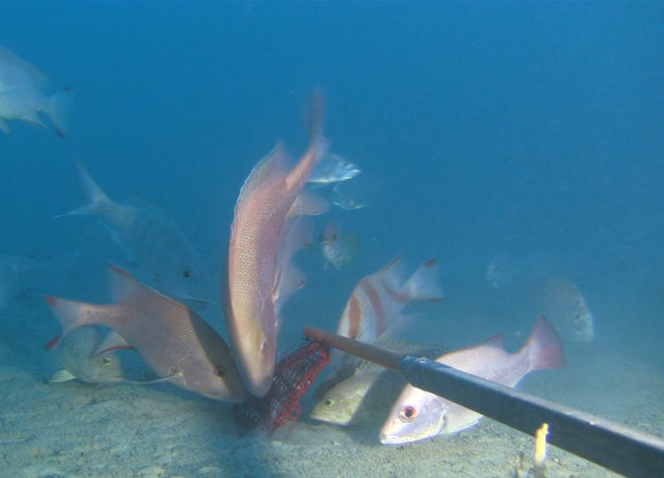
BAITED CAMERAS
Notes:
Image: https://blog.csiro.au/nice-one-bruv-counting-deep-water-fish-at-ningaloo-reef/

Slide 17
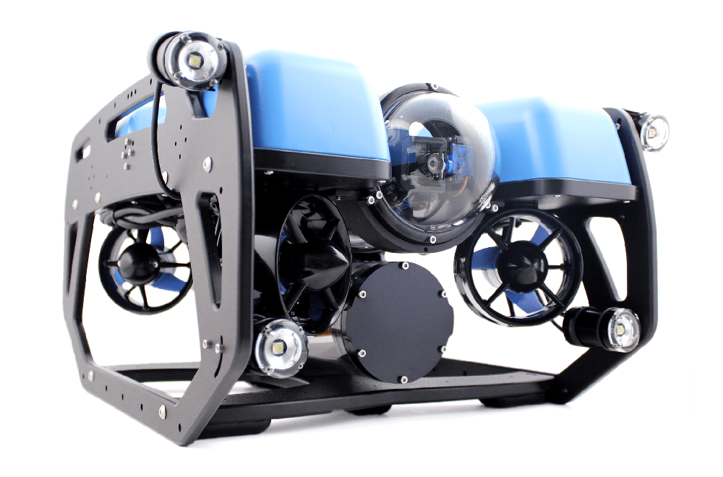
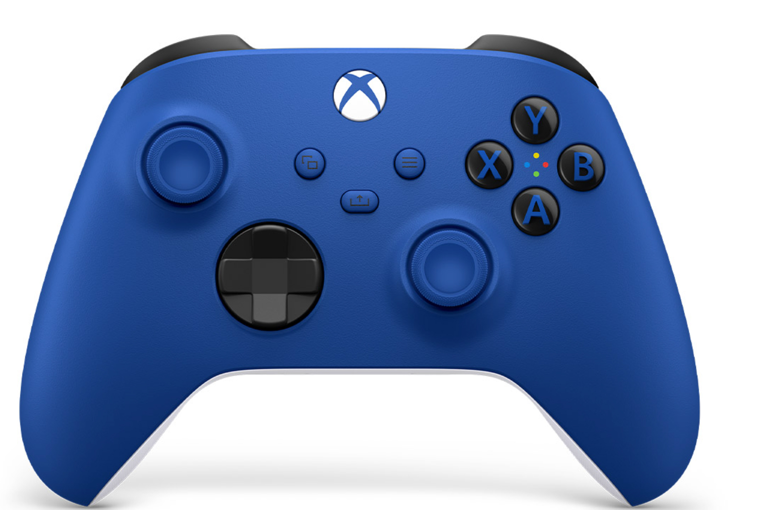
BlueROV2
REMOTE OPERATED CAMERAS
Notes:
Image; https://www.seaviewsystems.com/products/blue-robotics-bluerov2-and-accessories/blue-robotics-bluerov2/
Image (Controller): https://bluerobotics.com/store/rov/bluerov2-accessories/xbox-controller/

Slide 18
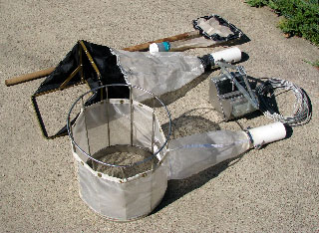
SAMPLING NETS and BENTHIC GRABS
Notes:
Image: https://www.aquaticbio.com/services/supply-sources/sampling-equipment/

Slide 19
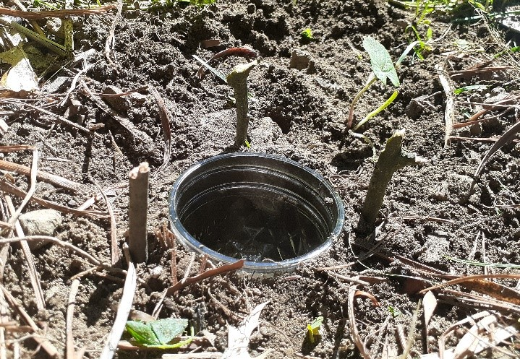
PITFALL TRAPS

Slide 20
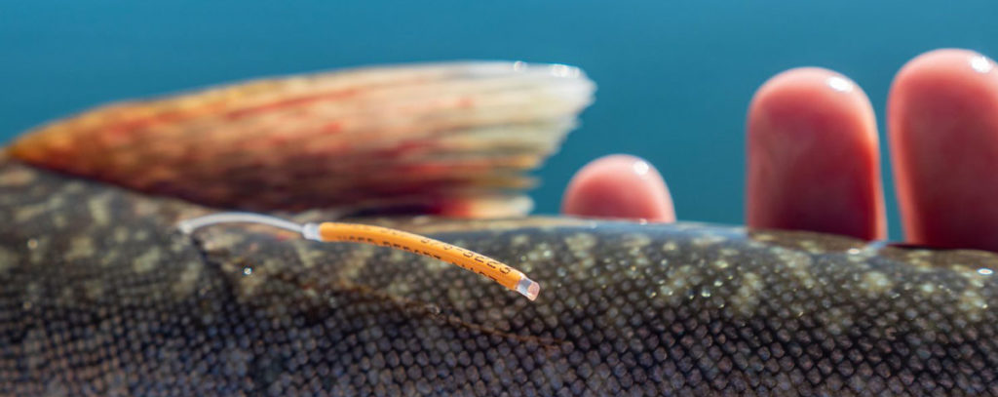
TAGS
Used when organisms do NOT remain stationary long enough for you to count them
Notes:
Image:

Slide 21
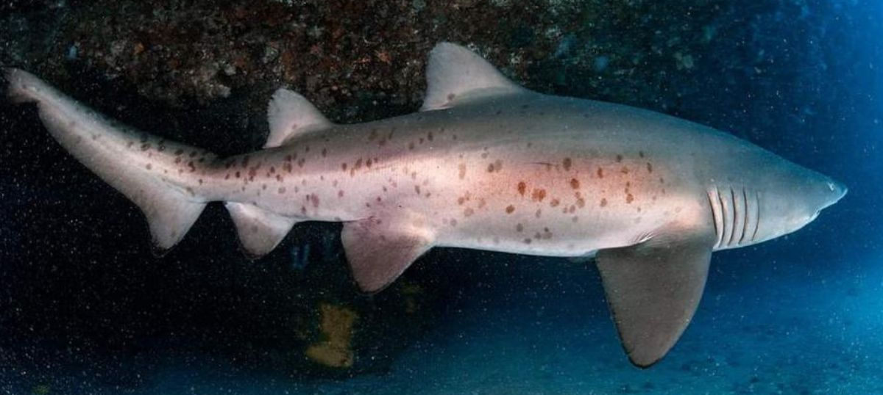
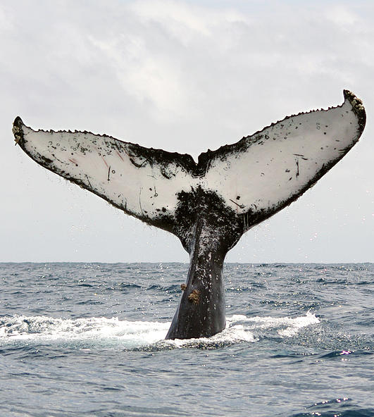
TAGS
Natural markings as tags (non-invasive)
Notes:
Image:

Slide 22
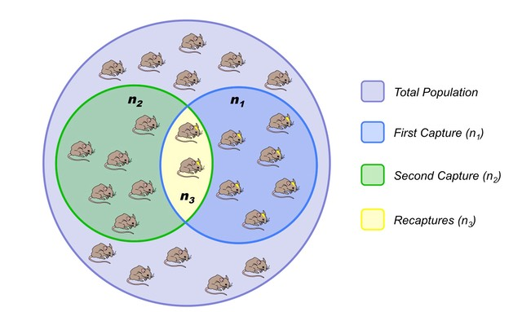
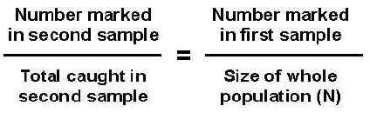
TAGS
E.g. Mark capture/recapture method & Lincoln Index
You will do this in year 12
Notes:
Image: https://ib.bioninja.com.au/options/option-g-ecology-and-conser/g5-population-ecology.html
Image (right): http://www.countrysideinfo.co.uk/lincoln.htm

Slide 23
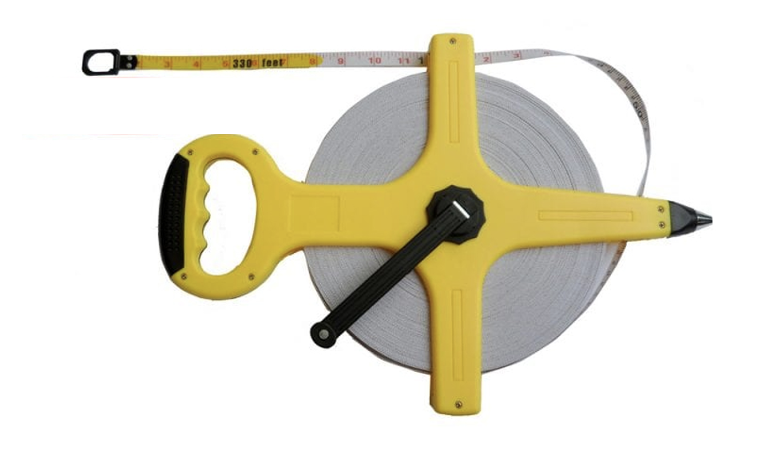
TRANSECT
Used when organisms remain stationary long enough for you to count them
Notes:
Image:

Slide 24
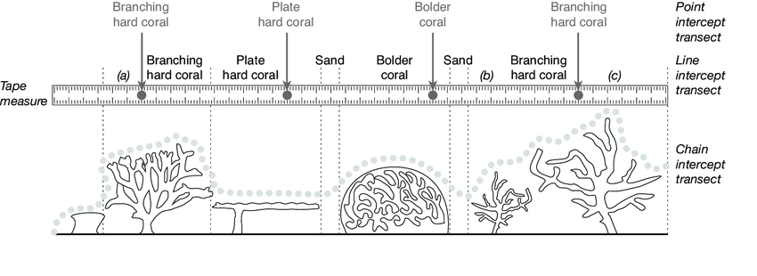
TRANSECT
Hill, Jos & Wilkinson, Clive. (2004). Methods for Ecological Monitoring of Coral Reefs.
E.g. Point intercept, line intercept and chain intercept methods
Source: Hill, Jos & Wilkinson, Clive. (2004). Methods for Ecological Monitoring of Coral Reefs.
Notes:
Image:https://www.researchgate.net/figure/A-comparison-of-point-intercept-transect-PIT-line-intercept-transect-LIT-and-chain_fig1_242384503
Paper: Hill, Jos & Wilkinson, Clive. (2004). Methods for Ecological Monitoring of Coral Reefs.

Slide 25
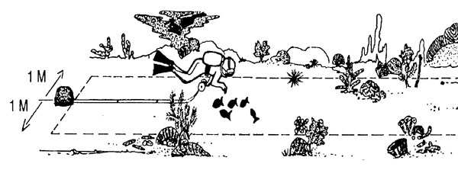
TRANSECT
E.g. Belt transect (distance either side of transect)

Slide 26
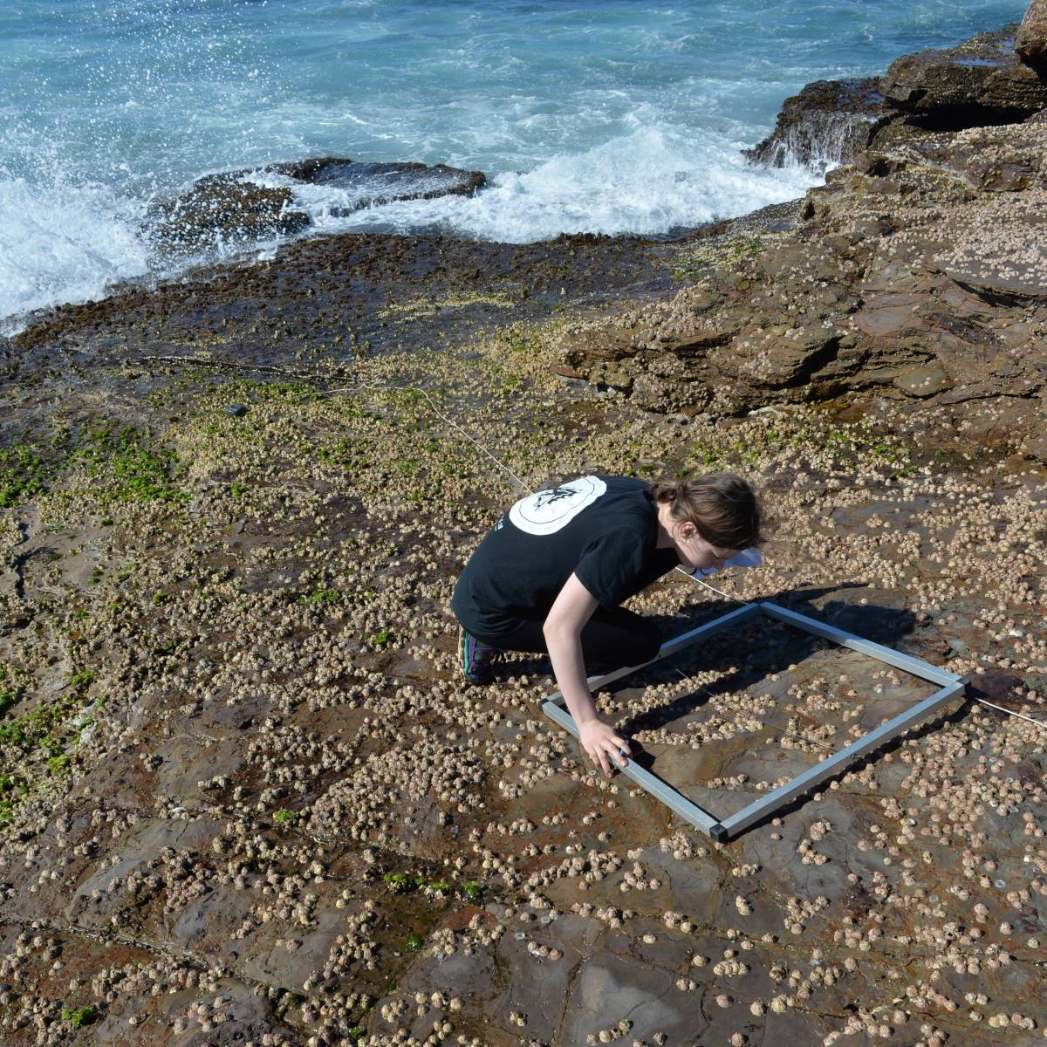
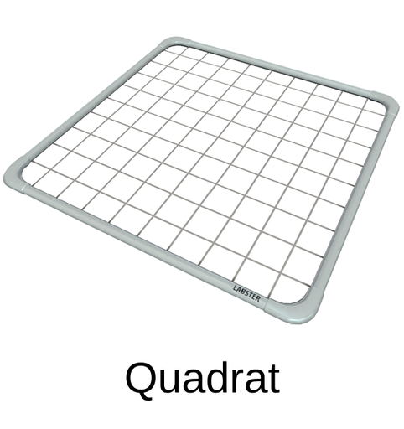
TRANSECT
E.g. Quadrat method
Notes:
Image: https://www.auseco.com.au/index.asp?pagename=Independent+Research+Project

Slide 27
Identify EVERYTHING inside the quadrat by Genus name
or assign to a (pre-determined) category
1m
Genus | #
Category | #
Hard coral
Soft Coral
Brown algae
Coralline algae
1m
OR
etc….
Notes:
Image:

Slide 28
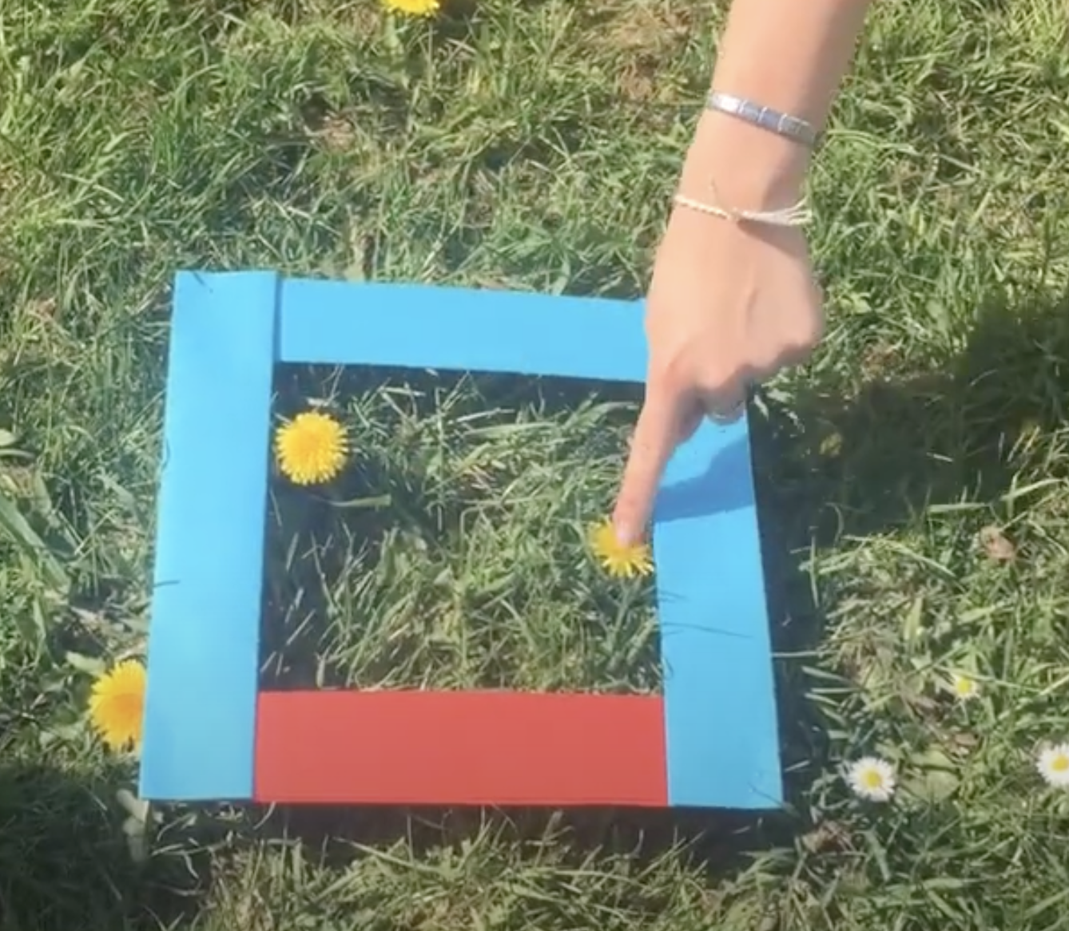

to either TALLY (count)….
5
Notes:
Image:

Slide 29
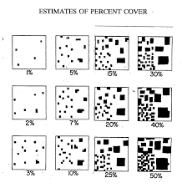
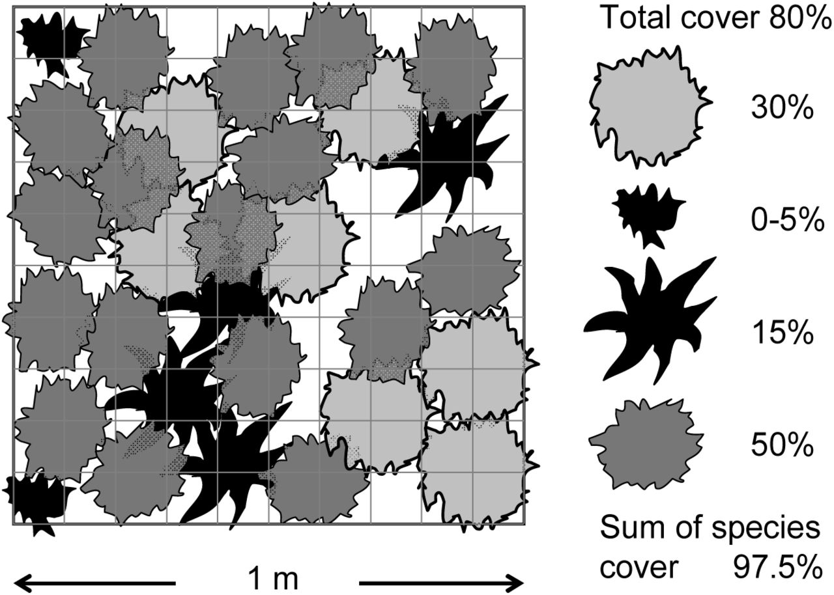
or estimate PERCENTAGE cover
For example:
Notes:
Image (left): https://www.mvp.usace.army.mil/portals/57/docs/regulatory/regulatorydocs/hydrophyticvegetationapril2010.pdf
Image (right): https://www.biorxiv.org/content/10.1101/012716v2.full

Slide 30
Alternatively….
place DOTS in a quadrat and IDENTIFY what’s under each dot.
Dots are either randomly or evenly placed.
Random
Even
Notes:
Image:

Slide 31
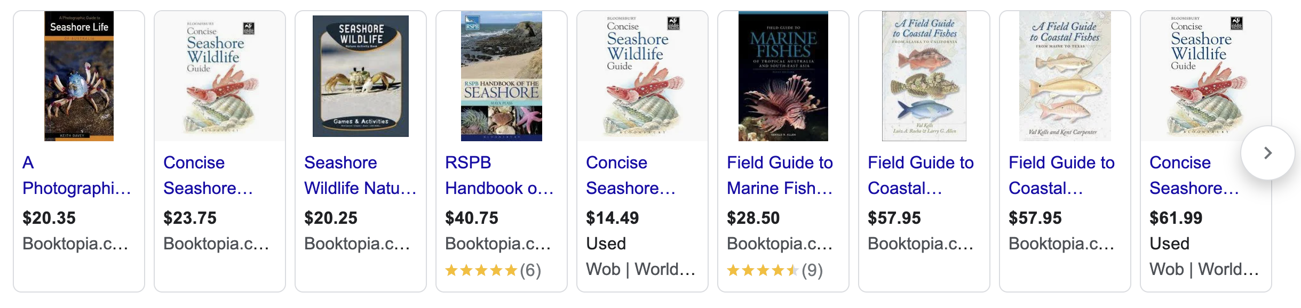
Use field guides to identify to a Genus level
Notes:
Image:

Slide 32
The ecosystem we will be investigating is the
rocky shore, using the quadrat/transect method

Slide 33
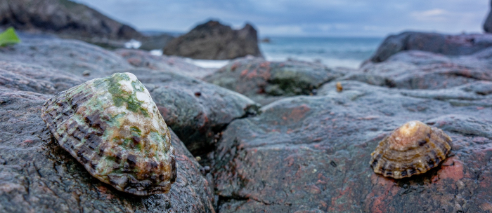
First, let’s meet the stars of the show…
Identify physical structures of each:
Notes:
Image: https://anyquestions.govt.nz/many-answers/rocky-shore-new-zealand

Slide 34
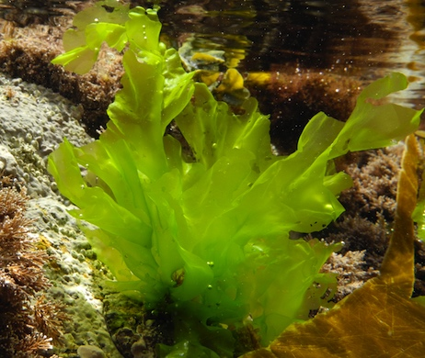
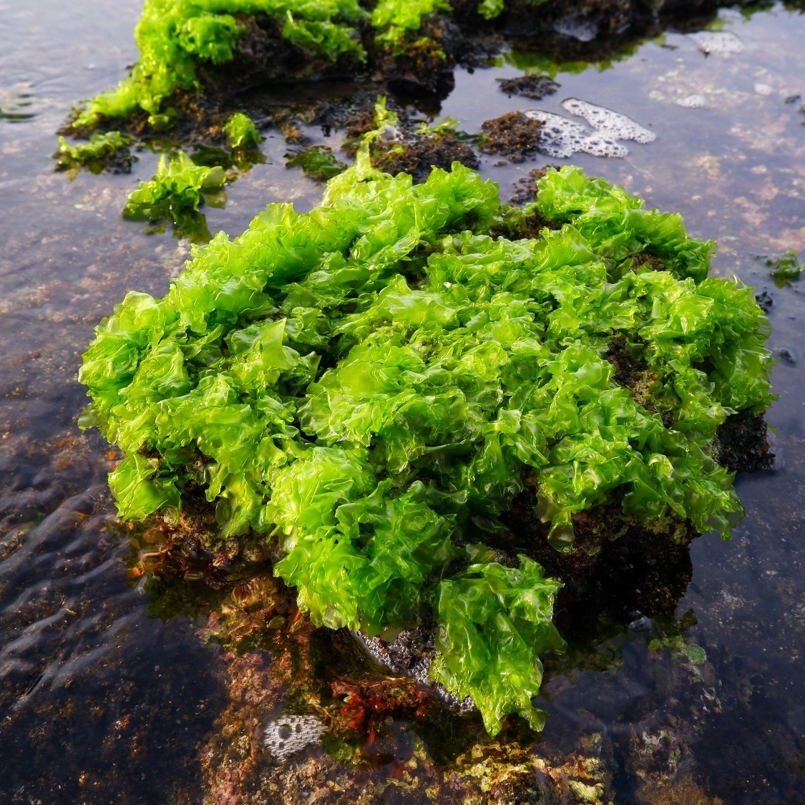
Green algae (seaweed)
Sea lettuce (Ulva sp.)

Slide 35
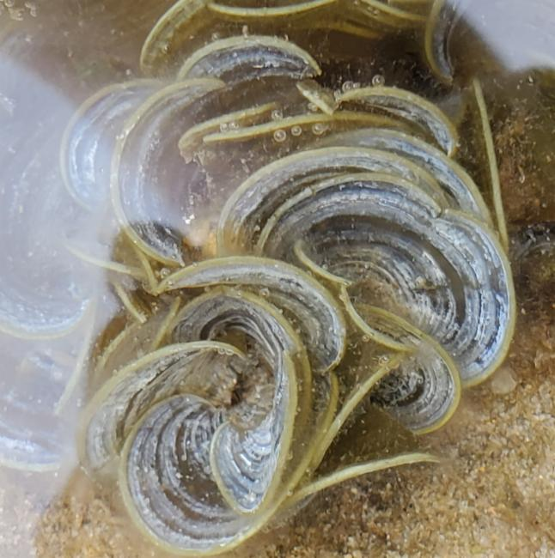
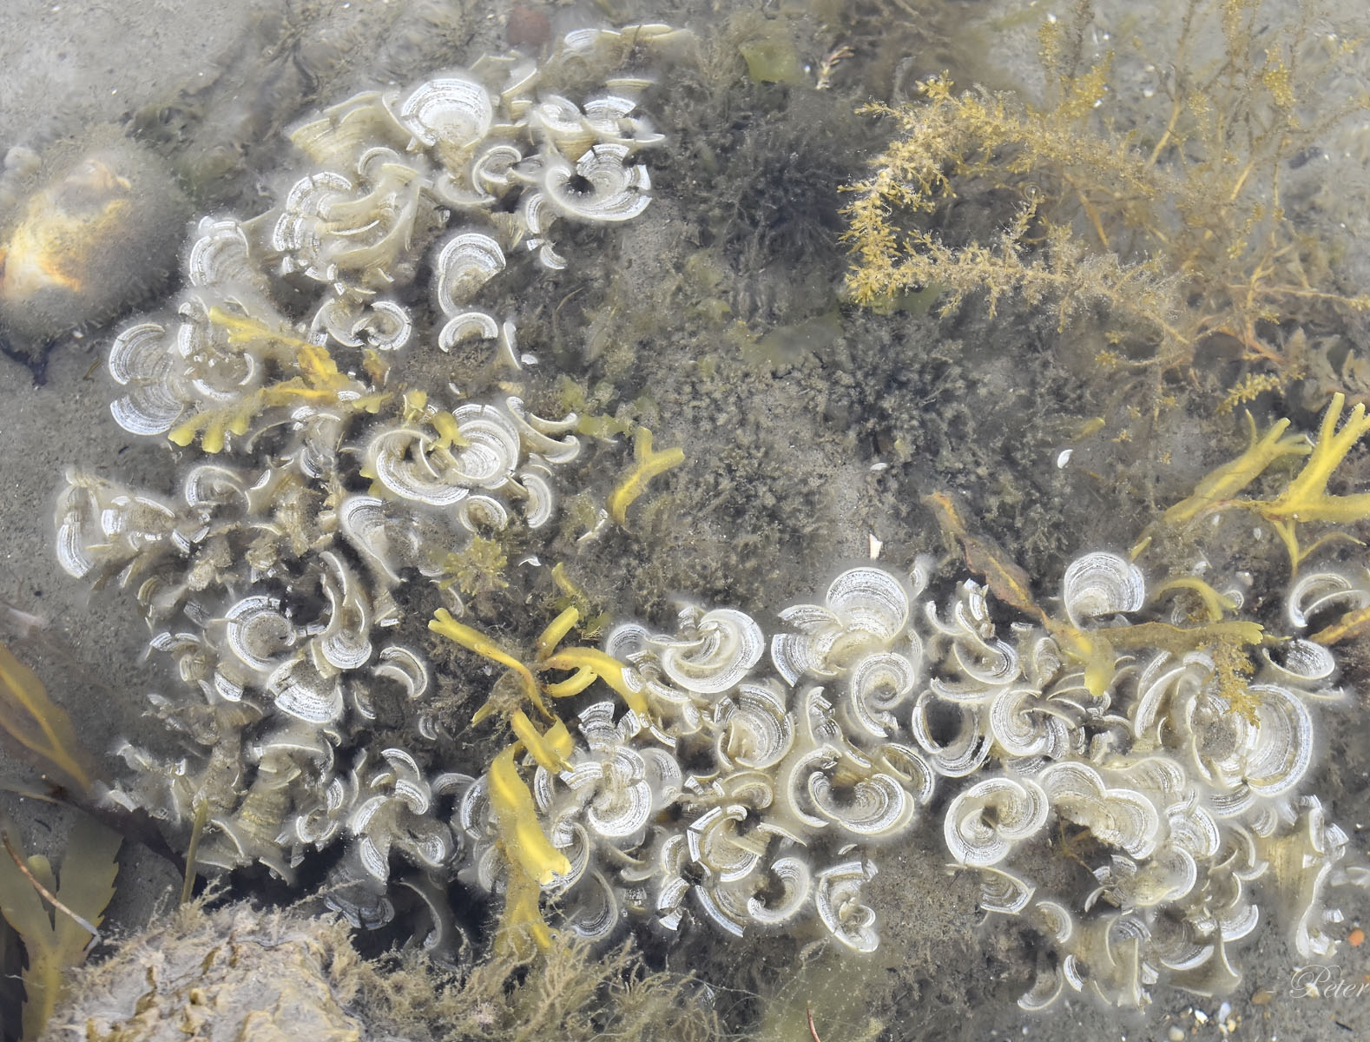
Brown algae (seaweed)
Peacocks Tail (Padina sp.)

Slide 36
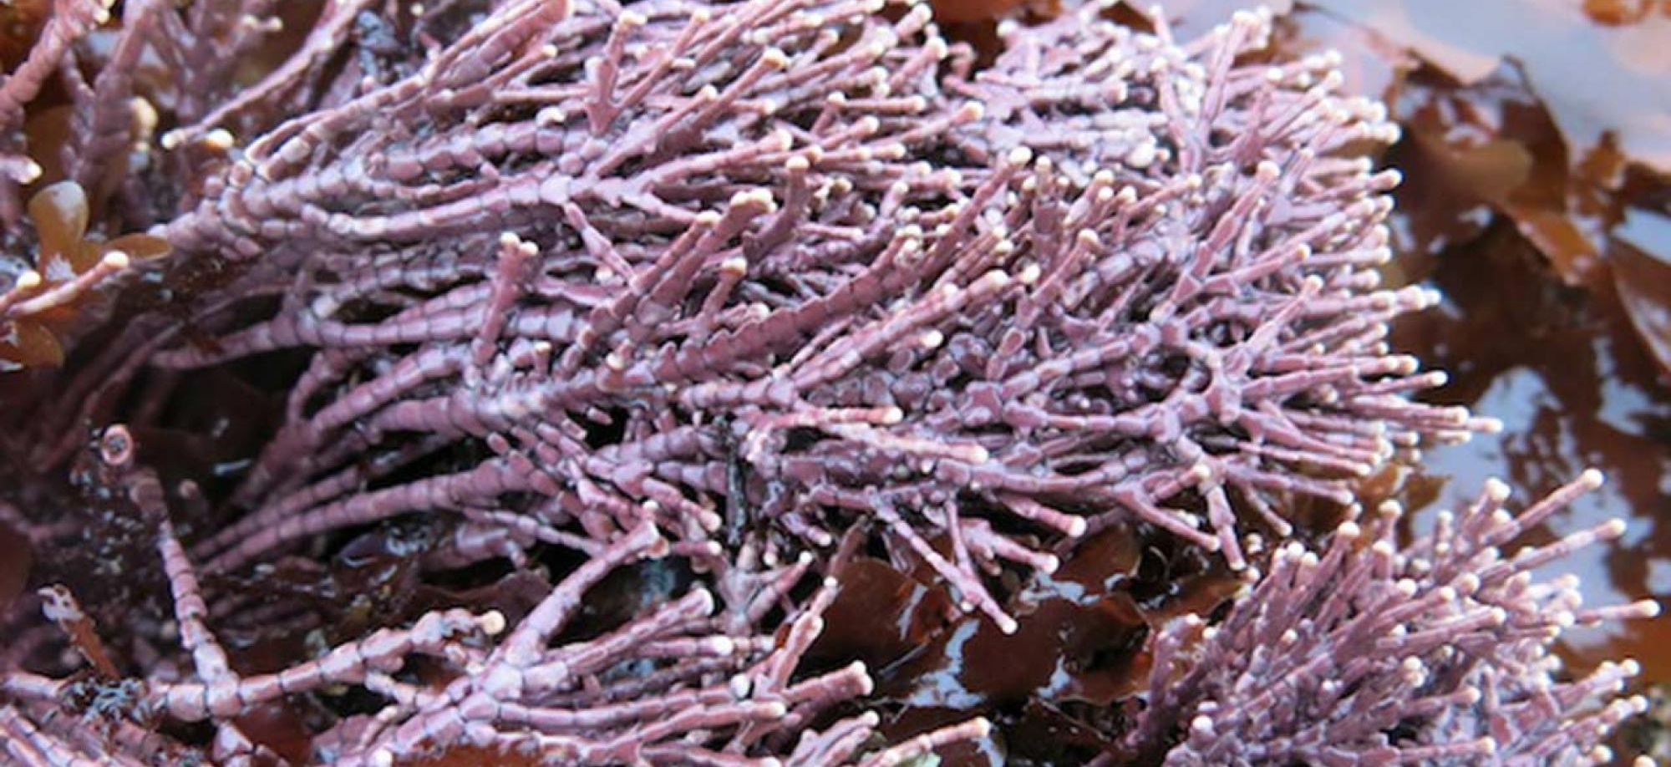
Red algae (seaweed)
red coralline algae

Slide 37
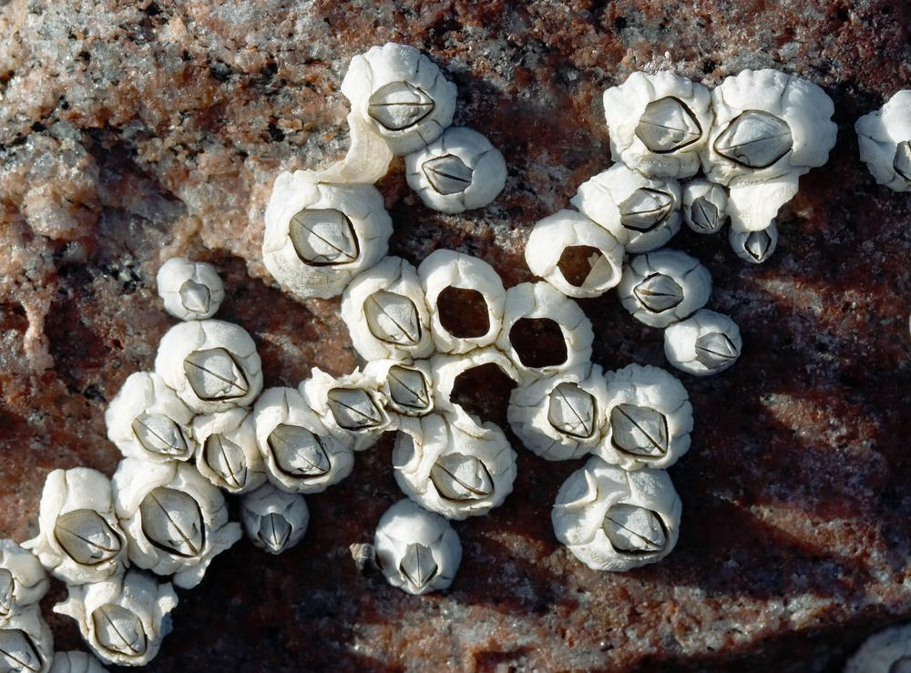
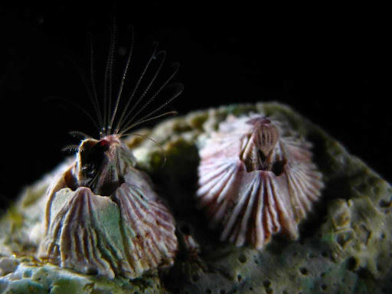
Barnacles
Notes:
Image: https://biol326.wordpress.com/2020/04/16/barnacles-who-turned-on-the-light/

Slide 38
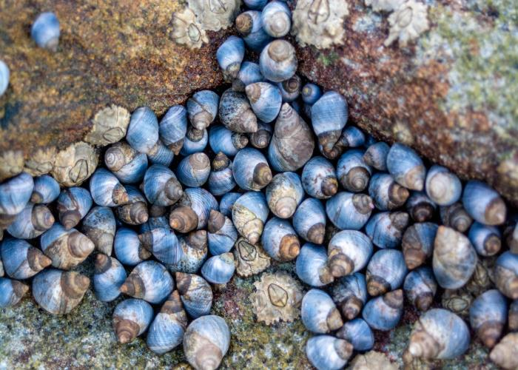
Blue Periwinkles
Notes:
Image: https://www.sunshinecoast.qld.gov.au/environment/education-resources-and-events/environment-resources-and-publications/coast-and-marine/rocky-shore-species-identification
Info: https://australian.museum/learn/animals/molluscs/little-blue-periwinkle/

Slide 39
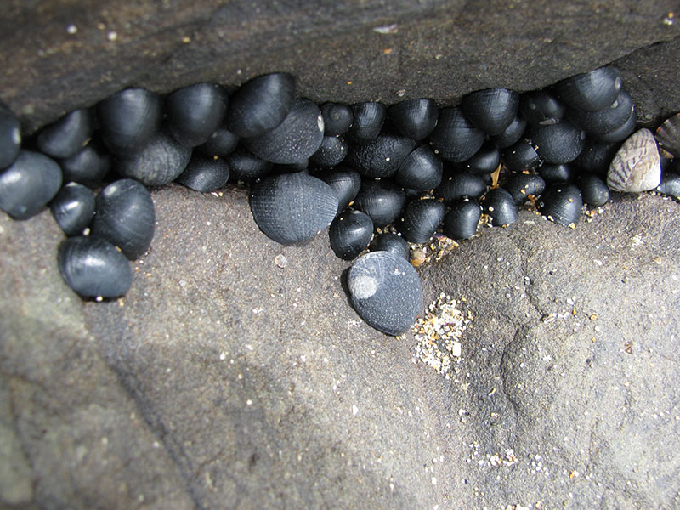
Black nerite
Notes:
Image: https://www.dpi.nsw.gov.au/fishing/marine-protected-areas/aquatic-reserves/long-reef-aquatic-reserve/meet-some-of-the-locals

Slide 40
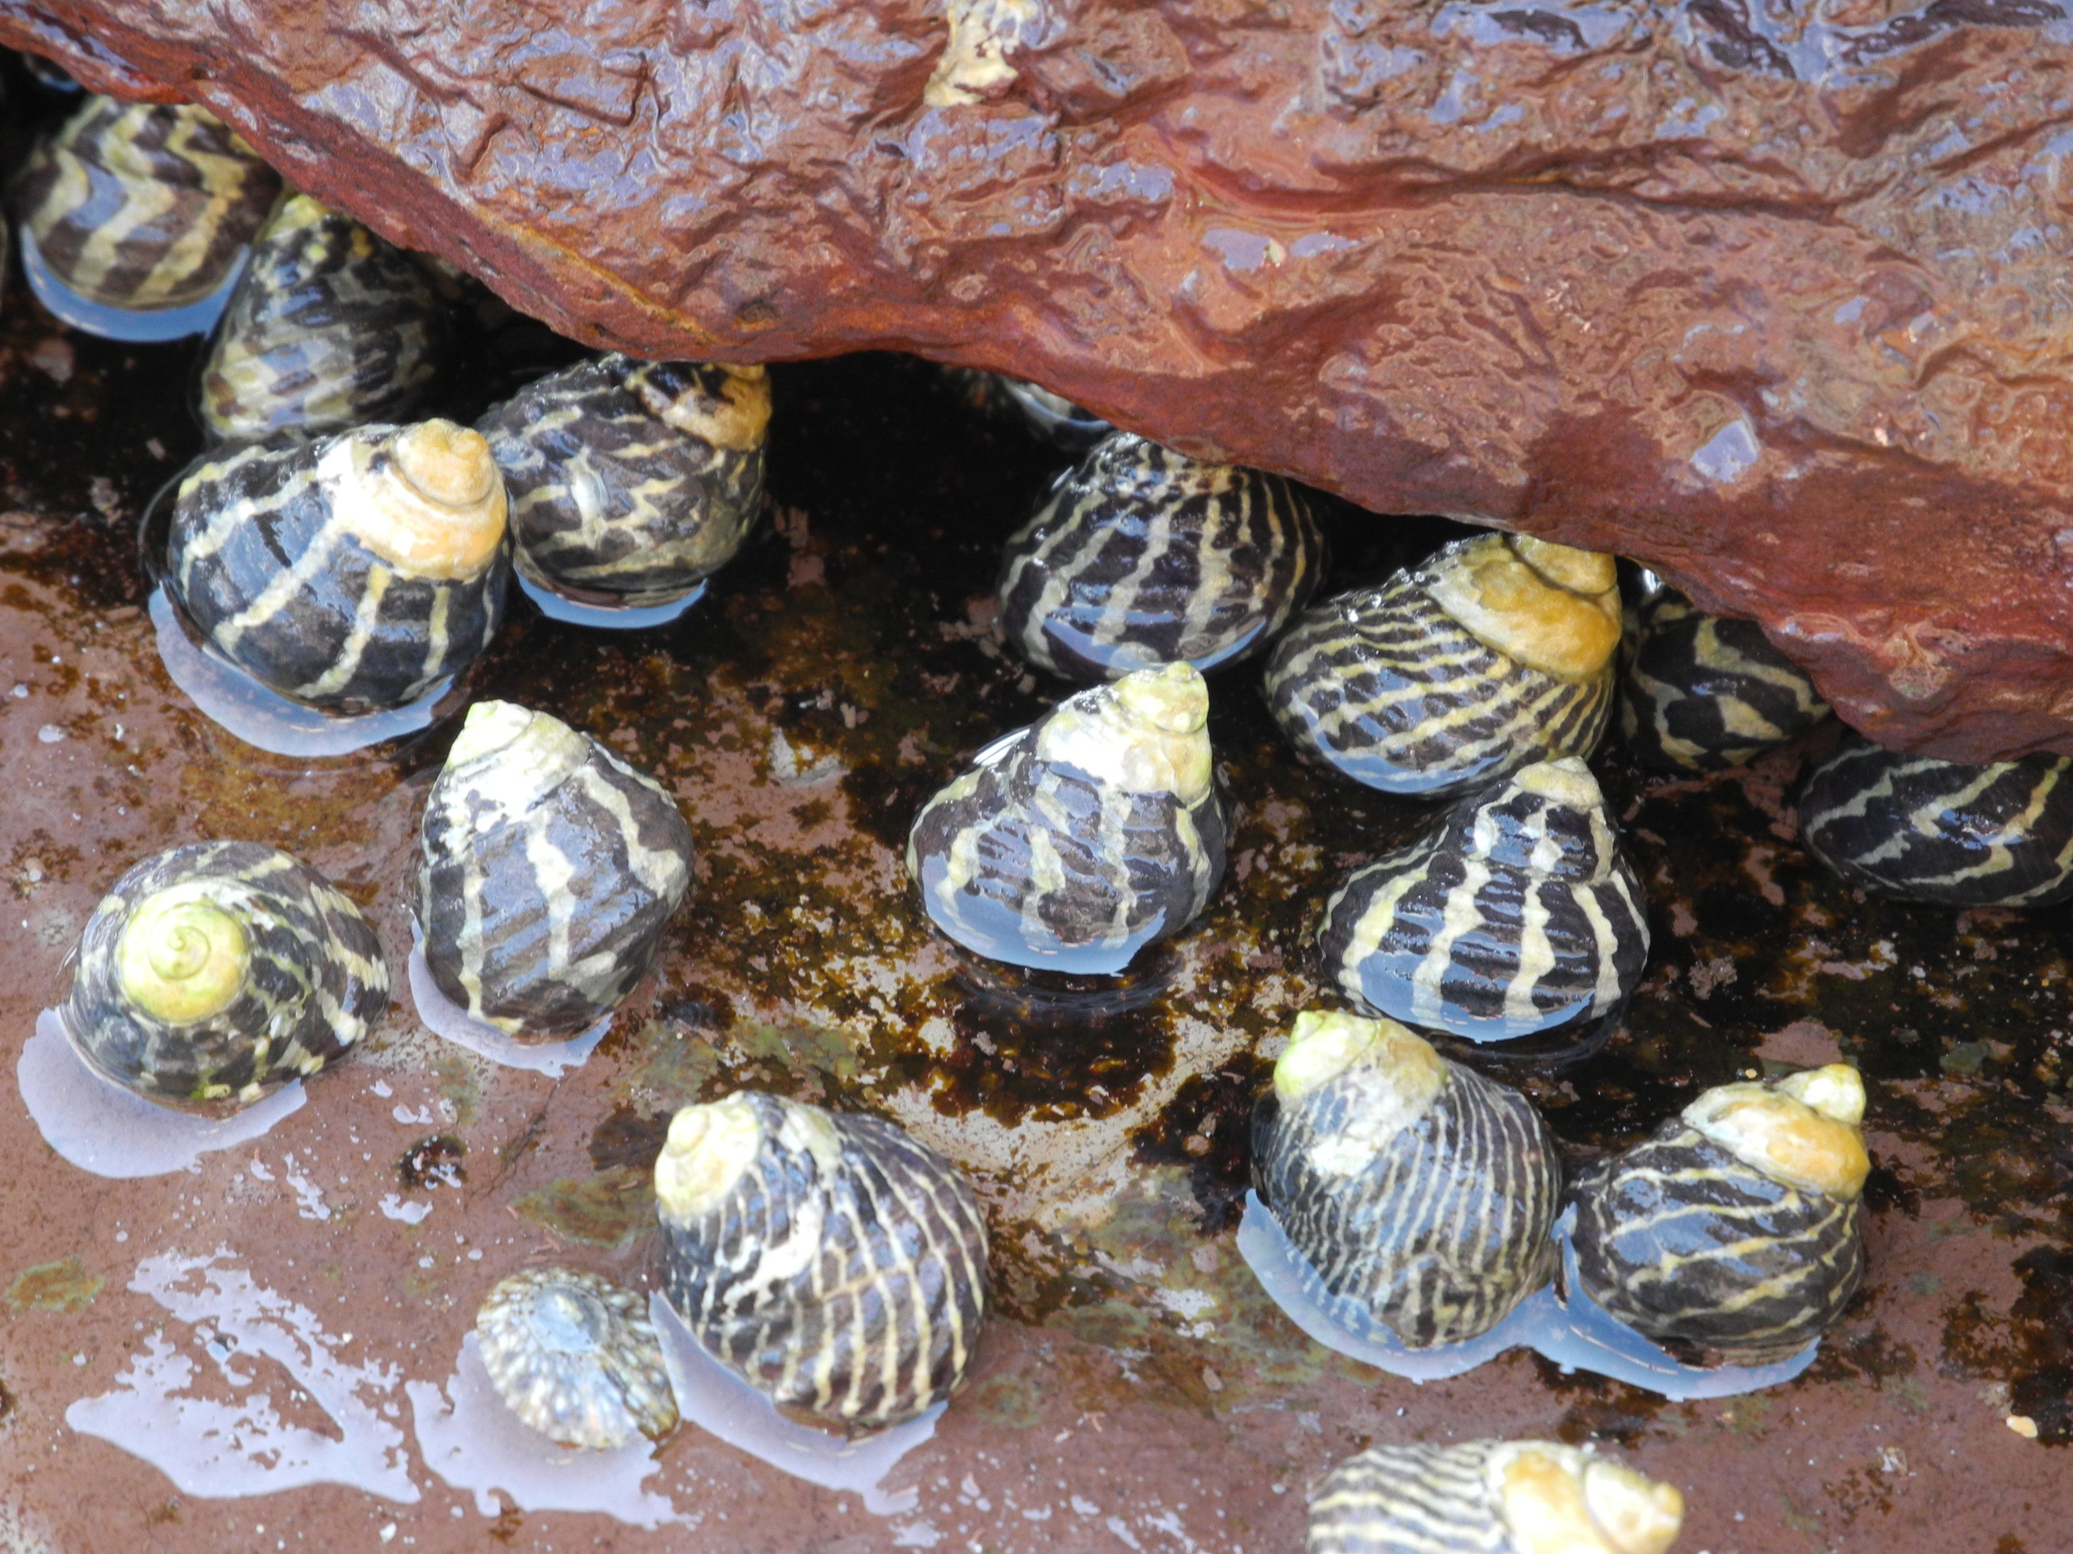
Zebra shells (Austrocochlea species)

Slide 41
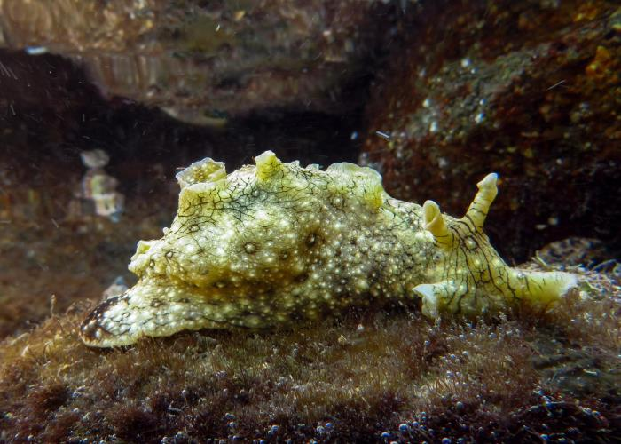
Sea hare (nudibranch)
Notes:
Image: https://www.sunshinecoast.qld.gov.au/environment/education-resources-and-events/environment-resources-and-publications/coast-and-marine/rocky-shore-species-identification

Slide 42
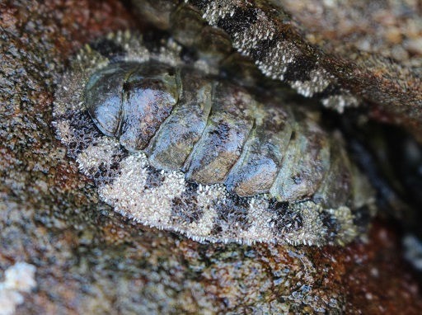
Chitons
Notes:
Image: https://www.sunshinecoast.qld.gov.au/environment/education-resources-and-events/environment-resources-and-publications/coast-and-marine/rocky-shore-species-identification

Slide 43
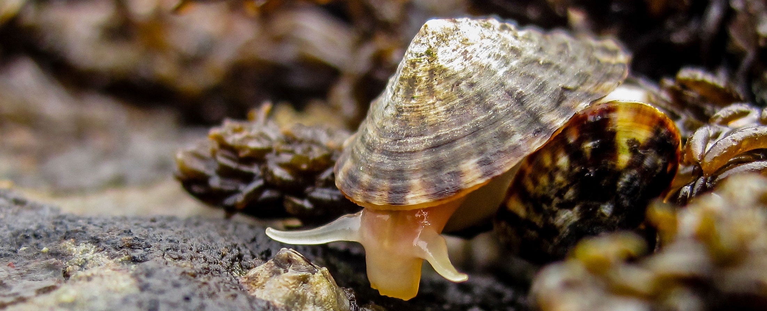
Limpets
sometimes called, chinese hats
Notes:
Image: https://hakaimagazine.com/news/how-tiny-limpets-do-the-heavy-lifting-of-climate-resilience/

Slide 44
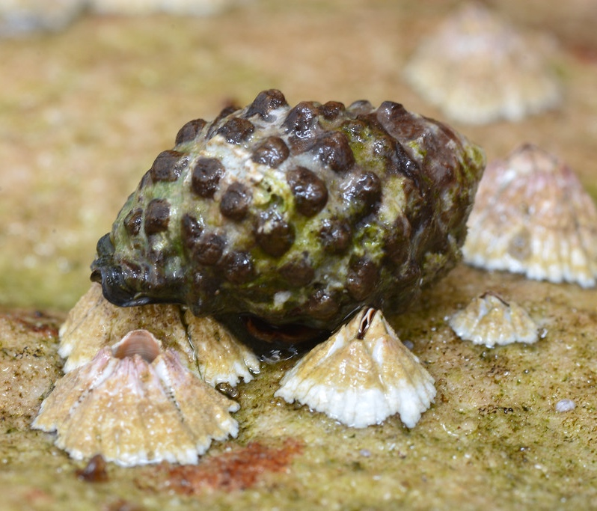
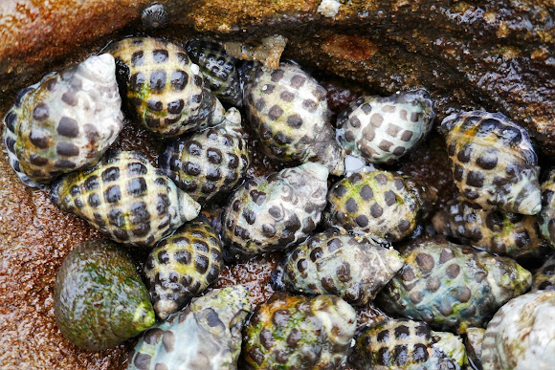
Mulberry whelks
Notes:
Info: https://www.dpi.nsw.gov.au/fishing/marine-protected-areas/aquatic-reserves/long-reef-aquatic-reserve/meet-some-of-the-locals
Image: https://www.flickr.com/photos/johnwturnbull/19235485586
Image (bottom right): https://www.projectnoah.org/spottings/194851422
Info on prey: https://www.int-res.com/articles/meps/22/m022p041.pdf

Slide 45
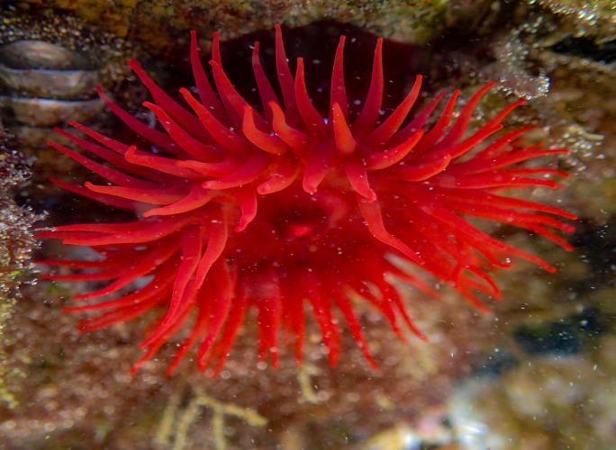
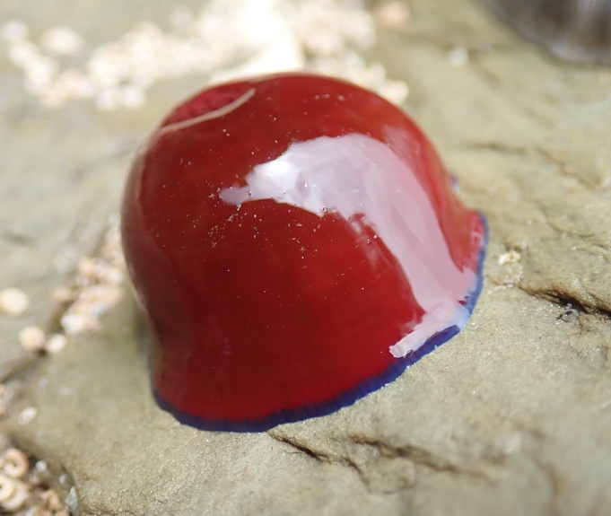
Anemones
Notes:
Image: https://www.sunshinecoast.qld.gov.au/environment/education-resources-and-events/environment-resources-and-publications/coast-and-marine/rocky-shore-species-identification

Slide 46

Shore Crabs
e.g. Grapsidae crabs
Grapsus albolineatus. Photo: Michael Nelson, iNaturalist
Notes:
Image: Atlas of Living Australia - https://bie.ala.org.au/species/https://biodiversity.org.au/afd/taxa/8be06ae6-440b-4044-817e-7b8d06ec2817

Slide 47


Zooanthids
or ‘zooids’
Notes:
Image: https://www.marinelifeofmumbai.in/photo/zoanthid/

Slide 48

Sea cucumbers

Slide 49

Hermit crab
Notes:
Image: https://www.nationalgeographic.com/animals/invertebrates/facts/hermit-crabs

Slide 50
Experimental design

Slide 51

Locate a nearby rocky shore.
For example:

Slide 52
Identify the low, mid and high tide zone.
For example:
Low tide zone
Mid tide zone
High tide zone

Slide 53

Lay down a 10m transect (tape measure) in each zone, each parallel to the water.
Low tide zone
Mid tide zone
High tide zone

Slide 54
Place a 1m x 1m quadrat down next to the transect

Slide 55
Identify EVERYTHING in the quadrat
If it’s too hard to tally, estimate percentage cover instead (e.g. algae cover).

Slide 56
Flip the quadrat and measure again!
# | Name (or description) | Tally (or % cover)
1
2
3
4
5
6
7
8
9
10
Quadrat 1
# | Name (or description) | Tally (or % cover)
1
2
3
4
5
6
7
8
9
10
Quadrat 2

Slide 57

Repeat for all transects
Low tide transect Quadrats 1-10
Mid tide transect Quadrats1-10
Option: flip the quadrat twice to halve the workload
Suggestion: Divide class into 3 groups, preferably with 3 people in each group.
If there’s more than 3 groups of 3 in a class, have more (shorter) transects with less quadrats each.
High tide transect
Quadrats 1-10

Slide 58


Also measure abiotic factors such as: temperature, dissolved oxygen, and salinity
Suggestion: designate one group as the water quality group (then you only need one set of equipment)

Slide 59

Transfer data from class worksheets to an excel spreadsheet

Slide 60

Copy/paste data from previous sheets to answer a research question

Slide 61


Learning Intention:
Investigate a local ecosystem to determine factors of population dynamics (e.g. density or distribution) and assess abiotic components, including:
estimating populations, e.g. survey count, quadrats, species density, percentage coverage, indirect or direct observation, catch and release
using field guides to identify to a genus level
using a range of field equipment to measure biotic factors related to marine environments
conducting in-field mapping of food webs via gut analysis to determine food sources
identifying physical structures of a specific marine organism (this could be virtual, practical or as a demonstration).
Success Criteria:
Complete Marine Education worksheet ‘rocky shore rambler’
Notes:
Image: https://answersingenesis.org/kids/sea-animals/common-limpet/

