Slide 1
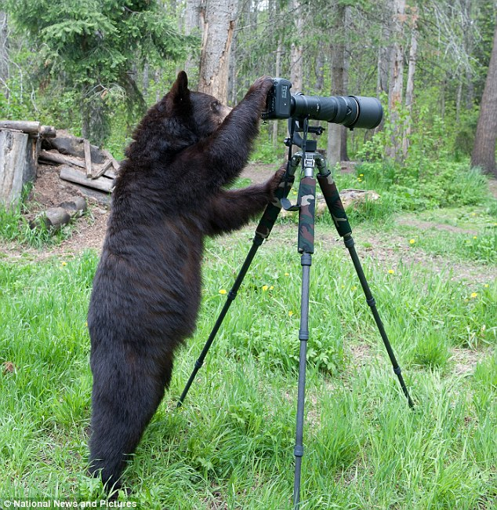
Learning Intention:
Assess the limitations of a chosen field technique, e.g. quadrat, transect.
Success Criteria:
Complete Marine Education worksheet ‘Science in the courtroom’
Notes:
Image: https://www.dailymail.co.uk/news/article-2247690/Curious-black-bear-takes-photography-hijacking-wildlife-snappers-camera.html

Slide 2
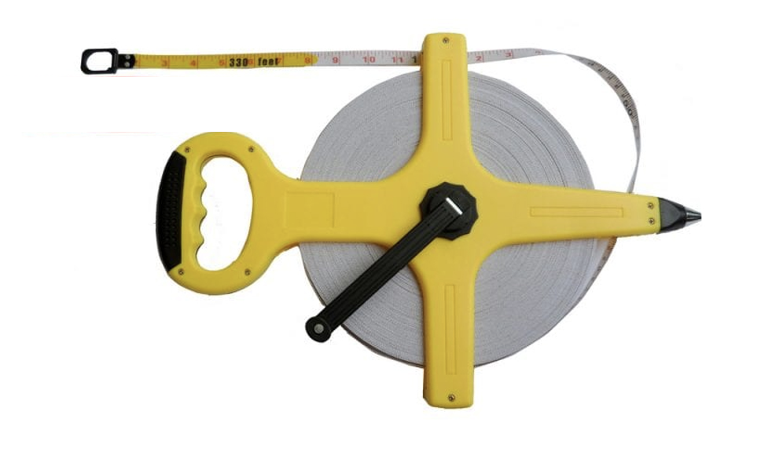
Line TRANSECT Limitations
Limitations:
Not suitable where organisms are widely spaced.
Not ideal for patchy reefs (transect replicates require continuous terrain for accuracy)
Provide limited information on the behaviour and interactions of organisms
When you record what is under the line
Notes:
Image:

Slide 3
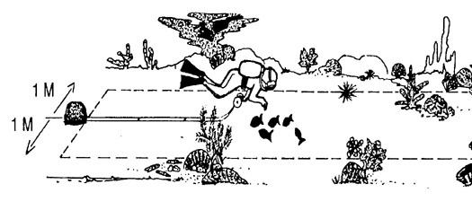
Belt TRANSECT Limitations
c
Limitations:
Time consuming – particularly if you need to collect data from more than one belt transect
(i.e. you need repeats).
Potential for selection bias
(see following slides)
Not suitable for densely populated areas (takes too long).
When you record what is either side of the line
Notes:
Image (belt): Villela, P.C. & Sale, Peter & Gold-Bouchot, Gerardo & Kjerfve, Björn. (2003). MESOAMERICAN BARRIER REEF SYSTEMS PROJECT: MANUAL OF METHODS FOR THE MBRS SYNOPTIC MONITORING PROGRAM. Selected Methods for Monitoring Physical and Biological Parameters for Use in the Mesoamerican Region.

Slide 4
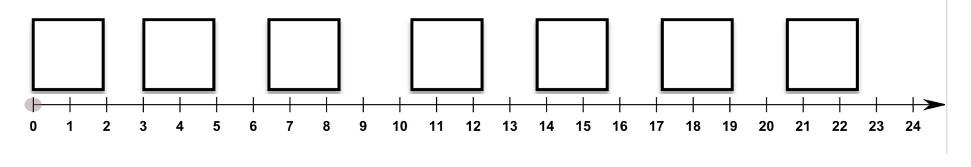
Quadrat/TRANSECT Limitations
c
Limitations:
Variations in the data may be missed in the gaps between quadrats
Not ideal for patchy reefs (replicates require continuous terrain for accuracy)
When you record what is inside a quadrat, that has been placed beside a transect
Notes:
Image: https://bwvp.ecolinc.vic.edu.au/sites/default/files/tempImages/ECOLINCQUADRATSAMPLINGOVERVIEW.pdf

Slide 5
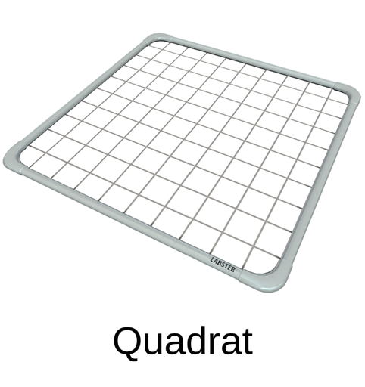
QUADRAT Limitations
Limitations:
Not suitable when organisms move
(in and out of quadrat).
Time consuming.
There is often bias to where the quadrat is placed (affecting validity).
Quadrat size may be too small to be representative of the population.
Difficult to see things hiding (2D not 3D)
Notes:
Image: https://www.auseco.com.au/index.asp?pagename=Independent+Research+Project

Slide 6
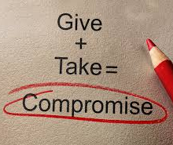
Every sampling method has limitations.
Plus, what you choose is often a compromise
(it will never be perfect).
How much you compromise is often determined by how much $ or time there is to spend time sampling.
Notes:
Image: https://www.diplomacy.edu/blog/what-is-the-true-meaning-of-compromise/

Slide 7

The more you compromise,
(e.g. the less sampling you do)
the lower your reliability (precision) and validity (accuracy).
Notes:
Image: https://www.harvardmagazine.com/2012/06/the-case-for-compromise

Slide 8
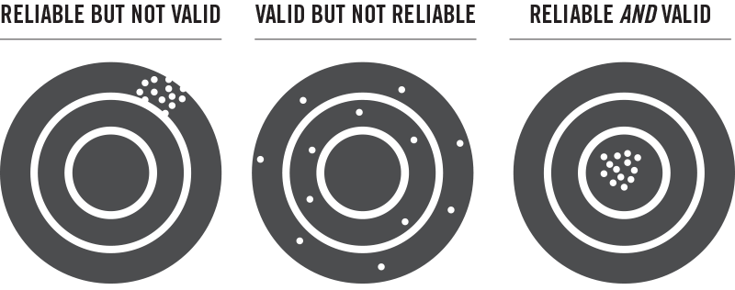
Reliability and Validity
Notes:
Image: https://mindthegraph.com/blog/reliability-vs-validity-in-research/

Slide 9
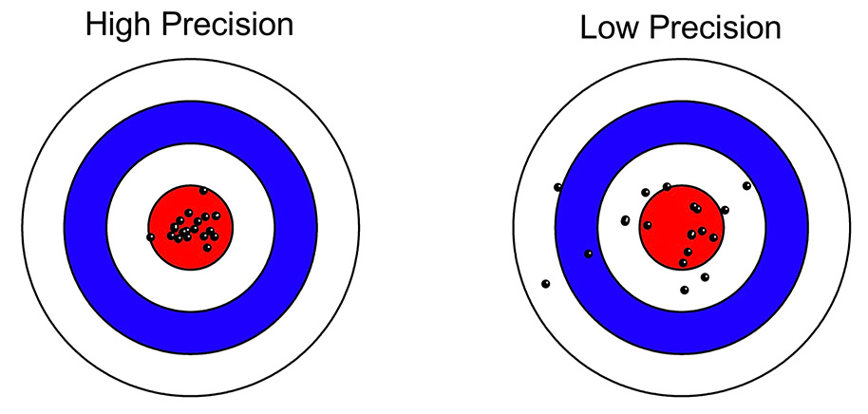
Reliability: consistency (is it the same result each time?)
Reliable
Unreliable
Notes:
Image: https://lucklab.ucdavis.edu/blog/2019/2/19/reliability-and-precision

Slide 10
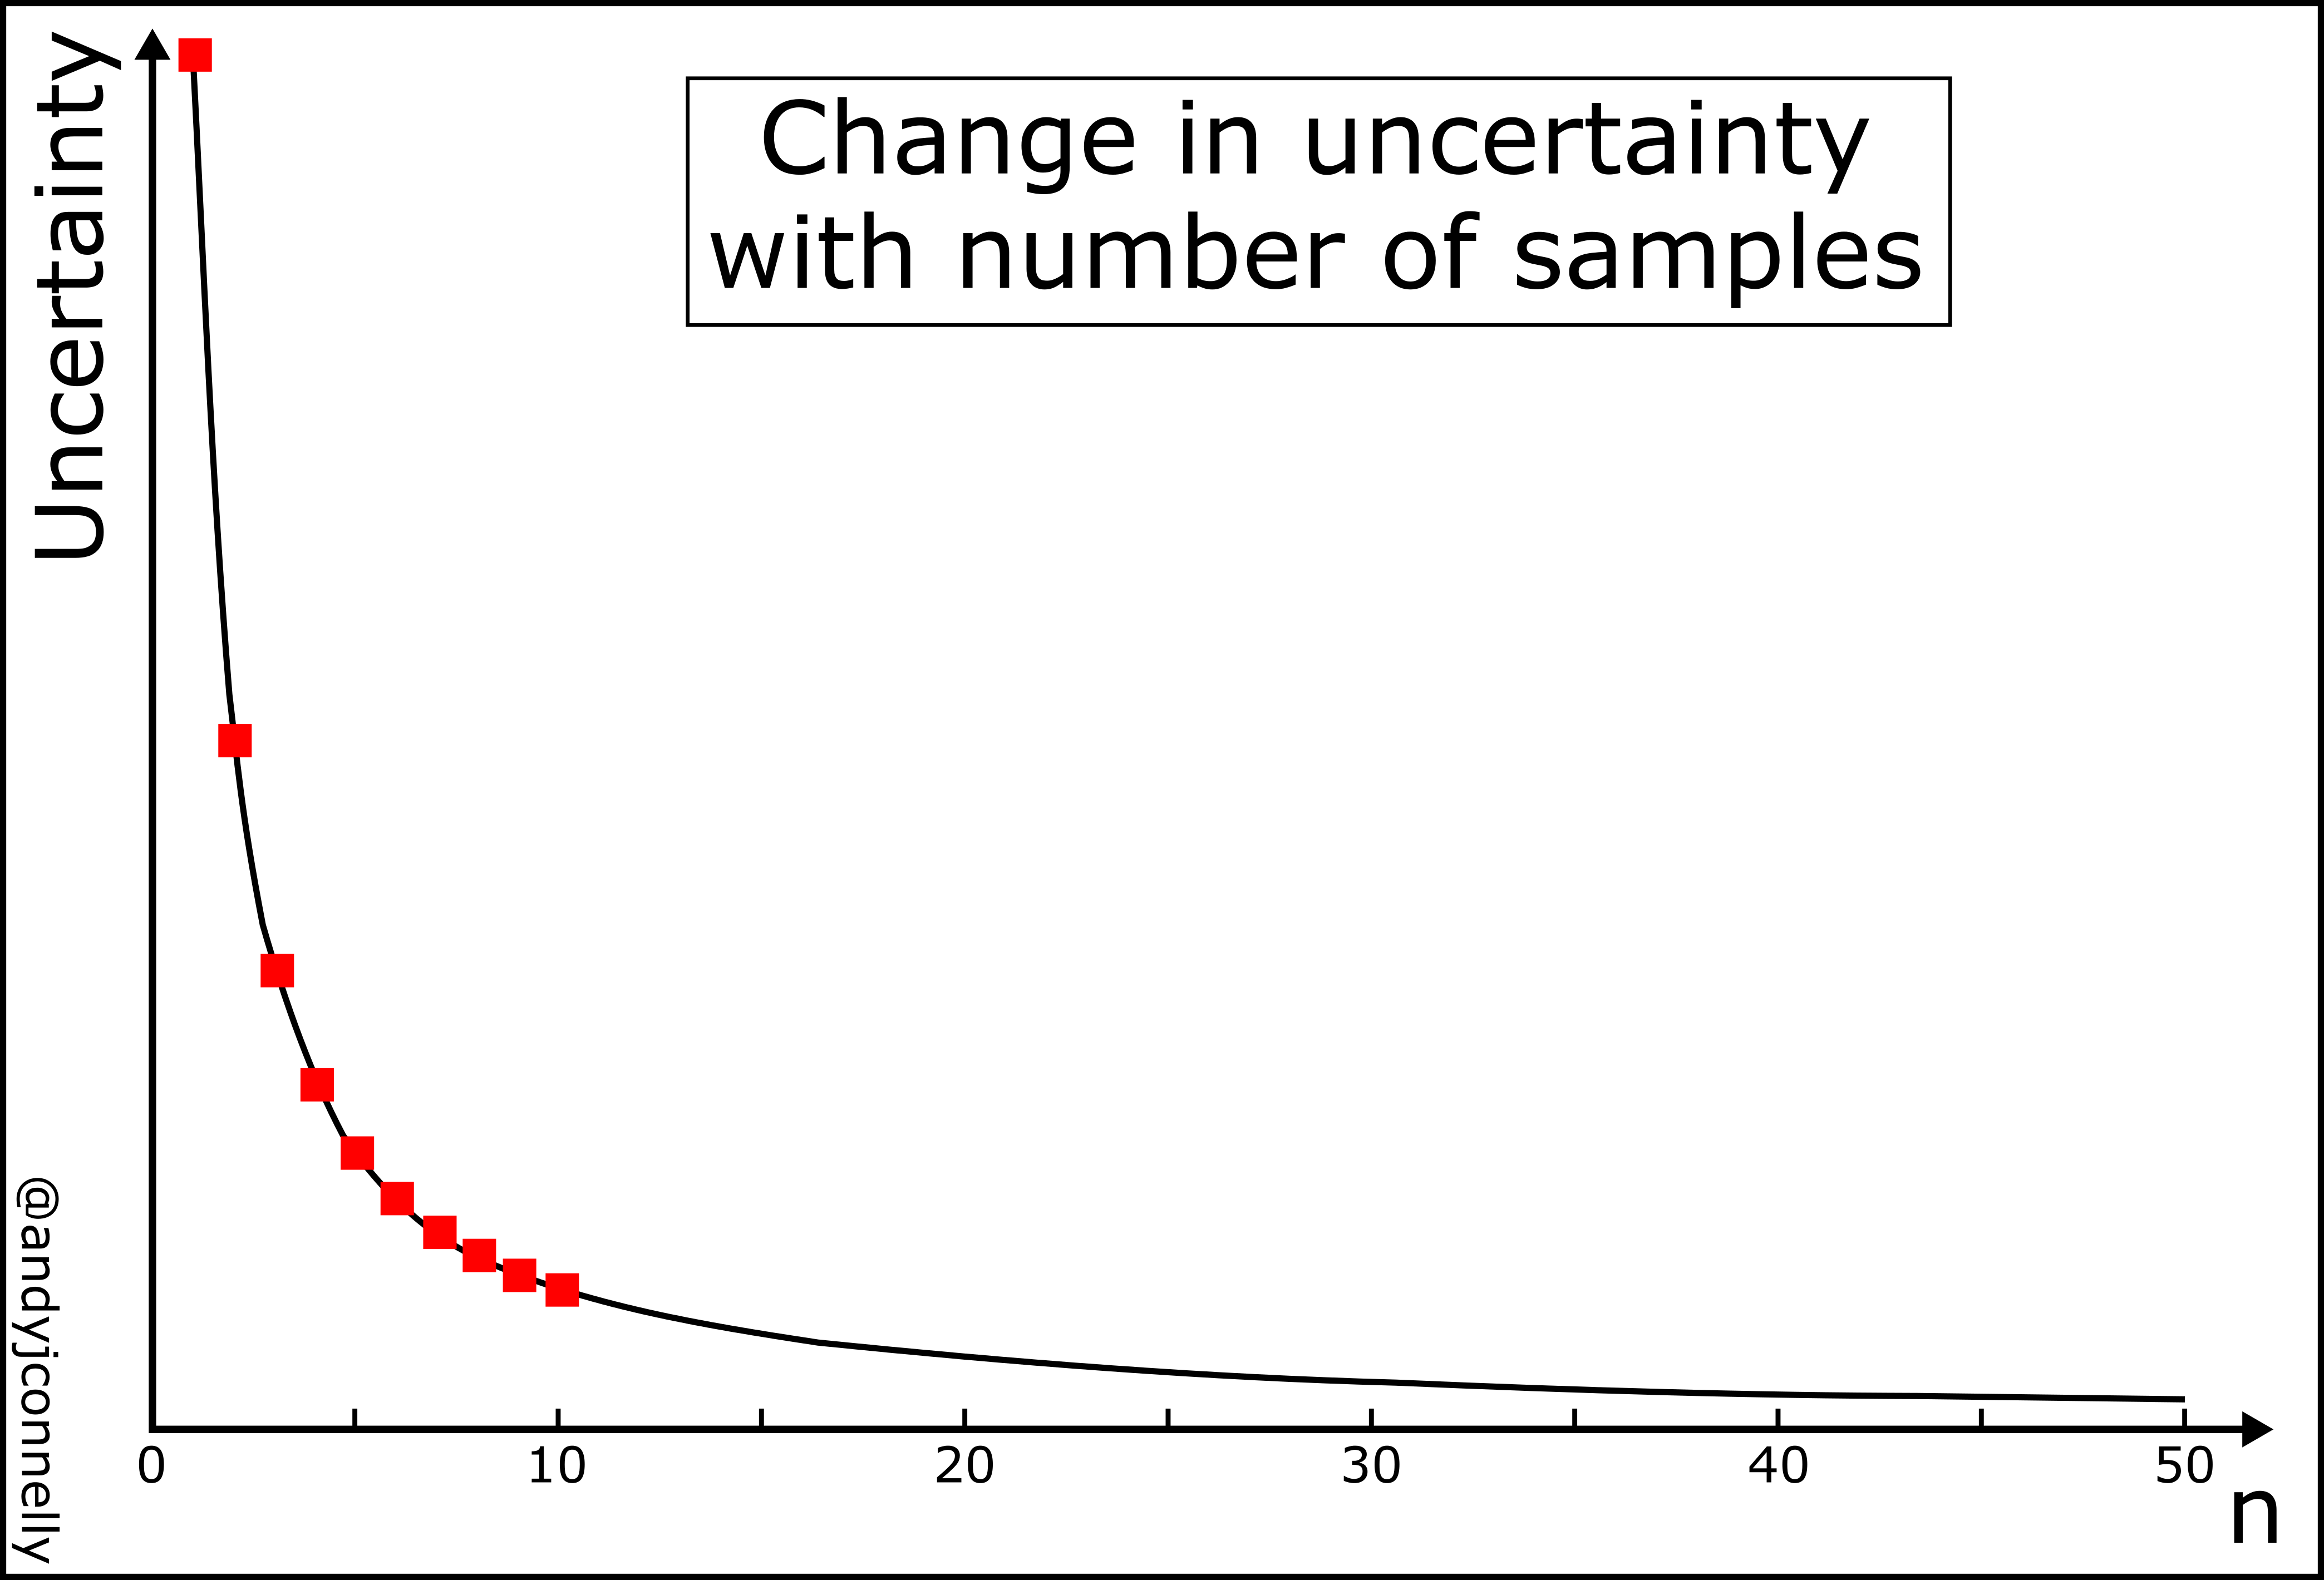
Reliability
You can test
(and often improve) reliability through repetition.
Suggest more repeats!
Notes:
Image: https://andyjconnelly.wordpress.com/2017/05/16/how-many-repeats/

Slide 11
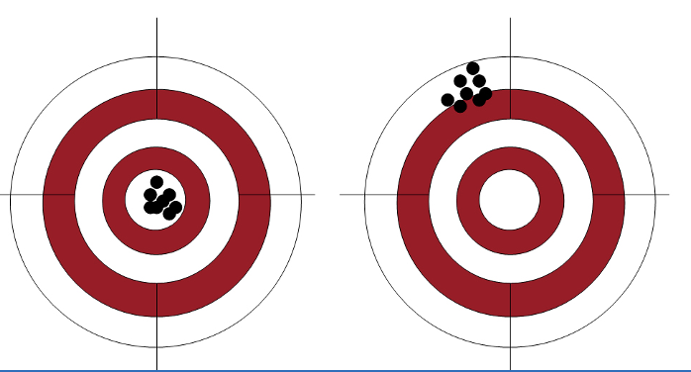
Validity: meaning (how close it is to the truth)
Invalid
VALID
Notes:
Image: https://shining.homes/validity

Slide 12
Validity
Follow the scientific method
Remove systematic error (see slides to follow)
Only change one thing (the independent variable) and keep everything else the same (controlled variables)
If you can’t control a variable, measure it instead (measured variable)
Do not make assumptions (measure what you don’t know)
Remove any bias (see slides to follow)
Cross-check your results with other reputable sources

Slide 13
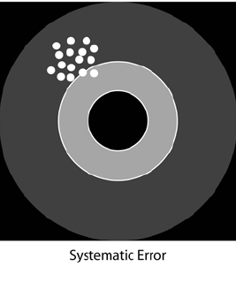
Systemic Error
occurs when an observed or calculated value deviates from the true value in a consistent way (affecting validity)
For example: calibration error, parallax error, limits of measurement and bias.
It’s consistently wrong!

Slide 14
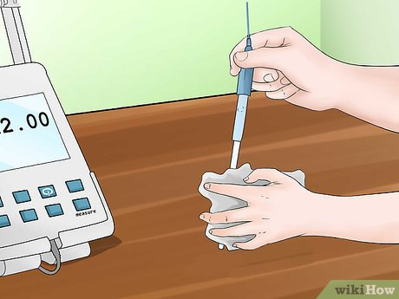
Calibration error
Notes:
Image: https://www.wikihow.com/Calibrate-and-Use-a-pH-Meter

Slide 15
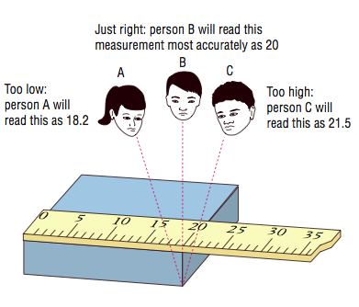
Parallax error
Notes:
Image: https://www.quora.com/How-do-I-use-set-squares-to-remove-parallax-error-in-measuring-the-displacement-of-pendulum

Slide 16
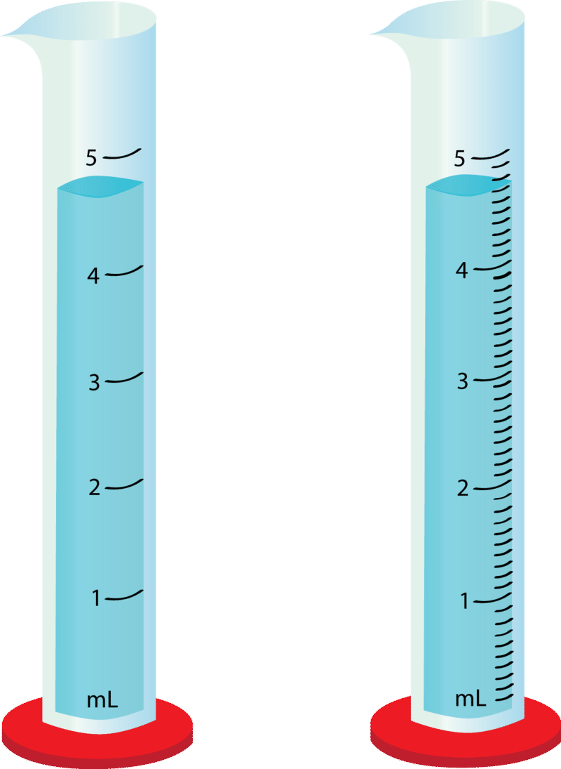
Limits of measurement
More error
Less error
Notes:
Image: https://utlas.net/product_details/36702534.html

Slide 17
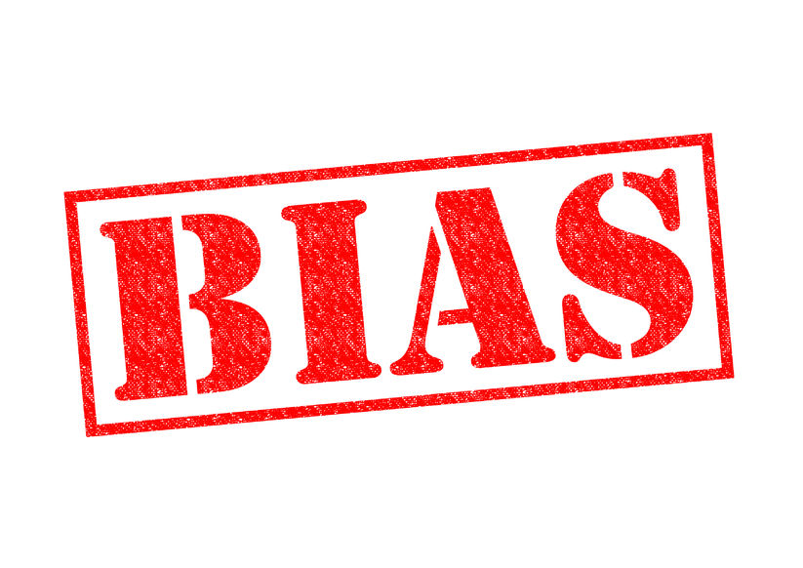

Slide 18
Bias
affects validity
Bias can occur during
the experimental design phase
(e.g. design bias, selection bias, the observer effect)
during measuring (e.g. observer bias)
during analysing and interpreting the results
(e.g. heuristics & algorithmic bias)
and/or during reporting the results
(e.g. reporting bias, overgeneralization bias and confirmation bias)…..

Slide 19
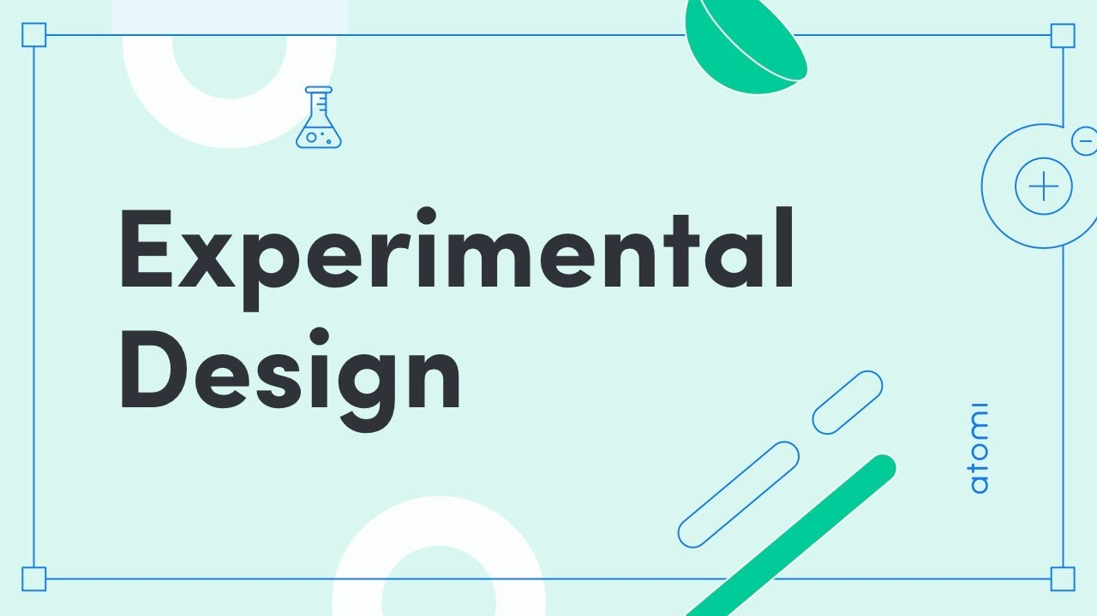
Bias in the
Notes:
Image: https://www.youtube.com/watch?app=desktop&v=9eZYufPP2-o

Slide 20
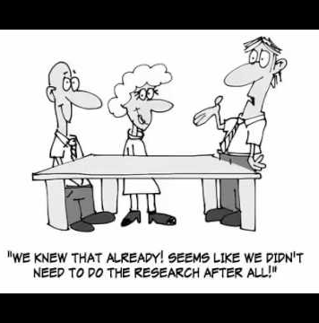
Design bias
begins as the research team creates the process in which the experiment will be performed.
Design bias is when the experiment has been designed in such a way to obtain an assumed or desired result
(e.g. thus, missing something that could potentially matter)
Notes:
Image: https://www.youtube.com/watch?v=VmdppCYR8wM

Slide 21
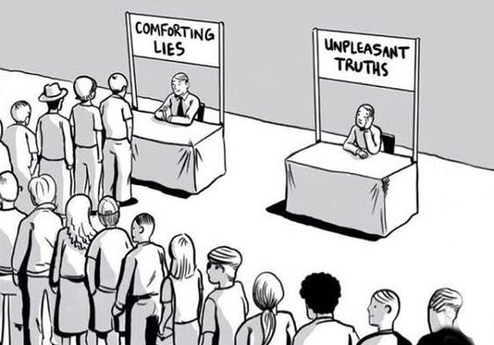
Ways to avoid Design bias
Challenge your assumptions
Do a thorough literature review first
Apply inclusive design principles
Standardise methods to previous peer-reviewed studies (do the same as them)
Notes:
Image: http://www.countrysideinfo.co.uk/wet_wood_survey_2001/randoms.htm

Slide 22
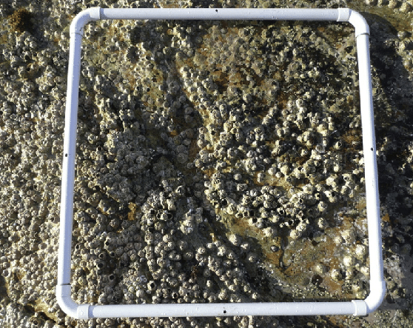
Selection bias
E.g. wanting to find more animals to count, therefore placing the quadrat in the most densely populated spot (resulting in an overestimation of the population)

Slide 23
Ways to avoid selection bias (e.g. bias placement of quadrats)
Use a transect (and measure at regular intervals along transect)
Notes:
Image: https://bwvp.ecolinc.vic.edu.au/sites/default/files/tempImages/ECOLINCQUADRATSAMPLINGOVERVIEW.pdf

Slide 24
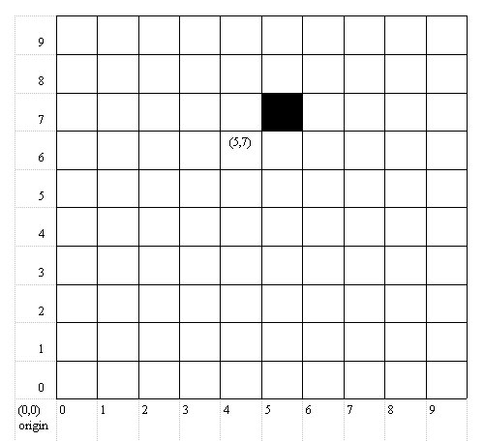
Ways to avoid selection bias (e.g. bias placement of quadrats)
Random placement of quadrats:
throw a coin over the sample area, with eyes closed (or with your back turned), and where the coin lands is where the quadrat is placed.
OR
Place two measuring tapes across an area like two axes of a graph. Consider every point along each tape as a point in a pair of cartesian co-ordinates (x, y). Then use a random number generator (or roll a dice) to make random (x, y) coordinates that will determine where to place the quadrat.
Notes:
Image: http://www.countrysideinfo.co.uk/wet_wood_survey_2001/randoms.htm

Slide 25
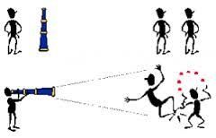
The observer effect is when the act of observation changes the behaviour of the subject being observed
Notes:
Image: https://steemit.com/life/@arbitrarykitten/fun-with-physics--the-observer-effect-1502007270-4300065

Slide 26
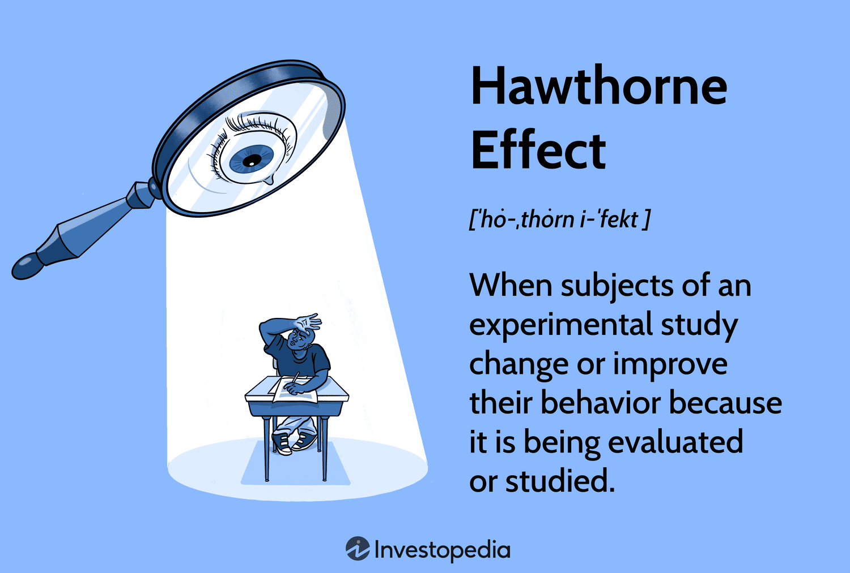
Notes:
Image: https://www.investopedia.com/terms/h/hawthorne-effect.asp

Slide 27
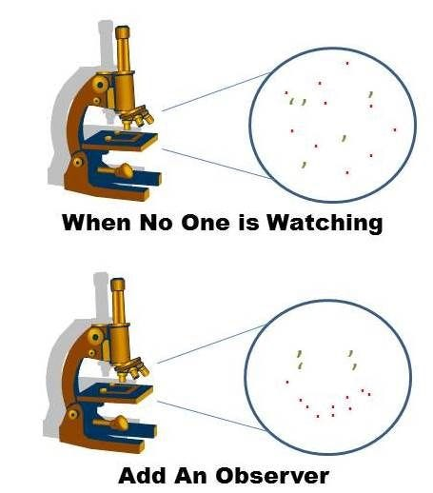

Slide 28
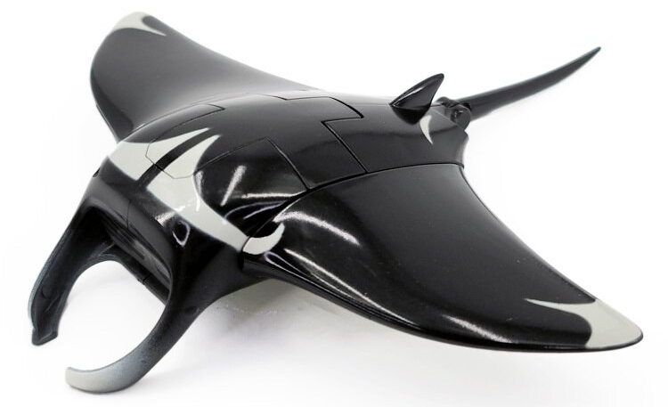
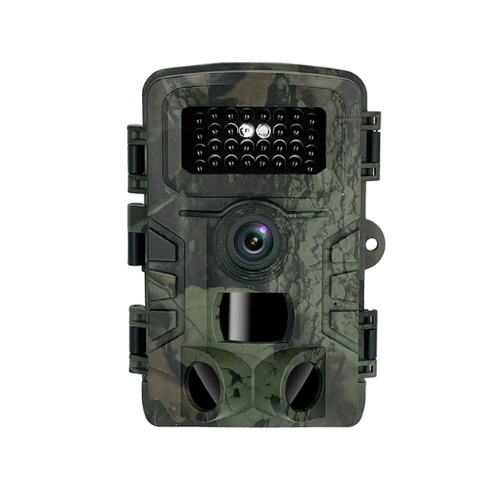
Ways to avoid the observer effect
Find a way to sample without disturbing those being observed. For example:
Monitor remotely
Using nature cameras that start
recording when they sense movement
Be aware the observer effect exists in the first place and do something to avoid it (and/or mention it in your discussion).
Robot manta ray
Notes:
Image: https://eshop.oceanpark.com.hk/en/products/manta-ray-animal-robot-

Slide 29
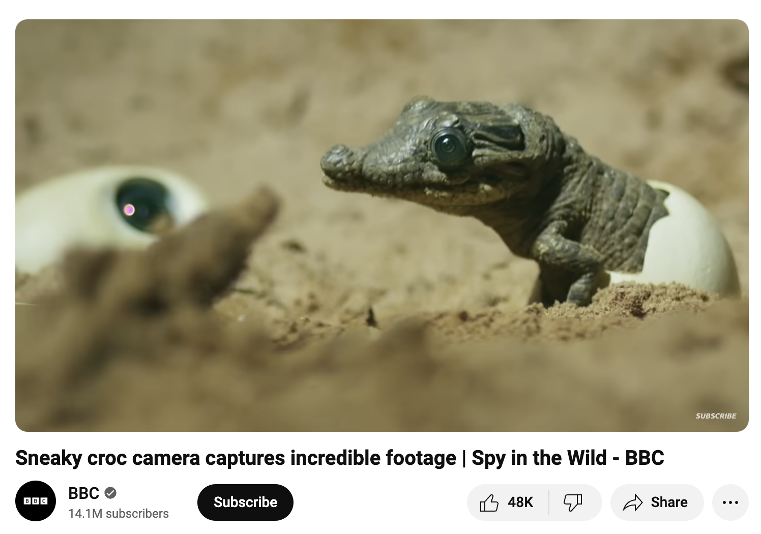
https://www.youtube.com/watch?v=_bVZeOt7bCw

Slide 30
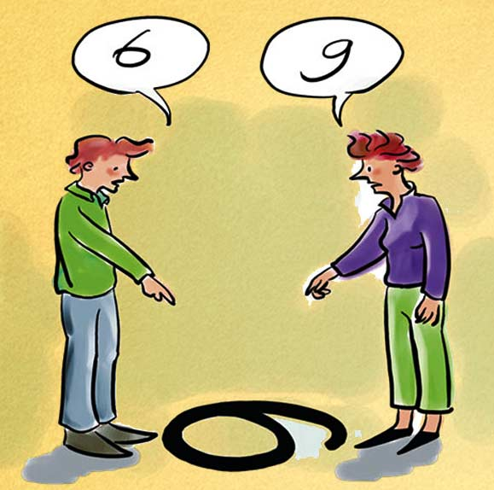
Bias when measuring
Observer bias

Slide 31
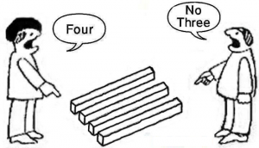

Observer bias
is when the observer’s opinion or perspective influences what is observed and recorded as being
(what they think is)
true.
placebo

Slide 32
Ways to avoid observation bias
Repeatability - check it can be repeated (by a different observer) and obtain the same result.
Use multiple observers
Blinding (hiding the purpose of the study from all observers – e.g. tell them the study is about one thing when its really about another; or add a placebo).
Train observers to be aware of, and how to control, their observation bias.

Slide 33
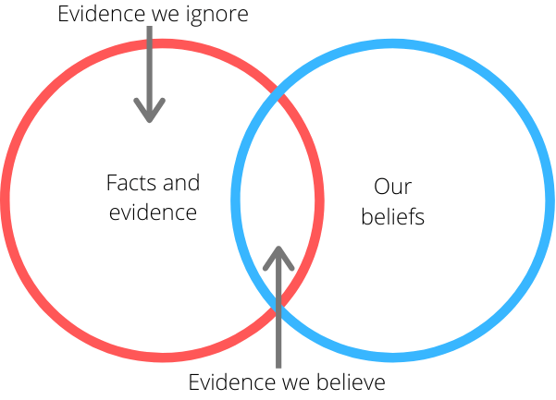
Confirmation bias
is our tendency to seek out information that supports our views.
E.g. we interpret results in a way that supports our original hypothesis.
Notes:
Info: https://www.codecademy.com/article/bias-in-data-analysis
Image: https://nigeldessau.substack.com/p/your-confirmation-bias-is-killing

Slide 34
Ways to avoid confirmation bias
Measure all results (e.g. to avoid the bias of wanting to find a significant difference)
If evaluating a claim, check the reliability and validity of all sources of information - is your selection of references/in-text citations bias towards your preferred thinking?

Slide 35
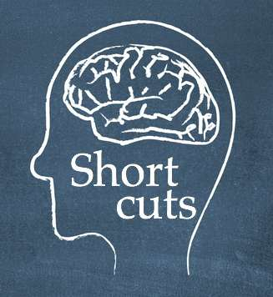
Bias when analysing and interpreting the results
Heuristics
Notes:
Image: https://mquinn.com/2012/09/mental-shortcuts-even-millionaires-unintentionally-take/

Slide 36
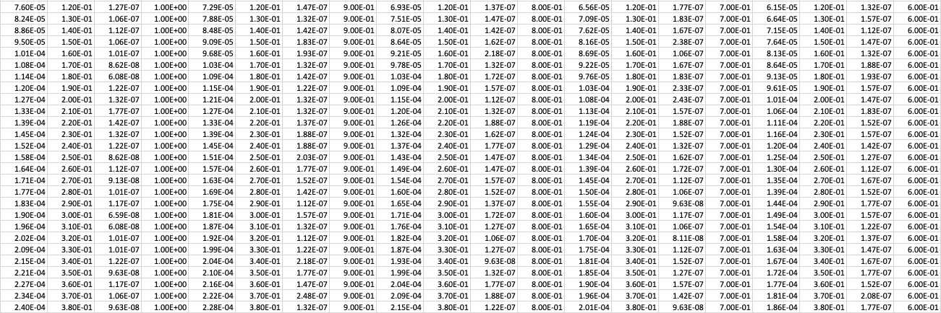
Heuristic Bias
Heuristics are mental SHORT CUTS that make processing times much FASTER.
Heuristics are helpful when your time, brain capacity or motivation is lacking.
E.g. finding patterns to make sense of large amounts of data
Notes:
Image:

Slide 37
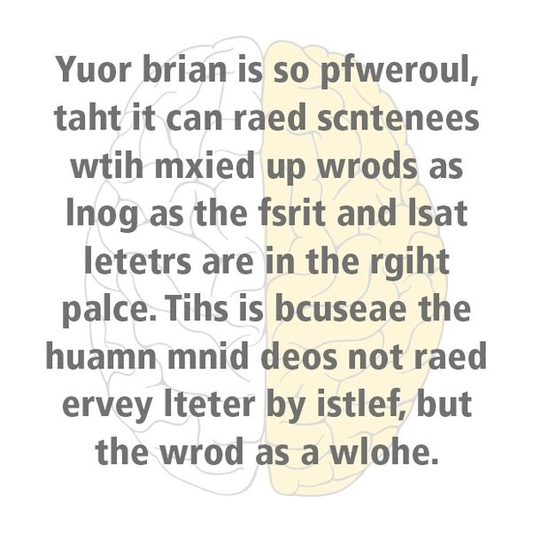
Notes:
Image: http://www.ereader1.net/2018/11/can-you-read-this.html

Slide 38
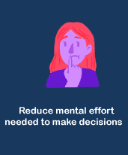

Good for making quick decisions fast ☺
Bad for conducting an in-depth analysis – subject to error ☹
vs.
Notes:
Image: https://www.javatpoint.com/heuristic-techniques

Slide 39
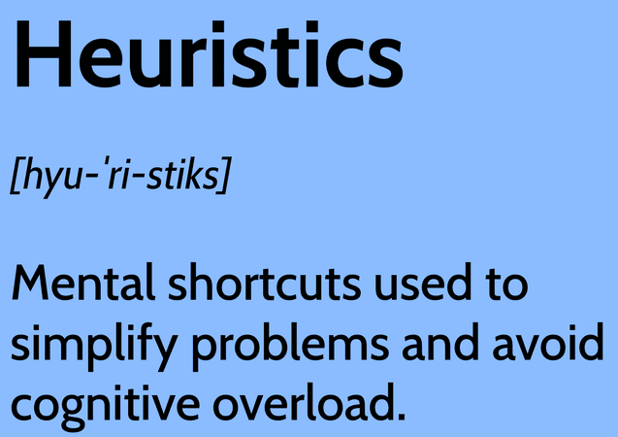
While heuristics are indeed useful, they can at times lead to the wrong conclusions being drawn.
Notes:
Image: https://www.investopedia.com/terms/h/heuristics.asp

Slide 40
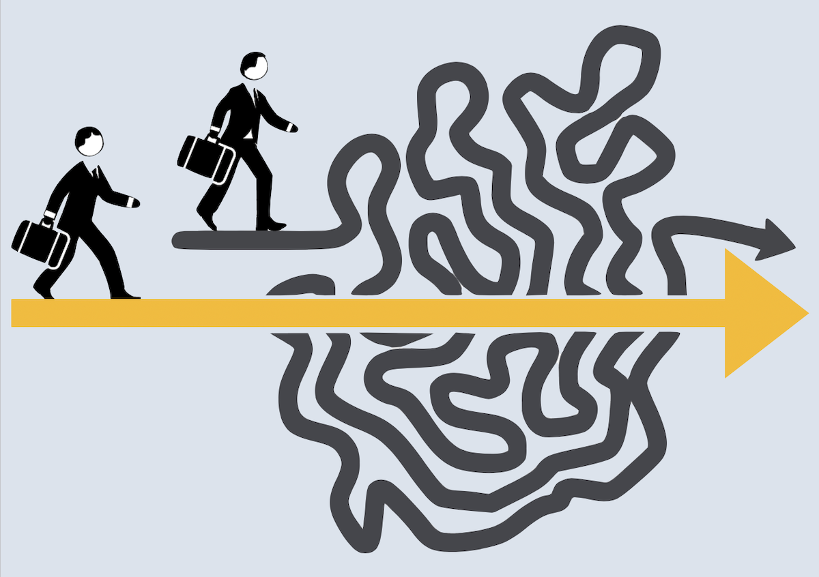
Ways to avoid heuristic bias
Be aware of it
Consider the limitations of heuristics (and not just the benefits)
Use a computer program to analyse the data instead.
Notes:
Image: https://paleofoundation.com/heuristics-decision-friction/

Slide 41
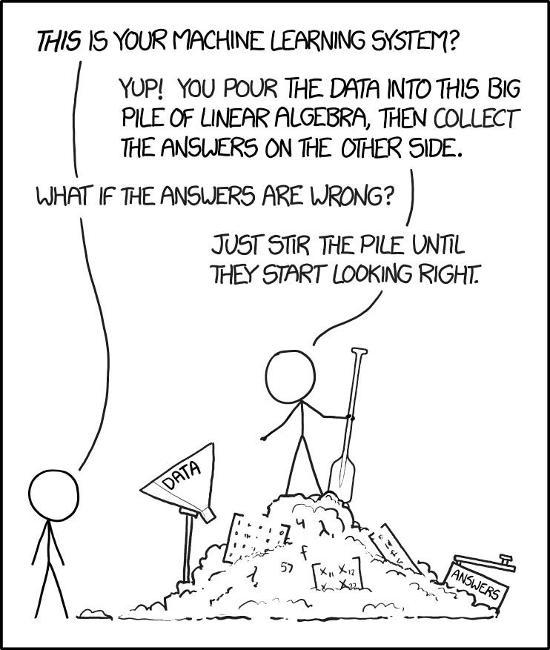
Algorithmic bias
arises when an algorithm produces systematic and repeatable errors that lead to unfair outcomes.
Notes:
Info: https://medium.com/enrique-dans/which-is-easier-to-correct-an-algorithms-bias-or-a-human-s-1d2fae7090e1

Slide 42
Ways to avoid algorithmic bias
Collect and use high-quality, representative, and relevant data, as well as apply appropriate methods and techniques to process, analyze, and interpret the data.
Carry out a method validation (e.g. conduct the analysis the time-consuming way, and then compare the results to the computers. Address any errors before getting the computer to calculate the rest).
Use the best program for the job (e.g. excel for graph-making)

Slide 43
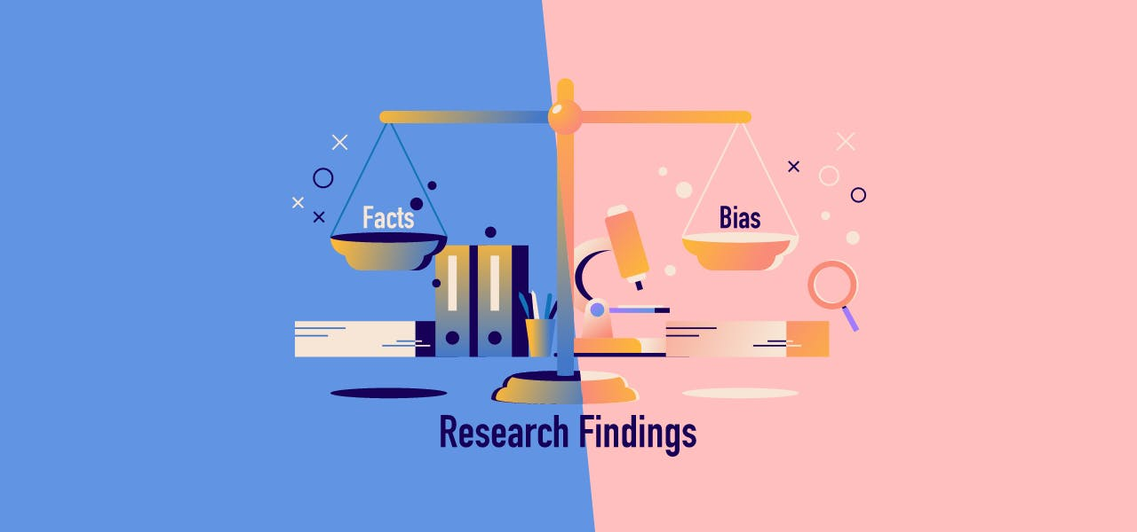
Bias reporting
Notes:
Image: https://www.impactio.com/blog/how-to-avoid-selective-reporting-bias-when-presenting-your-research-findings

Slide 44

Reporting bias
is the human tendency to only report or share results that affirm our beliefs or hypotheses.
Notes:
https://www.codecademy.com/article/bias-in-data-analysis

Slide 45

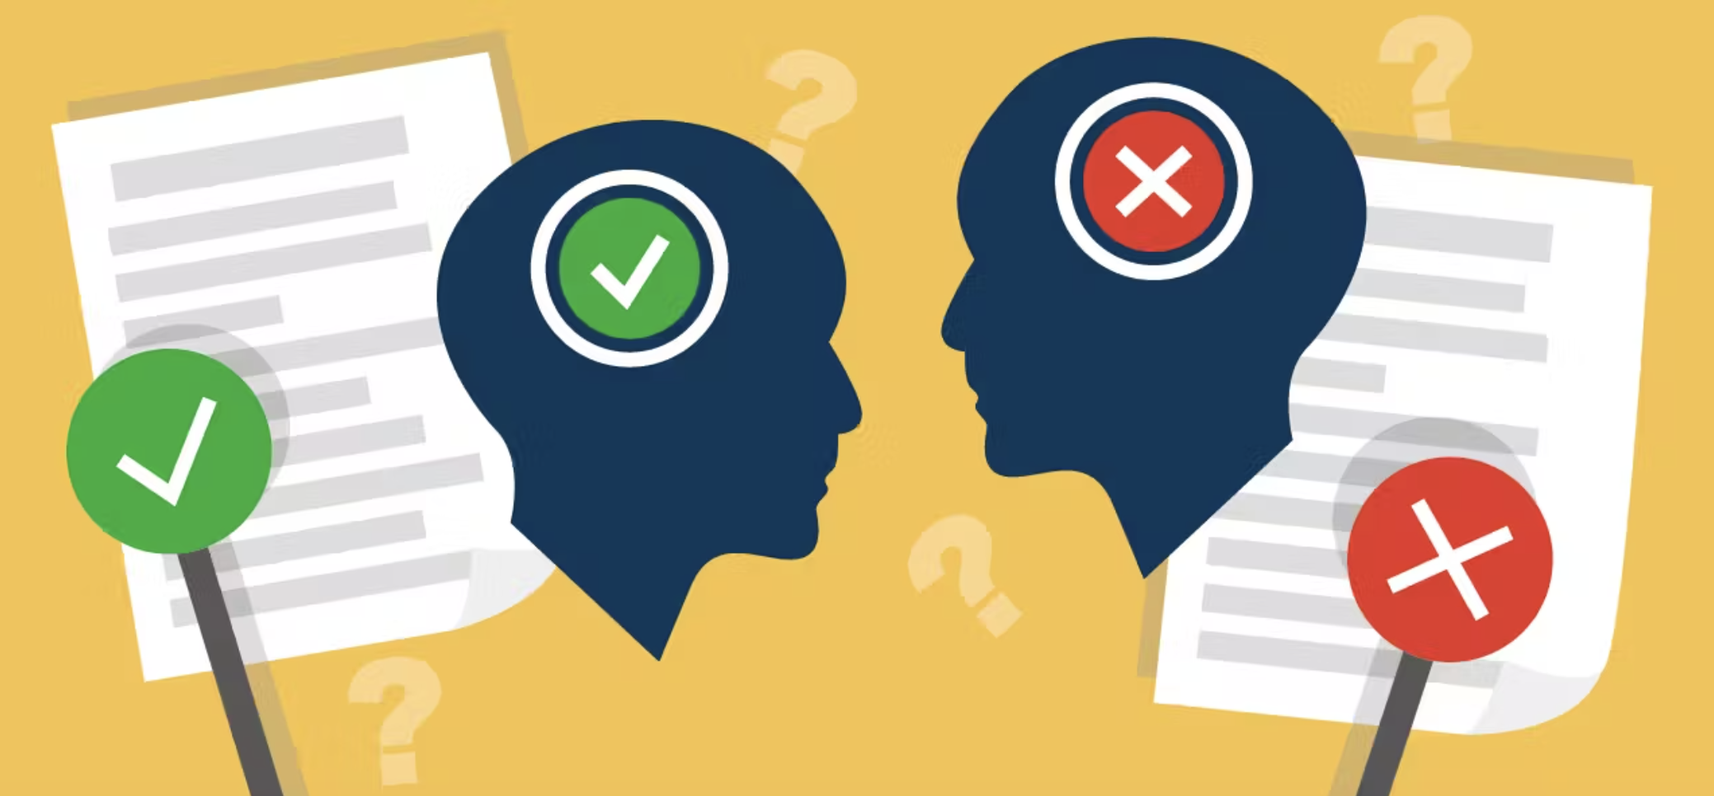
Citation bias
is the decision to cite or not cite someone’s work because you agree or disagree with the findings, the journal, or the author
Notes:
Info: https://www.impactio.com/blog/how-to-avoid-selective-reporting-bias-when-presenting-your-research-findings
Image (above): https://catalogofbias.org/biases/reporting-biases/
Image (below): https://www.impactio.com/blog/avoiding-selective-reporting-in-your-research-findings

Slide 46
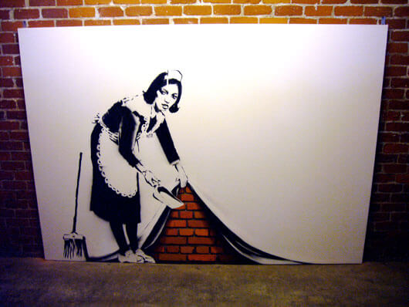
Outcome reporting bias
is choosing to report some outcomes and not others
(to purposely skew the solution in favour of the preferred results)
Sweep it under the carpet, 2006
Notes:
Image: https://banksyexplained.com/sweep-it-under-the-carpet-2006-2/

Slide 47
Ways to avoid reporting bias
Report ALL findings!
Use checklists
Have your paper peer-reviewed

Slide 48
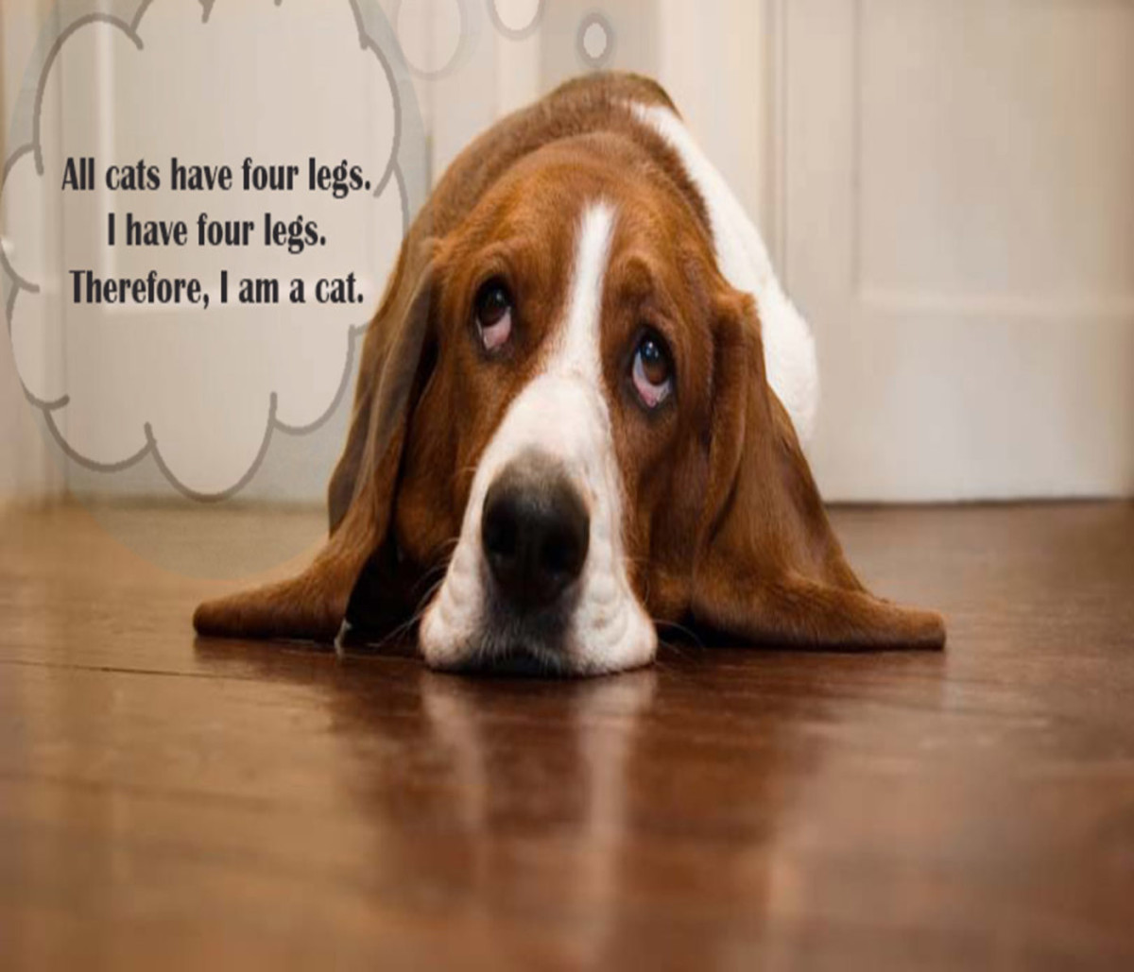
Overgeneralization bias
is inappropriately extending observations made with one dataset to other datasets, leading to overinterpreting results and unjustified extrapolation.
Notes:
Image: https://discover.hubpages.com/politics/The-Truth-about-Generalization-and-Overgeneralization

Slide 49
Ways to avoid overgeneralization bias
Report all limitations of your study
e.g. sub-title: Limitations of evidence
Take into consideration the margins of error and report the probability a generalization will be incorrect.
Increase the scale of your study (to avoid having to generalise in the first place)
Compare your results with other peer-reviewed studies

Slide 50
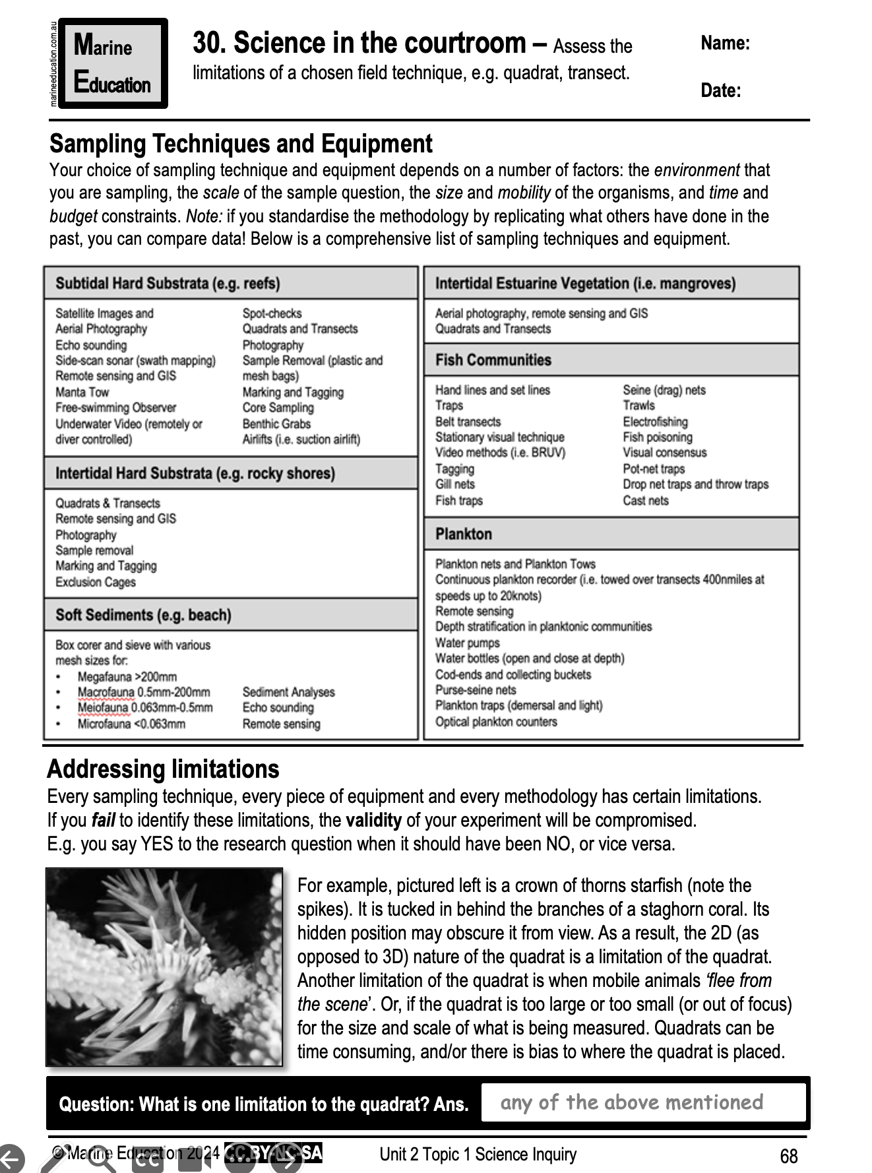
Learning Intention:
Assess the limitations of a chosen field technique, e.g. quadrat, transect.
Success Criteria:
Complete Marine Education worksheet ‘Science in the courtroom’
Notes:
Image: https://www.dailymail.co.uk/news/article-2247690/Curious-black-bear-takes-photography-hijacking-wildlife-snappers-camera.html

