Slide 1
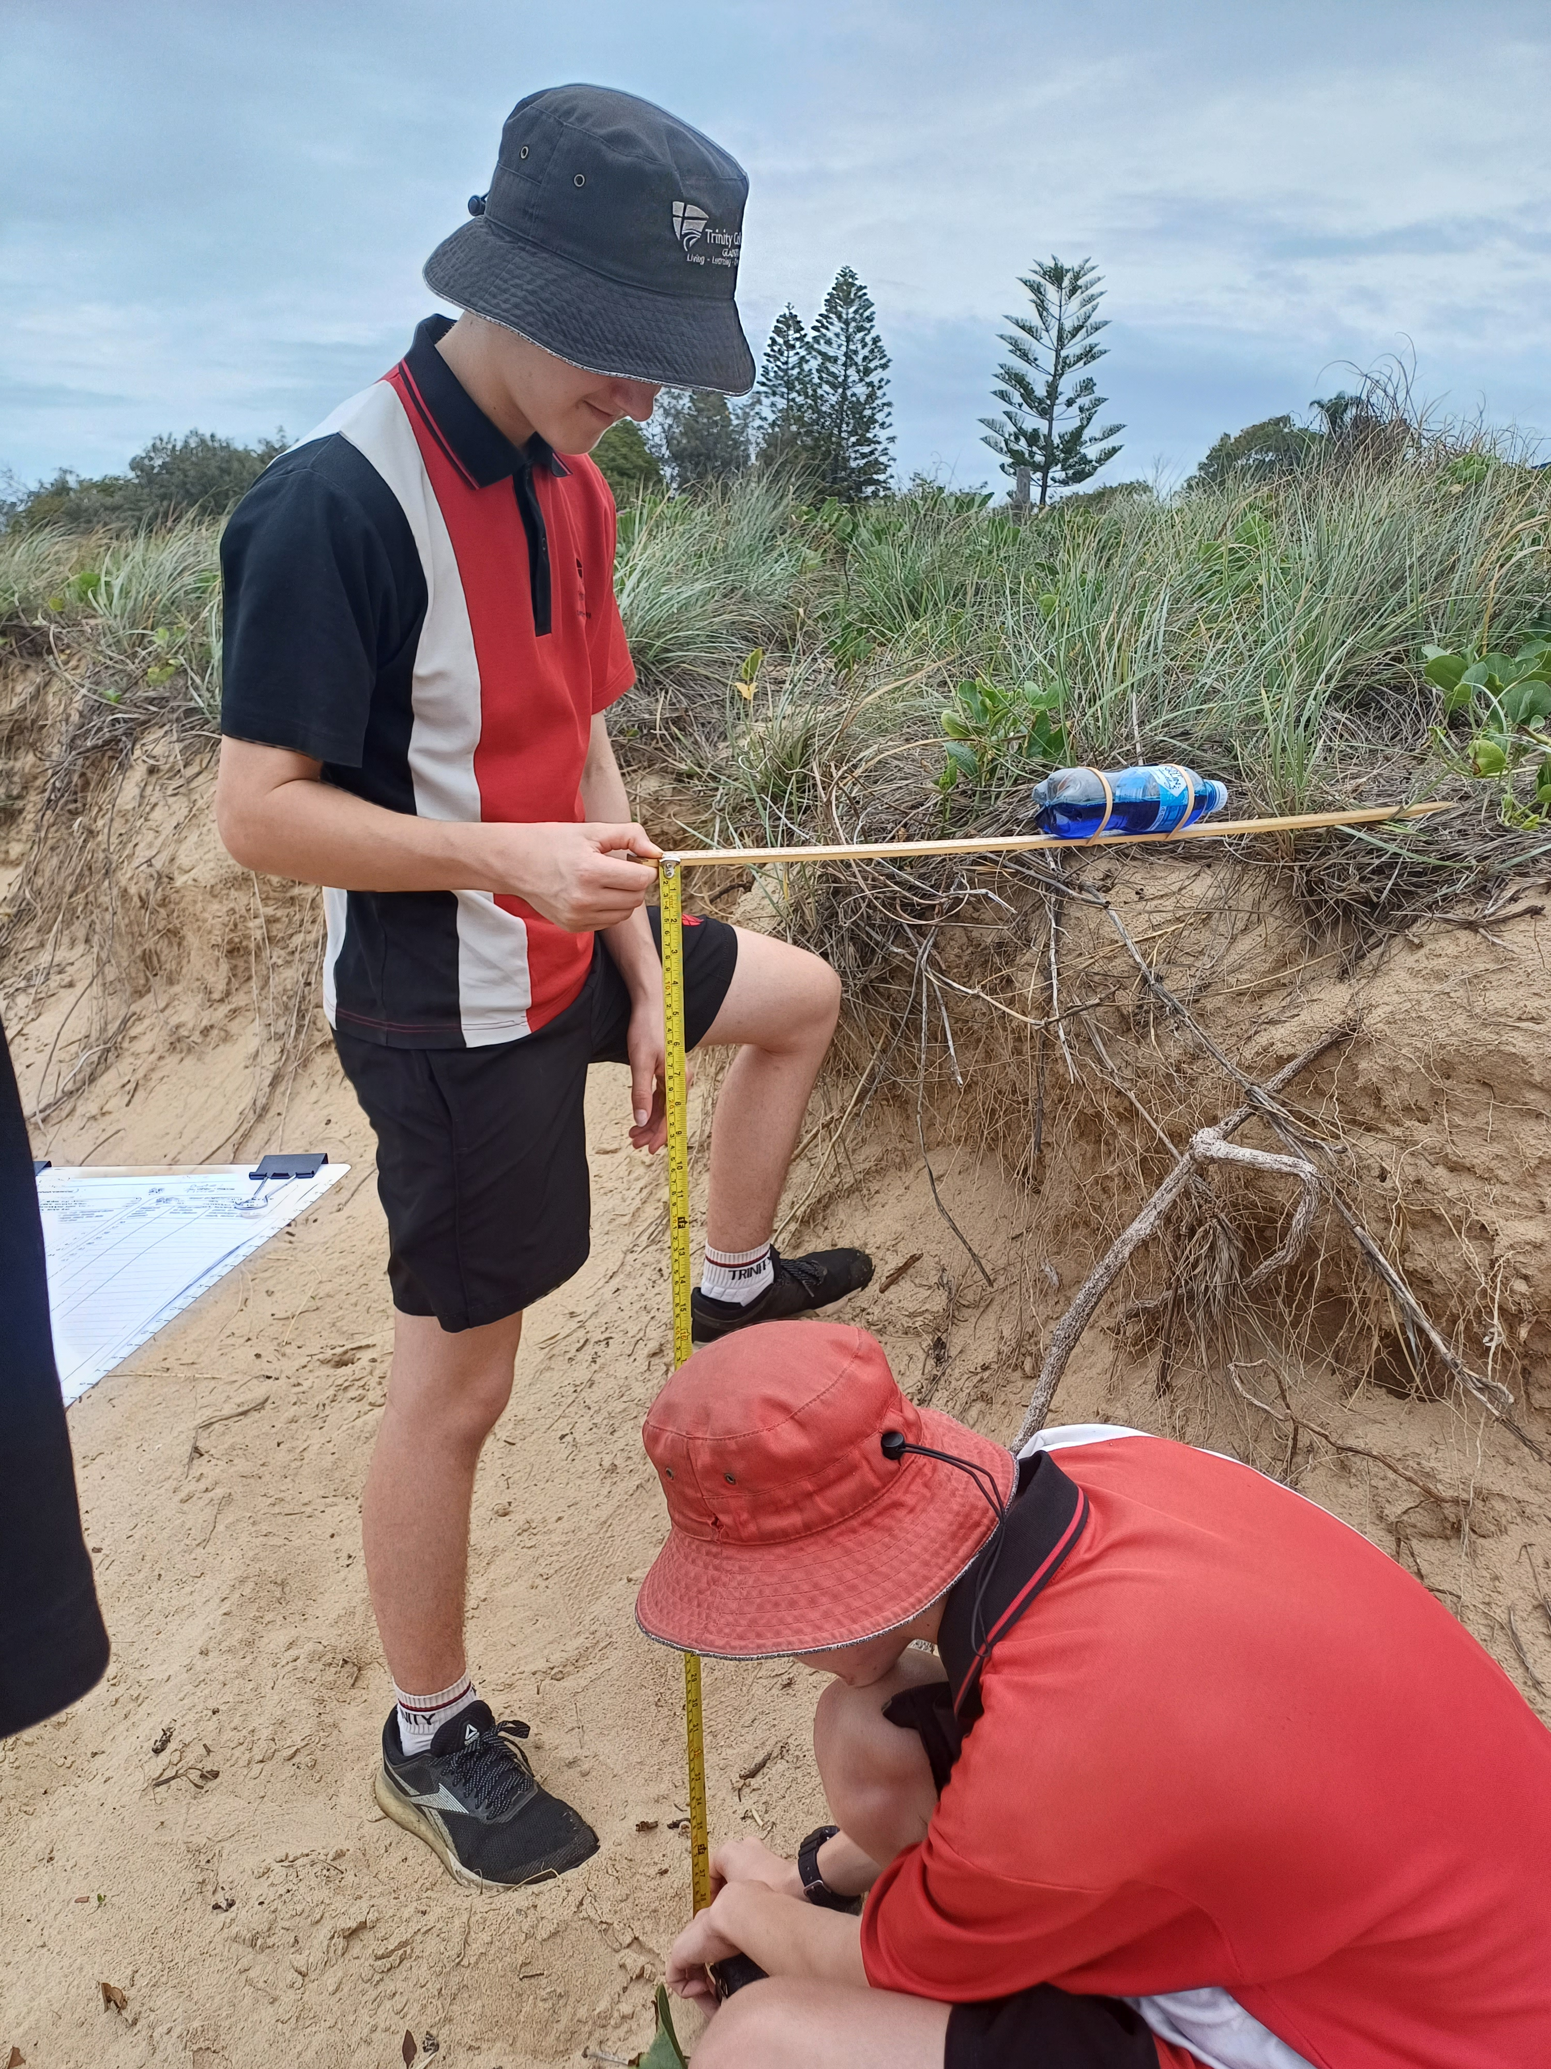
Learning Intention:
Investigate sandy coastlines using beach profiles, dune transects and sand sifts
Success Criteria:
Complete Marine Education worksheet ‘’32. Beach prac”
Notes:
Image: Trinity College marine science students Roy and Hayden measuring beach slope using a meter ruler, water bottle and tape measure.

Slide 2
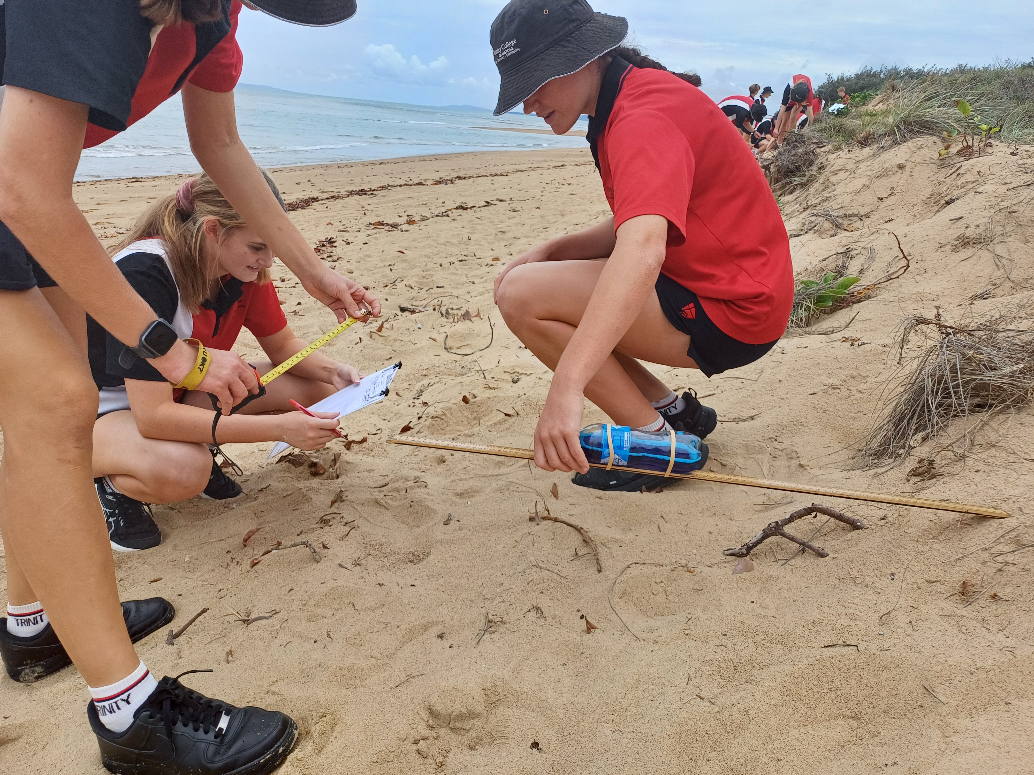
Measuring beach slope
Half fill a water bottle
Add food colouring
Attach to meter ruler using elastic bands
Hold level to the beach
(start on highest dune).

Slide 3
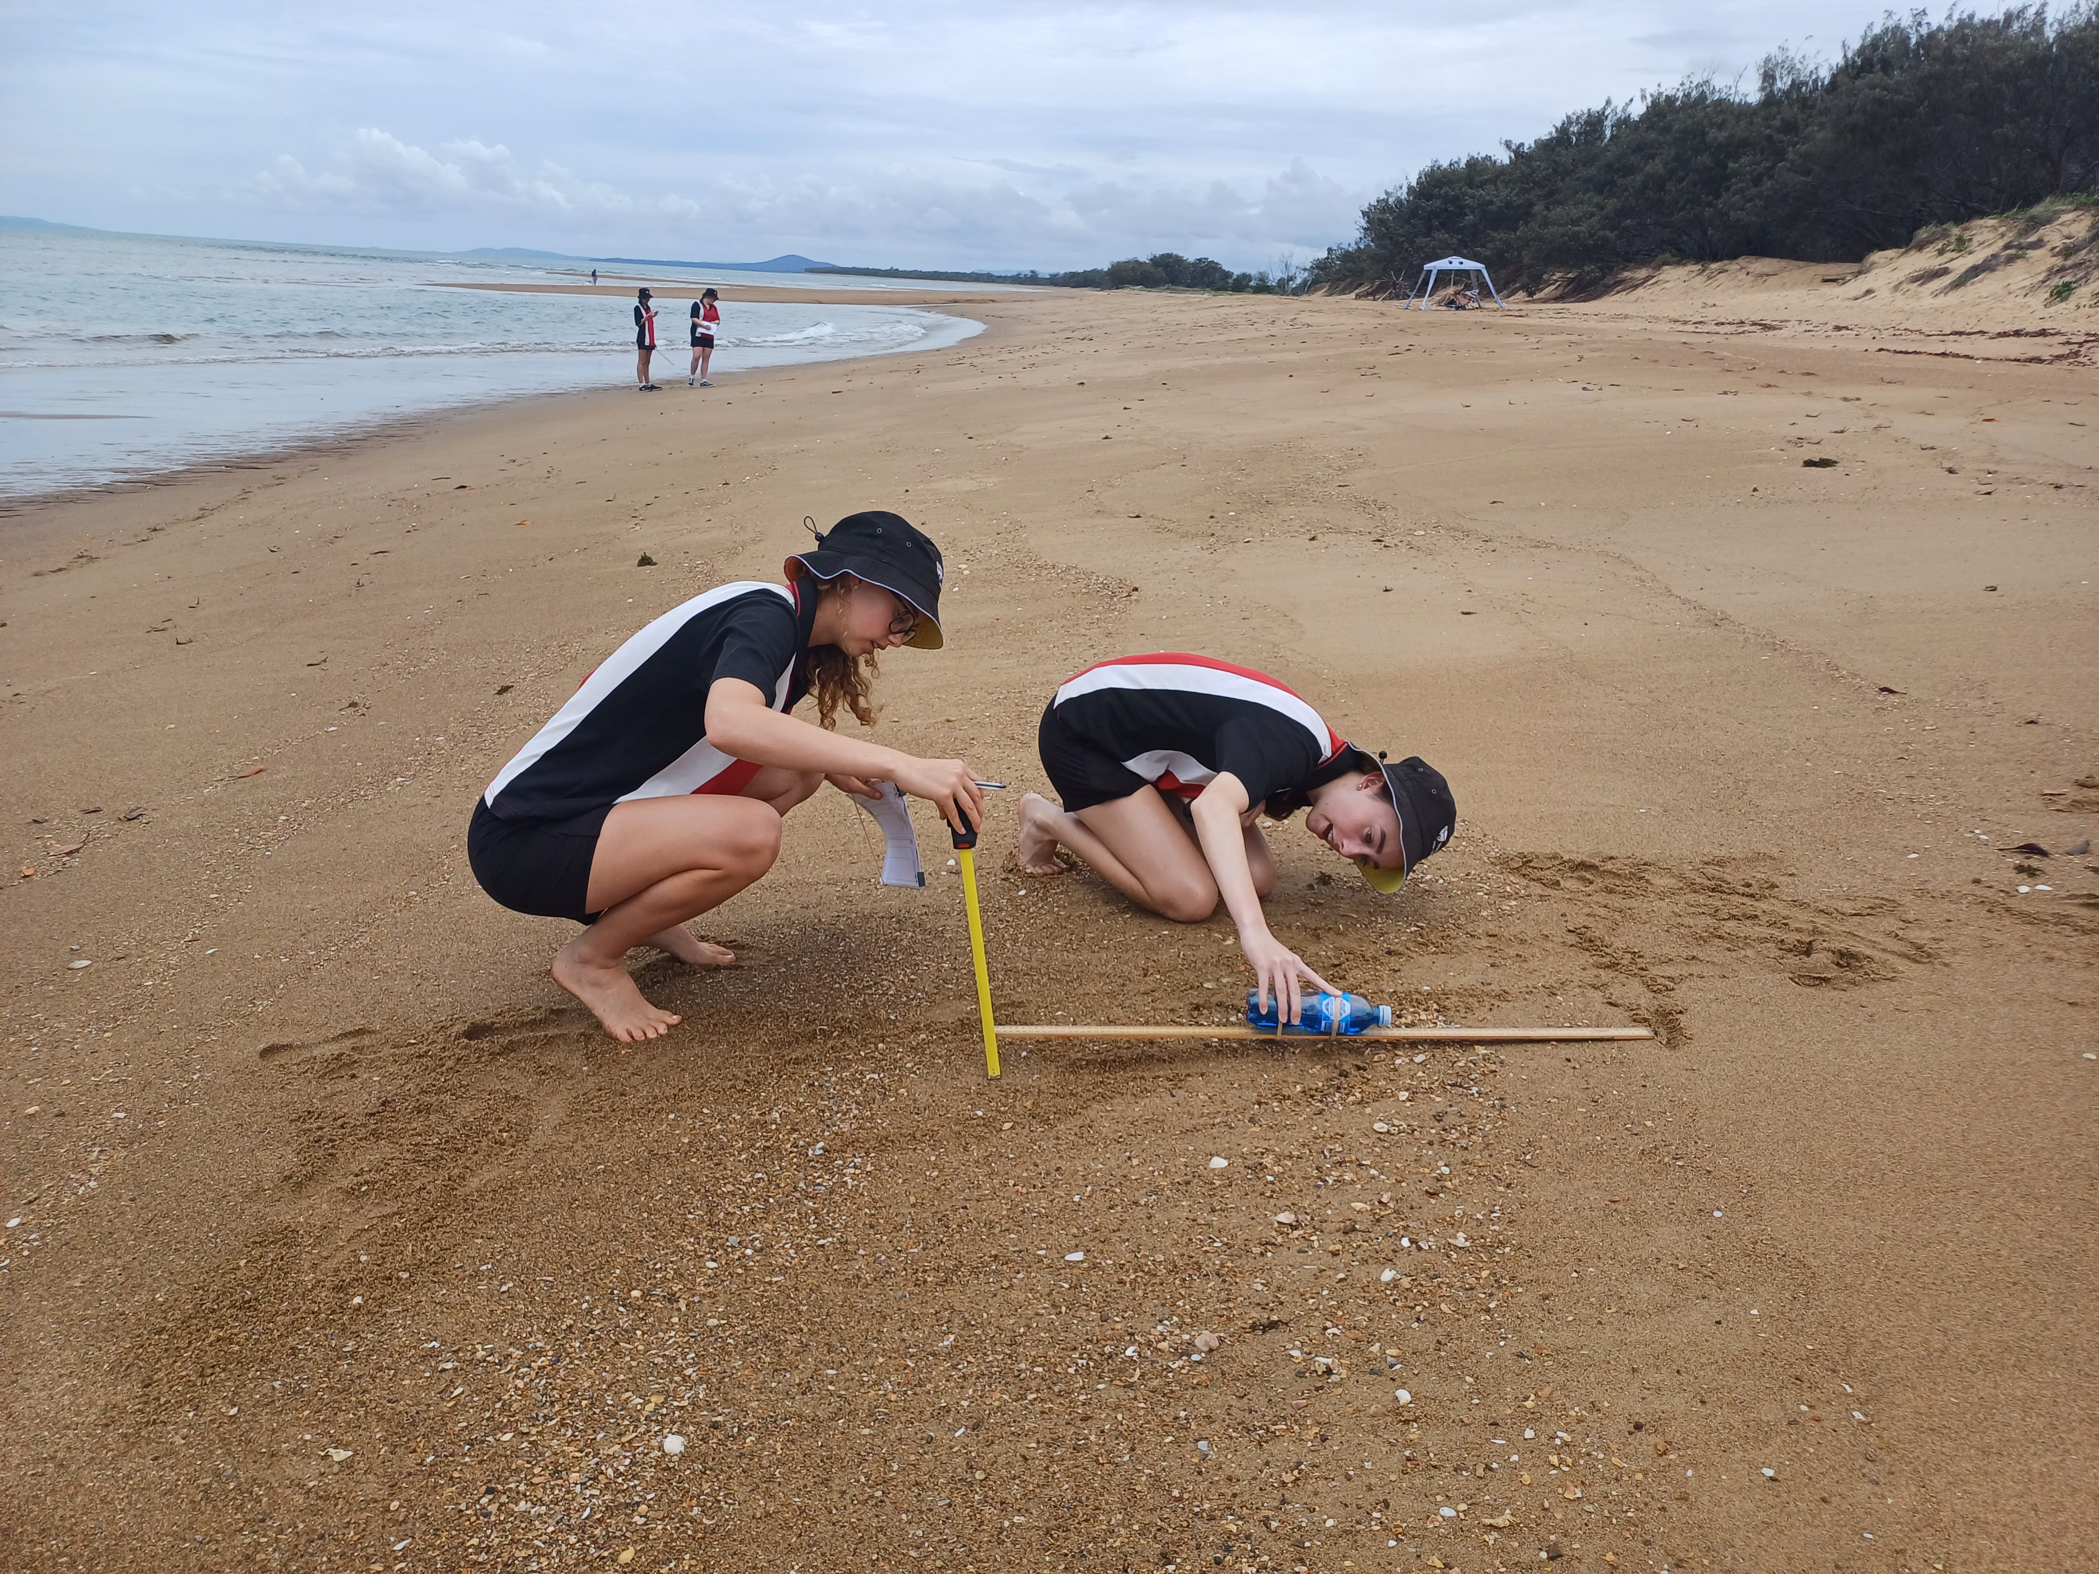
Measure the distance from the end of the ruler to the sand
Record on data sheet
Repeat, working your way down the beach

Slide 4
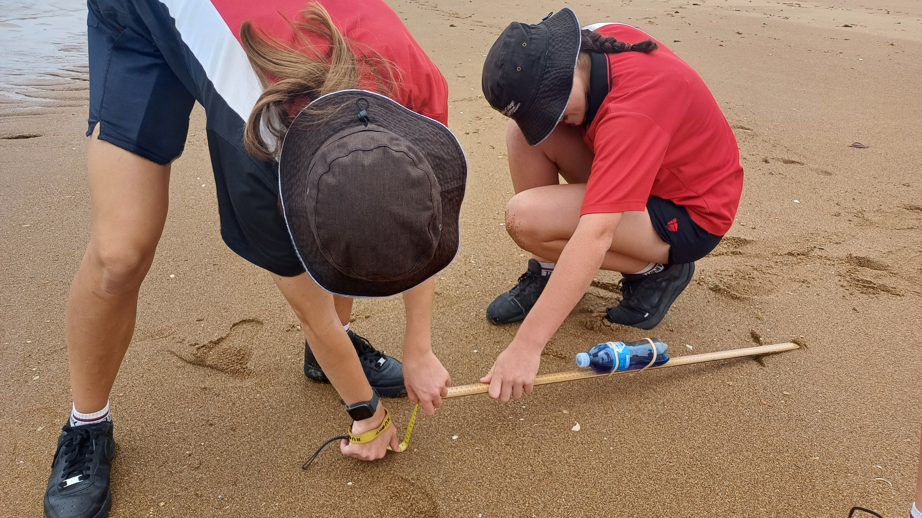

Slide 5
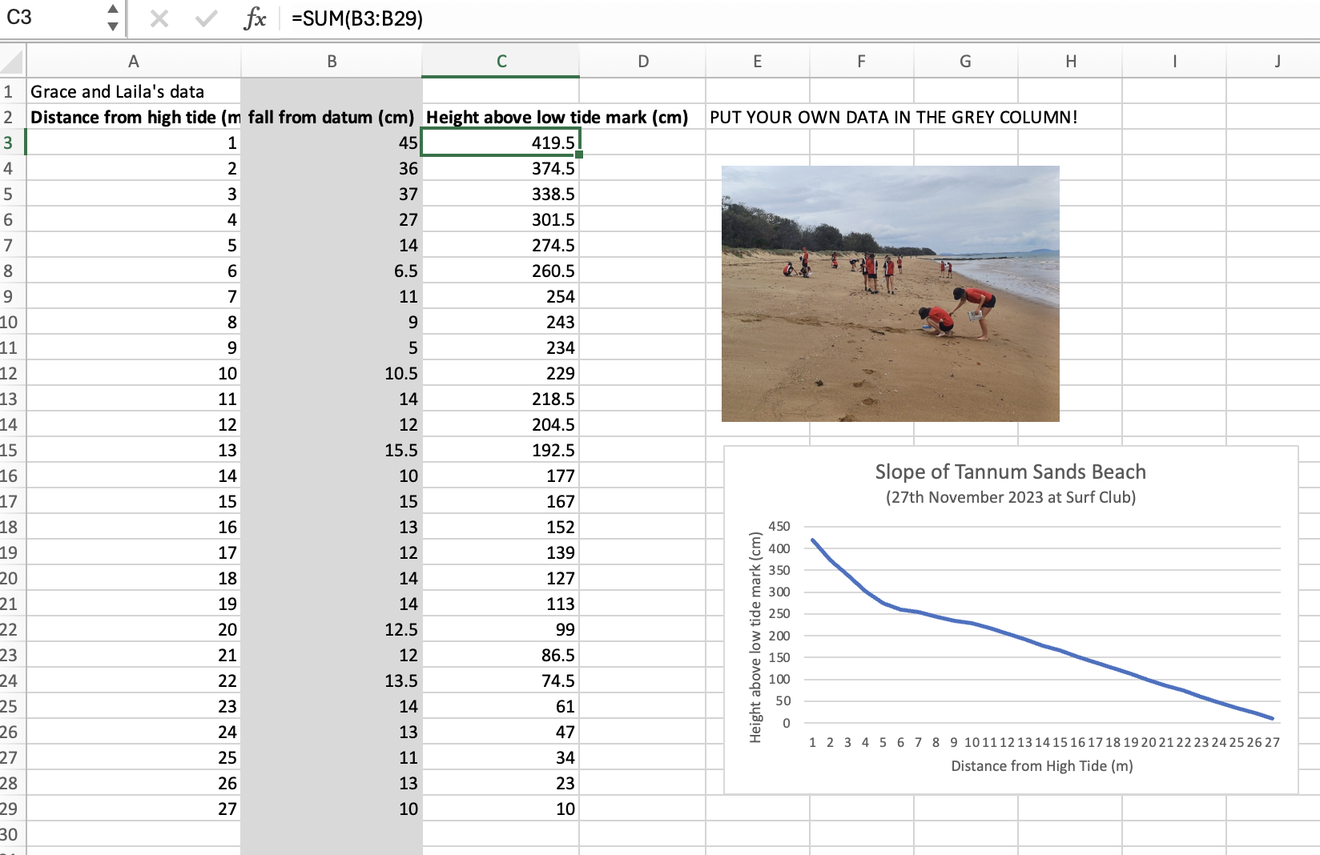
8) Transfer data to excel spreadsheet
9) Make new column (C) using formula pictured left
10) Highlight column A and C
11) Insert Line Graph

Slide 6
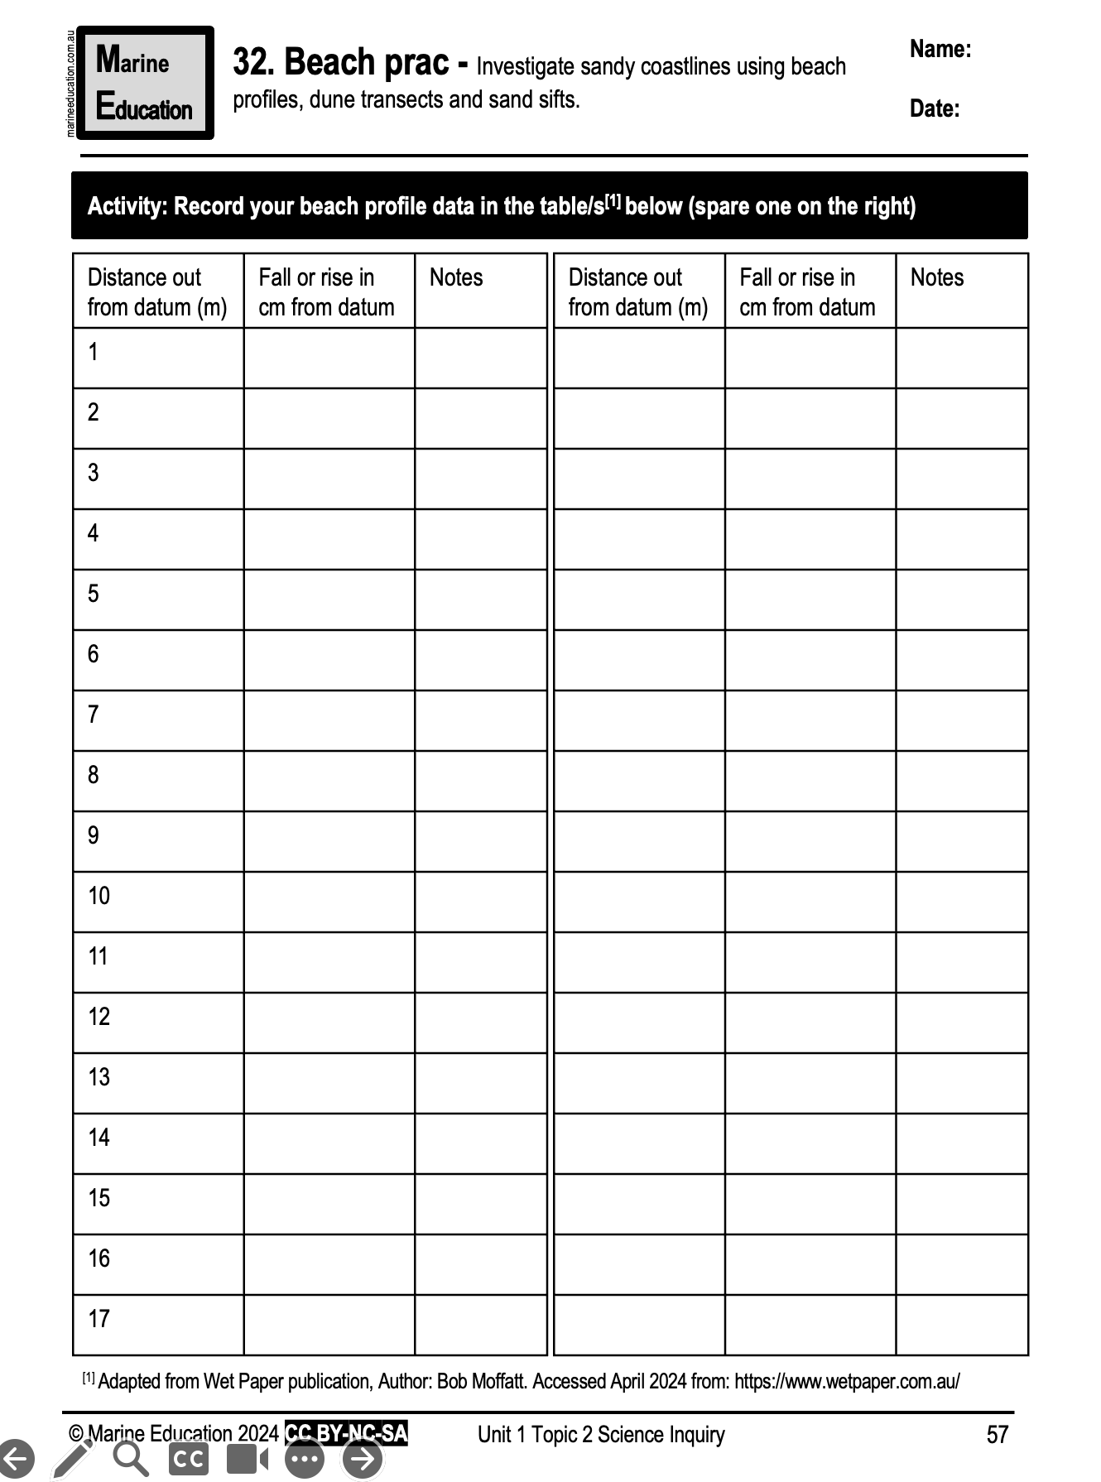
Learning Intention:
Investigate sandy coastlines using beach profiles, dune transects and sand sifts
Success Criteria:
Complete Marine Education worksheet ‘’32. Beach prac”

