Slide 1
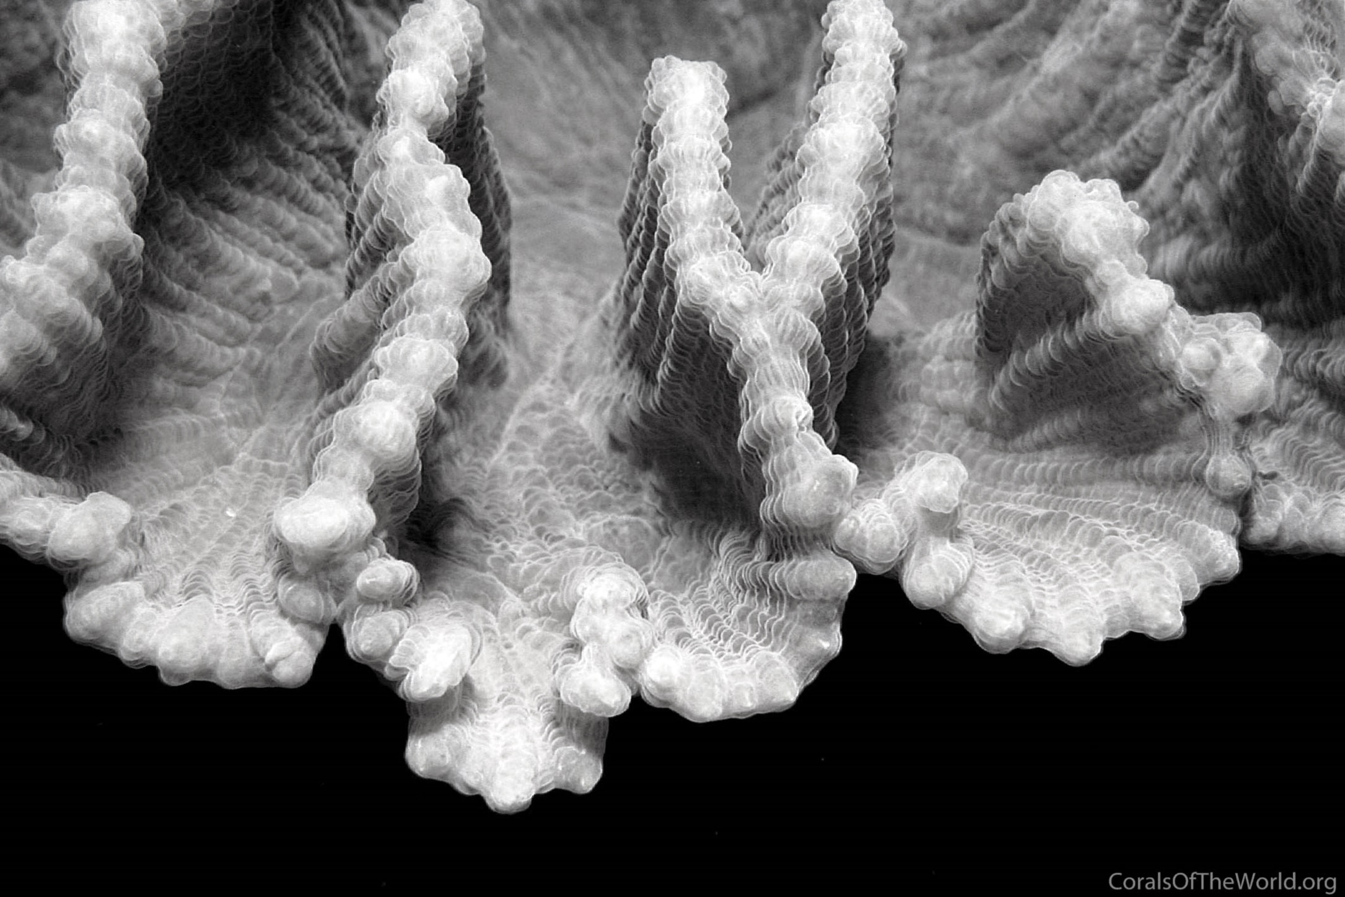
Marine
Education
Year 12 Marine Science
ANSWER BOOK
Name:
Date:
marineeducation.com.au
Marine Systems - Connections and Change
The Reef and Beyond Changes on the Reef
Ocean Issues and Resource Management
Oceans of the Future Managing Fisheries
Content from Marine Science Syllabus
State of Queensland (QCAA) 2025 v1.2
By Gail Riches
© Marine Education 2024 CC BY-NC-SA

Slide 2


Marine
Education
marineeducation.com.au
© Marine Education 2024 CC BY-NC-SA
Published by Marine Education 2024
ABN: 48765406873
Author: Gail Riches
Email: info@marineeducation.com.au
www.marineeducation.com.au
Course Overview and Learning Objectives derived from Marine Science 2025 v1.2 General senior syllabus, October 2024.
Queensland Curriculum & Assessment Authority PO Box 307 Spring Hill QLD 4004 Australia.
https://www.qcaa.qld.edu.au/downloads/senior-qce/syllabuses/snr_marine_science_25_syll.pdf
Image (front page): Veron J.E.N., Stafford-Smith M.G., Turak E. and DeVantier L.M. (2016). Corals of the World.
Accessed 27 May 2019. http://www.coralsoftheworld.org/species_factsheets/species_factsheet_summary/pectinia-lactuca/
Interested persons are invited to contact the author for information or to indicate errors and omissions.
This publication is available to download free-of-charge from the Marine Education website: www.marineeducation.com.au
The sale of this product is strictly prohibited.
Printing at a commercial printer such as Office Works is permitted for school-use only.
Marine Education would like to thank all the teachers, students and industry professionals who kindly shared their work.
© Marine Education 2024 CC BY-NC-SA

Slide 3
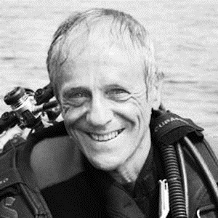
Marine
Education
marineeducation.com.au
Foreword
The Great Barrier Reef is known throughout the world as one of the greatest natural ecosystems on our planet. It is the largest and most spectacular structure built by living organisms on Earth, its size impossible to truly comprehend.
When I first started working on The Reef nearly 50 years ago, I thought it would always be there, a source of wonderment for unending generations to come. I was wrong. Reefs have been among the first victims of environmental upheavals for all geological time and now they are entering another crisis. Global warming from anthropogenic CO2 is killing corals at an unprecedented rate. The reason became clear to scientists over 20 years ago: it is all to do with the symbiosis between the corals and the unicellular algae – zooxanthellae – in their tissues. These zooxanthellae provide the nutrients that power the growth of corals and are essential to the very existence of reefs. Although corals are animals, this symbiosis allowed them to grow as if they were plants, powered by sunlight through photosynthesis. For millions of years, this coral/algal symbiosis has been incredibly successful. Over the past 100,000 years, corals around the globe have selected the type of zooxanthellae that give them ‘the biggest bang for their buck’ – the maximum amount of food possible. This has made them closely attuned to temperature, just as we are. If that temperature is exceeded, they become sick because their algae produce too much oxygen. In response, the corals rid themselves of their zooxanthellae just as we destroy pathogens in our bodies. However, that can be suicidal because corals cannot live for long without their algae; they turn pale (‘bleach’) and die. When this happens to most corals on a reef, we call it mass bleaching.
Mass bleaching, devastating though it is, is not the only crisis being created by CO2. When dissolved in seawater, CO2 forms carbonic acid which makes the ocean less alkaline – less super-saturated with aragonite, the most soluble form of calcium carbonate and the form corals use to build their skeletons. On current predictions, by the middle of this century or earlier, corals will be suffering from an osteoporosis-like condition or will not be able to grow skeletons at all.
The consequences of mass bleaching and ocean acidification are far more serious than most people realise because it is not just the corals that die, it is the entire reef ecosystem as that is entirely dependent on healthy corals. Reefs have by far the most diverse ecosystems of the entire marine realm. At least ⅓ of all marine species are dependent on reefs during some part of their life cycle. Should we lose our coral reefs, an ecological collapse of most ocean ecosystems will follow as all are closely interlinked. The geological record shows that the demise of reefs in the past has been the precursor to four of the earth’s five mass extinctions.
Of course, this reads like a nightmare fairytale and perhaps you think that it can’t be that serious. But this is not a fairytale, it is solid science and the facts have been known without question for at least a decade. If climate change continues unabated, young people today could inherit a world very different from that to which we are all accustomed.
We must do whatever we can to enhance the survival of corals by countering plagues of Crown-of-Thorns starfish and by closely monitoring all aspects of reef water quality. In short, we must keep the Great Barrier Reef as healthy as possible to enable it to recover from times of stress. Young people today have a critical role to play in this because The Reef’s future will soon be in their hands.
Charlie Veron
‘Charlie’ Veron, commonly called The Godfather of Coral, was the first full-time scientist to work on the Great Barrier Reef, eventually becoming Chief Scientist of the Australian Institute of Marine Science. He has published widely on reefs and their corals, see
Veron (2008) A Reef in Time: the Great Barrier Reef From Beginning to End and www.coralsoftheworld.org for further information.
© Marine Education 2024 CC BY-NC-SA

Slide 4
Marine
Education
Course Overview
marineeducation.com.au
Marine Science
Year 11
Assessment
Data Test 10%
Student Experiment 20%
Research Investigation 20%
Exam 50% (only examines SU dot points)
Year 12
Assessment
Data Test 10%
Student Experiment 20%
Research Investigation 20%
Exam 50% (only examines SU dot points)
Unit 1
Oceanography
Topic 1: An ocean planet
Topic 2: The dynamic shore
Unit 2
Marine Biology
Topic 1: Marine ecology and biodiversity
Topic 2: Marine environmental management
Unit 3
Marine systems – connections and change
Topic 1: The reef and beyond
Topic 2: Changes on the reef
Unit 4
Ocean issues and resource management
Topic 1: Oceans of the future
Topic 2 Managing fisheries
Syllabus Objectives
Describe ideas and findings
Apply understanding
Analyse data
Interpret evidence
Evaluate conclusions, claims and processes
Investigate phenomena
Science Strands
Science understanding (SU) - this is the ONLY Strand that is assessed in the (50%) exam
Science as a human endeavour (SHE)
Science inquiry skills (SIS)
© Marine Education 2024 CC BY-NC-SA
Course Overview

Slide 5
Marine
Education
Name:
Date:
marineeducation.com.au
Cognitive Verbs
Cognitive Verb | Description
Analyse | dissect to ascertain and examine constituent parts and/or their relationships; break down or examine in order to identify the essential elements, features, components or structure; determine the logic and reasonableness of information; examine or consider something in order to explain and interpret it, for the purpose of finding meaning or relationships and identifying patterns, similarities and differences
Apply | Use knowledge and understanding in response to a given situation or circumstance; carry out or use a procedure in a given or particular situation
Appreciate | recognise or make a judgment about the value or worth of something; understand fully; grasp the full implications of
Assess | Measure, determine, evaluate, estimate or make a judgement about the value, quality, outcomes, results, size, significance, nature or extent of something
Calculate | Determine or find (e.g. a number, answer) by using mathematical processes; obtain a numerical answer showing the relevant stages in the working; ascertain/determine from given facts, figures or information
Categorise | Place in or assign to a particular class or group; arrange or order by classes or categories; classify, sort out, sort, separate
Classify | Arrange, distribute or order in classes or categories according to shared qualities or characteristics
Consider | think deliberately or carefully about something, typically before making a decision; take something into account when making a judgment; view attentively or scrutinise; reflect on
Compare | Display recognition of similarities and differences and recognise the significance of these similarities and differences
Contrast | display recognition of differences by deliberate juxtaposition of contrary elements; show how things are different or opposite; give an account of the differences between two or more items or situations, referring to both or all of them throughout
Define | Give the meaning of a word, phrase, concept or physical quantity; state meaning and identify or describe qualities
Describe | Give an account (written or spoken) of a situation, event, pattern or process, or of the characteristics or features of something
Determine | establish, conclude or ascertain after consideration, observation, investigation or calculation; decide or come to a resolution
Discriminate | note, observe or recognise a difference; make or constitute a distinction in or between; differentiate; note or distinguish as different
© Marine Education 2024 CC BY-NC-SA
Cognitive Verbs

Slide 6
Marine
Education
Name:
Date:
marineeducation.com.au
Cognitive Verbs
Cognitive Verb | Description
Discuss | Examine by argument; sift the considerations for and against; debate; talk or write about a topic, including a range of arguments, factors or hypotheses; consider, taking into account different issues and ideas, points for and/or against, and supporting opinions or conclusions with evidence
Evaluate | Make an appraisal by weighing up or assessing strengths, implications and limitations; make judgements about ideas, works, solutions or methods in relation to selected criteria; examine and determine the merit, value or significance of something, based on criteria
Examine | investigate, inspect or scrutinise; inquire or search into; consider or discuss an argument or concept in a way that uncovers the assumptions and interrelationships of the issue
Explain | Make an idea or situation plain or clear by describing it in more detail or revealing relevant facts; give an account; provide additional information
Explain | Make an idea or situation plain or clear by describing it in more detail or revealing relevant facts; give an account; provide additional information
Explore | look into both closely and broadly; scrutinise; inquire into or discuss something in detail
Identify | Distinguish; locate, recognise and name; establish or indicate who or what someone or something is; provide an answer from a number of possibilities; recognise & state a distinguishing factor or feature
Infer | derive or conclude something from evidence and reasoning, rather than from explicit statements; listen or read beyond what has been literally expressed; imply or hint at
Interpret | use knowledge and understanding to recognise trends and draw conclusions from given information; make clear or explicit; elucidate or understand in a particular way; bring out the meaning of, e.g. a dramatic or musical work, by performance or execution; bring out the meaning of an artwork by artistic representation or performance; give one's own interpretation of; identify or draw meaning from, or give meaning to, information presented in various forms, such as words, symbols, pictures or graphs
Investigate | carry out an examination or formal inquiry in order to establish or obtain facts and reach new conclusions; search, inquire into, interpret and draw conclusions about data and information
Predict | give an expected result of an upcoming action or event; suggest what may happen based on available information
Recall | Remember; present remembered ideas, facts or experiences; bring something back into thought, attention or into one’s mind
Recognise | Identify or recall particular features of information from knowledge; identify that an item, characteristic or quality exists; perceive as existing or true; be aware of or acknowledge
Understand | Perceive what is meant by something; grasp; be familiar with (e.g. an idea); construct meaning from messages, including oral, written and graphic communication
© Marine Education 2024 CC BY-NC-SA
Cognitive Verbs

Slide 7
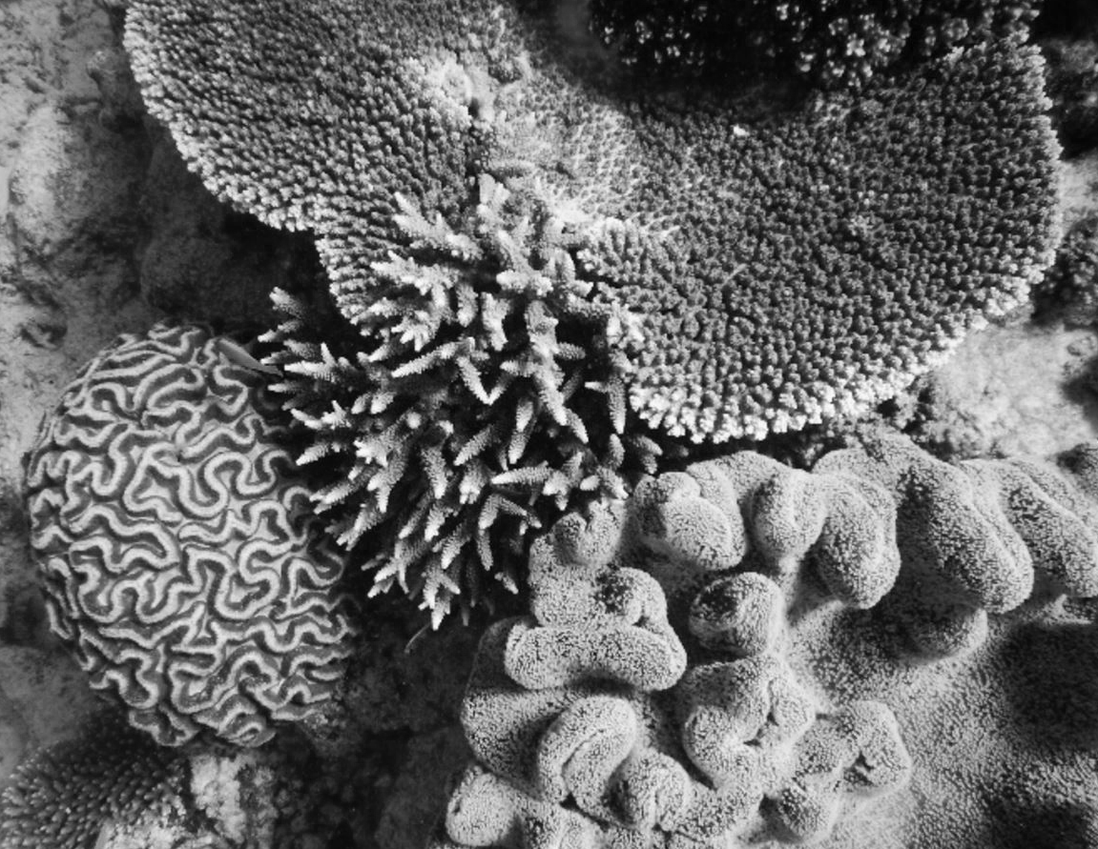
Marine
Education
Year 12 Marine Science
Name:
Date:
marineeducation.com.au
Unit 3 Marine Systems
Connections and Change
Topic 1:
The Reef and Beyond
Coral reef distribution
Coral reef development
Reef, habitats and connectivity
Flinders Reef Moreton Bay Marine Park July 2016
An assortment of corals photographed at Capricorn Bunker Group. Photograph © Mr. Brad Lawrence (Redlands SHS). Reprinted with permission.
© Marine Education 2024 CC BY-NC-SA

Slide 8
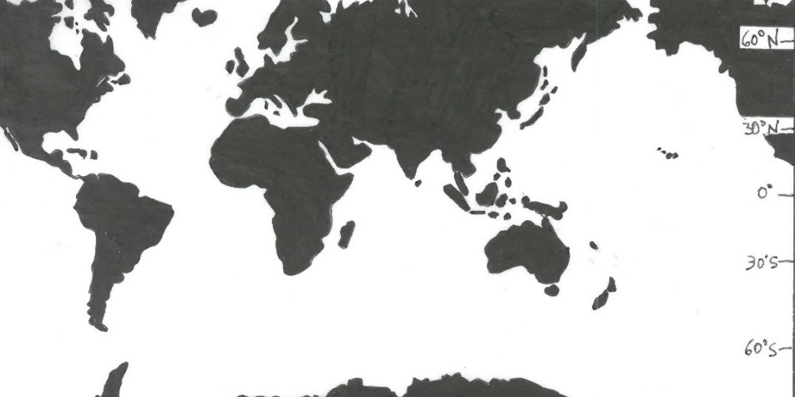
Marine
Education
1. Formula for Life – Identify the distribution of coral reefs globally and in Australia
Name:
Date:
marineeducation.com.au
The distribution of coral reefs is dependent on the ability for corals to do their thing - to turn calcium and carbonate ions, that are dissolved in seawater, into solid calcium carbonate or coral skeleton;
a process known as calcification. Notably, only reef-building corals (as opposed to non reef-building corals) can grow their skeletons fast enough to actually build a coral reef. This is because reef-building corals are given a helping hand by hosting algae (zooxanthellae) in their tissues. The algae carry out photosynthesis and, in doing so, ‘feed’ the corals with lots of energy, so the corals can grow fast enough to build a coral reef. Thus, the distribution of coral reefs is dependent on, not only the needs of the corals (e.g. calcium and carbonate ions, suitable substrate), but also the needs of the algae. The needs of the algae include warm water (but not too warm) and plenty of sunlight (e.g. shallow and clear water).
Reef-building corals need (their algae to have) warm, shallow, clear water to build reefs. For example, the table below features estimates of how warm the water needs to be, and what temperatures are too warm^{[1]}.
Range of Tolerance
Optimum Range
Abundance
Table 1: Sources of models used to calculate minimum and maximum temperatures for reef-building corals^{[1]}
Source | Scale | Min. °C | Max. °C
Reynolds & Marsico, 1993 (K97) | Weekly | 18.1 | 31.5
Reynolds & Marsico, 1993 (K99) | Weekly | 16.0 | 34.4
Locarnini et al., 2010 | Annually | 21.7 | 29.6
NOAA 01 SST V2 | Weekly | 15.7 | 35.5
(too COLD)
Temperature °C
(too WARM)
Min.
Max.
Figure 1: Corals like warm water, but not too warm^{[2]}
Activity: Shade the distribution of coral reefs, globally and in Australia, on the map below.
Hint: go to www.windy.com to view temperatures from all around the world (you will need to zoom out and change the display from wind to temperature).
Then, go to Google Maps (satellite view) to find areas that are also shallow enough for reefs to form.
The Coral Triangle
^{[1]} Adapted from: Guan, Y., Hohn, S. and Merico, A. (2015). Suitable Environmental Ranges for Potential Coral Reef Habitats in the Tropical Ocean. PLoS ONE 10(6). DOI: 10.1371/journal.pone.0128831
^{[2]} Adapted from: Buddemeier, R.W. and Smith, S.V. (1999). Coral Adaptation and Acclimatization: A Most Ingenious Paradox. Amer. Zool., 39(1):1-9. DOI: 10.1093/icb/39.1.1
© Marine Education 2024 CC BY-NC-SA
Unit 3 Topic 1 Science Understanding

Slide 9
Marine
Education
Name:
Date:
marineeducation.com.au
Identify the distribution of coral reefs globally and in Australia
© Marine Education 2024 CC BY-NC-SA
NOTES AND EXAM REVISION

Slide 10
Marine
Education
2. Title – Describe the distribution patterns of reefs, including changes moving down latitudinal gradients and across, from inshore to outer shelf reefs.
Name:
Date:
marineeducation.com.au
Teacher to write
© Teacher’s name [Year] CC BY-NC-SA
Unit 3 Topic 1 Science Understanding

Slide 11
Marine
Education
Describe the distribution patterns of reefs, including changes moving down latitudinal gradients and across, from inshore to outer shelf reefs.
Name:
Date:
marineeducation.com.au
© Marine Education 2024 CC BY-NC-SA
NOTES AND EXAM REVISION

Slide 12





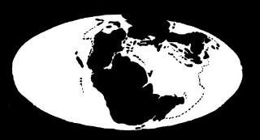


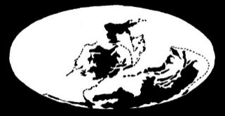

3. Paleo-perspectives – Explain how abiotic factors have affected the geographic distribution of corals over geological
time, including dissolved oxygen, light availability, salinity, temperature, substrate, aragonite and low levels of nitrates and phosphates.
Name:
Date:
Marine
Education
marineeducation.com.au
Corals likes and dislikes
Imagine you are holding a coral fossil in your hand that is 120 million years old. Imagine the conditions at that place and time (for it to be alive). Corals like certain conditions. Corals like warm, salty water
with lots of oxygen, light, aragonite and low levels of nitrates and phosphates. Corals dislike water that is too warm, too acidic and oxygen deficient (e.g. conditions during the P-T mass extinction event ~251mya).
Activity: Describe the abiotic conditions that killed all corals (and ~90% of marine life) ~251mya
35-40°C water, that was too acidic, and oxygen deficient (from lots of CO2).
Extensive reef development
20mya
Tethys Sea corals on Mt. Everest!
Many coral fossils have been found where the Tethys Sea used to be. The Tethys Sea was
an ancient ocean that existed from 250mya to 50mya. At one time it separated into Gondwana and Laurasia. Fossils from the Tethys Sea are now scattered from the depths of the Caspian Sea to the highest Himalayan peaks. Imagine hiking Mt Everest and finding a coral fossil!
Limited reef development
No reef development (not to scale)
Quaternary
Precambrian
Cenozoic
Tertiary
65mya
K-T Extinction event ~65 mya
Cretaceous
120mya
Mesozoic
Jurassic
Tethys
Extinction event ~205 mya
Imagine you are holding a coral fossil in your hand from the Tethys Sea 120mya.
Q. What conditions were necessary for that coral to form? (hint: title) Ans.
Triassic
200mya
P-T Extinction event ~251 mya
Tethys
Permian
260mya
Lots of dissolved oxygen
Lots of calcium and carbonate ions
(Ωara>3.3 – see next page)
Warm temperatures
Shallow, clear, sunlit water
Salty water (fresh water kills coral)
Low levels of nitrates and phosphates (excess nutrients kill coral)
Carboniferous
Extinction event ~360 mya
300mya
Palaeozoic
Devonian
Silurian
370mya
Extinction event ~434 mya
Ordovician
470mya
Q. Why does the Tethys Sea not exist anymore? Ans.
Cambrian
Tectonic plate movement and continental drift
Figure 1: Reefs over time^{[1][2][3]}
Figure 2: World maps over time^{[4]}
^{[1]} Adapted from Laurie, Dr J. (Editor), et al., (2013). Geological Timewalk. Geoscience Australia, Canberra. Accessed 22.11.18 from: https://d28rz98at9flks.cloudfront.net/69795/69795_Timewalk_WCAG.pdf
^{[2]} Adapted from Veron, J. E. N. (2008). Mass extinctions and ocean acidification: biological constraints on geological dilemmas. Coral Reefs. 27:459–472. DOI 10.1007/s00338-008-0381-8
^{{3]} Adapted from: Brannen, P. (2017). The Ends of the World. Oneworld Publications. London. England. Page 5.
^{[4]} Traced from screenshots of video from: TheBentastic (2009). Earth’s history in the last 600 million years. Youtube. Accessed 22.11.18 from www.youtube.com/watch?v=cQVoSyVu9rk
© Marine Education 2024 CC BY-NC-SA
Unit 3 Topic 1 Science Understanding – Coral Reef Distribution

Slide 13
Marine
Education
Explain how abiotic factors have affected the geographic distribution of corals over geological time, including dissolved oxygen, light availability, salinity, temperature, substrate, aragonite and low levels of nitrates and phosphates.
Name:
Date:
marineeducation.com.au
© Marine Education 2024 CC BY-NC-SA
NOTES AND EXAM REVISION

Slide 14
Marine
Education
4. WHAT IS ARAGONITE?
Name:
Date:
marineeducation.com.au
Aragonite is Calcium Carbonate (what coral skeletons are made of)
Coral skeletons are made of calcium carbonate. The chemical formula for calcium carbonate is CaCO3. However, there are 3 different types of calcium carbonate (with that same formula) – aragonite, calcite and vaterite! Scleractinian corals are made from the ‘aragonite version’ of calcium carbonate. Hence the name.
Q. What is the name, and chemical formula, for aragonite? Ans.
Calcium Carbonate CaCO3
Now take a closer look at the formula and you will see that it is made of two parts put together. Calcium ions (Ca ) and carbonate ions (CO3 ). Note: ions are atoms or molecules that carry a (+ or -) charge.
2+
2-
Q. What ions combine to make aragonite? Ans.
Calcium ions and Carbonate ions
Coral is made by combining (dissolved) calcium and carbonate ions to make (solid) calcium carbonate.
Calcium ions
Carbonate ions
Calcium Carbonate
Ca CO3 CaCO3
2+
2-
(aq)
(aq)
(s)
Left of the arrow features ions that are dissolved in seawater. Right of the arrow features solid calcium carbonate (i.e. coral). Note: the reaction can go both ways. Hence, the arrow points both ways. When the solution (left of arrow) is supersaturated with lots of dissolved ions, the arrow points right. When the solution (left of arrow) is undersaturated with dissolved ions, the arrow points left (CaCO3 dissolves!).
Q. What determines the direction of the arrow in the reaction above? Ans.
The concentration of ions in seawater (the saturation of the solution)
Hence, corals need the arrow to be pointing to the right to make their skeletons, and thus coral reefs.
The question remains, do they have enough ions? Well, calcium ions are always in ample supply, so no worries there. Carbonate ions, however, can be in short supply. Particularly when carbon dioxide levels in the atmosphere get too high and change the chemistry of the ocean. E.g. if there is too much CO2 in the atmosphere, the carbonate ion supplies in the ocean become dangerously low. In which case, corals do
not have enough carbonate ions to make their skeletons strong enough, or to calcify (grow) at a rate fast enough to build reefs. Which is not good news! Scientists use the aragonite saturation state “Ωara” to track the saturation of carbonate ions in seawater (and thus the potential calcification rate in corals) over time. Whereby, if the saturation of carbonate ions (CO3²⁻) decreases, Ωara decreases. Ωara is then used to map the distribution of coral reefs in the past, and to predict where reefs will be (or not be) in the future^{[1]}.
Ωara =
[ Ca²⁺ ] [ CO3²⁻ ]
when Ca²⁺ and Ksp (the stoichiometric solubility product) are kept constant…..
K sp
When CO3²⁻ decreases, Ωara decreases.
When CO3²⁻ increases, Ωara increases.
Q. True or False? when Ωara is low, CO3²⁻ concentrations are also low. Ans.
True
When Ωara is <3.3, corals get stressed. When Ωara is <1, the arrow points left and corals dissolve!
Q. What happens to coral when Ωara falls below 3.3? Ans.
They become stressed
^{[1]} Kleypas, J .A., Buddemeier, R.W., Archer, D., Guttuso, J., Langdon, C. and Opdyke, B.N. (1999). Geochemical Consequences of Increased Atmospheric Carbon Dioxide on Coral Reefs. Science 284, 118 DOI: 10.1126/science.284.5411.118.
© Marine Education 2024 CC BY-NC-SA
Unit 3 Topic 1 Science Understanding – Coral Reef Distribution

Slide 15
Marine
Education
Name:
Date:
marineeducation.com.au
What is aragonite?
© Marine Education 2024 CC BY-NC-SA
NOTES AND EXAM REVISION

Slide 16
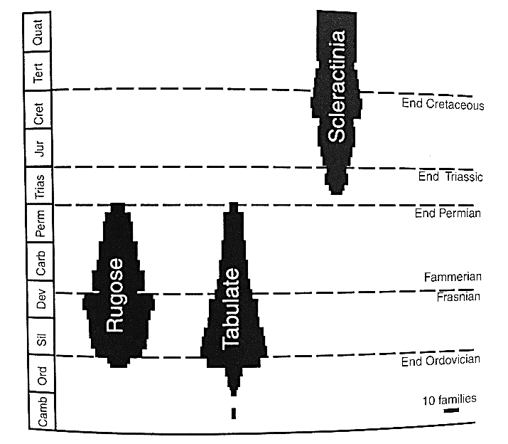
Marine
Education
5. Written in Stone – State that corals first appeared within the geological record over 250 million years ago but not in Australian waters until approximately 500 000 years ago.
Name:
Date:
marineeducation.com.au
Modern-day reef-building corals from the order Scleractinia first appeared after the P-T extinction event, over 250 million years ago. Note: Prior to the P-T extinction event, Scleractinia corals did not exist. Instead there were Paleozoic reef-building corals called Rugose corals and Tabulate corals (Figure 1).
Q. When did Scleractinia corals appear? Ans.
After the P-T event, over 250mya
Q. Did Scleractinia corals survive the K-T extinction event 65mya that killed the dinosaurs? Ans.
[Yes] [No]
Figure 1: Age ranges of tabulate, rugose and the modern Scleractinia corals. Reprinted with permission from Cambridge University Press^{[1]}.
Circle correct answer
A very confused Santa Clause
Most spectacularly, the location of magnetic north and magnetic south swapped places in the geological past. Yes, that’s right. The north pole was at the south pole and vice versa. This reversal has happened quite a few times actually! Every reversal is captured in the orientation of magnetic mineral
crystals in rocks (which point to where magnetic north was located at the time the rock was made). The
last pole reversal was ~780,000 years ago. No rock samples from the Great Barrier Reef contain evidence of a flip in Earth’s magnetic field. Therefore, paleo-ecologists are confident corals did not exist in Australian waters until after the last pole reversal ~790,000 years ago. Scleractinian coral fossils start to appear in Australia’s geological record in (as recent as) ~500,000 years ago (give or take 200,000 years)^{[2][3]}.
Q. When was the last reversal of Earth’s magnetic field? Ans.
~780,000 years ago
Q. When did corals first appear in Australia’s geological record? Ans.
~500,000 years ago
Activity: In the space below, draw a timeline with a scale of 1cm = 25 million years. Indicate when Scleractinian corals first appeared in the fossil record: (1) Globally and (2) in Australia.
Millions of years ago
250
225
200
175
150
125
100
75
50
25
0
1. When Scleractinian corals first appeared in the Global fossil record
2. When Scleractinian corals first appeared in Australia’s fossil record
^{[1]} Johnson, D. 2004. The Geology of Australia. Cambridge University Press, Cambridge, UK. Page 83. Figure 4.4: Age ranges of tabulate, rugose and the modern scleractinian corals. ISBN: 0521841216
^{[2]} Blewett, R.S. (ed) 2012. Shaping a Nation: A Geology of Australia. Geoscience Australia and ANU E Press, Canberra.
^{[3]} Webster, J. M. and Davies, P. J. 2003. Coral variation in two deep drill cores: significance for the Pleistocene development of the Great Barrier Reef. Sedimentary Geology 159. 61-80.
DOI: 10.1016/S0037-0738(03)00095-2
© Marine Education 2024 CC BY-NC-SA
Unit 3 Topic 1 Science Understanding – Coral Reef Distribution

Slide 17
Marine
Education
State that corals first appeared within the geological record over 250 million years ago but not in Australian waters until approximately 500 000 years ago.
Name:
Date:
marineeducation.com.au
© Marine Education 2024 CC BY-NC-SA
NOTES AND EXAM REVISION

Slide 18
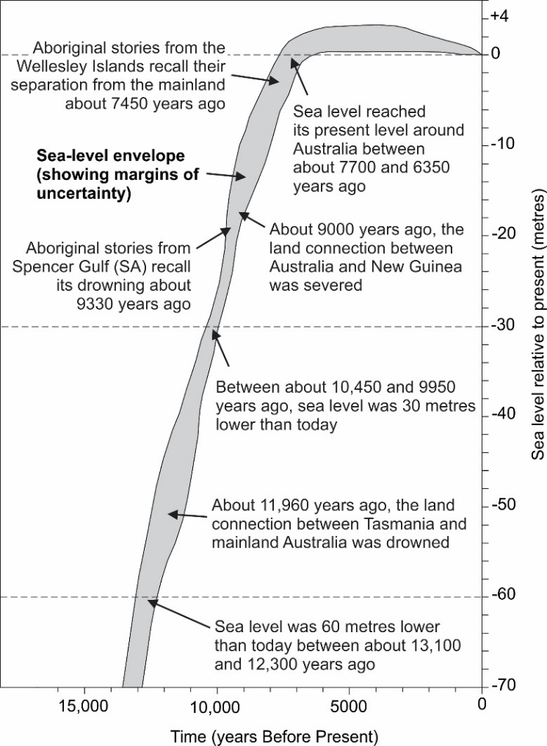
Marine
Education
6. Rising Seas – Describe how the Great Barrier Reef of today has been shaped by changes in sea levels that began over
20 000 years before present (BP) and only stabilised 6500 years BP
Name:
Date:
marineeducation.com.au
The Great Flood Event
Imagine it is very cold. It is an ice age. It is 20,000 years ago. Indigenous Australians are braving the cold. The sea level is ~120 metres below its present level. There is a land bridge between Tasmania and Victoria. Rivers flow all the way to the continental shelf. But the cold snap does not last forever. The Earth eventually warms. And a great flood event begins. The flood lasts more than 10,000 years! Ice sheets melt and sea levels rise. Sometimes very quickly. At one point, global sea levels rise 20m in less than 500 years (~14,600 BP during Meltwater Pulse 1A)^{[2]}. Tasmania and PNG separate from mainland Australia, and the Gulf of Carpentaria turns from a lake into a Gulf. Coastal mountains become islands. The Aborigines have no choice but to retreat. It is not until 6,500 BP that sea levels finally stabilise.
In the beginning, as far back as we remember, our home islands were not islands at all as they are today.
They were part of a peninsula that jutted out from the mainland and we roamed freely throughout the land without having to get in a boat like we do today. Then Garnguur, the seagull woman, took her raft and dragged it back and forth across the rock of the peninsula letting the sea pour in and making our homes into islands.
Paraphrased Aboriginal story from the Wellesley Islands, Southern Gulf of Carpentaria^{[1]}.
The story above and the graph pictured left are from research by Patrick Nunn and Nick Reid (2016)^{[1]} who travelled Australia and listened to many Aboriginal stories. All of which indicated post-glacial sea level rise and coastal inundation. Patrick Nunn and Nick Reid felt confident the stories survived unchanged for thousands of years!!!
Activity: Choose an island off the coast of Australia. Describe the appearance of the island 20,000 years ago compared to 6,500 years ago.
Hint: was it joined to the mainland?
E.g. 20,000 years ago, Island X was joined to the mainland.
6,000 years ago it appeared similar to today.
Figure 1: Sea level rise in Australia. Courtesy of Patrick Nunn.
^{[1]} Nunn, P.D. and Reid, N. 2015. Ancient Aboriginal stories preserve history of a rise in sea level. The Conversation, published online 13 January 2015. http://tinyurl.com/k63anzm
^{[2]} Weaver A.J., Saenko, O.A., Clark, P.U. and Mitrovica, J.X. 2003. Meltwater Pulse 1A from Antarctica as a Trigger of the Bolling-Allerod Warm Interval. Science Vol 299.
Pages 1709-1713. DOI: 10.1126/science.1081002
© Marine Education 2024 CC BY-NC-SA
Unit 3 Topic 1 Science Understanding – Coral Reef Distribution

Slide 19
Marine
Education
Describe how the Great Barrier Reef of today has been shaped by changes in sea levels that began over 20 000 years before present (BP) and only stabilised 6500 years BP
Name:
Date:
marineeducation.com.au
© Marine Education 2024 CC BY-NC-SA
NOTES AND EXAM REVISION

Slide 20
Marine
Education
7. Coral Necklaces and Ribbons – Describe the different types of reef structure, e.g. fringing, platform, ribbon, atolls, coral cays.
Name:
Date:
marineeducation.com.au
Activity: Complete the sentence below each diagram. Select from the following words below:
Coral Cay, Barrier Reef, Platform Reef, Fringing Reef, Atoll, Ribbon Reef
Land
Land
Reef
Reef
Deep lagoon
Reef
Reef
This type of reef is directly attached to land (e.g. mainland or continental island). You can snorkel this type of reef by simply stepping off the beach!
You have to catch a boat to snorkel this type of reef because of the deep lagoon (or channel) that separates the reef and the land.
Fringing Reef
It is called a….
Barrier Reef
It is called a….
Reef
Continental Shelf
Reef
Continental Slope
A nice patch of reef that rises up from the bottom as a small isolated platform of coral. They vary in size and rarely reach the surface of the water.
A narrow ribbon-shaped reef tracking alongside the edge of the continental shelf in N^{th} Qld. Thus, you need to travel a very long way to get there!
Ribbon Reef
It is called a….
It is called a….
Platform Reef
Reef
Deep lagoon
Coral Island
Reef
Imagine a fringing reef without the island in the middle. This reef is shaped like a ring. The middle of the ring is lagoon (where the island used to be)
A small low-lying sand island where the sand is made from bits and pieces of coral debris.
Reef surrounds the island. Many have a lagoon.
Coral Cay
It is called an….
It is called a….
Atoll
© Marine Education 2024 CC BY-NC-SA
Unit 3 Topic 1 Science Understanding – Coral Reef Distribution

Slide 21
Marine
Education
Describe the different types of reef structure, e.g. fringing, platform, ribbon, atolls, coral cays
Name:
Date:
marineeducation.com.au
© Marine Education 2024 CC BY-NC-SA
NOTES AND EXAM REVISION

Slide 22
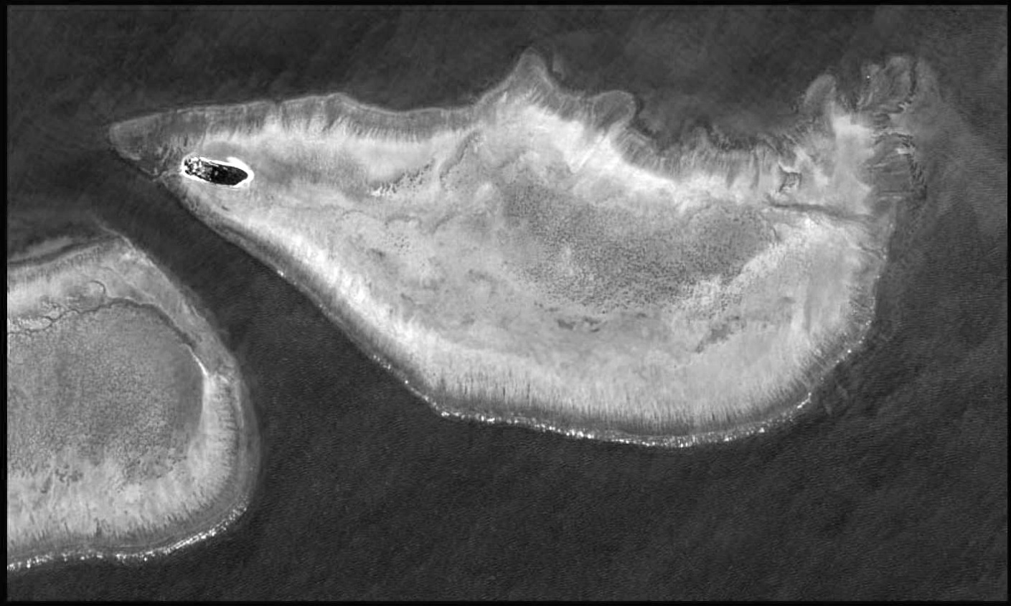
Marine
Education
8. Zone it – Describe the zonation within a reef cross-section,
e.g. reef slope, reef crest/rim, lagoon/back reef
Name:
Date:
marineeducation.com.au
Heron Island
Coral Cay
Lagoon
/back reef
Wistari Reef
A
Transect AB
B
Reef crest/rim
Reef slope
Figure 1: Heron and Wistari Reefs from the PlanetDove Satellite taken 12th January 2018 as a surface reflectance map, created by the Remote Sensing Research Centre, University of Qld^{[1]}. Satellite image data provided by Planet Inc. and the Allen Coral Atlas (https://allencoralatlas.org).
Activity: Write the names of the zones in the boxes below Transect AB (as pictured in Figure 1).
A
Transect AB
B
Lagoon/back reef
Reef crest/rim
Reef Slope
Activity: Complete the table below.
Zonation | Description
Lagoon/back reef | The back reef hugs the inner margin of the reef crest/rim and slopes down into a lagoon (towards land or reef centre).
Reef crest/rim | A formidable barrier that absorbs and dissipates the energy of incoming waves. The shallowest part of the reef.
Reef slope | Where the reef descends into deeper water down a ‘slope’.
^{[1]} Adapted with permission from Professor Stuart Phinn. Director of the Remote Sensing Research Centre located at the School of Environmental Sciences at the University of Qld.
© Marine Education 2024 CC BY-NC-SA
Unit 3 Topic 1 Science Understanding – Coral Reef Distribution

Slide 23
Marine
Education
Describe the zonation within a reef cross-section,
e.g. reef slope, reef crest/rim, lagoon/back reef
Name:
Date:
marineeducation.com.au
© Marine Education 2024 CC BY-NC-SA
NOTES AND EXAM REVISION

Slide 24
Marine
Education
9. Coral Classification – Discriminate between the following groups of coral: Alcyonacea ‘soft corals’ and the two morphological groups within Scleractinia ‘hard corals’ - reef-forming/hermatypic and non-reef
forming/ahermatypic.
Name:
Date:
marineeducation.com.au
Domain → Kingdom → Phylum → Class → Order → Family → Genus → Species
Activity: Create a quirky mnemonic to help remember the correct order for the above
id
ing
ome
ver
or
reat
pagetti?
D
K
hilip
G
S
P
C
O
F
PHYLUM CNIDARIA
Nematocysts (stinging cells)
One opening (mouth & anus)
Polyp or medusa
CLASS HYDROZOA
Polyps lack mesenteries
E.g. hydroids, fire corals,
blue-bottles etc.
CLASS CUBOZOA
Square-shape (like a ‘cube’) when viewed from above
E.g. box jellyfish, Irukandji
CLASS ANTHOZOA
Polyps with mesenteries
E.g. Corals
CLASS SCYPHOZOA
E.g. True Jellyfish
HEXACORALS (Subclass Hexacorallia)
OCTOCORALS (Subclass Octocorallia)
2
1
2
Polyps with 6 or multiples of 6 tentacles and mesenteries
1
3
Polyps with 8 or multiples of 8 tentacles and mesenteries
8
3
7
4
6
5
4
6
5
Order Scleractinia
Order Actiniaria
Order Alcyonacea
Order Pennatulacea
HARD CORALS
ANEMONES
SOFT CORALS
SEA PENS
includes
hermatypic and ahermatypic corals
includes
Gorgonian Sea Fans
Activity: Complete the table below
 | Hard Corals | Soft Corals
Phylum | Cnidaria | Cnidaria
Class | Anthozoa | Anthozoa
Sub-class | Hexacorallia | Octocorallia
Order | Scleractinia | Alcyonacea
© Marine Education 2024 CC BY-NC-SA
Unit 3 Topic 1 Science Understanding – Coral Reef Development

Slide 25
Marine
Education
Discriminate between the following groups of coral: Alcyonacea ‘soft corals’ and the two morphological groups within Scleractinia ‘hard corals’ - reef-forming/hermatypic and non-reef forming/ahermatypic.
Name:
Date:
marineeducation.com.au
© Marine Education 2024 CC BY-NC-SA
NOTES AND EXAM REVISION

Slide 26
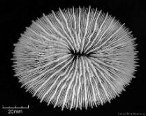
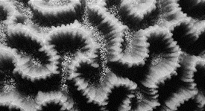
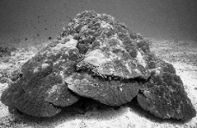
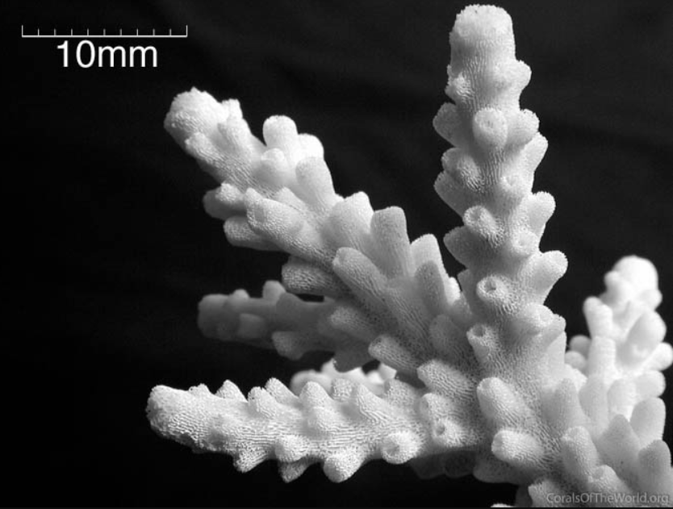
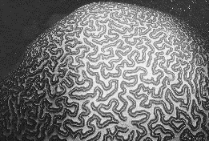
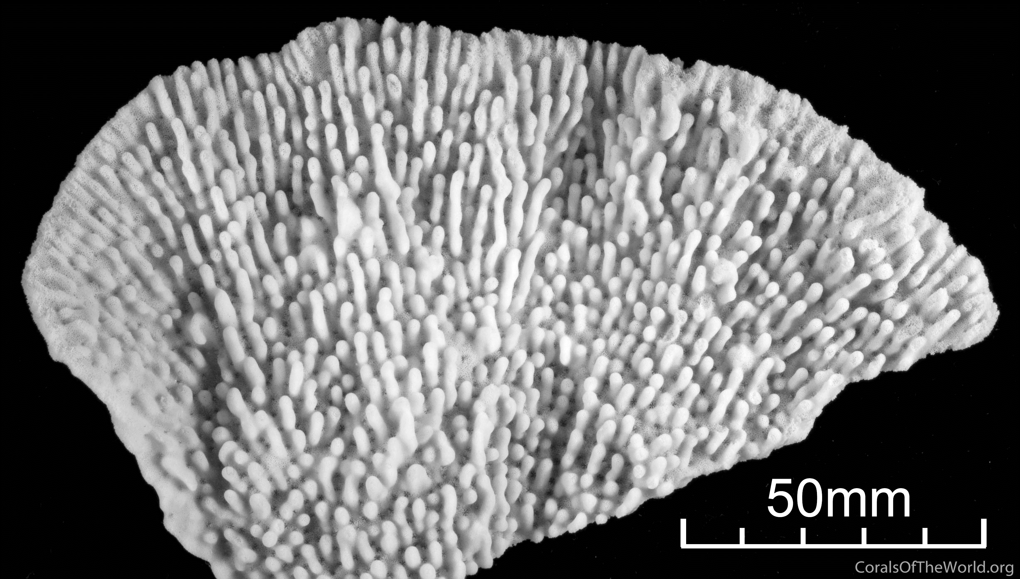
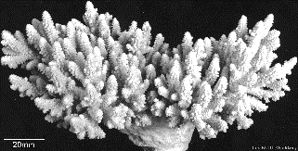
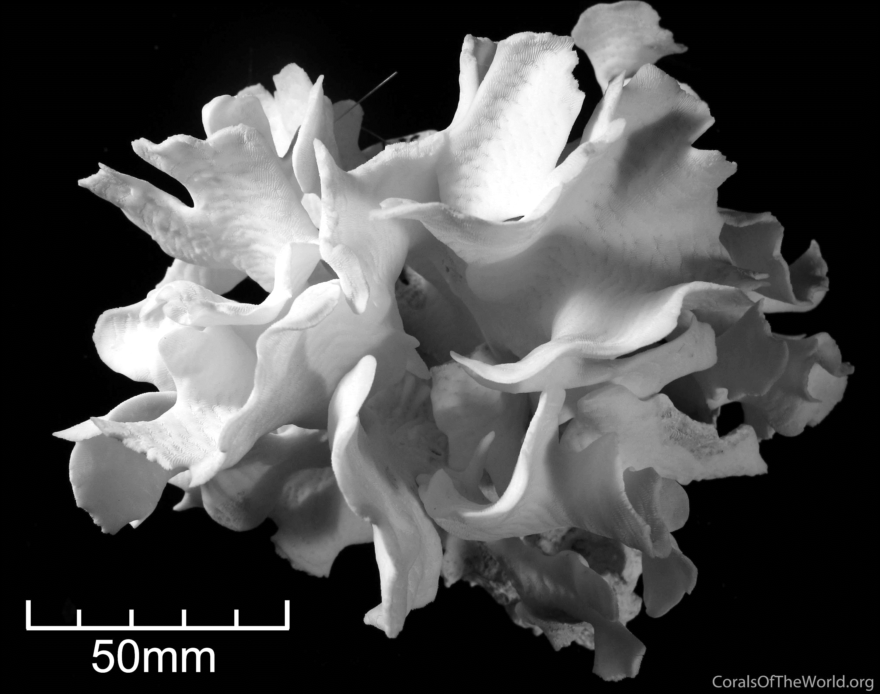
Marine
Education
10. Dichotomous Decisions – Classify a specific coral to genus level only, using a relevant identification key
Name:
Date:
marineeducation.com.au
Coral Sample 1
Coral Sample 2
Coral Sample 3
Coral Sample 4
Photograph: Charlie Veron
Photograph: Charlie Veron
Photograph: Charlie Veron
Photograph: Charlie Veron
Genus: Fungia
Genus: Platygyra
Genus: Porites
Genus: Acropora
Activity: Write the Genus for Coral Samples 1-4 above^{[1]} using the dichotomous key below
Dichotomous Key
1a) Solitary …………………………….Fungia
b) Colonial ……………………………Go to 2
2a) Brain-like appearance present……Platygyra
b) Brain-like appearance absent........Go to 3
3a) Helmet shaped…….......................Porites
b) Branching shaped….……………...Acropora
‘Mushroom Corals’ are
solitary corals that do not cement themselves to the reef but rather live as one giant individual coral polyp, unattached to the bottom.
‘Brain Corals’ have sinuous valleys and ridges that look
similar in appearance to the human brain, hence the name.
Porites have many shapes. However, this ‘helmet shape’ is perhaps its ‘signature’ shape.
‘Branching corals’ provide shelter for small fish that can retreat
into the branches when danger approaches. Note: Acropora also have many shapes, but are best known as branching coral.
Activity: Create your own dichotomous key using Coral Samples 5-8 below^{[1]}
Coral Sample 5
Coral Sample 6
Coral Sample 7
Coral Sample 8
Photograph: Charlie Veron
Photograph: Charlie Veron
Photograph: Charlie Veron
Photograph: Charlie Veron
Genus: Platygyra
Genus: Montipora
Genus: Acropora
Genus: Pavona
Dichotomous Key (fill in the blanks)
1a)
b)
2a)
b)
3a)
b)
How is Platygyra different to
coral samples 6, 7 and 8?
Brain-like appearance present
…...Platygyra
Brain-like appearance absent
..…...Go to 2
Plate-like appearance present
How is Montipora different
to coral samples 7 and 8?
….…Montipora
Plate-like appearance absent
……Go to 3
Branching shaped
How is Acropora
different to coral sample 8?
…...Acropora
.…..Pavona
Leaf-like shaped
^{[1]}Veron J.E.N., Stafford-Smith M.G., Turak E. and DeVantier L.M. (2016). Corals of the World. Accessed 10 May 2019. http://www.coralsoftheworld.org/species_factsheets/
© Marine Education 2024 CC BY-NC-SA
Unit 3 Topic 1 Science Understanding – Coral Reef Development

Slide 27
Marine
Education
Classify a specific coral to genus level only, using a relevant identification key
Name:
Date:
marineeducation.com.au
© Marine Education 2024 CC BY-NC-SA
NOTES AND EXAM REVISION

Slide 28
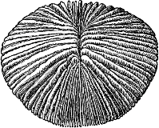
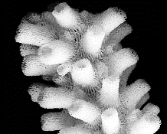
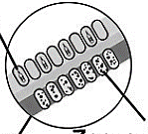
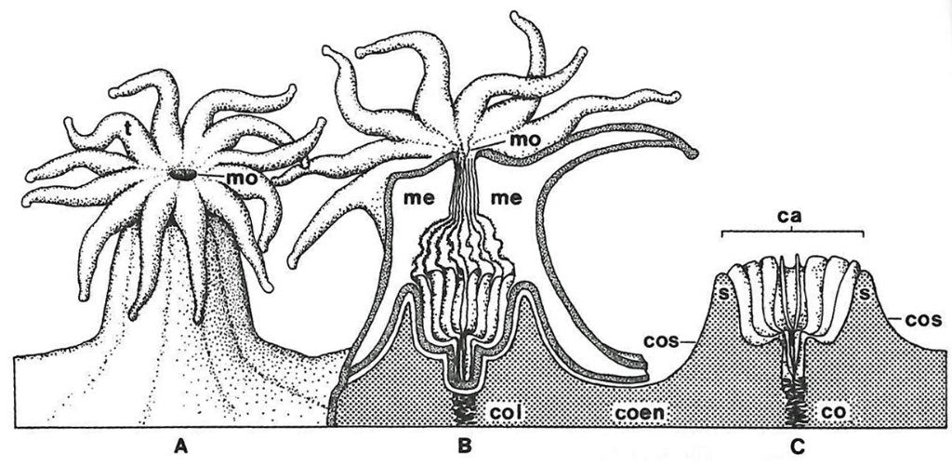
Marine
Education
11. An Octopus’s Garden of Stone Flowers – Describe the anatomy of a typical reef-forming hard coral, including skeleton, corallite, coelenteron, coral polyp, tentacles, nematocyst, mouth and zooxanthellae.
Name:
Date:
marineeducation.com.au
The mushroom coral (Fungia sp.) is a ‘solitary’ coral – one single coral polyp.
And a very big one! Its large size makes it easy to see its component parts.
Activity: Label the mouth (which is also the anus) in the picture (left).
Mouth
Mouth of coral polyp 1
Mouth of coral polyp 2
Upon entering the mouth is a cavity called the coelenteron (basically its gut). Note: In a colony, the contents of this cavity are shared with neighbouring polyps.
Activity: Circle the coelenteron of one of the polyps in the picture (left).
Activity: Write the % of coral nutrition provided by zooxanthellae (left).
~ __ __%
Zooxanthellae are symbiotic microscopic algae which live inside the tissues of reef-building corals. ~95% of coral nutrition is provided by zooxanthellae^{[1]}.
9 5
The skeleton that encases each individual coral polyp is called a corallite. Each corallite is shaped like a cup (or tube).
Activity: Circle ONE of the corallites on the branching coral pictured left.
Photograph: Charlie Veron^{[3]}
Trigger hair
Barb
All cnidarians have nematocysts – stinging cell capsules that fire poisonous barbs when trigger hairs on the tentacles are touched.
Some barb poisons can be fatal (box jelly). Others are just sticky (anemone).
Activity: Circle the nematocyst that has just been fired (pictured left).
Activity: Use words from the title of this worksheet to complete the Legend below right.
n
Legend
A Coral Polyp
t Tentacles
mo Mouth
n Nematocysts
z Zooxanthellae
coel Coelenteron
co Corallite
C Skeleton
me mesentery
col columella
coen coenosteum
cos costa
s septa
z
co
coel
col
Fig. 1. A: entire polyp; B: Section through polyp and skeleton; C: tissues removed to show polyp skeleton (corallite)^{[2].}
^{[1]}Allemand, D. and Furla, P. (2018). How does an animal behave like a plant? Physiological and Molecular adaptations of zooxanthellae and their hosts to symbiosis. Comptes Rendus Biologies. Vol 341. Issue 5. Pages 276-280. DOI:10.1016/j.crvi.2018.03.007
^{[2]}Adapted from: Mather, P. and Bennett, I. (2003). A Coral Reef Handbook: Australian Coral Reef Society. Surrey Beatty & Sons Pty Ltd. NSW. Pg. 60
^{[3]}Veron J.E.N., Stafford-Smith M.G., Turak E. and DeVantier L.M. (2016). Corals of the World. Accessed 10 May 2019. http://www.coralsoftheworld.org/species_factsheets/
© Marine Education 2024 CC BY-NC-SA
Unit 3 Topic 1 Science Understanding – Coral Reef Development

Slide 29
Marine
Education
Describe the anatomy of a typical reef-forming hard coral, including skeleton, corallite, coelenteron, coral polyp, tentacles, nematocyst, mouth and zooxanthellae.
Name:
Date:
marineeducation.com.au
© Marine Education 2024 CC BY-NC-SA
NOTES AND EXAM REVISION

Slide 30
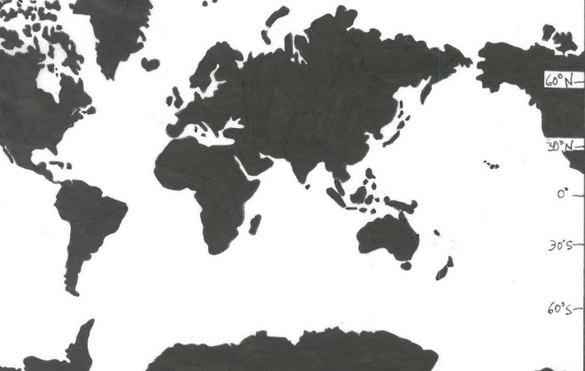
Marine
Education
12. Carbonate Count Down – Describe how the limestone skeleton of coral is built (i.e. when calcium ions [Ca²⁺] combine with carbonate ions [CO3^{2–}]) and is influenced by a variety of factors, e.g. concentration of ions, temperature, light and pH.
Name:
Date:
marineeducation.com.au
Note: Limestone is the well-known name given to rocks that are made out of coral.
BEFORE GOING ANY FURTHER, REVISE CONCEPTS INTRODUCED ON WORKSHEET “4.WHAT IS ARAGONITE?”
Corals turn calcium ions and carbonate ions, that are dissolved in seawater, in to solid calcium carbonate skeleton (CaCO3). Where? In the calcifying fluid directly above the skeleton!
Q. Where do corals turn calcium ions and carbonate ions in to solid coral skeleton?
Ans.
Calcium ions and carbonate ions are transferred from the seawater to the calcifying fluid…..
SEA WATER
Coral Tissue
in the Calcifying fluid (above the skeleton)
Gastrovascular Space
Atmospheric CO2 content (ppm)
Coral Tissue
Cross-section of a coral (not to scale)
Activity: Write the equation for this reaction
where the
magic happens!
Calcifying Fluid
2-
Ca (aq) + CO3 (aq) → CaCO3 (s)
2+
CaCO3 Skeleton
Corals NEED carbonate
Unfortunately, the way we are going, in your lifetime, there will not be enough carbonate ions in seawater for corals to make their skeletons strong enough or fast enough to build coral reefs.
Deviation from temperature in 2007 (°C)
8
6
4
2
0
-2
-4
200 300 400 600 800 1200
Atmospheric CO2 threshold 480 ppm
Reefs NOT dominated by corals ☹
Thermal threshold +2°C
C
“Field studies confirm that carbonate accretion on coral reefs approaches zero or becomes negative at aragonite saturation (Ωara) values of 3.3 in today’s oceans, which occurs when atmospheric CO2 content approaches 480 ppm and carbonate-ion concentrations drop below 200 µmol kg in most of the global ocean”^{[1]}.
Representative Concentration Pathways (RCPs)^{[3]}
Carbonate ion concentration (µmol kg )
-1
A
2007
Carbonate ion threshold
200 µmol kg
Ωara = 3.3
Figure 2: Carbon dioxide (CO2) concentrations predicted for the future, based on changes we make now to reduce CO2 emissions^{[2][3]}:
RCP8.5: Small changes ☹
RCP6.0: Medium changes
RCP4.5: Large changes
RCP2.6: Very large changes now
-1
CO2 (ppm)
800
700
RCP8.5
RCP6.0
400 | 300 | 200 | 100 | 0
600
RCP4.5
500
-1
400
Year
RCP2.6
300
2050
2075
2100
Figure 1: Thresholds indicate a point in time when corals will not have enough carbonate ions to make their
skeletons strong enough, or be able to calcify at a rate fast enough, to build coral reefs. Scenario : ~380ppm (2007). Scenario : Coral reefs will be reduced to crumbling frameworks of few calcareous corals. Reefs will become rubble banks^{[1]}.
2000
2025
A
Q. If we do NOT drastically reduce CO2 emissions NOW, in how many years will coral
reefs become rubble banks? Ans.
C
30-55 yrs
Activity: Mark the distribution of coral reefs on the maps below. Shaded areas have Ωara value <3.3
400ppm CO²
800ppm CO²
^{[1]} Adapted with permission from: Hoegh-Guldberg, O., Mumby, P.J., Hooten, J., Steneck, R.S., Greenfield, P., Gomez, E., Harvell, C.D., Sale, P.F., Edwards, A.J., Caldeira, K., Knowlton, N., Eakin, C.M., Iglesias-Trieto, R., Muthiga, N., Bradbury, R.H., Dubi, A. and Hatziolos, M.E. (2007). Coral Reefs Under Rapid Climate Change and Ocean Acidification. Science 318, 1737. DOI: 10.1126/science.1152509
^{[2]} Coast Adapt (2018). What are the RCP’s? Coastal Climate Change Infographics Series. Accessed 06.09.18 from: www.coastadapt.com.au (infographics tab)
^{[3]} See page 89
© Marine Education 2024 CC BY-NC-SA
Unit 3 Topic 1 Science Understanding – Coral Reef Development

Slide 31
Marine
Education
Describe how the limestone skeleton of coral is built (i.e. when calcium ions [Ca²⁺] combine with carbonate ions [CO3^{2–}]) and is influenced by a variety of factors, e.g. concentration of ions, temperature, light and pH
Name:
Date:
marineeducation.com.au
© Marine Education 2024 CC BY-NC-SA
NOTES AND EXAM REVISION

Slide 32
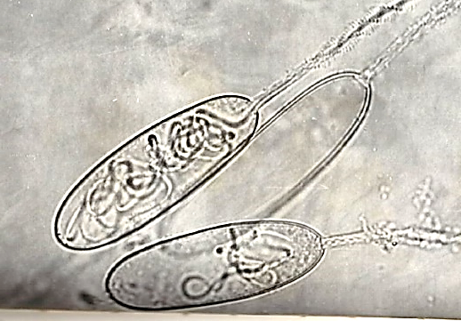
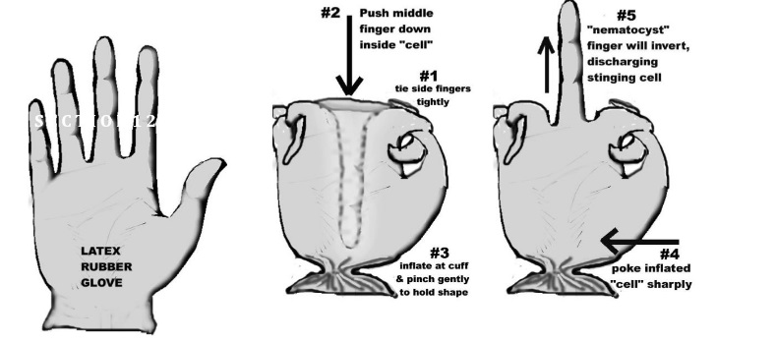
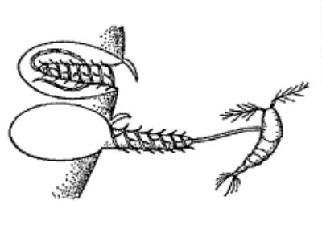

Marine
Education
13. Midnight Munchies – Describe the process of coral feeding, including night-feeding patterns and the function of
nematocysts
Name:
Date:
marineeducation.com.au
What does a coral eat?
Zooplankton and very small biota
How do they catch it?
With harpoons or mucous!
When?
Usually at night time
Cnido-BLAST off!
Coral tentacles possess batteries of stinging cells, called cnidoblasts ^{[a]}. Each cnidoblast contains a cylindrical capsule called a nematocyst ^{[b]}. Inside each nematocyst is a tightly coiled up thread, that ends in a
barb filled with poison. Outside the nematocyst is a trigger hair ^{[c]}.
When the trigger hair is touched by a passer-by, the thread and barb come shooting out of the nematocyst in a harpoon-like fashion to immobilise the passer-by^{[1]}.
A nematocyst that was just
fired →
An empty nematocyst
A half empty nematocyst
←
^{[a]} Also called a cnidocyte or nematocyte^{[3]}.
^{[b]} They are large organelles produced from the golgi apparatus as a secretory product within the cnidoblast^{[3]}.
^{[c]} A concentric hair bundle, also called the cnidocil or cnidocil apparatus.
Figure 1: Nematocysts under the microscope (x1000)^{[1]}
e m a t o c y s t
Q. What is the stinging capsule called? Ans. N __ __ __ __ __ __ __ __ __
Activity: Get a latex glove. Tie digits 1 and 2 together and 4 and 5 together, leaving the middle finger free. Push the middle finger inward inside the glove. Cup the bottom of the glove and gently blow to inflate WITHOUT disturbing the middle finger. Now your cell (glove) and nematocyst (middle finger) is armed ready. Ask someone to be a prey item that unknowingly bumps into the stinging cell. Have them sharply poke the side of the air-filled glove. The ‘nematocyst’ finger will invert discharging the stinging cell!^{[2]}
Push middle finger down inside ‘cell’
#5 ‘nematocyst’ finger will invert, discharging stinging cell
#1 Tie side fingers
#3 Inflate
at cuff and pinch gently to hold shape
#4 poke inflated ‘cell’ sharply
Activity: Cut holes in an old bed sheet, with each hole big enough for a student’s hands to fit through.
Students put on a glove each (use a marker pen to draw dots on the glove to represent the zooxanthellae). Students crouch beneath the sheet and poke their gloves through the holes in the sheet to try and catch any food held above the sheet by the teacher. When a student ‘catches’ a food item with their glove, they must pull it back down through the hole to eat and SHARE with the other ‘coral polyp coelenterons’.
Activity: Below, create a cartoon that best describes a coral catching an unsuspecting prey.
Do…do….do…do…
..doo..
ARGH!!!
^{[1]} Bennett, I. (1971). The Great Barrier Reef. Lansdowne Press. Victoria. Australia. Page 79. ISBN: 7018 0403 3
^{[2]} Adapted from: Panos, S. (n.d.). Lab Demo: How does a Cnidarian catch its prey? Earth Watch. Accessed 4/10/2018 from https://au.earthwatch.org/Portals/0/Downloads/Education/Lesson-Plans/Coral_Reefs.pdf
^{[3]} Beckman, A. and Ozbek, S. (2012). The Nematocyst: a molecular map of the Cnidarian stinging organelle. The International Journal of Developmental Biology. 56(6-8): 577-82. DOI: DOI: 10.1387/ijdb.113472ab
© Marine Education 2024 CC BY-NC-SA
Unit 3 Topic 1 Science Understanding – Coral Reef Development

Slide 33
Marine
Education
Describe the process of coral feeding, including night-feeding patterns and the function of nematocysts
Name:
Date:
marineeducation.com.au
© Marine Education 2024 CC BY-NC-SA
NOTES AND EXAM REVISION

Slide 34
Marine
Education
14. Plant or Animal? – Identify and describe the symbiotic relationships in a coral colony, including polyp
interconnections and zooxanthellae
Name:
Date:
marineeducation.com.au
Symbiosis is a host-guest relationship whereby two different species live together, in direct contact, for an extended period of time. Examples include: mutualism (+,+), commensalism (+,o), & parasitism (+, -).
The Coral Farmer
Reef-building corals obtain ~95% of their nutritional needs from zooxanthellae – an algae (dinoflagellate) from the Family Symbiodiniaceae that lives as a guest inside the tissues of its coral host in a mutualistic symbiotic relationship. The zooxanthellae guest carries out photosynthesis, providing its coral host with oxygen (for respiration) and energy
(for building reefs). A zooxanthellae guest also provides its coral host with its colour. In return, the coral host
provides its zooxanthellae guest with carbon dioxide (for photosynthesis) and an environment safe from predators^{[1]}.
Activity: Below, LIST the benefits that corals and zooxanthellae gain by living together
Coral (host) | Zooxanthellae (guest)
Oxygen (for respiration) Energy (e.g. glucose, glycerol, amino acids, etc., which are the products of photosynthesis) Colour | Carbon dioxide (for photosynthesis) An environment safe from predators
Coral Bleaching
When the water gets too warm, some zooxanthellae get stressed and start to produce toxic levels of oxygen
(reactive oxygen species or ROS). The coral does not like this and, as a result, expels the zooxanthellae, kicking it out of its home. Without its colourful zooxanthellae, the transparent tissue of the coral reveals its white coral skeleton. Hence, the name ‘coral bleaching’. And, without its regular food supply, the coral begins to starve^{[2]}.
Q. Why do corals bleach? Ans.
Water is too warm and zooxanthellae are expelled
Zooxanthellae Variability
Zooxanthellae are not all the same. Some zooxanthellae are more tolerant to thermal stress than others. Zooxanthellae variability had geneticists group them into clades (A-I). For example, clade D are more tolerant to thermal stress than Clade C. Hence, Clade D are less likely to be expelled by their host coral during a heat wave^{[1]}.
Q. Which clade of zooxanthellae are more tolerant to thermal stress? Ans.
Clade D
The Coral Holobiont
The coral holobiont is made up of the host organism and all its associated symbiotic microorganisms^{[2]}.
A consortium of bacteria, archaea, viruses, and fungi all form close associations with corals and contribute collectively to the overall function and environmental thresholds of corals (e.g. coral probiotic hypothesis).
Q. What is the coral holobiont? Ans.
The community of microbes that live in a coral
^{[1]} Stat, M. & Gates, R. D. (2011). Clade D Symbiodinium in Scleractinian Corals: A ‘Nugget’ of Hope, a Selfish Opportunist, an Ominous Sign, or All of the Above? Journal of Marine Biology. Vol. 2011, Review Article ID 730715. DOI: 10.1155/2011/730715 (Note: the nomenclature of zooxanthellae is currently under review; i.e. clades → Genus sp.)
^{[2]} Thompson, J.R., Rivera, H.E., Closek, C.J. and Medina, M. (2015). Microbes in the coral holobiont: partners through evolution, development, and ecological interactions. Front Cell Infect Microbiol Vol.4 Article 176. DOI: 10.3389/fcimb.2014.00176
© Marine Education 2024 CC BY-NC-SA
Unit 3 Topic 1 Science Understanding – Coral Reef Development

Slide 35
Marine
Education
Identify and Describe the symbiotic relationships in a coral colony, including polyp interconnections and zooxanthellae
Name:
Date:
marineeducation.com.au
© Marine Education 2024 CC BY-NC-SA
NOTES AND EXAM REVISION

Slide 36
Marine
Education
15. Coral Babies – Describe the life cycle stages of a typical reef-forming hard coral, i.e. asexual: fragmentation, polyp detachment; sexual: gametes, zygotes, planulae, polyp/asexual budding.
Name:
Date:
marineeducation.com.au
“Bundles of eggs and sperm which look like small polystyrene balls used in bean bags, float up to the surface like an up-side-down snowstorm” David Attenborough^{[1]}
Full moon of Oct/Nov on GBR
Q. What event is this quote describing? Ans.
Annual Coral Spawn Event
Sexual Reproduction
Asexual Reproduction
Broadcasters: External fertilisation (eggs and sperm fertilise in the water)
Brooders: Internal fertilisation (released sperm enters egg-carrying coral)
Gametes: Eggs & Sperm
Zygote: Fertilised Egg
Planulae: Coral Larvae
Budding: Polyps multiply (within a colony) by budding new polyps.
E.g. 1 polyp divides into 2 (intratentacular budding), or; a new mouth with tentacles forms between 2 polyps (extratentacular budding).
Polyp Detachment: A single polyp detaches itself from the colony.
Fragmentation: section breaks off; grows into new colony elsewhere.
Zygote
Planulae
Primary Polyp
planulae release
Budding
Polyp Detachment
Sperm
Brooders
Fragmentation
Colony fragment
synchronous release
Mature Colony
Eggs
Broadcasters
Budding
Q. What are the 2 modes of coral sexual reproduction? Ans.
Brooders and Broadcasters
Coral Restoration
Pictured below is a flowchart of some of the techniques used for coral reef restoration^{[2][3]}
(e.g. how to collect coral gametes, grow them and plant them, or; re-plant colony fragments in nurseries).
Activity: Fill in the blanks using words from the diagram above to recall each life cycle stage
Zygote
Do not disturb developing embryos in land tanks or sea floating ponds for
12 hrs (until they have a ‘bowl’ shape).
Planulae
When larvae begin swimming, change filtered seawater once every 12-24 hrs
Introduce larvae to tanks containing zooxanthellae
Introduce larvae to settlement
Primary Polyp
Stir bundles to mix eggs and sperm (optimal sperm density is 10 -10 sperm per mL. It should look like lemonade, not milky). After ~30min., collect fertilised eggs and rinse more than once with filtered sea water
(to remove excess sperm).
Collect planulae from colonies
ex situ or in situ. Transfer planulae to rearing tank.
4
6
Rear juvenile corals in cage
in situ, or in tank ex situ
Out-planting (plant on reef)
Collect eggs and sperm ex situ from colonies in land tanks, or, in situ from colonies in the sea using bundle collectors, or, from coral spawn slick
Sperm
Brooder
Maintain and Monitor
Predict
spawning date
Start here
Sexual Reproductive Mode of species?
Remove fragment from mature colony. Attach fragment to artificial substrate
(e.g. aragocrete).
Mature Colony
Colony Fragment
Eggs
Broadcaster
Grow in nursery
^{[1]} Byatt, A., Fothergill, A. and Holmes, M. (2001). The Blue Planet: A Natural History of the Oceans. BBC Worldwide Limited. London. UK.
^{[2]} Adapted from: Barton, J.A., Willis, B.L. and Hutson, K.S. (2015). Coral propagation: a review of techniques for ornamental trade and reef restoration. Reviews in Aquaculture 0, 1-19. DOI: 10.1111/raq.12135
^{[3]} Adapted from: Omori, M. and Iwao, K. (2014). Methods of farming sexually propagated corals and outplanting for rehabilitation. Akajima Marine Science Laboratory, Okinawa, Japan. p1-63
© Marine Education 2024 CC BY-NC-SA
Unit 3 Topic 1 Science Understanding – Coral Reef Development

Slide 37
Marine
Education
Describe the life cycle stages of a typical reef-forming hard coral, i.e. asexual: fragmentation, polyp detachment; sexual: gametes, zygotes, planulae, polyp/asexual budding.
Name:
Date:
marineeducation.com.au
© Marine Education 2024 CC BY-NC-SA
NOTES AND EXAM REVISION

Slide 38
Marine
Education
16. Finding Home – Explain the process of larval dispersal, site selection, settlement and recruitment of coral species and describe how factors (e.g. currents, bathymetry, substrate, sediment, predation, competition) affect this process.
Name:
Date:
marineeducation.com.au
Larval dispersal: the spread of coral larvae (planulae) from a spawning source to a settlement site.
Site Selection: when coral larvae (planulae) respond to environment cues (e.g. pressure, chemicals) to select a suitable site in which to settle, forever!
Settlement: when coral larvae (planulae) find a suitable substrate for attachment and complete metamorphosis (to become a polyp)^{[1]}.
Recruitment: the number of young individuals that undergo larval settlement and become part of the adult population^{[2]}.
1. Larval Dispersal
2. Site Selection
Species absent because of….
The arrival of new recruits
Dispersal
YES
During dispersal, planulae can swim up, down and sideways. Swimming rates average 1 to 5 mm/sec. Not as fast as the currents they are swimming in a lot of the time, but still fast enough to be able to control, to some degree, their vertical distribution in the water column. Whereby, any increase in pressure (i.e. depth) is the cue for planulae to swim UP, to avoid water that is too deep and too dark for coral reefs to be found^{[4]}. If they do happen to be at the right depth to encounter a reef (hopefully before their energy supply of lipids run out) they will actively and repeatedly test, probe and explore the substrate (usually guided by chemical cues) searching for some characteristic properties to indicate a favourable settlement location. In the absence of cues to stimulate settlement (or in the presence of inhibitors that deter settlement), planulae may either continue to seek a more suitable substrate, or re-enter the plankton to seek a more suitable reef^{[5]}.
When the recovery of a disturbed reef relies on the arrival of new recruits, larval dispersal (and connectivity - to get them there) become critical. Dispersal rescues declining populations, re-establishes extirpated (locally extinct) populations and maintains genetic diversity^{[3]}.
What if they don’t make it?!
A species may be absent from a reef because it has not been able to disperse there. Particularly if it was born a long distance away (see 1st box in Figure 1).
NO
(can’t get there)
Behaviour
YES
NO
(chooses not to be there)
Biotic Factors
YES
(Predation, competition etc.)
NO
YES
Abiotic Factors
(temp., light, currents, pH etc.)
Figure 1: To explain a problem of distribution, proceed down the chain by process of elimination^{[3]}.
4. Recruitment
3. Settlement
Counting the number of young individuals that become part of the adult population is termed recruitment (originally a fisheries term). Notably, it is tough going as a recruit. Early recruits are small (<1mm). Juveniles are not much bigger (1-5 cm) and still vulnerable to grazing, overgrowth and smothering from sediment^{[5]}. Then, competition for space on a coral reef can be quite the battlefield. For example, some hard corals attack their neighbours by extending out extra long sweeper tentacles at their margins. Soft corals resort to chemical weaponry releasing toxic allelopathic chemicals into the water column. All corals are competing for space. If new recruits happen to survive and make it to spawning age, their gametes become the next source of larvae. And so the cycle continues. That is, IF they make it. If not, the reef might have to rely on the arrival of larvae from elsewhere!
Planulae will not settle on live coral, loose sediment (i.e. sand), macro-algae or encrusting sponges. However, dead coral they are ok with (so long as it is not covered in macro-algae of course). What they really like to settle on is crustose coralline algae (CCA) and bacterial biofilms. If you want to get a planula to settle, leave your settlement panels in seawater for ~3 months to develop a thick assemblage of crustose coralline algae before introducing the planulae to settlement^{[5]}. The chemical cues from the CCA induce settlement. Planulae love the stuff! Then, upon settlement, planula undergo metamorphosis to become a coral polyp. During metamorphosis, the planula flatten out into a disc-shaped structure with septal mesenteries radiating from the central mouth region^{[5]}.
Activity: Explain the process of larval dispersal, site selection, settlement and recruitment
Dispersal: the spread of larvae (e.g. by ocean currents) from a spawning source to a settlement site.
Site Selection: when larvae respond to environmental cues to select a suitable site in which to settle.
Settlement: when larvae find a suitable substrate for attachment and complete metamorphosis → polyp
Recruitment: the number of young individuals that undergo larval settlement and become part of the adult population
^{[1]} Barton, J.A, Willis, G.L. & Hutson, K.S. (2015). Coral propagation: a review of techniques for ornamental trade and reef restoration. Reviews in Aquaculture 0, 1-19. DOI:10.1111/raq.12135
^{[2]} Reef Resilience Network (2018). Coral Reefs; Coral Reef Module; Reefs and Resilience; Understanding Coral Reef Resilience; Recruitment. The Nature Conservancy. Accessed 08/10/2018 from reefresilience.org/
^{[3]} Adapted from: Krebs, C. J. (1972). Ecology: The experimental analysis of distribution and abundance. Harper & Row, Publishers, Inc., New York. Library of Congress Catalog Card Number: 70-184931. p.16.
^{[4]} Stake, J.L. and Sammarco, P.W. (2002). Effects of pressure on swimming behaviour in planula larvae of the coral Porites astreoides (Cnidaria, Scleractinia). Journal of Experimental Biology and Ecology. 288 p.181-201. DOI:10.1016/S0022-0981(03)00018-2
^{[5]} Ricardo, G. F. and Negri, A.P. (2017). Settlement patterns of the coral Acropora millepora on sediment-laden surfaces. Science of the Total Environment. Vol. 609 pages 277-288. DOI:10.1016/j.scitotenv.2017.07.153
© Marine Education 2024 CC BY-NC-SA
Unit 3 Topic 1 Science Understanding – Coral Reef Development

Slide 39
Marine
Education
Explain the process of larval dispersal, site selection, settlement and recruitment of coral species and describe how factors (e.g. currents, bathymetry, substrate, sediment, predation, competition) affect this process.
Name:
Date:
marineeducation.com.au
© Marine Education 2024 CC BY-NC-SA
NOTES AND EXAM REVISION

Slide 40
Marine
Education
17. Construction and Destruction – Explain that growth of reefs is dependent on accretion processes being greater than
destructive processes.
Name:
Date:
marineeducation.com.au
Note: accretion refers to the growth of coral substrate due to calcification rate^{[1]}
Reef CITY Reno’s
Imagine the reef is a city, with buildings made of coral bricks (and mortar made of crustose coralline algae). The reef city is in a constant state of renovation. Old buildings are continuously being destroyed to make way for new buildings. The demolition crew comprise a workforce of grazers and borers (called bioeroders). One of the grazers is a parrotfish that uses a parrot-like beak as a scraping tool. One of the borers is a worm that uses hooks to mechanically grind its burrows. Some of the demolition crew cleverly manipulate the chemistry of their immediate environment to dissolve the coral. And if that isn’t enough, the mechanical erosion of the reef (waves, storms) will either get the job done, breaking them into pieces and carting them away, or, in the very least, weaken city structures.
The demolition crew are so efficient at their jobs, that the construction crew (corals) need to work fast. The reef city will only grow in size if the rate of construction is greater than the rate of destruction^{[2]}.
Reef growth = construction > destruction
Accretion Processes^{[2]}
Corals build their skeletons made of calcium carbonate (calcification).
Crustose coralline algae (CCA) carry out secondary calcification*, bind together any loose substrate (as well as form a protective barrier
to erosion) and provide settlement cues for reef-building coral larvae.
Welcome to reef city
Destructive Processes^{[2]}
Mechanical/Physical Erosion
(waves, storms, anchors, etc.)
Biological Erosion (bioerosion)
(grazers such as urchins, parrotfish, surgeonfish; and borers such as bivalves, sponges and marine worms)
Chemical Erosion (dissolution)
.
Reno’s in progress
.
.
.
.
.
.
.
* Secondary calcification is calcification by non-coral invertebrates and calcareous algae (often in the form of calcite, not aragonite)^{[2]}
Activity: Complete the sentence by circling the correct answer. The growth of reefs is
dependent on accretion processes being destructive processes.
[greater than] [less than]
A Ticking Time Bomb
Reef growth only occurs when reef-building corals and CCA carry out calcification faster than destructive processes carry out erosion. How fast is that exactly? Well, it is a little hard to say, because corals grow at different rates. For example, Acropora is much faster at growing than Porites! Rates of erosion also vary. But, when you add them altogether, the net rate of calcification and the net rate of erosion are very close^{[3]}. Thus, any decline in the rate of calcification will easily tip the balance to net erosion. Which may actually happen….in your lifetime. If corals do not have enough carbonate ions to make their skeletons fast enough or strong enough, coral reefs will erode faster than they calcify. Eyre et al., (2018)^{[3]} believe this will occur before the end of this century ☹.
Q. What is causing the rate of calcification to decline? Ans.
Rising atmospheric CO2
^{[1]} Queensland Curriculum and Assessment Authority (2018). Marine Science 2019 v1.2: General Senior Syllabus. QCAA. Queensland. Australia. Accessed 10.11.2018 from: https://www.qcaa.qld.edu.au/
^{[2]} Glynn, P. W. and Manzello, D.P. (2007). Bioerosion and Coral Reef Growth: A Dynamic Balance. Coral Reefs in the Anthropocene. Springer, Dordrecht. DOI: 10.1007/978-94-017-7249-5_4. ISBN: 978-94-017-7249-5
^{[3]} Eyre, D.E., Cyronak, T., Drupp, P., De Carlo, E.H., Sachs, J.P. and Andersson, A.J. (2018). Coral reefs will transition to net dissolving before end of century. Science. 359(6378):908-911. DOI: 10.1126/science.aao1118
© Marine Education 2024 CC BY-NC-SA
Unit 3 Topic 1 Science Understanding – Coral Reef Development

Slide 41
Marine
Education
Explain that growth of reefs is dependent on accretion processes being greater than destructive processes
Name:
Date:
marineeducation.com.au
© Marine Education 2024 CC BY-NC-SA
NOTES AND EXAM REVISION

Slide 42
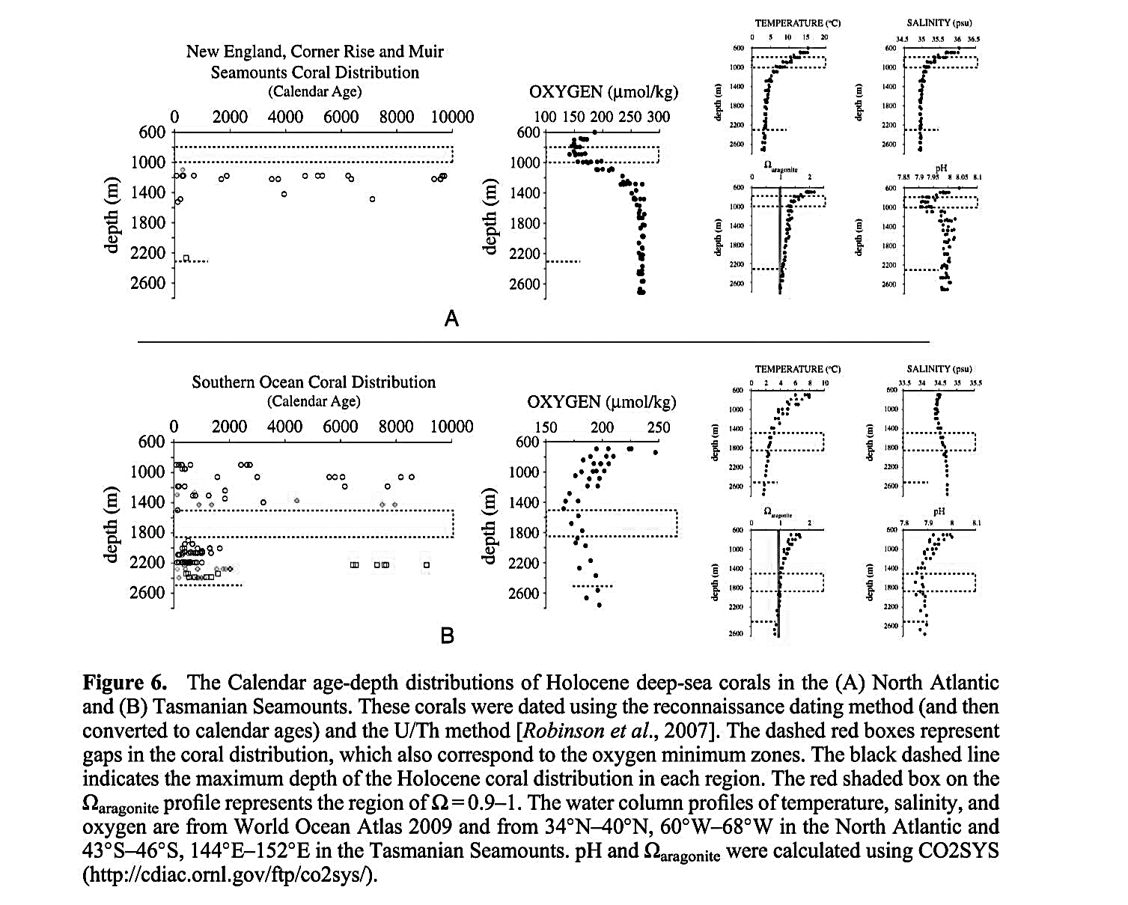
Marine
Education
18. Abiotic Borders – Analyse abiotic factors
(e.g. dissolved oxygen, salinity, substrate) that affect the distribution of
coral reefs.
Name:
Date:
marineeducation.com.au
Shallow-water coral reefs
Activity: Complete the empty boxes in Table 1 by referring to the data (in brackets) in Table 2
Table 1: Statistically derived environmental averages and extremes among reef sites^{[1]}
Note: does not include non-reef coral communities
Table 2: Examples of shallow-water reefs that exist within ‘marginal’ environmental conditions^{[1]}.
Note: ‘marginal’ means in close proximity to the minimum and maximum value/s for an environmental variable.
 | Min | Max | Avg | SD
Temperature (°C)
Avg | 21.0 | 29.5 | 27.6 | 1.1
Min |  | 28.2 | 24.8 | 1.8
Max | 24.7 |  | 30.2 | 0.6
Salinity (PSU)
Min |  | 40.0 | 34.3 | 1.2
Max | 31.2 |  | 35.3 | 0.9
Nutrients (µmol per Litre)
NO3 | 0.00 |  | 0.25 | 0.28
PO4 | 0.00 |  | 0.13 | 0.08
Low temperature reefs (minimum weekly SST <18°C). Minimum temperature °C in brackets. Northern Persian Gulf (16.0-17.8); Florida (16.5); SW Pacific: Elizabeth and Middle Reefs, Acacia Place, Lord Howe Island (17.3-17.7); Taiwan (17.9); Hawaiian Islands: Kure and Midway Atolls (17.9)
High temperature reefs (maximum weekly SST >31.5°C). Maximum temperature °C in brackets. Persian Gulf (33.6-34.4); Strait of Hormuz (34.2); Gulf of Oman (31.6-33.9); Southern Red Sea (31.7-32.9); Gulf of California (32.1); Gulf of Aden (31.8); Ctrl Red Sea (31.5-31.8); Andaman Is (31.6-31.7)
Low salinity reefs (monthly minimum <30PSU). Minimum salinity (PSU) in brackets. Burma (23.3); Bay of Bengal: St Martins I (27.0); Eastern Pacific: Ensenada de Utria, Isla de Gorgona (27.0-29.9); Central GBR: Cairns, Murray, Low Wooded I, Fitzroy I (28.9-29.3). Gulf on Thailand: Sichang I, Ko Lan, Ko Sak, Khao Sam Roi Yo (29.7).
High salinity reefs (monthly maximum >40PSU). Maximum salinity (PSU) in brackets. Gulf of Aqaba (41.8); Gulf of Suez (41.8); Northern Red Sea (41.2-41.8); Central Red Sea (40.0-41.2); Persian Gulf (40.3-40.9)
High nitrate reefs (average >2µmol per litre). NO3 values in brackets. Galapagos I (3.24-5.61); Strait of Hormuz (3.34); N Honduras: Guanaja, Laguna de Guaymoreto (2.50-2.76); Gulf of Oman (2.69); Mid Pacific: Marquises, Phoenix, Baker, Starbuck, Kiritimati, Malden (2.15-2.23); Micronesia: Gilbert I (2.00-2.23).
High Phosphate reefs (average 0.4µmol per litre). PO4 values in brackets. Galapagos I (0.41-0.54); Arabian Sea (0.40-0.54); Mid Pacific (as above) (0.40-0.49); Strait of Hormuz (0.43); Gulf of Oman (0.40); Gulf of California (0.40); French Polynesia (0.40).
16.0
34.4
23.3
41.8
5.61
0.54
(very old) Deep-sea coral populations
Temperature (°C)
Salinity (psu)
Oxygen (µmol/kg)
Ωaragonite
pH
Figure 1: The calendar age and depth of Holocene deep-sea coral Desmophyllum dianthus on North Atlantic Seamounts. The dashed boxes represent gaps in coral distribution (i.e. corals do not grow there) which also correspond to the oxygen minimum zones or OMZs (n=>5000)^{[2]}. Water column profiles for temperature, salinity and pH are from World Atlas 2009 (34°N–40°N, 60°W–68°W) and Ωaragonite and CO2 were calculated using CO2SYS^{[2]}.
Q. What abiotic factors are affecting the distribution of deep sea corals in Figure 1? Ans.
E.g. oxygen (no corals in OMZ), aragonite (no corals below Ωara = 1)
^{[1]} Adapted with permission from: Kleypas, J.A, McManus, J.W. and Menez, L.A.B. (1999). Environmental Limits to Coral Reef Development: Where Do We Draw the Line? Amer. Zool., 39: 146-159. DOI: 10.1093/icb/39.1.146
^{[2]} Adapted with permission from: Thiagarajan, N., Gerlach, D. Roberts, M.L., Burke, A., McNichol, A., Jenkins, W.J., Subhas, A.,V., Thresher, E.E., and Adkins, J.F. (2013). Movement of deep-sea coral populations on climatic timescales. Paleoceanography. Vol. 28. 227-236 DOI: 10.1002/palo.20023
© Marine Education 2024 CC BY-NC-SA
Unit 3 Topic 1 Science Understanding – Coral Reef Development

Slide 43
Marine
Education
Analyse abiotic factors (e.g. dissolved oxygen, salinity, substrate) that affect the distribution of coral reefs.
Name:
Date:
marineeducation.com.au
© Marine Education 2024 CC BY-NC-SA
NOTES AND EXAM REVISION

Slide 44
Marine
Education
19. Home Sweet Home – Explain that corals are habitat formers and ecosystem engineers
Name:
Date:
marineeducation.com.au
Everyone needs a place to live
Habitat formers are organisms that form a habitat – a place for other organisms to live. They are like the builders, creating living spaces for other organisms to live. Sometimes a primary habitat former creates a living space for a secondary habitat former that, in turn, creates a living space for focal organisms in what is called a habitat cascade.
Habitat cascades increase species richness and species abundance
by providing more spaces for more organisms to live^{[1]}.
Builder (primary habitat former)
Dog (secondary habitat former)
Flea
(focal organism) living on the dog which is living in the house
Figure 1: Example of a habitat cascade
Activity: Complete the table below right (‘unprotected’ column)
Protected Reef
Legend
Species | Protected | Unprotected
A | 2 | 0
B | 2 | 1
C | 3 | 2
D | 1 | 0
E | 1 | 1
F | 2 | 1
G | 2 | 1
H | 8 | 3
I | 3 | 0
TOTAL | 24 | 9
Primary
Habitat Formers
Secondary Habitat Formers
.
Focal Organisms
Unprotected Reef
A
D
G
B
E
H
C
F
I
Q. Which reef has more coral (A-C) and hence more residents (D-I)? Ans.
Protected Reef
Job Description: Ecosystem Engineer
Ecosystem engineers are organisms that directly or indirectly modulate (alter, control) the availability of resources to other species, by causing physical state changes in biotic or abiotic material. In doing so, they create, modify and maintain habitats^{[2]}. For example, hard corals build coral reefs. As a result, they modulate the availability of resources to other species by creating habitat (i.e. reef, sand) and by changing the velocity of currents (that carry food and larvae). The term ‘ecosystem engineer’ became popular when Jones et al. (1994) published an article^{[2]} elucidating the ecological importance of organisms that (inadvertently) dictate the fate of other species by altering the availability of resources (i.e. energy, food, water, sunlight) due to their form and structure (autogenic engineers such as corals) or due to their behaviour (allogenic engineers such as marine burrowing macrofauna)^{[3]}.
Q. What are ecosystem engineers? Ans.
Organisms that directly or indirectly modulate the availability of resources to other species, by causing physical state changes in biotic or abiotic material.
^{[1]} Thomsen, M.S., Wernberg, T., Altieri, A., Tuya, F., Gulbransen, D., McGlathery, K.J., Holmer, M. and Silliman, B.R. (2010). Habitat Cascades: The Conceptual Context and Global Relevance of Facilitation Cascades via Habitat Formation and Modification. Integrative and Comparative Biology. v50 (2).158-175. DOI: 10.1093/icb/icq042.
^{[2]} Jones, G.J, Lawton, J. H. and Shachak, M. (1994). Organisms as ecosystem engineers. OIKOS Volume 69, Number 3 pp. 373-386. DOI: 10.2307/3545850
^{[3]} Coleman, F. C. and Williams, S. L. (2002). Overexploiting marine ecosystem engineers: potential consequences for biodiversity. Trends in Ecology and Evolution. Vol. 17 No. 1. DOI: 10.1016/S0169-5347(01)02330-8
© Marine Education 2024 CC BY-NC-SA
Unit 3 Topic 1 Science Understanding – Reef, Habitats and Connectivity

Slide 45
Marine
Education
Name:
Date:
marineeducation.com.au
Explain that corals are habitat formers and ecosystem engineers
© Marine Education 2024 CC BY-NC-SA
NOTES AND EXAM REVISION

Slide 46
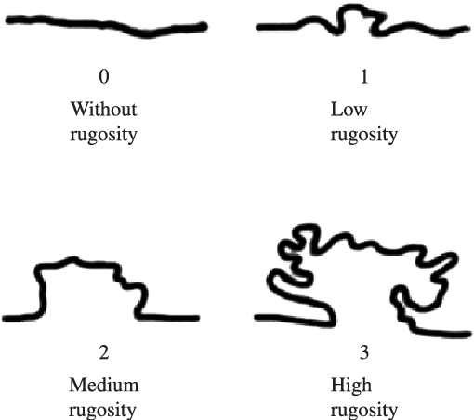
Marine
Education
20. Bumpy or Flat? – Explain that the habitat complexity (including species diversity, rugosity and percentage coral cover) established by corals influences the diversity of other species.
Name:
Date:
marineeducation.com.au
How to measure rugosity using the chain-and-tape method
Rugosity is a measure of habitat complexity (i.e. bumpy vs. flat). To measure rugosity using the chain-and-tape method, a light chain is laid over the contours of the reef in a straight line. Then, the ratio between the total length of the chain (a) and the straight-line distance between both ends of the chain (b) is calculated using the formula C=a/b whereby C is the rugosity index. The more bumps, the more chain, the greater the ratio, the more complex the habitat^{[1]}. Note: some papers use the formula C=1-(b/a).
Transect (tape measure): straight-line distance between both ends
← Transect length (b)
Q. What is the rugosity index if the chain length is 40m and the transect length is 20m? Ans.
← Chain length (a)
2
Thriving Cities vs Barren Deserts
Healthy, thriving, busy, city-like coral reefs, with high rugosity, provide more organisms with more places to live, and more places to hide than unhealthy, struggling, desert-like coral rubble banks with low rugosity. Structurally complex habitats have more surface area for larvae settlement, more refuge (shelter) for prey species, more vertical relief, and more microhabitat variability for a greater diversity of species to live in^{[1][3]}.
“A coral reef affords shelter for animals including fish of all shapes and sizes. For the agile swimmer, there is a forest of coral branches through which to weave an escape; for the reticent, there is a cave or crevice in which to hide or sleep; for the predator, there is a grotto in which to lurk, ready for ambush. As a result, after thousands of years in which marine life has been able to adapt to these opportunities, the bommies, reefs and coral beds have become like a high-density urban housing development” ^{[4]}.
Figure 1: Visual topographic estimate of substrates with different rugosity^{[2]}
Activity: In the space provided below, explain how habitat complexity (rugosity), established by corals, influences diversity of other species.
Structurally complex habitats increase species diversity by providing more habitat for coral colonisation, more surface area for larval settlement, more refuge (shelter) for prey species, more vertical relief, and more microhabitat variability.
^{[1]} Filip L. A. (2010). Habitat complexity in coral reefs: patterns of degradation and consequences for biodiversity. Thesis. UK.
^{[2]} Martinez, A.S., Mendes, L.F. and Leite, T.S. (2012). Spatial distribution of epibenthic molluscs on a sandstone reef in the Northeast of Brazilian Journal of Biology. Vol 72. no 2. p.287-298.
DOI: 10.1590/S1519-69842012000200009
^{[3]} Faud, M.A.Z. (2010). Coral Reef Rugosity and Coral Biodiversity. Thesis. The Netherlands.
^{[4]} McGregor, C. (1974). The Great Barrier Reef: The World’s Wild Places. Time-life Books. Amsterdam. Page 66.
© Marine Education 2024 CC BY-NC-SA
Unit 3 Topic 1 Science Understanding – Reef, Habitats and Connectivity

Slide 47
Marine
Education
Explain that the habitat complexity (including species diversity, rugosity and percentage coral cover) established by corals influences the diversity of other species.
Name:
Date:
marineeducation.com.au
© Marine Education 2024 CC BY-NC-SA
NOTES AND EXAM REVISION

Slide 48
Marine
Education
21. S.O.S. – Explain connectivity between ecosystems (including reef, estuaries, seagrass meadows and mangroves) and the role this plays in species replenishment.
Name:
Date:
marineeducation.com.au
Connectivity in a land-sea ecology context is defined as: the interaction (convenience or hindrance) of certain physical, chemical and biological processes between terrestrial and marine ecosystems^{[1]}.
Connectivity in a landscape ecology context is defined as: the degree to which the landscape facilitates or impedes the movement of organisms among patches, and; the ease with which individuals can move about within the landscape^{[2]}. Connectivity in a coral reef resilience context is defined as: the extent to which populations are linked by the exchange of eggs, larval recruits or adults, and ecological links associated with adjacent and distant habitats^{[3]}.
Connectivity - ReCONNECTing populations
Coral reefs must be able to replenish (restock, recruit) their population year after year, disturbance after disturbance, in order to survive. Usually a population can, to some degree, self-replenish (via births).
But often, the population will rely on the arrival of larvae, juveniles or adults from neighbouring populations (via immigration) to come to the rescue, or to simply maintain genetic diversity. The role of connectivity is to ensure the successful arrival of new recruits to replenish a population and maintain genetic diversity.
Births
Population Increases
Immigration
ARRIVALS
S.O.S..
Population size (R)
FLIGHT STATUS
Population Decreases
MANGROVES
CORAL REEF
SEAGRASS MEADOWS
OPEN OCEAN
CANCELLED
CANCELLED
CANCELLED
CANCELLED
Deaths
Emigration
Figure 1: Population size (R) = (B+I) – (D+E)
Figure 2: a cartoon to explain the importance of the arrival of new recruits (including larvae) to rescue declining populations needing help
Q. What is the role of connectivity in species replenishment? Ans.
To ensure the successful arrival of new recruits to replenish a population and maintain genetic diversity.
Coral Dispersal
Unlike fish that can swim to disperse, corals can only disperse
at the beginning stages of life. How far can their larvae travel?
The distance varies depending on the type of reproductive
mode of the species (e.g. brooders vs broadcasters) and the movement of the water in which they travel. Not surprisingly,
not as many coral larvae survive the longer journeys (Fig. 3)^{[4][5].}
Number of successful recruits
Distance from larval source
Figure 3: The dispersal kernel for corals^{[5]}.
Activity: Explain connectivity using an analogy (e.g. network of train stations)
Network of flight paths, roads, world wide web, etc.
Suggested practical: conduct a plankton tow to I.D. the ‘travellers’
^{[1]} Fang, X., Hou, X., Li, X., Hou, W., Nakaoka, M. and Yu, X. (2018). Ecological connectivity between land and sea: a review. Ecological Research. Volume 13 Issue 1 pp 51-61. DOI: 10.1007/s11284-017-1549-x
^{[2[} Kindlmann, P. and Burel, F. (2008). Connectivity measures: A review. Landscape Ecology. 23(8): 879-890. DOI: 10.1007/s10980-008-9245-4
^{[3]} Reef Resilience Network (2018). Resilient MPA Design: Connectivity: Principle 4. The Nature Conservancy. Accessed 08.12.2018 from www.reefresilience.org/
^{[4]} Cowen, R. and Sponaugle S. (2009). Larval Dispersal and Marine Population Connectivity. Annual Review of Marine Science. 1:443-66. DOI: 10.1146/annurev.marine.010908.163757
^{[5]} Adapted from: Raphael Ritson-Williams, Suzanne N. Arnold, Nicole D. Fogarty, Robert S. Steneck, Mark J. A. Vermeij, and Valerie J. Paul. 2009. New Perspectives on Ecological Mechanisms Affecting Coral Recruitment on Reefs .Smithsonian Contributions to the Marine Sciences : 437 -457. https://nsuworks.nova.edu/occ_facarticles/503.
© Marine Education 2024 CC BY-NC-SA
Unit 3 Topic 1 Science Understanding – Reef, Habitats and Connectivity

Slide 49
Marine
Education
Explain connectivity between ecosystems (including reef, estuaries, seagrass meadows and mangroves) and the role this plays in species replenishment
Name:
Date:
marineeducation.com.au
© Marine Education 2024 CC BY-NC-SA
NOTES AND EXAM REVISION

Slide 50
Marine
Education
22. Something Fishy – Describe how fish life cycles are integrated within a variety of habitats including reef and estuarine systems
Name:
Date:
marineeducation.com.au
Hermaphrodites: Fish that have both male and female reproductive organs.
Protandry: Fish that change gender from male to female (e.g. clownfish). Yes, Marlin should have changed sex and become Nemo’s mum!
Protogyny: Fish that change gender from female to male (e.g. groupers, parrotfishes and many wrasses).
Diadromous: Fish that spend portions of their life cycles partially in freshwater estuaries and partially in saltwater oceans.
Anadromous Life Cycle: Fish that live in the ocean but migrate to the estuary to spawn (e.g. salmon).
Catadromous Life Cycle: Fish that live in the estuary but migrate to the ocean to spawn (e.g. anguillid eels).
Bearers: Fish that carry their embryos (and sometimes their young) either externally or internally (e.g. seahorse, cichlids).
Guarders: Fish that guard their embryos until they hatch and, frequently, tend the larval stages as well (e.g. clownfish).
Non-guarders: Fish that do not protect their eggs and young once spawning has been completed (e.g. spawners, brood hiders)^{[1]}.
Fish Life Cycle Stages
Nearly all fish (~95%) are external fertilisers.
The fertilised eggs hatch and become larvae.
The larvae undergo metamorphosis to become juveniles (to fry and then fingerlings), that later become adults (when the gonads are mature).
Activity: Complete the life cycle stages (right).
Larvae
Egg
Juvenile
(fry and then fingerling)
Adult
‘Frank’ the reef FISH (is back!)
The diagram below demonstrates the ontogenetic^{[2][3]} migrations of ‘Frank’ the reef fish. When Frank was little,
he grew up in the mangroves and seagrass beds. When his gonads started to mature, he moved to the reef!
Activity: Fill in the blanks to complete the diagram below of Franks journey through life^{[4]}.
Adult
Juvenile
Eggs and Larvae
Mangroves
Seagrass
Coral Reef
Ocean
Activity: Below, describe the life cycle of the Mangrove Jack (Lutjanus argentimaculatus).
Spawning occurs on deeper offshore reefs during the summer months (oviparous pelagic spawners). Juveniles around 2cm in length settle out from the plankton into coastal estuaries during late summer. Juveniles and young adults spend several years in estuaries, amongst mangroves and in tidal creeks. Sometimes they are found in the lower reaches of freshwater streams. Tagging studies indicate that Mangrove Jacks migrate offshore to deeper reef areas at 40-50 cm in length. Adults usually inhabit coral reefs, often sheltering in caves or under ledges during the day (fishesofaustralia.net.au).
^{[1[} Moyle, P. B. and Cech, Jr. J. C. (2004). Fishes: An Introduction to Ichthyology: 5th Ed. Pearson Benjamin Cummins. USA. pg. 141-165 .
^{[2]} Some coral reef fishes undergo ontogenetic shifts where they use different habitat types (e.g. mangroves and seagrasses) as nursery grounds before moving to their adult habitat on coral reefs
(e.g. some parrotfishes, grunts, snappers, surgeonfishes, jacks, barracuda, emperors, groupers, goatfishes, wrasses and rabbitfishes)^{[3]}
^{[3]} Green, A. L. (2014). Larval dispersal and movement patterns of coral reef fishes, and implications for marine reserve network design. Biological Reviews. Volume 90. Issue 4. DOI: 10.1111/brv.12155
^{[4]} Adapted from: Dorenbosch, M. (2006). Connectivity between fish assemblages of seagrass beds, mangroves and coral reefs. Evidence from the Caribbean and the western Indian Ocean. Thesis.
Faculty of Science. Radboud University Nijmegan, The Netherlands. ISBN: 90-9020790-2.
© Marine Education 2024 CC BY-NC-SA
Unit 3 Topic 1 Science Understanding – Reef, Habitats and Connectivity

Slide 51
Marine
Education
Describe how fish life cycles are integrated within a variety of habitats including reef and estuarine systems
Name:
Date:
marineeducation.com.au
© Marine Education 2024 CC BY-NC-SA
NOTES AND EXAM REVISION

Slide 52
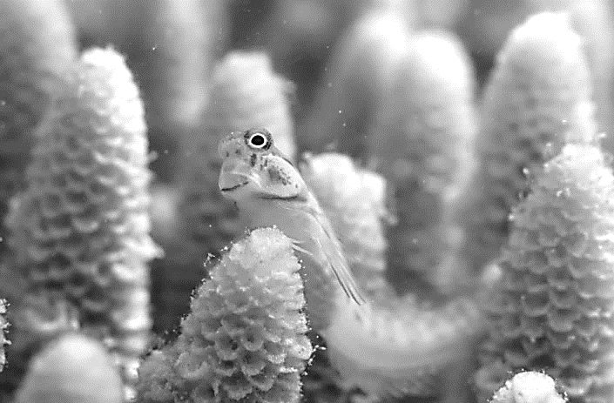
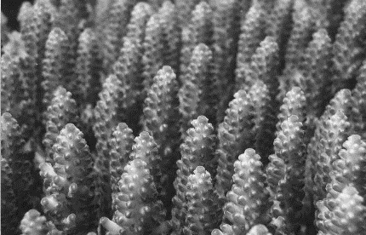
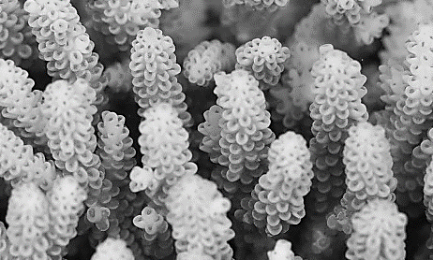
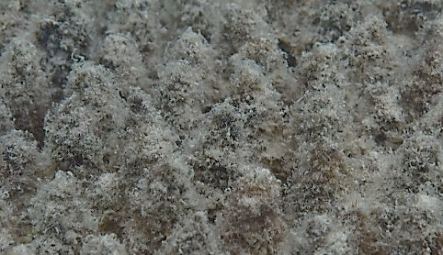
Marine
Education
23. Heroic Herbivores – Describe how fish, particularly herbivore populations, benefit coral reefs
Name:
Date:
marineeducation.com.au
Meet Bob the Blenny
This is Bob. Unfortunately, Bob is sitting in coral that has bleached, and a thin film of algae covers the branches. However, Bob is busy farming his patch and cropping the algae so that it does not become overgrown. Herbivores, like Bob, benefit coral reefs by eating the algae that compete with corals for space, to (hopefully) avoid a phase-shift following disturbances such as coral bleaching events. Good on ya Bob!!
Figure 1: Blenny sitting in bleached coral. Reproduced with permission^{[1]}.
Avoiding a Phase-Shift to ALGAE DOMINATION!!!!
When there are not enough herbivores (like Bob) to keep eating algae, the reef can become overgrown
with algae. This puts the reef at risk of undergoing a phase-shift from a coral-dominated state to an algae-dominated state. Sadly, once a phase-shift has occurred, it is very difficult to shift back (due to positive feedback loops and hysteresis)^{[2]}. For example, some algae produce chemicals that inhibit the settlement of tiny coral larvae that would otherwise aid reef recovery. And, some herbivores avoid eating algae when it gets too dense^{[2]}. Importantly, when a reef is already damaged and struggling to recover (low resilience) it is more susceptible of undergoing a phase-shift^{[3]}.
1
X
Figure 2: Reef X is resilient and eventually recovers from an intense and severe disturbance (big arrow).
On the other hand, reef Y is not resilient and undergoes a phase-shift to a new community state^{[3]}.
Community state
A resilient reef with lots of herbivores
2
Y
A reef that is not resilient with very few herbivores
Time
Note: the term ‘phase-shift’ has also been called a ‘regime-shift’ or ‘movement between alternate stable states’ or ‘basins of attraction^{’[4].}
Activity: Describe how fish, particularly herbivore populations, benefit coral reefs.
They eat the macroalgae that compete with corals for space, to (hopefully) avoid a phase-shift following disturbances such as mass coral bleaching events.
HEALTHY CORAL
BLEACHED CORAL
DEAD CORAL
Figure 3: Comparing healthy-looking coral to bleached coral and dead coral. Notice the layer of algae on dead coral. Reproduced with permission^{[1]}.
Q. True or False? Herbivores decrease CORAL reef resilience (ability to recover). Ans.
False
^{[1]} Photograph © Justin Marshall (2016). In pictures: a close up look at the Great Barrier Reef’s bleaching. Accessed 09/12/2018 from http://theconversation.com/in-pictures-a-close-up-look-at-the-great-barrier-reefs-bleaching-57495
^{[2]} Hoey, A.S. and Bellwood, B. D. (2011). Suppression of herbivory by macroalgal density: a critical feedback loop on coral reefs? Ecology Letters 14: 267-273. DOI:10.1111/j.1461-0248.2010.01581.x
^{[3]} Adapted from Connell S. D.and Gillanders G. M. (2007). Marine Ecology. Oxford University Press. Vic. Australia. pg.147
^{[4]} Hughes, T., Graham, N.A., Jackson, J.B., Mumby, P.J. and Steneck, R.S. (2010). Rising to the challenge of sustaining coral reef resilience. Trends in Ecology and Evolution. Vol. 25. No. 11 pp. 619-680. DOI: 10.1016/j.tree.2010.07.011
© Marine Education 2024 CC BY-NC-SA
Unit 3 Topic 1 Science Understanding – Reef, Habitats and Connectivity

Slide 53
Marine
Education
Describe how fish, particularly herbivore populations, benefit coral reefs
Name:
Date:
marineeducation.com.au
© Marine Education 2024 CC BY-NC-SA
NOTES AND EXAM REVISION

Slide 54

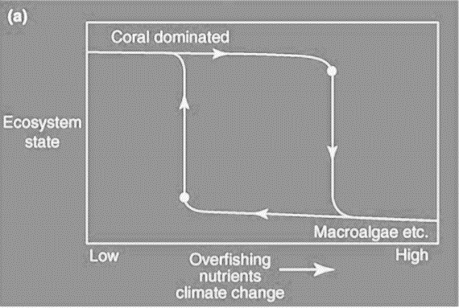
Marine
Education
24. Tipping over the Edge – Explain the concept of an ecological tipping point and how this applies to coral reef ecosystems.
Name:
Date:
marineeducation.com.au
Over the Edge – Ecological Tipping Points
Ecological tipping points are when natural systems cross a biophysical threshold as a result of human induced stressors, dramatically altering ecosystem function and services^{[1]}. An example would be the point in time when a phase-shift begins.
Like the straw that breaks the camel’s back, sometimes a system can take a substantial amount of stress, until it reaches a critical breaking point. At that point, it’s resilience (ability to recover) is so low that it only takes a small amount of further strain to initiate a significant change to the system^{[1]}.
Figure 1: The tipping point^{[3]}
Q. What is an ecological tipping point? Ans.
When natural systems cross a biophysical threshold as a result of human induced stressors, dramatically altering ecosystem function and services.
E.g. a phase-shift from a coral-dominated reef to an algae-dominated reef.
Q. What happens to a reef when it crosses its tipping point? Ans. a -shift begins
← Tipping point
p
h
a
s
e
A
Ecosystem State
Q. In Figure 2, is the shift in ecosystem state linear or non-linear? Ans.
Less desired More desired
(a straight line)
(not a straight line)
Non-linear
B
Q. True or False? At low resilience, a small change in stressor intensity can drive a dramatic change in ecosystem state. Ans.
Low High
Stressors
T
Figure 2: At low resilience, a small change in stressor intensity can drive a dramatic change in community state (e.g. point A to point B)^{[1][4]}.
Coral Larvae
Fecundity and Fertilisation (-)
Coral disease (-)
Biodiversity
and Fish Abundance
Q. What happens to a reef when macro-algae dominates? Ans.
Coral Cover
Habitat Complexity (+)
Macro-algae outcompete coral, inhibit and smother coral recruits, reducing the growth and survival of coral, which reduces habitat complexity, which, in turn, reduces biodiversity and fish abundance (including herbivores).
Connectivity (+)
Settlement (+)
Growth and Survival (+)
Shelter (+)
Coral Recruits
Coralline Algae
Habitat Complexity
Facilitation (+)
Cementation (+)
Competition (-)
Inhibition
and smothering (-)
Competition (-)
Shelter (+)
Bio-erosion (-)
Macro-algae
Herbivores
Productivity (-)
Grazing (-)
Figure 3: Conceptual model of interrelations among key habitat and ecosystem variables^{[2]}.
^{[1]} Adapted with permission from: Kelly, R.P., Erikson, A.L. and Mease, L.A. (2015). How Not to Fall Off a Cliff, or, Using Tipping Points to Improve Environmental Management. Ecology Law Quarterly. 41(4):843. DOI:10.15779/Z38FP1H
^{[2[} Adapted with permission from: Pratchett, M.S., Hobbs, J.A., Hoey, A.S., Baird, A.H. Ayling, A.M., Gudge, S. and Choat, J.H., (2011). Elizabeth and Middleton Reef Reserves Marine Survey 2011. Draft Report. Commonwealth of Australia.
^{[3]} Dibble, B.J. MD. (2012). Comprehending the Climate Crisis: Everything you need to know about the Global Warming and how to stop it. iUniverse Star. Bloomington, IN 47403.
^{[4]} Hughes, T., Graham, N.A., Jackson, J.B., Mumby, P.J. and Steneck, R.S., (2010). Rising to the challenge of sustaining coral reef resilience. Trends in Ecology & Evolution. Vol. 25. No. 11. pp. 619-680. DOI: 10.1016/j.tree.2010.07.011.
© Marine Education 2024 CC BY-NC-SA
Unit 3 Topic 1 Science Understanding – Reef, Habitats and Connectivity

Slide 55
Marine
Education
Explain the concept of an ecological tipping point and how this applies to coral reef ecosystems.
Name:
Date:
marineeducation.com.au
© Marine Education 2024 CC BY-NC-SA
NOTES AND EXAM REVISION

Slide 56
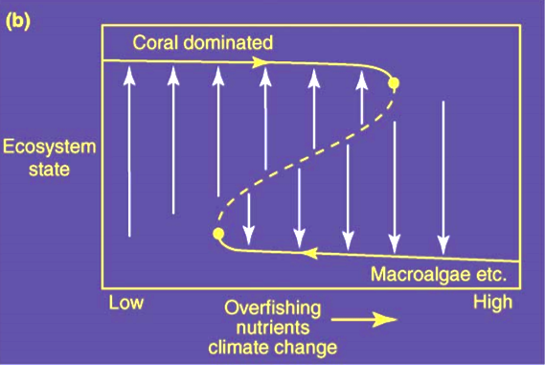
Marine
Education
25. Road Blocks to Recovery – Describe hysteresis and how this applies to the concept of reef resilience
Name:
Date:
marineeducation.com.au
Hysteresis: returning along a different path
When a phase-shift occurs on a coral reef, it is very sad. Corals die. Algae grows. Colours fade. Life disappears. It is only natural to feel compelled to want to change it back. However, it is not that easy. Because of hysteresis. Hysteresis is when the return pathway to recovery (e.g. back to a coral-dominated state) differs from the original pathway of degradation (Figure 1). So, even if the stressor that caused the reef to undergo a phase-shift in the first place is removed, unfortunately, the reef will still remain in the (less desired) algae-dominated state^{[1][2]}. ☹
Q. What is Hysteresis? Ans.
A
Hysteresis is when the return pathways to recovery differs from the original pathway of destruction.
Ecosystem State
Less desired More desired
C
The Coral’s Immune System
How do reefs avoid a phase-shift in the first place?
A reef ecosystem will remain in a more desired state, for longer, when its resilience is strong. Resilience is the ability to absorb acute disturbances without undergoing a phase-shift^{[1]}. For example, think of resilience like your immune system. If your immune system is weak, it will take you longer to recover from an illness. You may even catch another bug to make you feel even worse!
In contrast, if your immune system is strong, your recovery will be faster. The same applies to reefs.
Figure 1: Hysteresis: the reversal of a phase shift follows a different trajectory to the original pathway of degradation^{[2]}.
Note: the level of stress on the community is much lower at the reversal tipping point (C) than at the original tipping point (A).
A
Ecosystem State
Less desired More desired
Q. What happens to resilience when an ecosystem approaches its tipping point?
Ans..
C
[it increases] [it decreases]
Circle correct answer
Q. What does it take to reverse a phase-shift? How do we reduce the resilience of an algae-dominated reef so that it returns back to a coral-dominated reef (i.e. overtakes C)? Ans.
Figure 2: Drivers of change (i.e. acute disturbances) cause a reef to move from a more desired state to a less desired state. However, the reef will return to the more desired state (arrows pointing UP) provided it does not cross the dotted line separating the two alternate states (one dominated by coral, the other dominated by macroalgae etc.).
The vertical arrows also represent resilience - the ability to absorb acute disturbances without undergoing a phase-shift - whereby the long arrows have high resilience and the short arrows have low resilience. As the trajectory (solid line) approaches its tipping point, resilience decreases (arrows get shorter)^{[2][3].}
Reduce/remove ALL the stressors.
E.g. MPA’s, reduce pollution, improve water quality, protect species that eat algae in high densities, etc.
^{[1]} Kelly, R.P., Erikson, A.L. and Mease, L.A. (2015). How Not to Fall Off a Cliff, or, Using Tipping Points to Improve Environmental Management. Ecology Law Quarterly. 41(4):843. DOI: 10.15779/Z38FP1H
^{[2]} Reprinted from Trends in Ecology & Evolution, Vol. 25. No. 11, Hughes, T., Graham, N.A., Jackson, J.B., Mumby, P.J. and Steneck, R.S., Rising to the challenge of sustaining coral reef resilience, pp. 619-680, 2010, with permission from Elsevier.
^{[3]} Adapted from: Toh, T.C., Ng, C.S.L. and Chou, L.M. (2013). Enhancing Coral Reef Resilience through Ecological Restoration: Concepts and Challenges. The Asian Conference on Sustainability, Energy and the Environment: Official Conference Proceedings 2013. Osaka, Japan. Volume: 528-545. Accessed 07.04.2019 from: https://coralreef.nus.edu.sg/publications/Toh2013IAF.pdf
© Marine Education 2024 CC BY-NC-SA
Unit 3 Topic 1 Science Understanding – Reef, Habitats and Connectivity

Slide 57
Marine
Education
Describe hysteresis and how this applies to the concept of reef resilience
Name:
Date:
marineeducation.com.au
© Marine Education 2024 CC BY-NC-SA
NOTES AND EXAM REVISION

Slide 58
Marine
Education
26. Life in One Number – Interpret primary and secondary reef diversity data including abundance, species richness, Simpson’s diversity index, evenness and rank abundance, e.g. Whittaker plot.
Name:
Date:
marineeducation.com.au
Homer is back!
A diversity index is a formula that we use to convert diversity data (what and how many) into a single value. Why? Usually to compare ecosystems, classify ecosystems, or rank ecosystems (to better manage them). Today, we are ranking ecosystems. We are using Simpson’s Diversity Index (SDI) formula to calculate the SDI value for three different reefs to rank them in order of highest diversity to lowest diversity.
Index | Formula | Interpretation | Explanation
Simpsons Diversity Index (SDI) | 1- ∑ n(n-1) N(N-1) | 0 – 1 0 = no diversity 1 = infinite diversity | The probability that 2 randomly selected individuals will be 2 different species (or categories). 100% chance = infinite diversity
N = total number of organisms of all species
n = number of organisms of one species
Activity: Complete the Tables to calculate the SDI value for each (hypothetical) reef below.
Bailey Reef
IDENTIFY | COUNT | STATS
Name | n | n(n -1)
Species A | 19 | 342
Species B | 20 | 380
Species C | 30 | 870
Species D | 5 | 20
Species E | 0 | 0
Total | N 74 | ∑n(n-1) 1612
SDI Calculations | N(N-1)= 74x73 5402 | SDI = 1-(1612//5402) 0.70
Xenia Reef
IDENTIFY | COUNT | STATS
Name | n | n(n -1)
Species A | 2 | 2
Species B | 1 | 0
Species C | 3 | 6
Species D | 2 | 2
Species E | 1 | 0
Total | N 9 | ∑n(n-1) 10
SDI Calculations | N(N-1)= 72 | SDI = 0.86
Maxwell Reef
IDENTIFY | COUNT | STATS
Name | n | n(n -1)
Species A | 1 | 0
Species B | 3 | 6
Species C | 100 | 9900
Species D | 5 | 20
Species E | 0 | 0
Total | N 109 | ∑n(n-1) 9926
SDI Calculations | N(N-1)= 11772 | SDI = 0.16
REEF DIVERSITY SCOREBOARD
(rank the reefs from highest diversity to lowest diversity)
1st
2nd
3rd
Q. Which reef has the highest species richness?
Ans.
species richness = number of rows
Xenia Reef
Xenia Reef
Bailey Reef
Q. Which reef has the lowest species evenness?
Ans.
…whereby one or two species dominate in abundance?
Maxwell Reef
Maxwell Reef
Activity: Understand what is species richness and species evenness on a Whittaker Plot.
© Marine Education 2024 CC BY-NC-SA
Unit 3 Topic 1 Science Understanding – Reef, Habitats and Connectivity

Slide 59
Marine
Education
Interpret primary and secondary reef diversity data including abundance, species richness, Simpson’s diversity index, evenness and rank abundance, e.g. Whittaker plot.
Name:
Date:
marineeducation.com.au
© Marine Education 2024 CC BY-NC-SA
NOTES AND EXAM REVISION

Slide 60
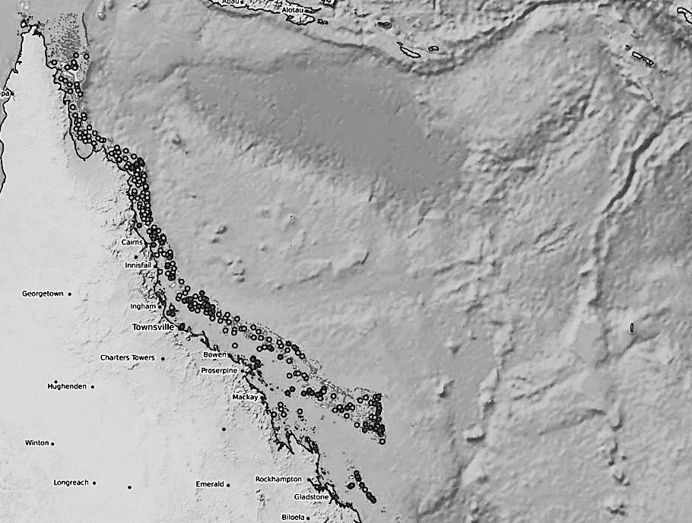
Marine
Education
27. Reef Reports – Interpret regional and temporal trends in coral cover.
Name:
Date:
marineeducation.com.au
AIMS Long Term Monitoring Program
We are very fortunate that the Australian Institute of Marine Science (AIMS) have been conducting surveys of the Great Barrier Reef, for decades now, as part of its Long Term Monitoring Program^{[1]}.
Add latest information here for Northern GBR
Add latest information here for Central GBR
Add latest information here for Southern GBR
Activity: In the spaces provided above and below, INTERPRET AIMS long term monitoring data to identify regional and temporal trends in coral cover for Northern, Central & Southern GBR.
Identify and explain trends here
Trend: when the data overall is moving in one particular direction over time, usually represented by a line or curve on a graph.
^{[1]} Adapted with permission from: Australian Institute of Marine Science (2011). Long-Term Monitoring Program – Annual Summary Report on coral reef condition for 2017/18. AIMS Data Centre. Accessed 19.01.2019 from: https://www.aims.gov.au/reef-monitoring/gbr-condition-summary-2018-2019
© Marine Education 2024 CC BY-NC-SA
Unit 3 Topic 1 Science Understanding – Reef, Habitats and Connectivity

Slide 61
Marine
Education
Name:
Date:
marineeducation.com.au
Interpret regional and temporal trends in coral cover.
© Marine Education 2024 CC BY-NC-SA
NOTES AND EXAM REVISION

Slide 62
Marine
Education
28. Water Quality Woes – Identify the relationship between water quality and some of the factors that affect coral cover,
e.g. crown-of-thorns.
Name:
Date:
marineeducation.com.au
CO2
°C
CO2
Land-based inputs
Factors that reduce coral cover, that are directly linked to water quality, are often derived from land-based activities of people^{[1]}.
COTS
Increased °C and Decreased DO
Decreased pH and Salinity
Increased Nutrients
Decreased Clarity/Increased Turbidity
Increased Faecal Coliforms
Disease
Land-based activities of people
°C
Coral bleaching
Ocean acidification
pH
CaCO3
Sedimentation and smothering
Figure 1: Schematic diagram summarising key factors that reduce coral cover, directly linked to water quality^{[1]}.
Activity: Listed below are factors that reduce coral cover directly linked to water quality. Tick the water quality parameter/s that each factor is likely to change the most and cause a hard coral to die.
Clarity/
Turbidity
Faecal Coliforms
Factors that reduce coral cover |  |  | °C | D.O. | pH
CLIMATE CHANGE | Increased Sea Surface Temperatures
 | Ocean acidification
 | Increase in size and frequency of natural disasters | Cyclones & Floods
 |  | Fires (and its debris)
URBAN RUNOFF | Sediments and suspended solids (from streets, construction sites, storm drains, etc.)
 | Pathogens and excess nutrients (from ineffective sewage treatment, septic overflows)
DESTRUCTION OF CRITICAL HABITAT | Sediments and suspended solids (from dredging, land clearing, development, etc.)
 | Acid sulphate soils (from exposed acid sulphate soils leaking acid)
 | Excess nutrients (from the removal of mangroves and wetlands etc.)
Salinity
Nutrients
answers may vary
Q. What variable causes every one of these factors to increase? Ans.
Human pop. density
Hungry Sea Stars
COTS larvae eat phytoplankton. It is hypothesised that a phytoplankton bloom (caused by flood waters carrying high nutrient loads) is a precursor to a COTS outbreak. COTS survival is also subject to spawning synchronisation and success, hydrodynamics and dispersal, settlement success, predation and disease^{[2][3][4]}.
Q. True or False? One adult COTS can produce up to 50 million eggs per year^{[4]}. Ans.
True
^{[1]} Adapted from: Crabbe, M.J.C. (2009). Climate change and tropical marine agriculture. Journal of Experimental Biology. 60(10):2839-44. DOI: 10.1093/jxb/erp004.
^{[2]} Hock, K., Wolff, N.H., Condie, S.A., Anthony, K.R.N. and Mumby, P. (2014). Connectivity networks reveal the risks of crown-of-thorns starfish outbreaks on the Great Barrier Reef. Journal of Applied Ecology 51 (5).
DOI: 10.1111/1365-2664.12320
^{[3]} Pratchett, M.S., Caballes, C.F., Wilmes, J.C., Matthews, S., Mellin, C., Sweatman, H.P.A, Nadler, L.E., Brodie, J., Thompson, C.A., Hoey, J., Bos, A.R., Byrne, M., Messmer, V., Valero-Fortunato, S., Chen, C.C.M., Buck, A.C.E., Babcock, R.C. and Uthicke, S. (2017). Thirty Years of Research on Crown-of-Thorns Starfish (1986-2016): Scientific Advances and Emerging Opportunities. Diversity 9 (41). DOI: 10.20944/preprints201708.0076.v1
^{[4]} AIMS (n.d.). Crown-of-thorns starfish. AIMS. Queensland. Australia. Accessed 3/1/2019 from: https://www.aims.gov.au/documents/30301/2107187/cots-revised.pdf
© Marine Education 2024 CC BY-NC-SA
Unit 3 Topic 1 Science Understanding – Reef, Habitats and Connectivity

Slide 63
Marine
Education
Identify the relationship between water quality and some of the factors that affect coral cover, e.g. crown-of-thorns.
Name:
Date:
marineeducation.com.au
© Marine Education 2024 CC BY-NC-SA
NOTES AND EXAM REVISION

Slide 64
Marine
Education
29. The Ultimate Board Game – Discuss how the processes in this sub-topic interact to have an overall net effect,
i.e. they do not occur in isolation.
Name:
Date:
marineeducation.com.au
Start
CORAL BLEACHING EVENT
4 Degree Heating Weeks (DHW)
Fish, coral and zooxanthellae Clade C all lose 1 lifeline
CORAL BLEACHING EVENT
8 DHW
Fish, coral and zooxanthellae Clade C all lose 2 lifelines
COTS OUTBREAK
Coral lose 1 lifeline
OIL SPILL
All organisms
lose 1 lifeline
TRADITIONAL OWNERS WIN RIGHTS TO, AND PROTECT, THE REEF
All organisms
gain 1 lifeline
Activity: (Part A) Prepare your game play
Allocate each student the name of a marine organism from the list below (start at the top of the list).
Draw a human circle on the board, like the one pictured below (you may have less circles/people).
Label each circle with the name of a person in your class and the name of their marine animal.
Starting at the top circle, ask if that person’s marine organism interacts with any other marine organisms on the board. For example, an interaction might exist between a habitat former and a habitat user, a predator and its prey, or between a coral and a clade of zooxanthellae. Draw a line between any 2 circles that represent 2 marine organisms sharing an interaction with each other.
FLOOD
Coral lose 1 lifeline
Macro-algae gain
1 lifeline
GROUND WATER CONTAMINATION
All organisms
lose 1 lifeline
(except macro-algae)
LAWS PASSED TO PROTECT MORE REEFS
All organisms
gain 1 lifeline
(except macro-algae)
List of Organisms
Acropora Branching Coral
Zooxanthellae Clade C
Brown macro-algae seaweed
Porites Boulder Coral
Zooxanthellae Clade D
Green macro-algae seaweed
Surgeon Fish (primary consumer/herbivore)
Coral Trout (secondary consumer)
Shark (tertiary consumer)
Pocillopora Branching Coral
You can make up the rest if you need more.
DREDGING
Corals lose
1 lifeline
CORAL LARVAE REPLENISHMENT & RECRUITMENT
Swap a macro-algae for a coral
(with 3 lifelines)
Activity: (Part B) Make a human model
Get up out of your seat and make the human circle that is drawn on the board.
Every person is given a bundle of strings. Each piece of string is the same length as the diameter of the circle.
One by one, each person holds one end of a string and passes the other end to whom they share an interaction with (as per the lines on the board).
Once complete, the circle should have a spider-like configuration. The more players, the more string (note: a biodiverse system, with lots of players, is a resilient one)!
SEVERE AND DESTRUCTIVE STORM EVENT
Coral lose 1 lifeline
OIL MINING & EXPLORATION WITHIN THE EEZ BANNED
All organisms gain
1 lifeline
CORAL BLEACHING EVENT (4 DHW)
Fish, coral and
zooxanthellae
Clade C
lose 1 lifeline
Activity: (Part C) The Rules of the Game
Each player starts with 3 lifelines. Except for Porites, Zooxanthellae Clade D and Brown Macro-algae that have 4 lifelines (because they are more resilient). Everyone in the circle should be able to see the number of lifelines you have at all times (e.g. raise that many fingers on your hand).
The teacher places a game piece on ‘start’ and rolls the dice, moving clockwise to begin with.
When a player runs out of lifelines, they must sit down and drop all their strings.
Anyone holding a string that was let go by a removed species loses a lifeline and must assess if its remaining interactions (string connections) will be enough for it to survive. If not, they must also sit down and drop all their strings.
When a coral sits down, it gets back up as a macro-algae seaweed and continues to play (making new connections with strings and starting with 4 lifelines).
Likewise, when a macro-algae seaweed sits down, it gets back up as an Acropora branching coral and continues to play (making new connections with strings and starting with 3 lifelines).
Stop playing when it becomes too difficult to reverse a phase-shift, or 15min before the end of the lesson, whichever comes first.
Start again, from Part B (3). But this time, the teacher goes anti-clockwise around the board.
MORE FUNDING TO STOP ILLEGAL FISHING
FISH gain 1 lifeline. Macro-algae
lose 1 lifeline
OCEAN ACIDIFICATION
IF
you have passed this point more than once already,
corals lose 3 lifelines.
Otherwise,
roll again.
PROTECTION & REPLANTING OF MANGROVES
All organisms gain 1 lifeline. Macro-algae
lose 1 lifeline
Activity: (Part D) Discus if (going anti-clockwise and) boosting resilience before disturbances makes a difference to the final outcome for the reef?
FRACKING BAN
All organisms gain
1 lifeline
(except macro-algae)
MASS SPAWNING EVENT
coral gain 1 lifeline
SEWAGE TREATMENT UPGRADES
All organisms gain 1 lifeline (except macro-algae)
MARINE DEBRIS
CLEAN-UP
All organisms gain 1 lifeline
(except macro-algae)
DISEASE OUTBREAK
Coral lose 1 lifeline
© Marine Education 2024 CC BY-NC-SA
Unit 3 Topic 1 Science Understanding – Reef, Habitats and Connectivity

Slide 65
Marine
Education
Discuss how the processes in this sub-topic interact to have an overall net effect, i.e. they do not occur in isolation.
Name:
Date:
marineeducation.com.au
© Marine Education 2024 CC BY-NC-SA
NOTES AND EXAM REVISION

Slide 66
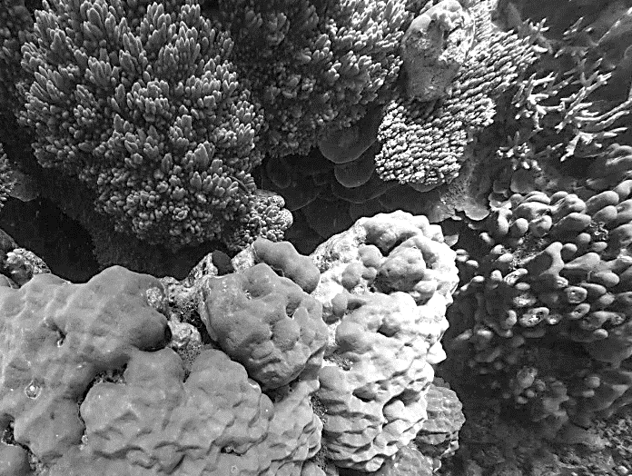
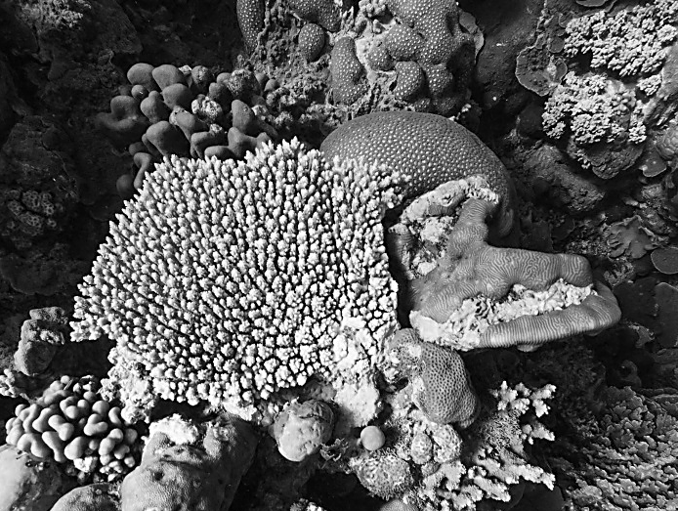
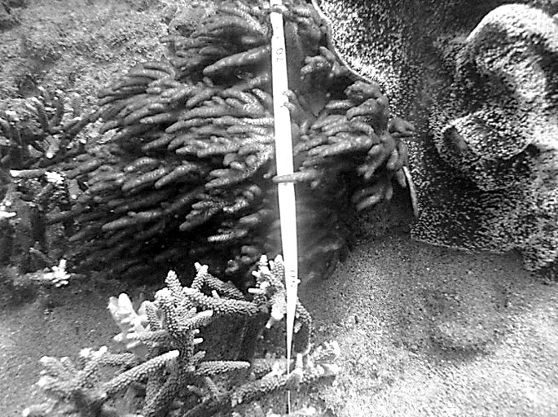
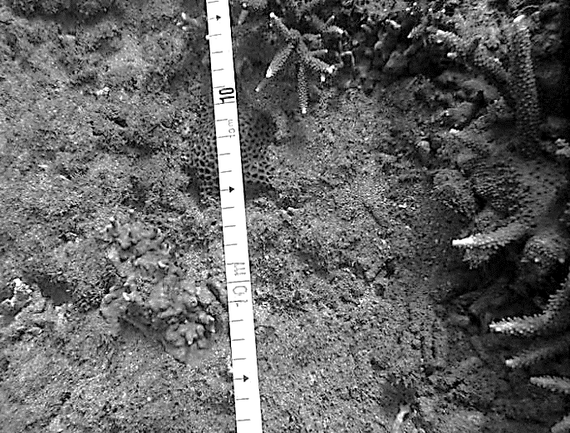
Marine
Education
30. Water Quality – Interpret data relating to the impact of water quality on reef health.
Name:
Date:
marineeducation.com.au
Question: Which reef (below) has the best water quality? Ans.
Agincourt Reef
Agincourt Reef
Magnetic Island (Nelly Bay)
Provide a reason for your answer in the space provided below. Hint: proximity to coastline
Magnetic Island is much closer to the mainland than Agincourt Reef. Magnetic Island is subject to coastal runoff, shipping, coastal development and flood waters, all of which impact water quality.
© Marine Education 2024 CC BY-NC-SA
Unit 3 Topic 1 Science Understanding – Reef, Habitats and Connectivity

Slide 67
Marine
Education
Interpret data relating to the impact of water quality on reef health.
Name:
Date:
marineeducation.com.au
© Marine Education 2024 CC BY-NC-SA
NOTES AND EXAM REVISION

Slide 68
Marine
Education
31. Title – Investigate how complex models of marine ecosystems can be developed based on a wide range of evidence from multiple individuals and across disciplines.
Name:
Date:
marineeducation.com.au
Teacher to write
© Teacher’s name [Year] CC BY-NC-SA
Unit 3 Topic 1 Science as a Human Endeavour

Slide 69
Marine
Education
32. Title – Analyse how the evidence from other disciplines, such as plate tectonics and shifts between glacial and interglacial periods, leads to improvements in the models used for the formation of reefs.
Name:
Date:
marineeducation.com.au
Teacher to write
© Teacher’s name [Year] CC BY-NC-SA
Unit 3 Topic 1 Science as a Human Endeavour

Slide 70
Marine
Education
33. Title – Consider Aboriginal perspectives and Torres Strait Islander perspectives on rising sea levels. Sea level change in the Holocene resulted in an increase of approximately 125 metres in depth.
Name:
Date:
marineeducation.com.au
Teacher to write
© Teacher’s name [Year] CC BY-NC-SA
Unit 3 Topic 1 Science as a Human Endeavour

Slide 71
Marine
Education
34. Title – Investigate the impact of water quality on reef health to infer connectivity within or between habitats. Consider the impacts qualitatively and quantitatively, using online, virtual or field data.
Name:
Date:
marineeducation.com.au
Refer to booklet titled,
‘Year 12 Student Experiment Mandatory Practical’
on marineeducation.com.au
© Teacher’s name [Year] CC BY-NC-SA
Unit 3 Topic 1 Science Inquiry

Slide 72
Marine
Education
Name:
Date:
marineeducation.com.au
35. Title – Examine coral to determine genus (photo, online or field).
Refer to booklet titled,
‘Coral Identification Guide’
on marineeducation.com.au
© Teacher’s name [Year] CC BY-NC-SA
Unit 3 Topic 1 Science Inquiry

Slide 73
Marine
Education
36. Title – Explore and classify plankton using field work techniques such as collection/trawls.
Name:
Date:
marineeducation.com.au
Teacher to write
© Teacher’s name [Year] CC BY-NC-SA
Unit 3 Topic 1 Science Inquiry

Slide 74
Marine
Education
37. Title – Investigate zooxanthellae (e.g. with flotsam jellyfish or aquarium coral) using a microscope.
Name:
Date:
marineeducation.com.au
Teacher to write
© Teacher’s name [Year] CC BY-NC-SA
Unit 3 Topic 1 Science Inquiry

Slide 75
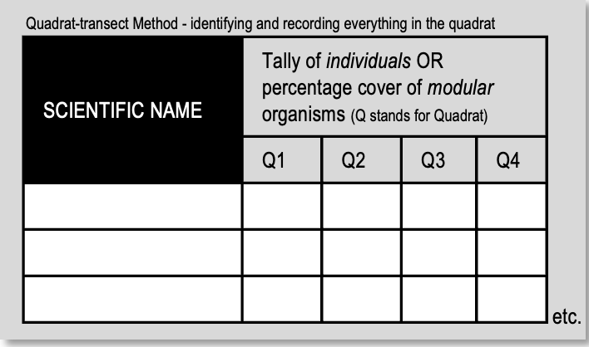
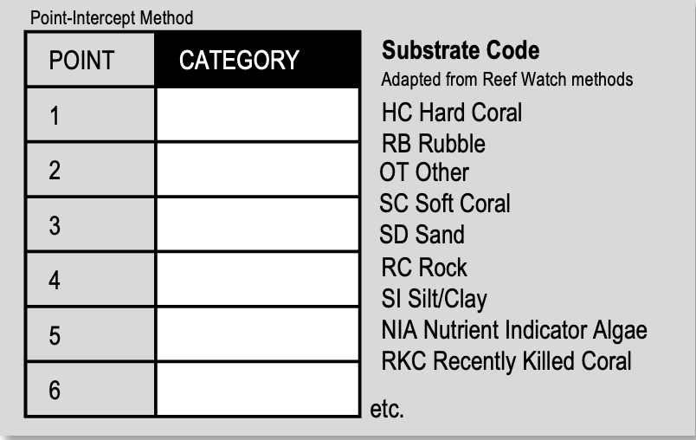
Marine
Education
38. Diversity in Data – Examine coral diversity using a transect technique (using online or field data).
Name:
Date:
marineeducation.com.au
Quadrats and Transects
Quadrats and transects are common tools of the trade in marine science research. Below is a brief overview of the Quadrat-transect method, the Point Intercept Method and the Line Intercept Method^{[1]}.
Quadrat-transect method
Quadrats (i.e. squares) are randomly placed along a transect, or, evenly spaced along a transect.
For example, a 1mx1m square quadrat is placed every 2m along a transect (tape measure)……
Q1 |  | Q2 |  | Q3 |  | Q4 |  | Q5 |  | Q6
0m
1m
2m
3m
4m
5m
6m
7m
8m
Transect (tape measure)
x3
Identify & record anything under a point (randomly or evenly spaced) in a quadrat
This method is commonly used when quadrats are photographs, called ‘photoquadrats’ (i.e. using Coral Point Count (CPCe) software with Excel extension).
…to EITHER
Identify and record everything within the quadrat
OR
Point Intercept Method
Identify & record anything under a point along a transect (points are randomly or equally spaced)
Line Intercept Method
Identify and record anything under a length of transect (the transect is a tape measure)
Branching
Plate
Boulder
Branching
10.0 cm
14.6 cm
8.4 cm
6.2 cm
4 cm
Branching Coral
Boulder Coral
Sand
Transect
Transect (tape measure)
Plate Coral
Branching
Results Tables
Create a results table before starting data collection. For example:
© Marine Education 2024 CC BY-NC-SA
Unit 3 Topic 1 Science Inquiry

Slide 76
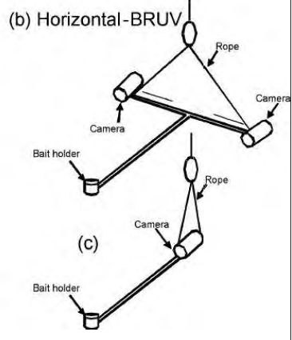
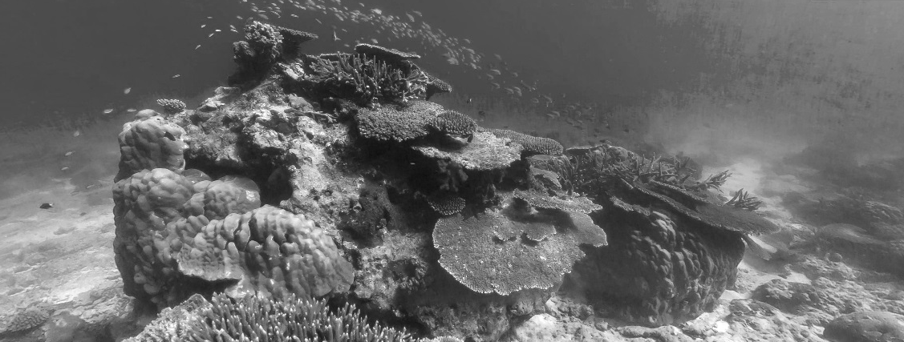
Marine
Education
39. Data Detectives - Assess the diversity of a reef system, e.g. using line intercept transects, quadrats, fish counts using underwater video survey techniques, benthic surveys, invertebrate counts and rugosity measurements.
Name:
Date:
marineeducation.com.au
Bottom dwellers
Benthos attach to, burrow or crawl on the seabed (as opposed to pelagics that swim or float).
Q. What do benthic surveys measure? Ans.
Benthos biodiversity
Line Intercept Transects
The Line Intercept Method identifies and records the substrate underneath a transect (i.e. tape measure).
Activity: Complete Table (refer to transect left)
Start | Finish | Category
0 cm | 25 cm | Branching | 25 %
25 cm | 60 cm | Plate | 35 %
60 cm | 80 cm | Boulder | 20 %
80 cm | 95 cm | Branching | 15%
95 cm | 100 cm | Sand | 5 %
TOTAL | 100cm | TOTAL | 100%
% Cover
0cm
25cm
60cm
80cm
95cm
100cm
Tape measure
Branching Coral
Branching
Sand
Plate Coral
Boulder Coral
Percentage Cover
Total length of transect occupied by a species
=
Total transect length
x100
Smile for the camera: Counting fish using video
Underwater video survey techniques are commonly used for surveying fish. The video camera can be controlled remotely (e.g. BlueROV2)^{[2]} or by a person in the water. Filming can be stationary (camera stays in the one spot) or along a belt transect (surveying a certain distance either side, or above, a transect). Some systems use bait to attract the fish. Some use more than one camera (Figure 1).
Hint: if filming stationary, one way to avoid counting the same fish twice, is to pause the video when the maximum number of your target fish are in the one frame.
Camera 1
Bait
Camera 2
OR
Bait
Camera
Activity: Check out James Cook University’s Classroom on the Reef Live Cam Footage on Orpheus Island!!!^{[3]}
Figure 1: Two different baited underwater video set-ups^{[1]}
19/12=1.5833’
Q. What is the RUGOSITY (C) of the reef below? Use the formula C=a/b Ans.
b
Hint: Use a ruler
to measure the length of b. Then, use a piece of string to follow the contours of the chain (a) to measure its length.
a
Figure 2: Measuring rugosity using the chain-and-tape method by laying a chain down over the substrate and comparing its length to the transect length.
Image (of Lady Elliot Island) sourced from the XL Catlin Global Reef Record. © Underwater Earth / XL Catlin Seaview Survey^{[4]}
^{[1]} Langlois, T.J., Chabanet, P., Dominique, P. and Harvey, E.S. (2006). Baited underwater video for assessing reef fish populations in marine reserves. Secretariat of The South Pacific Community Fisheries Newsletter #118. July-September 2006. Pg. 53-56.
^{[2]} Blue Robotics (2019). BlueROV2. Blue Robotics. Accessed 07.04.2019 from: https://www.bluerobotics.com/store/rov/bluerov2/bluerov2/
^{[3]} James Cooks University (2019). Classroom on the Reef. Accessed 07.04.2019 from: https://www.jcu.edu.au/classroom-on-the-reef
^{[4]} Reproduced with permission from Lorna Parry. www.catlinseaviewsurvey.com/
© Marine Education 2019
Unit. 3. Topic 1. Subject Matter: Reef, habitats and connectivity
71

