Slide 1

Learning Intention:
Describe the role of stakeholders in the use and management of marine ecosystems.
Success Criteria:
Complete Marine Education worksheet ‘3. The human dimension of marine management’
Notes:
Image: https://www.savills.com/prospects/themes-how-to-succeed-in-stakeholder-engagement.html

Slide 2
“Resource management is not about managing the resource,
It’s about managing the people!”

Slide 3
“The management of marine resources is a politically and culturally driven process,
shaped by human livelihoods and perceptions”
Levine A. S., Richmond, L. and Lopez-Carr, D. (2015). Marine resource management: culture, livelihoods, and governance. Applied Geography. Vol 59. P. 56-59. DOI: 10.1016/j.apgeog.2015.01.016

Slide 4

Environmental management is largely a social construct.
Shaped by people’s values, perceptions, cultures, world-views, behaviours and politics.

Slide 5
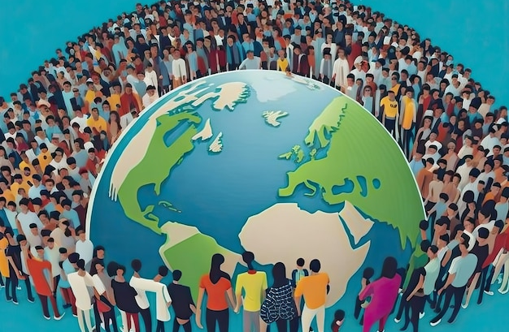
The world is made up of many different people
Notes:
Image: https://www.freepik.com/premium-ai-image/crowd-people-around-earth-globe-concept-world-population-day_49095497.htm

Slide 6
What is the role of stakeholders (people like you and me) in the use and management of marine ecosystems?

Slide 7
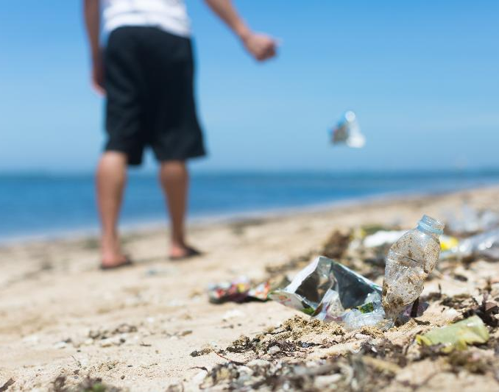
What can we do about this?
Pollution
Notes:
Image: https://storymaps.arcgis.com/stories/df9267f53b284f138cacdb6b9db8038d

Slide 8
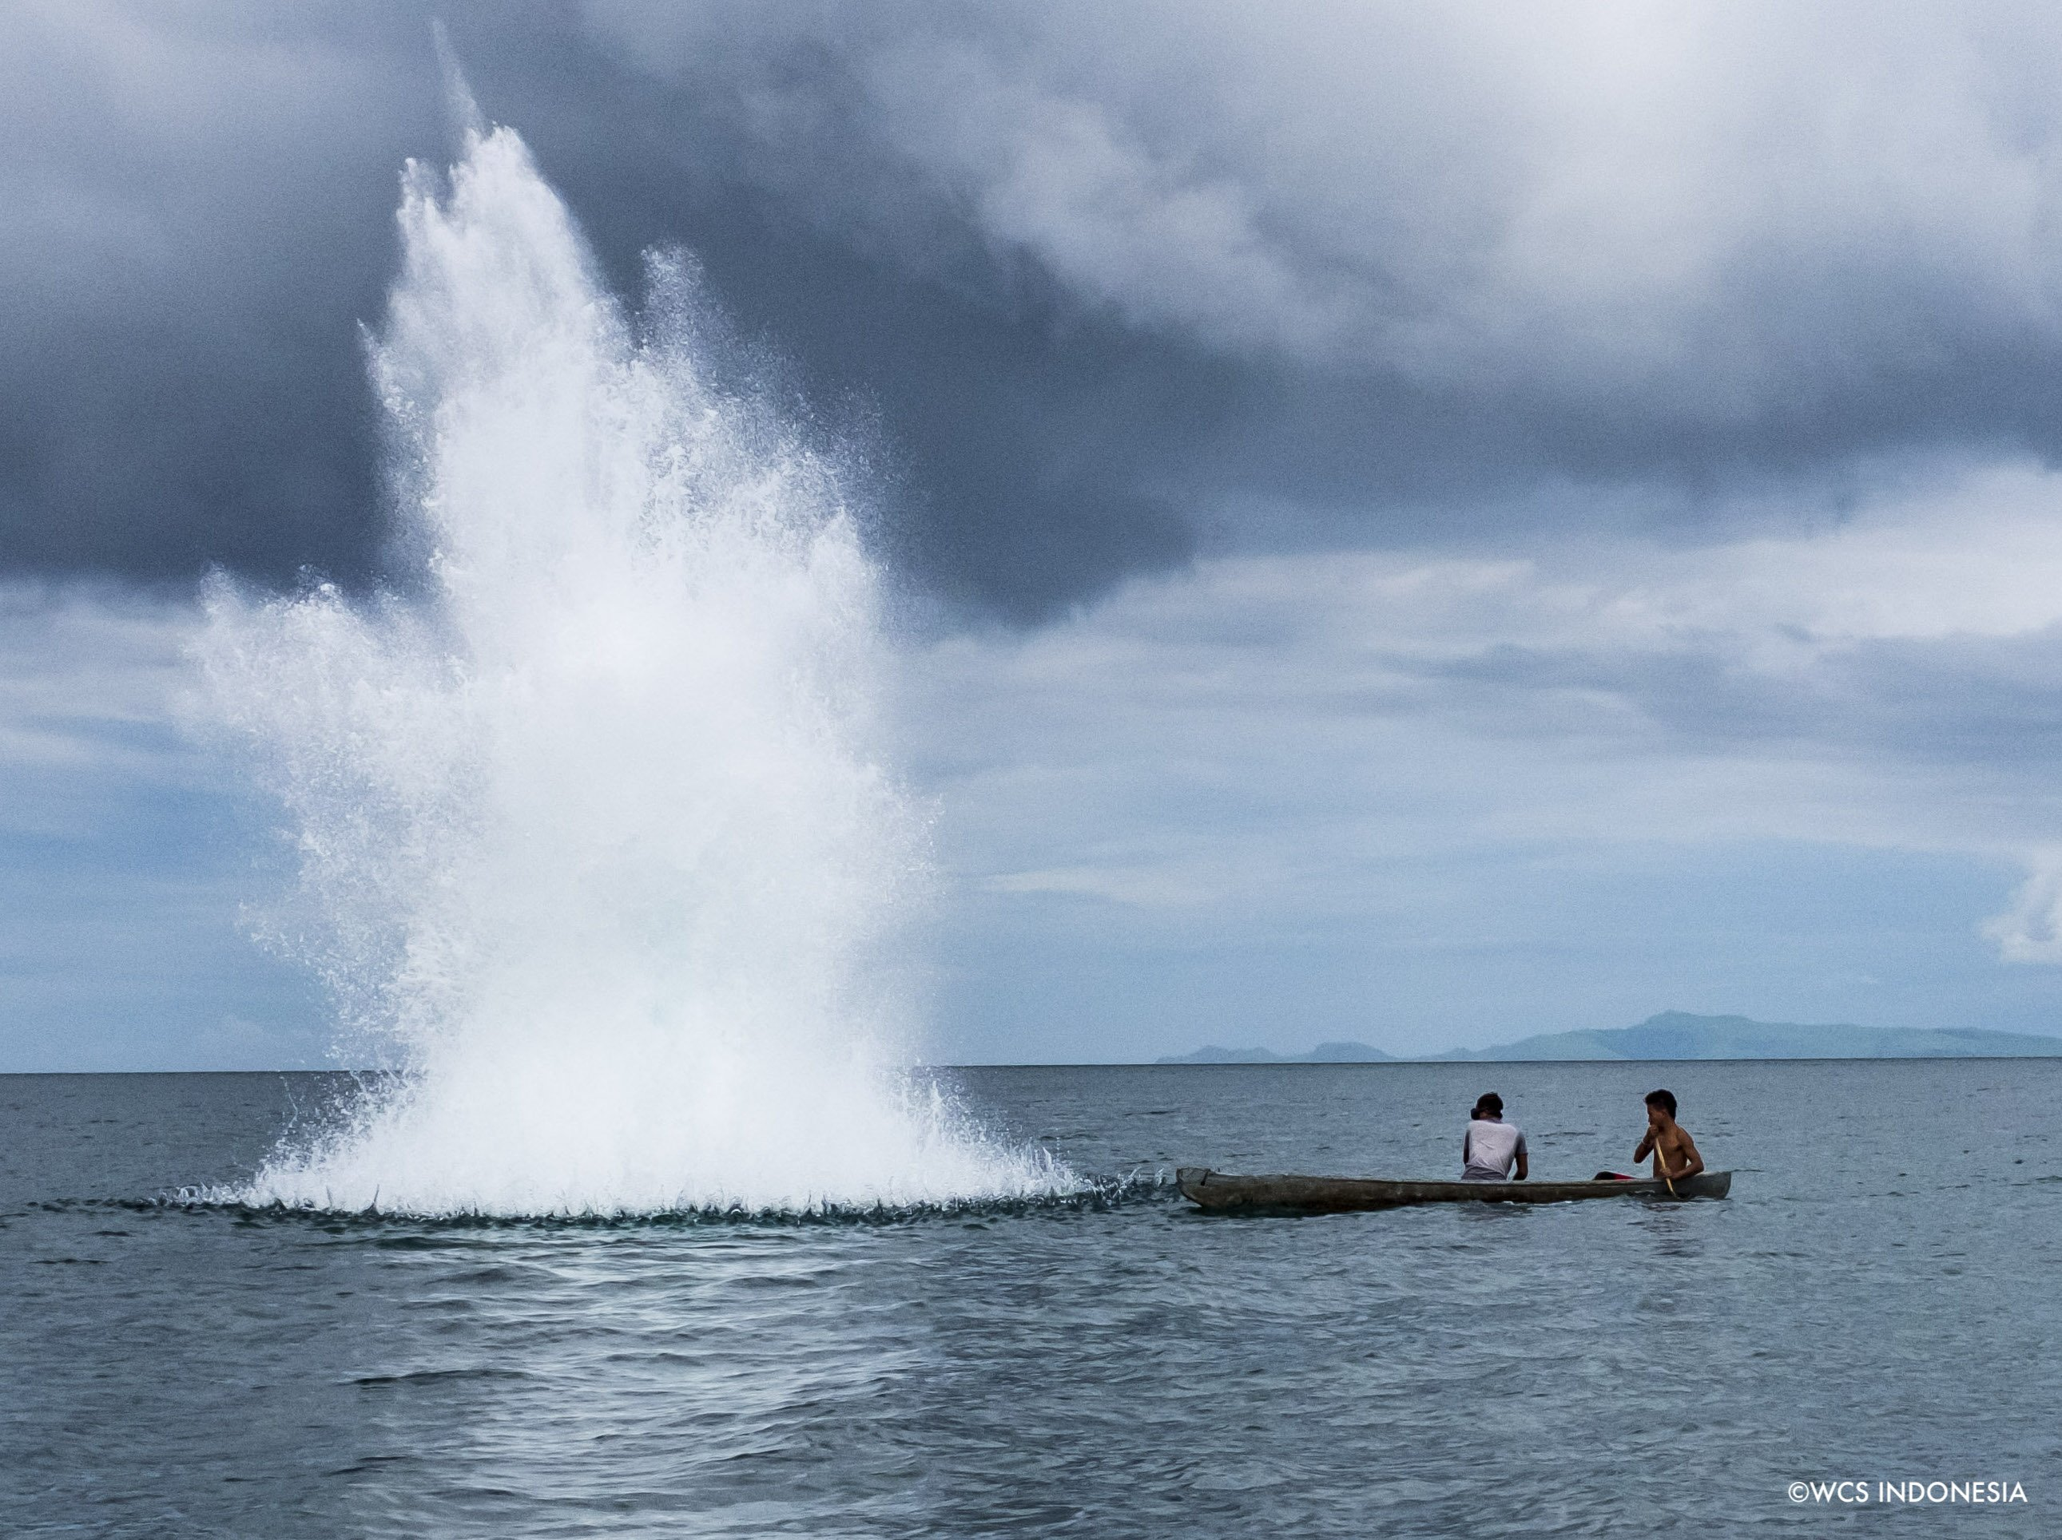
What can we do about this?
Destructive fishing practices
Notes:
Image: https://x.com/TheWCS/status/1137434157121003522?mx=2

Slide 9
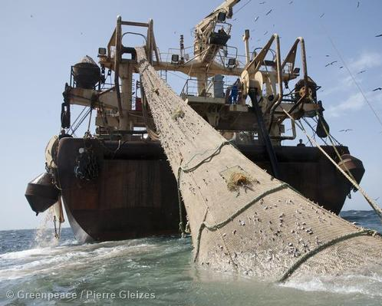
What can we do about this?
Overexploitation
Notes:
Image: https://www.greenpeace.org.au/article/monsters-oceans-7-criminal-super-trawlers-threaten-waters/

Slide 10

How do we manage people’s behaviours?
Notes:
Image: https://outreachmagazine.com/features/26148-where-god-points-finger.html

Slide 11

How does your school manage student behaviours?
Notes:
Image: https://maharshidps.com/all/?page_id=283

Slide 12
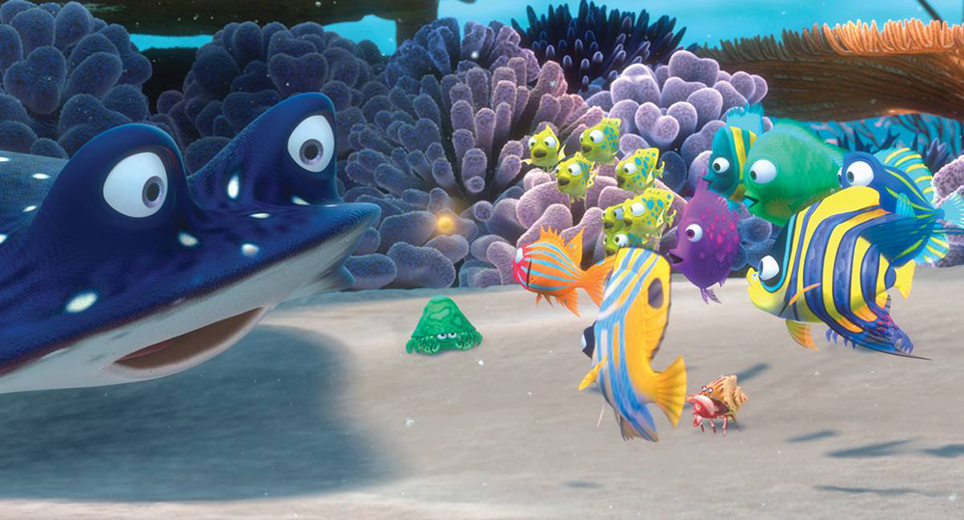
Think of the ocean as a school.
Who makes the rules?

Slide 13
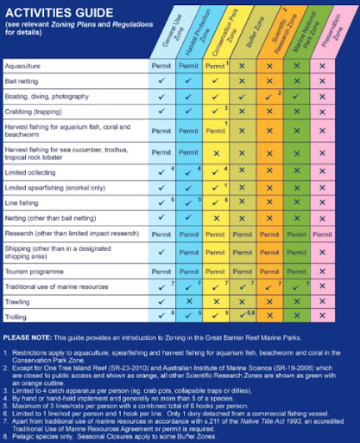
Governance sets the RULES
which are written into policies, procedures and laws.
Notes:
Image: http://envlaw.com.au/great-barrier-reef-marine-park-act-1975-cth/

Slide 14
Governance
Governance is how something is managed (by the governing authority), and the mechanisms by which it, and its people, are held to account.

Slide 15
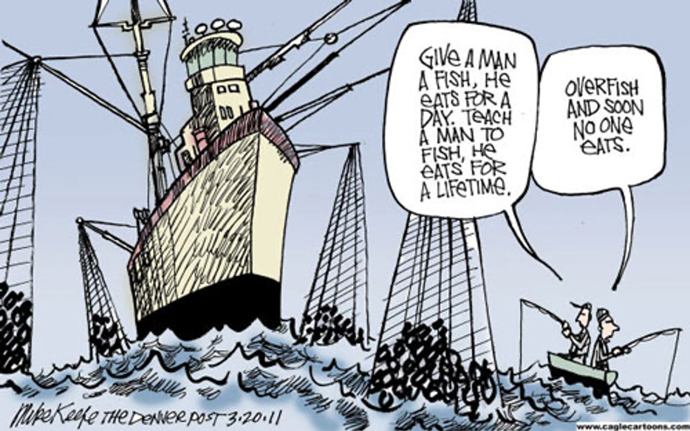
Tragedy of the Commons
RULES are made to protect a resource from overexploitation
Notes:
Image: https://andrewhening.medium.com/how-to-solve-tragedy-of-the-commons-f542e0d979dc

Slide 16
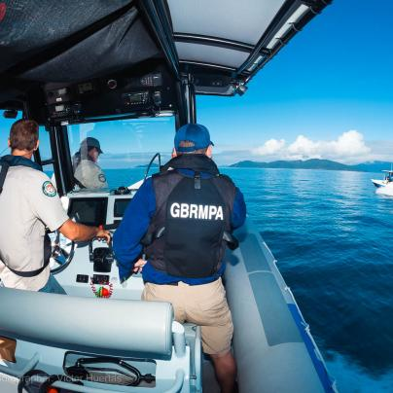
Compliance is the act of following the RULES.
Notes:
Image: https://www2.gbrmpa.gov.au/our-work/field-management/conservation-and-monitoring

Slide 17
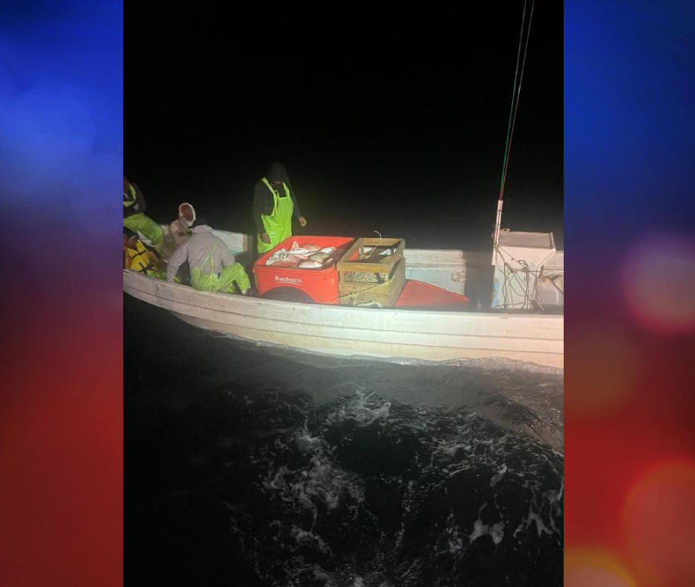
When people don’t follow the rules (and it costs too much to catch them in the act) rules that were put in place to protect something, don’t work anymore.
Notes:
Image: https://www.valleycentral.com/news/local-news/coast-guard-seizes-600-pounds-of-illegally-caught-shark-and-fish-near-spi/

Slide 18
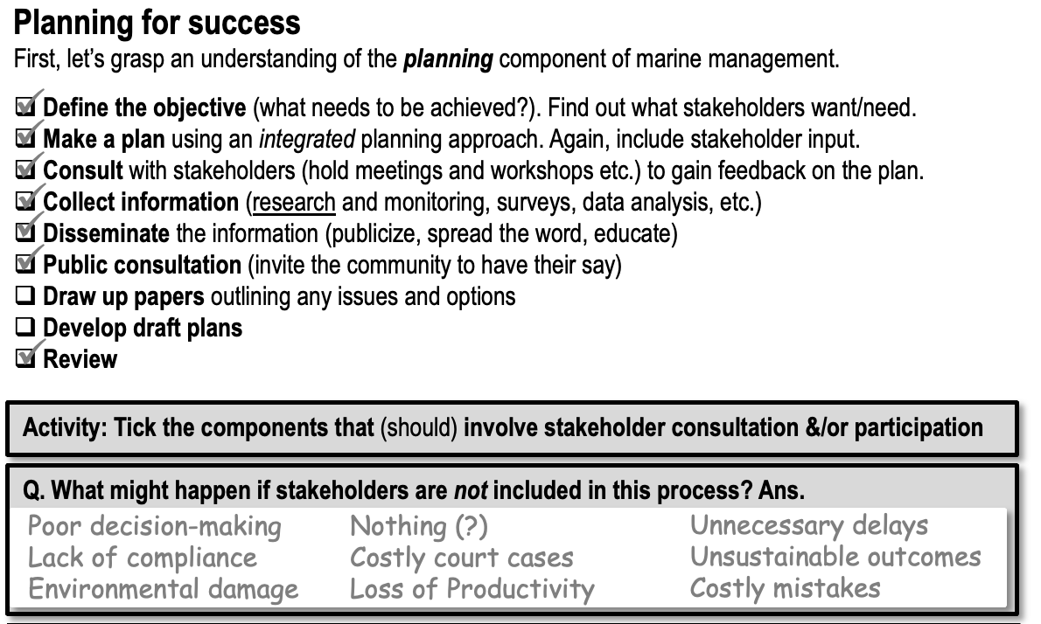
People are more likely to follow rules when they’re consulted in the making of the RULES.
Thus, good governance invites stakeholder input.

Slide 19
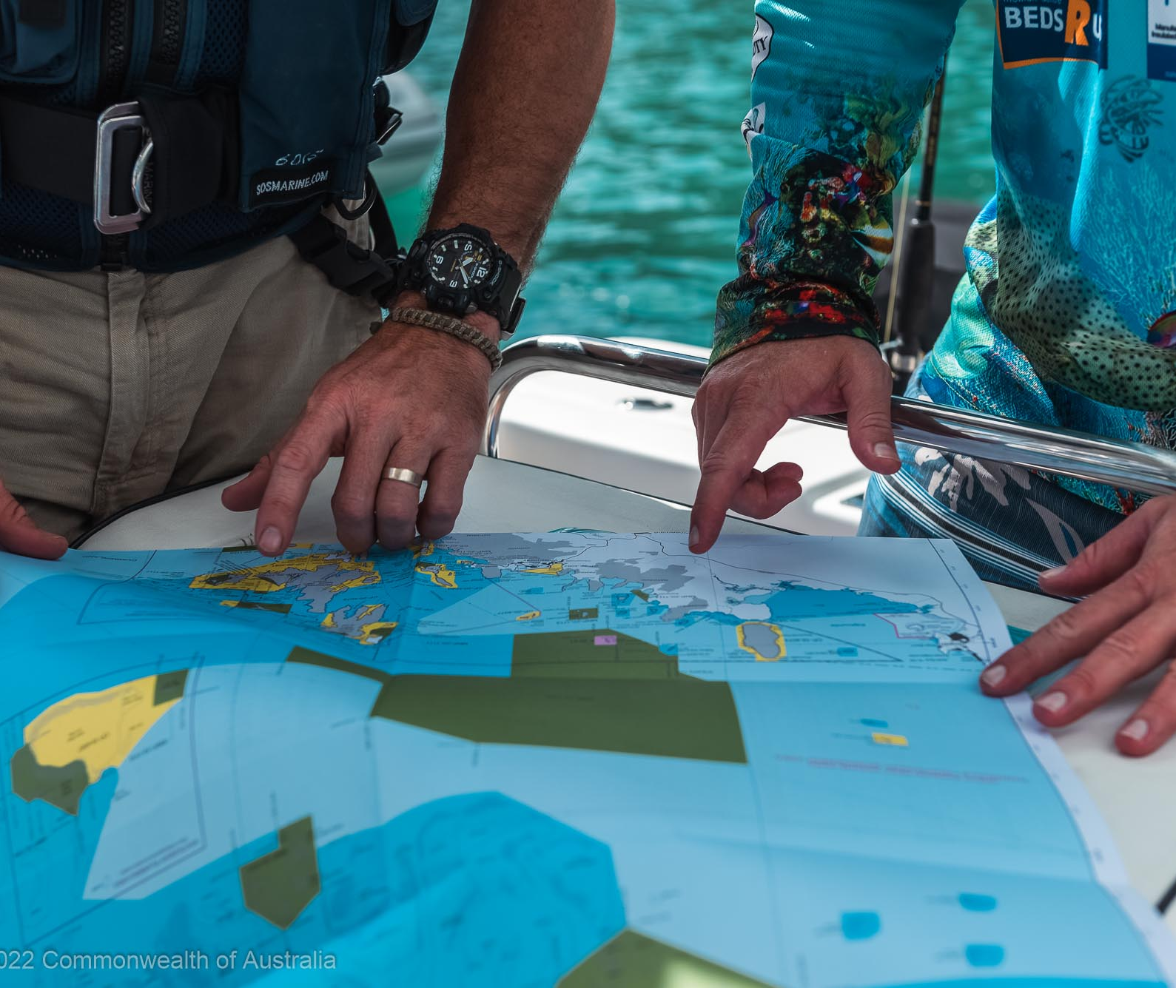
When stakeholders are given opportunities to participate in decision-making processes, compliance is more likely.
Notes:
Image: https://www2.gbrmpa.gov.au/access

Slide 20
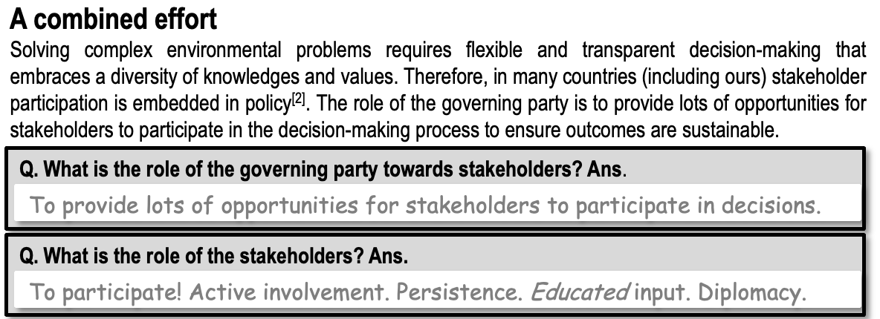
The role of stakeholders is to participate!
Have active involvement. Educated input. Persistence. Diplomacy.

Slide 21


Notes:
Image (left): https://www.whatsonbundaberg.com.au/events/event/3570/public-consultation-community-drop-in-information-session-for-the-southern-plan-of-management-for-the-great-barrier-reef
Image (right): https://www.linkedin.com/posts/great-barrier-reef-marine-park-authority_local-marine-advisory-committees-activity-7185899195503972354-dNGq

Slide 22
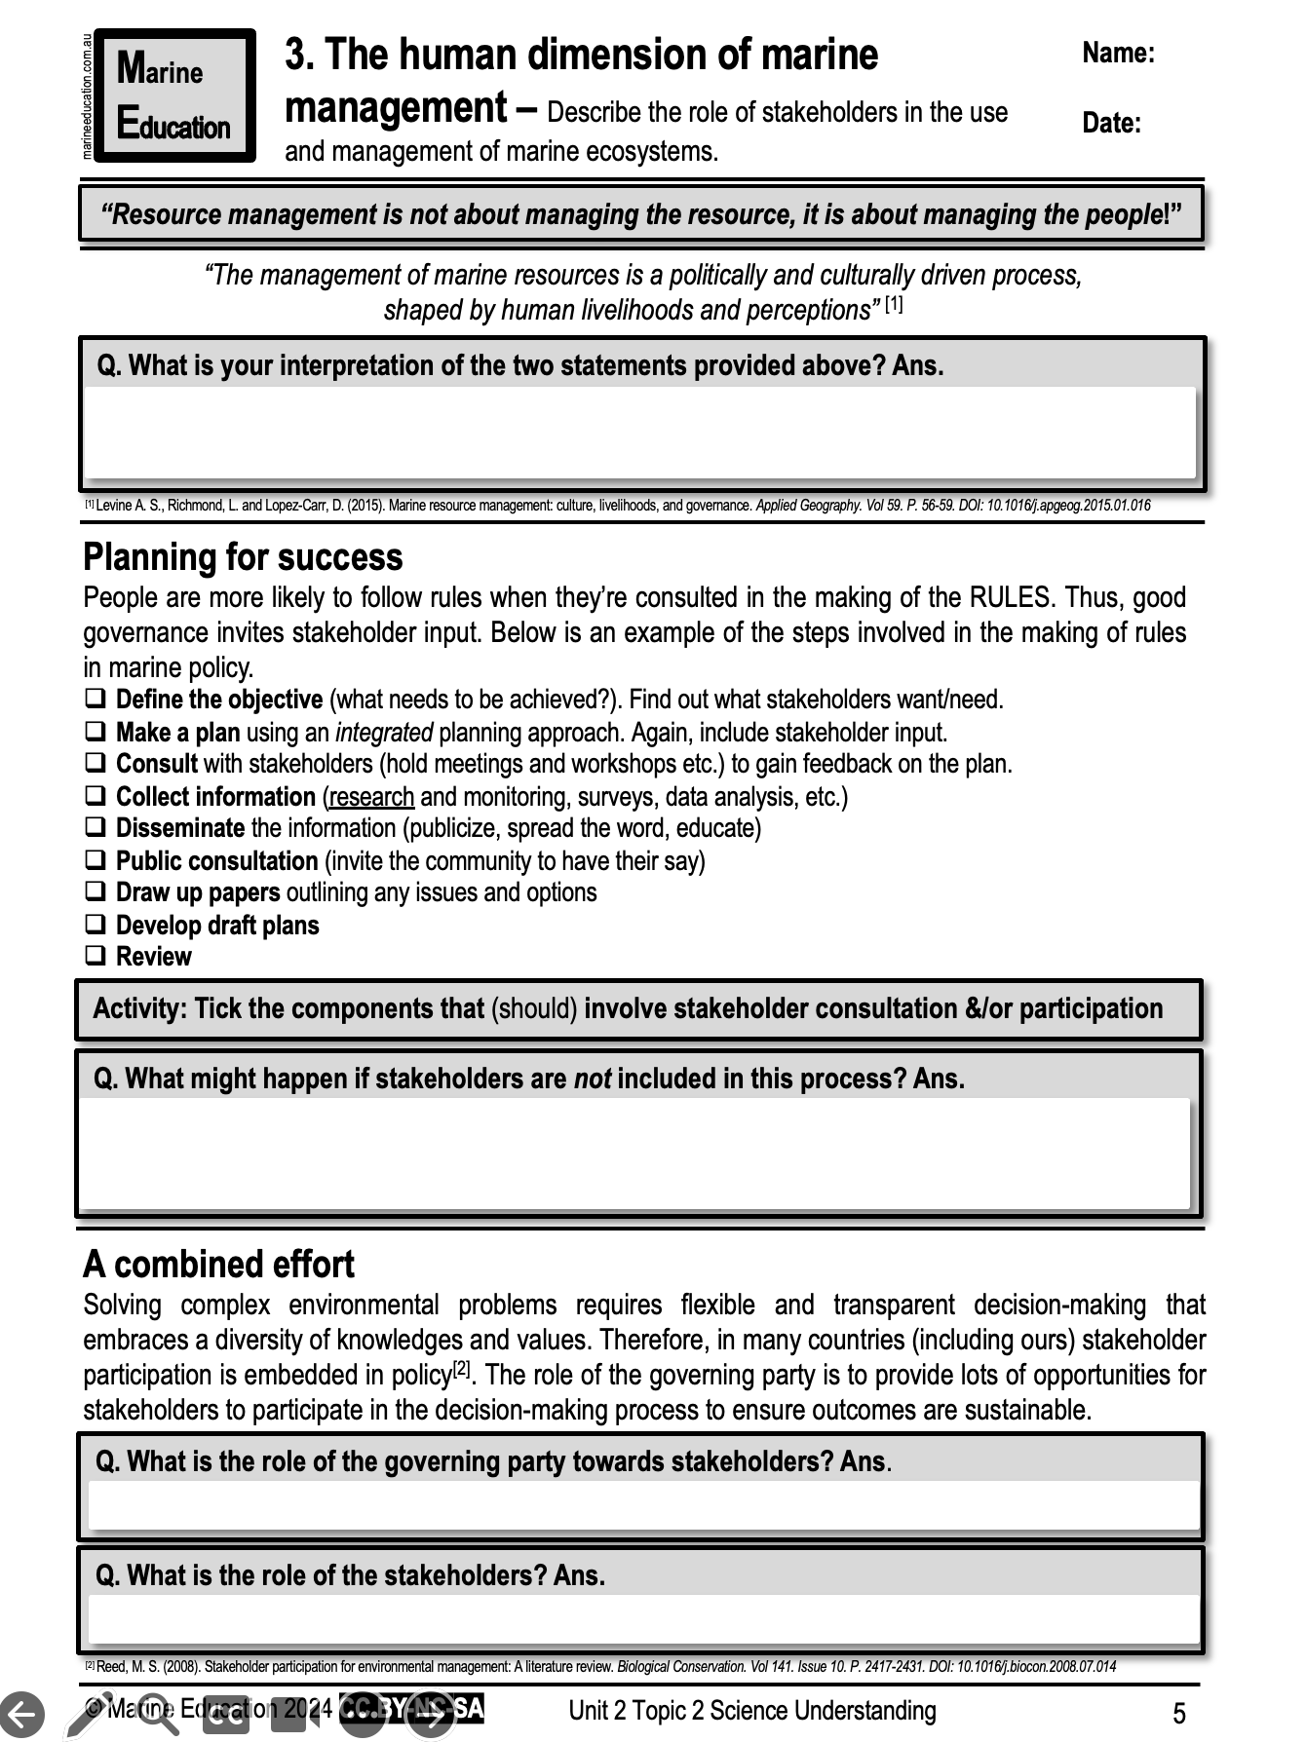
Learning Intention:
Describe the role of stakeholders in the use and management of marine ecosystems.
Success Criteria:
Complete Marine Education worksheet ‘3. The human dimension of marine management’
Notes:
Image: https://www.savills.com/prospects/themes-how-to-succeed-in-stakeholder-engagement.html

