Slide 1
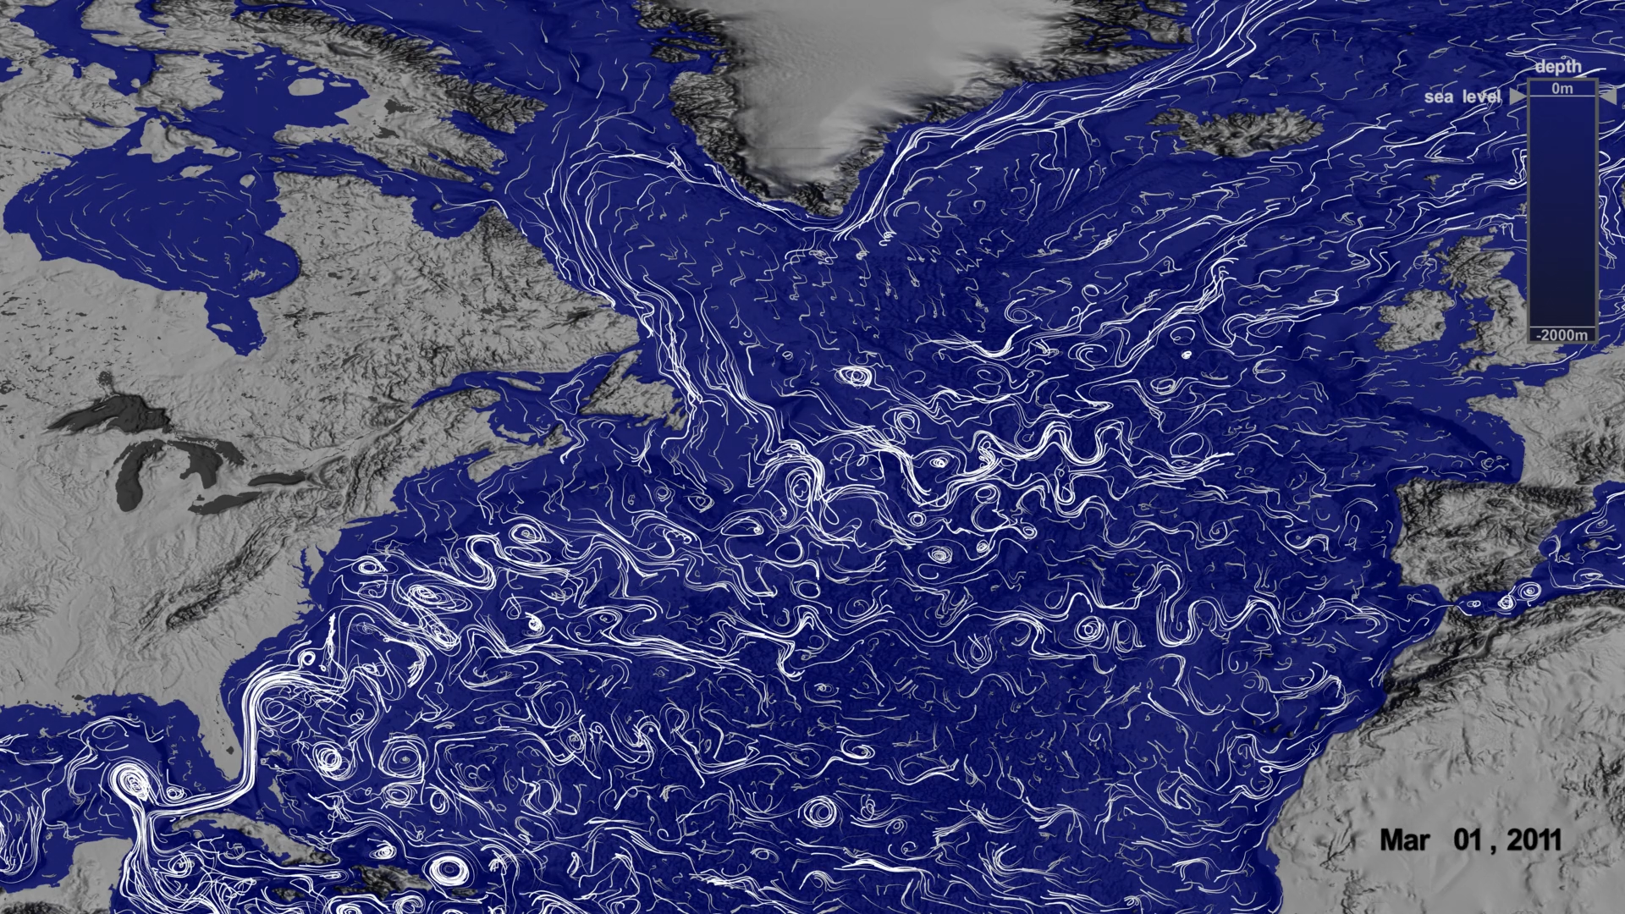
Learning Intention:
Describe how water, heat and nutrients are distributed across coastal regions and global ocean basins (e.g. upwelling and downwelling, El Nino and La Nina events, Langmuir circulation, Ekman spiral)
Success Criteria:
Complete Marine Education worksheet ‘5. Free postage & handling’

Slide 2
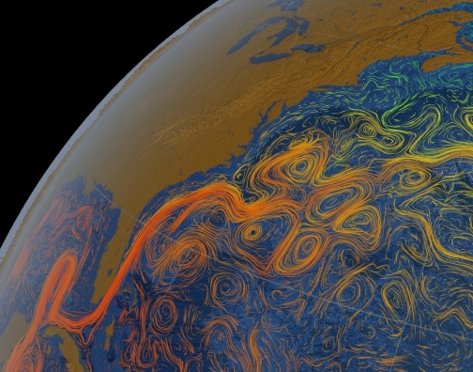
Imagine the ocean without currents….
There would be no recycling of food, no free-ride for migratory species, no dispersal of larvae from one ecosystem to the next. There would be no movement of heat around the earth, no oxygen in the deep oceans, or movement of sediment from one place to the next. Earth would be very different indeed.
Notes:
https://www.pbslearningmedia.org/resource/buac17-912-sci-ess-oceanoverturn/global-ocean-currents/

Slide 3
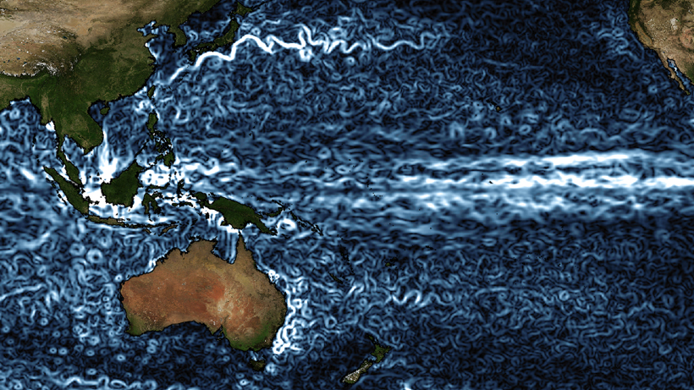
Notes:
https://eos.org/science-updates/exploring-the-interplay-between-ocean-eddies-and-the-atmosphere

Slide 4
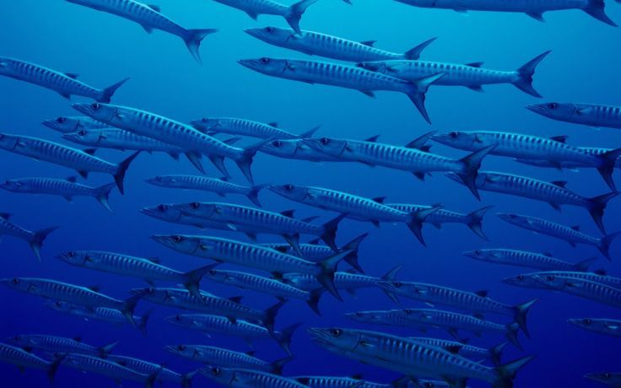
Currents bring food
Notes:
https://www.pinterest.com.au/pin/nature-ocean-fish-blue-sea-hd-wallpaper-wallpaper--309200330645767729/

Slide 5
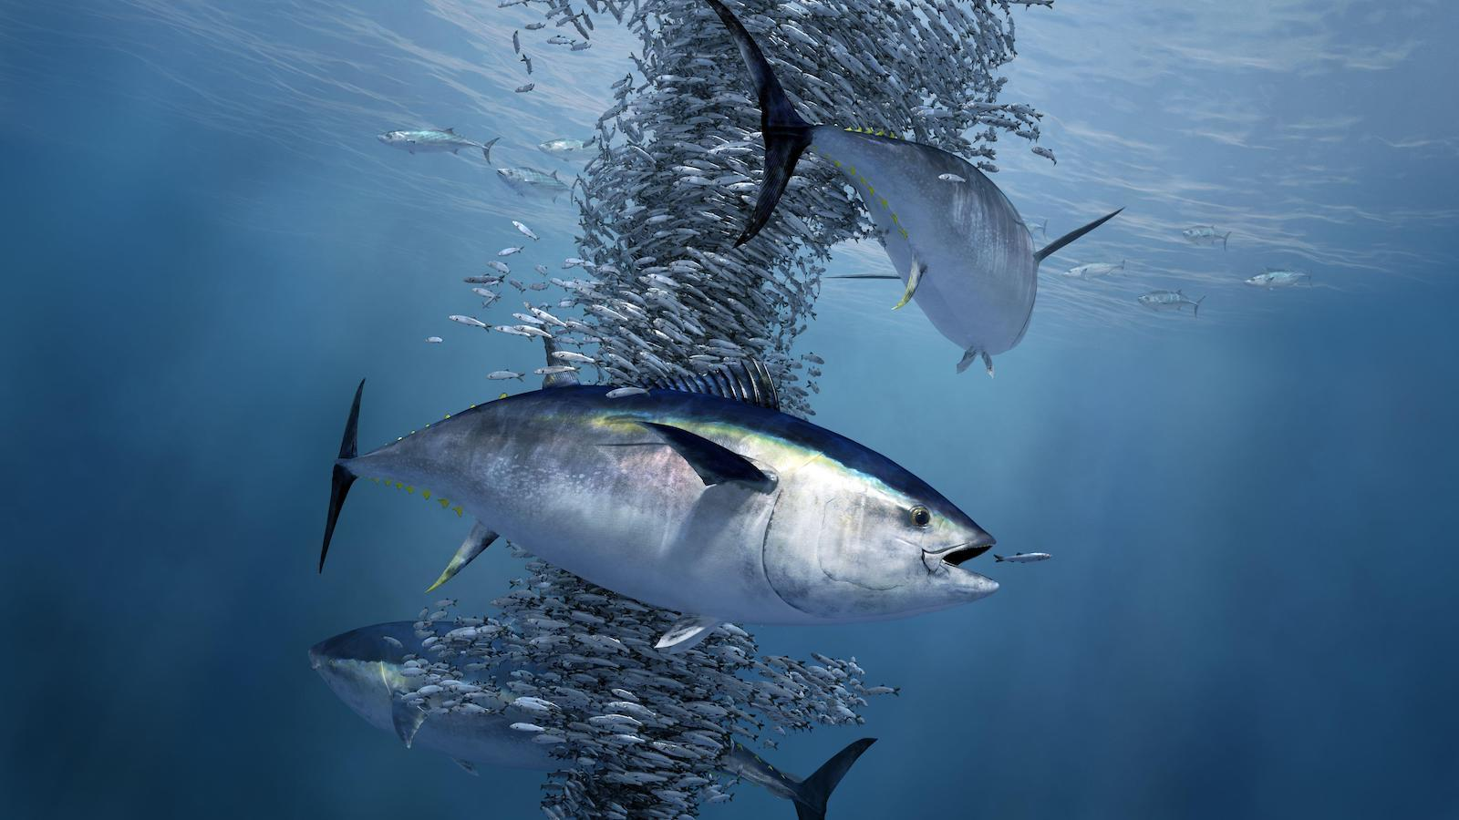
Notes:
https://e360.yale.edu/features/as-ocean-oxygen-levels-dip-fish-face-an-uncertain-future
Atlantic bluefin tuna, shown feeding on a school of herring, have been driven into narrower layers of water by oxygen declines. MARKO STEFFENSEN

Slide 6
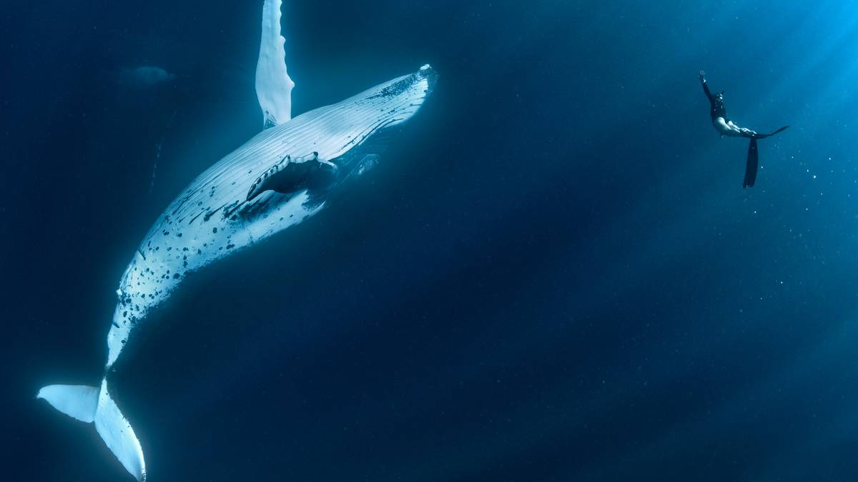
Currents aid long migrations
Notes:
https://www.nzherald.co.nz/travel/whale-watchers-and-swim-tours-see-violent-changes-to-humpback-behaviour/QBGVKTFPGSKAD6EQASGD27X2KA/

Slide 7
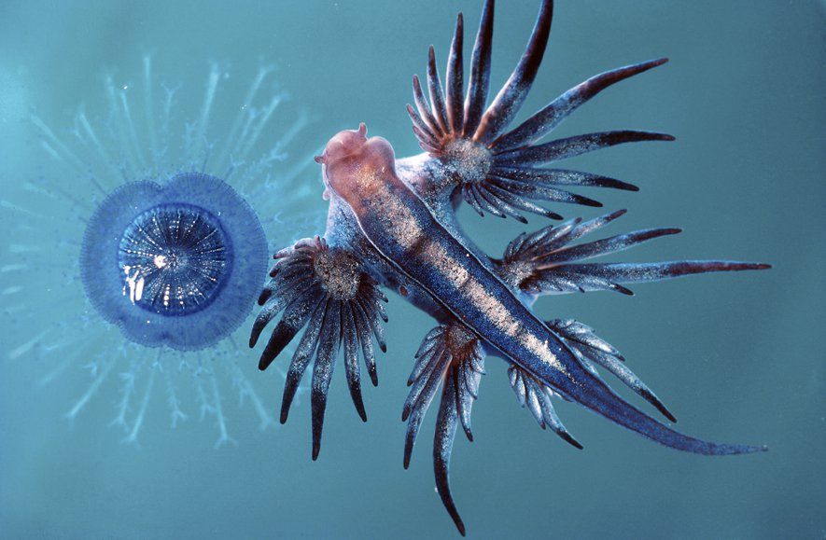
Currents transport drifting plankton
Blue Button Porpita Jellyfish and Glaucus nudibranch
Notes:
https://australian.museum/learn/animals/plankton/holoplankton/

Slide 8
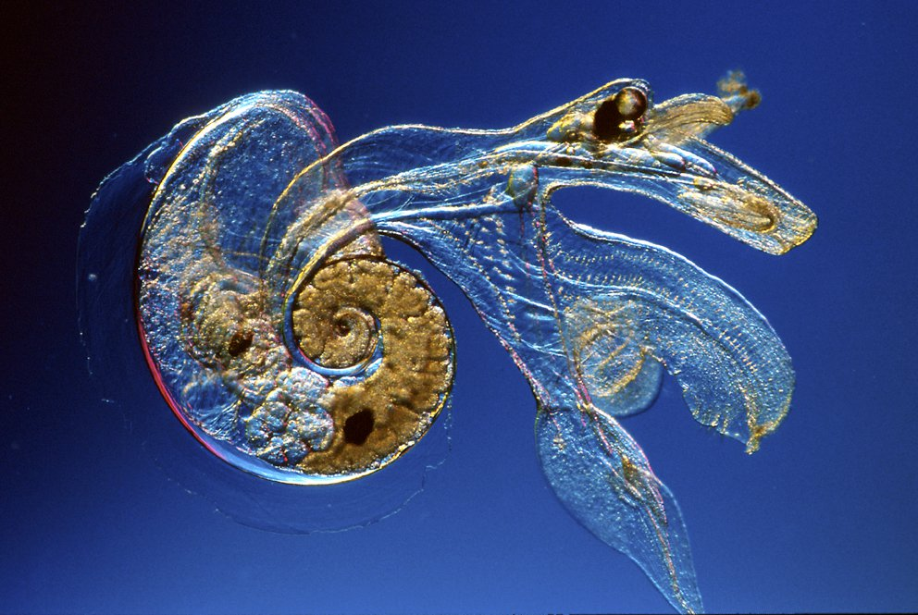
Planktonic peteropod
Notes:
https://australian.museum/learn/animals/plankton/holoplankton/

Slide 9
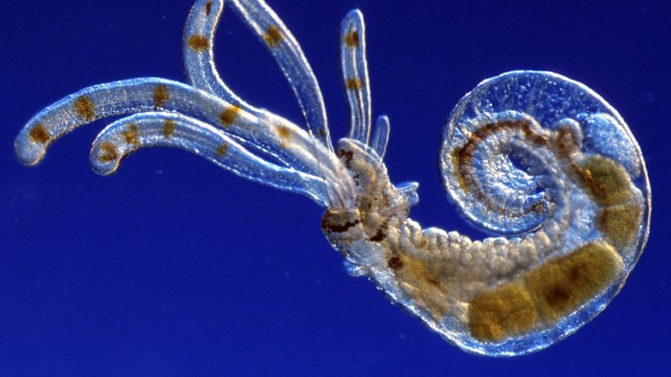
Planktonic terebellid worm
Notes:
https://australian.museum/learn/animals/plankton/zooplankton/

Slide 10
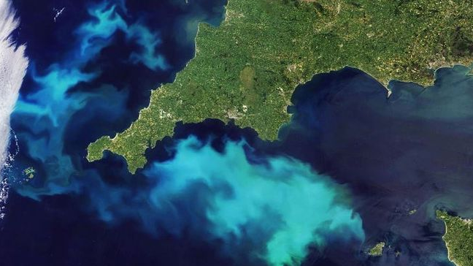
Currents fuel algae blooms
Notes:
https://newseu.cgtn.com/news/2020-08-19/Huge-plankton-bloom-off-UK-coast-visible-from-space--T2oNj5LZLO/index.html

Slide 11
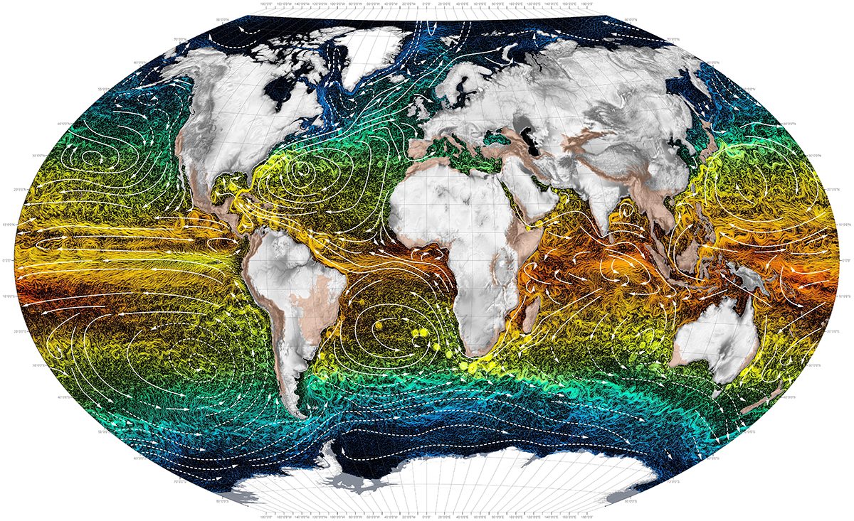
Currents create movement
Notes:
https://jupiterfoundation.org/current?offset=1524535200263

Slide 12
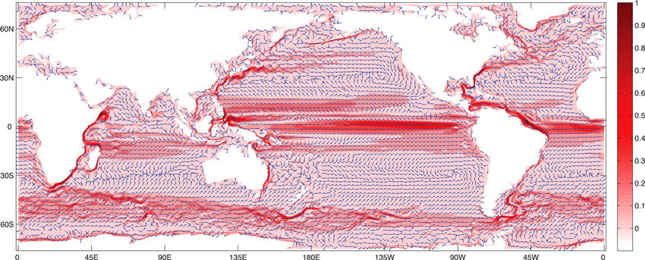
Currents go fast and slow
Mean speed of surface currents in m/sec
Notes:
Map of mean speed (red) in units of m/s and direction (arrows) of the surface flow from the OFES model over 48 weeks.
https://www.researchgate.net/figure/Map-of-mean-speed-red-in-units-of-m-s-and-direction-arrows-of-the-surface-flow-from_fig8_266569697

Slide 13
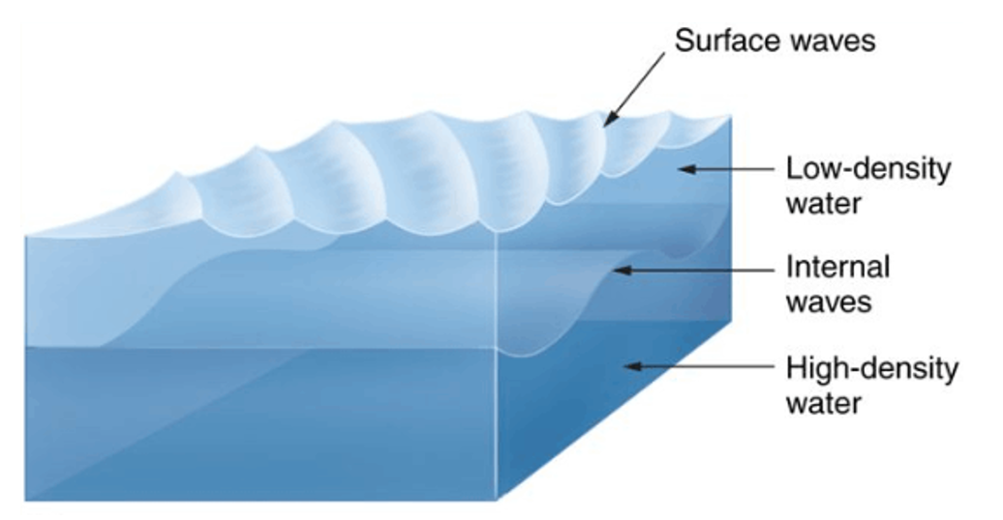
Currents go horizontal
Notes:
https://www.miracles-of-quran.com/internal_waves.html

Slide 14
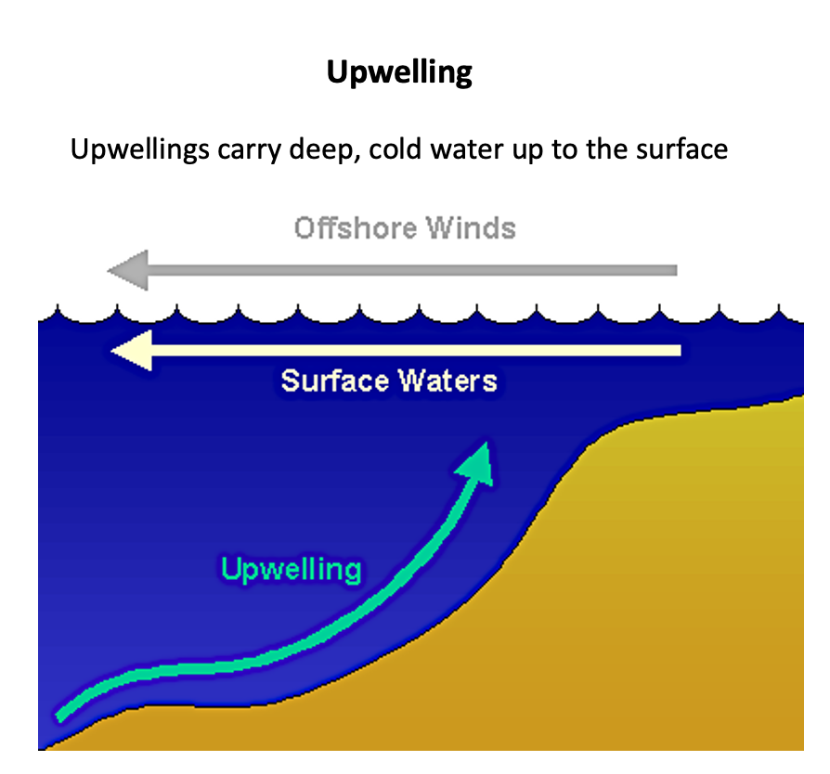
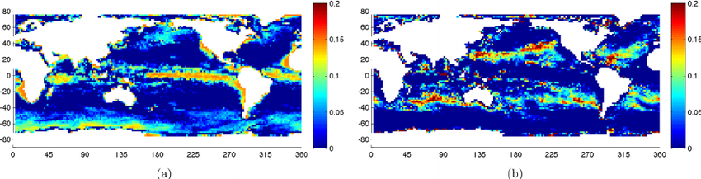
Currents go UP
Mean UPwellings rates (m/sec)
Notes:
https://www.researchgate.net/figure/Maps-of-average-upwelling-and-downwelling-rates-a-Average-rate-of-upwelling-over-48_fig2_266569697
Maps of average upwelling and downwelling rates. (a) Average rate of upwelling over 48 weeks (in m/day). (b) Average rate of downwelling over 48 weeks (in m/day).

Slide 15
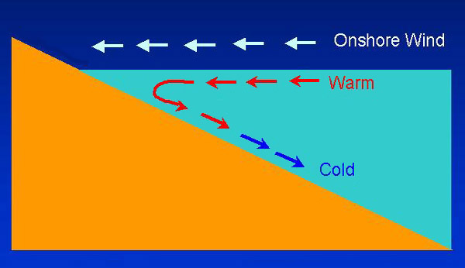
Currents go DOWN
Downwelling
Downwellings carry oxygen down deep
Mean DOWNwelling rates (m/sec)
Notes:
https://www.researchgate.net/figure/Maps-of-average-upwelling-and-downwelling-rates-a-Average-rate-of-upwelling-over-48_fig2_266569697
Maps of average upwelling and downwelling rates. (a) Average rate of upwelling over 48 weeks (in m/day). (b) Average rate of downwelling over 48 weeks (in m/day).

Slide 16
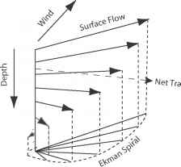
Currents spiral
(Ekman Spiral)
Net Transport

Slide 17
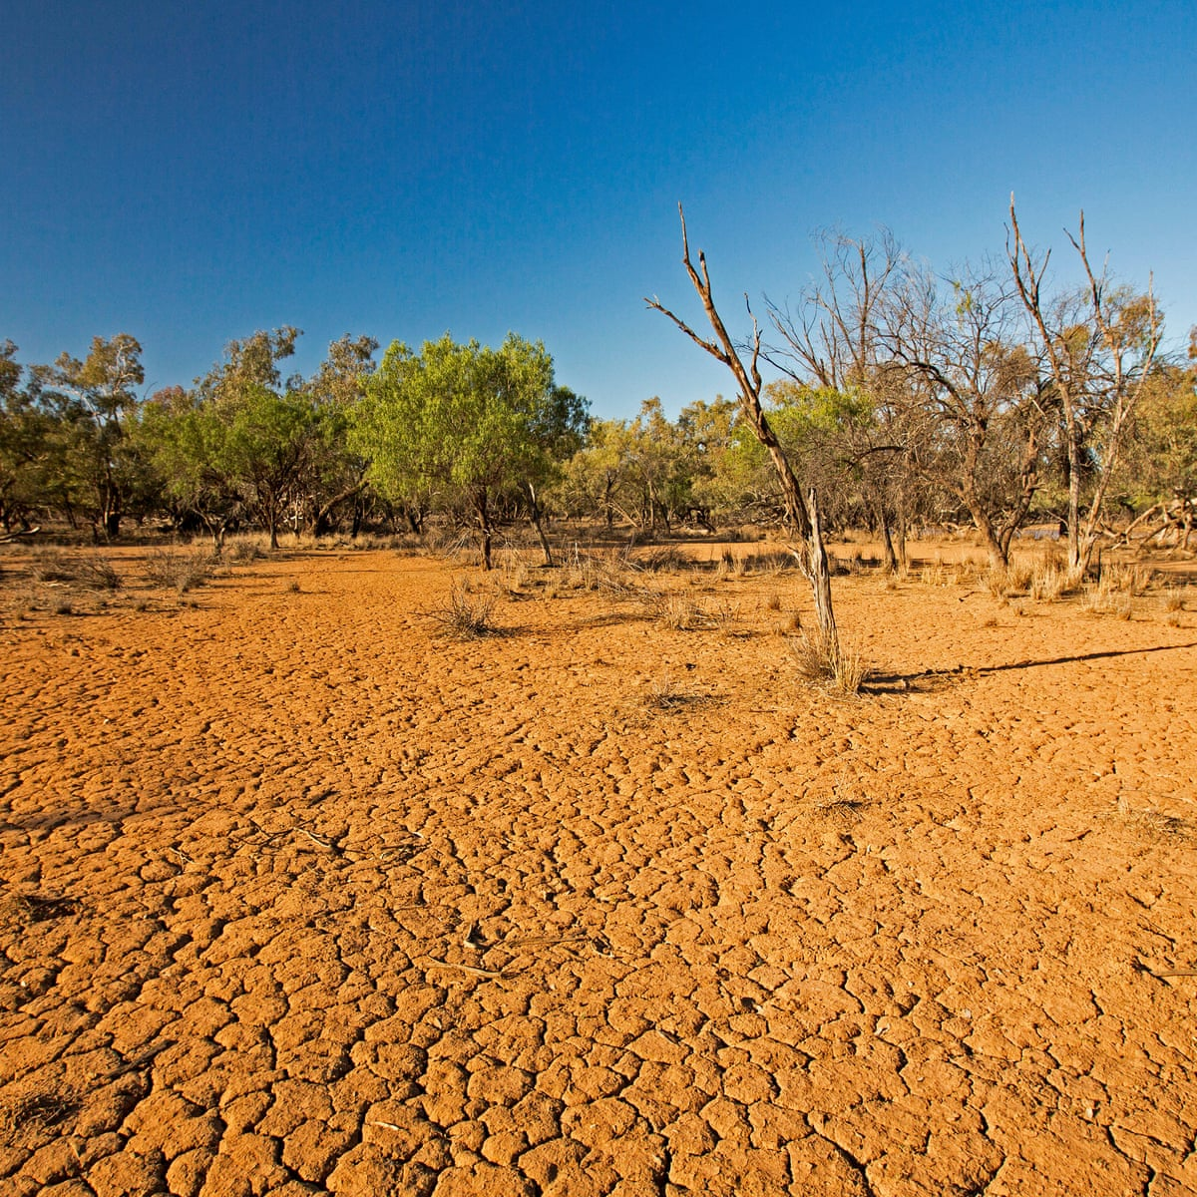
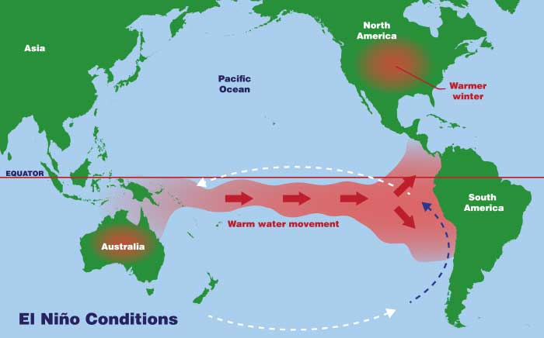
Currents cause climate chaos
(El Nino)
Notes:
Image: NASA

Slide 18
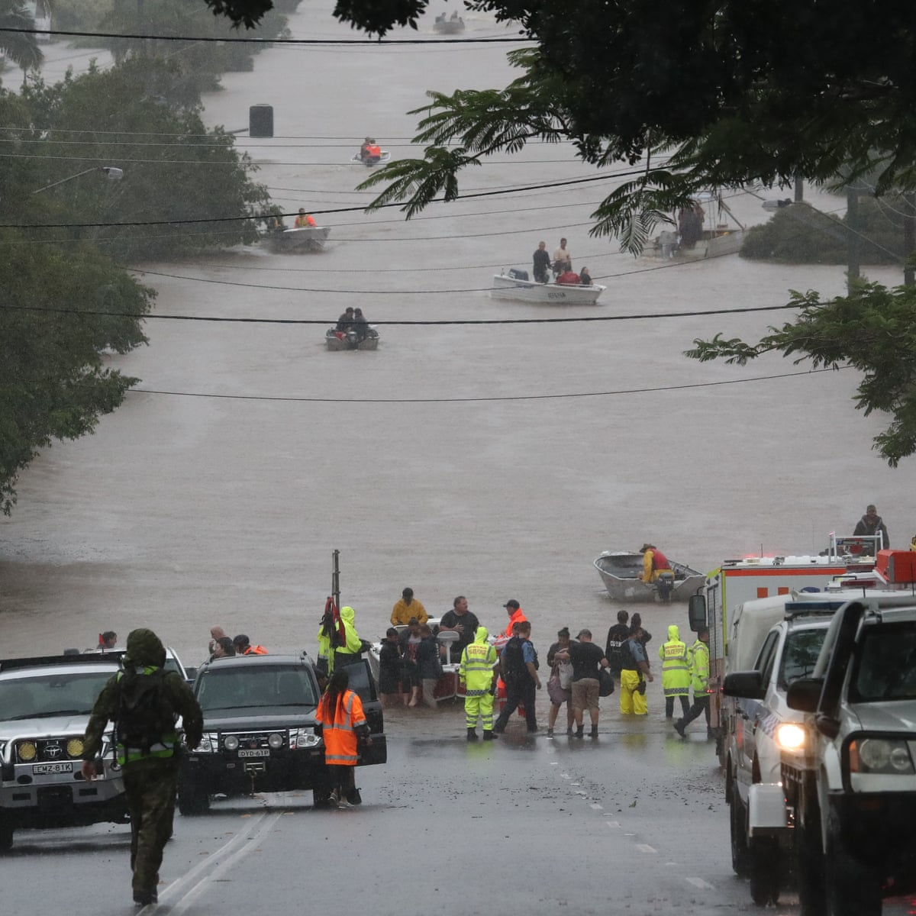
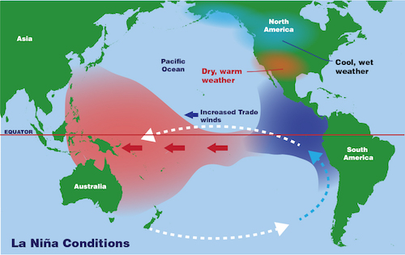
Currents cause flooding rains
(La Nina)
Notes:
Image: NASA

Slide 19
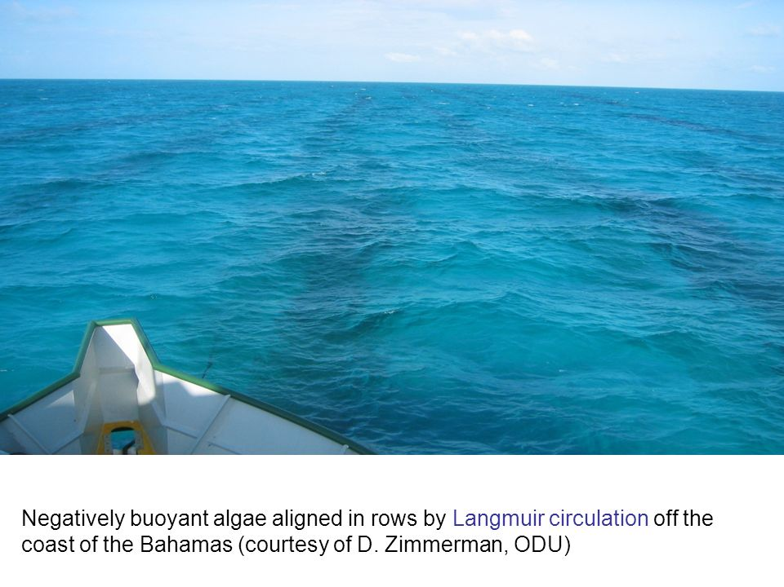
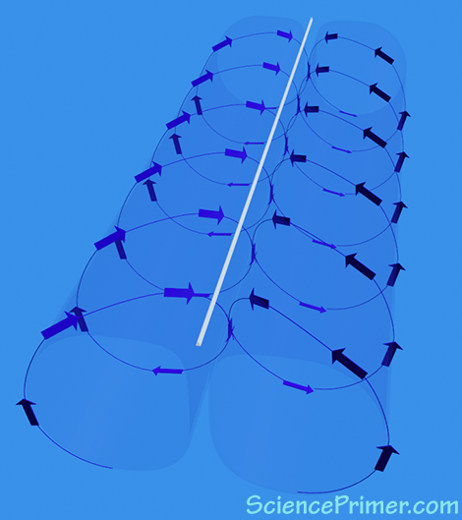
Currents make corkscrews and long streaks
(Langmuir circulation)

Slide 20
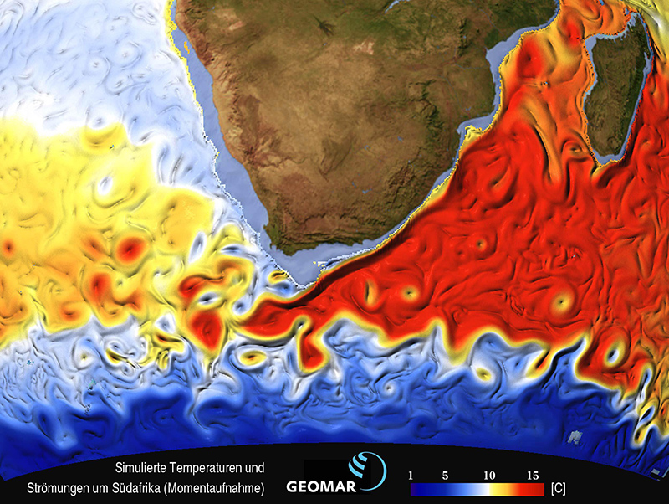
Currents make spinning loops
(Eddy currents)

Slide 21
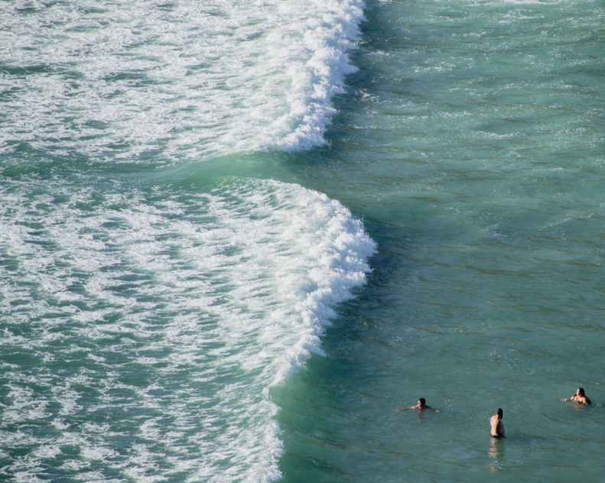
Currents give surfers a swift ride out the back of the surf break
(Rip currents)

Slide 22
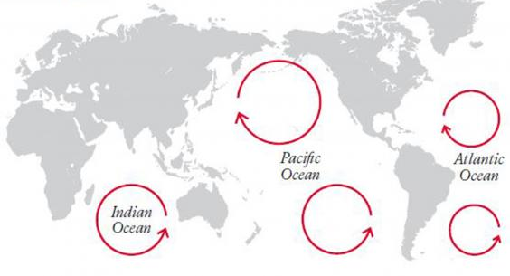
Currents circle entire oceans and collect rubbish
(ocean gyres)
Notes:
https://mooreforstaterep.info/what-are-the-5-garbage-patches

Slide 23
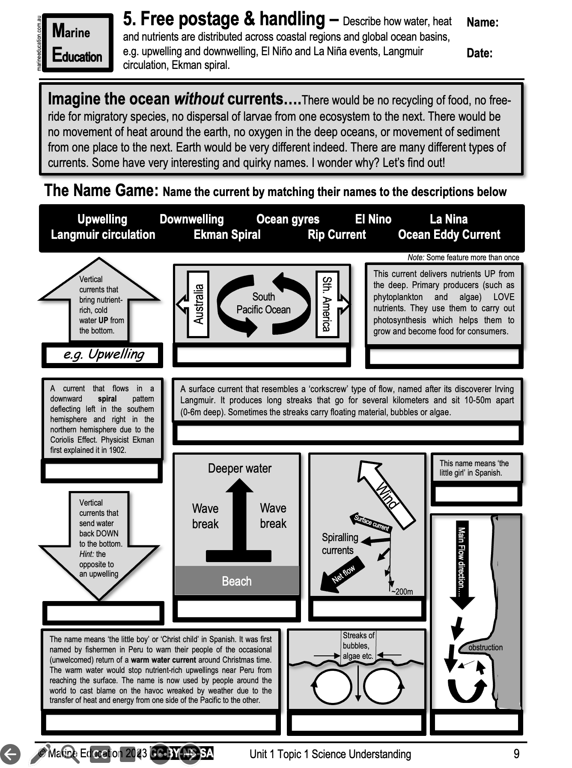
Learning Intention:
Describe how water, heat and nutrients are distributed across coastal regions and global ocean basins (e.g. upwelling and downwelling, El Nino and La Nina events, Langmuir circulation, Ekman spiral)
Success Criteria:
Complete Marine Education worksheet ‘5. Free postage & handling’

