Slide 1
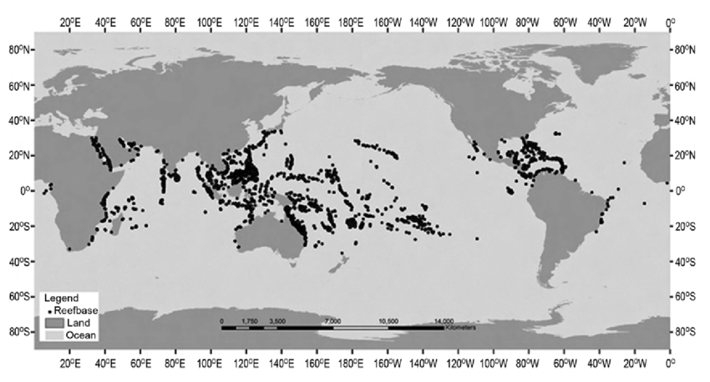
Marine
Education
2. What’s with the latitude? – Describe the distribution patterns of reefs, including changes moving down latitudinal gradients and across, from inshore to outer shelf reefs.
Name:
Date:
marineeducation.com.au
When observing the global distribution of coral reefs, a clear trend can be seen through comparing latitude gradients of coral reefs. In the last activity, we saw the importance of warm, shallow, clear water on the growth of coral reefs. How does latitude gradient relate to these requirements?
Use the Coral Reef Map website provided. When you hover over an area, latitude and longitude are shown. https://www.coralsoftheworld.org/coral_geographic/interactive_map/
Find and list 3 coral reefs at different latitudes in the table below:
Reef Name | Location | Latitude
Saravanan, Raju & Ranjith, L & Jasmine, Suryavamsi & Joshi, K K. (2017). Coral bleaching: causes, consequences and mitigation. Marine Fisheries Information Service.
Q. Describe the pattern you notice about reef distribution and latitude. i.e. What do the latitude of the reefs have in common?
Ans.
Inshore and outer shelf reefs also differ in various ways. Environmental factors such as water visibility, temperature, wave exposure and sediment run-off impact the coral types and cover that can be found on inshore and outer shelf reefs.
Use satellite imagery on the website provided to compare 3 different reef locations and investigate how and why they differ. https://allencoralatlas.org/atlas/#13.06/-16.9309/145.9912
Reef | Water Temperature | Water Clarity | Possible Sediment/Runoff? | Wave Exposure
Fitzroy (inshore)
Michaelmas (mid-shelf)
Agincourt (outer shelf)
Q. Which reef would likely have the highest coral diversity?
Q. What do your observations tell you about how reef distribution is shaped by environmental factors?
Ans.
Ans.
© Natasha Agra 2025 CC BY-NC-SA
Unit 3 Topic 1 Science Understanding

