Slide 1
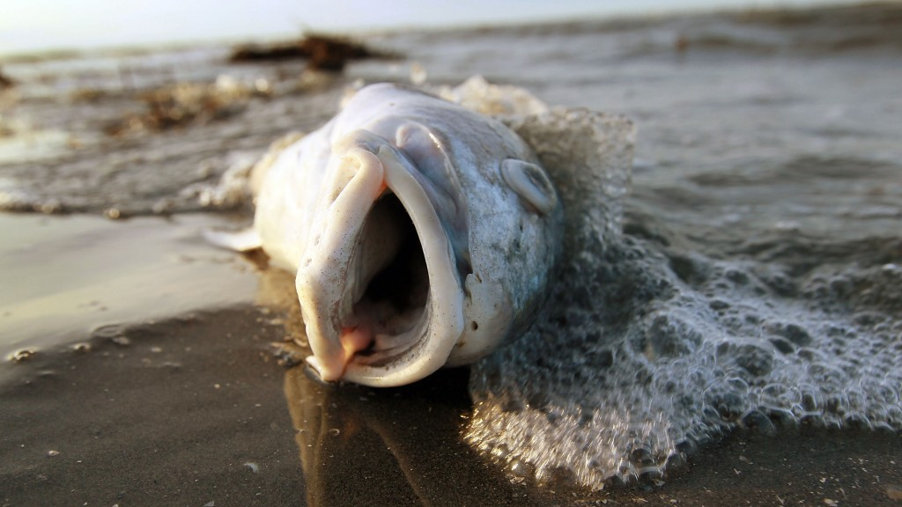
Learning Intention:
Identify issues affecting selected marine ecosystem, including erosion, eutrophication, overharvesting, runoff, sedimentation, urbanisation.
Success Criteria:
Complete Marine Education worksheet ‘5. Not aPEELing’
Notes:
Image: https://www.pbs.org/newshour/world/twitter-chat-greatest-threats-u-s-waters-fisheries

Slide 2
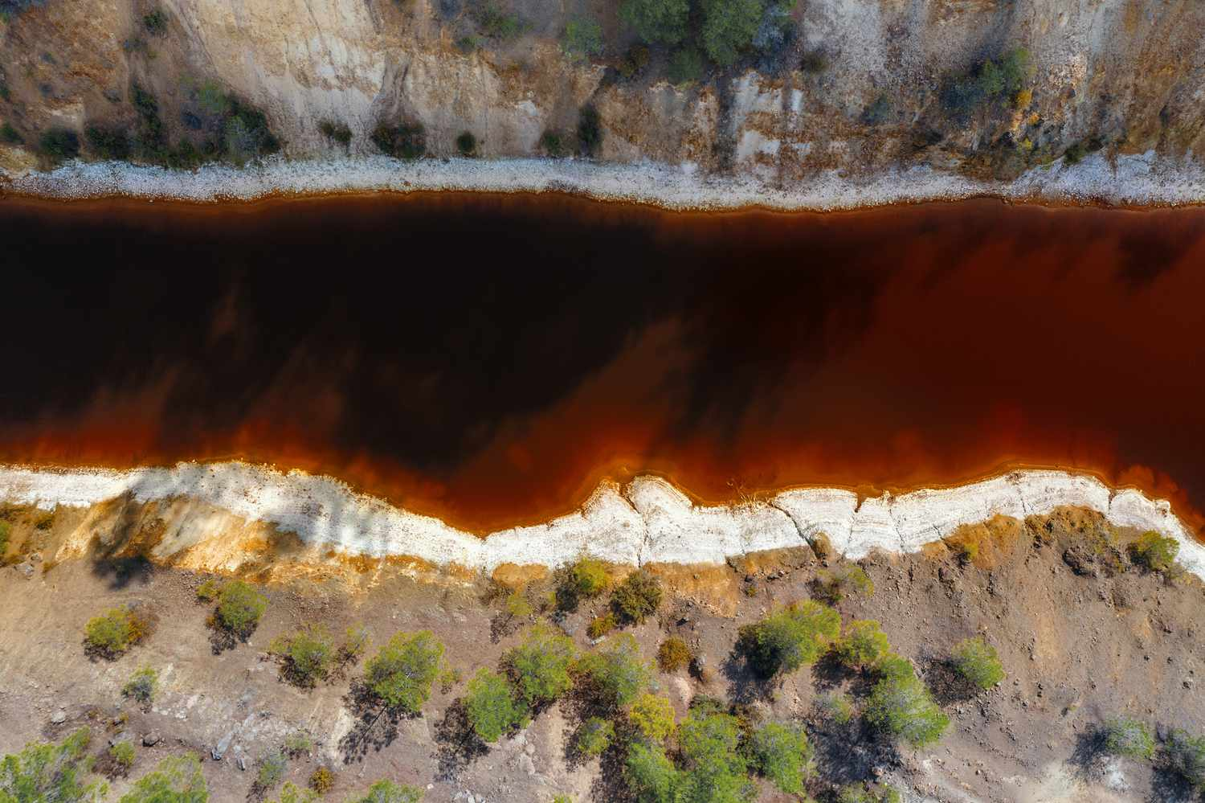
Estuaries
Issues:
Catchment runoff
Changing river flows
Acid soil runoff
Notes:
Image: https://www.treehugger.com/acid-mine-drainage-5220728

Slide 3
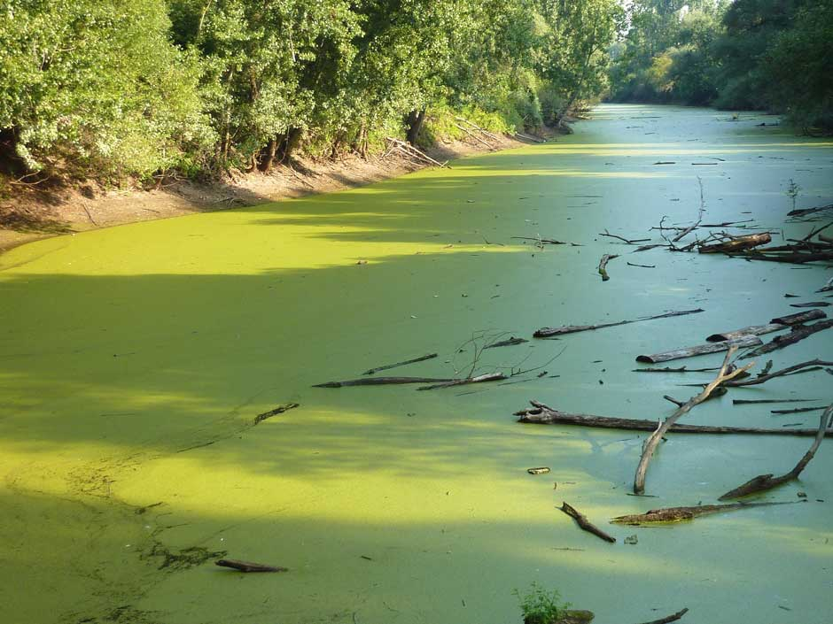
Coastal Lakes
Issues:
Urbanisation
Eutrophication
Sedimentation
Saltwater encroachment
Notes:
Image: https://oysterheaven.org/understanding-eutrophication/

Slide 4
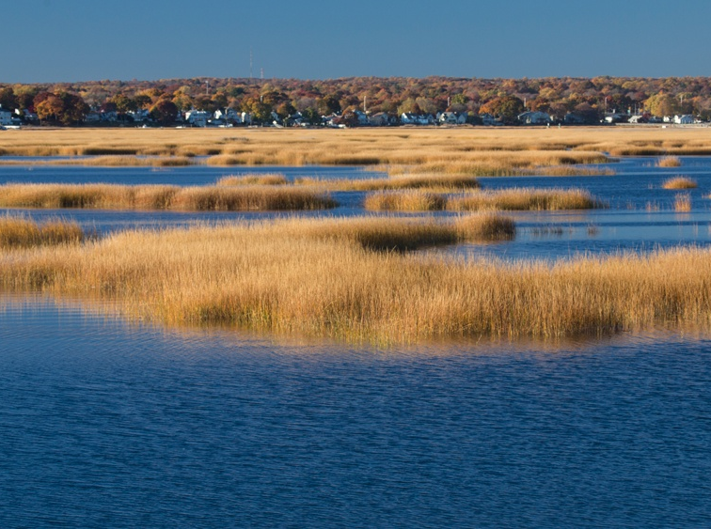
Saltmarshes
Issues:
Urbanisation
Sea level rise
Introduced species
Notes:
Image: https://today.tamu.edu/2020/12/17/rising-sea-levels-drown-coastal-marshes-wetlands/

Slide 5
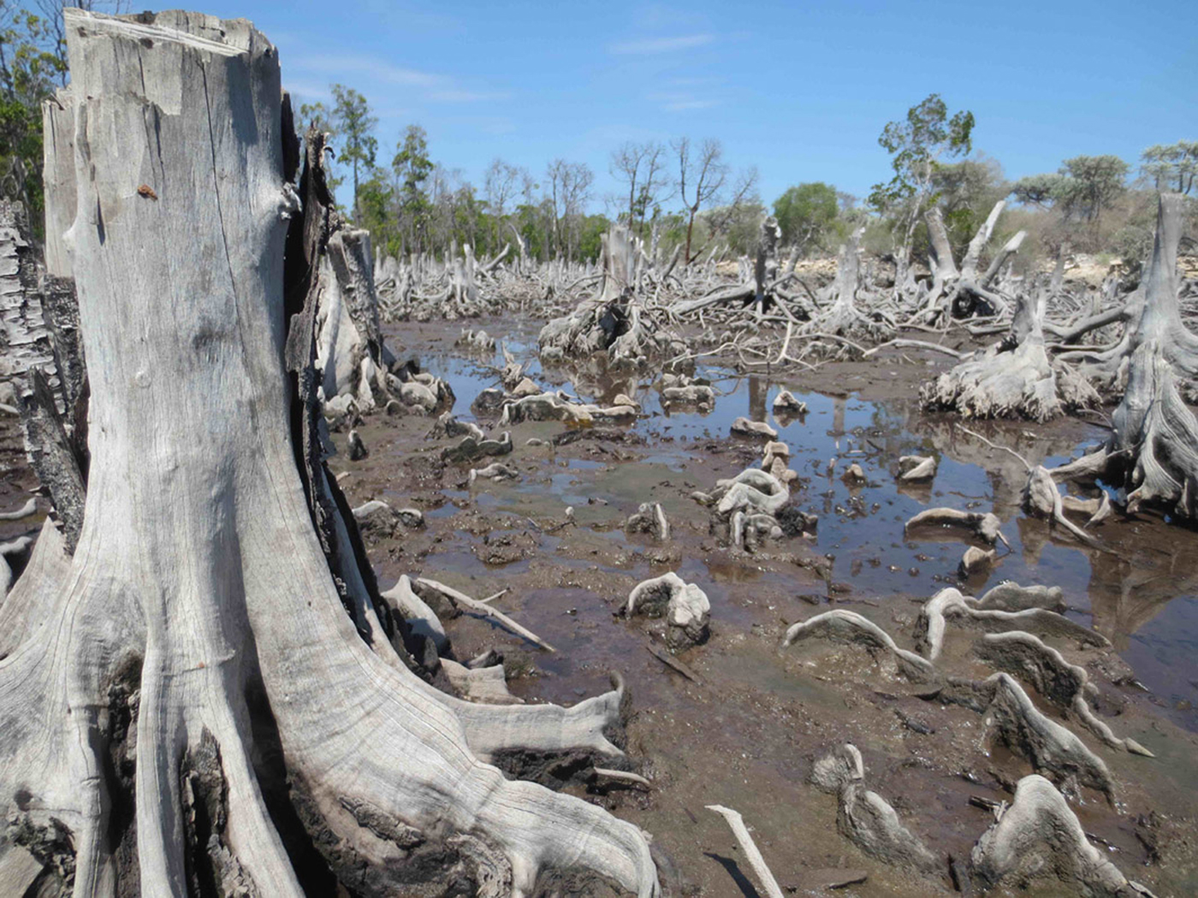
Mangroves
Issues:
Urbanisation
Contaminants
Climate change
Notes:
Image: https://www.cambridge.org/core/journals/oryx/article/rural-livelihoods-and-mangrove-degradation-in-southwest-madagascar-lime-production-as-an-emerging-threat/707766F7DCA65A5DAB58F88A7068479C

Slide 6
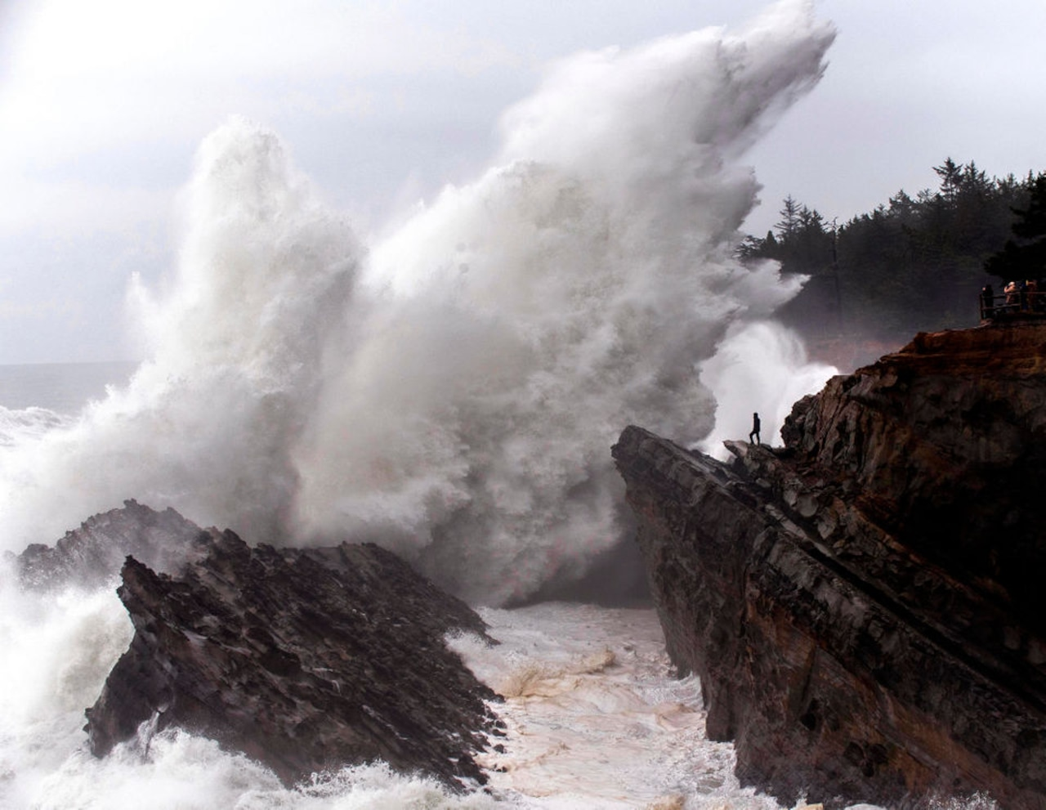
Rocky Shores
Issues:
Overharvesting
Climate change
(e.g. storm damage)
Notes:
Image: https://www.oregonlive.com/life-and-culture/erry-2018/12/b90cbbd2604531/10-awesome-storm-watching-spot.html

Slide 7
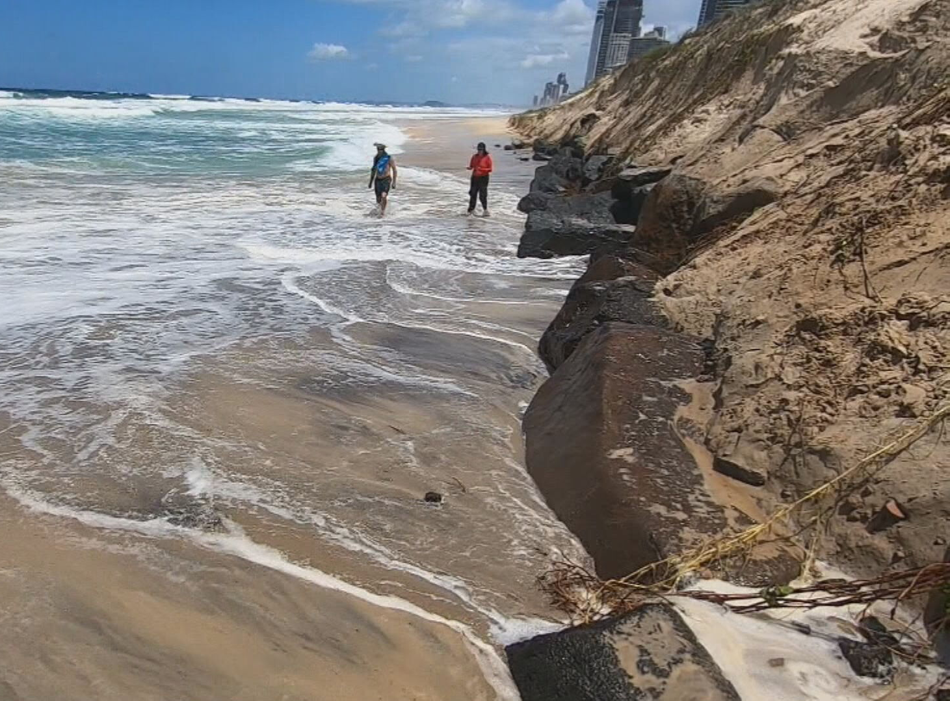
Sand Beaches
Issues:
Coastal Erosion
Overdevelopment
Sand budget interference
e.g. dredging
Notes:
Image: https://www.9news.com.au/national/queensland-weather-huge-waves-and-destructive-tides-see-mass-erosion-at-the-gold-coast/7110208d-78fe-4a1f-8471-78c01c75f3b9

Slide 8
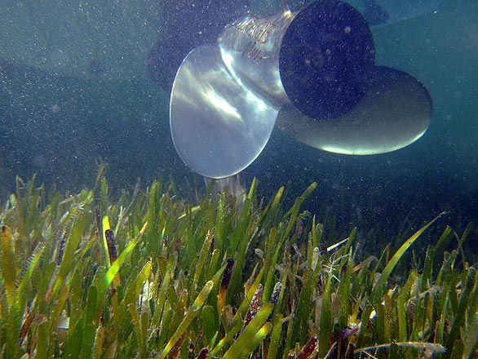
Seagrass meadows
Issues:
Sediment runoff
Nutrient runoff
Anchor damage
Notes:
Image: https://seagrassmeadow.weebly.com/threats.html

Slide 9
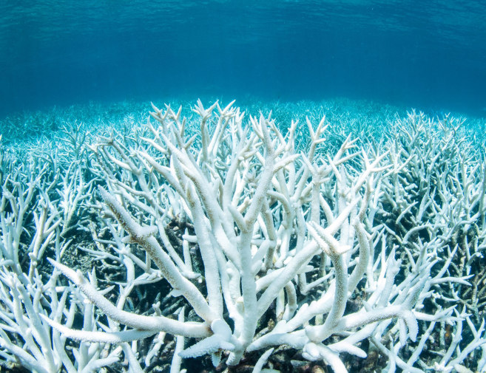
Coral Reefs
Issues:
Anchor damage
Climate change
Ocean acidification
Overfishing
Notes:
Image: https://www.nbcnews.com/science/environment/great-barrier-reef-hit-third-major-bleaching-event-five-years-n1166676

Slide 10
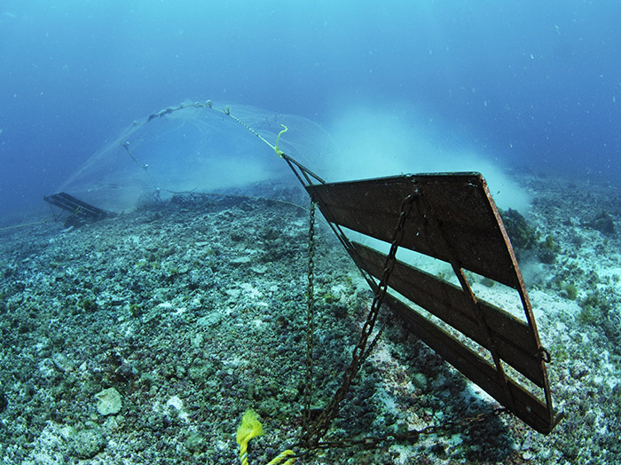
Deep Sea Ecosystems
Issues:
Overfishing
Damaging fishing methods
Notes:
Image: https://projectseahorse.org/limiting-fisheries/endbottomtrawling/acting-on-bottom-trawling/

Slide 11
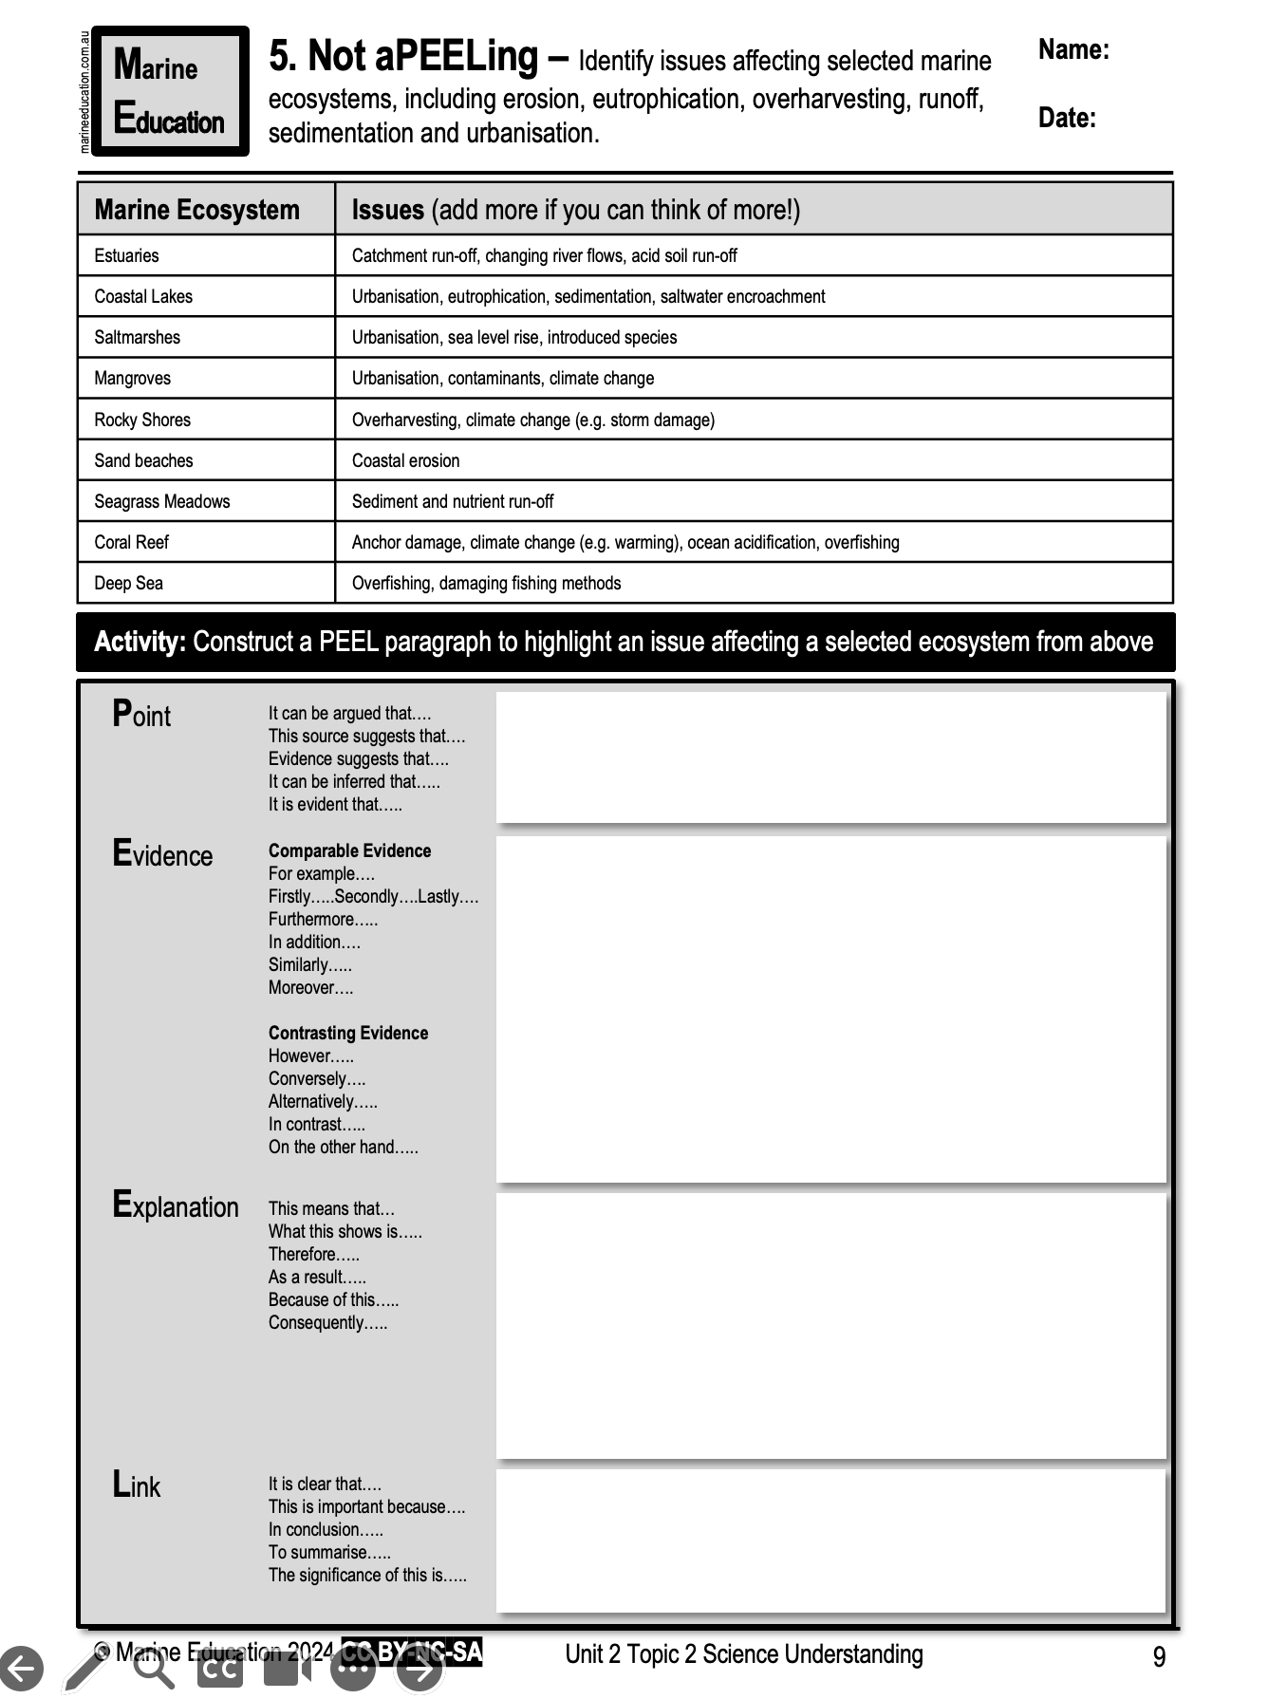
Learning Intention:
Identify issues affecting selected marine ecosystem, including erosion, eutrophication, overharvesting, runoff, sedimentation, urbanisation.
Success Criteria:
Complete Marine Education worksheet ‘5. Not aPEELing’
Notes:
Image: https://www.pbs.org/newshour/world/twitter-chat-greatest-threats-u-s-waters-fisheries

