Slide 1
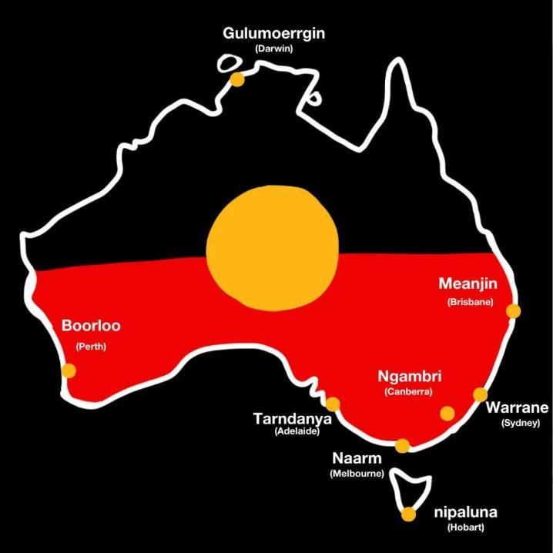
Illustration: Michelle Jackson
Learning Intention:
Recognise that in areas where marine management decisions reflect scientific, social, cultural and ethical considerations, Aboriginal knowledges and practices and Torres Strait Islander knowledges and practices related to sea country are often used to complement conservation practices.
Success Criteria:
Complete Marine Education worksheet ’14. TUMRAs’
Notes:
Image: https://www.pedestrian.tv/news/aboriginal-names-australian-cities/
A small selection of the commonly recognised Aboriginal names for major Australian cities. Illustration: Michelle Jackson.

Slide 2
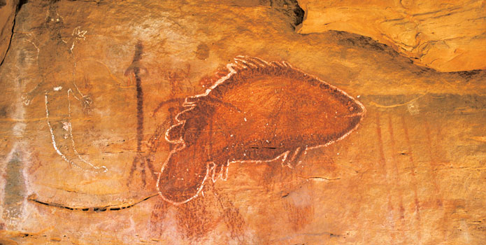
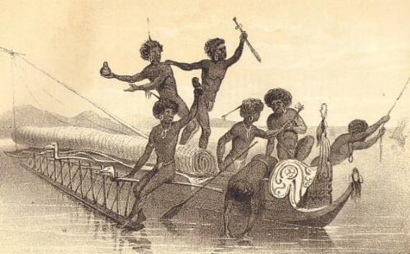
Aboriginal and Torres Strait Islander people are the
Traditional Owners of the Great Barrier Reef Region
Evidence of their sea country connections goes back over 60,000 years.
Today, approximately 70 Traditional Owner clan groups have Sea Country in the GBRMP.
Notes:
Quote: https://www.pc.gov.au/__data/assets/pdf_file/0020/209162/subdr093-fisheries-aquaculture-attachment.pdf (page 14)
Image (fish): https://japingkaaboriginalart.com/articles/kimberley-rock-art-traditional-owners-perspective/
Image (fishers): https://www.dailymail.co.uk/news/article-10562875/Astonishing-survival-stories-white-colonials-lived-happily-Aboriginals.html

Slide 3
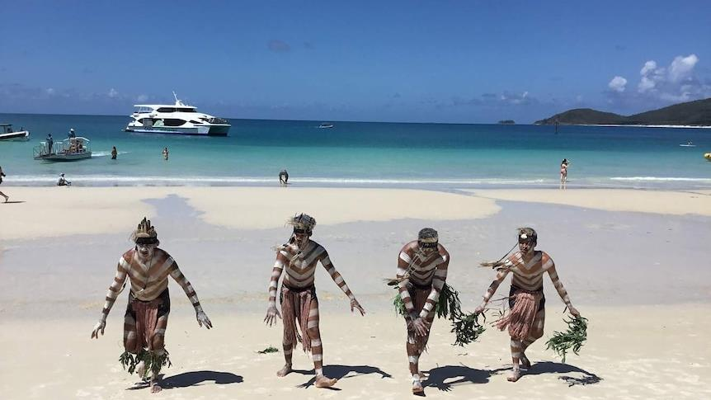
GBRMPA recognises that establishing an effective and meaningful partnership with Traditional Owners is essential to protect cultural and heritage values, conserve biodiversity and enhance the resilience of the GBR.
Notes:
Image: https://www.abc.net.au/news/2018-04-28/traditional-owners-capture-great-barrier-reef-creation-stories/9707068
The Warrior Descendance group from Gladstone performs at the Whitsundays on a cultural cruise. (Supplied: Kaylene Butler)

Slide 4
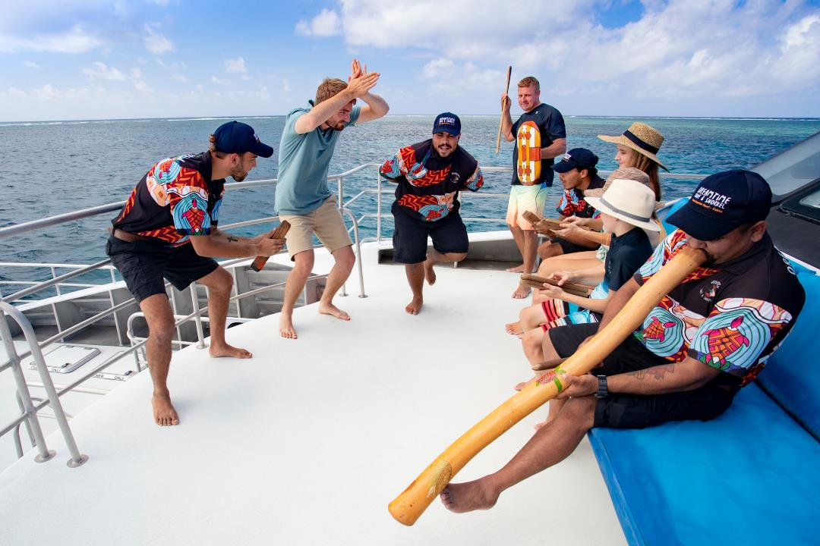
Dreamtime Dive & Snorkel, Great Barrier Reef, QLD © Tourism and Events Queensland
Notes:
Image: https://www.discoveraboriginalexperiences.com/article/drift-back-to-the-dreamtime-on-a-great-barrier-reef-cruise-with-a-difference/
Dreamtime Dive & Snorkel, Great Barrier Reef, QLD © Tourism and Events Queensland

Slide 5
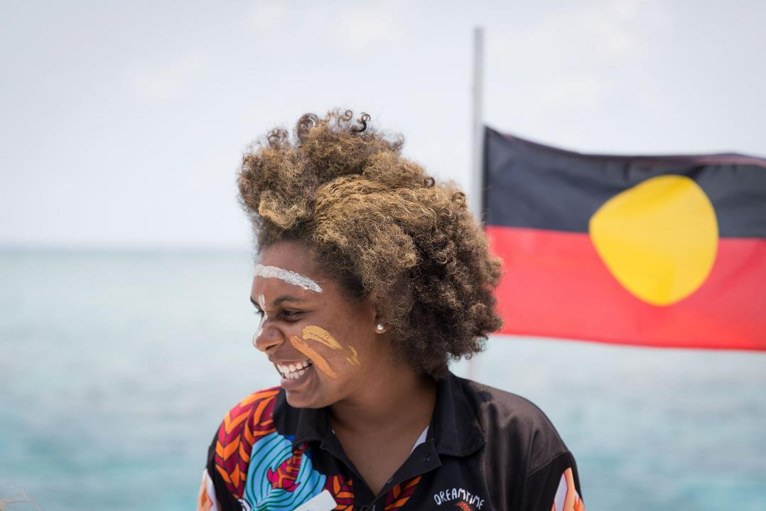
Crew from the Dreamtime Dive and Snorkel tour teach tourists about the significance of the Reef to the local Indigenous tribes.Photos: Shaney Hudson
Notes:
Image: https://adventure.com/great-barrier-reef-sustainable-indigenous-tourism/
Crew from the Dreamtime Dive and Snorkel tour teach tourists about the significance of the Reef to the local Indigenous tribes.Photos: Shaney Hudson

Slide 6
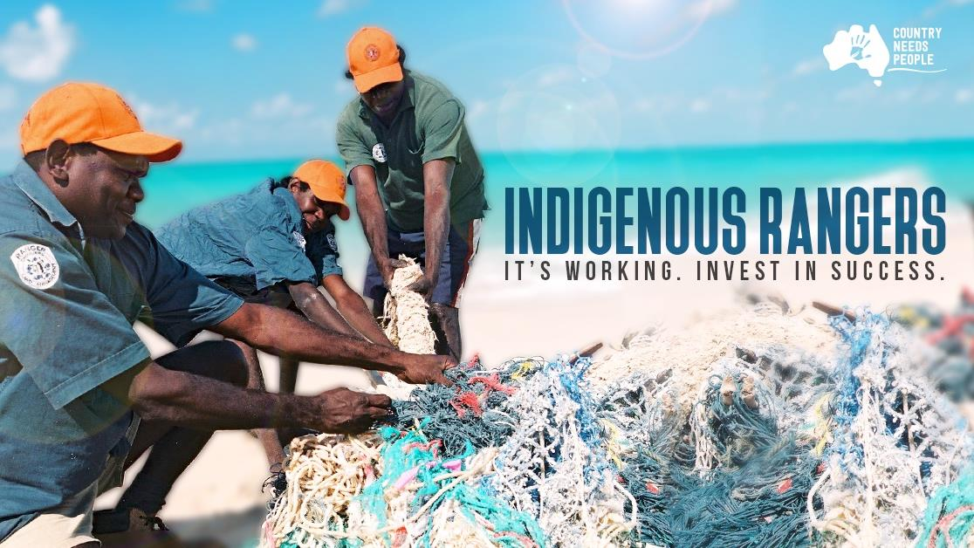
Notes:
Image: https://www.countryneedspeople.org.au/invest_in_success

Slide 7
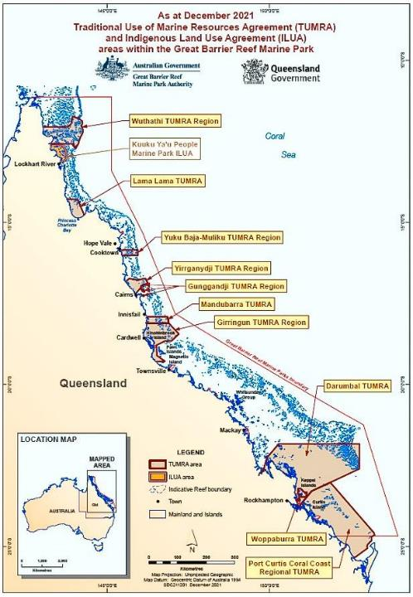
Traditional Use of Marine Resources Agreements (TUMRAs)
TUMRAs outline the rules allowed on Sea Country, such as fishing, collecting and hunting (protected turtles and dugongs) as well as caring for cultural and heritage sites.
These rules are negotiated between government and traditional owners (both have a say).
Notes:
Image: https://www2.gbrmpa.gov.au/learn/traditional-owners/traditional-use-marine-resources-agreements

Slide 8
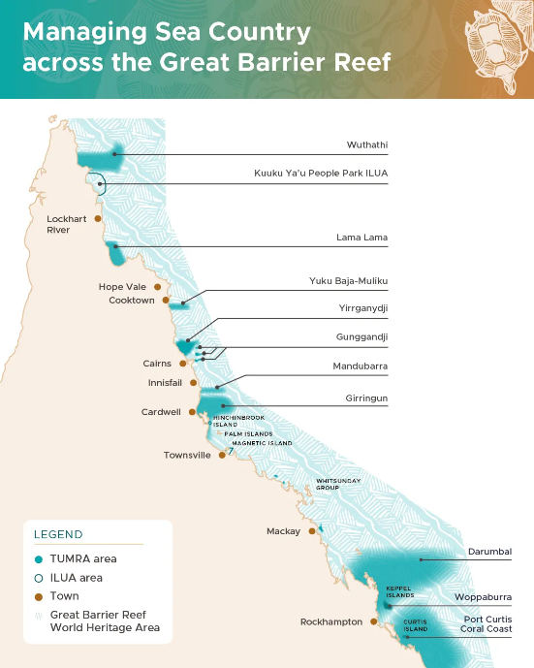
Click: https://www2.gbrmpa.gov.au/learn/traditional-owners/traditional-use-marine-resources-agreements
The following slides will further explore each TUMRA agreement
starting at the top of Queensland and working our way down.

Slide 9
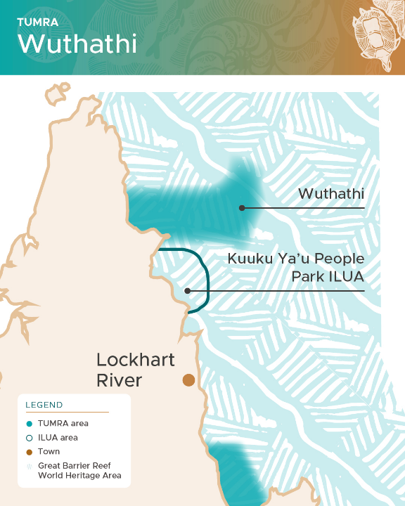
((Wuth-ath-ee)
Wuthathi Agreement

Slide 10
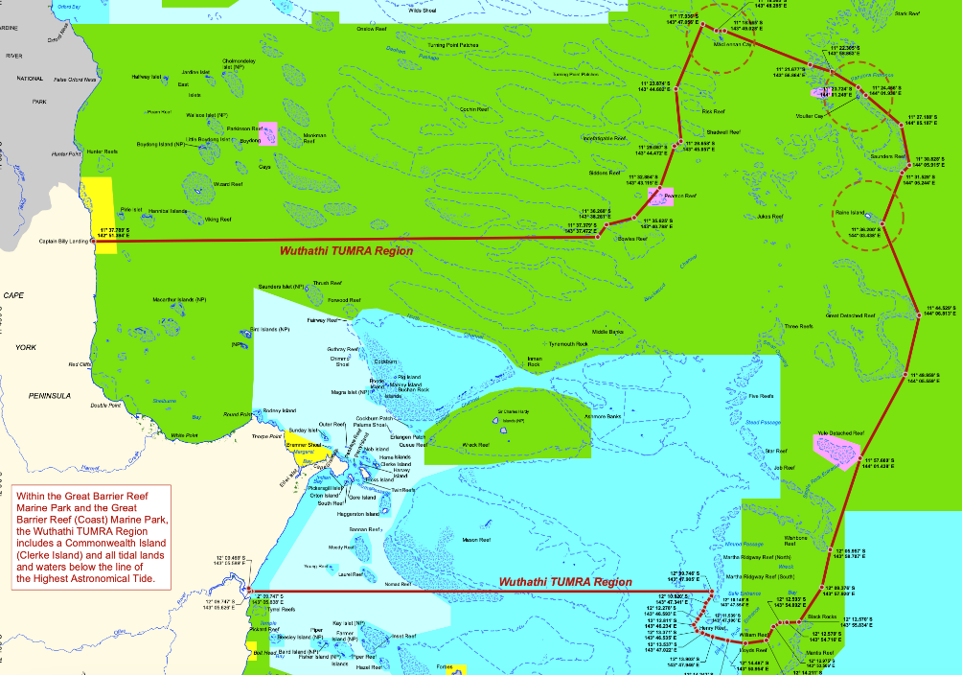
Extends all the way out to Raine Island (Thukuruu)
Notes:
Image: https://elibrary.gbrmpa.gov.au/jspui/handle/11017/965

Slide 11
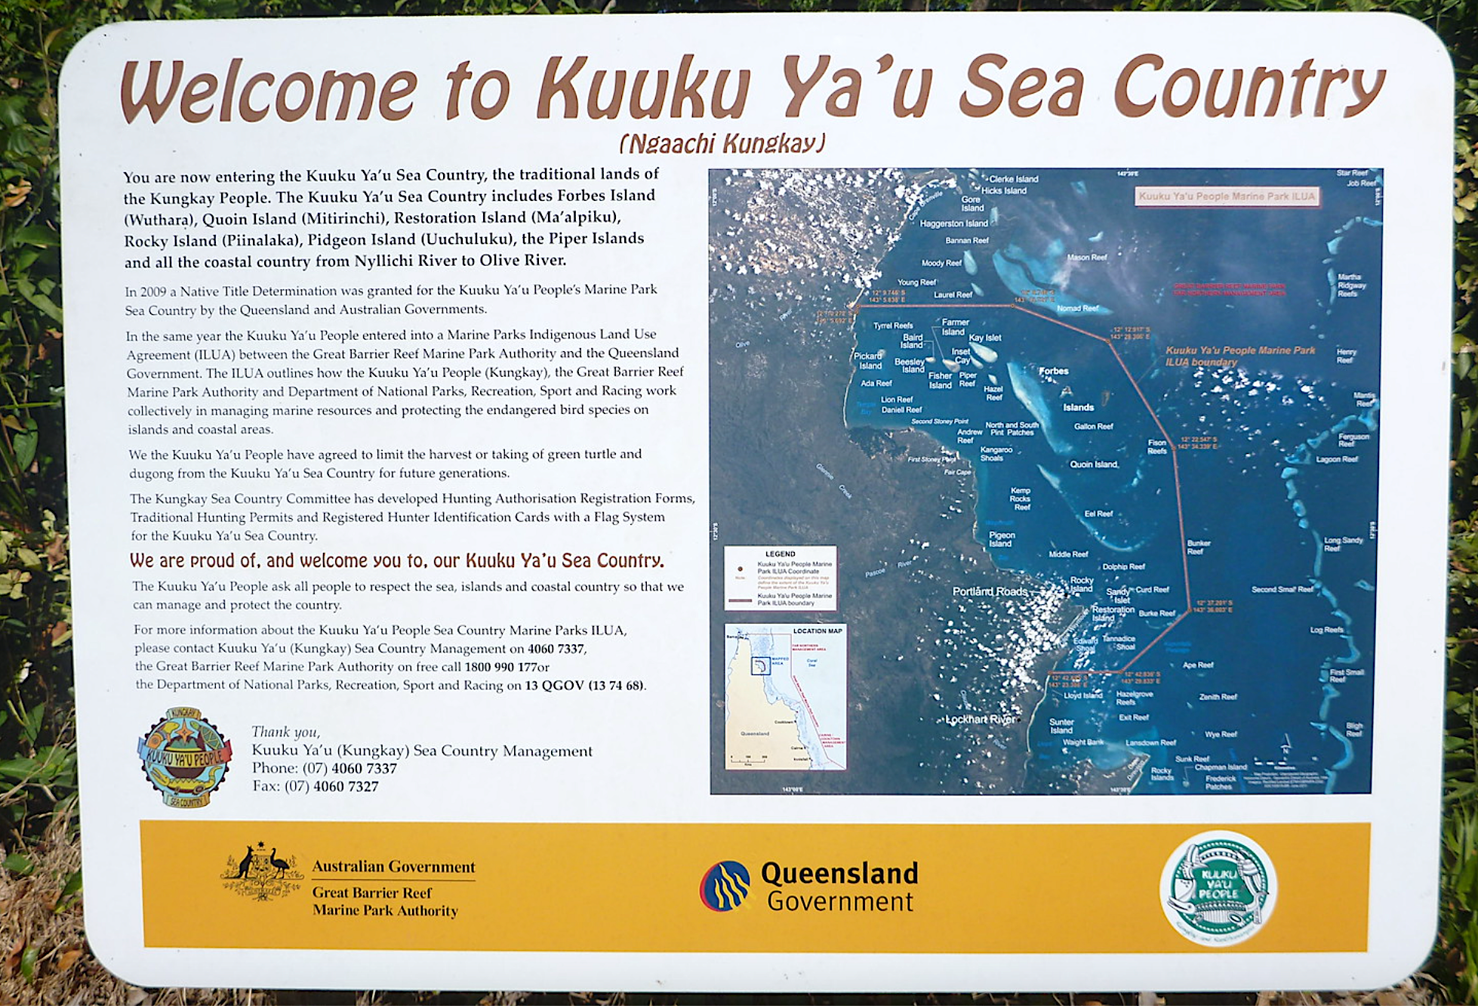
Notes:
Image: https://www.flickr.com/photos/dougbeckers/14753171262

Slide 12
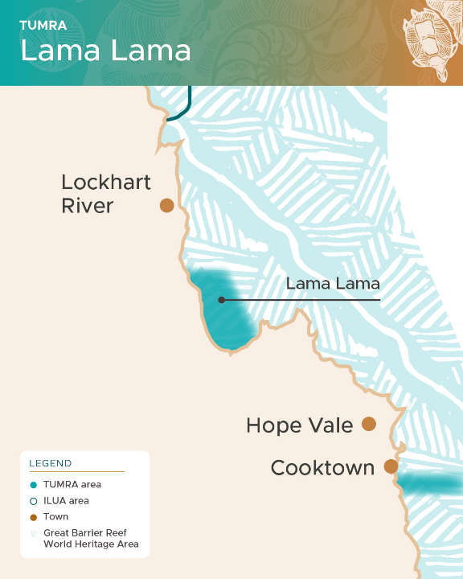
Lama Lama
(Lumma Lumma)
Agreement

Slide 13
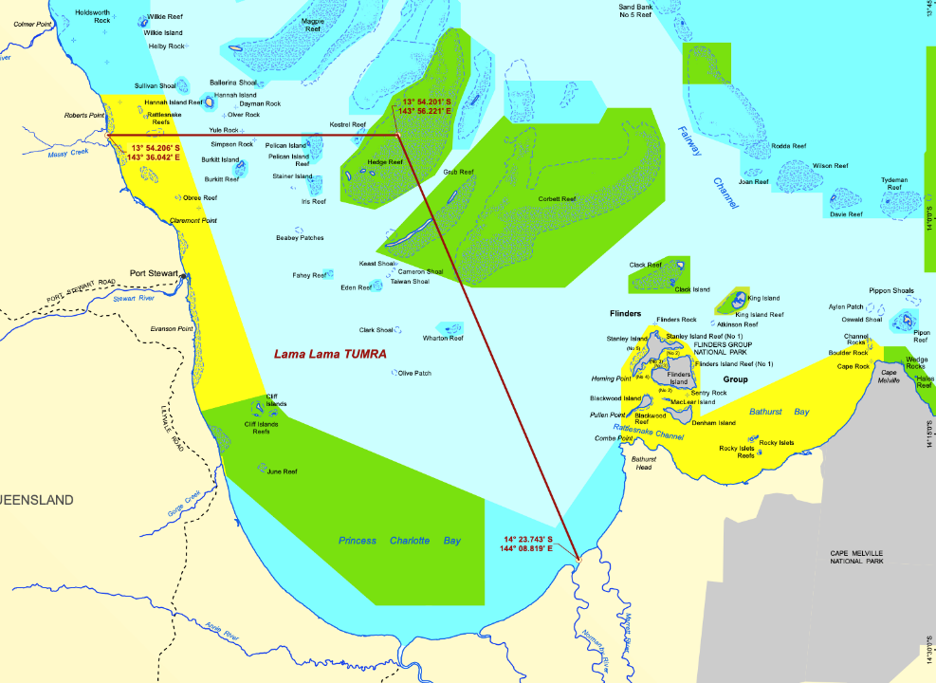
Extends through Princess Charlotte Bay

Slide 14
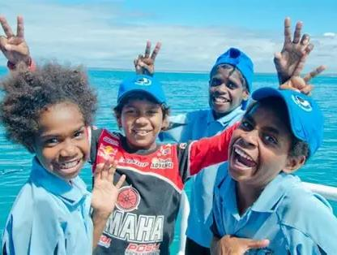
and has a Junior Rangers Program

Slide 15
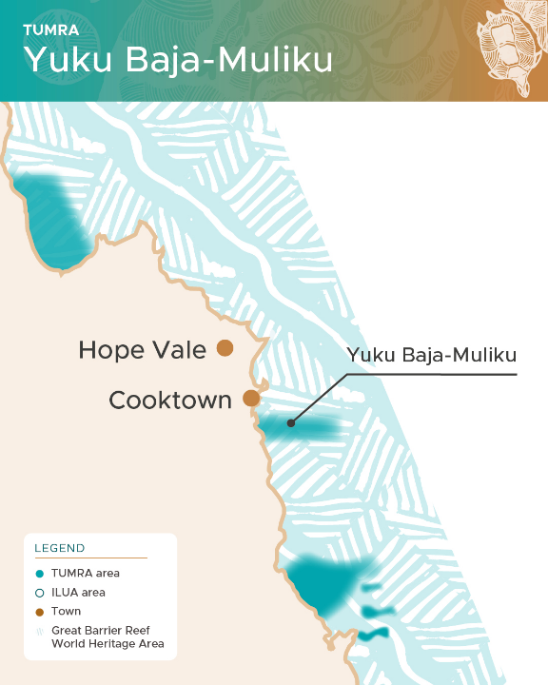
(Yu-ku Ba-jah Mul-i-ku)
Yuku-Baja-Muliku Agreement

Slide 16
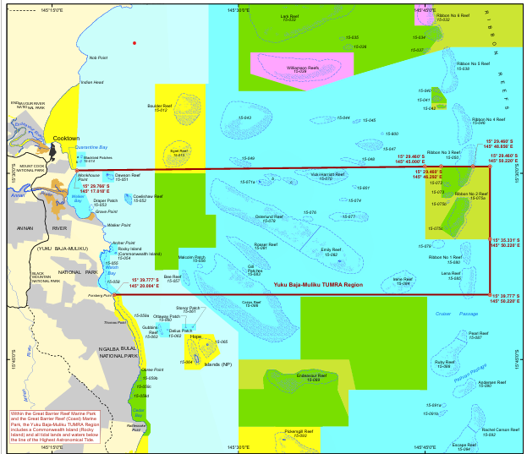
Sea country just south of Cooktown
(extending out past the Ribbon Reefs)

Slide 17
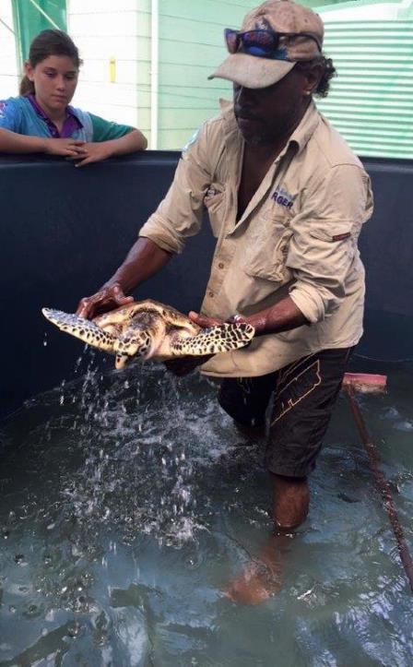
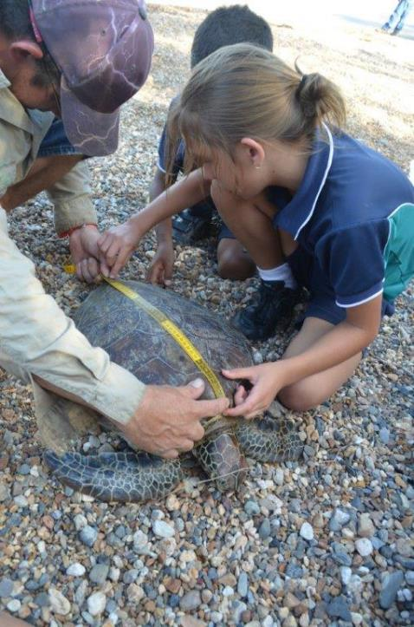
Includes a turtle rescue centre and comprehensive ranger program
Notes:
Image: https://www.archerpoint.com.au/turtle-rescue-and-rehabilition-centre/

Slide 18
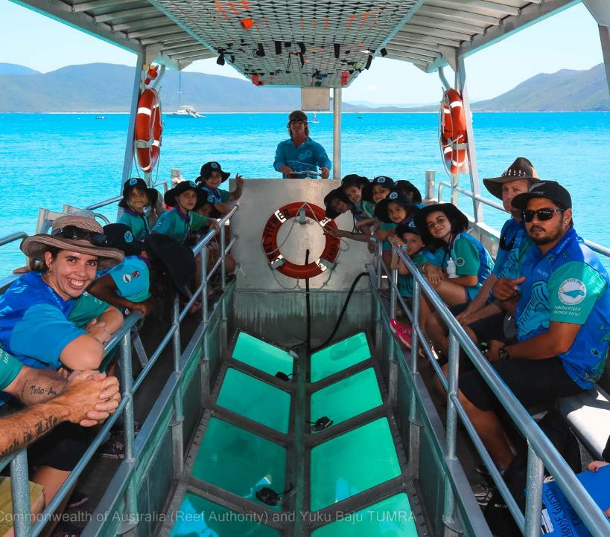
Rangers identify and monitor seagrass beds, develop visitor infrastructure, and manage pests, weeds, and fire.

Slide 19
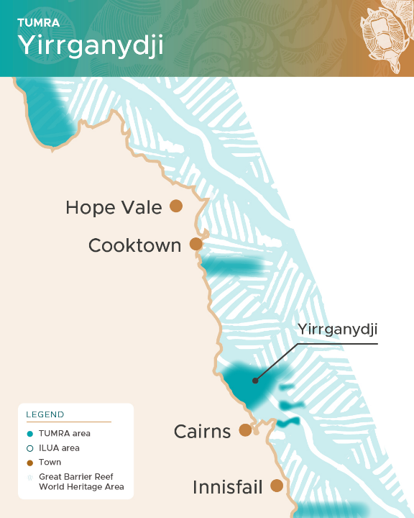
(Yirri-gand-jee)
Yirrganydji
Agreement

Slide 20
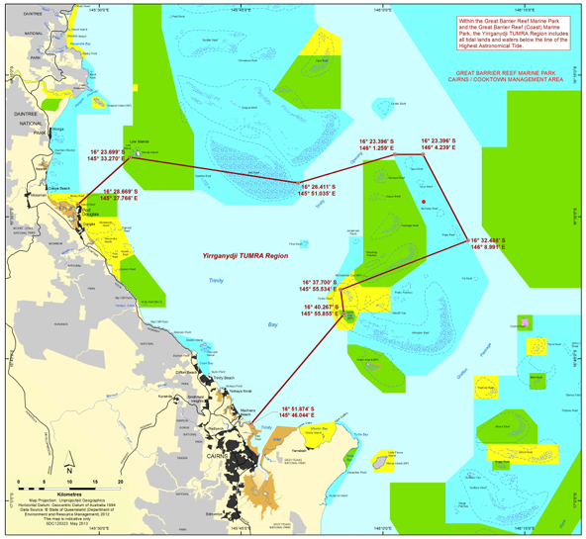
An area of sea country between Cairns and Port Douglas
Notes:
Image: https://elibrary.gbrmpa.gov.au/jspui/bitstream/11017/3936/1/gbrmpa-Yirrganydji-TUMRA-Region-Schedule-1.pdf

Slide 21
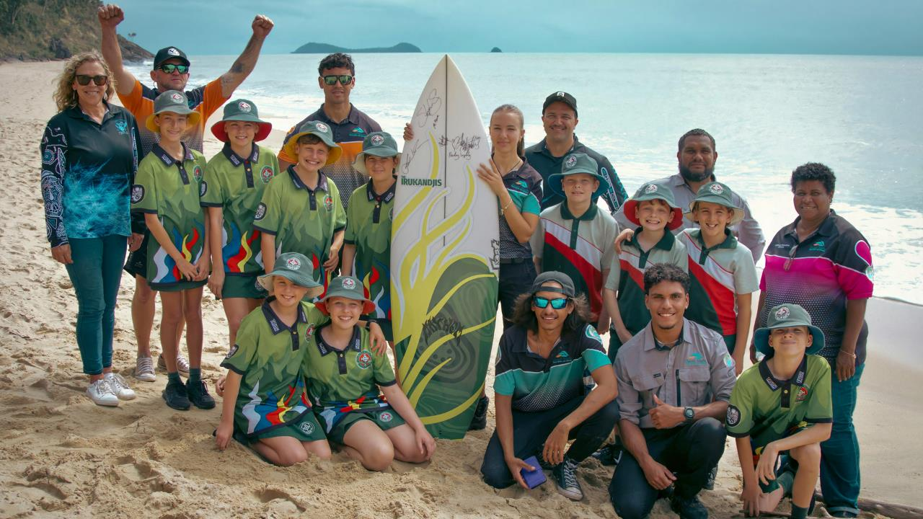
Yirrganydi are actively involved in Ranger programs, species monitoring, communication, and education
programs.
Notes:
Image: https://dawulwuru.com.au/projects/

Slide 22
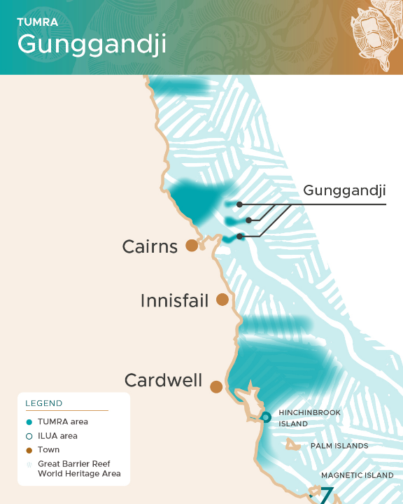
(Gun-gand-jee)
Gunggandji
Agreement

Slide 23
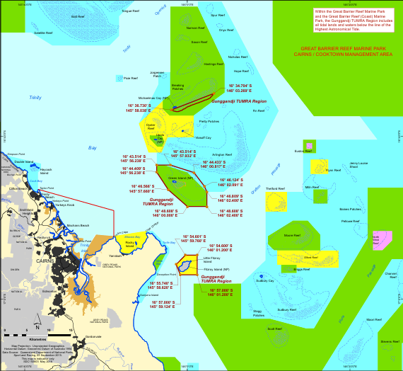
Includes Green Island, Michaelmas Cay and Fitzroy Island east of Cairns
Notes:
Image: https://elibrary.gbrmpa.gov.au/jspui/bitstream/11017/3936/1/gbrmpa-Yirrganydji-TUMRA-Region-Schedule-1.pdf

Slide 24
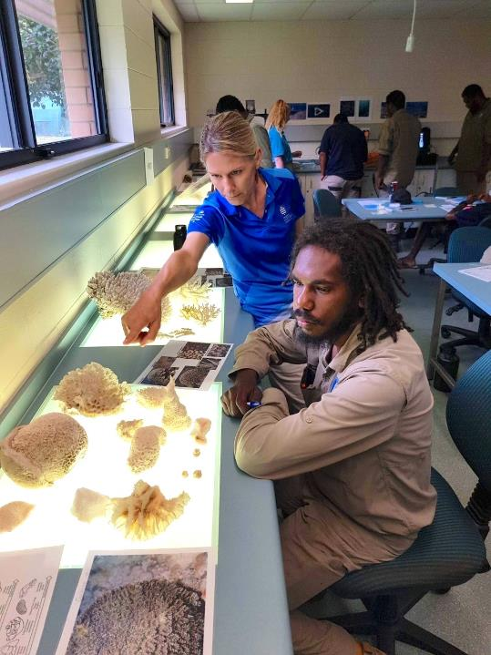
Gunggandjii-Mandingalbay Yindinji (GMY) Ranger Cadmas and Katie (TropWATER) identify corals in the Coral Habitat Workshop at James Cook University
Notes:
Image: https://www.qld.gov.au/environment/plants-animals/conservation/community/land-sea-rangers/rangers-make-a-difference/gunggandji-mandingalbay-yindinji-rangers

Slide 25
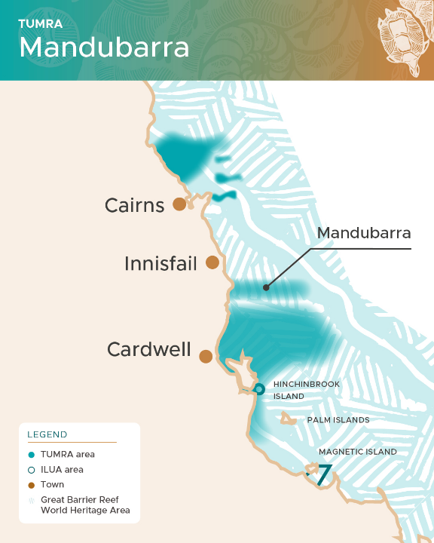
Mandubarra
Agreement

Slide 26
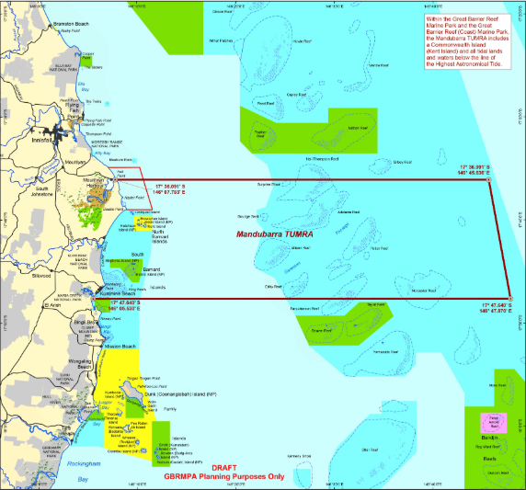
South of Innisfail, including North and South Barnard Islands, extending to the outer GBR.
Notes:
Image: https://elibrary.gbrmpa.gov.au/jspui/bitstream/11017/3936/1/gbrmpa-Yirrganydji-TUMRA-Region-Schedule-1.pdf

Slide 27
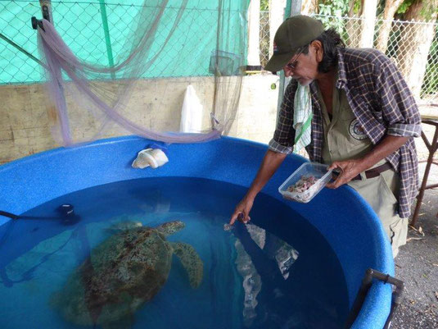
‘Sharon’ the Green Sea Turtle being fed squid in the Mandubarra sea turtle rehabilitation centre, Innisfail.
Notes:
Image: https://patspostcard.jimdofree.com/2016/07/31/innisfail-qld-mandubarra-aboriginal-land-and-sea-inc-turtle-rehabilitation/

Slide 28
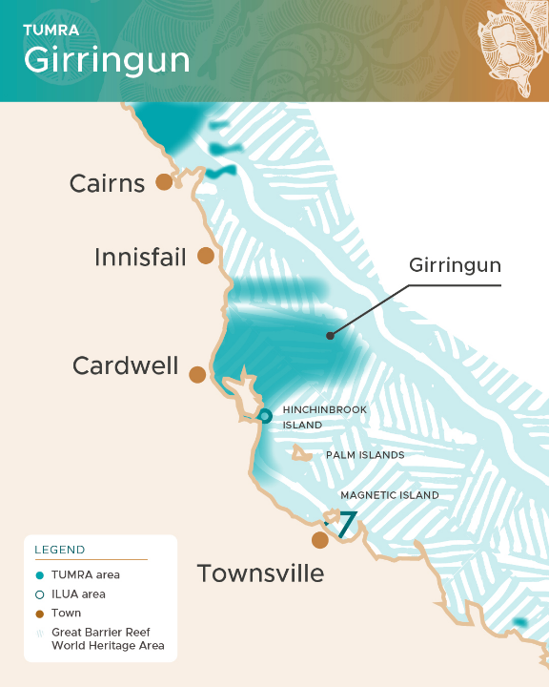
(Girrin-gun)
Girringun
Aboriginal Corporation
Agreement
Includes:
Djiru, Gulngay, Girramay, Bandjin, Warrgamay and Nywaigi

Slide 29
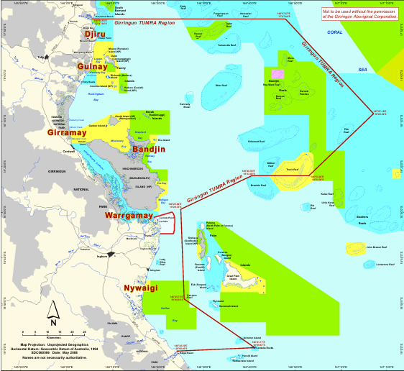
Located half-way between Townsville and Cairns, including Hinchinbrook Island
(not including Palm Islands)
Notes:
Image: https://www.girringun.com/_files/ugd/6b0ff6_9d3202ebf0654c15a6dc1e83f1b9ff8a.pdf

Slide 30
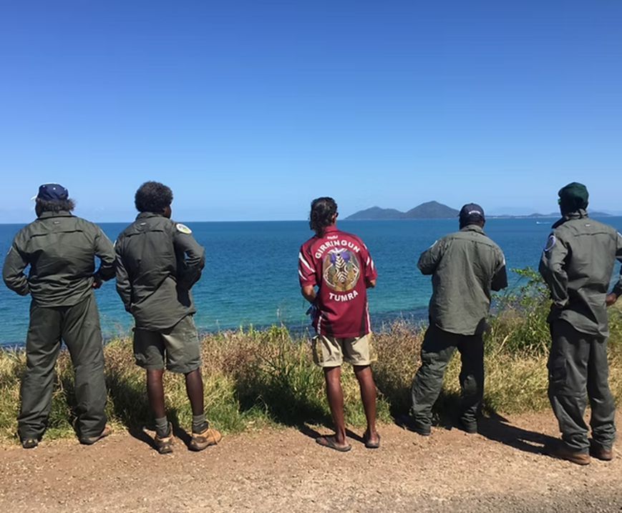
Girringun Aboriginal Rangers

Slide 31
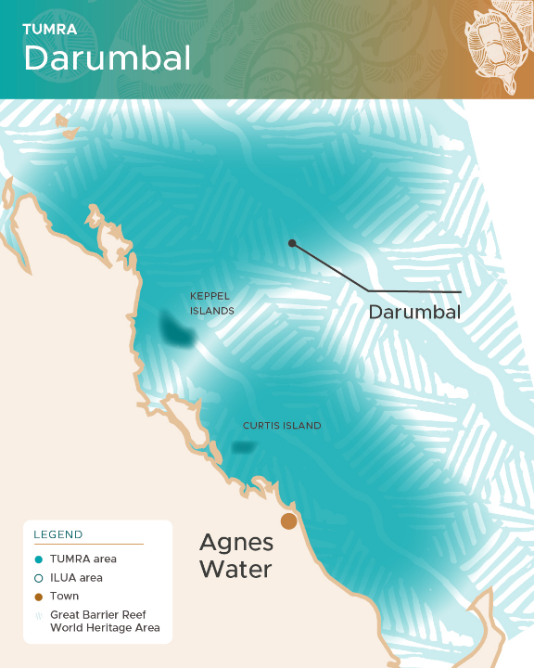
(Da-rum-bul)
Darumbal
Agreement

Slide 32
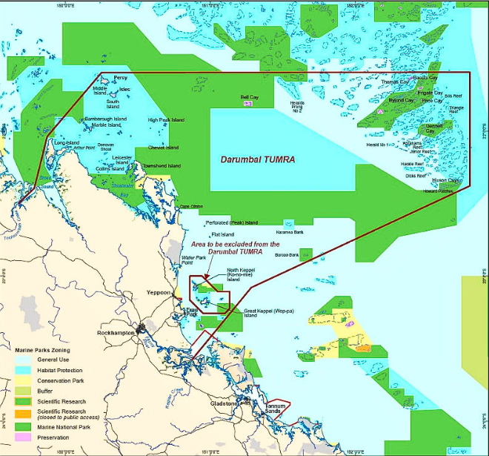
Rockhampton region out to Swains Reef
(not including the Keppel group)
Notes:
Image: https://www2.gbrmpa.gov.au/sites/default/files/inline-images/Commonwealth%20of%20Australia%20(Reef%20Authority)%20-%20%20Darumbal%20TUMRA%20Map%20(1%20of%201).jpg

Slide 33
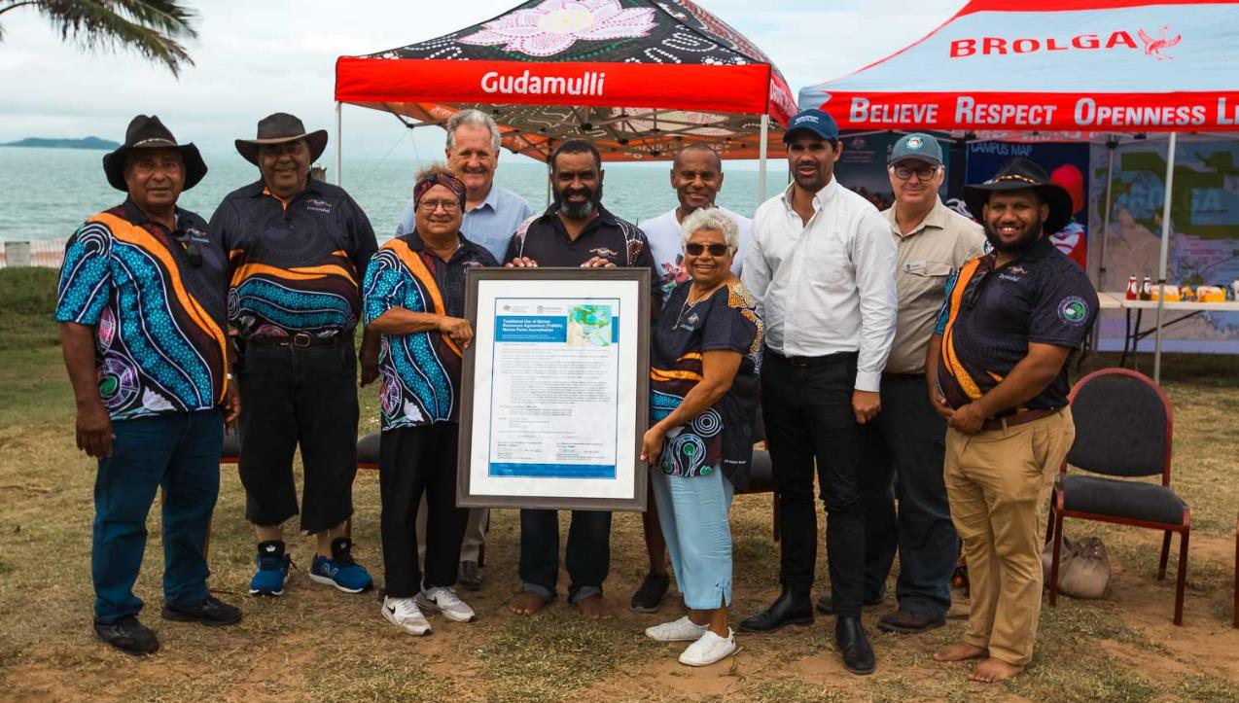

Slide 34
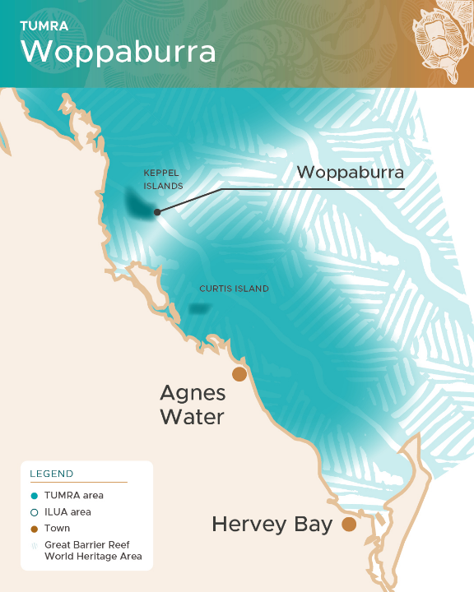
(Woppa-burra)
Woppaburra
Agreement

Slide 35
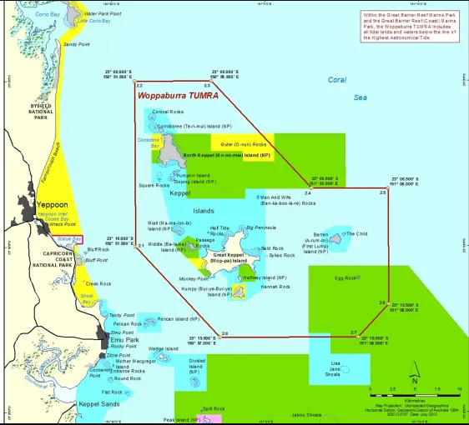
Keppel Islands only
(offshore Yeppoon)
Notes:
Image: https://elibrary.gbrmpa.gov.au/jspui/bitstream/11017/3936/1/gbrmpa-Yirrganydji-TUMRA-Region-Schedule-1.pdf

Slide 36
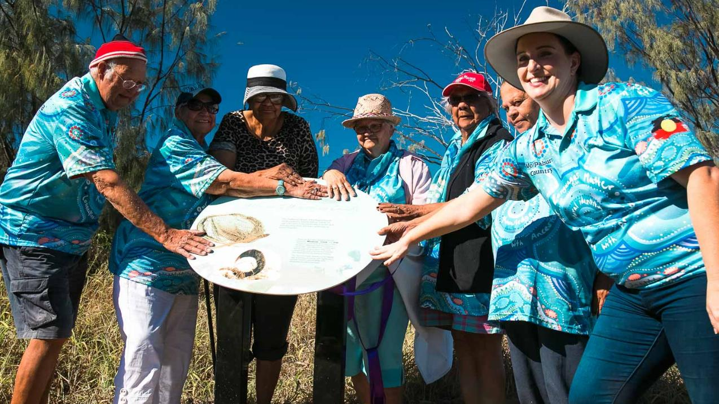

Slide 37
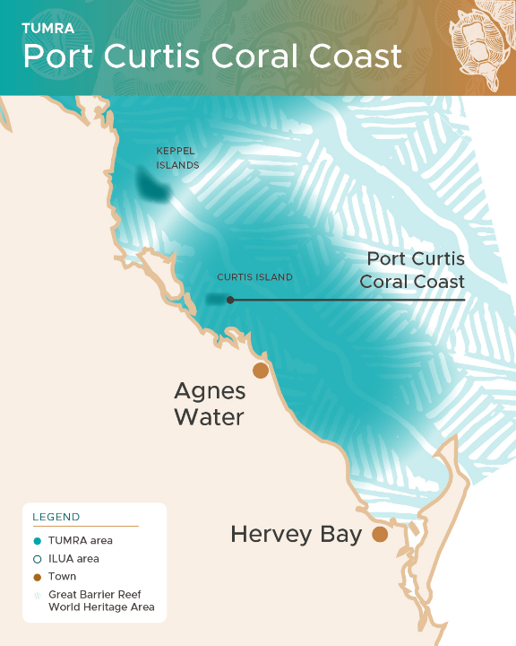
Port Curtis Coral Coast
Agreement
Includes Byelee, Gooreng Gorreng, Gurang, and Taribelang Bunda

Slide 38
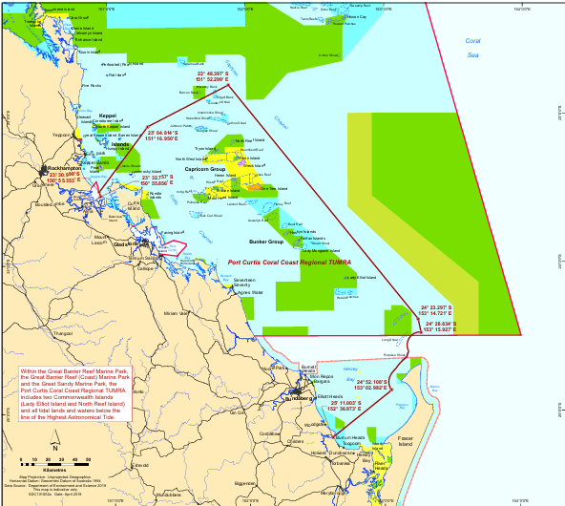
Gladstone to south of Bundaberg
(including Capricorn Bunker Group)
Notes:
Image: https://elibrary.gbrmpa.gov.au/jspui/bitstream/11017/3936/1/gbrmpa-Yirrganydji-TUMRA-Region-Schedule-1.pdf

Slide 39
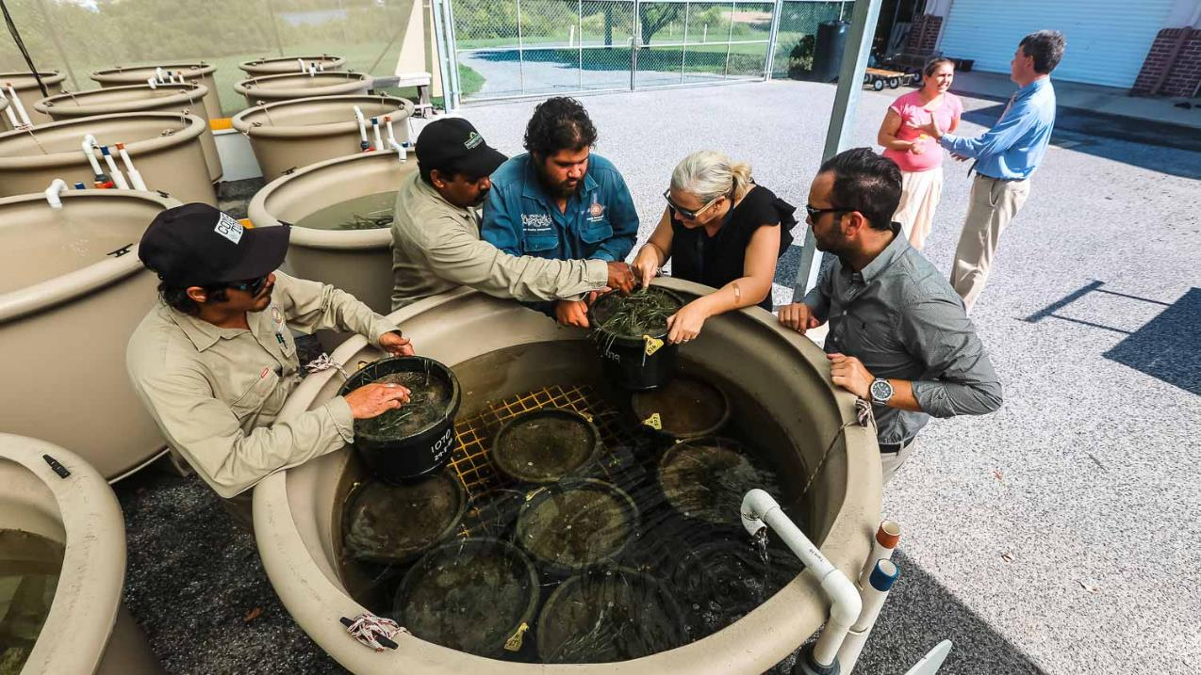

Slide 40

Illustration: Michelle Jackson
Learning Intention:
Recognise that in areas where marine management decisions reflect scientific, social, cultural and ethical considerations, Aboriginal knowledges and practices and Torres Strait Islander knowledges and practices related to sea country are often used to complement conservation practices.
Success Criteria:
Complete Marine Education worksheet ’14. TUMRAs’
Notes:
Image: https://www.pedestrian.tv/news/aboriginal-names-australian-cities/
A small selection of the commonly recognised Aboriginal names for major Australian cities. Illustration: Michelle Jackson.

