Slide 1
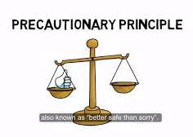
Learning Intention:
Explain the precautionary principle of the marine environmental planning and management process, and the requirements that marine protected area networks are comprehensive, adequate and representative.
Success Criteria:
Complete Marine Education worksheet
‘7. Proceed with Caution’
Notes:
Image:

Slide 2
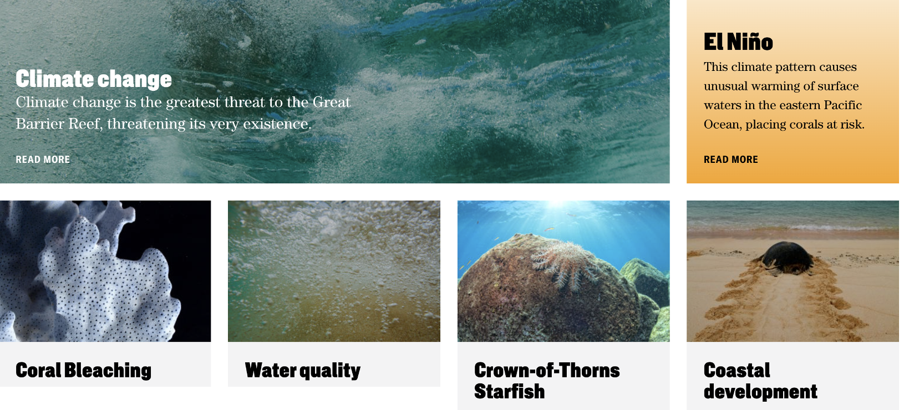
Threats to Marine Ecosystems
Notes:
Image: https://www.barrierreef.org/the-reef/threats

Slide 3

What will the future hold?
Notes:
Image: https://www.forbes.com/sites/sallypercy/2019/10/09/forget-your-crystal-ball-how-can-leaders-really-prepare-for-the-future/?sh=5ba0cace2122

Slide 4
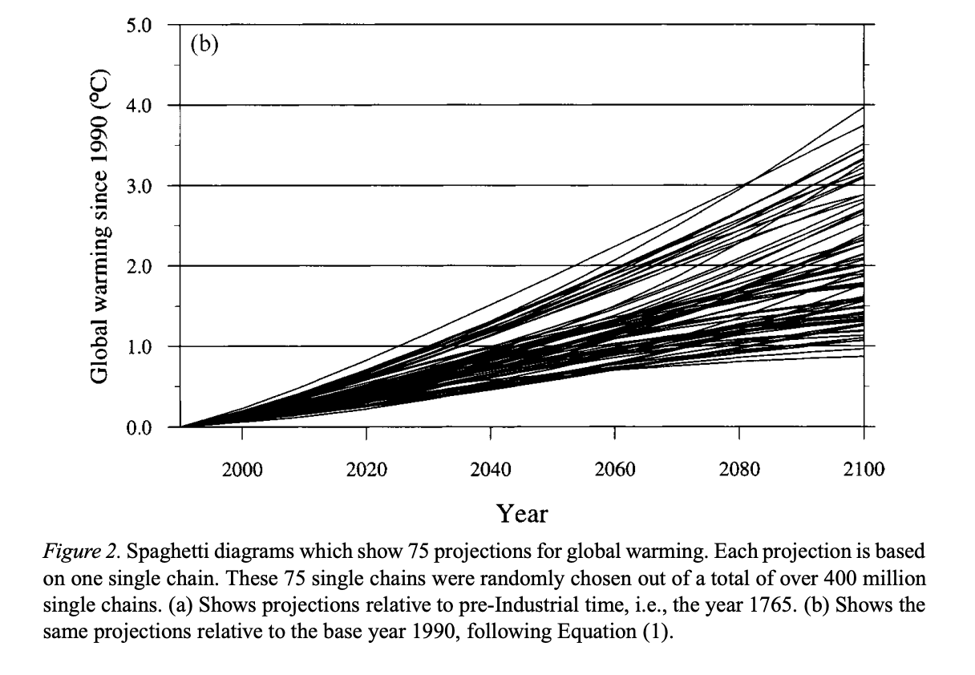
Which one will it be?
Image source: Visser, Hans & Folkert, R. & Hoekstra, Jeljer & Wolff, J.. (2000). Identifying Key Sources of Uncertainty in Climate Change Projections. Climatic Change. 45. 421-457. 10.1023/A:1005516020996.
Notes:
Image: Visser, Hans & Folkert, R. & Hoekstra, Jeljer & Wolff, J.. (2000). Identifying Key Sources of Uncertainty in Climate Change Projections. Climatic Change. 45. 421-457. 10.1023/A:1005516020996.

Slide 5

Picture a courtroom in 2100
You knew the threats. Why didn’t you do anything about it?
We didn’t have enough scientific certainty
at the time.
Future generations suing for damages to Earth
Government representative from 2023

Slide 6
“Where there are threats of serious or irreversible damage, lack of full scientific certainty shall not be used as a reason for postponing cost-effective measures to prevent environmental degradation”.
The precautionary principle.

Slide 7

The intent of the Precautionary Principle is clearly to
NOT allow the lack of (scientific) certainty to be used to prevent action that should be taken against threats of serious or irreversible damage.
The precautionary principle!
MPA approved!

Slide 8
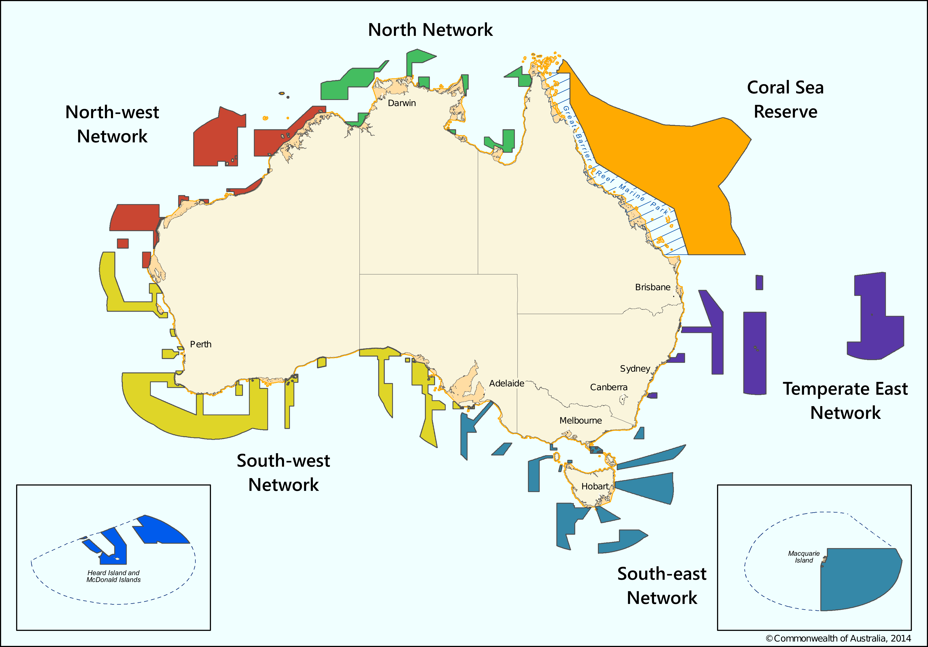

The precautionary principle gave the green light for governments in Australia to declare more areas of ocean as Marine Protected Areas (MPAs)
Notes:
Image; https://en.wikivoyage.org/wiki/Marine_parks_in_Australia

Slide 9
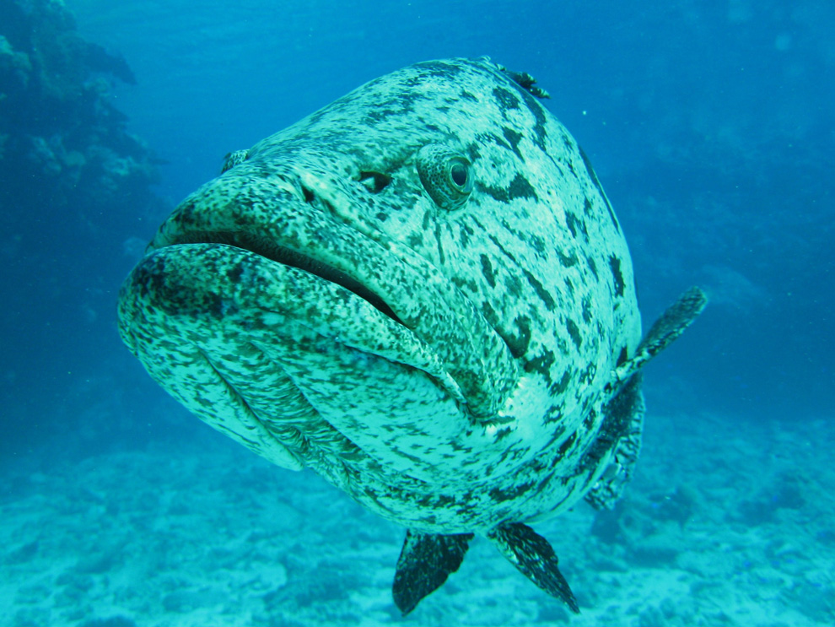
Thank you!
Because Marine Protected Areas (MPAs)
offer protection from threats to marine ecosystems
Notes:
Image: https://education.nationalgeographic.org/resource/no-take-zone/

Slide 10

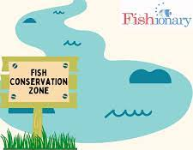
Importantly, MPAs must be comprehensive, adequate and representative to be effective.
Otherwise they just become ‘paper parks’
a.k.a. as good as the paper they’re written on (not worth much)
Notes:
Image (left): https://www.youtube.com/watch?v=2bkvVpEDYyU
Image (right): https://www.facebook.com/AmericanFisheriesSociety/photos/a.231471047019109/1877427189090145/?type=3

Slide 11




The precautionary principle was historically used to legally justify the development of more MPAs in Australia.
The Australian government even tweeked the definition a little, specifically for the implementation of the National Representative System of Marine Protected Areas (NRSMPA). The (new) definition states that…
“…the absence of scientific certainty should not be a reason for postponing measures to establish MPAs to protect representative ecosystems”
Reef Authority logo

Slide 12
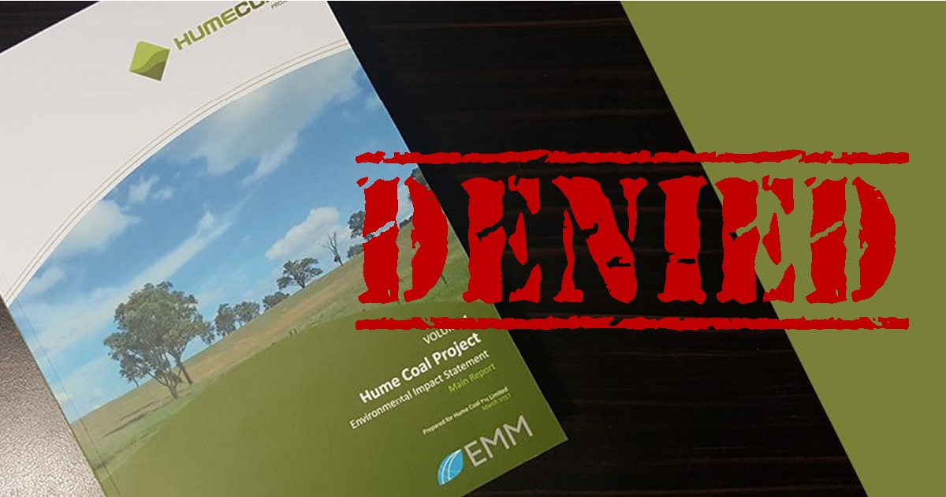
References to the precautionary principle have since been incorporated into many laws and policies including fisheries legislation, management of the Great Barrier Reef, rules governing the grant of development approvals, and other natural resource management policies.
Notes:
Info: https://www.pc.gov.au/research/supporting/precaution/precaution.pdf
Image (right): https://www.solarquotes.com.au/blog/hume-coal-denied-mb2139/

Slide 13
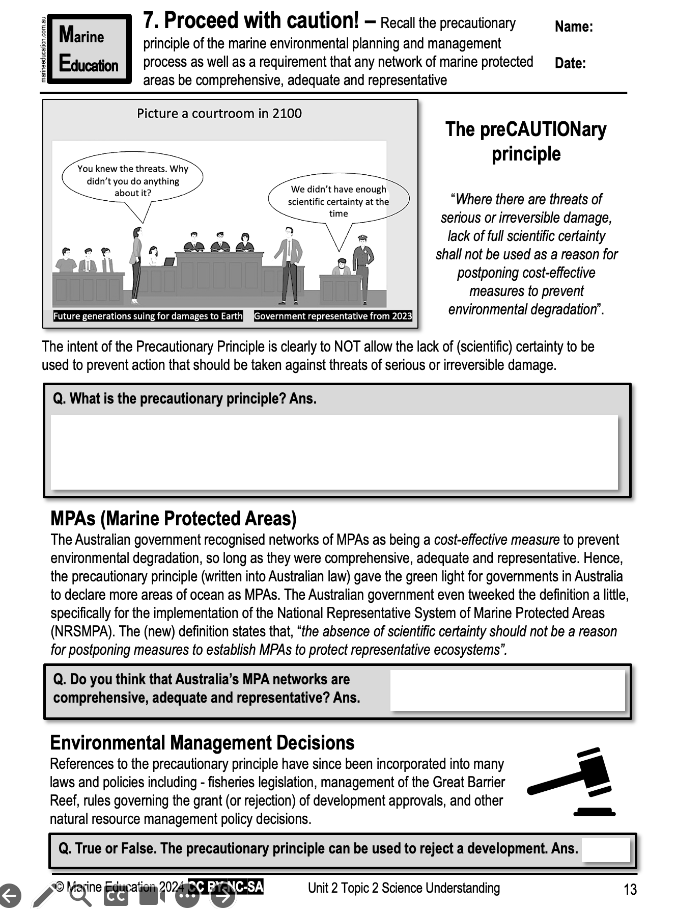
Learning Intention:
Explain the precautionary principle of the marine environmental planning and management process, and the requirements that marine protected area networks are comprehensive, adequate and representative.
Success Criteria:
Complete Marine Education worksheet
‘7. Proceed with Caution’
Notes:
Image:

