Slide 1
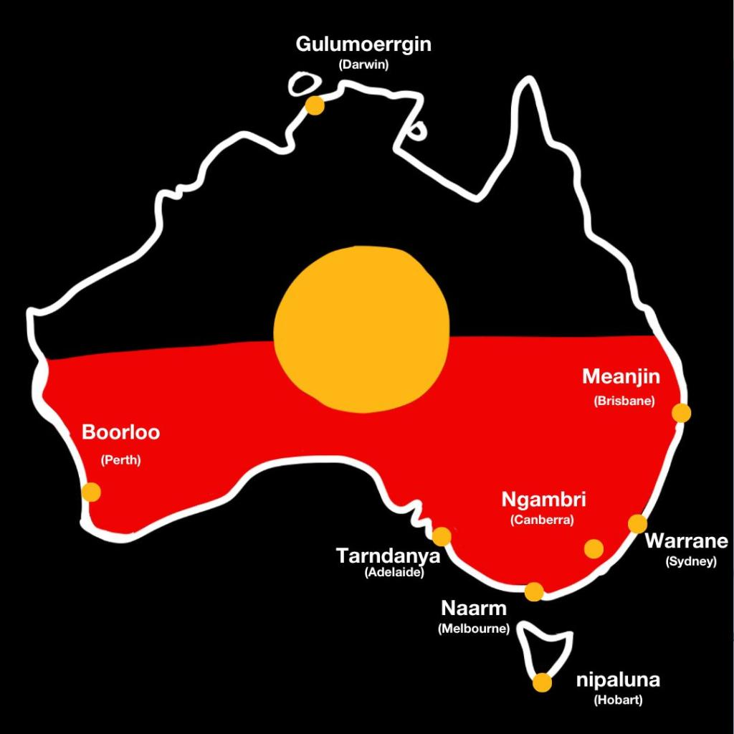
Illustration: Michelle Jackson
Learning Intention:
Recognise that in areas where marine management decisions reflect scientific, social, cultural and ethical considerations, Aboriginal knowledges and practices and Torres Strait Islander knowledges and practices related to sea country are often used to complement conservation practices.
Success Criteria:
Complete Marine Education worksheet ’14. TUMRAs’
Notes:
Image: https://www.pedestrian.tv/news/aboriginal-names-australian-cities/
A small selection of the commonly recognised Aboriginal names for major Australian cities. Illustration: Michelle Jackson.

Slide 2
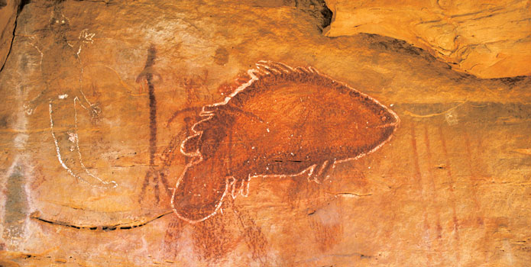
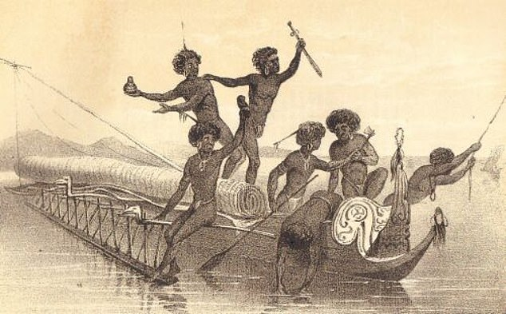
Aboriginal and Torres Strait Islander people are the
Traditional Owners of the Great Barrier Reef Region
Evidence of their sea country connections goes back over 60,000 years.
Today, approximately 70 Traditional Owner clan groups have Sea Country in the GBRMP.
Notes:
Quote: https://www.pc.gov.au/__data/assets/pdf_file/0020/209162/subdr093-fisheries-aquaculture-attachment.pdf (page 14)
Image (fish): https://japingkaaboriginalart.com/articles/kimberley-rock-art-traditional-owners-perspective/
Image (fishers): https://www.dailymail.co.uk/news/article-10562875/Astonishing-survival-stories-white-colonials-lived-happily-Aboriginals.html

Slide 3
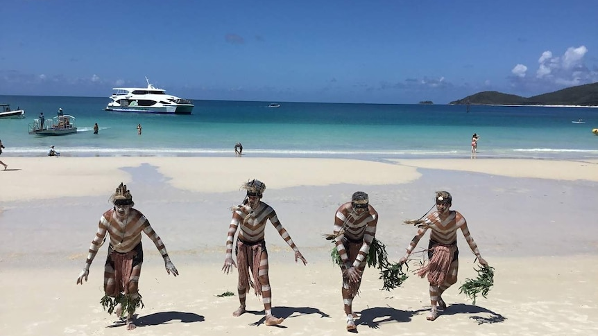
GBRMPA recognises that establishing an effective and meaningful partnership with Traditional Owners is essential to protect cultural and heritage values, conserve biodiversity and enhance the resilience of the GBR.
Notes:
Image: https://www.abc.net.au/news/2018-04-28/traditional-owners-capture-great-barrier-reef-creation-stories/9707068
The Warrior Descendance group from Gladstone performs at the Whitsundays on a cultural cruise. (Supplied: Kaylene Butler)

Slide 4
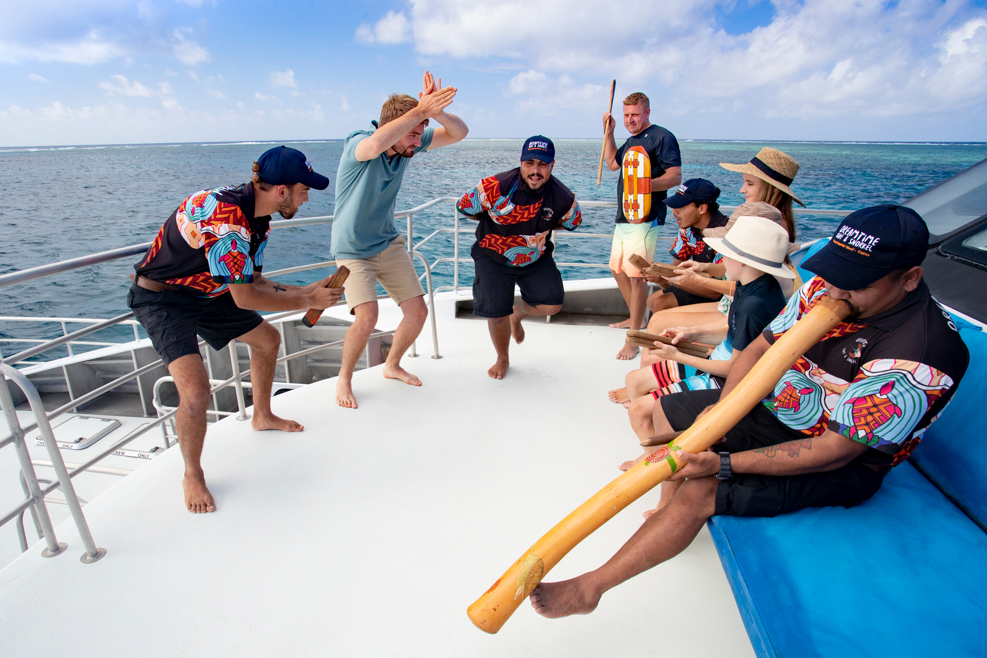
Dreamtime Dive & Snorkel, Great Barrier Reef, QLD © Tourism and Events Queensland
Notes:
Image: https://www.discoveraboriginalexperiences.com/article/drift-back-to-the-dreamtime-on-a-great-barrier-reef-cruise-with-a-difference/
Dreamtime Dive & Snorkel, Great Barrier Reef, QLD © Tourism and Events Queensland

Slide 5
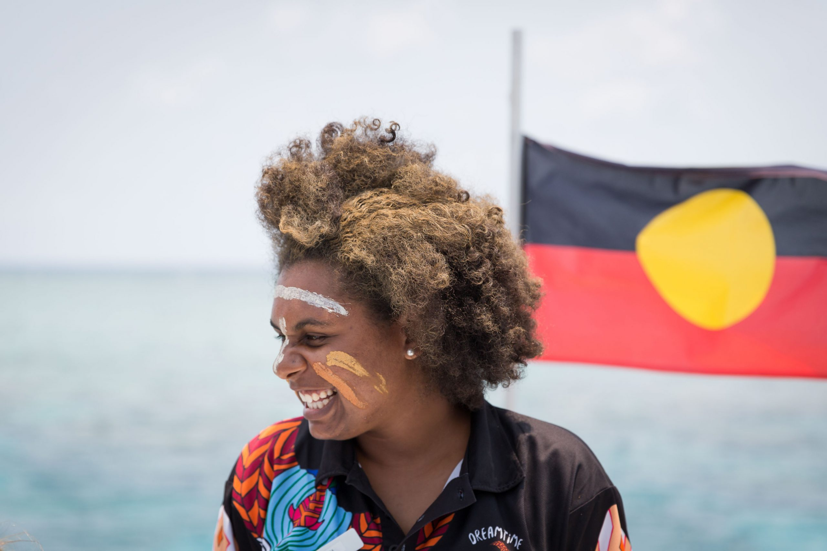
Crew from the Dreamtime Dive and Snorkel tour teach tourists about the significance of the Reef to the local Indigenous tribes.Photos: Shaney Hudson
Notes:
Image: https://adventure.com/great-barrier-reef-sustainable-indigenous-tourism/
Crew from the Dreamtime Dive and Snorkel tour teach tourists about the significance of the Reef to the local Indigenous tribes.Photos: Shaney Hudson

Slide 6
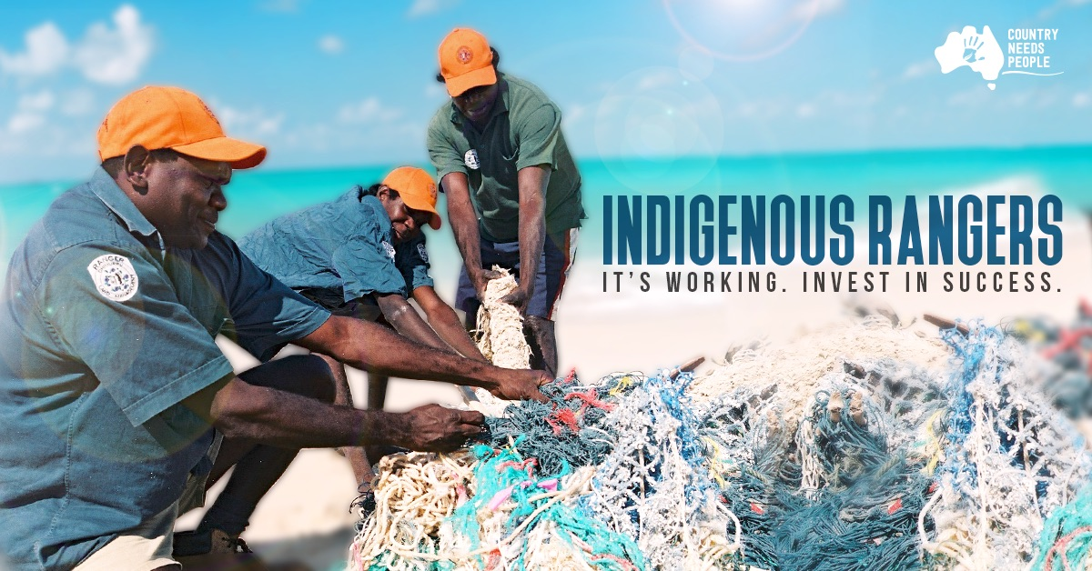
Notes:
Image: https://www.countryneedspeople.org.au/invest_in_success

Slide 7
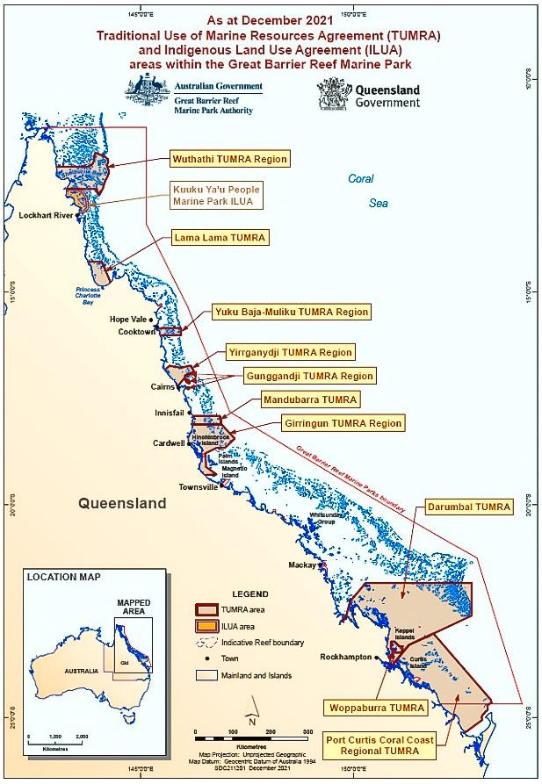
Traditional Use of Marine Resources Agreements (TUMRAs)
TUMRAs outline the rules allowed on Sea Country, such as fishing, collecting and hunting (protected turtles and dugongs) as well as caring for cultural and heritage sites.
These rules are negotiated between government and traditional owners (both have a say).
Notes:
Image: https://www2.gbrmpa.gov.au/learn/traditional-owners/traditional-use-marine-resources-agreements

Slide 8
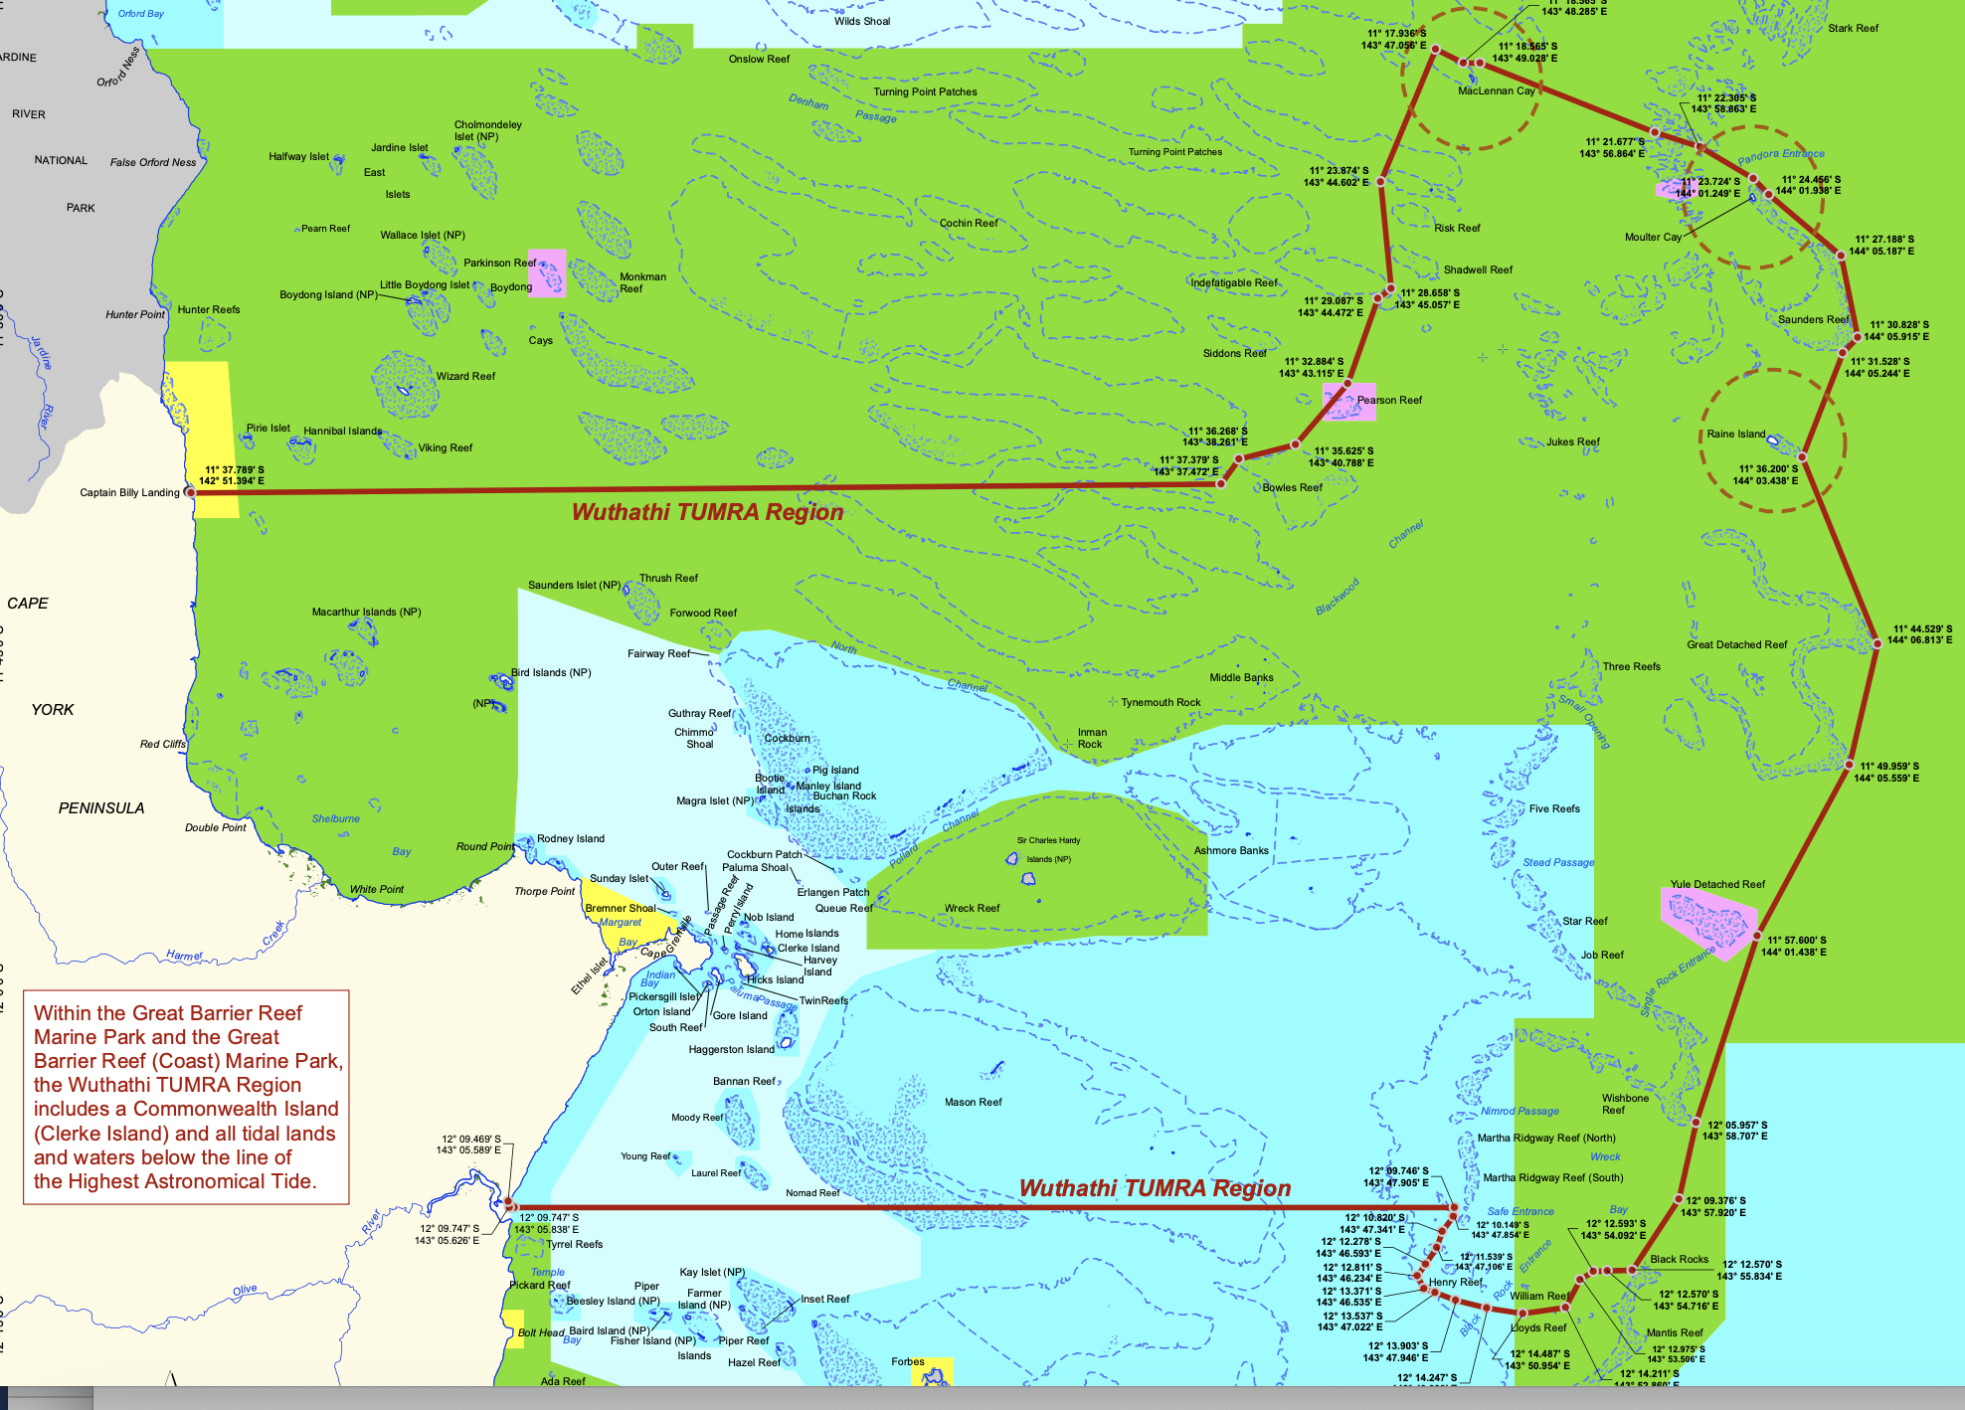
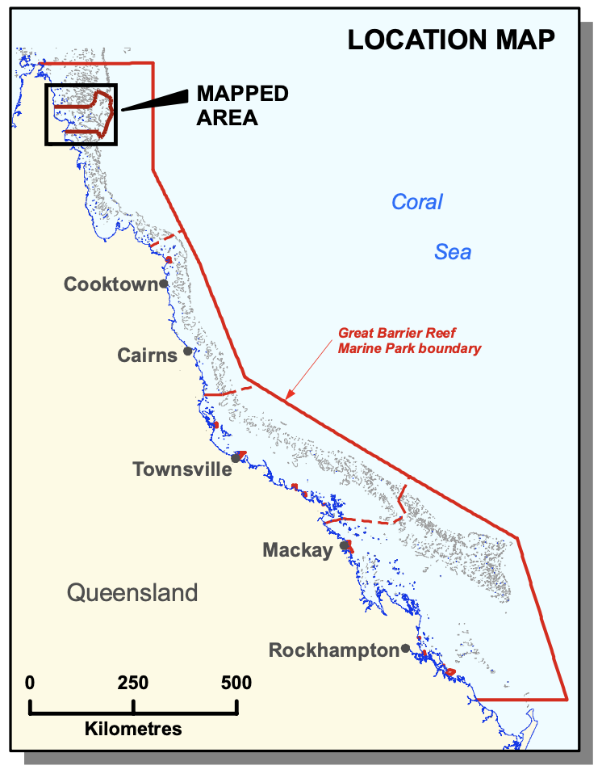
Wuthathi TUMRA Region
(Cape York)
Notes:
Image: https://elibrary.gbrmpa.gov.au/jspui/handle/11017/965

Slide 9
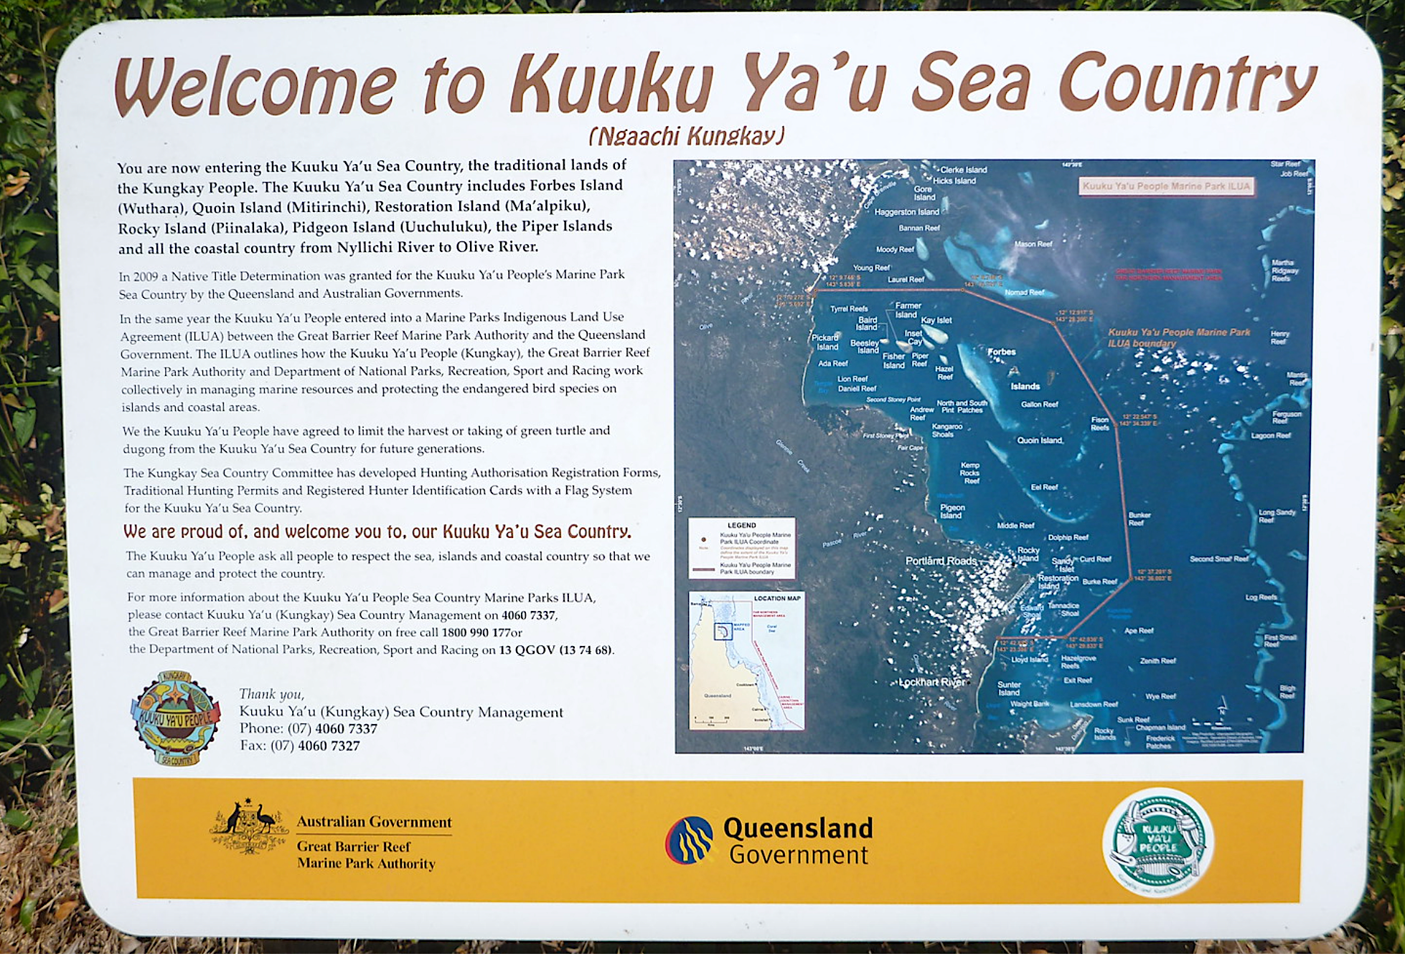
Notes:
Image: https://www.flickr.com/photos/dougbeckers/14753171262

Slide 10
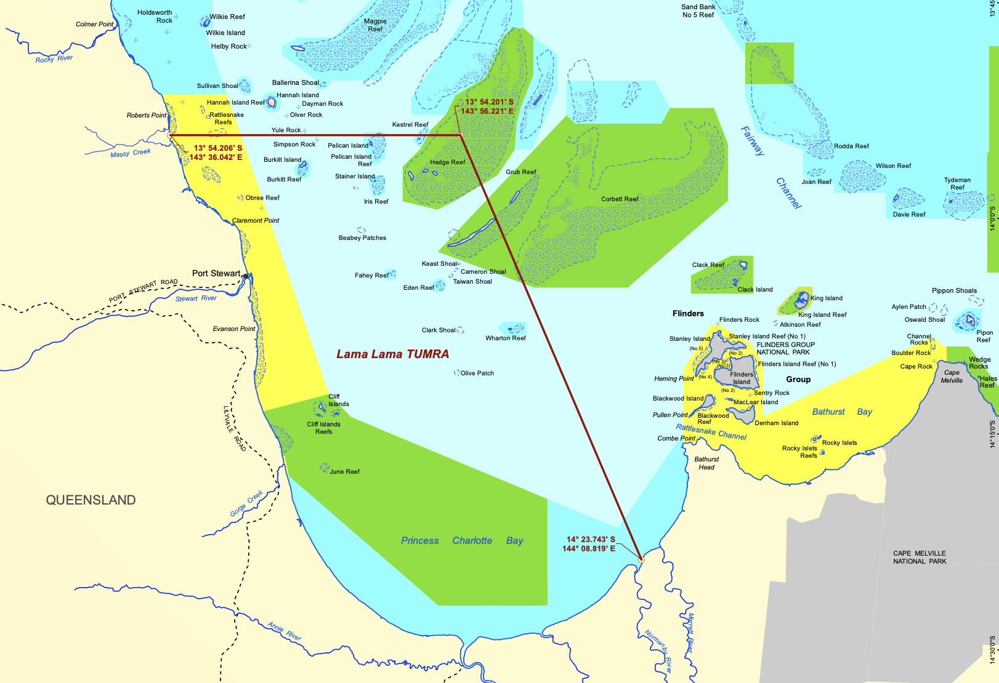
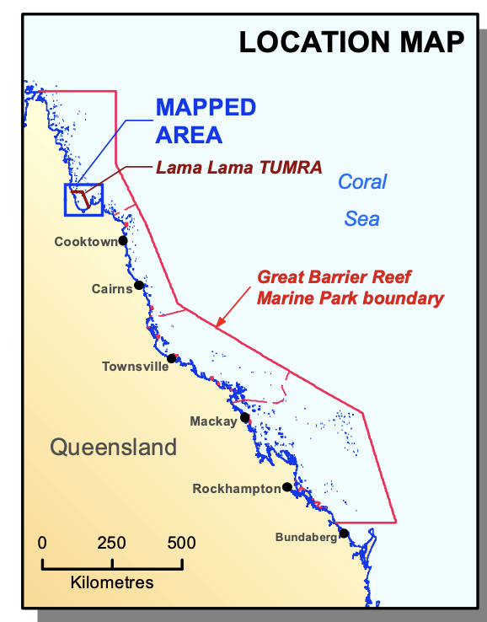
Lama Lama TUMRA

Slide 11
Please finish….

