Slide 1
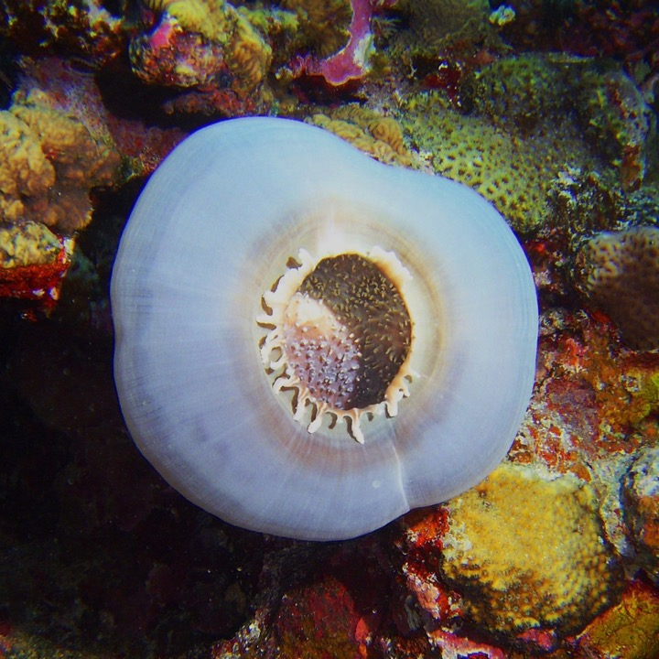
Learning Intention:
Describe criteria used to inform decisions regarding the design of protected marine areas.
Success Criteria:
Complete Marine Education worksheet
‘8. How to draw lines and make pretty shapes’
Corallimorpharian anemone in Huon marine park
Notes:
Image:https://parksaustralia.gov.au/marine/parks/south-east/huon/
Corallimorpharian anemone in Huon marine park

Slide 2
Part 2
Let’s take a trip around Australia to see what’s protected and what isn’t.
Are Australia’s MPAs comprehensive, adequate AND REPRESENTATIVE….. ????

Slide 3
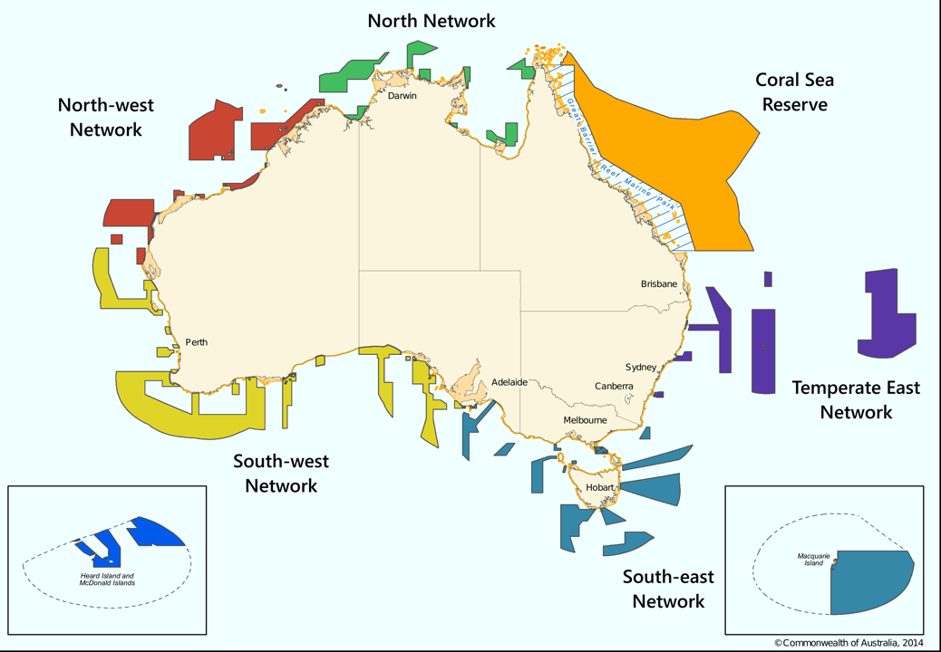
MPAs
in Australia
3 - 200 nautical miles offshore

Slide 4


The Australian Government manages all Commonwealth MPAs 3-200nm offshore
(who grouped them into ‘networks’ as per the NRSMPA)

Slide 5
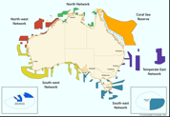
Temperate East Network
Established 2012
includes 3 seamount chains
Starts at Bundaberg
Finishes in NSW
8 MPAs
Notes:
Info: https://www.dcceew.gov.au/sites/default/files/env/pages/2b8154b0-dce9-4c9e-bffd-cfb1db8fab65/files/te-cmr-network-mgt-plan-information-only-has-no-legal-effect.pdf

Slide 6
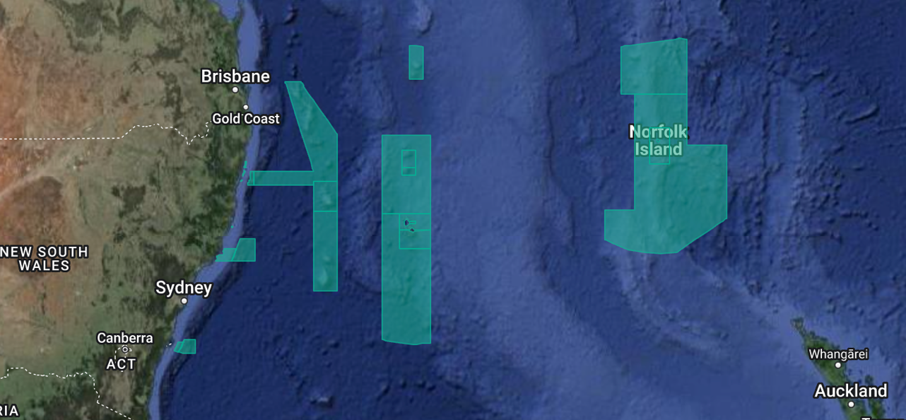
Temperate East Network
Notes:
Image: https://parksaustralia.gov.au/marine/

Slide 7
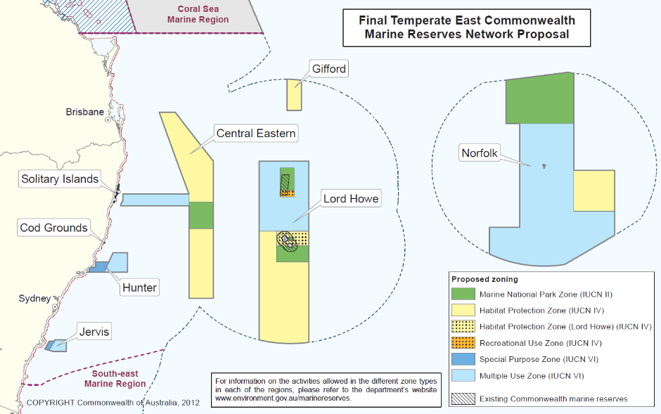
Notes:
Image: https://www.abc.net.au/news/2012-06-14/australian-marine-reserves-maps/4069666

Slide 8
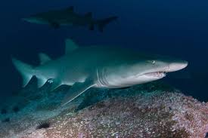
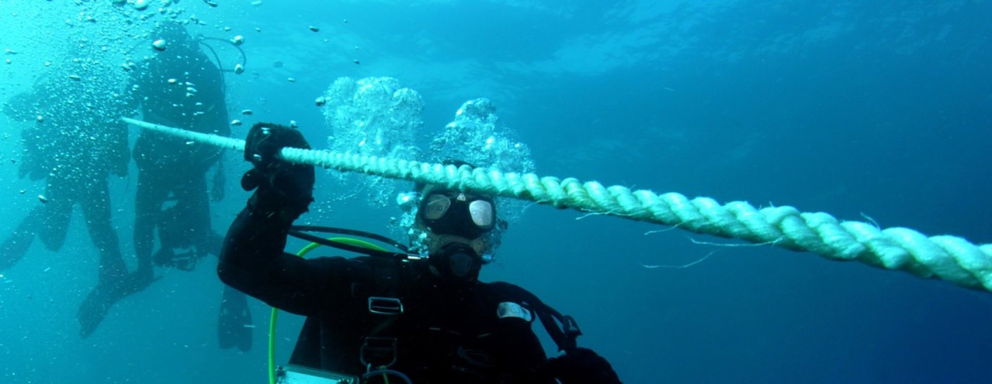
E.g. Cod Grounds
Notes:
Images: https://parksaustralia.gov.au/marine/parks/temperate-east/cod-grounds/

Slide 9
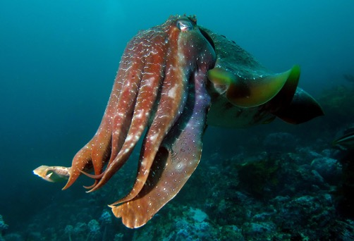
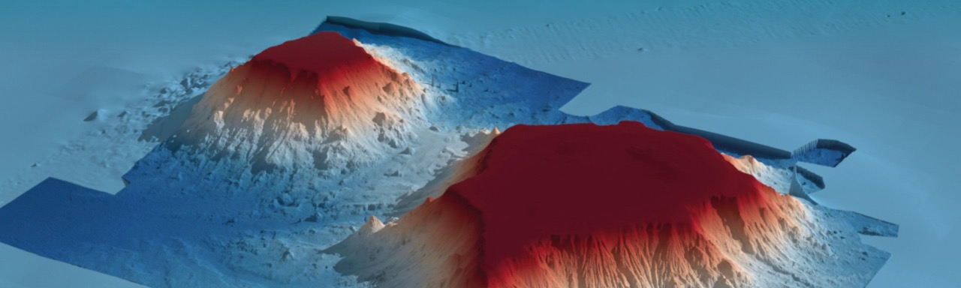
E.g. Gifford Marine Park
Gifford Marine Park protects a 2000m high flat-topped undersea volcano called Gifford Tablemount
Notes:
Images: https://parksaustralia.gov.au/marine/parks/temperate-east/gifford/
Gifford Marine Park protects a 2000 metre high flat-topped undersea volcano called Gifford Tablemount

Slide 10
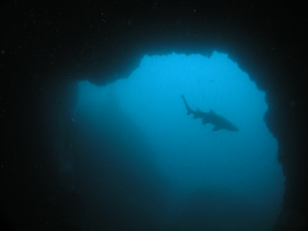
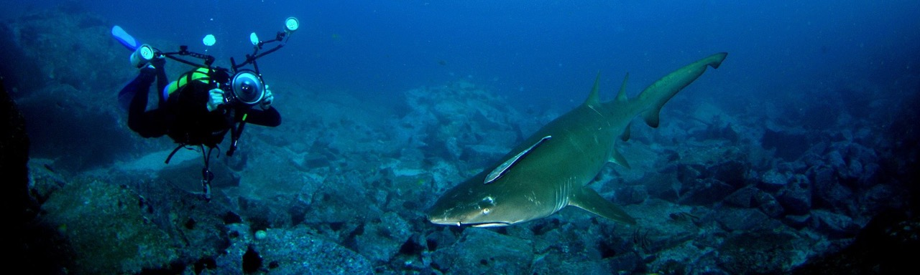
E.g. Solitary Islands Marine Park (including Pimpernel Rock pictured right)
Notes:
Image: https://parksaustralia.gov.au/marine/parks/temperate-east/solitary-islands/
Image (pimpernel rock): https://www.michaelmcfadyenscuba.info/viewpage.php?page_id=189

Slide 11
South East Network
Established 2007
22 different benthic ecosystems
NSW. Vic. Tas. SA.
10m to 6000m
14 MPAs
Notes:
Info: https://parksaustralia.gov.au/marine/files/south-east/Updates/SE-Network-Evaluation-Summary.pdf
Info: https://parksaustralia.gov.au/marine/files/south-east/AMP---SE-SOK-Summary_SE-Network.pdf

Slide 12
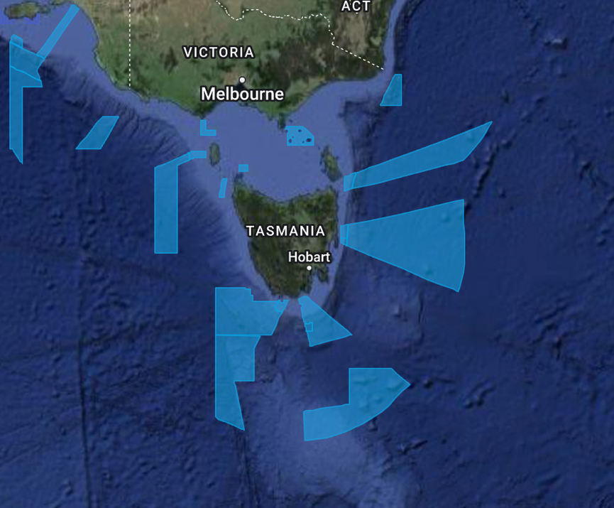
South East Network
Notes:
Image: https://parksaustralia.gov.au/marine/

Slide 13
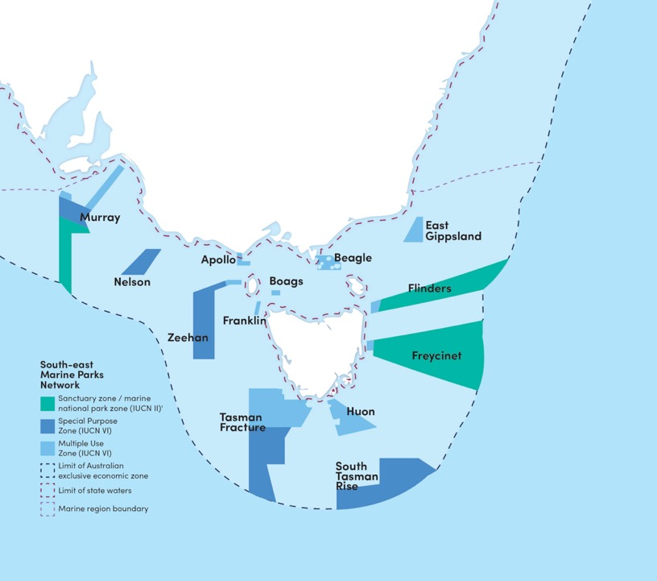
South East Network
Notes:
Image: https://www.marineconservation.org.au/south-east-marine-parks/

Slide 14
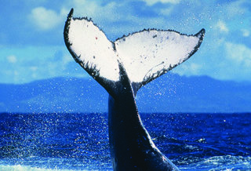
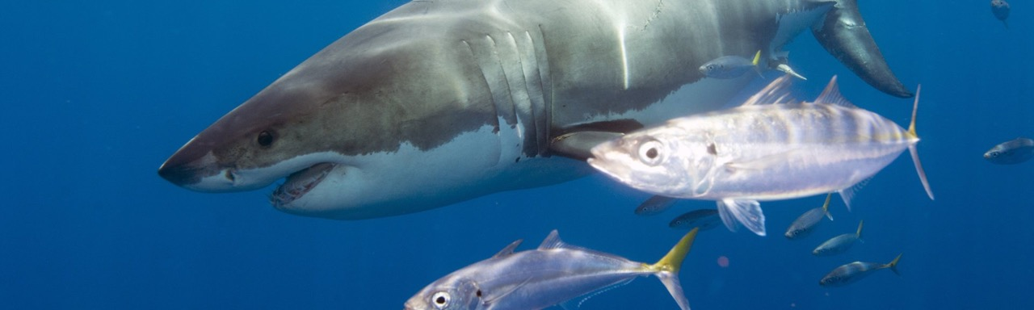
E.g. Nelson Marine Park
Notes:
Image (shark): https://parksaustralia.gov.au/marine/parks/south-east/nelson/

Slide 15
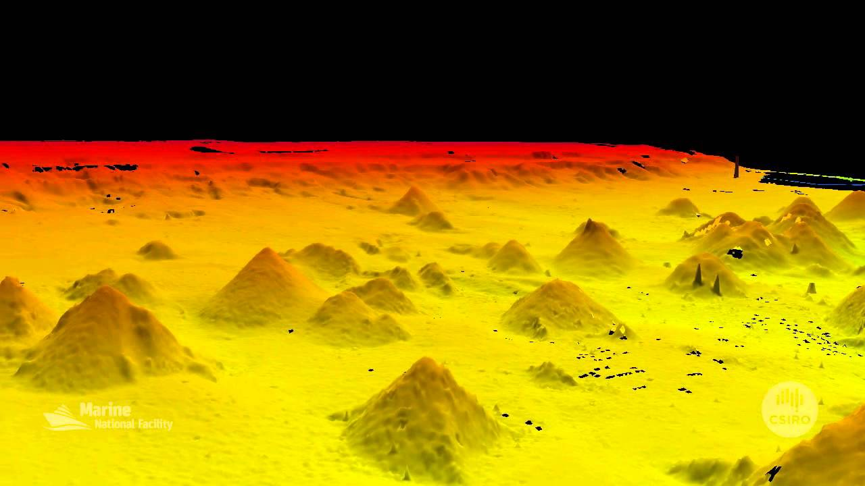
E.g. Huan Marine Park
(Australia’s largest cluster of seamounts)
Notes:
Image: https://atlas.parksaustralia.gov.au/amps?featureId=AMP_SE_HUO

Slide 16
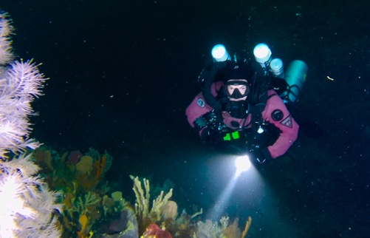
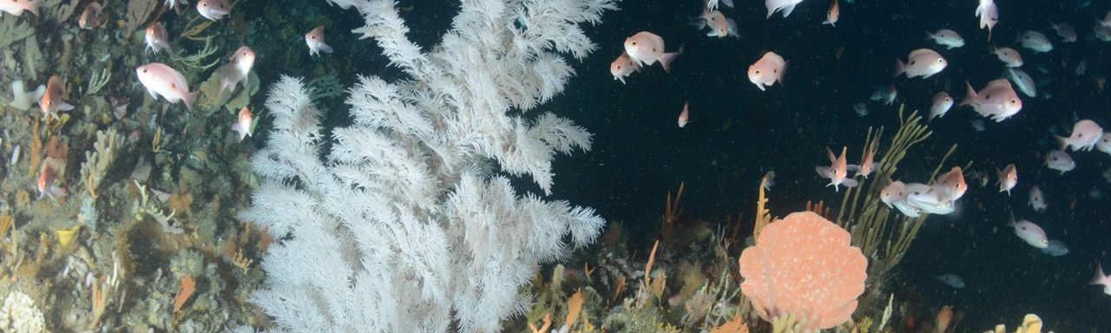
E.g. Freycinet Marine Park
“Black coral”
Notes:
Image: https://atlas.parksaustralia.gov.au/amps/research/black-corals-in-the-freycinet-marine-park
Image (top right): https://www.imas.utas.edu.au/news/news-items/citizen-scientists-film-black-corals-at-spectacular-unexplored-reef-off-tasmanias-east-coast

Slide 17
Macquarie Island Marine Park
Part of the South East Network
World Heritage Listed
Rangers belong to Tasmania Parks and Wildlife
Research Station there
Royal penguins (endemic)

Slide 18
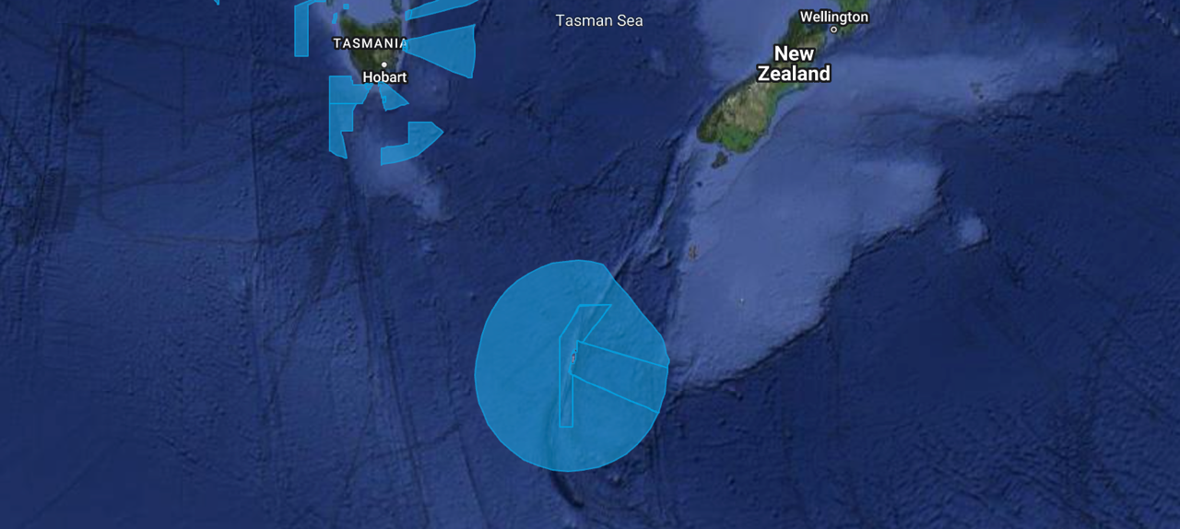
Macquarie Island Marine Park
Notes:
Image: https://parksaustralia.gov.au/marine/

Slide 19
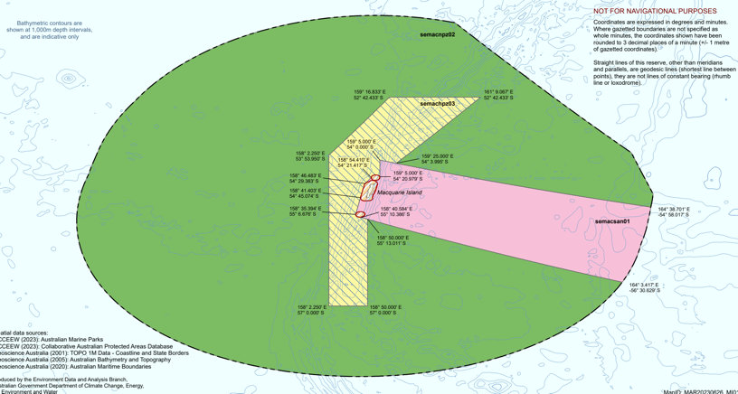
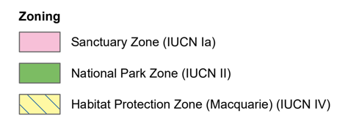
Macquarie Island Marine Park
Notes:
Image: https://parksaustralia.gov.au/marine/files/Final_Mac_Island_MP_zoning_bathy_contours_1000m.pdf

Slide 20
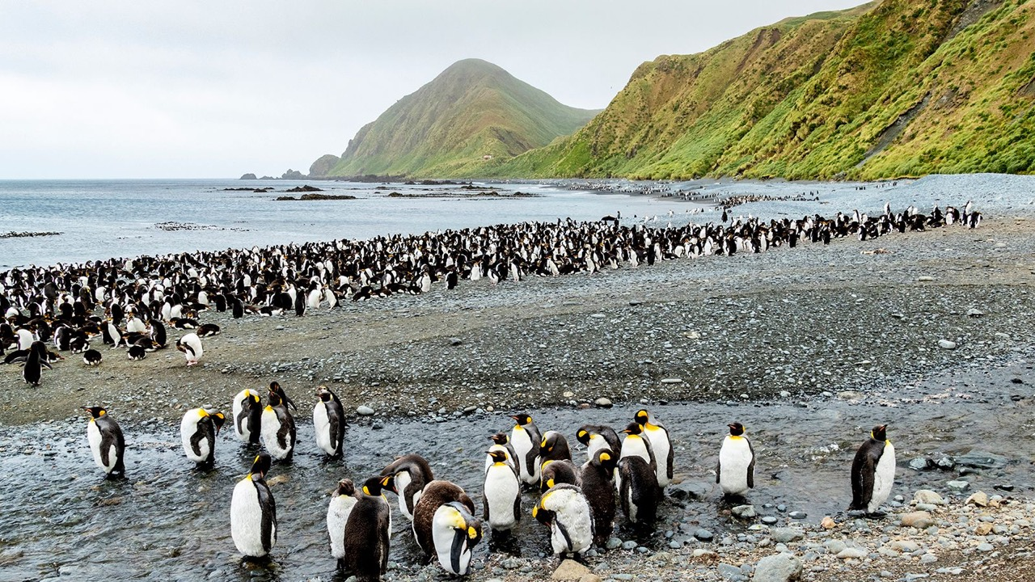
Macquarie Island
Notes:
Image: https://www.britannica.com/place/Macquarie-Island

Slide 21
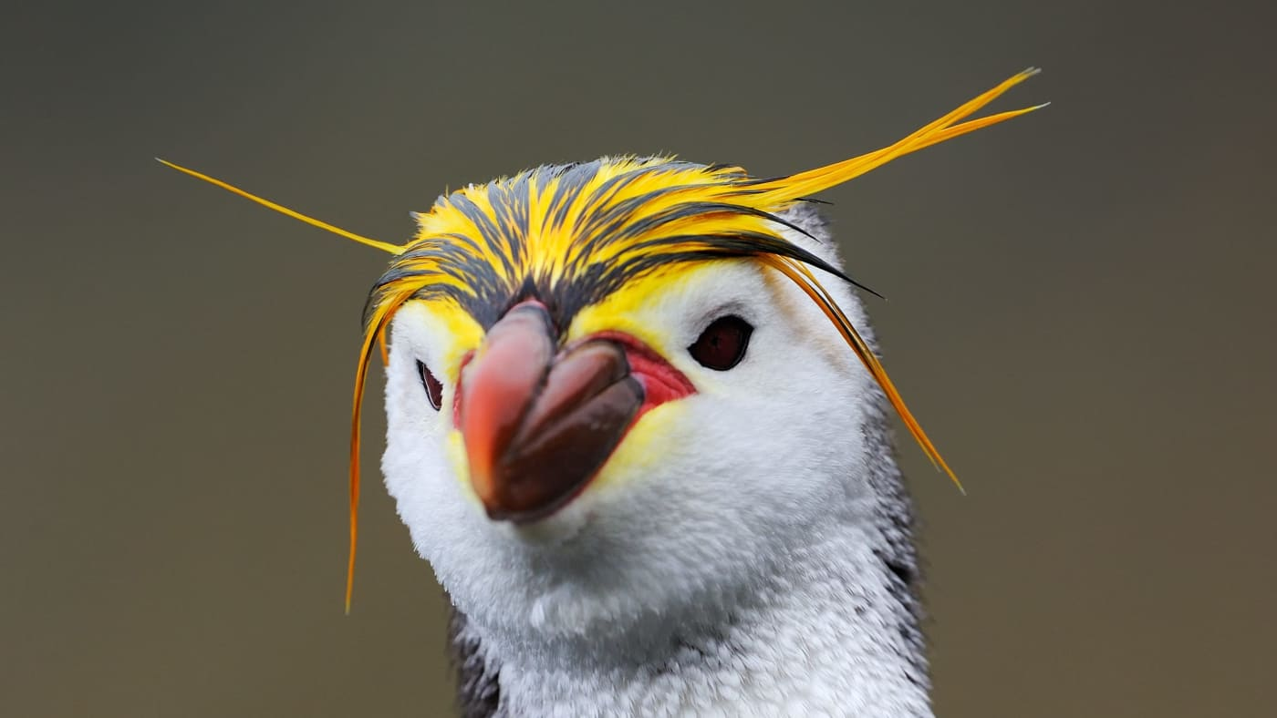
Royal Penguins (Eudyptes schlegeli) are endemic to Macquarie Island
Notes:
Image: https://wwf.org.au/blogs/coming-together-to-protect-the-royal-penguin/

Slide 22
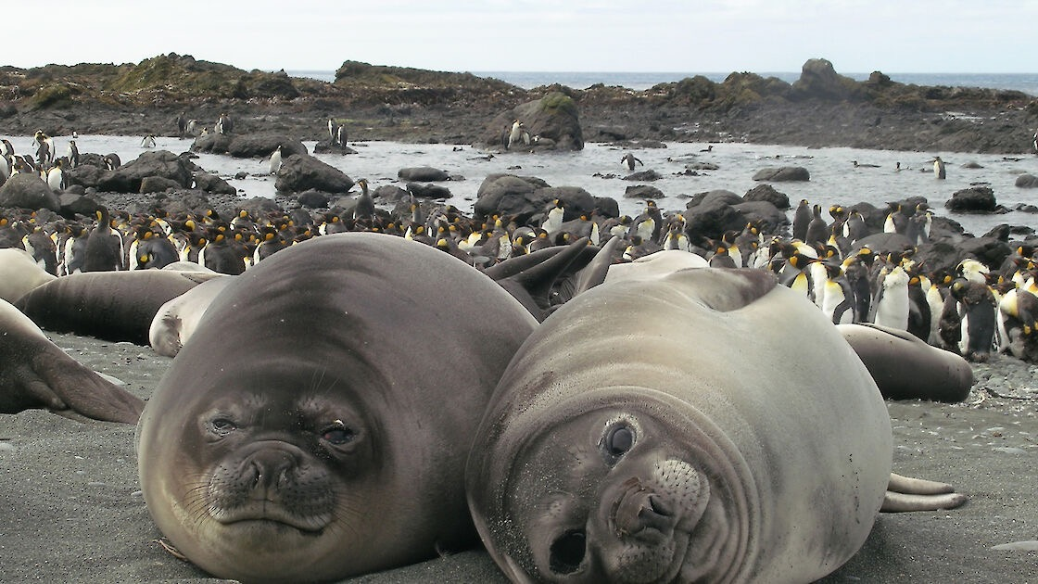
King Penguins and Elephant Seals on Macquarie Island
Notes:
Image: https://www.antarctica.gov.au/antarctic-operations/stations/macquarie-island/macquarie-is-science/
The large population of wildlife on Macquarie Island, including these elephant seals and king penguins, ensures that biological science is an important part of scientific research on the island. Photo: Kerry Steinberner

Slide 23
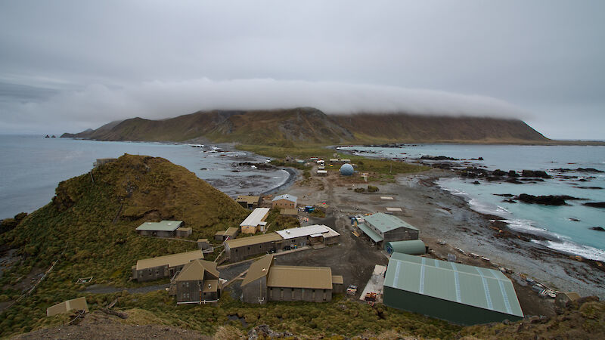
Macquarie Island Research station
(half way point to Antarctica)
Notes:
Image: https://www.antarctica.gov.au/antarctic-operations/stations/macquarie-island/macquarie-is-science/

Slide 24
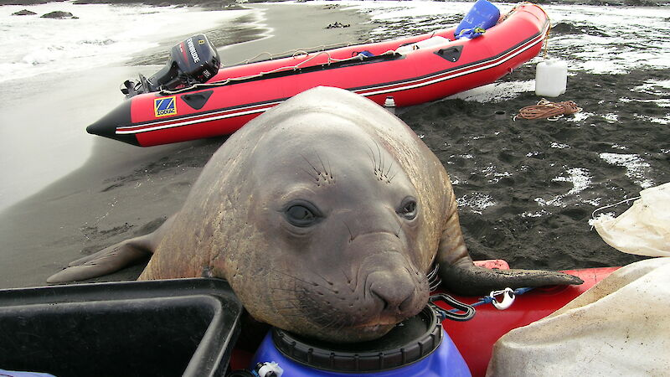
Elephant seals like boating too Photo: Kerry Steinberner
Notes:
Image: https://www.antarctica.gov.au/antarctic-operations/stations/macquarie-island/location/
Elephant seals like boating too Photo: Kerry Steinberner

Slide 25
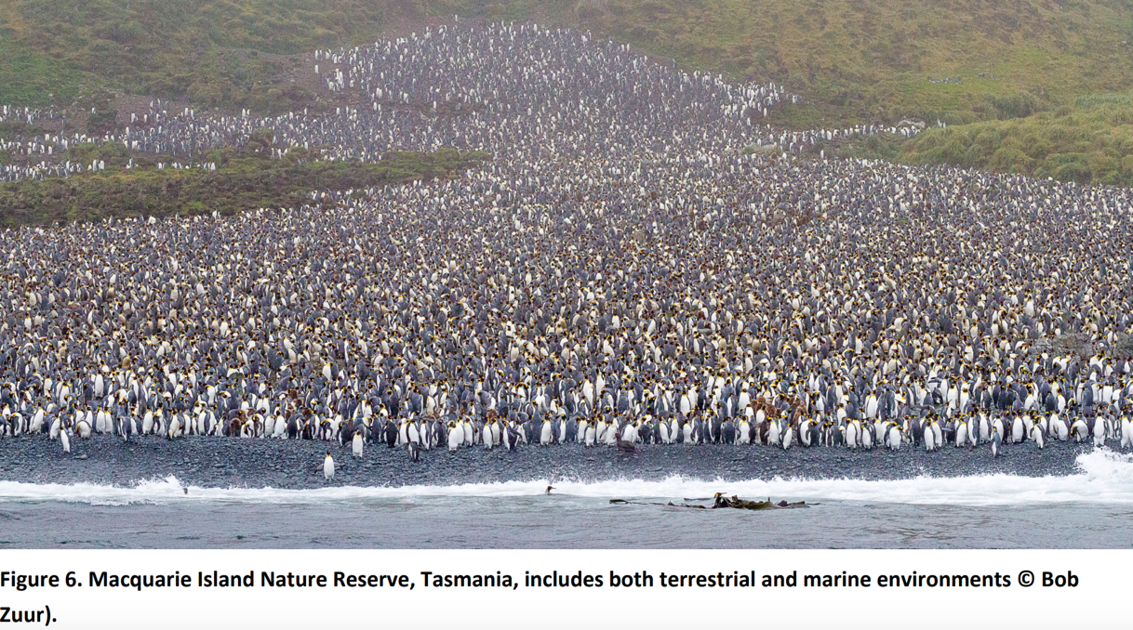
Notes:
Image: https://parksjournal.com/wp-content/uploads/2021/03/PARKS-24.2-Fitzsimons-and-Wescott-10.2305-IUCN.CH_.2018.PARKS%E2%80%9024%E2%80%902JAF.en_.pdf

Slide 26
Heard Island and MacDonald Islands
Established 2002
One of the most remote places on Earth
Australia’s only 2 active volcanoes
2 weeks to get there by boat
1 MPA
Notes:
Info: https://www.antarctica.gov.au/antarctic-operations/stations/other-locations/heard-island/protection-and-management/marine-reserve/

Slide 27
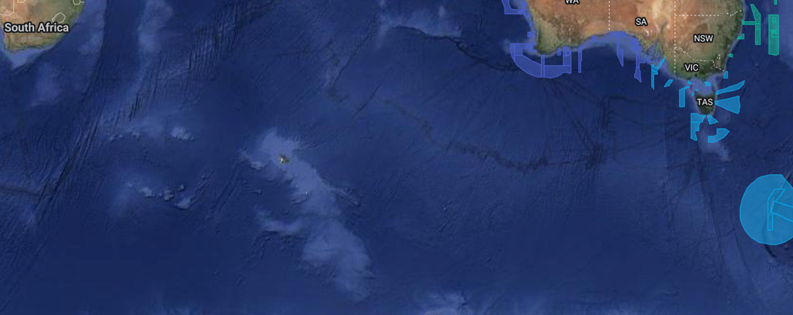
Heard Island and MacDonald Islands
Notes:
Image: https://parksaustralia.gov.au/marine/

Slide 28
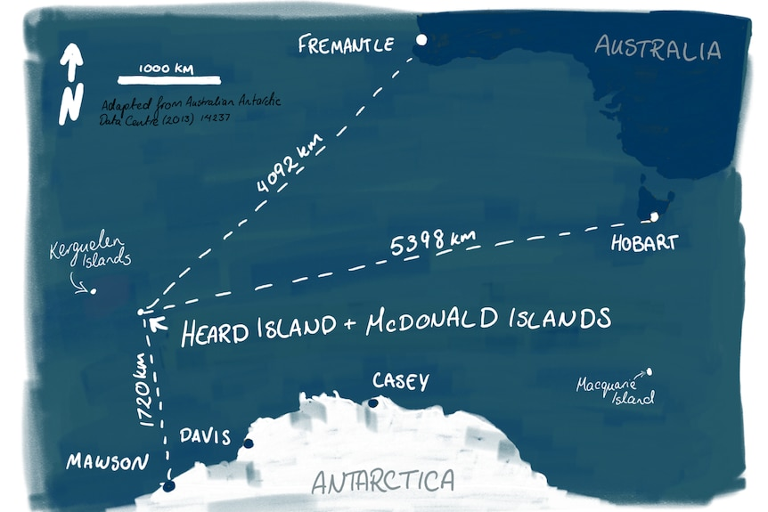
No-one lives there
Notes:
Image: https://www.abc.net.au/news/2019-01-25/heard-island-australias-mysterious-land-of-fire-and-ice/10713860

Slide 29
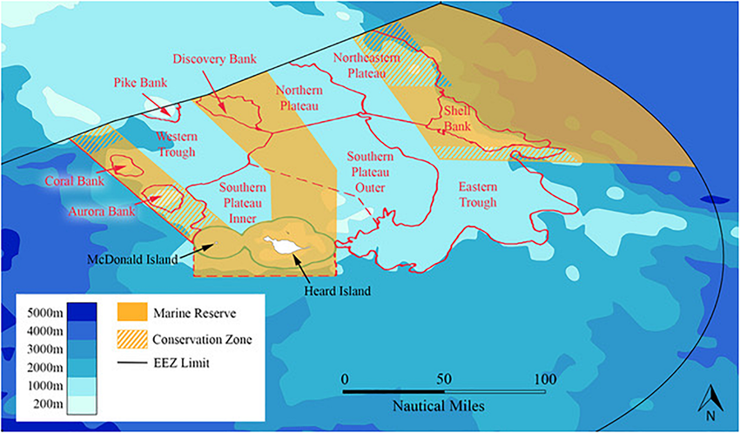
No take
Notes:
Image: Brooks, Cassandra & Epstein, Graham & Ban, Natalie. (2019). Managing Marine Protected Areas in Remote Areas: The Case of the Subantarctic Heard and McDonald Islands. Frontiers in Marine Science. 6. 10.3389/fmars.2019.00631.

Slide 30
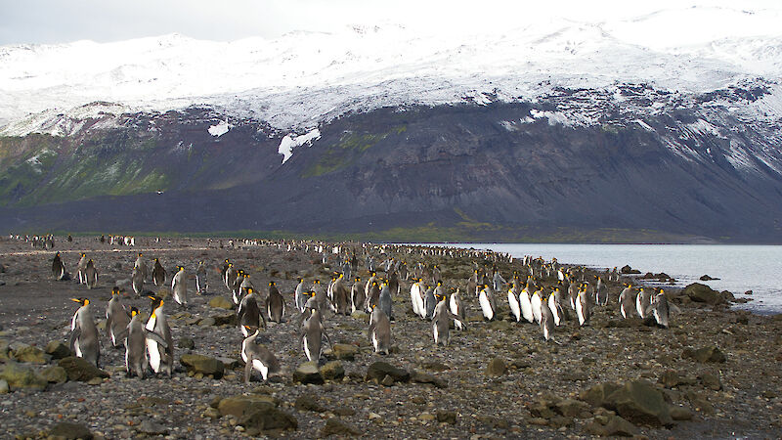
Heard Island and MacDonald Islands
Notes:
Image: https://www.antarctica.gov.au/antarctic-operations/stations/other-locations/heard-island/

Slide 31
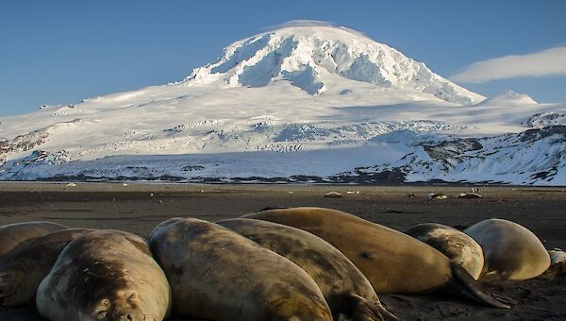
Notes:
Image (seals): https://www.antarctica.gov.au/antarctic-operations/stations/other-locations/heard-island/

Slide 32
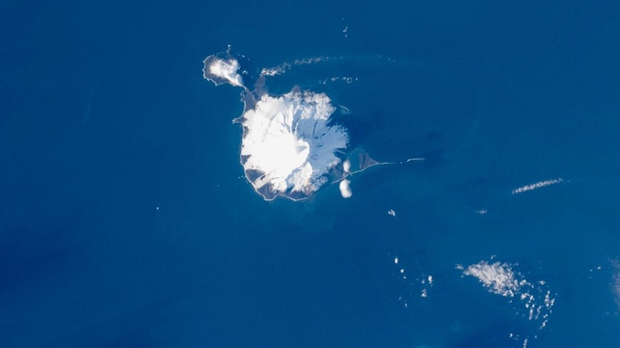
80% is snow/ice
Notes:
Image: https://www.abc.net.au/news/2019-01-25/heard-island-australias-mysterious-land-of-fire-and-ice/10713860

Slide 33
South West Network
includes the Great Australian Bight
Established 2018
SA and WA
Endangered southern right whales
14 MPAs

Slide 34
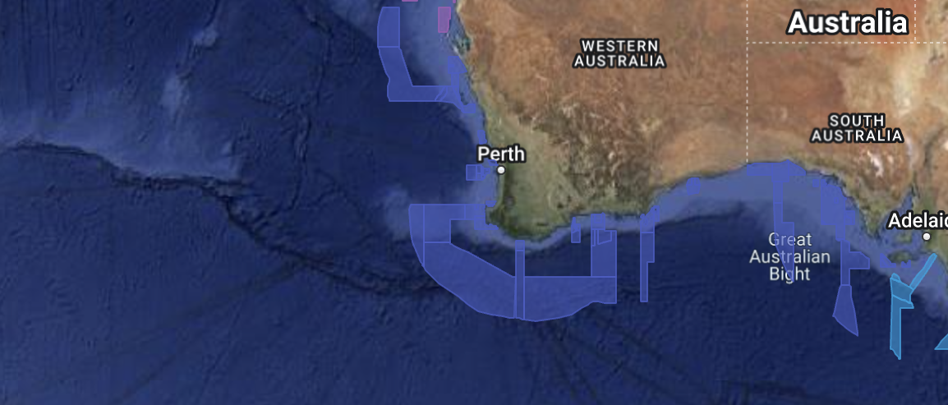
South West Network
Notes:
Image: https://parksaustralia.gov.au/marine/

Slide 35
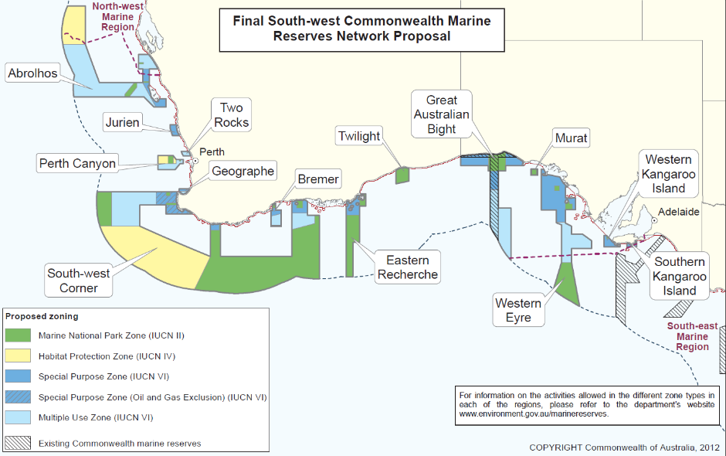
Notes:
Image: https://www.abc.net.au/news/2012-06-14/australian-marine-reserves-maps/4069666

Slide 36
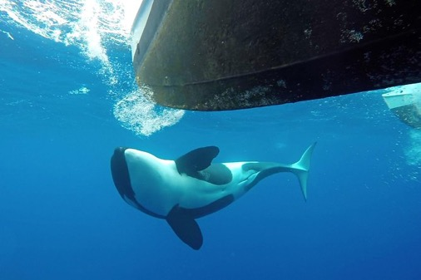
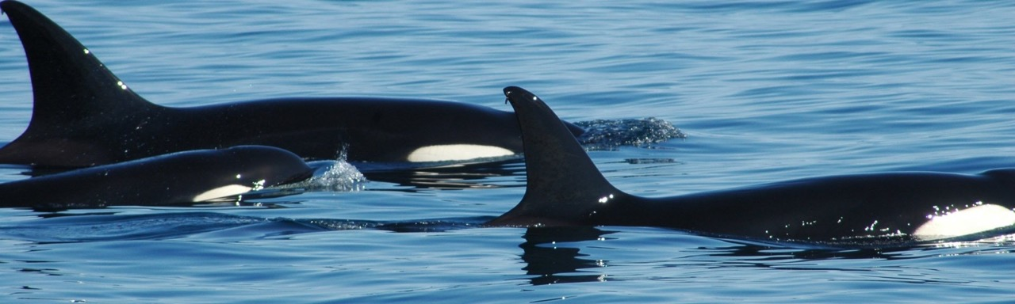
E.g. Bremer (Bay) Marine Park
Bremer Bay Orca watching tours
Photo by David Govoni
Notes:
Image (orcas): https://parksaustralia.gov.au/marine/parks/south-west/
Image (top right): https://www.viator.com/en-AU/tours/Western-Australia/Bremer-Bay-Orca-Experience/d126-10984P10

Slide 37
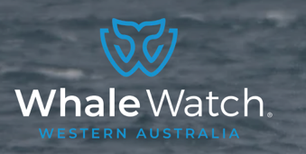
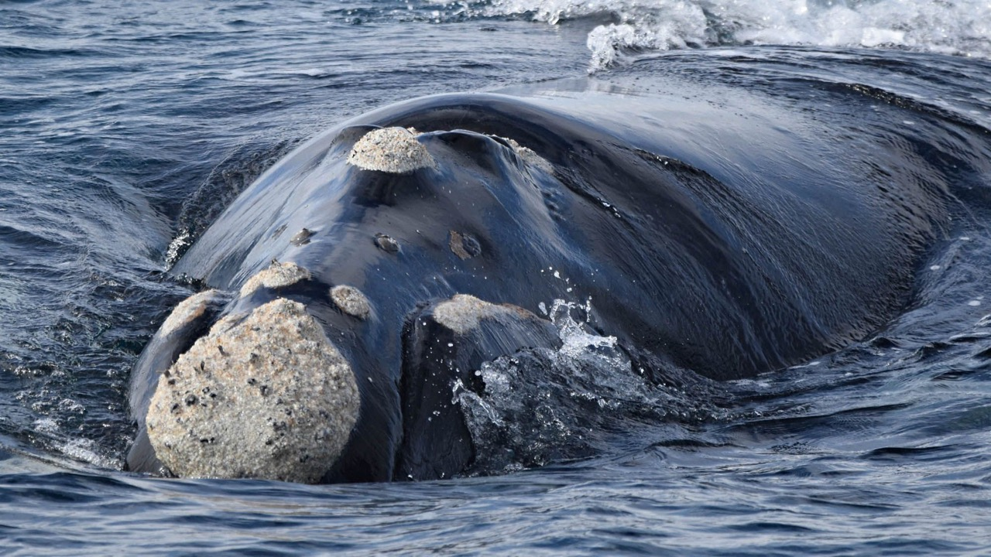
Southern Right Whale watching
Notes:
Image: https://whalewatchwesternaustralia.com/species/southern-right-whale/

Slide 38
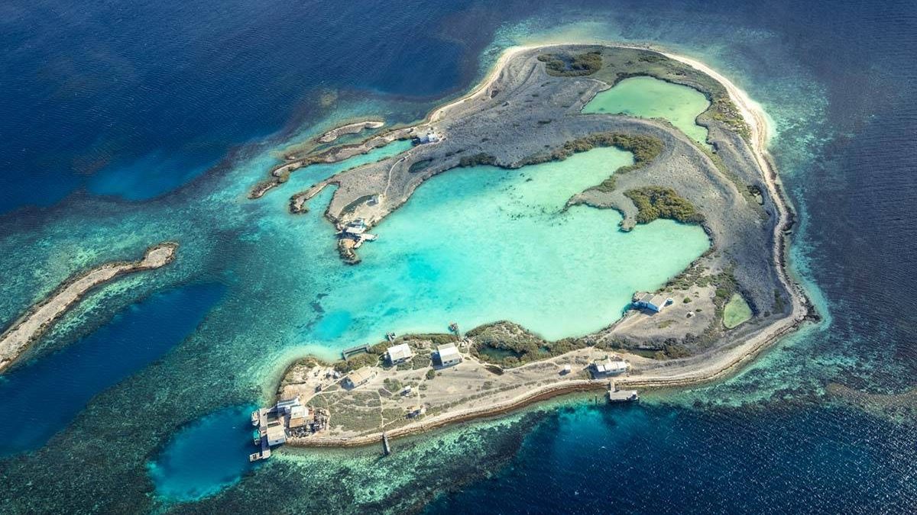
E.g. Abrolhos (Islands) Marine Park
Notes:
Image: https://www.chargetheglobe.com/the-ultimate-guide-to-the-abrolhos-islands/

Slide 39
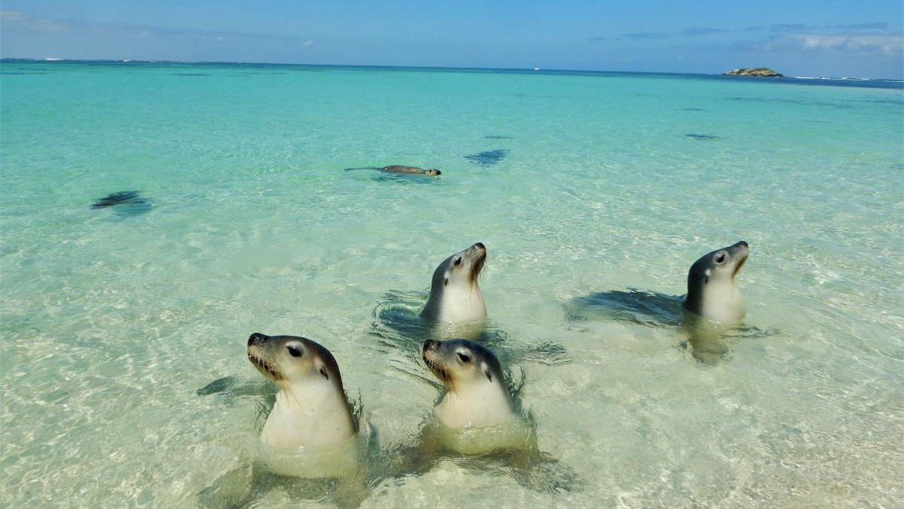
E.g. Jurien (Bay) Marine Park
Notes:
Image: https://exploreparks.dbca.wa.gov.au/park/jurien-bay-marine-park

Slide 40
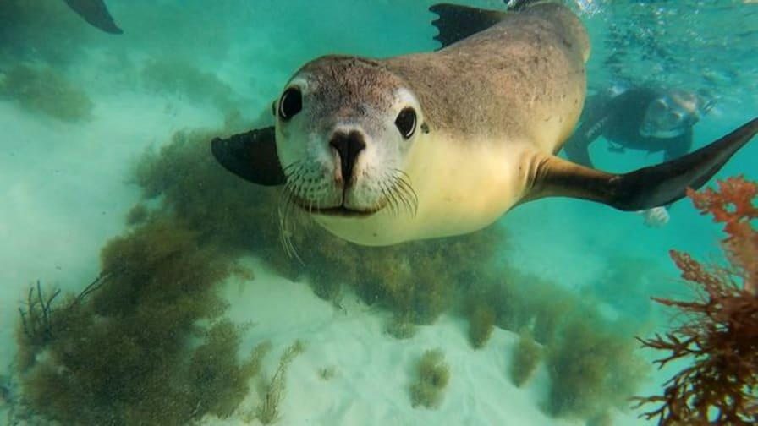
$255 to swim with seals in Jurien Bay
Notes:
Image: https://saltyswims.com.au/jurien-bay-marine-park-experience/

Slide 41
North West Network
Established 2018
Whale Sharks
Shark Bay
Ningaloo Reef
13 MPAs

Slide 42
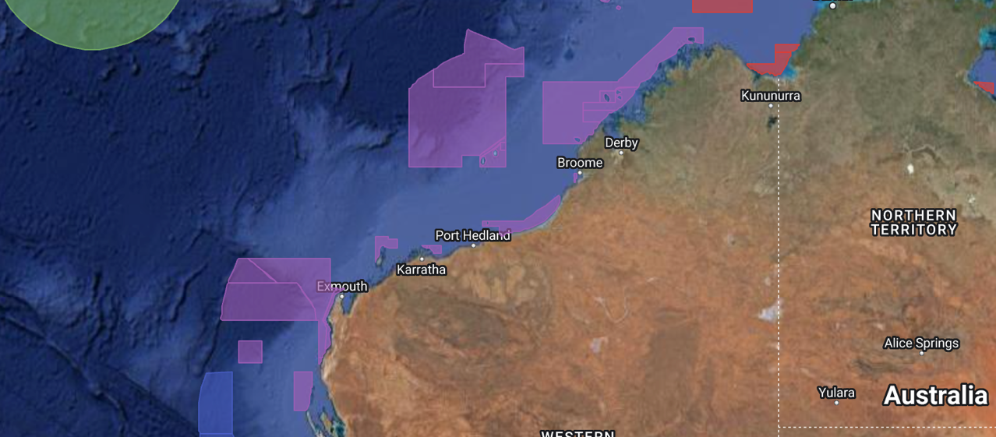
North West Network
Notes:
Image: https://parksaustralia.gov.au/marine/

Slide 43
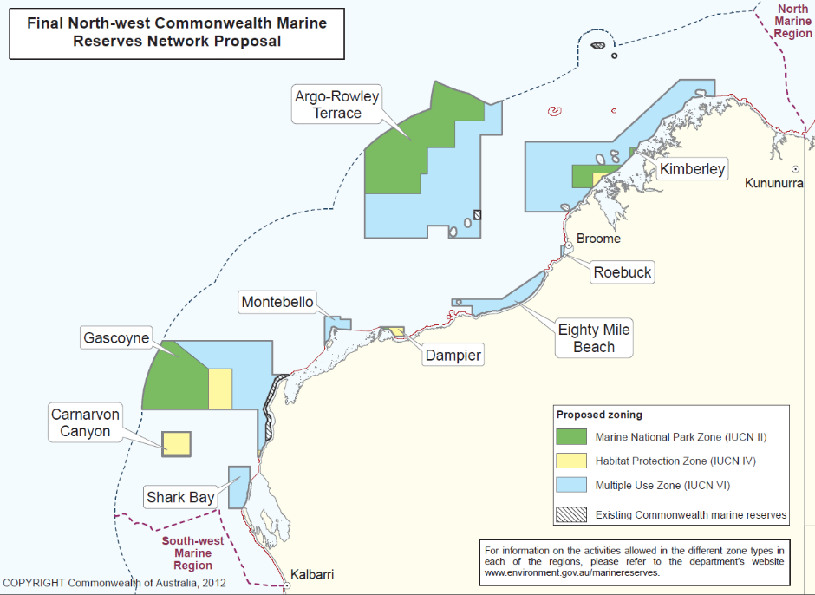
Notes:
Image: https://www.abc.net.au/news/2012-06-14/australian-marine-reserves-maps/4069666

Slide 44
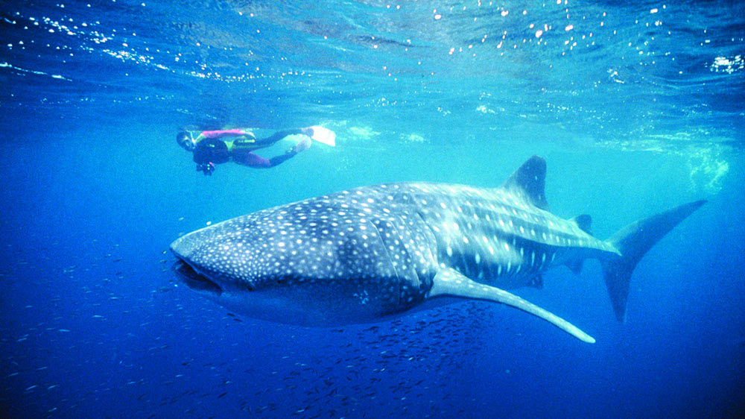
E.g. Ningaloo Marine Park
Notes:
Image: https://www.instyleadventures.com.au/news/experience-the-ningaloo-reef/

Slide 45
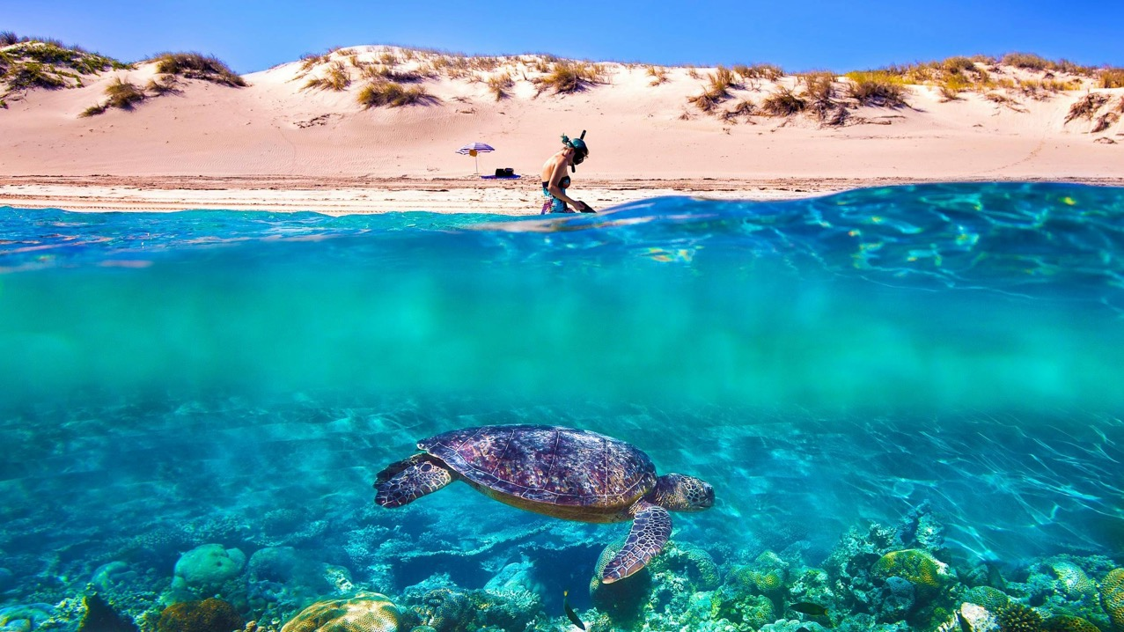

Slide 46
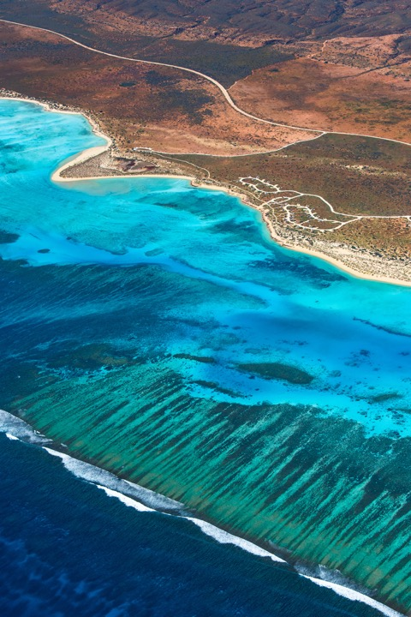
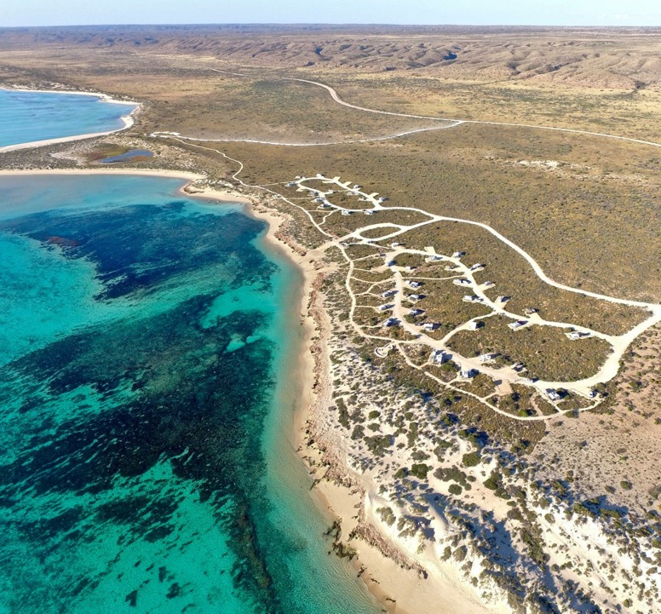
Camping Osprey Bay, Cape Range National Park/Ningaloo Reef WA
Notes:
Image: Cape Range National Park (camping) https://unisonconsulting.com.sg/kfyo.php?cname=osprey+bay&cid=160

Slide 47
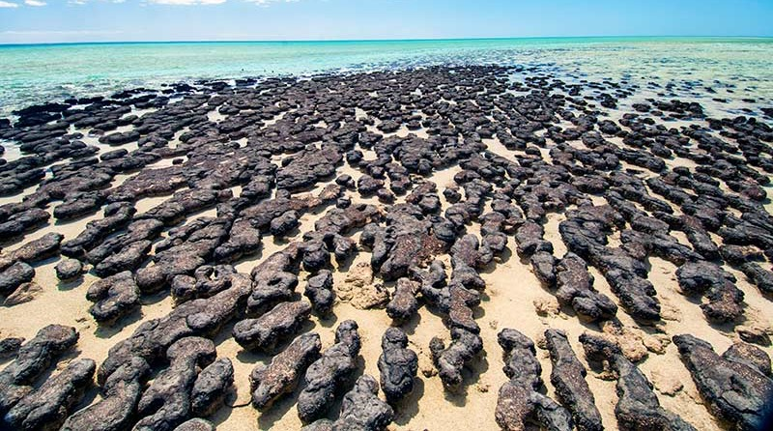
E.g. Shark Bay Marine Park
(Hamelin Pool stromatolites – ancient rock)
Notes:
Image: https://www.gorv.com.au/travel-guide-shark-bay-wa/
Hamelin Pool stromatolites.

Slide 48
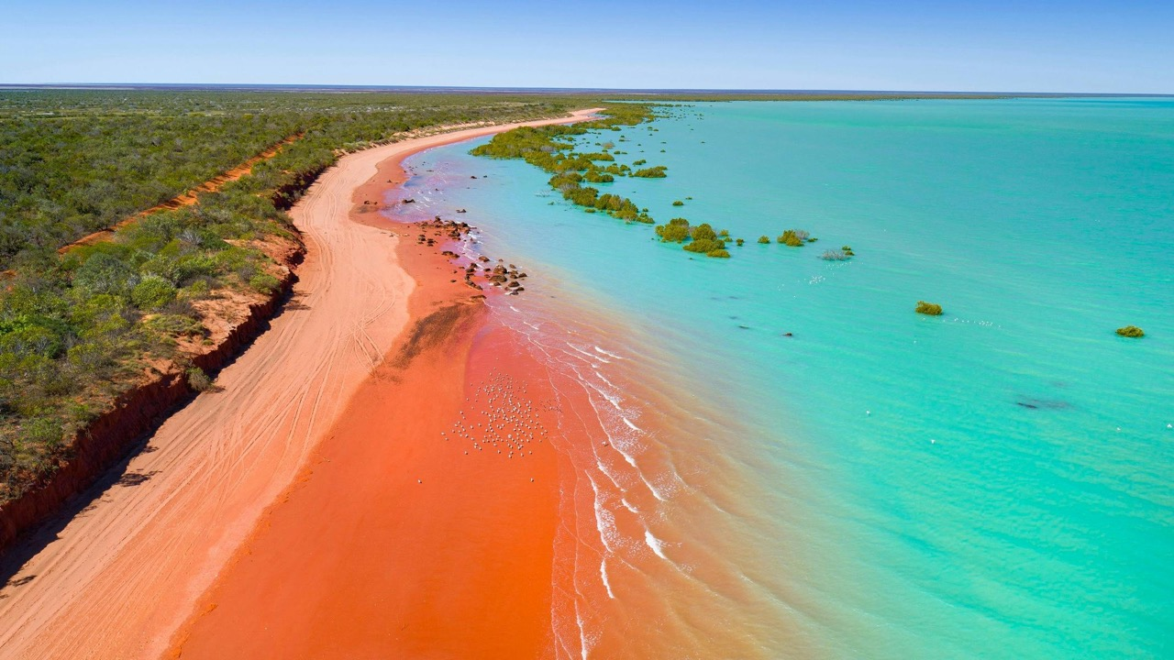
E.g. Roebuck (Bay) Marine Park

Slide 49

Notes:
Image: https://www.viewbug.com/photo/91007309

Slide 50
Christmas & Cocos (Keeling) Islands
”Indian Ocean Territories Marine Parks”
Christmas Island Red crab migration
Established 2022
Coral atolls
Christmas Island detention centre
2 MPAs

Slide 51

Australia
Notes:
Image: https://parksaustralia.gov.au/marine/

Slide 52

Notes:
Image: https://parksaustralia.gov.au/marine/pub/maps/christmas-island-marine-park-map-zoning-2022.pdf

Slide 53


Slide 54

Cocos (Keeling) Islands
Notes:
Image: https://earthobservatory.nasa.gov/images/76791/cocos-keeling-islands

Slide 55

Cocos (Keeling) Islands

Slide 56

https://www.youtube.com/watch?v=PLWSOjykTfQ&t=52s
Notes:
https://www.youtube.com/watch?v=PLWSOjykTfQ&t=52s

Slide 57

Christmas Island Red Crab migration

Slide 58

Christmas Island Detention Centre
Notes:
Image: https://www.theaustralian.com.au/subscribe/news/1/?sourceCode=TAWEB_WRE170_a_GGL&dest=https%3A%2F%2Fwww.theaustralian.com.au%2Fnation%2Fpolitics%2Fkillers-and-rapists-set-free-to-roam-on-christmas-island%2Fnews-story%2Fcc20d1e949a8f0885d73f4e6fdbcf720&memtype=anonymous&mode=premium&v21=GROUPA-Segment-1-NOSCORE&V21spcbehaviour=append

Slide 59
North Network
Established 2018
Shallow waters
Shallow continental shelf
NT and Qld
8 MPAs

Slide 60

North Network
Notes:
Image: https://parksaustralia.gov.au/marine/

Slide 61

Notes:
Image: https://www.abc.net.au/news/2012-06-14/australian-marine-reserves-maps/4069666

Slide 62

E.g. Oceanic Shoals Marine Park
https://www.youtube.com/watch?v=wPwmZ2AMeT0&t=12s

Slide 63

Notes:
Image: https://www.nespmarine.edu.au/tags/bruvs

Slide 64
Coral Sea Reserve
Established
Out past the GBR
2200 km long
1 MPA with many regional zoning plans
1300 km wide

Slide 65

Coral Sea Reserve
Notes:
Image: https://parksaustralia.gov.au/marine/

Slide 66

Coral Sea Reserve
Notes:
Image: https://www.abc.net.au/news/2012-06-14/australian-marine-reserves-maps/4069666

Slide 67

Notes:
Image: https://parksaustralia.gov.au/marine/files/scientific-publications/JamesCookUniversityCSMP-Coral-Reef-Health-Survey-2023.pdf

Slide 68

E.g. Willis Island
(weather station)
Notes:
Image: https://dxnews.com/forum/forum/dxing/45789-vk9wx-willis-island

Slide 69

E.g. Osprey Reef
(Spirit of Freedom Liveaboard)
Notes:
Image: https://greatbarrierreefliveaboards.com/tours/great-barrier-reef/spirit-of-freedom-4-night-liveaboard/

Slide 70
Great Barrier Reef Marine Park
Established
1975
World Heritage Listed
2300 km long
1 MPA with many regional zoning plans
60-250km wide

Slide 71

Marine jurisdiction boundaries
Notes:
Image: Outlook report 2019 https://elibrary.gbrmpa.gov.au/jspui/handle/11017/3474

Slide 72

© WWF / Jürgen FREUND
Notes:
Image: https://wwf.panda.org/wwf_news/?163783/AUSTRALIA---Great-Barrier-Reef-Marine-Park-Zoning-Plan
Image © WWF / Jürgen FREUND

Slide 73

Notes:
Image; https://www2.gbrmpa.gov.au/learn/fascinating-facts-about-great-barrier-reef

Slide 74



MPAs
Qld
0 - 3 nautical miles offshore
Notes:
Image: https://www.qld.gov.au/environment/coasts-waterways/marine-parks/about#gallery-66610

Slide 75

Great Sandy Marine Park
Starts south of Bundaberg
Established 2006
0-3 nm
Finishes north of Sunshine Coast
Notes:
Info: https://parks.desi.qld.gov.au/parks/great-sandy-marine

Slide 76

Great Sandy Marine Park

Slide 77

Great Sandy Marine Park
(update)
Notes:
Image; https://www.qld.gov.au/__data/assets/pdf_file/0012/401115/gsmp-dris.pdf

Slide 78

E.g. K’gari (Fraser) Island
Notes:
Image: https://www.escape.com.au/destinations/australia/queensland/8-reasons-to-head-to-the-fraser-coast-right-now/news-story/ad4399d8838f0304f73d8fa9d374c4d0
White sand beaches are just the beginning of what Fraser Island has to offer. Picture: Fraser Coast Tourism

Slide 79

E.g. Wolf Rock (Rainbow Beach)

Slide 80

E.g. Wolf Rock (Rainbow Beach)
Grey Nurse Shark
Notes:
Image: https://diveinaustralia.com.au/?product=wolf-rock

Slide 81
Moreton Bay Marine Park
Established 1993
Starts south of Sunshine Coast
0-3 nm
Finishes Gold Coast
Notes:
Info: https://parks.desi.qld.gov.au/parks/moreton-bay

Slide 82

Moreton Bay Marine Park

Slide 83

Moreton Bay Marine Park
Notes:
Image: https://moretonbayfoundation.org/moreton-bay-zones.html
https://moretonbayfoundation.org/moreton-bay/maps/interactive-moreton-bay-zone-map/

Slide 84

E.g. Moreton Island
Notes:
Image: https://www.tangalooma.com/moreton-island/moreton-bay-marine-park

Slide 85

Tangalooma Wrecks
Notes:
Image: https://www.viator.com/en-AU/tours/Moreton-Bay-Region/Eco-Cruise-Boom-netting-snorkeling-and-swimming-Moreton-Island/d50992-105025P1

Slide 86

E.g. Stradbroke Island
Notes:
Image: https://www.sealink.com.au/north-stradbroke-island/things-to-do/north-stradbroke-island-wildlife/

Slide 87

E.g. Flinders Reef
Tip of Moreton Island
Notes:
Image: https://sv-anui.com/2023/01/20/flinders-reef-and-other-wanderings/

Slide 88
So, who decides where the MPAs go, how big or small they are, and what levels of protection they offer?

Slide 89


Governance refers to who makes all the decisions and how those decisions are made.
Notes:
Image: https://www.nca.gov.au/attractions/parliament-house

Slide 90
Below is a list of Criteria used to inform decisions regarding the design of MPAs.
Activity: Find a location or ecosystem that is NOT protected (or, not protected enough).
Determine if it should be protected, based on the following criteria.
Explain WHY or WHY NOT.

Slide 91

Naturalness
Is it untouched?
Notes:
Info: Kenchington, R. & Kelleher, G. (1992). Guidelines for Establishing Marine Protected Areas. A Marine Conservation and Development Report. IUCN. Gland, Switzerland. Vii + 79 pp. P15-16. ISBN: 2831701058.

Slide 92

Biogeographic importance
Does it contain any unique or unusual geological features?
Notes:
Info: Kenchington, R. & Kelleher, G. (1992). Guidelines for Establishing Marine Protected Areas. A Marine Conservation and Development Report. IUCN. Gland, Switzerland. Vii + 79 pp. P15-16. ISBN: 2831701058.

Slide 93

Ecological importance
Does it provide habitat for any rare or endangered species?
Is it a breeding or rest area?
Notes:
Info: Kenchington, R. & Kelleher, G. (1992). Guidelines for Establishing Marine Protected Areas. A Marine Conservation and Development Report. IUCN. Gland, Switzerland. Vii + 79 pp. P15-16. ISBN: 2831701058.

Slide 94

Economic importance
Does (or can) it make money if protected?
Notes:
Info: Kenchington, R. & Kelleher, G. (1992). Guidelines for Establishing Marine Protected Areas. A Marine Conservation and Development Report. IUCN. Gland, Switzerland. Vii + 79 pp. P15-16. ISBN: 2831701058.

Slide 95

Social importance
Do people go there because of its heritage, historical, cultural, traditional, aesthetic, educational or recreational qualities?
Notes:
Info: Kenchington, R. & Kelleher, G. (1992). Guidelines for Establishing Marine Protected Areas. A Marine Conservation and Development Report. IUCN. Gland, Switzerland. Vii + 79 pp. P15-16. ISBN: 2831701058.

Slide 96

Scientific importance
Do scientists need it protected for research or monitoring?
Notes:
Info: Kenchington, R. & Kelleher, G. (1992). Guidelines for Establishing Marine Protected Areas. A Marine Conservation and Development Report. IUCN. Gland, Switzerland. Vii + 79 pp. P15-16. ISBN: 2831701058.

Slide 97

International or National significance
Is it worthy of being listed as a national or international heritage site or subject to an international or national conservation agreement?
Notes:
Info: Kenchington, R. & Kelleher, G. (1992). Guidelines for Establishing Marine Protected Areas. A Marine Conservation and Development Report. IUCN. Gland, Switzerland. Vii + 79 pp. P15-16. ISBN: 2831701058.

Slide 98

Practicality/feasibility
How easy is it to manage?
Notes:
Info: Kenchington, R. & Kelleher, G. (1992). Guidelines for Establishing Marine Protected Areas. A Marine Conservation and Development Report. IUCN. Gland, Switzerland. Vii + 79 pp. P15-16. ISBN: 2831701058.

Slide 99

MPAs
around the world
(as of 2022)
Notes:
Image: https://en.wikipedia.org/wiki/Marine_protected_area#/media/File:Global_Marine_Protected_Areas_as_of_Nov_2022.png

Slide 100

Learning Intention:
Describe criteria used to inform decisions regarding the design of protected marine areas.
Success Criteria:
Complete Marine Education worksheet
‘8. How to draw lines and make pretty shapes’
Corallimorpharian anemone in Huon marine park
Notes:
Image:https://parksaustralia.gov.au/marine/parks/south-east/huon/
Corallimorpharian anemone in Huon marine park

