Slide 1

Learning Intention:
Evaluate the success of a regional zoning plan or plan management, based on the social, economic and cultural context on which it was considered.
Success Criteria:
Complete Marine Education worksheet ‘11. Regional Values’
Notes:
Image: https://www.crownandchamparesorts.com/magazine/press-sea-turtle-hatching-at-kagi-maldives/

Slide 2
Regional plans are government documents that guide land use planning and development for each region of Queensland.
Notes:
Image: https://www.planning.qld.gov.au/planning-framework/mapping

Slide 3
The Qld government writes them by evaluating what is considered important to the region
(socially, economically and culturally)
Notes:
Image: https://www.planning.qld.gov.au/planning-framework/mapping

Slide 4
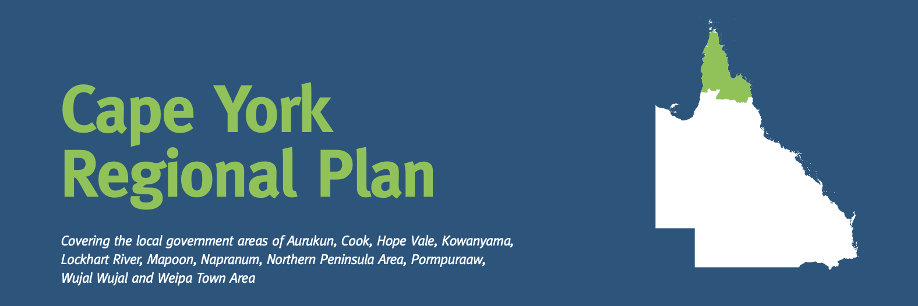
What is important to the Cape York region:
Support indigenous communities and protect the environment.
Notes:
https://www.planning.qld.gov.au/planning-framework/plan-making/regional-planning

Slide 5
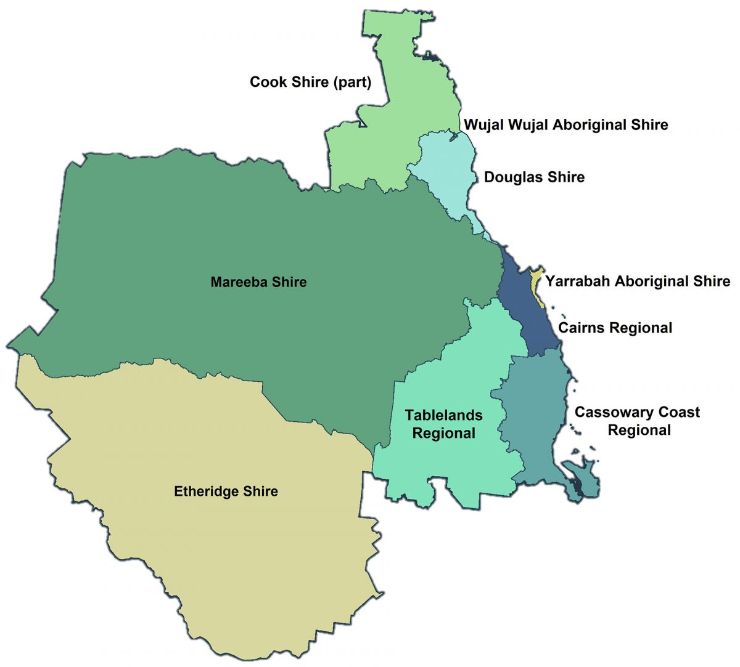
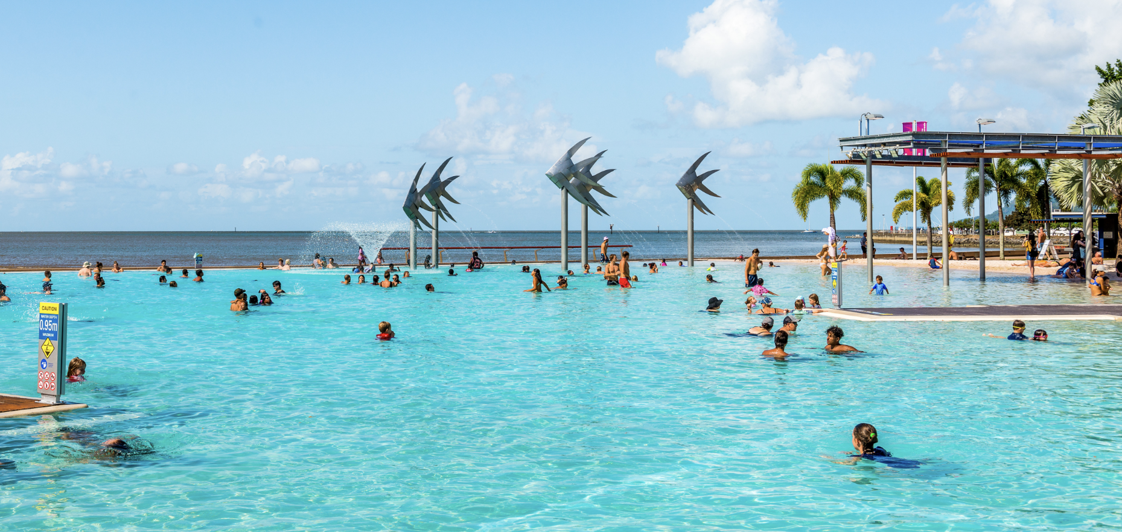
What is important to the Far North Qld region:
Manage the high amount of Urban Growth in the region so it’s sustainable and enhances quality of life
Cairns
Notes:
https://www.planning.qld.gov.au/planning-framework/plan-making/regional-planning

Slide 6


What is important to the North Qld region:
Grow an already strong economy
Townsville
Notes:
https://www.planning.qld.gov.au/planning-framework/plan-making/regional-planning

Slide 7
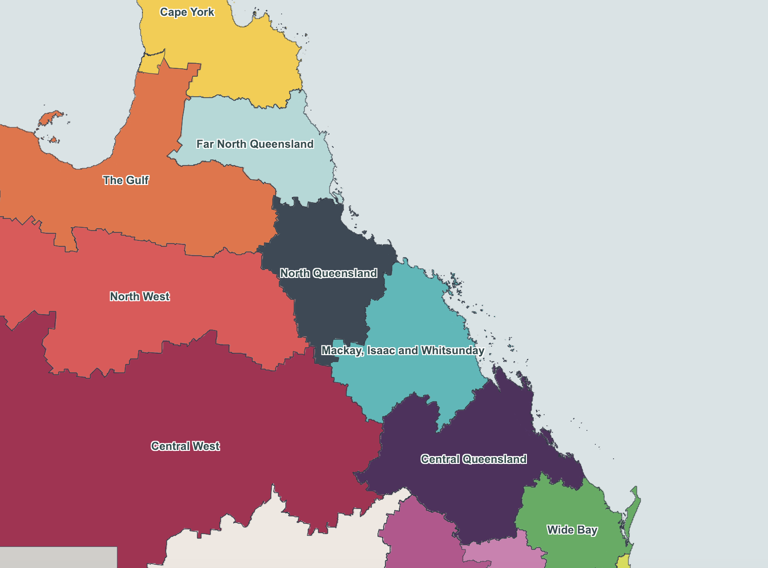

What is important to the Mackay, Isaac and Whitsunday region:
Ensure the region grows and changes in a sustainable way
Notes:
https://www.planning.qld.gov.au/planning-framework/plan-making/regional-planning

Slide 8

What is important to the Central Qld region:
Foster the four economic pillars of Central Qld:
agriculture, resources (coal, CSG/LNG), tourism and construction.
Notes:
https://www.planning.qld.gov.au/planning-framework/plan-making/regional-planning

Slide 9
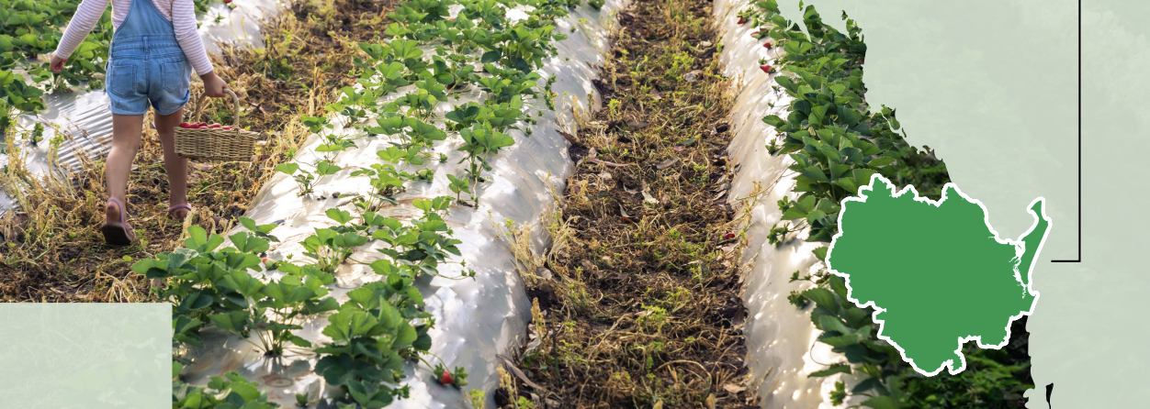
What is important to the Wide Bay Burnett region:
Retain youth and attract new residents to the region
Notes:
https://www.planning.qld.gov.au/planning-framework/plan-making/regional-planning

Slide 10
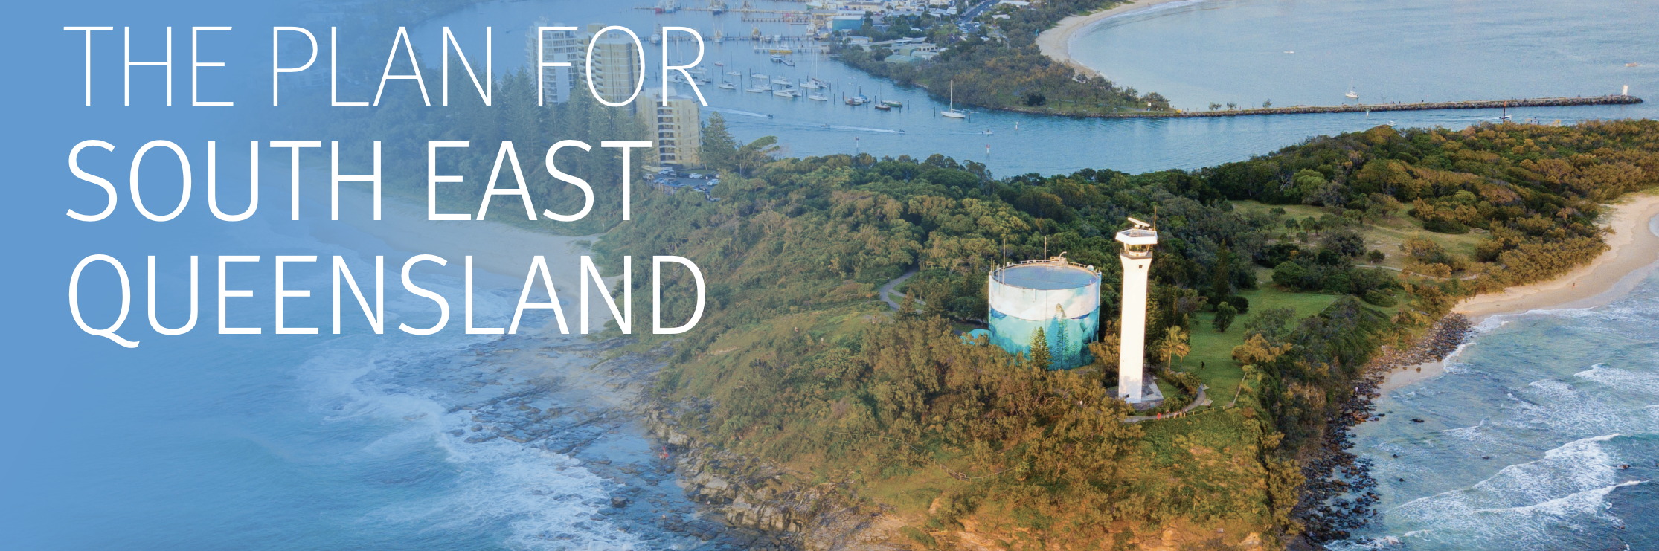
What is important to the SE Qld region:
Sustainably accommodate a growing population of
6 million people by 2046
Notes:
https://www.planning.qld.gov.au/planning-framework/plan-making/regional-planning

Slide 11
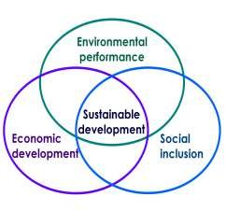
Choose the regional plan from your region.
Evaluate its success
(is the proposed development sustainable?).

Slide 12
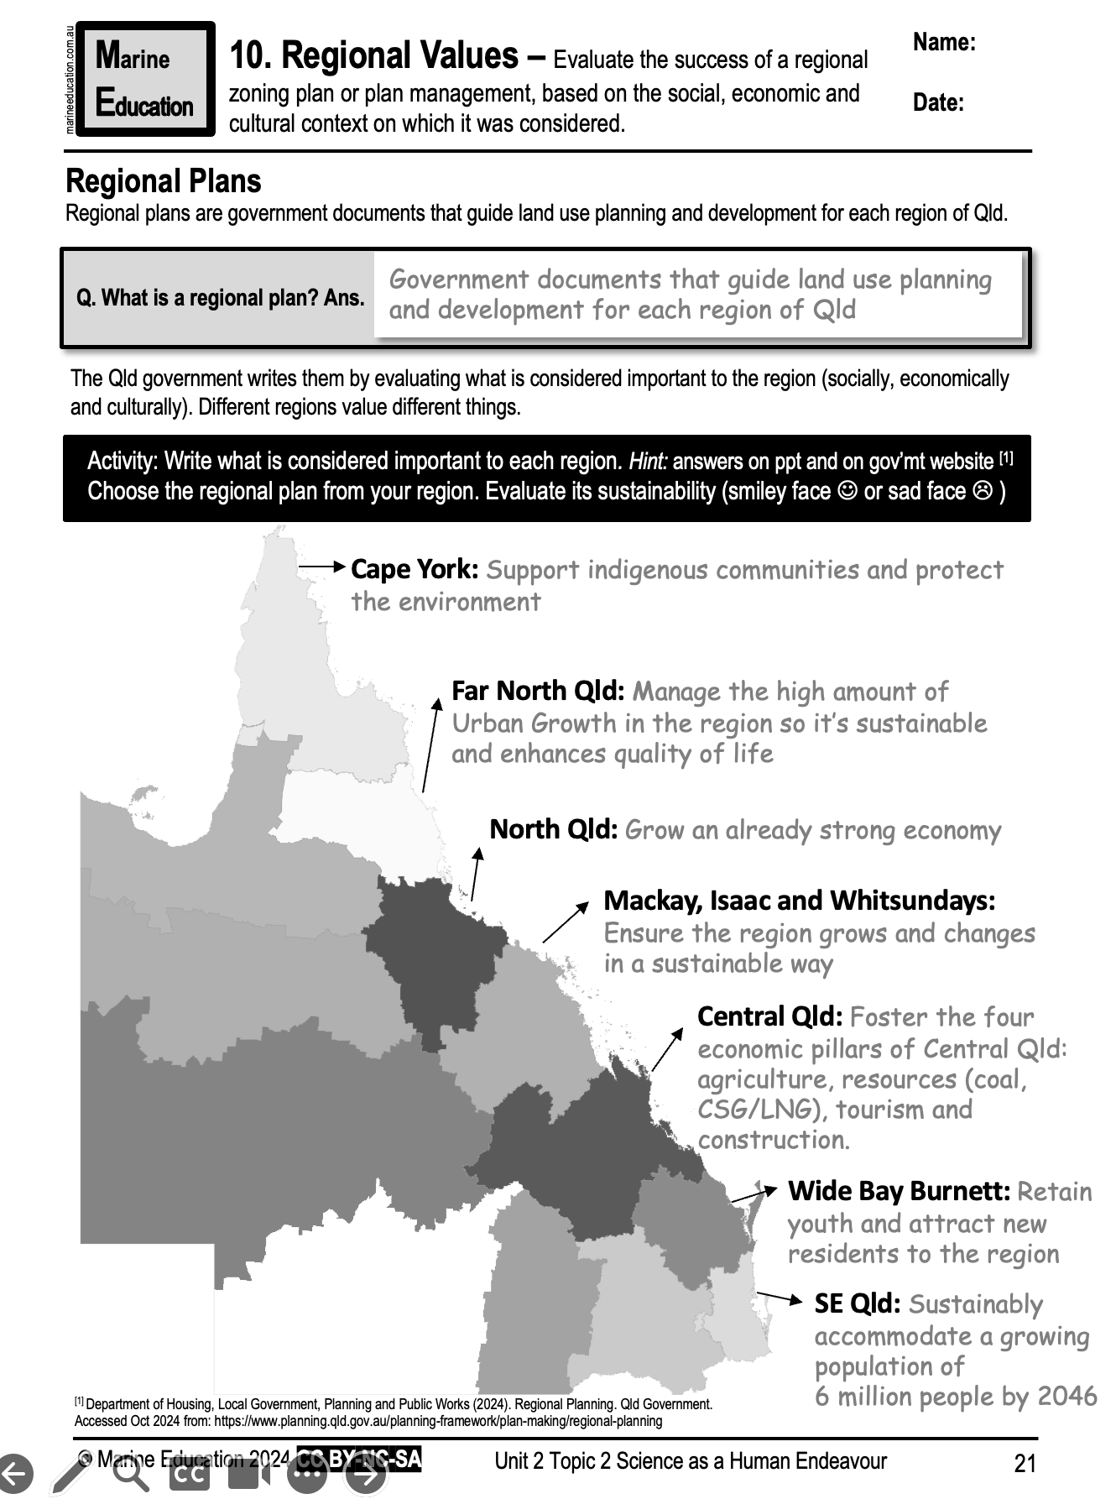
Learning Intention:
Evaluate the success of a regional zoning plan or plan management, based on the social, economic and cultural context on which it was considered.
Success Criteria:
Complete Marine Education worksheet ‘11. Regional Values’
Notes:
Image: https://www.crownandchamparesorts.com/magazine/press-sea-turtle-hatching-at-kagi-maldives/

