Slide 1
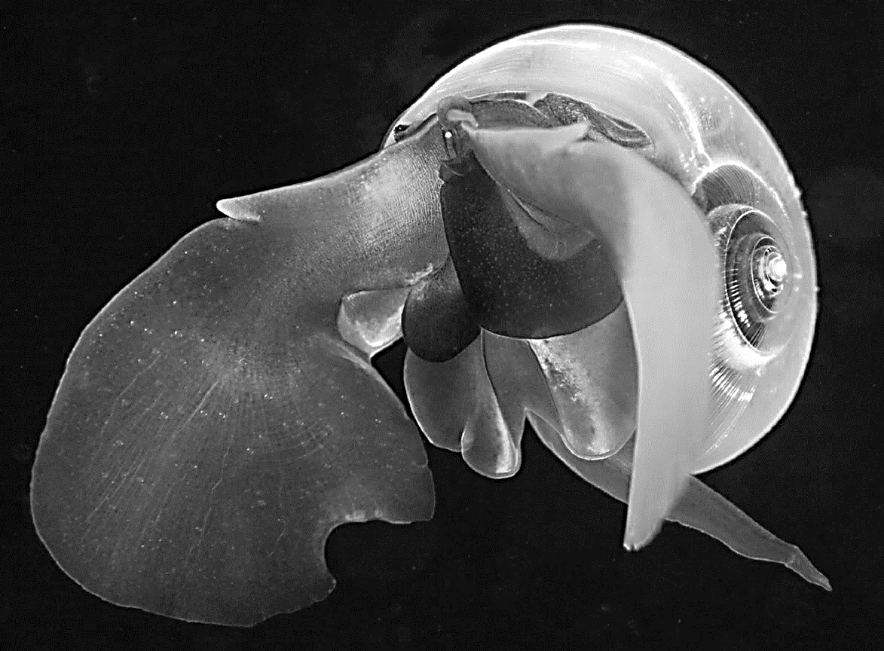
Marine
Education
Year 12 Marine Science
Name:
Date:
marineeducation.com.au
Unit 3 Marine Systems
Connections and Change
Topic 2:
Changes on the Reef
Anthropogenic change
Ocean equilibria
Implications for marine systems
A Pteropod Limacina helicina commonly known as ‘sea buttlerfly’. Photograph © Alexander Semenov. Reprinted with permission.
Flinders Reef Moreton Bay Marine Park July 2016
© Marine Education 2024 CC BY-NC-SA

Slide 2
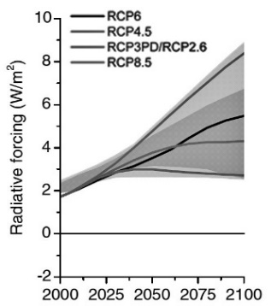
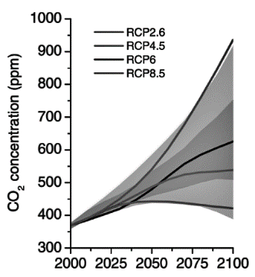
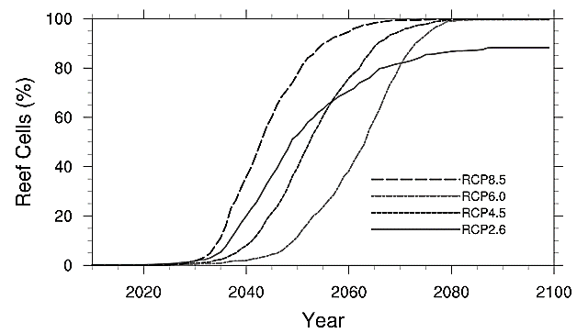
Marine
Education
1. Getting Warmer….Why 1.5°C Matters – Interpret data from models to determine potential reef futures under various scenarios.
Name:
Date:
marineeducation.com.au
The IPCC
Governments from around the world came together in 1988 and created the International Panel on Climate Change (IPCC). The IPCC recruit world leading experts on climate change – lots of them – to author reports
every 5-6 years, to help inform government policy decisions.
In 2018, the IPCC published A Special Report: Global Warming of 1.5°C^{[1]}. With 91 authors, the report states: ‘multiple lines of evidence indicate that the majority of warmer water tropical coral reefs that exist today (70-90%) will disappear even if global warming is constrained to 1.5°C (very high confidence)’.
Q. How much has the Earth warmed already (since pre-industrial levels)? Ans.
Representative Concentration Pathways (RCPs)
In 2014, the ICPP published a report that approximated radiative forcing (W/m²) in 2100 for 4 different greenhouse gas (GHG) concentration pathways, called RCPs^{[2]}. E.g. RCP8.5 is a future with high GHG concentrations, whereas RCP2.6 is a future with low GHG concentrations, expressed in ppm as CO2 equivalent (Fig. 1) or just CO2 (Fig. 2)^{[3]}.
Note: each RCP is simply a whole bunch of numbers that serve the purpose as inputs for climate models, to jump-start and standardise the climate modelling process. They are not a complete package of socio-economic, emissions, and climate projections^{[2]}.
Q. What does RCP stand for? Ans.
Representative Concentration Pathways
1370
RCP2.6
RCP 4.5
RCP 6.0
RCP 8.5
936
RCP8.5
RCP8.5
850
(bleaching annually)
650
670
<490
RCP2.6
538
RCP2.6
421
Fig. 1: CO2 concentration equivalent (ppm) in 2100 for each RCP^{[3]}
Fig. 2: CO2 concentrations (ppm)
(and only for CO2) in 2100 for each RCP^{[3]}
Fig. 3: Percentage of reefs globally projected to bleach every year. Bleaching will be an annual event for 3 out of 4 RCPs by 2100. Courtesy of Ruben van Hooidonk from data in van Hooidonk et al., (2014)^{[4]}
Activity: Complete the table below
Radiative
Forcing
W/m²
in 2100
RCP |  | CO2 | CO2 | Likelihood of staying below a specific temperature level over the 21st Century (relative to 1850-1900)^{[5]} |  |  |  | Potential Reef Futures in the year 2100
 |  |  |  | 1.5°C | 2°C | 3°C | 4°C
8.5 | 8.5 | 1370 | 936
6.0 | 6.0 | 850 | 670
4.5 | 4.5 | 650 | 538
2.6 | 2.6 | <490 | 421
concentration equivalent
(ppm) in 2100
concentration
(ppm) in 2100
Unlikely
More unlikely than likely
Reefs not dominated by coral ^{[pg.27]}
Annual bleaching^{[4]}
Unlikely
Unlikely
More unlikely than likely
Reefs not dominated by coral ^{[pg.27]}
Annual bleaching^{[4]}
More unlikely than likely
More Likely than not
Likely
Reefs not dominated by coral ^{[pg.27]}
Annual bleaching^{[4]}
More unlikely than likely
Likely
Likely
10-30% of reefs might be saved^{[1]}
^{[1]} IPCC (2018) Global warming of 1.5°C. An IPCC Special Report on the impacts of global warming of 1.5°C above pre-industrial levels and related global greenhouse gas emission pathways, in the context of strengthening the global response to the threat of climate change, sustainable development, and efforts to eradicate poverty [V. Masson-Delmotte, P. Zhai, H. O. Pörtner, D. Roberts, J. Skea, P.R. Shukla, A. Pirani, W. Moufouma-Okia, C. Péan, R. Pidcock, S. Connors, J. B. R. Matthews, Y. Chen, X. Zhou, M. I. Gomis, E. Lonnoy, T. Maycock, M. Tignor, T. Waterfield (eds.)]. In Press.
^{[2]} Vuuren, D.P.V., Edmonds, J.A., Kainuma, M., Riahi, K. and Weyant, J. (2011). Special Issue: The Representative Concentration Pathways in Climate Change. Climatic Change. 109 (1-2). DOI: 10.1007/s10584-011-0157-y
^{[3]} Adapted from: Climate Change in Australia (2015). Greenhouse Gas Scenarios. CSIRO. Accessed 16.02.2019 from https://www.climatechangeinaustralia.gov.au/en/climate-campus/modelling-and-projections/projecting-future-climate/greenhouse-gas-scenarios/
^{[4]} van Hooidonk R.J, Maynard J.A, Manzello D, Planes S (2014). Opposite latitudinal gradients in projected ocean acidification and bleaching impacts on coral reefs. Global Change Biology, 20, 103–112. DOI: 10.1111/gcb.12394
^{[5]} Adapted from: IPCC, 2014: Climate Change 2014: Synthesis Report. Contribution of Working Groups I, II and III to the Fifth Assessment Report of the Intergovernmental Panel on Climate Change [Core Writing Team, R.K. Pachauri and L.A. Meyer (eds.)]. IPCC, Geneva, Switzerland, 151 pp. Accessed 01.07.2019 from: https://www.ipcc.ch/report/ar5/syr/
© Marine Education 2024 CC BY-NC-SA
Unit 3 Topic 2 Science Understanding – Anthropogenic change

Slide 3
Marine
Education
Interpret data from models to determine potential reef futures under various scenarios.
Name:
Date:
marineeducation.com.au
© Marine Education 2024 CC BY-NC-SA
NOTES AND EXAM REVISION

Slide 4
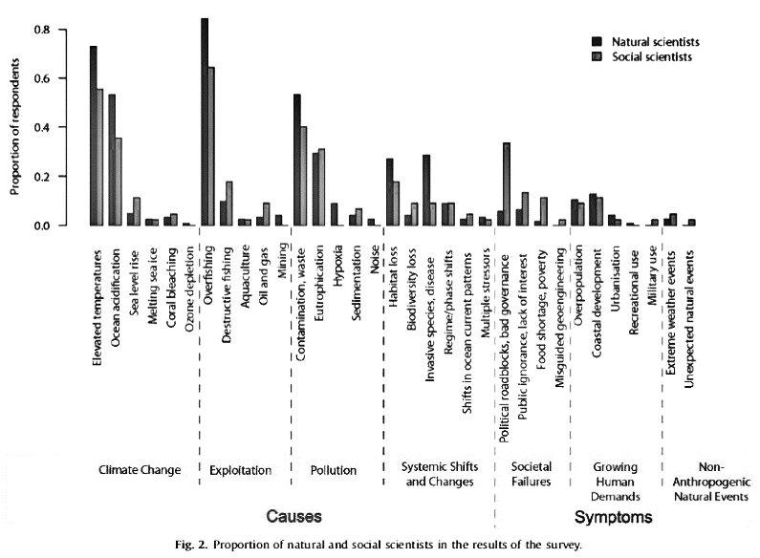
Marine
Education
2. Footprints of the Anthropocene –
Describe the global anthropogenic factors affecting the distribution of coral (i.e. coral mining, organic and non-organic pollution, fishing practices, dredging, climate change, ocean acidification and shipping).
Name:
Date:
marineeducation.com.au
What do SCIENTISTS perceive as the greatest global threats?
An email survey in 2015^{[1]} asked 171 leading academics in marine science (126 natural scientists and 45 social scientists) the following question. ‘Could you tell us which five topics represent the greatest global threats or potential impacts in marine environments?’. See the results of the survey in Figure 1 below:
Natural scientists
Social scientists
Proportion of respondents
Elevated temperatures
Ocean Acidification
Sea level rise
Melting sea ice
Coral bleaching
Ozone depletion
Overfishing
Destructive fishing
Aquaculture
Oil and gas
Mining
Contamination and waste
Eutrophication
Hypoxia
Sedimentation
Noise
Habitat loss
Biodiversity loss
Invasive species, disease
Regime/phase shifts
Shifts in ocean current patterns
Multiple stressors
Overpopulation
Coastal development
Urbanisation
Recreational use
Military use
Political roadblocks, bad governance
Public ignorance, lack of interest
Food shortage, poverty
Misguided geoengineering
Extreme weather events
Unexpected natural events
Climate Change
Exploitation
Pollution
Systemic Shifts and Changes
Societal Failures
Growing Human Demands
Non-Anthropogenic Natural Events
Figure 1: Global threats or potential impacts in marine environments, according to 126 natural scientists and 46 social scientists in an email survey^{[1]}.
Q. What is perceived as the greatest global threat in Figure 1? Ans.
Overfishing
Activity: Rank what you perceive as the top 5 greatest global threats in marine environments
1.
2.
3.
4.
5.
^{[1]} Adapted with permission from: Boonstra, W.J., Ottosen, K.M., Ferreira, A.S.A., Richter, A., Rogers, L.A., Pedersen, M.W., Kokkalis, A., Bardarson, H., Bonanomi, S., Butler, W., Diekert, F.K., Fouzai, N., Holma, M., Holt, R.E., Kvile, K.O., Malanski, E., MacDonald, J.I., Nieminen, E., Romagnoni, G., Snickars, M., Weigel, G., Woods, P., Yletyinen, J. and Whittington, J.D. (2015). What are the major global threats and impacts in marine environments? Investigating the contours of a shared perception among marine scientists from the bottom-up. Marine Policy 60: 197-201 DOI: 10.1016/j.marpol.2015.06.007.
© Marine Education 2024 CC BY-NC-SA
Unit 3 Topic 2 Science Understanding – Anthropogenic change

Slide 5
Marine
Education
Describe the global anthropogenic factors affecting the distribution of coral (i.e. coral mining, organic and non-organic pollution, fishing practices, dredging, climate change, ocean acidification and shipping).
Name:
Date:
marineeducation.com.au
© Marine Education 2024 CC BY-NC-SA
NOTES AND EXAM REVISION

Slide 6
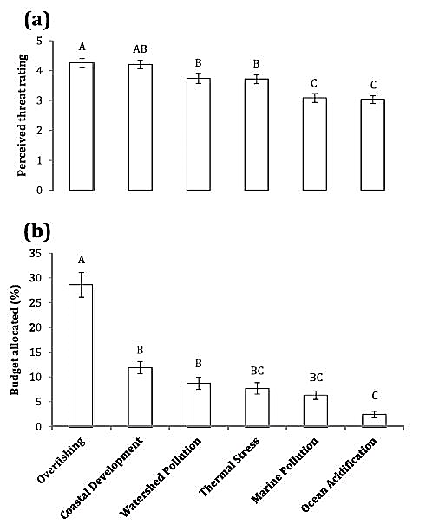
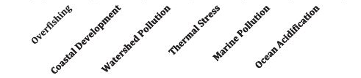
Marine
Education
3. Under Pressure….Threats to Reefs – Describe the specific pressures affecting coral reefs, i.e. surface run-off, salinity fluctuations, climate change, cyclic crown-of-thorns outbreaks, overfishing, spills and improper ballast.
Name:
Date:
marineeducation.com.au
What do coral reef MANAGERS perceive as the greatest local threats?
An email survey in 2016^{[1]} listed six threats to coral reefs (see x-axis) and asked coral reef managers to (a) rate the level each threat posed to reefs in their jurisdiction (0=no threat and 6=extreme threat) and
(b) report on how much money (% of budget) is allocated to abate each threat. Below are the results.
Perceived Threat
Budget allocated (%)
Figure 1: The results of an email survey asking coral reef managers to (a) rate their perceived threat level of six named threats to local coral reefs (threat rating scale of 0-6, with 0=no threat and 6=extreme threat) and (b) report on how much money (%) is allocated to abate each threat, n=110^{[1]}.
Q. What is perceived as the greatest local threat in Figure 1? Ans.
Overfishing
Activity: Complete the table below. Describe each threat. Then, rate the level each threat poses to a reef close to your location (0=no threat; 6 =extreme threat). Reef Name:
Threat | Describe the threat | Rate the local threat (0-6)
Surface run-off | Sedimentation reduces clarity and causes smothering. Increased nutrient input leads to disease, COTS, etc.
Salinity fluctuations | Freshwater inundation causes corals to bleach
Climate change | Increasing temperatures causes corals to bleach
 | COTS (Crown of Thorns Starfish) eat corals
Overfishing | Functional contributions of fish are lost
Oil spills | Large infrequent oil spills, and small chronic oil spills, impede coral growth, reproduction and much more…
Improper ballast | Introduced species (entering via improper ballast water management) outcompete native species
Cyclic COTS outbreaks
^{[1]} Adapted with permission from: Wear, S. L. (2016). Missing the boat: Critical threats to coral reefs are neglected at global scale. Marine Policy 74: 153-157. DOI: 10.1016/j.marpol.2016.09.009.
© Marine Education 2024 CC BY-NC-SA
Unit 3 Topic 2 Science Understanding – Anthropogenic change

Slide 7
Marine
Education
Describe the specific pressures affecting coral reefs, i.e. surface run-off, salinity fluctuations, climate change, cyclic crown-of-thorns outbreaks, overfishing, spills and improper ballast.
Name:
Date:
marineeducation.com.au
© Marine Education 2024 CC BY-NC-SA
NOTES AND EXAM REVISION

Slide 8
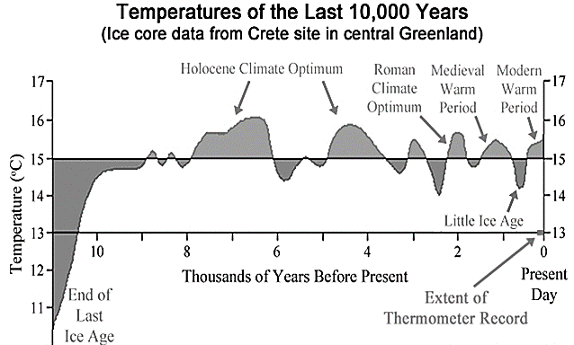
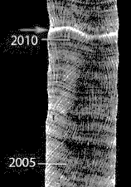
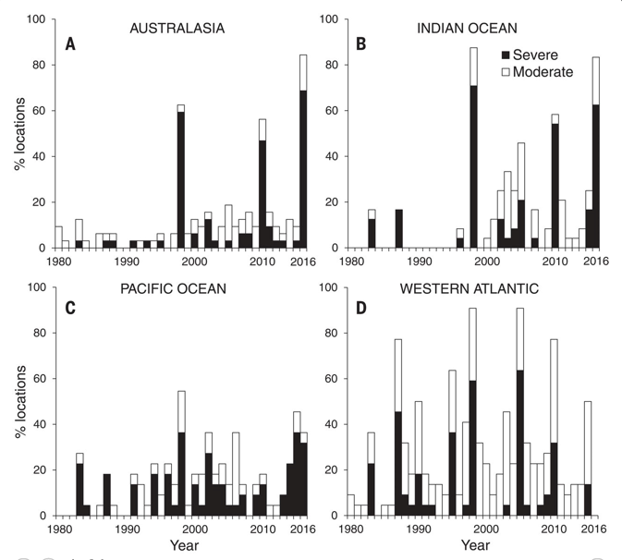
Marine
Education
4. Sclerochronometer Secrets – Explain how coral cores provide a historical record of coral growth rates and environmental
conditions.
Name:
Date:
marineeducation.com.au
Q. Was the beginning of the Holocene associated with a period of global warming or cooling? Ans.
warming
Q. Was there a time during the Holocene when temperatures were warmer than today? Ans.
Yes
Q. Is there evidence of bleaching then? Ans.
No
and beginning of Holocene
Fig. 1: Temperatures since the beginning of the Holocene^{[1]}.
Coral core climate records
Coral cores provide a very handy record of coral bleaching events from the past.
For example, any heat wave that causes a coral to become stressed, the coral records as a discrete, high density ‘stress band’ on its skeleton^{[2]} (see white line in Figure 2). Conveniently, the date of the stress band can be calculated using its position in
relation to growth bands on the skeleton (which appear like the growth rings on a tree). Note: coral cores can be taken from live corals (see p. 98, Fig. 2) or from fossil corals whereby radiocarbon (¹⁴C) dating is used to obtain the initial calendar age of the coral^{[3]}.
Fig. 2: Coral core stress band (in white) from the 2010 bleaching event^{[2]}.
Q. What does a high density ‘stress band’ indicate? Ans.
Past stress (e.g. bleaching)
Mass Bleaching Events Timeline
Prior to 1979, reports of coral bleaching events in the primary literature are virtually non-existent^{[4]}.
Fig. 3: Geographic variation in the timing and intensity of coral bleaching from 1980 to 2016. (A) Australasia (32 locations). (B) Indian Ocean (24 locations). (C) Pacific Ocean (22 locations). (D) Western Atlantic (22 locations). For each region, black bars indicate the % of locations that experienced severe bleaching, affecting >30% of corals. White bars indicate the % of locations per region with additional moderate bleaching affecting <30% of corals^{[5]}.
Q. When was the first severe bleaching event in Figure 3? (hint: 1st black line in all 4 graphs) Ans.
1983
Q. In what year did a mass coral bleaching event capture the world’s attention? Ans.
1998
^{[1]} Adapted with permission from: Wagg, G. (2015). Lesson 1 – Palaeoclimatology. Wordpress. London. UK. Accessed 26.06.2019 from: https://mrgeogwagg.wordpress.com/2015/06/22/lesson-1-palaeoclimatology/
^{[2]} Adapted with permission from: Barkley, H.C. and Cohen, A.L. (2016). Skeletal records of community-level bleaching in Porites corals from Palau. Coral Reefs. DOI: 10.1007/s00338-016-1483-3
^{[3]} Lough, J.M., Llewellyn, L.E., Lewis, S.E., Turney, C.S.M., Palmer, J.G., Cook, C.G. and Hogg, A.G. (2014). Evidence for suppressed mid-Holocene northeastern Australian monsoon variability from coral luminescence. Paleoceanography, 29(6), 581–594. DOI: 10.1002/2014PA002630
^{[4]} Hoegh-Guldberg, O. (1999). Climate change, coral bleaching and the future of the world’s coral reefs. Marine Freshwater Research. Vol. 50, 839-66. DOI: 10.1071/mf99078
^{[5]} From Hughes, T., Anderson, K.D., Connonlly, S., Heron, S.F., Kerry, J.R., Lough, J.M., Baird, A.H., Baum, J.K., Berumen, M.L., Bridge, T.C., Claar, D.C., Eakin, M., Gilmour, J.P., Graham, N.A.J., Harrison, H., Hobb, J.A., Hoey, A.S., Hoogenboom, M., Lowe, R.J., McCulloch, M., Pandolfi, J.M., Pratchett, M., Schoepf, V., Torda, G. and Wilson, S.K. (2018). Spatial and temporal patterns of mass bleaching of corals in the Anthropocene. Science 359, 80-83. DOI: 10.1126/science.aan8048. Reprinted with permission from AAAS.
© Marine Education 2024 CC BY-NC-SA
Unit 3 Topic 2 Science Understanding – Anthropogenic change

Slide 9
Marine
Education
Explain how coral cores provide a historical record of coral growth rates and environmental conditions.
Name:
Date:
marineeducation.com.au
© Marine Education 2024 CC BY-NC-SA
NOTES AND EXAM REVISION

Slide 10
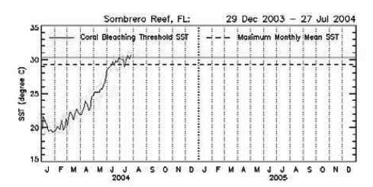
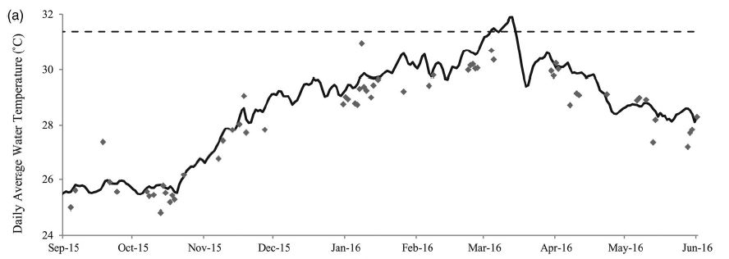
Marine
Education
5. In Hot Water…How warm is too warm? – Explain the concept of coral bleaching in terms of Shelford’s law of tolerance.
Name:
Date:
marineeducation.com.au
Threshold Theatre
The reason why there were so few bleaching events recorded prior to 1979 is because the sea surface temperature (SST) rarely exceeded the upper thermal limit of coral and zooxanthellae^{[1]}. The upper thermal limit (also called the thermal threshold, bleaching threshold or a combination of both) is the temperature that corals are likely to bleach. That temperature varies between species, location and time. But for modelling purposes, it is generally set to 1°C above a long-term average for that month and location (e.g. maximum monthly mean or MMM + 1°C)^{[2]}. Whereby, any temperature above that threshold is considered as out of the ordinary, too warm, and likely to cause bleaching^{[2]}. Conversely, the optimal temperature for reef-building corals is ~2-4°C below its upper thermal limit^{[3][5]}.
bleaching threshold (~31.3°C)
Bleaching alert!
SST (°C)
Bleaching alert!
Daily Average Water Temperature (°C)
Figure 1: The SST of Sombrero Reef being plotted against, and rising above, the MMM (dashed line) and the bleaching threshold (solid straight line)^{[2].}
Figure 2: Thursday Island 2015-16 had 10 days above the thermal threshold and temperatures 2.6°C above normal (mid-March) causing bleaching^{[4]}.
Q. At what temperature are corals on Thursday Island likely to bleach (Fig. 2)? Ans.
~31.3°C
Activity: Draw a graph of Shelford’s Law of Tolerance. Indicate the approximate position of (i) MMM and (ii) the upper thermal limit.
Activity: Explain the concept of coral bleaching in terms of Shelford’s Law of Tolerance
Corals live close to their upper thermal limit. Therefore, water temperatures only need to warm up a few degrees before corals start to expel their zooxanthellae and turn white, known as ‘coral bleaching’.
Note: the damaging effects of high temperatures are also time dependent (see next page). Hence, it is not possible to cite a single lethal temperature without specifying the exposure period (unless it is ridiculously warm and the corals simply cook to death).
Range of Tolerance
Zone of Intolerance
Zone of Stress
Optimum Range
Zone of Stress
Zone of Intolerance
Abundance
Temperature °C
(ii)
(i)
Adapted from: Buddemeier, R. W. and Smith, S. V. (1999). Coral Adaptation and Acclimatization: A Most Ingenious Paradox. Amer. Zool., 39(1):1-9
^{[1]} Hoegh-Guldberg, O. (1999). Climate change, coral bleaching and the future of the world’s coral reefs. Marine Freshwater Research. Vol. 50, 839-66. DOI: 10.1071/mf99078
^{[2]} Liu, G., Strong, A. E., Skirving, W. J. and Arzayus, F. (2006). Overview of NOAA Coral Reef Watch Program’s Near-Real-Time Satellite Global Coral Bleaching Monitoring Activities. Proceedings of the 10th International Coral Reef Symposium, Okinawa: 1783-1793. Accessed 23.02.2019 from www.coralreefwatch.noaa.gov
^{[3]} Langlais, C., Lenton, A., Evenhuis, C., Gupta, A.S., Brown, J.N. and Kuchinke, M. (n.d.). Local SST variability determines coral bleaching risk under global warming. As: Coral_variability_warming_MMM_resubmitted.docx In: Langlais et al., (2015). Projections of coral bleaching risk in the Western Pacific under different levels sea surface temperature increases. v1. CSIRO. Data Collection. DOI: 10.4225/08/551413D6B8141
^{[4]} Adapted with permission from: Bainbridge, S. (2017). Temperature and light patterns at four reefs along the Great Barrier Reef during the 2015–2016 austral summer: understanding patterns of observed coral bleaching. Journal of Operational Oceanography. 10:1. 16-29. DOI:10.1080/1755876X.2017.1290863. Reproduced with permission.
^{[5]} Cantin N.E. and Lough, J.M. (2014). Surviving Coral Bleaching Events: Porites Growth Anomalies on the Great Barrier Reef. PLoS One. 9(2): e88720. DOI: 10.1371/journal.pone.0088720
© Marine Education 2024 CC BY-NC-SA
Unit 3 Topic 2 Science Understanding – Anthropogenic change

Slide 11
Marine
Education
Explain the concept of coral bleaching in terms of Shelford’s law of tolerance
Name:
Date:
marineeducation.com.au
© Marine Education 2024 CC BY-NC-SA
NOTES AND EXAM REVISION

Slide 12
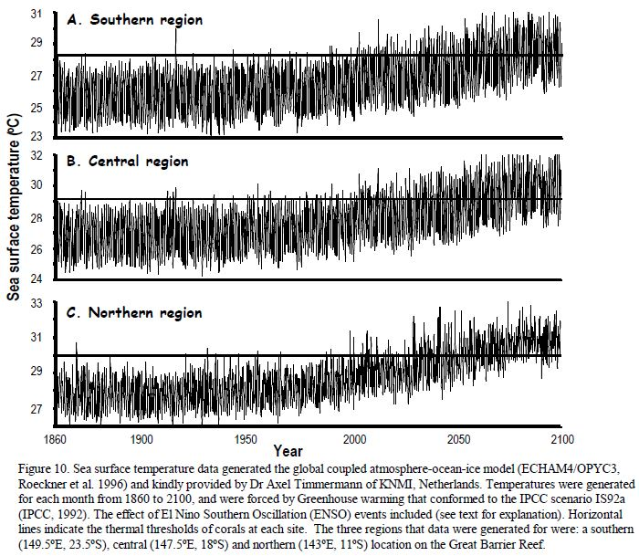
Marine
Education
6. In Hot Water...How long is too long? –
Interpret degree heating weeks, sea surface temperature and thermal threshold data for reefs in the northern, central and southern sections of the Great Barrier Reef to predict the likelihood of a bleaching event.
Name:
Date:
marineeducation.com.au
T104
Temperature Time Bomb
The graph pictured left^{[1]} was published in a paper by Professor Ove Hoegh-Guldberg in 1999 - a paper that has been referenced >3000 times. The horizontal lines indicate the thermal threshold of corals for sites in the northern, central and southern locations of the GBR.
Activity: Estimate the likelihood of a bleaching event in 1950 vs. 2100 for each region of the Great Barrier Reef
Region | 1950 | 2100
Northern | Very Low | Very High
Central | Very Low | Very High
Southern | Very Low | Very High
Reproduced with Permission^{[1]}.
Bleaching Alert!
The severity of a mass bleaching event largely depends on how warm the water gets, and for how long.
A Degree Heating Week (DHW) is a metric used to quantify the accumulated thermal stress on coral reefs over a period of time. DHW is a way to measure not only how far the temperature is above the bleaching threshold, but also how long it has stayed above that point. The higher the DHW, the greater the heat stress on corals^{[3]}. When temperatures reach 4DHW, significant coral bleaching is likely, especially in more sensitive species. When temperatures reach 8DHW or higher, widespread bleaching and mortality from thermal stress may occur.
Activity: Complete the table below for today’s date, using real-time data from ReefTemp and eReefs on the Bureau of Meteorology^{[4]} or Coral Reef Watch on NOAA^{[5]}
Region
Northern GBR | 29.0°C | 30.0°C
Central GBR | 28.1°C | 29.1°C
Southern GBR | 27.2°C | 28.2°C
MMM
(long-term mean SST for
hottest month of the year)
Thermal Threshold
MMM + 1°C
DHW
(as of today)
^{[1]} Hoegh-Guldberg, O. (1999). Climate change, coral bleaching and the future of the world’s coral reefs. Marine Freshwater Research. Vol. 50, 839-66. DOI: 10.1071/mf99078
^{[2]} Maynard, J. A. (2008). ReefTemp: An interactive monitoring system for coral bleaching using high-resolution SST and improved stress predictors. Geophysical Research Letters (35)
^{[3]} Liu, G., Strong, A.E., Skirving, W. and Arzayus, L.F. (2006). Overview of NOAA Coral Reef Watch Program’s Near-Real-Time Satellite Global Coral Bleaching Monitoring Activities. Proceedings of the 10th International Coral Reef Symposium, Okinawa. June 28-July 2, 2004. 1783-1793. Accessed 23.02.2019 from www.coralreefwatch.noaa.gov
^{[4]} Bureau of Meteorology (2019). ReefTemp Next Generation (BOM>Environmental Information>Coastal Information). URL: www.bom.gov.au/environment/activities/reeftemp/reeftemp.shtml
^{[5]} NOAA Satellite and Information Service (2019). Coral Reef Watch Home Page. URL: https://coralreefwatch.noaa.gov/satellite/index.php
© Marine Education 2024 CC BY-NC-SA
Unit 3 Topic 2 Science Understanding – Anthropogenic change

Slide 13
Marine
Education
Interpret degree heating weeks, sea surface temperature and thermal threshold data for reefs in the northern, central and southern sections of the Great Barrier Reef to predict the likelihood of a bleaching event.
Name:
Date:
marineeducation.com.au
© Marine Education 2024 CC BY-NC-SA
NOTES AND EXAM REVISION

Slide 14
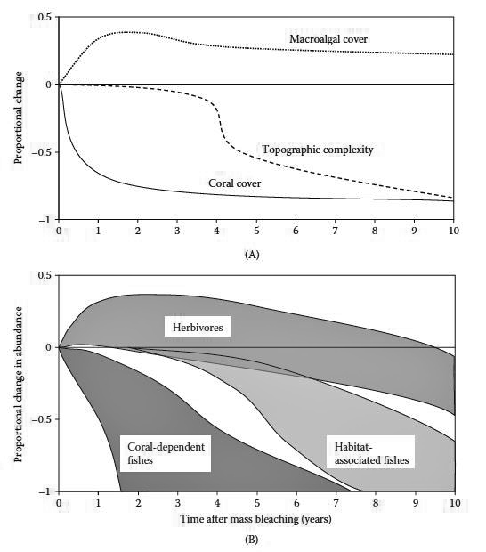
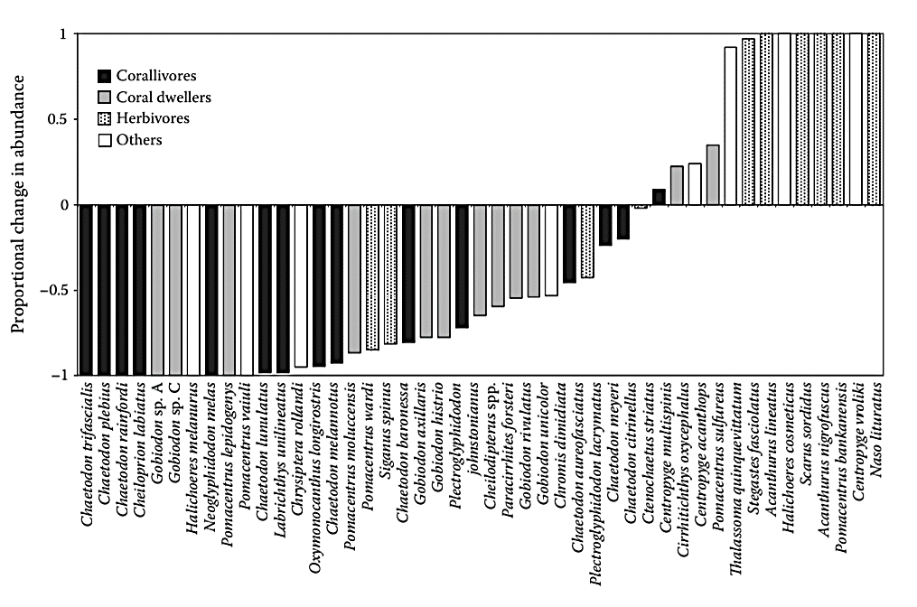
Marine
Education
7. What’s the Damage Bill? – Discuss the ecological effects of a bleaching event on other reef organisms, e.g. fish.
Name:
Date:
marineeducation.com.au
Assessing the damage
How organisms respond to bleaching events varies depending on the severity of the bleaching event, and the ecology and life-history of the species^{[1]}. For example, when a bleaching event is severe and lots of live coral dies, coral-dependent fishes (e.g. butterflyfish and damselfish) are most at risk because of their direct reliance on corals for food, habitat and recruitment^{[1]}. In particular, coral-dependent fish that depend on live coral for food (e.g. Chaetodon spp.) experience significant declines in abundance (although sometimes
these declines are not observed for a few years)^{[1].} Importantly, if a hard coral colony is dead, it still remains structurally intact, contributing to the reef’s topographic complexity^{[2]}. It usually takes ~4 years* for the colony to break down from erosion and for a decline in topographic complexity to be observed (unless a cyclone hits before then). When the reef loses its topographic complexity, the effects are more widespread^{[2]}.
A
Macro-algal cover
B
Herbivores
Proportional change
Topographic Complexity
Proportional change in abundance
Coral Cover
Coral-dependent fishes
Habitat-
associated fishes
Time after mass bleaching (years)
Time after mass bleaching (years)
Figure 1: Conceptual diagram of changes in coral reef habitats and fish communities following climate-induced coral bleaching.
(A) Timing and magnitude of proportional changes in macro-algal cover, topographic complexity and coral cover.
(B) Response envelops for strongly coral-dependent fishes (e.g., obligate corallivores), habitat-associated fishes and herbivores^{[2]}.
Activity: Use a specific case study to evaluate the ecological effects on other organisms
(e.g. fish) after a bleaching event has occurred. Reference the case study in the space provided.
Figure 2: Changes in the abundance of coral reef fishes (corallivores in black, coral dwellers in grey, herbivores with dots, and others in white) 1-3 years following climate-induced coral bleaching. Data presented for 45 (of 116) species that exhibited significant changes in abundance following mass bleaching that caused >50% coral loss^{[2]}.
Proportional change in abundance
Reference
^{[2]} Pratchett, M. S. et al., (2008). Effects of Climate-Induced Coral Bleaching on Coral Reef Fishes – Ecological and Economical Consequences. Oceanography and Marine Biology: An Annual Review (46) 251-296. DOI: 10.1201/9781420065756.ch6
* However, Eakin et al., (2019)^{[3]} suggest bioerosion might be more rapid than previously understood, with a significant reduction in topographic complexity observed within less than a year after bleaching.
^{[1]} Coker, D. J. (2012). The importance of live coral habitat for reef fishes and its role in key ecological processes. PhD thesis. James Cook University.
^{[2]} Adapted with permission from: Pratchett, M. S., Munday, P. L., Wilson, S. K., Graham, N.A.J., Cinner, J. E., Bellwood, D.R., Jones, G.P., Polunin, N.V.C., and McClanahan, T.R. (2008). Effects of Climate-Induced Coral Bleaching on Coral Reef Fishes – Ecological and Economical Consequences. Oceanography and Marine Biology: An Annual Review (46) 251-296. DOI: 10.1201/9781420065756.ch6
^{[3]} Eakin, M.C., Sweatman, H.P.A. and Brainard, R.E. (2019). The 2014-2017 global-scale coral bleaching event: insights and impacts. Coral Reefs. P. 1-7. DOI: 10.1007/s00338-019-01844-2
© Marine Education 2024 CC BY-NC-SA
Unit 3 Topic 2 Science Understanding – Anthropogenic change

Slide 15
Marine
Education
Discuss the ecological effects of a bleaching event on other reef organisms, e.g. fish.
Name:
Date:
marineeducation.com.au
© Marine Education 2024 CC BY-NC-SA
NOTES AND EXAM REVISION

Slide 16
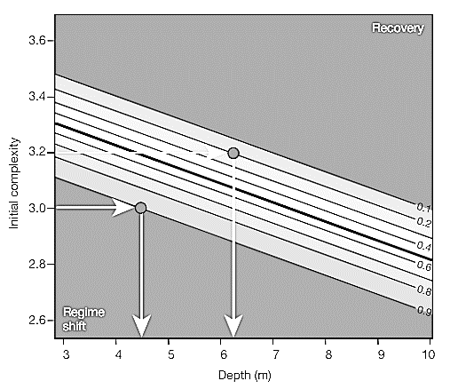
Marine
Education
8. Recipe for Rebuilding – Describe the conditions necessary for recovery from bleaching events
Name:
Date:
marineeducation.com.au
Reefs need ‘heat tolerant’ zooxanthellae to multiply – quickly
Even when bleached, corals keep a few surviving zooxanthellae – usually the heat tolerant ones. After the heat wave has passed, these heat tolerant zooxanthellae multiply and bring the coral back to life. But, this only happens if (a) the water does not get too hot (literally cooking the coral)^{[1]} and (b) the heat wave passes within a short time frame (ensuring zooxanthellae multiply before the coral starves to death). Coral mortality starts at approximately 3-8 degree heating weeks^{[2][3]} (the number of DHWs varies between Genus species).
Q. How many Degree Heating Weeks do reefs have before corals start dying? Ans. DHW
3-8
Reefs need lots of coral survivors
Lots of coral survivors means lots of corals to regrow, reproduce and reseed affected areas.
Q. WHY does it matter how many corals survive? Ans.
Surviving corals regrow, reproduce and reseed affected areas
Reefs need fish (and other biodiversity) and, therefore, PROTECTION
Reefs need fish to eat competing algae, poop nutrients (food) and heat tolerant zooxanthellae, and chase away predators (e.g. ‘farmer (damsel) fish’ chase away hungry butterflyfish). Sea cucumbers, giant clams and many other species also play important functional roles in the recovery of reefs, post bleaching.
Q. True or False? Reefs in Green & Pink Zones have a better chance of recovery. Ans.
True
Reefs need time
Reefs need enough time to recover before the next disturbance hits.
Q. Is 4 years enough time to recover between large disturbance events? Ans.
[Yes] [No]
Circle correct answer
Reefs need structural complexity
Reefs need structural complexity to sustain the diversity
of life that, in functioning, helps the reef to recover.
Figure 1 illustrates the importance of complexity (and depth) to avoid a phase shift from a coral-dominated state to an algae-dominated state (which, as you know, is very difficult to reverse). For example, if the initial complexity is low (3.0), there is a high probability (0.9) that shallow sites (4.5m) will undergo a phase shift. Then, as the initial complexity increases (3.2), and the depth increases (6.3m), the probability of a phase shift decreases (0.2)^{[4]}.
Recovery
Probability of a phase shift (whereby 1 = 100%)
Initial complexity
Phase Shift
Depth (m)
Figure 1: Contour biplot of the probability of a phase shift based on initial structural complexity and water depth^{[4]}.
Q. True or False? As complexity increases, the probability of a phase shift decreases. Ans.
True
^{[1]} Hughes, T., Kerry, J.T., Baird, A.H., Connolly, S. R., Dietzel, A., Eakin, C.M., Heron, S.F., Hoey, A.S., Hoogenboom, M.O., Liu, G., McWilliam, M.J., Pears, R.J., Pratchett, M.S., Skirving, W.J., Stella J.S. & Torda, G. (2018). Global warming transforms coral reef assemblages. Nature 556, 492-496. DOI: 10.1038/s41586-018-0041-2
^{[2[} De Carlo, T.M., Harrison, J., Gajdzik, L., Alaguarda, D., Rodolfo-Metalpa, R., D’Olivo, D., Liu, G., Patalwala, D. & McCulloch, M.T. (2019). Acclimatization of massive reef-building corals to consecutive heatwaves. Proc. R. Soc. B. 286.
^{[3]} Kayanne, H. (2017). Validation of degree heating weeks as a coral bleaching index in the Northwestern Pacific. Coral Reefs. Vol. 36, Issue 1, pp 63-70. DOI:10.1007/s00338-016-1524-y
^{[4]} Adapted by permission from Springer Nature Customer Service Centre GmbH: Nature. Predicting climate-driven regime shifts versus rebound potential in coral reefs. Graham, N.A.J., Jennings, S., MacNeil, M.A., Mouillot, D. & Wilson, S.K., 2015.
© Marine Education 2024 CC BY-NC-SA
Unit 3 Topic 2 Science Understanding – Anthropogenic change

Slide 17
Marine
Education
Name:
Date:
marineeducation.com.au
Describe the conditions necessary for recovery from bleaching events
© Marine Education 2024 CC BY-NC-SA
NOTES AND EXAM REVISION

Slide 18
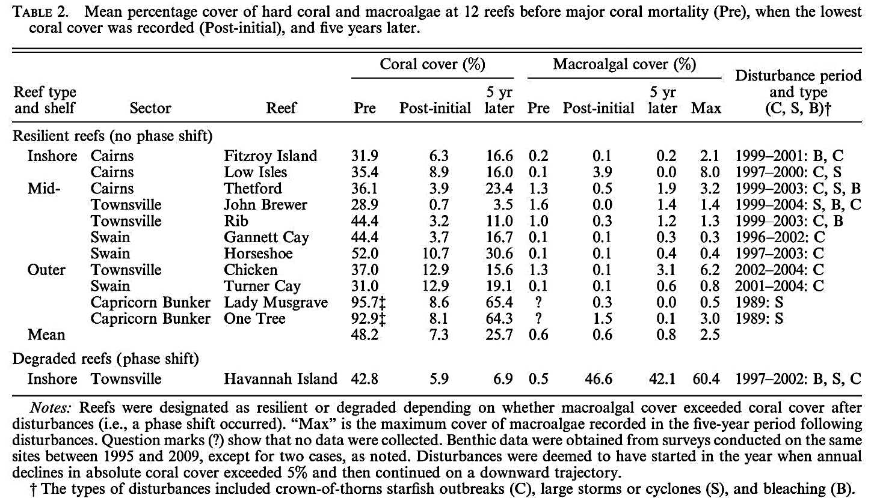
Marine
Education
9. Reef-cover-y? – Compare the responses to bleaching events between two regions, recognising that coral cover
increases on resilient reefs once pressures are reduced or removed.
Name:
Date:
marineeducation.com.au
Table 1:
^{[1]}
Note: Inshore reefs were 5-30km from land; Mid-shelf reefs were located on the Continental shelf within the bulk of the GBR matrix; and Outer-reefs were seaward, exposed to oceanic influences of the Coral Sea^{[1]}.
Activity: Compare the responses to bleaching events between two regions in Table 1 (pick 2). Note: the disturbances on a number of reefs did not involve bleaching (so do not pick those).
Notably, all reefs in Table 1 suffered a coral decline that was great enough to favour a phase shift^{[1]}. Thus, students could pick any two reefs or regions from Table 1 that experienced a bleaching event (B). All ‘resilient’ reefs recovered
with mean coral cover increasing post disturbance/s once pressures were
reduced or removed.
Note: some recovered faster than others (more resilient).
Only Havannah Island underwent a phase shift whereby mean coral cover declined from 42.8% to 5.9%, while macroalgal cover increased from 0.5% to >40%^{[1]}.
So why did Havannah Island undergo a phase shift when the other reefs did not? At Havannah Island, the species richness and abundance of four herbivore functional groups (i.e. scrapers, excavators, grazer/detrivores and algal browsers) were among the lowest recorded on any of the 12 reefs. However,
One Tree Island also had low herbivore numbers but did not undergo a phase shift. Which lead the author to suggest that the relative vulnerability to a phase shift varies spatially depending on a wide range of biological, physical and hydrodynamic factors that interact to raise or lower phase shift thresholds^{[1]}.
^{[1]} Adapted with permission from: Cheal, A. J., Emslie, M., MacNeil, M.A., Miller, I. and Sweatman, H. (2013). Spatial variation in the functional characteristics of herbivorous fish communities and the resilience of coral reefs. Ecological Applications, 23 (1). Pp. 174-188. DOI:10.1890/11-2253.1
© Marine Education 2024 CC BY-NC-SA
Unit 3 Topic 2 Science Understanding – Anthropogenic change

Slide 19
Marine
Education
Compare the responses to bleaching events between two regions, recognising that coral cover increases on resilient reefs once pressures are reduced or removed.
Name:
Date:
marineeducation.com.au
© Marine Education 2024 CC BY-NC-SA
NOTES AND EXAM REVISION

Slide 20
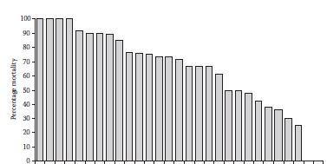
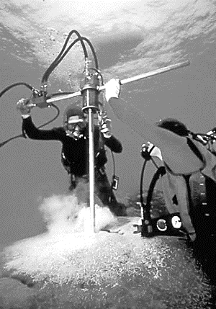

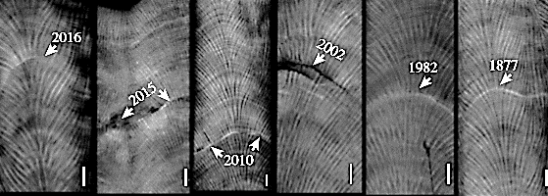
Marine
Education
10. Natural Archives – Interpret data (including qualitative graphical data of coral cores) that demonstrates that coral
cores can act as a proxy for the climate record.
Name:
Date:
marineeducation.com.au
Porites power on
Porites corals often survive mass bleaching events when other corals (i.e. Tabular Acropora) do not (Fig. 1). A stressful mass bleaching event leaves its mark on the skeleton of a Porites coral as a stress band, which can act as a proxy for the climate record (i.e. warm weather events cause bleaching)^{[1].}
Tab Acropora
Stylophora
Mydedium
Isopora
Montastrea
Hynophora
Coeloseris
Cor Acropora
Cyphastrea
Pocillopora
Montipora
Leptoria
Echinophyllia
Lobophyllia
Acanthastrea
Arb Acropora
Goniopora
Pectinia
Galaxea
Goniastrea
Seriatopora
Porites
Favia
Echinopora
Favites
Pavona
Merulina
Turbinaria
Astreopora
Porites
Percentage Mortality
Fig. 3: Porites annual growth bands used to date stress bands^{[3]}.
Fig. 1: Variation in bleaching susceptibility among different coral types (genera plus growth forms: Tab, tabular; Cor, corymbose; Arb, arborescent) on the Great Barrier Reef^{[1]}
Fig. 2: Drilling a core from a Porites. Note: the hole is filled with a cement plug so the colony does not die^{[2]}.
Q. What do the dates on the coral cores in Figure 4 (below) represent? Ans.
Stress Bands
El Nino is a time when sea surface temperatures (SSTs) are warmer than usual, and reefs become more susceptible to mass bleaching events.
Table 1: Strength of El Nino (based on SOI values) since 1916^{[5]}
Strong
Weak |  | Moderate
1951-52 1957-58 1963-64 1969-70 2002-03 2006-07 | 1919-20 1946-47 2009-10 | 1925-26 1972-73 1977-78 1993-94 | 1965-66 1987-88 1991-92 2015-16 | 1940-41 1941-42 1994-95 1997-98 | 1982-83
Weak
Weak-Moderate
Moderate
Moderate-strong
Very Strong
Fig. 4: Stress bands on Porites cores from the Great Barrier Reef^{[4]}.
SST very high in 2015-16
SST very high in 1997-98
Q. What is the likelihood that there was an El Nino in 1877? Ans.
Circle correct answer
[High] [Low]
In the past, El Nino had to be strong or very strong for corals to bleach. But not anymore. Discuss why.
Q. Do all the stress bands in Fig. 4 coincide with a strong or very strong El Nino? Ans.
No
Q. Which summer had very high SSTs but only a moderate-strong El Nino? Ans.
2015/16
^{[1]} Adapted with permission from: Pratchett, M.S., Munday, P.L., Wilson, S.K., Graham, N.A.J., Cinner, J.E., Bellwood, D.R., Jones, G.P., Polunin, N.V.C. and McClanahan, T.R. (2008). Effects of Climate-Induced Coral Bleaching on Coral Reef Fishes – Ecological and Economical Consequences. Oceanography and Marine Biology: An Annual Review (46) 251-296.
^{[2]} Maris Kazmers of Sharksong Photography. Published In: Russell, R. M. (2010). Coral Reef Cores – Paleoclimate proxy records. UCAR Office of Education and Outreach. Accessed 07.03.2019 from: https://eo.ucar.edu/staff/rrussell/climate/paleoclimate/coral_reef_proxy_records.html
^{[3]} Adapted with permission from: De Carlo, T. M. and Cohen, A. L. (2017). Dissepiments, density bands and signatures of thermal stress in Porites skeletons. Coral Reefs. DOI 10.1007/s00338-017-1566-9
^{[4]} Adapted with permission from : De Carlo, T.M., Harrison, H.B., Gajdzik, L., Alaguarda, D., Rodolfo-Metalpa, R., D’Olivo, J., Liu, G., Patalwala, D. and McCulloch, M.T. (2019). Acclimatization of massive reef-building corals to consecutive heatwaves. Proc. R. Soc. B. 286. DOI: 10.1098/rspb.2019.0235
^{[5]} Adapted from: Bureau of Meteorology (2018). El Nino – Detailed Australian Analysis (Bureau Home > Climate > ENSO Wrap Up > El Nino Summaries). Accessed 09/03/2019 from www.bom.gov.au/
© Marine Education 2024 CC BY-NC-SA
Unit 3 Topic 2 Science Understanding – Anthropogenic change

Slide 21
Marine
Education
Interpret data (including qualitative graphical data of coral cores) that demonstrates that coral cores can act as a proxy for the climate record.
Name:
Date:
marineeducation.com.au
© Marine Education 2024 CC BY-NC-SA
NOTES AND EXAM REVISION

Slide 22
Marine
Education
11. Balancing Act – Explain that the reason for differences between ocean pH and freshwater pH is the presence of carbonate buffering system
Name:
Date:
marineeducation.com.au
Note: a rise in salinity decreases the solubility of gases^{[2]}.
Activity: Use a straw to blow into a beaker of water. Use a pH probe^{[1]} to watch the pH go down!
When CO2 is added to water (H2O), it reacts with the water molecules to make carbonic acid (H2CO3)^{[1]}.
Q. What is the chemical equation for this reaction? Ans.
CO2 + H2O → H2CO3
The pH of water is controlled by the number of free hydrogen ions (H+). More free H+ means lower pH^{[1]}.
Q. What is the pH of seawater? Ans. Q. What is the pH of freshwater? Ans.
8.1
~7.0
Discuss why
Q. Which one has more free hydrogen ions (H⁺), seawater or freshwater? Ans.
Fresh
Abrupt changes in pH can really stuff up marine life. Hence, water has a unique system, called the carbonate buffering system, that (tries to) keep the pH, more or less, stable. Whereby, if there are
not enough free H⁺ (pH too high), water releases more to fix the problem (black arrows point right, below).
In contrast, if there are too many free H⁺(pH too low) water removes them (white arrows point left, below).
Activity: Fill in the blanks (white boxes).
H2CO3 HCO3⁻ +
HCO3⁻ CO3 ²⁻ +
H+
carbonic acid
bicarbonate ion
hydrogen ion
H+
bicarbonate ion
carbonate ion
hydrogen ion
Activity: Fill in the blanks (white boxes).
CO2
CO2
CO2
CO2
CO2
CO2
CO2 + H2O ←→ H2CO3
H2CO3 HCO3⁻ +
HCO3⁻ CO3²⁻ +
CO2
CO2
CO2
CO2
CO2
carbonic acid
If the pH is too low, and there are too many H+ ions, the carbonate ions ‘scoop’ up the H+ ions to make more bicarbonate ions
(white arrow points left).
Carbon dioxide molecules readily react with water molecules to make carbonic acid.
H⁺
carbonic acid
bicarbonate ion
hydrogen ion
Then, carbonic acid dissociates into a bicarbonate ion and a free hydrogen ion.
H⁺
bicarbonate ion
carbonate ion
hydrogen ion
If the pH is too high (not enough free H+), the bicarbonate ion dissociates into a carbonate ion and another hydrogen ion.
CO3²⁻ + Ca²⁺ ←→
CaCO3
carbonate ion
calcium ion
calcium carbonate
Figure 1: carbonate buffering system^{[2]}. Black arrows point right when pH is too high. White arrows point left when pH is too low.
Q. When the white arrows point left, does CO3²⁻ increase or decrease? Ans.
decrease
^{[1]} You can purchase a hand held pH meter for $64.95 from any Jaycar store (category number QM1670) or online from: https://www.jaycar.com.au/hand-held-ph-meter/p/QM1670
^{[2]} Pinet, P. A. (1998). Invitation to Oceanography: Oceanlink. Jones and Bartlett Publishers, Inc. London. http://science.jbpub.com/oceanlink/
© Marine Education 2024 CC BY-NC-SA
Unit 3 Topic 2 Science Understanding – Ocean Equilibria

Slide 23
Marine
Education
Explain that the reason for differences between ocean pH and freshwater pH is the presence of carbonate buffering system
Name:
Date:
marineeducation.com.au
© Marine Education 2024 CC BY-NC-SA
NOTES AND EXAM REVISION

Slide 24
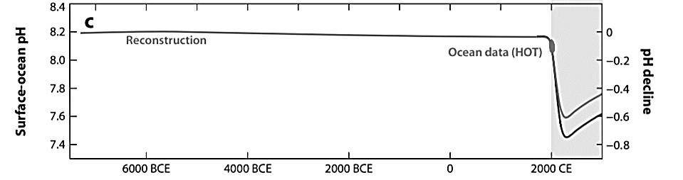
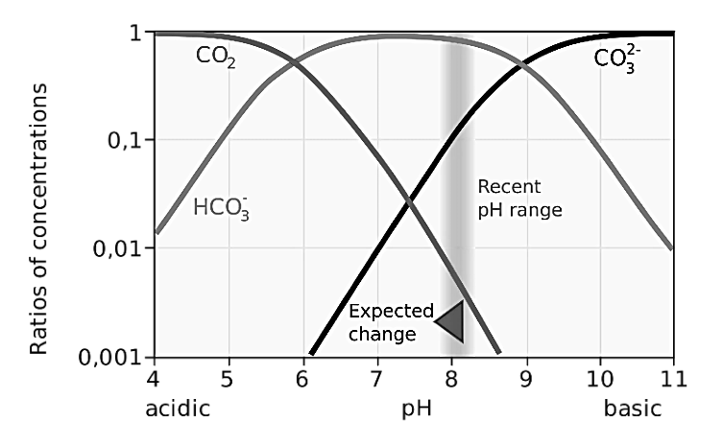
Marine
Education
12. Race Against Time – Explain that the carbonate system is linked to geological processes and operates on
geological timescales.
Name:
Date:
marineeducation.com.au
Buffer capacity overwhelmed
Ocean carbonate chemistry throughout the Holocene (and before industrialisation) was extremely stable. Atmospheric CO2 levels did not change much, and nor did ocean pH (remaining at 8.2)^{[1].} But all that has changed now. The ocean is struggling to cope with the large amounts of CO2 that have been released to the atmosphere over a geologically short period of time. Geological processes, that are part of the carbon cycle and act as a neutralising process (i.e. chemical weathering*) operate over geological timescales and can not keep up with the rate of CO2 being released into the atmosphere and absorbed by the ocean^{[2]}.
As a result, for the first time in thousands of years, the pH has declined, from 8.2 to 8.1 (~30% more H⁺)^{[1]}.
*“The gradual process of weathering break down rocks on land, washing them into the ocean and,
in doing so, buffer the seas against acidification like a Tums to an upset stomach^{” [3].}
“It is the pace of carbon dioxide emissions (not the absolute volume) that is making the pH decline”^{[3]}
Figure 1: Holocene versus Anthropocene. Results of modelling surface-ocean pH using reconstructed and future pH for 5000 PgC and 3000 PgC. Ocean data is the Hawaii Ocean Time (HOT)-series pH data at 25°C in 2012^{[1]}.
Activity: Discuss the imbalance that is identified by the following statement:
Fossil fuels take million of years to make…..but only seconds to burn.
Q. Why is the pH declining? Ans.
The rate of CO2 emissions is too fast for the ocean to properly buffer against the influx of CO2, resulting in a decline of pH.
Bjerrum Plot explains
What happens when ocean pH declines?
The concentration of carbonate ions (CO3²⁻) declines ☹. For example, the concentration of carbonate ions at pH 8.2 is less than the concentration of carbonate ions at pH 8.1 (Fig. 2). Corals need carbonate ions to make their skeletons. Importantly, carbonate ion supplies take geological timescales to replace (via geological processes). The ‘Expected change’ (shaded area) is a continued decline in pH and in carbonate ions concentrations.
Figure 2: Bjerrum Plot - ratios of Dissolved Inorganic Carbon (DIC) for various pH values. Source: Wikapedia at: https://en.wikipedia.org/wiki/Bjerrum_plot
Q. What form of DIC dominates the ratio of concentration at pH 8.2? Ans.
HCO3⁻
^{[1]} Republished with permission of Annual Reviews, Inc., from: History of seawater carbonate chemistry, atmospheric CO2 and ocean acidification, Zeebe, R., 40:141-65, 2012; permission conveyed through Copyright Clearance Center, Inc.
^{[2]} Raymond, P. A. and Hamilton, S. K. (2018). Anthropogenic influences on riverine fluxes of dissolved inorganic carbons to the oceans. Limnology and Oceanography Letters 3: 143-155. DOI: 10.1002/lol2.10069
^{{3]} Brannen, P. (2017). The Ends of the World. Oneworld Publications. London. England. Page 132
© Marine Education 2024 CC BY-NC-SA
Unit 3 Topic 2 Science Understanding – Ocean Equilibria

Slide 25
Marine
Education
Explain that the carbonate system is linked to geological processes and operates on geological timescales.
Name:
Date:
marineeducation.com.au
© Marine Education 2024 CC BY-NC-SA
NOTES AND EXAM REVISION

Slide 26
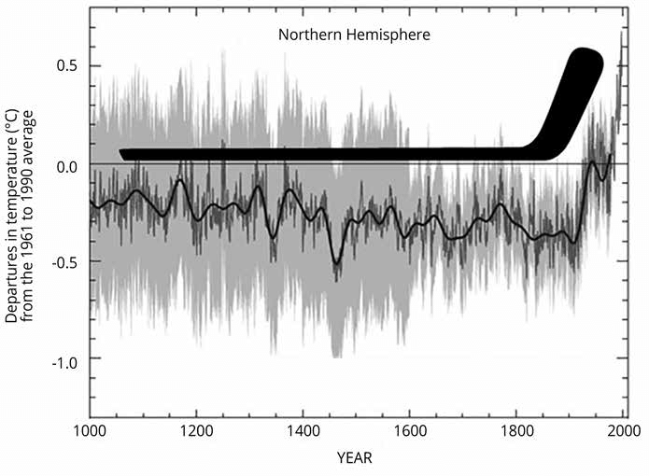

Marine
Education
13. Disrupting Nature’s Balance – Interpret data to determine how increases in atmospheric carbon dioxide influences both global temperature and ocean pH.
Name:
Date:
marineeducation.com.au
The Greenhouse Effect
Imagine the Earth is wrapped in a thermal blanket to keep it warm. Imagine no more. It actually exists!
Except, the blanket is made of greenhouse gasses, such as water vapor, CO2, nitrous oxide and methane (and any reactive gasses that absorb wavelengths longer than 4 µm^{[1]}). The ‘blanket’ traps heat in the atmosphere. Similar to how glass traps heat in a greenhouse. Hence the name, the greenhouse effect.
Sun
Q. What is the Greenhouse Effect? Ans.
When gasses in Earth’s atmosphere, such as water vapour, CO2, nitrous oxide and methane, act as a blanket by trapping the Sun’s heat (i.e. wavelengths longer than 4µm) and keeping the Earth warm.
Discussion point: without the greenhouse effect, the average global temperature would be -18°C
Atmosphere
Earth’s surface
Fig. 1: The Greenhouse Effect
Global Warming
As you know, CO2 is one of the greenhouse gasses. Adding more CO2 to Earth’s atmosphere is like adding an extra blanket. Earth warms up. This warming effect is global in scale. Hence the name, global warming.
Q. What did Mann, Bradley and Hughes^{[1]} say was causing the temperature to rise
in their famous Hockey-stick graph? Ans.
Anthropogenic emissions of CO2, mainly from the increase of industrialisation and the use of fossil fuels^{[2]}
Fig. 2: The hockey-stick graph^{[1]}
Fig. 3: Mann’s book^{[2]}
Ocean Acidification
The term ocean acidification can be a little misleading. It does not mean the ocean is acidic as such. The pH of the ocean is still basic (above pH 7). Indeed, the addition of CO2 adds more free hydrogen ions (H+) to the ocean. And, the chemical activity of these free hydrogen ions can be very powerful, measured as an indirect function of their concentration level known as pH = -log10(H+). Thus, ocean acidification simply refers to the increasing number of free hydrogen ions in the ocean (due to high CO2 input rates), and the corresponding drop in pH…towards the acidic end of the pH scale. Hence the name, ocean acidification.
Q. What is Ocean Acidification? Ans.
The increasing number of free H+ in the ocean (due to high CO2 input rates) and the corresponding drop in pH towards the acidic end of the pH scale.
^{[1]} Espach, R., Zvijac, D. and Filadelfo, R. (2016). Impact of Climate Change on U.S. Military Operations in the Western Pacific. MCU Journal. 89-113. DOI: 10.21140/mcuj.2016si05.
^{[2]} Mann, M. E. (n.d). Books: The Hockey Stick and the Climate Wars. Michael E. Mann. Accessed 12.04.2019 from: http://www.michaelmann.net/books/hockey-stick
© Marine Education 2024 CC BY-NC-SA
Unit 3 Topic 2 Science Understanding – Ocean Equilibria

Slide 27
Marine
Education
Interpret data to determine how increases in atmospheric carbon dioxide influences both global temperature and ocean pH.
Name:
Date:
marineeducation.com.au
© Marine Education 2024 CC BY-NC-SA
NOTES AND EXAM REVISION

Slide 28
Marine
Education
14. Source of Imbalance – Describe sources of carbon dioxide in the atmosphere.
Name:
Date:
marineeducation.com.au
Activity: In boxes 1-4, name and describe four sources of CO2 in the atmosphere.
In boxes 5 and 6, describe each chemical reaction (with arrows pointing right).
In box 7, describe the chemical reaction when the pH is too low (with white arrow pointing left).
1
2
3
4
CO2 + H2O ←→ H2CO3
H2CO3 HCO3⁻ +
HCO3⁻ CO3²⁻ +
Fossil Fuel Combustion
Cement Production
Deforestation
Volcanic Activity
Trees that are cut down no longer carry out photosynthesis and remove atmospheric CO2
Combustion of hydrocarbons
(e.g. coal, oil, gas) releases CO2
CO2 is produced in the making
of cement:
CaCO3 → CaO + CO2
Erupting volcanoes release CO2
CO2
CO2
CO2
CO2
CO2
CO2
CO2
CO2
CO2
CO2
CO2
CO2
CO2
CO2
CO2
CO2
CO2
CO2
CO2
CO2
CO2
CO2
CO2
CO2
5
carbonic acid
CO2 readily reacts with H2O to make carbonic acid
7
If the pH is too low, carbonate ions complex with H+ to (reduce the concentration of H+ and) make bicarbonate ions (white arrow points left). As a result, there are less
carbonate ions left
over for corals to make CaCO3.
H⁺
?
carbonic acid
bicarbonate ion
hydrogen ion
6
Then, carbonic acid dissociates into a bicarbonate ion and a hydrogen ion
H⁺
bicarbonate ion
carbonate ion
hydrogen ion
CO3²⁻ + Ca²⁺ ←→
CaCO3
carbonate ion
calcium ion
calcium carbonate
© Marine Education 2024 CC BY-NC-SA
Unit 3 Topic 2 Science Understanding – Ocean Equilibria

Slide 29
Marine
Education
Describe sources of carbon dioxide in the atmosphere.
Name:
Date:
marineeducation.com.au
© Marine Education 2024 CC BY-NC-SA
NOTES AND EXAM REVISION

Slide 30
Marine
Education
15. Carbonate ion Count – Describe the effect of ocean acidification on sea water, including that - carbon dioxide (CO₂) is absorbed from the atmosphere and bonds with sea water, forming carbonic acid (H₂CO₃) - the acid releases a bicarbonate ion (HCO^{3–}) and a hydrogen ion (H⁺) - the hydrogen ion bonds with free carbonate ions (CO3^{2–}) in the water, forming another bicarbonate ion - the more dissolved carbon dioxide in the ocean, the fewer free carbonate ions are available to marine organisms for making calcium carbonate shells and skeletons
Name:
Date:
marineeducation.com.au
Carbon creating chaos
When CO2 is added to seawater, most of it turns into HCO3⁻ . For example, if you look at a Bjerrum plot
(p. 100) you will see that most dissolved inorganic carbon (DIC) is in the form of HCO3-. This transformation of CO2 (+H2O) into (H2CO3 and then) HCO3- releases a free hydrogen ion (H+) which, as you know, lowers pH (‘not good’, says the ocean). So, CO3²⁻ quickly scoops up the free H+ (making more HCO3⁻) to maintain the balance of pH (as best it can). But in doing so, there is now less CO3²⁻ left behind for marine critters (e.g. corals, marine molluscs, forams) to make their CaCO3 body parts^{[1]}.
Activity: Write [H+] in the small circles below right to represent CO2 being added to water. Cross out two [H+] and two [CO3²⁻]. Instead, write [HCO3⁻] in the 2 large empty circles provided below.
CO2 is added to the water (adding H+)
CO3²⁻
Ca²⁺
CO3²⁻
CO3²⁻
Ca²⁺
CO3²⁻
H+
CO3²⁻
Ca²⁺
Ca²⁺
CO3²⁻
Ca²⁺
Ca²⁺
H+
HCO3-
HCO3-
Ca²⁺ + CO3²⁻ → CaCO3
Ca²⁺ + CO3²⁻ → CaCO3
Q. How many CO3²⁻ pictured above? Ans.
3
Q. How many CO3²⁻ left over? Ans.
1
Activity: Describe the effect of ocean acidification on sea water in terms of increasing the concentration of hydrogen ions decreasing the concentration of carbonate ions
With respect to ocean acidification students should understand that carbon
dioxide (CO2) is absorbed from the atmosphere and it bonds with sea water
forming carbonic acid. This acid then releases a bicarbonate ion and a hydrogen ion. The hydrogen ion bonds with free carbonate ions in the water forming another bicarbonate ion. That carbonate would otherwise be available to marine animals for making calcium carbonate shells and skeletons. The more dissolved carbon dioxide in the ocean, the less free carbonate ions available for making calcium carbonate^{[1].}
^{[1]} Queensland Curriculum and Assessment Authority (2018). Marine Science 2019 v1.2: General Senior Syllubus. QCAA. Pg. 40. Accessed 13.04.2019 from: https://www.qcaa.qld.edu.au/senior/senior-subjects/sciences/marine-science/syllabus
© Marine Education 2024 CC BY-NC-SA
Unit 3 Topic 2 Science Understanding – Ocean Equilibria

Slide 31
Marine
Education
Describe the effect of ocean acidification on sea water, including that - carbon dioxide (CO₂) is absorbed from the atmosphere and bonds with sea water, forming carbonic acid (H₂CO₃) - the acid releases a bicarbonate ion (HCO^{3–}) and a hydrogen ion (H⁺) - the hydrogen ion bonds with free carbonate ions (CO3^{2–}) in the water, forming another bicarbonate ion - the more dissolved carbon dioxide in the ocean, the fewer free carbonate ions are available to marine organisms for making calcium carbonate shells and skeletons
.
Name:
Date:
marineeducation.com.au
© Marine Education 2024 CC BY-NC-SA
NOTES AND EXAM REVISION

Slide 32
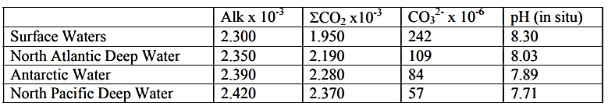
Marine
Education
16. Ooze Clues – Explain how the carbonate compensation depth (CCD) varies due to depth, location and oceanographic processes such as upwelling and coastal influences.
Name:
Date:
marineeducation.com.au
It’s snowing!
Did you know it snows in the ocean? The snow is called ‘marine snow’. It is created when marine life dies (or defecates) to make particles that fall like ‘snow’ to the depths below. Particles made of CaCO3 (i.e. dead forams and coccolithophores) that reach the seafloor, settle on the bottom as ‘calcareous ooze’. But only when the seafloor is above the carbonate compensation depth or CCD.
Below the CCD they dissolve (faster than they accumulate).
The CCD can be compared to the snow line of a mountain front where the supply of snow is exactly balanced by melting (but, in
this case, dissolving) leaving only the elevations above the CCD
(i.e. tops of seamounts and mid-ocean ridges) draped in snow.
It’s
snowing!
Calcareous CaCO3 ooze
CCD
Seafloor
Figure 1: The ‘snow line’ or ‘CCD’.
Q. Does calcareous ooze exist below the CCD (i.e. below the dotted line in Figure 1)? Ans.
No
Cold and Under Pressure
The CCD is often deep. Deep water is cold water. Deep water is also under a lot of (hydrostatic) pressure. Therefore, it holds a lot of carbon dioxide. Lots of carbon dioxide makes calcium carbonate dissolve.
Activity: Tick the factors listed below that increase the solubility of gasses, such as CO2
A decrease in temperature
(e.g. cold water)
An increase in (hydrostatic) pressure
(e.g. deep water)
Table 1: Measurements from water masses in thermohaline circulation^{[1]}
As CO2 increases, pH
(circle correct answer)
[increases] [decreases]
The snow line
The snow line, or CCD, is NOT the same depth all around the globe. The depth of the CCD is determined by the rate of dissolution versus the rate of accumulation. The rate of dissolution depends on the CO2 content of the water. The higher the CO2 content, the shallower the CCD. For example, the CCD is shallower in the Pacific Ocean than in the Atlantic Ocean because the CO2 content in North Pacific Deep Water is higher than the CO2 content in North Atlantic Deep Water (Table 1). The rate of accumulation depends on how much marine snow is falling. The heavier the snow fall, the deeper the CCD*.
Q. What (formula) determines the depth of the CCD? Ans. (hint: second sentence)
The rate of dissolution (i.e. CO2 content) versus the rate of accumulation
Activity: Discuss what the composition of the seafloor can tell us about past ocean chemistry?
*But only if the water below, through which it must fall, is not too rich in CO2 from being too cold (e.g. polar regions) or from prolonged, high decomposer activity.
^{[1]} Adapted from: Samford University (n.d.). Lecture 10 – Acids and Bases: Ocean Carbonate System. Accessed 13.04.2019 from: http://ocean.stanford.edu/courses/bomc/chem/lecture_10.pdf
© Marine Education 2024 CC BY-NC-SA
Unit 3 Topic 2 Science Understanding – Ocean Equilibria

Slide 33
Marine
Education
Explain how the carbonate compensation depth (CCD) varies due to depth, location and oceanographic processes such as upwelling and coastal influences.
Name:
Date:
marineeducation.com.au
© Marine Education 2024 CC BY-NC-SA
NOTES AND EXAM REVISION

Slide 34
Marine
Education
17. Oceans…the sponges of our climate – Determine the effect of temperature (uptake) and changes in primary productivity (storage, e.g. biological pump) on the ocean’s capacity to absorb carbon dioxide.
Name:
Date:
marineeducation.com.au
The carbon couriers: phytoplankton
The ocean removes CO2 from the atmosphere. Not just chemically. But also biologically! When phytoplankton bloom, they use up lots of CO2 via photosynthesis. Then, when they die, they sink as marine snow.
Q. What is the equation for photosynthesis? Ans.
6CO2 + 6H2O ---> C6H12O6 + 6O2
sunlight energy
Biological Pump
Marine snow sinks very slowly. If it makes it all the
way to the seafloor, or a least below the thermocline barrier, and into the bathypelagic zone, it stays there
for a very long time^{[1]}. Which is a good thing.
Because one more carbon atom in the bathypelagic zone (as marine snow) is one less carbon atom in the atmosphere (as CO2). For example, a coccolithophore fixes CO2 in the sunlit zone, via photosynthesis, to make its CaCO3 body parts, and later dies and sinks as marine snow. If it makes it all the way down to the bathypelagic zone, its carbon atoms will be removed from circulation with the atmosphere for a very long time (see Figure 1).
CO2
Atmosphere
CO2
CO2
CO2
CO2
CO2
CO2
Phytoplankton
(photosynthesis)
Zooplankton (respiration)
Pelagic Predators
(respiration)
Bacteria (decomposition and respiration)
Bottom of thermocline (~1000m)
Bathypelagic zone
Carbon as CaCO3
Sea floor (e.g. above the CCD)
Figure 1: Schematic of the biological pump. Phytoplankton fix CO2 in the euphotic zone to produce particulate organic carbon (POC) of which a small percentage makes it down to the deep ocean^{[1]}. Meanwhile, decomposition and respiration continues to return organic carbon back to CO2, where it can recirculate with the atmosphere^{[1]}.
Activity: Circle the correct answer...
If phytoplankton numbers decline, you might expect:
- the amount of carbon sinking all the way down to the deep sea would
- the amount of CO2 in the atmosphere would
[increase] [decrease]
[increase] [decrease]
Phytoplankton need light, carbon dioxide and nutrients to bloom.
Q. What do phytoplankton need to bloom? Ans.
light, carbon dioxide, nutrients
Warm Water Barriers
Nutrients in the bathypelagic zone remain there for a very long time. Until, upwellings bring them back UP to the surface, triggering a phytoplankton bloom^{[3]}. That is, IF the nutrients even make it to the surface. If the sea surface temperatures (SSTs) are too warm, such as during an El Nino event, the intensity of an upwelling can be reduced by stratification caused by warming of the surface layers of the ocean. The people of Peru know this all too well. If the upwelling does not make it to the surface, the nutrients (also) do not make it up to the surface, which means less phytoplankton (less fish) and less absorption of atmospheric CO2^{[2][3]}.
Q. If there are less nutrients, will there be less phytoplankton? Ans.
[Yes] [No]
circle correct answer
^{[1]} Adapted from: Basu, S. and Mackey, K. R. M. (2018). Phytoplankton as Key Mediators of the Biological Carbon Pump: Their Responses to a Changing Climate. Sustainability, 10, 869 DOI:10.3390/su10030869
^{[2]} Lluch-Cota, S.E., Hoegh-Guldberg, P., Karl, D., Portner, H.O., Sundby, S. and Guttuzo, J.P. (2014). Uncertain Trends in Major Upwelling Ecosystems. In: IPCC, 2014: Climate Change 2014: Impacts, Adaptation, and Vulnerability. Summaries, Frequently Asked Questions, and Cross-Chapter Boxes. A Contribution of Working Group II to the Fifth Assessment Report of the Intergovernmental Panel on Climate Change [Field, C.B., V.R. Barros, D.J. Dokken, K.J. Mach, M.D. Mastrandrea, T.E. Bilir, M. Chatterjee, K.L. Ebi, Y.O. Estrada, R.C. Genova, B. Girma, E.S. Kissel, A.N. Levy, S. MacCracken,P.R. Mastrandrea, and L.L. White (eds.)]. World Meteorological Organization, Geneva, Switzerland, 190 pp. (in Arabic, Chinese, English, French, Russian, and Spanish). p.149-151.
^{[3]} Winder, M. and Sommer, U. (2012). Phytoplankton response to a changing climate. Hydrobiologica 698(1):5 -16. DOI: 10.1007/s10750-012-1149-2
© Marine Education 2024 CC BY-NC-SA
Unit 3 Topic 2 Science Understanding – Ocean Equilibria

Slide 35
Marine
Education
Determine the effect of temperature (uptake) and changes in primary productivity (storage, e.g. biological pump) on the ocean’s capacity to absorb carbon dioxide.
Name:
Date:
marineeducation.com.au
© Marine Education 2024 CC BY-NC-SA
NOTES AND EXAM REVISION

Slide 36
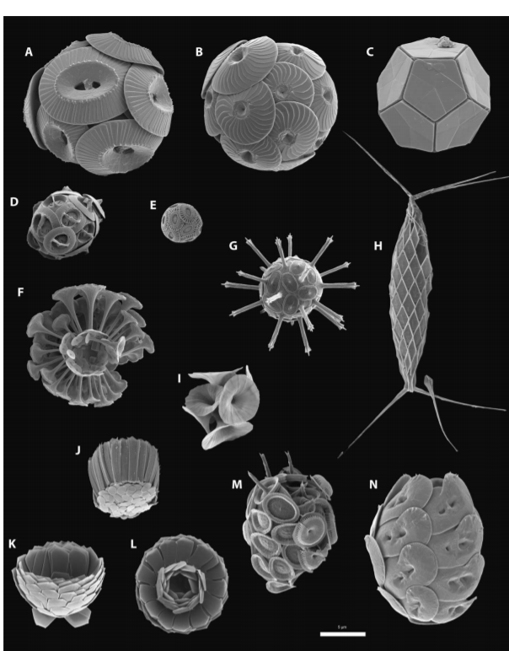
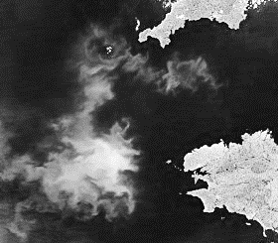
Marine
Education
18. CaCO3 Critters – State that calcium carbonate (CaCO₃) can be precipitated into two main forms: calcite and aragonite.
Name:
Date:
marineeducation.com.au
Tiny but tough
Coccolithophores are single-celled phytoplankton. They carry out photosynthesis and make armoured
plates (coccoliths) out of CaCO3^{[1]}. They might be small, but coccolithophores are the most productive pelagic calcifiers on the planet (alongside forams)^{[2]}. Coccolithophore blooms can be seen from space!
5µm
Fig. 1: Scanning electron micrographs of coccolithophores^{[2]}.
Fig. 2: A chalky, white coccolithophore bloom visible from space^{[5]}.
Coccolithophores vs Corals
Coccolithophores are made of the calcite version of calcium carbonate. Corals are made of the aragonite version of calcium carbonate. Same formula. Different arrangement of atoms. Thus, different skeletons. Aragonite is more soluble than calcite. Therefore, organisms made of aragonite, such as corals, pteropods and Halimeda sp., may not cope with ocean acidification as well as organisms made of calcite, such as coccolithophores, forams, crustaceans and echinoderms ^{[3][4]}.
Activity: Complete the table below. Identify the organisms made of aragonite vs calcite.
Organisms made of aragonite (CaCO3) | Organisms made of calcite (CaCO3)
Pteropods | Foraminifera (forams)
Coral, halimeda
(the major planktonic producers of aragonite)
Coccolithophores, crustaceans, echinoderms
^{[1]} Doney, S.C., Fabry, V.J., Feely, R.A. & Kleypas, J.A. (2009). Ocean Acidification: the other CO2 problem. Annual Reviews. Washington Journal of Environmental Law and Policy. Vol. 6:2. DOI: 10.1146/annurev.marine.010908.163834
^{[2]} Reproduced with permission from: Monteiro, F.M., Back, L.T., Brownlee, C., Bown, P. Rickaby, R.E.M., Poulton, A.J., Tyrrell, T., Beaufort, L., Dutkiewicz, S., Gibbs, S., Gutowska, M.A., Lee, R., Riebesell, U., Young, J. and Ridgwell, A. (2016). Why marine phytoplankton calcify. Science Advances 2(7). DOI: 10.1126/sciadv.1501822.
^{[3]} Kleypas, J.A., Buddemeier, R.W., Archer, D., Guttuso, J., Langdon, C. and Opdyke, B.N. (1999). Geochemical Consequences of Increased Atmospheric Carbon Dioxide on Coral Reefs. Science 284 (5411), 118-120. DOI: 10.1126/science.284.5411.118
^{[4]} Orr, J.C., Fabry, V.J., Aumont, O., Bopp, L., Doney, S.C., Feely, R.A., Gnanadesikan, A., Gruber, N., Ishida, A., Foos, F., Key, R.M., Lindsay, K., Maier-Reimer, E., Matear, R., Monfray, P., Mouchet, A., Najjar, R.G., Plattner, G.K., Rodgers, K.B., Sabine, C.L., Sarmiento, J.L., Schlitzer, R., Slater, R.D., Totterdell, I.J., Weirig, M.F., Yamanaka, Y. and Yool, A. (2005). Anthropogenic ocean acidification over the twenty-first century and its impact on calcifying organisms. Nature Articles. Vol. 437:29. DOI: 10.1038/nature04095
^{[5]} On June 15, 2004, the Moderate Resolution Imaging Spectroradiometer (MODIS) on NASA’s Aqua satellite captured this image of a bloom off the coast of Brittany, France. The bloom had been developing for a few days before this image was taken. Image Credit: Jacques Descloitres, MODIS Rapid Response Team, NASA/GSFC. Accessed 03.07.2019 from: https://visibleearth.nasa.gov/view.php?id=71344
© Marine Education 2024 CC BY-NC-SA
Unit 3 Topic 2 Science Understanding – Implications for Marine Systems

Slide 37
Marine
Education
State that calcium carbonate (CaCO₃) can be precipitated into two main forms: calcite and aragonite.
Name:
Date:
marineeducation.com.au
© Marine Education 2024 CC BY-NC-SA
NOTES AND EXAM REVISION

Slide 38
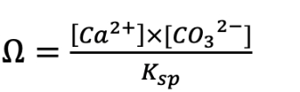
Marine
Education
19. Title - Determine whether aragonite will precipitate, using the equation:
where 𝛺 = precipitation of aragonite and 𝐾𝑠𝑝 = solubility product
Name:
Date:
marineeducation.com.au
Teacher to write
© Marine Education 2024 CC BY-NC-SA
Unit 3 Topic 2 Science Understanding – Implications for Marine Systems

Slide 39
Marine
Education
Determine whether aragonite will precipitate, using the equation:
where 𝛺 = precipitation of aragonite and 𝐾𝑠𝑝 = solubility product
Name:
Date:
marineeducation.com.au
© Marine Education 2024 CC BY-NC-SA
NOTES AND EXAM REVISION

Slide 40
Marine
Education
20. Title - Explain that the type of carbonate ions and concentration of ions have an implication for the development of shell-forming and skeletal-forming organisms, including hard corals (Scleractinia), coralline algae, molluscs, plankton and crustaceans.
Name:
Date:
marineeducation.com.au
Teacher to write
© Marine Education 2024 CC BY-NC-SA
Unit 3 Topic 2 Science Understanding – Implications for Marine Systems

Slide 41
Marine
Education
Explain that the type of carbonate ions and concentration of ions have an implication for the development of shell-forming and skeletal-forming organisms, including hard corals (Scleractinia), coralline algae, molluscs, plankton and crustaceans.
Name:
Date:
marineeducation.com.au
© Marine Education 2024 CC BY-NC-SA
NOTES AND EXAM REVISION

Slide 42
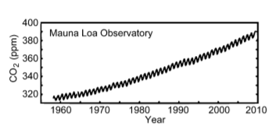
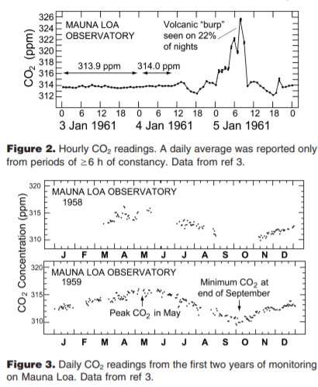
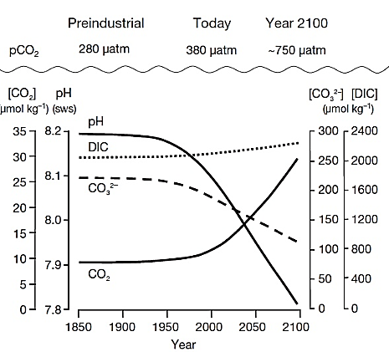
Marine
Education
21. Watching the Earth Breathe CO2 – Interpret trends in data in relation to the carbonate system and changes in pH.
Name:
Date:
marineeducation.com.au
Keeling Curve
Charles David Keeling (1928-2005) received funding in 1957 (at a time when the concentration of CO2 in the air was not well known) to design and build a CO2 monitoring station on Moana Loa in Hawaii. His rigorous measurements set the stage for today’s profound concerns about climate change, now referred to as the Keeling Curve (Figure 1)^{[1]}.
Figure 2 shows hourly CO2 readings. Some readings were steady, whilst others varied (e.g. from volcanic burps). To enhance reliability, an average reading for a given day was only reported if there were at least 6 hours of steady data. Plus, Keeling rejected readings for any hour with >0.5ppm variability.
Figure 1: Keeling Curve^{[1]}
Q. Why the zig zag pattern in Figure 1? Ans. (hint: see Fig. 3)
Seasonal variation (lower CO2 at end of growing season)
Commonly quoted as being the first time we could actually ‘see’ earth ‘breathing’
^{[1]}
Q. How did those decisions make his data more reliable? Ans.
It removed the daily CO2 variation (noise)
^{[1]}
Activity: Interpret trends in the data below
As atmospheric pCO2 concentrations increase, dissolved CO2 concentrations increase and pH and CO3²⁻ concentrations decrease.
DIC increase (Fig. 4).
Note: DIC includes dissolved carbon dioxide + carbonic acid + bicarbonate ions + carbonate ions.
By the year 2100, pCO2 concentrations will be in the order of 750 µatm (RCP 6.0-8.5) and carbonate ion concentrations will have fallen to approximately 120µmol kg⁻¹ (Fig. 4).
Year 2005
Figure 4: Changes in atmospheric carbon dioxide (pCO2), dissolved CO2, pH, carbonate ion concentrations (CO3²⁻) and DIC (dissolved inorganic carbon) over time^{[2]}
^{[1]} Adapted with permission from: Harris, D. C. (2010). Charles David Keeling and the Story of Atmospheric CO2 Measurements. Analytical Chemistry:Feature. 82, 7865-7870. Accessed 30/03/2019 from: https://pubs.acs.org/doi/pdf/10.1021/ac1001492. Copyright (2010) American Chemical Society.
^{[2]} Reprinted with permission from: Forus Na Mara Marine Institute (2005). Nutrients and Ocean Acidification (OA). Forus Na Mara Marine Institute. Ireland. Accessed 30/03/2019 from: https://www.marine.ie/Home/site-area/areas-activity/marine-environment/nutrients-and-ocean-acidification-oa
© Marine Education 2024 CC BY-NC-SA
Unit 3 Topic 2 Science Understanding – Implications for Marine Systems

Slide 43
Marine
Education
Interpret trends in data in relation to the carbonate system and changes in pH
Name:
Date:
marineeducation.com.au
© Marine Education 2024 CC BY-NC-SA
NOTES AND EXAM REVISION

Slide 44
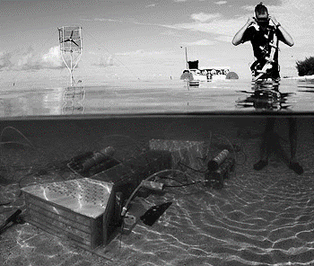
Marine
Education
22. Acid Test – Distinguish between laboratory-scale and field-based experiments and what they demonstrate
about ocean acidification.
Name:
Date:
marineeducation.com.au
Laboratory-scale experiments are conducted in the lab. Field-based experiments are conducted in the field (called ‘in situ’)
Ocean acidification experiments aim to lower the pH of seawater to simulate pH values predicted for the future.
There is abundant evidence from laboratory experiments that OA causes reduced calcification in marine organisms^{[1][3]}
In the lab
Lab-scale OA experiments are highly controlled and can investigate the effect of changing pH levels on a single species in isolation. Methodologies used to reach the desired pH in tanks in the lab include the addition of strong acids and bases, or the addition of high-CO2 seawater^{[1]}. For example, in the aeration technique, a value opens or closes to deliver CO2 gas to a tank whenever pH goes above or below a set value^{[2]}. The beauty of a lab-scale experiment is that you can test a single variable (pH) in a highly controlled setting and identify a species pre-adapted sensitivity to increasing CO2^{[1]}. The problem with lab-scale experiments is that you are not simulating the high complexities of nature, and organisms may not react to stressors in a realistic way^{[5]}.
In the field
Field-based OA experiments are conducted in the field with lots of natural variability. Surprisingly, the pH on a reef flat changes a lot over the course of a day. The field-based experiment pictured in Figure 1^{[3]} was able to mimic those changes whilst investigating the effects of ocean acidification on corals and algae. The device you can see sitting on the reef flat is called the cpFOCE. It has corals and algae inside. CO2 was injected into the device to maintain a pH that was always 0.06 pH units lower than the surrounding seawater (e.g. if the pH went up or down, so did the pH in cpFOCE). A second device (not pictured) was maintained at 0.22 pH units lower than the surrounding seawater, while a third device was the control^{[3]}.
Figure 1: One of the three cpFOCE flumes underwater, with the wind-power generator and floating computer control system in the background. Image © David Kline^{[3]}
Nature’s lab
Environments that are naturally low in pH and Ω, such as CO2-rich volcanic vent sites and submarine springs, serve as natural laboratories* that can be used to observe organisms over time scales long enough for adaptation
or acclimatization to be observed (see next page)^{[4][6]}.
*Note: problematic is when the water chemistry mimics high atmospheric CO2 concentrations but does not mimic temperatures predicted for future global warming.
Activity: Distinguish between lab-scale experiments and field-based experiments and what they demonstrate about ocean acidification (OA).
Lab-scaled OA studies are highly controlled and can investigate the effect of changing pH levels on a single species in isolation. Field-based OA studies are conducted in the field with lots of natural variability. Both have demonstrated calcification rates declining with ocean acidification^{[1][4]}.
^{[1]} Doney, S.C., Fabry, V.J., Feely, R.A. and Kleypas, J. (2009). Ocean Acidification: the other CO2 problem. Annual Reviews. Washington Journal of Environmental Law and Policy. Vol. 1:169-192. DOI: 10.1146/annurev.marine.010908.163834
^{[2]} Riebesell, U., Fabry, V.J., Hansson, L. and Guttuso, J. (2010). Guide to best practices for ocean acidification research and data reporting. European Commission. DOI: 10.2777/66906.
^{[3]} Adapted with permission from: Kline, D.I., Teneva, L., Schneider, K., Miard, T., Chai, A., Marker, M., Headley, K., Opdyke, B., Nash, M., Valetich, M., Caves, J.K., Russell, B.D., Connell, S.D., Kirkwood, B.J., Brewer, P., Peltzer, E., Silverman, J., Caldeira, K., Dunbar, R.B., Koseff, F.R., Monismith, S.G., Mitchell, B.G., Dove, S. and Hoegh-Guldberg, O. (2012). A short-term in situ CO2 enrichment experiment on Heron Island (GBR). Nature. Scientific Reports. 2:413 DOI:10.1038/srep00413.
^{[4]} Crook, E.G., Cohen, A.L., Rebolledo-Vieyra, M., Hernandez, L. and Payten, A. (2013). Reduced calcification and lack of acclimatization by coral colonies growing in areas of persistent natural acidification. PNAS Vol 110 no. 27. DOI: 10.1073/pnas.1301589110
^{[5]} Hoegh-Guldberg, O. (n.d.). Science, solutions and the future: the Great Barrier Reef in a time of change. Final Synthesis Stakeholder Report. Qld Premier’s Fellowship. Accessed 02.04.2019 from: https://gci.uq.edu.au/filething/get/194/GCIQLDPremiersFellowshipReport.pdf
^{[6]} Camp, E.F., Nitschke, M.R., Rodolfo-Metalpa, R., Houlbreque, F., Gardner, S.G., Smith, D.J., Zampighi, M. and Suggett, D.J. (2017). Reef-building corals thrive within hot-acidified and deoxygenated waters. Scientific Reports.
Article number (7) 2434. DOI: 10.1038/s41598-017-02383-y
© Marine Education 2024 CC BY-NC-SA
Unit 3 Topic 2 Science Understanding – Implications for Marine Systems

Slide 45
Marine
Education
Distinguish between laboratory-scale and field-based experiments and what they demonstrate about ocean acidification.
Name:
Date:
marineeducation.com.au
© Marine Education 2024 CC BY-NC-SA
NOTES AND EXAM REVISION

Slide 46
Marine
Education
23. The Great Debate – Describe the potential consequences of ocean acidification for coral reef ecosystems.
Name:
Date:
marineeducation.com.au
Suggested Activity: Conduct a debate. Team 1 argues the potential consequence of ocean acidification is a looming death sentence for coral reef ecosystems. Team 2 argues there is
still hope for coral reef ecosystems, owing to species adaptation and acclimatization.
Both teams must do their research prior to the debate and base their arguments on science.
Activity: Create a flow chart to describe the potential consequences of ocean acidification for coral reef ecosystems, beginning with the addition of CO2
Note: Ocean acidification (OA) and coral bleaching are often discussed together. Even though OA and coral bleaching are two different types of disturbance
(i.e. OA is a ramp-type disturbance, whereas, coral bleaching is an episodic pulse-type disturbance), they are both caused by quickly rising atmospheric CO2 concentrations^{[1]}. In addition, coral bleaching (if it does not kill the coral) reduces the fitness of coral (due to the coral starving from a lack of zooxanthellae). Whereby, a bleached coral lacks the energy needed to maintain its internal pH (see pH up-regulation next page) to maintain a rate of calcification that exceeds the rate of erosion. Thus, the question remains, will reef-building corals be able to avoid bleaching (see next page Figures 1 and 2), and then find ways to adapt and/or acclimatize to an increase in H⁺ ions (drop in pH) from OA^{[8]}? If so, which corals will be able to do this^{[2]}? And, what is the role of the coral holobiont in making that possible^{[3][4][5]}? And, could the corals that survive (if they survive) be the ones to ‘seed’ and aid recovery of damaged reefs in the future^{[6]}?
Activity: In the space provided below, define the terms adaptation* and acclimatization**
Adaptation refers to a long-term genetic response that allows an organism to tolerate a new environment.
Acclimatization refers to a short-term phenotypic response that allows an organism to tolerate a new environment.
* Adaptation refers to a long-term genetic response that allows an organism to tolerate a new environment.
**Acclimatization refers to a short-term phenotypic response that allows an organism to tolerate a new environment.
Note: when a phenotypic response is investigated experimentally (e.g. by manipulating a single environmental factor in the lab) it is termed acclimation^{[7]}.
Activity: Describe the potential consequences of ocean acidification for coral reef ecosystems
Answers may vary. See references below and in other worksheets.
^{[1]} Van Hooidonk, R., Maynard, J.A., Manzello, D. & Planes, S. (2014). Opposite latitudinal gradients in projected ocean acidification and bleaching impacts on coral reefs. Global Change Biology. 20, 103-112. DOI: 10.1111/gcb.12394.
^{[2]} De Carlo, T. M. (2019). Acclimatization of massive reef-building corals to consecutive heatwaves. Proc. R. Soc. B. 286. DOI: 10.1098/rspb.2019.0235. https://royalsocietypublishing.org/doi/full/10.1098/rspb.2019.0235
^{[3]} Stat, M. & Gates, R. D. (2011). Clade D Symbiodinium in Scleractinian Corals: A ‘Nugget’ of Hope, a Selfish Opportunist, an Ominous Sign, or All of the Above? Journal of Marine Biology. Vol. 2011, Review Article ID 730715.
DOI: 10.1155/2011/730715 (Note: the nomenclature of zooxanthellae is currently under review; i.e. clades → Genus sp.)
^{[4]} Thompson, J.R., Rivera, H.E., Closek, C.J. and Medina, M. (2015). Microbes in the coral holobiont: partners through evolution, development, and ecological interactions. Front Cell Infect Microbiol Vol.4 Article 176. DOI:10.3389/fcimb.2014.00176
^{[5]} Torda, G., Donelson, J.M., Aranda, M., Barshis, D.J., Bay, L., Berumen, M.L., Bourne, D.G., Cantin, N., Foret, S., Matz, M., Miller, D.J., Moya, A., Putnam, H.M., Ravasi, T., Van Oppen, M.J.H., Thurber, R. V., Vidal-Dupiol, J., Voolstra, C.R., Watson, S.A., Whitelaw, E., Willis, B.L. & Munday, P.L. (2017). Rapid adaptive responses to climate change in corals. Nature Climate Change, 7(9), 627-636. doi:10.1038/nclimate3374
^{[6]} Beyer, H.L., Kennedy, E.V., Beger, M., Allen Chen, C., Cinner, J., Darling, E.S., Eakin, C.M., Gates, R.D., Heron, S.F., Knowlton, N., Obura, D.P., Palumbi, S.R., Possingham, H.P., Puotinen, M., Runting, R.K., Skirving, W.J., Spalding, M., Wilson, K.A., Wood, S., Veron, J.E. & Hoegh-Guldberg, O. (2018). Risk-sensitive planning for conserving coral reefs under rapid climate change. Conservation Letters. Volume 11, Issue 6. DOI: 10.1111/conl.12587
^{[7]} Edmunds, P.J. & Gates, R.D. (2008). Acclimatization in tropical coral reefs. Marine Ecology Progress Series. Volume 361: 307-310. DOI: 10.3354/meps07556.
^{[8]} Camp, E.F., Nitschke, M.R., Rodolfo-Metalpa, R., Houlbreque, F., Gardner, S.G., Smith, D.J., Zampighi, M. and Suggett, D.J. (2017). Reef-building corals thrive within hot-acidified and deoxygenated waters. Scientific Reports.
Article number (7) 2434. DOI: 10.1038/s41598-017-02383-y
© Marine Education 2024 CC BY-NC-SA
Unit 3 Topic 2 Science Understanding – Implications for Marine Systems

Slide 47
Marine
Education
Describe the potential consequences of ocean acidification for coral reef ecosystems
Name:
Date:
marineeducation.com.au
© Marine Education 2024 CC BY-NC-SA
NOTES AND EXAM REVISION

Slide 48
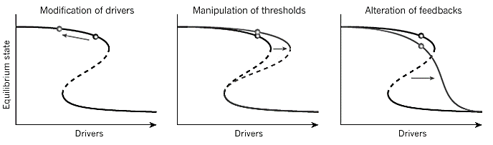

Marine
Education
24. Buying Time – Explain how resilience may partially offset ocean acidification responses in the short term
Name:
Date:
marineeducation.com.au
Building resilience
Removing the pressures on reefs builds resilience. Energy that would otherwise be used on surviving drivers of change such as climate change, pollution and overfishing, can instead be used for calcification.
In Figure 1, vertical arrows that represent resilience - whereby long arrows represent high resilience and short arrows
represent low resilience.
Figure 1: By reducing the relative strength of multiple drivers of change (i.e.stressors), the system moves away from a dangerous threshold (see black arrow). E.g. establish more marine parks, reduce pollution, and encourage shifts in social norms (the informal rules that shape people’s attitudes and behaviours) to foster compliance^{[1]}.
Figure 2: Thresholds are manipulated to allow the system to handle higher levels of drivers without collapsing. E.g. the impact of fishing is reduced by gear modifications, or by increasing the proportion of species that are more tolerant to escalating drivers
(e.g. heat tolerant species)^{[1]}.
Figure 3: Multiple feedbacks (consequences) could be managed to flatten the slope of the equilibrium response curve, reducing the risk
of surpassing a tipping point (or to eliminate it altogether). E.g. when fish stocks decline,
fishers that do not have access to alternative livelihoods (and may increase their fishing
efforts as a result) are given government-backed incentives to exit a fishery when stocks decline^{[1]}.
pH up-regulation
Incredibly, scleractinian corals can actively pump H+ ions out of their calcifying fluid (cf) where calcification takes place (see page 27). This increases their internal pH (pHcf ~8.3-8.6) and internal (calcifying fluid) saturation state (Ωcf ~15-25) and therefore rate of calcification^{[2]}. Pretty neat huh! Then, when seawater pH and Ωara decline with ocean acidification, the corals simply pump out more H+ ions! However, some do it better than others. And, to pump out H+ ions requires energy. Energy that comes from zooxanthellae. Further emphasizing the importance for corals to maintain their symbiotic relationship with zooxanthellae and avoid bleaching^{[2]}. Importantly, bleaching is not limited to just thermal stress. It can also happen with excessive UV, aerial exposure, pollutant and toxin exposure, reduced salinity, and high sedimentation^{[3]}.
Q. How do scleractinian corals maintain calcification rates under OA conditions? Ans.
They actively pump H+ out of their calcifying fluid to lower their internal pH
Assisted Evolution
Assisted evolution aims to enhance the resilience of organisms to climate change. Whereby naturally occurring evolutionary processes, that would normally take a very long time to evolve, are accelerated. For example, exposing corals to stressful conditions to unlock (epigenetic) coping mechanisms and induce acclimatization; selectively breeding certain corals that possess desirable traits (and replanting them); subjecting zooxanthellae to stress hoping to elicit an adaptive response through selection or random somatic mutations; and actively modifying the community composition of coral-associated microbes (e.g. inoculating young corals with stress tolerant zooxanthellae), all aim to enhance resilience^{[4]}. However, you don’t always need a lab to make ‘super corals’. There are super corals that already exist in the wild! They’re the ones that survive bleaching events.
Q. What is a super coral? Ans.
Heat adapted coral that survive bleaching events
^{[1]} Adapted by permission from Springer Nature Customer Centre GmbH: Nature Springer. Coral Reefs in the Anthropocene, Hughes, T.P., Barnes, M.L., Bellwood, D.R., Cinner, J.E., Cumming, G.S., Jackson, J.B.C, Kleypas, J., Van de Leemput, I.A., Lough, J.M., Morrison, T.H., Palumbi, S.R., Van Nes, E.H. and Scheffer, M. © 2017. Nature. 546(7656):82-90. DOI: 10.1038/nature22901.
^{[2]} McCulloch, M., Falter, J., Trotter, J. and Montagna, P. (2012). Coral resilience to ocean acidification and global warming through pH up-regulation. Nature. Climate Change. 2(8). DOI: 10.1038/nclimate1473
^{[3]} Pratchett, M.S., Munday, P.L., Wilson, S.K., Graham, N.A.J., Cinner, J.E., Bellwood, D.R., Jones, G.P., Polunin, N.V.C. and McClanahan, T.R. (2008). Effects of Climate-Induced Coral Bleaching on Coral Reef Fishes – Ecological and Economical Consequences. Oceanography and Marine Biology: An Annual Review (46) 251-296.
^{[4]} Van Oppen, M.J.H., Oliver, J.K., Putnam, H.M. and Gates, R. D. (2015). Building coral reef resilience through assisted evolution. PNAS. Vol. 112 no. 8. DOI:10.1073/pnas.1422301112
^{[5]} Filbee-Dexter, K. and Smajdor, A. (2019). Ethics of Assisted Evolution in Marine Conservation. Perspective Article: Frontiers of Marine Science. DOI: 10.3389/fmars.2019.00020
© Marine Education 2024 CC BY-NC-SA
Unit 3 Topic 2 Science Understanding – Implications for Marine Systems

Slide 49
Marine
Education
Explain how resilience may partially offset ocean acidification responses in the short term
Name:
Date:
marineeducation.com.au
© Marine Education 2024 CC BY-NC-SA
NOTES AND EXAM REVISION

Slide 50
Marine
Education
25. Title - Discuss how resilience of coral reefs is improved by minimising other impacts including coastal run-off (nitrogen inputs), and habitat destruction and fishing.
Name:
Date:
marineeducation.com.au
Teacher to write
© Marine Education 2024 CC BY-NC-SA
Unit 3 Topic 2 Science Understanding – Implications for Marine Systems

Slide 51
Marine
Education
Discuss how resilience of coral reefs is improved by minimising other impacts including coastal run-off (nitrogen inputs), and habitat destruction and fishing.
Name:
Date:
marineeducation.com.au
© Marine Education 2024 CC BY-NC-SA
NOTES AND EXAM REVISION

Slide 52
Marine
Education
26. Title - Interpret data relating to the effects of altered ocean pH on marine carbonate structures.
Name:
Date:
marineeducation.com.au
Teacher to write
© Marine Education 2024 CC BY-NC-SA
Unit 3 Topic 2 Science Understanding – Implications for Marine Systems

Slide 53
Marine
Education
Interpret data relating to the effects of altered ocean pH on marine carbonate structures.
Name:
Date:
marineeducation.com.au
© Marine Education 2024 CC BY-NC-SA
NOTES AND EXAM REVISION

Slide 54
Marine
Education
27. Title - Appreciate that international collaboration is often required when addressing global issues
Name:
Date:
marineeducation.com.au
Teacher to write
© Marine Education 2024 CC BY-NC-SA
Unit 3 Topic 2 Science as a Human Endeavour

Slide 55
Marine
Education
28. Title - Recognise the ecological consequences of climate change for reefs with reference to each of the four RCPs (2.6–8.5) identified in the IPCC’s 2014 Fifth Assessment Report.
Name:
Date:
marineeducation.com.au
Teacher to write
© Marine Education 2024 CC BY-NC-SA
Unit 3 Topic 2 Science as a Human Endeavour

Slide 56
Marine
Education
29. Title - Examine how decisions made on reef management and conservation are based on scientific knowledge, which relies on clear communication of findings, peer review and reproducibility.
Name:
Date:
marineeducation.com.au
Teacher to write
© Marine Education 2024 CC BY-NC-SA
Unit 3 Topic 2 Science as a Human Endeavour

Slide 57
Marine
Education
30. Title - Recognise that the majority of scientists accept that anthropogenic atmospheric changes are linked to global temperature increases.
Name:
Date:
marineeducation.com.au
Teacher to write
© Marine Education 2024 CC BY-NC-SA
Unit 3 Topic 2 Science as a Human Endeavour

Slide 58
Marine
Education
31. Title - Appreciate that scientists agree that global predictions on climate change are accurate; however, at a regional scale, due to localised conditions, predictions are less reliable.
Name:
Date:
marineeducation.com.au
Teacher to write
© Marine Education 2024 CC BY-NC-SA
Unit 3 Topic 2 Science as a Human Endeavour

Slide 59
Marine
Education
32. Title - Understand that decisions about actions to mitigate the effects of climate change depend on the perception of risk by individuals, communities, governments and international agencies and reflect their social, economic and cultural values.
Name:
Date:
marineeducation.com.au
Teacher to write
© Marine Education 2024 CC BY-NC-SA
Unit 3 Topic 2 Science as a Human Endeavour

Slide 60
Marine
Education
33. Title - Evaluate the ecological effects of bleaching on other reef organisms (e.g. fish) using a case study.
Name:
Date:
marineeducation.com.au
Teacher to write
© Marine Education 2024 CC BY-NC-SA
Unit 3 Topic 2 Science Inquiry

Slide 61
Marine
Education
34. pH test – Investigate the effects an altered ocean pH has on marine carbonate structures.
Name:
Date:
marineeducation.com.au
The aim of this experiment is to measure the dissolution rates of
marine carbonate structures in various pH solutions
Suggested Activity: Conduct one or more of the Practical Activities provided by Coral Watch^{[1]}
Activity: Create a flow chart to describe the potential consequences of ocean acidification for coral reef ecosystems, beginning with the addition of CO2
Dissolution means to dissolve. Dissolution rates increase as H⁺ ion concentrations increase (pH decreases).
Concentration (%)
H+
OH-
pH 0 | 1 | 2 | 3 | 4 | 5 | 6 | 7 | 8 | 9 | 10 | 11 | 12 | 13 | 14
Figure 1: Each one-unit change in pH corresponds to a ten-fold change in H+ ion concentration. Acidic solutions have more H+ ions than OH⁻ ions.
Experimental Design
An easy way to achieve the desired pH for each treatment is to add hydrochloric acid (HCl) to distilled water. The more you add, the stronger the solution. Alternatively, your teacher will prepare HCl solutions for you. Measure the pH and record below. Then, measure and record the dry weight of CaCO3 before the experiment, and again after the experiment. The dissolution rate will be the (mean) change in mass over time.
Treatment 1
Treatment 2
Treatment 3
Control
% HCl
% distilled water
% HCl
% distilled water
% HCl
% distilled water
% HCl
% distilled water
0
100
pH
pH
pH
pH 7
CaCO3
Activity: Record and Discuss your Results below. Discuss how to improve the experiment.
 | Treatment 1 (g) |  |  | Treatment 2 (g) |  |  | Treatment 3 (g) |  |  | Control (g)
1
2
3
MEAN
Repeats
Before
Change
in mass
Change
in mass
Change
in mass
Change
in mass
After
Before
After
Before
After
Before
After
© Marine Education 2024 CC BY-NC-SA
Unit 3 Topic 2 Science Inquiry

Slide 62
Marine
Education
35. Title - Investigate how increasing the concentration of dissolved CO2 lowers the pH of a solution.
Name:
Date:
marineeducation.com.au
Teacher to write
© Marine Education 2024 CC BY-NC-SA
Unit 3 Topic 2 Science Inquiry

Slide 63
Marine
Education
36. Title - Investigate how changes in temperature and salinity affect the solubility of CO2 in aqueous saline solutions.
Name:
Date:
marineeducation.com.au
Teacher to write
© Marine Education 2024 CC BY-NC-SA
Unit 3 Topic 2 Science Inquiry

Slide 64
Marine
Education
37. Title - Investigate the effect of CO2 on planktonic organisms.
Name:
Date:
marineeducation.com.au
Teacher to write
© Marine Education 2024 CC BY-NC-SA
Unit 3 Topic 2 Science Inquiry

