Slide 1
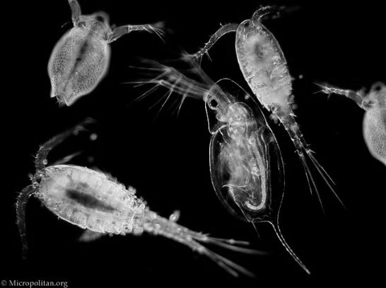
Marine
Education
Year 11 Marine Science
Student Workbook
Name:
Date:
marineeducation.com.au
Student Experiment
Formative Assessment number 2 (FA2)
Content from Marine Science Syllabus
State of Queensland (QCAA) 2019
By Gail Riches
© Marine Education 2023 CC BY-NC-SA
FA2 Student Experiment

Slide 2
Marine
Education
Name:
Date:
marineeducation.com.au
1. Choose a prac to modify
Original experiment to modify
Below is a list of pracs completed in class that you can modify for your FA2.
Mandatory practical: conduct water quality tests on a water sample
Suggested practical: conduct a beach profile/dune transect
Suggested practical: estimate populations, e.g. survey count, quadrats
Mandatory practical: conduct an investigation to determine factors of population dynamics (e.g. abundance, density or distribution) and assess abiotic components of a local ecosystem case study. Emphasis should be placed on assessing the processes and limitations of the chosen technique (e.g. quadrat, transect). When students identify and describe marine species, they should use field guides and identification keys.
Other
Activity: Tick one box above to indicate the prac you wish to modify for your FA2
Activity: Below, list improvements that you could make to that original prac to make it better.
© Marine Education 2023 CC BY-NC-SA
FA2 Student Experiment

Slide 3
Marine
Education
Name:
Date:
marineeducation.com.au
2. Modify it
What does it mean by ‘modify’?
When we modify an experiment, we change the methodology (and perhaps the aim and RQ too).
When we modify an experiment we redirect, refine and/or extend the experiment.
Redirect: this means that you’ll change the methodology to develop more insight into what was observed in the original experiment.
Refine: this means that you’ll change the methodology to gather more accurate or precise data and increase validity and reliability.
Extend: this means that you’ll change the methodology in order to overcome certain limitations of the scope, or how the data can be applied. This typically allows for further investigations and to understand what is happening in the experiment better.
Question: HOW did you modify the original experiment? Tick the applicable box/es.
REDIRECT
REFINE
EXTEND
WHY do we modify experiments?
We modify experiments to improve on them. When you did the original experiment in class, you would’ve made lots of observations and answered a research question. For example, you might’ve made an observation that gave you an idea of another research question (so you decide to redirect the experiment). Or, you might’ve observed a large margin of error in the results and thought of ways to make the results more reliable and valid (so you refine the experiment). Or, you might’ve observed the scope of the experiment was too limiting so you decide to add the previous year’s results to this year’s results (so you extend the experiment).
Question: WHY did you modify the practical or simulation? Tick the correct box
I REDIRECTED the experiment by changing the methodology, aim and research question
I REFINED the experiment by changing the methodology to increase it’s reliability and validity
I EXTENDED the experiment by changing the methodology to overcome limitations of scope
How to identify and improve VALIDITY
When measurements are ALL too high or ALL too low, the result will not be valid. It will be inaccurate. This can occur when instruments are not calibrated (thus giving the same wrong answer every time) or the person taking the measurements does it incorrectly every time. Obviously, to increase the validity (and accuracy) of an experiment requires careful planning. For example, check instruments are calibrated. Refine the measurement method or sampling technique. Brainstorm BEFORE the experiment to make sure all factors that could affect the results are considered. Plan thoroughly. Check equipment. Replace equipment if damaged. If using new equipment, find out how to use it correctly.
WARNING - You may be getting the same ‘wrong’ result every time! Validity & reliability are two different things.
What does VALIDITY mean? How accurate your data was. How close a measurement (your data) is to the true or accepted value.
What does RELIABILITY mean? How precise your data was. E.g. were the repeats all close to being the same (as they should be)?
Question: What type of modification increases the validity (redirect, refine, extend) ? Ans.
© Marine Education 2023 CC BY-NC-SA
FA2 Student Experiment

Slide 4
Marine
Education
Name:
Date:
marineeducation.com.au
3. Create your Aim and Research Question
The aim of this investigation is to measure the effect of …….on……..
The aim of your investigation will be to measure the effect of the independent variable on the dependent variable.
Activity: Complete this sentence: The aim of this investigation is to …..
The Research Question
It is very important to create a research question that can be answered using the data that you collect!!!!!
One way to ensure you can do this, is to word the research question in one of two ways….
Is there a difference in ….. between ……. & .……?
Is there a (linear) relationship between ……. & ……..?
Wording it like this will ensure you can (statistically) answer your research question with a yes/no answer.
Q. Is there a difference in between & ?
The dependent variable
Two groups to compare
For example,
Is there a significant difference in water salinity (ppt) between high tide and low tide?
Is there a significant difference in Mulberry Whelk abundance between high tide and low tide?
Is there a significant difference in the turbidity levels between Location A and Location B?
Is there a significant difference in water temperature between last year and this year?
P=0.12
Salinity (ppt)
Or, you can word it like this….
Low Tide
High Tide
Q. Is there a (linear) relationship between & ?
Must be CONTINUOUS data (& measured as a pair)
For example,
Is there a (linear) relationship between ghost crab abundance and distance from low tide?
Is there a (linear) relationship between microplastic abundance and distance from low tide?
Is there a (linear) relationship between turbidity levels and total suspended solids (TSS)?
Is there a (linear) relationship between temperature and depth of sand (cm)?
y=mx+c
For this type of question, once you have measured both pairs of continuous data, draw up a scatter graph (with one dataset on the x-axis and the other dataset on the y-axis). Plot the data and draw a (straight) line of best fit (y=mx+c).
If plots are close to the line, a ‘linear’ relationship exists, which is quantified by Pearson’s Correlation Coefficient or ‘r’. The closer r is to 1, the closer the plots are to the line and the stronger the relationship.
Turbidity (m)
r=0.80
Total Suspended Solids (mg/L)
Activity: Create one or more research questions using the formatting described above
© Marine Education 2023 CC BY-NC-SA
FA2 Student Experiment

Slide 5
Marine
Education
Name:
Date:
marineeducation.com.au
4. Write your Rationale
Rationale
SO….you’ve made the observations and obtained the results from the original prac, listed some improvements, chosen a modification, and created an aim and research question. I ask you this…..WHY did you choose that particular modification, aim and research question? The definition of a “rationale” is when you’re asked to give the reasoning or justification for an action or choice you make. There is a focus on the WHY in a rationale: why you chose to do something, study or focus on something. It is a set of statements of purpose and often addresses a gap or a need. The reason for doing your experiment may be, for example, to fill a knowledge gap or explain why it’s important to do something in a certain way?
One way to think of a rationale is to consider the problem or issue requiring attention, the solution, and then the rationale or justification for the solution (the ‘why’). This sets the rationale (the reason) within a context. Importantly, there should be some in-text citations in every rationale to demonstrate your choices have been informed choices – informed by science. E.g. why do beach surveys?
Language to signal rationale
because
in order to
as
so that
therefore
the reason this was done/chosen …
for the following reason(s) …
for two/three reasons …
Activity: Write a rationale for your experiment (the reason for doing it).
Activity: Below, identify the reasons for your experiment (spoken as though you haven’t done it yet)
© Marine Education 2023 CC BY-NC-SA
FA2 Student Experiment

Slide 6
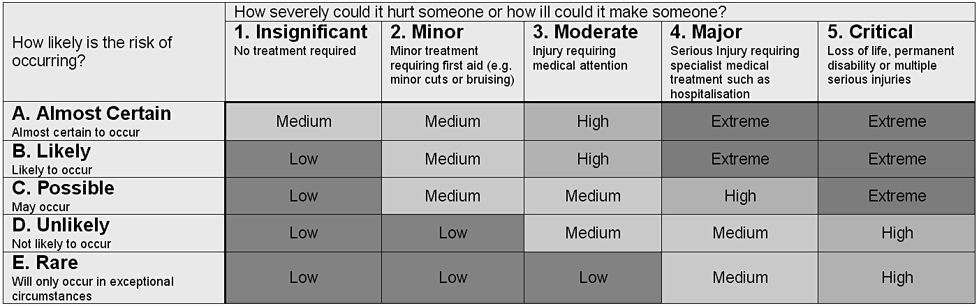
Marine
Education
5. Consider the Risks
Name:
Date:
Risk Level Matrix
The risk level matrix is used as a guide to identify level of risk. The basic elements in a risk level matrix include:
Consequence: This is a measure of the severity and ranges from fatality to something so minor that not even a "Band Aid" is needed. This must be assessed as the worst case scenario. Issues to consider with consequence are duration of exposure to the hazard, frequency of exposure, number of people being exposed and human differences.
Probability: This is how likely it is to happen.
Consequence
Probability
Matrix ratings
Activity: Complete the table below for your experiment (example provided in first row)
Description of Risk/issue | Probability | Consequence | Matrix rating | Recommended Controls (mgmt.)
Sunburn | C. Possible | 2. Minor | Medium | Hat and sunscreen will be worn
Risk:
Risk:
Ethical Issue*:
Environmental Issue*:
*DO NOT CONDUCT EXPERIMENT IF IT’S POSSIBLE ANY LIVING ORGANISM WILL BE HARMED!
© Marine Education 2023 CC BY-NC-SA
FA2 Student Experiment

Slide 7
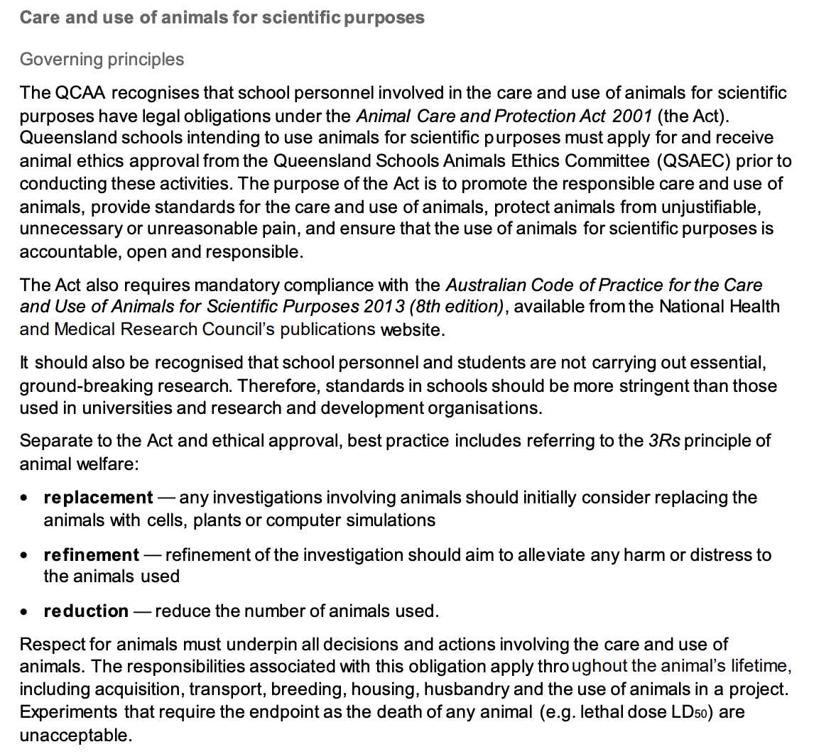
Marine
Education
A note on Safety and Ethics from QCAA
Name:
Date:
© Marine Education 2023 CC BY-NC-SA
FA2 Student Experiment

Slide 8
Marine
Education
6. Design the experiment
Name:
Date:
Activity: Write your methodology below. Ensure it enables the collection of sufficient and relevant data. Hint: write in past tense, third person. Include labelled diagrams if relevant.
© Marine Education 2023 CC BY-NC-SA
FA2 Student Experiment

Slide 9
Marine
Education
7. Collect raw data
Name:
Date:
Activity: Record your raw data in the space below. Make sure it’s sufficient and relevant.
© Marine Education 2023 CC BY-NC-SA
FA2 Student Experiment

Slide 10

Marine
Education
Name:
Date:
marineeducation.com.au
8. Analyse your data (answer the RQ)
Activity: Follow the flow chart to analyse your data and answer your research question
Q. Is there a difference in between & ?
Dependent Variable
GROUP 1
GROUP 2
Start here
Q1. Is this the wording of your research question?
No
Yes
Calculate the
mean and
standard deviation
of each group.
Conduct a t-test to get a
P value
to statistically answer your
research question.
Create a column graph using mean values.
Draw error bars using standard deviation (or SEM) values to illustrate margin of error.
Go to Next Page
Q2. Is the dependent variable abundance?
Yes
No
Q3. Is the dependent variable population size (N)?
No
No
Yes
Population Size= x total area of population
area of one quadrat
(Quadrat Method)
where:
N = Total Population Size
= sample mean = TOTAL count of individuals / number of quadrats
Q4. Is the dependent variable population density?
No
No
Yes
Density = Population size (see above) / Area
Q5. Is the dependent variable percentage cover?
No
Yes
See your teacher
Q6. Did you use sample points in your methods?
No
Percentage Cover
Yes
x100
Total number of sample points occupied by a species
=
Total points sampled
Q7. Did you use the Line Intercept Method?
No
Yes
No
Percentage Cover
x100
Total length of transect occupied by a species
=
Total transect length
Q8. Did you use a quadrat in your methods?
No
Yes
Percentage Cover
x100
=
Total % cover for all quadrats
Total number of quadrats
See your teacher
© Marine Education 2023 CC BY-NC-SA
FA2 Student Experiment

Slide 11
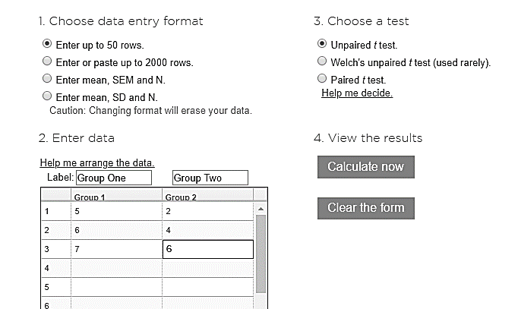

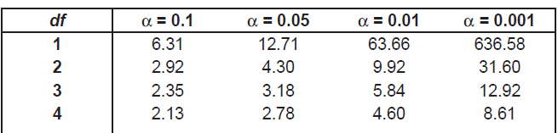

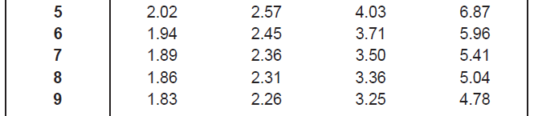
Marine
Education
HOW TO IDENTIFY A SIGNIFICANT DIFFERENCE BETWEEN 2 GROUP MEANS using a t-test
Name:
Date:
marineeducation.com.au
Online
Google ‘t-test calculator’. Open GRAPHPAD at: https://www.graphpad.com/quickcalcs/ttest1.cfm
Enter data for Group 1 and Group 2. If P = <0.05, they are significantly different!
Maintain default values/assumptions: two sample t-test, two-tailed test, unpaired t-test, independent groups, groups have equal variance, 0.05 significant level.
P = < 0.05
There is a significant difference between 2 groups
Don’t change
P = > 0.05
There is NO significant difference between 2 groups
Enter Data
Calculate now
Note: The word SIGNIFICANT is ONLY used when a STATISTICS test, such as a t-test with a P value, has been used to answer the research question. Importantly, the word significant has NOTHING to do with the SIZE difference between 2 groups. Significant is a Science term. Its only purpose is to notify the audience that the research question was answered using a STATISTICS test.
Hand calculation
The formula is:
numerator
Difference between
the means
=
Group 1 mean – Group 2 mean
Standard error of
the difference
[(s₁² x df₁)+ (s₂² x df₂)] / [df₁ + df₂ ] + ← that again
denominator
Square root √ of:
n1
n2
Note: s=standard deviation; SE=Standard Error; = sample mean; df (degrees of freedom) = (n1 –1) + (n2 –1).
Whereby n=sample size, and subscripts indicate group number.
The t test formula is simply a ratio (also a fraction). The numerator is the difference between two means.
The denominator is a measure of variability or dispersion of the scores (standard error of the difference).
Note: a t test by hand calculates tcalc sometimes called t Stat or t (instead of a P value).
Step 1: Calculate tcalc using the formula above
Step 2: Calculate tcrit using the Student’s t-distribution table (left) whereby = 0.05
Step 3: Compare tcalc to tcrit
Table 1: Student’s t-distribution
numerator
Medium variation
P is close to 0.05
High variation
P is > 0.05
tcrit is large.
If tcalc ≥ tcrit
there is a significant difference between the
2 groups
Figure 1 (right): Even though the difference between the means (the gap between the peaks, or distance between the vertical lines) are the SAME for all three graphs, the denominator determines the amount of overlap (variation) between both data sets. Only when the overlap is minimal can a significant difference be identified.
Low variation
P is < 0.05 and closer to zero.
tcrit is small.
denominator
© Marine Education 2023 CC BY-NC-SA
FA2 Student Experiment

Slide 12
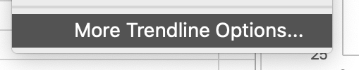

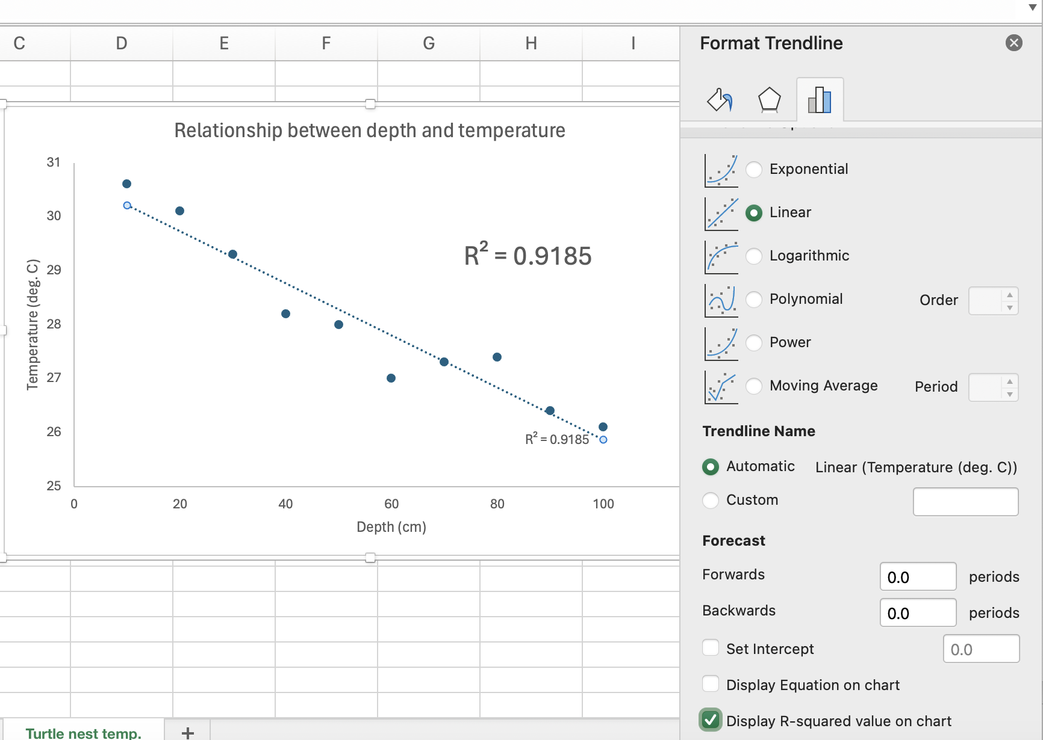
Marine
Education
Name:
Date:
marineeducation.com.au
8. Analyse your data (answer the RQ)
Q. Is there a (linear) relationship between & ?
Dependent Variable
Independent Variable
Y
X
Condense your data into two columns, x and y.
For example….
5
4
3
2
1
(50,5)
X | Y
10 | 1
20 | 2
30 | 2
40 | 3
50 | 5
Line of best fit (y=mx+c)
(10,1)
Y
(40,3)
(20,2)
(20,2)
(30,2)
(30,2)
r = 0.938
(see below for instructions)
(10,1)
(40,3)
10 | 20 | 30 | 40 | 50
(50,5)
X
Pearson’s Correlation (r)
…is a measure of the strength of the linear relationship between two variables, x and y.
The value r =1 indicates the strongest possible positive relationship between x and y (i.e. as one increases the other increases).
The value r = - 1 indicates the strongest possible negative relationship between x and y (as one increases, the other decreases).
The value r = 0 ± 0.5 indicates no linear relationship between x and y.
Note: this does not rule out any strong relationship between x and y.
There could still be a strong relationship, but one that is not linear.
How to calculate r in excel manually
How to calculate R² on excel graph:
See your teacher
Simply click on an empty cell and type =CORREL( X , Y )
where: X is the column containing all the data for the x-axis &
Y is the column containing all the data for the y-axis.
 | A | B | C
1 | X | Y | = CORREL(A2:A6,B2:B6)
2 | 10 | 1
3 | 20 | 2
4 | 30 | 2
5 | 40 | 3
6 | 50 | 5
© Marine Education 2023 CC BY-NC-SA
FA2 Student Experiment

Slide 13

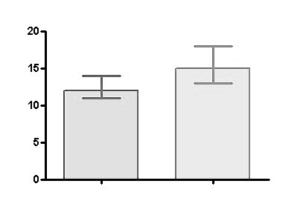
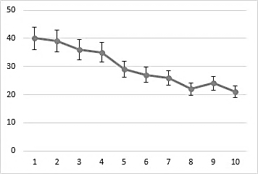


Marine
Education
Name:
Date:
marineeducation.com.au
9. Add error bars (if applicable)
Error Bars
Error Bars look like this!
Error Bars also look like this!
MEAN
MEAN
Note: error bars can only be added to graphs with MEAN (average) values (as opposed to raw data).
Each error bar has a top cap and a bottom cap. The mean always goes in the middle of the error bar. Hence, the top half of the error bar equals the mean plus the margin of error. And the bottom half of the error bar equals the mean minus the margin of error. The margin of error, in this case, is standard deviation (s). Note: a large error bar means the repeats are far apart, so the results are not very reliable. As opposed to a small error bar whereby the repeats are close together and the results are much more reliable (with less error).
The mean plus the margin of error
The Mean goes in the middle
Margin of error
The Margin of ERROR quantifies the range of uncertainty in your result (chance of an error).
The mean minus the margin of error
© Marine Education 2023 CC BY-NC-SA
FA2 Student Experiment

Slide 14
Marine
Education
Name:
Date:
marineeducation.com.au
9. Copy/paste graph (with caption)
Activity: Copy/paste your graph below. Add caption beneath the graph (include P value or r or R² value).
Write a caption for your graph, starting with the words, ”Figure 1: …….” Write what you see on the graph.
Activity: Below, identify any trends, patterns or relationships in your graph
© Marine Education 2023 CC BY-NC-SA
FA2 Student Experiment

Slide 15
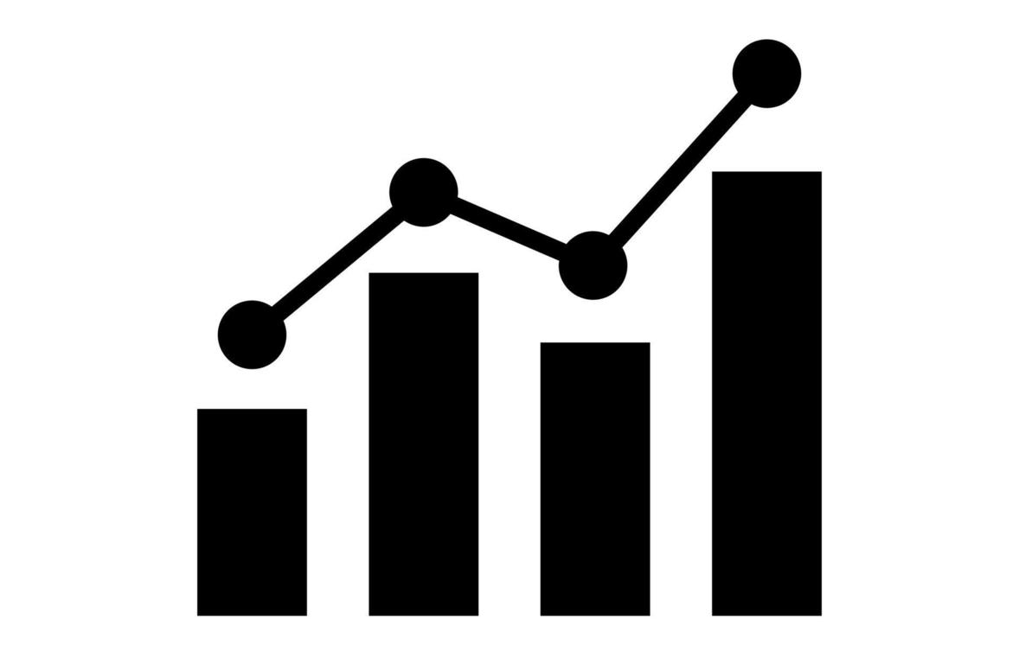
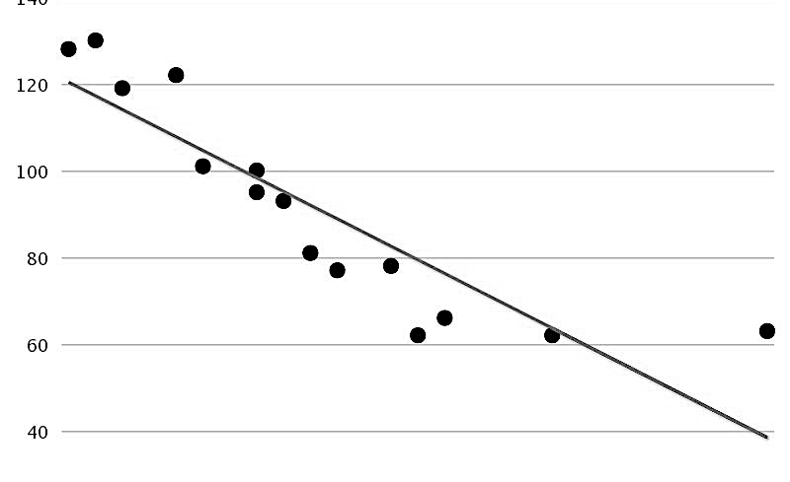
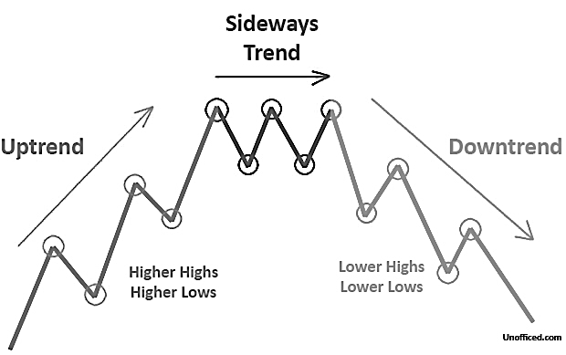
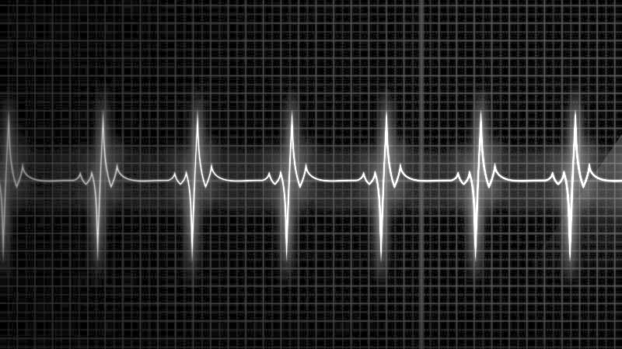
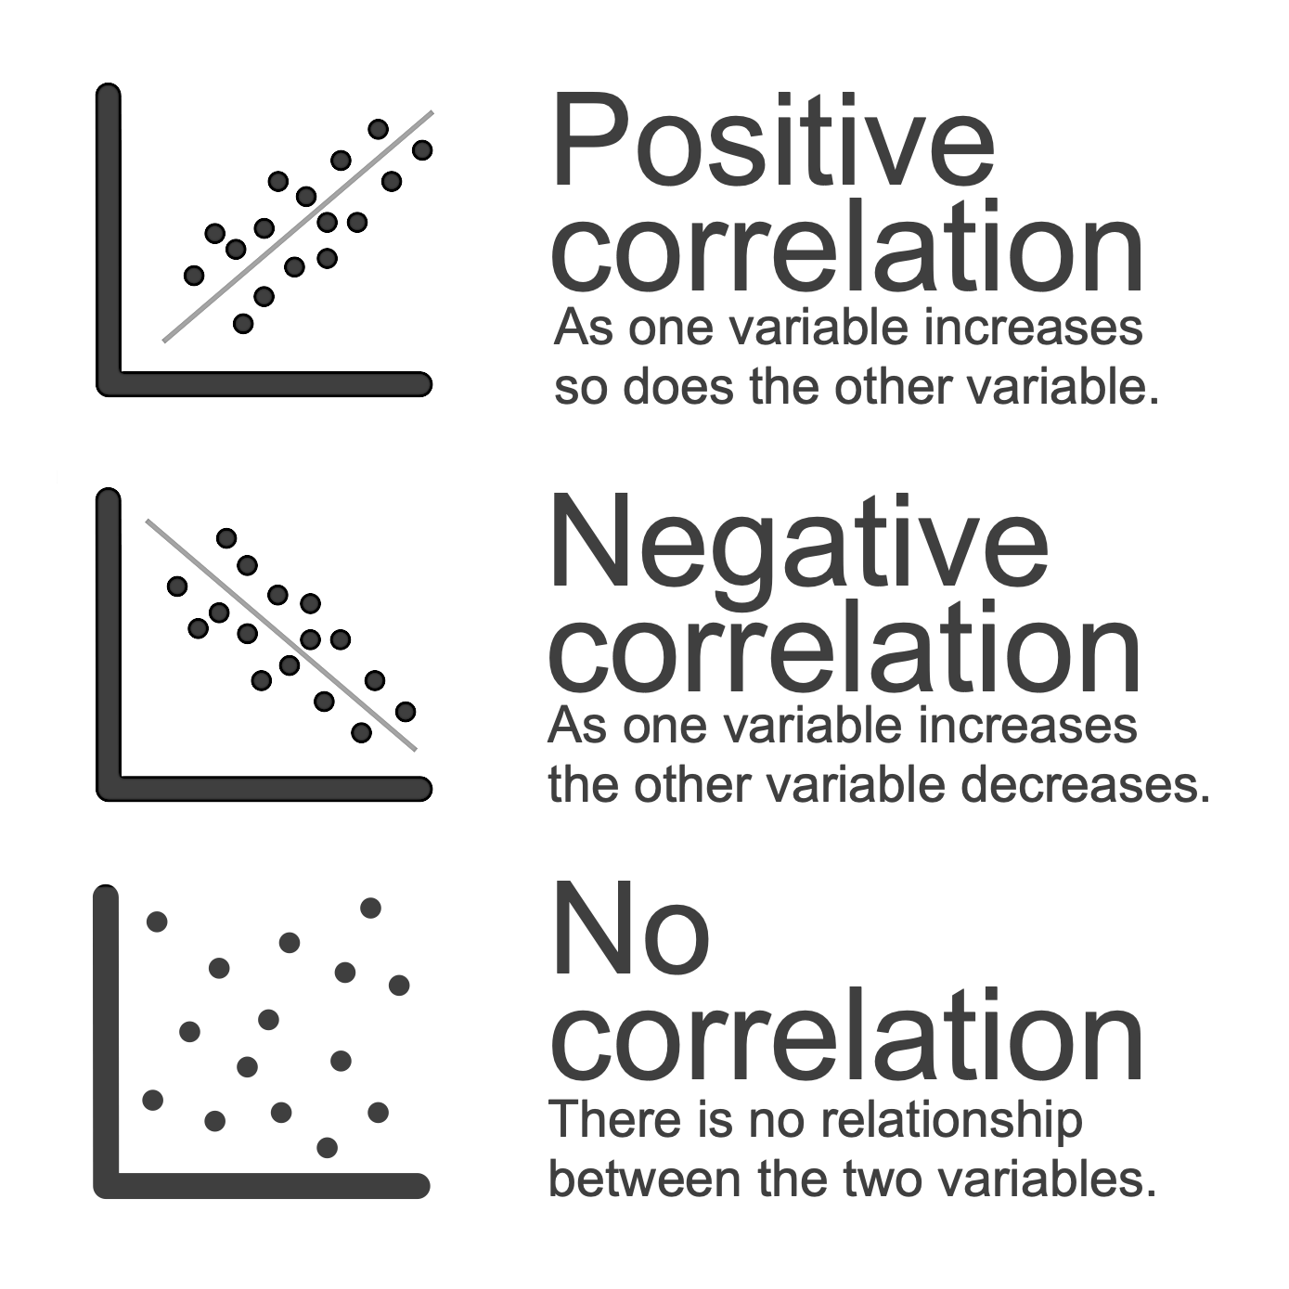
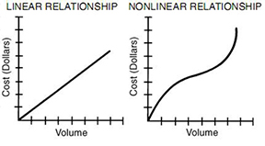
Marine
Education
Name:
Date:
marineeducation.com.au
10. Identify trends, patterns, relationships
QCAA asks you to thoroughly identify any RELEVANT TRENDS/PATTERNS/RELATIONSHIPS
Trends
A trend is the general direction in which something is developing or changing over time.
E.g. the line on a line graph, the line of best fit on a scatterplot, or the column heights on a column graph are trending in one particular direction.
Identifying a trend makes it easier to then make predictions.
Upwards trend: the data is showing a general increase in direction (going upwards).
Downwards trend: the data is showing a general decrease in direction (going downwards).
Sideways trend: the data is flatlining, with no increase or decrease in direction (going horizontally).
Upwards trend
Downwards trend
Sideways trend
Patterns
Patterns are changes that occur more than once. Look for a repeating PATTERN.
A pattern is a series of data that repeats in a recognisable way.
For example, the amount of something may increase or decrease regularly
(e.g. the temperature where you live usually goes up during the day and down during the night).
Relationships
A relationship refers to the correspondence between two variables.
whereby, one of the variables is on the x-axis and the other variable is on the y-axis.
If one variable increases, does the other variable increase or decrease?
relationship
relationship
relationship
© Marine Education 2023 CC BY-NC-SA
FA2 Student Experiment

Slide 16
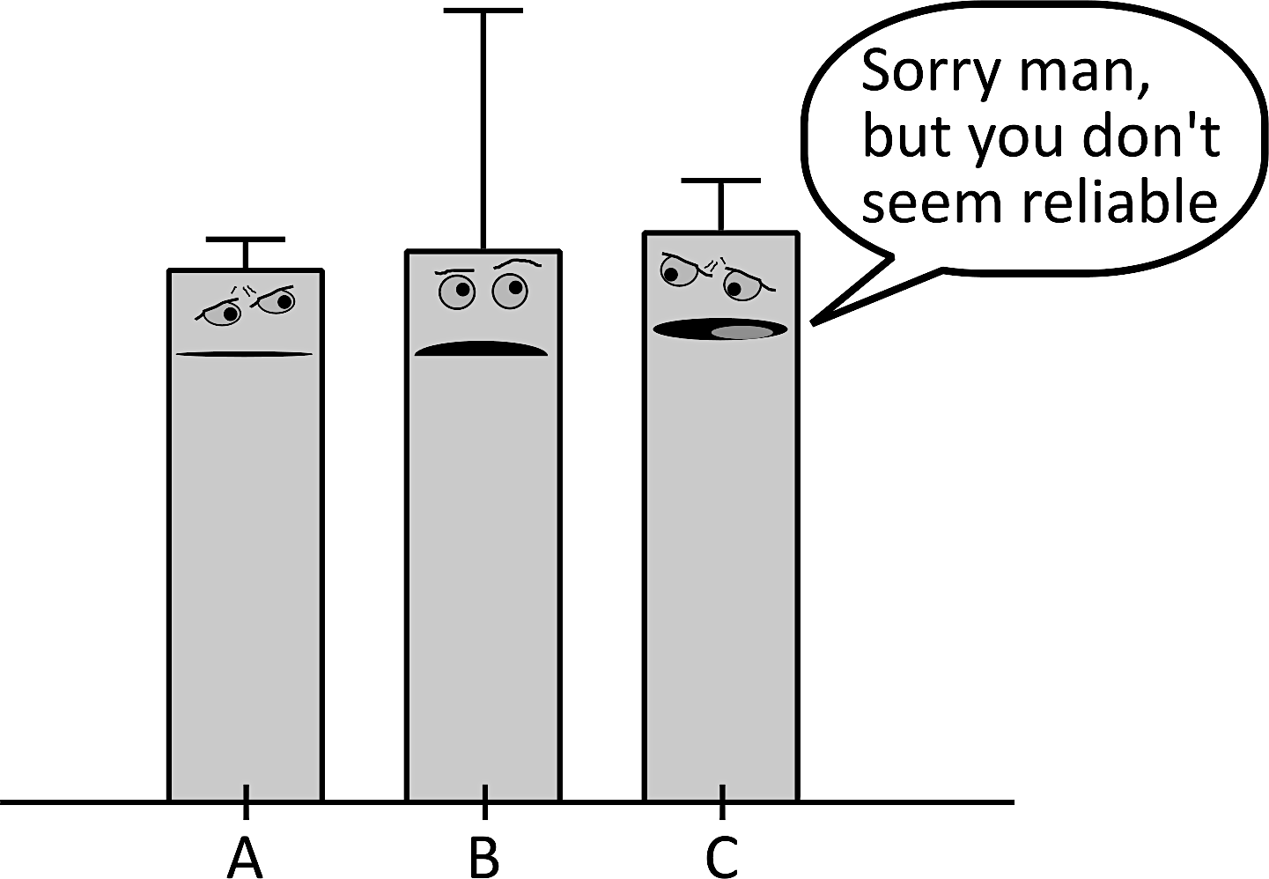
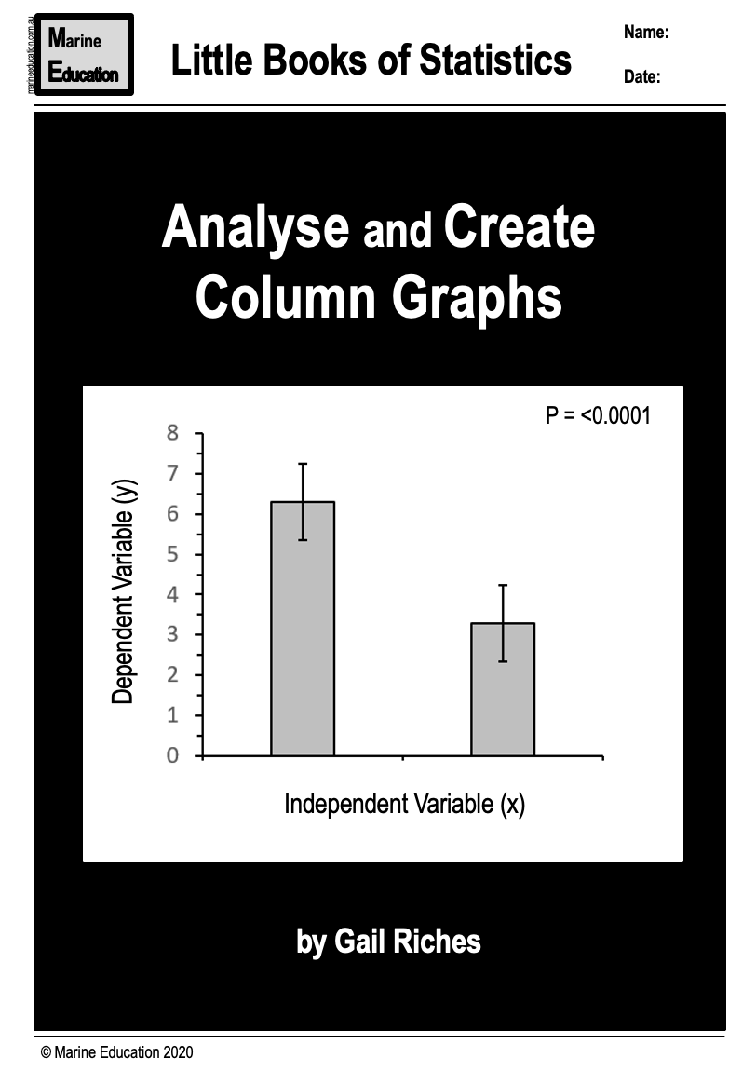
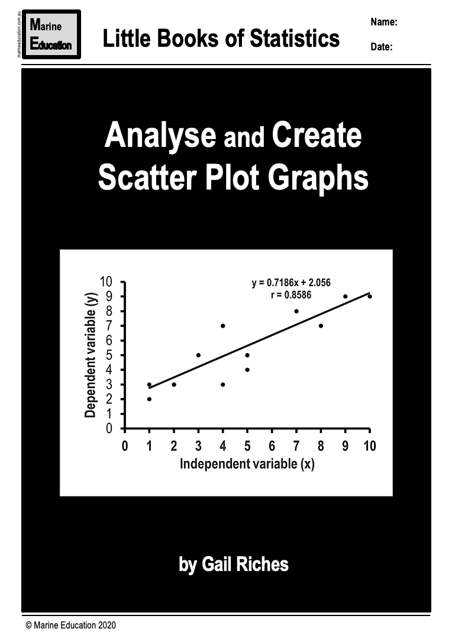
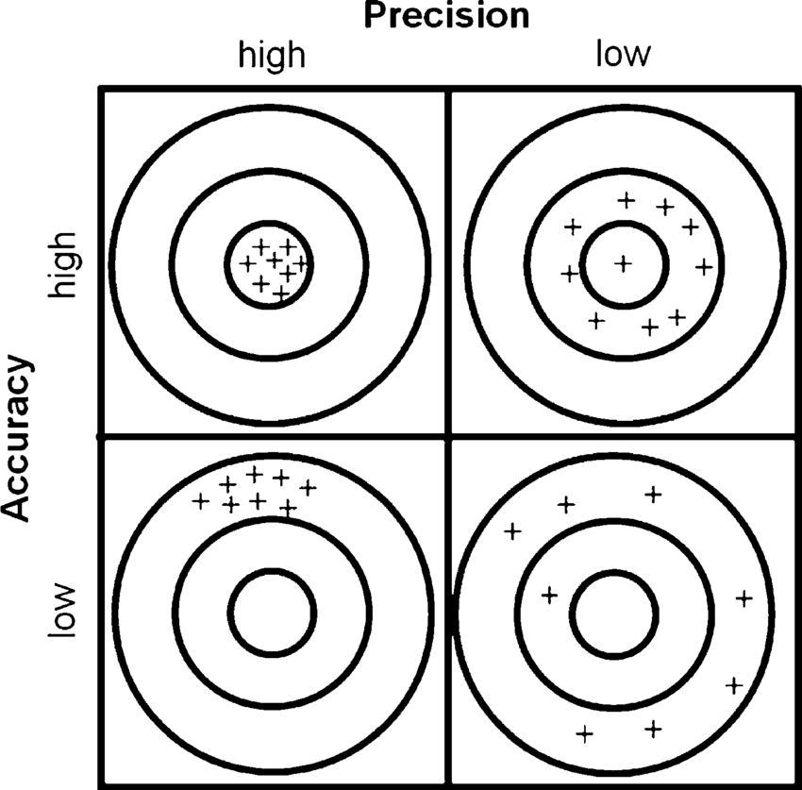
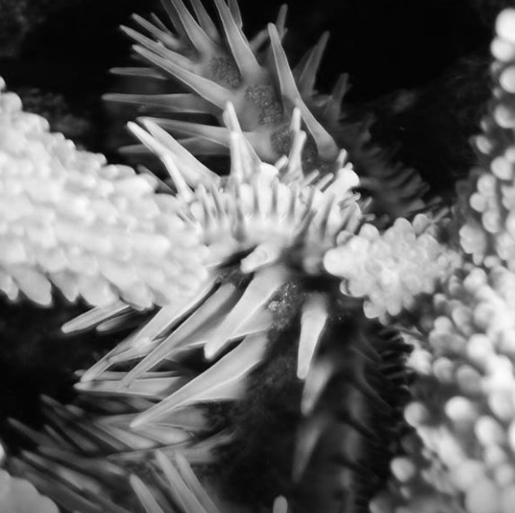
Marine
Education
11. Identify uncertainty and limitations
Name:
Date:
marineeducation.com.au
Analyse THE evidence (NOT the lack of evidence)
Uncertainty of evidence
QCAA asks you to identify uncertainty of evidence. Indicators of uncertainty include standard deviation (s) and [in population studies] standard error of the mean (SEM) and (sometimes) confidence intervals (CI). Hopefully, you have already calculated these values and picked one to create the error bars on your graph/s. Refer to the s and SEM values (and the sizes of the error bars) to determine if the evidence that will be used to draw a conclusion to the research question is reliable and valid.
Standard deviation will tell you if it’s reliable or not. SEM will tell you if it’s valid or not. Error bars will illustrate by how much. The larger the s, SEM or CI values, the larger the uncertainty of evidence.
Activity: read the ‘little books of statistics’ on MarineEducation.com.au to learn about Error Bars etc.
Reliability = precision
Validity = accuracy
Addressing limitations
QCAA also asks you to identify limitations of evidence.
Limitations identify WHY there was uncertainty in your experiment, specifically.
Every sampling technique, every piece of equipment and every methodology has certain limitations.
If you fail to identify these limitations, the validity of your experiment will be compromised.
E.g. the answer to your research question was yes, when it should have been no, or vice versa.
For example, pictured left is a crown of thorns starfish (note the spikes). It is tucked in behind the branches of a staghorn coral. Its hidden position may obscure it from view. A 2D quadrat was used to measure its abundance. The 2D (as opposed to 3D) nature of the quadrat is a limitation of the quadrat. Another limitation is when mobile animals ‘flee from the scene’. Or, if the quadrat is too large or too small (or out of focus) for the size and scale of what is being measured.
Limitations identify the main weak points or disadvantages that make the data less effective in answering the research question. For example, WHY your standard deviation, SEM or CI was high (and not closer to zero). Remember, no research method is perfect. There will always be some form of error.
© Marine Education 2023 CC BY-NC-SA
FA2 Student Experiment

Slide 17
Marine
Education
Name:
Date:
marineeducation.com.au
12. Justify your conclusions linked to the RQ
Conclusions (linked to the RQ)
Restate the aim and answer the research question (should be a yes or no answer).
Restate your level of confidence in your answer to your research question with a statistical value such as a P value or an r value.
Explain reasons for the P value or r value by referring to your measures of uncertainty (e.g. s, SEM or CI) as well as the size and (if applicable) the overlapping of your error bars.
For example, if the P value was above 0.05 (i.e. there was no significant difference between two group means) or the r value was closer to zero than one (i.e. there was no linear relationship between two variables) was it because the s value was large (and precision was low)? Was there an anomaly in the dataset that made it that way? Should the anomaly be removed? Does the outcome change if an anomaly is removed? Was the margin of error large because of an experimental design flaw? Does it change if the analysis is done differently?
Finally, provide a scientific explanation for your results. Lots of in-text references needed here.
For example, ‘the results suggest…..’. This is supported by …….that states…..(Author, date).
Activity: Restate the aim. E.g. the aim of this experiment was to….
Activity: Answer the research question. E.g. there was/wasn’t a significant difference in…between… OR; there was/wasn’t a linear relationship between…
Activity: Restate the P value or the r value. E.g. the P value was…. Or; the r value was….
Activity: State the margins of error. E.g. the standard deviation for group 1 was [ ] suggesting the results are reliable/unreliable.
Then continue to discuss WHY.
© Marine Education 2023 CC BY-NC-SA
FA2 Student Experiment

Slide 18
Marine
Education
Name:
Date:
marineeducation.com.au
13. Discuss reliability and validity
Taking control
In the lab, when conducting an experiment, conditions are strictly controlled. In the field, we aim to control as many variables possible (i.e. date, time, tide, etc.). However, given that it is outside, there are many variables that can not be controlled. These are called ‘measured variables’. They’re called measured variables because they need to be measured. Why? Because they can influence the result.
Activity: Below, list the measured variables from your experiment (those you couldn’t control….and hopefully measured!). Rank them from most likely to least likely to influence the result (a.k.a. reliability).
Detective work
A researcher must always consider the probability that the result is incorrect – either the experiment failed
to pick up a difference when there was one, or the experiment found a difference that didn’t exist. Your experiment must therefore be critically analysed – the data analysis part and the experimental design.
 | Question
Data Analysis | Did you use the correct statistics test for the wording of the research question? How close to 0.05 (the cut-off point) was the P value? If the difference was significant, how close to zero was the P value? If applicable, how close was r (Pearson’s correlation coefficient) to 1.0 or -1.0? How close to zero were the values for s (standard deviation), SE & Cl? (if they were not close to zero, you need to examine why your replicates were not the same) Did you construct a graph to make a visual comparison before reaching a conclusion? Were there any variables that could not be controlled, measured? Were any measured variables likely to have influenced the result?
Experimental Design | Could you have picked a better dependent variable (population) to measure? Could you have changed the independent variable in a different (and more effective) way? Should you have used qualitative data instead of quantitative data and vice versa? Did the experimental design take into account the dispersion patterns of the population (i.e. clumped)? Were there enough replicates? Were the replicates independent of each other, to avoid double counts? Was there randomisation in sampling to avoid bias (and validity)? Was the size of the sample unit appropriate for the size of the organism? Was the choice of sample unit appropriate for the mobility of the organism? Were the limitations of the sampling technique addressed? Was the scale of the experimental design suitable for the scale of the research question?
Q. How valid (how close to the truth) are your results and WHY? Ans.
Q. How reliable (how precise) are your results and WHY? Ans.
© Marine Education 2023 CC BY-NC-SA
FA2 Student Experiment

Slide 19
Marine
Education
Name:
Date:
marineeducation.com.au
14. Suggest Improvements and Extensions
Suggested improvements
Any limitations of your experimental design can now be turned into a suggestion on how to reduce the margin of error, improve reliability and validity, and thus improve the experiment. For example, if you listed ‘not enough repeats’ as a limitation, suggest more repeats! Justify all suggestions to explain how they improve the experiment (how to refine the experiment). Activity: complete the tables below.
Limitation (of the methodology) | Suggested improvement (to the methodology) | Justification (logically derived from the analysis of evidence)
Suggested extensions
What’s next? Now you’ve completed this experiment, what more can you discover?!
Examples of extensions include:
change the methodology
change the independent variable
change the dependent variable
change the aim and research question
Suggested extension | Justification (logically derived from the analysis of evidence)
© Marine Education 2023 CC BY-NC-SA
FA2 Student Experiment

Slide 20
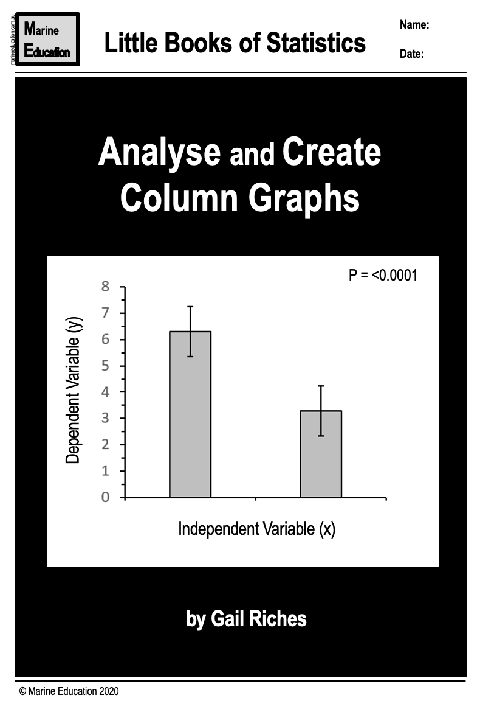
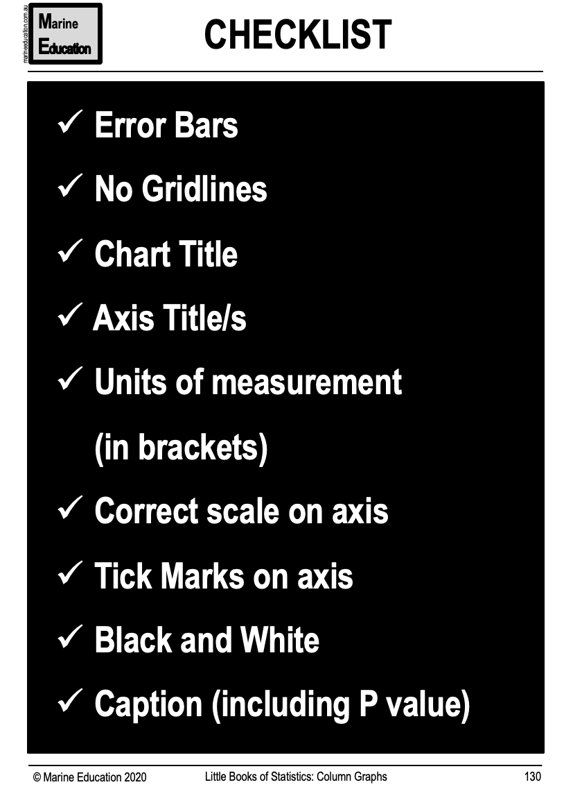
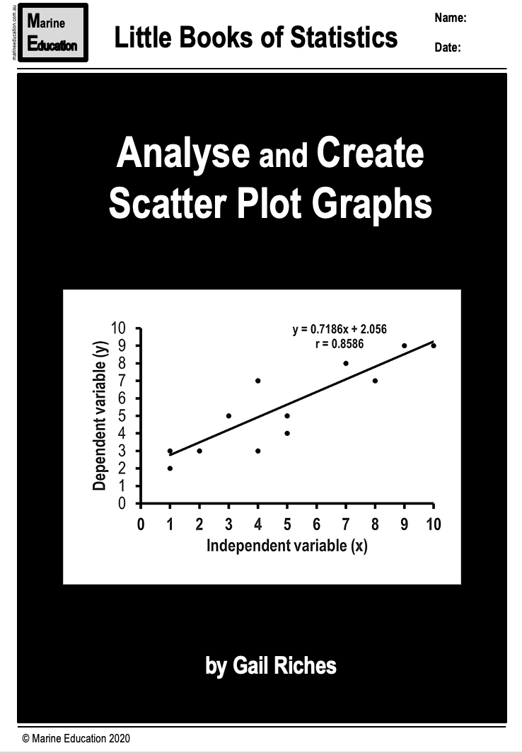
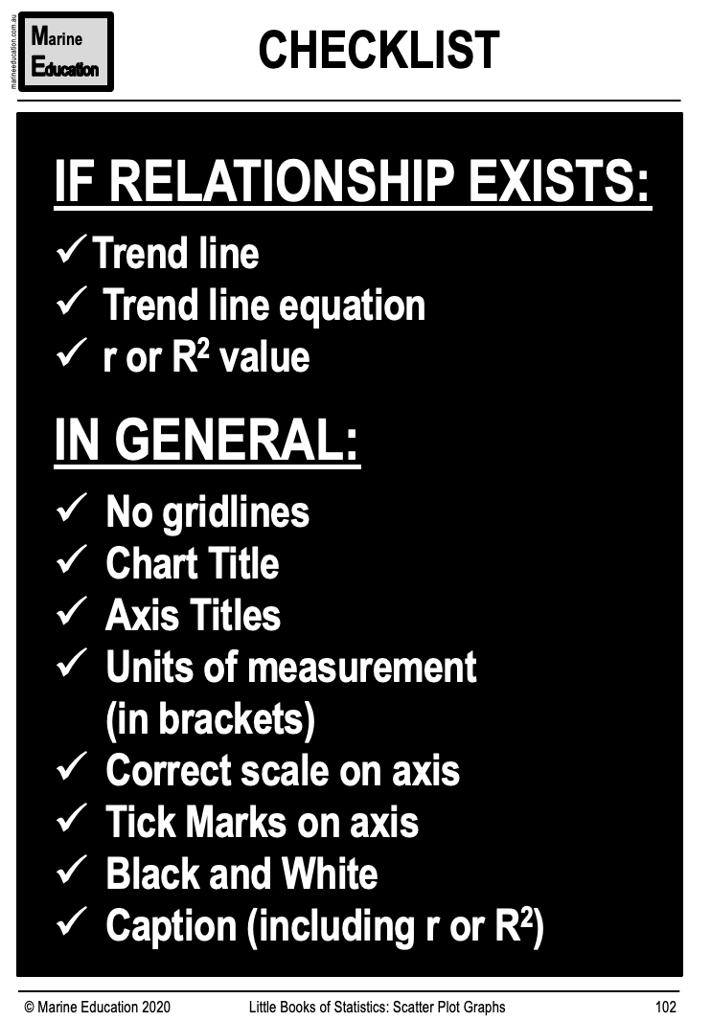
Marine
Education
Name:
Date:
marineeducation.com.au
11. Use scientific language and representations
Check you have been Fluent and Concise in the use of scientific language and representations
Fluent: able to express oneself easily and articulately, with no mistakes. Smooth, graceful and effortless. Easy to read.
Concise: giving a lot of information clearly and in a few words; brief but comprehensive.
Activity: Download the ‘Little Books of Statistics’ from MarineEducation.com.au to check your graph is fluent and concise.
or
Activity: In the space below, list your results from the previous page as dot points, starting with the answer to the research question, followed by the stats test results, followed by the margins of error.
Activity: rewrite the dot points above as a paragraph in the space below. Make it fluent and concise.
© Marine Education 2023 CC BY-NC-SA
FA2 Student Experiment

Slide 21

Marine
Education
Name:
Date:
marineeducation.com.au
12. Use Language Conventions
QCAA asks you to use the appropriate genre and referencing conventions.
Activity: below is a checklist of expected genre conventions for marine science for you to tick.
Scientific writing follows certain conventions related to format, citation, design, voice, tense, concision and organization that may differ from writing in other contexts.
Genre conventions (in Marine Science)
Includes title page with your name on it.
Raw data is recorded with the associated uncertainties and expressed consistently to the correct number of significant figures.
No spelling and grammar mistakes.
Correct tense is used.
No first person (no “I” or “we”).
Follows a general scientific report structure using headings and subheadings.
Units of measurement and symbols are correctly written.
Data is represented in an appropriate format
Data is represented so that trends, patterns and relationships can be accurately interpreted.
Figures have captions.
Tables have titles.
All figures and pictures in black and white (not everybody can print in colour) and can still be read.
Figures and captions are numbered accordingly.
It’s easy to read and understand and avoids unnecessary repetition.
Information flows smoothly/coherently and is easy to understand.
Writing is concise - brief, comprehensive and to the point (no waffling).
Within the word limit.
No appendix.
Referencing conventions
Appropriate acknowledgment of sources of information as in-text citations and a reference list.
Use of in-text citations to clearly distinguish your work from others (so the source of information can be located and verified and the work or intellectual property of the author can be honoured).
© Marine Education 2023 CC BY-NC-SA
FA2 Student Experiment

Slide 22
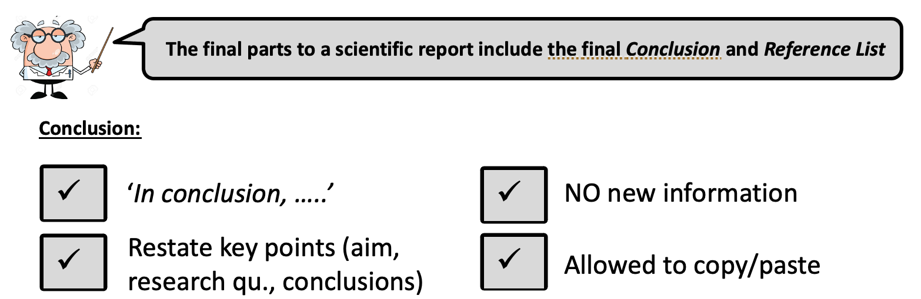
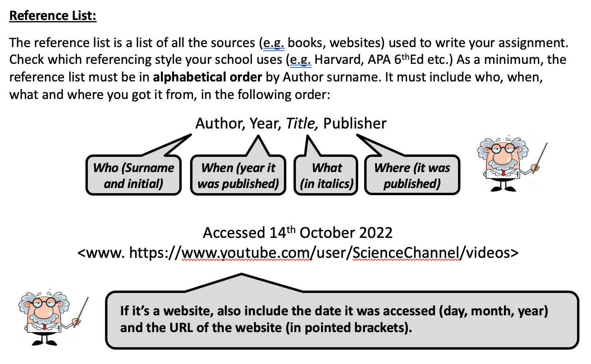
Marine
Education
Name:
Date:
marineeducation.com.au
13. Use referencing conventions
For example
In conclusion, the aim of this experiment was to [ ____________________ ] .
The results suggest [ ____________________ ] because [ ____________________ ].
The values for [standard deviation?] suggest the answer to the research question is
[reliable] [unreliable] (select one).
The values for [standard error of the mean?] suggest the answer to the research question is
[valid] [invalid] (select one).
Suggested improvements include [ ____________________ ] .
Suggested extensions include [ ____________________ ] .
© Marine Education 2023 CC BY-NC-SA
FA2 Student Experiment

Slide 23
Marine
Education
Name:
Date:
14. Mark your paper
Criterion: Research and Planning
Rationale
Considered rationale (5-6)
Reasonable rationale (3-4)
Vague or irrelevant rationale (1-2)
Modifications
Justified modifications (5-6)
Feasible modifications (3-4)
Inappropriate modifications (1-2)
Research Question
Specific and Relevant (5-6)
Relevant (3-4)
Inappropriate (1-2)
Methodology
Sufficient and relevant (5-6)
Relevant (3-4)
Insufficient and irrelevant (1-2)
Management of risks AND ethical or environmental considerations
Considered management (5-6)
Management (3-4)
Inadequate management (1-2)
Criterion: Analysis of Evidence
Processing of Data
Correct and relevant (5-6)
Basic (3-4)
Incorrect or irrelevant (1-2)
Identification of Trends
Thorough and relevant (5-6)
Obvious (3-4)
Incorrect or irrelevant (1-2)
Identification of Uncertainty AND Limitations of Evidence
Thorough and Appropriate (5-6)
Basic (3-4)
Incorrect or insufficient (1-2)
The collection of ….raw data
Sufficient and relevant (5-6)
Relevant (3-4)
Insufficient and irrelevant (1-2)
Activity: Using the ISMG Criteria below, give a mark out of 5 for the rationale provided above.
© Marine Education 2023 CC BY-NC-SA
FA2 Student Experiment

Slide 24
Marine
Education
Name:
Date:
14. Mark your paper
Criterion: Interpretation and Evaluation
Conclusion (linked to the RQ)
Justified (5-6)
Reasonable (3-4)
Inappropriate or irrelevant (1-2)
Evaluation of the experimental process
Justified discussion of its reliability AND validity (5-6)
Reasonable description of its reliability AND validity (3-4)
Cursory or Simplistic Statements about its reliability AND validity (1-2)
Suggested Improvements AND extensions to the experiment that are…
LOGICALLY DERIVED FROM the analysis of evidence (5-6)
RELATED TO the analysis of evidence (3-4)
Ineffective or irrelevant suggestions (1-2)
Criterion: Communication
Use of scientific language and representations
Fluent and concise (2)
Competent (1)
Use of Genre Conventions
Appropriate (2)
Basic (1)
Referencing
Appropriate (2)
Basic (1)
Activity: Using the ISMG Criteria below, give a mark out of 5 for the rationale provided above.
© Marine Education 2023 CC BY-NC-SA
FA2 Student Experiment

