Slide 1
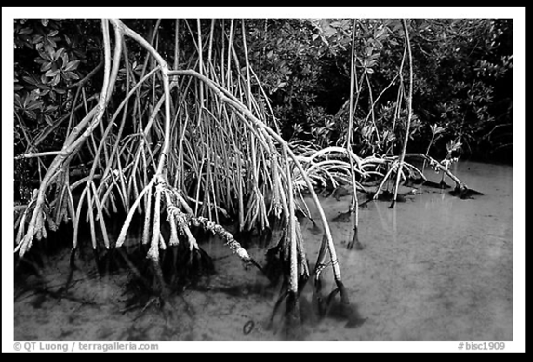
Marine
Education
Student Workbook
Name:
Date:
marineeducation.com.au
Measuring Marvellous Mangroves
using Rapid Long Plots (RLPs)
a.k.a. transects
Methods provided by Dr Norm Duke & Jock Mackenzie
@MangroveWatch and Earthwatch
Booklet created by Gail Riches
© Marine Education
© Marine Education 2023 CC BY-NC-SA

Slide 2
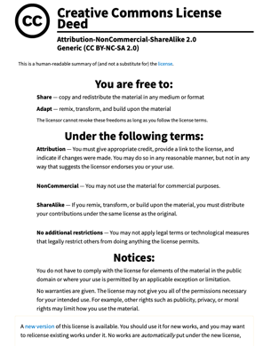
Marine
Education
marineeducation.com.au
© Marine Education 2023 CC BY-NC-SA
Published by Marine Education 2023
ABN: 48765406873
Author: Gail Riches
Email: info@marineeducation.com.au
www.marineeducation.com.au
M. 0434 934 184
More resources available at: https://earthwatch.org.au/research/wetlands-reefs/wetlands-education-resources
EarthWatch Australia School programs; https://earthwatch.org.au/education/school-programs
Interested persons are invited to contact the author for information or to indicate errors and omissions.
This booklet was created by Gail Riches following a teacher PD at Boyne Island Environmental Education Centre in August 2023 as part of EarthWatch Australia’s ‘Protecting Wetlands for the Future’ program.
@mangrovewatch @earthwatch_aus @GreatBarrierReefFoundation.
Department of Climate Change, Energy and Water.
The ‘Protecting Wetlands for the Future’ program is proudly supported by partnerships between the Australian Government Reef Trust and the Great Barrier Reef Foundation Citizen Science for Change Grants.
#lovethe reef #ReefTrust #TeachLive #ProtectingWetlandsForTheFuture #mangrove #CitizenScience #education #professionaldevelopment #greatbarrierreef #wetlands #mangroves #conservation #teachers #STEM #stemeducation #environment #conservation #benanddiphotography #BIEEC #MarineEducation
© Marine Education 2023 CC BY-NC-SA

Slide 3
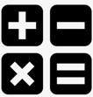
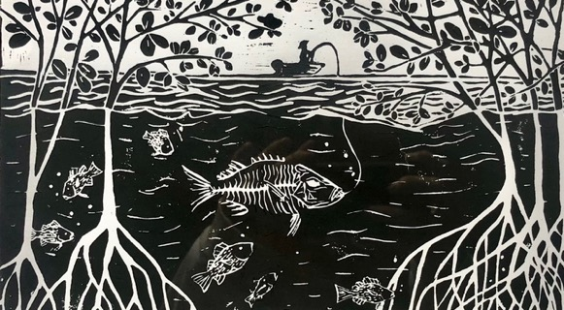
Marine
Education
Multi disciplinary
Name/s:
Date:
marineeducation.com.au
This booklet is used to teach science and math, plus many more subjects
Science (yr5-10)
Mathematics
Cross-curriculum priorities: Aboriginal and TS Islander Histories and Culture; and Sustainability
ART
Biology
(yr11&12)
Earth & Environmental Science
(yr11&12)
Marine Science
(yr11&12)
Aquatic Practices
(yr11&12)
Artwork by Lily Hass https://bluethumb.com.au/lily-hass
© Marine Education 2023 CC BY-NC-SA

Slide 4
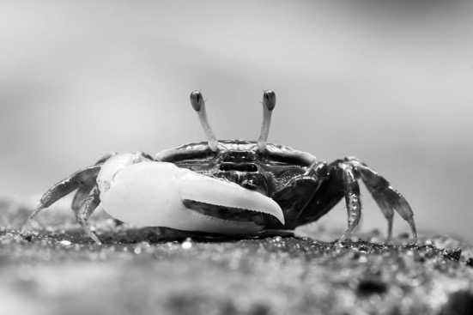
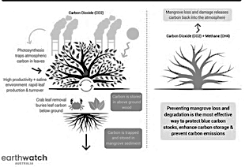
Marine
Education
Carbon Super Stores
Name/s:
Date:
marineeducation.com.au
Mangroves trap carbon 50 times faster than any other forest!
How?
Mangroves have adapted to living in very salty environments
by dropping lots of leaves (containing salt) all the time.
This rapid leaf production and leaf turnover rates trap more carbon than any other forest.
Photo: Fidler Crab © Our Wild World
Hence, mangrove forests store 4-10 times MORE carbon than any other forest!
Walk into a mangrove forest.
Is there a healthy population of crabs?
Can you see lots of burrows?
How many leaves do you see?
Not many?
Crabs are super efficient at burying the leaves.
Lots of crabs = very few leaves
(now buried and stored as carbon under the ground).
© Marine Education 2023 CC BY-NC-SA
Notes:
Picture: https://adlayasanimals.wordpress.com/2013/11/17/fiddler-crab-genus-uca/

Slide 5
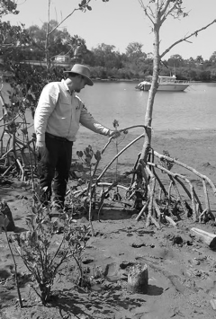
Marine
Education
Jock Mackenzie
The scientist for this program
Name/s:
Date:
marineeducation.com.au
HELP JOCK save the mangroves!
Jock Mackenzie
Wetlands Program Manager and MangroveWatch Coordinator @ Earthwatch Institute Australia Mangrove and Saltmarsh Conservation and Management through Citizen Science.
Founder and Co-Director of MangroveWatch - a community science partnership to educate, engage and empower local communities to protect and improve mangrove habitats through local management initiatives. 15+ years playing in the mangrove mud.
Jock will turn your data into meaningful outcomes for mangroves. But he needs more data. He can’t do it on his own.
Jock developed this methodology so you can help him collect the data he needs to save the mangroves. It’s easy and it’s fun!
Email your data to him directly at: jmackenzie@earthwatch.org.au
© Marine Education 2023 CC BY-NC-SA

Slide 6
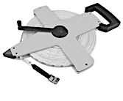
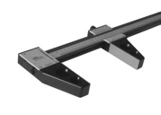
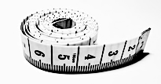
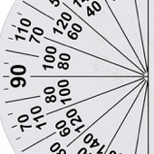
Marine
Education
Equipment
Name/s:
Date:
marineeducation.com.au
Step 1: Tick the box to remember what each group has packed in their equipment bag
Transect (tape measure)
Compass to measure transect direction
Clipboard, pencil and data sheet
GPS to measure location
Camera to take photos
Callipers to measure tree girth (circumference)
OR
Protractor to measure tree height
Meter ruler
(or 2m pvc pipe ruler)
to measure distance from transect
OR
© Marine Education 2023 CC BY-NC-SA

Slide 7
Marine
Education
Data SHEET
Name/s:
Date:
marineeducation.com.au
Date: | Start Time: End Time: | Location:
 |  | Forest Type:
Collectors: |  | Plot number:
GPS Start Coordinates: |  | Distance to shore:
GPS End Coordinates: |  | Plot length: | Plot Width
Compass bearing from START:
Dead Tree Tally: |  | Live Canopy Tree Tally:
Stem Number | Tree Number | Multi-stem (a,b ?) | Distance Along Tape (in m) | Distance From Tape (in m) | Side of transect: Left (L) or Right (R) | Species code | Tree girth (cm) |  | Tree height (m) to 0.1 decimal point |  |  |  | Lean: (º) | Position: Canopy (C) or Sub-canopy (SC) or Emergent (E) | Health score (0-5) | Tree Damage Code
 |  |  |  |  |  |  | Diameter (cm) to 0.1 decimal point | Circumference – calculate in class (3.14 x D) to 0.1 decimal point | Degrees to top of tree (protractor) | Height of person (cm) | Distance from person to tree (cm) | Tree height (m) – calculate in class
1
2
3
4
5
6
7
8
© Marine Education 2024 CC BY-NC-SA

Slide 8
Marine
Education
Data SHEET
(make enough copies to record 50 stems)
Name/s:
Date:
marineeducation.com.au
Stem Number | Tree Number | Multi-stem (a,b ?) | Distance Along Tape (in m) | Distance From Tape (in m) | Side of transect: Left (L) or Right (R) | Species code | Tree girth (cm) |  | Tree height (m) to 0.1 decimal point |  |  |  | Lean: (º) | Position: Canopy (C) or Sub-canopy (SC) or Emergent (E) | Health score (0-5) | Tree Damage Code
 |  |  |  |  |  |  | Diameter (cm) to 0.1 decimal point | Circumference – calculate in class (3.14 x D) to 0.1 decimal point | Degrees to top of tree (protractor) | Height of person (cm) | Distance from person to tree (cm) | Tree height (m) – calculate in class
© Marine Education 2024 CC BY-NC-SA

Slide 9
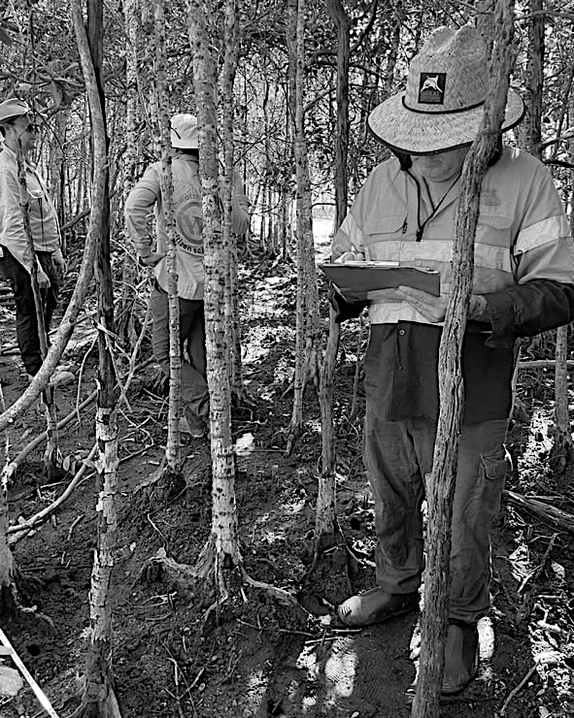
Marine
Education
Look the Part
Name/s:
Date:
marineeducation.com.au
Step 2: Put on your hat, long-sleeve shirt, long pants & dive booties (or old full-covered shoes)
Hat
Long sleeve shirt
Long plants
Dive Booties (or old full-covered shoes)
Photo © BenAndDi. On location in Yellow Mangrove Forest at EarthWatch’s ‘Protecting Wetlands for the Future’ program, Boyne Island Environmental Education Centre August 2023. From left to right: Jock MacKenzie (MangroveWatch, EarthWatch), Liz Irvine (EarthWatch) and Danny Hudson (Pioneer Catchment & Landcare Group Inc.)
© Marine Education 2023 CC BY-NC-SA

Slide 10
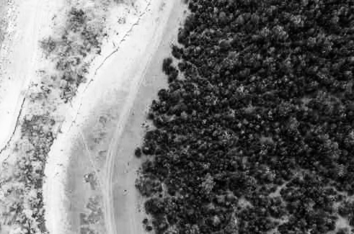
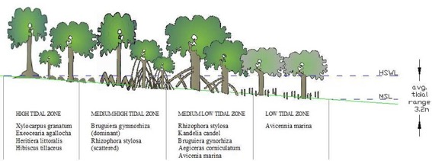
Marine
Education
Select a Mangrove Forest
Name/s:
Date:
marineeducation.com.au
Photo: Louise Jasper/Blue Ventures
Check the tides BEFORE you go – organize your day around the tides
High Tide Zone
Mid Tide Zone
Low Tide Zone
Yellow Mangrove Ceriops australis have ‘buttress roots’
Red Mangrove Rhizophora stylosa have very distinctive ‘stilt-like roots’
Cool fact: The tall stilt-like roots of red mangrove trees enable them to remain above water during mid-high tides (and thus avoid drowning). Hence, why they often dominate in the low tide zone!
River Mangrove Aegiceras corniculatum is a short tree or shrub-like mangrove
Orange Mangrove Bruguiera gymnorhiza have ‘knee roots’
Grey Mangrove Avicennia marina have pneumatophores or ‘peg-type snorkel roots’
© Marine Education 2023 CC BY-NC-SA

Slide 11
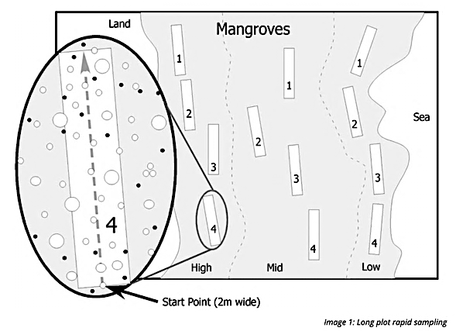
Marine
Education
Position the Plots
PARALLEL to shore
Name/s:
Date:
marineeducation.com.au
START TIME: LOCATION:
Step 3: Select a dense part of the mangrove forest parallel to the shoreline to put your first transect (tape measure). Pick a spot that is representative of the dominant vegetation zone.
Step 3: trees that are more than 3cm in diameter.
PLOT Nº: DISTANCE FROM SHORE: FOREST TYPE:
Plot Number (transect or group number): Number each transect as plot 1, 2, 3, etc. Hint: 4 people/transect works well.
Distance from Shore: How close are you to water (when it’s low tide)? 10 metres? 30 metres? 50 metres?
Forest Types: What is the dominant type of vegetation? E.g. Red mangrove forest, grey mangrove forest, etc.
Experimental Design
Long plots are line transects set up parallel to the shore in (the middle of) each zone of a mangrove forest (e.g. low-tide zone, mid-tide zone, high-tide zone) ideally with a similar number of trees left and right of the transect line. Teams of 4 people measure 1-2 long plots each (one at a time).
Pictured above is the ideal scenario, with 4 long plots in each zone, making a total of 12 long plots. Each long plot takes approximately 1-2 hours to measure (after learning the method and finding your groove by creating a system that works best for you). Therefore, this is a full day excursion.
© Marine Education 2023 CC BY-NC-SA

Slide 12
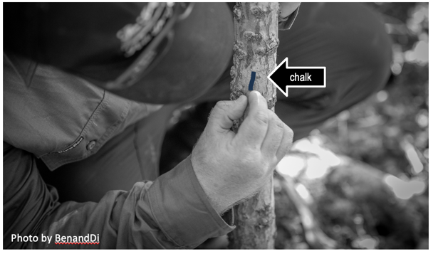
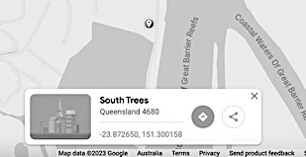
Marine
Education
Tag a Tree
Name/s:
Date:
marineeducation.com.au
Step 4: Pick a tree to be the start of the transect. It can NOT be too thin.
If the tree is >10cm in circumference or >3.2cm in diameter, write number “1” on the tree trunk with chalk. This is tree number 1 !!! This is the START of your transect/long plot.
Step 3: Attach the tape measure to tree 1 and record your GPS location (on google maps)
A global positioning system (GPS) is a network of satellites and receiving devices (e.g. you phone) used to determine the location of something on earth. GPS coordinates pinpoint your start & end point.
Latitude (N or S)
Longitude (E or W)
Q: What is the GPS reading for LATITUDE? Ans. S
Q: What is the GPS reading for LONGITUDE? Ans. E
© Marine Education 2023 CC BY-NC-SA

Slide 13
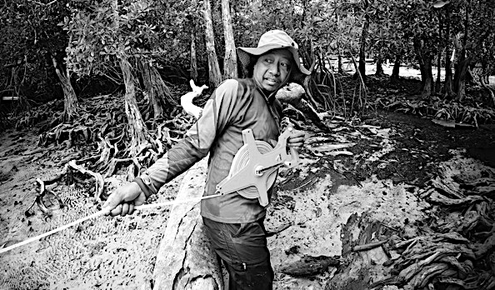
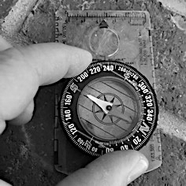
Marine
Education
Reel out the Line
Name/s:
Date:
marineeducation.com.au
Step 5: Roll out the tape measure approximately 10-20m. The length of each transect will be determined by the density of the forest, but is required to include at least 25 canopy trees (trees that reach the top of the canopy).
Tape measure
Step 5: Take a compass bearing of the direction of the transect line
Your compass bearing is the clockwise angle between north and your point of reference
(i.e. the direction of the transect line).
Instructions on how to take a magnetic compass bearing
Step 1: hold the compass flat so the red part of the compass needle points to NORTH.
Step 2: stand in the direction you wish to measure (in this case, the direction of the transect line).
Step 3: turn the bezel so that zero degrees is on NORTH (the needle always points to North).
Step 4: read the bearing (where the lubber line intercepts the bezel) and write that down.
Q: What is the compass bearing of the transect line? Ans. degrees
© Marine Education 2023 CC BY-NC-SA

Slide 14
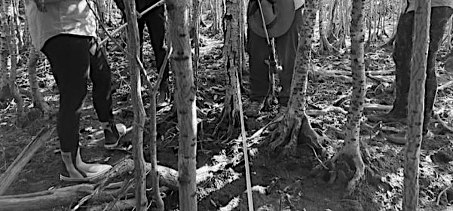
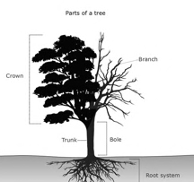
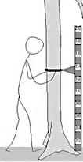
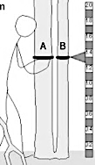
Marine
Education
Snap a Pic
Name:
Date:
marineeducation.com.au
Step 6: Take a photo of your transect.
transect
Is the forest dense?
YES
Measure 1m either side
NO
Measure 2m either side
Step 7: Decide the width of your transect (how far either side of the tape measure you will be measuring). Choose between 1m (dense forest) or 2m (less dense forest).
Q: What is your PLOT WIDTH going to be? Ans:
1m either side or 2m either side
Trees with multiple stems
Some mangrove trees have more than one stem, a.k.a. trunk. For example, the stem in the ground splits in two stems at some point (not to be confused with branches). We count each stem as a separate entity. On multi-stem trees, we call the first stem “a” and the second stem “b” and so on.
Parts of a Tree
stem
© Marine Education 2023 CC BY-NC-SA

Slide 15
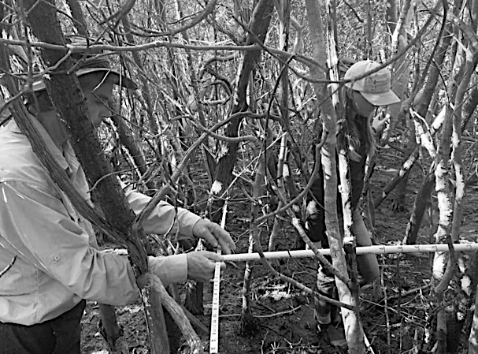
Marine
Education
Measure distance (m)
Name:
Date:
marineeducation.com.au
Step 8: Measure distance along, and distance from the tape measure.
For every tree, you will measure:
how far along the tape measure it is (distance along tape in metres), and
how far left or right it is from the tape measure (distance from tape in metres) pictured below.
Example
Tree (#4)
PVC ruler
transect
Q: How far is tree 1 from the start of the tape measure (m)? Ans.
0m
Q: What far left or right is tree 1 from the tape (m)? Ans.
0m
LEFT RIGHT
Hint: Tree #1 will always be at the start of the tape measure and neither left nor right.
Do NOT spend too much time measuring this EXACT distance. You only need to give the measurement to one decimal place in meters. In the picture above, you can see the person is not using a meter ruler, but instead has made his own (2m) ruler using PVC pipe from bunnings (25mm) that works well too!
© Marine Education 2023 CC BY-NC-SA

Slide 16
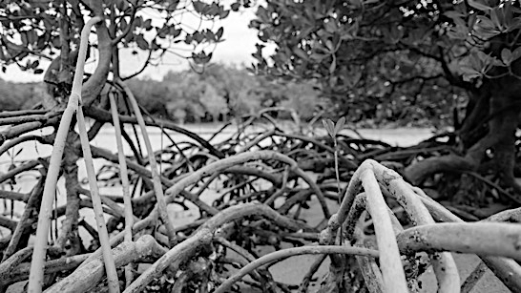
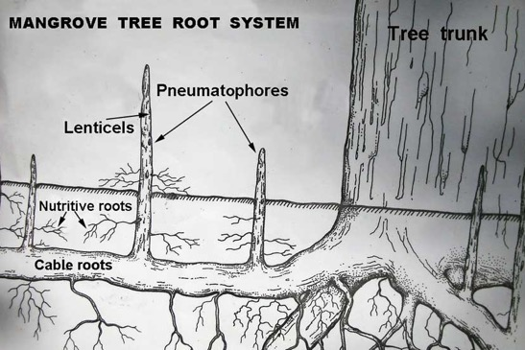
Marine
Education
ID the Tree
Name/s:
Date:
marineeducation.com.au
Step 9: Identify the Genus and Species of the Mangrove Tree. Remember, Red Mangrove trees (Rhizophora stylosa or RS) have large stilt-like prop roots to breathe and Grey mangrove trees (Avicennia marina or AM) have snorkel-like pneumatophores to breathe ☺
RS
(red)
Photo above: Red Mangrove Trees (Rhyzophora stylosa) © GBR Foundation ^{[1]} Photo below: Grey Mangrove (Avicennia marina)
Grey
AM
(grey)
^{[1]} Project News (2022). Citizen Science project wrap: Stories of impact. Accessed Sept 4th 2023 from: https://www.barrierreef.org/news/project-news/kickstarting-blue-carbon-projects-in-the-asia-pacific
© Marine Education 2023 CC BY-NC-SA

Slide 17
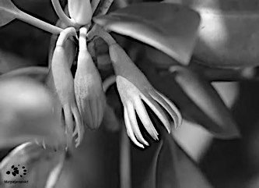
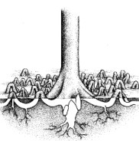
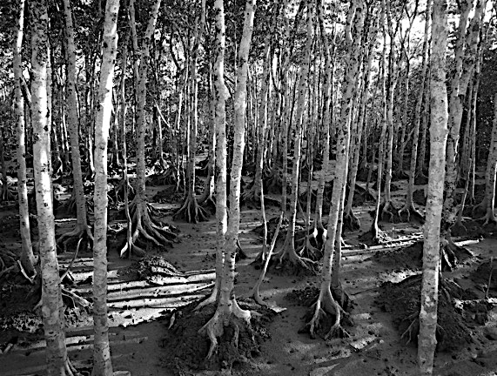
Marine
Education
ID the Tree
Name/s:
Date:
marineeducation.com.au
Orange Mangrove Trees Bruguiera gymnorhiza (BG) have very distinctive ‘knee roots’
BG
(orange)
Yellow Mangrove Trees Ceriops australis (CA) have very yellow leaves and distinctive ‘buttress roots’. They are often found in the high tide zone & above (less muddy to walk!)
CA
(yellow)
© Marine Education 2023 CC BY-NC-SA

Slide 18
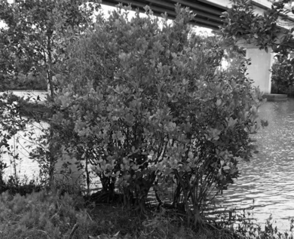
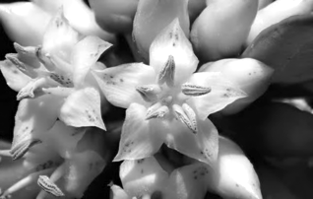
Marine
Education
ID the Tree
Name/s:
Date:
marineeducation.com.au
River Mangrove Trees Aegiceras corniculatum (AC) occur as a bushy shrub 2 to 3 m high.
AC
(river)
Photos: Col Grant @inaturalist
Species Index: Black Mangrove Lumnitzera racemosa (RS); Blind-Your-Eye Mangrove Excoecaria agallocha (EA); Cannonball Mangrove Xylocarpus granatum (XG); Cedar Mangrove Xylocarpus mekongensis (XM); Club Mangrove Aegialitis annulate (AA); Freshwater Mangrove Barringtonia racemose (BR); Grey Mangrove Avicennia marina (AM); Holly Mangrove Acanthus ilicifolius (AI); Large-Leafed Orange Mangrove Bruguiera gymnorrhiza (BG); Looking-Glass Mangrove Heritiera littoralis (HL); Mangrove Apple Sonneratia caseolaris (SC); Mangrove Fern Acrostichum speciosum (AS) Mangrove Lily Crinum pedunculatum (CP); Mangrove Palm Nypa fruticans (NF); Myrtle Mangrove Osbornia octodonta (OO); Native Hibiscus Hibiscus tiliaceus (HT); Red Mangrove Rhizophora stylosa (RS); River Mangrove Aegiceras corniculatum (AC); Small-Leafed Orange Mangrove Bruguiera parviflora (BP); Tall-Stilted Mangrove Rhizophora apiculate (RA); Wrinkle Pod Mangrove Cynometra iripa (CI); Yellow Mangrove Ceriops australis (CA).
Example
Q: What is the species code (first letter of Genus & Species) of Tree 1? Ans.
© Marine Education 2023 CC BY-NC-SA

Slide 19
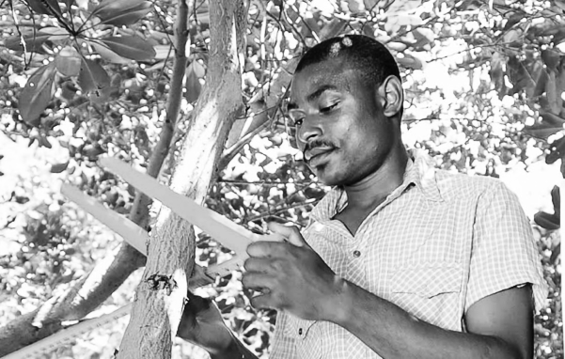
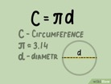
Marine
Education
Measure tree GIRTH
a.k.a. circumference
Name/s:
Date:
marineeducation.com.au
Save the mangrove trees and help save the planet!
During these transect (long plot) studies you will be doing lots of measuring. Dr Jock Mackenzie converts your measurements of tree girth (circumference) and tree height to estimate the amount of carbon dioxide the mangrove forest removes from the atmosphere (via photosynthesis) every year. This information is used to preserve and protect mangrove forests. By measuring the trees and sending that information to Jock, you will be directly helping to reduce carbon emissions by saving the mangrove trees.
Step 10: Measure tree thickness ABOVE the roots and BELOW the lowest branch
You can measure tree thickness two ways:
Wrap the measuring tape around the tree to measure its girth (circumference); or
Use a set of vernier calipers (or ruler) to measure tree DIAMETER - and later in class, convert all measurements of diameter (D) to circumference (C) using the formula: C = 3.14 x D.
Example
callipers
Photo: Global Mangrove Alliance
Q: What is diameter of Tree 1 (if applicable)? Ans.
Q: What is the circumference of Tree 1? Ans.
exact, to one decimal point
© Marine Education 2023 CC BY-NC-SA

Slide 20
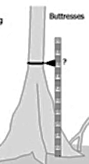
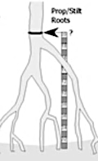
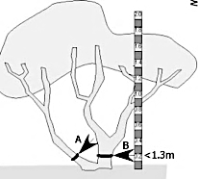
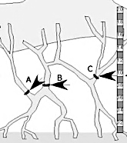
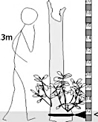
Marine
Education
Importance of accuracy
Name/s:
Date:
marineeducation.com.au
To estimate biomass as accurately as possible, it is important to measure girth correctly
High stem
Buttress roots
Stilt-like roots
Multi-stem tree
Tapered stem
Shrub
Sprawling Rhizophora (stilted red mangrove)
Low branching
Sprouting foliage at base of dead stump – use stem below
Remember, measure tree thickness ABOVE the roots and BELOW the lowest branch
© Marine Education 2023 CC BY-NC-SA

Slide 21
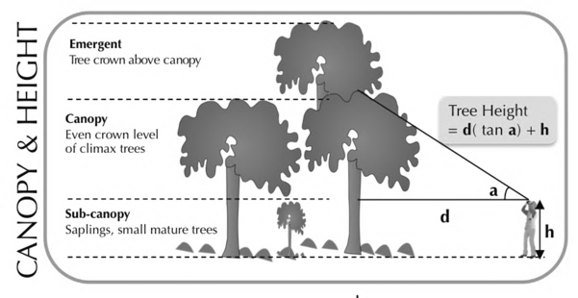
Marine
Education
Measure tree HEIGHT
Name/s:
Date:
marineeducation.com.au
Step 11: Measure the height of the tree
How do you to calculate the height of the tree when it’s all the way up there? It MUST be as accurate as possible, and exact to one decimal of a meter, for Jock to get his biomass estimates correct. If you have a ruler or pole (of known length) high enough to reach, great! Otherwise, use your protractor and apply some maths to calculate tree height. See below:
How to calculate tree height when your measuring stick doesn’t reach…
Determine the highest point of the tree (you may need to shake the tree to see it).
Measure the distance (d) from you and the point directly beneath the tree’s highest point.
Measure the angle (a) between your eye level and the top of the tree (use your protractor).
Apply the formula above*, not forgetting to add your own height (h).
*Hint: record d and a on your data sheet, and do the calculations when you return to school.
Working area:
Q: What is the HEIGHT of Tree Nº. 1? Ans. (to one decimal point)
Step 12: Decide if the tree is sub-canopy (short) canopy (forest roof) or emergent (extra tall)
Q: Is the tree a sub-canopy, canopy or emergent tree? Ans.
© Marine Education 2023 CC BY-NC-SA

Slide 22
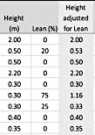
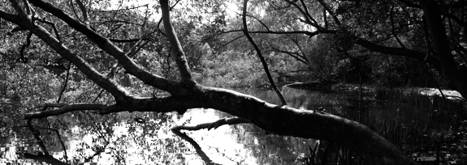
Marine
Education
Measure tree LEAN
Name:
Date:
marineeducation.com.au
Step 12: Measure the lean (off vertical) of tree 1. How much is it leaning over? Estimate the lean between the base of the tree (looking straight up) and the top of the tree, in degrees.
Note: overall percent lean is measured to adjust any trigonometric calculations related to (height and thus) biomass
Example
For example…
35°
Photo: Clyde Butcher @ Black and White Fine Art Photography
For example…
75°
Q: What is the average LEAN on tree 1? Ans.
© Marine Education 2023 CC BY-NC-SA

Slide 23
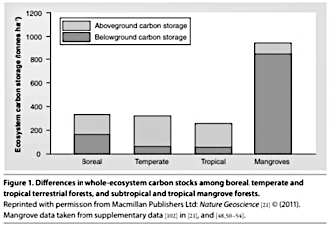
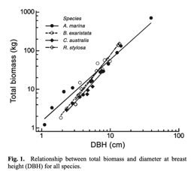
Marine
Education
WHY measure these?
Name/s:
Date:
marineeducation.com.au
Tree girth, height and lean are used to calculate total standing biomass (carbon capture)
Tree girth and stem diameter
The reason for measuring the stem diameter of trees and shrubs is to use those measurements as proxies of their standing biomass (to estimate the mass of all the wood and leaves etc. in the forest). The standing biomass is directly related to the amount of carbon stored in the trees and below the ground.
Tree height
Height data is used to verify (check) biomass calculations, particularly for species without specific allometric equations (that estimate biomass using tree girth and diameter), and for small trees. Tree height, therefore, like tree girth and diameter, should be determined with as much accuracy as possible. Up to 5 metres in height, a height pole is the best method. For taller trees, trigonometric methods or a laser device is useful.
Tree lean
If trees are leaning over, the height measurement could be misleading (i.e. biomass estimate comes up short). Therefore, the overall percent lean is measured to adjust any trigonometric calculations related to biomass. E.g. tree lean is recorded to enable calculation of the total length of the trunk.
Below are graphs that highlight the importance of your work towards protecting mangroves
^{[1]}
Mangroves are one of the most carbon-rich ecosystems on earth. In order for mangroves to be included in carbon offsets, it is necessary to know how much carbon they store and sequester. Mangroves use atmospheric carbon to grow. Some carbon is locked up in their trunks, branches and roots. But even more is isolated in the forest soils. The deep muddy soils that mangroves live in provide ideal conditions for preventing decomposition of carbon, keeping it locked up for millennia.
Below are some ideas of what you can do with YOUR data to help save the mangroves
AIM: The aim of this study is to assess mangrove forest condition and forest structure within the fringing mangroves of [your location].
Data collected during this study will contribute to three long-term outcomes;
Development of a map of [your location’s] mangrove biomass to contribute to assessment of mangrove values (needed as justification for their protection).
Monitoring mangrove condition in different mangrove zones in [your location] over time.
Validation of MangroveWatch shoreline condition data collected previously.
During this study you will be helping to answer the following questions:
Do field observations of mangrove forest structure and condition match previous assessments?
Is the condition of fringing mangrove forest representative of overall forest condition?
Which mangrove zone has the greatest mangrove biomass (carbon storage)?
Has mangrove biomass and forest condition changed over time? If so, how?
LET’s KEEP GOING!!!
^{[1]} Comley, B. W. T. and McGuinness, K. A. (2005 ). Above- and below-ground biomass, and allometry, of four common northern Australian mangroves. Australian Journal of Botany. 53, 431–436.
© Marine Education 2023 CC BY-NC-SA

Slide 24
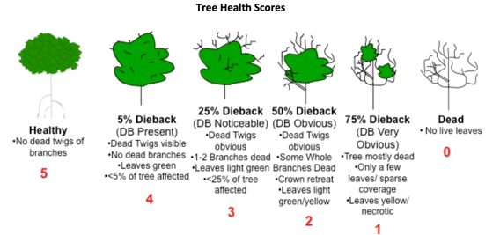
Marine
Education
Measure tree HEALTH
Name:
Date:
marineeducation.com.au
Step 13: Measure tree health (1-5) for the entire tree. For example, 5 is healthy, 3 is half dead
Q: What is the tree health code for tree 1? Ans.
Step 14: Measure tree damage (see codes below). You can choose more than one code.
Live Trees |  | Dead Trees
LTW | Live with dead twigs | DTW | Dead with twigs
LDB | Live with dead branches | DB | Dead with branches
LC | Live with low canopy cover | DT | Dead trunk (no branches)
ID | Live with insect damage (herbivory) | ST | Dead stump (<1m tall)
LF | Live Fallen Tree | DF | Dead fallen
LBT | Live Broken Trunk | DC | Dead cut
LHD | Live with Cut or Trimmed Branches | STC | Dead stump cut (<1m tall)
LSD | Live with grazing damage (e.g. cows)
Note: A dead tree (or dead branch) will have NO GREEN. If you’re not sure if the tree (or branch) is dead or alive, take a finger nail and scratch the bark. If you see no green, assume that part of the tree is dead. Green is an indicator of photosynthesis – yes, mangrove trees carry out photosynthesis in their trunks (as well as their leaves). Pretty cool huh.
Q: What is the tree damage code/s for tree 1? Ans.
© Marine Education 2023 CC BY-NC-SA

Slide 25
Marine
Education
Designate Roles
Name:
Date:
marineeducation.com.au
Step 14: Now you know what to do….designate jobs to people in your group so you can complete the remainder of the transect as fast as possible. Complete the table below.
Job | Name of Group Member
Record data on data sheet (and be the boss person)
Write tree number (and letter) on tree with chalk
Measure distance along tape
Measure distance from tape
Determine LEFT or RIGHT side
Measure girth or diameter
Measure tree HIEGHT
Measure tree LEAN
Decide on Position (canopy, sub-canopy, emergent)
Identify the tree (Genus species code)
Determine the HEALTH score (0-5)
Determine the TREE DAMAGE CODE
© Marine Education 2023 CC BY-NC-SA

Slide 26
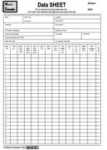
Marine
Education
Complete the data sheet
Name:
Date:
marineeducation.com.au
Step 15: Select your next (closest) tree (>10cm girth)…label it with chalk as tree number ‘2’
IN or OUT?
Only measure trees inside the long plot area. More than 50% of it’s stem must be inside the long plot.
Step 16: Complete the remainder of the data sheet (remember to add tree #1 data).
Record at least 30 live trees, including at least 25 live canopy trees.
At the end, remember to measure…
Length of entire transect (plot length)
GPS coordinates at the very last tree
Tally the number of dead trees
Tally the number of live canopy trees
Take photos of transect and canopy every 10m
Q: What is the length of the entire transect? Ans.
Q: What is the LATITUDE of the last tree? Ans. S
Q: What is the LONGITUDE of the last tree? Ans. E
Q: What is number of DEAD trees? Ans.
Q: What is the number of live canopy trees? Ans.
© Marine Education 2023 CC BY-NC-SA

Slide 27
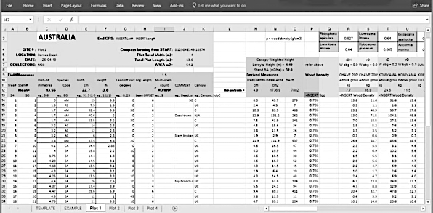
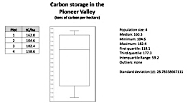
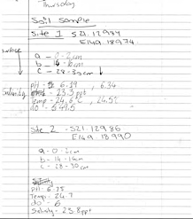
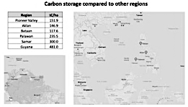
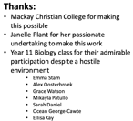
Marine
Education
What happens next?
Name/s:
Date:
marineeducation.com.au
Examples of processed data & results kindly shared by students at Pioneer Valley (Mackay)
Soil Abiotic factors:
pH
Salinity
Temperature
Dissolved Oxygen (DO)
SE Asia
South America
© Marine Education 2023 CC BY-NC-SA

Slide 28
Marine
Education
Email Jock Mackenzie
Name/s:
Date:
marineeducation.com.au
Thank you!
Last step: Email your datasheet and photos to… jmackenzie@earthwatch.org.au
Jock will send you an excel spreadsheet that will include pre-filled formulas used to calculate: Stem Above Ground Biomass (kg), Stem Below Ground Biomass (kg), Stem Total Biomass (kg), Stem Carbon Content (kg C) and Stem CO₂ Storage Equivalent (tonnes).
From there, you can make any graph you need!
For example:
This booklet was created by Gail Riches following a teacher PD at Boyne Island Environmental Education Centre in August 2023 as part of EarthWatch Australia’s ‘Protecting Wetlands for the Future’ program
@mangrovewatch @earthwatch_aus @GreatBarrierReefFoundation. Department of Climate Change, Energy and Water.
The ‘Protecting Wetlands for the Future’ program is proudly supported by partnerships between the Australian Government Reef Trust and the Great Barrier Reef Foundation Citizen Science for Change Grants.
#lovethe reef #ReefTrust #TeachLive #ProtectingWetlandsForTheFuture #mangrove #CitizenScience #education #professionaldevelopment #greatbarrierreef #wetlands #mangroves #conservation #teachers #STEM #stemeducation #environment #conservation #benanddiphotography #BIEEC #MarineEducation
© Marine Education 2023 CC BY-NC-SA

Slide 29
Marine
Education
Marvellous Mangroves
Cheat sheet
Name/s:
Date:
marineeducation.com.au
© Marine Education 2024 CC BY-NC-SA

