Slide 1
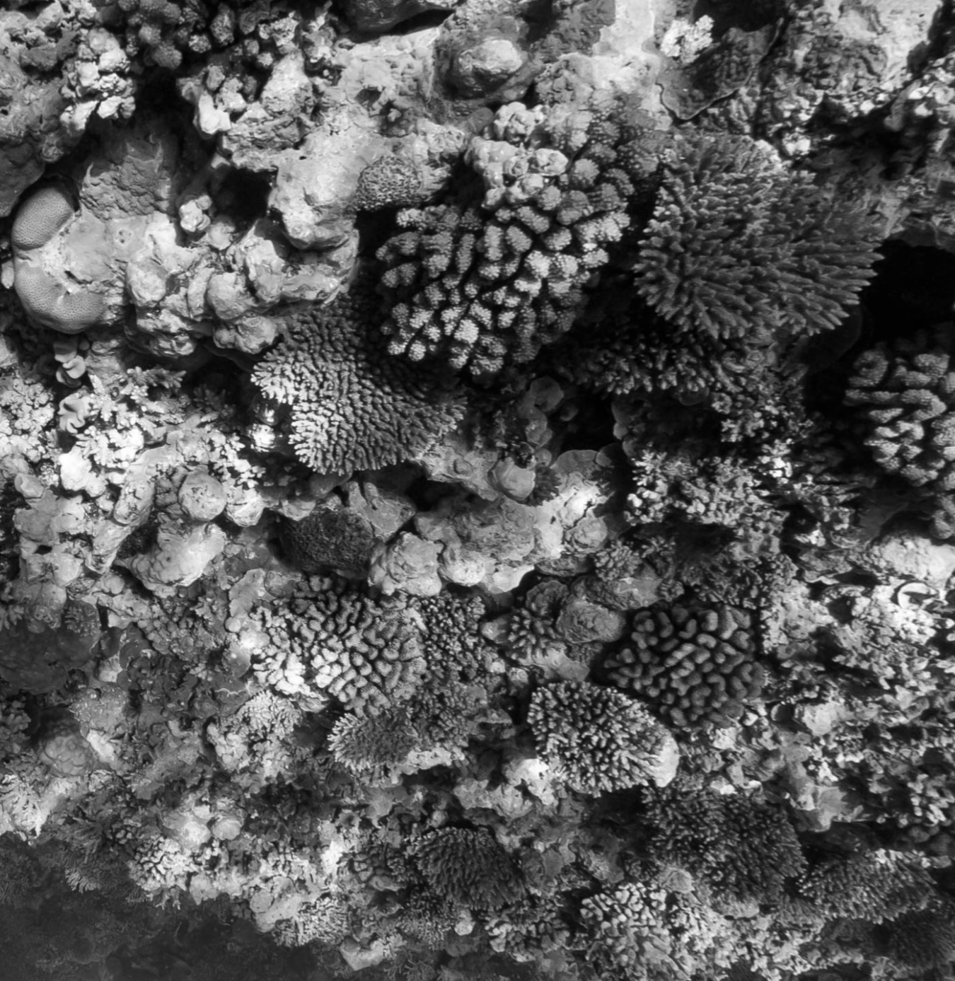
Marine
Education
Student Experiment
Name:
Date:
marineeducation.com.au
Year 12 Mandatory Practical
Examine the concept of connectivity within or between habitats by investigating the impact of water quality on reef health
ANSWERS
Image (of Osprey Reef) sourced from the XL Catlin Global Reef Record. © Underwater Earth / XL Catlin Seaview Survey
Flinders Reef Moreton Bay Marine Park July 2016
© Marine Education 2019
Gail Riches

Slide 2

Marine
Education
marineeducation.com.au
© Marine Education 2019
CC BY: Attribution-NonCommercial-NoDerivatives 4.0 International (CC BY-NC-ND 4.0).
This license is only granted to the school or persons named on a receipt of payment for an annual subscription to Marine Education which allows them to print from a private printer, school printer, or commercial printer, copy and distribute the material in any medium or format in unadapted form only, for noncommercial purposes only, for within-school use only, for a period of one year only from date of payment on the receipt, so long as attribution is given to the creator or publisher.
Publisher
Gail Riches
Marine Education
ABN: 48765406873
PO Box 394
Bli Bli Qld 4560
Email: info@marineeducation.com.au
www.marineeducation.com.au
Edited by Maria Bavins
Course Overview and Learning Objectives derived from Marine Science 2019 v1.2 General Senior Syllabus^{[1]}
ISBN: 13: 978-0-6484089-3-2
^{[1]} Queensland Curriculum and Assessment Authority (2018). Marine Science 2019 v1.2: General Senior Syllabus. QCAA.
Accessed 20th July 2021 from: https://www.qcaa.qld.edu.au/senior/senior-subjects/sciences/marine-science/syllabus
Interested persons are invited to contact the author for information or to indicate errors and omissions.

Slide 3
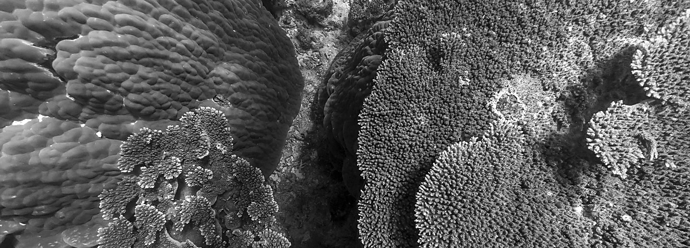
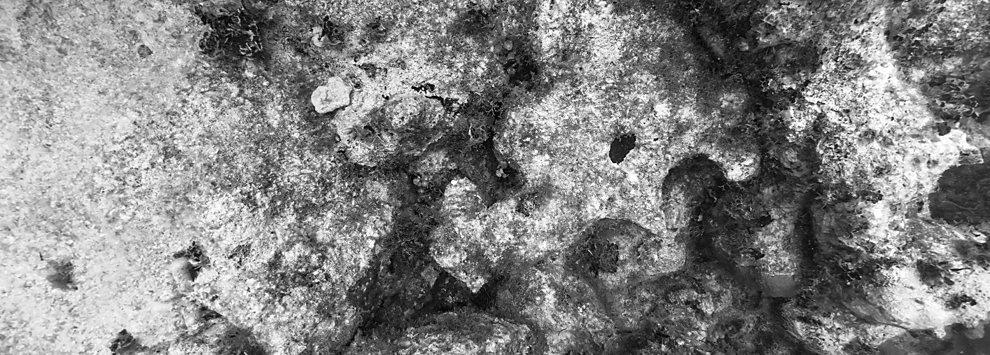
Marine
Education
Name:
Date:
marineeducation.com.au
Making OBSERVATIONS
What’s in the Water?
For this practical, we want to investigate the impact of water quality on reef health, whilst examining
connectivity. Thus, you get to visit the reef! Even if it’s only a virtual visit, you still get to see it! Let’s begin by looking at reefs from all around the world (see activity below). Whilst you are looking, find a reef that you would call ‘unhealthy’. Ask yourself, why is it unhealthy? Do you think water quality has anything to do with it? Alas, corals do live in water! And, how does that water even get to that reef? Connectivity right?!
Activity: View quadrat photographs from the following websites (tick when done).
XL Catlin Global Reef Record www.globalreefrecord.org ‘Enter’ and then click on ‘Data’
Reef Life Survey www.reeflifesurvey.com Access ‘Survey Data’
Classroom on the Reef www.jcu.edu.au/classroom-on-the-reef Curriculum → Coral identification practical
MarineEducation.com.au Data tab
.
For example, pictured below are quadrats from Lady Elliot Island (1) and Belize (2). They were captured as screenshots from the XL Catlin Seaview Survey Virtual Tour with the camera pointing down.
1
Figure 1: Image (of Lady Elliot Island) sourced from the XL Catlin Global Reef Record. © Underwater Earth / XL Catlin Seaview Survey
2
Figure 2: Image (of Belize Reef) sourced from the XL Catlin Global Reef Record. © Underwater Earth / XL Catlin Seaview Survey
Q. Which reef looks healthier? Ans.
1. Lady Elliot Island. Discuss why? Any bias? (i.e. one photo). How did they measure health?
© Marine Education 2019
Mandatory Practical
1

Slide 4
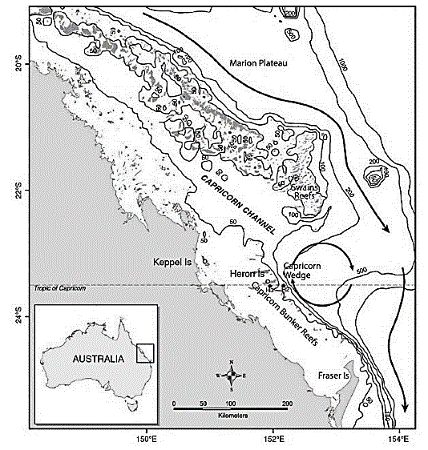
Marine
Education
Name:
Date:
marineeducation.com.au
GATHERING INFORMATION
☺ or ☹ Help or Hinder?
Connectivity can be a ‘double-edged sword’. It can both help and hinder coral reefs.
- It can help reefs by delivering water carrying coral larvae and other hitch-hikers for replenishment.
- But, it can also hinder reefs by delivering water carrying unwanted COTS larvae^{[1]} and pollutants.
Q. How might connectivity (1) help a reef and (2) hinder a reef? Ans.
(1) it helps by delivering water carrying coral larvae for reef replenishment.
(2) it hinders by delivering water carrying unwanted COTS larvae and pollutants
Eddying Around
Pictured right is a meso-scale eddy dubbed the ‘Capricorn Eddy’. When water from the East Australian Current (EAC) flows past
a huge ‘wedge’ in the continental shelf, the water ‘swirls’ around clockwise in a big circle. Inside the cyclonic feature is an upwelling, where cool, nutrient-rich waters rise up from the deep and spill onto the Capricorn-Bunker reefs^{[2]}. One of those reefs is Lady Elliot Island (LEI), where many mantas rays visit.
Q. Is the Capricorn Eddy helping or hindering reefs of the Capricorn Bunker Group? Ans.
LEI
(Lady Elliot Is.)
Could be both. Helping (if water is cold enough to mitigate bleaching); or, Hindering (corals don’t like nutrient-rich water).
Figure 1: Schematic map of southern GBR. Solid dark arrows represent the southward flow of the EAC. Dark circular arrows show the location of the Capricorn Eddy with an indentation of 200-m isobath, referred to as the Capricorn Wedge^{[2]}.
Marvellous Mangroves: coastal kidneys and natural nurseries
Reefs are better off when close to mangroves. Mangrove forests filter the water, stabilise sediments
(with their roots), reduce coastal erosion and siltation, and trap pollutants. Mangroves also act as natural nurseries for important reef fish species, such as herbivores^{[3]}. How awesome are mangroves!
In a study by Olds et al., (2011)^{[4]} there were significantly more fish at protected coral reefs and mangroves that were close together (by <250m) as opposed to protected coral reefs and mangroves that were far apart (by >500m).
Q. How does connectivity between reefs and mangroves help the reef? Ans.
They filter the water, stabilise sediments (with their roots), reduce coastal erosion and siltation, and trap pollutants. Mangroves also act as nurseries for important reef fish species, such as herbivores.
^{[1]} Hock, K., Wolff, N.H., Ortiz, J.C., Condie, S.A., Anthony, K.R.N., Blackwell, P.G. and Mumby, P.J. (2017). Connectivity and systemic resilience of the Great Barrier Reef. PLoS Biol 15(11):
DOI: 10.1371/journal.pbio.2003355
^{[2]} Weeks S.J., Bakun, A., Steinberg, C.R., Brinkman, R. and Hoegh-Guldberg, O. (2010). The Capricorn Eddy: a prominent driver of the ecology and future of the southern Great Barrier Reef. Coral Reefs.
29 (4): 975-985. DOI: 10.1007/s00338-010-0644-z. Adapted with permission from Professor Ove Hoegh-Gulberg. Director, Global Change Institute. Coral Reef Ecosystems Lab UQ.
^{[3]} Spalding M., McIvor, A., Tonneijck, F., Tol, S. and Eijk, P.V. (2014). Mangroves for coastal defence: Guidelines for coastal managers and policy makers. Published by Wetlands International and The Nature Conservancy. 42 p. Accessed 09.04.2019 from: https://www.nature.org/media/oceansandcoasts/mangroves-for-coastal-defence.pdf
^{[4]} Olds, A. D., Connolly, R. M., Pitt, K. A. and Maxwell, P. S. (2011). Habitat connectivity improves reserve performance. Conservation Letters 5 (1). DOI: 10.1111/j.1755-263X.2011.00204.x
© Marine Education 2019
Mandatory Practical
2

Slide 5


Marine
Education
RESEARCH QUESTIONS
Dependent and Independent Variable
Name:
Date:
marineeducation.com.au
Dependent and Independent Variable
Both the Dependent variable and Independent variable must feature in the research question. For example,
Q1. Is there a difference in between and ?
Dependent variable
Independent variable (e.g. two groups to compare)
Q2. Is there a linear relationship between and ?
Dependent variable
Independent variable
Dependent Variable – Reef Health
How do we measure reef health? There are many ways. A common way is to estimate the percentage of hard coral cover using quadrats, either with the help of a grid (below left) OR datum points (below right)^{[1].}
Grid
1
Datum Points
Coral Point Count with Excel Extension is a popular data analysis program that makes adding datum points to your quadrat photographs very easy. You can make the datum points as dots, crosses or even triangles, of any size. You can choose how many datum points to use, and if you want them randomly or evenly spaced^{[1]}.
OR
2
3
4
(must be continuous data and measured as a pair)
6
5
8
7
9
10
% Hard Coral = 40% (7.2 squares)
% Hard Coral = 40% (2,3,4,10)
Hard Coral
Soft Coral
Coral Rubble
Sand
Rock
Silt/Clay
Nutrient Indicator Algae
Other
You could also use CoralWatch data^{[2]} (in combination with % coral cover) to measure reef health!!
Independent Variable – Water Quality
How do we measure water quality whilst incorporating the concept of connectivity? One way is to create a set of questions that, when answered, allocate each reef a score for water quality. Whereby every ‘yes’ answer is worth 1 point. The questions must be about how connectivity either helps or hinders a reef. Below is an example. Of course, you can create your own set of criteria/questions and scores.
QUESTIONS (Yes=1 No=0) (Note: 1 nautical mile equals one minute of latitude or longitude)
7-8
VERY HIGH QUALITY
Is the reef within 1 nautical mile of a mangrove forest or seagrass meadow?
Is the reef within 2 nautical miles of the continental shelf?
Is the reef within 30 nautical miles of the continental shelf?
Is the reef >30 nautical miles away from a major river carrying urban runoff?
Is the reef >30 nautical miles away from a city with a population > 50,000?
Is the reef within a Marine Protected Area?
Is the reef within a Green or Pink Zone of a Marine Protected Area?
Is the reef within dispersal range of coral larvae from a robust source reef?^{[3]}
5-6
HIGH QUALITY
3-4
MEDIUM QUALITY
0-2
LOW QUALITY
Alternatively, if you have access to water quality samples or water quality data^{[4]}, you could
allocate each reef a score for water quality using a water quality index, such as a Q value^{[5]}
and then incorporate the concept of connectivity into your research question!
^{[1]} Nova Southeastern University (2019). Tools and Resources. NSU Accessed 09.04.2019 from: https://cnso.nova.edu/cpce/index.html (click on ‘CPCe Download Request Form’).
^{[2]} Coral Watch (2019). Data: Surveys. Accessed 09.04.2019 from: https://coralwatch.org/index.php/data/surveys/
^{[3]} Hock, K., Wolff, N.H., Ortiz, J.C., Condie, S.A., Anthony, K.R.N., Blackwell, P.G. and Mumby, P.J. (2017). Connectivity and systemic resilience of the Great Barrier Reef: FIGURE 5. PLoS Biol 15(11):
DOI: 10.1371/journal.pbio.2003355
^{[4]} eReefs (2019). eReefs. A collaboration between the GBR Foundation, BOM, CSIRO and AIMS. Accessed 09.04.2019 from: https://ereefs.org.au/ereefs
^{[5]} Moffatt, B. (2019). F45R Oceanography Study Guide. Wet Paper Publications. Accessed 09.04.2019 from: http://www.wetpaper.com.au/media/F45ROceanographySample/176/
© Marine Education 2019
Mandatory Practical
3

Slide 6
Marine
Education
Name:
Date:
marineeducation.com.au
EXPERIMENTAL DESIGN
Study SITES
Over the next 4 worksheets, you have access to photo quadrats from the 4 reef locations listed below.
Activity: Give each reef a score for water quality by completing the table
(refer to previous page for ‘calculations’)
Reef Location | Calculations | Score | Water Quality
(i) Agincourt Reef | 0, 1, 1, 1, 1, 1, 1, 1 | 7 | Very High Water Quality
(ii) Lady Elliot Island | 0, 0, 1, 1, 1, 1, 1, 1 | 6 | High Water Quality
(iii) Magnetic Island (Nelly Bay) | 1, 0, 0, 0, 0, 1, 0, 1 | 3 | Medium Water Quality
(iv) Sloping Island (Keppel Group) | 1, 0, 0, 0, 0, 1, 0, 1, | 3 | Medium Water Quality
Activity: Complete Question 1 below. DISCUSS your hypotheses for both research questions..
Q1. Is there a difference in between & ?
Mean Percentage
Hard Coral Cover
Very High Water Quality (Agincourt Reef)
Medium Water Quality (Sloping Is)
Mean Percentage
Hard Coral Cover
Q2. Is there a linear relationship between & ?
x-axis
Water Quality
Controlled Variables
Controlled variables are all the variables that are kept the same (so they do not influence the outcome).
E.g. what do all 4 reefs have in common? How were they the same when photographed and analysed?
Activity: List the controlled variables below
E.g. The photo quadrat method was used to photograph all 4 reefs
Random datum points A-J were used for all photo quadrats
All reefs were classed as tropical or sub-tropical reefs (no temperate reefs)
All reefs were within the boundaries of the Great Barrier Reef Marine Park
Measured Variables
If variables can not be controlled, they must be measured, so their influence can be considered in the outcome of the study. E.g. How were the reefs different to each other when photographed and analysed? Note: Do not include any differences that were part of the criteria/questions used for scoring water quality.
Activity: List the measured variables below
E.g. photo quadrats were in different spatial and temporal scales (e.g. resolution, area, size, date)
Photo quadrats were from different sources using different methods
Reef types were different (e.g. fringing reef vs coral cay)
Depths were different (e.g. Magnetic Is. and Sloping Is. much shallower)
Habitat Complexity (rugosity) different for all 4 reefs
© Marine Education 2019
Mandatory Practical
4

Slide 7
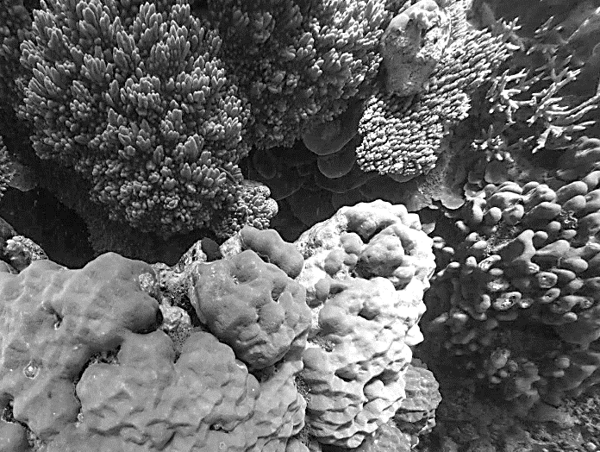
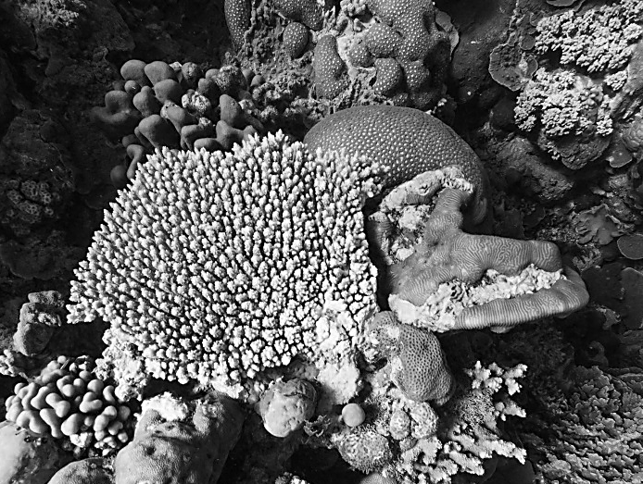
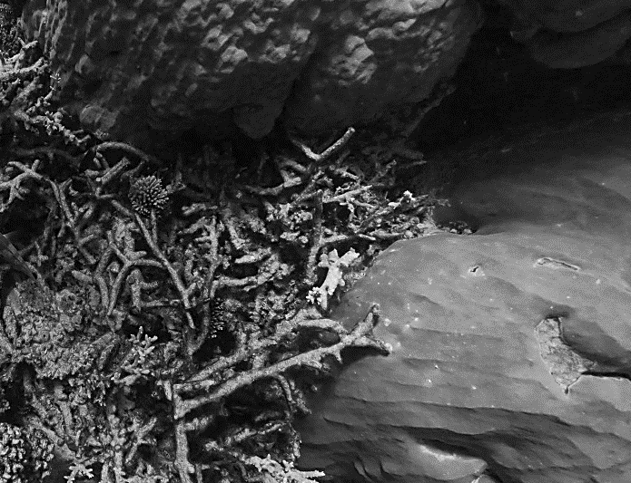
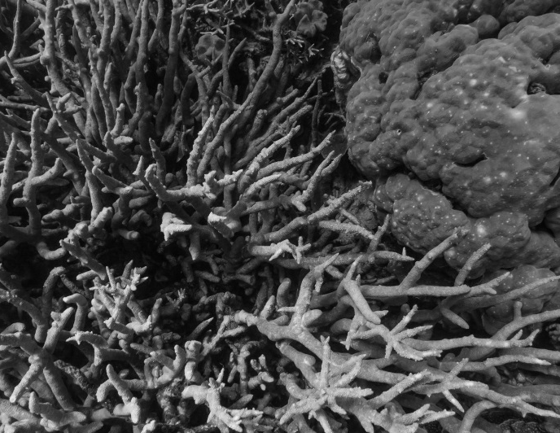
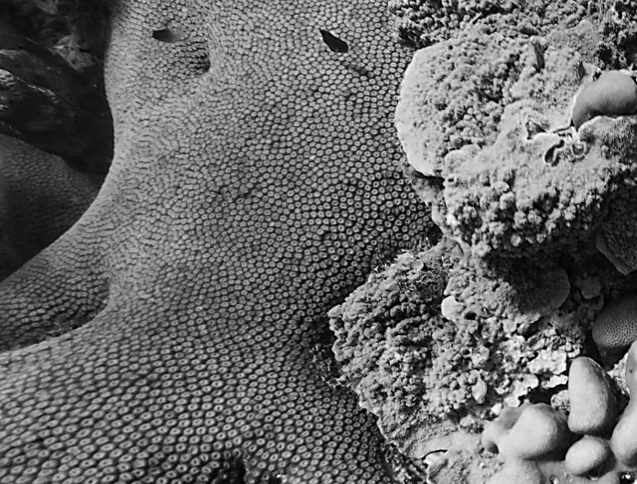
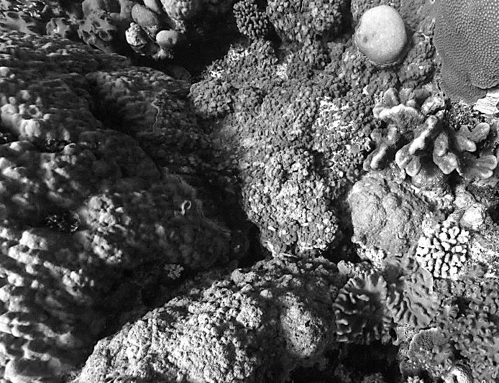
Marine
Education
DATA COLLECTION: Example
Name:
Date:
marineeducation.com.au
(i) Agincourt Reef
Original colour photos available on www.marineeducation.com.au (data)
1
B
2
A
A
C
B
C
D
D
E
F
I
E
G
F
H
G
J
H
J
I
% hard coral cover: 100% (A-J)
% hard coral cover: 100% (A-J)
3
A
B
4
A
B
C
C
D
D
E
F
F
G
E
G
H
I
I
H
J
J
% hard coral cover: 70% (A,B,C,E,G,H,J)
% hard coral cover: 100% (A-J)
5
A
6
A
B
C
B
D
D
C
E
E
F
G
F
G
H
H
I
J
I
J
% hard coral cover: 100% (A-J)
% hard coral cover: 100% (A-J)
Images (of Agincourt Reef) sourced from the XL Catlin Global Reef Record. © Underwater Earth / XL Catlin Seaview Survey.
Taken 23.11.2012. Accessed 24.01.2019 from www.catlinseaviewsurvey.com/ Datum points (A-J) were added at random.
© Marine Education 2019
Mandatory Practical
5

Slide 8
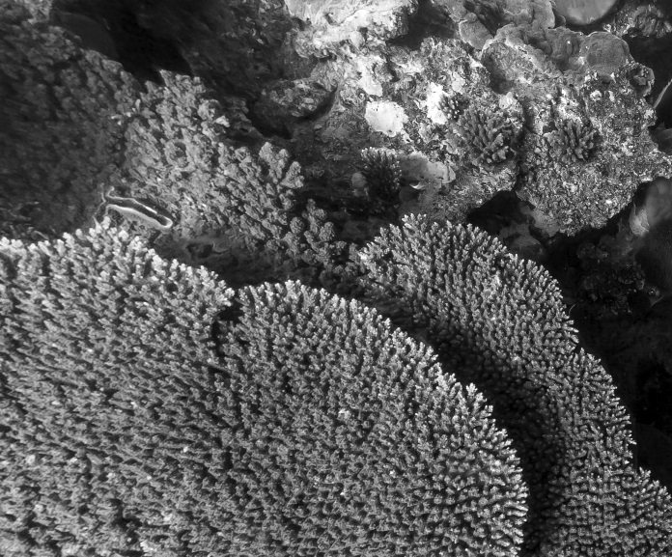
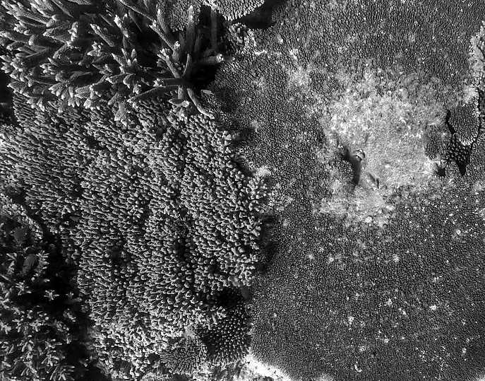
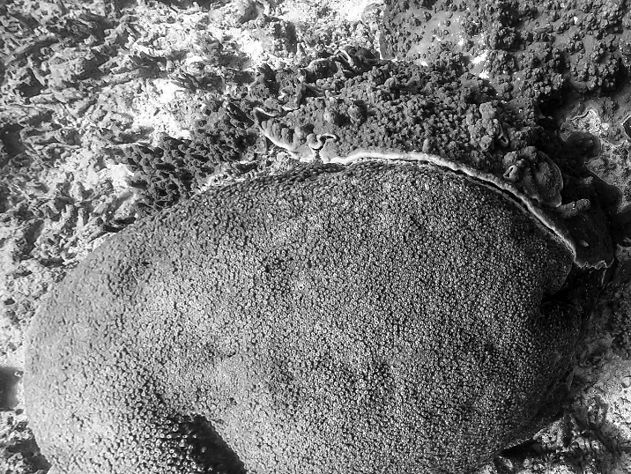
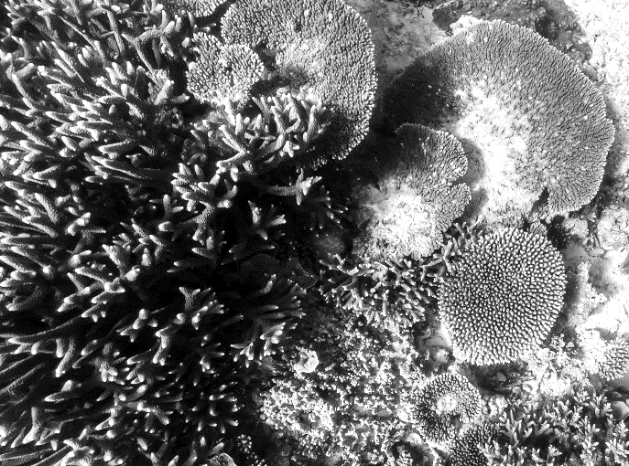
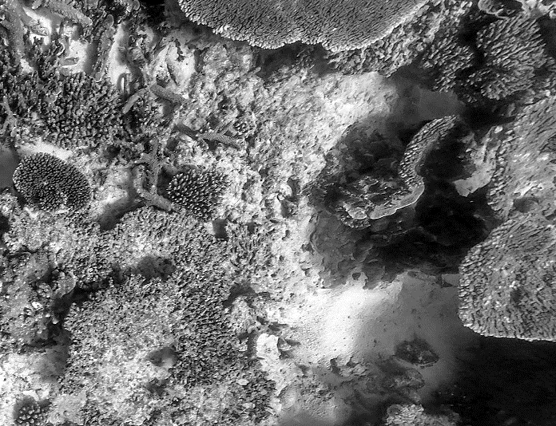
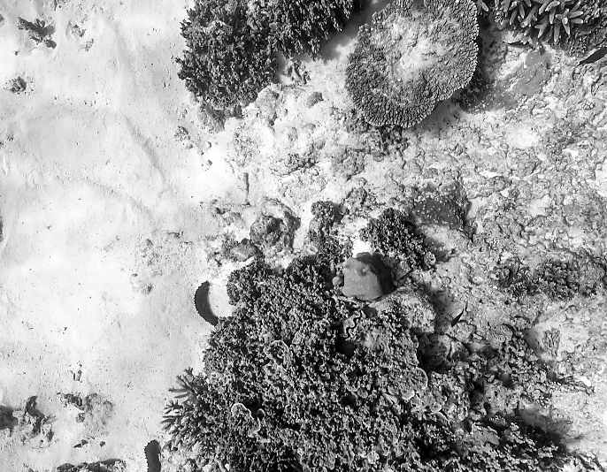
Marine
Education
DATA COLLECTION
Name:
Date:
marineeducation.com.au
(ii) Lady Elliot Island
Activity: Estimate and record the percentage hard coral cover in each quadrat below
1
A
2
A
B
B
C
C
D
D
F
E
E
F
G
G
H
I
J
H
I
J
% hard coral cover: 80% (A,B,D,F,G,H,I,J)
% hard coral cover: 100% (A-J)
3
A
4
A
B
C
B
C
E
D
E
D
F
F
G
G
H
H
I
J
I
J
% hard coral cover: 70% (A,B,D,F,G,H,J)
% hard coral cover: 100% (A-J)
5
A
B
6
A
C
C
B
D
D
E
E
F
F
G
H
G
I
J
H
I
J
% hard coral cover: 50% (A,B,D,F,G)
% hard coral cover: 50% (C,F,G,H,I)
Images (of Lady Elliot Is.) sourced from the XL Catlin Global Reef Record. © Underwater Earth / XL Catlin Seaview Survey.
Taken 29.06.2013. Accessed 24.01.2019 from www.catlinseaviewsurvey.com/ Datum points (A-J) were added at random.
© Marine Education 2019
Mandatory Practical
6

Slide 9
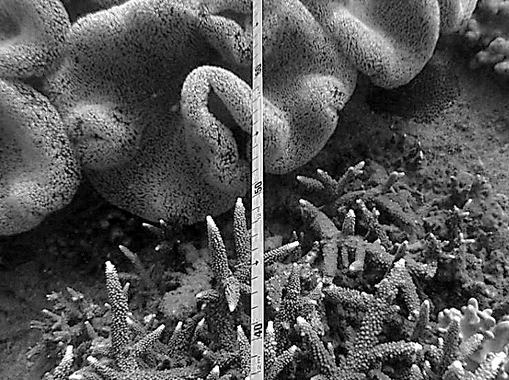
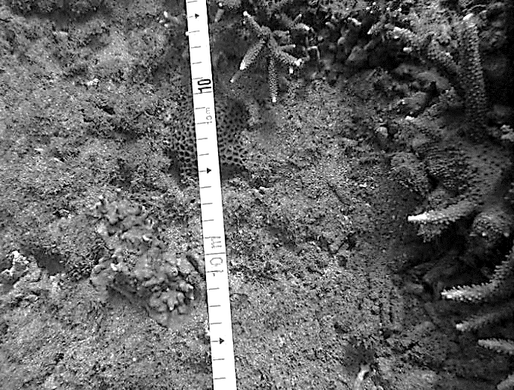
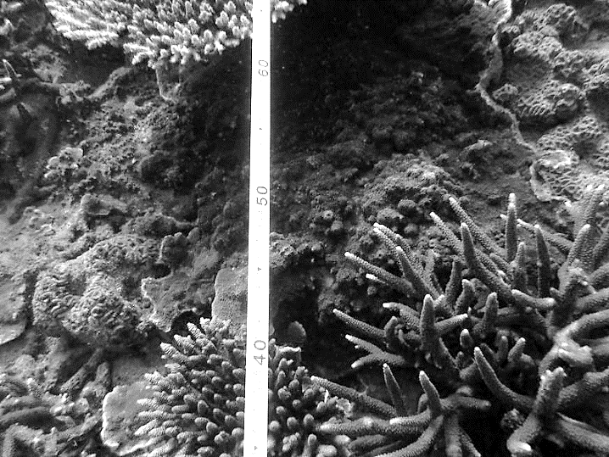
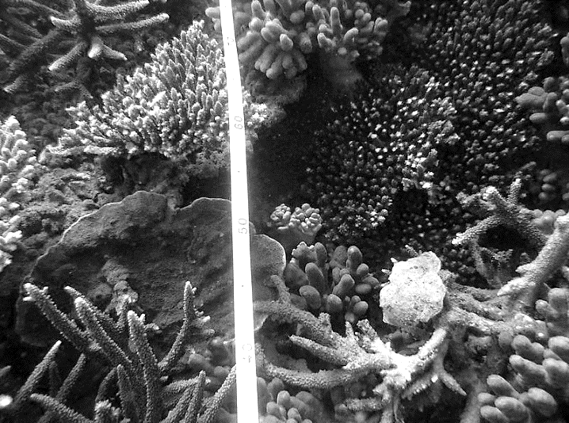
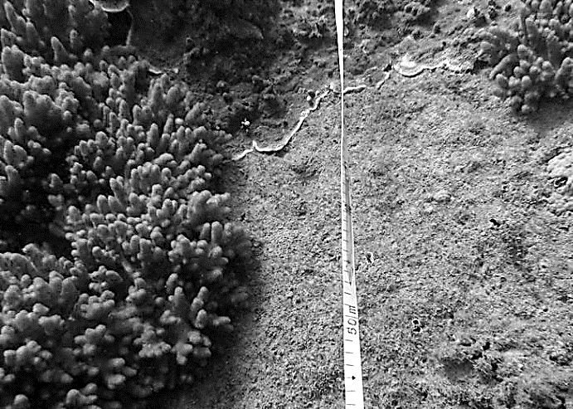
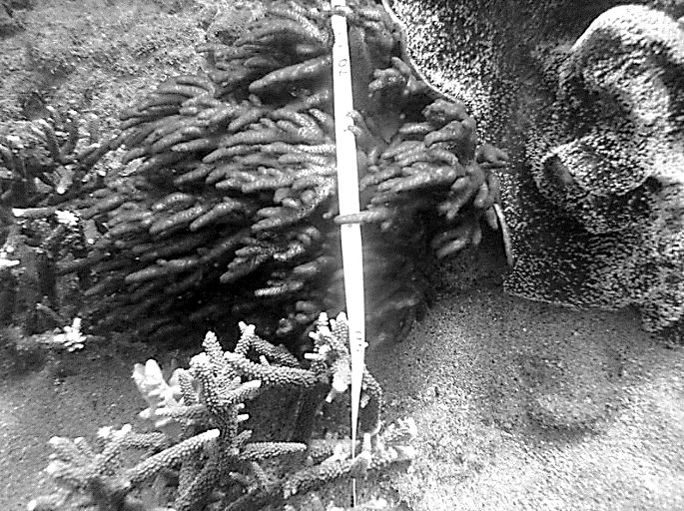
Marine
Education
DATA COLLECTION
Name:
Date:
marineeducation.com.au
(iii) Magnetic Island (Nelly Bay)
Activity: Estimate and record the percentage hard coral cover in each quadrat below
A
1
soft coral
2
B
C
A
B
C
E
D
D
E
G
F
F
H
G
I
H
I
J
J
% hard coral cover: 40% (F,H,I,J)
% hard coral cover: 20% (B,C)
3
A
B
4
A
C
B
D
C
D
E
F
E
F
G
G
H
H
I
J
I
J
% hard coral cover: 100% (A-J)
% hard coral cover: 100% (A-J)
5
A
6
B
A
B
C
D
D
C
soft coral
E
E
soft coral
F
F
G
H
I
G
H
I
J
J
% hard coral cover: 20% (A,B)
% hard coral cover: 20% (I,J)
Photographs adapted from screenshots from Reef Life Survey Data Portal: Habitat Quadrats. Reprinted with permission. Date unknown. Accessed 24.01.2019 from www.reeflifesurvey.com/ All datum points (A-J) selected at random.
© Marine Education 2019
Mandatory Practical
7

Slide 10
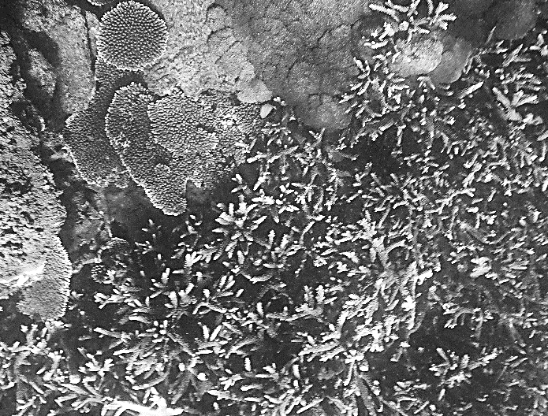
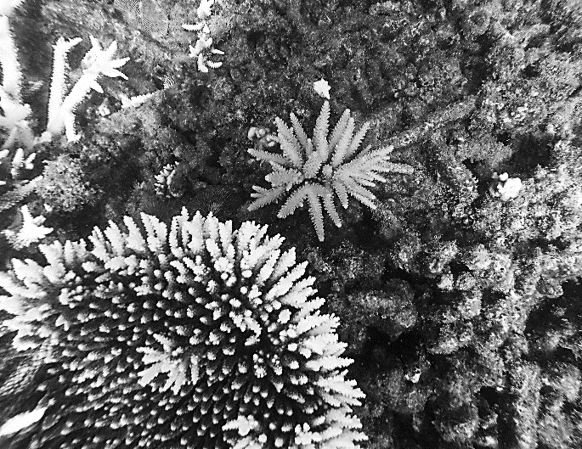
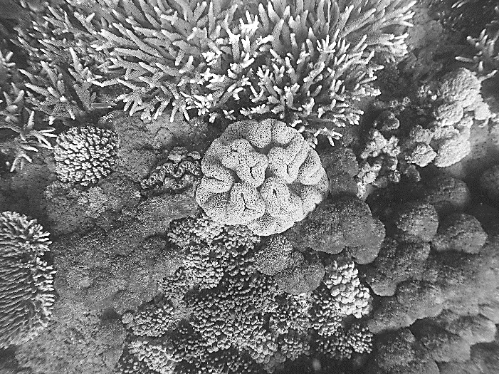
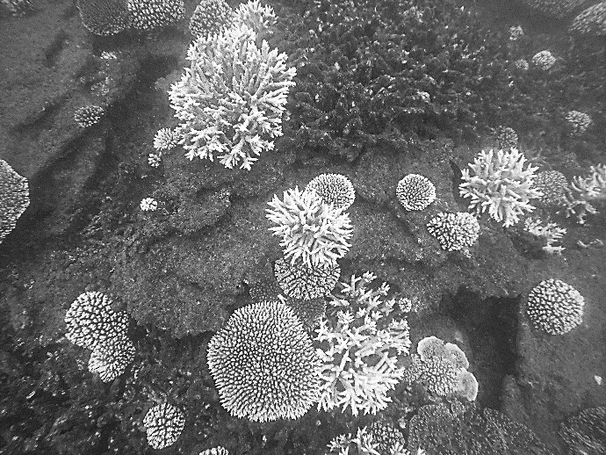
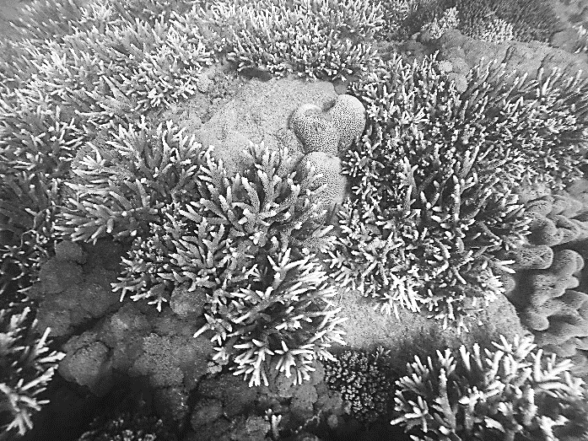
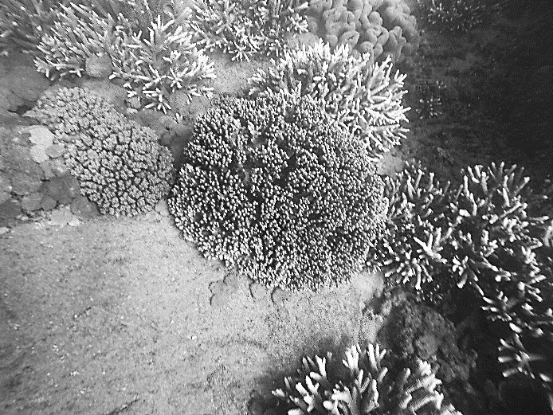
Marine
Education
DATA COLLECTION
Name:
Date:
marineeducation.com.au
(iv) Sloping Island (Keppel Group)
Activity: Estimate and record the percentage hard coral cover in each quadrat below
1
A
soft coral
2
A
B
B
C
C
D
D
E
F
G
F
E
H
G
I
J
H
I
J
% hard coral cover: 90% (A,C,D,E,F,G,H,I,J)
% hard coral cover: 50% (D,F,G,I,J)
3
A
4
A
C
D
B
B
C
D
E
can you see the clam?
F
G
H
F
E
I
soft coral
J
H
G
J
I
% hard coral cover: 40% (A,C,D,I)
% hard coral cover: 30% (C,F,G)
5
A
B
6
A
B
C
C
D
D
F
E
G
E
G
F
H
I
H
J
J
I
% hard coral cover: 80% (A,B,C,D,E,F,G,J)
% hard coral cover: 40% (D,E,F, I)
Photographs kindly provided by North Keppel Island Environmental Education Centre (found within the Capricorn GBRMPA Management Area). Date of photograph: Winter, 2018. Datum points (A-J) were selected at random.
© Marine Education 2019
Mandatory Practical
8

Slide 11
Marine
Education
DATA ANALYSIS
Results
Name:
Date:
marineeducation.com.au
Activity: Copy and complete the research questions from page 80 into the blank spaces below.
Q1. Is there a difference in between & ?
Mean Percentage
Hard Coral Cover
V. High Water Quality (Agincourt Reef)
Medium Water Quality
(Sloping Island)
Answer using a t-test (P-value)
y-axis
x-axis
Q2. Is there a linear relationship between &
Mean Percentage
Hard Coral Cover
Water Quality
?
Answer using a Pearson’s correlation test (r-value)
Activity: Use your answers from the previous worksheets to complete the Results Table below
Excel cells
 | A | B | C | D | E | F | G | H | I | J | K
1 | Reef Location |  | Percentage Hard Coral Cover |  |  |  |  |  | Mean
2
3 | (i) Agincourt Reef | 7 | 100 | 100 | 70 | 100 | 100 | 100 | 95.0 | 12.25 | 12.85
4 | (ii) Lady Elliot Is | 6 | 80 | 100 | 70 | 100 | 50 | 50 | 75.0 | 22.58 | 23.70
5 | (iii) Magnetic Is | 3 | 40 | 20 | 100 | 100 | 20 | 20 | 50.0 | 39.50 | 41.45
6 | (iv) Sloping Is | 3 | 90 | 50 | 40 | 30 | 80 | 40 | 55.0 | 24.29 | 25.49
Water quality
score
Standard Deviation (s)
Confidence Interval
(CI)
1
2
3
4
5
6
=AVERAGE(C3:H3)
=STDEV(C3:H3)
=CONFIDENCE.T(0.05,J3,6)
To calculate the mean, s, and CI, in Microsoft Excel, start by entering values from in to cells C3-H6. Starting with Agincourt Reef, in cell I3, type the formula: =AVERAGE(C3:H3) In cell J3, type the formula: =STDEV(C3:H3) And, in cell K3, type the formula: =CONFIDENCE.T(0.05,J3,6) Repeat for the other reefs, substituting the 3 in the formulas for 4, 5 and 6. Alternatively, just drag down the tiny square on the bottom right-hand corner of cell I3, J3 and K3.
Complete the table to find a P-value for Q1
Complete the table to find a r-value for Q2
Q1
Q2
(i)
(iii)
r
 | QUADRATS | P
 | 100,100,70,100,100,100
(iv) Sloping Is | 90,50,40,30,80,40
(ii)
(iv)
Reef Locations →
y |  | 95 | 75 | 50 | 55
x |  | 7 | 6 | 3 | 3
1
2
3
4
5
6
-axis
Mean % hard coral cover
(i) Agincourt Reef
0.0048
hint: Column I
0.97298
-axis
Water Quality Score
hint: Column B
To calculate the P-value, google GraphPad QuickCalcs: t test calculator. Enter data for Agincourt Reef in to the Group 1 column. Enter data for Great Keppel Island in to the Group 2 column. Select unpaired test and click ‘Calculate Now’. If the P-value is =< 0.05, the difference is significant.
To calculate the r-value, in Excel, enter the water quality scores in to cells B3-B6.
Then, click on any blank cell in Excel and type the formula: =CORREL(I3:I6,B3:B6)
If the r value is between 0.5 and 1.0 or between -0.5 and -1.0, a linear
relationship exists. The closer the r value is to ±1.0, the stronger the relationship.
comma !
Complete the Bar graph for Q1 Results
Complete the scatter plot for Q2 Results
Note: the top of the error bar is the mean + CI. Whilst, the bottom of the error bar is the mean - CI
Note: Create a dot on the graph for each x and y co-ordinate pair. Draw a (straight) line of best fit and write the value for r.
y
y
100
75
50
25
95%
n=6
100
75
50
25
r = 0.97298
Mean % hard coral cover
Mean % hard coral cover
55%
n=6
Very High Water Quality (Agincourt Reef)
Medium Water Quality
(Sloping Island)
x
1 | 2 | 3 | 4 | 5 | 6 | 7 | 8
x
Water Quality Score
[Yes] [No]
[Yes] [No]
Answer to research question 1?
Answer to research question 2?
© Marine Education 2019
Mandatory Practical
9

Slide 12
Marine
Education
Name:
Date:
marineeducation.com.au
INTERPRETATION and EVALUATION
Activity: Analyse the evidence (i.e. results) to identify trends, patterns or relationships.
As water quality increases, reef health increases (and vice versa).
Activity: Analyse the evidence (i.e. methods and results) to identify uncertainty and limitations
Number of quadrats per site (6) not enough. Also, not enough reefs and not enough datum points per photo quadrat. Standard deviations were too high.
Photo quadrats were from various online sources using different methods.
Method used to calculate water quality (i.e. questions) were simply made up.
Activity: Interpret the evidence (i.e. results) to draw conclusion/s to the research questions
Note: the null hypothesis always states there is
no difference or
no relationship
between this
and that.
Q1. There was a significant difference in percentage hard coral
cover between Very High water quality (Agincourt) and Medium water
quality (Sloping Is.). The null hypothesis was rejected (P=0.0048).
Q2. There was a strong linear relationship between mean percentage hard coral cover and water quality. The null hypothesis was rejected (r=0.97298).
Activity: Evaluate the reliability and validity of the experimental process
Reliability: Needed more replicates. ‘s’ & ‘CI’ were too high and ‘n’ was too low.
Validity: accuracy compromised by uncertainties and limitations listed above.
Revisit measured variables and their influence on the outcome of the study.
Activity: Suggest possible improvements and extensions to the experiment
Increase the number of replicates (i.e. reefs, photo quadrats, datum points)
Collect dependent and independent data at the same time (e.g. go to Keppel)
Keep the AREA of each photo quadrat the same (e.g. 1m x 1m).
Base criteria/questions used to score water quality on scientific research.
Activity: Plan and justify a modification of the research question and methodology.
Add coral watch data (i.e. for more information to add to your analysis).
Change or add locations (e.g. more locations will give you more plots to add to Pearson’s correlation analysis).
Change criteria/questions when scoring water quality (validated by science).
Use a water quality index (e.g. Q-value) instead of criteria/questions
See previous suggestions for possible improvements and extensions.
© Marine Education 2019
Mandatory Practical
10

