Slide 1
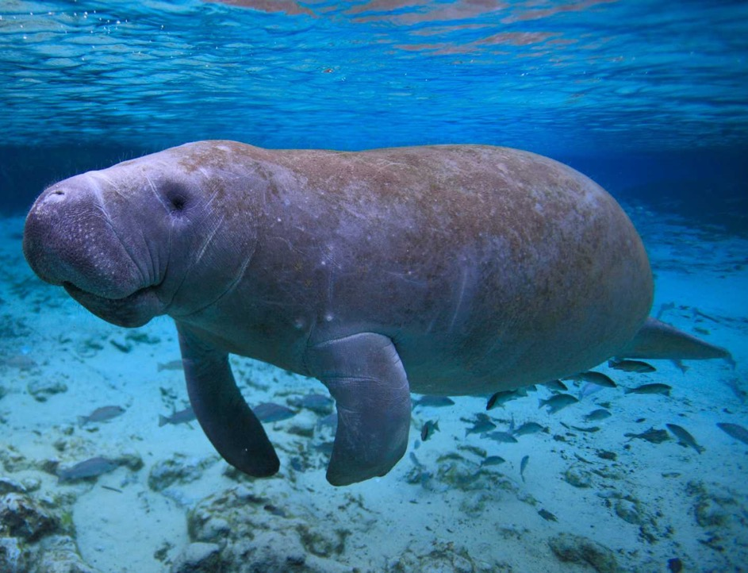
Learning Intention:
Assess the use of remote sensing radar imagery, satellite tracking in real time and remotely piloted aircraft systems (RPAS) (i.e. drones) to enable scientists to measure and monitor populations in large or inaccessible ecosystems such as dugongs.
Success Criteria:
Complete Marine Education worksheet ’12. Follow Me’
Notes:
Image: https://www.crownandchamparesorts.com/magazine/press-sea-turtle-hatching-at-kagi-maldives/

Slide 2
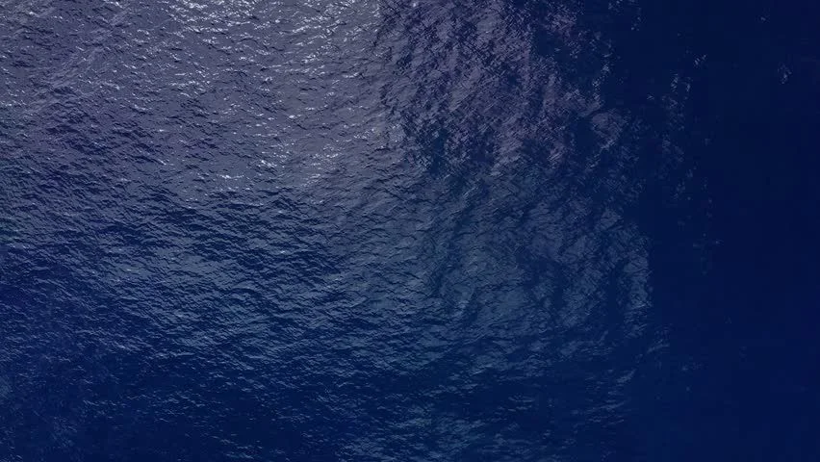
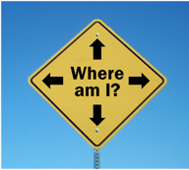
If you want to protect a species, you have to know where it is.
NOAA Fisheries scientist Jeffrey Polovina
Notes:
Quote: https://www.fisheries.noaa.gov/feature-story/satellite-tags-reveal-how-animals-see-ocean

Slide 3
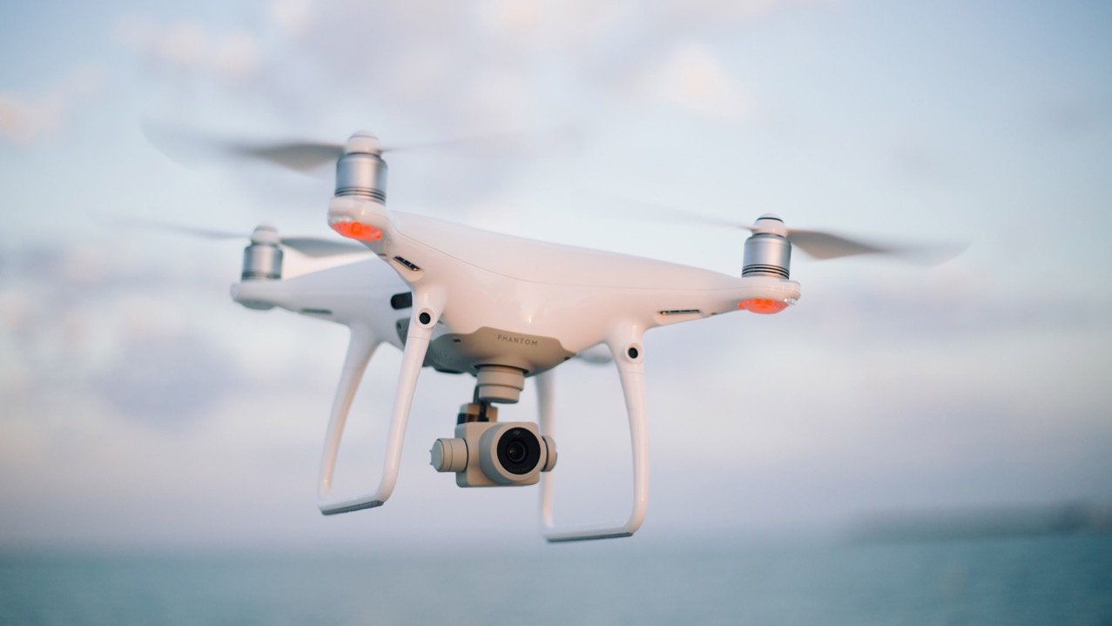
Find them using a Remotely Piloted Aircraft System (RPAS) such as a drone
Notes:
Image: https://www.lojo.co.nz/insights/new-rules-for-remotely-piloted-aircraft-systems-do-you-know-the-risks-have-you-got-permission-to-fly

Slide 4
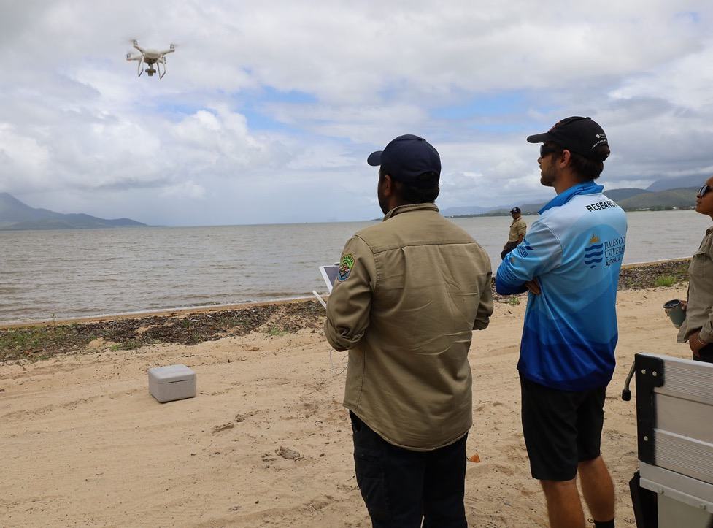
TropWATER scientists equipping Indigenous rangers with the skills to utilise small drones for dugong surveys

Slide 5
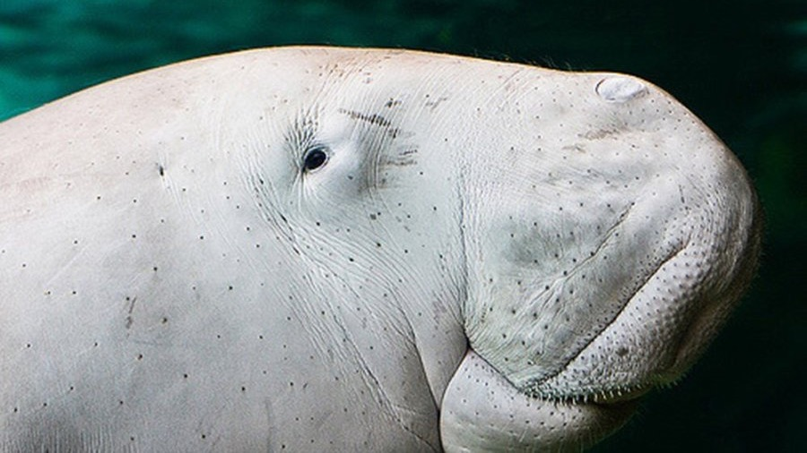
Dugong. Image credit: Flickr/Moushik
You found me!
Notes:
Image: https://www.australiangeographic.com.au/news/2017/05/the-number-of-baby-dugongs-in-the-great-barrier-reef-has-increased/
Aerial surveys found that baby dugongs make up 10 per cent of the overall dugong population. Image credit: Flickr/Moushik

Slide 6
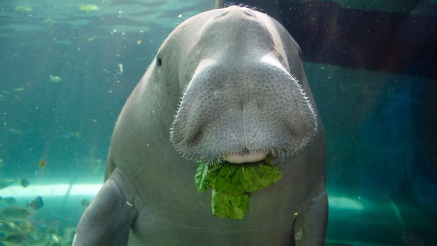
Dugong. Image credit: Sarah Thomas
Notes:
Image: https://www.smh.com.au/environment/conservation/dugong-calves-make-strong-comeback-on-reef-20170522-gwaesh.html

Slide 7
Attach a tag?

Slide 8
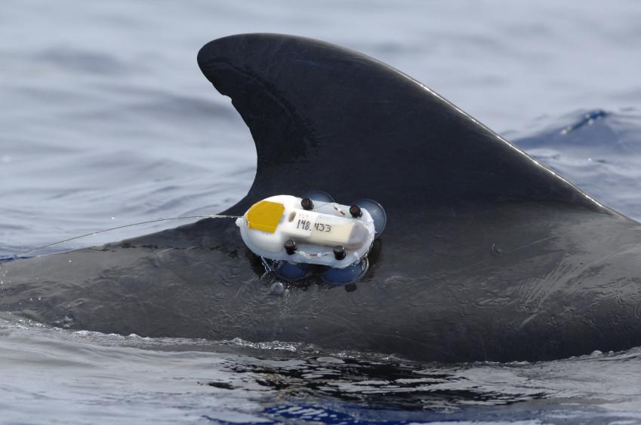
How?

Slide 9
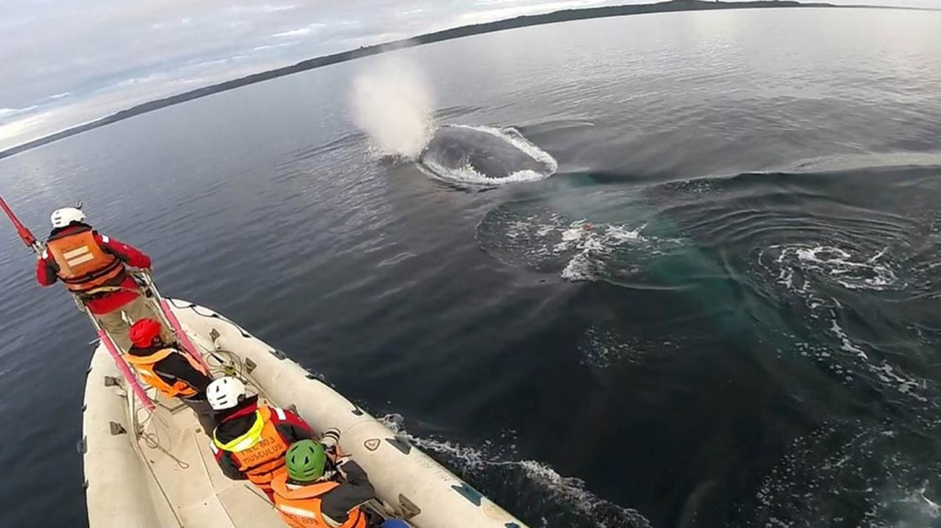
Too dangerous?
Stressful for the animal?

Slide 10
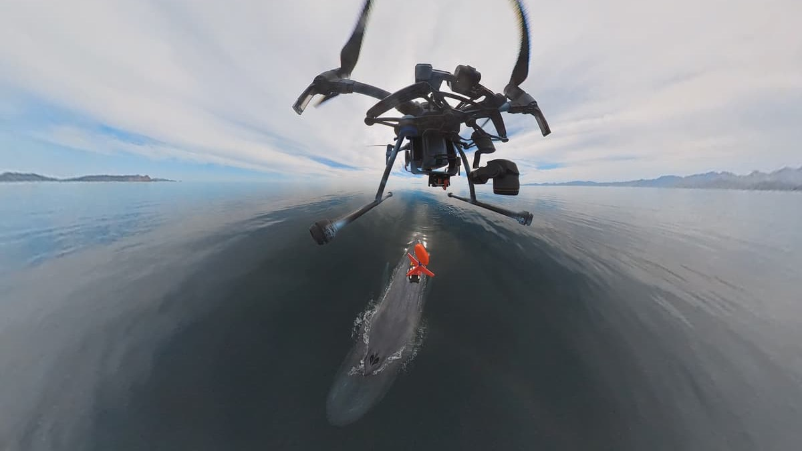
Solution:
Tag remotely

Slide 11
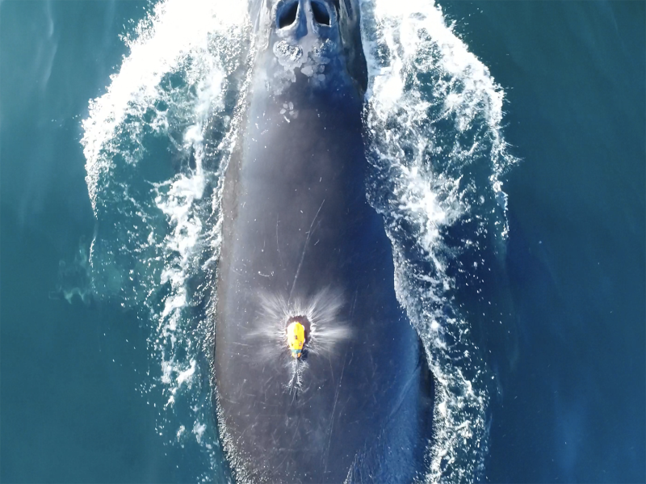
A suction cup tag just dropped onto the back of a North Atlantic right whale. The photo was taken by the drone that deployed the tag (Permit #24359). Credit: NOAA Fisheries, Ocean Alliance/Chris Zadra
Notes:
Image: https://www.fisheries.noaa.gov/feature-story/short-term-tagging-rare-whale-takes-step-forward
A suction cup tag just dropped onto the back of a North Atlantic right whale. The photo was taken by the drone that deployed the tag (Permit #24359). Credit: NOAA Fisheries, Ocean Alliance/Chris Zadra

Slide 12
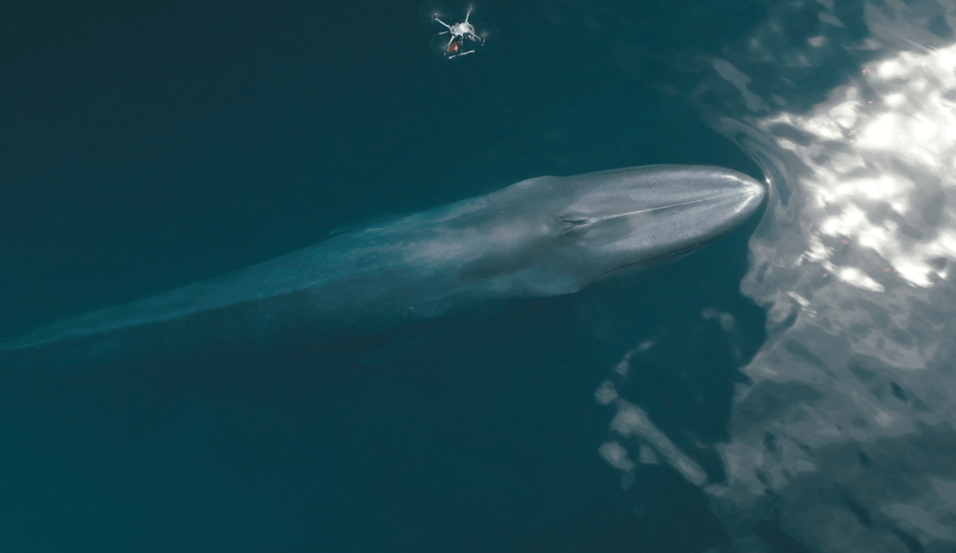
Notes:
Image: https://enterprise-insights.dji.com/blog/tagging-whales-from-above-with-drones

Slide 13
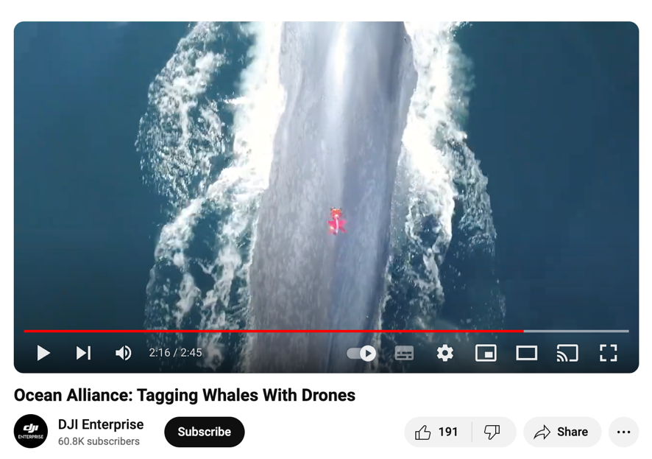
https://www.youtube.com/watch?v=OJIHb0hi1xM
Notes:
https://enterprise-insights.dji.com/blog/tagging-whales-from-above-with-drones

Slide 14
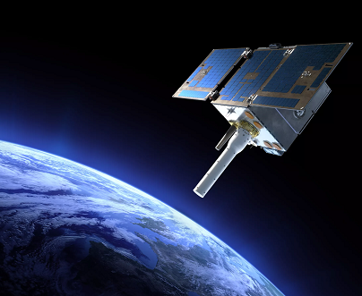
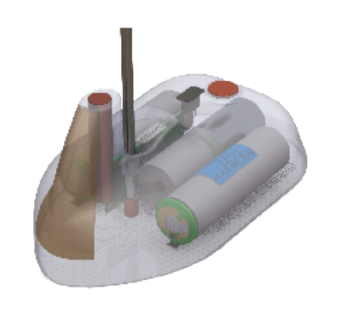
Satellite tags
Notes:
Image: https://www.argos-system.org/about-argos/

Slide 15
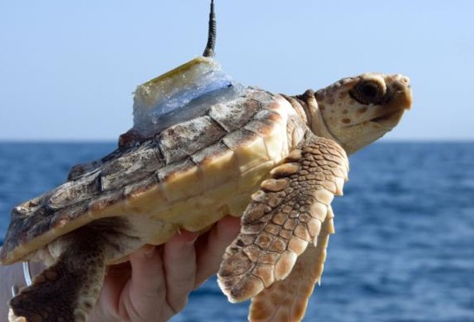
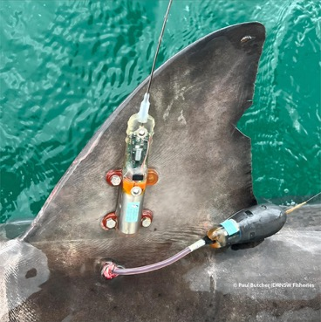
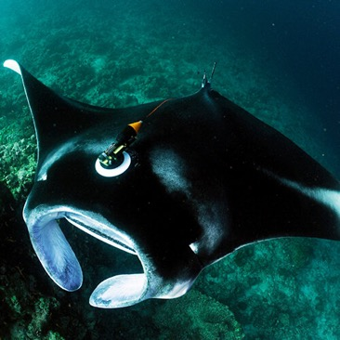
Satellite tracking in real time
If you want to protect a species, you have to know where it is.
Notes:
Image (Turtle): https://www.fisheries.noaa.gov/feature-story/satellite-tags-reveal-how-animals-see-ocean
Image (dorsal fin): https://wildlifecomputers.com/blog/transforming-marine-animal-tracking-with-micropat/
Image (manta): https://www.mantatrust.org/tagging-and-tracking

Slide 16
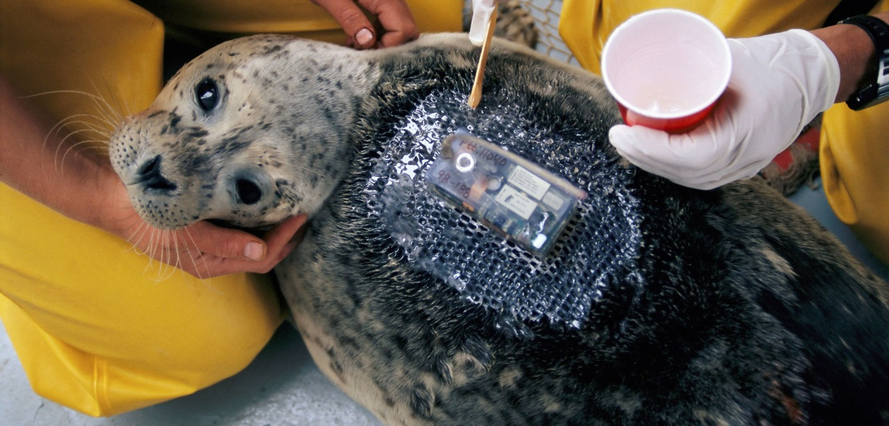
Satellite tracking in real time
Notes:
Image: https://hakaimagazine.com/news/are-scientific-tracking-tags-hurting-wild-animals/
Tracking tags help researchers get to know their subjects like never before. But scientists are still not sure how well animals adapt to the tags. Here, researchers apply a tag to a harbor seal. Photo by RGB Ventures/SuperStock/Alamy Stock Photo

Slide 17
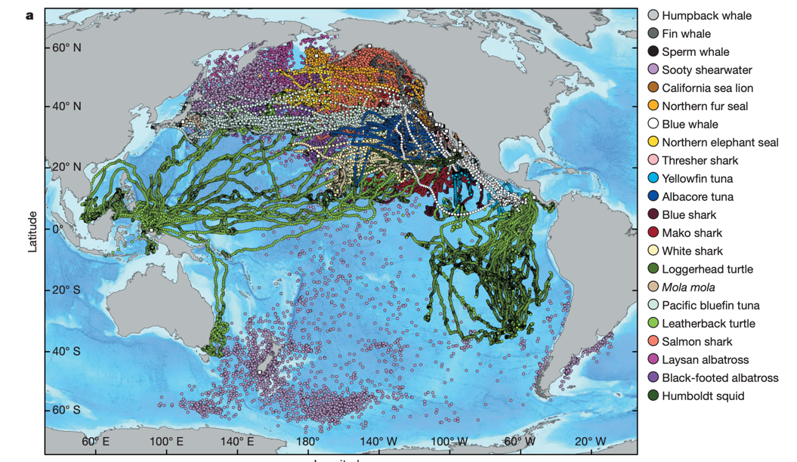
One Study:
4,306 tags on 23 species in the North Pacific Ocean tracked for 9 years
Notes:
Block et al (2011). Tracking apex marine predator movements in a dynamic ocean. Letter. https://gtopp.org/images/stories/publications/nature10082%20Published%20Version.pdf

Slide 18
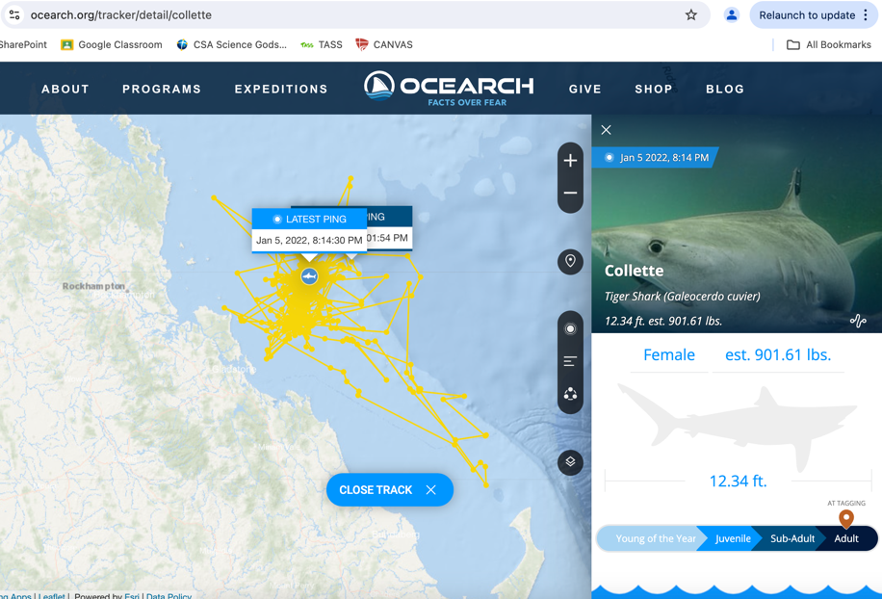
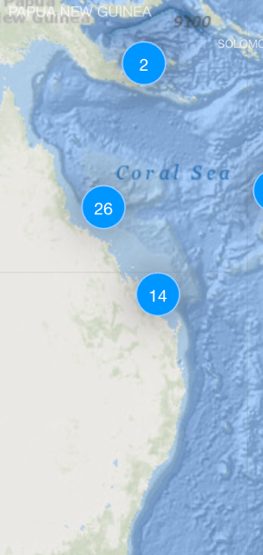
Choose a shark to track
https://www.ocearch.org/tracker/

Slide 19
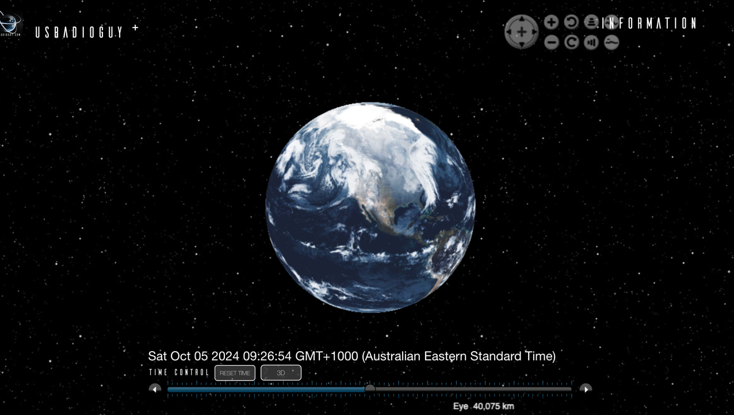
Notes:
https://usradioguy.com/3Ddata/Tracker/

Slide 20
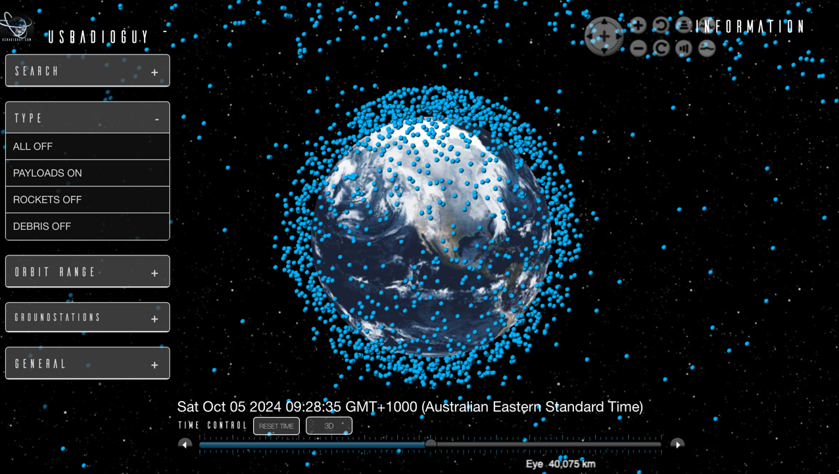
Payloads (satellites)

Slide 21
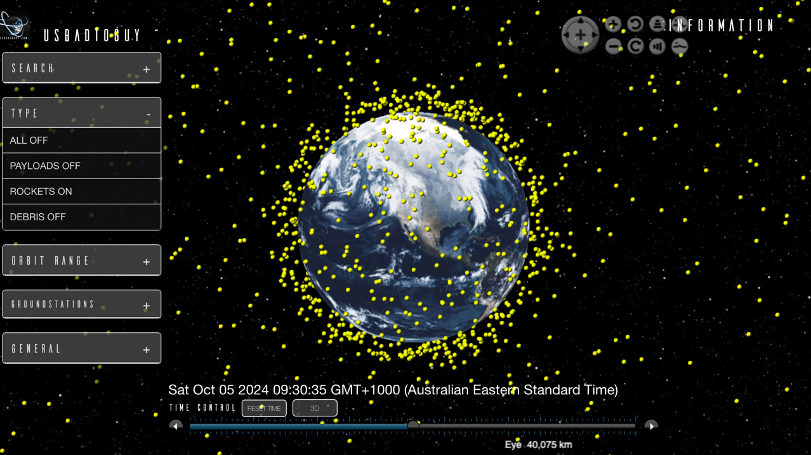
Rockets

Slide 22
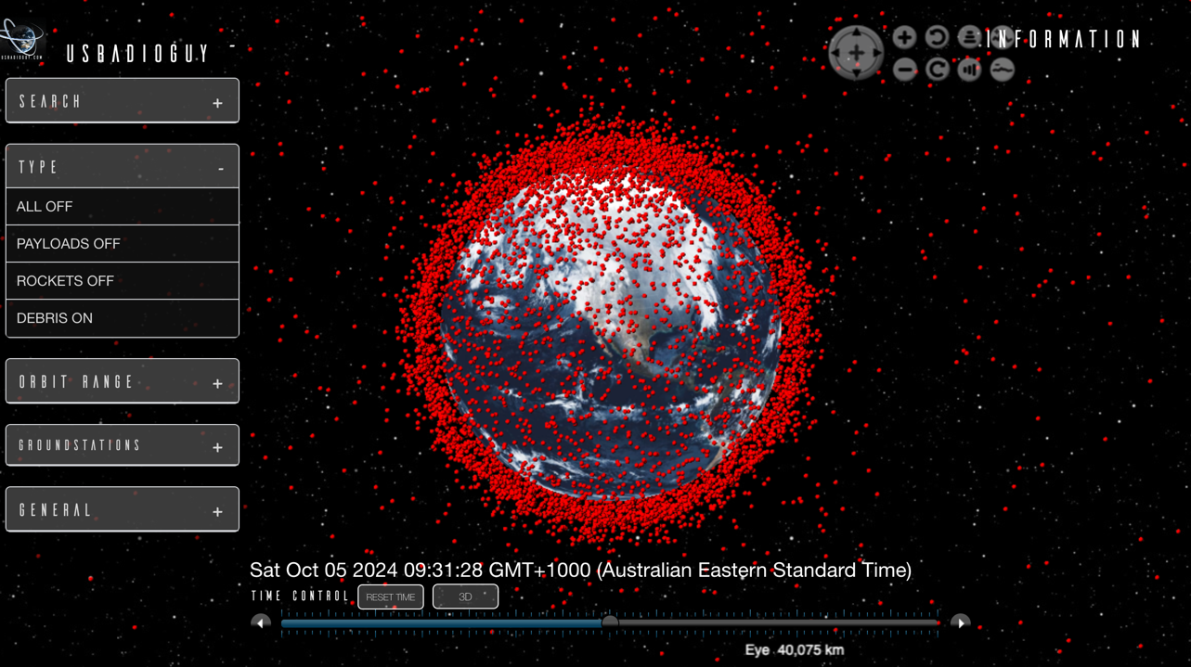
Debris

Slide 23
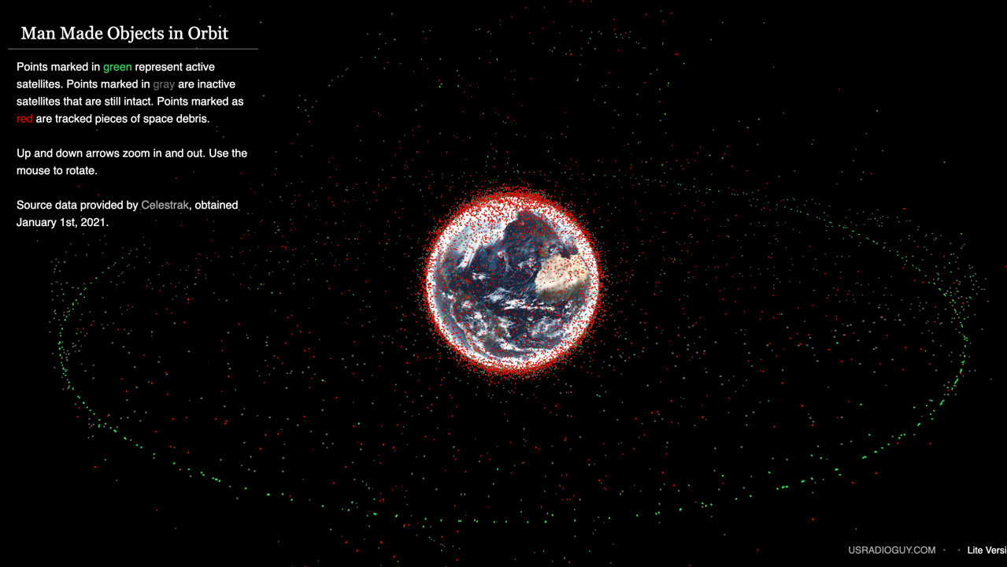
https://usradioguy.com/3Ddata/lite3D/

Slide 24
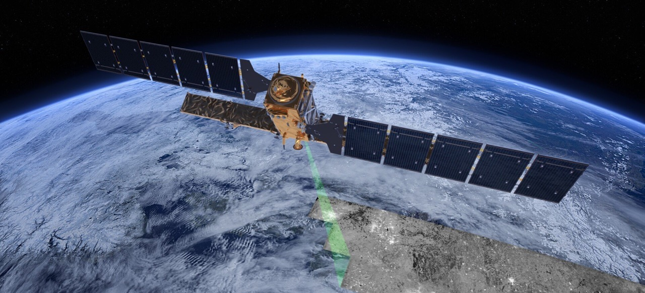
Satellite tag readings not only show where the animals are travelling (and how deep) but when combined with ocean-observing satellite data such as currents, fronts, and eddies, we see how animals are navigating through and around these features.
Notes:
Info: Polovina, J. (2014). Satellite Tags Reveal How Animals See the Ocean. Feature Story by NOAA in September 2014. Accessed Oct 2025 from: https://www.fisheries.noaa.gov/feature-story/satellite-tags-reveal-how-animals-see-ocean
Image: https://www.space-intelligence.com/2018/04/04/introduction_active-sensing-monitoring/

Slide 25

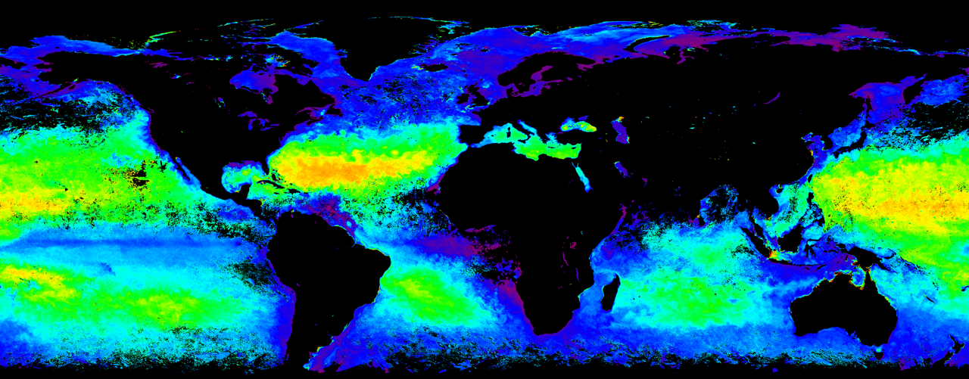
Remote sensing radar imagery can still ‘see’ at night and through clouds
Notes:
Image: https://oceanbites.org/surfo-special-from-outer-space-to-the-microscope-how-nasas-satellites-are-helping-us-understand-the-oceans-smallest-life/

Slide 26
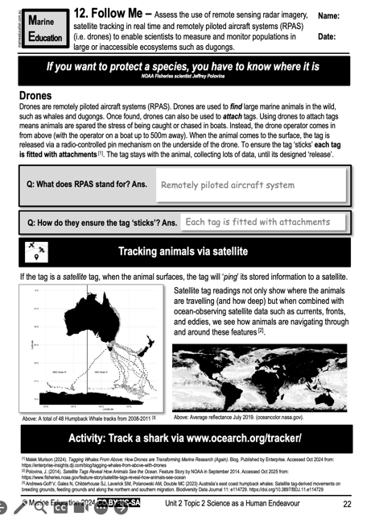
Learning Intention:
Assess the use of remote sensing radar imagery, satellite tracking in real time and remotely piloted aircraft systems (RPAS) (i.e. drones) to enable scientists to measure and monitor populations in large or inaccessible ecosystems such as dugongs.
Success Criteria:
Complete Marine Education worksheet ’12. Follow Me’
Notes:
Image: https://www.crownandchamparesorts.com/magazine/press-sea-turtle-hatching-at-kagi-maldives/

