Slide 1
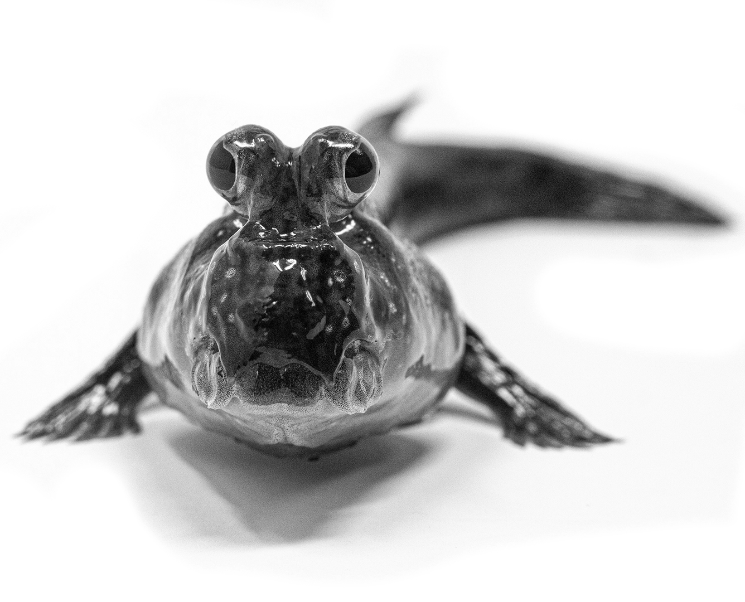
Marine
Education
Year 11 Marine Science
Student Workbook
Name:
Date:
marineeducation.com.au
Unit 1 Topic 2
The Dynamic Shore
Content from Marine Science Syllabus
State of Queensland (QCAA) 2025 v1.2
By Gail Riches
© Marine Education 2024 CC BY-NC-SA

Slide 2


Marine
Education
marineeducation.com.au
© Marine Education 2024 CC BY-NC-SA
Published by Marine Education 2024
ABN: 48765406873
Author: Gail Riches
Email: info@marineeducation.com.au
www.marineeducation.com.au
Course Overview and Learning Objectives derived from Marine Science 2025 v1.2 General senior syllabus, October 2024.
Queensland Curriculum & Assessment Authority PO Box 307 Spring Hill QLD 4004 Australia.
https://www.qcaa.qld.edu.au/downloads/senior-qce/syllabuses/snr_marine_science_25_syll.pdf
Image (front page mudskipper): Hutchings Museum, 55 N Center Street, Lehi, UT 84043. Accessed from: https://johnhutchingsmuseum.org/atlantic-mudskipper/
Interested persons are invited to contact the author for information or to indicate errors and omissions.
This publication is available to download free-of-charge from the Marine Education website: www.marineeducation.com.au
The sale of this product is strictly prohibited.
Printing at a commercial printer such as Office Works is permitted for school-use only.
Marine Education would like to thank all the teachers, students and industry professionals who kindly shared their work.
© Marine Education 2024 CC BY-NC-SA

Slide 3
Marine
Education
Course Overview
marineeducation.com.au
Marine Science
Year 11 (this booklet)
Assessment
Data Test 10%
Student Experiment 20%
Research Investigation 20%
Exam 50% (only examines SU dot points)
Year 12 (next booklet)
Assessment
Data Test 10%
Student Experiment 20%
Research Investigation 20%
Exam 50% (only examines SU dot points)
Unit 1
Oceanography
Topic 1: An ocean planet
Topic 2: The dynamic shore
Unit 2
Marine Biology
Topic 1: Marine ecology and biodiversity
Topic 2: Marine environmental management
Unit 3
Marine systems – connections and change
Topic 1: The reef and beyond
Topic 2: Changes on the reef
Unit 4
Ocean issues and resource management
Topic 1: Oceans of the future
Topic 2 Managing fisheries
Syllabus Objectives
Describe ideas and findings
Apply understanding
Analyse data
Interpret evidence
Evaluate conclusions, claims and processes
Investigate phenomena
Science Strands
Science understanding (SU) - this is the ONLY Strand that is assessed in the (50%) exam
Science as a human endeavour (SHE)
Science inquiry skills (SIS)
© Marine Education 2024 CC BY-NC-SA
Course Overview

Slide 4
Marine
Education
marineeducation.com.au
Table of Contents
Topic 2: The dynamic shore
Strand: SCIENCE UNDERSTANDING
Subject Matter: Coastlines | Page
1. The Dynamic Shore: Describe how coastlines are shaped by a number of factors, including tectonic plate movements, shifts in climate patterns and sea level change, weather patterns, and movement of sediments and water, e.g. waves, currents. | 1
2. Tide Trickery: Explain how gravitational pull, current strength and wave action cause tidal movement. | 3
3. Shifty Sand: Describe the concepts of sand budget and longshore drift | 5
4. Wave Wrap: Contrast refraction, reflection and diffraction. | 7
5. All aboard: Describe how wave action, wind and longshore drift influence the movement of water, nutrients, sand, sediment and pollutants, e.g. oil spills, debris. | 9
6. The sea-saw of sand: Compare accretion and erosion in the processes of coastal erosion. | 11
7. Well, blow me down: Explain how weather patterns and climate (e.g. temperature, wind speed and direction, rainfall, breezes, barometric pressure) are driven by atmosphere/ocean interactions. | 13
8. Surfs Up: Describe the processes of wave formation, e.g. fetch, relationship of wave height and type to water depth and wave celerity. | 15
9. That’s just swell: Explain how the properties of waves are shaped by weather patterns, natural formations and artificial structures, e.g. interference patterns, fetch, wave sets. | 17
Subject Matter: Coastal impacts
10. Engineering Marvels or Mayhem?: Explain how coastal engineering regulates water or sediment flow, affects currents and impacts the coastline, including marine ecosystems. | 19
11. Information in Imagery: Analyse evidence from longitudinal studies showing changes that occur in marine environments, e.g. satellite imagery, aerial photography, field research. | 21
12. Success-ion: Identify how organisms populate areas following changes in habitats, e.g. succession. | 23
13. Pollution Playlist: Identify types of pollution of coastal zones, including organic wastes, thermal, toxic compounds, heavy metals, oil, nutrients and pesticides. | 25
Subject Matter: coastal conservation and monitoring impacts
14. The Ability to Sustain: Describe the concept of sustainable management practices. | 27
15. Pin-pointing Pollution: Compare point source and non-point source forms of pollution. | 29
16. Testing the Waters: Describe two direct methods of monitoring water pollution levels using an abiotic test (e.g. nitrate, phosphate, heavy metals) or a biotic test (e.g. faecal coliform). | 31
© Marine Education 2024 CC BY-NC-SA

Slide 5
Marine
Education
marineeducation.com.au
Table of Contents
17. I demand Oxygen!: Describe how biochemical oxygen demand (BOD) is used to indirectly assess water pollution levels (worksheet #1) | 33
18. Cracking the Case: Describe how biochemical oxygen demand (BOD) is used to indirectly assess water pollution levels (worksheet #2) | 35
19. Nutrient overload: Explain the process of eutrophication. | 37
20. Saving our soils and seas: Describe land management practices that contribute to the health of marine ecosystems, including siltation, algal blooms and agricultural practices | 39
21. Bug life: Explain an indirect method of measuring pollution levels using a biotic index. | 41
22. Biology as indicators of change: Describe the concept of marine bio-indicators with an example, e.g. mussels (Mytilus galloprovincialis), mudskippers (Scartelaos histophorus), seagrass (Zostera spp.) and changes in concentration of pigments in certain corals. | 43
23. Muddy Waters: Interpret data from biotic and abiotic tests on a water sample to determine water quality. | 45
Strand: SCIENCE AS A HUMAN ENDEAVOUR
24. Constructing Coastlines: Consider how historical local planning decisions on dynamic shorelines have influenced the selection of coastal management strategies. | 49
25. Disturbance Dynamics: Recognise that impact levels from pulse events alter as populations increase and landscape dynamics change. This leads to increased pressure on infrastructure designed to mitigate risk. | 50
26. Eyes under the water: Appreciate that diver-propelled vehicles with customised high-definition cameras and automated image-annotation methods have dramatically increased the size, accuracy, and geographic and temporal scope of the datasets that marine scientists work with. | 51
27. Roads to Reefs: Recognise that the effectiveness of land-based management practices has a direct impact on the health of marine ecosystems. Scientific monitoring of these practices can be used to develop and evaluate projected impacts on marine conservation strategies | 52
28. High stakes: Discuss that the education of stakeholders is essential to encouraging sustainable management practices. | 53
29. Power in data: Consider that the use of data can inform the selection of coastal management strategies that may have beneficial, and/or harmful and/or unintended consequences. | 54
Strand: SCIENCE INQUIRY
30. What’s in the water?: Investigate water quality by conducting biotic and abiotic tests on a water sample. | 55
31. Making waves: Investigate wave properties using a wave tank. | 56
32. Beach prac: Investigate sandy coastlines using beach profiles, dune transects and sand sifts. | 57
© Marine Education 2024 CC BY-NC-SA

Slide 6
Marine
Education
marineeducation.com.au
Table of Contents
Strand: SCIENCE INQUIRY (continued) | Page
33. Peeps: Interpret population density data of coastal areas to identify the impact on the health of coastal water. | 58
34. Finger on the pulse: Interpret evidence used to inform the monitoring, assessment and evaluation of risk in relation to pulse events, i.e. cyclone, storm surge, tsunami and floods. | 59
35. Shifting sands: Analyse evidence from the use of groynes, river walls and sand bypass systems to determine the effects on longshore drift for a beach system resource, e.g. the Delft report; Griffith University Centre for Coastal Management. | 60
© Marine Education 2024 CC BY-NC-SA

Slide 7
This page is intentionally blank

Slide 8
Marine
Education
Cognitive Verbs
marineeducation.com.au
Cognitive Verb | Description
Analyse | dissect to ascertain and examine constituent parts and/or their relationships; break down or examine in order to identify the essential elements, features, components or structure; determine the logic and reasonableness of information; examine or consider something in order to explain and interpret it, for the purpose of finding meaning or relationships and identifying patterns, similarities and differences
Apply | Use knowledge and understanding in response to a given situation or circumstance; carry out or use a procedure in a given or particular situation
Appreciate | recognise or make a judgment about the value or worth of something; understand fully; grasp the full implications of
Assess | Measure, determine, evaluate, estimate or make a judgement about the value, quality, outcomes, results, size, significance, nature or extent of something
Calculate | Determine or find (e.g. a number, answer) by using mathematical processes; obtain a numerical answer showing the relevant stages in the working; ascertain/determine from given facts, figures or information
Categorise | Place in or assign to a particular class or group; arrange or order by classes or categories; classify, sort out, sort, separate
Classify | Arrange, distribute or order in classes or categories according to shared qualities or characteristics
Consider | think deliberately or carefully about something, typically before making a decision; take something into account when making a judgment; view attentively or scrutinise; reflect on
Compare | Display recognition of similarities and differences and recognise the significance of these similarities and differences
Contrast | display recognition of differences by deliberate juxtaposition of contrary elements; show how things are different or opposite; give an account of the differences between two or more items or situations, referring to both or all of them throughout
Define | Give the meaning of a word, phrase, concept or physical quantity; state meaning and identify or describe qualities
Describe | Give an account (written or spoken) of a situation, event, pattern or process, or of the characteristics or features of something
Determine | establish, conclude or ascertain after consideration, observation, investigation or calculation; decide or come to a resolution
Discriminate | note, observe or recognise a difference; make or constitute a distinction in or between; differentiate; note or distinguish as different
© Marine Education 2024 CC BY-NC-SA
Cognitive Verbs

Slide 9
Marine
Education
Cognitive Verbs
marineeducation.com.au
Cognitive Verb | Description
Discuss | Examine by argument; sift the considerations for and against; debate; talk or write about a topic, including a range of arguments, factors or hypotheses; consider, taking into account different issues and ideas, points for and/or against, and supporting opinions or conclusions with evidence
Evaluate | Make an appraisal by weighing up or assessing strengths, implications and limitations; make judgements about ideas, works, solutions or methods in relation to selected criteria; examine and determine the merit, value or significance of something, based on criteria
Examine | investigate, inspect or scrutinise; inquire or search into; consider or discuss an argument or concept in a way that uncovers the assumptions and interrelationships of the issue
Explain | Make an idea or situation plain or clear by describing it in more detail or revealing relevant facts; give an account; provide additional information
Explain | Make an idea or situation plain or clear by describing it in more detail or revealing relevant facts; give an account; provide additional information
Explore | look into both closely and broadly; scrutinise; inquire into or discuss something in detail
Identify | Distinguish; locate, recognise and name; establish or indicate who or what someone or something is; provide an answer from a number of possibilities; recognise & state a distinguishing factor or feature
Infer | derive or conclude something from evidence and reasoning, rather than from explicit statements; listen or read beyond what has been literally expressed; imply or hint at
Interpret | use knowledge and understanding to recognise trends and draw conclusions from given information; make clear or explicit; elucidate or understand in a particular way; bring out the meaning of, e.g. a dramatic or musical work, by performance or execution; bring out the meaning of an artwork by artistic representation or performance; give one's own interpretation of; identify or draw meaning from, or give meaning to, information presented in various forms, such as words, symbols, pictures or graphs
Investigate | carry out an examination or formal inquiry in order to establish or obtain facts and reach new conclusions; search, inquire into, interpret and draw conclusions about data and information
Predict | give an expected result of an upcoming action or event; suggest what may happen based on available information
Recall | Remember; present remembered ideas, facts or experiences; bring something back into thought, attention or into one’s mind
Recognise | Identify or recall particular features of information from knowledge; identify that an item, characteristic or quality exists; perceive as existing or true; be aware of or acknowledge
Understand | Perceive what is meant by something; grasp; be familiar with (e.g. an idea); construct meaning from messages, including oral, written and graphic communication
© Marine Education 2024 CC BY-NC-SA
Cognitive Verbs

Slide 10
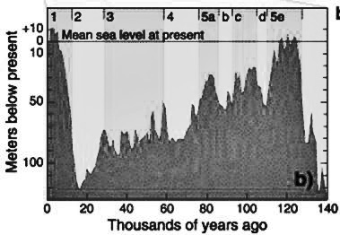
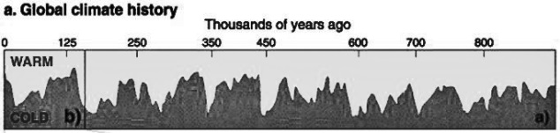
Marine
Education
1. The Dynamic Shore – Describe how coastlines are shaped by a number of factors, including tectonic plate movements, shifts in climate patterns and sea level change, weather patterns, and movement of sediments and water, e.g. waves, currents.
Name:
Date:
marineeducation.com.au
Geological Time Travel
The coastline that you see today looked very different 17,000 years ago when sea levels were much lower. In fact, it was so low, there was a land bridge between Tasmania and Victoria. Rewind even further back in time – millions of years ago – and the coastline was unrecognisable. Probably because it was still attached to Antarctica! So, what you see today is very different to what it looked like in the past, and perhaps very different to what it will look like in the future. Activity: Study the graph pictured right. Q. How far above sea level was the ground you are now standing on, 17,000 years ago? Ans.
Sea level rise and fall over time
17,000 years ago….
Land bridge between Tasmania & Victoria
b)
b)
Figure 1: Sea level change over time. Source: Wikapedia (2017). Past Sea Level.
Accessed 2018 from: https://en.wikipedia.org/wiki/Past_sea_level. CC BY-SA 3.0.
Activity: Complete the table below
Factors shaping our coastlines | How? | Provide One Example of a coastline feature (living or non-living) in your region that only exists because of this factor
Tectonic Plate Movements | Tectonic plate movements create mountain ranges, islands, headlands and underwater bathymetry | Q. Any large mountain ranges, islands or headlands
Shifts in Climate Patterns | Climate (average rainfall and temperature) determines what plants and animals live and thrive best there. | Q. Any rainforests? Coral bleaching? Flora/fauna?
Sea Level Change | Sea Level rise submerges the coastline. Whereas, sea level fall exposes the coastline to the elements. | Q. Any extensive shallow area? Any elevated, layered cliffs?
Weather Patterns | Weather patterns determine the amount of rain that falls, as well as the direction and the energy of the wind. | Q. Any big rivers (from lots of rain)? Is it wind-swept?
Movements of Sediment and Water | Waves and currents move, and drop, sediment (i.e. sand, mud, gravel, etc.). | Q. Where do you find lots of sand or mud or gravel?
Q. Will your house be under water in 2100? Go to www.coastalrisk.com.au to find out! Ans.
[Yes][No]
Circle your answer
Circle your answer
© Marine Education 2024 CC BY-NC-SA
Unit 1 Topic 2 Science Understanding
1

Slide 11
Marine
Education
Describe how coastlines are shaped by a number of factors, including tectonic plate movements, shifts in climate patterns and sea level change, weather patterns, and movement of sediments and water, e.g. waves, currents.
Name:
Date:
marineeducation.com.au
© Marine Education 2024 CC BY-NC-SA
NOTES AND EXAM REVISION
2

Slide 12
Marine
Education
2. Tide Trickery – Explain how gravitational pull, current strength and wave action cause tidal movement.
To download tide charts, go to www.bom.gov.au (marine and ocean tab)
Name:
Date:
marineeducation.com.au
(designed for tourist snorkellers)
Activity: On the signs below, complete a ‘tide report’ for today and tomorrow
Tide Report Location:
Moon Phase:
Heights and Times for tides today….
Tide Report Location:
Moon Phase:
Heights and Times for tides tomorrow….
Q. If I want to snorkel the same tide height tomorrow, how much later in the day will it be? Ans.
Q. Which day and time has the largest tidal range (difference between high tide and low tide)? Ans.
Q. Which day and time will the current be strongest (and for snorkellers to avoid)? Ans*.
*Note: tidal currents are strongest half way between high tide and low tide (Rule of Twelfths). Calculate using the largest tidal range from your previous ans.
Sun
Lunar Logic
The ‘tidal bulge’ is a bulge of water that is pulled towards the moon’s position due to gravity.
A second tidal bulge exists on the opposite side of Earth due to centrifugal forces. Notably, the sun does the same thing, however the force of the pull is comparatively smaller. The moon takes one lunar month to orbit earth. When the sun, earth and moon are all positioned in a straight line (full moon or new moon), the earth experiences its highest and lowest tides for the month, called spring tides. When the sun, earth and moon are positioned as a right angle (half moon), the earth experiences its smallest tides for the month, called neap tides.
Earth
Activity: In the picture above, draw the location of the moon and tidal bulges for today
Q. Are the tides today closer to a spring tide or a neap tide? Ans.
Passing tidal waves
The tide is actually classed as a ‘shallow water wave’ (do not get confused with a ‘tidal wave’ or ‘tsunami’ – that is completely different again). A shallow water wave (as opposed to a deep water wave) makes contact with the sea floor. In this case, the wave crest (highest point of the wave) is the tidal bulge (with one on each side of Earth) and the wavelength (distance between 2 crests) stretches 1000’s of kilometres & hugs every contour of the sea floor. Because the sea floor differs in shape, and the moon changes position (& declination) every day, the tides are different everywhere and every day.
Q. Can a strong wind change the direction or strength of the flow of the tide? Ans. [Yes] [No ]
© Marine Education 2024 CC BY-NC-SA
Unit 1 Topic 2 Science Understanding
3

Slide 13
Marine
Education
Explain how gravitational pull, current strength and wave action cause tidal movement.
Name:
Date:
marineeducation.com.au
© Marine Education 2024 CC BY-NC-SA
NOTES AND EXAM REVISION
4

Slide 14
Marine
Education
3. Shifty Sand – Describe the concepts of sand budget and longshore drift
Name:
Date:
marineeducation.com.au
Suggested Practical: Visit a sandy beach soon after a big storm and measure the slope of the beach. Take with you a level metre ruler and tape measure. Hold the ruler horizontal, point it towards the ocean, and with one end on the sand dune, measure the height of the other end above the sand. Repeat, working your way down to the water. Graph the results. Come back in six
months and repeat. Q. Does the beach profile (slope) change over time? Ans.
[Yes] [No]
Circle your answer
A Sand ($) budget
Imagine the beach as your bank account. The more sand you have on your beach, the more money in your bank account! During periods of calm weather, sand accumulates on the beach because the waves are small and weak (constructive waves). Your bank account is looking great, and so is the amount of sand on your beach. Then, the weather turns rough and windy, and the waves are big and destructive (destructive waves). The backwash is strong and large chunks of sand are scooped off the beach and dumped out in the water, making sandbanks. So now all your money sits in the many sand banks in and behind the surf break. Now you have to be patient and wait for the weather to settle into a regular pattern of constructive waves before you will see the sand, and your money, back on the beach.
Q. What type of wave removes sand from the beach? Ans. [constructive] [destructive]
Circle correct answer
A river of sand
‘Longshore drift’ is the term given to a process that slowly transports sand along a coastline, in the general direction of the prevailing wind and waves. For example, approximately 500,000 cubic metres of sand crosses the border of NSW into Qld every year due to longshore drift and the south-east trade winds^{[1]}. The sand slowly creeps its way north by zig-zagging back and forth with the swash and backwash.
Q. What is swash? Ans.
Q. What is backwash? Ans.
N
Longshore Drift (of sand)
W
E
beach
S
Prevailing wind and wave direction
swash
backwash
Activity: Complete the table below
Term | Description
Sand Budget
Longshore Drift
^{[1]}Johnson, D. (2004). The Geology of Australia. Cambridge University Press, Cambridge, UK. Page 198.
© Marine Education 2024 CC BY-NC-SA
Unit 1 Topic 2 Science Understanding
5

Slide 15
Marine
Education
Name:
Date:
marineeducation.com.au
Describe the concepts of sand budget and longshore drift
© Marine Education 2024 CC BY-NC-SA
NOTES AND EXAM REVISION
6

Slide 16
Marine
Education
Name:
Date:
marineeducation.com.au
4. Wave Wrap – Contrast refraction, reflection and diffraction.
Quick Quiz
When a wave encounters an obstruction in its path, what happens to the wave? Does it…
Appear to ‘bend’ towards the obstruction
Bounce off the obstruction in the total opposite direction
Appear to ‘wrap around’ the obstruction
Refraction
If you picked answer (a) appear to ‘bend’ towards the obstruction, you would be correct. But only if the obstruction changes the depth of the water, such as a headland. E.g. the first part of the wave to encounter shallow water, slows down first, whilst the rest of the wave continues to travel at normal speed. Thus, the wave (overall) appears to ‘bend’ towards the obstruction. This is called ‘refraction’.
Reflection
If you picked answer (b) bounce off the obstruction in the total opposite direction, you would also be correct. But only if the obstruction was wide enough to stop the wave, and steep enough to push it back the other way, such as a rock wall. This is called ‘reflection’.
Diffraction
If you picked answer (c) appear to ‘wrap around’ the obstruction, you would also be correct. But only if the wave can gain access to the area ‘behind’ the obstruction (in which it wraps around), such as around an island, a gap between two obstructions, or again, a headland. This is called ‘diffraction’.
Activity: Complete the table below
Term | Definition
Refraction
Reflection
Diffraction
headland
Rock wall
obstruction
© Marine Education 2024 CC BY-NC-SA
Unit 1 Topic 2 Science Understanding
7

Slide 17
Marine
Education
Name:
Date:
marineeducation.com.au
Contrast refraction, reflection and diffraction.
© Marine Education 2024 CC BY-NC-SA
NOTES AND EXAM REVISION
8

Slide 18
Marine
Education
5. All aboard! – Describe how wave action, wind and longshore drift influence the movement of water, nutrients, sand, sediment and pollutants, e.g. oil spills, debris.
Name:
Date:
marineeducation.com.au
The Particle Parade
Particles include items such as sediment, pollutants, debris and nutrients. Particles travel downstream. They either float, travel as suspended particles, as bed load or dissolved (see below) depending on their shape, size, density and solubility as well as the energy of the water (wave, wind and current strength).
Floating
Suspended
Dissolved
(in solution)
as Bed load
Q. How might a tiny, flat, buoyant piece of micro-plastic travel in water? Ans.
Activity: Roll a full water bottle containing particles of assorted shape, size and density. Roll fast and slow. Observe particle movements. Next, stand bottle upright and observe settling rates. Apply your observations to the placement of particles (and energy levels) along a coastline.
Activity: In the box below, draw arrows at right angles to the lines of incoming wave crests to demonstrate the direction and force of the wind and wave energy that move particles in the water.
Creek
Not to scale!
Beach sand
Beach sand
Headland
Headland
& Pebbles
& Pebbles
Rock
Rock
Marine Debris (pronounced ‘deb-bree’) is a word used to describe waste items that drift in the ocean or wash up on the shoreline. For example, tiny pieces of plastic (‘micro-plastics’) hiding between grains of sand, discarded fishing nets, cigarette butts and straws are all forms of marine debris.
Q. Where might tiny pieces of plastic be found washed up in the picture above? Ans.
A nutrient is simply a substance that stimulates the growth of algae and plants. Examples include substances containing nitrogen, phosphorus, or silicon (i.e. nitrates NO3). Nutrients are measured in parts per million (not much is required!). Harmful sources of excess nutrients include untreated sewage and fertilisers in rainfall runoff. Dissolved nutrients go wherever the water goes.
Q. Where might excess nutrients be found in the picture above? Ans.
© Marine Education 2024 CC BY-NC-SA
Unit 1 Topic 2 Science Understanding
9

Slide 19
Marine
Education
Describe how wave action, wind and longshore drift influence the movement of water, nutrients, sand, sediment and pollutants, e.g. oil spills, debris.
Name:
Date:
marineeducation.com.au
© Marine Education 2024 CC BY-NC-SA
NOTES AND EXAM REVISION
10

Slide 20
Marine
Education
6. The Sea-Saw of Sand – Compare accretion and erosion in the processes of coastal erosion.
Name:
Date:
marineeducation.com.au
Activity: In the boxes below, draw a definition for weathering, erosion and transport, and deposition
Weathering breaks apart rock into particles (either physically &/or chemically)
Erosion lifts particles.
Transport moves particles to new places
Deposition drops (deposits) the particles
Accretion is an accumulation of particles.
Activity: Use a thesaurus to find other words that mean ‘accretion’. Write them in this box:
Processes of Coastal Erosion
Coastal erosion occurs when rates of erosion exceed rates of accretion. Remember the sand budget? Erosion occurs when there are more outputs of sand, than inputs of sand to a beach. For example:
Inputs (minus) Outputs = Balance
Longshore drift delivering sand to beach Rivers suppling the beach with sand Constructive waves bringing sand onshore | Longshore drift taking sand away Destructive waves moving sand offshore | Accretion ☺ (+) Erosion ☹ (-) Steady state (0)
Activity: Calculate the balance for the hypothetical sand budget below:
Q. Is the sand budget balance in a state of accretion, erosion or steady? Ans.
Total Inputs: 510,000 cubic metres
(minus)
Total Outputs: 550,000 cubic metres
=
Balance:
Activity: Compare accretion and erosion in the processes of coastal erosion.
© Marine Education 2024 CC BY-NC-SA
Unit 1 Topic 2 Science Understanding
11

Slide 21
Marine
Education
Compare accretion and erosion in the processes of coastal erosion.
Name:
Date:
marineeducation.com.au
© Marine Education 2024 CC BY-NC-SA
NOTES AND EXAM REVISION
12

Slide 22
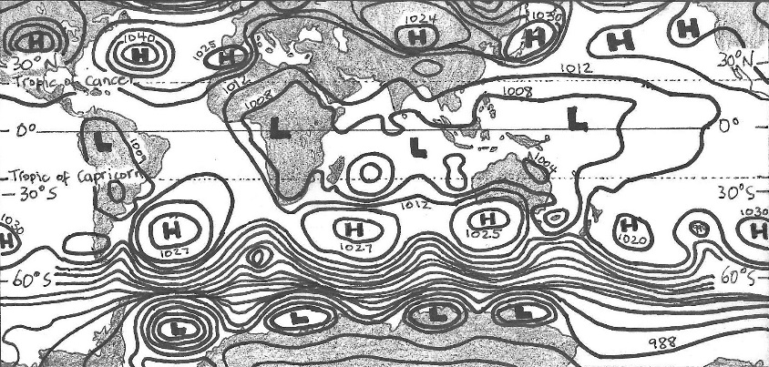
Marine
Education
7. Well, blow me down – Explain how weather patterns and climate (e.g. temperature, wind speed and direction, rainfall, breezes, barometric pressure) are driven by atmosphere/ocean interactions.
Name:
Date:
marineeducation.com.au
Under Pressure
Atmospheric pressure is essentially the pressure exerted by the weight of the atmosphere. It is measured with a barometer in hectopascals. The lines (isobars) on a weather map (synoptic chart) connect areas of equal pressure. For example, a person standing at Point A (pictured right) has the same atmospheric pressure reading on their barometer as a person standing at
Point B. The weight of the air at Point A & B is the same.
1004
A
L
1008
1016
B
H
996
Q. What do the isobars on a synoptic chart connect?
Ans. areas of [equal][different] pressure (circle correct ans.)
1012
Synoptic Signs
If the pressure is low (L) it is raining (or snowing). If the pressure is high (H) it is calm and sunny.
If the isobars (lines) are close together, it is very windy. Activity: On the synoptic chart below, shade in the windy areas, and draw umbrellas in the boxes next to the Lows (L). Note: 60-90°N lat. is not shown.
Q. What patterns do you identify?
Ans.
Figure 1: Interactive Weather and Wave Forecast Map for 14.01.2018 at 1200 hours (www.bom.gov.au).
Hadley, Ferrel and Polar pack a punch
Global wind patterns are created by 3 massive convection current cells in each hemisphere, as pictured below. These cells, of rising and falling air, create the predictable wind patterns that shape our climate and drive our ocean currents. Q. What is the heat source for the Hadley cell? Ans. the S u n .
Upper atmosphere
Jet
Streams
Why wet summers and dry winters?
Locations such as Darwin have wet summers and dry winters because of the changing position of the sun and convection cells. For example, in summer, the sun in Darwin is overhead. It is hot. Warm air is rising and it is the wet season. During winter, the sun is in the northern sky. It is not so hot. Cold air is sinking over Darwin and it is mostly dry and calm.
Q. What cell influences N^{th} Qld. weather?
Ans.
Cold air falling
POLAR CELL
Warm air rising
FERREL CELL
Cold air falling
HADLEY CELL
Warm air rising
HADLEY CELL
Cold air falling
FERREL CELL
Warm air rising
POLAR CELL
Cold air falling
Sea level
Trade
Winds
High
Low
High
Low
High
Low
High
90°N
60°N
30°N
0°
30°S
60°S
90°S
Nth Pole
Equator
Sth Pole
Hadley, Ferrel and Polar Cells positioning when sun is above equator
© Marine Education 2024 CC BY-NC-SA
Unit 1 Topic 2 Science Understanding
13

Slide 23
Marine
Education
Explain how weather patterns and climate (e.g. temperature, wind speed and direction, rainfall, breezes, barometric pressure) are driven by atmosphere/ocean interactions.
Name:
Date:
marineeducation.com.au
© Marine Education 2024 CC BY-NC-SA
NOTES AND EXAM REVISION
14

Slide 24
Marine
Education
8. Surf’s Up – Describe the processes of wave formation, e.g. fetch, relationship of wave height and type to water depth and wave celerity.
Name:
Date:
marineeducation.com.au
Wave Characteristics
Crest: Highest point of the wave
Wavelength (λ): Distance between crests
Trough: Lowest point of the wave
Wave Period (T): Time between crests (sec.)
Wave Speed (Celerity*): λ / T Activity: Label the crest, trough and wavelength
Wave height
*Physicists use the word ‘celerity’ instead of ‘speed’, to remind themselves that it’s the energy (not the mass) of the wave that is in motion.
The Orbitals
A wave represents ENERGY travelling through the water. The water itself does not flow along with the wave crest. Instead, the water particles circle up, down and back up again in a circular motion as the wave passes overhead (called an ‘orbital’). For example, fishing line bobbers move up and down as waves pass but are not carried along with the wave. These markers demonstrate that wave energy is moving through the water, but there is little lateral transport of the water itself*. Similarly, when surfers duck-dive a wave, their boards are propelled by the movement of the orbitals going in the same direction as the surfer – towards the back of the wave. Q. What is the circular motion of water particles in a wave called? Ans. An O _ _ _ _ _ _
Direction of wave ENERGY flow
Wave Break
The orbitals get progressively smaller with depth. At a depth of half the wavelength, the orbitals are so small, they are no longer detectable (called a ‘deep water wave’).
However, if the seafloor is at a depth of less than half the wavelength, the orbitals come into contact with the seafloor and erosion of the seafloor occurs (called a ‘shallow water wave’).
Upon making contact with the seafloor, the orbitals become ‘squashed’. Squashed orbitals slow down the wave’s advance towards shore, due to friction. As a result, the wavelength becomes shorter and shorter and the wave height becomes taller and taller, until it breaks at a depth 1.3 x the wave height.
Q. What depth will a wave break if the wave height is 2m.? Ans. = _____m
1.3 x wave height
λ ⁄ 2
Erosion of the seafloor occurs
The wave breaks when the depth is 1.3 x wave height
At a depth half the wavelength, orbitals do not contact the seafloor
(called a ‘deep water wave’)
At a depth less than half the wavelength,
orbitals do contact the seafloor
and become squashed
(called a ‘shallow water wave’)
Fetch Qu.: Why can’t waves get really big when cyclonic winds blow on a small dam or lake?
© Marine Education 2024 CC BY-NC-SA
Unit 1 Topic 2 Science Understanding
15

Slide 25
Marine
Education
Describe the processes of wave formation, e.g. fetch, relationship of wave height and type to water depth and wave celerity.
Name:
Date:
marineeducation.com.au
© Marine Education 2024 CC BY-NC-SA
NOTES AND EXAM REVISION
16

Slide 26
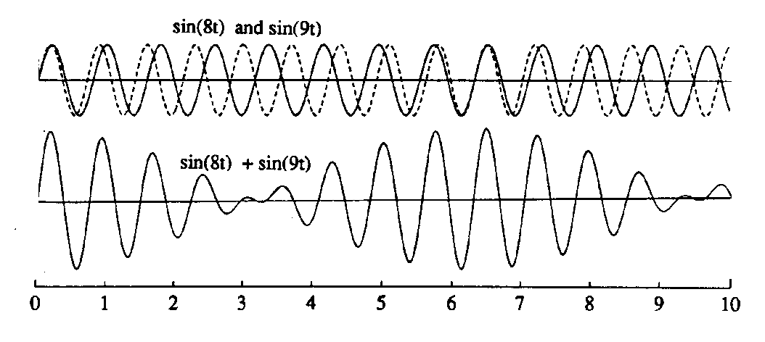
Marine
Education
9. That’s just Swell – Explain how the properties of waves are shaped by weather patterns, natural formations and artificial structures, e.g. interference patterns, fetch, wave sets.
Name:
Date:
marineeducation.com.au
Wave Size
Waves grow in size depending on 3 factors about the wind:
Strength. How strong is the wind? The stronger the wind, the bigger the wave.
Duration. How long has the wind been blowing for? The longer the time, the bigger the wave.
Fetch. How far does the wind blow? The longer the distance, the bigger the wave.
Note: If the fetch is small (i.e. your pool) the waves will never, ever, grow big.
Activity: Go to windy.com and compare the ‘wind’ data to the ‘waves’ data.
Go to bom.gov.au and compare the synoptic charts to the wave maps (marine & ocean)
Q. Why does the Southern Ocean have such big waves? (address all 3 factors above) Ans.
Activity: Find a surf cam online (live video feed of surf conditions). Go to bom.gov.au and find the current wind speed in knots for that location (Qld…Observations…). Record your findings below:
Location: Wind Speed in knots:
Find a marine Beaufort Scale. Q. What should waves look like for that wind speed? Ans.
Q. Are the waves on the surf cam the same as on the Beaufort Scale? Ans. …Why?
Revisit 3 factors
[Yes] [No]
Swell’s rolling in!
Ever noticed how big waves can turn up on days with no wind? How does that happen? Waves can travel long distances. E.g. a cyclone at Fiji can generate massive waves that travel all the way to Queensland, far away from the cyclone. These waves are known as swell or groundswell and have a wave period of >10sec., creating the slow up-and-down movement of the sea (causing sea-sickness!).
Q. True or False? Swell direction is the direction the wave is coming from (not going to). Ans.
Wave Interference Patterns
This diagram represents what happens to the water when two waves are travelling in the same direction, but at slightly different speeds. When the crests and troughs overlap each other, the water rises high (constructive interference). When the crests and troughs alternate, one cancels out the other, and the water does not rise (destructive interference). Constructive interference causes wave sets, and destructive interference causes gaps between wave sets.
2 waves travelling in the same direction, but at slightly different speeds
Destructive
Interference
Constructive
Interference
The end result….what we see….are the wave sets!
Q. What are two types of wave interference? Ans. C _ _ _ _ _ _ _ _ _ _ _ & D _ _ _ _ _ _ _ _ _ _
© Marine Education 2024 CC BY-NC-SA
Unit 1 Topic 2 Science Understanding
17

Slide 27
Marine
Education
Explain how the properties of waves are shaped by weather patterns, natural formations and artificial structures, e.g. interference patterns, fetch, wave sets.
Name:
Date:
marineeducation.com.au
© Marine Education 2024 CC BY-NC-SA
NOTES AND EXAM REVISION
18

Slide 28
Marine
Education
10. Engineering Marvels or Mayhem? – Explain how coastal engineering regulates water or sediment flow, affects currents and impacts the coastline, including marine ecosystems.
Name:
Date:
marineeducation.com.au
The Issue of Beach Erosion
Beach erosion would not be an issue if there were no people living along the coastline. River mouths would shift from left to right along the coastline. Sand would shift from offshore to onshore with the seasons and storms. Sand would cross river mouths and hug coastlines on its northbound longshore drift. Sandbars would appear and disappear. Bars would change location. Vegetation would be left to trap sand and build dunes. Over longer time scales, sea levels would rise and fall. However, given their beauty, productivity and roar energy, it’s no mystery why people have flocked to live at the beach – maybe a little too close. Coastal engineering is designed to protect property and infrastructure by regulating water and sediment flow. Pictured below are 3 broad categories of current strategies used to combat the issue of beach erosion.
Current strategies for combatting Beach Erosion
Engineer Structures
Move the sand
from here to there.
Do Nothing.
Let it erode.
Groyne (wall perpendicular to shore)
Rock Wall (parallel, on the shore)
River Training Wall (river mouth)
Artificial Reef (acts as a barrier)
Breakwaters
Sand bypass system
(suck here, dump there)
Beach nourishment (tractor in sand to beach)
Plan a ‘Retreat’ Policy
People are not allowed to protect their property – people must retreat along with the sand. Often ends up in court. E.g. Byron Bay
Activity: Apply your knowledge of longshore drift to explain the before & after scenes below
Ocean
Before
After
Groyne
Longshore Drift
Beach (sand)
© Marine Education 2024 CC BY-NC-SA
Unit 1 Topic 2 Science Understanding
19

Slide 29
Marine
Education
Explain how coastal engineering regulates water or sediment flow, affects currents and impacts the coastline, including marine ecosystems.
Name:
Date:
marineeducation.com.au
© Marine Education 2024 CC BY-NC-SA
NOTES AND EXAM REVISION
20

Slide 30
Marine
Education
11. Information in Imagery – Analyse evidence from longitudinal studies showing changes that occur in marine environments, e.g. satellite imagery, aerial photography, field research.
Name:
Date:
marineeducation.com.au
Maxed out Maps
We all know that maps have been around for a very long time. People have been using maps for navigation and linking map objects together to derive information since the Middle Ages. However, recent developments, such as powerful computers, satellites, web-based development and internet map servers, have turned the humble old map into a powerful analytic tool. For example, satellite images capture and document changes to a landscape over time. Scientists use this information to model and predict what the future will bring, to inform management when making important decisions.
Image 1
image 2
Computer models and predictions
?
Decision-making
time
Image 3
Activity: Find a mapping project on the Great Barrier Reef. Describe their methods below:
The Beauty of Photographs
Photographs give maps so much more detail and information to work with. Photographs can be taken by satellites, drones and aircraft (aerial photography) or manually with a camera (during field research) to provide some great information. Particularly if taken repeatedly over time. For example, a longitudinal study is a research design method that observes the same subjects repeatedly over long periods of time, sometimes decades. Only then can you get a real sense of what’s going on.
Q. What is a longitudinal study? Ans.
What is the meaning of this?!
GIS or Geographic Information System is a computer software program that many researchers use to visualise, question, analyse and interpret mapping data to understand relationships, trends and patterns.
GIS is also used to model future events, such as what would happen if the sea level rose by one metre.
Q. What computer software program is commonly used by researchers into mapping? Ans. _ _ _
Q. What event is documented in the images below? Ans.
26°C
34°C
26°C
Healthy
coral
Bleached
coral
Dead
coral
algae
Beach (sand)
December 2014
February 2015
August 2015
© Marine Education 2024 CC BY-NC-SA
Unit 1 Topic 2 Science Understanding
21

Slide 31
Marine
Education
Analyse evidence from longitudinal studies showing changes that occur in marine environments, e.g. satellite imagery, aerial photography, field research.
Name:
Date:
marineeducation.com.au
© Marine Education 2024 CC BY-NC-SA
NOTES AND EXAM REVISION
22

Slide 32
Marine
Education
12. Success-ion – Identify how organisms populate areas following changes in habitats, e.g. succession.
Name:
Date:
marineeducation.com.au
Disturbance Events (that change ecosystems and habitats)
A “disturbance” is regarded as an event of intense environmental stress, forcing change upon an ecosystem. Examples include floods, cyclones, crown of thorns outbreaks and coral bleaching.
A disturbance event can smother, scour and dislodge marine organisms and damage their physical habitat, creating patches of free space on coral reefs and in mussel beds and gaps in the canopy of kelp and mangrove forests. Despite this impact, the corals, mussels, kelps and mangroves typically regenerate, demonstrating adaptations and a capacity to respond following natural disturbance. Occasionally, however, the original members of the community do not recover, and local populations go extinct or there is a shift of the community to a new state with a different composition of species and habitat features^{[1]}.
Q. What is a disturbance event? Ans.
Who’s to succeed?
Coastal marine life is constantly competing for space. The real estate game on the coast is brutal! When there is a disturbance, or when a new habitat forms (i.e. sand dune), free space becomes available! Woohoo! But who is going to get there first? The order in which species occupy a given space is called ‘succession’. The initial winners of the space do not stay there for long. They are replaced by other species which, in turn are replaced by different species again, in an ongoing battle for space, over time. The battle continues to change the habitat in, somewhat predictable, (‘serel’) stages of succession.
For example, fast growing, r-selected species populate free spaces first (like weeds do on land), whilst slow-to-mature, K-selected species populate those areas last (like big trees do on land). The most competitively superior species, at the time, wins the space.
Q. What is succession? Ans.
Primary Succession of a Coral Cay
Types of succession include primary and secondary succession. Primary succession is when a community develops in a space that was never before occupied. Secondary succession is when a community develops in a space that was previously occupied (made available by a disturbance event). The development of a coral cay is a great example of primary succession. A coral cay is a small island made from coral fragments (as sand). Initially the island starts off as a sandbar. Birds visit the sand bar and poop. Seeds in the poop germinate and grow into trees. The trees trap more sand and the island grows in size. Activity: Indicate the correct order of the primary succession of a coral cay, below.
^{[1]}Connell S. D. and Gillanders G. M. (2007). Marine Ecology. Oxford University Press. Vic. Australia. pg.138. ISBN: 9780195553024
23
© Marine Education 2024 CC BY-NC-SA
Unit 1 Topic 2 Science Understanding

Slide 33
Marine
Education
Identify how organisms populate areas following changes in habitats, e.g. succession.
Name:
Date:
marineeducation.com.au
© Marine Education 2024 CC BY-NC-SA
NOTES AND EXAM REVISION
24

Slide 34
Marine
Education
13. Pollution Playlist – Identify types of pollution of coastal zones, including organic wastes, thermal, toxic compounds, heavy metals, oil, nutrients and pesticides.
Name:
Date:
marineeducation.com.au
Organic Wastes
When plants and animals die or defecate, the decay process uses up lots of oxygen. Large amounts of decay make oxygen levels dangerously low. Not good news for oxygen breathing animals!
Activity: Draw an example of organic waste in the box
Thermal Pollution
Thermal means temperature. Thermal pollution changes the temperature of waterways. Sources include industrial factories releasing hot water (that was used to remove heat from machinery) & the release of water from a dam.
Activity: Draw a thermometer in the box
Dam
Toxic Compounds
Toxic chemicals are those that cause harm when inhaled, ingested or absorbed. Their toxicity depends on the concentration and degree in which it harms the organism. Examples include chemical, biological, physical or nuclear. Activity: Draw a symbol used to identify a toxic waste
DANGER
Heavy Metals
A heavy metal is an element on the Periodic Table noted for its potential toxicity such as lead, mercury, copper, zinc & arsenic. Mining and industrial wastes are likely sources. They do not biodegrade and effects are horrendous.
Activity: Draw the chemical symbol for a heavy metal
Oil Pollution
Oil (incl. fuel) does not dissolve in water. When spilled, oil forms a thick sludge that suffocates and smothers. Major oil spills are catastrophic, but rare. Other sources include industrial discharge, urban runoff & oil leaking from boats.
Activity: Add oil to water and draw the layers
Oil Spill
Nutrients and Pesticides
Nutrients and pesticides are sprayed on food crops to enhance growth & control pests. They enter waterways via rainfall runoff (when it rains, the chemicals wash into the waterways) and groundwater contamination.
Activity: Draw the symbol for poisonous pesticides
Plastics & Marine Debris
Plastics became popular over half a century ago for their durability & affordability. Marine life now get tangled in it & ingest plastic by mistake. Even our seafood contains traces of plastic. Activity: Conduct a marine debris survey, or, source marine debris data from Tangaroa Blue website.
Draw and label the most common marine debris item.
© Marine Education 2024 CC BY-NC-SA
Unit 1 Topic 2 Science Understanding
25

Slide 35
Marine
Education
Identify types of pollution of coastal zones, including organic wastes, thermal, toxic compounds, heavy metals, oil, nutrients and pesticides.
Name:
Date:
marineeducation.com.au
© Marine Education 2024 CC BY-NC-SA
NOTES AND EXAM REVISION
26

Slide 36
Marine
Education
14. The Ability to Sustain – Describe the concept of sustainable management practices.
“the application and monitoring of practices and/or policies that are informed by the concept of sustainability”^{[2]}
Name:
Date:
marineeducation.com.au
What is sustainability?
There is no universally agreed definition on what sustainability means (making it difficult to measure!)
Flip the word sustainability and what does it read?…the ABILITY to SUSTAIN. What does the word ‘sustain’ mean? According to Collins English Dictionary^{[1]}, if you sustain something, you continue it, or maintain it for a period of time.
The original, most frequently quoted, definition for sustainable development is in the Brundtland Report (Our Common Future)^{[2]} as, ‘development that meets the needs of the present without compromising the ability of future generations to meet their own needs’.
The Queensland Marine Science Curriculum^{[3]} defines sustainability as, ‘in science, the quality of not being harmful to the environment or depleting natural resources, and therefore supporting long-term ecological balance’.
UNESCO’s Teaching and Learning for a Sustainable Future^{[4]} defines sustainability as, ‘a future in which a healthy environment, economic prosperity and social justice are pursued simultaneously to ensure the well-being and quality of life of present and future generations. Education is crucial to attaining that future’.
The stool model: According to the stool model for Sustainable development, sustainability requires all 3 legs of the stool to be equal in size. If not, the stool falls over and it’s not sustainable.
society
economy
Sustainable Development
environment
Activity: List 3 important considerations YOU believe should be included in any good definition of sustainability. Write them in the space provided below:
Activity: Apply the 3 considerations you just listed above to DESCRIBE the concept of sustainable management practices in the space below.
^{[1]} Collin’s English Dictionary (2018). Definition of ‘sustain’. Collins. Accessed 2018 from: https://www.collinsdictionary.com/dictionary/english/sustain
^{[2]} IISD (2018). Sustainable Development. International Institute for Sustainable Development. Accessed 2018 from: https://www.iisd.org/topic/sustainable-development
^{[3]} Queensland Curriculum and Assessment Authority (2018). Marine Science 2019 v1.2: General Senior Syllabus. QCAA. Accessed 2018 from: https://www.qcaa.qld.edu.au/
^{[4]} UNESCO (2018). Teaching and Learning for a Sustainable Future: a multimedia teacher education programme. UNESCO. Accessed 2018 from: http://www.unesco.org/education/tlsf/
© Marine Education 2024 CC BY-NC-SA
Unit 1 Topic 2 Science Understanding
27

Slide 37
Marine
Education
Describe the concept of sustainable management practices.
“the application and monitoring of practices and/or policies that are informed by the concept of sustainability”^{[2]}
Name:
Date:
marineeducation.com.au
© Marine Education 2024 CC BY-NC-SA
NOTES AND EXAM REVISION
28

Slide 38
Marine
Education
15. Pin-pointing Pollution – Compare point source and non-point source forms of pollution.
Name:
Date:
marineeducation.com.au
Point vs Non-point
The term point source means the source of the pollution has one specific discharge point (pipe, ditch..).
The term non-point source means the source of pollution comes from multiple points, spread out (runoff).
Activity: In the box above each picture, write the name of the pollutant (one of the dot points).
Point Sources
Raw sewage discharge
Industrial factory drain
A noise-polluting ship
A smoke stack
Live-a-board
Pew!
Seismic ship
Blast!
smoke
House
Non-Point Sources
Rainfall runoff from farms
Rainfall runoff from homes and streets
Marine debris
Air pollution from cars
House
House
Storm Water Drain
House
House
House
Rain cloud
smoke
farm
car
car
car
car
To the river
© Marine Education 2024 CC BY-NC-SA
Unit 1 Topic 2 Science Understanding
29

Slide 39
Marine
Education
Compare point source and non-point source forms of pollution.
Name:
Date:
marineeducation.com.au
© Marine Education 2024 CC BY-NC-SA
NOTES AND EXAM REVISION
30

Slide 40
Marine
Education
16. Testing the waters – Describe two direct methods of monitoring water pollution levels using an abiotic test (e.g. nitrate, phosphate, heavy metals) or a biotic test (e.g. faecal coliform).
Name:
Date:
marineeducation.com.au
Test Kit Methods
The direct measurement of nitrates, phosphates, heavy metals and faecal coliforms etc. requires special equipment – test kits! Order your test kits through your school lab or online.
Activity: In the boxes below, copy down the test kit instructions for an abiotic and biotic test.
But first, reformat the test kit instructions to read like the ‘Methods’ section in a scientific report. E.g.
Write in past tense and in paragraph format - no dot points or numbered instructions
Write in a clear and concise manner using scientific language and conventions
Ensure the reader has enough information to be able to repeat the test, exactly, based on your description
Include labelled diagrams where required
Method for testing __________
Write pollutant here
Method for testing __________
Write pollutant here
© Marine Education 2024 CC BY-NC-SA
Unit 1 Topic 2 Science Understanding
31

Slide 41
Marine
Education
Describe two direct methods of monitoring water pollution levels using an abiotic test (e.g. nitrate, phosphate, heavy metals) or a biotic test (e.g. faecal coliform).
Name:
Date:
marineeducation.com.au
© Marine Education 2024 CC BY-NC-SA
NOTES AND EXAM REVISION
32

Slide 42
Marine
Education
17. I demand Oxygen! – Describe how biochemical oxygen demand (BOD) is used to indirectly assess water pollution levels (#1)
“a measure of the amount of dissolved oxygen required to decompose the organic material in a given volume of water through aerobic biological activity; used as an index of the degree of organic pollution in water” ^{[1]}
Name:
Date:
marineeducation.com.au
Dissolved Oxygen (DO) is life
Animals need oxygen to breathe. Oxygen is dissolved in water (called DO or dissolved oxygen). Most marine animals have gills to breathe in dissolved oxygen. Animals die without oxygen. DO is measured using a probe or with micro-titration kits. If DO levels significantly drop in concentration over time (to anything below 3ppm) there is serious cause for concern. DO levels that low can result in large fish kills.
Q. What is DO? Ans.
Dissolved Oxygen increases with
Photosynthesis*
Diffusion and aeration**
Falling temperatures
Dissolved Oxygen decreases with
Respiration
Decomposition (aerobic bacteria)
Rising temperatures
DO
DO
* Photosynthesis occurs during daylight hours therefore, DO concentrations can change significantly between day and night.
** Diffusion rate depends on wave action, barometric pressure, oxygen saturation, salinity and humidity.
Activity: Complete the boxes below
Dissolved Oxygen increases with…..
Dissolved Oxygen decreases with…..
DO
DO
Decomposition is the breaking down of organic matter. Aerobic bacteria are decomposers that require oxygen to do the job of breaking down the organic matter. Q. What is decomposition? Ans.
Biochemical oxygen demand (BOD) is a measure of the amount of DO consumed by aerobic bacteria during the decomposition of organic material in a given volume of water. In other words, it is the demand for oxygen from the bacteria when decomposing organic material. Therefore, when the amount of organic material increases (via pollution), so does the amount of decomposition, the demand for DO, and BOD. Then, the fish might have trouble breathing! Q. What is BOD? Ans.
^{[1]} Queensland Curriculum and Assessment Authority (2018). Marine Science 2019 v1.2: General Senior Syllabus. QCAA. Accessed 2018 from: https://www.qcaa.qld.edu.au/
© Marine Education 2024 CC BY-NC-SA
Unit 1 Topic 2 Science Understanding
33

Slide 43
Marine
Education
Describe how biochemical oxygen demand (BOD) is used to indirectly assess water pollution levels
“a measure of the amount of dissolved oxygen required to decompose the organic material in a given volume of water through aerobic biological activity; used as an index of the degree of organic pollution in water” ^{[1]}
Name:
Date:
marineeducation.com.au
© Marine Education 2024 CC BY-NC-SA
NOTES AND EXAM REVISION
34

Slide 44


Marine
Education
18. Cracking the case – Describe how biochemical oxygen demand (BOD) is used to indirectly assess water pollution levels (#2)
Name:
Date:
marineeducation.com.au
Is that water polluted?
Let’s say you’ve been measuring the dissolved oxygen (DO) levels in a waterway every week for a year. You’ve been happy that all results indicate healthy, oxygenated water. Until now. Just recently, you noticed a significant drop in DO. You suspect organic waste as the cause. It is now time to conduct a BOD (biochemical oxygen demand) test. A BOD test measures the amount of DO required by bacteria to decompose organic waste over a period of time (e.g. 5 days). If organic waste is the cause, the BOD will be high. Below is a table that describes how BOD is used to indirectly assess water pollution levels.
BOD Level (ppm or mg/L) | Water Quality
1-2 (small amount of DO required by bacteria) | Very Good: clean water
3-5 | Fair: Moderately clean water
6-9 | Poor: Somewhat polluted water
10+ (large amount of DO required by bacteria) | Very Poor: Very polluted water
Q. What does a BOD reading of 8 indicate about water quality? Ans.
How to conduct a BOD test
BOD = Average DO on Day 1 minus (–) Average DO on Day 5
Step 1
Collect Samples
Steps 2 & 3
Measure DO. Cover. Store at constant temperature
Step 4
5 days later, measure DO again.
Step 5
Average DO on Day 1 minus (–)
Average DO on Day 5
# | DO Day 1 | DO Day 5
1
2
3
4
5
Av
Fill to the top and screw on the lid before removing from the water
Cover with alfoil
Control
Cover to eliminate photosynthesis (and any addition of oxygen)
minus
To improve accuracy, increase the number of repeats & controls
20°C
equals…
BOD!
(temperature changes DO therefore keep temperature the same throughout)
Activity: Below, describe how BOD is used to indirectly assess water pollution levels
© Marine Education 2024 CC BY-NC-SA
Unit 1 Topic 2 Science Understanding
35

Slide 45
Marine
Education
Describe how biochemical oxygen demand (BOD) is used to indirectly assess water pollution levels
“a measure of the amount of dissolved oxygen required to decompose the organic material in a given volume of water through aerobic biological activity; used as an index of the degree of organic pollution in water” ^{[1]}
Name:
Date:
marineeducation.com.au
© Marine Education 2024 CC BY-NC-SA
NOTES AND EXAM REVISION
36

Slide 46
Marine
Education
19. Nutrient overload – Explain the process of
eutrophication
“the natural or artificial enrichment of a body of water, particularly with respect to nitrates and phosphates,
that results in depletion of the oxygen content of the water” (QCAA Syllabus)
Name:
Date:
marineeducation.com.au
Eutrophication
Excessive BOD (biochemical oxygen demand) creates massive fish kills from dangerously low levels of DO (dissolved oxygen). How does this happen you ask? It all starts with nutrient pollution
(e.g. the dumping of raw sewage, or farmland fertilisers washing into rivers and lakes). Lots of nutrients stimulate lots of plant growth, and/or algae to bloom. So what? Don’t plants and algae supply oxygen and that’s a good thing? Yes, they do. But after awhile, they grow so much, they block out the sun, or deplete all the nutrients. As a result, they die and sink to become organic material for bacteria to decompose. Decomposition, if you remember, requires oxygen. Eventually, the DO levels drop so low, that fish can not breathe and die. Eutrophication is the name given to this whole process, starting with nutrient enrichment and ending in low DO and fish kills.
Activity: Explain the process of eutrophication in the space below the picture clues.
6CO2+6H2O → C6H12O6+6O2
6CO2+6H2O → C6H12O6+6O2
DO
Farm
6CO2+6H2O → C6H12O6+6O2
6CO2+6H2O → C6H12O6+6O2
6CO2+6H2O → C6H12O6+6O2
6CO2+6H2O → C6H12O6+6O2
fertiliser
6CO2+6H2O → C6H12O6+6O2
6CO2+6H2O → C6H12O6+6O2
6CO2+6H2O → C6H12O6+6O2
6CO2+6H2O → C6H12O6+6O2
6CO2+6H2O → C6H12O6+6O2
6CO2+6H2O → C6H12O6+6O2
6CO2+6H2O → C6H12O6+6O2
Lake
6CO2+6H2O → C6H12O6+6O2
6CO2+6H2O → C6H12O6+6O2
6CO2+6H2O → C6H12O6+6O2
6CO2+6H2O → C6H12O6+6O2
6CO2+6H2O → C6H12O6+6O2
6CO2+6H2O → C6H12O6+6O2
6CO2+6H2O → C6H12O6+6O2
6CO2+6H2O → C6H12O6+6O2
6CO2+6H2O → C6H12O6+6O2
6CO2+6H2O → C6H12O6+6O2
6CO2+6H2O → C6H12O6+6O2
Nutrient enrichment Increased Biomass Dead Biomass Decomposition Fish Kills
Natural Eutrophication…. “lake aging”
Without the pollution, eutrophication occurs naturally in lakes and ponds over hundreds and thousands of years. An ‘aging’ lake or pond gradually builds up concentration of nutrients over time, classed initially as ‘oligotrophic’ (few nutrients) changing to ‘mesotrophic’ (some nutrients) and eventually becoming ‘eutrophic’ (lots of nutrients). Q. What is natural eutrophication? Ans.
Limiting nutrients Nitrogen and Phosphorus
Photosynthesising plants and algae require carbon, nitrogen and phosphorus in a ratio of 106:16:1 (‘redfield ratio’). Even though carbon is needed most (116), carbon is plentiful in water. Nitrogen and phosphorus, on the other hand, are not plentiful in water. Their bioavailability limits the amount of photosynthesis that can occur. Therefore, when water contains excess nitrogen and phosphorus (e.g. water is polluted, eutrophic, or an upwelling), with enough sunlight, plants and algae grow like crazy!
Q. What are 2 limiting nutrients for primary productivity? Ans. N _ _ _ _ _ _ _ & P _ _ _ _ _ _ _ _ _
© Marine Education 2024 CC BY-NC-SA
Unit 1 Topic 2 Science Understanding
37

Slide 47
Marine
Education
Explain the process of eutrophication
“the natural or artificial enrichment of a body of water, particularly with respect to nitrates and phosphates,
that results in depletion of the oxygen content of the water” (QCAA Syllabus)
Name:
Date:
marineeducation.com.au
© Marine Education 2024 CC BY-NC-SA
NOTES AND EXAM REVISION
38

Slide 48
Marine
Education
20. Saving our soils & seas – Describe land management practices that contribute to the health of marine ecosystems, including siltation, algal blooms and agricultural practices
Name:
Date:
marineeducation.com.au
Supporting our farmers
We know that poor land management practices damage reefs. However, no farmer wants to see their
hard earned money - soil, nutrients and pesticides - being washed away with the rain. Likewise, no marine management authority wants soil, nutrients or pesticides washed on to the reef. Government support and funding for best management practices (BMP) on land, not only saves farmers money, but saves the reef by keeping soil, nutrients and pesticides on farms instead of on reefs.
Q. How are farmers being supported to help the reefs? (e.g. Smartcane BMP) Ans.
Soil erosion and siltation
When water hits soil with enough force, it breaks the soil aggregates and washes the soil (and nutrients and pesticides) away, sometimes crossing several properties and roads before entering a major drainage line. Siltation is the addition of silt (soil particles) to a waterbody. Siltation reduces water quality. It makes the water cloudy, blocking sunlight and smothering benthos. Soil erosion and siltation intensify with tree clearing, overgrazing, poor drainage, un-stabilised soils and intense rainfall events. Maintaining surface cover (i.e. grass, trees) is an effective land management practice that reduces erosion and siltation. Table 1 illustrates the importance of cover in an experiment from a 54mm storm^{[1]}.
Activity: Analyse the data in Table 1 below. Apply your analysis and knowledge of BMP to write a conclusion about the importance of surface cover in the box below
Table 1: Results from a 54mm storm at Mt Mort^{[1]}
Conclusion
Treatment | A | B | C
Percent Surface Cover | 87 | 69 | 6
Total Runoff from storm (mm) | 1.5 | 14 | 38
Percent of Rainfall that ran off | 3 | 26 | 70
Soil loss (t/ha) | 0.03 | 0.3 | 22
Depth of soil loss (mm) | 0.002 | 0.02 | 1.7
Sediment concentration (g/L) | 1.5 | 1.9 | 63
Nitrogen removed (kg/ha) | 0.14 | 1.9 | 15.3
Phosphorus removed (kg/ha) | 0.02 | 0.26 | 4.3
^{[1]} Queensland Government (2018). Preventing and managing erosion. Accessed 2018 from: www.qld.gov.au/environment/land/soil/erosion/managment
© Marine Education 2024 CC BY-NC-SA
Unit 1 Topic 2 Science Understanding
39

Slide 49
Marine
Education
Describe land management practices that contribute to the health of marine ecosystems, including siltation, algal blooms and agricultural practices
Name:
Date:
marineeducation.com.au
© Marine Education 2024 CC BY-NC-SA
NOTES AND EXAM REVISION
40

Slide 50
Marine
Education
21. Bug life – Explain an indirect method of measuring pollution levels using a biotic index.
Name:
Date:
marineeducation.com.au
Bug tolerance to pollution
Tolerance levels to pollution are not the same for all organisms. Some organisms survive in polluted waters, others don’t. If a waterbody is polluted, only tolerant species will be present. A biotic index is a rapid assessment technique for stream pollution and water quality based on the tolerance levels of species present.
The tolerance levels (bug values) are predetermined^{[1]}. All you have to do is sample the water by catching as many species as you can in a given time period, identify what you find and count how many there are (abundance). Table 1 below includes the bug abundance data collected from a local stream.
Activity: Analyse the data in the table below (fill in the blanks)^{[1]}
Bug type | Scientific Name | Bug Value | Abundance (raw data collected from the stream!!) | Weight |  | Index (Bug Value x Weight)
 |  |  |  | Abundance | Weight
 |  |  |  | 1-2 | 1
 |  |  |  | 3-5 | 2
 |  |  |  | 6-10 | 3
 |  |  |  | 11-20 | 4
 |  |  |  | >20 | 5
Very sensitive
Stonefly nymph | Plecoptera | 10 | 2 | 1 |  | 10
Mayfly nymph | Ephemeroptera | 9 | 4
Caddis fly larva | Tricoptera | 8 | 1
Sensitive
Water mite | Acarina | 6 | 1
Beetles larvae | Coleoptera | 6 | 25
Beetles adult | Coleoptera | 5 | 30
Tolerant
Freshwater slater | Isopoda | 4 | 4
Mussel or clam | Bivalvia | 3 | 10
Flatworm | Turbellaria | 3 | 1
Very tolerant
Fly and mosquito larva | Diptera | 2 | 8
Leeches | Hirudinea | 2 | 2
Copepods & water fleas | Copepoda | 1 | 15
Snail | Gastropoda | 1 | 2
Totals
Total Index /Total Weight = Stream Water Quality Rating (<3 Poor; 3-4 Fair; 4-6 Good; >6 Excellent)
Q. What is the stream’s biotic index value? Ans.
^{[1]} Adapted from: Chessman, B. (2001). Signal 2 Manual: A scoring system for macro-invertebrates (‘Water Bugs’) in Australian Rivers: User Manual, Version 2. ACT Waterwatch. Accessed 2018 from: http://www.act.waterwatch.org.au/library.html
© Marine Education 2024 CC BY-NC-SA
Unit 1 Topic 2 Science Understanding
41

Slide 51
Marine
Education
Explain an indirect method of measuring pollution levels using a biotic index.
Name:
Date:
marineeducation.com.au
© Marine Education 2024 CC BY-NC-SA
NOTES AND EXAM REVISION
42

Slide 52
Marine
Education
22. Biology as indicators of change – Describe the concept of marine bio-indicators with an example, e.g. mussels (Mytilus galloprovincialis), mudskippers (Scartelaos histophorus), seagrass (Zostera spp.) and changes in concentration of pigments in certain corals.
Name:
Date:
marineeducation.com.au
What is a bio-indicator?
A bio-indicator is something that is biological and indicates that a change has occurred (i.e. pollution).
A bio-indicator can be something really obvious that we’re all familiar with observing (e.g. more mozzies in summer) or, it can be something really specific that scientists choose to measure to reveal the qualitative status of the environment.
AIMS (2018)^{[1]} explains, it is not possible to test and monitor water quality at all places at all times. Bio-indicators are organisms, chemical markers or biological processes whose change
points to altered environmental conditions….Bio-indicators can also provide information on the harmful effects of contaminants, acting as an early warning system for larger-scale effects.
Q. What is a bio-indicator? Ans.
Activity: Draw an arrow to connect what each bio-indicator, indicates (last one is done for you)
Mussels
Mytilus galloprovincialis
Seagrass
Zostera spp. (eelgrass)
Mudskippers
Scartelaos histophorus
Coral bleaching (corals turn white)
Anyone want some toxins?!
Healthy
coral
Bleached
coral
Indicates pollution (e.g. heavy metals, radionuclides, hydrocarbons and sewage discharges) trapped by intertidal mudflats where they live.
Because it’s a filter feeder and relatively immobile, it’s a great bio-indicator for the toxic effects of chemical pollutants, particularly heavy metals.
The depth in which it grows indicates water clarity. The clearer the water, the deeper it can grow. Clarity is reduced by terrestrial inputs and sediment resuspension.
Indicates abnormally high sea surface temperatures (SST) affecting algal symbionts of corals (Symbiodinium spp. or zooxanthellae).
^{[1]} AIMS (2018). Bioindicators. Australian Institute of Marine Science. Accessed 2018 from www.aims.gov.au/docs/research/water-quality/runoff/bioindicators.html
© Marine Education 2024 CC BY-NC-SA
Unit 1 Topic 2 Science Understanding
43

Slide 53
Marine
Education
Describe the concept of marine bio-indicators with an example, e.g. mussels (Mytilus galloprovincialis), mudskippers (Scartelaos histophorus), seagrass (Zostera spp.) and changes in concentration of pigments in certain corals.
Name:
Date:
marineeducation.com.au
© Marine Education 2024 CC BY-NC-SA
NOTES AND EXAM REVISION
44

Slide 54
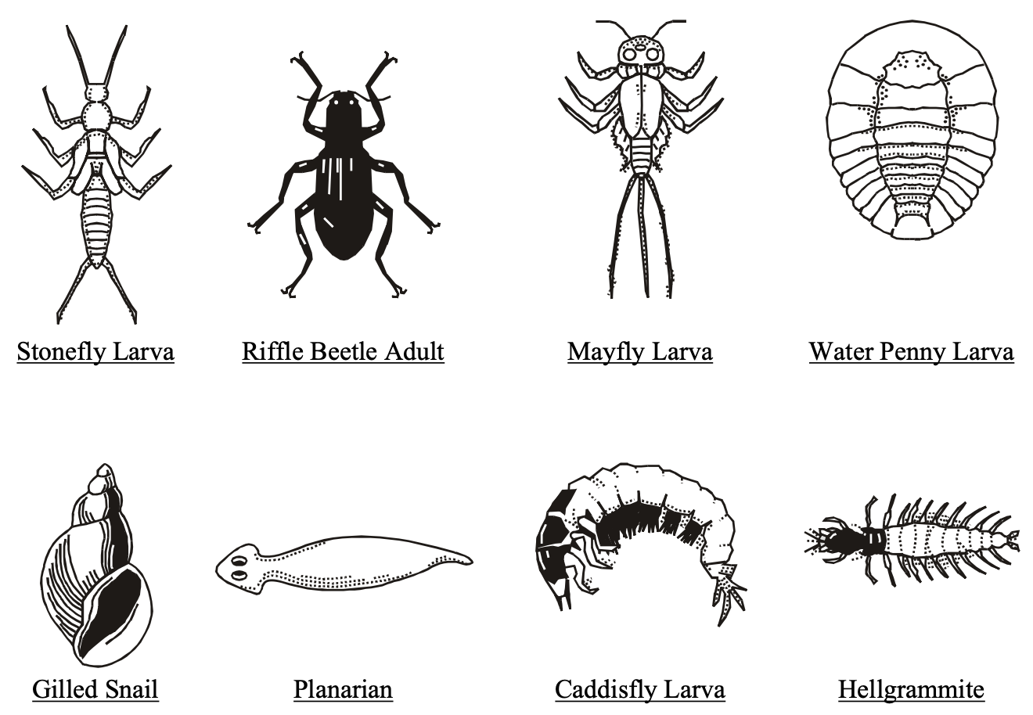
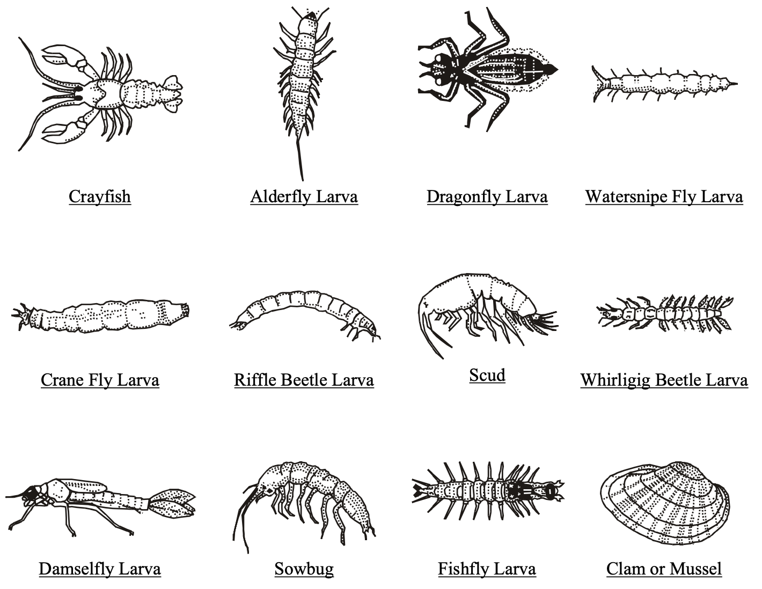
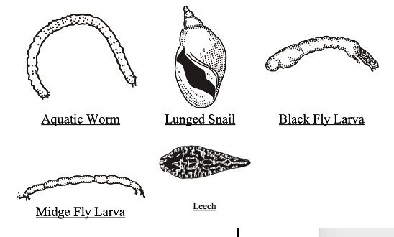
Marine
Education
23. Muddy Waters - Interpret data from biotic and abiotic tests on a water sample to determine water quality.
Name:
Date:
marineeducation.com.au
Activity: Interpret the data below to determine water quality (data has already been collected)
Sensitive to pollution | Somewhat sensitive to pollution | Tolerant of pollution
20
15
10
Temperature °C | pH 0-14 | Dissolved Oxygen mg/L or ppm or % saturation | Salinity ppt or psu (at 25°C) | Turbidity NTU or metres or other | TSS (total suspended solids) mg/L or ppm
Probe or thermometer | Probe or litmus paper or indicator | Probe or titration kit | Probe, conductivity meter, hydrometer, refractometer | Turbidity meter, Secchi disk or transparency tube | Filtration method
20°C | 8.2 | 100% | 10ppt | 1.2m | 10mg/L
Depth metres (m) | Water Source | Flow m³/sec | Nitrogen as Total N, DIN, nitrate, nitrite or ammonium µg/L | Phosphorus as Total P, DIP or filterable reactive P µg/L | Chlorophyll a µg/L | Faecal bacteria cfu/100mL (colony forming units)
Echo sounder, long ruler (staff, pvc), weighted tape measure | maps | Float method | Test kit | Test kit | Spectrormeter, fluorometer, satellite | Agar plate, water test kit or membrane filtration technique
0.1m | Coles Creek | 1m/s | DIN=8µg/L | DIP=5µg/L | 3µg/L | 100cfu/100mL
Q. Is the water quality very good, good, or poor? Hint: read next 2 pages. Ans.
© Marine Education 2024 CC BY-NC-SA
Unit 1 Topic 2 Science as a Human Endeavour
45

Slide 55
Marine
Education
30. What’s in the water? – Investigate water quality by conducting biotic and abiotic tests on a water sample.
Name:
Date:
marineeducation.com.au
Temperature
Temperature controls the rate of fundamental biochemical processes in organisms. Organisms that can only live within a narrow temperature range are called stenothermal. Whereas, organisms that can live within a wide temperature range are called eurythermal. Water temperature is affected by air temperature, stormwater runoff, groundwater inflow, turbidity and exposure to sunlight.
A rise in temperature reduces the concentration of dissolved oxygen (DO) in the water.
Likewise, a drop in temperature increases the concentration of dissolved oxygen (DO) in the water.
A thermocline is when there is an abrupt change in temperature with depth, forming a barrier between the warm water (usually above the thermocline) and the cold water (usually below the thermocline).
pH
pH is used to measure the acidity or alkalinity of a solution. Changing levels of pH in a creek or river can be an indicator of increasing pollution or some other environmental factor. A pH value is a number from 1-14, with 7 as the middle (neutral) point. The optimum pH levels for fish is between 6.5 and 8.4
Dissolved Oxygen (DO)
Aquatic animals rely on oxygen that is dissolved in the water to survive. Levels of Dissolved Oxygen (DO) vary depending on factors including water temperature, time of day, season, depth, altitude, rate of flow, and levels of pollution. If DO levels drop too low, there is not enough oxygen for the animals to ‘breathe’ and it can lead to ‘fish kill events’ where large numbers of fish die within a short period.
DO is measured in milligram per litre (mg/L) or parts per million (ppm). Exposure to less than 2 mg/L oxygen for one to four days may kill most of the biota in a system, leaving behind only the low-DO-tolerant fish, air-breathing insects and anaerobic (not requiring oxygen) bacteria and fungi (microflora).
Lethal DO concentrations for fish are generally between 1 and 3 mg/L. DO can also be measured as % saturation, whereby DO should be somewhere between 80-110%. DO <61% or >110% is poor quality.
Salinity
Salinity is a measure of salt content. Salinity is usually measured in parts per thousand (ppt). The salinity of fresh-water in rivers and creeks averages 0.5ppt or less. The salinity of sea-water averages 35ppt. The mixture of seawater and freshwater in estuaries is called brackish water and its salinity can range from 0.5ppt to 35ppt. Organisms that can only live within a narrow salinity range are called stenohaline. Whereas, organisms that can live within a wide salinity range are called euryhaline.
Turbidity
Turbidity is the cloudiness or haziness of the water caused by suspended solids. Turbidity does not identify individual substances; it just indicates that something is there. Turbidity units have no inherent value. E.g. clear water is not always healthy, and likewise turbid water does not necessarily indicate an issue. Turbidity data must always be taken in context! Turbidity is commonly measured in meters using a secchi disk or in Nephelometric Turbidity Units (NTU) using a turbidity meter, but it can also be a qualitative measurement (i.e. categorical data on a CoralWatch chart). Importantly, if comparing datasets, make sure the method is the same each time.
© Marine Education 2024 CC BY-NC-SA
46

Slide 56
Marine
Education
30. What’s in the water? – Investigate water quality by conducting biotic and abiotic tests on a water sample.
Name:
Date:
marineeducation.com.au
TSS Total suspended solids
TSS is the total concentration of suspended solids (particles) bigger than 2µm, expressed in mg/L or parts per million (as opposed to turbidity which is an optical measurement). Clean water has low TSS. Murky water has high TSS. Examples of suspended solids includes sand, silt, clay and algae.
Water Depth, Source and Flow
Water quality is closely related to water quantity. Water quantity describes how much water there is. This is largely governed by water depth, source and flow which differ between catchments and ecosystems. The deeper a waterbody, the more water it holds. Notably, as depth increases, light and temperature decrease. The water source describes where the water comes from (level of contamination?). Flow = volume of water (m³) per time (second). As flows increase or decrease, abiotic factors change. Any one of these could be used as an independent variable or could be used as a measured variable to simply provide context.
Nutrients – Nitrogen and Phosphorus
Nitrogen and phosphorus naturally enter estuarine waters when freshwater runoff passes over geologic formations rich in phosphate or nitrate, or when decomposing organic matter and wildlife waste get flushed into rivers and streams. Man-made sources of nutrients entering estuaries include sewage treatment plants, leaky septic tanks, industrial wastewater, acid rain, and fertilizer runoff from agricultural, residential, and urban areas. Too much nitrogen and phosphorus in a lake, for example, leads to explosive algae blooms that cloud the water and deplete the oxygen (eutrophication). There are many ways N & P exist in nature, so there are many ways to measure N & P. What you measure depends on what you want to know. E.g. Dissolved inorganic nitrogen (DIN) and dissolved inorganic phosphorus (DIP) often control the formation of algae blooms due to their bioavailability. Thus, if wanting to monitor potential algae blooms, measure DIN & DIP (usually expressed as µg/L or parts per billion). Both should be single digit values to avoid algae bloom conditions (bad if it’s a lake).
Chlorophyll a (µg/L)
All plants, algae and cyanobacteria contain chlorophyll a. Chl-a plays a role in converting light energy into chemical energy during photosynthesis. It is used to measure the amount of algae growing in a body of water. The higher the concentration of chl-a, the greater the algal content (<10 is good; >30 is bad). Whilst high nutrient levels alert the potential for an algae bloom, high chl-a levels (double digits) confirm the algae has indeed bloomed! Chl-a is usually measured in µg/L using a spectrometer.
Faecal bacteria (e.g. E. coli)
E. coli are found in the faeces of warm-blooded animals. It’s presence in water is an indicator of faecal pollution and possible enteric pathogens. Faecal bacteria are measured in colony forming units (cfu) per mL or per 100mL. But, you must grow the colonies before you can count them! This can be done in a petri dish or liquid medium. There can be 1000s in stormwater. You want none in drinking water.
Activity: Research the water quality standards for your local area
© Marine Education 2024 CC BY-NC-SA
47

Slide 57
Marine
Education
Interpret data from biotic and abiotic tests on a water sample to determine water quality.
Name:
Date:
marineeducation.com.au
© Marine Education 2024 CC BY-NC-SA
NOTES AND EXAM REVISION
48

Slide 58
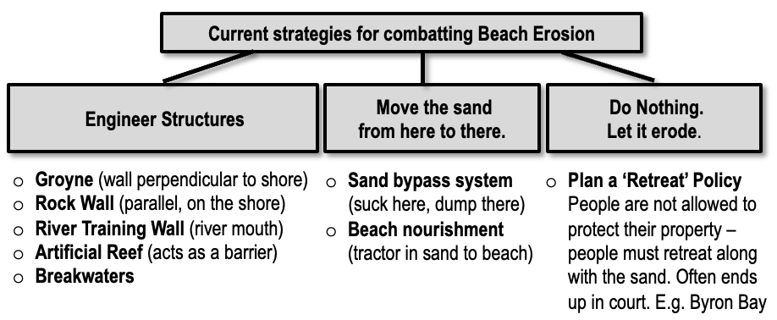
Marine
Education
24. Constructing Coastlines - Consider how historical local planning decisions on dynamic shorelines have influenced the selection of coastal management strategies..
Name:
Date:
marineeducation.com.au
Activity: Research the historical local planning decisions made by your local council to address a retreating or growing shoreline and write them in the box below.
Q. What coastal management strategies do they now have to choose from as a result?
For example:
© Marine Education 2024 CC BY-NC-SA
Unit 1 Topic 2 Science as a Human Endeavour
49

Slide 59
Marine
Education
25. Disturbance Dynamics - Recognise that impact levels from pulse events alter as populations increase and landscape dynamics change.
This leads to increased pressure on infrastructure designed to mitigate risk.
(mitigate: to make less severe or painful; alleviate; to try lessen the seriousness or extent of).
Name:
Date:
marineeducation.com.au
Pulse events
A pulse event is a (short-term) extreme weather event. As opposed to a (long-term) press event such as rising sea surface temperatures (SSTs) associated with climate change. Importantly, pulses and presses do not occur in isolation. Rather, they interact with each other. In a press-pulse framework, the impacts of an extreme weather event depends not only on the magnitude, duration, frequency and timing of the pulse, but also the state of the press. E.g. thanks to climate change, heat waves are expected to become hotter and last longer and storms more frequent and severe.
Question: True or False? Pulses and presses are totally unrelated. Ans.
Mangroves against the storm
Mangroves provide a protective buffer from strong winds and large waves, reducing wave height. More mangroves means more protection during pulse events. When mangroves are gone, their protective function is also gone. Mangroves are lost when replaced by housing and development to accommodate more people wanting an ocean view or close access to seawater. This leads to increased pressure on infrastructure designed to mitigate the risk of damage to structures that mangroves would otherwise protect.
“Protected areas have a high capacity to supply regulating ecosystem services (e.g. storm protection, flood control, erosion regulation)…the larger the protective buffer, the greater the damage reduction” ^{[1]}.
Mangroves not only protect people from the effects of climate change – they also combat it at the source – CO₂ emissions. Mangrove forests are extremely effective at storing carbon. Mangroves trap carbon 50 times faster than any other forest! How? Rapid leaf production and high leaf turnover rates (from ditching salty leaves all the time). Crabs then grab the leaves and bury them under the mud, thus locking up the carbon and throwing away the key. Notice how the leaves are never on the ground for very long? That’s why! Mangroves also filter the water, keeping it clean, and provide habitat for juvenile and transient marine life. What man-made infrastructure, designed to mitigate risk, can do all that (and for free)?!?
Activity: Below, explain why the impact levels from pulse events alter as populations increase and landscape dynamics change.
^{[1]} Pert, P.T. et al., (2014). Chapter 1: The ecosystem service value of protected areas for cyclone protection in Queensland, Australia. ANU. DOI: 10.13140/2.1.4251.1040
50
© Marine Education 2024 CC BY-NC-SA
Unit 1 Topic 2 Science as a Human Endeavour

Slide 60
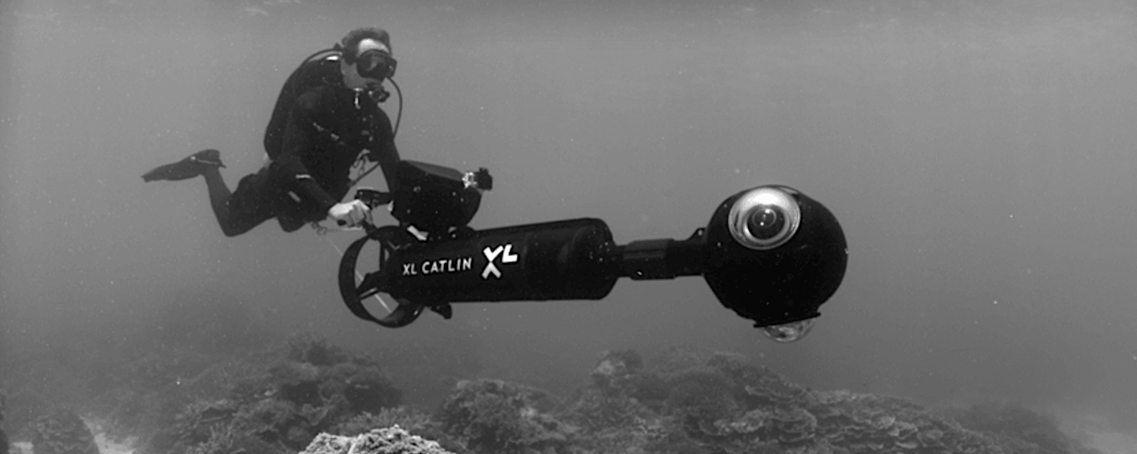
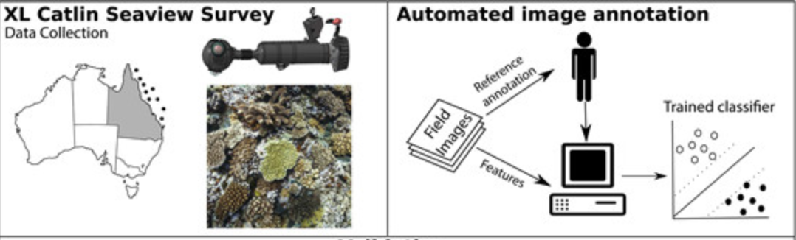
Marine
Education
26. Eyes under the water - Appreciate that diver-propelled vehicles with customised high-definition cameras and automated image-annotation methods have dramatically increased the size, accuracy, and geographic and temporal scope of the datasets that marine scientists work with.
Name:
Date:
marineeducation.com.au
Photogrammetry: ‘photo’ = image; ‘grammetry’ = precise measurement
.
Monitoring the Reef using Fun Toys
E.g. XL Catlin Seaview Surveys uses diver-propelled vehicles with cameras attached to collect data. Their mission? To scientifically record the world’s coral reefs and reveal them to all in high resolution, 360-degree panoramic vision ^{[1]} . Images now available through GlobalReefRecord.org
AI analyses the images for us!
Have you ever had to download all your photos from a visit to the reef? It takes a long time, right? Imagine doing that on a much bigger scale. Like any reef survey, there’s always lots and lots of images that need to be analysed. Often it is left up to a few dedicated people who volunteer their time to painstakingly identify and annotate individual components in each image, one click at a time.
Enter, Artificial Intelligence or AI. We now have automated image-annotation methods that can do the work for us! For example, the University of Qld used artificial intelligence (and other methods) to analyse all the images from the XL Catlin Seaview Surveys collected from 23 coral reef countries over multiple expedition years. They checked the system for accuracy by comparing automated annotation errors to those of multiple human annotators. The AI was able to identify key benthic groups correctly 95% of the time and estimate coral cover 88-98% of the time. Satisfied this was accurate enough to detect significant changes among dominant groups, AI has become a game changer that now allows for the rapid collection of in-situ observations at much bigger scales – more than previously possible^{[2]}. Other great examples worth checking out include Reef Cloud (AIMS) and Squidle.
Activity: Analyse a quadrat from Global Reef Record (click on the ‘Data’ tab) to appreciate how long it takes to
analyse a single image.
^{[1]} XL Catlin Seaview Survey. Accessed 12th July 2023 from: https://www.catlinseaviewsurvey.com/
^{[2]} González-Rivero, M. et al., (2016). Scaling up Ecological Measurements of Coral Reefs Using Semi-Automated Field Image Collection and Analysis. Remote Sens. 2016, 8(1), 30; https://doi.org/10.3390/rs8010030
© Marine Education 2024 CC BY-NC-SA
Unit 1 Topic 2 Science as a Human Endeavour
51

Slide 61
Marine
Education
27. Roads to Reefs - Recognise that the effectiveness of land-based management practices has a direct impact on the health of marine ecosystems. Scientific monitoring of these practices can be used to develop and evaluate projected impacts on marine conservation strategies.
Name:
Date:
marineeducation.com.au
Land & Sea Interactions
Land-use & land-cover change affects marine ecosystems through several key ecological processes: Freshwater regulation: Land and sea interact through surface and groundwater flows. E.g. Land cover effects how much freshwater reaches a coral reef, which can alter reef salinity and temperature.
Contaminant retention: Land spaces may either serve as sources or sinks for surface and ground-water contaminants such as nutrients, sediment, herbicides and pathogens like faecal bacteria.
Land-sea biological exchange: Land-use and land-cover change can affect the abundance of marine species. E.g. Mangrove habitat loss reduces filtration of contaminants → poor water quality ^{[1]}.
Land-based management practices can have a POSITIVE impact on the health of marine ecosystems, OR, they can have a NEGATIVE impact on the health of marine ecosystems ^{[1]}.
Activity: Write a (+) sign next to the land management strategies below that have a positive impact on the health of marine ecosystems. Write a (-) sign next to the negative ones.
Type of land use | Land Management Strategy | + or -
Forest | Tree cover reduces erosion as roots improve soil structure, arrest topsoil runoff, and stabilize riverbanks.
 | Mangrove forests trap sediment and provide a nursery habitat for reef species.
 | Plants sequester heavy metals in tissues and transform/volatilize organic pesticides, selenium, and organo-mercury compounds.
Agriculture | Grazing increases soil compaction and infiltration, increasing episodic surface water runoff.
 | Certain types of agriculture like taro and rice paddy may help retain sediment during the rainy season.
 | Fertilizer and manure increase leaching of nitrate and other inorganics in groundwater (that eventually flows into the ocean).
Urban | Impervious surfaces increase frequency and intensity of floods and reduce groundwater recharge.
 | Roads increase frequency and intensity of surface runoff.
 | “First flush” effect: acute discharge of urban contaminants during early-season rainfall.
^{[1]} Calson R.R. et al., (2019). Land Use Impacts on Coral Reef Health: A Ridge-to-Reef Perspective. Sec. Marine Conservation and Sustainability
Volume 6 - 2019 | https://doi.org/10.3389/fmars.2019.00562
© Marine Education 2024 CC BY-NC-SA
Unit 1 Topic 2 Science as a Human Endeavour
52

Slide 62
Marine
Education
28. High stakes – Discuss that the education of stakeholders is essential to encouraging sustainable management practices
Name:
Date:
marineeducation.com.au
The holders of stakes
A stakeholder is a person or group of people who have an interest in (and will be affected by) the outcome of an environmental management decision. Examples of stakeholders include: locals, students, scientists, agencies, business owners and indigenous peoples. Stakeholder consultation and participation involves processes whereby all those with a stake in the outcome of a plan or project can actively contribute to decisions on planning and management. If no stakeholders speak up, there’s a real risk that decisions made may not be sustainable. When stakeholders are willing to speak up, they’re able to influence what decisions are made. With so much influence, it’s important they’re well educated. When educated, stakeholders can make informed decisions and contributions to the decision-making process that encourage sustainable management practices.
Q. What could happen if stakeholders don’t speak up, or are not educated? Ans.
How do stakeholders become informed?
Where do stakeholders obtain their information from? What and who influences opinions and behaviours?
Activity: Below, write as many examples of sources of information as you can
Activity: Circle all the trustworthy and reputable information sources
Activity: Underline information sources that people pay most attention to, or understand best
Q. Did you circle and underline the same ones? Ans. [Yes][No][sort of]. Compare answers. Discuss.
Activity: Astericks* information sources that are related to educating people in sustainability
© Marine Education 2024 CC BY-NC-SA
Unit 1 Topic 2 Science as a Human Endeavour
53

Slide 63
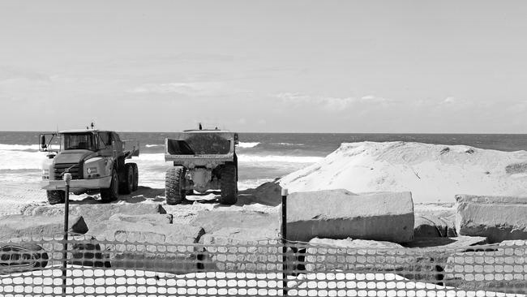
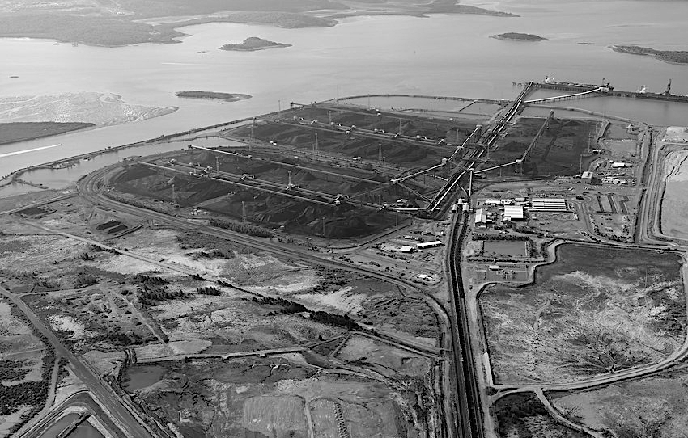
Marine
Education
29. Power in data - Consider that the use of data can inform the selection of coastal management strategies that may have beneficial, and/or harmful and/or unintended consequences.
Name:
Date:
marineeducation.com.au
Decisions decisions…
Most of the population lives near the coast. Thus, there are lots of decisions that need to be made about how these coastlines are managed. E.g. What do we do about the issue of erosion? Should we bulldoze that wetland and build more housing or industry? Should we build that dam to secure more water supplies? And so on. Coastal management decisions and strategies are often a compromise. Governments take into consideration the wants and needs of stakeholder groups (including investors) to decide who can build what and where, and what is allowed or not allowed. Decisions like these can be politically motivated and heavily influenced by media, particularly when there is no scientific data available to give decision-makers any clear direction of the consequences of their decisions. For example, a decision-maker may be convinced something is a good idea, but it ends up being a bad idea. The use of data can inform the decision-making process.
Activity: Pretend you write for a newspaper. You’ve been tasked with creating two headlines for the image of Gladstone harbour below. One headline is positive. The other headline is negative.
Headline (positive):
Headline (negative):
Beach goers happy for more sand on the beach
Beach closures cause community anger
Headline (positive):
Headline (negative):
© Marine Education 2024 CC BY-NC-SA
Unit 1 Topic 2 Science as a Human Endeavour
54

Slide 64
Marine
Education
30. What’s in the water? – Investigate water quality by conducting biotic and abiotic tests on a water sample.
(hint: refer to pages 45-47 to help you remember what to do)
Name:
Date:
marineeducation.com.au
Activity: Sample for macroinvertebrates and tally your count in the blank spaces below
Sensitive to pollution | Somewhat sensitive to pollution | Tolerant of pollution
Activity: Record abiotic measurements in the tables below (leave blank those that do not apply)
Temperature °C | pH 0-14 | Dissolved Oxygen mg/L or ppm or % saturation | Salinity ppt or psu (at 25°C) | Turbidity NTU or metres or other | TSS (total suspended solids) mg/L or ppm
Probe or thermometer | Probe or litmus paper or indicator | Probe or titration kit | Probe, conductivity meter, hydrometer, refractometer | Turbidity meter, Secchi disk or transparency tube | Filtration method
Depth metres (m) | Water Source | Flow m³/sec | Nitrogen as Total N, DIN, nitrate, nitrite or ammonium µg/L | Phosphorus as Total P, DIP or filterable reactive P µg/L | Chlorophyll a µg/L | Faecal bacteria cfu/100mL (colony forming units)
Echo sounder, long ruler (staff, pvc), weighted tape measure | maps | Float method | Test kit | Test kit | Spectrormeter, fluorometer, satellite | Agar plate, water test kit or membrane filtration technique
© Marine Education 2024 CC BY-NC-SA
Unit 1 Topic 2 Science Inquiry
55

Slide 65
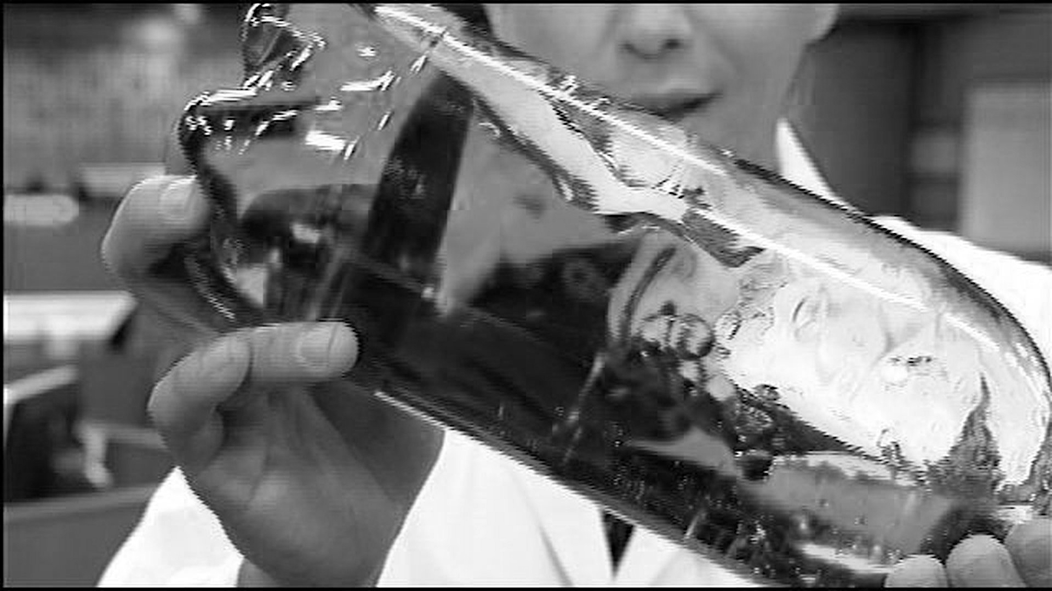
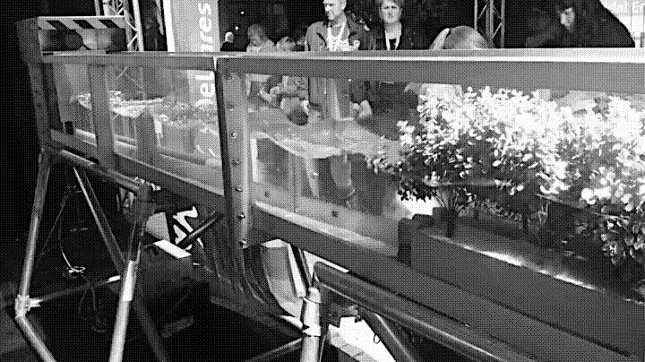

Marine
Education
31. Making waves – Investigate wave properties using a wave tank.
Before starting this worksheet, revise the content on the ‘Surf’s Up’ Worksheet
Name:
Date:
marineeducation.com.au
Ocean in a bottle
Fill 2L bottle two thirds of the way with water. Add some blue food colouring to the water and swirl the bottle around to mix. Fill the remainder of the bottle with (clear) baby oil and cap the bottle tightly. If possible, add enough oil so that there is no air left in the bottle.
Allow to sit. Tilt back & forth.
“Waves are most rapidly reduced when they pass through a greater density of obstacles. Mangroves with aerial roots will attenuate (reduce) waves in shallow water more rapidly than those without” ^{[1]}.
Activity: Write your observations of wave properties in the space below.
^{[1]} McIvor, A.L., Möller, I., Spencer, T. and Spalding. M. (2012) Reduction of wind and swell waves by mangroves. Natural Coastal Protection Series: Report 1. Cambridge Coastal Research Unit Working Paper 40. Published by The Nature Conservancy and Wetlands International. 27 pages. ISSN 2050-7941. URL: http://www.naturalcoastalprotection.org/documents/reduction-of-wind-and-swell-wavesby-mangroves
© Marine Education 2024 CC BY-NC-SA
Unit 1 Topic 2 Science Inquiry
56

Slide 66
Marine
Education
32. Beach prac - Investigate sandy coastlines using beach profiles, dune transects and sand sifts.
Name:
Date:
marineeducation.com.au
Activity: Record your beach profile data in the table/s^{[1]} below (spare one on the right)
Distance out from datum (m) | Fall or rise in cm from datum | Notes
1
2
3
4
5
6
7
8
9
10
11
12
13
14
15
16
17
Distance out from datum (m) | Fall or rise in cm from datum | Notes
^{[1]} Adapted from Wet Paper publication, Author: Bob Moffatt. Accessed April 2024 from: https://www.wetpaper.com.au/
© Marine Education 2024 CC BY-NC-SA
Unit 1 Topic 2 Science Inquiry
57

Slide 67
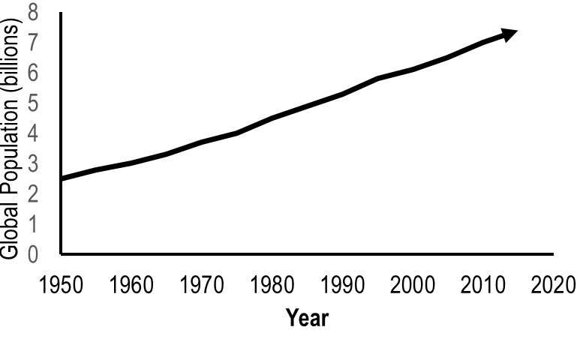
Marine
Education
33. Peeps – Interpret population density data of coastal areas to identify the impact on the health of coastal water.
Name:
Date:
marineeducation.com.au
The Population Explosion
The global human population increases every year.
Activity: Go to www.worldometers.info
Q. What is the current global population? Ans.
Q. What was the global population in 1950? Ans.
Figure 1: Global Population (billions) over time^{[1]}.
Loving our coast to death
In Australia, 85% of people live within 50km of the coast with more people populating it every year^{[2]}. Why is this an issue? What do people do that’s so destructive to the health of coastal waters? First of all, we need to find a place to live (clearing vegetation that would normally function to keep oceans healthy). We need water to drink (building dams and stealing water from rivers). We need to eat (removing seafood stocks, clearing coastal habitat for aquaculture and polluting waterways with agricultural runoff). We need energy (supporting the mining of oil and gas and increasing CO2 emissions). We like to play (using noisy, oily boat engines and damaging anchors). And, we like to shop (more waste, more industrial pollution and more shipping requiring dredging and dumping of ballast water)!
Q. What percentage of people live within 50km of the Australian coast? Ans.
Activity: Indicate if the population is going up or down over time by drawing an arrow to identify a trend. Then, beneath the picture clues below, name the impacts of this trend on coastal waters.
Local Government Area (LGA) | Population^{[3]} |  |  | Trend? or
 | 2006 | 2010 | 2016
Gold Coast | 450,075 | 506,135 | 576,918
Brisbane | 987,831 | 1,073,144 | 1,184,215
Sunshine Coast | 236,654 | 263,053 | 303,389
Fraser Coast | 86,117 | 96,618 | 102,953
Bundaberg | 84,816 | 91,400 | 94,453
Gladstone | 52,051 | 57,697 | 63,288
Rockhampton | 74,204 | 78,193 | 81,589
Mackay | 103,567 | 113,669 | 117,703
Whitsunday | 30,255 | 32,140 | 34,626
Townsville | 159,482 | 176,528 | 192,058
Cairns | 131,843 | 148,943 | 162,451
Aerial View
Shipping
River
Dredge
Industrial Port
Plastic Bag
Turtle
^{[1]} Worldometers (2018). World Population. Accessed 2018 from: https://www.worldometers.info/
^{[2]} Clark GF & Johnston EL (2017). Australia state of the environment 2016: coasts, independent report to the Australian Government Minister for Environment and Energy. Australian Government Department of the Environment and Energy, Canberra.
^{[3]} Queensland Government Statistician’s Office (2016). Estimated resident population by local government area (LGA), Queensland, 2006 to 2016p. The State of Queensland (Queensland Treasury). Accessed 30.12.2017 from: http://www.qgso.qld.gov.au/products/tables/erp-lga-qld/index.php
© Marine Education 2024 CC BY-NC-SA
Unit 1 Topic 2 Science Inquiry
58

Slide 68
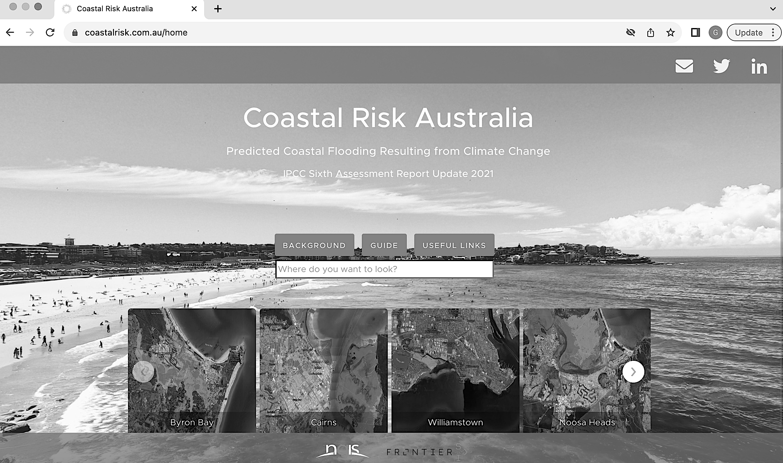
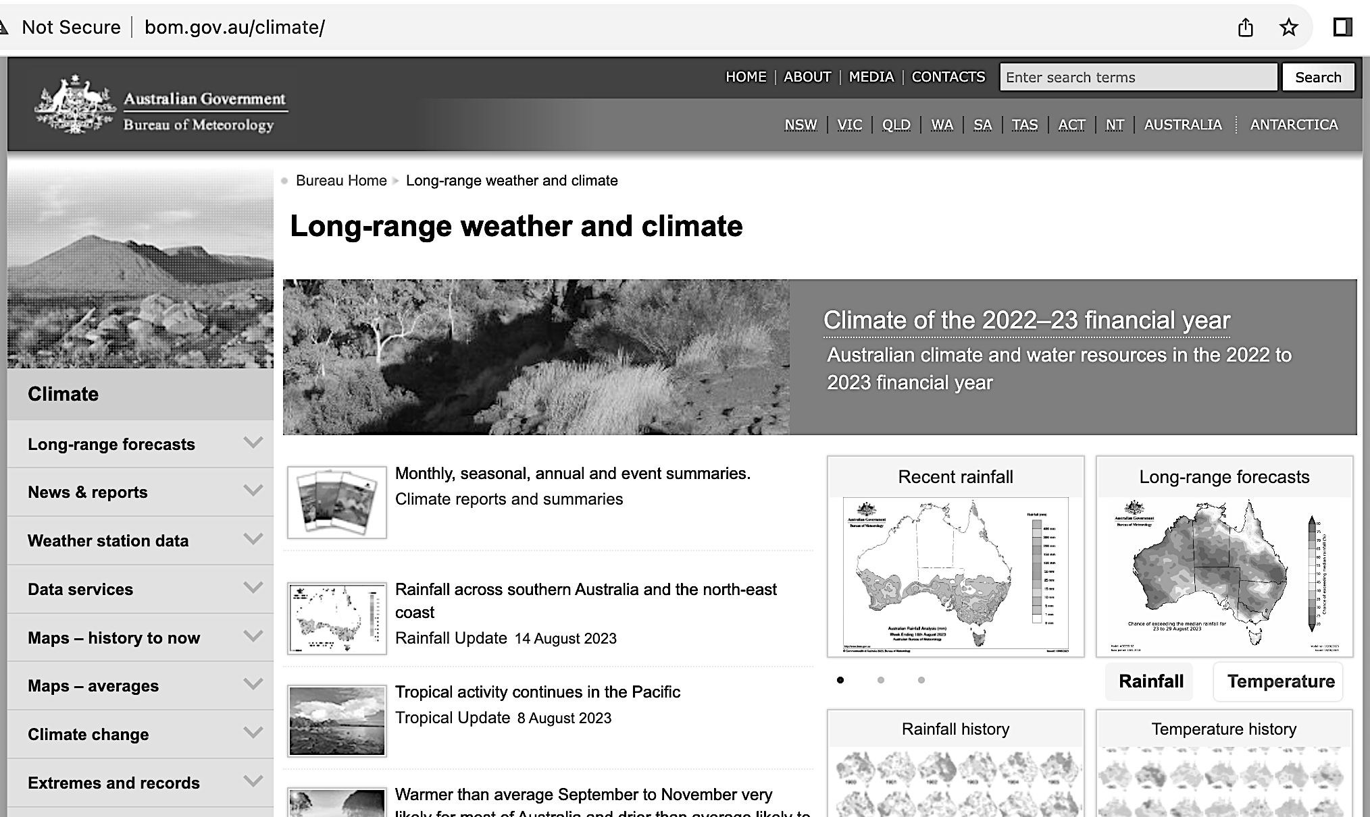
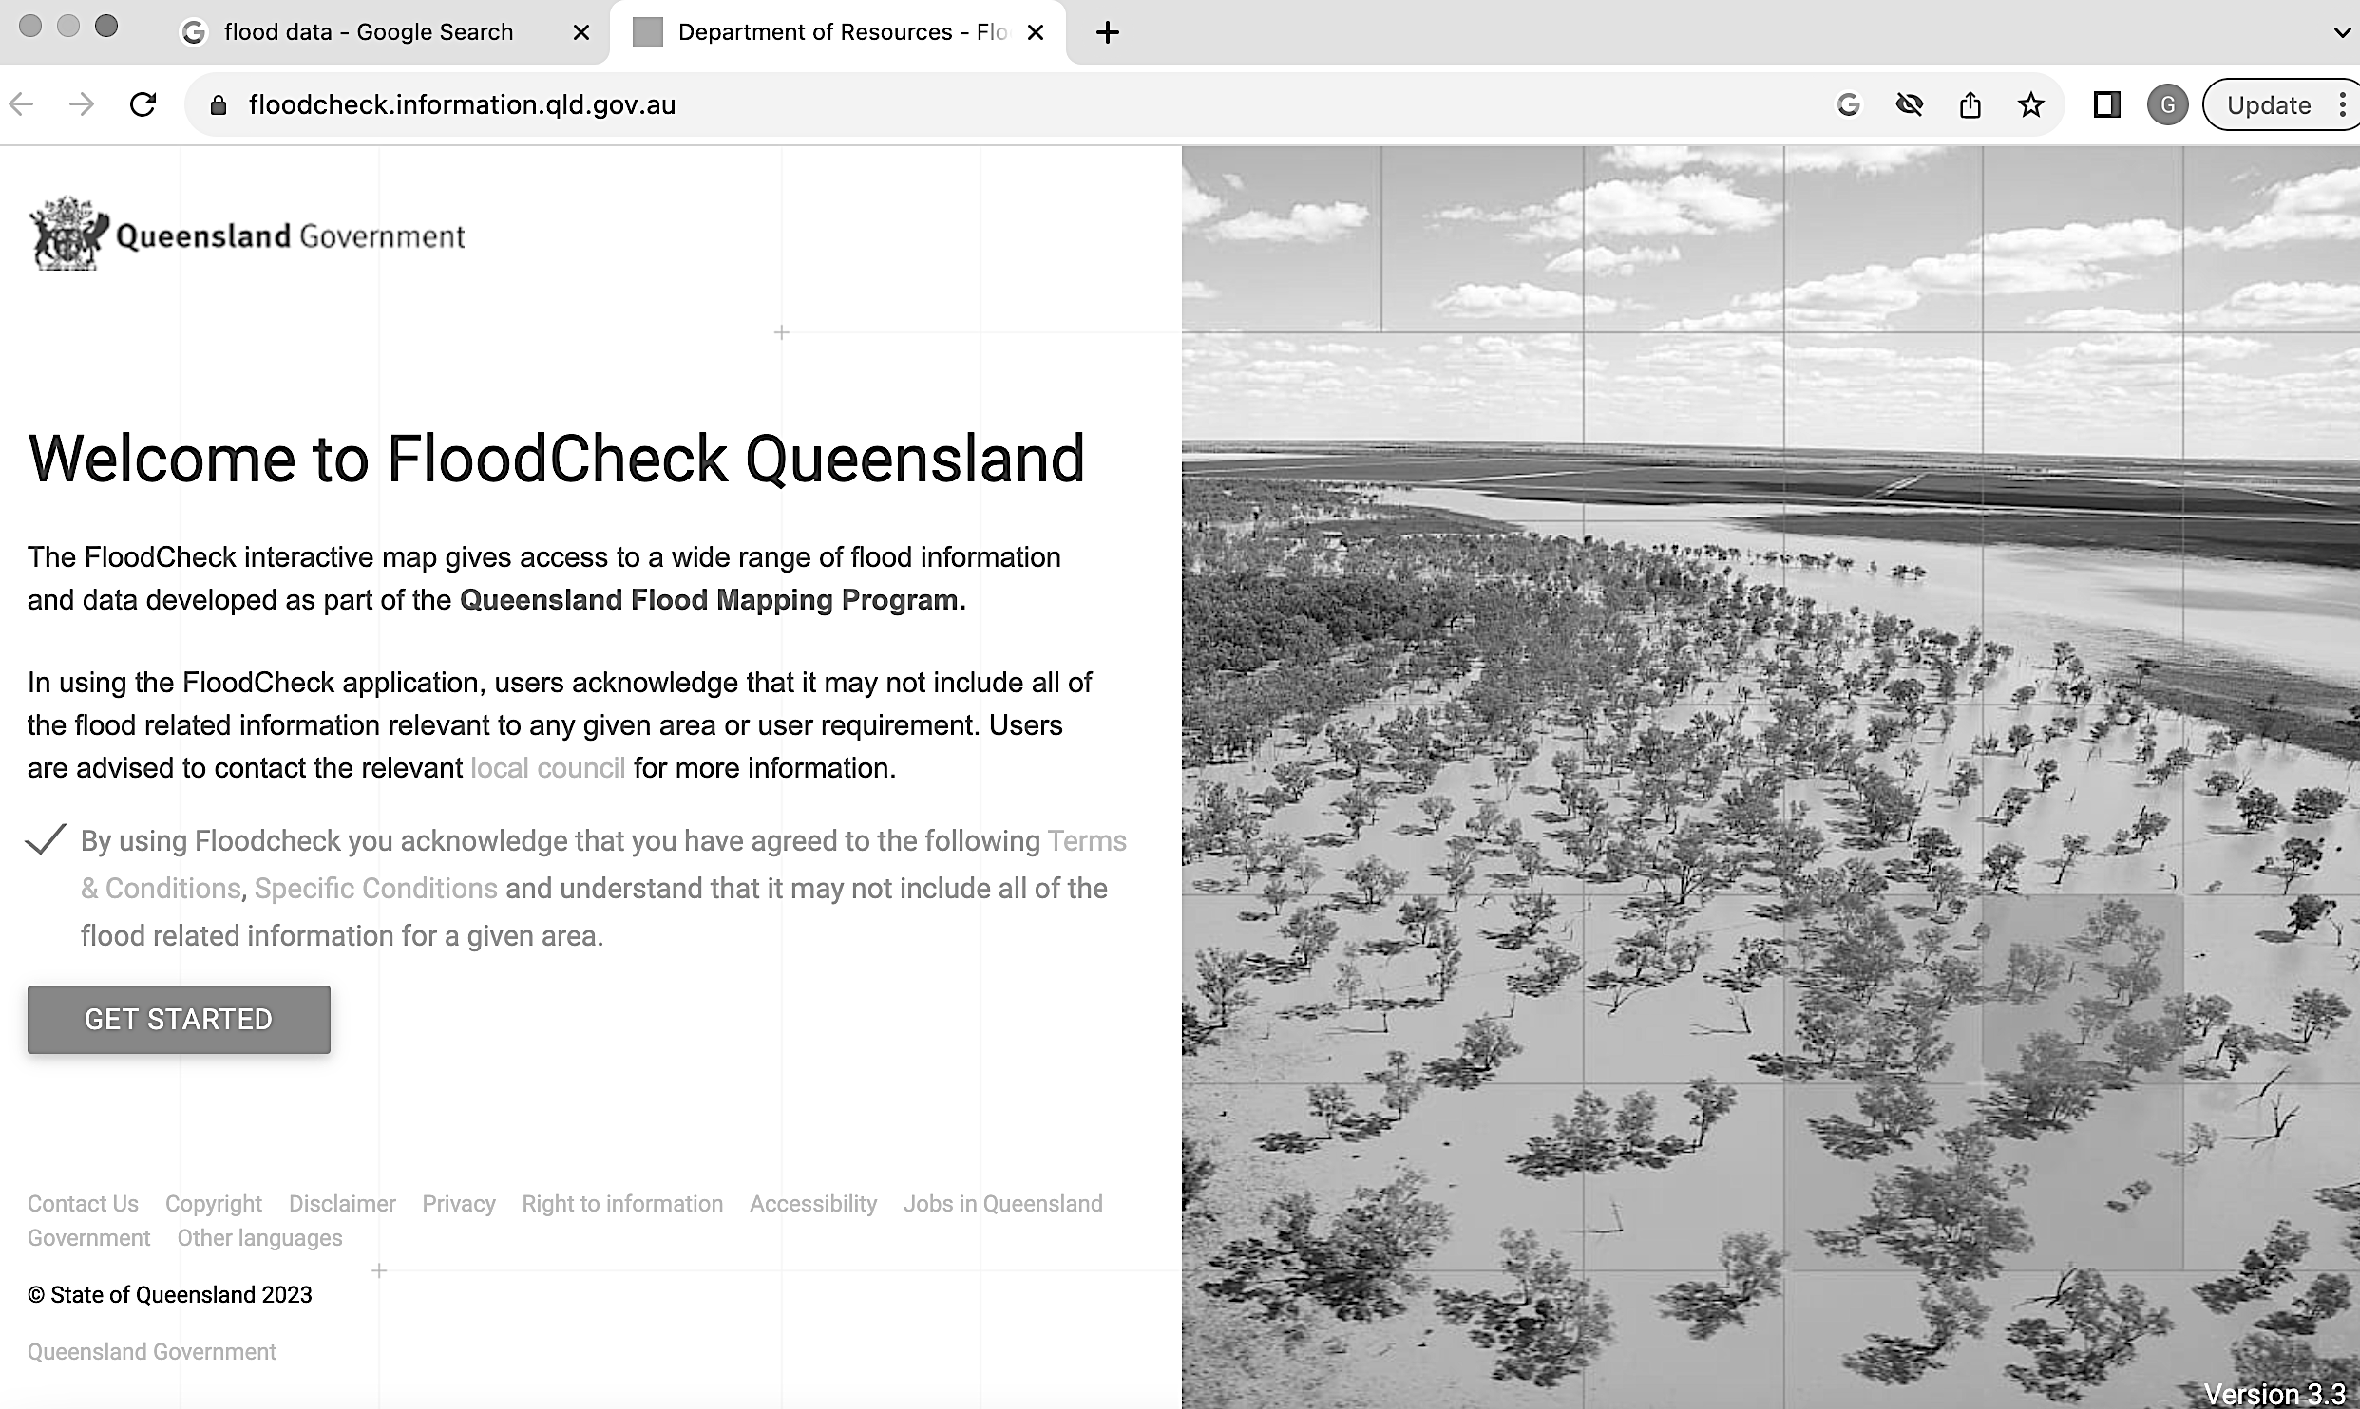
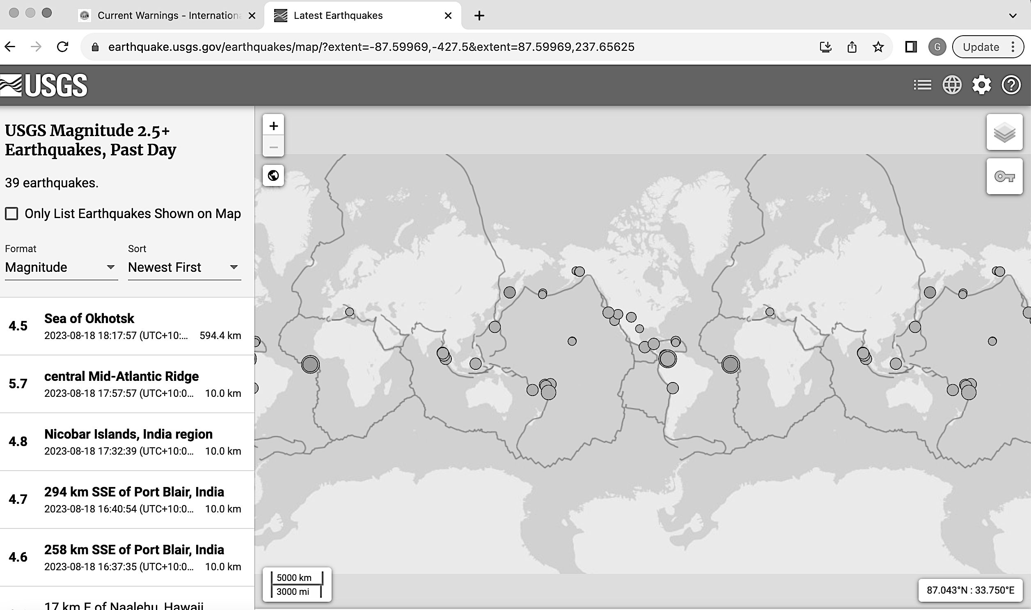
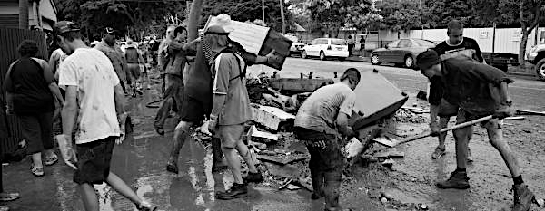
Marine
Education
34. Finger on the pulse – Interpret evidence used to inform the monitoring, assessment and evaluation of risk in relation to pulse events, i.e. cyclone, storm surge, tsunami and floods.
Name:
Date:
marineeducation.com.au
Activity: As a stakeholder yourself, analyse the evidence published on the websites below to evaluate the risk of a pulse event such as cyclone, storm surge, tsunami and/or flood.
coastalrisk.com.au
bom.gov.au (climate and past weather tab)
https://floodcheck.information.qld.gov.au/
https://www.usgs.gov/programs/earthquake-hazards/earthquakes
Mud army of the 2011 Brisbane floods
© Marine Education 2024 CC BY-NC-SA
Unit 1 Topic 2 Science Inquiry
59

Slide 69
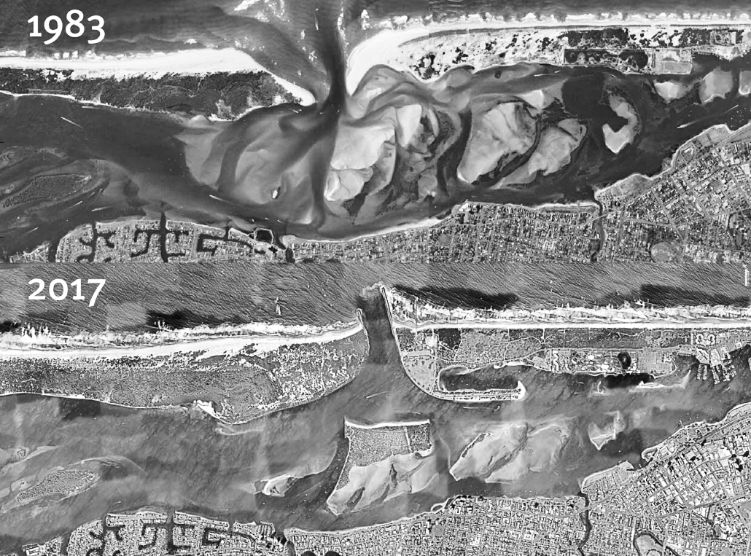
Marine
Education
35. Shifting Sands - Analyse evidence from the use of groynes, river walls and sand bypass systems to determine the effects on longshore drift for a beach system resource, e.g. the Delft report; Griffith University Centre for Coastal Management.
Name:
Date:
marineeducation.com.au
The Delft Report
Following cyclone damage of 1967, the Delft report recommended an extensive sand nourishment regime across all Gold Coast beaches in volumes large enough to withstand a similar event. Since then, Gold Coast beaches have been adorned with groynes, river walls and sand bypass systems.
Groyne: A structure built perpendicular to the shoreline designed to trap sand moving along the shore due to the longshore drift. A groin or group of groins usually extend to the end of the surf zone and are used primarily to replenish or stabilize beaches.
River wall (also called breakwater, training walls or seawall): a wall, bank, or jetty built to confine and direct the flow of a river or tide.
Sand bypass system: Completed in 1986, the Gold Coast Sand Bypass System was the first of its kind in the world. The system pumps 500,000 cubic metres of sand northwards every year to ensure the Seaway entrance remains clear. It cost $50 million to build ^{[1]} .
Sand bypass
new pipeline – Surfers Paradise Sand Bypass System
Question: how many sand bypass systems are there on the Gold Coast? Ans.
^{[1]} Gold Coast WaterWays Authority (2023). Sandy Bypass System. Accessed 12 July 2023 from: https://gcwa.qld.gov.au/portfolio-item/sand-bypass-system/
© Marine Education 2024 CC BY-NC-SA
Unit 1 Topic 2 Science Inquiry
60

