Slide 1

Learning Intention:
Appreciate that effective marine ecosystem management is informed by the development of complex models requiring a broad range of scientific knowledge in gathering data, identifying indicators and ensuring measurement is valid and reliable.
Success Criteria:
Complete Marine Education worksheet ’13. Code Red’
Notes:
Image:

Slide 2
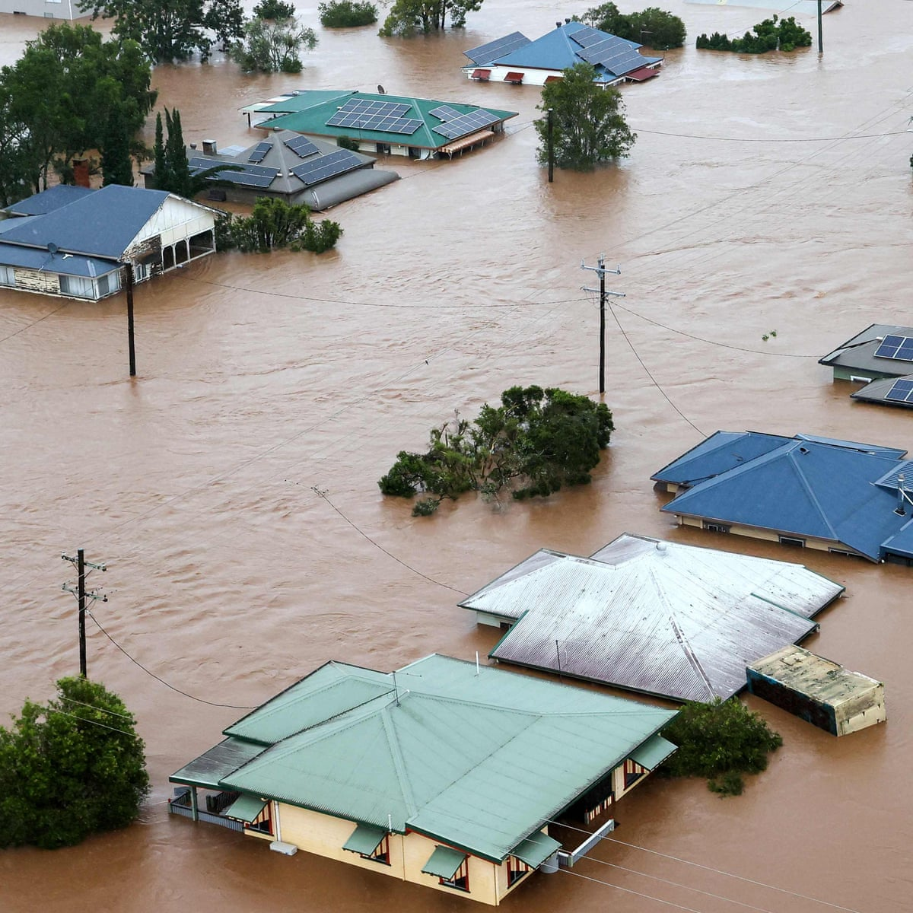
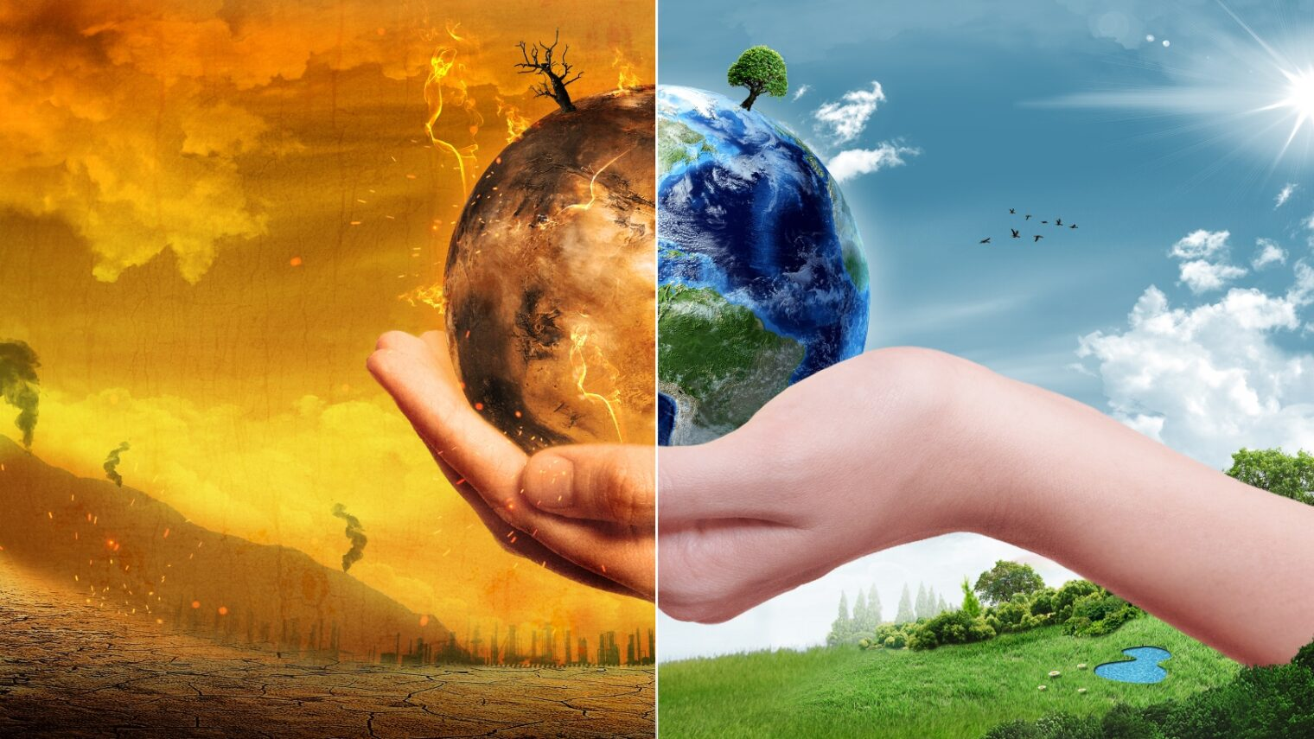
Managing ecosystems requires us to predict the future…..
…..so we know what will happen when we make a decision

Slide 3

The future is predicted using computer models
(not crystal balls)

Slide 4

For example,
computer models are used to predict the effects of decisions made today, and in the future, about Climate Change and our carbon emissions.

Slide 5

Computer models use mathematical equations and data inputs from observations to make those predictions
Notes:
https://www.meteosource.com/blog/category/meteorology

Slide 6

Corridor of computer servers
Notes:
https://www.noaa.gov/media-release/noaa-upgrades-global-ensemble-forecast-system

Slide 7

Notes:
https://www.innovationnewsnetwork.com/aspire-project-optimises-accuracy-and-efficiency-of-weather-forecasts/27771/

Slide 8
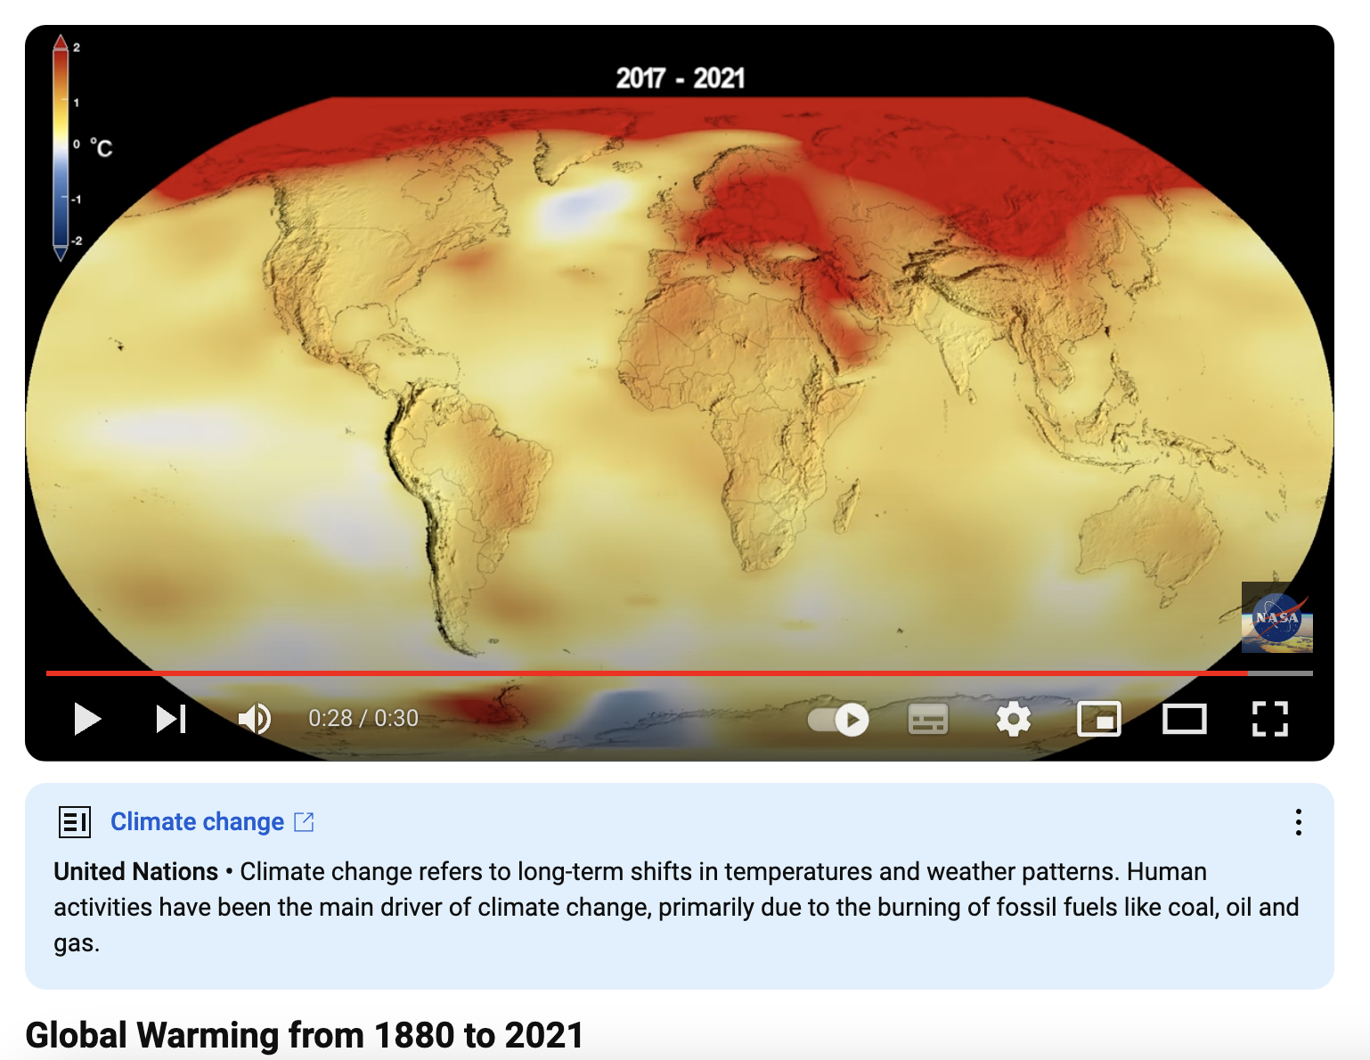
Models use data inputs from observations to make their predictions
https://www.youtube.com/watch?v=haBG2IIbwbA

Slide 9
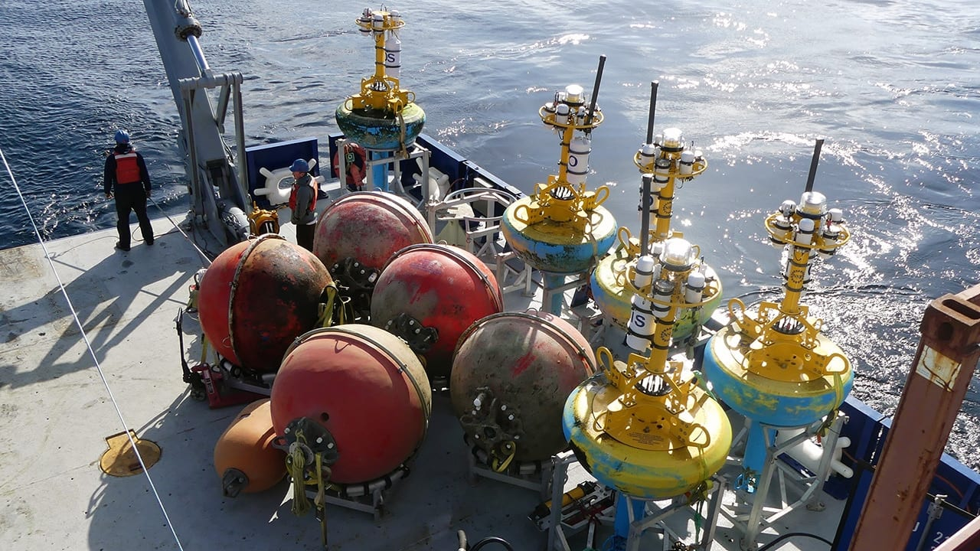
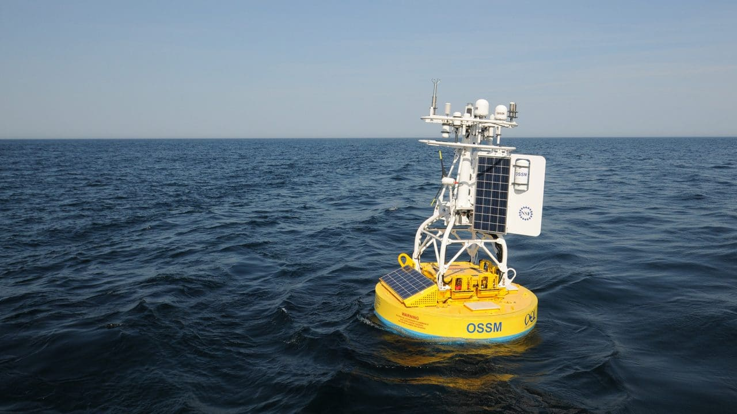
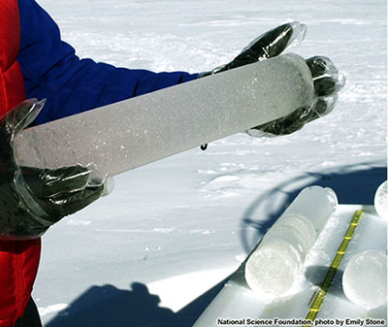
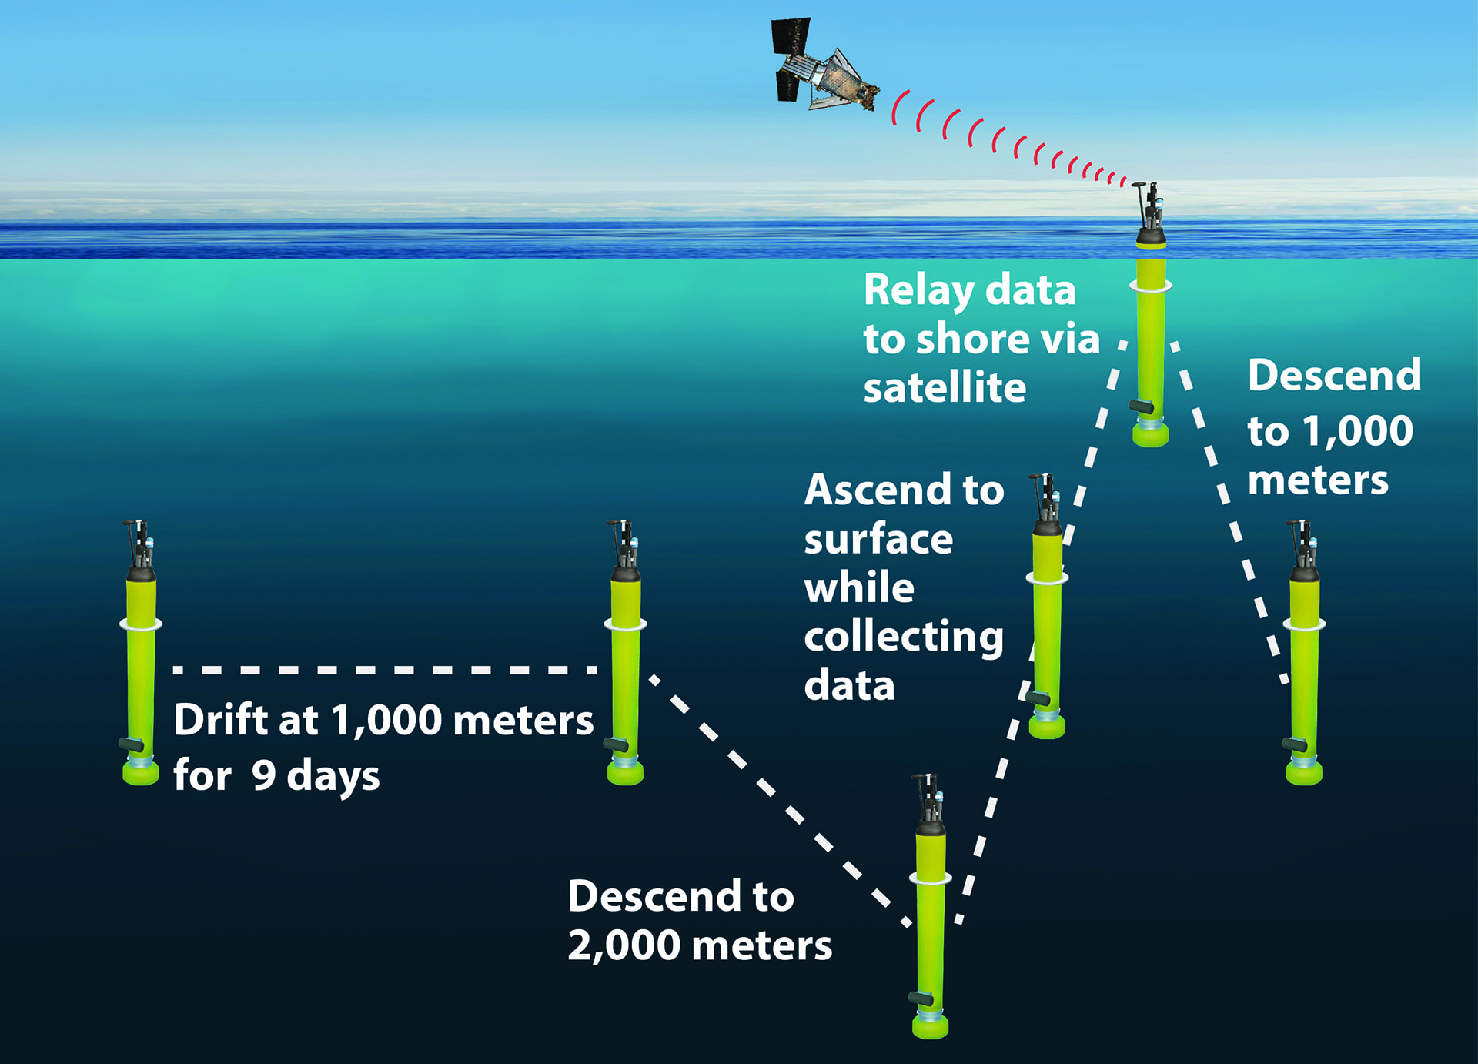

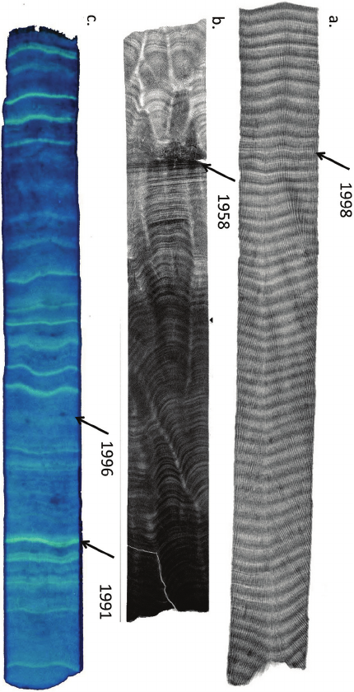
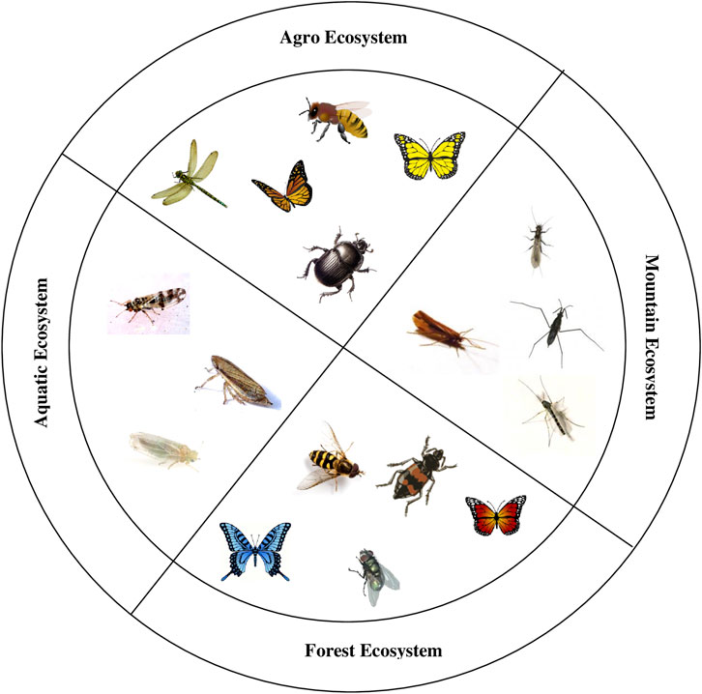
Examples of sources of observational data

Slide 10
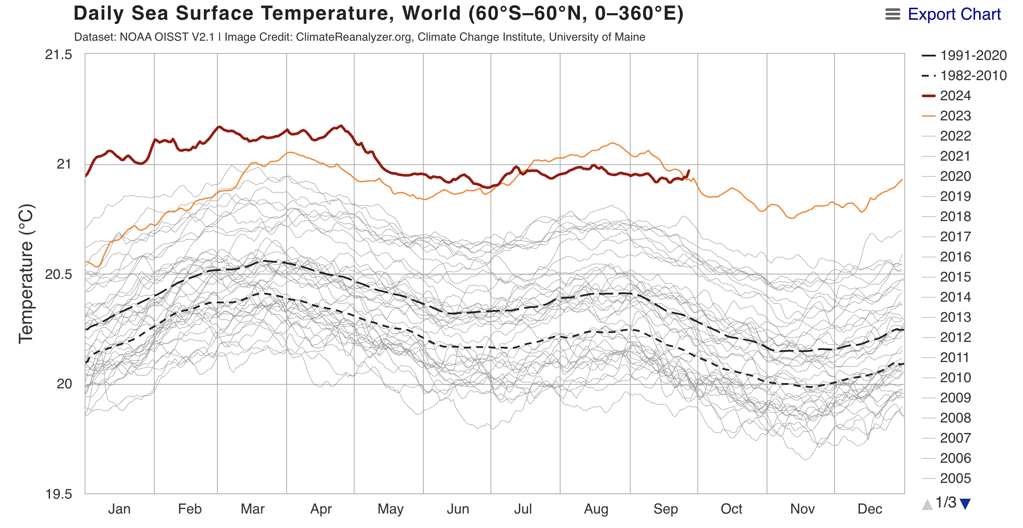
Every year, the Ocean gets warmer
2024
2023
Image: Climate Reanalyzer™
Notes:
Image: https://climatereanalyzer.org/clim/sst_daily/?dm_id=world2
Climate Reanalyzer (n.d.). Daily Sea Surface Temperature. Climate Change Institute, University of Maine. Retrieved Oct 2024, from https://climatereanalyzer.org/

Slide 11
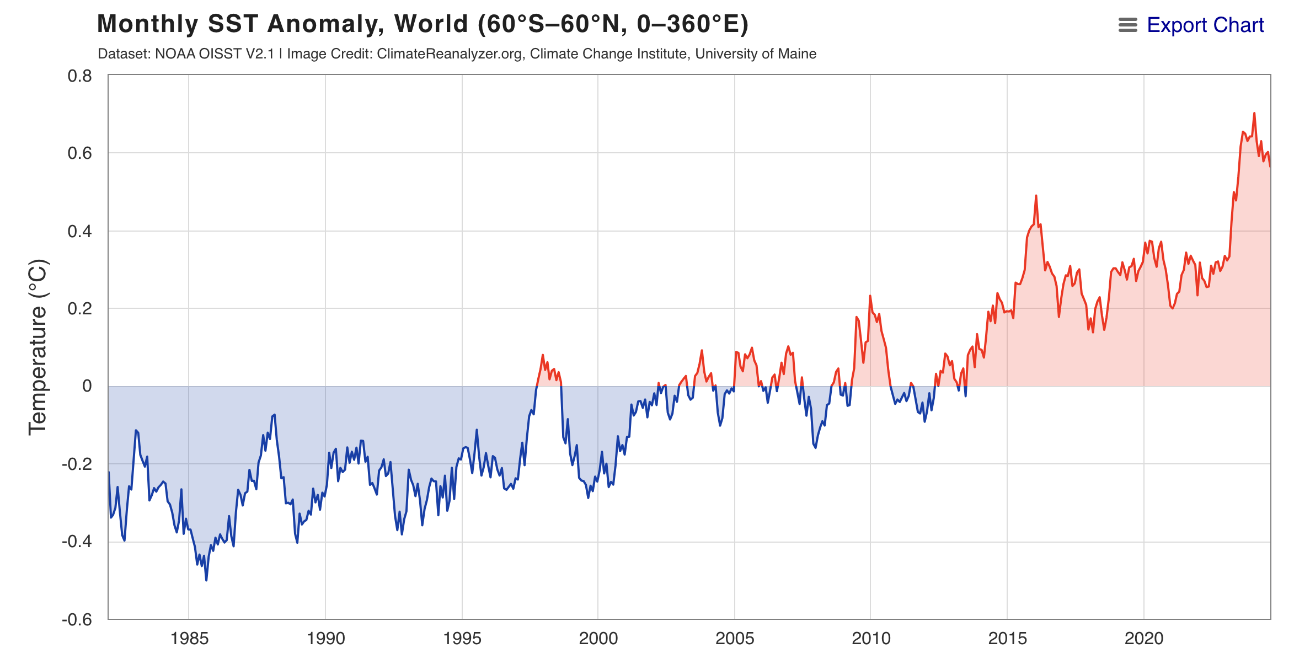
As the ocean warms, the atmosphere warms
Image: Climate Reanalyzer™
Notes:
Image: https://climatereanalyzer.org/clim/sst_daily/?dm_id=world2
Climate Reanalyzer (n.d.). Monthly Sea Surface Temperature. Climate Change Institute, University of Maine. Retrieved Oct 2024, from https://climatereanalyzer.org/

Slide 12
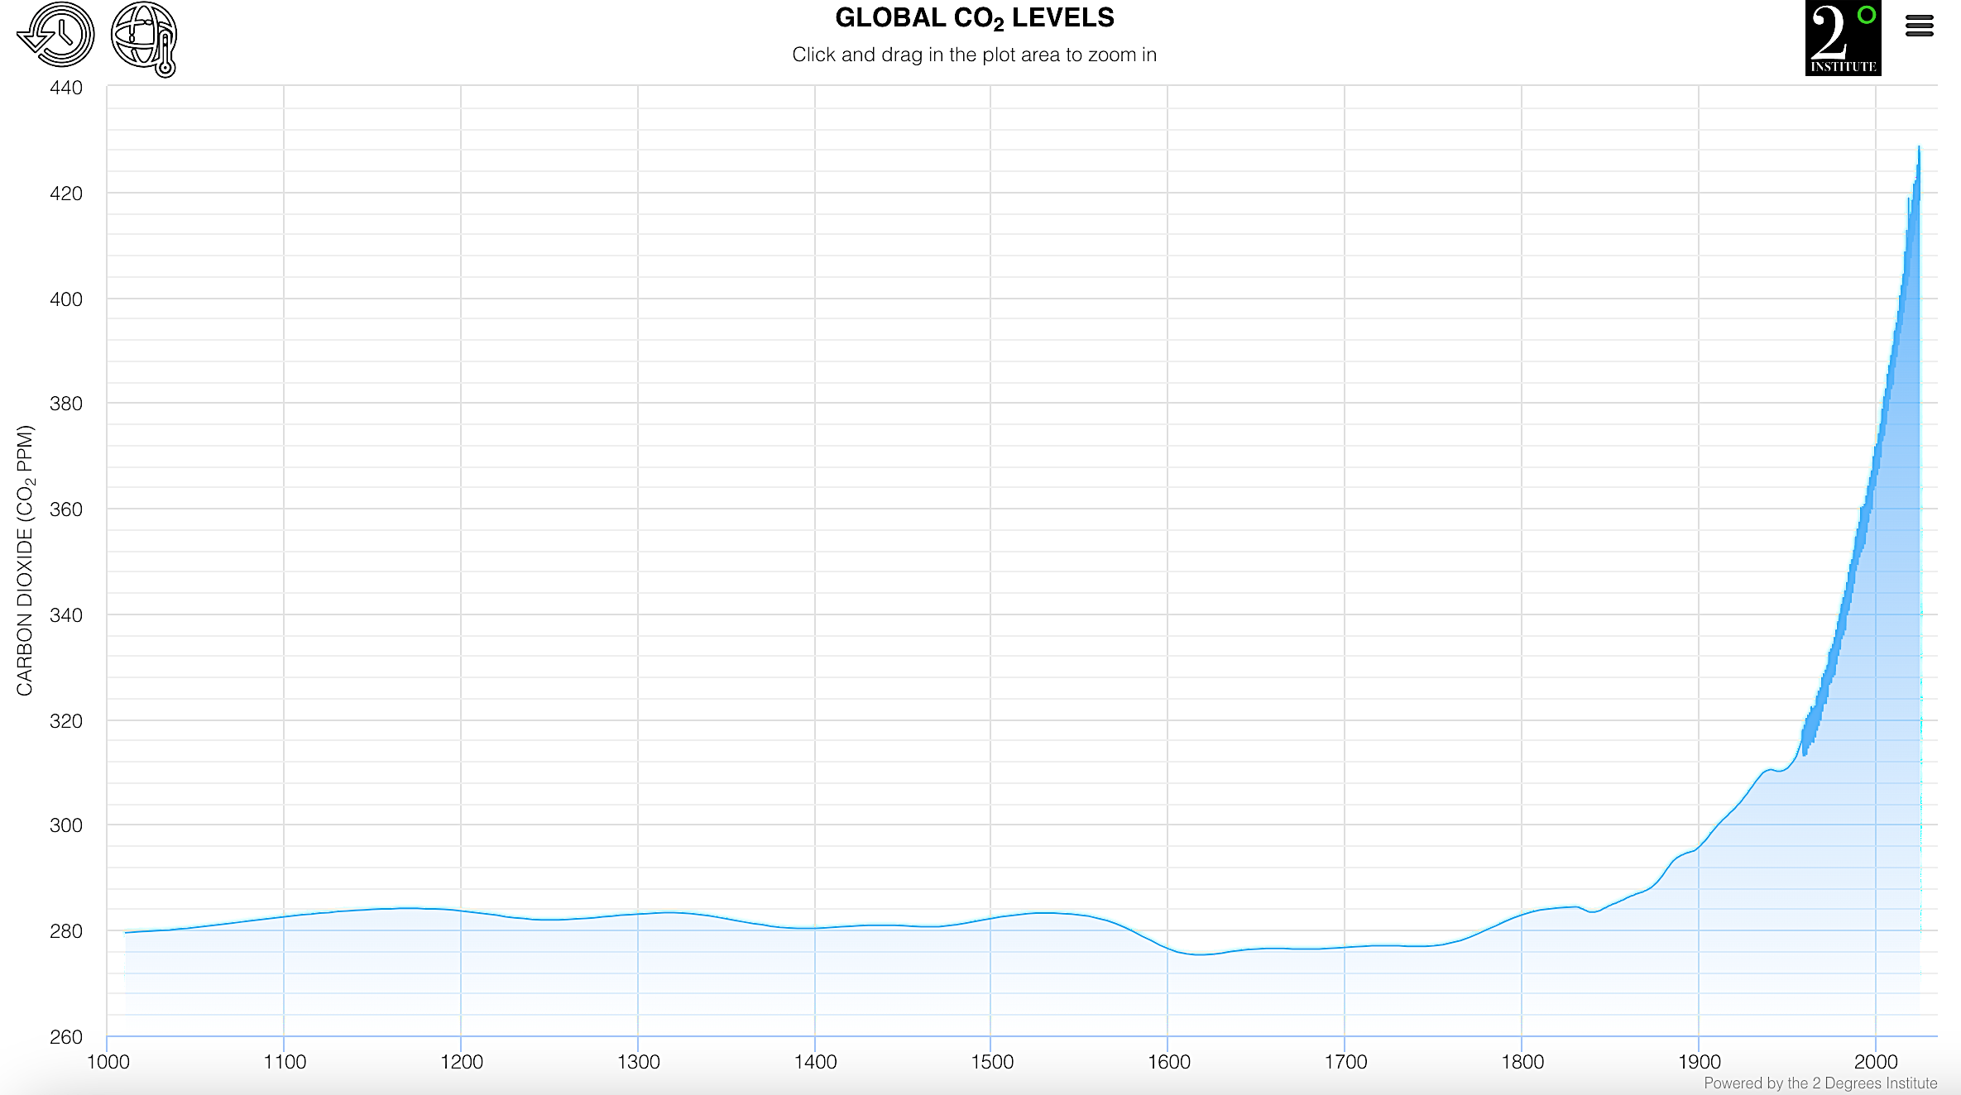
The ocean (and atmosphere) warm due to CO₂
https://www.co2levels.org/
Notes:
Image: https://www.co2levels.org/

Slide 13
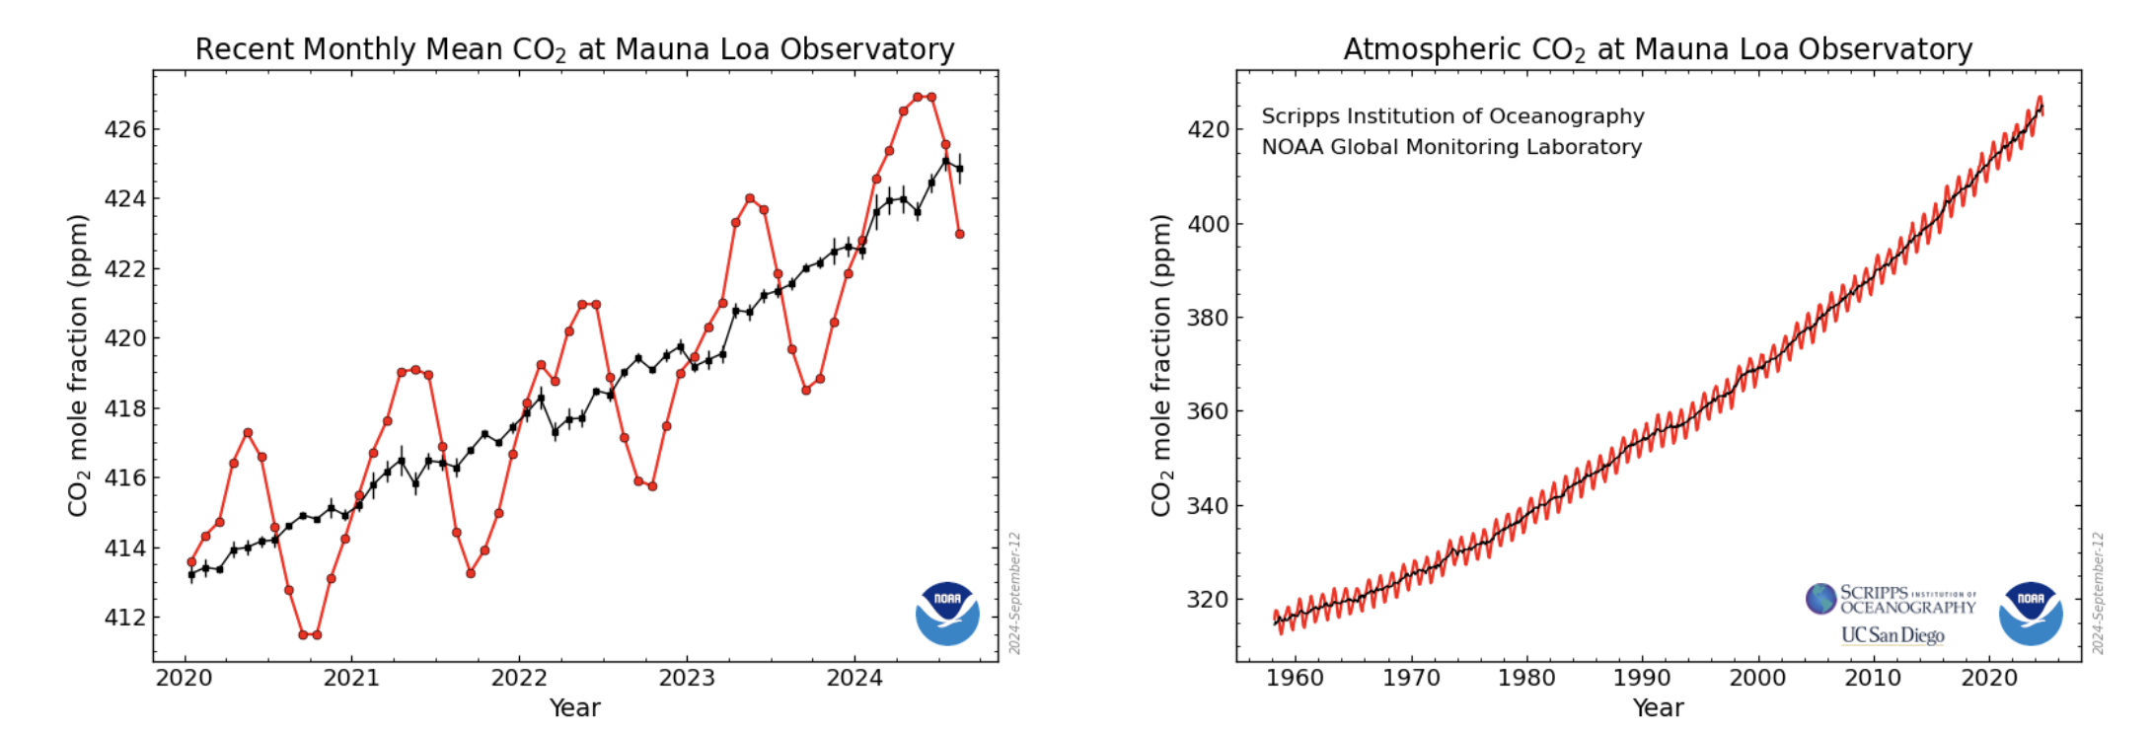
CO₂ continues to rise
The red lines and symbols represent the monthly mean values, centered on the middle of each month.
The black lines and symbols represent the same, after correction for the average seasonal cycle.
Notes:
Image: https://gml.noaa.gov/ccgg/trends/

Slide 14
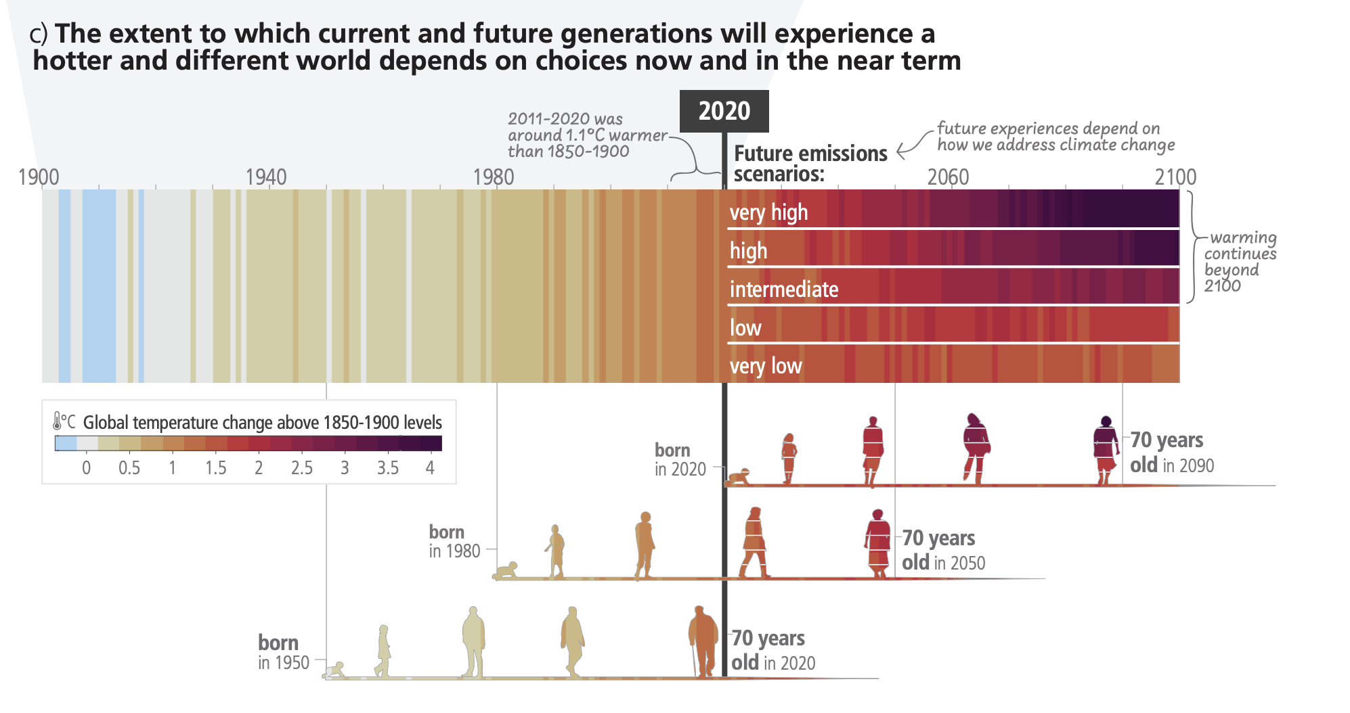
Earth will continue to warm long into the future
(how much we reduce CO₂ emissions will determine how warm it will get)
IPCC 6th Report
Notes:
Image: https://www.ipcc.ch/report/ar6/syr/downloads/report/IPCC_AR6_SYR_SPM.pdf

Slide 15
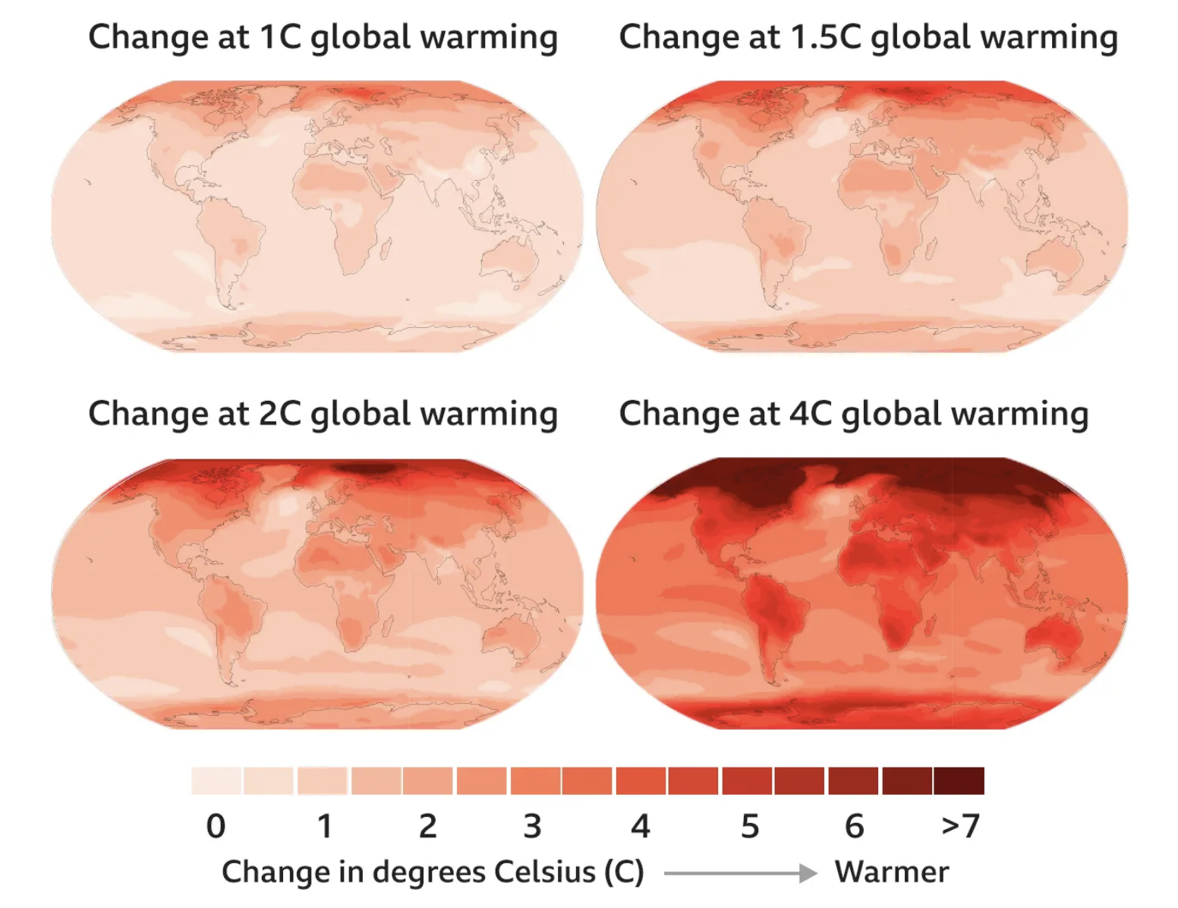
Predictions from around the globe….
…code RED for humanity
Notes:
Image: https://www.bbc.com/news/science-environment-58130705

Slide 16
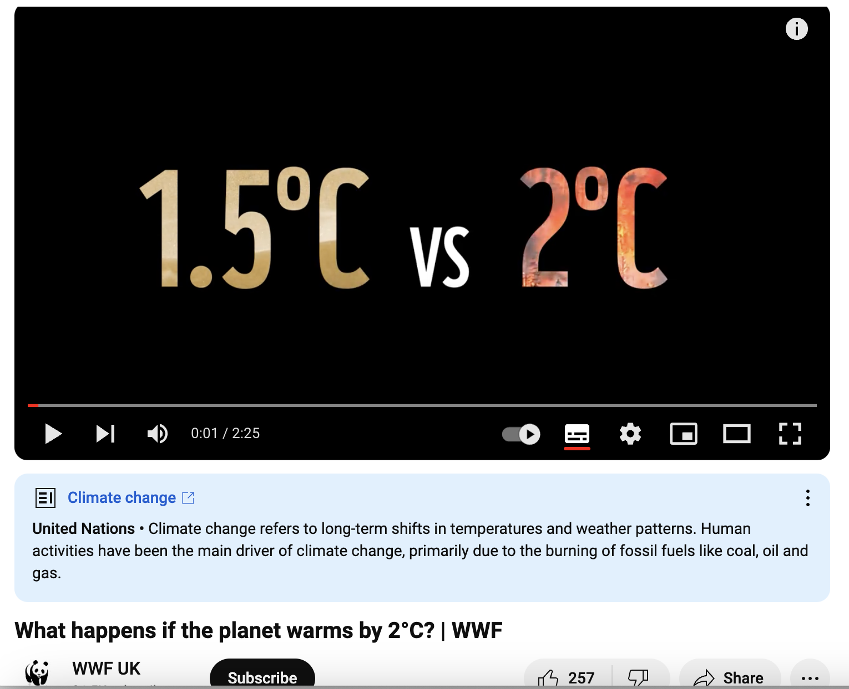
It was 1.1°C in 2020
https://www.youtube.com/watch?v=0zOvpSLXG18

Slide 17
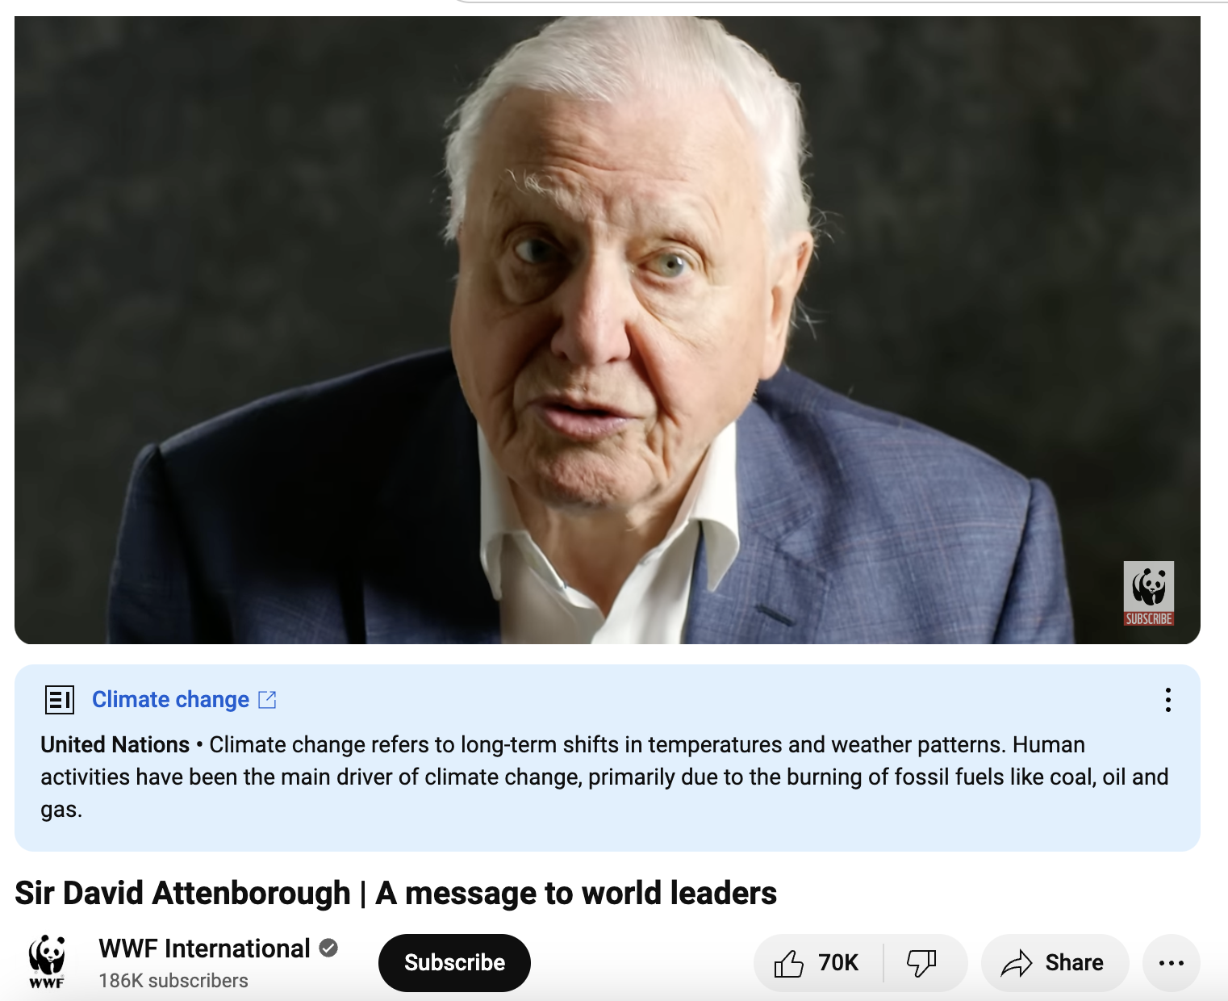
https://www.youtube.com/watch?v=fyYpExl8AJU

Slide 18
Don’t believe it?

Slide 19
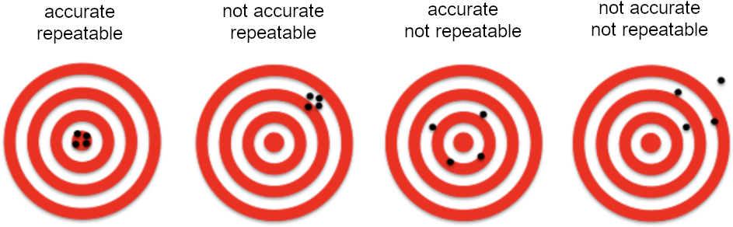
To be
Valid = reliable AND accurate
it must be..
Reliable
Accurate
Reliable
Not accurate
Not reliable
Accurate
Not reliable
Not Accurate

Slide 20
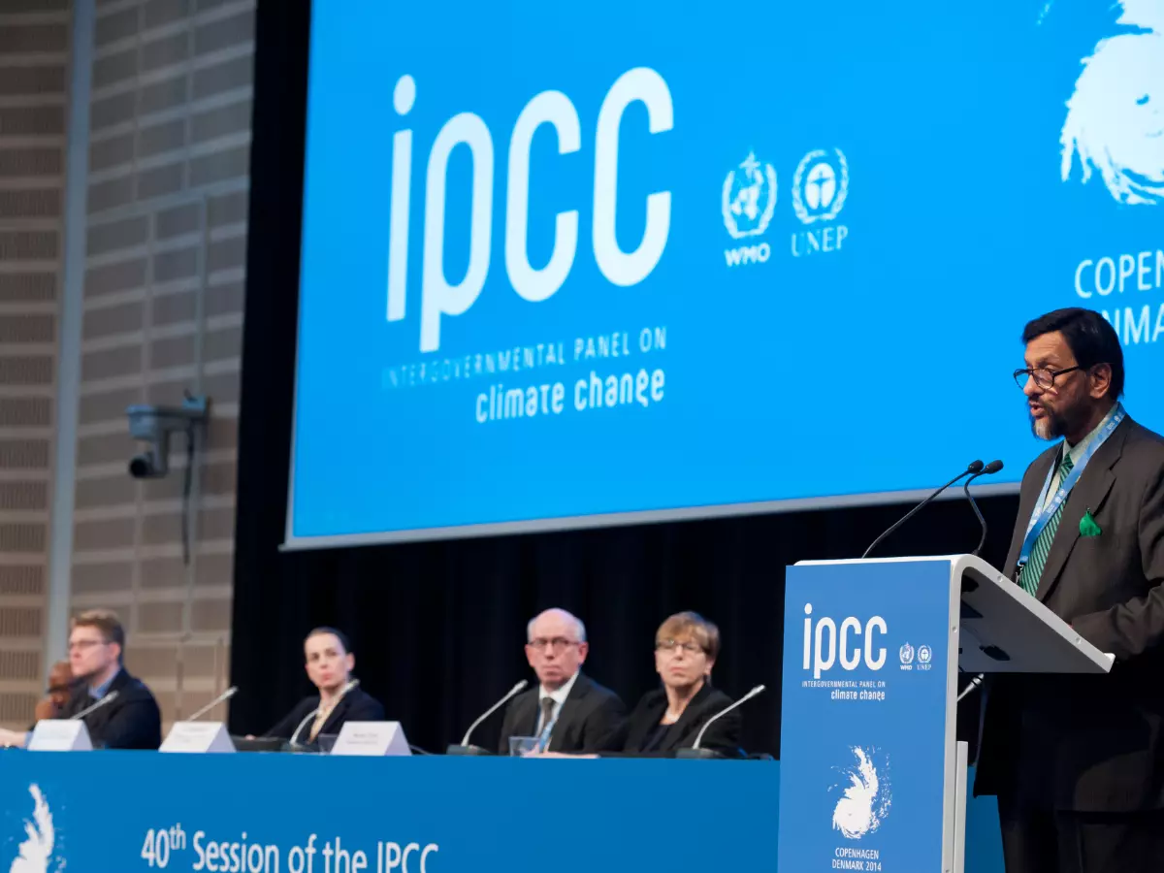
The IPCC creates reports for policy makers about climate change.
The reports are peer-reviewed by 1000s of scientists.
Their validity is highly respected.

Slide 21
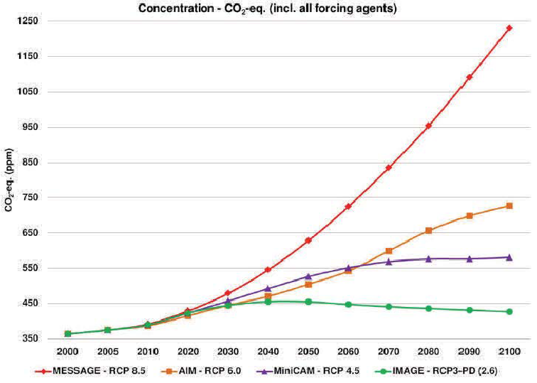
In the 5th IPCC report (2014),
four climate change scenarios (called RCPs) were made for predicting future CO₂ and warming.
RCP 2.6 is best case scenario;
RCP 8.5 is worst case scenario.
RCP 8.5
RCP 6.0
RCP 4.5
RCP 2.6
Notes:
Image: Bhatt, Ramesh. (2018). Climate Change Assessment, Impacts of Global Warming, Projections and Mitigation of GHG Emissions Endorsing Green Energy.
https://www.researchgate.net/figure/Representative-Concentration-Pathways-RCPs-are-the-four-greenhouse-gas-concentration_fig1_322851886

Slide 22
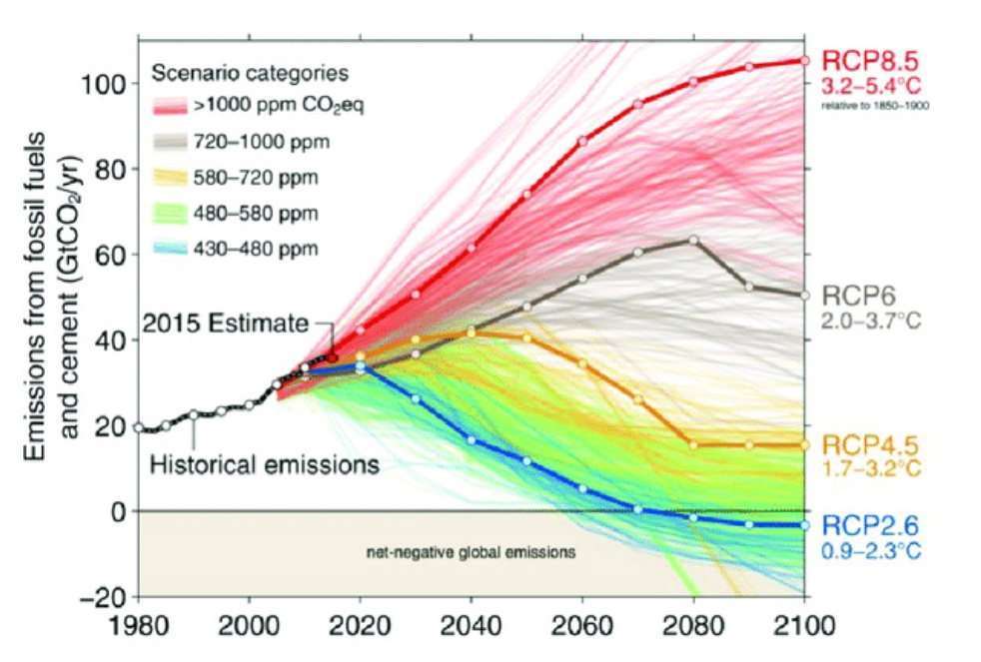
Earth warms under every scenario.
What we do now to reduce CO₂ will determine how warm it gets.
RCP 8.5
3.3-5.7°C
RCP 6.0
2.8-4.6°C
RCP 4.5
2.1-3.5°C
RCP 2.6
1.4-2.4°C
Notes:
IPCC 6th Report (page 18): 30 The best estimates [and very likely ranges] for the different scenarios are: 1.4 [1.0 to 1.8 ]°C (SSP1-1.9); 1.8 [1.3 to 2.4]°C (SSP1-2.6); 2.7 [2.1 to 3.5]°C (SSP2-4.5); 3.6 [2.8 to 4.6]°C (SSP3-7.0); and 4.4 [3.3 to 5.7 ]°C (SSP5-8.5). {3.1.1} (Box SPM.1)
https://www.ipcc.ch/report/ar6/syr/downloads/report/IPCC_AR6_SYR_SPM.pdf

Slide 23
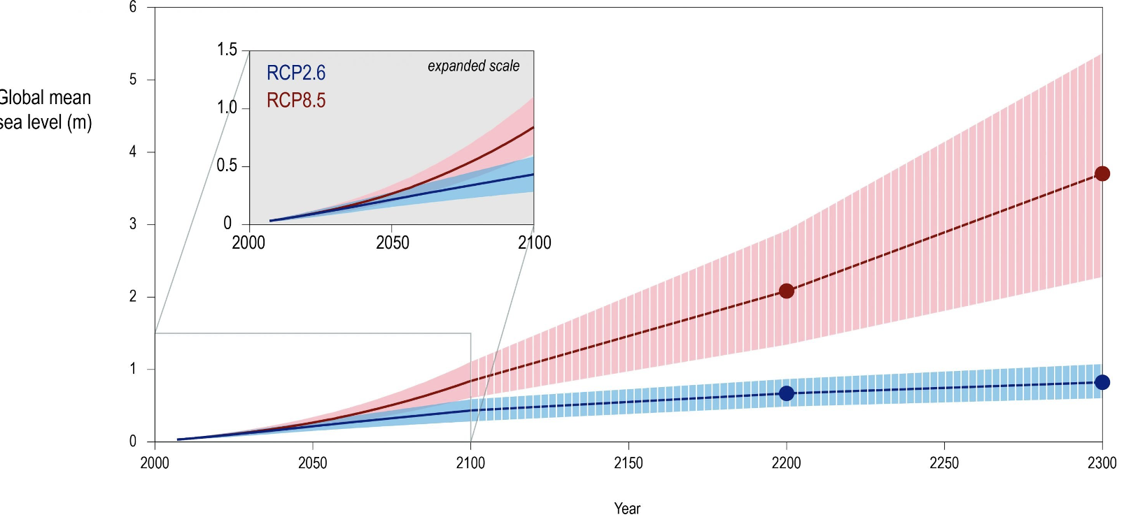
Sea level will rise
(how much we reduce CO₂ emissions will determine how high)
RCP8.5
RCP2.6
Notes:
Global mean sea level increased by 0.20 [0.15 to 0.25] m between 1901 and 2018. The average rate of sea level rise was 1.3 [0.6 to 2.1] mm yr-1 between 1901 and 1971, increasing to 1.9 [0.8 to 2.9] mm yr-1 between 1971 and 2006, and further increasing to 3.7 [3.2 to 4.2] mm yr-1 between 2006 and 2018 (high confidence). IPCC 6th Report.page 11.
https://www.ipcc.ch/report/ar6/syr/downloads/report/IPCC_AR6_SYR_SPM.pdf

Slide 24
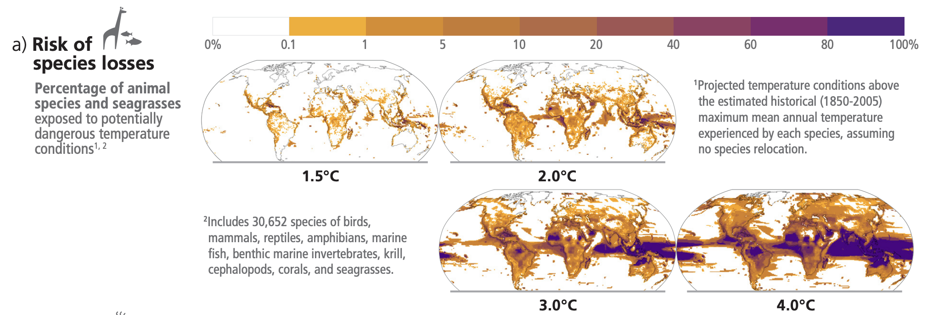
“Global warming is likely to reach 1.5°C between 2030 and 2052 if it continues to increase at the current rate (high confidence)”
(IPCC , 2018)
IPCC 6th Report (2023)
“Without a strengthening of policies, global warming of 3.2°C
(2.2-3.5°C) is projected by 2100 (medium confidence)”
IPCC (6th Report A4.4), 2023
Notes:
18IPCC, 2018: Summary for Policymakers. In: Global Warming of 1.5°C. An IPCC Special Report on the impacts of global warming of 1.5°C above pre-industrial levels and related global greenhouse gas emission pathways, in the context of strengthening the global response to the threat of climate change, sustainable development, and efforts to eradicate poverty [Masson-Delmotte, V., P. Zhai, H.-O. Pörtner, D. Roberts, J. Skea, P.R. Shukla, A. Pirani, W. Moufouma-Okia, C. Péan, R. Pidcock, S. Connors, J.B.R. Matthews, Y. Chen, X. Zhou, M.I. Gomis, E. Lonnoy, T. Maycock, M. Tignor, and T. Waterfield (eds.)]. Cambridge University Press, Cambridge, UK and New York, NY, USA, pp. 3-24. https://doi.org/10.1017/9781009157940.001.

Slide 25
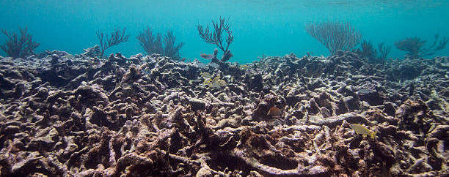
Coral reefs are predicted to decline by 70–90% at 1.5°C (high confidence) with larger losses (>99%) at 2°C (very high confidence).
(IPCC , 2018)
Notes:
18IPCC, 2018: Summary for Policymakers. In: Global Warming of 1.5°C. An IPCC Special Report on the impacts of global warming of 1.5°C above pre-industrial levels and related global greenhouse gas emission pathways, in the context of strengthening the global response to the threat of climate change, sustainable development, and efforts to eradicate poverty [Masson-Delmotte, V., P. Zhai, H.-O. Pörtner, D. Roberts, J. Skea, P.R. Shukla, A. Pirani, W. Moufouma-Okia, C. Péan, R. Pidcock, S. Connors, J.B.R. Matthews, Y. Chen, X. Zhou, M.I. Gomis, E. Lonnoy, T. Maycock, M. Tignor, and T. Waterfield (eds.)]. Cambridge University Press, Cambridge, UK and New York, NY, USA, pp. 3-24. https://doi.org/10.1017/9781009157940.001.

Slide 26
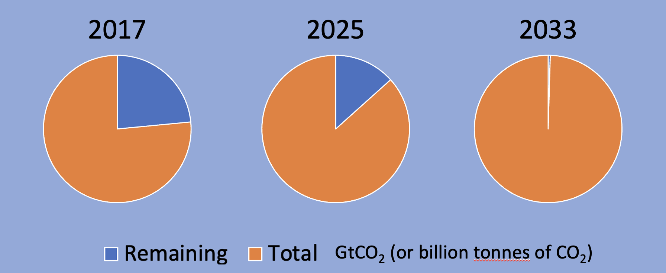
Staying below 1.5°C requires staying within a total atmospheric carbon budget of 2875 GtCO₂. By the end of 2017, CO₂ emissions since the pre-industrial period reduced that total carbon budget by 2200 GtCO₂. The remaining carbon budget (of 675 GtCO₂) is being depleted by current emissions by approximately 42 GtCO₂ per year (high confidence).
Notes:
Image: adapted from IPCC 1.5C Report and CSIRO report: https://www.csiro.au/en/news/All/Articles/2022/November/global-carbon-budget
https://www.ipcc.ch/site/assets/uploads/sites/2/2022/06/SPM_version_report_LR.pdf (C.1.3 - page 12).

Slide 27
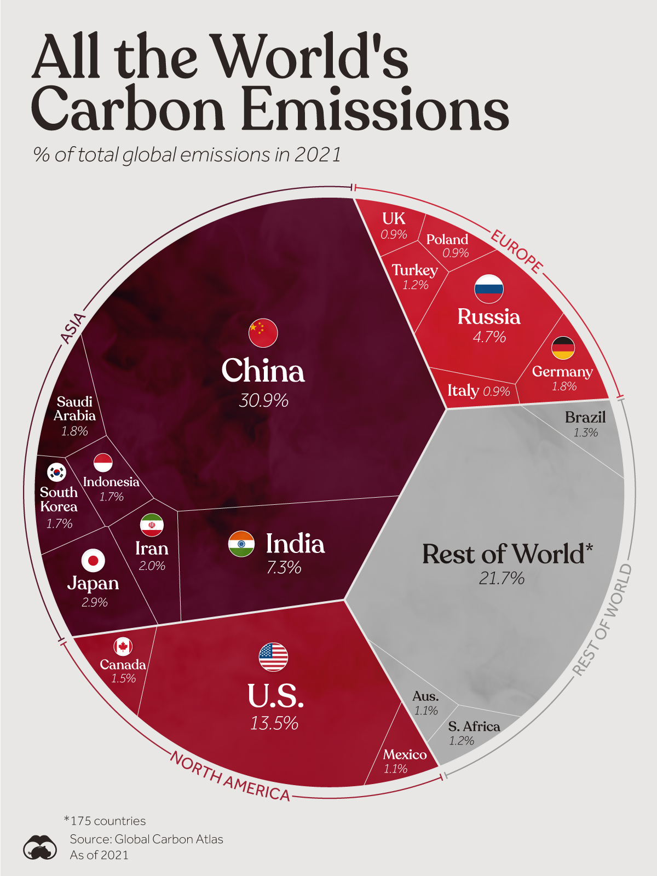
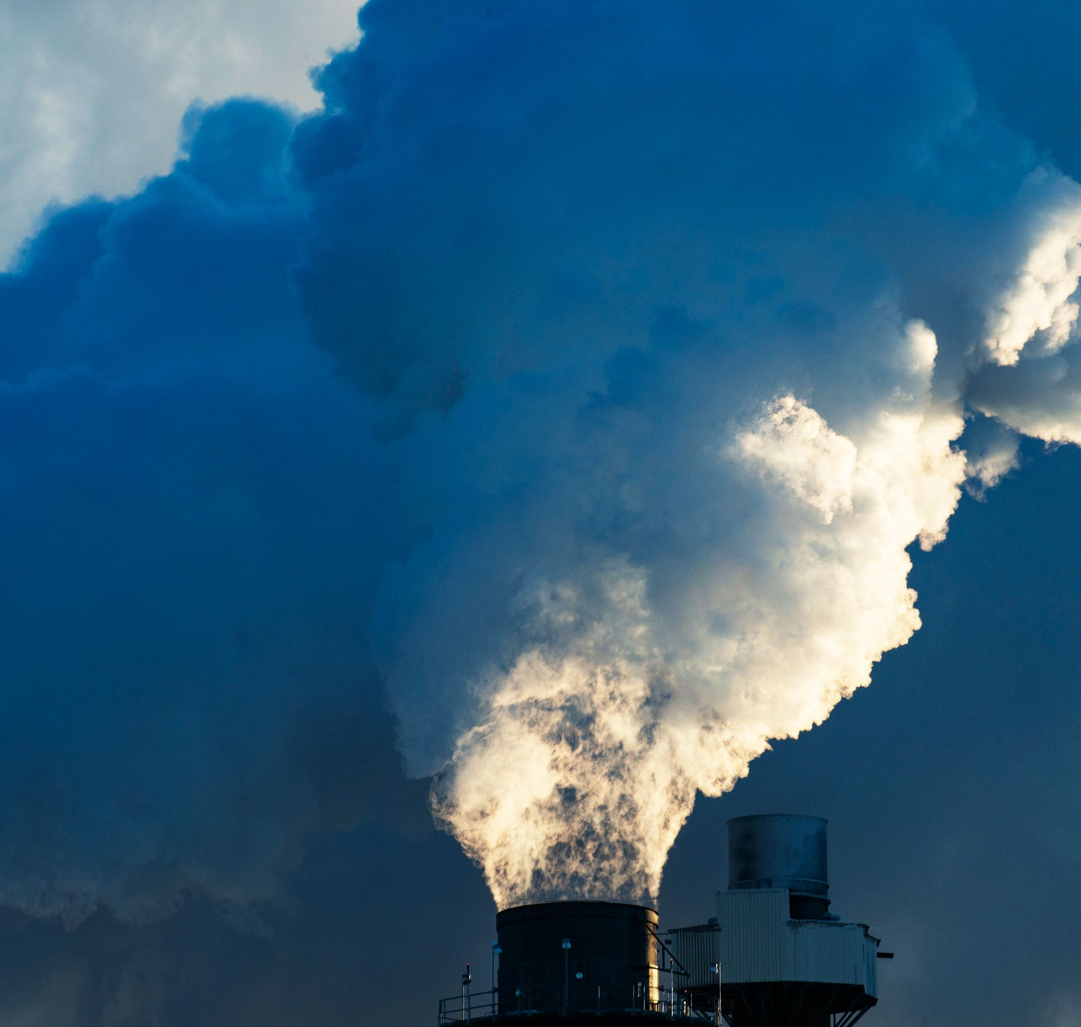
China emits the most carbon per year
Notes:
Image: https://www.reddit.com/r/Infographics/comments/17raxbk/all_the_worlds_carbon_emissions_in_2021/#lightbox

Slide 28
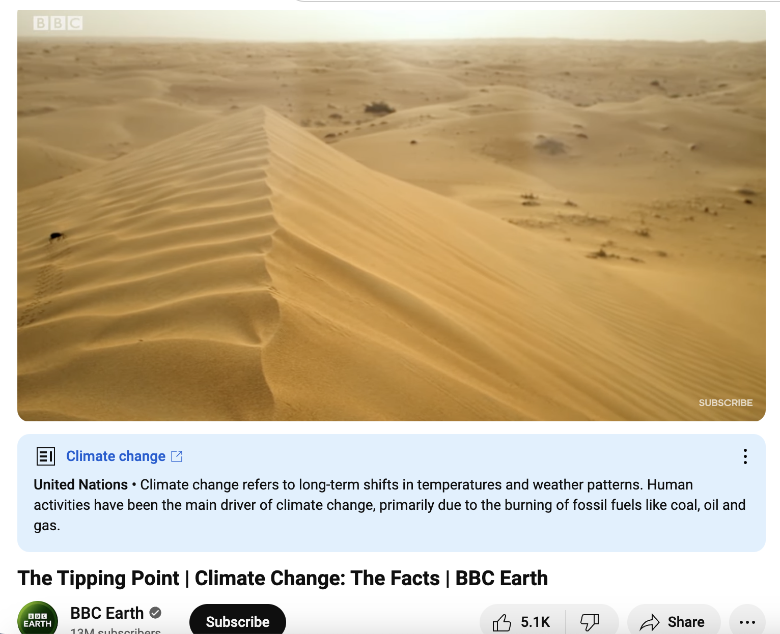
Tipping points
https://www.youtube.com/watch?v=febBRv2Vftk

Slide 29
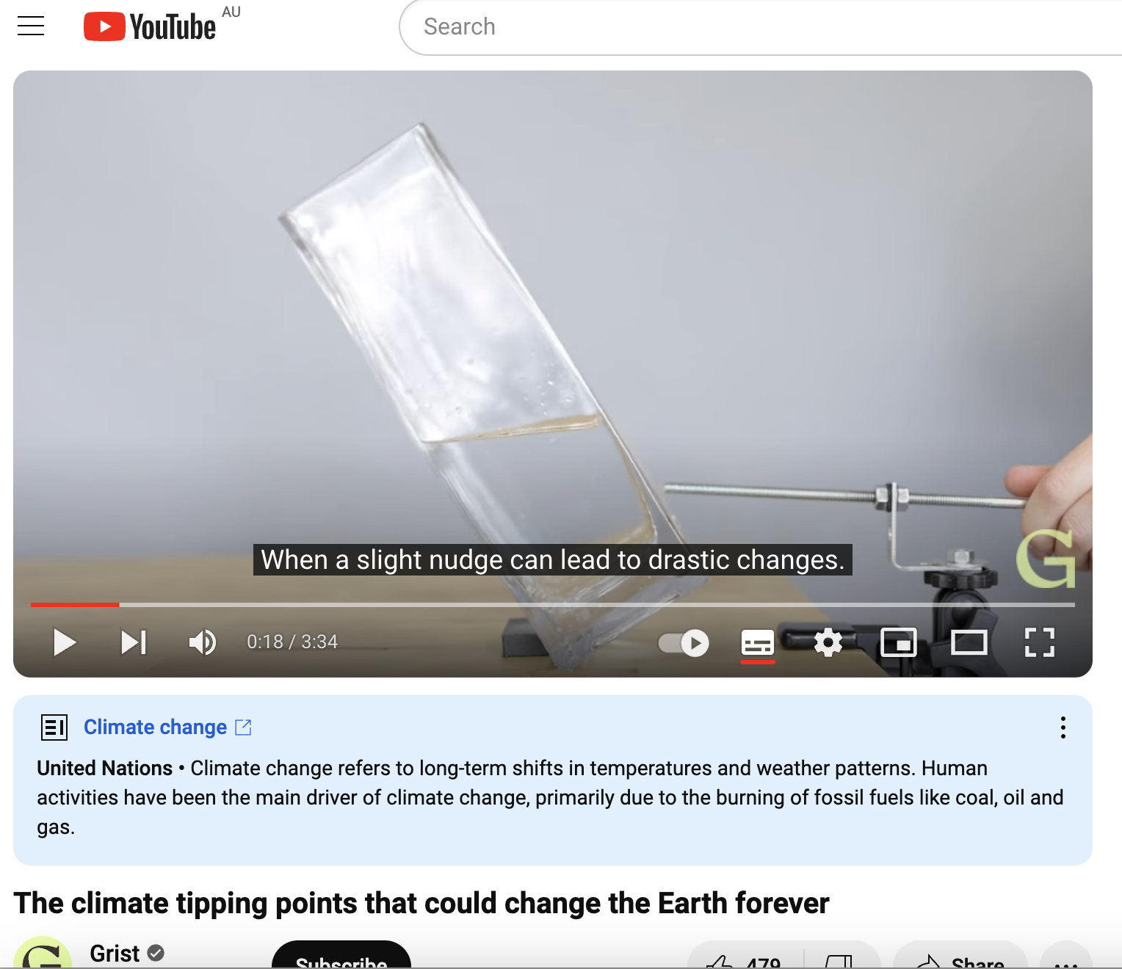
Tipping points
https://www.youtube.com/watch?v=j3q7j8igyN4

Slide 30
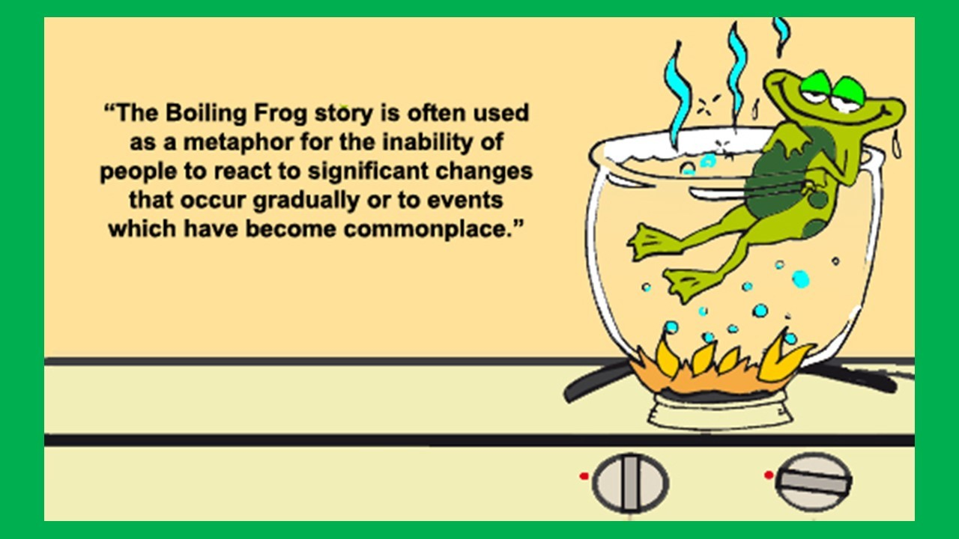
Imagine if we didn’t have these complex models…
it would continue to be business as usual.
Notes:
Image: https://iluearth.com/what-are-the-different-methods-to-remove-carbon-from-environment/

Slide 31
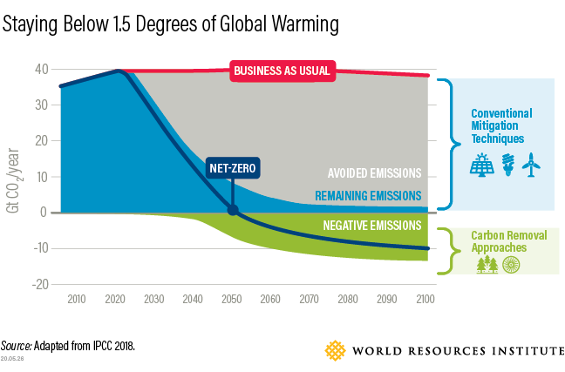
Now, we know what we need to do
Notes:
Image: https://iluearth.com/what-are-the-different-methods-to-remove-carbon-from-environment/

Slide 32


Slide 33
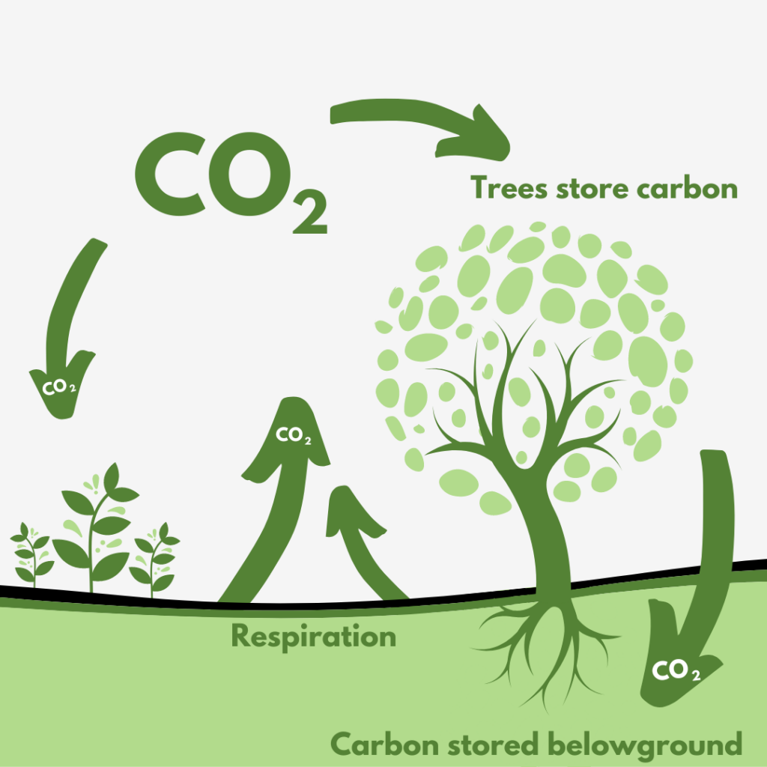
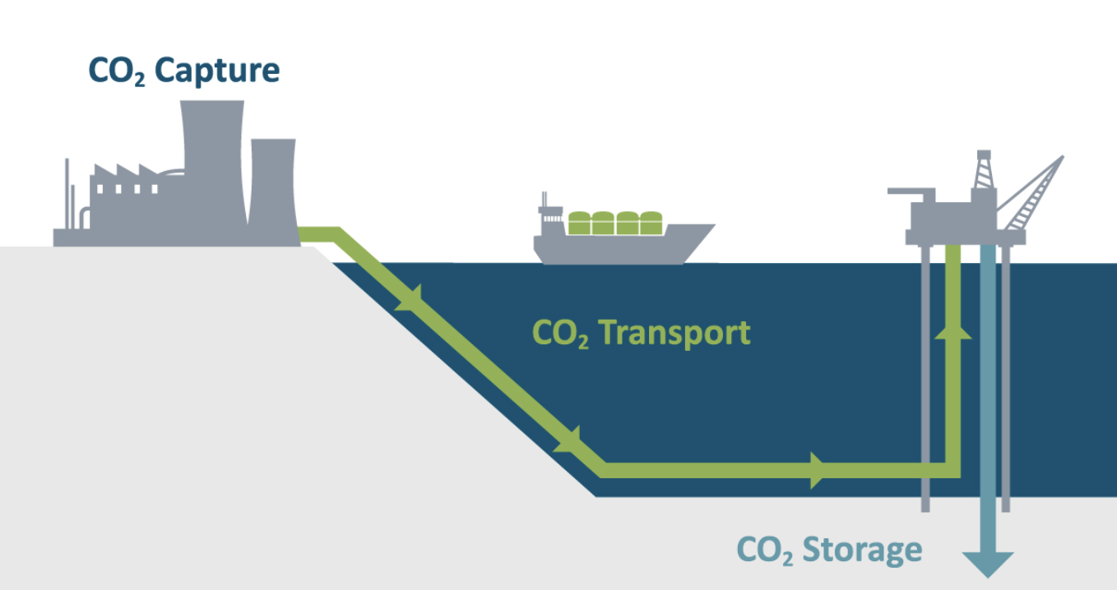
Examples of carbon removal approaches
Plant trees
CO₂ capture and storage (CCS)
Notes:
CCS Image: https://www.solartronisa.com/industries/clean-energy/carbon-capture/what-is-ccs

Slide 34
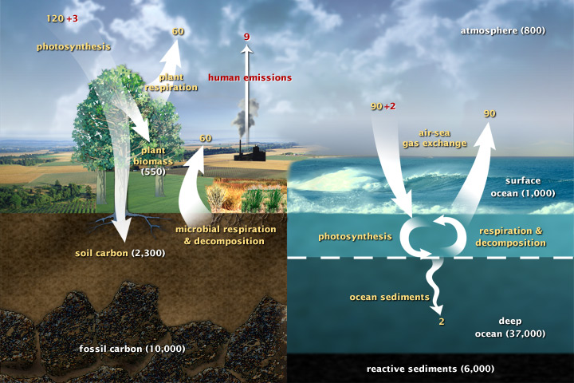
Carbon cycle
(GtCO₂/yr)
Notes:
Image:https://earthobservatory.nasa.gov/features/CarbonCycle

Slide 35
Learning Intention:
Appreciate that effective marine ecosystem management is informed by the development of complex models requiring a broad range of scientific knowledge in gathering data, identifying indicators and ensuring measurement is valid and reliable.
Success Criteria:
Complete Marine Education worksheet ’13. Code Red’
Notes:
Image:

