Slide 1

Marine
Education
Year 11 Marine Science
Student Workbook
Name:
Date:
marineeducation.com.au
Unit 2 Topic 2
Marine Environmental Management
ANSWER BOOK
Content from Marine Science Syllabus
State of Queensland (QCAA) 2025 v1.2
By Gail Riches
© Marine Education 2024 CC BY-NC-SA

Slide 2

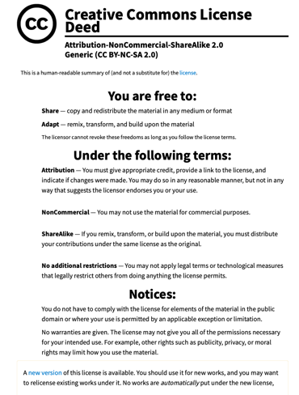
Marine
Education
marineeducation.com.au
© Marine Education 2024 CC BY-NC-SA
Published by Marine Education 2024
ABN: 48765406873
Author: Gail Riches
Email: info@marineeducation.com.au
www.marineeducation.com.au
Course Overview and Learning Objectives derived from Marine Science 2025 v1.2 General senior syllabus, October 2024.
Queensland Curriculum & Assessment Authority PO Box 307 Spring Hill QLD 4004 Australia.
https://www.qcaa.qld.edu.au/downloads/senior-qce/syllabuses/snr_marine_science_25_syll.pdf
Image (front page): The Ocean Agency / Adobe. Published by the Government of WA (2024). Grey Nurse Shark. Department of Biodiversity, Conservation and Attractions. Accessed July 2024 from: https://www.dbca.wa.gov.au/wildlife-and-ecosystems/marine/marine-parks/fun-facts/grey-nurse-shark
Interested persons are invited to contact the author for information or to indicate errors and omissions.
This publication is available to download free-of-charge from the Marine Education website: www.marineeducation.com.au
The sale of this product is strictly prohibited.
Printing at a commercial printer such as Office Works is permitted for school-use only.
Marine Education would like to thank all the teachers, students and industry professionals who kindly shared their work.
© Marine Education 2024 CC BY-NC-SA

Slide 3
Marine
Education
Course Overview
marineeducation.com.au
Marine Science
Year 11 (this booklet)
Assessment
Data Test 10%
Student Experiment 20%
Research Investigation 20%
Exam 50% (only examines SU dot points)
Year 12 (next booklet)
Assessment
Data Test 10%
Student Experiment 20%
Research Investigation 20%
Exam 50% (only examines SU dot points)
Unit 1
Oceanography
Topic 1: An ocean planet
Topic 2: The dynamic shore
Unit 2
Marine Biology
Topic 1: Marine ecology and biodiversity
Topic 2: Marine environmental management
Unit 3
Marine systems – connections and change
Topic 1: The reef and beyond
Topic 2: Changes on the reef
Unit 4
Ocean issues and resource management
Topic 1: Oceans of the future
Topic 2 Managing fisheries
Syllabus Objectives
Describe ideas and findings
Apply understanding
Analyse data
Interpret evidence
Evaluate conclusions, claims and processes
Investigate phenomena
Science Strands
Science understanding (SU) - this is the ONLY Strand that is assessed in the (50%) exam
Science as a human endeavour (SHE)
Science inquiry skills (SIS)
© Marine Education 2024 CC BY-NC-SA
Course Overview

Slide 4
Marine
Education
marineeducation.com.au
Table of Contents
Unit 2 Marine biology | Page
Topic 2: Marine environmental management
Strand: SCIENCE UNDERSTANDING
Subject Matter: Marine conservation
1. Nature’s Capital: Classify the arguments for preserving species and habitats as ecological, economic, social, aesthetic or ethical. | 1
2. Valuing Nature: Describe the direct and indirect values of marine ecosystems of Australia. | 3
3. The Human Dimension of Marine Management: Describe the role of stakeholders in the use and management of marine ecosystems. | 5
4. Psychology Insights: Discuss the specific value systems that identified stakeholders use, i.e. ecocentric, technocentric and anthropogenic. | 7
5. Not aPEELing: Identify issues affecting selected marine ecosystems, including erosion, eutrophication, overharvesting, runoff, sedimentation and urbanisation. | 9
6. Marine Diagnosis: Apply the terms ecosystem resilience, disturbance and recovery as indicators of ‘health’ of marine environments to a chosen case study | 11
Subject Matter: Resources and sustainable use
7. Proceed with Caution: Explain the precautionary principle of the marine environmental planning and management process, and the requirements that marine protected area networks are comprehensive, adequate and representative. | 13
8. How to draw lines and make pretty shapes: Describe criteria used to inform decisions regarding the design of protected marine areas. | 15
9. Marine Park or Paper Park?: Compare the strategies and techniques used for marine environmental planning and management with reference to a specific case study. | 17
10. Research Investigation: Interpret data related to the marine environmental planning and management process. | 19
Strand: SCIENCE AS A HUMAN ENDEAVOUR
11. Evaluate the success of a regional zoning plans or plan management, based on the social, economic and cultural context on which it was considered. | 21
12. Assess the use of remote sensing radar imagery, satellite tracking in real time and remotely piloted aircraft systems (RPAS) (i.e. drones) to enable scientists to measure and monitor populations in large or inaccessible ecosystems such as dugongs. | 22
13. Appreciate that effective marine ecosystem management is informed by the development of complex models requiring a broad range of scientific knowledge in gathering data, identifying indicators and ensuring measurement is valid and reliable. | 23
14. Recognise that in areas where marine management decisions reflect scientific, social, cultural and ethical considerations, Aboriginal knowledges and practices and Torres Strait Islander knowledges and practices related to sea country are often used to complement conservation practices. | 24
© Marine Education 2024 CC BY-NC-SA

Slide 5
Marine
Education
Cognitive Verbs
marineeducation.com.au
Cognitive Verb | Description
Analyse | dissect to ascertain and examine constituent parts and/or their relationships; break down or examine in order to identify the essential elements, features, components or structure; determine the logic and reasonableness of information; examine or consider something in order to explain and interpret it, for the purpose of finding meaning or relationships and identifying patterns, similarities and differences
Apply | Use knowledge and understanding in response to a given situation or circumstance; carry out or use a procedure in a given or particular situation
Appreciate | recognise or make a judgment about the value or worth of something; understand fully; grasp the full implications of
Assess | Measure, determine, evaluate, estimate or make a judgement about the value, quality, outcomes, results, size, significance, nature or extent of something
Calculate | Determine or find (e.g. a number, answer) by using mathematical processes; obtain a numerical answer showing the relevant stages in the working; ascertain/determine from given facts, figures or information
Categorise | Place in or assign to a particular class or group; arrange or order by classes or categories; classify, sort out, sort, separate
Classify | Arrange, distribute or order in classes or categories according to shared qualities or characteristics
Consider | think deliberately or carefully about something, typically before making a decision; take something into account when making a judgment; view attentively or scrutinise; reflect on
Compare | Display recognition of similarities and differences and recognise the significance of these similarities and differences
Contrast | display recognition of differences by deliberate juxtaposition of contrary elements; show how things are different or opposite; give an account of the differences between two or more items or situations, referring to both or all of them throughout
Define | Give the meaning of a word, phrase, concept or physical quantity; state meaning and identify or describe qualities
Describe | Give an account (written or spoken) of a situation, event, pattern or process, or of the characteristics or features of something
Determine | establish, conclude or ascertain after consideration, observation, investigation or calculation; decide or come to a resolution
Discriminate | note, observe or recognise a difference; make or constitute a distinction in or between; differentiate; note or distinguish as different
© Marine Education 2024 CC BY-NC-SA
Cognitive Verbs

Slide 6
Marine
Education
Cognitive Verbs
marineeducation.com.au
Cognitive Verb | Description
Discuss | Examine by argument; sift the considerations for and against; debate; talk or write about a topic, including a range of arguments, factors or hypotheses; consider, taking into account different issues and ideas, points for and/or against, and supporting opinions or conclusions with evidence
Evaluate | Make an appraisal by weighing up or assessing strengths, implications and limitations; make judgements about ideas, works, solutions or methods in relation to selected criteria; examine and determine the merit, value or significance of something, based on criteria
Examine | investigate, inspect or scrutinise; inquire or search into; consider or discuss an argument or concept in a way that uncovers the assumptions and interrelationships of the issue
Explain | Make an idea or situation plain or clear by describing it in more detail or revealing relevant facts; give an account; provide additional information
Explain | Make an idea or situation plain or clear by describing it in more detail or revealing relevant facts; give an account; provide additional information
Explore | look into both closely and broadly; scrutinise; inquire into or discuss something in detail
Identify | Distinguish; locate, recognise and name; establish or indicate who or what someone or something is; provide an answer from a number of possibilities; recognise & state a distinguishing factor or feature
Infer | derive or conclude something from evidence and reasoning, rather than from explicit statements; listen or read beyond what has been literally expressed; imply or hint at
Interpret | use knowledge and understanding to recognise trends and draw conclusions from given information; make clear or explicit; elucidate or understand in a particular way; bring out the meaning of, e.g. a dramatic or musical work, by performance or execution; bring out the meaning of an artwork by artistic representation or performance; give one's own interpretation of; identify or draw meaning from, or give meaning to, information presented in various forms, such as words, symbols, pictures or graphs
Investigate | carry out an examination or formal inquiry in order to establish or obtain facts and reach new conclusions; search, inquire into, interpret and draw conclusions about data and information
Predict | give an expected result of an upcoming action or event; suggest what may happen based on available information
Recall | Remember; present remembered ideas, facts or experiences; bring something back into thought, attention or into one’s mind
Recognise | Identify or recall particular features of information from knowledge; identify that an item, characteristic or quality exists; perceive as existing or true; be aware of or acknowledge
Understand | Perceive what is meant by something; grasp; be familiar with (e.g. an idea); construct meaning from messages, including oral, written and graphic communication
© Marine Education 2024 CC BY-NC-SA
Cognitive Verbs

Slide 7
Marine
Education
1. Nature’s Capital – Classify the arguments for preserving species and habitats as ecological, economic, social, aesthetic or ethical.
Name:
Date:
marineeducation.com.au
Reasons (arguments) to protect nature
Benefiting by default
Biodiversity is Earth’s workforce (without a HR or finance department, lol). As organisms go about their day-to-day lives, trying to survive, grow and reproduce, their attempts to do so (indirectly) become the ecosystem services that we benefit from. For example, when phytoplankton carry out photosynthesis, they are providing us with oxygen to breathe. Our ability to breathe is not why they do it. Phytoplankton carry out photosynthesis to live. And lucky for us, they do! Likewise, fish do not grow for us to have the pleasure of eating them. They grow to survive and reproduce. But, in doing so, we get a nice meal.
Activity: Think, pair, share and complete the table below
Organisms | Functional Trait* | Benefit (ecosystem service) and reason/argument to protect it
Phytoplankton | Photosynthesis | Provides oxygen for us to breathe
Mangroves | Roots | Trap sediment and prevent erosion
Humpback Whales | Annual migration | Spiritual, nutrient transport (via faeces) tourism $...
Dolphins | Social interactions | As above
*Functional traits are morphological, biochemical, physiological, structural, phenological, or behavioural characteristics that influence performance or fitness^{[1]}.
Economic reasons to protect nature
Ecosystem services
The ecosystem services that biodiversity provides also has an economic value ($). For example, the Great Barrier Reef has an economic, social and icon asset value of $56 billion. It supports 64,000 jobs and contributes $6.4 billion to the Australian economy ^{[2]}.
Q. How much money is the Great Barrier Reef worth in AUS dollars? Ans.
6.4 billion
The most valuable thing we extract from the ocean is our existence
Sylvia Earle^{[3]}
Q. Watch the video^{[3]}. What does Sylvia Earle mean by this quote? Ans.
Answers may vary – e.g. the ocean provides us with oxygen to breathe and moderates climate for us to live in.
^{[1} Diaz, S., et al., (2013). Functional traits, the phylogeny of function and ecosystem service vulnerability. Ecology and Evolution. 3(9); 2958-2975.
^{[2]} Great Barrier Reef Foundation (2024). The Value. Accessed July 2024 from: https://www.barrierreef.org/the-reef/the-value
^{[3]} TEDx (2009). Sylvia Earle: How to protect the oceans (TED Prize winner!). Youtube. Accessed 2018 from: https://www.youtube.com/watch?v=43DuLcBFxoY
© Marine Education 2024 CC BY-NC-SA
Unit 2 Topic 2 Science Understanding
1

Slide 8
Marine
Education
2. Valuing nature – Describe the direct and indirect values of marine ecosystems of Australia.
Name:
Date:
marineeducation.com.au
The dollar value of nature
We live in a world where money and economics influences so many of our decisions and behaviours. Thus, ecosystem services are often assigned economic values ($) to assist decision-making.
Q. What do you think of the idea of putting a price (a dollar value) on the environment? Ans.
Answers will vary. For example:
Bad: Disputes over amount.
Good: Environment gets included into cost-benefit analysis.
Making nature’s values visible
The terms direct and indirect values are economics terms. They are part of a formula (see below) used by economists to calculate the total economic value (TEV) of an ecosystem (i.e. its total value in dollars)^{[1]}.
A direct use value is the product value of nature, when you remove or exploit something from it for money. An indirect use value is the social and functional value of nature, when you still use it (indirectly) & benefit from it, but you don’t take anything from it, nor profit from it. The dollar values are calculated using various methods, including market prices, as well as surveys asking how much money people are willing to pay.
How much is it worth if we ‘use’ it? E.g. remove fish from it (direct) OR
use it for recreation (indirect), our mental health (indirect), or even flood protection
(indirect)?
Total Economic Value ($$$)
How much is it worth for just being there (and not being used)?
E.g. how much is preserving the gene pool worth (bequest), the fact it will still exist for future generations to enjoy (existence), or the potential it will be worth more in the future (option)?
Use Value
Non-use Value
Direct
Value
Indirect
Value
Bequest
Value
Existence
Value
Option
Value
Activity: Write examples of Direct Values
Activity: Write examples of Indirect Values
Provisional Ecosystem Services:
Food, Medicines, fuel (oil)
Cultural Services:
Recreation (e.g. whale watching, diving), tourism, education, research
Regulating services
water purification, climate regulation, erosion regulation, carbon storage, flood protection,
Supporting Services
Primary productivity, oxygen production
Cultural Services
Scenery, recreation, mental health
BP
O2
O2
Fish Market Open
Krill Oil Tablets
****Resort
O2
Shell
O2
O2
^{[1]} TEEB (2010). The Economics of Ecosystems and Biodiversity: Mainstreaming the Economics of Nature: A synthesis of the Approach, Conclusions and Recommendations of TEEB. Accessed 2018 from: www.teebweb.org
© Marine Education 2024 CC BY-NC-SA
Unit 2 Topic 2 Science Understanding
3

Slide 9
Marine
Education
3. The human dimension of marine management – Describe the role of stakeholders in the use and management of marine ecosystems.
Name:
Date:
marineeducation.com.au
“Resource management is not about managing the resource, it is about managing the people!”
“The management of marine resources is a politically and culturally driven process,
shaped by human livelihoods and perceptions” ^{[1]}
Q. What is your interpretation of the two statements provided above? Ans.
Environmental management is largely a social construct. Shaped by people’s values, perceptions, cultures, world-views, behaviours and politics.
^{[1]} Levine A. S., Richmond, L. and Lopez-Carr, D. (2015). Marine resource management: culture, livelihoods, and governance. Applied Geography. Vol 59. P. 56-59. DOI: 10.1016/j.apgeog.2015.01.016
Planning for success
People are more likely to follow rules when they’re consulted in the making of the RULES. Thus, good governance invites stakeholder input. Below is an example of the steps involved in the making of rules in marine policy.
Define the objective (what needs to be achieved?). Find out what stakeholders want/need.
Make a plan using an integrated planning approach. Again, include stakeholder input.
Consult with stakeholders (hold meetings and workshops etc.) to gain feedback on the plan.
Collect information (research and monitoring, surveys, data analysis, etc.)
Disseminate the information (publicize, spread the word, educate)
Public consultation (invite the community to have their say)
Draw up papers outlining any issues and options
Develop draft plans
Review
Activity: Tick the components that (should) involve stakeholder consultation &/or participation
Q. What might happen if stakeholders are not included in this process? Ans.
Poor decision-making
Lack of compliance
Environmental damage
Nothing (?)
Costly court cases
Loss of Productivity
Unnecessary delays
Unsustainable outcomes
Costly mistakes
A combined effort
Solving complex environmental problems requires flexible and transparent decision-making that embraces a diversity of knowledges and values. Therefore, in many countries (including ours) stakeholder participation is embedded in policy^{[2]}. The role of the governing party is to provide lots of opportunities for stakeholders to participate in the decision-making process to ensure outcomes are sustainable.
Q. What is the role of the governing party towards stakeholders? Ans.
To provide lots of opportunities for stakeholders to participate in decisions.
Q. What is the role of the stakeholders? Ans.
To participate! Active involvement. Persistence. Educated input. Diplomacy.
^{[2]} Reed, M. S. (2008). Stakeholder participation for environmental management: A literature review. Biological Conservation. Vol 141. Issue 10. P. 2417-2431. DOI: 10.1016/j.biocon.2008.07.014
© Marine Education 2024 CC BY-NC-SA
Unit 2 Topic 2 Science Understanding
5

Slide 10
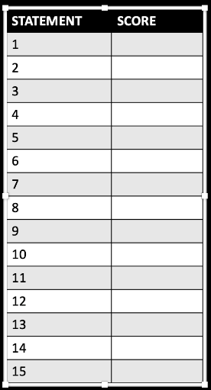
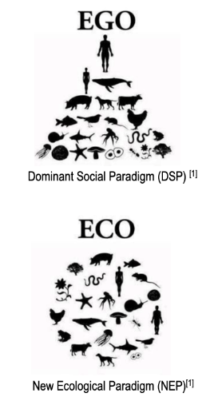
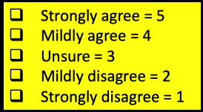



Marine
Education
4. Psychology Insights – Discuss the specific value systems that identified stakeholders use, i.e. ecocentric, technocentric and anthropogenic.
Name:
Date:
marineeducation.com.au
Activity: Participate in the survey (statements and score sheet below. Interpretation of results on ppt).
Below are 15 statements from the New Ecological Paradigm (NEP) scale – a widely used tool to measure the environmental concern of groups of people (e.g. stakeholders).
We are approaching the limit of the number of people the Earth can support.
Humans have the right to modify the natural environment to suit their needs.
When humans interfere with nature it often produces disastrous consequences.
Human ingenuity will ensure that we do not make the Earth unliveable.
Humans are seriously abusing the environment.
The Earth has plenty of natural resources if we just learn how to develop them.
Plants and animals have as much right as humans to exist.
The balance of nature is strong enough to cope with the impacts of modern industrial nations.
Despite our special abilities, humans are still subject to the laws of nature.
The so-called “ecological crisis” facing humankind has been greatly exaggerated.
The Earth is like a spaceship with very limited room and resources.
Humans were meant to rule over the rest of nature.
The balance of nature is very delicate and easily upset.
Humans will eventually learn enough about how nature
works to be able to control it.
If things continue on their present course, we will soon
experience a major ecological catastrophe.
Score sheet
Q. Do you share the view that shortages in natural resources will always be overcome by advances in technology? If Yes, you are also ‘technocentric’
Worldviews
“We don’t see things as they are.
We see them as we are”^{[2]}.
A worldview is a set of assumptions about physical and social reality that effect cognition and behaviour. It’s a way of describing the universe and life within it, both in terms of what is and what ought to be done^{[2]}. For example, worldviews are one’s philosophy of life, world hypothesis, world outlook, visions of reality or self-and-world construct. There are many models (paradigms and theories) that are used to measure people’s worldviews (in order to explain and predict their behaviours). One is Cultural Theory….
Cultural Theory
You can map people’s worldviews (which is collectively the culture) on two dimensions. The y-axis is a scale of how much we think we should stick to the rules, with rule-book followers at the top, and those who couldn’t care for rules at the bottom. The x-axis is a scale of how much we think we can achieve on our own, as opposed to wanting to be part of a group and to do what the group says.
Must follow rules
Fatalism
Hierarchism
Individualism
Egalitarianism
Activity: Mark your position along the x axis (social integration) and y axis (social regulation). Repeat as a class. The position of all the plots reveals the class culture.
Stakeholder values?
As you can see, there are many flavours of society and many different viewpoints.
Q. What might the following stakeholders say about what we should do about climate change? Ans.
The egocentric stakeholder would say …
The ecocentric stakeholder would say…
The technocentric stakeholder would say…
Answers will vary
^{[1]} Dunlap R.E.V.L., Van Liere, K.D., Mertig, A.G., and Jones, R.E. (2000). Measuring Endorsement of the New Ecological Paradigm: A Revised NEP Scale. Journal of Social Issues. 56(3):425-442. DOI: 10.1111/0022-4537.00176
^{[2]}Koltko-Rivera, M. E. (2004). The Psychology of Worldviews. Review of General Psychology. 8(1):3-58. DOI: 10.1037/1089-2680.8.1.3
© Marine Education 2024 CC BY-NC-SA
Unit 2 Topic 2 Science Understanding
7

Slide 11
Marine
Education
5. Not aPEELing – Identify issues affecting selected marine ecosystems, including erosion, eutrophication, overharvesting, runoff, sedimentation and urbanisation.
Name:
Date:
marineeducation.com.au
Marine Ecosystem | Issues (add more if you can think of more!)
Estuaries | Catchment run-off, changing river flows, acid soil run-off
Coastal Lakes | Urbanisation, eutrophication, sedimentation, saltwater encroachment
Saltmarshes | Urbanisation, sea level rise, introduced species
Mangroves | Urbanisation, contaminants, climate change
Rocky Shores | Overharvesting, climate change (e.g. storm damage)
Sand beaches | Coastal erosion
Seagrass Meadows | Sediment and nutrient run-off
Coral Reef | Anchor damage, climate change (e.g. warming), ocean acidification, overfishing
Deep Sea | Overfishing, damaging fishing methods
Activity: Construct a PEEL paragraph to highlight an issue affecting a selected ecosystem from above
Point
It can be argued that….
This source suggests that….
Evidence suggests that….
It can be inferred that…..
It is evident that…..
Evidence
Comparable Evidence
For example….
Firstly…..Secondly….Lastly….
Furthermore…..
In addition….
Similarly…..
Moreover….
Contrasting Evidence
However…..
Conversely….
Alternatively…..
In contrast…..
On the other hand…..
Explanation
This means that…
What this shows is…..
Therefore…..
As a result…..
Because of this…..
Consequently…..
Link
It is clear that….
This is important because….
In conclusion…..
To summarise…..
The significance of this is…..
© Marine Education 2024 CC BY-NC-SA
Unit 2 Topic 2 Science Understanding
9

Slide 12
Marine
Education
6. Marine Diagnosis – Apply the terms ecosystem resilience, disturbance and recovery as indicators of ‘health’ of marine environments to a chosen case study
Name:
Date:
marineeducation.com.au
Ecosystem Resilience: the capacity of an ecosystem to recover from a disturbance or withstand ongoing pressures.
Ecosystem Disturbance: a temporary change in environmental conditions that alters physical structures or arrangements of biotic and abiotic elements within an ecosystem; can occur over larger temporal scales and affect diversity; can be natural or anthropogenic.
Ecosystem Recovery: the return of a damaged ecological system and associated ecosystem services to a stable state.
Functional biodiversity
An ecosystem’s resilience and recovery rate following a disturbance is largely dependent on the functional biodiversity of the ecosystem. What is that you ask? It is quite simply another way to measure biodiversity. But instead of measuring, for example, how many different species there are, it is measuring how many different functional groups there are. What is a functional group? A functional group is a group of organisms that share a similar function^{[1]}. For example, grazers that intensely graze on epilithic algal turf such as rabbitfish, angelfish and surgeonfish comprise one functional group. Browsers that constantly feed on macro-algae is another. It takes many different functional groups to keep the ecosystem healthy. Why? Let me explain using an analogy (stay with me). Think of biodiversity as a workforce. Workers have job descriptions that help the business (ecosystem) to remain productive and resilient to withstand disturbances such as price hikes or flu epidemics (pollutants, storms, outbreaks of disease etc.). If you start removing job descriptions (functional groups) from the business model, the business (ecosystem) will be unhealthy and its products (ecosystem services) will diminish in quality and quantity. If too many job descriptions go, the resilience of the business (ecosystem) will decline resulting in a slow recovery post disturbance. Worse, the business (ecosystem) may never recover (undergo a phase shift). Those once dependent on the business will suffer too.
Q. In the graph below, what percentage of jobs are done by only one species? Ans.
38.5%
250
200
150
100
50
0
Indo-Pacific Fish Functional Diversity
This graph shows the functional diversity of fish communities in the Indo-Pacific region, which includes the Great Barrier Reef. While there are some jobs (functional groups) that are performed by lots of fish, the steep downward slope of the curve indicates that most jobs are done by only a few species^{[2][3]}.
Number of species per job
(functional redundancy)
Vulnerable jobs
What happens if
a disturbance
takes them
out?
Popular jobs
Number of jobs done by only one species
38.5%
Average number
of species
per job = 7.9
 | 100 | 200 | 300 | 400 | 500
Number of Jobs (Functional Groups)
Q. What happens to ecosystem health when functional diversity declines (jobs go)? Ans.
(Use the terms ecosystem resilience, disturbance and recovery in your response)
Ecosystem health declines. Ecosystem resilience declines. Recovery is slow (if at all) following disturbance/s.
^{[1]} Bellwood D. R. and Green A. L. (2009). Monitoring functional groups of herbivorous reef fishes as indicators of coral reef resilience – A practical guide for coral reef managers in the Asia Pacific region. IUCN working group on Climate Change and Coral Reefs. IUCN. Gland. Switzerland. Page 9.
^{[2]} Adapted from: Bellwood, D. and Mallela, J. (2016). Biodiversity and the Great Barrier Reef. Australian Academy of Science. Accessed 2018 from: www.science.org.au/curious/great-barrier-reef
^{[3]} Adapted from: Mouillot, D., Villeger, S., Parravicini, V., Kulbicki, M., Arias-Gonzalez, J.E., Bender, M., Chabanet, P., Floeter, S.R., Friedlander, A., Vigliola, L. and Bellwood, D.R. (2014). Functional over-redundancy and high functional vulnerability in global fish faunas on tropical reefs. PNAS. 111(38) 13757-13763. 10.1073/pnas.1317625111.
© Marine Education 2024 CC BY-NC-SA
Unit 2 Topic 2 Science Understanding
11

Slide 13
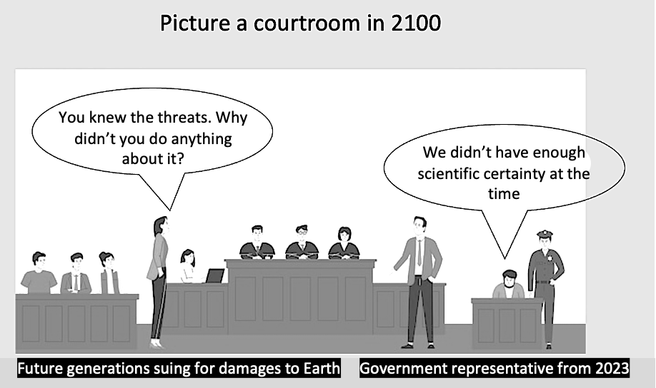

Marine
Education
7. Proceed with caution! – Recall the precautionary principle of the marine environmental planning and management process as well as a requirement that any network of marine protected areas be comprehensive, adequate and representative
Name:
Date:
marineeducation.com.au
The preCAUTIONary principle
“Where there are threats of serious or irreversible damage, lack of full scientific certainty shall not be used as a reason for postponing cost-effective measures to prevent environmental degradation”.
The intent of the Precautionary Principle is clearly to NOT allow the lack of (scientific) certainty to be used to prevent action that should be taken against threats of serious or irreversible damage.
Q. What is the precautionary principle? Ans.
Where there are threats of serious or irreversible damage, lack of full scientific certainty shall not be used as a reason for postponing cost-effective measures to prevent environmental degradation.
MPAs (Marine Protected Areas)
The Australian government recognised networks of MPAs as being a cost-effective measure to prevent environmental degradation, so long as they were comprehensive, adequate and representative. Hence, the precautionary principle (written into Australian law) gave the green light for governments in Australia to declare more areas of ocean as MPAs. The Australian government even tweeked the definition a little, specifically for the implementation of the National Representative System of Marine Protected Areas (NRSMPA). The (new) definition states that, “the absence of scientific certainty should not be a reason for postponing measures to establish MPAs to protect representative ecosystems”.
Q. Do you think that Australia’s MPA networks are
comprehensive, adequate and representative? Ans.
Environmental Management Decisions
References to the precautionary principle have since been incorporated into many laws and policies including - fisheries legislation, management of the Great Barrier Reef, rules governing the grant (or rejection) of development approvals, and other natural resource management policy decisions.
Q. True or False. The precautionary principle can be used to reject a development. Ans.
© Marine Education 2024 CC BY-NC-SA
Unit 2 Topic 2 Science Understanding
13

Slide 14
Marine
Education
8. How to draw lines & make pretty shapes – Understand that criteria are used to inform decisions regarding the design of protected marine areas
Name:
Date:
marineeducation.com.au
What is governance?
Governance refers to who makes all the decisions and how those decisions are made. Governance also describes who has all the influence, authority and accountability. Governance is often the job of the government (i.e. GBRMPA). Particularly in Australia. However, private individuals, organisations (i.e. not-for-profit), Indigenous peoples and local communities can also be the governing party^{[1]}. Sometimes, it is a collaborative effort between community and government (i.e. co-managed fisheries).
Q. What is governance? Ans.
Who makes all the decisions and how they are made.
What is a Marine Protected Area (MPA)?
Marine Protected Areas go by many names, come in lots of different shapes and sizes and offer different levels of protection. There are marine parks (MP), extensive marine management areas (MMA), small no-take fishery reserves (NTR) and locally managed marine areas (LMMA) to name a few. Some MPAs are further divided into zones. For example, in the Great Barrier Reef (GBR) marine park, the highest level of protection is in the pink zone.
It is a no-go zone. The second highest level of protection in the GBR marine park is the green zone (no-take zone). In contrast, the lowest level of protection in the GBR marine park, where fishing is allowed, is the blue zone.
Q. What does MPA stand for?
Marine Protected Area
The DESIGN phase of an MPA….
It is no use just drawing a line on a map to indicate where the border of an MPA might go. It is not a game of pin the tale on the donkey. There’s a lot more to it than that! The following list of criteria can be used to decide whether an area should be included in an MPA or to determine the boundaries of an MPA^{[2]}.
Naturalness | The extent to which the area has been protected from, or has not been subject to human change.
Biogeographic importance | Either contains rare biogeographic qualities or is representative of a biogeographic ‘type’ or types. Contains unique or unusual geological features.
Ecological importance | Contributes to maintenance of essential ecological processes or life-support systems. E.g. source for larvae for downstream areas. The degree to which the area (either by itself or in association with other protected areas) encompasses a complete ecosystem (connectivity). Contains a variety of habitats (representativeness). Contains habitat for rare or endangered species. Contains nursery or juvenile areas. Contains feeding, breeding or rest areas. Contains rare or unique habitat for any species. Preserves genetic diversity (i.e. abundant or diverse).
Economic importance | Existing or potential contribution to economic value by virtue of its protection e.g. protection of an area for recreation, subsistence, use by traditional inhabitants, appreciation by tourists and others or as a refuge nursery area or source of supply for economically important species.
Social importance | Existing or potential value to the local, national or international communities because of its heritage, historical, cultural, traditional, aesthetic, educational or recreational qualities.
Scientific importance | Value for research and monitoring.
International or National significance | is or has the potential to be listed on the World or a national Heritage List or declared as a Biosphere Reserve or included on a list of areas of international or national importance or is subject to an international or national conservation agreement.
Practicality/feasibility | Degree of insulation from external destructive influences. Social and political acceptability, degree of community support. Accessibility for education, tourism, recreation compatibility with existing uses. Ease of management. Compatibility with existing management regimes.
Q. Name a location/ecosystem that is not protected. Ans.
Q. Should it be protected, based on the above criteria? Ans.
Q. Why/why not? Ans.
[Yes] [No] Circle your answer
^{[1]} Lewis, N., Day, J.C., Wilhelm, A., Wagner, D., Gaymer, C., Parks, J., Friedlander, A., White, S., Sheppard, C., Spalding, M., San Martin, G., Skeat, A., Taei, S., Teroroko, T. and Evans, J. (2017). Large-Scale Marine Protected Areas: Guidelines for design and management. International Union for Conservation of Nature and Natural Resources (IUCN). Gland, Switzerland: IUCN. Xxviii + 120 pp. P.27. ISBN: 9782831718644
^{[2]} Adapted from: Kenchington, R. & Kelleher, G. (1992). Guidelines for Establishing Marine Protected Areas. A Marine Conservation and Development Report. IUCN. Gland, Switzerland. Vii + 79 pp. P15-16. ISBN: 2831701058.
© Marine Education 2024 CC BY-NC-SA
Unit 2 Topic 2 Science Understanding
15

Slide 15
Marine
Education
9. Marine Park or Paper Park? – Compare the strategies and techniques used for marine environmental planning and management with reference to a specific case study
Name:
Date:
marineeducation.com.au
Top-down or Bottom-up?
Government makes the rules
Top-down governance is when the government makes the rules and the community must comply.
If the community does not comply and the regulating body is unable to enforce the rules, the marine park quickly becomes a ‘paper park’ (as good as the paper it is written on) ^{[1]}. Unfortunately there are many paper parks^{[2]}.
Bottom-up governance is when the community makes the rules. Arguably, customary and traditional management practices and taboos have been doing this for years. Advantages include ownership and (therefore) compliance. Disadvantages include lack of funding, technical/scientific support, and lacking legal status.
Community makes the rules
E.g. management strategies for GBR marine park….
E.g. management strategies of Nguna-Pele MPA….
Management strategy/technique | Who it applies to
GBRMPA Act and regulations (rules) | All marine park users
Zoning plans (what is allowed, permits) | All marine park users
Economic Instruments | Most commercial operations
Surveillance & enforcement | All marine park users & visitors
Research and monitoring | (informs) management
Education and interpretation | Targeted MP users and visitors
It began as a small area closure in the 1990’s when Fisheries began speaking to communities on Efate Island (Vanuatu) about the benefits of area closures for trochus stock recovery. Later, a turtle monitoring programme gained momentum.
The message of conservation began to spread with each village-based marine closure, taboo or conservation area. By 2003 four chiefs from Piliuru, Worearu, Unakap and Taloa established the Nguna-Pele MPA network. Today 16 villages have officially joined the network. Each village has set aside one or two reefs to protect. Working together rather than as individual villages, they have improved food and livelihood security and maintained critical ecosystem processes and services. Community lectures, village clean-up campaigns and school outings are all part of the ongoing environmental awareness programme. Regular monitoring and review ensures goals and aspirations of member communities and residents are being met.
Adapted from: Day,J.C.(2002). Zoning: lessons from the GBRMPA. Ocean and Coastal Mgmt. (45) p.151
UNDP (2012 ). Nguan-Pele Marien and Land Protected Area Network, Vanuatu. Equator Initiative. NY.
Strategies and Techniques
Strategies and techniques for marine environmental planning and management include policies (mission statements), plans (game plans), regulations (rules) and legislation (laws). For example,
as manager of a fishery, your policy is to ensure fish for the future. Your plan includes input controls and output controls. To enforce these controls, you have rules and regulations that people must follow. If passed by government, these become law under another piece of legislation called an Act (e.g. Fisheries Act 1994).
Input Controls
Fishing effort restrictions that apply before the fish are caught. For example, limiting the number of boats (i.e. through licencing), seasonal closures, gear restrictions and MPA’s.
Output Controls
Imposing limits on how many fish are taken out of the water, after the fish are caught.
For example, assigning quotas, total allowable catch (TAC) limits, bag limits, size limits and throwing the pregnant females back.
Activity: Compare the strategies and techniques used for marine environmental planning and management with reference to a specific case study.
Straight from the syllabus:
Plans: zoning plans or plans for management for Cairns, Hinchinbrook, Whitsundays, Great Sandy Strait, Moreton Bay, Shoalwater Bay
Policies: Reef 2050 long-term sustainability plan
Regulations: commercial and recreational fishing, permits for activities
Legislation: Great Barrier Reef Marine Park Act 1975 (Cwlth)
^{[1]} Bennet, N. J. and Dearden, P. (2014). From measuring outcomes to providing inputs: Governance, management, and local development for more effective marine protected areas. Marine Policy. (50) A p.96-110. DOI: 10.1016/j.marpol.2014.05.005
^{[2]} Ban, N.C., Adams, V.M., Almany, G.R., Ban, S., Cinner, J.E., McCook, L.J., Mills, M., Pressey, R.L. and White, A. (2011). Designing, implementing and managing marine protected areas: Emerging trends & opportunities for coral reef nations. Journal of Experimental Marine Biology & Ecology. (408) p.21-31. DOI: 10.1016/j.jembe.2011.07.023
© Marine Education 2024 CC BY-NC-SA
Unit 2 Topic 2 Science Understanding
17

Slide 16
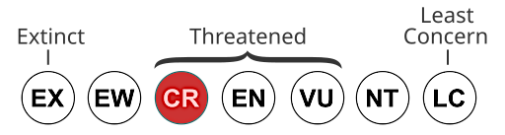
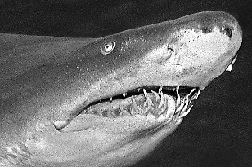

Marine
Education
10. Research Investigation – Interpret data related to the marine environmental planning and management process.
Name:
Date:
marineeducation.com.au
The story of the critically endangered Grey Nurse Shark (GNS)
Despite their terrifying toothy grin, grey nurse sharks (Carcharias taurus) are mostly harmless to humans.
Due to loss of habitat and overfishing, the east coast population is now threatened with extinction, listed as critically endangered (as per the IUCN Red List of Threatened Species – see below) and thus protected.
EW: Extinct in the Wild
CR: Critically Endangered
EN: Endangered
VU: Vulnerable
NT: Near Threatened
Explosive shotgun powerheads invented and killed many sharks (thought to be dangerous).
Reduced numbers of GNS caught in shark nets. The game-fishing industry also noticed a decline in numbers, voluntarily banned GNS captures in 1979. GNS listed as vulnerable and protected in 1984.
1992 - First official count
1997 - GNS upgraded to endangered.
2001 – First large-scale count (300-3000 sharks with 40/60 critical habitat sites abandoned). GNS listed as critically endangered
Survey Methods include tagging (genetic, physical and natural tags).
2017 – estimates of 2000-3000 sharks.
Sharks turning up at previously abandoned habitat sites and many more at Wolf Rock Qld.
Q. When was the GNS first protected (not allowed to be caught)? Ans.
1984
Recovery Plans
If a species or community is listed as ‘threatened’ under the EPBC Act, the Minister for Environment and Water may decide to adopt a recovery plan to outline management actions to stop their decline. A recovery plan was made for the east coast population of grey nurse sharks (GNS) in 2002 and in 2014. By 2009 (the first plan review) 10 GNS dive sites in NSW were protected and 4 GNS dive sites in Qld were protected. This meant that as the sharks (in southern NSW) embarked on a journey to migrate north to breed at Wolf Rock in Qld (and then go back again), some of their ‘stop-over’ points (called GNS aggregation or critical habitat sites) were protected. But not all. Divers want more sites protected (as no-take zones). But there has been push-back from politicians afraid of upsetting fishers by declaring more no-take zones. Divers argue the spill-over effect would instead improve fishing. Note: the spill-over effect is when the benefits of an MPA (more species) spills over the borders of the MPA and into the surrounding water. Between 2007 and 2024, a total of ZERO GNS aggregation sites were protected.
Q. When is a recovery plan first made? Ans.
When a species is listed as threatened and the minister decides to make one.
Q. Has there been any GNS aggregation sites protected since the 2014 recovery plan? Ans.
© Marine Education 2024 CC BY-NC-SA
Unit 2 Topic 2 Science Understanding
19

Slide 17
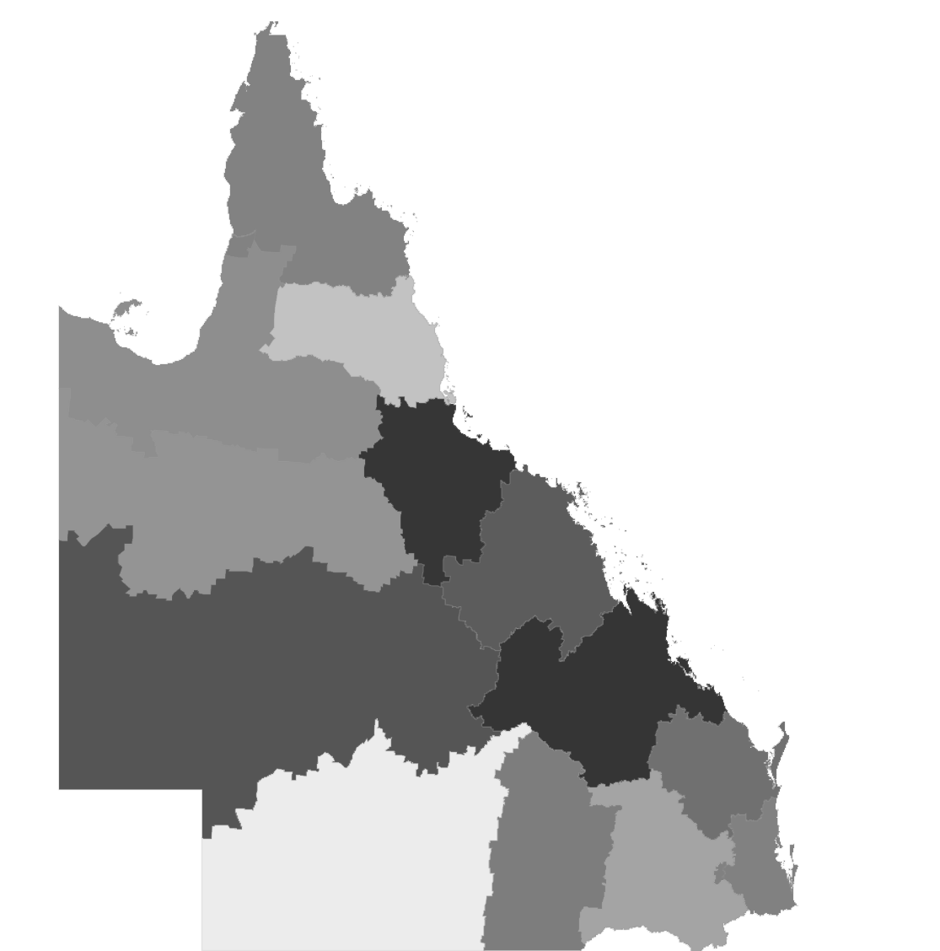
Marine
Education
11. Regional Values - Evaluate the success of a regional zoning plan or plan management, based on the social, economic and cultural context on which it was considered.
Name:
Date:
marineeducation.com.au
Regional Plans
Regional plans are government documents that guide land use planning and development for each region of Qld.
Q. What is a Regional Plan? Ans.
Government documents that guide land use planning and development for each region of Qld.
The Qld government writes them by evaluating what is considered important to the region (socially, economically and culturally). Different regions value different things.
Activity: Write what is considered important to each region. Hint: answers on ppt and government website ^{[1]}. Choose one. Evaluate its sustainability (smiley face ☺ or sad face ☹ ).
Cape York: support Indigenous communities and protect the environment
Far North Qld: Manage the high amount of Urban Growth in the region so it’s sustainable and enhances quality of life
North Qld: Grow an already strong economy
Mackay, Isaac & Whitsundays: Ensure the region grows and changes in a sustainable way
Central Qld: Foster the four economic pillars of Central Qld: agriculture, resources (coal, CSG/LNG), tourism and construction
Wide Bay Burnett: Retain youth and attract new residents to the region
SE Qld: Sustainably accommodate a growing population of 6 million people by 2046
^{[1]} Department of State Development, Infrastructure and Planning (2025). Regional Planning. Accessed 23/05/2025 from: https://www.planning.qld.gov.au/planning-framework/plan-making/regional-planning
© Marine Education 2024 CC BY-NC-SA
Unit 2 Topic 2 Science as a Human Endeavour
21

Slide 18
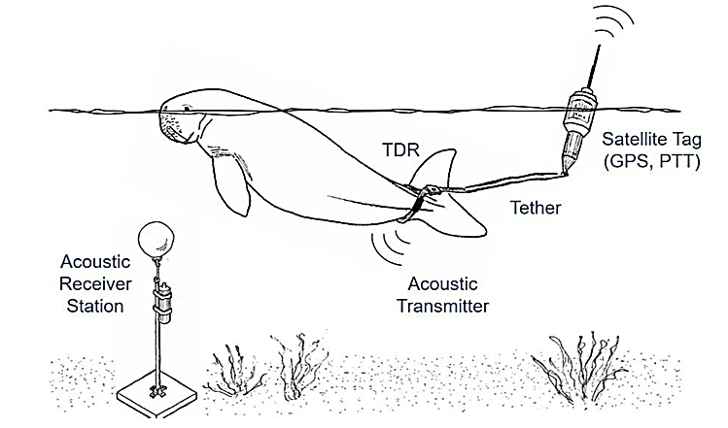
Marine
Education
12. Follow Me - Assess the use of remote sensing radar imagery, satellite tracking in real time and remotely piloted aircraft systems (RPAS) (i.e. drones) to enable scientists to measure and monitor populations in large or inaccessible ecosystems such as dugongs.
Name:
Date:
marineeducation.com.au
“If you want to protect a species, you have to know where it is”
NOAA Fisheries scientist Jeffrey Polovina ^{[1]}
Drones
Drones are remotely piloted aircraft systems (RPAS). Drones are used to find large marine animals in the wild, such as whales. Once found, drones can also be used to attach tags. Using drones to attach tags means animals are spared the stress of being caught or chased by people in boats. Instead, the drone operator comes in from above (with the operator on a boat up to 500m away). When the animal comes to the surface, the tag is released via a radio-controlled pin mechanism on the underside of the drone. To ensure the tag ‘sticks’ each tag is fitted with attachments ^{[2]}. The tag stays with the animal, collecting lots of data until it’s designed ‘release.
Q1. What does RPAS stand for? Ans.
Remotely piloted aircraft system
Q2. How do they ensure the tag ‘sticks’? Ans.
Each tag is fitted with attachments
Tracking animals via satellite
If the tag is a satellite tag, when the animal surfaces, the tag will ‘ping’ its stored information to a satellite. Some satellite tag readings not only show where the animals are travelling, but also how deep. When combined with remote sensing radar imagery and other satellite data of ocean currents, fronts and eddies, we see how animals are navigating through and around these features ^{[2]}.
Q3. True or False? Satellite tags fitted with GPS can track an animal’s location. Ans.
True
Tracking Dugongs
Dugong location can be tracked every hour using GPS satellite tags attached to their tails via a 3m long tether ^{[3]}. Notably, dugongs can also be tracked using acoustic transmitters (different to a satellite tag) but the location of the animal with an acoustic transmitter is only recorded when they swim within 800m of an acoustic receiver (and recording) station (whereby divers later retrieve data).
Activity: DISCUSS the advantages and disadvantages of satellite tags
Above: Illustration of tracking equipment (not to scale) ^{[3]}
^{[1]} Quote: https://www.fisheries.noaa.gov/feature-story/satellite-tags-reveal-how-animals-see-ocean
^{[2]} NOAA (2014). Satellite tags reveal how animals see the ocean. Accessed 23/05/2025 from: https://www.fisheries.noaa.gov/feature-story/satellite-tags-reveal-how-animals-see-ocean
^{[3]} Zeh, Daniel R. (2022) Using acoustic and satellite tracking data to better understand the factors associated with marine mammal habitat use and movements
within urban coastal environments: dugongs in Moreton Bay, Queensland. PhD. Thesis, James Cook University.
© Marine Education 2024 CC BY-NC-SA
Unit 2 Topic 2 Science as a Human Endeavour
22

Slide 19

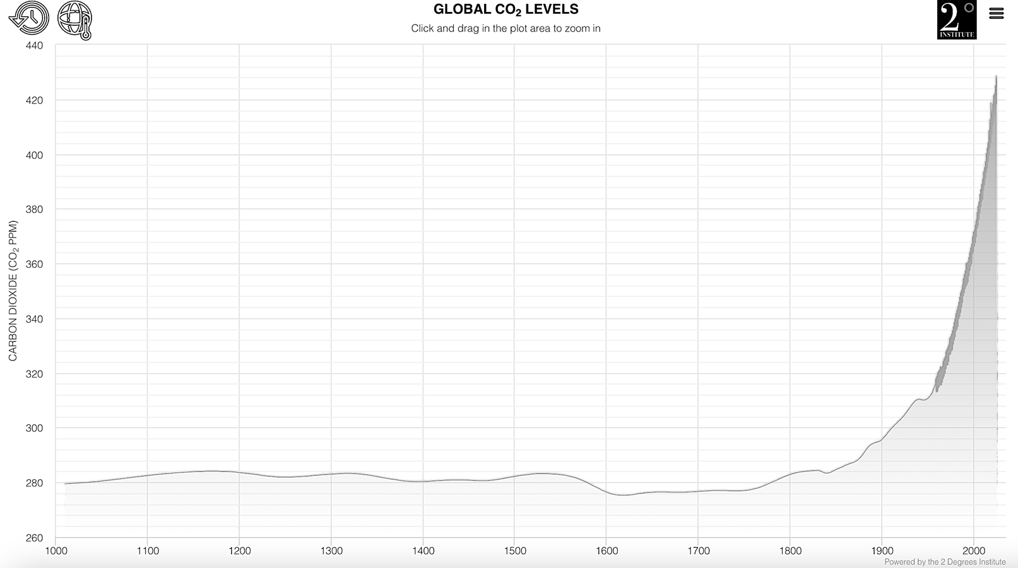

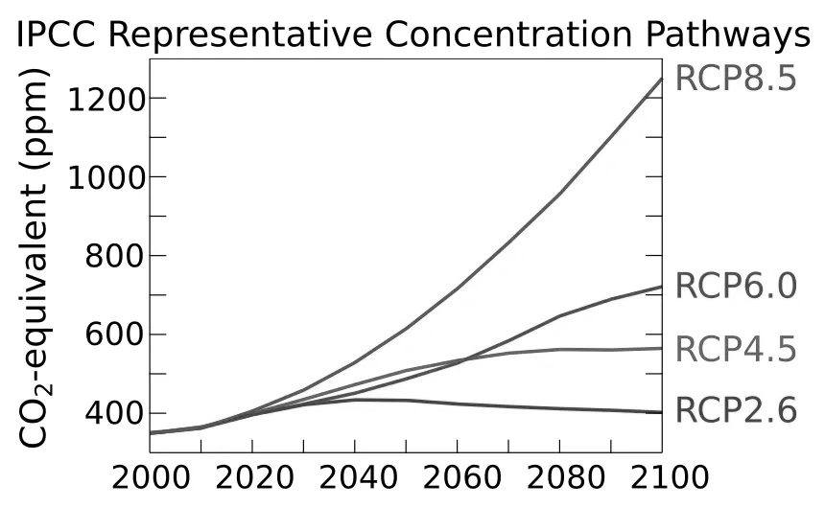
Marine
Education
13. Code Red - Appreciate that effective marine ecosystem management is informed by the development of complex models requiring a broad range of scientific knowledge in gathering data, identifying indicators and ensuring measurement is valid and reliable.
Name:
Date:
marineeducation.com.au
Mirror mirror on the wall…
Managing ecosystems requires us to predict the future…so we know what will happen when we make a decision. The future is predicted using computer models (not crystal balls). For example, computer models are used to predict the effects of decisions made today, and in the future, about Climate Change and our carbon emissions. Computer models use mathematical equations and data inputs from observations to make those predictions.
Q1. What ocean parameters are satellites capable of measuring? Ans.
Satellites can measure depth (bathymetry), ocean colour, circulation, sea ice, sea surface height, temperature, weather …
2020
2100
© Marine Education 2024 CC BY-NC-SA
Unit 2 Topic 2 Science as a Human Endeavour
23

Slide 20

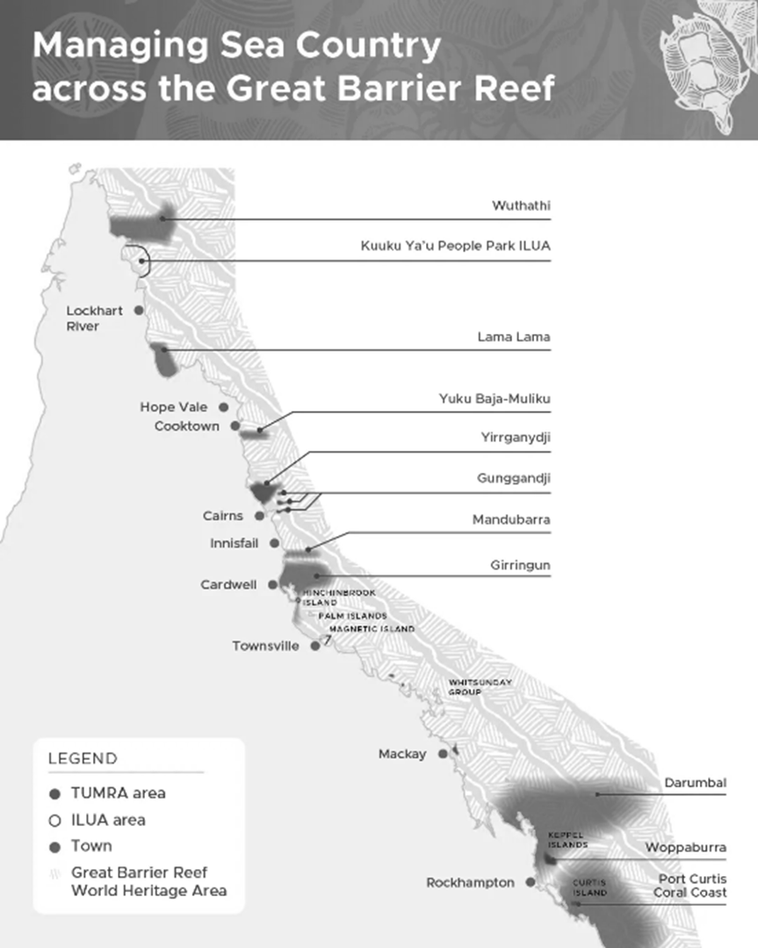
Marine
Education
14. TUMRAs - Recognise that in areas where marine management
decisions reflect scientific, social, cultural and ethical considerations, Aboriginal knowledges and practices and Torres Strait Islander knowledges and practices related to sea country are often used to complement conservation practices.
Name:
Date:
marineeducation.com.au
Traditional Use of Marine Resources Agreements (TUMRAs).
Today, more than 43% of the Marine Park coastline is managed under these agreements. TUMRAs are community-based plans for management of traditional resources which are accredited in legislation. The agreements describe how GBR Traditional Owner groups work in partnership with the Australian and Queensland governments to manage traditional use activities on their Sea Country.
Artwork: https://japingkaaboriginalart.com/collections/black-and-white-aboriginal-art/
© Marine Education 2024 CC BY-NC-SA
Unit 2 Topic 2 Science as a Human Endeavour
24

