Slide 1
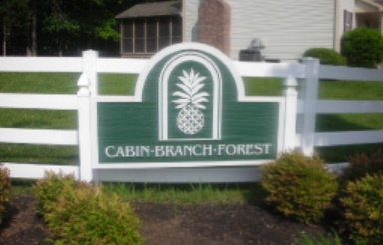
2021 Cabin Branch Forest Association - Annual General Meeting
Reminder: please mute microphone if not speaking
March 4, 2021
Online meeting - Zoom Meeting ID: 894 7764 3411
Welcome friends and neighbors – please enter name and address in chat section

Slide 2
AGENDA
Proof of Quorum
Welcome
HOA Board Members and Volunteers
Treasurer’s Report (HOA Financial Statements)
CBFA Annual Inspections
Community Activities and News
Open Forum
Adjournment

Slide 3
Proof of Quorum
Annual meeting quorum requirement is 25% (20 homes including proxies)
Virtual Sign In:
Please enter your name and address in the Zoom meeting “chat” section to register your attendance at the meeting

Slide 4
Welcome Friends and Neighbors!
Virtual Meetings Continue!
Board still at 100% virtual meetings, including bi-monthly BOD
This meeting is for us!
CBFA is a self-managed Homeowner’s Association
Our people, and their investment into the community, make all the difference
We have a website and a Facebook page
www.cabinbranchforest.com – Updated for 2021!
Facebook (invite only – contact Richard Young)
Concerns? Let’s address them as a community!
Reach us at: board@cabinbranchforest.com
ARC and/or Covenants Questions: ccommittee@cabinbranchforest.com [note the two “c’s”]

Slide 5
HOA Board Members and Volunteers
Current Board members (4 of 5 positions filled)
Dan Hibbard (President) – 2020
Jim Clute – 2018
TJ Vestal – 2020
Jason Yard – 2020
VACNANT – 2020
Treasurer - Cliff Miller
ARC Committee Lead – Thera Miller
Website Curator – Gary Marsh
Newsletter Curator – Danielle Vestal
CBFA Facebook Group Owner – Richard Young
We’d like to solicit nominations for, and vote on, a new member to fill this role!
Actively looking for volunteers to sign up and support the ARC!

Slide 6
Treasurer’s Report
Long Time Cabin Branch HOA Treasurer is Cliff Miller. A very special thanks for volunteering his time!
Annual Dues
2021 assessment is $400 per home; payments in January and July
Due to excess reserves and known hardships due to the pandemic, a $200 credit was applied to all homes in the community. If you paid in full, next year’s dues will be reduced by $200. If you paid in half, there is no second payment due
Dues cover common areas, maintenance/upkeep, improvements and community wide trash/recycling service
If you need a copy of your dues statement showing $0-balance please email board@cabinbranchforest.com
Assessment of expenses/activities indicate we are “right sized” again based on activities
Keeping dues low past two years (and offering discount), coupled with $200 credit for 2021.
Increased operating costs (Trash/Recycling)
Forecast increase in reserves for assets (Bike/Walking Path and Playground)
Evaluating 2022 possible dues increase. Evaluation underway and HOA will let the community know as soon as changes are anticipated
HOA has worked for several years to keep dues stable even with increasing operating costs

Slide 7
2020 Income Statement
 | 2020 | 2019 | Variance
INFLOWS
Disclosure Packet Fee | 0 | 100
Dues Income | 29,890.00 | 33,508.53
Interest Inc | 74.57 | 23.94
Late Fee Income | 0 | 25
TOTAL INFLOWS | 29,964.57 | 33,657.47 | -3,692.90
Outflows
Administrative Expenses | 1,536.99 | 1,581.78
Operating Expense:Common Elements Repair | 0 | 270.14
Operating Expense:Landscape Maintenance | 7,375.00 | 6,840.00
Operating Expense:Landscape Repair |  | 0
Operating Expense:Meeting Expense |  | 649.7
Operating Expense:Utilities
Operating Expense:Utilities:Garbage & Recycling | 16,342.48 | 16,012.13
Total Operating Expenses | 25,254.47 | 25,353.75 | -99.28
Net Income | 4,710.10 | 8,303.72 | -3,593.62
All homes paid dues in 2020
70 of 77 homes have paid 2021 dues
Income less than previous years for late fees and violation fees
Interest rate on Money Market account dropped significantly at EOY
Investigating moving into CDs similar to other reserves

Slide 8
Cash Flow and Reserves
Account Balances - As of 12/31/2020
Business Premium Money Market | 29,533.74
CBFA Checking | 10,603.55
CD#1 | 7,785.86
CD#2 | 6,308.55
CD#3 | 5,264.16
OVERALL TOTAL | 59,495.86
EOY excess reserve still below funds
Planned projects still in work
Re-evaluating stance on percent reserves required for our community

Slide 9
CBFA Annual Inspections
Actively looking for volunteers to sign up and support the ARC!
Annual Inspections scheduled for April-5 to April-9; continuous monitoring and follow-ups in progress
To be completed by ARC and neighborhood volunteers; continuous monitoring in effect, and will continue to be in effect, for cited violations
Please be aware inspectors view front, side and rear areas of lots to perform inspections and follow-ups
Inspection checklist posted on the Cabin Branch Forest website
Check to see if you have items that may be in violation
Policy and timeline for resolution also posted on the website
What to do if you are cited for a violation?
Resolve the issue and/or communicate with the ARC/Board for clarification
Don’t wait until the last minute or let the issue(s) return; fines will be assessed
A very special thank you to Thera M. and Tom D. for volunteering their time for many years

Slide 10
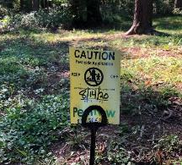
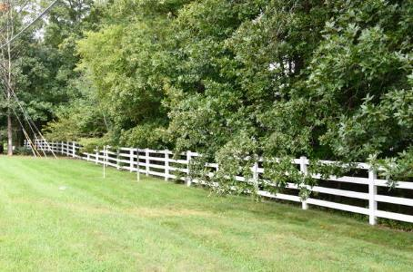
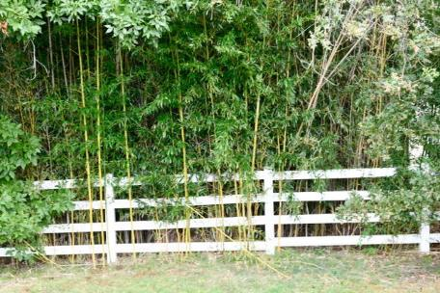
Community Activity and News
Reinstated CBFA Newsletter
Let us know if mailing was not received. Special thanks to Danielle Vestal for coordinating and mailing.
Playground Pest Control starts this month
Applied monthly, March – October
Usually 2nd Friday of each month
Keep kids/pets away for 48 hours after application based on signs
Community Cleanup Day March-13, 2021 at 10 AM
Volunteers to meet at front entrance. Activities include fence line maintenance and trash pickup.
Bike/Walking Path Improvement
Final scope determined, quotes in progress
Repair of existing determined to be best solution based on condition, cost, and required reserves
Email survey to go out to solicit community input on improvements, funds management and other activities. Please email board@cabinbranchforest.com if you’d like to confirm you are on the email distribution

Slide 11
Community Activity and News
Trash Services Contract Extended with Republic Services
Costs per home increased $5.07/quarter. HOA Burden increase $390/quarter.
TRASH – Tuesday’s & Fridays | YARD WASTE – Wednesday’s | RECYCLING – Friday’s
Individual issues call 703-818-8222 (e.g. new trash can). All other issues contact the HOA at board@cabinbranchforest.com so we can work with our HOA account manager
Safety
See something suspicious? Report it! “See something, Say Something” - 703-777-1021
Please observe speed limits and stop signs; lots of kids in the neighborhood
Parking
Commercial vehicles prohibited by community rules; Parking on grass is prohibited by the county
Cabin Branch streets are public streets, but please be considerate of your neighbors.
Snow Removal
VDOT utilizes contractors for street plowing; not coordinated by the HOA
Residents are responsible for removing snow on sidewalks in front of their houses
Spring is around the corner – but please don’t feed the animals
See article in newsletter for more details

Slide 12
Open Forum
Please raise any questions, comments or concerns on topics presented tonight or others you’d like addressed.

Slide 13
Adjournment
Thank you for coming!
Bi-monthly board meetings open to all neighbors – email board@cabinbranchforest.com for schedule and locations
Virtual meetings planned for foreseeable future
Important Dates (tentative)
Community cleanup day – March 13, 10 AM, Front Entrance [Rain Date March 20]
Community Wide Inspections – April 5-9
Community Wide Yard Sale - TBD
Community block party – TBR
Contact
board@cabinbranchforest.com
www.cabinbranchforest.com
Or just stop by!

