Slide 1
Pathways Enhancements – Let’s make it happen!
Toastmasters International
Enhancing Member Experience and Club Success
Notes:
Original PPT slidedeck developed by Wendy Pesavento, October 2025
Updated PPT slidedeck developed by Maryann Reichelt, October 16, 2025

Slide 2
Agenda
Pathways Overview
Enhanced Pathways Requirements
Enhancements by Level
Affected Paths
What Stays the Same
Resources
Next Steps

Slide 3
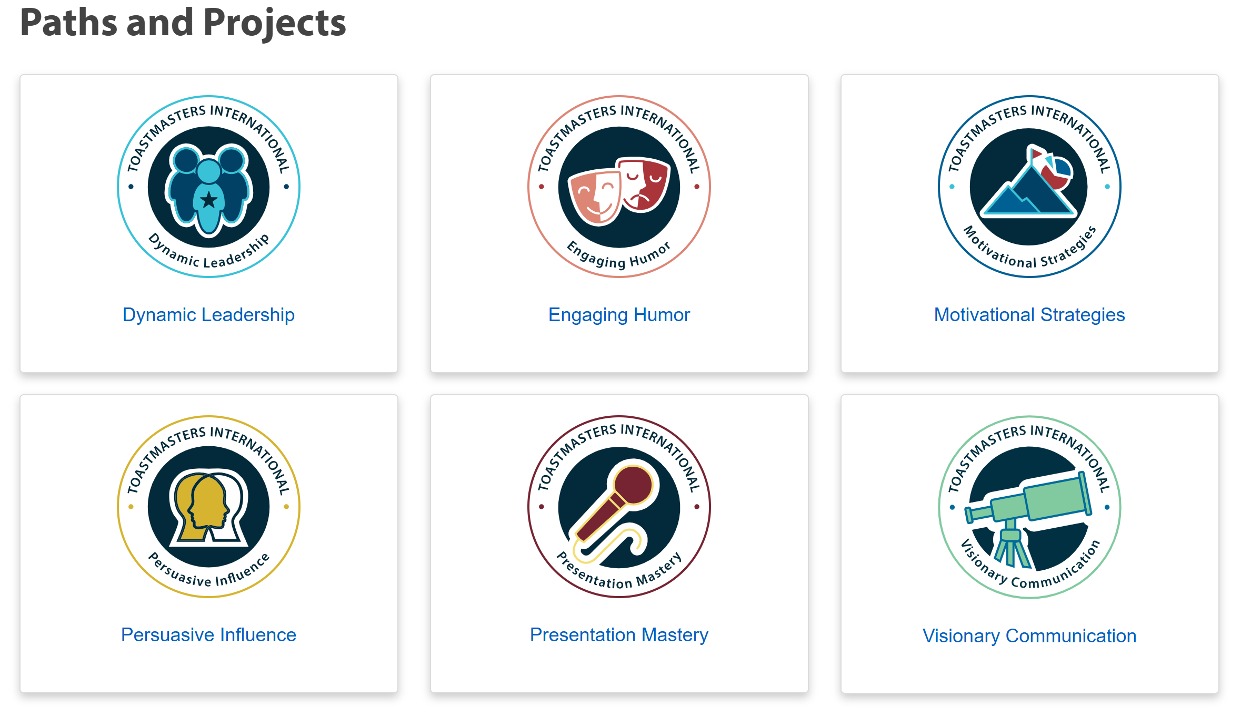
Pathways Overview

Slide 4
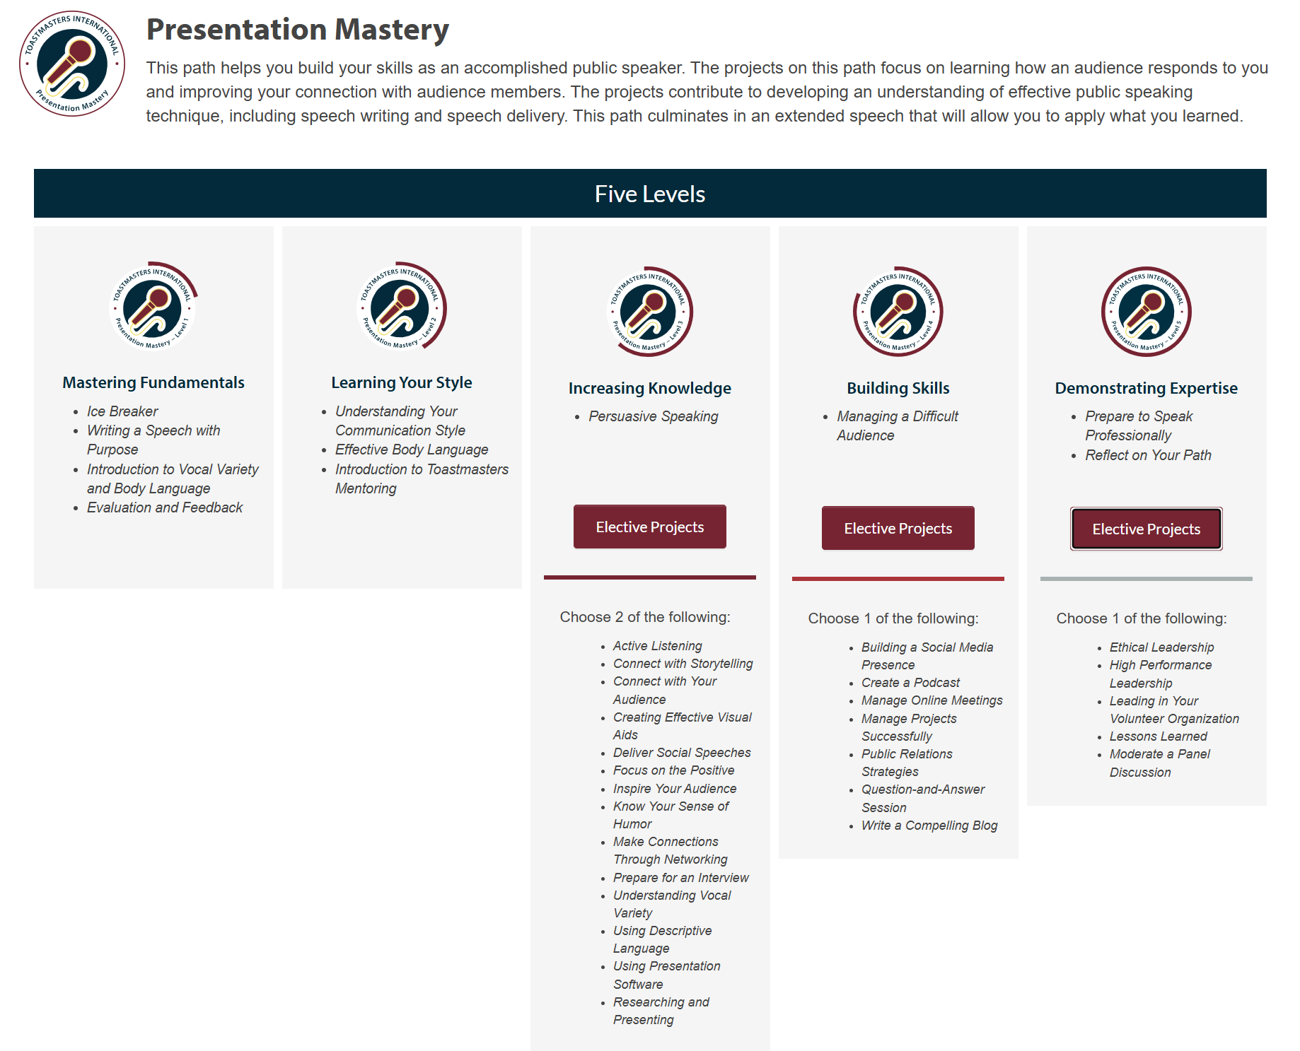
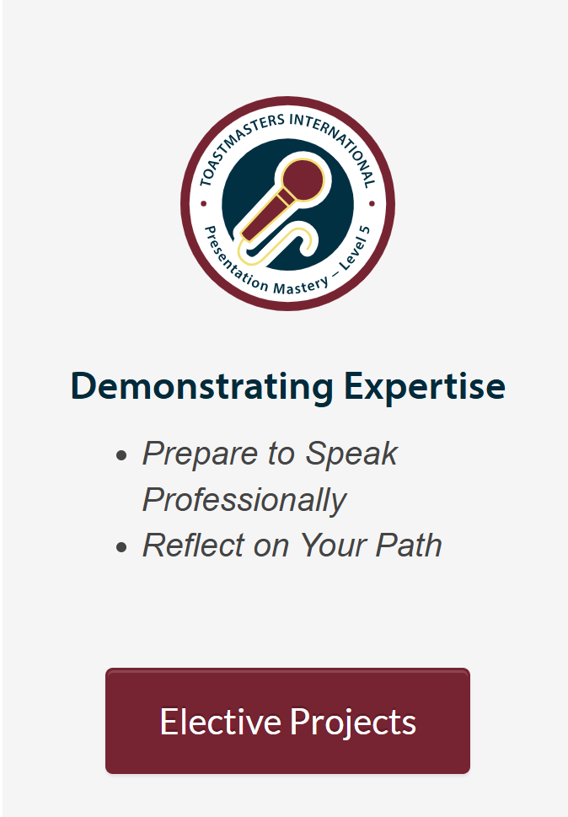
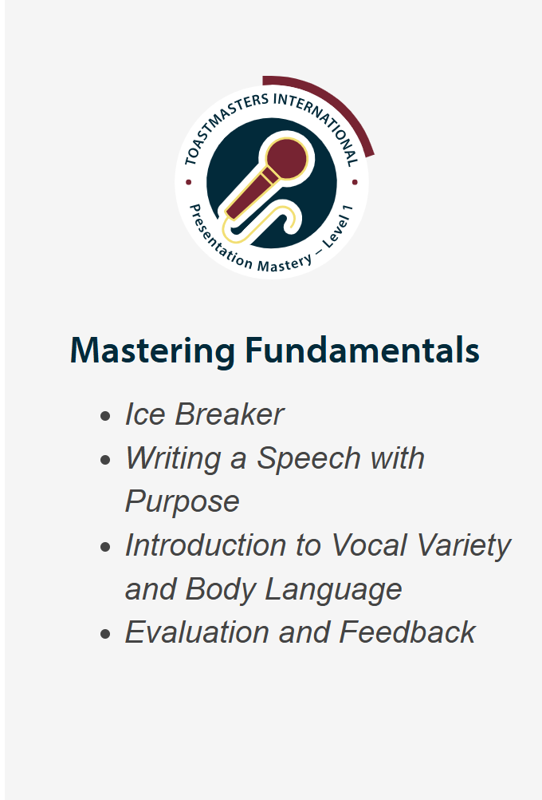
Pathways Overview

Slide 5
What Are the New Enhanced Pathways Requirements?
Complete current Pathways projects levels 1-5 (No change)
Serve in club meeting role(s) in path levels 1-5 (New)
Present Education Series program in levels 3-5 (New)
Notes:
Enhancements for each Level will appear above that Level’s projects.
Meeting Roles will NOT be tracked in Base Camp. Clubs can discern if a member may complete meeting roles out of Level order.
The Board of Directors has determined that members must complete their required meeting roles within the relevant level to receive credit. For example, a role completed in Level 1 cannot count toward Level 3
Education Series Presentations will appear similar to Electives and be tracked in Base Camp.

Slide 6
Meeting Roles
• Members serve in specific meeting roles at each level
• Roles build from simple (Table Topics Speaker) to more advanced (Toastmaster of the Day)
• Member and VPE record roles
Notes:
Meeting roles for each level can be downloaded from the Toastmasters International implementation notice e-mail sent October 22. 2025 by clicking on
”how to support these changes in your club”.

Slide 7
Toastmasters Education Series
• The Successful Club Series (Levels 3–5).
• The Better Speaker Series (Level 4).
• The Leadership Excellence Series (Level 5).
• Presentations: 10–15 minutes.
Notes:
Members can be directed to Toastmasters International Resources site via the link in the Toastmasters International implementation notice e-mail sent October 22, 2025 “how to support these changes in your club”.

Slide 8
Level 1 Enhancements
Meeting Roles:
• Table Topics Speaker*
• Evaluator (part of Project 4)
• Timer OR Ah-Counter
No Education Series presentations.
* Recommended after Ice Breaker
Notes:
While it is suggested that a member respond to a Table Topic thought or question prior to the Ice Breaker, the club can discern if a speech is delivered AND the member also answers a Table Topics thought or question, if the member can get credit for both roles on the same date.

Slide 9
Level 2 Enhancements
Meeting Roles:
• Grammarian
• Table Topics Master
• Evaluator
• Toastmaster, Timer, OR Ah-Counter
No Education Series presentations.

Slide 10
Level 3 Enhancements
Meeting Roles:
• Toastmaster
• Evaluator
• Table Topics Master, Table Topics Speaker, OR Introductory Mentor*
Education Series:
• One Successful Club Series presentation
Notes:
Introductory Mentor is a member that helps a guest navigate the agenda, answers their questions, helps them navigate what each meeting role requires. Is NOT their ‘official’ mentor.
Check if a meeting role is part of a transcript project, such as Table Topics Master (elective - Active Listening). The Club can discern if a member completing an elective that contains a meeting role would qualify as both a project completion AND a meeting role fulfilment.

Slide 11
Level 3 Successful Club Series Speech Options
Creating the Best Club Climate
Meeting Roles and Responsibilities
Keeping the Commitment
Going Beyond Our Club
Notes:
The other options will appear in Levels 4 and 5

Slide 12
Level 4 Enhancements
Meeting Roles:
• Toastmaster
• General Evaluator
• Evaluator
• Table Topics Speaker, Table Topics Master, Specialized Role*, or repeat role listed above
Education Series:
• One Successful Club Series presentation
• One Better Speaker Series presentation
Notes:
Check if a meeting role is part of a transcript project, such as Table Topics Master (elective - Active Listening). The Club would have to discern if a member completing an elective that contains a meeting role would qualify as both a project completion AND a meeting role fulfilment.

Slide 13
Level 4: Pick 1 from Each Series
Successful Club Series
Better Speaker Series
Finding New Members
Closing the Sale
How to be a Distinguished Club
Toastmasters Education Program
Beginning Your Speech
Concluding Your Speech
Controlling Your Fear
Impromptu Speaking
Selecting Your Topic
Know Your Audience
Organizing Your Speech
Creating an Introduction
Preparation and Practice
Using Body Language

Slide 14
Level 5 Enhancements
Meeting Roles:
• General Evaluator (twice)
• Toastmaster (twice)
• Evaluator (twice)
• Other roles: Table Topics, Table Topics Master, Grammarian, Timer, Ah-Counter, Mentor, or Specialized Role*
Education Series:
• One Successful Club Series presentation
• One Leadership Excellence Series presentation
Notes:
Check if a meeting role is part of a transcript project, such as Table Topics Master (elective - Active Listening). The Club would have to discern if a member completing an elective that contains a meeting role would qualify as both a project completion AND a meeting role fulfilment.

Slide 15
Level 5: Pick 1 from Each Series
Successful Club Series
Leadership Excellence Series
Moments of Truth
Evaluate to Motivate
Mentoring
Visionary Leader
Developing a Mission
Values and Leadership
Goal Setting and Planning
Delegate to Empower
Building a Team
Giving Effective Feedback
The Leader as Coach
Motivating People
Service and Leadership
Resolving Conflict

Slide 16
Level | Meeting Roles
1 | Table Topics Speaker (1) Evaluator (1) Timer or Ah Counter (1)
2 | Grammarian (1) Table Topics Master (1) Evaluator (1) Toastmaster, Timer or Ah-Counter (1)
3 | Toastmaster (1) Evaluator (1) Table Topics Master, Table Topics Speaker or Introductory Mentor (1)
4 | Toastmaster (1) General Evaluator (1) Evaluator (1) Table Topics Speaker, Table Topics Master, Specialized Role or repeat role listed above (1)
5 | General Evaluator (2) Toastmaster (2) Evaluator (2) Other roles: Table Topics Speaker, Table Topics Master, Grammarian, Timer Ah-Counter, Mentor, or Specialized Role (1)
Required Meeting Roles for Each Level

Slide 17
Education Series for Enhanced Pathways
Level 3 | Successful Club Series (1) | 10-15 minutes
Level 4 | Successful Club Series (1) Better Speaker Series (1) | 10-15 minutes
Level 5 | Successful Club Series (1) Leadership Excellence Series (1) | 10-15 minutes

Slide 18
Affected Paths
Enhancements apply to 6 paths:
• Dynamic Leadership
• Engaging Humor
• Motivational Strategies
• Persuasive Influence
• Presentation Mastery
• Visionary Communication

Slide 19
What Stays the Same
• Existing project requirements remain unchanged.
• Completed levels remain completed.
• Members in legacy or translated paths can participate but not required.
Notes:
Legacy and translated Paths will NOT contain the 2025 Pathways enhancements. Legacy (retired) Paths are on a different system than LMS Pathways and will not be updated to include the 2025 enhancements. As Paths get translated, the 2025 enhancements WILL be included in the transcripts.

Slide 20
What Materials Are Provided By Toastmasters International For Each Education Presentation ? Example: Successful Club Series “Moments Of Truth Materials”:
Manual
Powerpoint

Slide 21
Resources - where can I find Role Descriptions and Education Series?
Each Level in Pathways Base Camp has a link to what is needed for that Level
Each role description and educations series can be downloaded – see next slide

Slide 22
Resources
Meeting Roles Descriptions
www.toastmasters.org/membership/club-meeting-roles
Successful Club Series
https://www.toastmasters.org/resources/the-successful-club-series-set
Better Speaker Series
www.toastmasters.org/resources/ the-better-speaker-series-set
Leadership Excellences Series
www.toastmasters.org/resources/the-leadership-excellence-series-set
Tracking Tool
https://d54tm.com/pathways-1

Slide 23
Important Next Steps
Understand Meeting Roles.
Review/Download Education Series content.
Sign up for Meeting Roles.
Prepare/present Education module(s).
Track new enhancements.

Slide 24
Conclusion
Pathways enhancements began October 2025.
• Members gain more opportunities to lead and speak.
• Clubs benefit from stronger member engagement.
• Together, we build better communicators and leaders.

Slide 25
Pathways Enhancements – Let’s make it happen!
Toastmasters International
Enhancing Member Experience and Club Success
Notes:
Original PPT slidedeck developed by Wendy Pesavento, October 2025
Updated PPT slidedeck developed by Maryann Reichelt, October 16, 2025

