Slide 1
Pathways Moment - I need help Dick Poirier 10 January 2023

Slide 2
Agenda
Access your Path
Launch/Work in a Project
Completing Projects
Submitting Awards
Evaluations

Slide 3
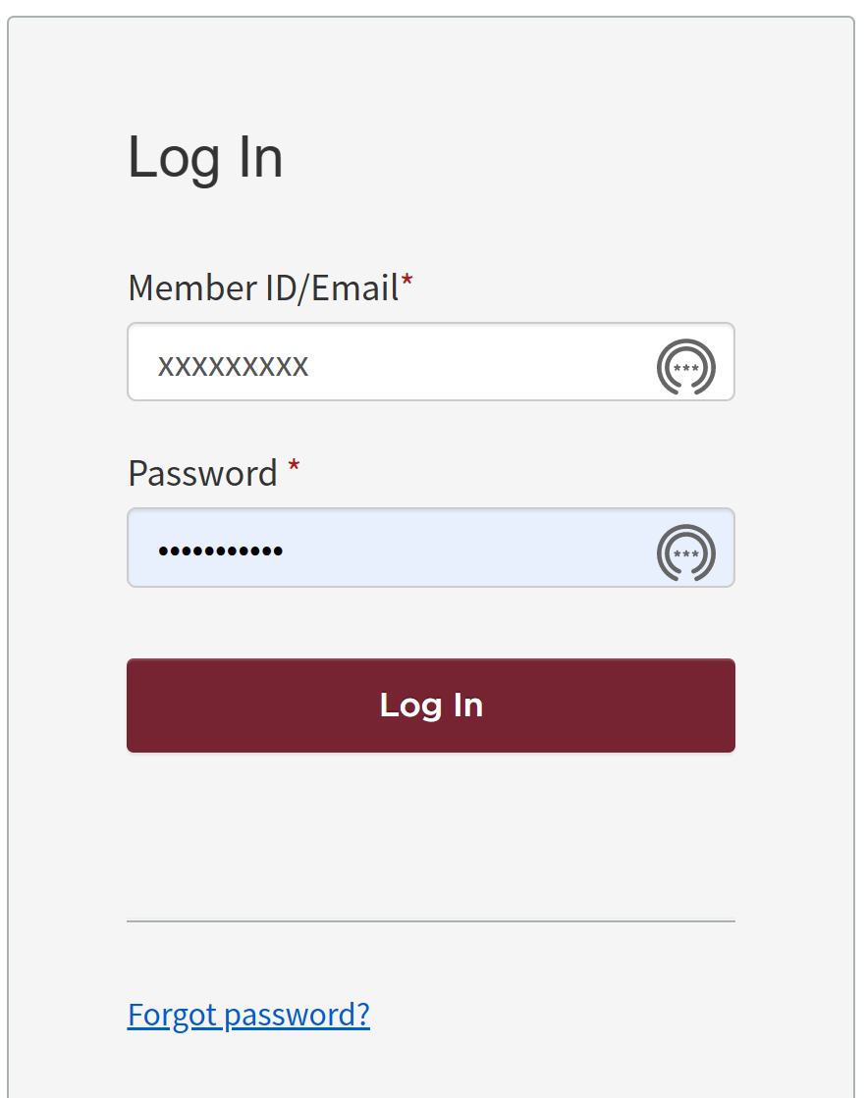
Access your Path
Assumption: Path has already been selected
Login to Toastmasters website: http://www.toastmasters.org/

Slide 4
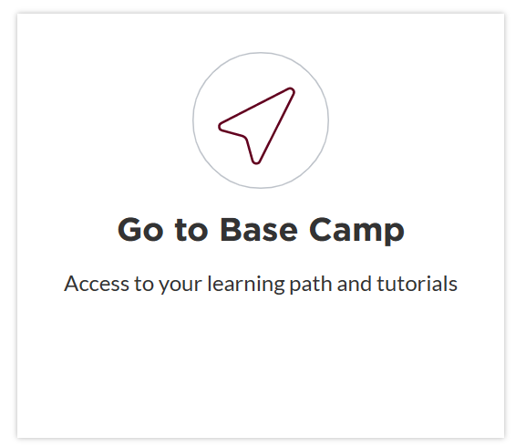
Access your Path
On the default Home page, scroll down to “Go To Base Camp”:

Slide 5
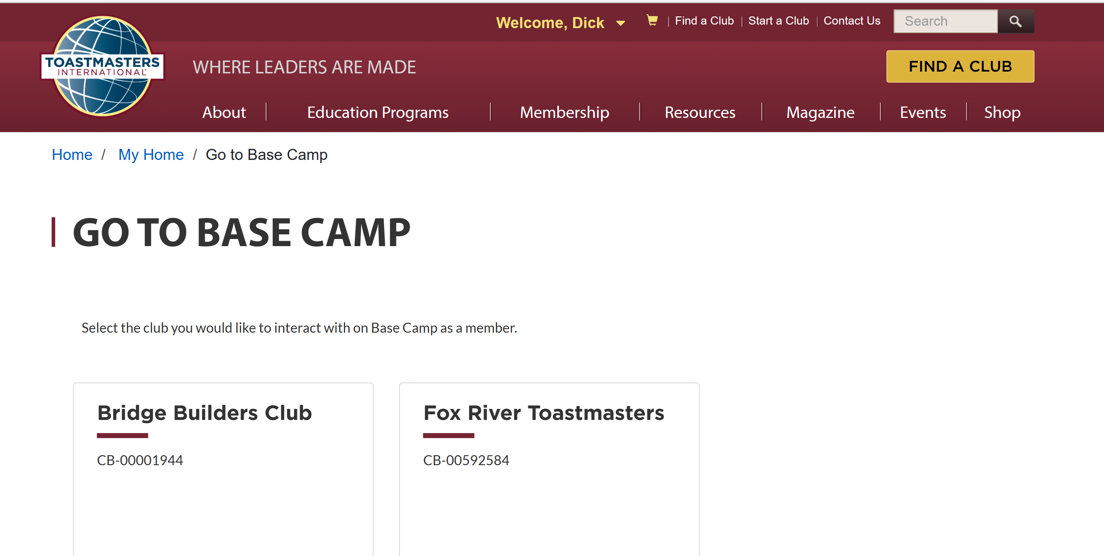
Access your Path
Select desired club if member of more than one club:

Slide 6
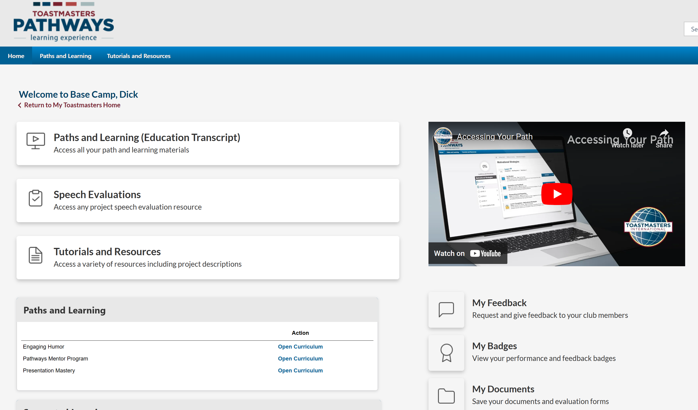
Access your Path
Select Transcript or Path:

Slide 7
Agenda
Access your Path
Launch/Work in a Project
Completing Projects
Submitting Awards
Evaluations

Slide 8
Launch/Work in a Project
Open Curriculum:

Slide 9
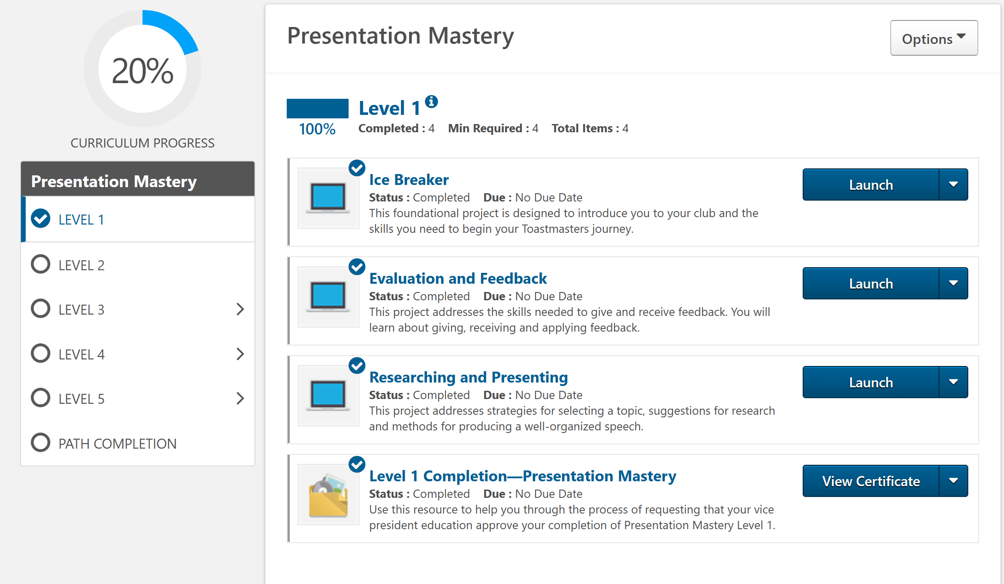
Accessing/Working in your Path
For Paths purchased before October 27, 2021
Select desired club if member of more than one club:

Slide 10
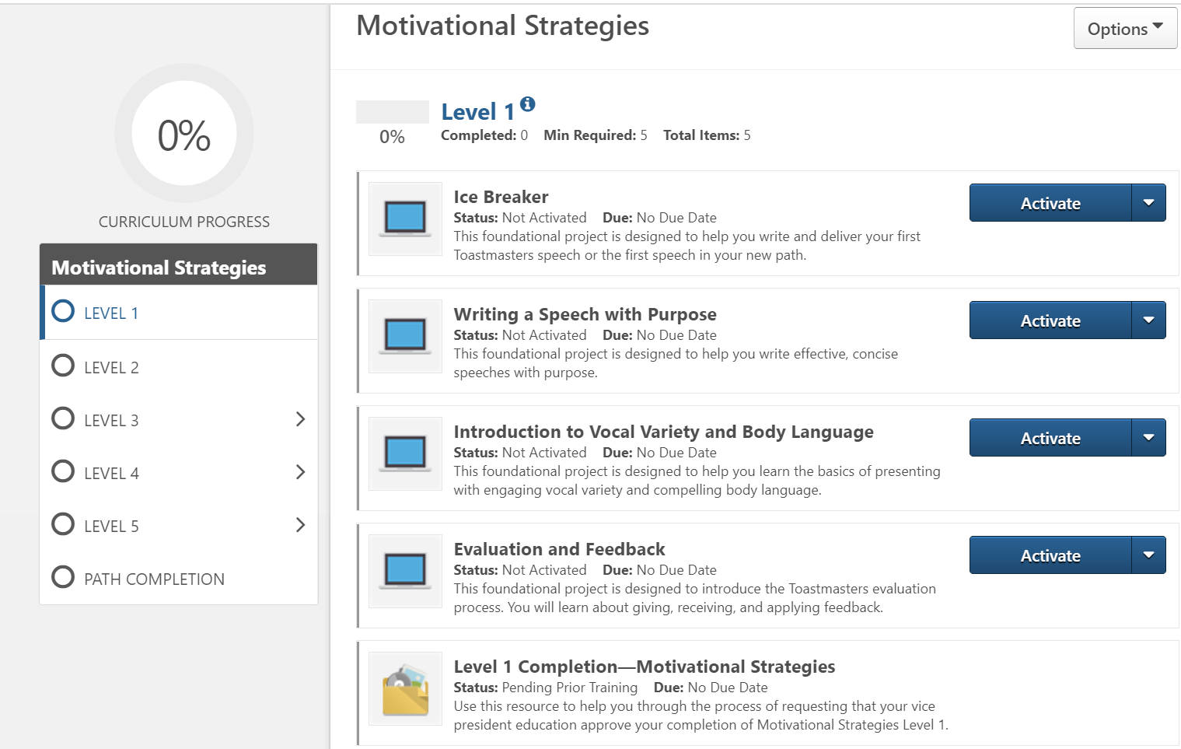
Accessing/Working in your Path
For Paths purchased on or after October 27, 2021

Slide 11
Launch/Work in a Project
Select desired club if member of more than one club:

Slide 12
Launch/Work in a Project
Select desired club if member of more than one club:

Slide 13
Launch/Work in a Project
Select desired club if member of more than one club:

Slide 14
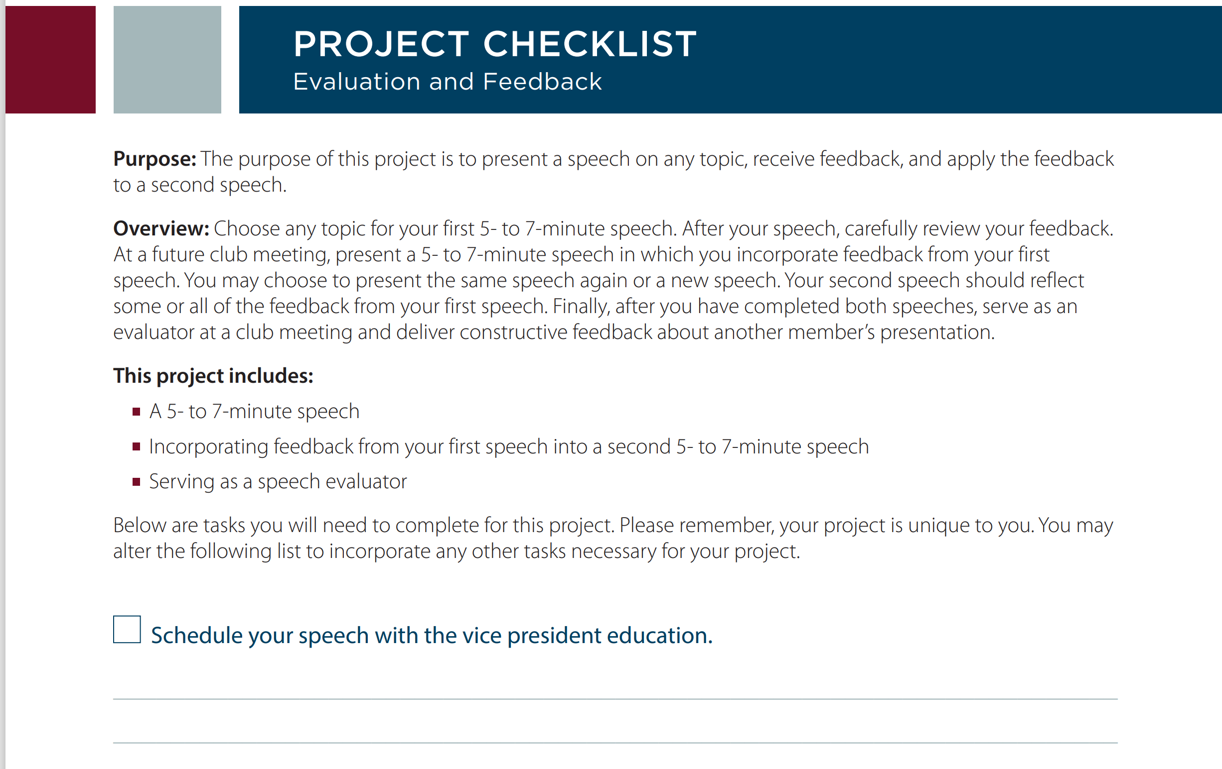
Launch/Work in a Project

Slide 15
Agenda
Access your Path
Launch/Work in a Project
Completing Projects
Submitting Awards
Evaluations

Slide 16
Completing Projects
Reopen Project in Base Camp

Slide 17
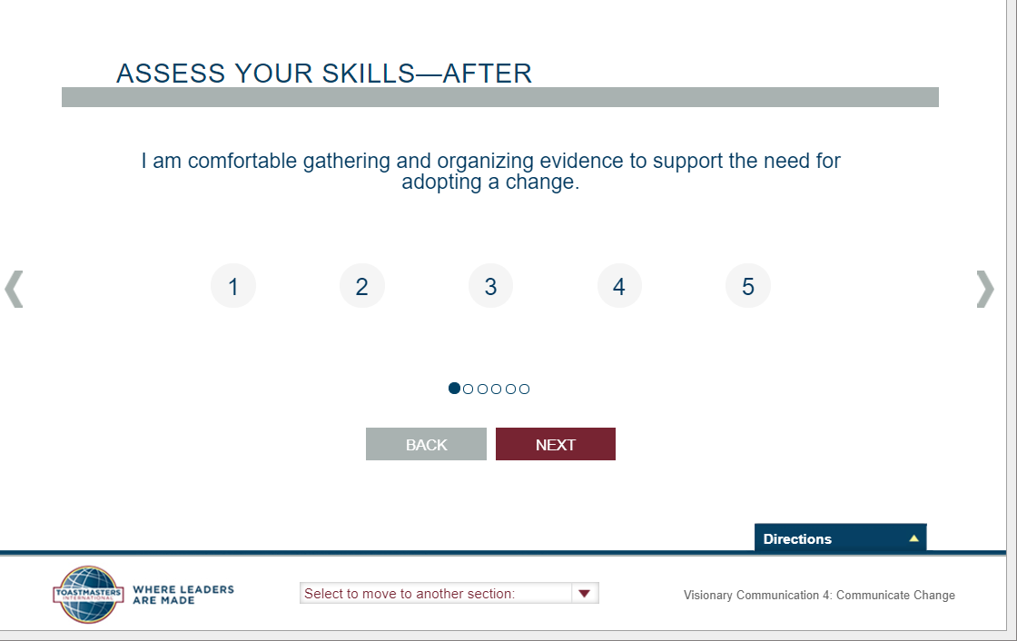
Completing Projects

Slide 18
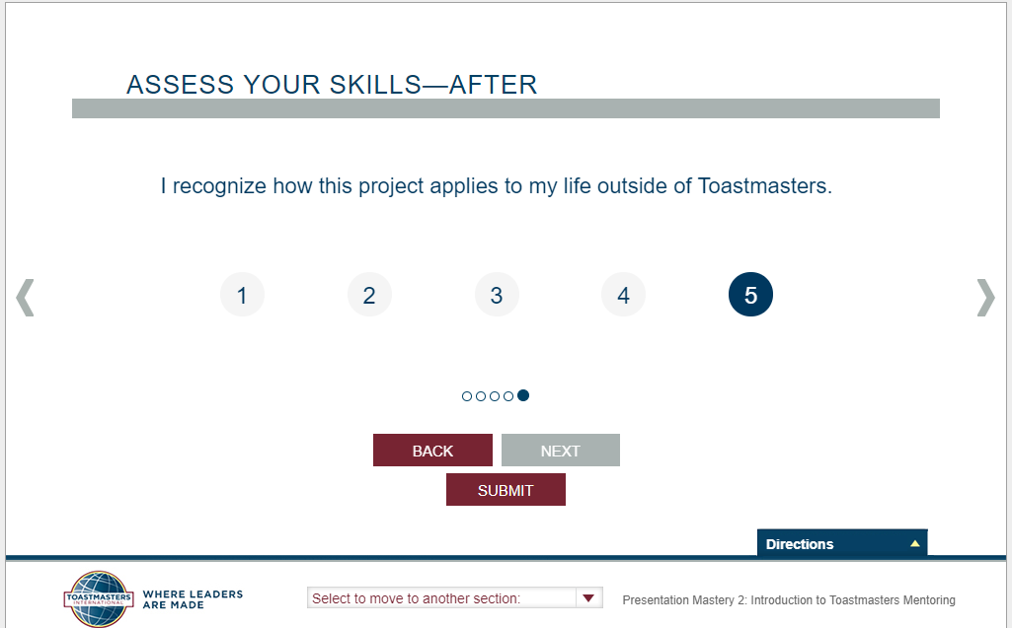
Completing Projects
Click ‘Submit’ on last screen!
There is no “Undo” feature

Slide 19
Completing Projects

Slide 20
Agenda
Access your Path
Launch/Work in a Project
Completing Projects
Submitting Awards
Evaluations

Slide 21
Submitting Awards
Member
Complete a level (after completing the req’d projects)
Select the desired club in Base Camp
Run the “Level Completion” task
Notify your VPE and base camp managers (auto email)
Base Camp Manager (VPE, Pres or Sec)
Mark the member’s level as Approved
Certificate available
VPE (or Any Officer)
Submit Level award in Club Central – TI website for DCP Credit

Slide 22
Submitting Awards
Select desired club if member of more than one club:

Slide 23
Submitting Awards
Member
Complete a level
Select the desired club in Base Camp
Run the “Level Completion” task
Notify your VPE and base camp managers (auto email)
Base Camp Manager (VPE, Pres or Sec)
Mark the member’s level as Approved
Certificate available
VPE (or Any Officer)
Submit Level award in Club Central – TI website for DCP Credit

Slide 24
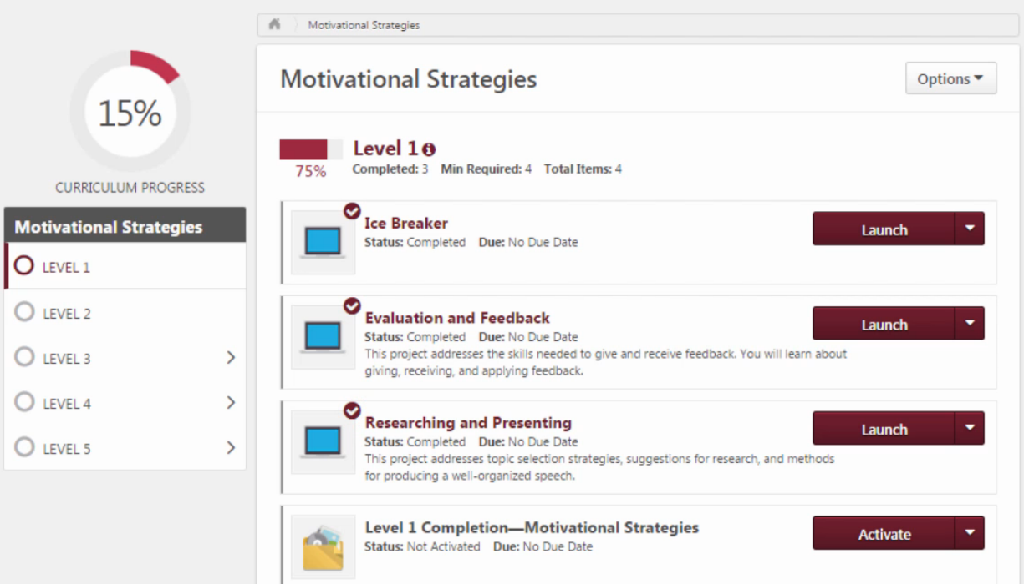
Submitting Awards

Slide 25
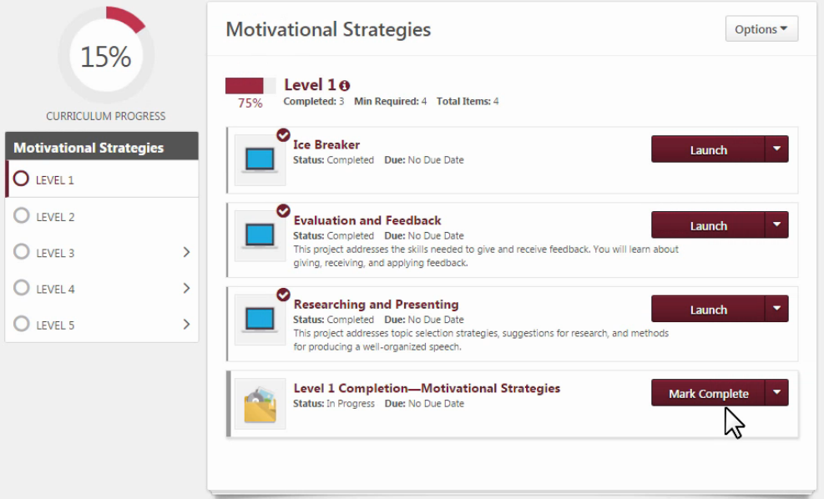
Submitting Awards

Slide 26
Submitting Awards
Member
Complete a level
Select the desired club in Base Camp
Run the “Level Completion” task
Notify your VPE and base camp managers (auto email)
Base Camp Manager (VPE, Pres or Sec)
Mark the member’s level as Approved
Certificate available
VPE (or Any Officer)
Submit Level award in Club Central – TI website for DCP Credit

Slide 27
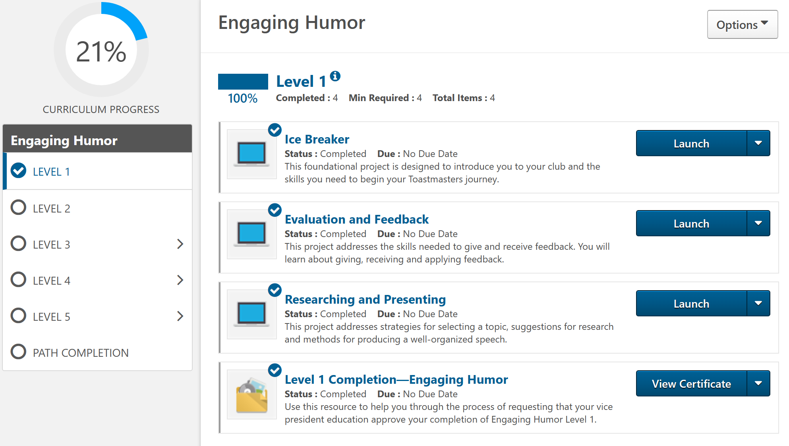
Submitting Awards
Select desired club if member of more than one club:

Slide 28
Submitting Awards
Member
Complete a level
Select the desired club in Base Camp
Run the “Level Completion” task
Notify your VPE and base camp managers (auto email)
Base Camp Manager (VPE, Pres or Sec)
Mark the member’s level as Approved
Certificate available
VPE (or Any Officer)
Submit Level award in Club Central – TI website for DCP Credit (only if previous Levels are completed)

Slide 29
Agenda
Access your Path
Launch/Work in a Project
Completing Projects
Submitting Awards
Evaluations

Slide 30
Evaluations
Speaker
Provide Evaluator with Project Evaluation Form
Access it in the Project
Or access it in Base Camp

Slide 31
Evaluations

Slide 32
Evaluations

Slide 33
Evaluations
Speaker
Provide Evaluator with Project Evaluation Form
Access it in the Project
Or access it in Base Camp Home Page (any member can)

Slide 34
Evaluations
Access Evaluation Forms from Base Camp Home Page:

Slide 35
Generic Evaluation resource

Slide 36
Other Resources

Slide 37
Agenda
Access your Path
Launch/Work in a Project
Completing Projects
Submitting Awards
Evaluations

