Slide 1
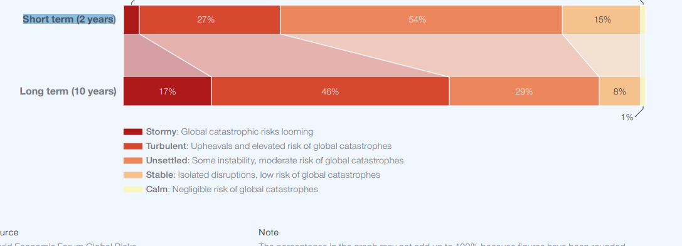
2024 Global risk outlook
Short turn 2 years
Long turn 10 years

Slide 2
Environmental risks could hit the point of no return

Slide 3
Global risk by severity ( Economic, Environmental, Geopolitical, Technological)

Slide 4
Changes in Short run

Slide 5
Misinformation risk
Misinformation and disinformation may radically disrupt electoral processes in several economies over the next two years. –
A growing distrust of information, as well as media and governments as sources, will deepen polarized views – a vicious cycle that could trigger civil unrest and possibly confrontation from climate activism to conflict escalation
national security should be deprioritized as a top objective in terms of innovation and industrial policy, including the United Kingdom, Türkiye, and Italy, in favour of, for example, addressing environment and education priorities

Slide 6
Risk interconnections

Slide 7
AI Risk
Market concentration and national security incentives could constrain the scope of guardrails to AI development
Cyber insecurity and Technological power concentration as the only risk drivers of Adverse outcomes of AI technologies The production of AI technologies is highly concentrated
Taiwan Semiconductor Manufacturing Company (TSMC) holds around a 56% share of the global semiconductor foundry market, followed by Samsung at nearly 12%Over 80% of the world’s ATP production is currently centered in Asia, split between Integrated Device Manufacturers and Outsourced Semiconductor Assembly and Test (OSAT) companies.

Slide 8
Geopolitical risk
Over the next two years, the attention and resources of global powers are likely to be focused on three hotspots in particular: the war in Ukraine, the Israel-Gaza conflict and tensions over Taiwan. Escalation in any one of these hotspots would radically disrupt global supply chains, financial markets, security dynamics and political stability
As described in last year’s Global Risks Report Resource Rivalries, the extraction and processing of critical metals and minerals used in advanced AI chips are highly geographically concentrated.
Taiwan Semiconductor Manufacturing Company (TSMC) holds around a 56% share of the global semiconductor

Slide 9
Economic Risk

Slide 10
Debt Distress
Higher interest rates amid slowing growth will strain debt loads for the public and private sector alike. The corporate debt default rate remains far lower than peaks hit during the 2008-09 Global Financial Crisis
The majority of corporate debt is also years from maturity. Less than 14% of S&P 500 debt is set to mature in the next two years, with nearly half to mature after 2030. In essence, the world’s largest companies will be effectively insulated from higher interest rates for more than half a decade

Slide 11
Locked
The rest of slides are not for free. If required kindly contact 8801914576001 or ehsaan16@gmail.com

