Slide 1
Bangladesh Economic Review 2024
Ehsaanur Rahman

Slide 2
Key points
Problem
Exports falling comparing to import
Export goals are set to be 80 billions in 2024 , 75%-80% will be reflected in import figure of raw material.
Debt energy
Slow credit growth
Will be single digit with double Digit NPL., and credit growth and inflation both comes closer to 10 %
Total debt-servicing liabilities of state-owned enterprises (SOEs) stood at BDT2.15 trillion (8.5% of GDP) at end-December 2018, of which 45% was owed by the Bangladesh Power Development Board (BPDB). rising
Public Debt Dynamics
If the government decides to return to the average fiscal deficit of 3.5% in the five years through 2017, government debt would fall to around 30% of GDP by 2028

Slide 3
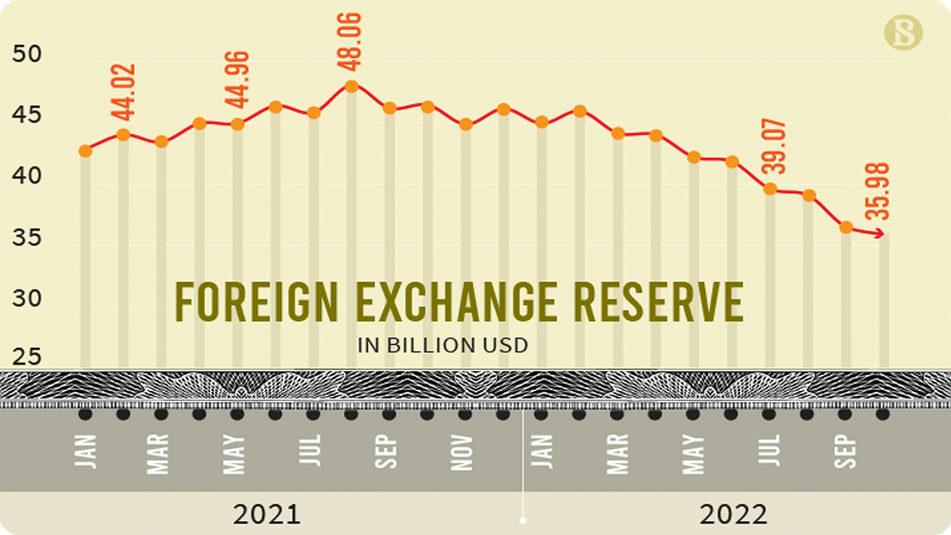
FX reserve downwards
Problem
RESERVE buffer
Now around $26.75 billion in 2023 ,
Official reserve$ 28 billion in 2024 in
Export growth 12%.
From Remittance
In Million USD 1856 average in 2022
In Million USD 1227 in 2023-2024
Exchange rate
In 2024, 129.7/1 USD.

Slide 4
Key points to reduce Food import pressure
On average 245 million yearly rice import
MRY 4
$1B
India’s Advancement in Agricultural Economy ensured they are in Number 1 position in Sugar, Number 2 in Rice production
Milled Rice Yield higher than india but Technology and Supply chain and Export subsidy has caused Indian rice industry to boost( Basmati)
Invent in high premium Rice verities, research and development and export in long term take advantage of MRY

Slide 5
Locked
Locked
2024
2025

Slide 6
TWO-YEAR ACTION PLAN
Election
A budget to face economic turmoil
Diversifying the Export Reducing RMG dominance less than 80%
2024
JAN
FEB
MAR
APR
MAY
JUN
JUL
AUG
SEP
OCT
NOV
DEC
2025
JAN
FEB
MAR
APR
MAY
JUN
JUL
AUG
SEP
OCT
NOV
DEC
Correction of Budget
Reducing Import pressure in Food security
Dec 2024
GDP Growth 7%, Slowly reducing RMG dominance 10 % per year
June 2024, Prioritization food Security , Education

Slide 7
SUMMARY
The Hardest Part for Bangladesh is
Diversifying Export
Correction of Banking policy
Foreign Debt management
Since 2023 was the hardest financial year for the world it reflected for Bangladesh too.
summary

Slide 8
Thank You
Ehsaanur Rahman
ehsaan16@gmail.com
www.economy-talks.com

