Slide 1
Prepared by: Ehsaanur Rahman ehsaan16@gmail.com https://economytalks.godaddysites.com/

Slide 2
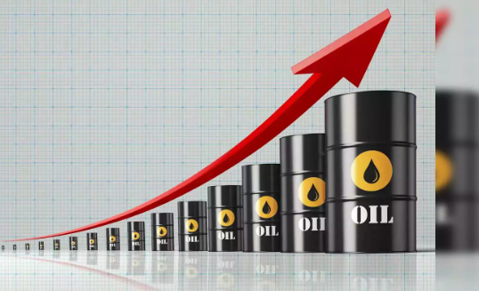
2024 Global Economic Review
2023-5.9%
2024-4.8%
USA Election
Global rates hike to cut
2023-5.8%
2024-5.21%

Slide 3
Global Economic Outlook 2022-2024* ( China versus Rest of the World)

Slide 4
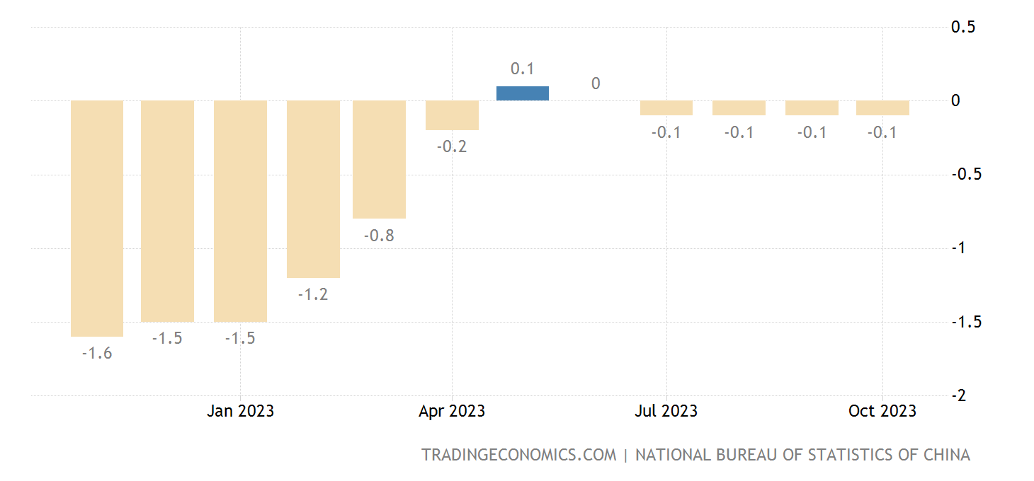
China’s Economic Outlook
Real Estate compromise around 15 to 30 % of Chinese economy.
About 50% of the largest private developers have now defaulted on their debts, causing consumers to lose confidence in developers and in the idea that home prices always go up.

Slide 5
Why the U.S. Will Evade Deflation
The labor market has seen an addition of approximately 239,000 jobs per month over the past year.
An expectation of job growth is associated with the upcoming 2024 election year, which may support further interest rate hikes.
The current budget deficit stands at 1.70 trillion USD.
There is an argument that increasing the budget deficit by 10-15% could be sustainable without raising tax rates.
Emphasis is placed on controlling inflation and food prices, alongside the development of industrial policy.

Slide 6
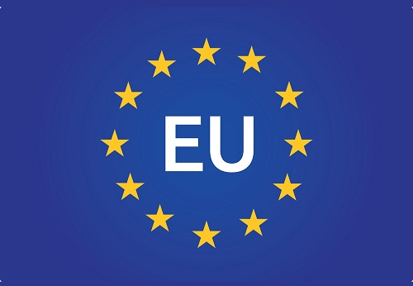
Euro Zone Most Dangerous Zone
70% Corporate funding from Banks. Rising interest expenses and sharply higher fuel prices hit Germany hardest, with industrial production
Chance of recession in Germany around 20-25%. Have to find out alternative source to reduce importing cost of Energy.

Slide 7
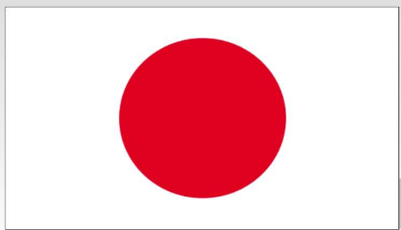
Japan
Interest rate
Government bond
End of Negative interest rate
Demographics
Yield 1 percentage on bond 10 years
Main Concern
Women participation

Slide 8
Conclusion: Don’t need to worry about the recession
The Hardest part is over for the world Disinflation is underway and developed market central banks have likely finished their rate hike cycles
With the added dimension of geopolitical uncertainty investors will also likely need to seek expert advice on how to navigate risks and opportunities that don’t lend themselves to free cash flow models, but instead are more at home in a tail-risk stress test.
The road doesn’t look rosy but not bleak

