Slide 1


Public Health Emergency Preparedness
Notes:
The PHEP program originates with the Center for Disease Control and Prevention and is managed by the Administration for Strategic Preparedness and Response.

Slide 2
Public Health Emergency Planners
Collaboration with Public Health and Healthcare Partners
Knowledge, plans, and tools for preparedness, response, and recovery
Notes:
Public Health Emergency Planners are utilized to collaborate between the stakeholders in Public Health. These planner are a source of knowledge and support for preparedness, response, and recovery. They are equipped with plans and tools to assist.

Slide 3
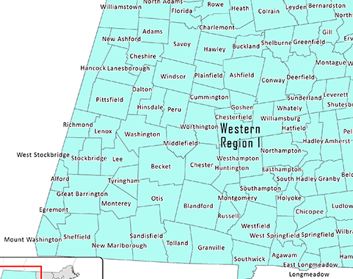
Region 1 Overview
Berkshire, Franklin, Hampshire, and Hampden Counties
Public Health Emergency Planners as points of contact
Community- focused emergency planning
Notes:
Region One encompasses four counties: Berkshire, Franklin, Hampshire, and Hampden. Between these Counties there are four Public Health Coalitions. The coalitions are loosely reflective of the municipalities in the counties. Each coalition has a planner or planner/coordinator as points of contact for the coalition. The planners assist the coalitions to remain community focused on its Public Health emergency planning.

Slide 4
Western MA Public Health Advisory Group (WAG)
Monthly meetings for collaboration and idea sharing
Focus on projects & improving public health emergency response
Notes:
The four coalitions have formed an advisory group called the Western Massachusetts Public Health Advisory Group (WAG). The WAG allows for collaboration between the coalitions to focus on projects that improve the ability to respond Public Health Emergencies.

Slide 5
Budget Period
5-year cooperative agreement
Priorities set by CDC & MDPH
Notes:
The CDC/ASPR administers the PHEP program in five-year cycles. 2023-2024 was the fifth year (BP5) of the previous cycle. We are currently BP1 (2024-2025) of the new five-year cycle. The CDC, ASPR, and MDPH have set the priorities for the coalitions in BP1. This is due in part to the shift from preparedness to response for Public Health.

Slide 6

BP1 Goals
July 1, 2024 to
June 30, 2025
Understanding roles and responsibilities in emergencies
Framework development for public health roles, activities, and responsibilities
Feedback collection and framework refinement
Training needs assessment
Review and update emergency plans
Notes:
The GOALS for BP1 are :
Understand the roles and responsibilities of Public Health in emergencies.
Framework development for Public Health roles, responsibilities, and activities.
Collection of feedback and refinement of the framework.
Develop and administer a training needs assessment.
Review and update emergency plans.

Slide 7
Priority #1 –
Create an Emergency Response Framework
Expand local support for jurisdictional readiness
Develop and workshop emergency response frameworks
Steps:
Survey municipalities
Develop all-hazards response framework
Present framework and solicit feedback
Conduct workshop
Notes:
The guidance given to the coalitions in BP1 identify three priority areas.
Priority One has the coalitions expanding local support for readiness.
Creating and assuring each municipality has an emergency response plan.
The coalition should coordinate a workshop to socialize the framework with the local municipalities.

Slide 8
Priority #2 - Develop & Administer Needs Assessment
Build workforce capacity for surge management
Support staff recruitment, retention, resilience, and mental health
Steps:
Develop standard training survey by 3/14/25
Compile and evaluate survey responses by 5/12/25
Discuss findings at health coalition meeting by 6/30/25
Notes:
Priority two has coalitions building workforce capacity to manage surge needs.
This includes recruitment, retention, resiliency, and mental health.
The coalition will develop a training survey to establish a baseline of current knowledge by compiling the survey responses and sharing the results with the coalition.

Slide 9
Priority #3 - Review &
Update Plans
Address evolving threats and support logistics
Enhance preparedness for health equity
Steps:
Review Response Readiness Framework and HVA
Update plans and Standard Operating Procedures
Include health equity findings
Partner with MRC
Risk-based all-hazards planning
Notes:
The third priority has the coalitions reviewing and updating Risk-Based All-Hazards planning.
The plans should reflect evolving threats and the logistics to support the response.
The coalition should assure that all plans address any health inequities.
The coalition should incorporate and collaborate with Medical Reserve Corp relative to the emergency response plans.

Slide 10
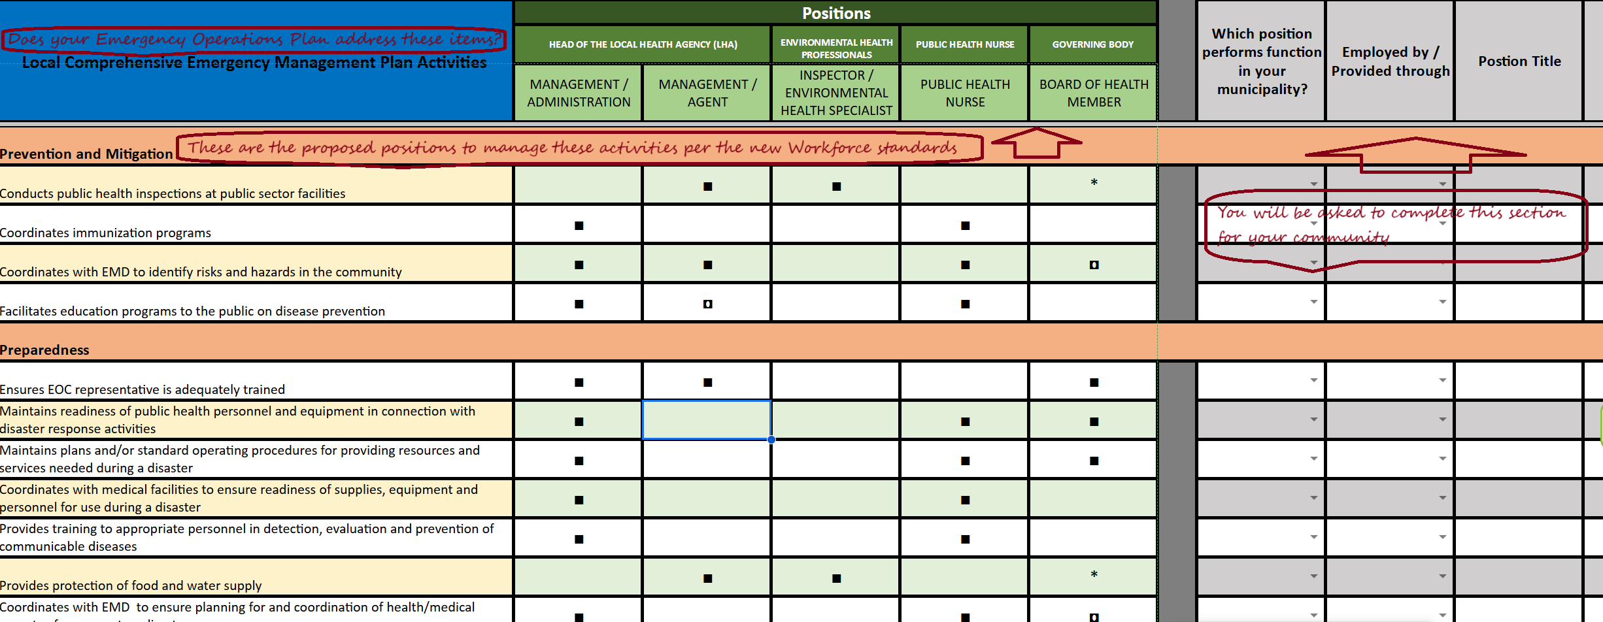
Notes:
This is the framework that is being developed to assess the current status of your Emergency Operations Plan.
The first column is asking you about specific components that should be addressed in your plan. This is not a total comprehensive list, but a solid basis as provided by the Massachusetts Emergency Management.
The Positions column are positions assumed that would manage the activities identified in the first column. This is based off the Workforce Standards established by Massachusetts Department of Public Health.
The third set of columns is for you to complete for your municipality and or Local Board of Health. This is where we will begin to gather data about your current status and how the Framework correlates to your scenario.

Slide 11
Next Steps:
Use training needs assessment to develop future training
Implement training programs based on identified needs
Notes:
As a result of the assessments, the coalitions will need to identify and assist in developing future trainings. The coalitions will assist in implementing a training program based on the needs identified.

