Slide 1
Health Equity and Stroke Care
Stroke Coordinator Guide

Slide 2
Summary of Expectations
The Joint Commission expects each accredited hospital to address a single issue related to equity in health care as one of the National Patient Safety Goals
This goal is aimed at closing any potential gaps in care related to disparity in access to and receipt of healthcare
The requirements focus on obtaining and analyzing data around:
    Populations served
    Social determinants of health
    Acting on that data in a meaningful way to support patient care
    Provide community-based resources

Slide 3
Aim
The FOCUS of your plan around this patient safety goals should be on fostering belonging and advancing health equity across your health settings
Include how your project advances your CORE VALUES and MISSION
Emphasize the goal of the project is to:
  Strengthen care through quality, resilience, and patient trust
  Build a culture of belonging for staff and patients
  Improve outcomes
Give examples of how your hospital and stroke program is currently enhancing patient-centered care and health equity

Slide 4
The following slides can be used in your survey presentation…
Notes:
NPSG are listed on the following slides. Customize the slides with your own information on the left and add your own image/graph on the right, as you choose.

Slide 5
NPSG.16.01.01 EP2: The organization assesses the patient’s health-related social needs (HRSNs) and provides information about community resources and support services.
Action: Formal assessment of SDOH in Stroke admissions with follow up for community resources based on needs Add SDOH with case management referral on all stroke admissions Provide education to clinical staff on SDOH in stroke and available services for those with identified SDOH needs Stroke coordinator will collect social data on stroke log: Gender, Age, Race/Ethnicity
Notes:
This slide is very specific to stroke; can use this one freely to meet this goal.

Slide 6
NPSG.16.01.01 EP3: The organization identifies health care disparities in its patient population by stratifying quality and safety data using the sociodemographic characteristics of the organization’s patients.
Action (example):
Review program data for demographics:
  Gender
  Race
  Age
  Rural vs. urban
Compare different data points of your program in relationship to your demographic data:
  Arrival modes
  TNK administration rate
  Thrombectomy rate
  DIDO
Are you identifying any disparities? If yes, what have you done to reduce disparity in stroke care?
Notes:
Can add graphs to this one that are specific to your program.

Slide 7
NPSG.16.01.01 EP4: The organization develops a written action plan that describes how it will address at least one of the health care disparities identified in its patient population.
Action (example):
Develop a written action plan to address identified disparity:
  Who does project impact?
  Who will implement project?
  What are the interventions?
  Time Intervals?
  How will the impact of the interventions be measured?
  What are the expected outcomes?
  Reporting Structure?
Notes:
Fill in this information as specific to your program’s plan for how to address these things.

Slide 8
NPSG.16.01.01 EP5: The organization acts when it does not achieve or sustain the goal(s) in its action plan to reduce health care disparities.
Action (example):
How do you review the data?
How often are you reviewing data?
Where do you report data?
Who do you report data to?
Who re-develops the plan when goals are not met?
Who is included in the plan? Is it multi-disciplinary?
Notes:
Add specifics to answer these questions about what to do if you don’t meet the goal.

Slide 9
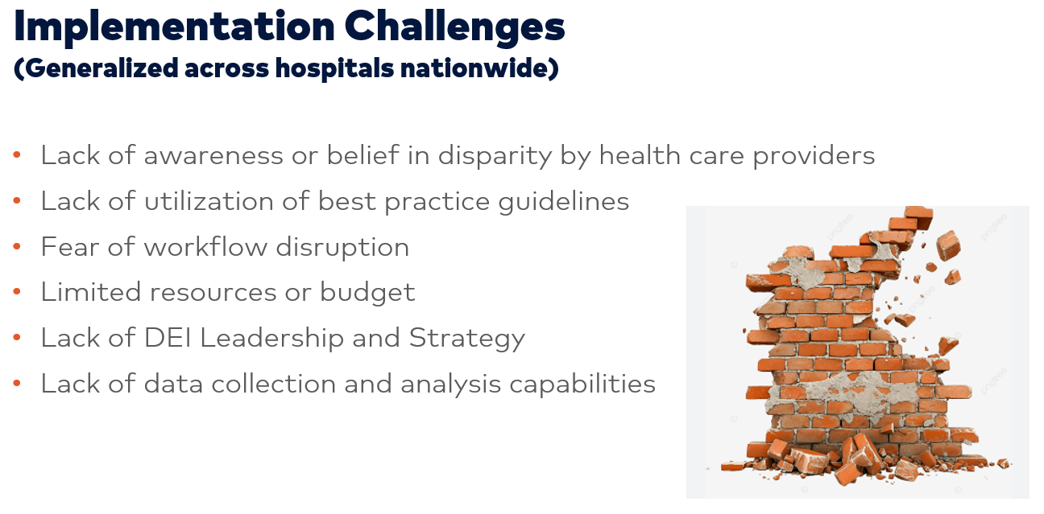
NPSG.16.01.01 EP6: At least annually, the organization informs key stakeholders, including leaders, licensed practitioners, and staff, about its progress to reduce identified health care disparities.
Action (example):
Updates of data, completed training, and initiatives for clinical staff and EMS staff will be provided quarterly to :
  Hospital Leadership
  Medical Executive Leadership
  Board Members
Disparity data provided in Stroke Meeting reports and departmental meeting agendas
Notes:
Could use this slide and fill in the light blue/gray area to make specific for your facility.

Slide 10
Addressing Gaps
Our program is aware there are gaps in stroke care identified in our data. For this reason, members of our team have been exploring interventions to close the gap:
List community projects, partnerships, and education you have done to address identified gaps in stroke care here. Add pictures or brochures.
Notes:
Customize this to your facility’s information. Can include pictures, protocol snapshots, brochures, etc.

