Slide 1
7 man mechanics
Gulf Coast Football Officials Association
Jeff McCroskey

Slide 2
Pre-Game
R/U meet with coaches 90 minutes prior to kick off.
All officials on the field 60 minutes prior to kick off.
R/B walk the field perimeter.
All officials enforce L warm up for 20 minutes.
Enforce 45 to 45 40 minutes prior to game.
FJ-Home, SJ-Visitor Captains, 5 minutes prior to kick off.
LJ-Home, HL-Visitor Teams

Slide 3
Coin Toss
3 minutes prior to kick, R/U go to center of the field.
R signals for F/S to bring captains to the middle. F/S stop at numbers.
B/F/L on press box side. H/S on chain side.
After captains leave the field, all come together in the center.
Line up in the huddle as you are on the field. No crossing.

Slide 6
Kick Off
B/U K restraining line.
F/S R restraining line.
H/L goal line.
R middle of the field behind the deepest receiver.
B/F/L on the pressbox side.
U/S/H on the chain side.
Keys

Slide 7
Kick Off Keys
X
X X X X X X X X X X
1 2 3 4 5 5 4 3 2 1

Slide 8
Free Kick Responsibilities
R-Move laterally to watch action at POA. Primarily responsibility for illegal blocks. Watch action IN FRONT OF runner. Be alert for reverse and hand off.
U/B-Move between hash and numbers. U has illegal action on kicker. Both move only 8 to 10 yards downfield. Observe action in the middle of the field and off ball action.
L/H-Be prepared to wind the clock. Stay on the GL until it is no longer threatened. When the runner is on your side of the field, watch the action at the point of attack and on the runner. If runner is on the other side of the field position yourself for blocks behind the runner.
F/S-Move 10 yards downfield and watch your keys.
Kick off after score. 1 minute to kick.

Slide 9
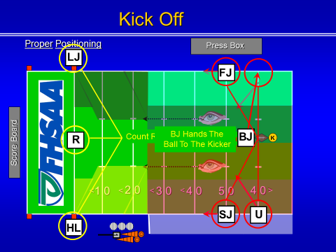

Slide 10
Onside Kick
R will take a position behind the deepest receiver in the middle of the field. R also has GL and EL responsibilities.
B/U keep the K restraining line.
L/H leapfrog over and take the midway point between the restraining lines.
F/S have R restraining line.
If kick goes deep, reverse mechanics are in effect and F/S now have R’s GL.

Slide 12
Running Plays
R-Counts A. Rule on numbering and formations. 12-14 yards deep and at least wider than TE.
U-Counts A. Look at correct numbering on 5 linemen. Watch for snap infractions and other umpire responsibilities.
L/H-Know your eligible receivers, shifts, formations.
F/S-Start 20-22 yards deep. Watch keys. NO FALSE STARTS!!
B-Start 25 yards deep. Watch key.
F/S/B count B.
Philosophy of 12 on the field.
Where do we look on running plays.

Slide 13
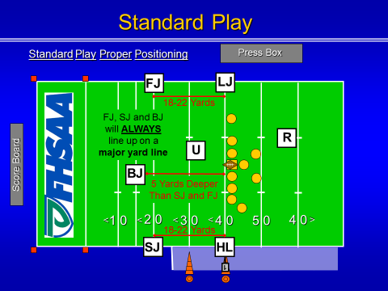

Slide 14
Minus Goal Line Scrimmage Play
Ball snapped on 3, both H/L retreat to GL.
Ball snapped on 5, L goes to GL.

Slide 15
Plus Goal Line Scrimmage Plays
Ball touching 7 yard line, H/L have GL.
F/S take endline with BJ.
Ball touching 25, F/S GL responsibilities.
H/L up to and including 2 yard line.
Communicate.

Slide 16
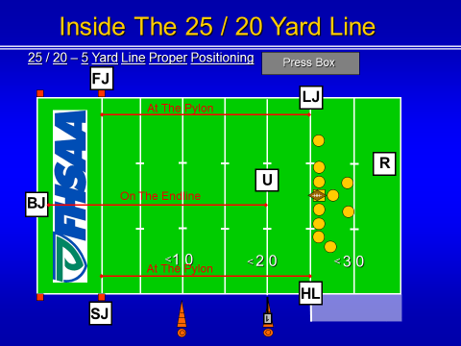

Slide 17
Pass Plays
R-Responsible for tackle on opposite side and any other lineman who is a threat to foul and the passer. Assist L on legality of forward pass. Rule on Intentional Grounding.
U-Read pass, adjust position for view of center and 2 guards. Pivot on all passes to assist on trapped passes. Be aware of ineligibles.
H/L-Regular responsibilies until you read pass. Then switch to key, so be prepared to slide downfield. Key not threatened, assist with tackle your side.
L has primary responsibility whether pass is forward or backward.
F/S-Watch key. Maintain cushion. Know when to switch to zone.

Slide 18
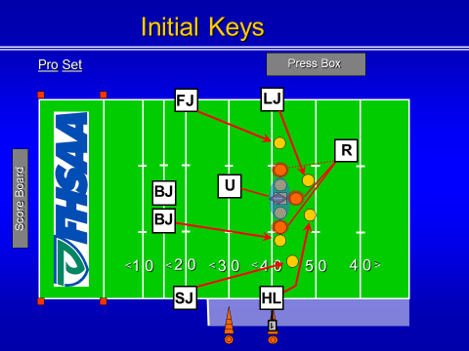

Slide 23
Scrimmage Kicks
R-Positioned behind the Kicker and outside the TE. See the snap and blockers. Watch for action on Kicker.
U-About 7-10 yards and watch action on snapper.
L/H-Hold the line of scrimmage until ball crosses the neutral zone.
B/F/S will be on the same line and no less than 5 yards behind the deepest receiver.
B will be behind the receiver and just off of the receivers wide side shoulder. Watch for KCI. Have bean bag to rule on end of kick.
F/S WILL NOT watch the receiver. They have responsibility on gunners. Watching for illegal blocks.
Touching 50 yard line to GL, F/S will go to GL and stay until it is no longer threatened.
Kicks OOB. Signal from R.

Slide 25
Scoring Kicks
R/U/H/L/B will maintain same style coverage as 5 man mechanics.
S will move inside and become a 2nd Umpire.
F will move under goal post with B
F/B count D and communicate eligible receivers. Also communicate if live ball.

Slide 27
Measurements
H will grab the chains by the clip mark and bring chains into the ball.
L will place foot on the spot.
B will hold the ball.
S clears the path and view for press box to see the measurement.
U takes the front stake and pulls chain and places on the ground.
R rules on measurement.
F secures appropriate ball.

Slide 29
Post Game
Do not shake hands on the field.
If anyone not affiliated with GCFOA is present, DO NOT TALK ABOUT THE GAME
For those who remember bullet 2, shut the ones that don’t remember up!

Slide 30
Things to think about.
Prepare for the game all week.
Go to pre-game prepared, don’t go to pre-game to prepare.
Communicate!!!!! Look at each other!!!!!
If you think something is wrong, SPEAK UP.
Pre-snap routine.
Don’t watch the game!
Trust your crew and watch YOUR areas of responsibility.
Make your calls felonies! No misdemeanors! Don’t pick the pepper out of the the fly poop!
Officiate with whistle out of your mouth.
Covering official whistles ball dead.
Incomplete pass. Covering official signals incomplete. All others kill clock.
Touchdowns are FOREVER. Slow down.
Buckle to ball.

