Slide 1
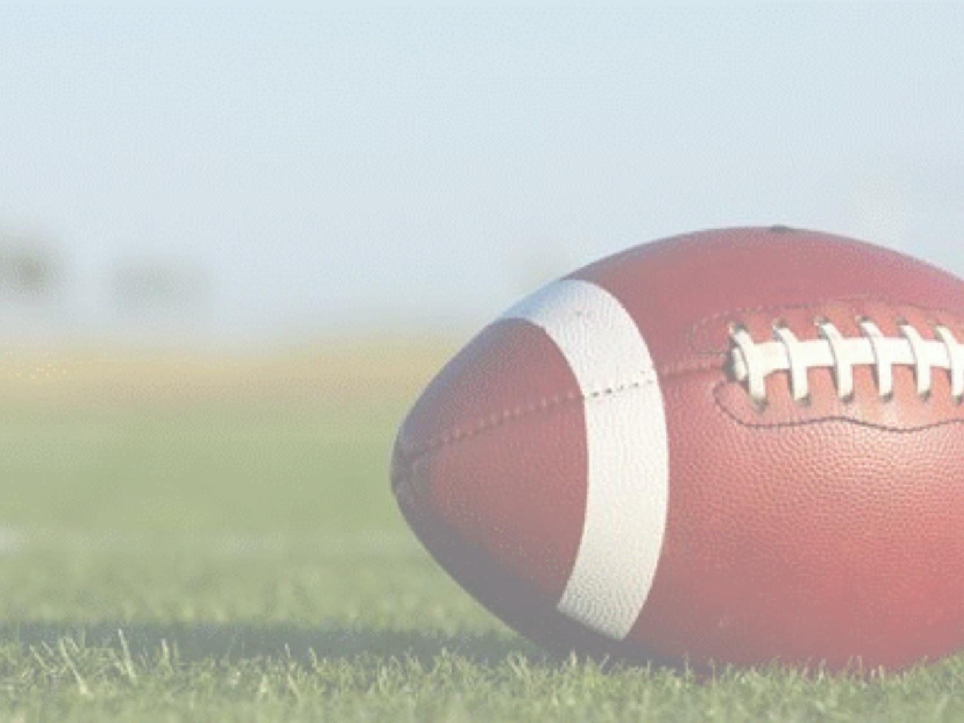


Alternate – Umpire Mechanics
5-Man Crew
Presented by:
Sunshine Football Officials Association

Slide 2
Current Umpire Mechanics
Variable according to the formations of both teams, avoiding a position which will interfere with linebackers. Adjust distance behind the defensive line according to the width of Team A's formation and (except on goal line or try situations) be at least 5 yards but seldom more than 7 yards deep.
Whenever possible, coordinate your position with the R for best coverage of the interior line play.
NEVER have an initial position outside the inbound lines (hashmarks).
Normal position is on side opposite the tight end.

Slide 3
Position Change Philosophy
To better provide the Umpire position a social distancing option, the Umpire has the option to move to the offensive backfield.
This allows the umpire to maintain a distance of 6 feet from any player on the field at the snap and not interfere with a defensive player, nor take him/her out of position for pre-snap responsibilities.
The mechanics are a hybrid of current NFL Umpire and NCAA Center Judge Mechanics.

Slide 4
Recommended Mechanic Change

Slide 5
Initial Positioning & Pre-Snap Responsibilities
R is positioned on the right side of the QB (no matter if the QB is right or left-handed)
U is positioned on the left side of the QB equal depth as the R
U has the Snap, Center, Two Guards, and Left Tackle
R has QB, Back(s) and the Right Tackle
R and U still responsible for pre-snap count of offensive players (Team A)

Slide 6
All Running Plays
R, U and LJ/HL have adjusted zone coverage and zones remain relative as play advances if run is to left or right.
R will have trailing coverage on runner to the right side of the field
U will have trailing coverage on runner to the left side of the field
R/U will have backside coverage depending on which direction the ball goes
  Exception – R will take QB on all scrambles to either side
Run Up the Middle
  R will focus on Center and Right Guard and work outward as play develops
  U will focus on Center and Left Guard and work outward as play develops
  LJ/HL will focus on Tackle and TE (if there is one) on their respective side.
  BJ will look in and focus on blocks by linemen at second level on linebackers

Slide 7

R
U
22
48
12
82
83
78
67
65
68
63
89
HL
LJ
BJ

Slide 8
All Running Plays - Continued
Run to Right Side
  R will focus on Center and Right Guard and work outward to blocks by Right Tackle and TE (if there is one)
  U will focus on Center and Left Guard and work to clean up blocks in the middle including blocks at second level.
  LJ will focus on Right Tackle and TE (if there is one). Continue to focus on blocks on the edge as run comes towards you.
  HL will focus on Left Tackle and TE (if there is one) and work to clean up backside blocks at LOS and backside blocks at second level
  BJ will focus initially inside on blocks at second level and then work outwards at blocks on the edge

Slide 9
R
U
22
48
12
82
83
78
67
65
68
63
89
HL
LJ
BJ

Slide 10
All Running Plays - Continued
Run to Left Side
  R will focus on Center and Right Guard and work to clean up blocks in the middle including blocks at second level
  U will focus on Center and Left Guard and work outward to blocks by Left Tackle and TE (if there is one)
  LJ will focus on Right Tackle and TE (if there is one) and work to clean up backside blocks at LOS and backside blocks at second level
  HL will focus on Left Tackle and TE (if there is one). Continue to focus on blocks on the edge as run comes towards you.
  BJ will focus initially inside on blocks at second level and then work outwards at blocks on the edge

Slide 11
R
U
22
48
12
82
83
78
67
65
68
63
89
HL
LJ
BJ

Slide 12
Pass Coverage
R has Right Guard and Tackle… Takes Center only if/when he overtly blocks toward the R’s Guard & Tackle
U has Center, Left Guard and Tackle… Yields Center when he overtly blocks toward R’s Guard and Tackle
Greater dependency on HL/LJ for Ineligible Player Downfield on passing plays
R would have QB to either side on roll outs. R would have responsibility for Roughing the Passer, Illegal Forward Pass and Intentional Grounding

Slide 13
Goal Line (at or inside the 5-yard line)
R is responsible for Illegal Forward Pass
U is responsible for Ineligible Player Downfield
H/L secondary responsibility for Ineligible Player Downfield
Reverse Mechanics
R always has GL responsibility
U will hold back and observe from inside out

Slide 14
Punt Formation
R will be on right side of kicker no matter if kicker is right or left footed.
R position outside the tight end and 2 yards behind the kicker
R takes Right Guard and Personal Protector(s) and Kicker
R has responsibility of kicker to either side to rule on roughing
U will be on left side of kicker no matter if kicker is right or left footed.
U position 2-3 yards outside the kicker and 2 yards behind the kicker.
U has Center, Left Guard and Left Tackle. U can help with Personal Protectors if more than one.
R and U will revert to zone after ball is kicked
HL takes Tackle and Ends on their side
LJ still releases on snap for downfield coverage
R still has goal line responsibility on reverse mechanics
U will maintain zone in middle of the field

Slide 15
R
U
3
42
22
48
83
78
67
65
68
63
89
HL
LJ
BJ

Slide 16
Field Goal and Try Attempts
R always goes to the side of the Kicker, has Kicker, Holder and assists with coverage on Wing Backs
R will always look into kicker and holder
U lines up opposite the R and has all action on the Snapper, both Guards and Tackle on side opposite HL
HL will take Tackle and TE on his side as well as assist on coverage on Wing Back to your side
LJ will always go under for coverage with BJ

Slide 17

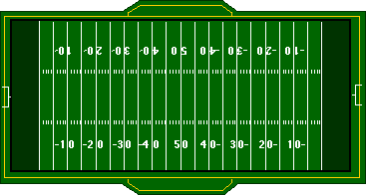

VISITOR
H
21
36
B
54
U
44
99
Kicker #89 is right footed.
11
74
89
L
63
7
R
19
Field Goal or Extra Point
Kick Mechanic – 5 Man

Slide 18

VISITOR
H
R
36
21
Kicker #89 is right footed.
54
44
B
89
11
99
74
L
U
63
7
19
Field Goal or Extra Point
Kick Mechanic – 5 Man

