Slide 1
Geospatial Data Act of 2018
Update on Implementation
Coalition of Geospatial Organizations
July 9, 2019

Slide 2





Geospatial Data Act of 2018
Executive Summary
Codifies the role and authorities of the FGDC
Establishes the NGAC as a statutory advisory committee
Establishes stewardship of geospatial assets
Policy and guidance to empower the use of geospatial data and technology
National Spatial Data Infrastructure
Establishes agency responsibilities
Budgeting and reporting requirements
Notes:
Key
Authorities of FGDC
NGAC as a statutory advisory committee

Slide 3

Geospatial Data Act of 2018
The GDA reflects growing recognition of the essential role of geospatial data and technology and highlights the need to support their continuing development as critical infrastructure for the Nation.
The GDA formalizes Federal government structures related to geospatial data
The GDA provides policy and guidance to empower the use of geospatial data and technology
Facilitates broad cooperation between the public and private sector
Positions the U.S. to be a global leader in utilization of geospatial technology
Notes:
The GDA reflects growing recognition of the essential role of geospatial data and technology and highlights the need to support their continuing development as critical infrastructure for the Nation.
- Largely codifies A-16 and adds additional oversight and reporting requirements

Slide 4
Geospatial Data Act of 2018
Context–
The GDA is one of several new data initiatives aimed at:
Federal Data Strategy
Geospatial Data Act
Promoting and improving access to data for public health, economic growth, environment and other purposes
Promoting use of quality scientific and other data to improve policymaking
Sparking public private partnerships, new innovative start-ups & services
Foundations for Evidence-Based Policymaking Act
  - TITLE I: Federal Evidence-Building Activities
  - TITLE II: Open Government Data Act
  - TITLE III: Confidential Information Protection And Statistical Efficiency
Notes:
3 recent actions by the administration and congress codify and promote the strategic importance of open data for public good
Paying close attention to these activities.
Participating in the FDS action plan, - use of geospatial data can enhance and improve decision making
Put forth platform, NGDA’s and standards to support the newly established US data federation use case pilots – planned meeting date ??
Attending Data.gov calls to stay in form
For the purposes of this meeting I will focus on the GDA

Slide 5

Geospatial Data Act of 2018
Implementation Approach
Workshops/Establishment Tiger Teams
Initial assessment of GDA
Stakeholder engagement
High-level implementation roadmap
Updated OMB guidance (Circular A-16)
GDA Implementation Strategy / NSDI Strategic Plan
Notes:
Implementation Strategy

Slide 6
Geospatial Data Act of 2018
GDA Implementation Roadmap
KEY TASKS
OMB Circular A-11 Language Revision
Federal Data Strategy (FDS) Action Plan Update
Ongoing Stakeholder Engagement
GDA Interagency Budget Initiative
GDA Work Groups – Critical Issues
GDA Communication Strategy
Development of OMB Guidance

Slide 7
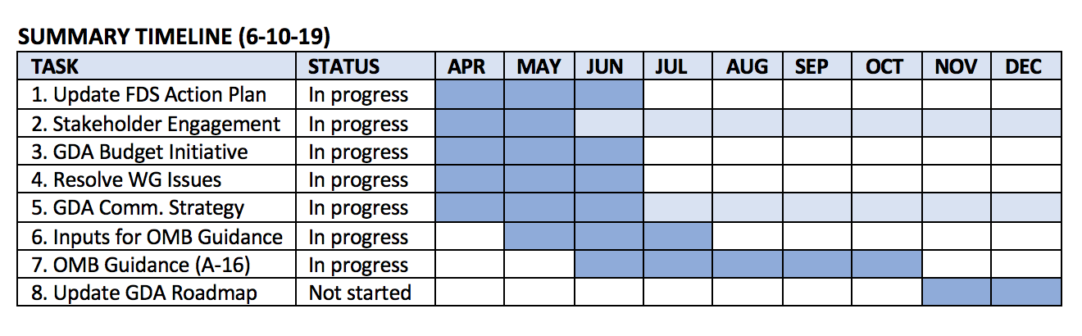
GDA Roadmap Highlights

Slide 8
How the Geospatial Data Act requirements overlap with Federal Data Strategy & Evidence Act
Geospatial Data Act Covered Agency Responsibilities
Federal Data Strategy
Evidence
Act
1 | Prepare and implement a strategy for advancing geospatial data activities appropriate to the agency’s mission
2 | Collect, maintain, disseminate, and preserve geospatial data such that resulting data, information, or products can be shared
3 | Promote geospatial data integration.
4 | Ensure that geospatial information is included on agency record schedules that have been approved by the National Archives and Records Administration.
5 | Allocate resources to fulfill geospatial data responsibilities
6 | Use geospatial data standards
7 | Coordinate with other federal agencies, state, local, and tribal governments, institutions of higher education, and the private sector.
8 | Make federal geospatial information more useful to the public, enhance operations, support decision making, and enhance reporting to the public and to Congress
9 | Protect personal privacy and maintain confidentiality in accordance with federal policy and law.
10 | Participate in determining whether declassified data can become part of the NSDI
11 | Search all sources to determine if existing data meet the needs of the covered agency before expending funds to acquire geospatial data
12 | Ensure that those receiving federal funds for geospatial data collection provide high-quality data
13 | Appoint a contact to coordinate with other lead covered agencies
DRAFT – PRE-DECISIONAL – FOR INTERNAL USE ONLY

Slide 9
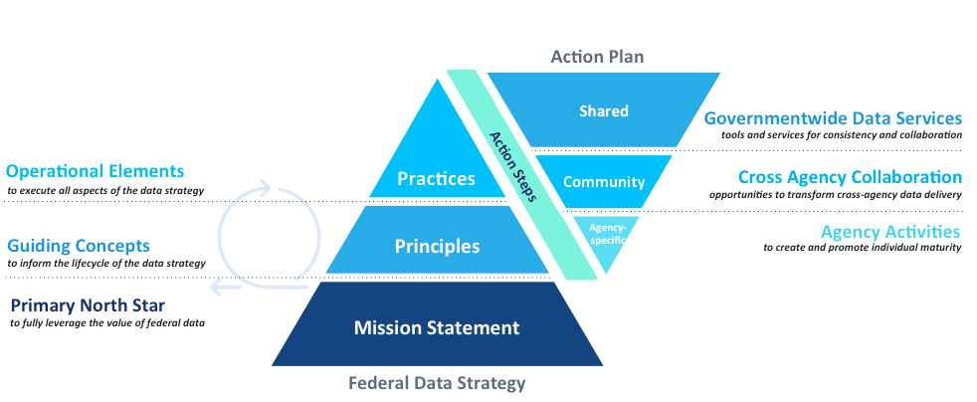
Include FGDC priorities in the Federal Data Strategy 2019-2020 Action Plan
Draft Language
Action 11: Improve Geospatial Data Standards
By June 2020, the Federal Government will have improved geospatial data standards for all Federal Geospatial Data Committee (FGDC) data themes. The Geospatial Data Act requires the FGDC to establish standards for each of the National Geospatial Data Asset data themes and content standards for metadata, consistent with international standards and with public feedback, excluding public disclosure of any information that reasonably could be expected to cause damage to the national interest, security, or defense of the nation.
Responsible: Federal Geospatial Data Committee
Supported practice(s): Prioritize Data Governance; Leverage Data Standards
Measurement: Number of FGDC data themes with improved geospatial data standards
Established content standards for metadata (Y/N)
Timeline: Completed within 12 months

Slide 10
FDS Action Plan – Proposed Revisions
Revision of FGDC’s Federal Data Strategy (FDS) Action:
Integrate Geospatial Practices into the Federal Data Enterprise
  NSDI Strategic Plan
  Spatially Enable the Federal Data Enterprise – process
  Increase Access to Spatial Data Services (GeoPlatform)
  Improve Geospatial Standards

Slide 11
Get Involved
Visit https://Strategy.Data.Gov
Meet the team
See progress to date
Submit comments
Learn about opportunities for input
Email federaldatastrategy@gsa.gov
Ask to be a subject matter expert
Subscribe to the Federal Data Strategy newsletter
Tweet #FedDataStrategy
Engage on social media
Notes:
I want to wrap up by just reiterating that the Federal Data Strategy team values your input and your support. Learn more and be in touch if you want to get involved!

Slide 12
A-16 Revision Process - FGDC
Small team to draft: OMB, DHS, VA, DOI, DOC, FGDC OS
Input for approach and consideration:
  OMB direction on A-16 revision and A-16 Supplemental Guidance
  Tiger Team workgroup items (workgroups be ready for questions)
  NGAC recommendations
Will require the A-16 team’s dedicated time, meeting more than weekly to adhere to the July 12 deadline
FGDC OS staff to develop initial working document
Anticipate questions for the A-16 Team after the agencies’ review and public review processes
Supplemental Guidance content will be referenced in A-16 and specific content released as FGDC technical guidance that can be updated outside of the Circular update process

Slide 13
Draft – A-16 Revision Timeline
GDA Guidance – A-16 Revision Action | Start Date | Due Date
FGDC: Draft of A-16 recommended text updates to OMB (from SC meeting – 28 days) | June 13 | July 10 (Wed)
Recommendation Incorporation | Early July
Interagency Review | Mid July
Comment Adjudication | Late July
Public Comment (30 days) | ~Aug 1 | Aug 30
Comment Adjudication | Early September
OMB: Internal Review | September 2019
A-16 Target Release | October 2019

Slide 14
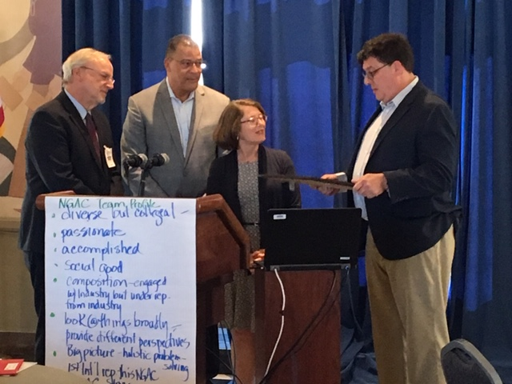
June 2018 NGAC Meeting – Agenda
Leadership Dialogue
Spotlight Session: Geospatial Data Act
NGAC Operations Discussion
NGAC Subcommittees
  Landsat Advisory Group
  Infrastructure
  Cultural/Historical Resources
  A-16 Work Group
Emerging Technologies Presentations
NGAC 2019 Planning
Lightning Sessions

Slide 15
National Geospatial Advisory Committee
Mr. Keith Masback (Chair) U.S. Geospatial Intelligence Foundation | Mr. Mike Hussey State of Utah | Ms. Rebecca Somers Somers-St. Claire GIS Consultants
Mr. Mark Reichardt (Vice-Chair) Open Geospatial Consortium | Mr. Xavier Irias East Bay Municipal Utility District | Ms. Jennie Stapp State of Montana
Mr. Frank Avila National Geospatial-Intelligence Agency | Mr. Sanjay Kumar World Geospatial Industry Council | Ms. Christine Stinchcomb Paulding County, GA
Dr. Sarah Battersby Tableau Software | Mr. Tony LaVoi NOAA | Ms. Julie Sweetkind-Singer Stanford University
Mr. Byron Bluehorse University of Alaska Fairbanks | Ms. Roberta Lenczowski Roberta E. Lenczowski Consulting, LLC | Mr. Gary Thompson State of North Carolina
Mr. Gar Clarke State of New Mexico | Mr. Kevin Pomfret Centre for Spatial Law and Policy | Dr. Harvey Thorleifson Minnesota Geological Survey
Mr. Garet Couch National Tribal GIS Center | Ms. Amber Reynolds City of Lawrence, KS | Mr. Jason Warzinik Boone County Fire District, MO
Ms. Patricia Cummens ESRI | Mr. Cy Smith State of Oregon | Dr. May Yuan University of Texas – Dallas

Slide 16
Landsat Advisory Group
DECISION: NGAC adopted paper: “Evaluation of a Range of Landsat Data Cost Sharing Models”
Recommendations:
  The LAG recommends that the Department of the Interior not implement any fees for Landsat data with the characteristics of Landsat 8 and 9.
  The LAG recommends further review of the concerns identified regarding charging for “enhanced” Landsat data.
  The LAG recommends that further research is needed to examine the benefits and costs of transitioning from GOCO to COCO at the USGS Earth Resources Observation and Science (EROS) Center.
  The LAG recommends that further research is needed to determine if a sufficient business case exists and what legal changes are required to support exploration of the creation of public-private partnership(s).
16

Slide 17
Infrastructure Subcommittee
DECISION: NGAC adopted paper, “Infrastructure Renewal Best Practices”
Paper includes “Top 10” list of geospatial best practices.
Complements previous NGAC paper, “Geospatial Information: The Key to Smart Infrastructure Investments” and use cases on Permit Streamlining, Underground Renewal, Pavement Management, and the New York Cultural Resource Information System.
Subcommittee Membership: Cy Smith (Chair), Keith Masback (Vice-Chair), Pat Cummens, Xavier Irias, Amber Reynolds

Slide 18
Questions and Discussion

