Slide 1
Building the National Address Database
COGO Summer Meeting
July 2019

Slide 2
First Step: The National Address Database Summit
Held April 8-9, 2015 at the Maritime Institute in Linthicum, MD
Funded by DOT
Objective: To identify and discuss possible options for developing a National Address Database (NAD)
Broad stakeholder representation
Government (Federal, State, Local, and Tribal) – 45 representatives
Private Sector – 8 representatives
Non-Profits and Trade Organizations – 5 representatives

Slide 3
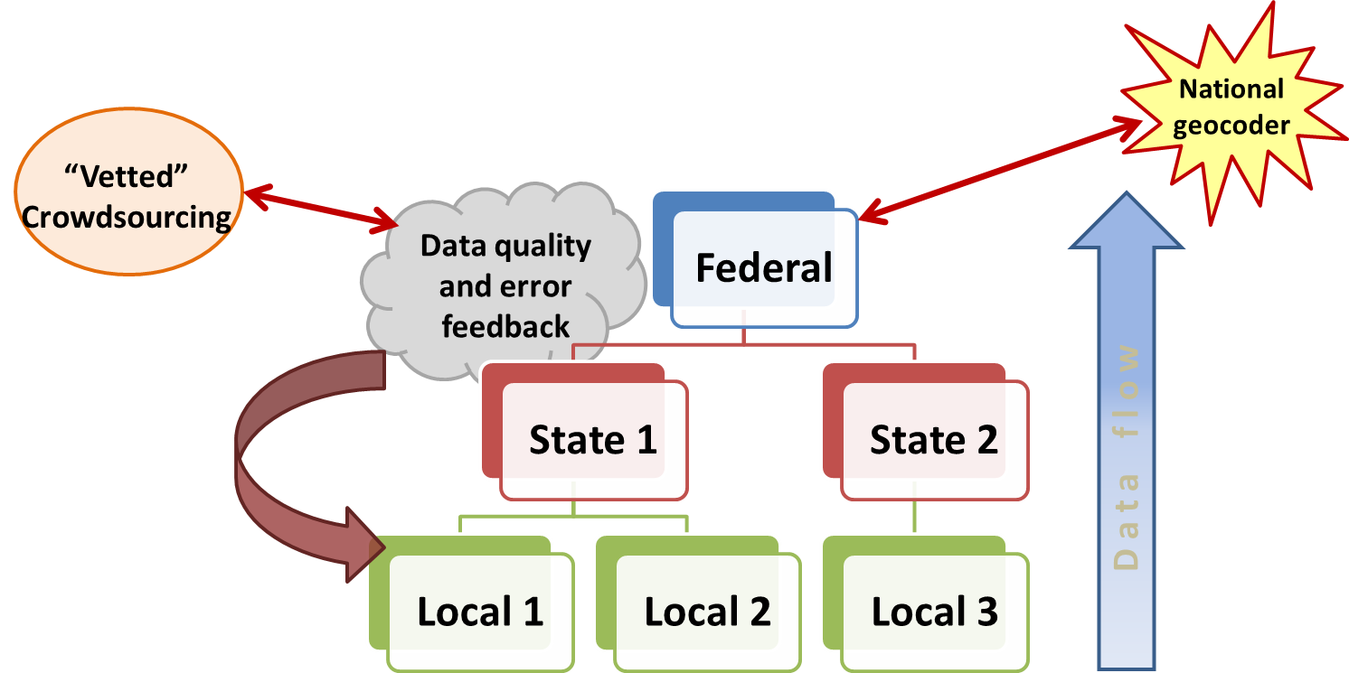
How it would work

Slide 4
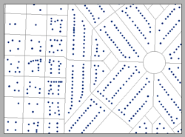
Pilot Launch October 2015
DOT Funded
Included State and Local Partners
Arizona
Arkansas
Boone County, Missouri
Goals
Explore workflows and understand best practices for address roll-up
Compare Data Schemas
Develop minimum content guideline and associated data schema
Explore geocoding options for “have nots”

Slide 5
NAD Minimum Content Guideline
The Address Itself
Address Number
Geographic Location of the Address
Lat/Long
Metadata About the Address
Address authority
Street Name
Subaddress
City/Town/Place
County
State
Zip
National Grid Coordinates
Address source
Address date
Unique ID
Type (residential, commercial, etc.)
Placement (rooftop, driveway access, etc.)
A database schema and a file geodatabase template were developed from this guideline
Arizona, Arkansas, and Boone County, MO data were loaded into the schema

Slide 6
Coalition of the Willing
After the release of the minimum content guideline and schema, 15 additional address programs volunteered to develop their own ETLs
District of Columbia
New Jersey
Ohio
Utah
Virginia
9 additional counties and 1 city from Missouri (Locals Helping Locals)
After the pilot concluded in July 2016, Colorado, Indiana, Maryland, Massachusetts, Montana, New Mexico, New York, North Carolina, and Tennessee, volunteered to provide data
No additional resources were available at the time, so a queue was created and the NAD went dormant

Slide 7
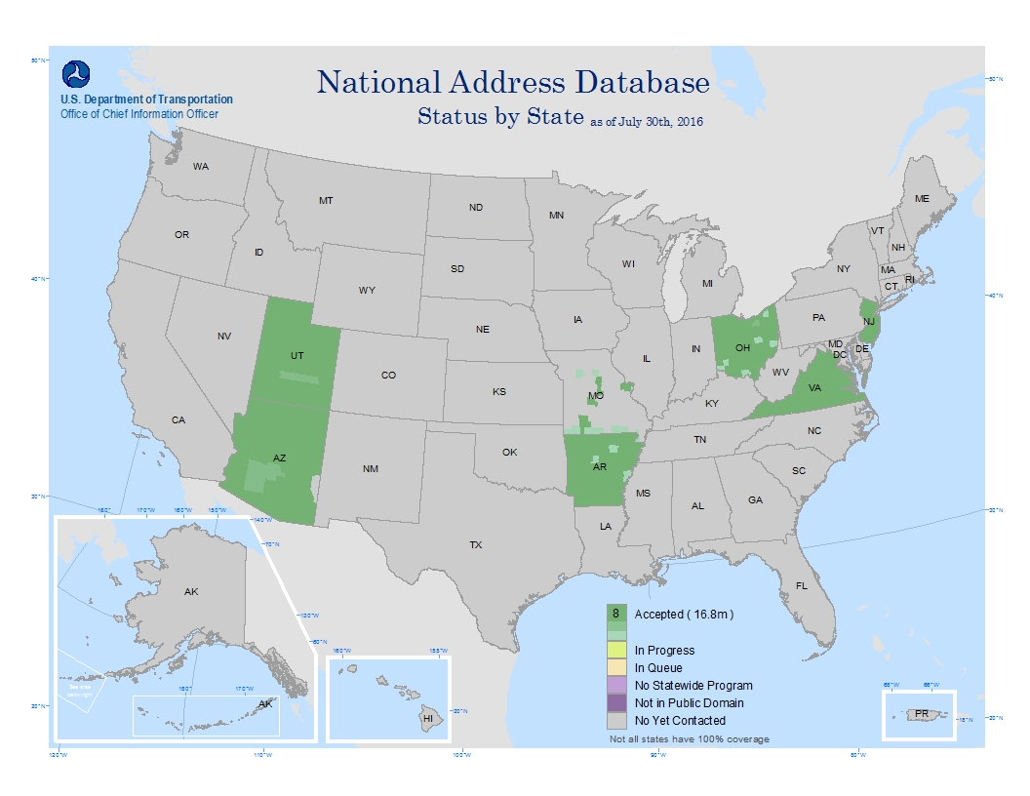
NAD Status – July 2016

Slide 8
Contract for NAD ETL Developer
After 1 year of dormancy, NHTSA provided funding to continue NAD Development
Contract awarded to GIS Inc. at the end of June 2017
Onsite developer reported to DOT on July 17, 2017
Initial focus on QA/QC of data submissions
Transitioned to assisting states with ETL development
Notes:
As you’ll recall, the NAD Pilot ended in the summer of 2016. Because of a lack of resources at DOT/OCIO, we were dormant for more than a year. Thanks to funding from NHTSA’s 9-1-1 Program, we were able to award a contract for an ETL Developer. The contract was awarded to GIS Inc. and an onsite developer reported to DOT on July 17. His initial focus was on developing QA/QC procedures for verifying data supplied by partner states who developed their own ETLs. He’s now also assisting additional partners with ETL Development.

Slide 9
DOT Quality Checks for Data Submissions
Data Completeness Assessment
Required and supported NAD data variables - count and percentage populated
Data Quality Assessment
Duplicate records
Missing required data variables
Missing required metadata
Invalid geometry
Attribute Domain Quality Assessment
Invalid values
Non-documented values, proposed expansion of domain
Base on these assessments, reports were generated and provided to each partner state
Notes:
QC process determines which records are included in the NAD

Slide 10
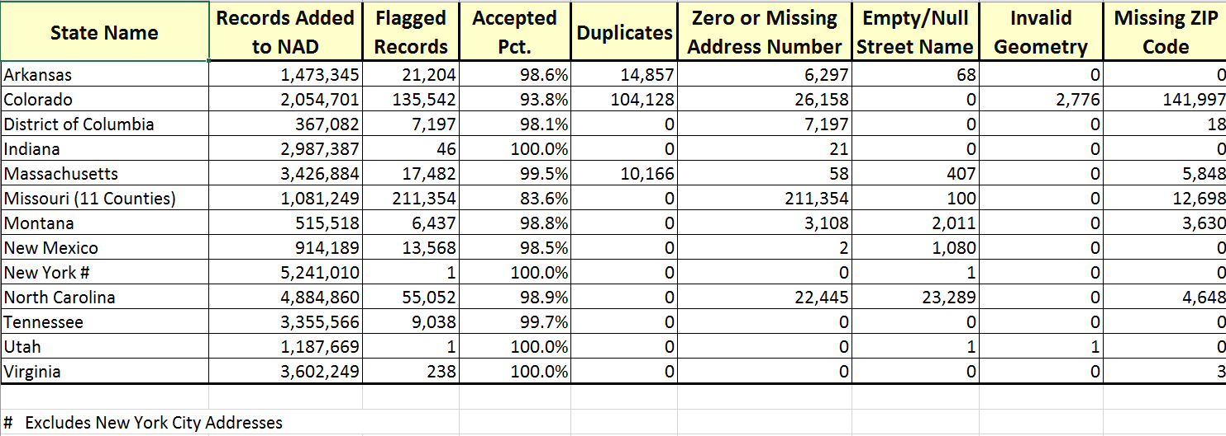
DOT Quality Review Summary Statistics

Slide 11
Progress – Year 1 with ETL Developer
States with data in the NAD grew from 8 to 22
Number of records in the NAD grew from 16.8 million to 45.7 million
Received updates from all but 2 of the original pilot states
An additional 5 states have agreed to be partners, but have yet to provide data
Of the states contacted, 4 have expressed interest, but currently have no statewide address program
Of the states contacted, 5 have data, but it is not currently publicly available

Slide 12
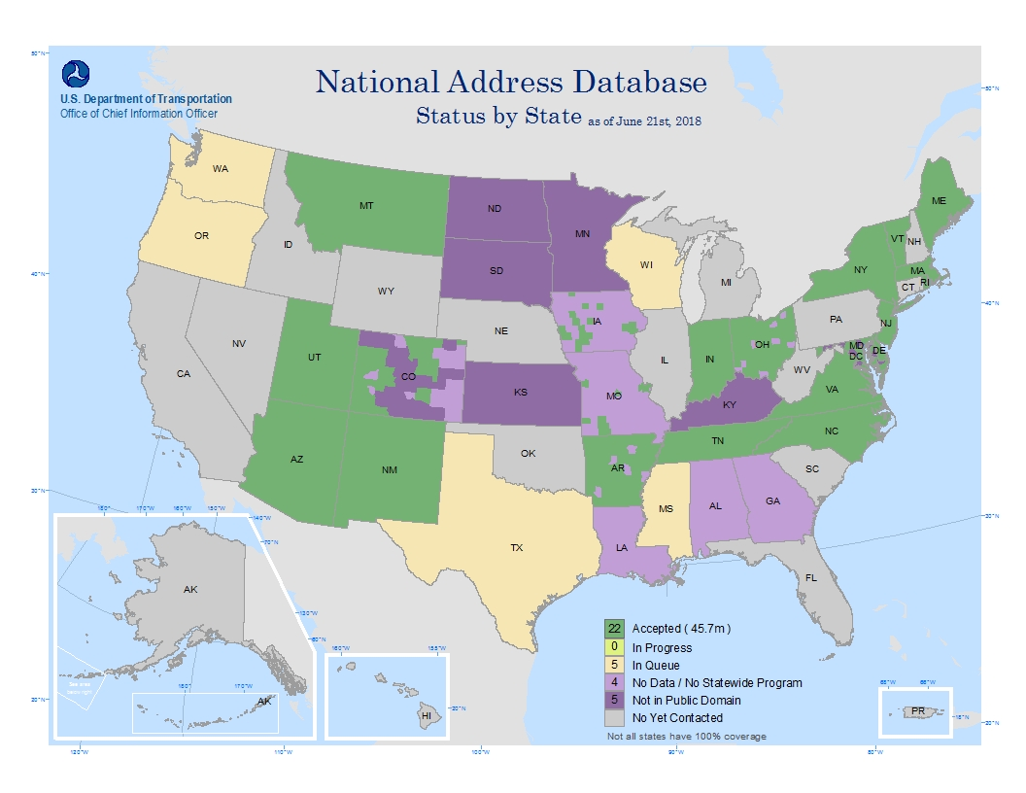
NAD Status – July 2016

Slide 13
When Year 1 Ended
Good News – NHTSA agreed to fund the ETL Developer for another year
Bad News – Year 1 ended on 6/25/2018 and the NHTSA funding was for FY2019 (not available until 10/1/2018)
The NAD was in “stop work” mode for 3+ months
With the uncertainty over funding, GIS Inc. reassigned the developer to a different full time position
A new developer started in 11/2018, but there was additional time lost in the knowledge transfer process
Progress was further hindered by the month long government shutdown.

Slide 14
Progress in Year 2
Received initial submissions from Texas (9.2 million) and Wisconsin (2.1 million)
Received initial submission from several counties in Wyoming, which has no statewide address program
Received updates from 9 states: Arizona, Arkansas, Delaware, Massachusetts, Montana, New Mexico, New York, Tennessee, and Utah
Kansas, originally a “not in the public domain” state, will provide an initial submission soon (76 of 105 counties)
Oregon will provide an initial submission soon

Slide 16
NAD V2 Available for Download
A second release of the NAD was made available in early May
File geodatabase and flat ASCII formats
https://s3.amazonaws.com/nationaladdressdata/NAD_r2_WithMetadata.zip
https://s3.amazonaws.com/nationaladdressdata/NAD_r2_ASCIIWithMetadata.zip
Almost 47 million points
Includes basic metadata
Also available from the DOT website
www.transportation.gov/nad
Hope to do quarterly releases

Slide 17
NAD Timeline
NAD Summit
NAD Pilot
Year 1 with Developer
Year 2 with Developer
October 2015
July 2017
October 2018
April 2015
July 2016
July 2018
Now

Slide 18
Value on a Shoestring Budget
Over the last 4 years, DOT has spent $700,000 on NAD development (Summit, Pilot, 2 years of developer)
Over that time, partners have provided 56 million address points that have been incorporated (or soon will be incorporated) into the NAD
1.25 cents per address point
Imagine what we could do with committed resources!

Slide 19
Contact Info
Steve Lewis
Chief Geospatial Information Officer
U.S. Department of Transportation
(202) 366-9223
steve.lewis@dot.gov

