Slide 1
Gulf States Collectors Association 2024 Annual Meeting
Jennifer Whipple| ACA President Elect

Slide 2
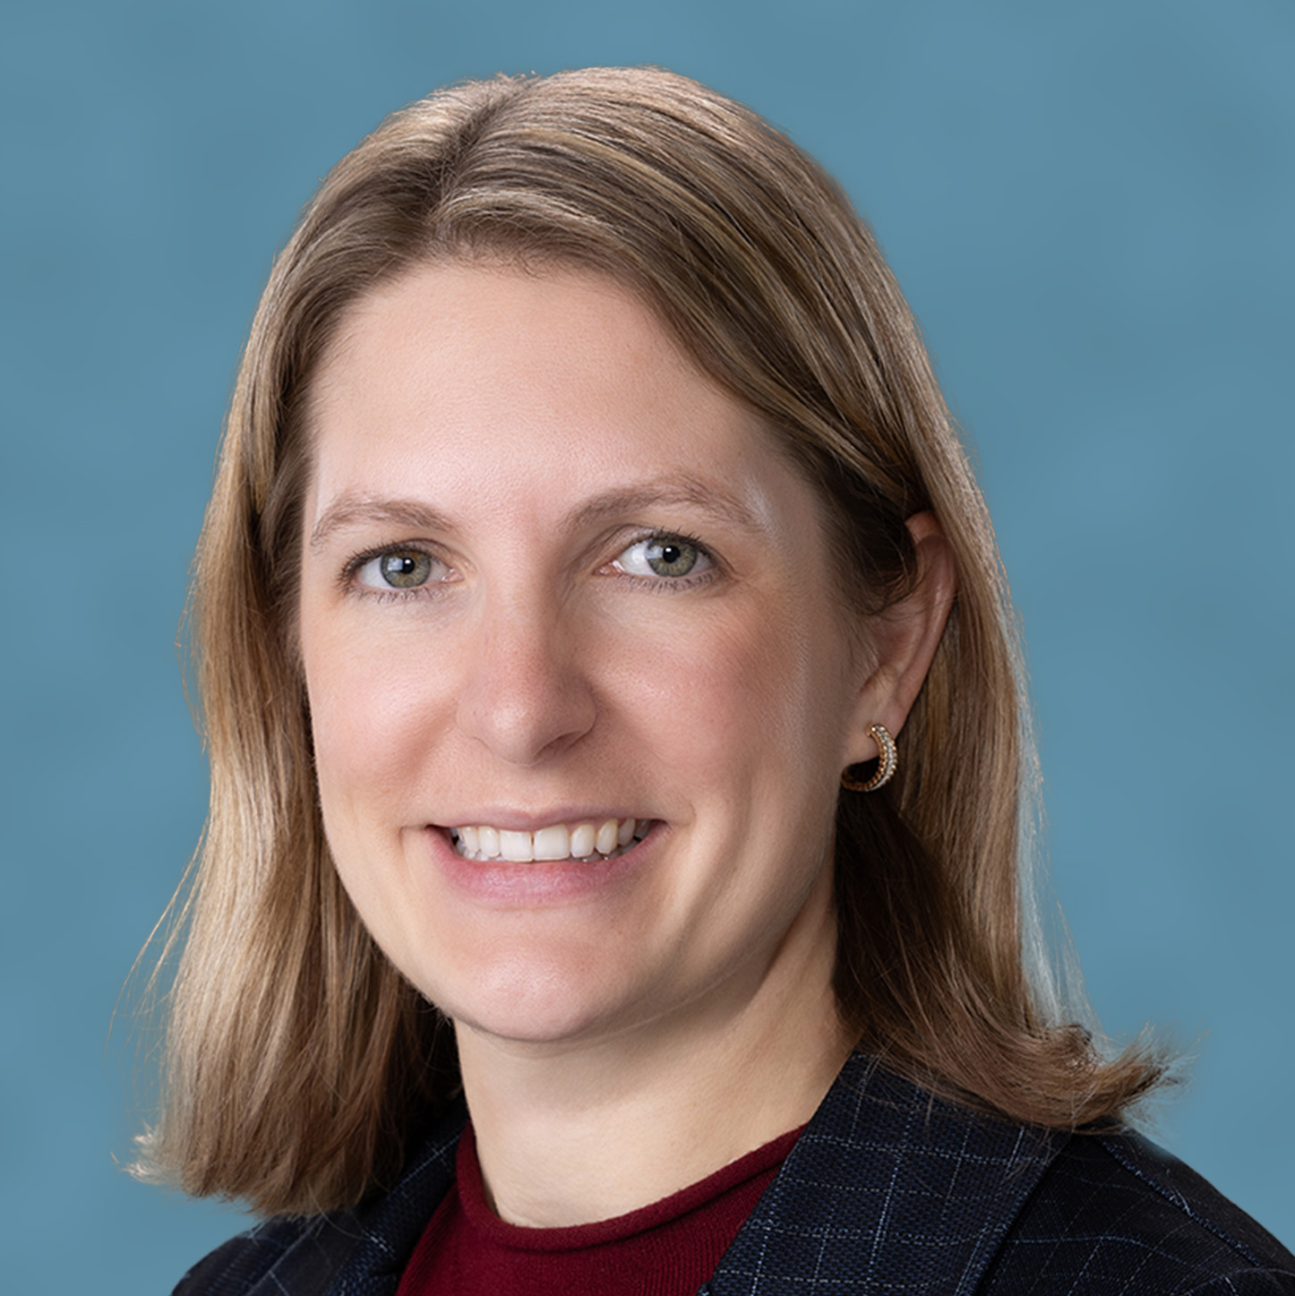
2024/25 Board of Directors, Officers
Tim Haag ACA President
President & CEO of State Collection Service Inc. in Wisconsin
Jennifer Whipple ACA President-Elect
President of Collection Bureau Services Inc. in Montana
Jeff DiMatteo ACA Treasurer
Owner/founding partner of American Profit Recovery, Inc. in Michigan
Notes:
Visit our website to read ACA’s Strategic Plan in its entirety, including our values, vision and mission.

Slide 3
ACA Highlights
1.
ACA holds six annual events: -Committee of 100
-ACA HOW: Revenue Growth Summit
-Washington Insights
-Convention & Expo
-Fall Forum
-Visionaries
2.
ACA offers seven professional designations that are highly recognized in the accounts receivable management industry.
3.
300 attorneys are employed at Brownstein Hyatt Farber Schreck, where ACA’s award-winning lobbyist, Leah Dempsey, is a shareholder.
4.
Our ACA Daily newsletter and bimonthly Collector magazine recently won ASBPE awards for excellence.
5.
ACA partnered with Kaulkin Ginsberg to produce a report on diversity in the ARM industry, which is used as part of our advocacy efforts.
6.
ACA conducts close to 60 members-only ACA Huddle webinars every year, with dozens of unique guest speakers.

Slide 4
New Innovations
Benchmarking Intelligence™
ACA’s Benchmarking Intelligence tool enables members to anonymously compare their results to others using a wide range of criteria and metrics, giving you greater insight into your operations. We’re also excited about what this means for our advocacy efforts.
Role-Based Communities
One of our biggest initiatives involves a programming change to enable members to quickly set communication preferences and, more importantly, list what role each member employee plays in your organization.
This enables accountants to talk with other accountants, IT folks to talk to other IT folks, etc.—further expanding each role’s contribution by hearing role-specific best practices and bringing even greater insight to your organization.
Recognizing Excellence
ACA partners with the Best Places to Work in Collections program, a research-driven survey from Best Companies Group that examines your company’s practices, programs and benefits and surveys your employees for their perspective. Participation is free for ACA members.
The 2024 winners were announced at ACA’s Convention in July.

Slide 5
What Is It?
Your organization's cybersecurity is crucial. That's why we've created the Cybersecurity Collective.
This exclusive community offers:
Collaboration with industry peers.
A private forum for Q&A and knowledge sharing.
Quarterly live webinars starting this September 2024!
While you can have more than one person from your company join, this group was designed for your Chief Cybersecurity Officer and designated Qualified Individual under the Safeguards Rule.
How to Join
You or someone on your team can sign up in two easy steps:
Scan this QR code and agree to the terms of participation.
In your welcome email, follow the instructions to request access to our private LinkedIn group.
Once approved for our private LinkedIn group, you’ll be able to connect, engage and share insights with like-minded professionals.
Join today!

Slide 6
Special Offers for Members
IT Services
Our partner, TPx, makes IT affordable to members.
Vendors
Vendors in our Alliance ACA program give members product discounts and enhanced offerings.
Insights
Know My Debt is ACA’s financial literacy website that can help you educate consumers.
Education
Use the All-Access Training Zone to access all of ACA’s webinars for one low price.
Marketing
ACA’s digital media services can help you reach your markets through videos and animation.
Notes:
ACA has partnered with TPx, a leading managed services provider. TPx makes IT affordable to all ACA members, including Incident Detection and Response solutions, phishing tests and other cybersecurity measures at a price that won’t break the bank. ACA’s Tier 1 and 2 members get special pricing on TPx services.
Know My Debt is a free and easy way for you to address common consumer questions. Provide it to your collectors and post the link on your website!
Through our Alliance ACA program, we develop strategic partnerships with ARM industry vendors to give members discounts and enhanced offerings. Take advantage of discounts from more than two dozen companies!

Slide 7
Deadline Extended for Visa-MC Claim Submission
Our Alliance ACA partner can help you navigate a $5.6 billion antitrust settlement in an interchange fee case.
If your business accepted any Visa or Mastercard payments between 2004 and 2019, you may be eligible to recover funds from this $5.6 billion antitrust settlement—but you have to file your claim by Feb. 4, 2025 (recently extended).
ACA has joined forces with DCap Claims, a member of the Alliance ACA program, to help our members with the process of filing a claim in order to receive the funds due to them.
DCap Claims works directly with and on behalf of clients to file claims, maximize their value, communicate with the claims administrators and service claims through ultimate recovery.
Reach out to Dcap Claims for more information

Slide 8
Leadership Development Opportunities from ACA
01
Committee identifies and builds up future leaders of our industry.
Leadership Development Committee
A monthly online chat to empower your leadership journey with insights
and peer support.
02
Leadership Exchange Chat
03
Celebrating up-and-coming leaders in the industry.
Emerging Leaders Program
Connect with other leaders at ACA’s in-person events and grow your skills.
04
Event Connections

Slide 9
How to Interact with ACA
Update the information in your online profile.
Opt In to Our Communications
Opt in to receive ACA emails, including:
ACA Daily newsletter
Collector magazine announcements
Compliance alerts
Product discount offers
Member/breaking news alerts
And more!
Join Groups on The Hub
Join groups in our online community, including:
Collection Floor Leadership
Compliance
Health Care Collection
Human Resources Professionals
Supervisors/Managers
Training Professionals
Keep Your Team Updated
Customize the emails your employees receive from ACA, too. To get started:
Log in to acainternational.org
In your profile, you’ll be able to update information for your team.

Slide 10
ACA’s 2024-25 Conferences
Visionaries
Nov. 5, 2024
Chicago
Fall Forum
Nov. 6-8, 2024
Chicago
Committee of 100 Meeting
Feb. 25-28, 2025
Kapolei, Hawaii
Washington Insights Fly-In
Spring 2025
Washington, D.C.
Annual Convention & Expo
July 23-25, 2025
Louisville, Kentucky

Slide 11
Collectors Insurance Agency
Bonds
Licensing
Our Surety Bond Program offers automatic renewals, expedited document prep & competitive rates for Statutory, Blanket Client & Client Contract Bonds.
Insurance
We work with proprietary automation and ACA’s Compliance Department to bring you the best, most affordable licensing service available.
We offer E&O, Commercial Crime, Umbrella, Business Owners’, Workers Comp and Cyber Security.
NEW: Passive Debt Buyer Insurance! Our new Passive Debt Buyer coverage can be accessed exclusively through Collectors Insurance Agency (CIA), a subsidiary of ACA International.
Notes:
Collectors Insurance Agency provides ACA members exclusive access to world-class commercial insurance products, including bonds and licensing services tailored to each member’s specific needs.
In a world affected by inflation, CIA’s bond unit is excited to announce a reduction in rates.
CIA’s broker Aon Risk Services worked on negotiating lower rates in most states for our members with our surety partner, Travelers. CIA continues to commit to providing the best service and rates in the market for our members.

Slide 12
ACA Compliance Resources
ACA’s Compliance team reviews all new federal and state judicial decisions and selects the most relevant cases to summarize for members in bite-sized Daily Decisions.
ACA membership includes access to our library of Daily Decisions—more than 2,000 searchable case summaries at your fingertips!
ACA SearchPoint features 220+ documents that put important compliance information at your fingertips.
The Compliance Help Desk is available to answer members’ questions. Fill out the online form, submit your question, and ACA’s compliance team will respond within a few days. Last year our team answered 400 member questions!
Notes:
Daily Decision provides a brief summary and analysis of recent legal rulings significant to the ARM industry. Our compliance and legal team pores over numerous new cases each day to select the most relevant cases and outcomes to share with membership. Each case is rated with a thumbs-up or thumbs-down, indicating its potential influence over the industry.
Daily Decisions: In 2021, the compliance team reinvented the
ACA Daily Decisions, a section that appears every day in the ACA
Daily newsletter. Under the new approach, ACA’s compliance team
increased coverage of judicial decisions threefold and adopted a
new format that offers readers a more streamlined case summary
and takeaways to focus on the key compliance concern, legal
consideration or judicial trend reflected in each decision. Additionally,
the compliance team revised and updated its list of tags for Daily
Decisions to enhance searchability so that members can more easily
locate prior Daily Decisions via the search tool on ACA’s website.

Slide 13
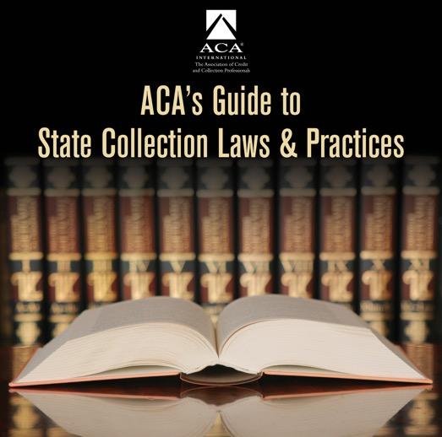
Creditor Resources
State Info
ACA’s State Guide Cohort gives subscribers a regularly updated collection of ARM-relevant state laws that impact debt collection and business operations.
What you get from the cohort:
✓ Monthly summaries of laws and regulations
✓ Detailed state-specific information
✓ Exclusive live monthly webinars & access to past recordings
✓ Access to our expert Hub discussion group
✓ Subscriber-only articles
Tools
ACA’s All-Access Training Zone can save your company thousands of dollars on education. It gives users full access to all of ACA’s webinar recordings. After just a few events, the pass will pay for itself! Learn more and purchase: www.acainternational.org/ education/trainingzone
Notes:
The value of Creditor Membership and the value of the State Guide.
ACA creditor membership helps you keep your business and career healthy and stay on top of industry changes as they occur.
Creditor members have open access to many free resources as well as the unique opportunity to purchase other products and services at rates significantly less than those charged to the public.
Subscribers to ACA International’s Guide to State Collection Laws & Practices now get more bang for their buck each month with the introduction of the State Guide Cohort, a collaborative subscribers-only community through which ACA staff, industry attorneys and agency compliance experts can share information about state statutes, regulations and state-specific judicial decisions.

Slide 14
ACA Supports Your Technology Journey
01
Vendors
Find the vendors you need through our online & printed annual Buyers Guide
02
Events
ACA’s main annual conferences feature an expo hall where vendors can both exhibit and lead learning sessions.
03
Education
Seminars on new technology are regularly presented online and at our conferences.
04
Articles
Articles in ACA Daily & Collector magazine explore how members are using new tech in their organizations.
05
Committee
ACA’s Technology and Innovation Committee guides our education content and provides info on emerging technology
06
Connection
Talk with other ACA members at our events to learn how your peers are using technology.
Notes:
We convene all relevant industry vendors so you can easily see what products and services are available to help optimize your business. We provide education to help you understand the technology that is available and the problems it can solve.

Slide 15
Expanding Industry Participation and Innovation
01
02
03
We’re bringing in vendors that enhance innovation and technology in our industry.
We only accept Affiliate vendors that offer significant value to our membership.
We added 17 new vendors to the Expo Hall at the 2024 Convention.

Slide 16
Advocacy Team
Leah Dempsey Shareholder, Brownstein Hyatt Farber Schreck LLP
As ACA’s lobbyist, Dempsey expands our advocacy efforts through Brownstein’s relationships with legislators and regulators.
Scott Purcell CEO, ACA
As a registered federal lobbyist, Purcell dedicates over 20% of his time to lobbying at the federal level in concert with Dempsey.
Andrew Madden VP State Unit and Government Affairs, ACA
Madden works with state units and their lobbyists, as well as coalition partners, to advance ACA’s advocacy work with both state legislators and regulators.
Travis Snyder PAC Director, ACA
Snyder leads ACA’s efforts in executing its PAC strategy with members of Congress in concert with the Board Advocacy Committee and ACA’s ACPAC Committee.
Katy Zillmer Public Affairs Director, ACA
Zillmer develops research and communications materials to build support for ACA’s advocacy priorities and initiatives.

Slide 17
ACA Builds Coalitions with Other Groups
Strength in Numbers:
ACA brings the right people to the table. We share data and insights with groups that increase our effectiveness in the legislative and regulatory arena.
Examples:
The Collaborative
HFMA
Trade Groups
ACA joined with four groups to provide education on new CA medical debt laws.
ACA & HFMA recently published the 2nd edition of Best Practices in Medical Debt Collection.
ACA regularly joins with other industry groups to advocate with state and federal regulators on issues such as TCPA reform.

Slide 18
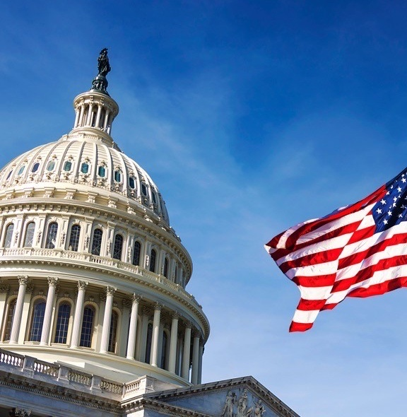
Proactive Federal Advocacy
ACA’s team engages with lawmakers and regulators on a constant basis. We have 50+ active, robust and relevant relationships with members of Congress.
ACA continues to successfully advocate on challenges to the industry, including legislation and regulations on medical debt collection, FCC TCPA regulations and CFPB guidance.
We strive to have a sitting member of Congress or regulator at every major ACA conference.

Slide 19
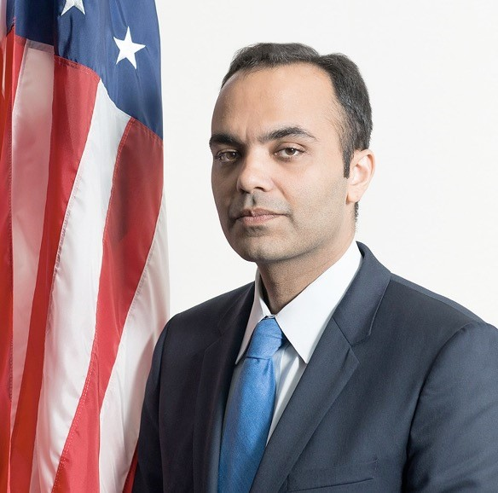
Working with the CFPB & FCC
We continue to see rulemaking by enforcement from both agencies.
ACA submitted comments to educate the CFPB and FCC on industry practices and to advocate for policies and regulations that are balanced, well-reasoned, and designed to avoid unintended negative consequences impacting consumers and clients.
ACA also pushed back on CFPB overreach working with Congress and the SBA Office of Advocacy and in a brief filed for the CFPB’s constitutionality case before the Supreme Court.
ACA has successfully slowed the CFPB down and forced them to consider their legal authority on several issues.
Rohit Chopra
CFPB Director
Notes:
ACA consistently evaluates CFPB and FCC activity to determine potential impacts on the accounts receivable management industry.
ACA staff, ACA Board officers and members from across the country continue to meet frequently with the CFPB.
No Surprises Act bulletin – ACA pushed back on jurisdictional and APA issues.

Slide 20
ACA’s Initiatives to Represent Members’ Interests in the FCRA Rulemaking Proposals
Helped members to provide compelling data-driven insights.
ACA highlighted economic data and member input in our comments to the CFPB.
1
4
2
3
4
Two ACA members participated in the SBREFA process.
ACA is coordinating with other financial services trade groups.
Notes:
A Notice of Proposed Rulemaking on the FCRAis expected to be published later this year after the CFPBreleased its final report on Small Business Review Panel discussions of the bureau’s proposals and alternatives for a credit reporting rule.
The CFPB’s recommendations for the FCRA rulemaking align closely with ACA’s advocacy on the issue, including defining medical debts and additional opportunities for public comment on how the proposals will impact consumers’ access to and ability to afford medical care as well as the impact on small medical providers.
Key components of the report include panel findings and recommendations regarding the number and types of small entities affected, related federal laws and regulations, the compliance burden, medical debt collection information and much more.
ACA was significantly involved in the panel meetings required by the Small Business Regulatory Enforcement Fairness Act (SBREFA) through participation of two members as small-entity representatives (SERs): Jennifer Whipple, president of Collection Bureau Services, and Jack Brown III, president of Gulf Coast Collection Bureau.
Stay in the know on ACA’s advocacy on the FCRA proposals and other topics by attending the free weekly ACA Huddle for members and the 2024 Washington Insights conference in the spring.

Slide 21
Medical Debt on the Federal Level
Bipartisan legislation introduced in the Senate targets communications with consumers from health care providers about any medical debt owed as well as transparency on their medical debt practices.
ACA is working hard on this issue and is actively engaged with the bill sponsors. We support the intent to improve any deficiencies in providers’ processes related to ensuring charity care is properly identified and that payor’s responsibilities.
However, there are concerns regarding draconian consequences that could negatively impact provider finances for rare mistakes as it is expected medical debt credit reporting will be a continued focus in Congress and at the regulatory level this year.
Notes:
ACA’s advocacy team has been focused on communicating the value medical debts on credit reports.
The Consumer Financial Protection Bureau recently released a report about the U.S. medical billing system and the credit reporting infrastructure connected to medical debt. The bureau’s research unfortunately focuses on the back end of the credit cycle and gives consumers a false impression that the debt collection industry is responsible for billing issues that occurred on the front end, contrary to the explicit goals of the No Surprises Act.
The CFPB’s press release states that medical bills placed on credit reports can result in reduced access to credit, increased risk of bankruptcy, avoidance of medical care and difficulty securing employment.
“The CFPB’s research does not seem to grasp the existing infrastructure related to medical debt that has strong safeguards for consumers to dispute any amounts that are in question or that they feel they don’t owe. If a consumer disputes a bill, there are procedures in place to ensure credit reporting is paused while the issue is being resolved,” said ACA International CEO Scott Purcell. “There are also controls in the communication of the debt well in advance of any credit reporting through Regulation F and its predecessor rules.”
ACA thinks setting an arbitrary threshold, and removing a vital communication tool, to not include any type of debt in a consumer credit portfolio is a slippery slope to risky lending for creditors and could ultimately harm consumers by reducing access to credit or medical services, and increasing costs.
Delaying credit reporting harms consumers. Consumers who are not aware of a medical bill until they see it on their credit report are denied an opportunity for insurance to pay the claim. Many insurance contracts limit claim submission to either six or 12 months. Asking these consumers to now pay in full without the ability to submit an insurance claim is harmful.
. Taking away credit reporting as a tool in the collections process, which notably is the last option used when it comes to medical debt, will without question force certain providers to turn to litigation sooner and more often to recover fees for services already provided. As outlined below, it will also lead to increased costs and less access to medical care for all consumers.
change the timeframe for including unpaid consumer debt on a credit report and to not include certain unpaid debt owed to medical providers
ACA supports the goal to not have a consumer’s credit report include bills that should have been paid by insurance companies (“Payors”). However, Equifax, Experian, and TransUnion’s actions are a misdirect from addressing the significant problem with Payors’ claim payment processes

Slide 22
Current Federal Legislative & Regulatory Efforts
FCRA Proposed Rulemaking:
Medical Debt Credit Reporting
Credit Header Data et al (mid October)
The Do Not Disturb Act from Congressman Frank Pallone Jr. (D-N.J.)
New Bipartisan Privacy Bill: The American Privacy Rights Act of 2024
CFPB Reform
Notes:
ACA’s advocacy team has been focused on communicating the value medical debts on credit reports.
The Consumer Financial Protection Bureau recently released a report about the U.S. medical billing system and the credit reporting infrastructure connected to medical debt. The bureau’s research unfortunately focuses on the back end of the credit cycle and gives consumers a false impression that the debt collection industry is responsible for billing issues that occurred on the front end, contrary to the explicit goals of the No Surprises Act.
The CFPB’s press release states that medical bills placed on credit reports can result in reduced access to credit, increased risk of bankruptcy, avoidance of medical care and difficulty securing employment.
“The CFPB’s research does not seem to grasp the existing infrastructure related to medical debt that has strong safeguards for consumers to dispute any amounts that are in question or that they feel they don’t owe. If a consumer disputes a bill, there are procedures in place to ensure credit reporting is paused while the issue is being resolved,” said ACA International CEO Scott Purcell. “There are also controls in the communication of the debt well in advance of any credit reporting through Regulation F and its predecessor rules.”
ACA thinks setting an arbitrary threshold, and removing a vital communication tool, to not include any type of debt in a consumer credit portfolio is a slippery slope to risky lending for creditors and could ultimately harm consumers by reducing access to credit or medical services, and increasing costs.
Delaying credit reporting harms consumers. Consumers who are not aware of a medical bill until they see it on their credit report are denied an opportunity for insurance to pay the claim. Many insurance contracts limit claim submission to either six or 12 months. Asking these consumers to now pay in full without the ability to submit an insurance claim is harmful.
. Taking away credit reporting as a tool in the collections process, which notably is the last option used when it comes to medical debt, will without question force certain providers to turn to litigation sooner and more often to recover fees for services already provided. As outlined below, it will also lead to increased costs and less access to medical care for all consumers.
change the timeframe for including unpaid consumer debt on a credit report and to not include certain unpaid debt owed to medical providers
ACA supports the goal to not have a consumer’s credit report include bills that should have been paid by insurance companies (“Payors”). However, Equifax, Experian, and TransUnion’s actions are a misdirect from addressing the significant problem with Payors’ claim payment processes

Slide 23
FCC Call & Text Blocking
ACA is working with the FCC to ensure it understands our industry’s need for consumer communication while supporting mitigation against bad actors.
Resources for Working with Phone Carriers
ACA created a resource on our website to help members understand how they can work with their phone carrier and telecom providers to increase the chances of their legitimate calls getting through.
Share Your Experience with ACA
If you’re hearing from your carriers about call or text blocking in their systems, we want to hear about your experiences to better advocate on your behalf.
Scan for info on how you can share your experience with ACA!

Slide 24
ACA’s Political Action Committee
ACPAC is the voluntary, bipartisan political action committee (PAC) for ACA.
ACPAC helps raise ACA’s profile on Capitol Hill and allows us to proactively build connections with candidates who recognize the role the collection industry plays in the financial services ecosystem.
Scan for more information on ACPAC!
Notes:
THE TEXT BELOW MAY BE FURTHER TWEAKED BY OUR FEC COUNSEL -
Proposed ACPAC “Speech” component of Unit Updates where the general public will be present (local references, such as the Steil reference in this one, will be changed based on the unit being presented to and if any such items exist). This type of language is only needed when the group is mixed and certain people are covered by and SRF and some are not, including the low likelihood of people not eligible to be covered by an SRF. If presenting to a group entirely covered by SRF’s don’t use this script, and feel free to talk more openly about fundraising for ACPAC.
So much of what we do as an industry is dependent on the actions of policymakers – especially at the federal level. At ACA we are constantly strategizing, and re-strategizing, for different scenarios to make sure our members are as protected as possible from harmful and misguided legislation and regulation.
November 4th of 2020 – the day after the last election – we were already putting into action our game plan based on the election results. We knew we were going to have our work cut out for us due to the stated ideas and world views of certain leaders over key committees that impact us directly with legislation, as well as having responsibility over regulators that affect us.
We are able to execute a well-thought political strategy due to ACA’s PAC. ACPAC is ACA International’s bipartisan political action committee. It exists entirely to help ACA engage with, build relationships with, and support, candidates for federal office. ACA uses a multipronged approach when it comes to shaping the political landscape on Capitol Hill – advocacy and education are key, but so is political work, and ACPAC allows us to play a role in electing candidates who not only understand our issues but support our efforts.
Every election cycle – which is every two years - we set out to make sure as many industry-friendly, business-friendly, markets-friendly candidates are elected as possible. Traditionally we’ve working with anywhere from 30 to 40 candidates. In 2020 we were able to increase the number of candidates to engage with by 36% and our financial support of those candidates by 39% – focusing on those most likely to make an impact for our industry - from both sides of the aisle. Our budget for 2022 includes a further increase in the number of candidates we work with. ACPAC ended the 2020 cycle with an 86% win-rate.
With the current regulatory overreach the stakes couldn’t be higher for identifying candidates that understand the benefit of the credit eco-system and how it works.
Every two years, all 435 House seats are up for re-election. Going into the 2022 midterms, 55 House members have announced they will not be running for re-election and in the Senate six members have announced their retirement. When you combine the two chambers, it means that there will certainly be a lot of new faces on Capitol Hill come January. Engagement will have to start well before then if we want to have a say in who those faces belong to – ACPAC is the tool to help us hone in on candidates who are aligned with our issues and receptive to our positions and who could have a significant impact on our industry’s future when it comes to fighting back against government overreach. Relationships developed late in the game are no where as effective as those nurtured over time.
Congress is a main backstop when it comes to regulation. Oversight can serve as a means of stemming overreach (from any agency) and ACPAC is ACA’s tool to develop effective working relationships with members of Congress. If leadership in the House Financial Services Committee or the Senate Banking, Housing and Urban Affairs Committee changes from its current leadership, the way the oversight role of the regulators is handled today, will most likely change—in addition to the types of policies we see the new Congress consider.
We are in a situation where there is plenty of room – and ample opportunity - for ACA to make inroads with scores of candidates – newcomers and incumbents alike. There are something like 4,600 federal PACs out there competing to get their message across, and ACPAC has its reputational strength, and being known as an honest player, and this solid reputation helps ensure the ARM industry is well represented.
The framework of how PAC’s function is for interested and eligible industry participants to be covered by an agreement called an SRF, a solicitation request form. Once that agreement is completed then open discussions, in-depth stories and insights can be shared. Outside of physical events if you’re opted in to the PAC you’ll be able to hear about upcoming events and situations via email and virtual calls. As we’re currently in a mixed group with some people covered with an SRF and some people not, the only thing I can state is how to learn about getting an SRF—and you can do that by reaching out to Travis Snyder ACA’s DC office; his information is on the ACPAC section of the ACA website.
I am able to give you insight to where we currently stand in our PAC. We have 65 givers to the PAC so far this year. We are taking a much more proactive approach in teaching about the PAC and partnering with members of the units. In fact we were in Madison WI last week for an event sponsored by WI members supporting Bryan Steil, a young congressman who is very in touch with what sound economic policy looks like and is a member of the House Financial Services Committee, amplifying the relationship building efforts of ACPAC with this candidate.

Slide 25
Macro-Level Factors Affecting the Industry
Private Equity Investments
Innovations in Debt Types
Consolidation Opportunities
The Role of Automation
The Growth of Credit
Enhanced Need for State & Federal Advocacy

Slide 26
The Collections Industry Helps All Consumers
Consumers
Lenders/Creditors
Provide access to credit with the expectation that they will be paid back.
Purchase goods and services and have access to credit.
Credit Reporting Agencies
Collections
Recover legitimately owed debts so creditors can continue to lend.
Help creditors make informed lending decisions.
The collections industry has an integral role in the credit-based ecosystem. It returns over $90 billion a year to creditors, saving every American family $706 each year from rising costs. How?
If nobody repaid their debts, the companies that extend loans would have to find other ways to cover those losses, such as through high interest rates, which would make it more expensive for consumers to get a loan or pay their existing credit card bill. By restoring these funds, the collections industry helps sustain access to credit at a reasonable cost.

Slide 27
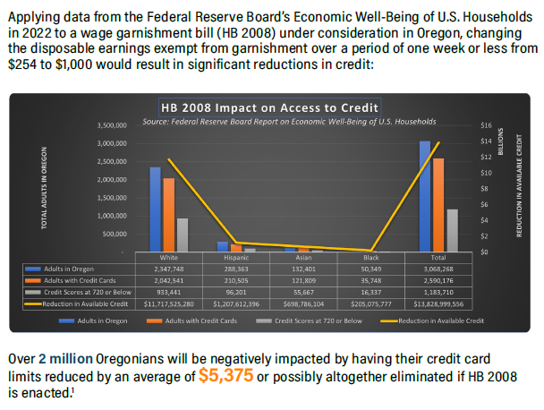
New Research Demonstrates Impact on Consumer Credit
Notes:
The Federal Reserve Bank of New York found that limiting debt collection practices leads to a decline in access to credit.
Their research suggests a $1 change in garnishment exemption causes a $7.69 decrease in available credit for every consumer
This breakdown helped frame the issue and derail efforts in Oregon. The same is being used to lobby against legislation in Michigan.
Oregonians will see an average reduction of $5,375 to their credit card limits if HB 2008 is enacted. Can be broken down by race.

Slide 28
Working with Journalists
When the media needs an industry response, they turn to ACA.
ACA’s senior staff and members have been quoted in multiple U.S. media outlets clarifying the ARM industry’s role in the economy as well as speaking on specific topics, like credit reporting and medical debt collection.
We’ve participated in articles that have appeared in The Wall Street Journal, American Banker and the New York Times.
ACA regularly issues press releases to a targeted media list and monitors how issues are reported.

Slide 29
With their business in the crosshairs, debt collectors are warning that cracking down on credit reporting and other collection tools may prompt more hospitals and doctors to demand patients pay upfront for care.
There are some indications this is happening already, as hospitals and clinics push patients to enroll in loans or credit cards to pay their medical bills.
Scott Purcell, CEO of ACA International, said it would be wiser for the federal government to focus on making medical care more affordable. "Here we're coming up with a solution that only takes money away from providers," Purcell said. "If Congress was involved, there could be more robust solutions."
NPR, “Why a financial regulator is
going after health care debt,”
March 1, 2024

Slide 30
ACA’s Industry Advancement Fund
The only industry-specific mechanism that provides direct financial support
to members to help combat frivolous litigation.
The Judicial Advocacy Program
Traditional Support: Up to $25,000 in support for members in cases of industry-wide significance, with additional funds available in special cases upon approval of ACA’s Board of Directors.​
Amicus Support: Funding for ACA’s participation in appellate cases as an amicus curiae.
The Matching Funds Program
Provides financial support in lawsuits that may not have nationwide impact but reflect instances of frivolous or abusive plaintiff’s litigation.​
Dollar-for-dollar match up to $10,000 for out-of-pocket expenses.

Slide 31
Notable IAF Victories
Funded briefs and appellate counsel retention, leading to industry win.
Hunstein case
ACA
Nevada SB 248
Supported litigation efforts through multiple IAF grants.
Success stopping AG’s efforts to halt collection calls to Massachusetts consumers.
Massachusetts

Slide 32
Thanks!
Any questions?

