Slide 1
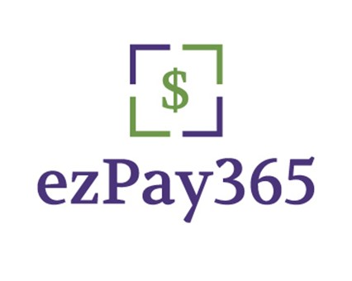
Digital Debt Recovery
Less Agents &
Improve your Yield per Account

Slide 2
Bio
30+ years ARM industry
ezPay365 founded in 2016- Payment solutions and Consumer Technology
Goal is to assist agencies compress payment costs while focusing on improving your yield per account & reduce labor costs

Slide 3
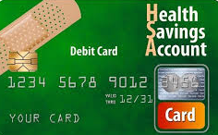
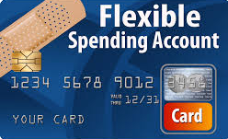
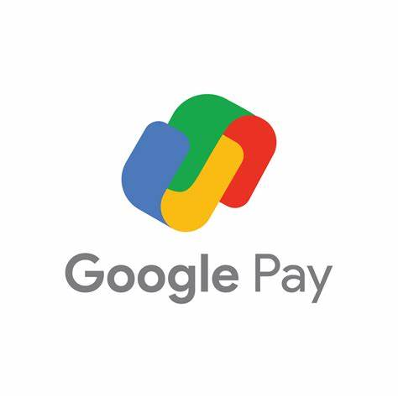
Payment Types
ezPay365 Payment Types

Slide 4
Buzz Words
AI/Artificial Intelligence: refers to the simulation of human intelligence in machines that are programmed to perform tasks that normally require human intervention. AI encompasses a wide range of techniques, like machine learning, natural language processing and computer vision to solve complex problems.
ML/Machine Learning: ML is a subset of AI, that enables machines to learn & improve from experiences without being specifically programmed. It does require feeding a fair amount of data into algorithms that can make predictions on the data.
Text Messaging Codes: Short Code/10DLC, Long Code: Short codes are regulated by the CTIA (Cellular Telecom Industry Assoc), they are the most expensive, commonly used for high volume. 10DLC: is a branded 10-digit long code for commercial messaging, allows for scale and send A2P/P2A (application to Person/vice versa). Long code is what consumers use to send text messages.
API: Application programming interface, refers to a set of guidelines and protocols for interacting with a software application to communicate with each other via a series of predefined methods or functions.

Slide 5
Agency Communications
Letters
Telephone calls
Email
Text
Ringless Voice Mail
Consumer Portal
IVR
Chatbot and Webchat ( Human)

Slide 6
USPS InfoStats

Slide 7
Email InfoStats

Slide 8
Email 101
Email notices: Select your templates- Start with payment notices
Good stewardship- emails are not part of the 7 and 7, California FDCPA rules
No reply emails- ensure you validate your state regs
MAP/CFPB- email in the body versus hyper links
Regulatory: FDCPA, CAN-SPAM, TCPA and FTC
Outsource/Insource (Tech Team):
Set-up your Subdomain or Select your domain(s)- be aware of blacklisting
Domain Name System (DNS)- The phone book for the internet
Sender Policy Framework (SPF-authenticator)- validates domain and IP Address so mail servers verify if authorized domain/Reputation- Online Domain Library
DMARC (protect from spoofing), and DKIM(Domain Key Identified Mail)
The two primary authentication protocols that help validate that an email message comes from the owner are SPF and DKIM( crypto signature). Layered on top of SPF and DKIM is DMARC. DMARC uses SPF and DKIM and provides a set of instructions to receiving email servers with what to do if they receive unauthenticated mail.

Slide 9
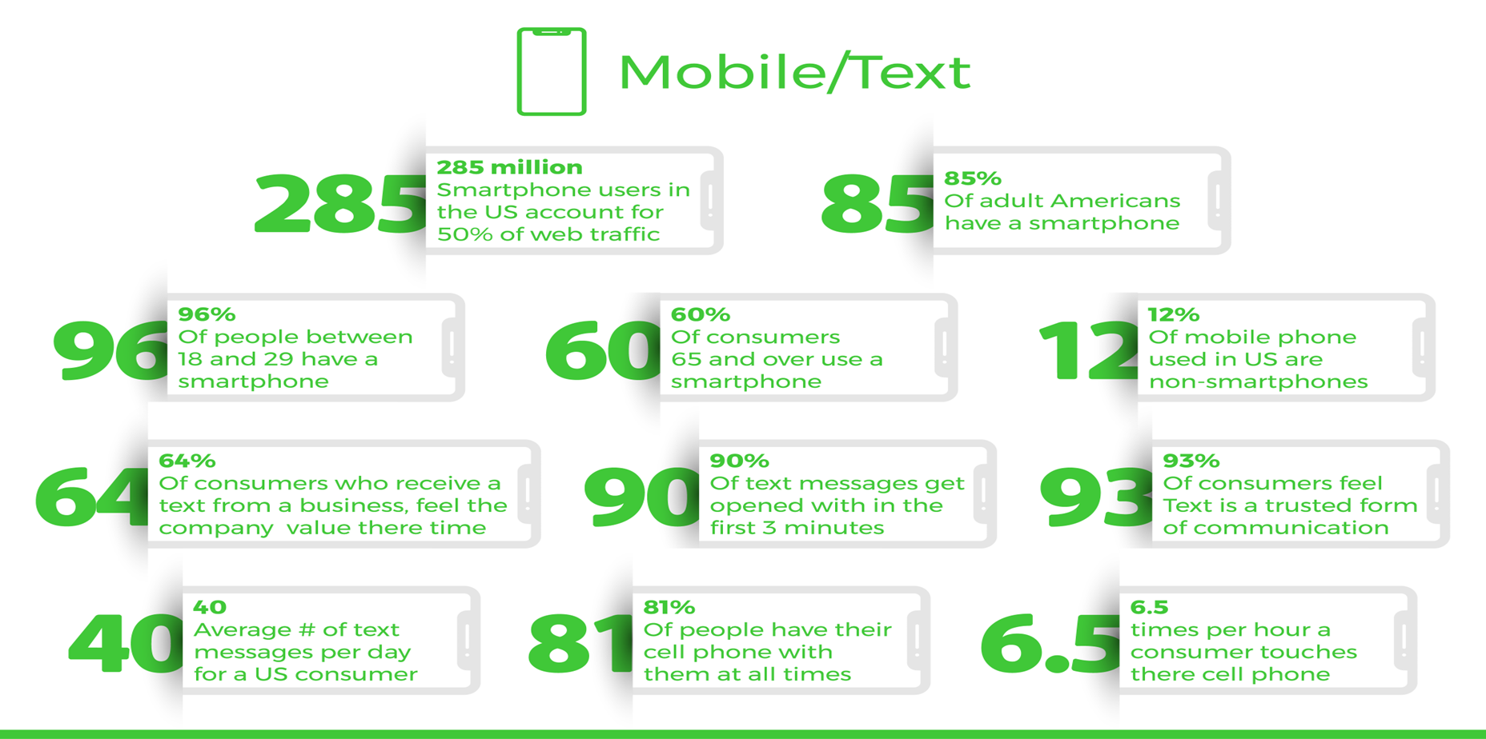
Mobile/Text InfoStats

Slide 10
Scrubbing
Waterfall process- NCOA, Banko, deceased and scoring
RND- Reassigned Number Database- every 30 days to evoke safe harbor certificate
Email Scrubbing
Spelling cleansing- @, .xom, #- bad domains
Domain & Email cleansing- blacklister, SPAM, Open/Closed
Work emails

Slide 11
Industry Stats
Did you know?

Slide 12
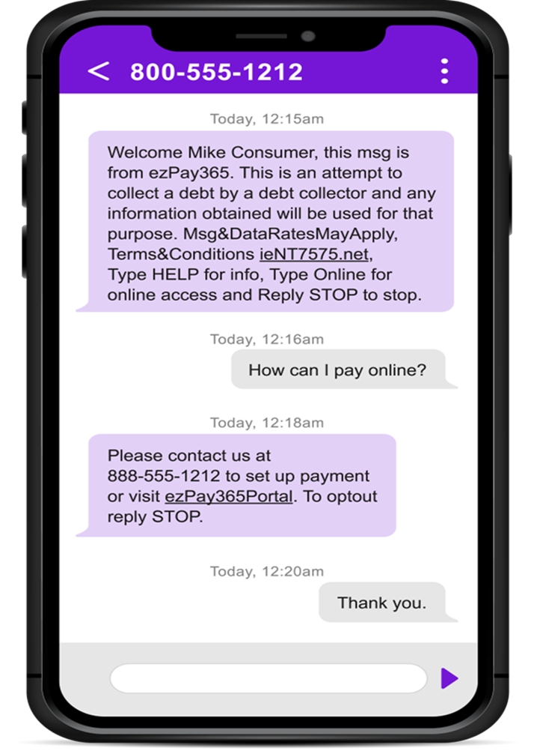
Text Message/Bi-directional

Slide 13
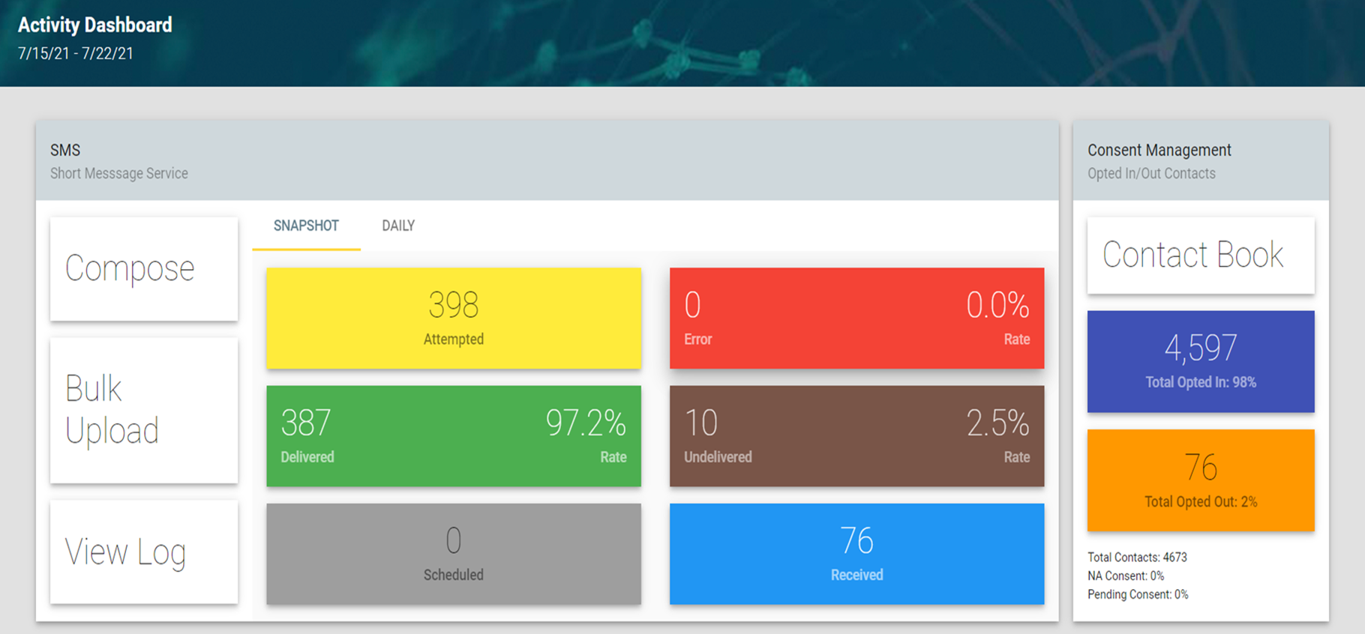
Text Dashboard

Slide 14
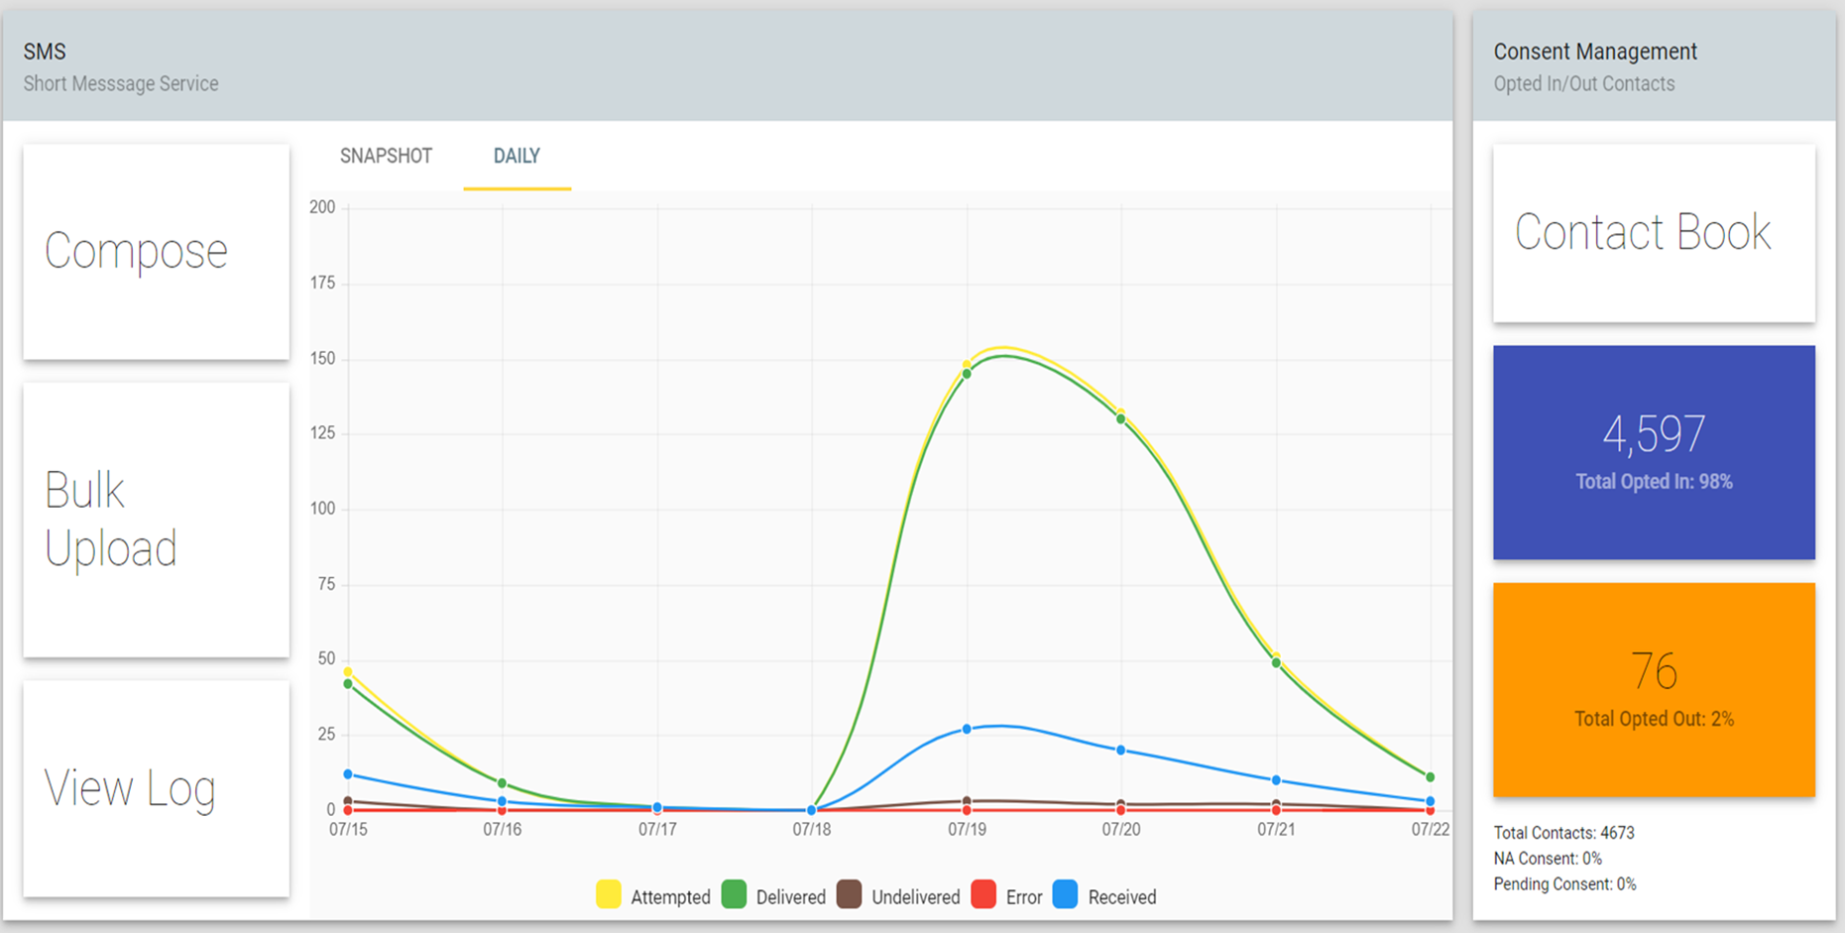
Communications stats

Slide 15
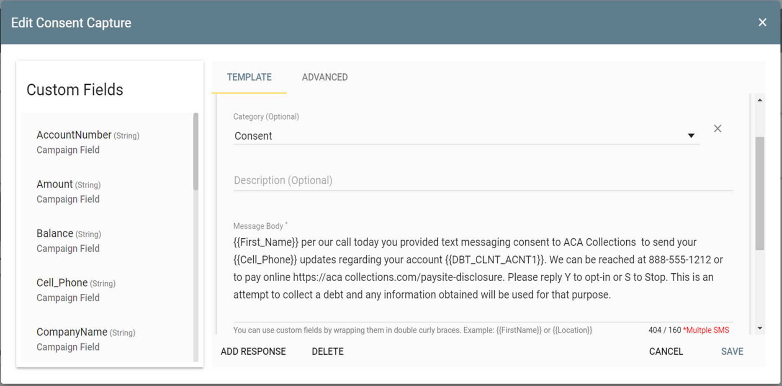
Ez text Communications

Slide 16
US Mobile payments

Slide 17
Consumer Portal
Secure QuickPay
Secure Account Login
24x7, accounts, payments, documents, eForms, consent opt-ins & eForms

Slide 18
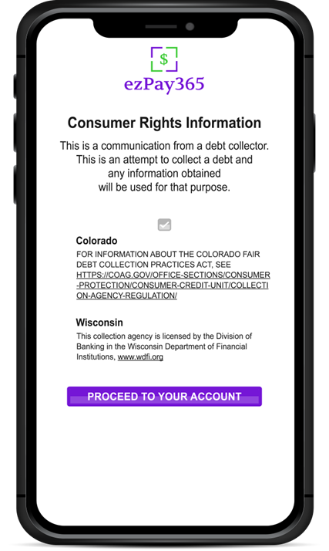
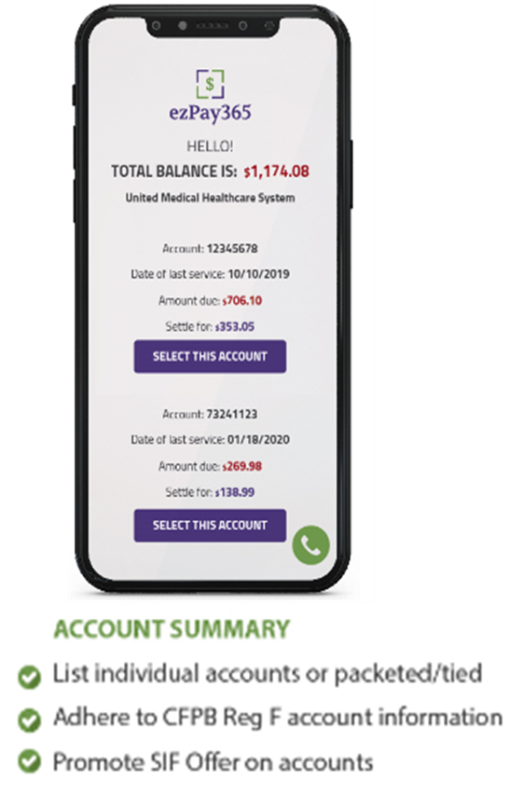
Consumer Experience

Slide 19
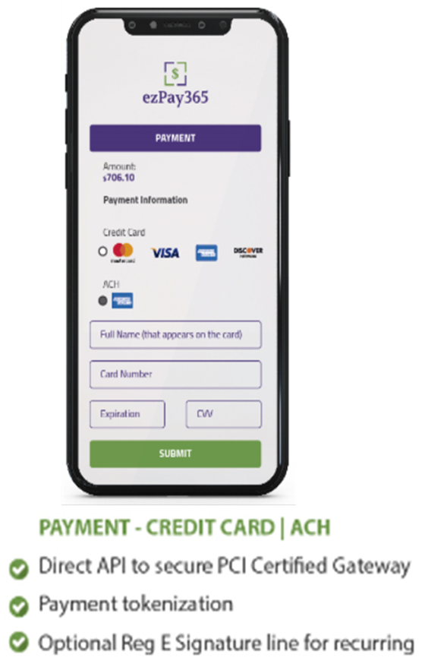
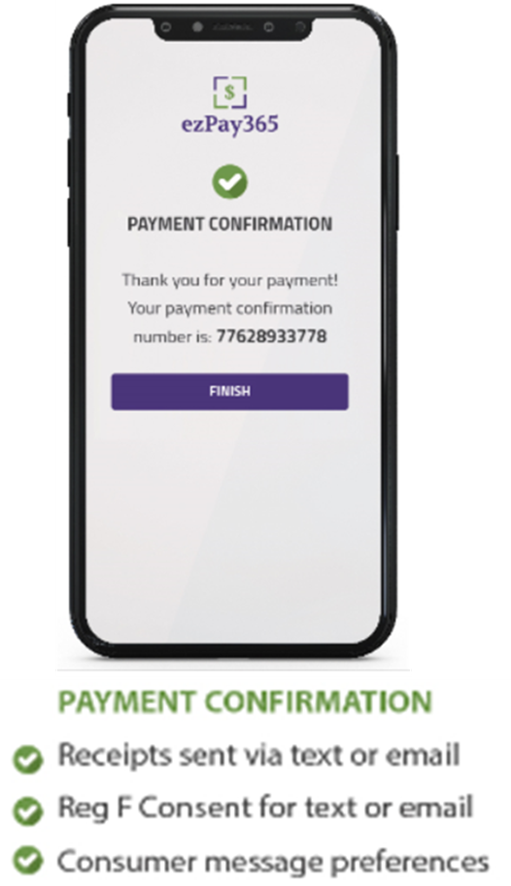
Consumer Experience

Slide 20
Admin Portal
File Transfer
Payment Metrics
Campaign via Email & Text with Analytics
Self Service platform- see everything on Payments, Email & Text

Slide 21
It’s a wrap
Thank you
Kevin Gaffer
614-738-4900
Kevin@ezpay365.com
Ron Bonavita
334-329-4756
Ron@ezpay365.com

