Slide 1
NEW GUIDANCE ON CREDIT REPORTING AND REASONABLE INVESTIGATIONS
John H. Bedard, Jr. Bedard Law Group, P.C. jbedard@bedardlawgroup.com

Slide 2
Disclaimer
This information is not intended to be legal advice and may not be used as such. Legal advice must be tailored to the specific circumstances of each case.
Every effort has been made to assure this information is up-to-date. It is not intended to be a full and exhaustive explanation of the law in any area, however, nor should it be used to replace the advice of your own legal counsel.
You should not change any business practice as the result of reviewing any content contained in this presentation.

Slide 3
AGENDA
Top 10 Considerations
A Vocal CFPB
Proposed Rule Are Here
Future of Credit Reporting?

Slide 4
TOP 10 CONSIDERATIONS

Slide 5
1. “PRE-LOAD” DILIGENCE
Accuracy and Integrity
Not Just Technical Errors, But Logical Errors
Matching Media to Data
No Blind Reliance On Client
“Extra” Examination On Purchased Paper
Chain of Title
Balance Integrity
“Reasonable Basis To Believe” Consumer Owes Debt

Slide 6
2. “POST-LOAD” DILIGENCE
Every Time Data “Moves” – Check It
Does System Of Record Reflect Input File Data?
Field Matching/Checking etc.

Slide 7
3. REFRAIN FROM REPORTING BEFORE REG F DISCLOSURE
“. . . collector must not furnish . . . information about the debt before the debt collector:
Speaks to the consumer about the debt in person or by telephone; or
Places a letter in the mail or sends an electronic message to the consumer about the debt and waits a reasonable period of time to receive a notice of undeliverability.”
Reasonable Period Of Time = 14 days
Must Monitor For Undeliverability
Must Refrain From Reporting If Undeliverable
MVN = “about the debt”

Slide 8
4. DOCUMENTING DISPUTE INTAKE
FDCPA or FCRA Dispute?
Direct Or Indirect Dispute?
Direct Dispute: means a dispute submitted directly to a furnisher (including a furnisher that is a debt collector) by a consumer concerning the accuracy of any information contained in a consumer report and pertaining to an account or other relationship that the furnisher has or had with the consumer.
Accuracy: means that information that a furnisher provides to a consumer reporting agency about an account or other relationship with the consume correctly:
Reflects the terms of and liability for the account or other relationship;
Reflects the consumer’s performance and other conduct with respect to the account or other relationship; and
Identifies the appropriate consumer.
12 CFR §1022.41

Slide 9
4. DOCUMENTING DISPUTE INTAKE
Categorize Nature Of Dispute
Your Company’s Top 10-15 Dispute Categories
E-Oscar Dispute Categories
Notate Exceptions for Direct Disputes
“Identifying Information”
Past/Present Employers
Inquiries/Requests for Consumer Reports
Information Derived From Public Records (judgments/BK etc.)
Information Related to Fraud/Active Duty Alerts
Information Provide By Other Furnisher
Structured Data Format!!!
Notate Response Deadline

Slide 10
5. INVESTIGATE DISPUTE
Review All Info/Documents From Consumer/E-Oscar
Review All Info/Documents In Furnisher Possession
For ID Theft – Review Evidence Of Identity
ID, Payments, Bank Info, etc.
If Info Not Sufficient To Investigate Dispute:
Make Effort To Contact Consumer (This is not prohibited!)
Make Effort Contact Creditor/Original Creditor
Use Proper Compliance Condition Code
Review Collection Activity On Account(s)
Avoid “Circular” Investigations
Escalation Process/Procedure
Review Previous Disputes, Communications, and Investigation Results

Slide 11
5. INVESTIGATE DISPUTE
Note – Technology Assisted Investigations
Nothing Wrong With This! But…
Document How It Works
Document What Instructions It’s Given
Document Controls In Place To Ensure Proper Behavior
Avoid “Circular” Investigations
Audit Behavior/Decision Making Results

Slide 12
6. DOCUMENT INVESTIGATION ACTIVITY AND RESULTS
Document, Document, Document Everything You Did During Investigation Process.
Structured Data Format Documentation (Avoid natural language text fields!)
Radio buttons
Dropdowns
Checkboxes
Especially When You Contact Creditor/Consumer – Document In A “Queriable” Format.
Consider “Result Codes” To Document Investigation Results

Slide 13
7. INVESTIGATION RESPONSE
Timely Respond
Address The Actual Dispute
Document Response Code

Slide 14
8. PROPER DISPUTE NOTATION
Mark Account Disputed (For Next Reporting Cycle)
Consider Different Workflow For Disputed Accounts Pending Investigation Results

Slide 15
9. AUDIT PROCESS
How Do You Know You’re Handling Disputes Properly?
And Making Changes To Business Operations As A Result?
Audit Dispute Investigations And Results
Can You “Recreate” The Investigation 6 Months Later?

Slide 16
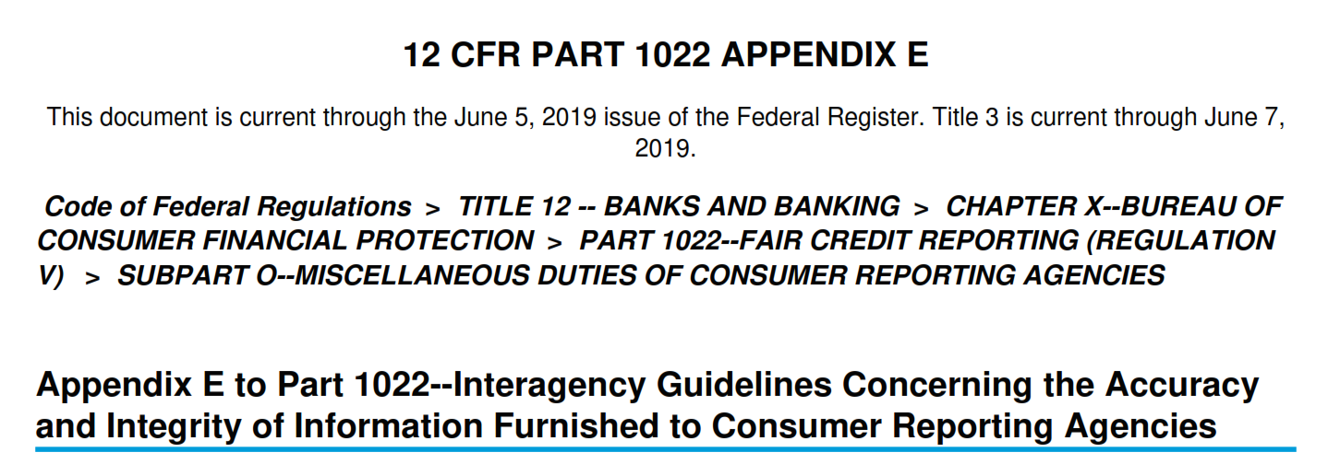
10. APPENDIX E AND YOUR P&P’S
Every Word, Every Line – Somewhere In Your Policies And Procedures

Slide 17
10. APPENDIX E AND YOUR P&P’S
Broken Down Into Three Sections:
Nature, Scope, and Objectives of Policies and Procedures
Establishing and Implementing Policies and Procedures
Specific Components of Policies and Procedures
https://www.consumerfinance.gov/rules-policy/regulations/1022/e/

Slide 18
11. BONUS CONSIDERATION!
Dispute Analysis And Trending
Focus On Changes To Business Practices Which May Reduce Disputes

Slide 19
A VOCAL CFPB

Slide 20
DISCLAIMER ON CONSENT ORDERS
TWO SIDES TO EVERY STORY
CONSENT ORDERS ONLY TELL ONE SIDE

Slide 21
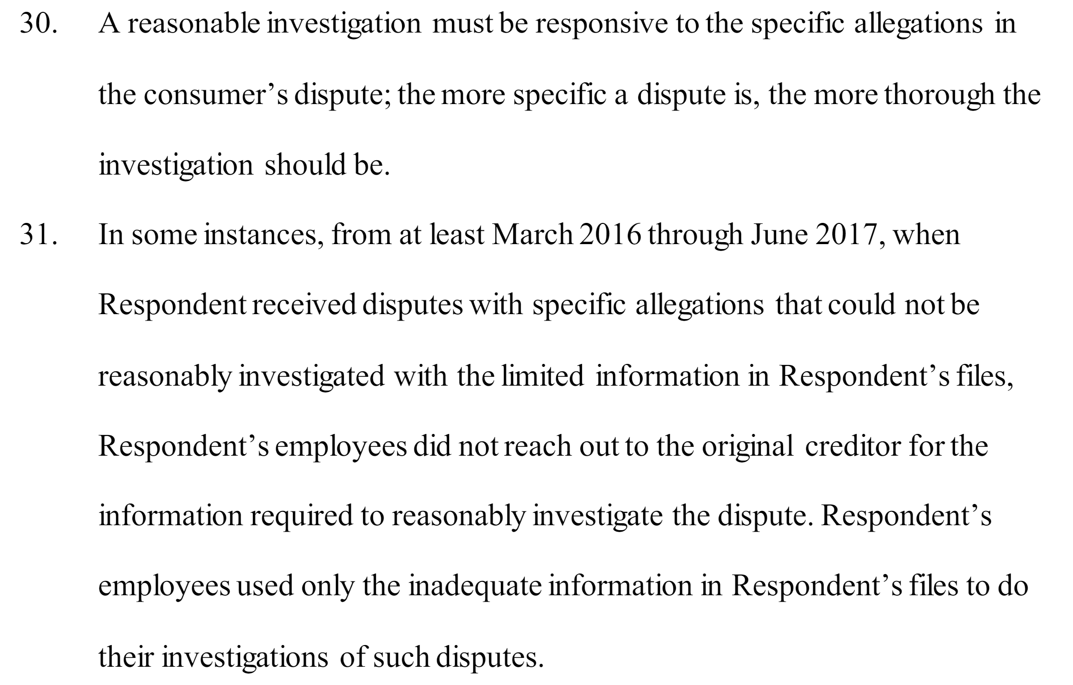
In The Matter Of Afni, Inc. (11/12/20)

Slide 22
In The Matter Of Afni, Inc. (11/12/20)

Slide 23
In The Matter Of Afni, Inc. (11/12/20)
https://files.consumerfinance.gov/f/documents/cfpb_afni-inc_consent-order_2020-11.pdf

Slide 24
In The Matter Of Phoenix Financial Services, LLC (6/8/23)
Must Read - Really Good For:
Reasonable Investigation Expectations
Expected Content of Policies and Procedures
Circular Investigations
Defects In Technology Assisted Investigation Processes

Slide 25
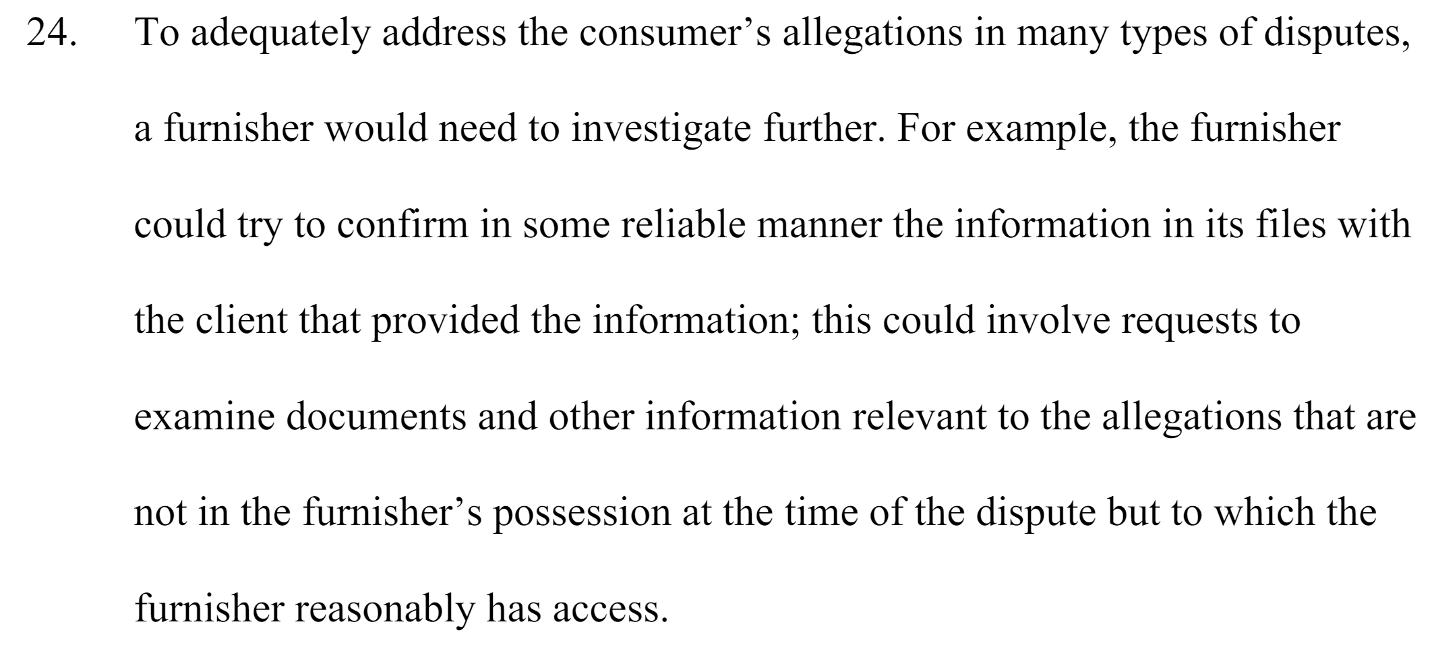
In The Matter Of Commonwealth Financial Systems, Inc. (12/15/2023)
Must Read - Really Good For:
Defects in Medical Debt Placement Process
Circular Investigations
Inadequate Policies and Procedures
Reasonable Investigations

Slide 26
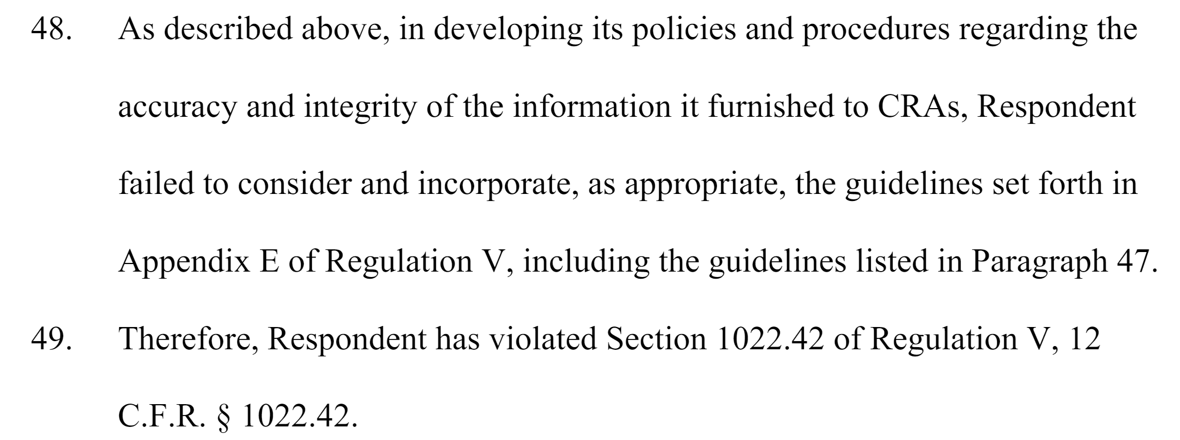
In The Matter Of Commonwealth Financial Systems, Inc. (12/15/2023)
https://files.consumerfinance.gov/f/documents/cfpb_commonwealth_consent-order_2023-12.pdf

Slide 27
A Vocal CFPB
SUPERVISORY HIGHLIGHTS

Slide 28
Supervisory Highlights: Consumer Reporting Companies and Furnishers (Issue 32, Spring 2024)

Slide 29
A Vocal CFPB
INFORMATION REQUESTS

Slide 30
INFORMATION REQUESTS
Total Number Of Accounts, And Dollar Value:
Furnished To A CRA At Least 60 Days Ago
Communicated With A Consumer Directly, Other Than By Sending MVN
Percentage Of Accounts, And Total Dollar Value, About Which:
You Received A Dispute Directly From a Consumer
You Received A Dispute Other Than Directly From A Consumer
You Received More Than One Dispute

Slide 31
INFORMATION REQUESTS
Provide Percentage Of Accounts And Total Dollar Value Whose Balance You Have Verified With The Creditor’s System Of Record:
In The Last 30, 60, 90, 120 etc. Days
At Least Once Since Receiving The Account
Provide Percentage Of Accounts And Total Dollar Value Whose Balance Has Changed Based On Updated Information From The Creditor:
In The Last 30, 60, 90, 120 etc. Days

Slide 32
INFORMATION REQUESTS
Provide All Policies And Procedures Related To How You Ensure That The Amounts Being Collected By You Are Expressly Authorized By The Agreement Creating The Debt Or Permitted By Law, Including:
P&Ps To Ensure Debts Are Not From Bills Which Violate The No Surprises Act
P&Ps About Making Consumers Aware Of Eligibility For a Financial Assistance Plan Under 501(r)

Slide 33
INFORMATION REQUESTS
P&Ps To Ensure Debts Being Collected Have Not Been Paid By Worker’s Comp, Or Are Otherwise Not Subject To Worker’s Comp.
P&P’s Relating To Consumer Questions About The Debt Or When A Consumer Does Not Recognize Debt
. . . And The List Goes On. . .

Slide 34
RULEMAKING

Slide 35
RULEMAKING
https://files.consumerfinance.gov/f/documents/cfpb_consumer-reporting-rule-sbrefa_outline-of-proposals.pdf

Slide 36
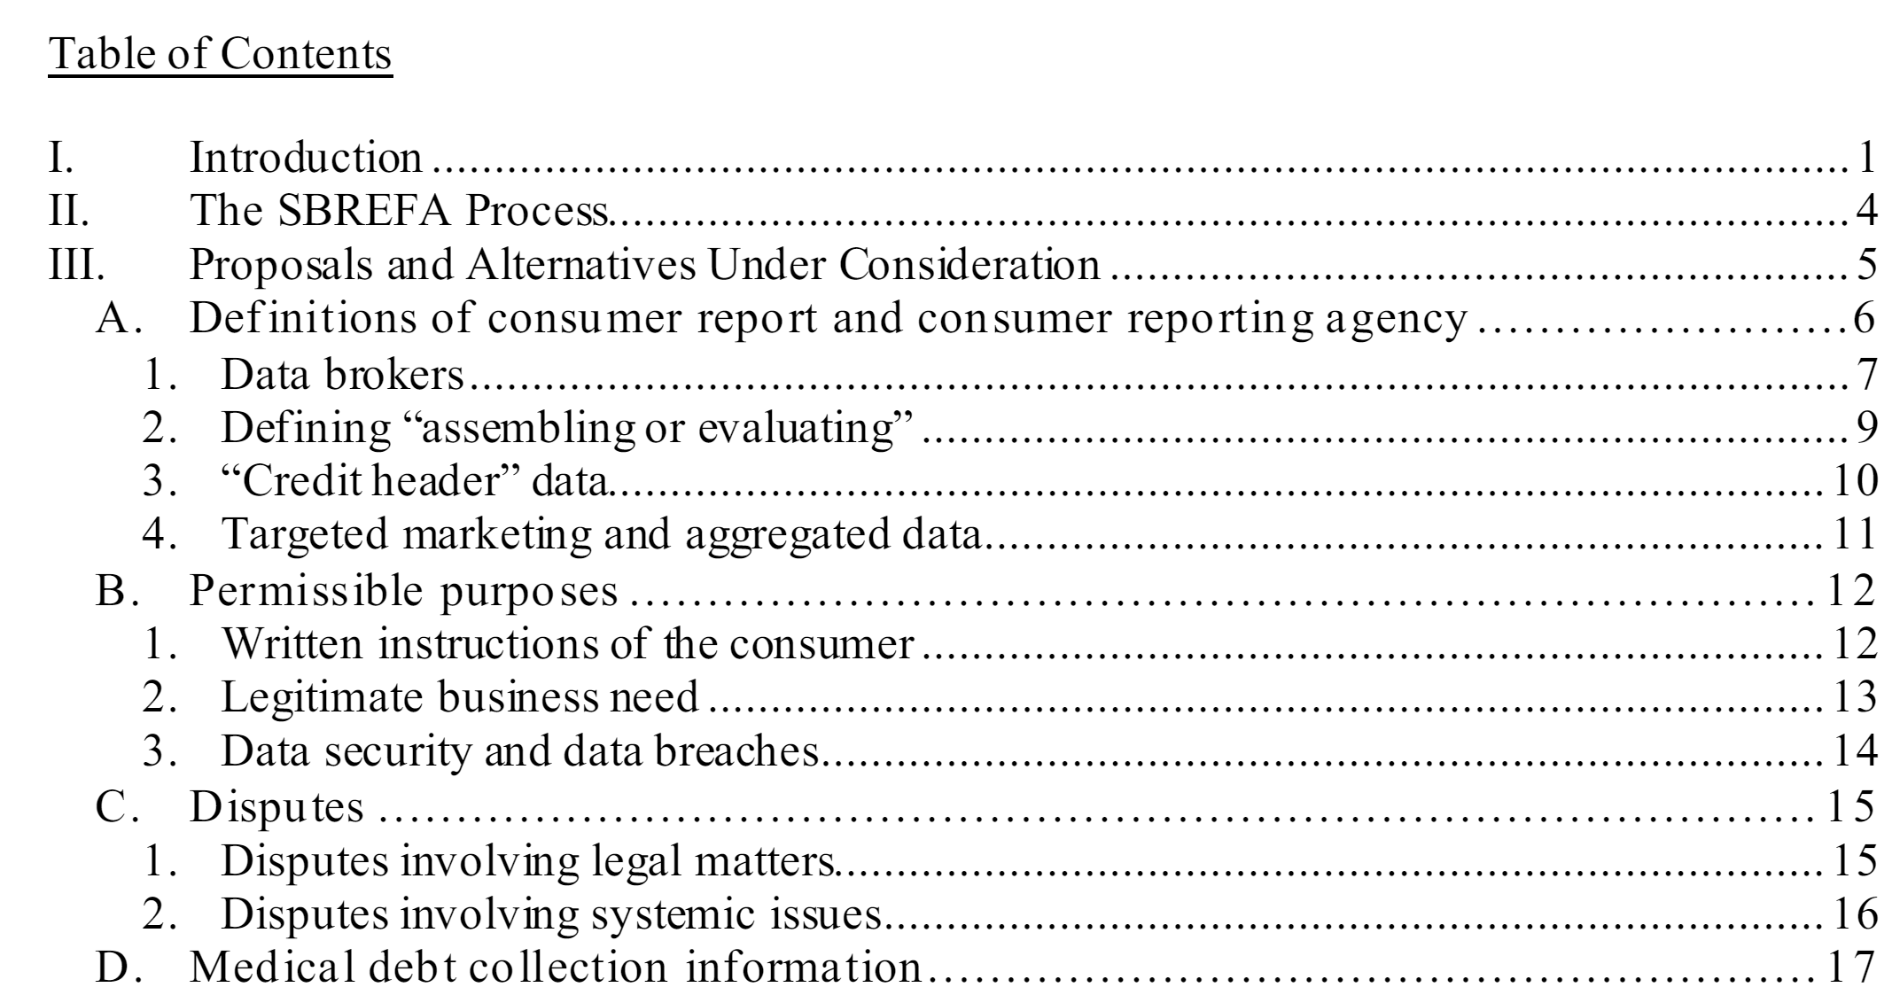
RULEMAKING

Slide 37
RULEMAKING

Slide 38
NOTICE OF PROPOSED RULEMAKING IS HERE!
https://www.consumerfinance.gov/rules-policy/notice-opportunities-comment/open-notices/prohibition-on-creditors-and-consumer-reporting-agencies-concerning-medical-information-regulation-v/

Slide 39
NPRM
Ban On Creditor Use Of Medical Information Already Hard-Coded Into FCRA. (See, 15 U.S.C.1681b(g))
In 2003, FACT Act Amended FCRA to give Federal Reserve (and other regulators) Rulemaking Authority.
2 Years Later (2005), They Implemented Rules Creating Exceptions To The Statute’s Ban (12 CFR 1022.30(d))
Technically, the proposal not banning anything, but removing exceptions to the statutory ban (and creating some more restrictions on CRAs) which have been in place since 2005.

Slide 40
NPRM
Under The Proposal:
Creditors would not longer be able to obtain and use medical information as it pertains to debts, expenses, assets, or collateral for credit eligibility determinations under certain conditions (but can still use income, benefits, and purpose of credit)
CRAs would be prohibited from including medical debt information on a consumer report unless (1) it has reason to believe the creditor intends to use the information lawfully, and (2) the CRA is not otherwise prohibited from furnishing the medical debt information i.e. via state law or regulation etc.
Not a ban on furnishing. . . but effectively eliminates usefulness of credit reporting medical debt.
August 12, 2024 - Comment Period Ends
Rule Becomes Effective 60 days after publication in Federal Register

Slide 41
QUESTIONS/DISCUSSION?
John H. Bedard, Jr. Bedard Law Group, P.C. jbedard@bedardlawgroup.com

