Slide 1
Technology Makes IT Possible. Our People Make IT Happen!
Notes:
Change the image:
1- Right click on the transparent shape >> Send to Back >> Send to Back
2- Right Click on Image >> Change Picture >> Choose your Image
3- Right Click on Image >> Send to Back >> Send to Back

Slide 2
Our History
BCI was founded by Tony Bailey in 1993 as a structured cabling company and has continued to evolve with the IT technology industry. Today BCI not only provides total IT solutions across the south, but has also earned the distinction of being one of the industry’s most respected managed services providers (MSP).In 2010, BCI announced the opening of our world class SSAE 16, SOC 2, Type II compliant, secure data center to providing a fault-tolerant, secure environment for applications, servers, and network equipment. Our diverse services options are backed up by N+1 environmentals, redundant power, and multiple carrier internet connectivity, providing the latest and most reliable technologies and services available. In 2021, Jonathan Hollingshead became CEO and Majority owner for BCI.
Back To About BCI
BCI History Timeline
Notes:
Change the image:
1- Right Click on Image >> Change Picture >> Choose your Image
3- Right Click on Image >> Send to Back >> Send to Back

Slide 3
BCI Overview
Business Communications, Inc. has been a solutions provider for over 30 years. We are a traditional Value Added Reseller that has transitioned to a Managed Service Provider in the last 15 years. We are a regional company with offices in Arkansas and Mississippi. We have an outstanding group of Engineers that are managed by four Practice Directors with a focus on specific engineering disciplines - routing & switching, collaboration, wireless & security, and storage & virtualization. This gives our customers access to highly trained and certified Engineers in each area. We have dedicated sales and customer service team members that are eager to work with our customers to provide solutions that meet their needs.
Enterprise Solutions
Our Enterprise Solutions provide the convenience of a single source technology partner for configuration, procurement, implementation, management and maintenance of your IT and networking needs. BCI provides superior network management utilizing hardware from industry-leading manufacturers with a variety of value-added, world-class service, support models.
Managed Services
BCI provides a diverse suite of Cloud & Managed Services, hosted at your location or within our secure, SSAE 16, SOC 2, Type II compliant data center. Improve your TTM (time to market) for new services and applications, while enabling your staff to focus on your core business!
Support
We pride ourselves on personalized service and strive to ensure that our customer’s IT requirements are not only met but surpassed. Whether it’s a small support request or a large, complex project, we view all customer engagements as an important partnership endeavor. .
Notes:
Change the image:
1- Right Click on Image >> Change Picture >> Choose your Image

Slide 4
Choose Your Own Adventure
Topics of Interest:
FTC Safeguards Review– Quick review of the discussion from last year regarding best practices to ensure you are FTC compliant.
CrowdStrike/Microsoft Outage: What Happened?– Crowdstrike brought the whole world to a screeching halt.
Recent Cyber Incidents that BCI has remediated – Anecdotal stories about recent cyber incidents that our engineers have remediated or advised on. Helpful for understanding real life threats to your IT systems.
Q&A– Any question about technology.
What’s the Deal with AI?– Personal thoughts on AI, things I have seen in the industry and pitfalls to avoid.
.
Notes:
Change the image:
1- Right Click on Image >> Change Picture >> Choose your Image

Slide 5
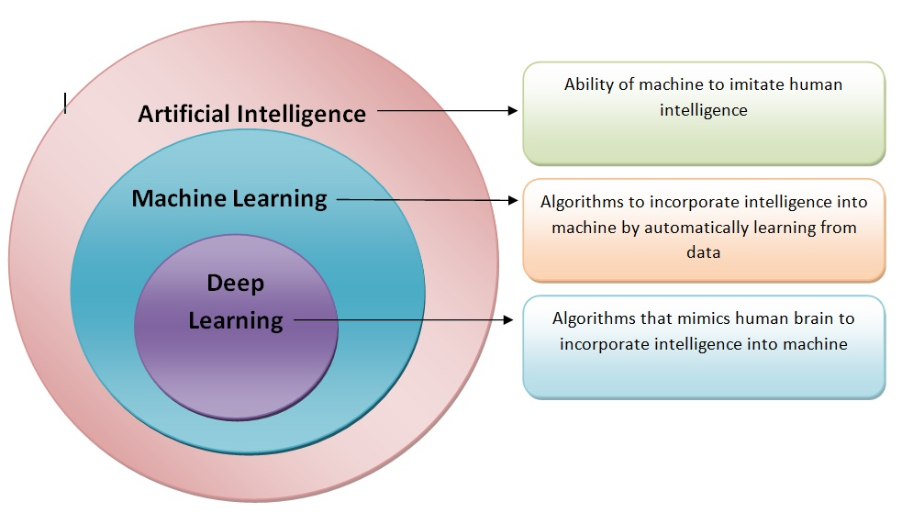
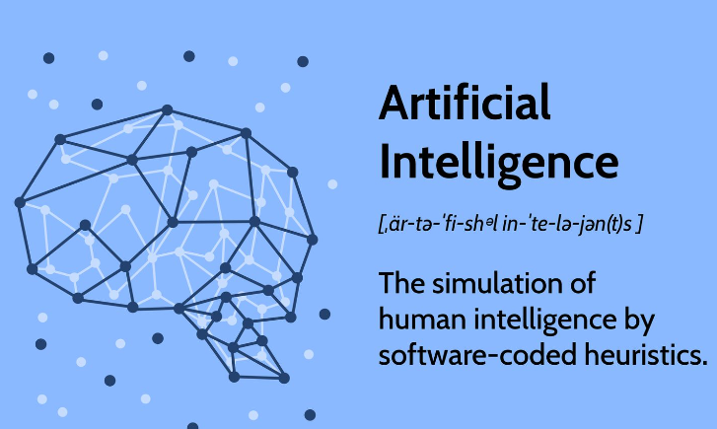
The Bad:
AI Bias – Built by humans, inherited our biases.
Job Loss – 1.8mm estimated jobs eliminated.
Accelerated Hacking
Data Leak – What PII are you feeding into AI?
Use Case:
Pearl SD – Superintendent Chris Chism
https://www.youtube.com/watch?v=kLgkD4rwRHE
Back To Title
Notes:
Change the image:
1- Right click on the transparent shape >> Send to Back >> Send to Back
2- Right Click on Image >> Change Picture >> Choose your Image
3- Right Click on Image >> Send to Back >> Send to Back

Slide 6
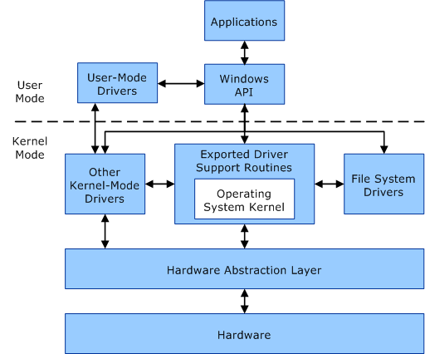
Crowd Strike Outage
$5.4 billion in total Loss for Fortune 500:
Healthcare – 1.94 Billion est. Loss
Banking 1.15 Billion est. Loss
It was the confluence of these issues that resulted in a system crash: the mismatch between the 21 inputs validated by the Content Validator versus the 20 provided to the Content Interpreter, the latent out-of-bounds read issue in the Content Interpreter, and the lack of a specific test for non-wildcard matching criteria in the 21st field. While this scenario with Channel File 291 is now incapable of recurring, it also informs process improvements and mitigation steps that CrowdStrike is deploying to ensure further enhanced resilience.
-CrowdStrike Root Cause Analysis 8/6/24
EDR – Endpoint Detection and Response (Falcon)
XDR – Extended Detection and Response
MDR – Managed Detection and Response
Back To Title
Notes:
Falcon hooks into the Microsoft Windows OS as a Windows kernel process. The process has high privileges, giving Falcon the ability to monitor operations in real time across the OS. There was a logic flaw in Falcon sensor version 7.11 and above, causing it to crash. Due to CrowdStrike Falcon's tight integration into the Microsoft Windows kernel, it resulted in a Windows system crash and BSOD.
Ultimately an issue of quality control. They released a patch that was not properly verified and it set off a chain reaction.
Thousands of patches have this ability to bring down networks and systems.
What can you do? Not much.

Slide 7
FTC Safeguards
Implement and periodically review access controls. Determine who has access to customer information and reconsider on a regular basis whether they still have a legitimate business need for it.
Know what you have and where you have it. A fundamental step to effective security is understanding your company’s information ecosystem. Conduct a periodic inventory of data, noting where it’s collected, stored, or transmitted. Keep an accurate list of all systems, devices, platforms, and personnel. Design your safeguards to respond with resilience.
Encrypt customer information on your system and when it’s in transit. If it’s not feasible to use encryption, secure it by using effective alternative controls approved by the Qualified Individual who supervises your information security program.
Assess your apps. If your company develops its own apps to store, access, or transmit customer information – or if you use third-party apps for those purposes – implement procedures for evaluating their security.
Implement multi-factor authentication for anyone accessing customer information on your system. For multi-factor authentication, the Rule requires at least two of these authentication factors: a knowledge factor (for example, a password); a possession factor (for example, a token), and an inherence factor (for example, biometric characteristics). The only exception would be if your Qualified Individual has approved in writing the use of another equivalent form of secure access controls.
6. Dispose of customer information securely. Securely dispose of customer information no later than two years after your most recent use of it to serve the customer. The only exceptions: if you have a legitimate business need or legal requirement to hold on to it or if targeted disposal isn’t feasible because of the way the information is maintained.
7. Anticipate and evaluate changes to your information system or network. Changes to an information system or network can undermine existing security measures. For example, if your company adds a new server, has that created a new security risk? Because your systems and networks change to accommodate new business processes, your safeguards can’t be static. The Safeguards Rule requires financial institutions to build change management into their information security program.
8. Maintain a log of authorized users’ activity and keep an eye out for unauthorized access. Implement procedures and controls to monitor when authorized users are accessing customer information on your system and to detect unauthorized access.
Written Information Security Plan
Risk Assessment - (Vuln Scan, Review with IT)
Review ACL
Encryption In transit (And Rest)
Assess App Security - 3rd Party/Webapps
MFA
Disposal of Data (HW too)
Firewall Log
Monitoring / Penetration Testing - IDS/IPS FW EDR MDR XDR
Security Awareness Training - Phishing Training
Business Continuity Plan / IR Plan
Back to Title
Notes:
Written Information Security Plan
Risk Assessment - (Vuln Scan, Review with IT)
Review ACL
Encryption In transit (And Rest)
Assess App Security - 3rd Party/Webapps
MFA
Disposal of Data (HW too)
Firewall Log
Monitoring / Penetration Testing - IDS/IPS FW EDR MDR XDR
Security Awareness Training - Phishing Training
Business Continuity Plan / IR Plan

Slide 8
Recent Cyber Incidents
Phishing
Spear Phishing/Whale
3rd Party Vendor Access
Offboarding Users
Social Engineering
Back To Title
Notes:
Written Information Security Plan
Risk Assessment - (Vuln Scan, Review with IT)
Review ACL
Encryption In transit (And Rest)
Assess App Security - 3rd Party/Webapps
MFA
Disposal of Data (HW too)
Firewall Log
Monitoring / Penetration Testing - IDS/IPS FW EDR MDR XDR
Security Awareness Training - Phishing Training
Business Continuity Plan / IR Plan

Slide 9
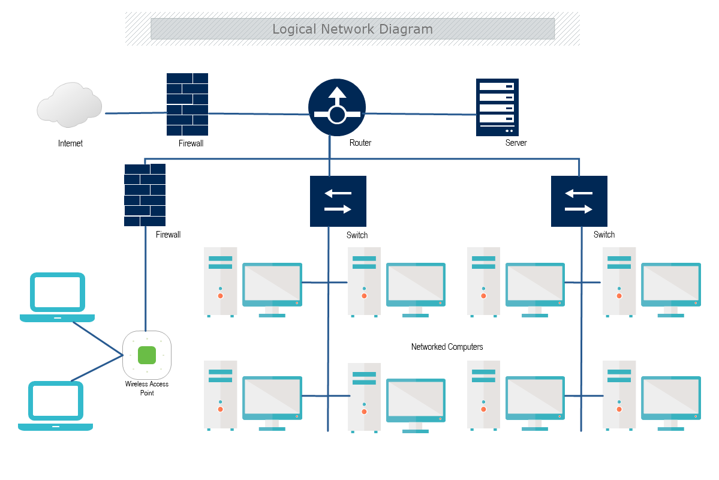
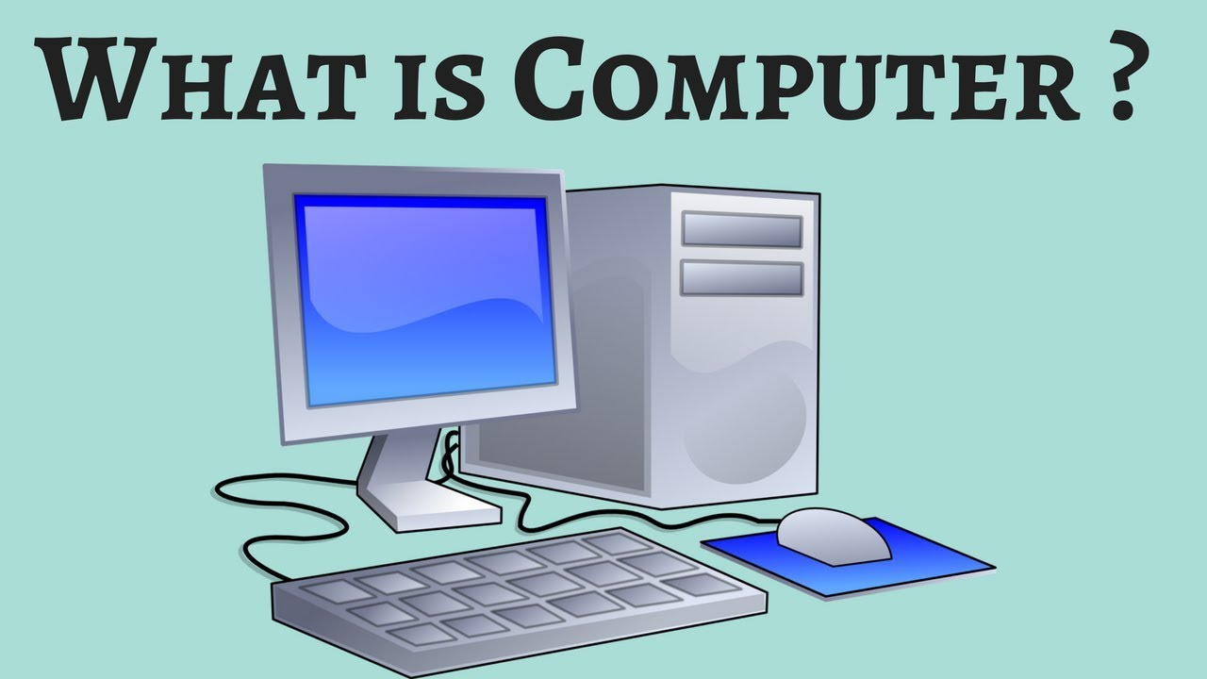
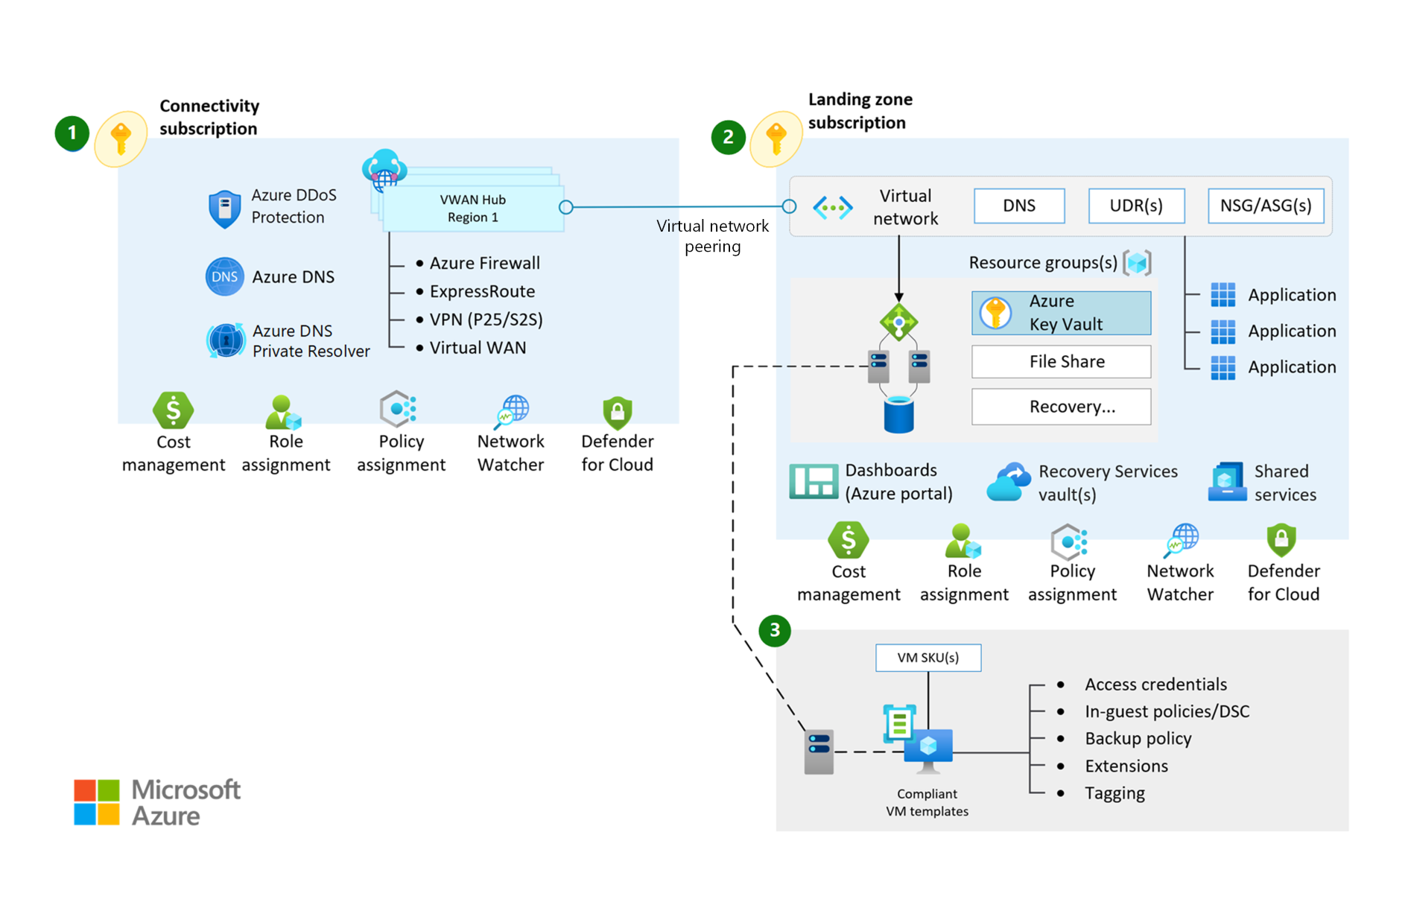
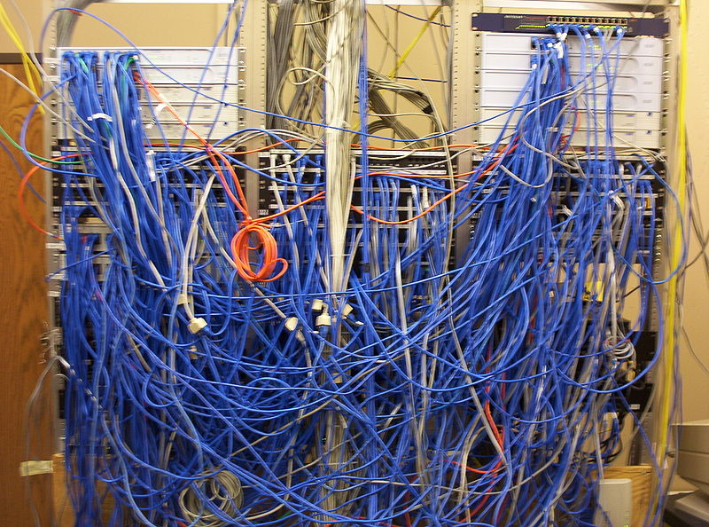
Q&A
Back To Title
Notes:
Written Information Security Plan
Risk Assessment - (Vuln Scan, Review with IT)
Review ACL
Encryption In transit (And Rest)
Assess App Security - 3rd Party/Webapps
MFA
Disposal of Data (HW too)
Firewall Log
Monitoring / Penetration Testing - IDS/IPS FW EDR MDR XDR
Security Awareness Training - Phishing Training
Business Continuity Plan / IR Plan

