Slide 1


Cornerstone House of God
Elect Lady Sandra Cobb, Pastor
Anniversary Order of Service
7th Pastor and 26th Church Appreciation!

Slide 2


Cornerstone House of God
Elect Lady Sandra Cobb, Pastor
Anniversary Order of Service

Slide 3
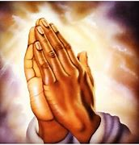
Prayer

Slide 4
THE TEN COMMANDMENTS
Exodus 20:1-17
And God spake all these words, saying, I am the LORD thy God, which have brought thee out of the land of Egypt, out of the house of bondage.
I. Thou shalt have no other gods before me.
II. Thou shalt not make unto thee any graven image, or any likeness of any thing that is in heaven above, or that is in the earth beneath, or that is in the water under the earth: Thou shalt not bow down thyself to them, nor serve them: for I the LORD thy God am a jealous God, visiting the iniquity of the fathers upon the children unto the third and fourth generation of them that hate me; And shewing mercy unto thousands of them that love me, and keep my commandments.

Slide 5
THE TEN COMMANDMENTS
Exodus 20:1-17
III. Thou shalt not take the name of the LORD thy God in vain; for the LORD will not hold him guiltless that taketh his name in vain.
IV. Remember the sabbath day, to keep it holy. Six days shalt thou labour, and do all thy work: But the seventh day is the sabbath of the LORD thy God: in it thou shalt not do any work, thou, nor thy son, nor thy daughter, thy manservant, nor thy maidservant, nor thy cattle, nor thy stranger that is within thy gates: For in six days the LORD made heaven and earth, the sea, and all that in them is, and rested the seventh day: wherefore the LORD blessed the sabbath day, and hallowed it.

Slide 6
THE TEN COMMANDMENTS
Exodus 20:1-17
V. Honour thy father and thy mother: that thy days may be long upon the land which the LORD thy God giveth thee.
VI. Thou shalt not kill.
VII. Thou shalt not commit adultery.
VIII. Thou shalt not steal.
IX. Thou shalt not bear false witness against thy neighbour.
X. Thou shalt not covet thy neighbour's house, thou shalt not covet thy neighbour's wife, nor his manservant, nor his maidservant, nor his ox, nor his ass, nor any thing that is thy neighbour's.

Slide 7
THE TEN COMMANDMENTS
Exodus 20:1-17
So readeth the law, including James the Second Chapter, Verses Ten, Eleven, and Twelve:
10: For whosoever shall keep the whole law, and yet offend in one point, he is guilty of all.
11: For he that said, Do not commit adultery, said also, Do not kill. Now if thou commit no adultery, yet if thou kill, thou art become a transgressor of the law.
12: So speak ye, and so do, as they that shall be judged by the law of liberty.

Slide 8

7th Pastor and 26th Church Appreciation!

Slide 9

Selection
Conerstone Youth Choir

Slide 10

Encouraging Words
From Lady Bertha Johnson

Slide 11

Selection
By Brother Demetrius Ruth

Slide 12

Presentation
By Elder Omar Arki

Slide 13
Tithes and Offering
2 Ways to give:
You can Zelle your money to CHOG114@outlook.com
You can give cash

Slide 14


Praise and Worship

Slide 15

Bread of Life
From Bishop Quincy Slaughter
Rhema Tabernacle, Pastor

Slide 16
Genesis 32: 22-24 KJV
[22] And he rose up that night, and took his two wives, and his two womenservants, and his eleven sons, and passed over the ford Jabbok.
[23] And he took them, and sent them over the brook, and sent over that he had.
[24] And Jacob was left alone; and there wrestled a man with him until the breaking of the day.

Slide 17
Genesis 32: 25-27 KJV
[25] And when he saw that he prevailed not against him, he touched the hollow of his thigh; and the hollow of Jacob's thigh was out of joint, as he wrestled with him.
[26] And he said, Let me go, for the day breaketh. And he said, I will not let thee go, except thou bless me.
[27] And he said unto him, What is thy name? And he said, Jacob.

Slide 18
Genesis 32: 28-29 KJV
[28] And he said, Thy name shall be called no more Jacob, but Israel: for as a prince hast thou power with God and with men, and hast prevailed.
[29] And Jacob asked him, and said, Tell me, I pray thee, thy name. And he said, Wherefore is it that thou dost ask after my name? And he blessed him there.

Slide 19
Genesis 32: 30 KJV
[30] And Jacob called the name of the place Peniel: for I have seen God face to face, and my life is preserved.

Slide 20
Bread of Life
From Bishop Quincy Slaughter
Rhema Tabernacle, Pastor

Slide 21

Acknowledgements
Pastors

Slide 22
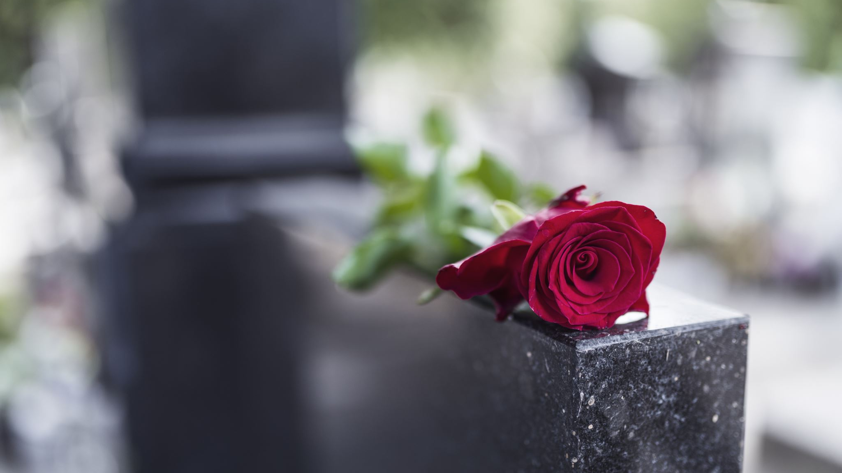
Remarks
From Elect Lady Sandra Cobb, Pastor

Slide 23

Benediction
From Vicar Parmenas West

Slide 24

Thank You for coming and supporting!
God Bless!

