Slide 1
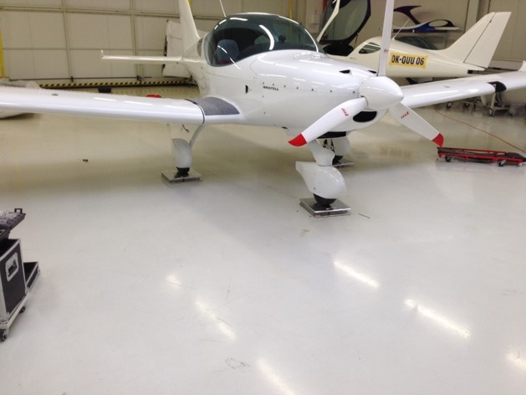
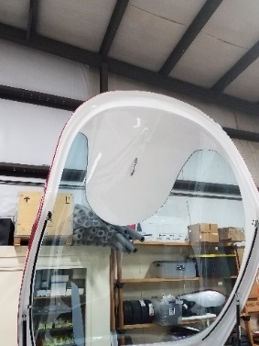
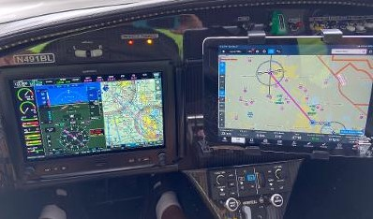
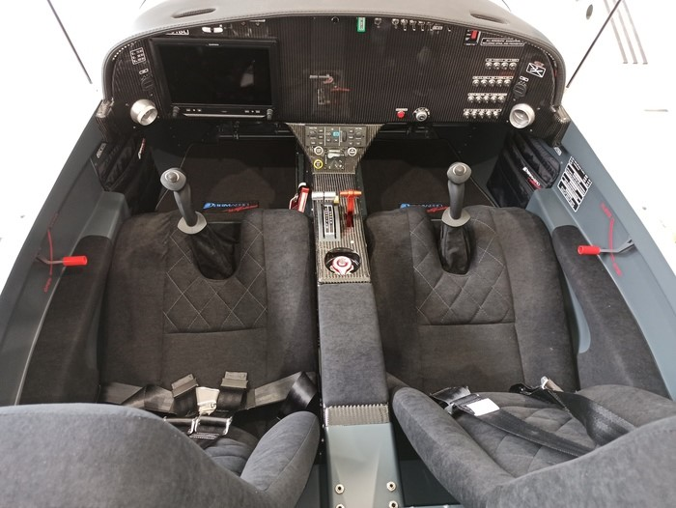
568/2021 Bristell 915 SLSA TURBO $250,272 N567BL Pre-wire BRS
Rotax 915iS Sport 141 HP, Sensenich 3 Blade Prop
Electric elevator trim, 4-inch vents, External Static system
Grey tinted canopy, Elevator Gap seals
White base ready for Graphics, Prewired for BRS Chute
Charcoal interior and carbon fiber panel, Wheel Fairings
Black Cloth seats, upgradeable to Bentley Leather
2.4V USB on right and left side, Heated Pitot, AOA
Dual Teleflex nose wheel steering cables
Berringer Anti Lock Hand Brakes 2 Tosten CS 8 grips
Wing Locker, Dual Landing Lights, Nav and Strobe lights
Kanad ELT, inclinometer above G3X Back up IBBS-12V-3Ah battery
EarthX battery and battery minder cable at oil door
10-inch G3X Touch GDU 460, GDL51R, ADAHARS, GTR20R, Com GNX375 WAAS IFR Certified LPV GPS, GAD 29, ADS-B IN and OUT
Garmin GMC 507 Autopilot module, Electric Aileron Trim
Delivery July 2021
Louis Mancuso 516658-1847
Gross Weight 1320 lbs Empty Weight 865 lbs Useful Load 455 lbs
Payload with 4 hours fuel 360 lbs Range 500 miles no reserves 170 MPH

