Slide 1


Bluetooth Hotel System Manual

Slide 2
Functional iteration Version 2.3.1
Add “card encoder assistant ” module
> The tool is a Windows PC application. Open the cardencoderassistant.exe file to connect to the card encoder
> The tool supports a wide variety of major browsers on Windows computers. It is not restricted by browser versions and does not require the installation of browser extensions
Optimize the instructions

Slide 3
Content
01
system introduction
02
card Encoder Instruction
03
Initial use of system processes
04
function introduction

Slide 4


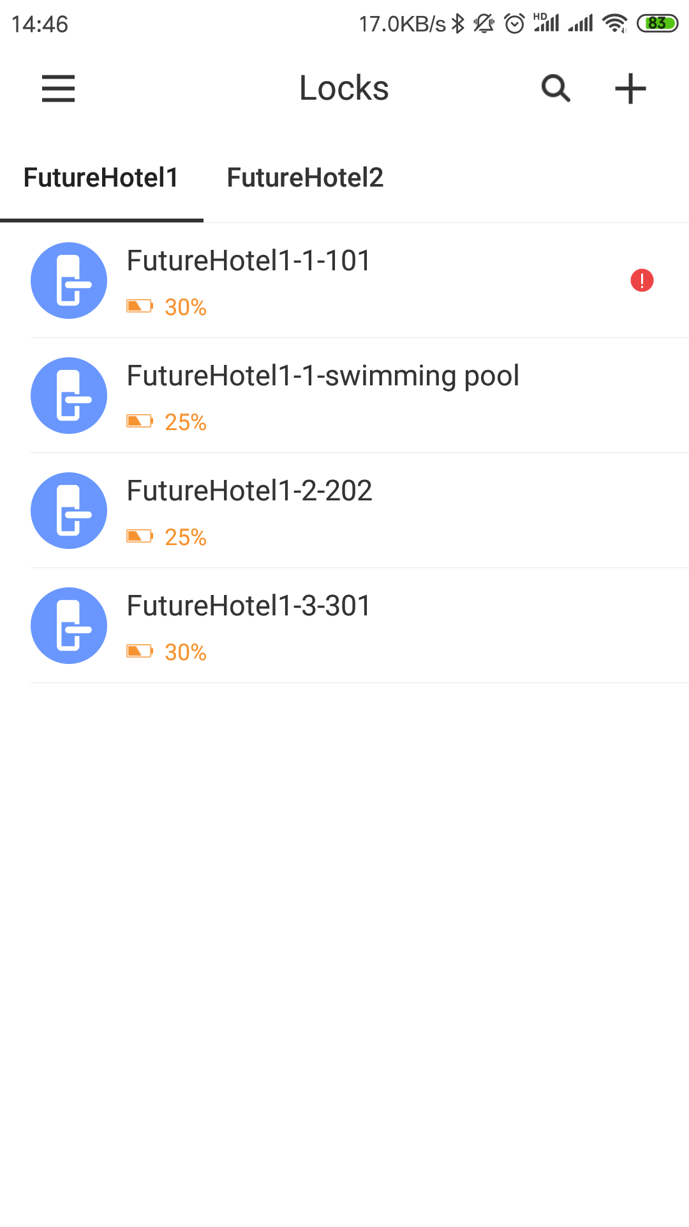
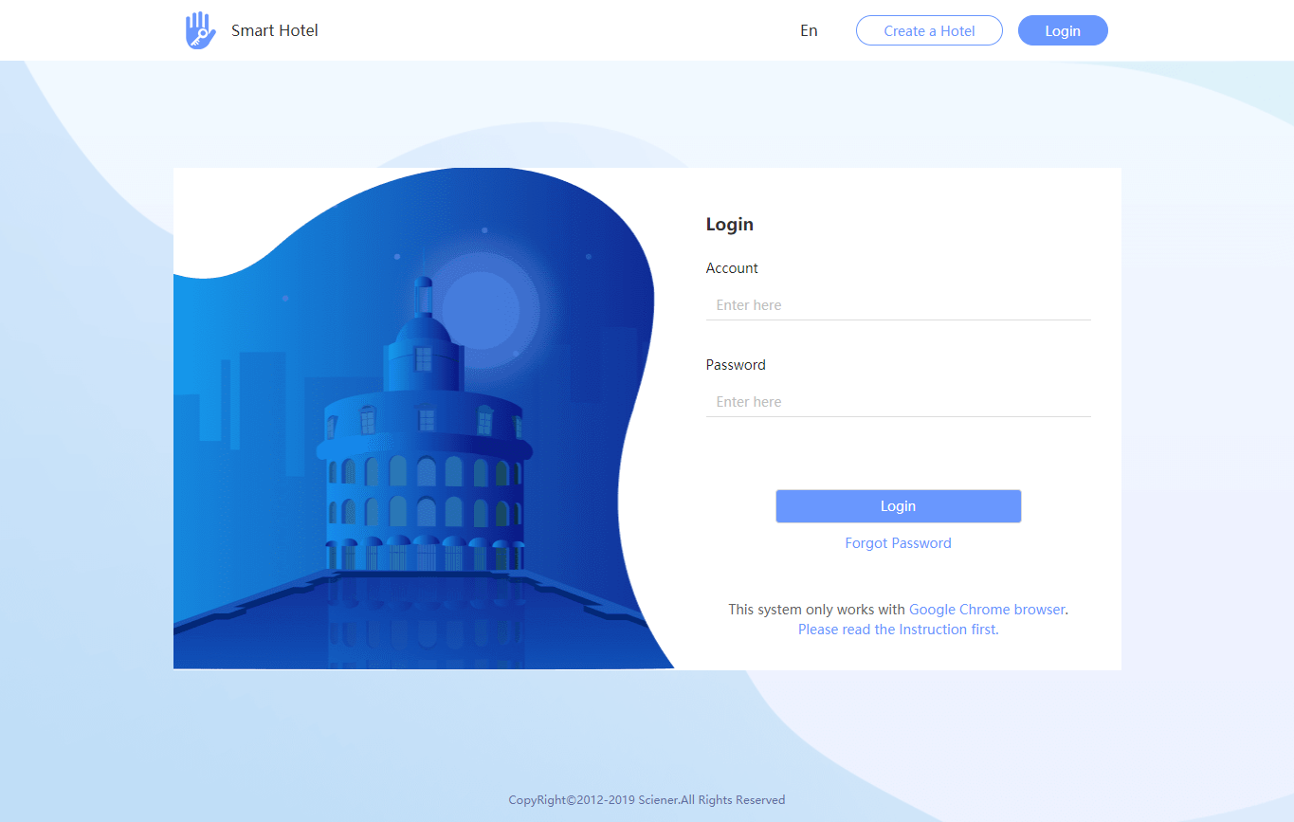
System Introduction
Bluetooth Hotel System is suitable for centralized/distributed hotels and apartments. It is an intelligent hotel management software.
The software consists of a web-side management system and a tool APP, which includes various practical functions such as room, staff, intelligent hardware control and convenient check-in. It solves all kinds of problems encountered in hotel management and improves management efficiency. It is centralized. The best choice for intelligent management of hotels and decentralized apartments.
PC-side System
TTHotel APP

Slide 5
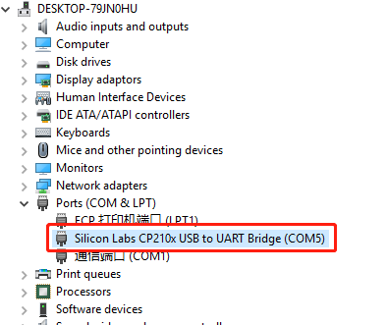
Introduction
1、Support for Windows PC mainstream browser
2、Use the special card encoder of the hotel system
3、Install the card encoder driver and run the card encoder assistant software
4、Check that device drivers are installed. Step：Insert the card encoder into the computer => right click“my computer”=>“manage”=>“port（COM和LPT）”，Check if there is Silicon Lab CP210x USB to UART Bridge，if yes，installed successfully， if no，You need to install your own card issuer to connect the driver.

Slide 6
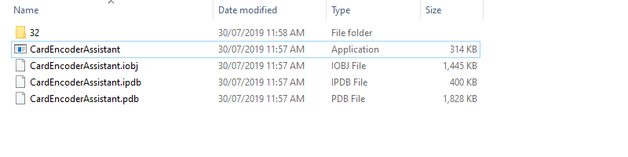
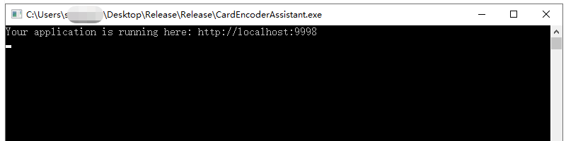
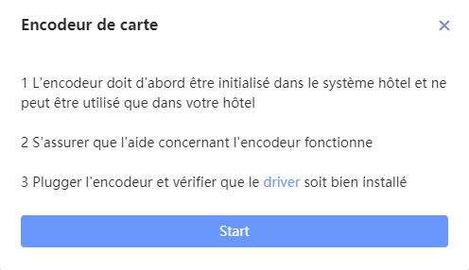
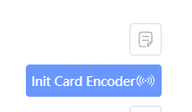

使用须知
5、Run“card encoder assistant”module. Step ：Open“CardEncoderAssistant” => keep the procedure running
6、After completing the above steps, you can configure the card encoder and IC card

Slide 7
Datas Creation Process
Creat the hotel data：
register the hotel
creat buildings
creat floors
creat rooms
creat posts/staffs
add smart lock
Check-in：
check-in
tenant to shop
get card/passcode
choose the room
receive
IC card/passcode
……
check out/renewal
Password expires automatically/
Automatically delete on APP
Staff management：
staff management
card/send eKey
choose the room
receive
IC card/eKey
……
Unlock with APP
get the operation records
lock management&personal settings
PC-side system
APP

Slide 8
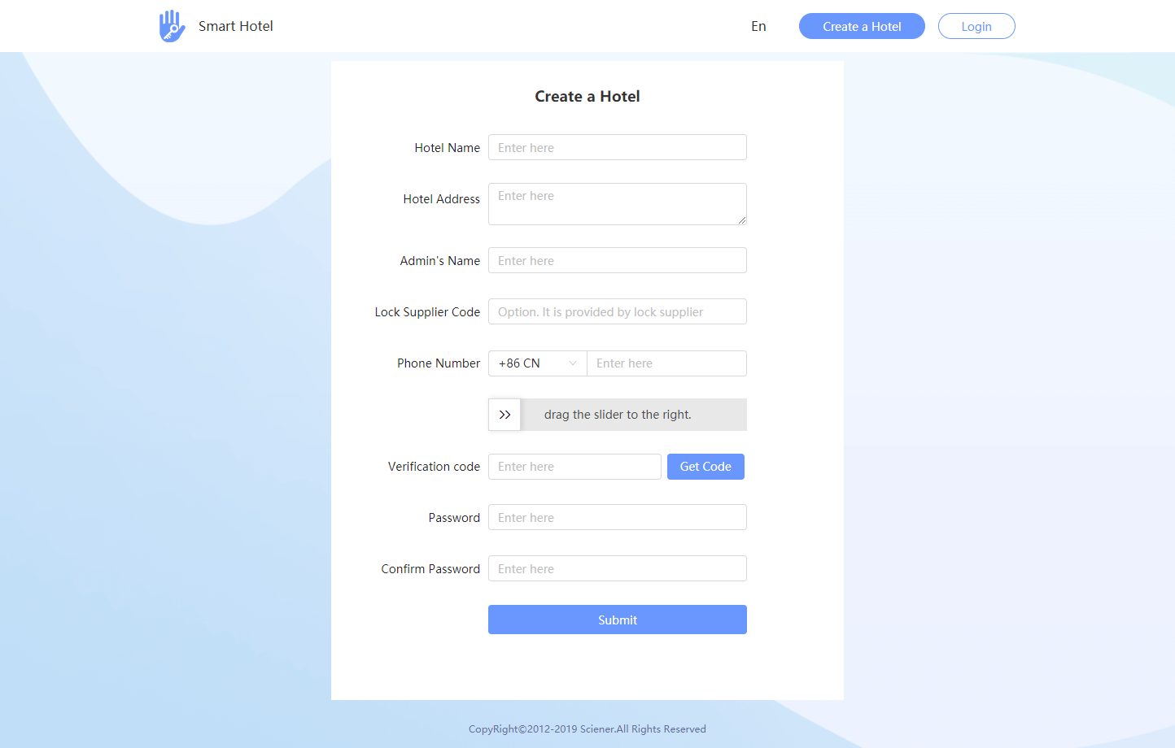
PC-side of TTHotel
Register the hotel
Website address：https://hotel.sciener.cn/user/register
Please fill in the real information when registering
One administrator can only pair one hotel. One mobile phone number cannot register two hotels.
The lock supplier number is the basis for the hotel to be associated with the lock supplier and is provided by the supplier to the hotel.

Slide 9

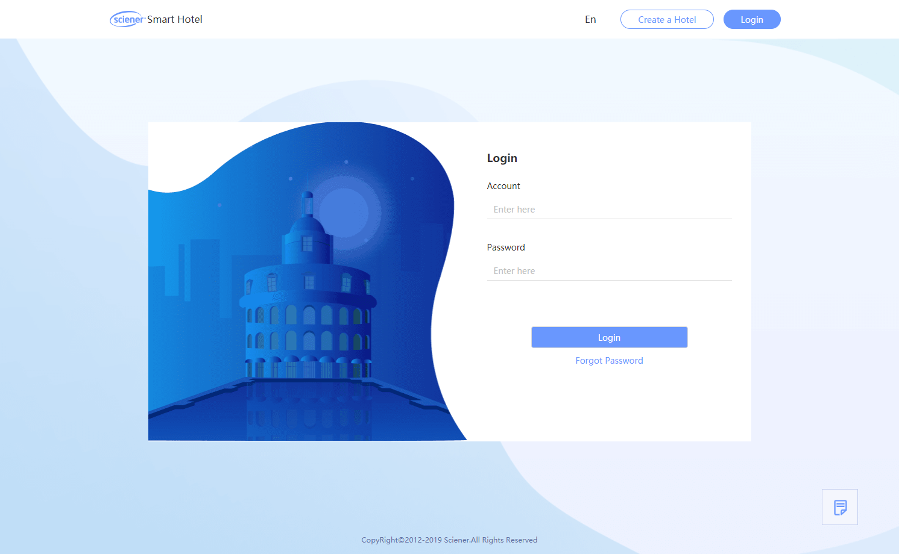
PC-side of TTHotel
Login
Login address：
https://hotel.ttlock.tech;
The employee can log in with the phone number and password filled in when adding
Hotel staff can click "Forgot Password" on the login page and use the mobile account to verify and change the login password
Users who have not granted Web login permission cannot log in.

Slide 10
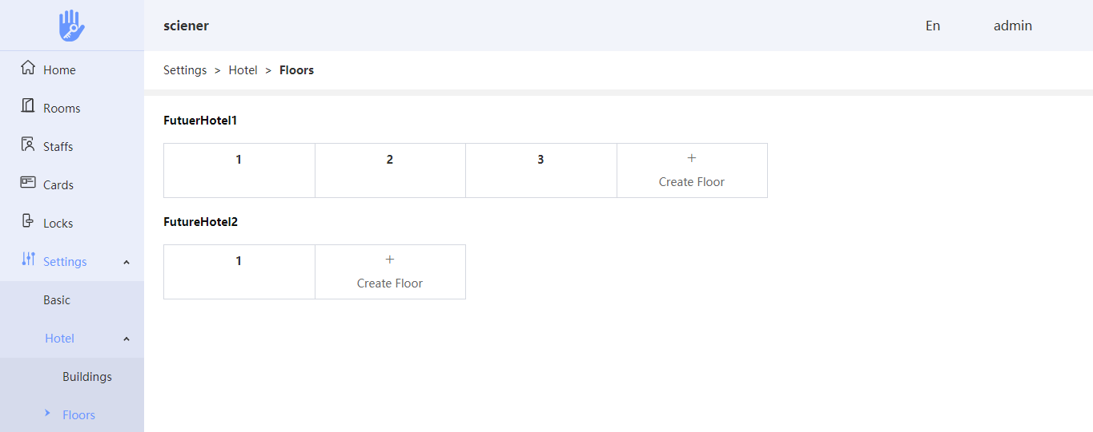
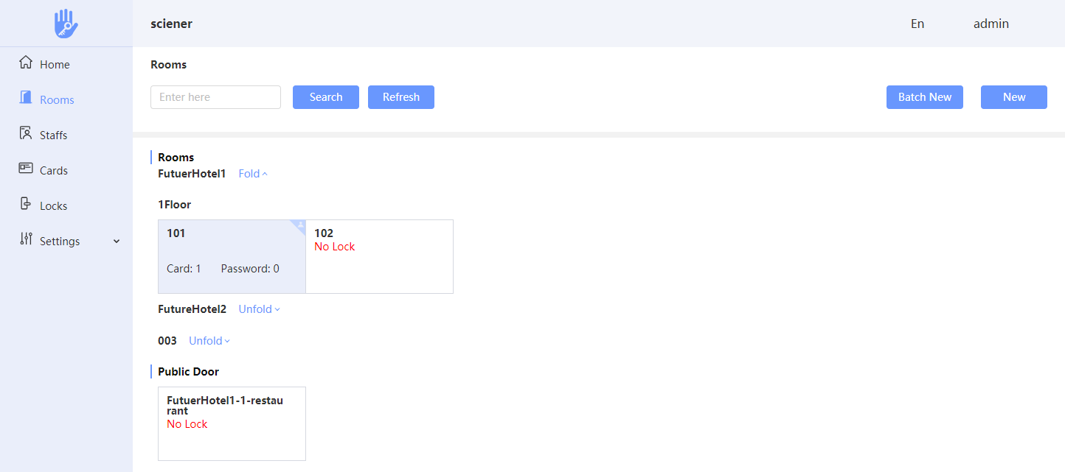
PC-side of TTHotel
Hotel and Room management
For the first time, the administrator should first add a building, floor, and room.
Click“Settings”=>“Hotel”“Buildings”“Floors”to add building, floor .
Click“Rooms”to choose the room types you want.
After the room is added, the APP can add the smart lock.
Users can check in and get passcode when the door has smart lock.

Slide 11
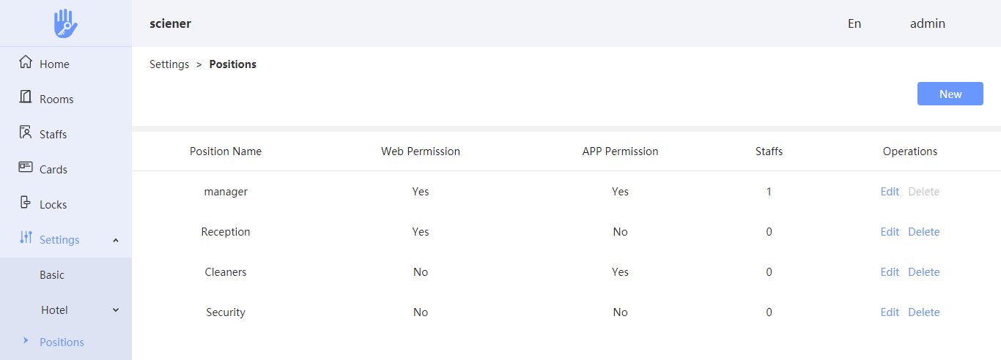
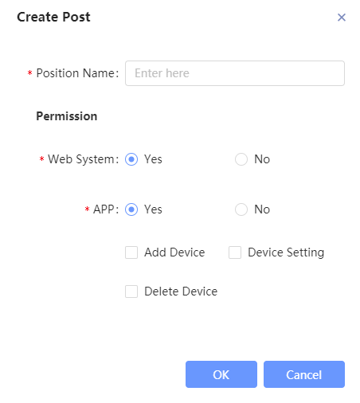
PC-side of TTHotel
Settings-Post
Before adding an employee, the administrator needs to set up the employee position first.
Click“Settings”=>“Post”to add a position and set the its login permission.
Staffs can use the APP to add locks, set and delete permissions when employees have the APP login and add device permissions.

Slide 12
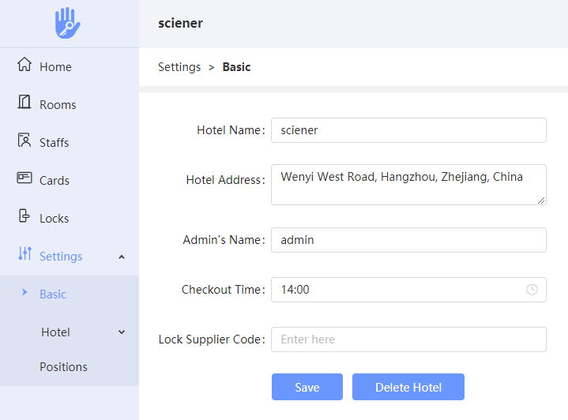
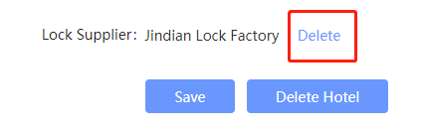
PC-side of TTHotel
Settings-Basic
Select“Edit”Modify the hotel name, address, administrator name and check-out time.
The lock supplier code can be entered when select“Edit”.
If the lock supplier is already bound, the supplier name will be displayed. When editing, you can apply for unbinding.
If the hotel is repeatedly registered and there is no binding lock under the hotel, you can delete the hotel when you edit.

Slide 13
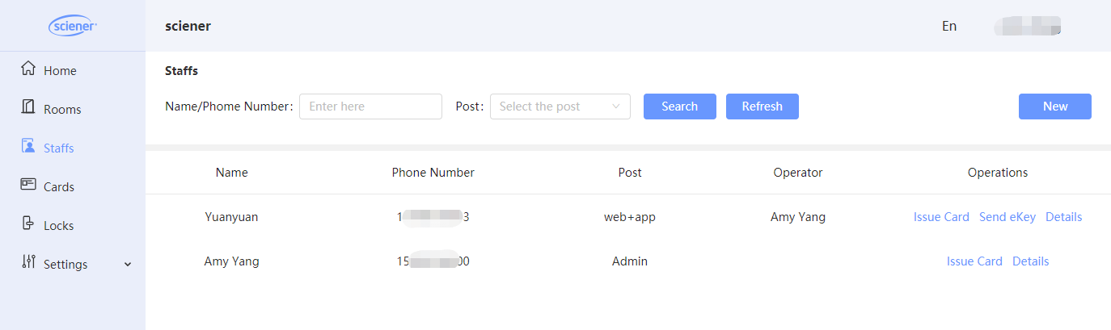
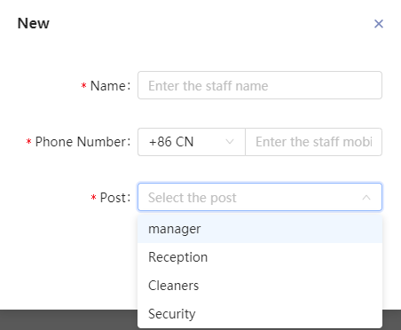
PC-side of TTHotel
Staffs
Employee management has functions of add, edit, delete, view details, issue card, send electronic key.
Employee editing and deletion functions are on the details page.
The employee is added successfully, and the employee is given the post permission. If there is corresponding login permission, the employee will receive the notification message.
The electronic key is the Bluetooth electronic key, which can be unlocked via APP Bluetooth.
If the employee does not have the APP login permission, the electronic key cannot be sent.

Slide 14
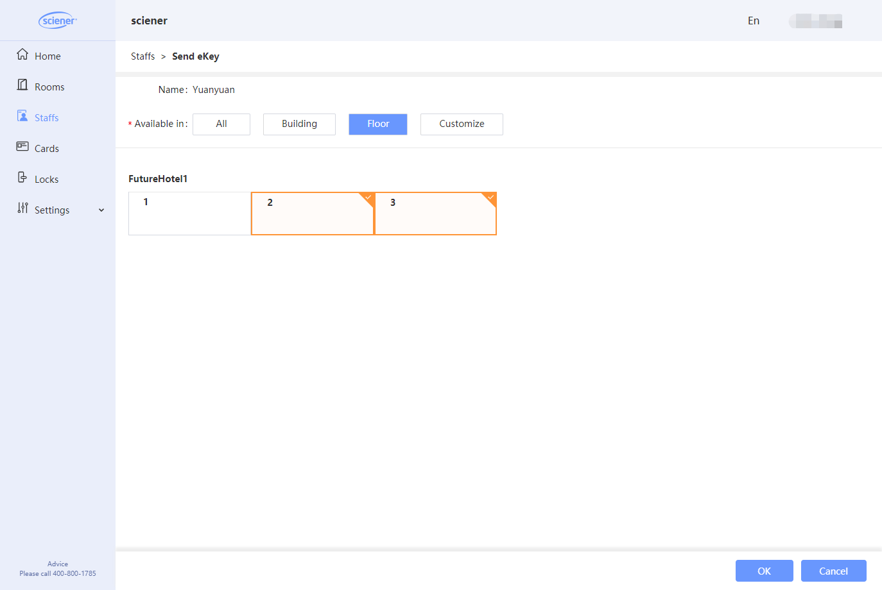
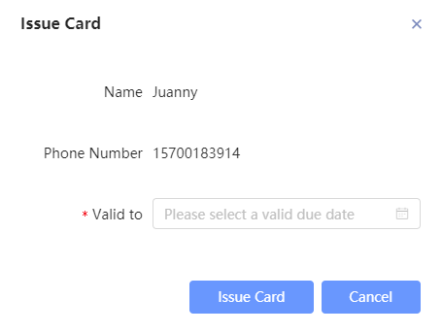
PC-side of TTHotel
Staffs-Send eKey
Four types of staff card: All / Building / Floor / Customize
All: The employee will be granted the right to open the door lock of the hotel.
Building：The employee will be granted the right to open all the door locks of the designated building of the hotel.
Select Customize, you can customize the room door lock and give the employee a custom door open permission.
Notice：Employee card can select up to 40 rooms;
There is no limit to the number of employee electronic keys. And
the validity period is permanent.

Slide 15
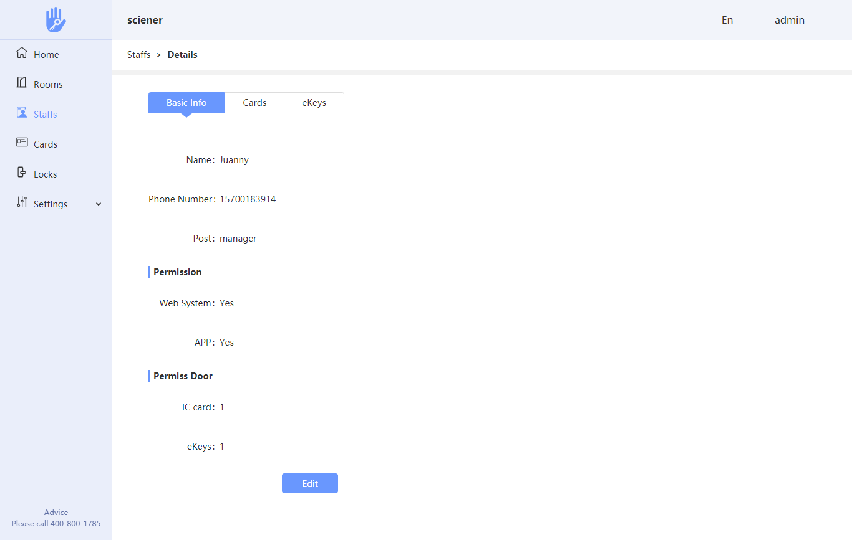
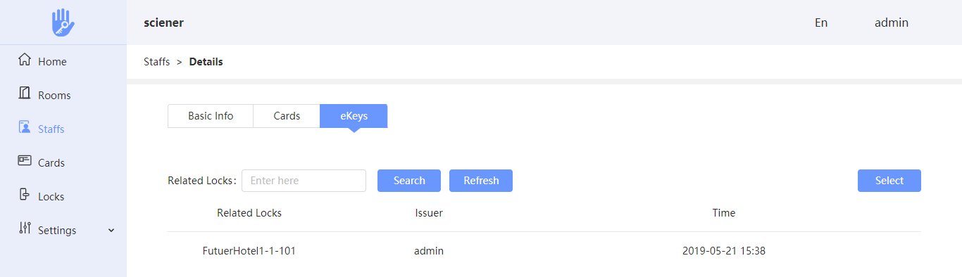
PC-side of TTHotel
Staffs-Details
On the Basic Info page，staffs can be viewed, edited, and deleted. Details page has staff information, card information, and key records
If you want to modify the login permission of an employee, you can only modify the post permission
If you want to modify the eKey that the staff has sent, you can click "eKeys" - > "Select" to edit the key data

Slide 16
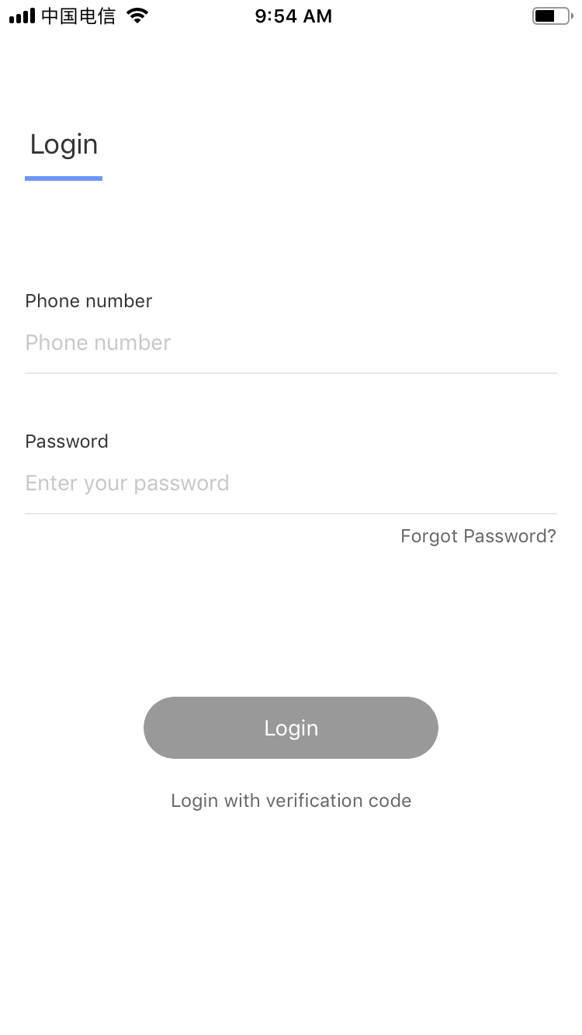
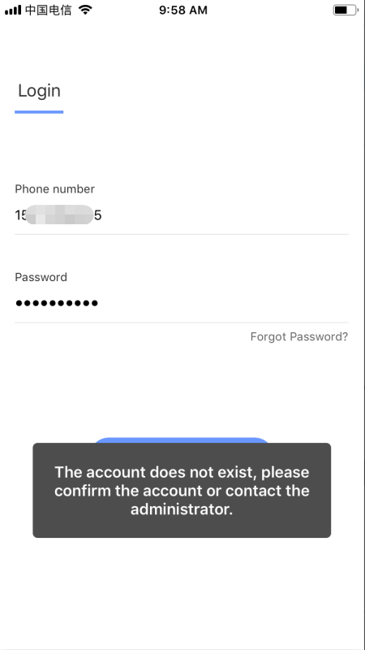
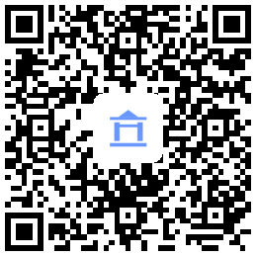
APP of TTHotel
Staff Login with the APP
Employees (granted with APP login rights) can log in using their mobile phone number and password.
Employees (does not granted with APP login rights) can not log in.
When successful login, the interface jumps to the APP homepage.
iOS & Android download

Slide 17
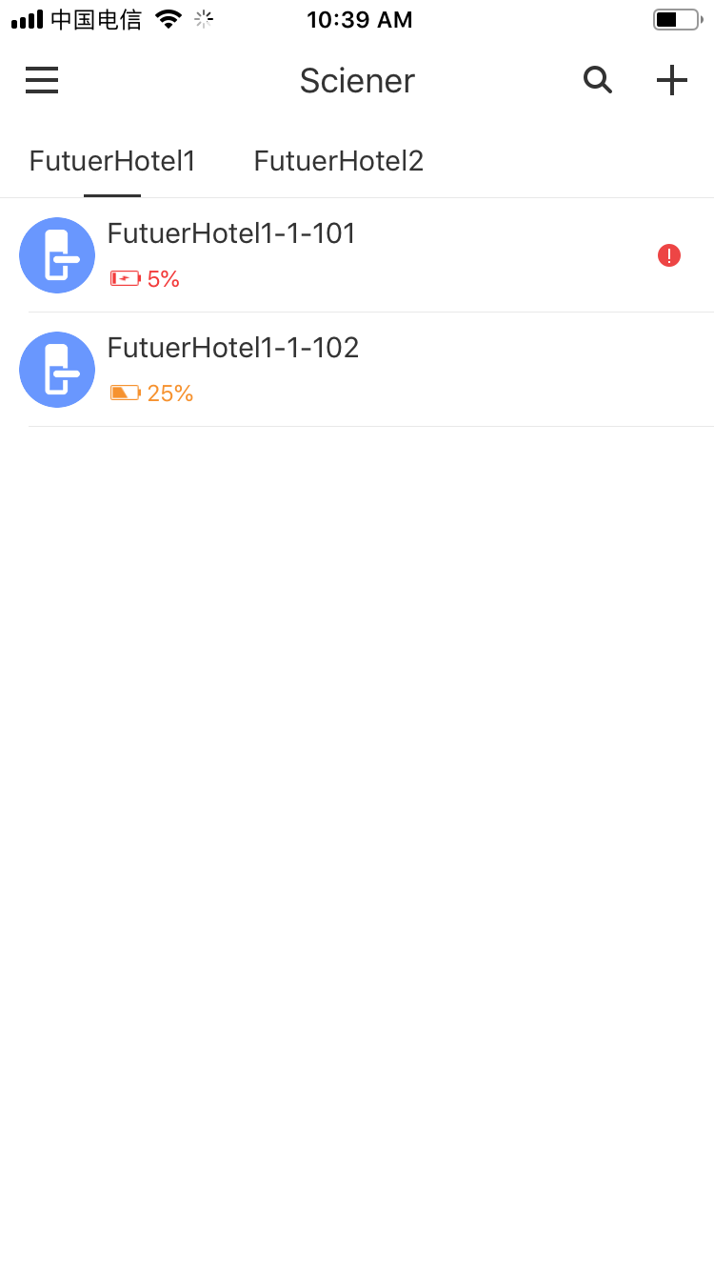
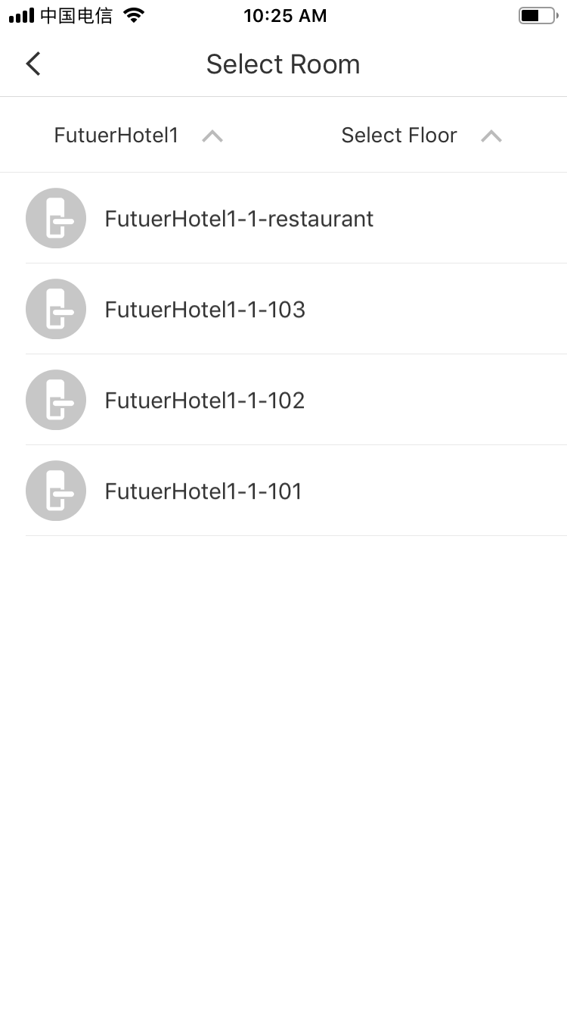
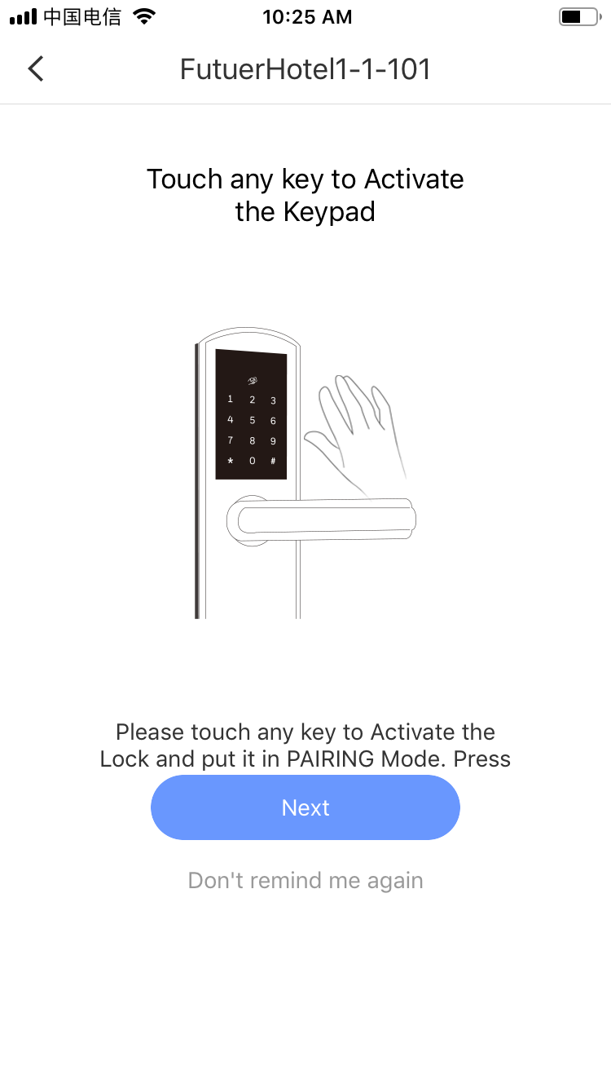
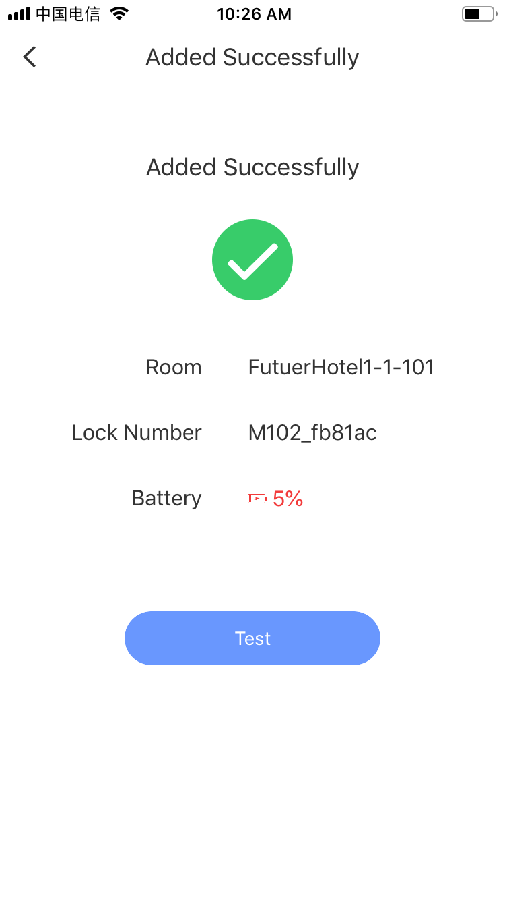
APP of TTHotel
Add Lock
On the APP homepage, you can see the list of added locks; add [+] to add the lock, select the door to be added and then touch the lock. When the lock status is “Addable”, click [+] to add it successfully. After the addition is successful, click [Test] to check if the door lock can be used normally.

Slide 18
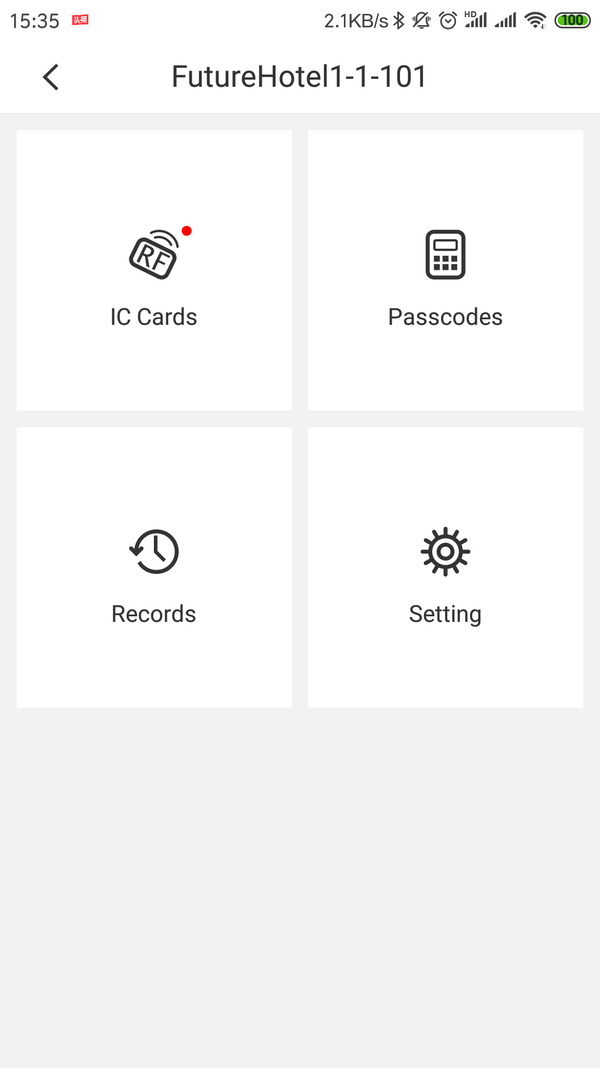
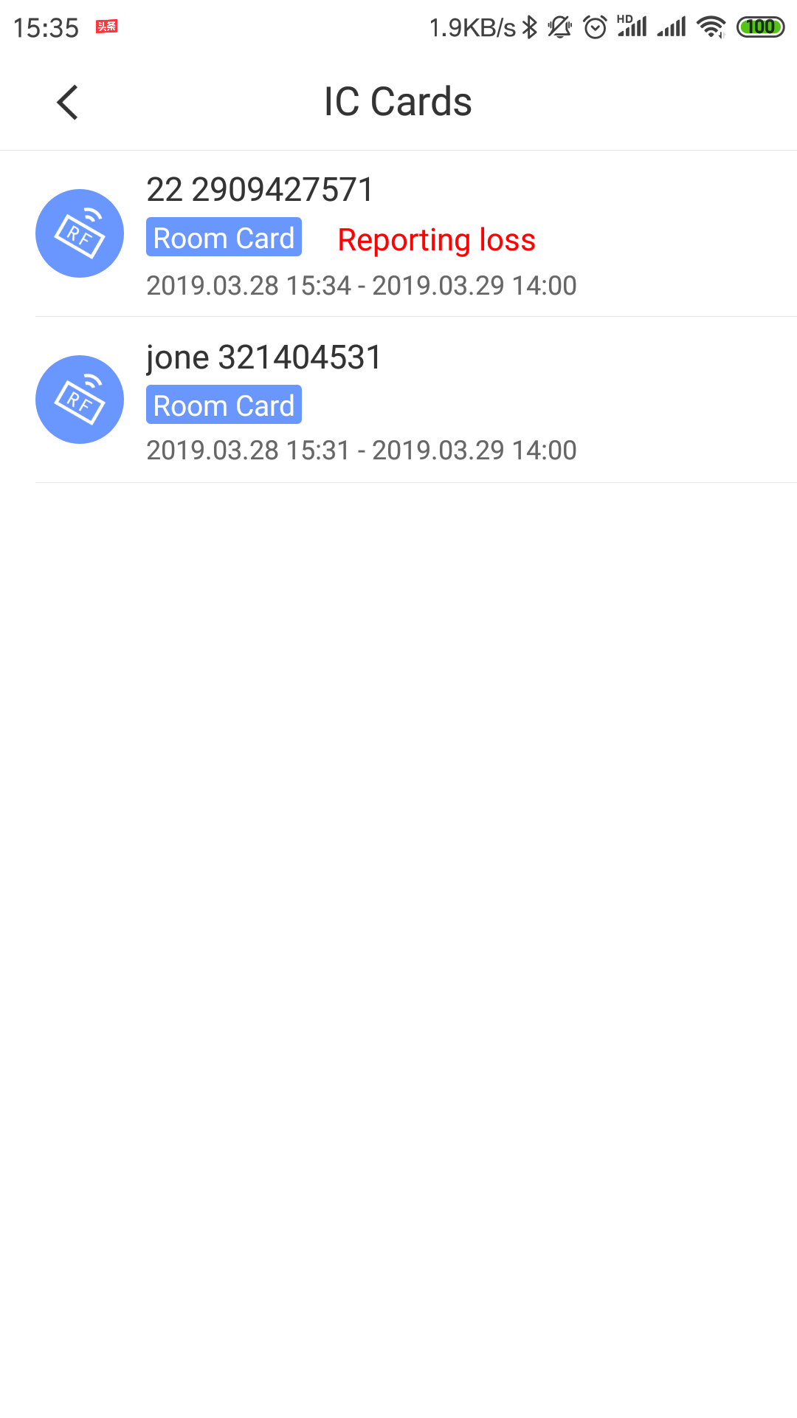
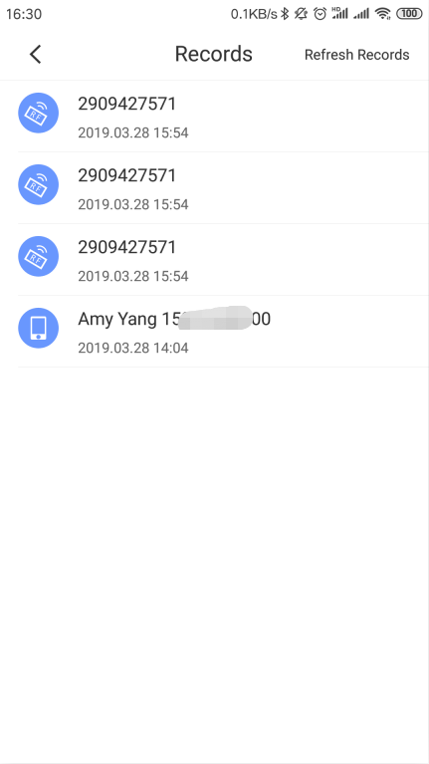
APP of TTHotel
Lock Setting
Report loss
Four functions of card module：
  check and report loss card
  check and delete avilable password
  check and read records
  lock setting
When the card need to be reported, card module will shows“·” icon. Hotel staff can enter the IC card list, view and report the card.
The door opening record needs to be read by using the mobile APP near the door lock.

Slide 19
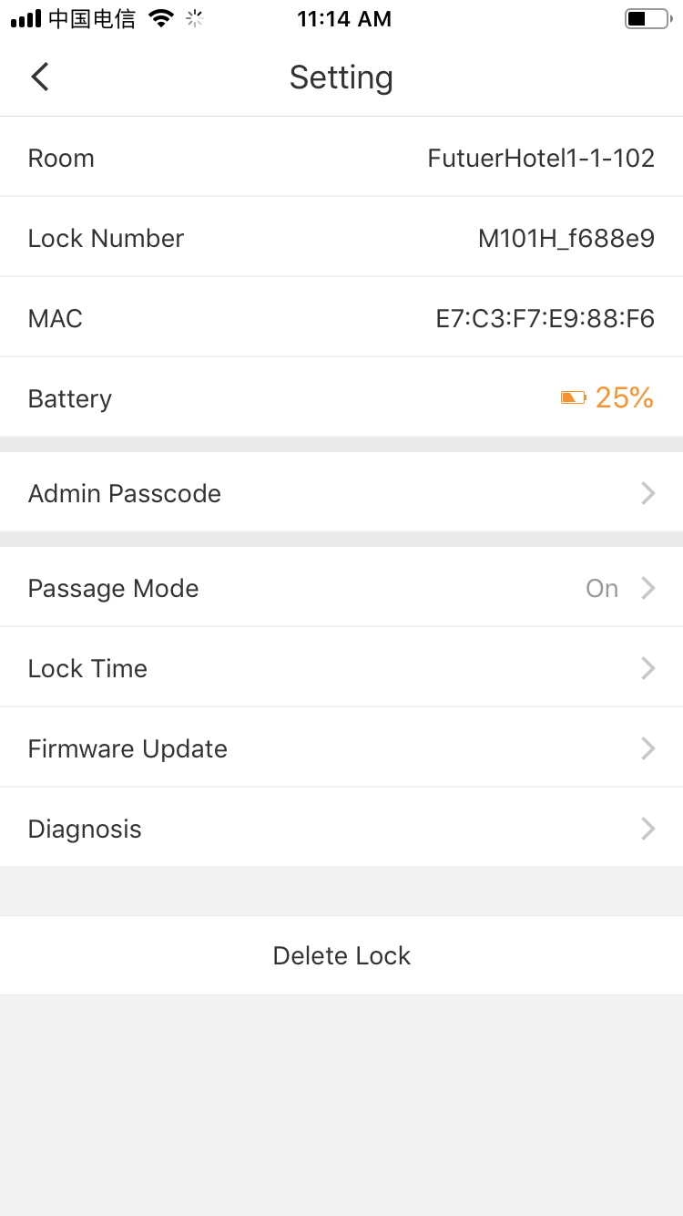
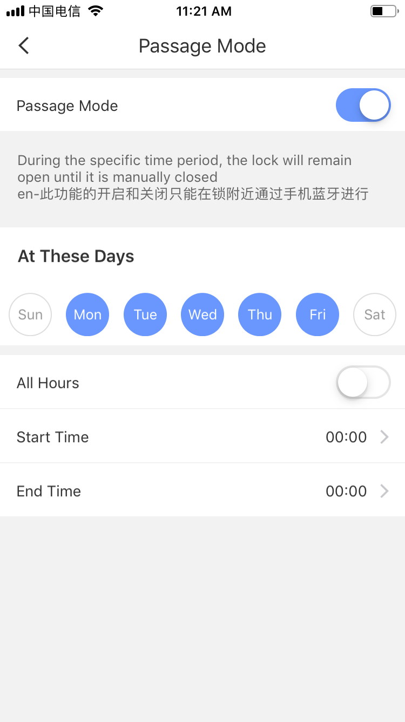
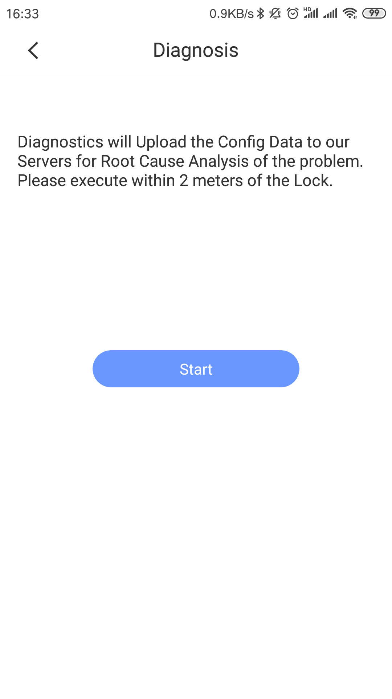
APP of TTHotel
Lock Setting
Click [Setting] to enter the lock setting page, you can view the basic information of the lock and can calibrate and update the lock time and version.
The administrator has unlock passwords for all locks.
The normally open mode can be applied to a common door. When this mode is turned on, the public door will not automatically lock during the normally open time.
When there is a problem with the lock, you can click the diagnosis to report the configuration information in the lock, and the professional staff can help resolve the fault.

Slide 20
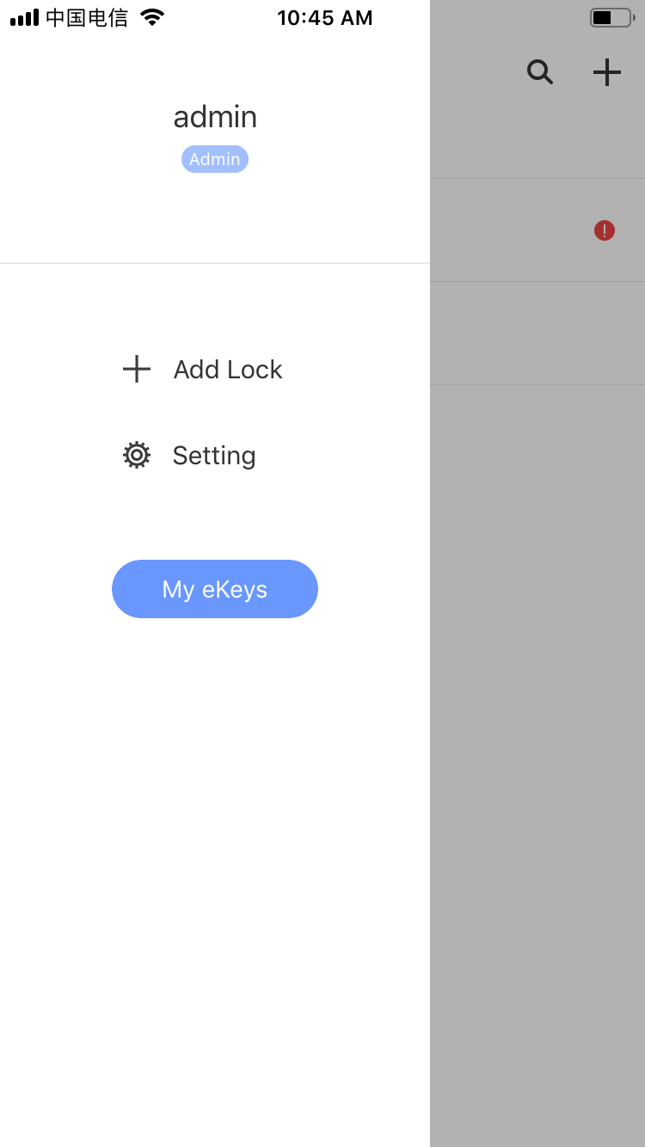
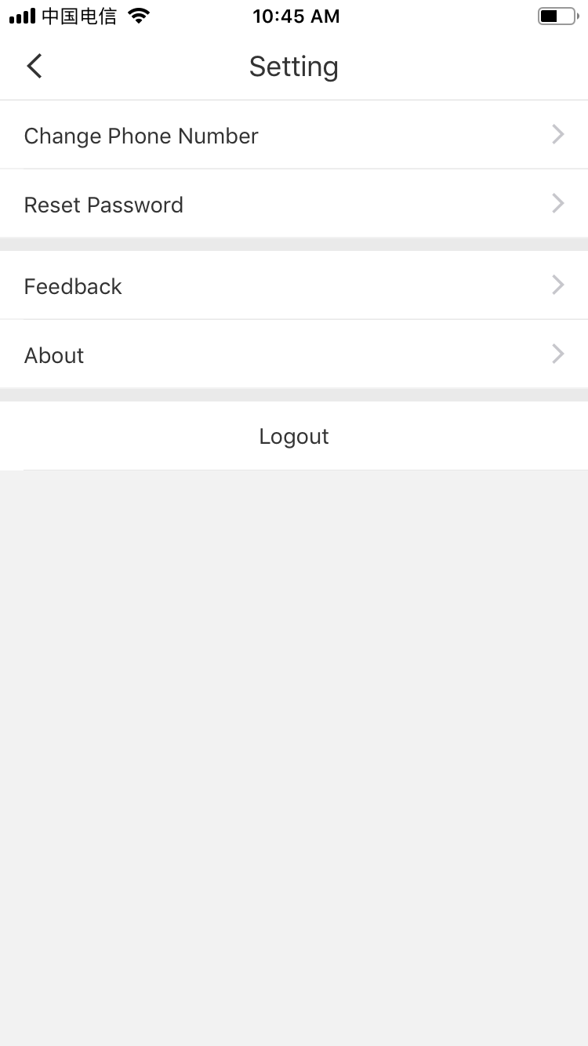
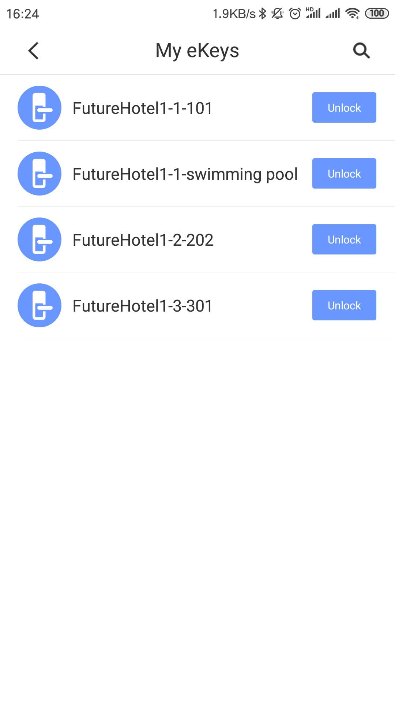
APP of TTHotel
Personal Settings
Employees can modify their mobile phone number, password, and feedback through the app.
The hotel administrator has an electronic key for all locks, and the employee only has the electronic key that was sent.
Use an electronic key to open the door near the door lock in the room.

Slide 21
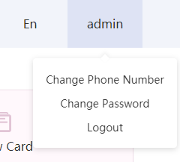
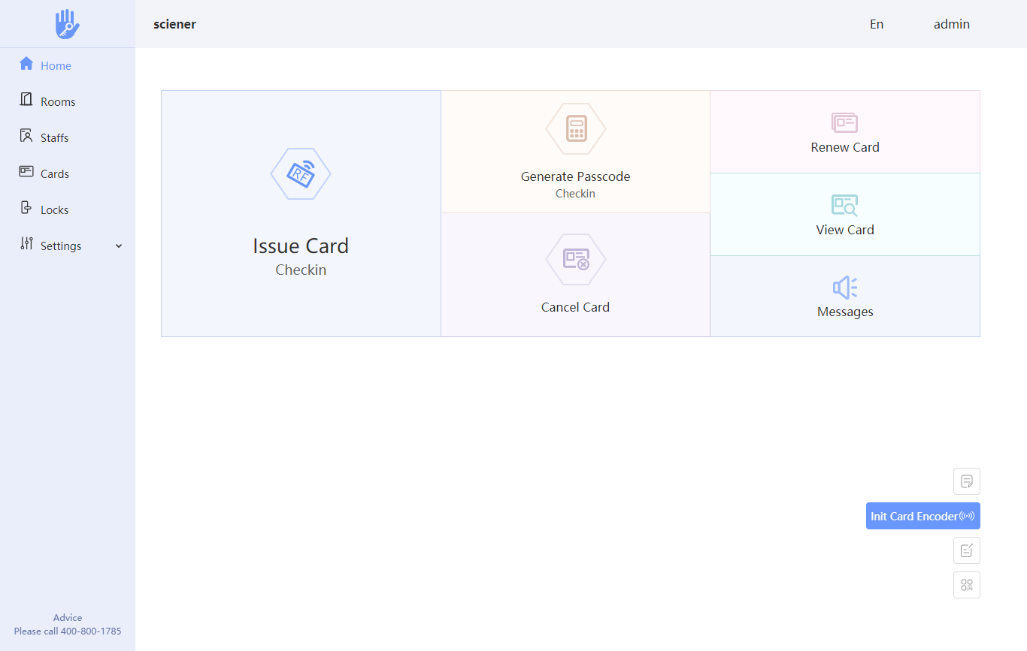
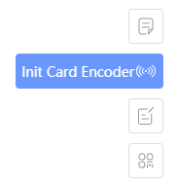
PC-side of TTHotel
Home
The left side of the home page is the system's menu navigation bar
here are six modules: Issue Card/Generate Passcode/Renew Card/View Card/Cancel Card/Messages/View Card
Introduction/Init Card Encoder/ Feedbacks/ Scan the QR code
If you are prompted to "unrecognized card encoder" when you issue the card, you can click "Init Card Encoder" to initialize the card issuer.

Slide 22
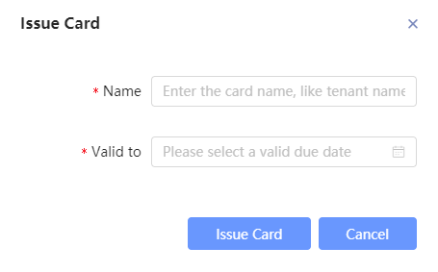
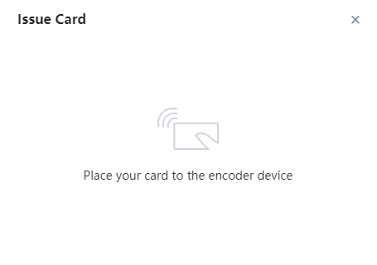
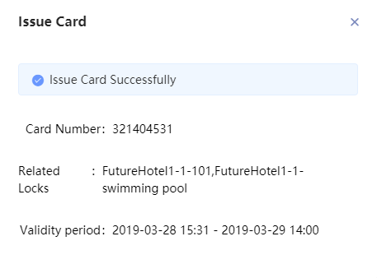
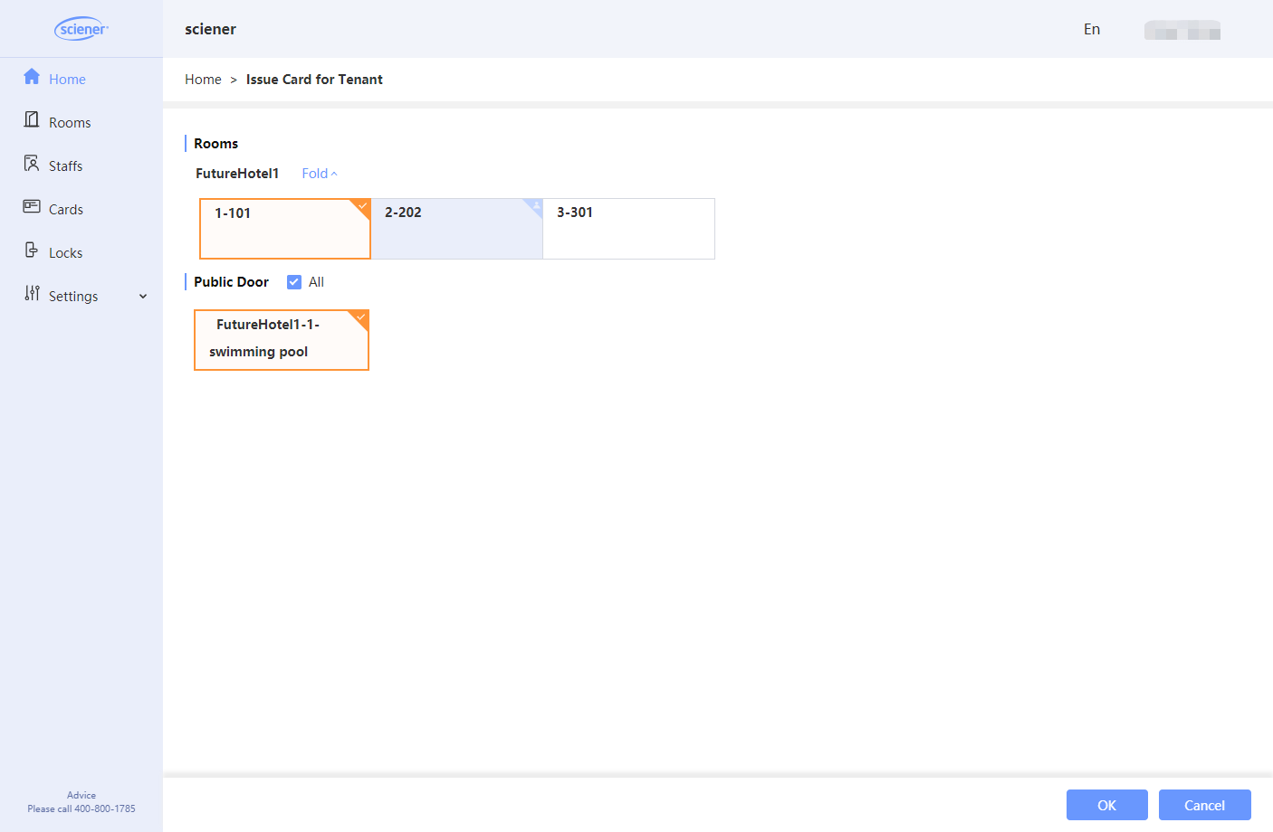
PC-side of TTHotel
Home
Issue Card
After the room is locked, the card can be opened for the room.
When the room has been checked in and the room will show the checked in check mark.
Process：choose the hotel room and the public doors => Registration name and card validity period => Click to issue card，place card => issue card successfully.
Notice：at least choose one room，choose up to 39 public doors.
check in successfully
the room choosed

Slide 23
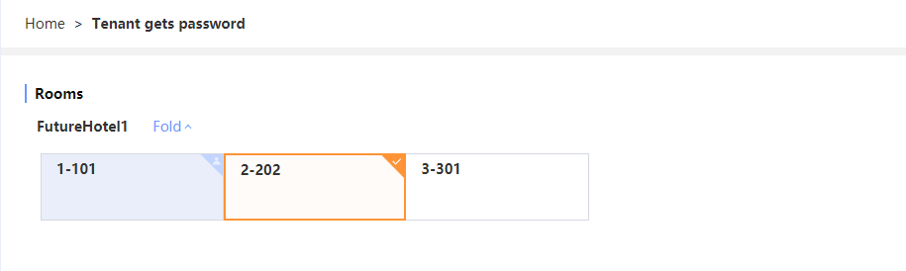
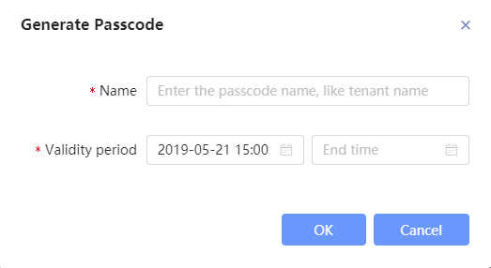
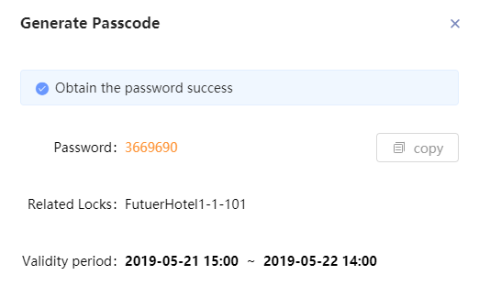
PC-side of TTHotel
Home-Tenant gets password
Only get tenants password.
Process：Choose the room => input the name and validity => Click [OK]，obtain the password success => Copy the password.
Only one door opening password can be obtained at a time.
The same door lock, the same end time to get the same password.

Slide 24
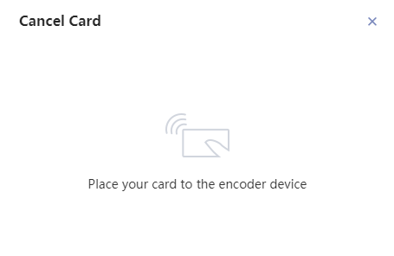
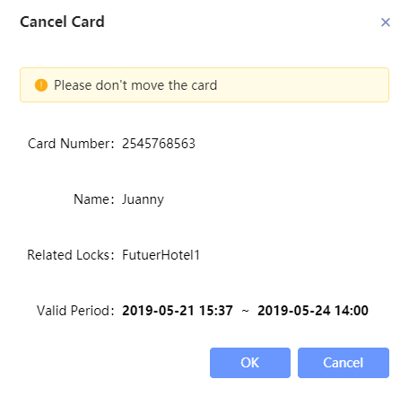
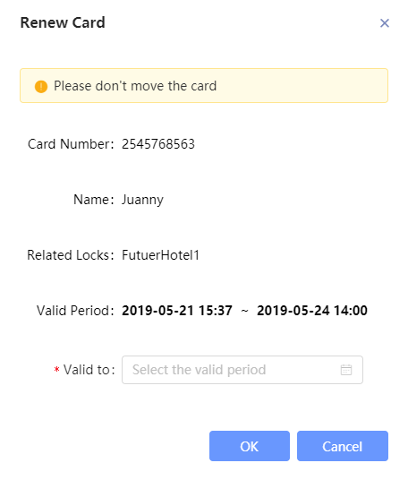

PC-side of TTHotel
Home-Cancel Card/Renew Card/View Card
Click “Cancel Card”，place your card to the encoder device to cancel card.
Click “Renew Card”，modify the valid period to renew card.
place the card to the reader collection to view card information.

Slide 25

PC-side of TTHotel
Rooms Details
You can issue card, generate passcode, edit and delete the information.
The room cannot be deleted if there has people is living at.

Slide 26

PC-side of TTHotel
The module can perform operations such as Cancel card , Renew Card, and loss reporting. When the card validity period is about to expire, the system will automatically provide a warning prompt, and the hotel staff can promptly process according to the prompts.
When the IC card is lost or damaged, the administrator can report the card and simultaneously report the loss on the App.
IC Cards
Notes:
33333333333

Slide 27


PC-side of TTHotel
When add a successful hotel lock on the app, which will be displayed in the list.
The administrator can check the status of the lock in the hotel lock list, such as the lock power, etc.
When the lock is less than 20%, the alarm will be automatically prompted.
Smart Locks

Slide 28

THANK YOU！

