Slide 1
Matthew 17:24-27

Slide 2
Today’s CRAZY Bible Story is found in the book of Matthew, chapter 17. One day, Jesus and the disciples arrived at a town called Capernaum. One of Jesus’ disciples, Peter, was approached by some of the temple tax collectors. They got in his face and said, “Doesn’t your teacher pay the temple tax?”
Peter was surprised, but he responded, “Of course, He does.” Now Peter was in a tough situation. He had just promised these tax collectors that he and Jesus were going to pay this tax. The problem was that Peter had left his fishing business behind, so he didn’t have a way of making money anymore. He was probably just a little bit worried about how in the world
he was going to actually pay this tax.

Slide 3
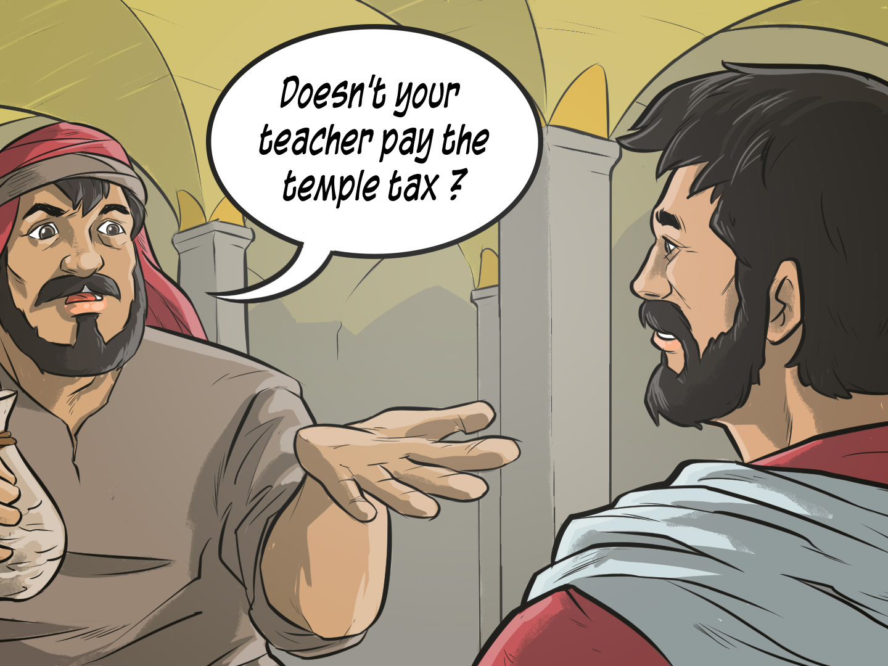

Slide 4
Peter went to find Jesus and bring his need to Jesus’ attention. He went to the house where Jesus was staying. The moment Peter walked up to Him, Jesus spoke to him - even before Peter could tell him why he was there. Jesus said, “What do you think, Peter? Do kings tax their own people or the foreigners they have conquered?” Peter had to be shocked. Jesus was asking him a question about taxes before he even had a chance to say anything about why he was coming to Him. That’s CRAZY! Jesus went on to say, “We don’t want to offend anyone, so we should pay the temple tax.”
Then, Jesus told Peter, “Go down to the lake and throw in a fishing line. Open the mouth of the first fish you catch, and you will find a coin. Take the coin, and go pay the tax for both you and for me.” WOW! What a CRAZY idea. How was he going to find money in a fish? But Jesus had told Peter what to do, and Peter obeyed.

Slide 5
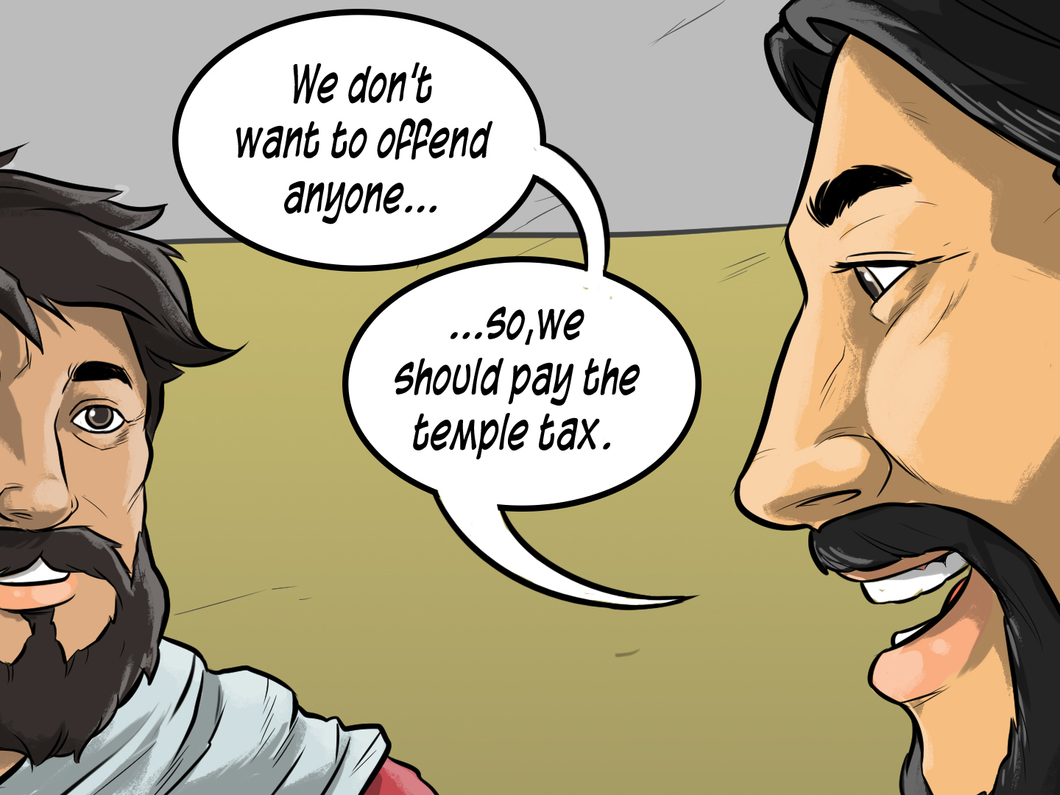

Slide 6
Can you imagine what it must have been like for Peter? He went down to the lake, put out a fishing line, pulled in a fish, reached into the fish’s mouth, and pulled out a coin to pay the temple tax. Can you imagine how awesome it must have been for him to go back to those tax collectors and hand them a coin with fish guts all over it? It must have been so much fun!
Peter learned a lesson that you are going to learn today, as well. You are going to learn that when you have a need, God can provide - even in the CRAZIEST of ways!

Slide 7
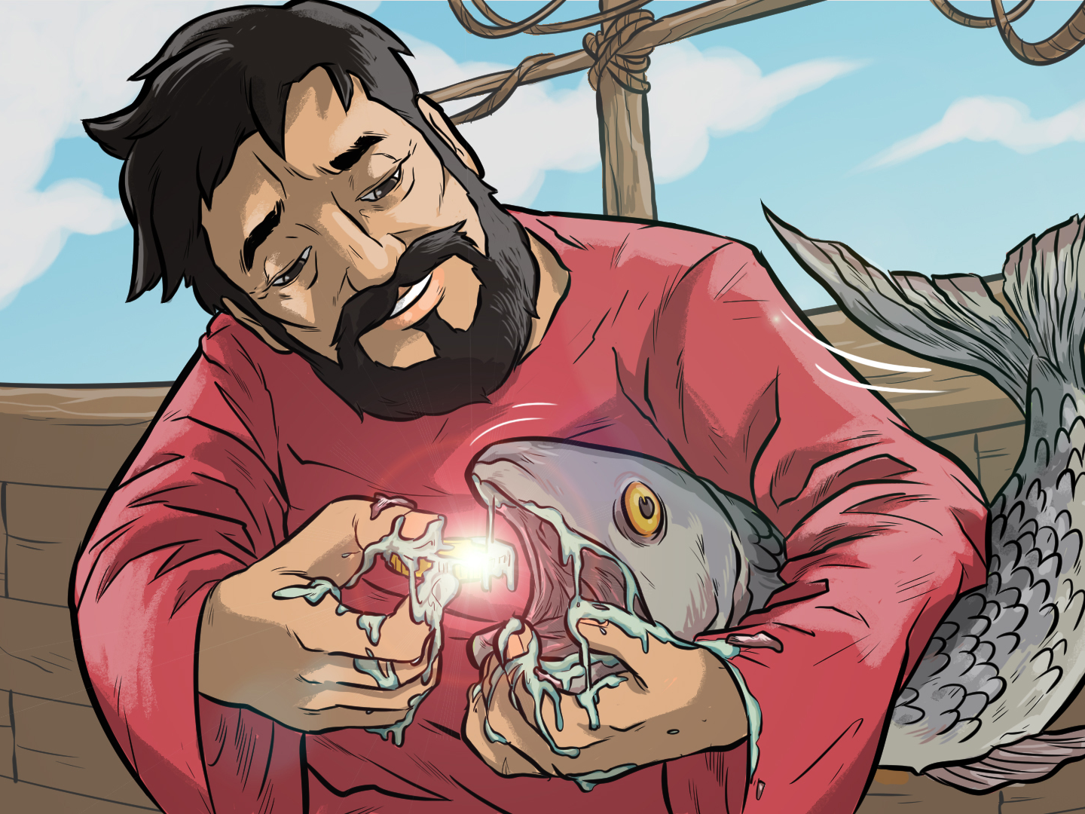

Slide 14
1. Whatchagaddaknow
today?
“God Is My Provider!”
“When I Have A Need - God Will
Provide!”
“Let’s Go Fishing!”

Slide 15
1. Whatchagaddaknow
today?
ANSWER:
“When I Have A Need - God Will Provide!”

Slide 16
2. Which of the disciples had a need in our Bible Story today?
Peter
Paul
Pat

Slide 17
2. Which of the disciples had a need in our Bible Story today?
ANSWER:
Peter

Slide 18
3. What did Peter owe money for?
A House
The Temple Tax
A Dog

Slide 19
3. What did Peter owe money for?
ANSWER:
The Temple Tax

Slide 20
4. What did Jesus tell Peter to do
in order to get the money?
“Go Fishing”
“Go Pray”
“Go To Sleep”

Slide 21
4. What did Jesus tell Peter to do
in order to get the money?
ANSWER:
“Go Fishing”

Slide 22
5. Where did Peter find the money?
Under A Rock
In His Shoe
The Fish’s Mouth

Slide 23
5. Where did Peter find the money?
ANSWER:
The Fish’s Mouth

Slide 24
6. According to our lesson today, “When You Have A Need, Come To Jesus _______.”
FIRST
SECOND
THIRD

Slide 25
6. According to our lesson today, “When You Have A Need, Come To Jesus _______.”
ANSWER:
FIRST

Slide 26
7. According to our lesson today, “God _________ What You Need Before You Even Ask.”
Sees
Knows
Does

Slide 27
7. According to our lesson today, “God _________ What You Need Before You Even Ask.”
ANSWER:
Knows

Slide 28
8. According to our lesson today, “God Will __________.”
Be There
Provide
Help

Slide 29
8. According to our lesson today, “God Will __________.”
ANSWER:
Provide

Slide 30
9. True or False: God can provide for ANY need you have.
True
False

Slide 31
9. True or False: God can provide for ANY need you have.
ANSWER:
True

Slide 32
10. Where was our Power Verse
found?
John 8:9
* Paul 4:9
2 Corinthians 9:8

Slide 33
10. Where was our Power Verse
found?
ANSWER:
2 Corinthians 9:8

