Slide 1
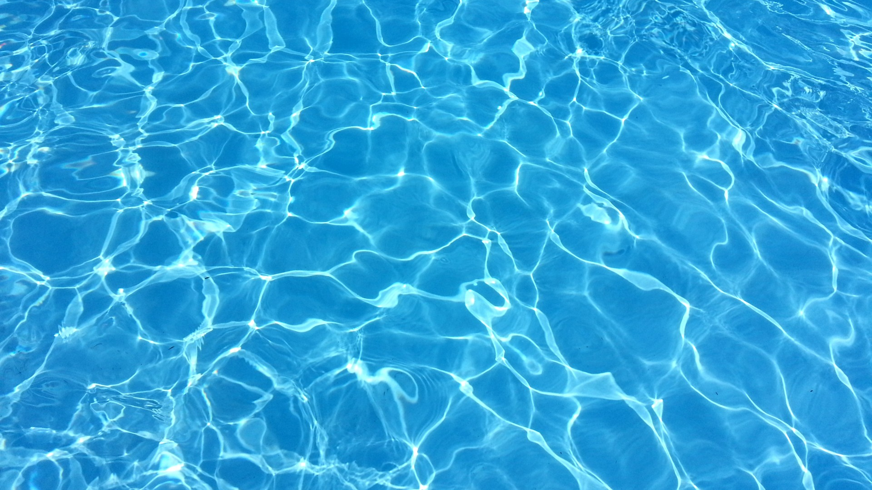
Reverse Osmosis Desalination and the Environment:
Searching for Solutions
Notes:
Look at the Earth and notice how much of it is blue, instead of green or brown. Over 70% of our planet is covered with water…most of it is seawater, which humans cannot drink or use for much. Only about 3% of the Earth’s water is “fresh,” yet, we can drink less than 1.2% of that! Humans must have clean water to survive; without it, we die of dehydration within a few days. Aside from drinking it, we need clean water to grow our crops, to use in industry, and in countless other areas of society…yet, every year the problem of water scarcity grows, as climate change worsens and the human population increases. In the face of this mounting threat, it is natural for humans to look at all that beautiful blue ocean water and wonder if the answer to this problem lies there. Perhaps seawater is not the answer, but it could be an answer to this problem, specifically in the desalination of seawater through reverse osmosis technology. In this presentation, I will introduce the science behind seawater desalination and how it is done, the environmental implications of this technology, and will explain why I care about the issue—and why you should, too.

Slide 2
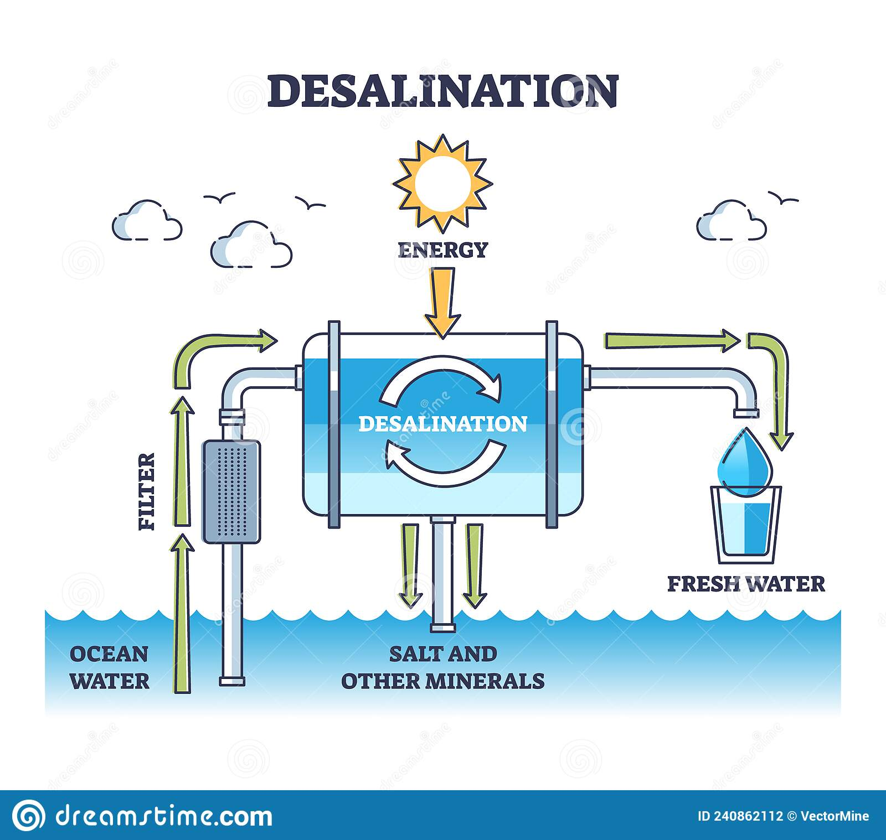
What is Desalination?
The process of removing the dissolved salts and minerals from seawater or brackish water is called DESALINATION
There are 2 main ways to desalinate water: thermal (distillation) and pressure (membrane)
All methods have their pros and cons and environmental impacts
Notes:
Desalination touches on multiple natural sciences, from chemistry to physics to hydrology; it is a truly well-rounded issue, something of a scientific “Renaissance Man.” Geologically, the Earth is a watery planet, and scientists (biologists, astronomers, and more) believe that one major reason that our planet was able to develop and sustain life is due to the amount of liquid water our planet possesses. Climate science, data from the fossil record and human documentation over the last several centuries all concur that climate change is occurring, and one effect of climate change is the disruption of the hydrologic, or water, cycle, as well as disruption of weather patterns. These changes are a cause of water scarcity, such as through usual water sources such as rivers, lakes, and aquifers ebbing and drying up. This brings up the need for alternative measures for supplying clean, fresh water. Separating seawater or brackish water from its dissolved salts is called “desalinization,” or “desalination.” Humans have been distilling liquids, including desalinating seawater and brackish (not-quite salty, not-quite fresh) water, on a small scale for millennia, in a process that marries physics and chemistry. The main physical scientific principle in seawater desalination involves the “how” to separate the water from its dissolved salts, rendering it drinkable, or potable. There are two main methods of doing so: thermal (using heat to evaporate the water), and pressure or membrane-based (passing the water through a barrier). Each main method and its sub-categories have its own scientific principles governing how it works and how it can be used (Trexler, 2019). Another scientific principle involved in desalination is that for every action there is some consequence, and in desalination one major consequence is environmental impact. There are multiple and cascading deleterious environmental results from the various desalination techniques, and they must be mitigated to make the technology safer for the environment (Elimelech, 2011). These must be considered in the larger picture, to avoid worsening environmental and climate issues in the long-term, which is why seeking a method which is energy efficient as well as “green” is the goal of desalination research and technology. Of the existing technologies, reverse osmosis provides the most water with the least or most easily mitigated environmental fallout.

Slide 3
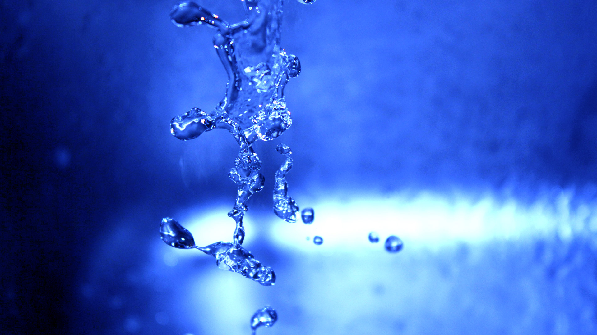
Why should the community care about water scarcity and desalination technology?
Notes:
Water scarcity and water quality is an issue that will eventually touch every person on earth, even in areas that do not currently have acute water problems. At the larger scale, billions of humans currently do not have regular access to clean drinking water. That problem is worsening as climate change alters the water cycle and as the human population increases. As time passes and water scarcity increases (as experts say it is, and will), the need for other water resources will touch places closer to home. Under normal circumstances, we cannot just “make” more water—except, in the case of desalination, we actually can. At the smaller scale, in this specific coastal community, which has already demonstrated shrinking water resources and increasing water needs, every person in the area has a vested and personal interest in the salient points of installing a desalination plant: water quality, water cost, and feasibility of obtaining that water are everyday concerns, as every person needs water every day, and they must be able to afford it. Without a new source of water, the community may begin restricting water usage, and utility prices may rise, as would the cost of living and doing business in the community, which is something no one wants. There are potential ecological factors associated with the method of desalination that will directly touch every resident, whether individuals or businesses operating in the region. Even if desalination produces clean drinking water at a decent price for the community, if there are negative local environmental consequences, such as pollution, affecting local wildlife, “progress” is debatable, at least long-term. It is a holistic problem which must be considered by the community, for its health and prosperity, both for today and in the future. With greater access to clean water, the community would grow and be a more attractive place to do business. By tending to the local environment, the community would stay an attractive place to live and do business for many years to come.

Slide 4
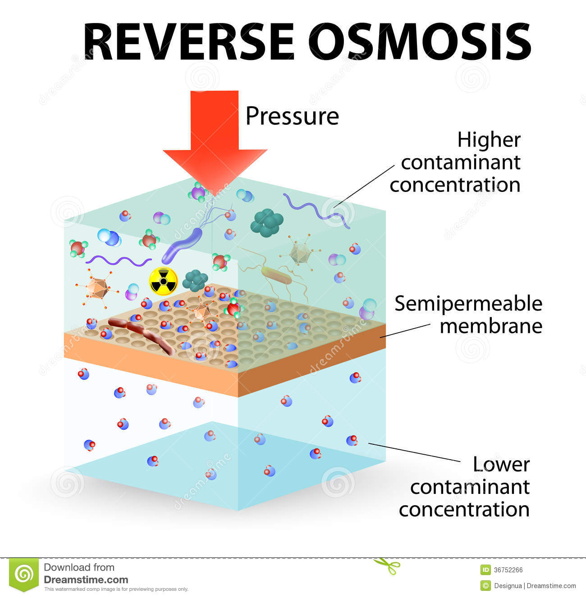
Water Scarcity and Reverse Osmosis Desalination: One Potential Solution to a Complex Problem
Issues to overcome:
High cost
Environmental impacts
Technology is developing that addresses these obstacles!
Notes:
Potable water is both a renewable and a non-renewable natural resource. It is considered renewable because potable water can be distilled from brackish water and replenished by the hydrological (water) cycle. However, if the water cycle is compromised (such as by climate change) or over-exploited by human use, then groundwater aquifers and the waters of lakes and rivers are diminished and may never recover--this is currently happening at an alarming rate in the interior of the American West right now (UN, 2021).
These factors dramatically affect both the quantity and quality of the water that people need to drink and carry out daily tasks, not to mention industrial production activities. The population of the globe is increasing exponentially, and more people means more pressure on water supplies, which are on the verge of collapse, according to some experts (WHO, 2022).
Currently, only about 1% of the world’s fresh water is generated through desalination. The energy used by desalination plants currently in operating is often generated by burning fossil fuels, which in turn release excess carbon dioxide into the atmosphere, thus speeding the climate change which contributes to water scarcity—a negative feedback loop that must be halted.
Like all technology, the large-scale process of desalination can have an impact on the environment, which can include:
Water intakes at desalination plants damaging marine ecosystems
energy costs (using fossil fuels to generate the thermal energy needed to distill is contributing to the greenhouse effect, and makes the technology costlier to use overall)
thermal pollution (releasing water that is warmer than ambient temperature) can disrupt marine ecosystems, especially when coupled with brine contamination
brine contamination (brine is a dense, corrosive fluid of highly concentrated salts and minerals produced as a byproduct of the desalination process; it is heavier than seawater and can sink to the seafloor, disrupting marine ecosystems, and it is also toxic to most life)
chemical pollution from cleaning/disinfection/defouling/descaling agents used in pressure/membrane methods, such as reverse osmosis, which can leak into groundwater if pipes are damaged
Reverse osmosis (RO) is currently the fastest-growing method of desalination, and it is the least energy-intensive while having the greatest water output, hence its popularity and growth. Compared to other methods, RO is less energy-intensive, as the water does not have to be heated first. RO does have specific environmental detriments related to the cleaners and disinfectants needed to keep the membrane from accumulating biofilm, mineral scaling and other physical contaminants that impede the process and reduce desalination process efficiency, but there are ways to mitigate these negative effects and both private and public industry are developing ways to make the technology more efficient and “greener” (Service, 2021)

Slide 5
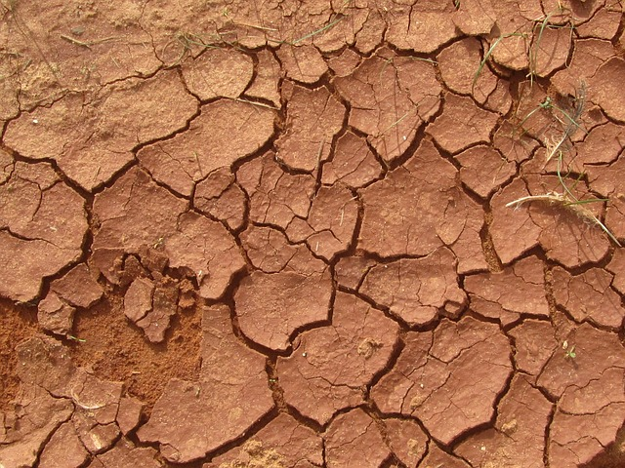
What does this mean to me personally?
Notes:
I view the problems of water scarcity, water insecurity and water quality with urgency on a personal basis because I lived in a Third World country for over a decade. During those years, I lived in communities affected by water scarcity; I even lived in areas where there was no running water, or in areas where water was available but unsafe to drink, so I appreciate the ability to run a faucet and have as much clean water as I need or want. While living abroad, I also saw the local climate change over time, and I saw how those changes affected the local weather patterns and the availability and the quality of water. I know that I was fortunate in that I could leave that country and move elsewhere, but I know that this is not possible for everyone. I am a humanist, and a Buddhist, and believe that all lives are sacred—and that the quality of that life is important, also, and water scarcity does not produce quality of life. Overall, I am also passionate about environmental preservation, as well as about technology. I believe these two things can coexist, and that technology can assist in healing what humans have done to our planet through our careless rush of progress and growth over the past centuries.

Slide 6

Investigation: Is Reverse Osmosis Environmentally Friendly...or Can it Be?
Notes:
As I had read more about climate change and water scarcity, I had come across references to mitigation efforts such as desalination, but there were always issues with the scalability and cost of the technology, as well as environmental impacts. This led me to want to investigate this problem and research potential solutions. The desalination method that seems to have the greatest yield at the lowest cost seems to be reverse osmosis technology (Service, 2021). Remembering that one reason that we are in this situation in the first place is the reckless damage humanity has done to the Earth, my next thought was whether seawater desalination via reverse osmosis damages the environment. To determine whether reverse osmosis desalination of seawater produces potable water with the least negative environmental impact, the negative environmental impacts of desalination in general and in particular to the different methods would have to be qualified (described) and quantified (measured, both in the moment and over time), and then compared with one another. Every desalination method has its own advantages and disadvantages, environmentally. Desalination plants of several types have been running for decades all over the world, so there is a wealth of information about their output and the environmental impacts seen both in the moment and over time. This data is readily available from multiple sources, including from regulatory bodies such as the EPA and other government agencies in the United States, as well as in other countries such as Israel, China, India, the UAE, and Saudi Arabia, all of which use desalination of seawater to produce potable water for their citizens. There is also a great deal of data from academic and industry sources, from studies done by universities and energy and tech companies that are involved in developing, implementing, and improving desalination techniques. These sources are not always without bias, especially industry data, but it can be balanced by with information from environmental groups and NGOs.
By weighing all the variables and the data, it would be very possible for a natural scientist to establish which large-scale desalination method is the most environmentally friendly. The scientist would need to determine their criteria for what constitutes “environmentally friendly” and measure each method’s performance against those criteria; some potential categories might include wildlife and ecosystem effects, energy consumption rates, amount/rate of chemical contamination, and waste production and disposal. At that point, more effort and research can be devoted into mitigating the environmental dangers, improving, and streamlining the actual process of reverse osmosis desalination, and reducing the energy needs for producing potable water this way.
Based on the evidence evaluated during this investigation, reverse osmosis desalination is a process that seems to offer the best chance to increase potable water at the least cost and with the least environmental impact. Considering the potential benefits for both the community and the world, this tech needs to be pursued and developed.

Slide 7
REFERENCES:
Trexler, R. D. (2019). Desalination of seawater. Salem Press Encyclopedia of Science.
Ihsanullah, Ihsanullah, Muataz A. Atieh, Muhammad Sajid, and Mazen K. Nazal. 2021. “Desalination and Environment: A Critical Analysis of Impacts, Mitigation Strategies, and Greener Desalination Technologies.” Science of the Total Environment 780 (August). doi:10.1016/j.scitotenv.2021.146585.
Elimelech, M., & Phillip, W. A. (2011). The Future of Seawater Desalination: Energy, Technology, and the Environment. Science, 333(6043), 712–717. https://doi-org.ezproxy.snhu.edu/10.1126/science.1200488
Service, P. N. (2021, May 12). Breakthrough in reverse osmosis may lead to most energy-efficient seawater desalination ever. Purdue University News. Retrieved August 14, 2022, from https://www.purdue.edu/newsroom/releases/2021/Q2/breakthrough-in-reverse-osmosis-may-lead-to-most-energy-efficient-seawater-desalination-ever.html
UN Environmental Programme. (2021, January 11). Five things to know about desalination. UNEP. Retrieved August 14, 2022, from https://www.unep.org/news-and-stories/story/five-things-know-about-desalination
WHO. (2022, March 21). Drinking-water. World Health Organization. Retrieved August 14, 2022, from https://www.who.int/news-room/fact-sheets/detail/drinking-water#:~:text=Over%202%20billion%20people%20live,water%20source%20contaminated%20with%20faeces

